Slide 1
Chapter 18: Vacuum
Andrea Liedl
(INFN-LNF)
This project has received funding from the European Union´s Horizon Europe research and innovation program under grant agreement No. 101079773
IX TDR Review Committee Meeting
June 16-18, 2025

Slide 2
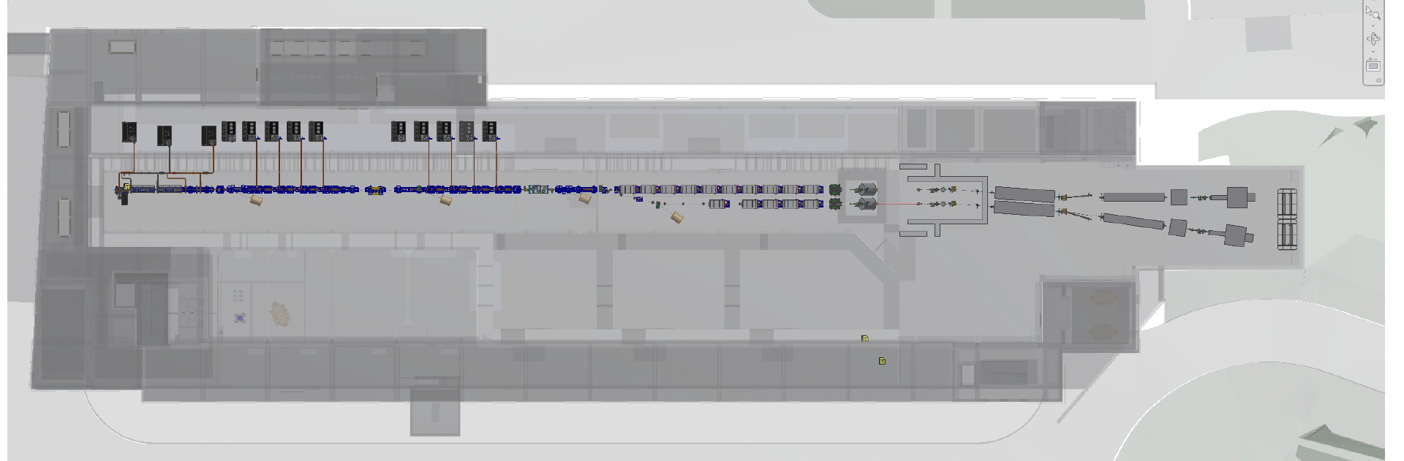
My Area
This chapter addresses general characteristics of the machine vacuum system. (type of pumping distribution, sectioning, joints…etc..)
The relevant points with specific impact for a machine area is addressed and described within the related chapter.

Slide 3
Chapter Index

Slide 4
Global Goals: (Brief description of system objectives and specs)
Conductance limited system;
General requirement of 10-9 mbar with negligible presence of masses above 50;
Definition of the general requirements and features of the vacuum system
General choices for
Pumping system
Sensors
Sectioning
Joinings
Sputtering Ion Pumps and NEG Pumps;
Cold Cathode Gauges
All-Metal Gate valve
All Metal Fast valve
Ceramic RF Windows
Metal gasket based Joinings (QConflat – LIL – International Xband)
Definition of procedures for:
Cleaning and Acceptance Test
Storaging
Installation
Venting – Pumping Down – NEG activation
Specific Outgassing Characterization
Heat Treatments for reduction of Total load
Standard UHV metal cleaning processesù
Dry Nitroen storaging
Eventual portable clean room for the installation of specific machine area
Use of LNF Outgassing facility (LATINO) for characterization
Use of LNF Vacuum furnaces (LATINO) for reduction of outgassing

Slide 5
Achievements: Technological Readiness Level (Sub-Components)
Sub - systems | TRL | Comments
Pumps – Gauges - Valve | 9 | All these devices are fully commercialized and such solutions are based on previous experiences or tested in our actual facilities (TEX – SPARC etc..)
Cleaning procedure and storaging | 9 | All the systems required for these procedures are currently in use at LNF - Vacuum Laboratory.
Installation and Intervention Procedures | 9 | These Procedures are well known and all the components/devices needed are fully commercialized
Outgassing characterization and Heat Treatments | 8 | These procedures are well known and operated at LNF - Vacuum Laboratory facilities.

Slide 6
Planned Actions: (What will be done, by when.)
Goals of the TdR Chapter can be considered achieved;
However characterization of the outgassing of the single devices/prototypes will be studied during the next prototyping phase;

Slide 7
Conclusions
The Vacuum System described in the TdR chapter is compatible with the UHV specification of the machine;
Critical features of such a system are pointed out;
Procedures and Operation required in order to fulfil the specifications have been identified and are based on previous experience and operating facilities;
Particular points (specific chambers/components, particular differential pumping strategies, etc…etc…) related to vacuum issues but inherent to a specific area, are addressed in the specific chapter describing that area;

