Slide 1
Chapter 8: X-Band LINAC
D. Alesini on behalf of the RF/vacuum/LINAC team* (LNF)
* M. Bellavelgia, S. Bini, B. Buonomo, F. Cardelli, P. Chimenti, M. Del Franco, C. Di Giulio, E. Di Pasquale, G. Di Raddo, R. Di Raddo, M. Diomede, L. Faiilace, S. Farina, M. Ferrario, A. Gallo, A. Giribono, L. Giuliano, G. Latini, A. Liedl, V. Lollo, L. Piersanti, S. Pioli, G. Scarselletta, B. Serenellini, L. Spallino, C. Vaccarezza
This project has received funding from the European Union´s Horizon Europe research and innovation program under grant agreement No. 101079773
IX TDR Review Committee Meeting
June 16-18, 2025

Slide 2
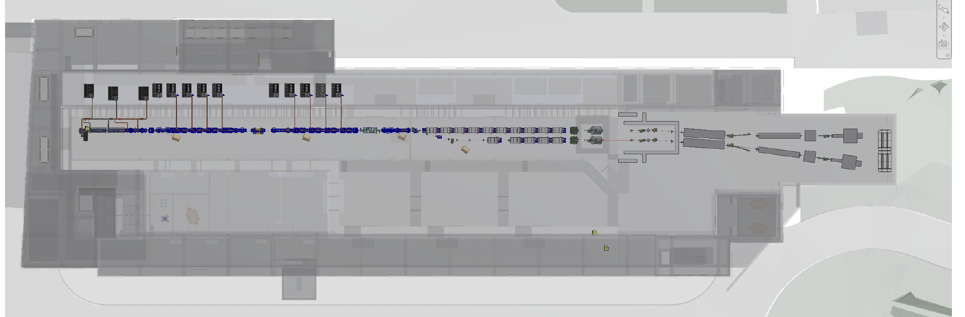
My Area
D. Alesini, X-Band LINAC, 9° EUPRAXIA@SPARC_LAB TDR Review meeting, LNF 16-18 June 2025

Slide 3
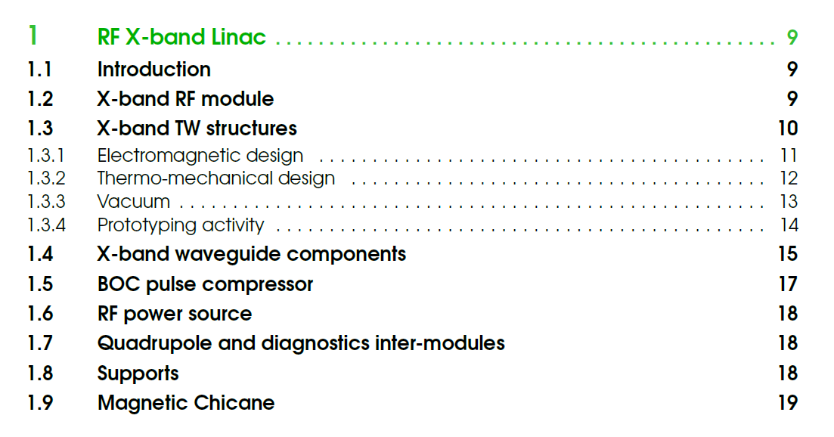
Chapter description
Review received from P. Muggli on 26/5. Correction implemented.
Few minor remaining comments sent from my side to Patric on 30/5.
D. Alesini, X-Band LINAC, 9° EUPRAXIA@SPARC_LAB TDR Review meeting, LNF 16-18 June 2025

Slide 4
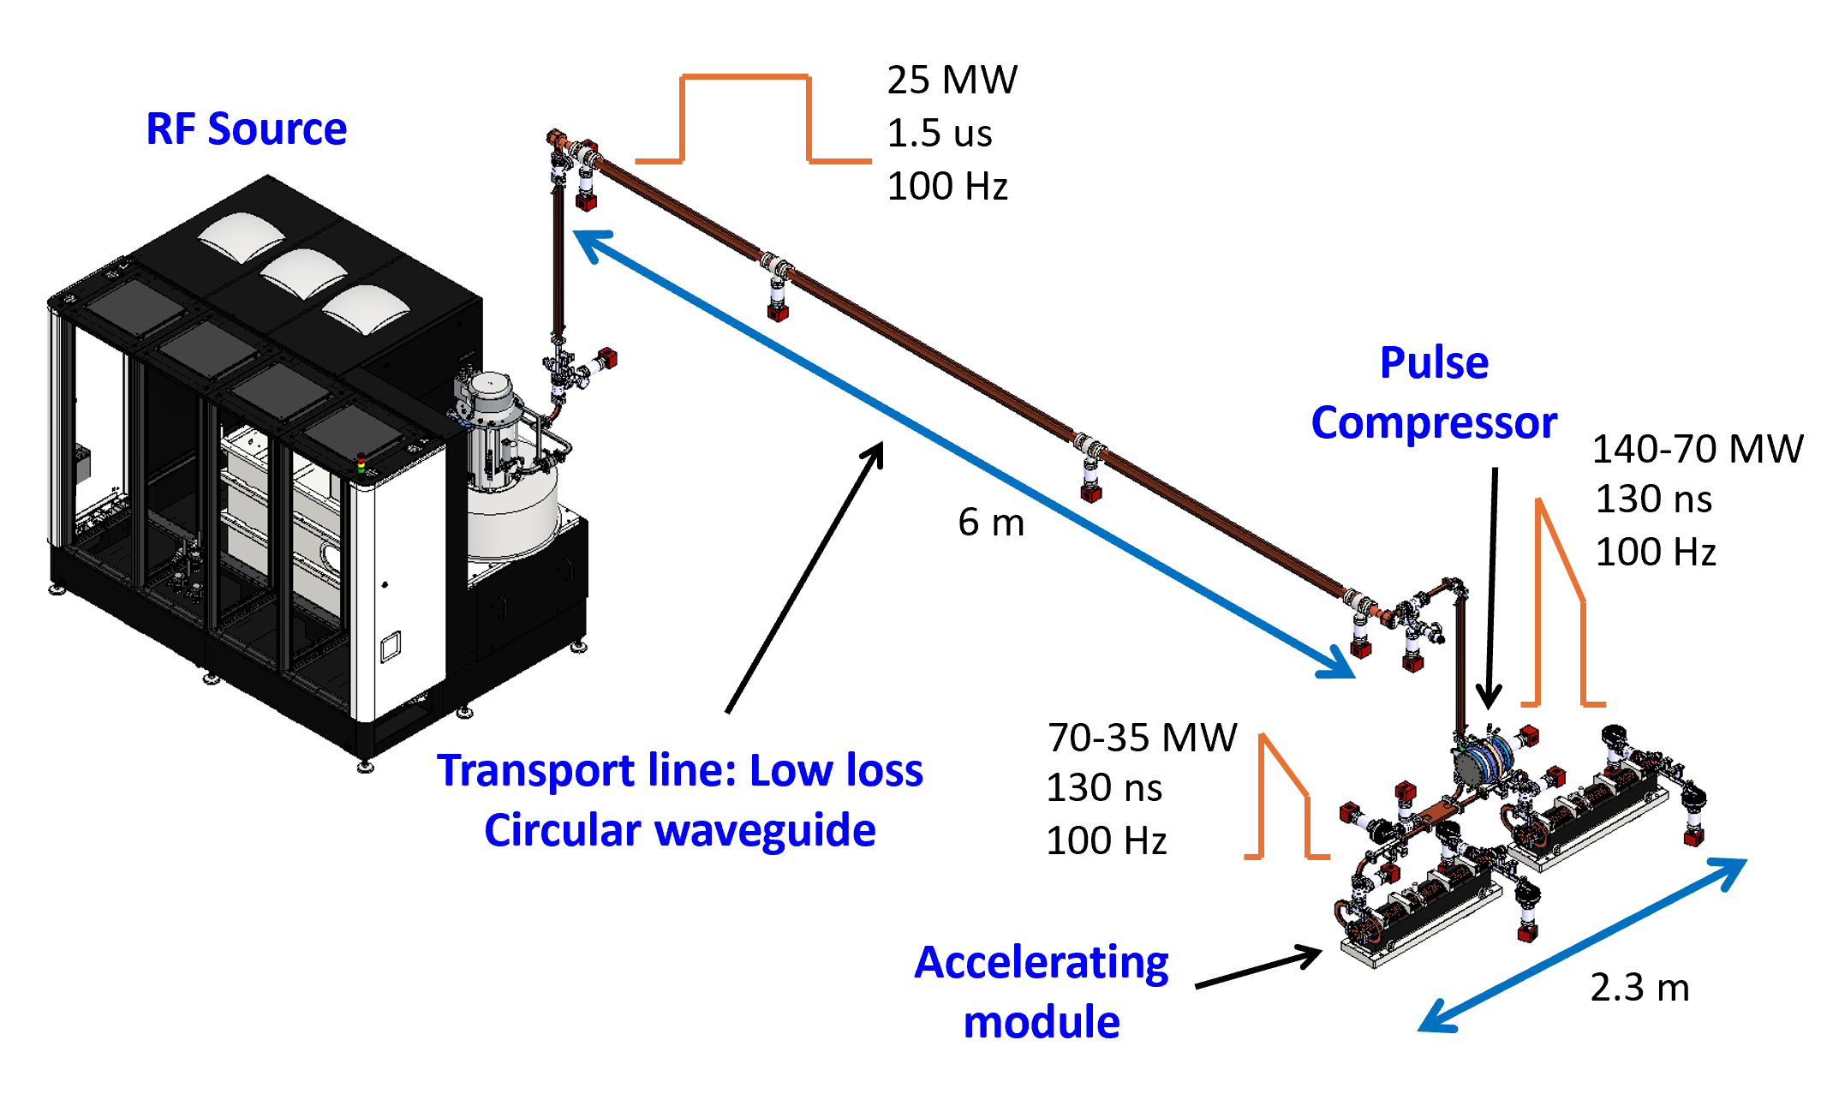
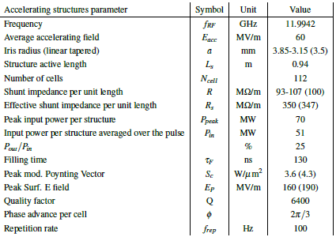
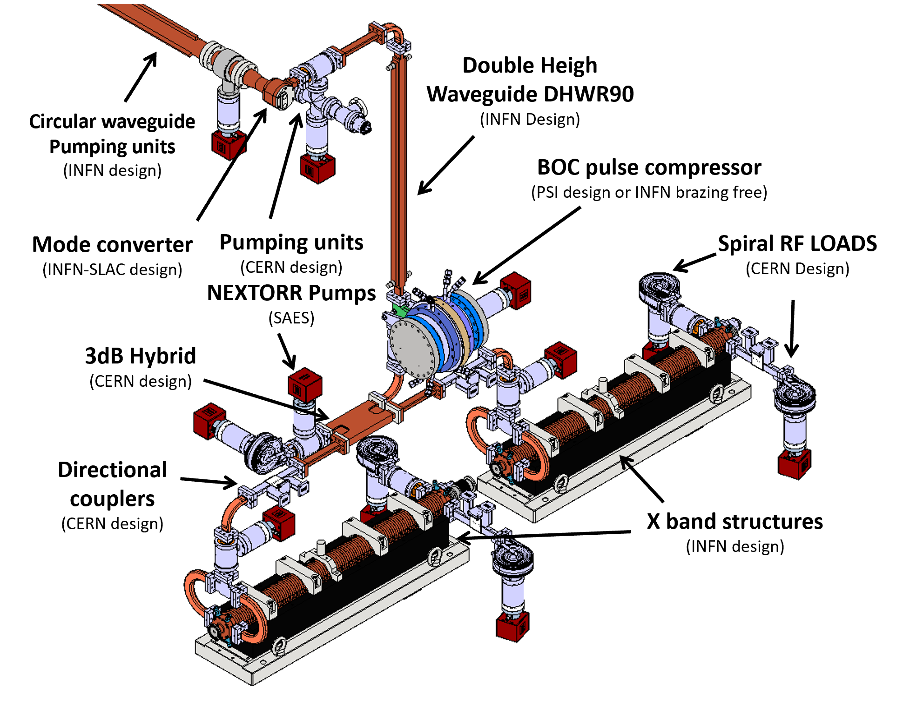
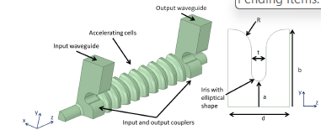
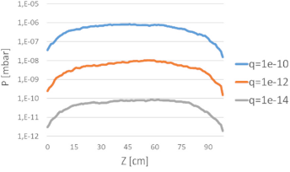
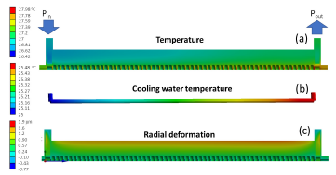
Global Goal of the chapter
Describe the X-band accelerating module we want to implement in terms of:
RF structure design and parameters (electromagnetic design, cooling, etc.)
Waveguide components (DC, pumping, etc.)
Expected performance (RF, vacuum, etc.)
Supports
Parameters of the power sources (with reference to the dedicated chapter)
Magnetic chicane layout and main parameters.
Quadrupoles and diagnostics discussed in other chapters and not repeated here.
D. Alesini, X-Band LINAC, 9° EUPRAXIA@SPARC_LAB TDR Review meeting, LNF 16-18 June 2025

Slide 5
Achievements: Only referred to the X band accelerating module components
Sub - systems | TRL | Comments
X band Power Source | 6 | The nominal X-band power source has been acquired and is ready to be tested at TEX to reach the nominal parameters.
X band structure | 6 | The final full-scale prototype is ready to be tested. The tuning-free fabrication has been successfully completed, except for a relatively small detuning with respect to the nominal parameters (which can be corrected by setting the operating temperature to 18 °C). A 20-cell prototype has been successfully tested with uncompressed pulse at 50 Hz, 60 MV/m, reaching the nominal performance in terms of accelerating field.
Mode converter rectangular to Circular waveguide | 8 | Prototype fabricated and tested at 21 MW, 50 Hz, 1 us (nominal 25 MW, 100 Hz, 1.5 us).
Pumping unit circular waveguide | 8 | Prototype fabricated and tested at 21 MW, 50 Hz, 1 us (nominal 25 MW, 100 Hz, 1.5 us).
Pumping unit rectangular waveguide | 7 | Prototype tested at 45 MW, 1 us, uncompressed pulse, 50 Hz. Needs to be tested at 100 Hz with compressed pulse 70-35 MW, 0.13 us.
Directional coupler | 7 | Prototype tested at 45 MW, 1 us, uncompressed pulse, 50 Hz. Needs to be tested at 100 Hz with compressed pulse 70-35 MW, 0.13 us.
BOC pulse compressor | 6 | Device ready to be tested with the nominal power source now installed at TEX. Device already tested in other laboratories, but at reduced repetition rate and peak power.
3dB splitter | 6 | Fabricated but still to be tested at TEX at nominal full power. Already tested in other lab but at a reduced power.
Rf load | 8 | Fabricated and tested at nominal peak and average power (50 Hz, 0.6 us)
D. Alesini, X-Band LINAC, 9° EUPRAXIA@SPARC_LAB TDR Review meeting, LNF 16-18 June 2025

Slide 6
Pending Items and Plans for the TDR and Beyond
There are no pending items for the TDR, but a significant experimental effort is required for the implementation phase as reported below: this timeline is strongly linked to the authorization process for the new RF source, which is currently under review.
July | Ago | Sept | Oct | Nov | Dec | Jan | Feb | Mar | Apr | May
Nominal Klystron and modulator test (K300+E37119)
Test of waveguide components at nominal parameters (BOC, …)
High power test of the full scale accelerating structure prototype
Realization and test of a second prototype CI for correction of tuning free technology
Realization and test of a tapered a prototype of the accelerating structure with tapered irises
D. Alesini, X-Band LINAC, 9° EUPRAXIA@SPARC_LAB TDR Review meeting, LNF 16-18 June 2025

Slide 7
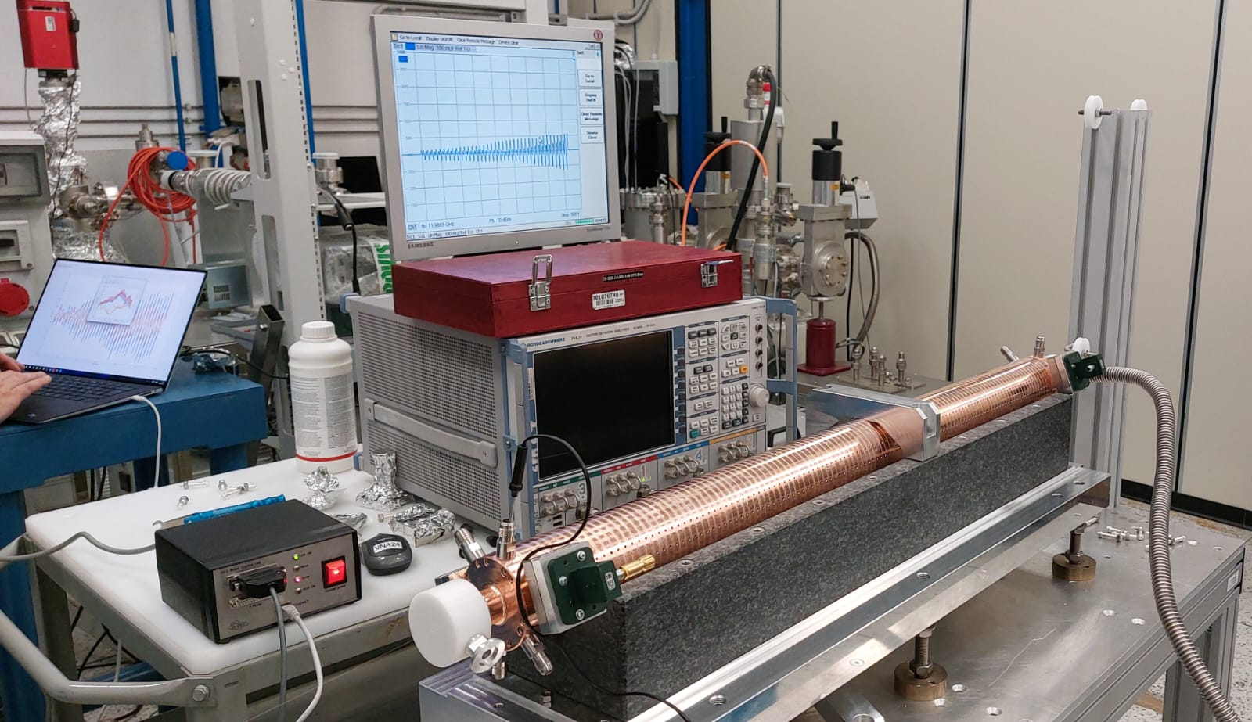
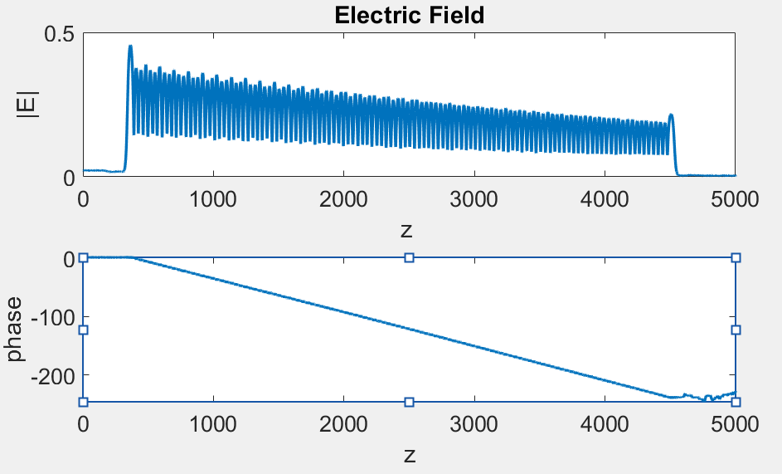
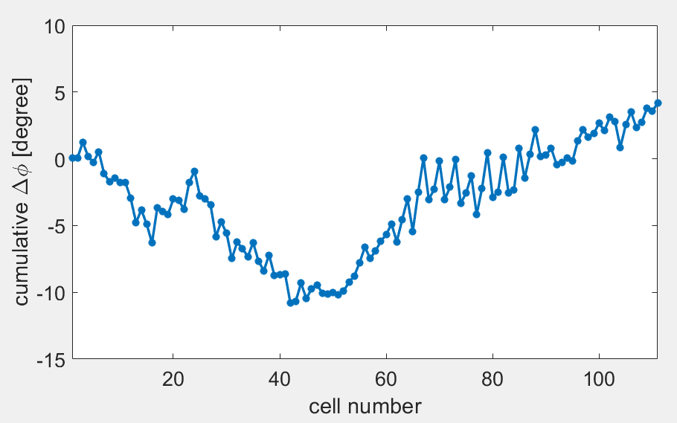
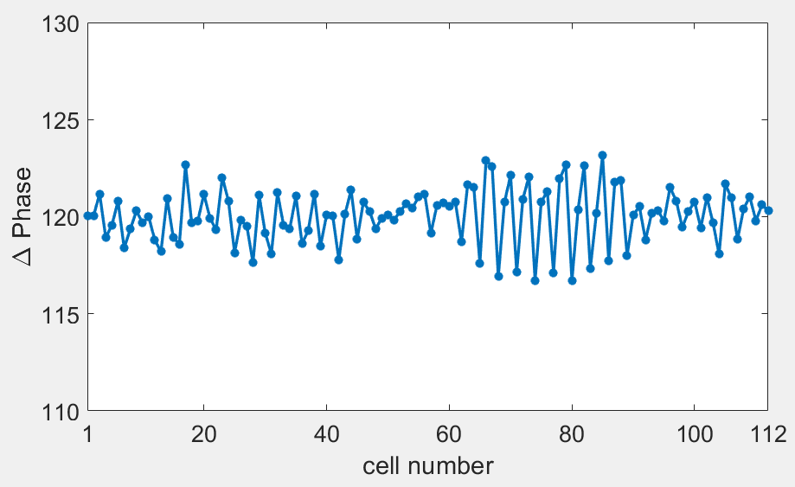
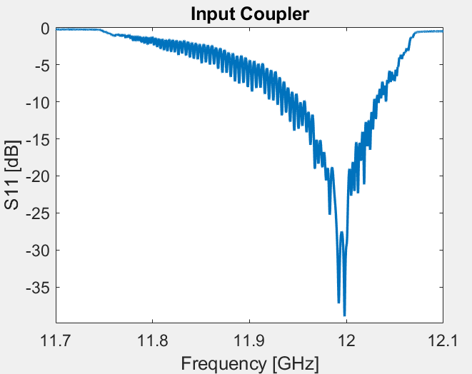
1st X band full scale structure ready for high power test
D. Alesini, X-Band LINAC, 9° EUPRAXIA@SPARC_LAB TDR Review meeting, LNF 16-18 June 2025

Slide 8
Conclusions
The X-band linac design and parameters have been finalized, and they are consistent with the various beam dynamics working points in terms of accelerating field, number of cells, and iris aperture: chapter completed.
All waveguide components of the module have been fabricated, and many of them have already been tested at high power. However, tests at nominal power, repetition rate, and pulse length require the commissioning of the X-band nominal power source. The most critical components under these conditions are the BOC pulse compressor and the waveguide elements following the compressed pulse.
Testing the RF power source is of fundamental importance to assess the performance, stability, and reliability of the waveguide components. This phase is currently waiting the necessary authorizations.
A cross-check with the beam dynamics group is needed regarding the use of constant impedance (CI) structures instead of tapered iris designs. Adopting CI structures could lead to significant cost savings in the fabrication process.
D. Alesini, X-Band LINAC, 9° EUPRAXIA@SPARC_LAB TDR Review meeting, LNF 16-18 June 2025

