Slide 1
Chapter 7: RF Photo-injector
Enrica Chiadroni on behalf of WA2 Contributors,
in particular M. P. Anania, M. Bellaveglia, G. Campri, F. Cardelli, M. Del Franco, F. Demurtas, L. Faillace, M. Galletti, A. Giribono, L. Piersanti, L. Sabbatini, G. J. Silvi, A. Vannozzi
This project has received funding from the European Union´s Horizon Europe research and innovation program under grant agreement No. 101079773
IX TDR Review Committee Meeting
June 16-18, 2025

Slide 2
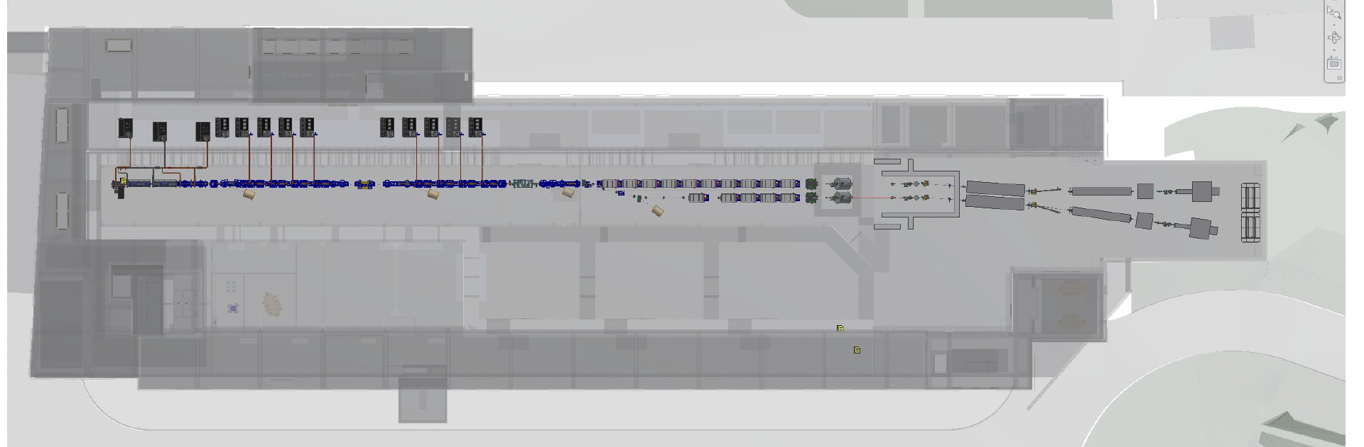
WA2 - Injector
SPARC_LAB-like photo-injector, except mainly for
the length and number of the S-band accelerating structures;
the choice of the S-band European frequency;
the insertion of an X-band linearizing cavity.

Slide 3
Describe your Chapter

Slide 4
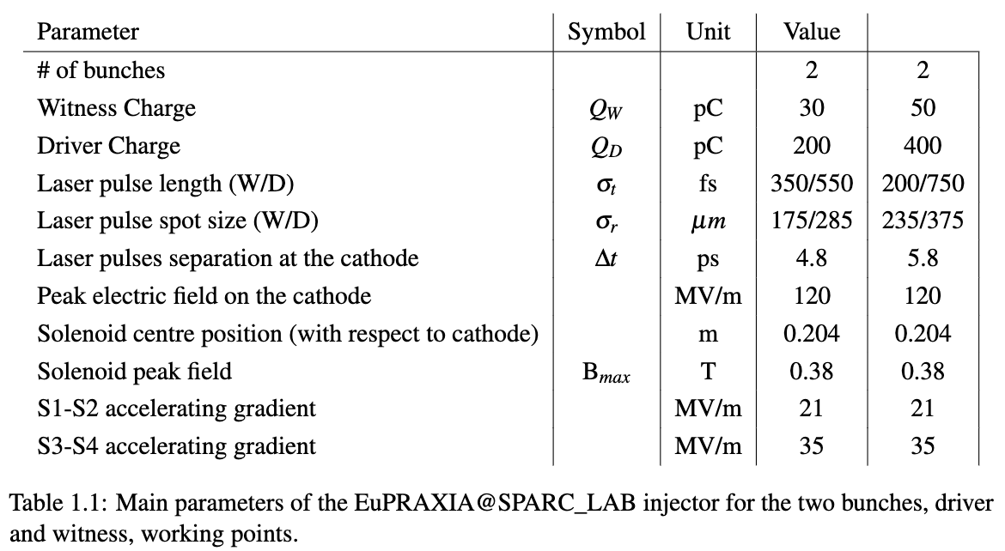
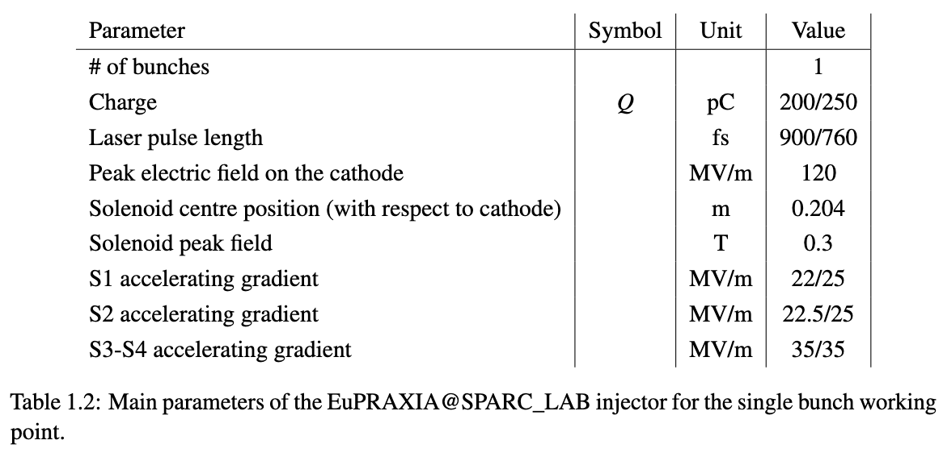
Global Goals: Injector Requirements
PWFA working point
Pure RF working point

Slide 5
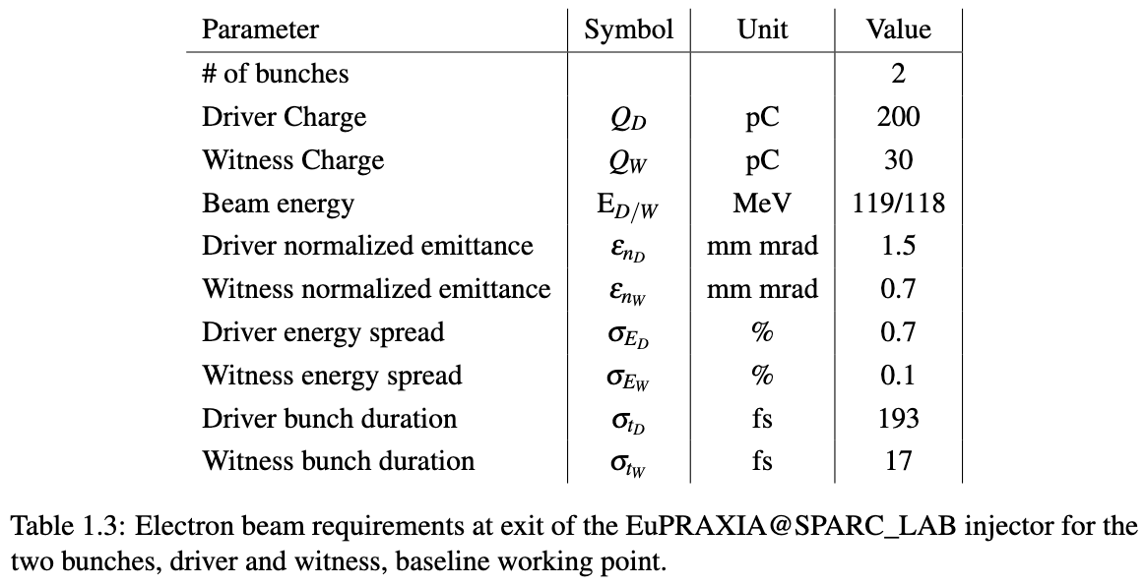
Global Goals: Injector Requirements
PWFA baseline working point
Machine parameters
Two-bunches beam parameters at the injector

Slide 6
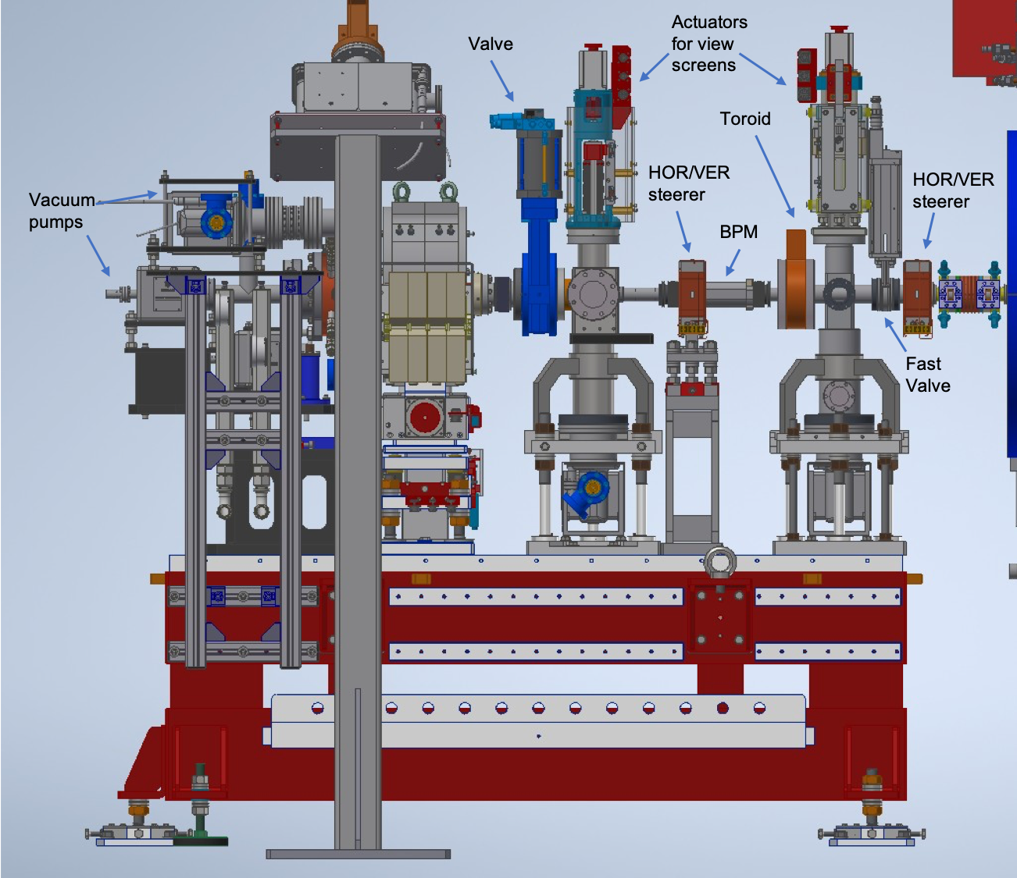
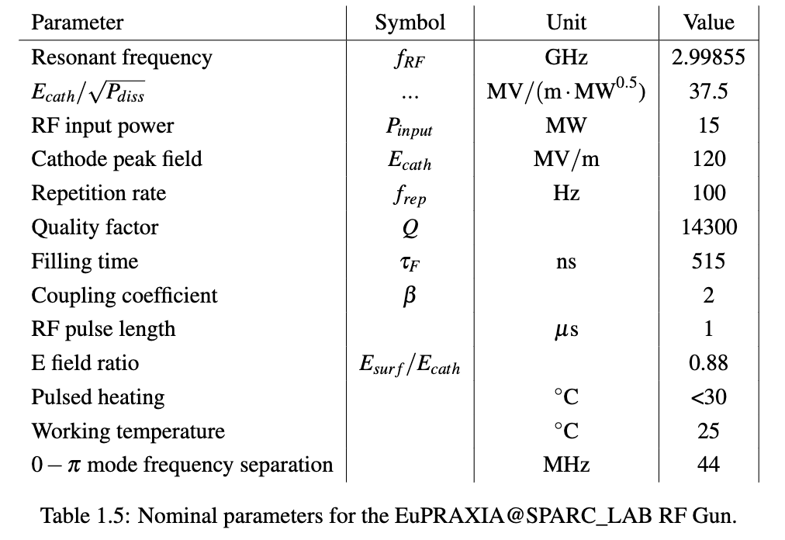
Gun Area
RF Gun parameters
Brazing-free technology
Better pumping speed
Full compensation of both dipole and quadrupole field components

Slide 7
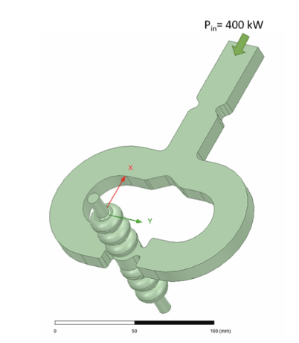
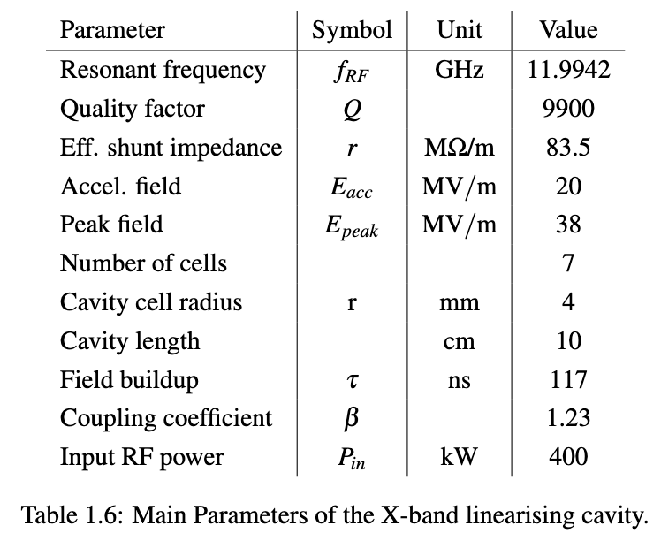
Gun Area
X-band linearizer parameters

Slide 8
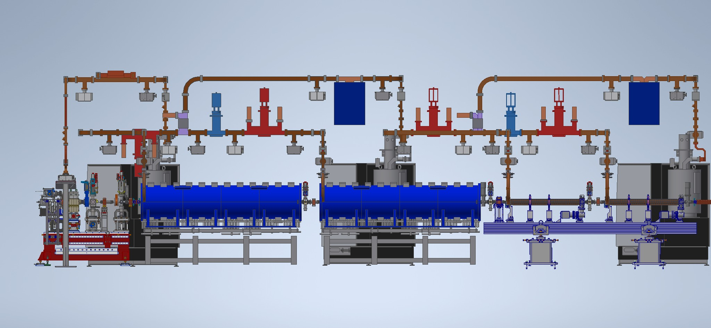
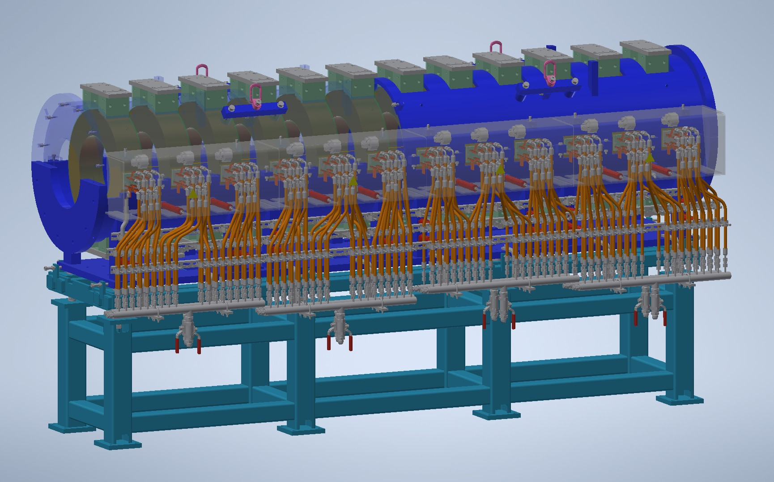
Boosting Structures
SPARC_LAB like S-band TW structures
Pure RF working point
Similar solenoids recently designed, tested and installed at SPARC

Slide 9
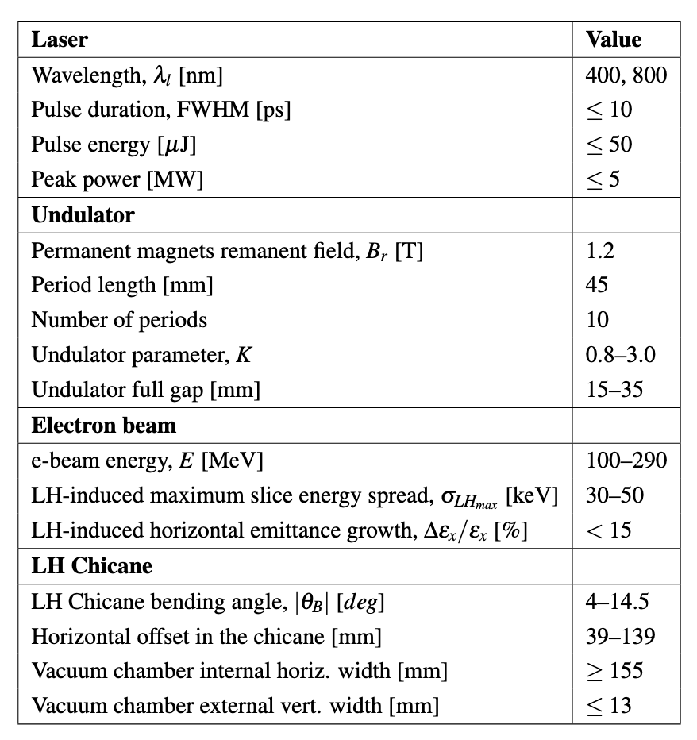
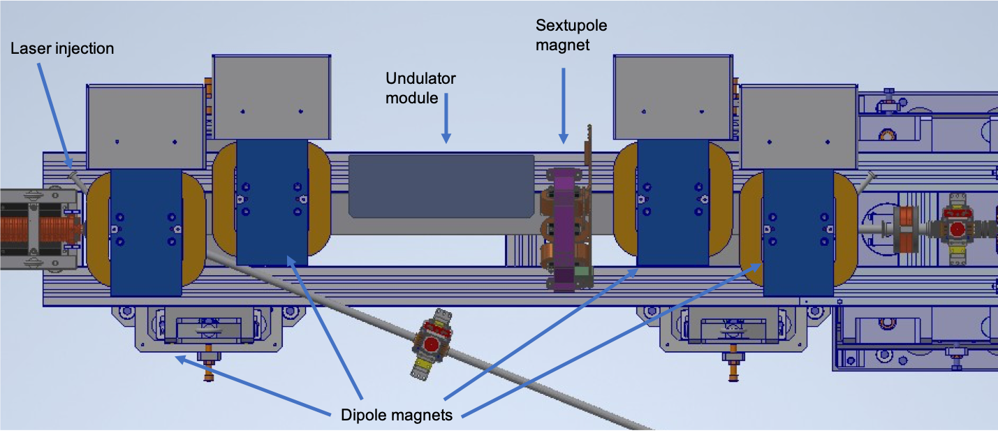
Laser Heater
Laser Heater system for pure RF working point
An undulator is placed in the magnetic chicane. A laser, interacting with the electron beam in the undulator, causes an energy modulation within the bunch on the scale of the optical wavelength.

Slide 10
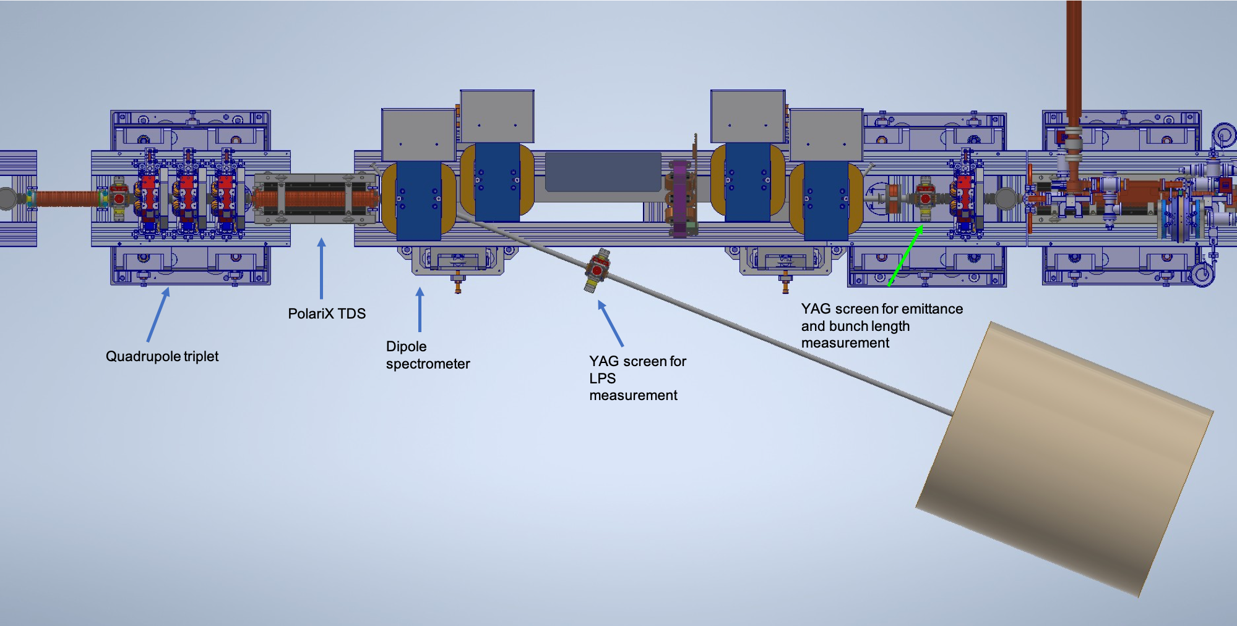
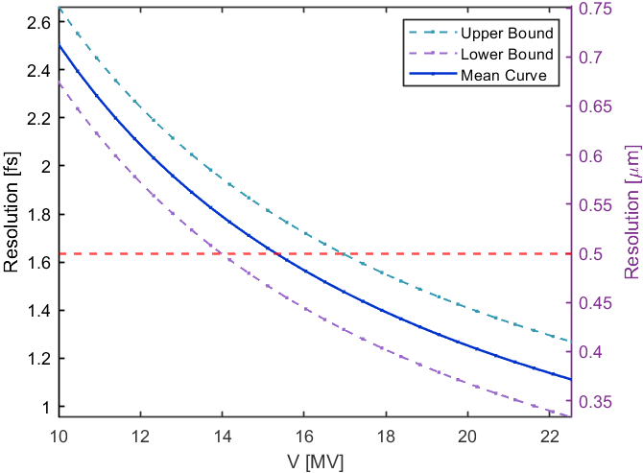
PolariX-based diagnostics
High (injector) energy diagnostics
Low-Energy Deflector designed according to the needed resolution and available space, leading to a structure of 50 cells and a length of 60 cm.
Field maps generated with HFSS and implemented in ASTRA for beam dynamics simulations.
➔ Collaboration with PSI

Slide 11
Achievements: Technological Readiness Level (Sub-Components)
S-Band injectors are widely used in many facilities including SPARC_LAB. S-Band technology is fully available in the market.
Sub - systems | TRL | Comments
RF Gun | 9 | S-Band RF guns are widely used in many facilities including SPARC_LAB. S-Band technology is fully available in the market.
Solenoids | 9 | Technology demonstrated in other facilities (FERMI, SwissFEL, etc.)
X-band Linearizer | 7 | Higher harmonic cavities are used already in several facilities for manipulating the LPS; X-band linearizer is still relatively new in daily user operation.
S-band linac | 9 | S-Band linac structurs are widely used in many facilities including SPARC_LAB. S-Band technology is fully available in the market.
Laser heater | 7 | Laser heater systems are routinely in operation in several facilities (FERMI, SwissFEL, etc.), a design more suitable for our layout is needed.
Diagnostic | 8 | Diagnostics instrumentations are based on standardized components daily used in other facilities; only very few devices cannot be considered plug-and-play.
Photo-cathode laser | 9 | Photocathode laser is now a proven technology tested in real facilities (including SPARC_LAB). The systems are full available in the market almost as off-the shelf products.

Slide 12
Pending Items: (What is still in progress or incomplete.)
Pending Items
Final (executive) design of the laser heater system
Optimization of the layout (to include inter-diagnostics)
Laser transport line
Realistic model of undulator module (to perform realistic S2E simulation with 15Mparticles)
Toward Executive Machine Design:
EM design of the S-band structures with the European frequency
Toward a future upgrade at high rep rate:
Systematic design of a C-band injector

Slide 13
Planned Actions: (What will be done, by when.)
For the Executive Design
The finalization of the LH design impacts slightly on the layout, and not on the main working point based on the 2-bunches generation and manipulation for PWFA
Resources (to be found in Beam Physics and Undulator Areas) should be focused on the finalization of design and simulations
Tentative due date December 2025

Slide 14
Dependencies / Risks (optional): (Any blocking issues or critical path items.)
none

Slide 15
Conclusions
RF photo-injector specifications align with
the required two-bunches beam configuration for PWFA
the requirements on stability and reproducibility
the versatility needed for exploring different working points
The injector layout is consistent with the requirements from beam dynamic studies, virtual diagnostics and multi-working point operation

