Slide 1
EuPRAXIA@SPARC_LAB
TDR Machine Layout
at SPARC_LAB
Andrea Ghigo, INFN
8th EuPRAXIA@SPARC_LAB Review Committee Meeting, LNF June 16-18, 2025

Slide 2
Machine Layout 1
In this chapter the layout of the entire infrastructure is reported:
1 Machine layout
1.1 EuPRAXIA layout
1.1.1 Introduction to EuPRAXIA layout
1.2 Building Functional layout 11
1.2.1 General description
1.2.2 The accelerator and undulator tunnel
1.2.3 Modulator and power supplies area
1.2.4 Laser Rooms
1.2.5 Beam lines and Users area
8th EuPRAXIA@SPARC_LAB Review Committee Meeting, LNF June 16-18, 2025 Andrea Ghigo

Slide 3
Machine Layout 2
In this paragraph the layout of the accelerator is reported:
1.3 The machine layout
1.3.1 Introduction
1.3.2 S-band injector
1.3.3 X-band linac
1.3.4 Plasma accelerating section
1.4 Free Electron Laser radiation
1.4.1 The FEL undulators
1.4.2 FEL radiation beam transport lines
1.4.3 End station and user area
8th EuPRAXIA@SPARC_LAB Review Committee Meeting, LNF June 16-18, 2025 Andrea Ghigo

Slide 4
List of Figures
1.1 Layout of the accelerator in the building
1.2 Functional layout
1.3 Layout of the accelerator and beam lines
1.4 S-band injector
1.5 Layout of the X-band accelerator
1.6 Area dedicated to plasma acceleration
1.7 Free Electron Laser undulators
1.8 Schematic layout of the FEL beamlines
8th EuPRAXIA@SPARC_LAB Review Committee Meeting, LNF June 16-18, 2025 Andrea Ghigo

Slide 5
Building areas
Ground floor
Accelerator Tunnel
Modulator & power supply area
Undulator tunnel
FEL user area
Experimental Areas
Laser Rooms
First floor
Control room
Laser Rack room
UTA corridors
Users offices & meeting room
Break area
Terrace
8th EuPRAXIA@SPARC_LAB Review Committee Meeting, LNF June 16-18, 2025 Andrea Ghigo

Slide 6
Building Functional Layout – Ground floor
Particle experimental area
Laser clean rooms
Cooling Plants area
FEL user area
Undulators tunnel
Klystron Gallery
Accelerator tunnel
cfr Simona Incremona talk
8th EuPRAXIA@SPARC_LAB Review Committee Meeting, LNF June 16-18, 2025 Andrea Ghigo

Slide 7
Building Functional Layout – First floor
Laser racks area
Control Room
Users & meeting rooms
UTA -corridors
UTA -corridors
Elecric cabins
8th EuPRAXIA@SPARC_LAB Review Committee Meeting, LNF June 16-18, 2025 Andrea Ghigo

Slide 8
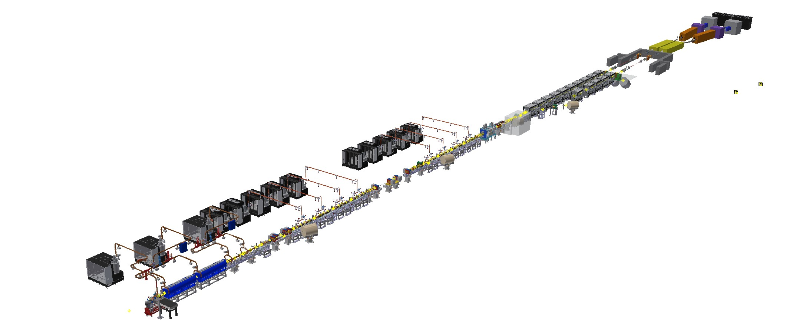
Accelerator, undulators & Beam lines 3D Layout
8th EuPRAXIA@SPARC_LAB Review Committee Meeting, LNF June 16-18, 2025 Andrea Ghigo

Slide 9
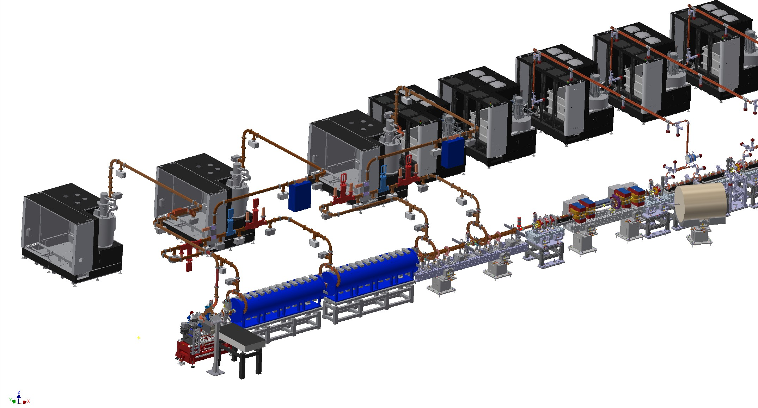
Injector
S-band photogun
S-Band accelerating section
First accelerating section Solenoids
Laser heater – magnetic compressor
X-band linearizer
Injector diagnostics
RF modulator & Klystron
RF waveguide network

Slide 10
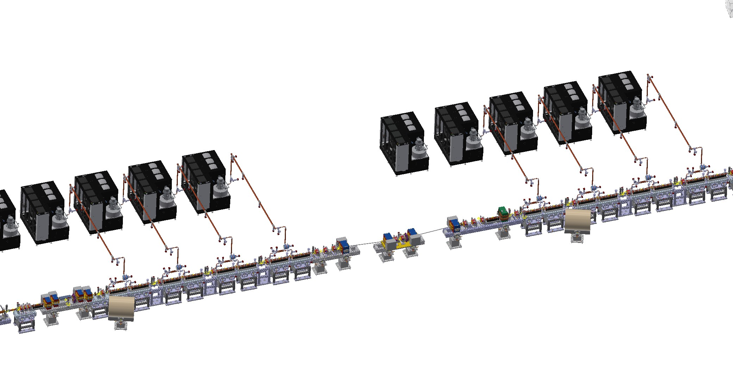
X-band linac & bunch compressor

Slide 11
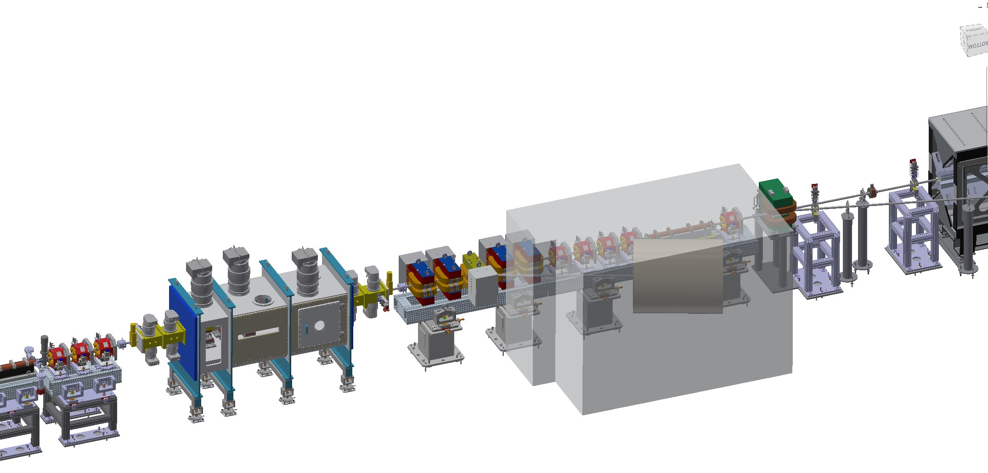
Plasma section

Slide 12
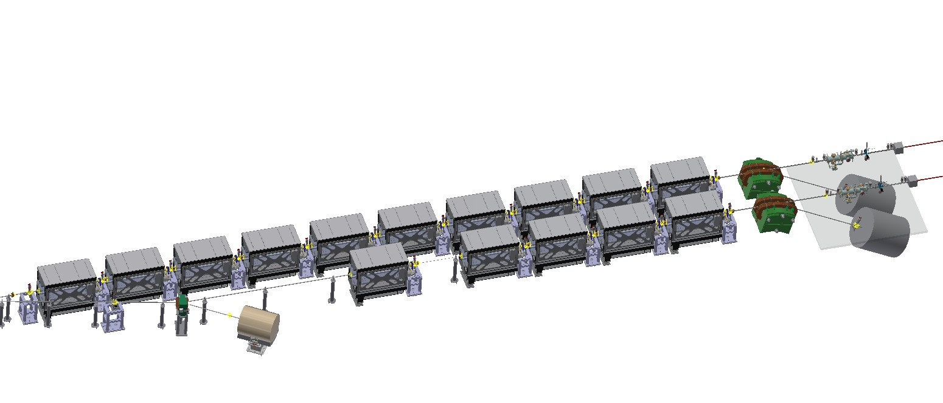
Undulators area

Slide 13
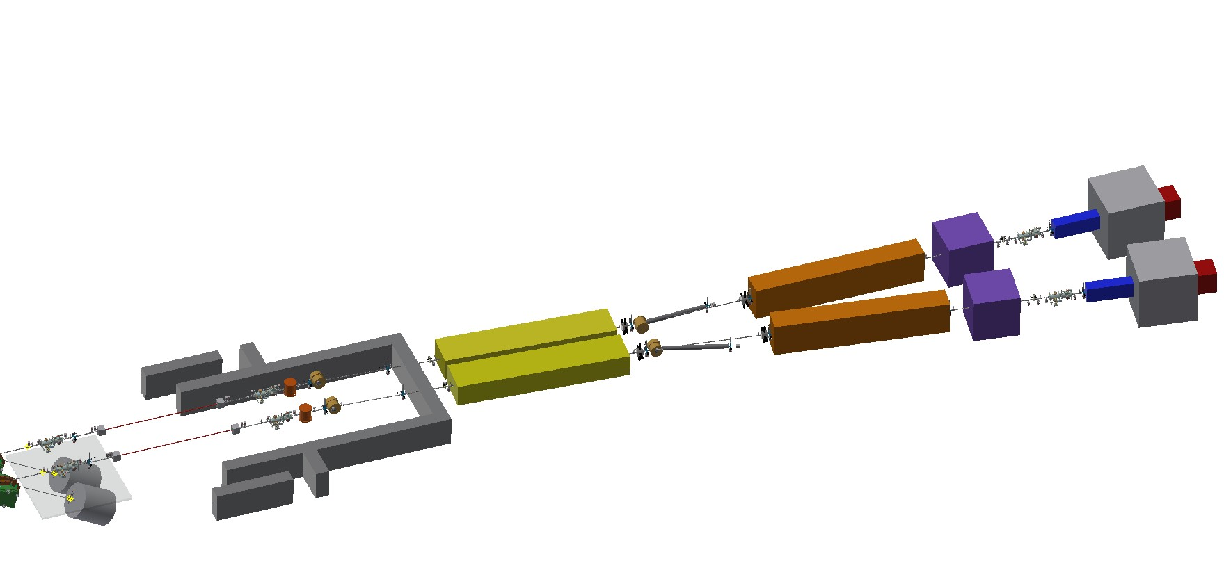
Beam lines & FEL users area

Slide 14
Thanks for
the attention
8th EuPRAXIA@SPARC_LAB Review Committee Meeting, LNF June 16-18, 2025 Andrea Ghigo

