Slide 1
Chapter 05: Beam Physics
C. Vaccarezza
On behalf of the WA1-Team
This project has received funding from the European Union´s Horizon Europe research and innovation program under grant agreement No. 101079773
IX TDR Review Committee Meeting
June 16-18, 2025

Slide 2
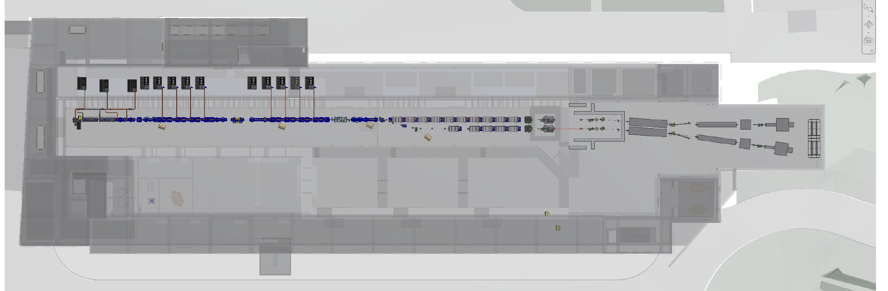
My Area

Slide 3
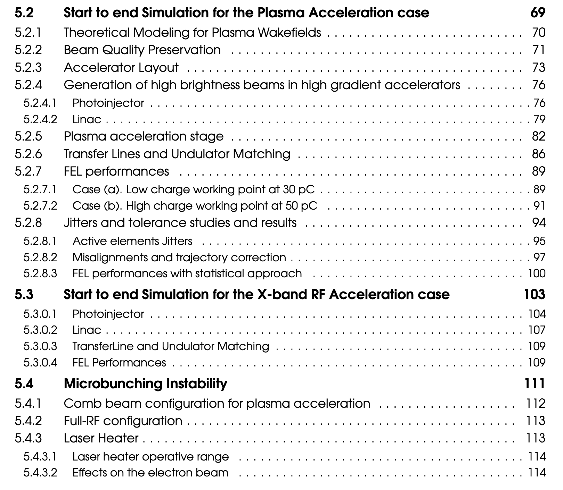
Chapter 05 Description

Slide 4
GLOBAL GOALS
 | Units | PWFA | Full RF
 |  | 30 pC with tapering | Hybrid compression
Electron Energy | $$GeV$$ | 1 | 1
Repetition rate | $$Hz$$ | 100 | 100
Bunch charge | $$pC$$ | 30 | 200
Peak current at undulator entrance | $$kA$$ | 3.3 | 3.4
RMS bunch length at undulator entrance | 𝜇m | 1.4 | 16.9
RMS normalized emittance (x,y) | $$mm mrad$$ | 0.7,0.6 | 2.1,1.0
RMS energy spread | $$\%$$ | 0.5 | 0.2
Slice length | $$μm$$ | 0.5 | 0.5
Slice Normalized emittance (x,y) | $$mm mrad$$ | 0.7,0.6 | 0.3,0.3
Slice energy spread | % | 0.04* | 0.02
𝜌 (3D) | $$×{10}^{−3}$$ | 0.77 | 1.49
Radiation wavelength | $$nm$$ | 4.0 | 4.0
Saturation length | $$m$$ | 20.5 | 20.0
Photon Pulse Energy | $$μJ$$ | 16 | 150
Photon per pulse | $$×{10}^{11}$$ | 3.2 | 31.3
Photon Bandwith | $$\%$$ | 0.4 | 0.5
Photon Brilliance per shot | $$×{10}^{30}$$ | 0.12 | 2.1
Study and feasibility check of the accelerator working points for the generation of an electron beam able to drive FEL radiation emission at $λ_{r}=4 nm$ in the AQUA undulator.
Innovative topics:
PWFA acceleration
X-band technology
Provision of technical specifications for the construction of the accelerator. (nominal+tolerances)
* Calculated with the 5 % cut of off-energy charge ( not lasing )

Slide 5
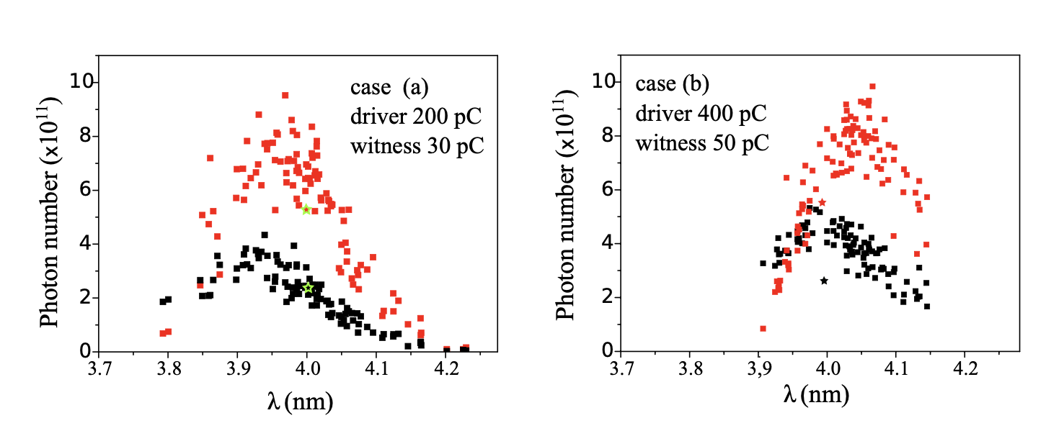
STATISTICAL ANALYSIS
A deep attention has been devoted to the statistical analysis of the FEL source performance for the plasma acceleration case taking into account the 200+30pC working point. All active elements have been included to identify their acceptable tolerance values.
A detail analysis of the wakefield effects for the low and high charge plasma working points has also been performed to evaluate the shot-to-shot energy jitter and pointing stability between Witness and Drive.
The obtained results indicates that the low charge case shows a higher energy jitter shot to shot, while the high charge case shows a worse pointing stability between Witness and Driver. An intermediate working point will be addressed to enhance the positive effect of the two options and the 3D tracking in plasma will be performed to verify the extent of the effect

Slide 6
Achievements: Technological Readiness Level (Sub-Components)
Sub - systems | TRL | Comments
Electron beam tracking codes (2D-3D) | 9 | Several codes are immediately available, most of them are open source or commercial, optimized for multi-core and cluster operation (Tstep (Parmela commercial), Astra, Elegant, Genesis, CST, HFSS).
Cluster Technology | 9 | High level computational systems able to perform state of the art level simulations of plasma acceleration, are available and commercialized.
Fast 2D tracking plasma codes | 8 | Several codes are available which can perform meter scale plasma acceleration simulations with a hybrid fluid-PIC framework (Architect) and quasi-static framework (HiPACE). Another 3D fluid code is currently under development within an INFN-Tor Vergata collaboration.
Plasma PIC 3D Simulation Codes | 7 | Full PIC 3D code Osiris is open source and available for the EuPRAXIA project, currently in use to cross check the start to end nominal working points of the TDR. Its use to perform simulation scans for stability analysis with reasonable computational resources is still not possible.
Plasma Discharge Simulation Codes | 4 | Despite several codes are currently being developed for simulating a plasma capillary discharge, there are several doubts over the applicability of underlying models, due to the difficulty in correctly modelling the electron-wall interaction which is of primary importance in our density range.

Slide 7
Pending Items: (What is still in progress or incomplete.)
Pending Items:
Full RF working point: Jitter analysis (estimated less severe than Plasma case)
Toward Executive Machine Design:
Field Maps insertion in the codes for all magnetic elements.
PWFA: 3D simulations including offset and angle between Driver and Witness bunch:
3d Simulation of plasma module already started with the Osiris code thank to the EuPRAXIA-PP network (Lisboa PhD student) 6 months estimate
3D tracking code under development at LNF (Post Doc ), 1 year estimate
Discharge simulation code preliminary evaluation started, 4-5 years estimate

Slide 8
Dependencies / Risks (optional): (Any blocking issues or critical path items.)
Low Risk: Reduction of statistical performance of the FEL source due to purely 3D effects in plasma acceleration module.

Slide 9
Conclusions
The results of the Start-to-end simulations, supported by the in-depth study of the effects of system performance tolerances on the electron beam quality, show that the designed accelerator, based on PWFA+X-band technology, is able to drive a 4 nm FEL source, with the expexted radiation parameters, i.e ≥ ${10}^{11}photons/shot$ in a 25 m Aqua undulator and so on.
All the performed simulations took into account the state of the art of the active and passive elements as reached in our Lab or in international landscape (SLAC, DESY, PSI, FERMI).
e.g. for the plasma density profile, the measurement results have been considered as obtained at plasma lab for the 40 cm capillary prototype, both for the flat top density profile (over 15-20 cm) and for the density ramps at capillary ends.

Slide 10
Back-up slides

Slide 11
TRL LEVEL | TRL Description
TRL 1 | Basic principles observed – Scientific research begins to be translated into applied research and development (R&D).
TRL 2 | Technology concept formulated – The basic principles are explored and practical applications are identified.
TRL 3 | Experimental proof of concept – Active R&D is initiated, including analytical and laboratory studies to validate predictions.
TRL 4 | Technology validated in lab – Basic technological components are integrated to establish that they work together.
TRL 5 | Technology validated in relevant environment – The technology is tested in a simulated or relevant environment
TRL 6 | Technology demonstrated in relevant environment – A prototype system is tested in an environment similar to the operational one.
TRL 7 | System prototype demonstration in operational environment – A working prototype is demonstrated in a real operational setting.
TRL 8 | System complete and qualified – The technology is proven to work in its final form and under expected conditions.
TRL 9 | Actual system proven in operational environment – The technology is fully commercialized and operational in its intended setting.

Slide 13
E carica degli spazi fase completamente diversi. Queste sono le distribuzioni sul picco di corrente: con le slice con le particelle

Slide 14
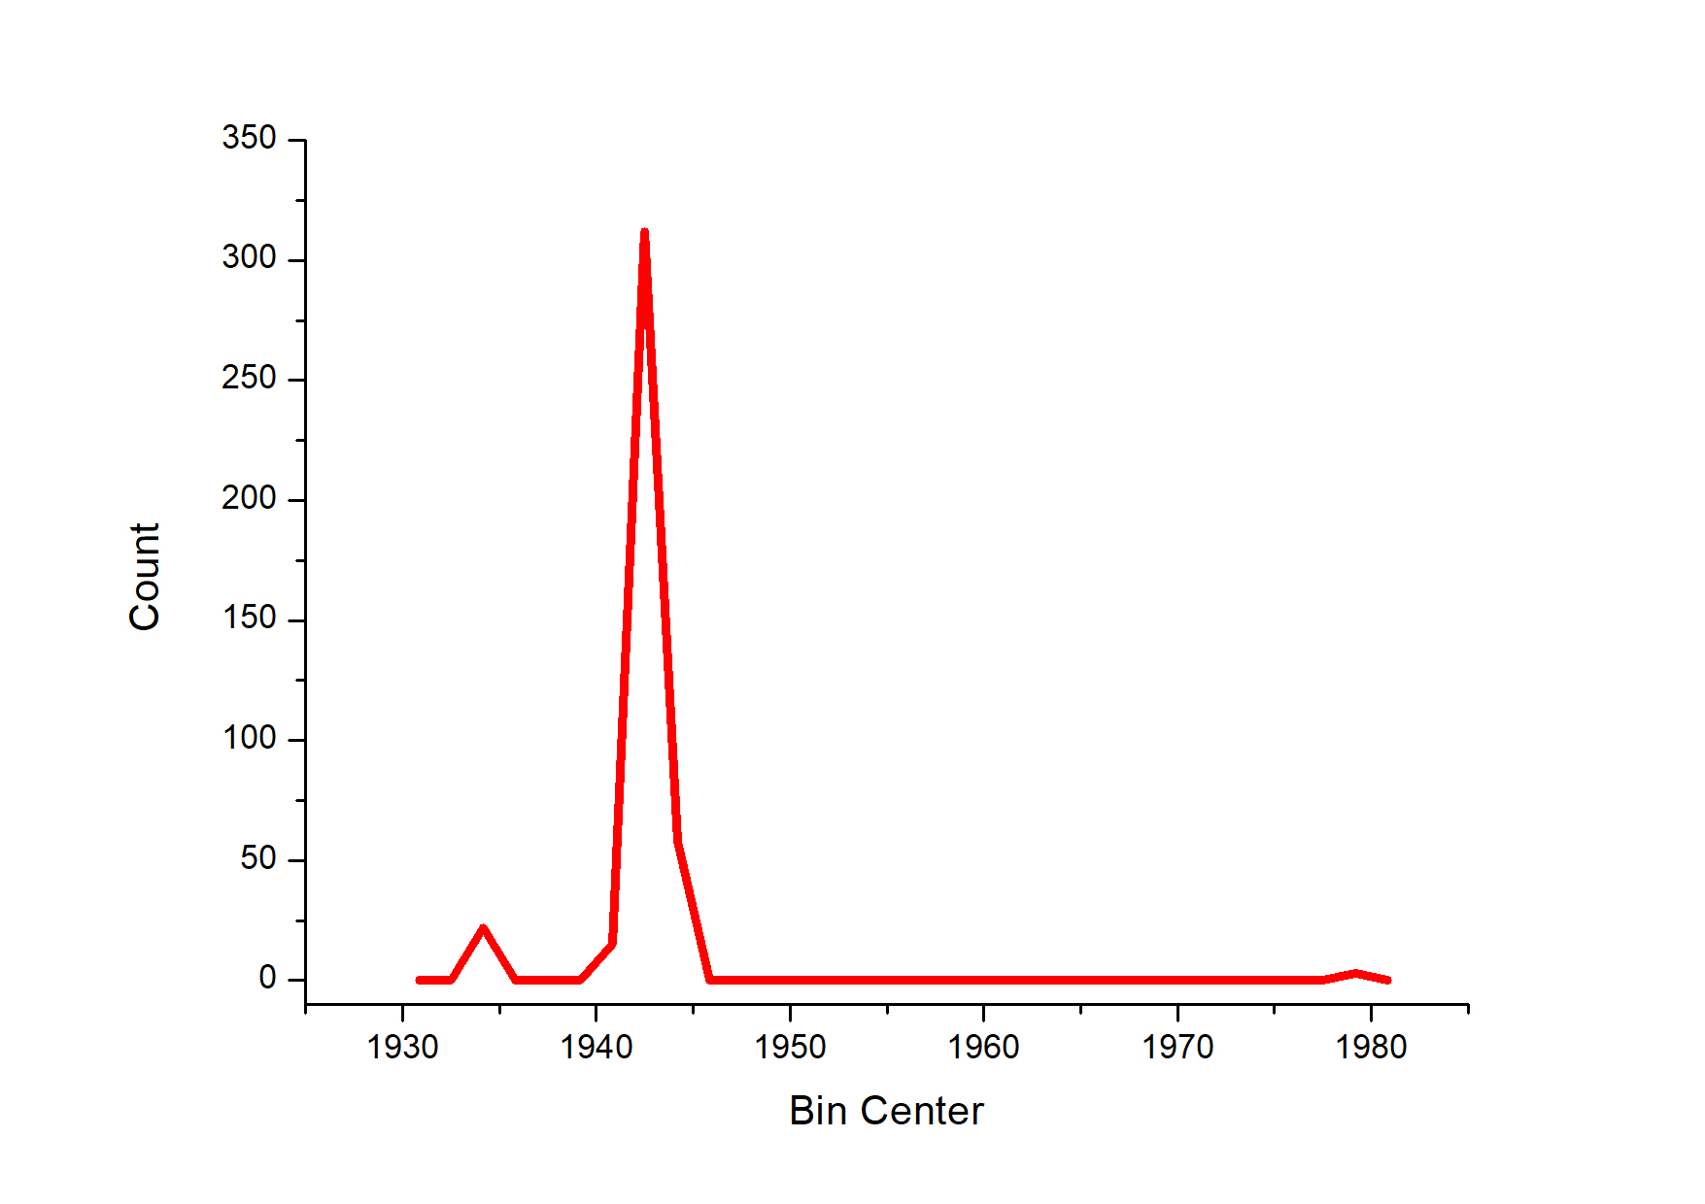
Quale delle due corrisponde al fascio che stiamo simulando? Analizzando direttamente il fascio di Cristina abbiamo sul picco di corrente in un intervallo analogo a quello usato da Genesis (32 nm):
Eliminando i gruppi di particelle satelliti,
l’energy spread del picco centrale è delta_gamma=0.7
invece che 5

Slide 15
Quindi possiamo concludere che la rilettura corretta che genesis dà dello spazio fase è quella con particelle e non con le slice.
Questa analisi giustifica anche perché nel caso con le slices la radiazione non sale. L’energy spread valutato da genesis in modalità slice è almeno 8 volte quello effettivo valutato in modalità particelle che elimina correttamente le code.

