Slide 1

Chapter 12: Experimental Endstation
Francesco Stellato
On behalf of Working Area 8
This project has received funding from the European Union´s Horizon Europe research and innovation program under grant agreement No. 101079773
IX TDR Review Committee Meeting
June 16-18, 2025

Slide 2
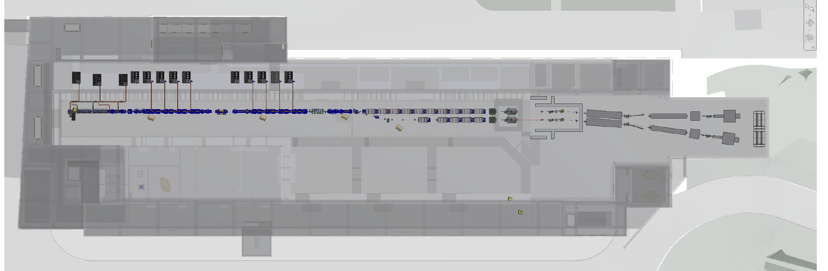
My Area – Experimental Endstation

Slide 3
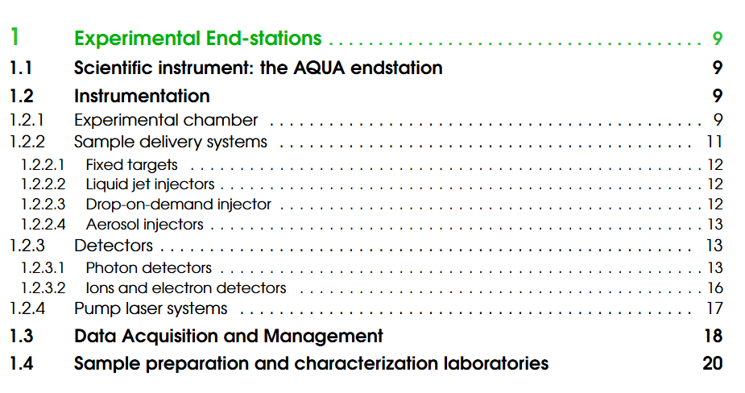
Describe your Chapter
Instrument overview: why and what
Description of the experimental end-station main components
DAQ & sample preparation requirements

Slide 4
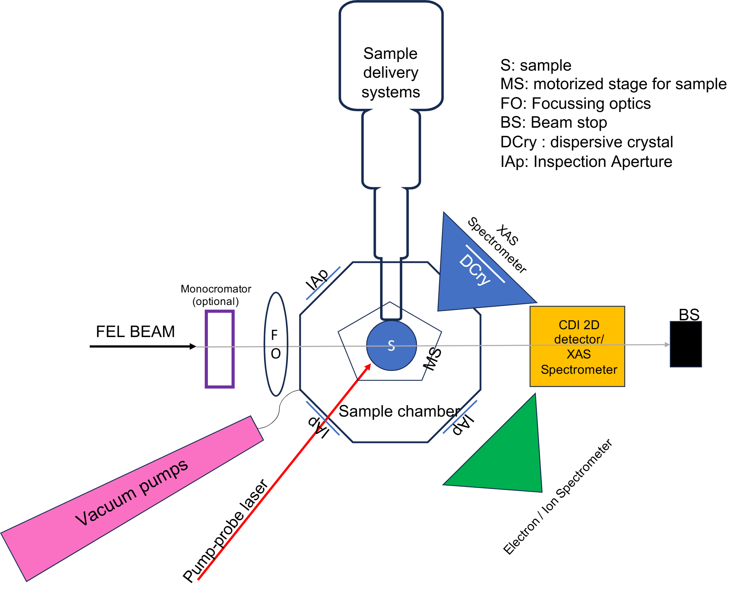
Global Goals
Design a flexible experimental endstation allowing users performing imaging & spectroscopy experiments
Static measurements at day-one,
ultra-fast, time resolved ones at a later stage.

Slide 5
Achievements:
Technological Readiness Level (Sub-Components)
Sub - systems | TRL | Comments
Experimental chamber | 9 | A schematic view of the experimental chamber has been prepared. A detailed design will be prepared at a later stage.
Sample delivery systems | 8 | Sample delivery systems are at present installed at operational FEL facilities. However, some care must be taken to adapt them to the specific EuPRAXIA beamline(s). Most of the sample delivery systems (fixed target supports, liquid jets, aerosol injectors) have already been used at FEL facilities and are commercially available.
Photon Detectors | 9 | Photon detectors having the required features (vacuum compatibility, pixel size, intrinsic noise, readout rate) are commercially available.
X-ray spectrometer | 8 | Crystals to build the X-ray spectrometer are also available on the market, but the details have to be tailored for the EuPRAXIA setup.
Ions & Electron Detectors | 8 | Ions and electron detectors are routinely used at similar facilities, but optimized schemes for EuPRAXIA have to be implemented.
Pump Lasers | 9 | Pump laser are commercially available.
DAQ systems | 8 | DAQ pipeline will be adapted - and then optimized - from those used by similar facilities.
Sample Characterization Laboratories | 9 | A list of general-purpose, commercially available instruments has been prepared.

Slide 6
Pending Items:
(What is still in progress or incomplete.)
TDR
  TDR is completed, pending minor editorial optimization (explicative figures) and appropriate referencing of connections with other chapters
After the TDR:
  Volumetric analysis to optimize end-station modularity and instrument placement. The TDR chapter will be used as a baseline for future executive designs needed for procurement of the elements
  Executive designs needed for procurement of the elements
  Extended simulations of different experiments to guide the tailoring of the design

Slide 7
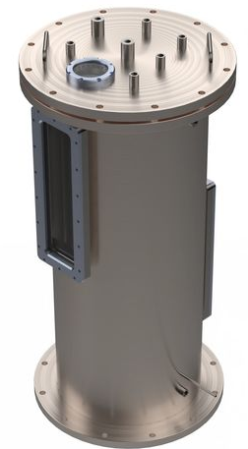
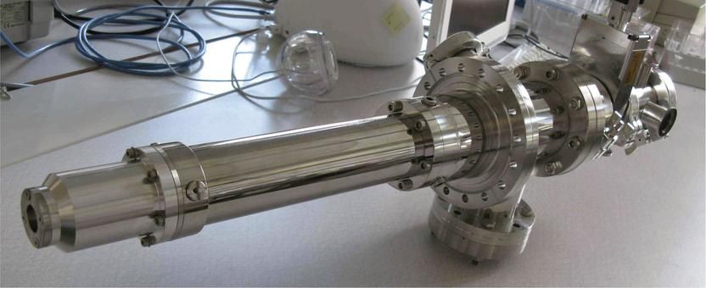
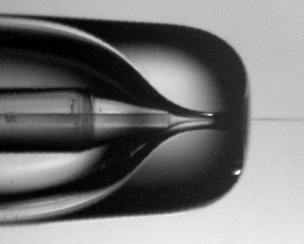
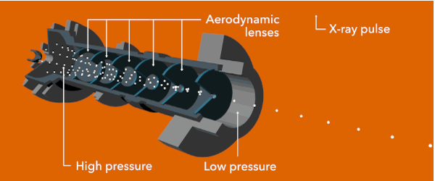
Dependencies / Risks (optional):
(Any blocking issues or critical path items.)
Dependencies (Very important, but already accounted for)
  Upstream beamline description (Chapter ‘Photon beamline’)
  Pulse characterization (Chapter ‘Electron and Photon Diagnostics’)
Risks
  Minor variations in FEL pulse spectral shape, intensity, stability, and beam focal must be considered
  Many components are present in the endstation. Although commercially available, procurement might be complicated (mitigation: order complete systems instead of parts when possible - e.g. for sample injectors)
+ + =
Notes:
stability

Slide 8
Conclusions
The experimental endstation is designed to fully exploit the unique characteristics of the EuPRAXIA FEL beam — including its photon wavelength, SASE spectral profile, and high peak brilliance.
From day one, it will support a science program that demonstrates the FEL’s capability to deliver state-of-the-art photon beam to perform experiments on suitable samples.
The system is also flexible, allowing adaptation to machine upgrades and accommodating diverse user requirements.

