Slide 1
Chapter 4: Scientific Case
Francesco Stellato
On behalf of Working Area 8
This project has received funding from the European Union´s Horizon Europe research and innovation program under grant agreement No. 101079773
IX TDR Review Committee Meeting
June 16-18, 2025

Slide 2
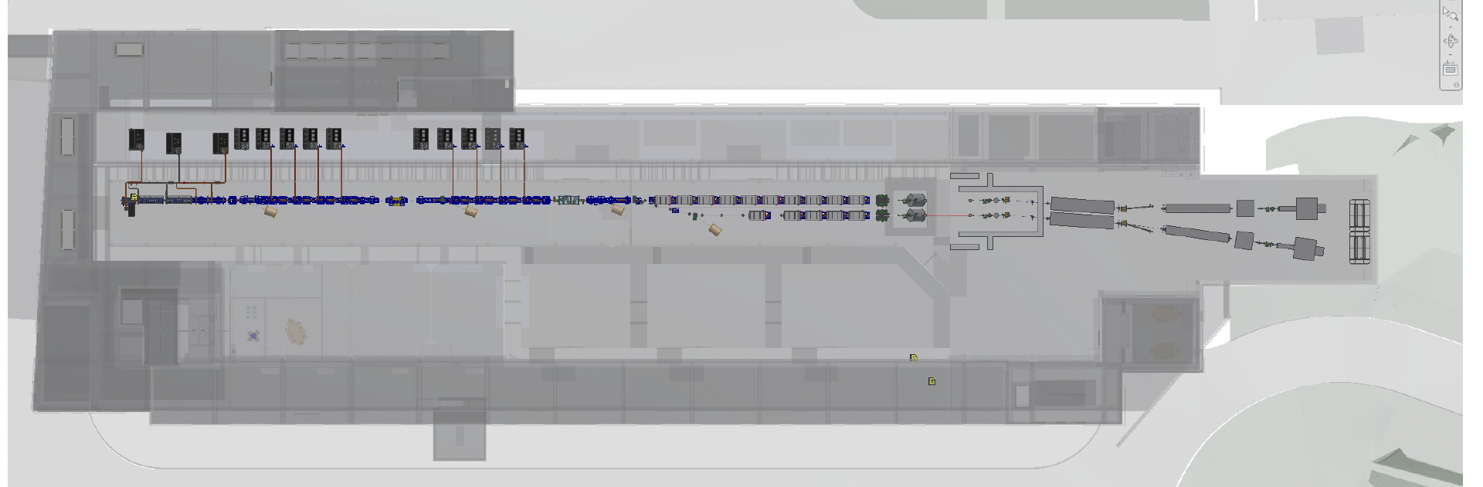
My Area – Downstream of everything

Slide 3
Describe your Chapter
Overview
Main photon science
applications
Main photon experimental techniques

Slide 4
Global Goals
Identify the most promising applications of the AQUA FEL in various fields:
Condensed matter
Biophysics
Chemistry
Structural biology
Environmental sciences
Astrophysics
Geology
AQUA key features
- Ultra-short pulses
High-brilliance
Soft X-ray wavelength

Slide 5
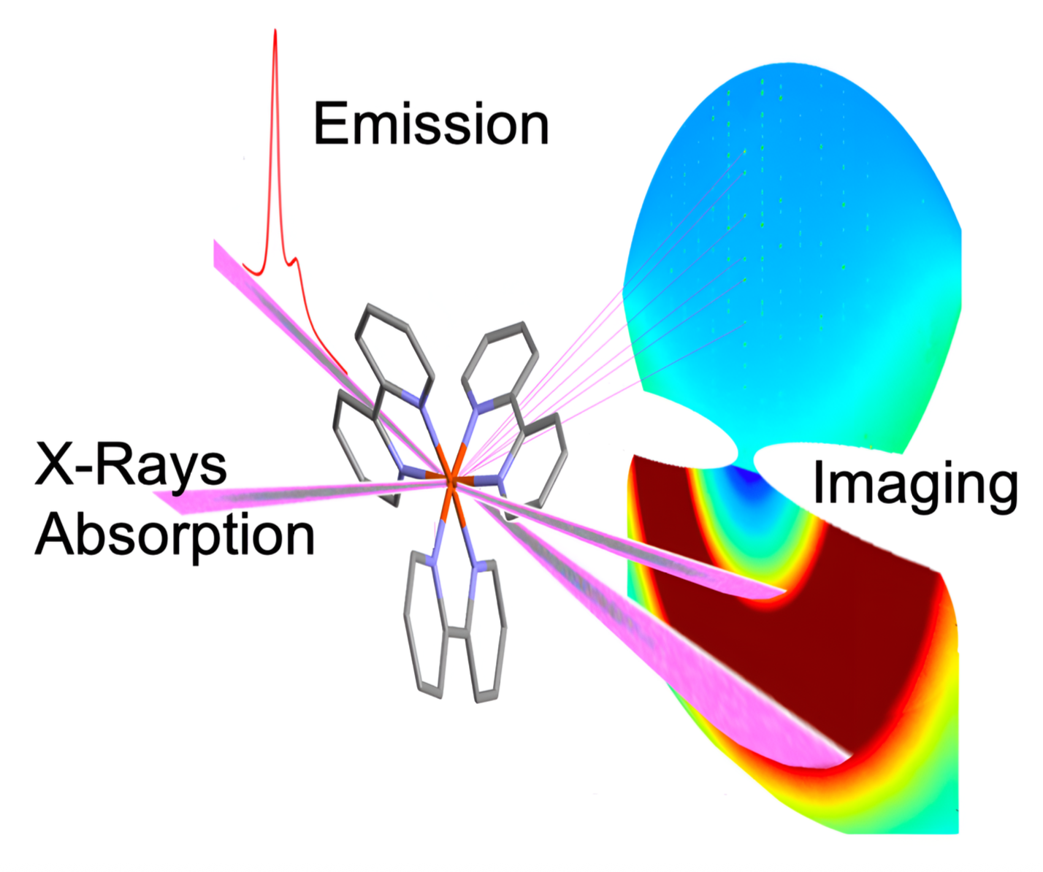
Global Goals
Identify the experimental techniques that are compatible with and can benefit most from the AQUA femtosecond, high-brilliance, soft X-ray SASE pulses
Provide a framework to guide the beamline and experimental endstation design

Slide 6
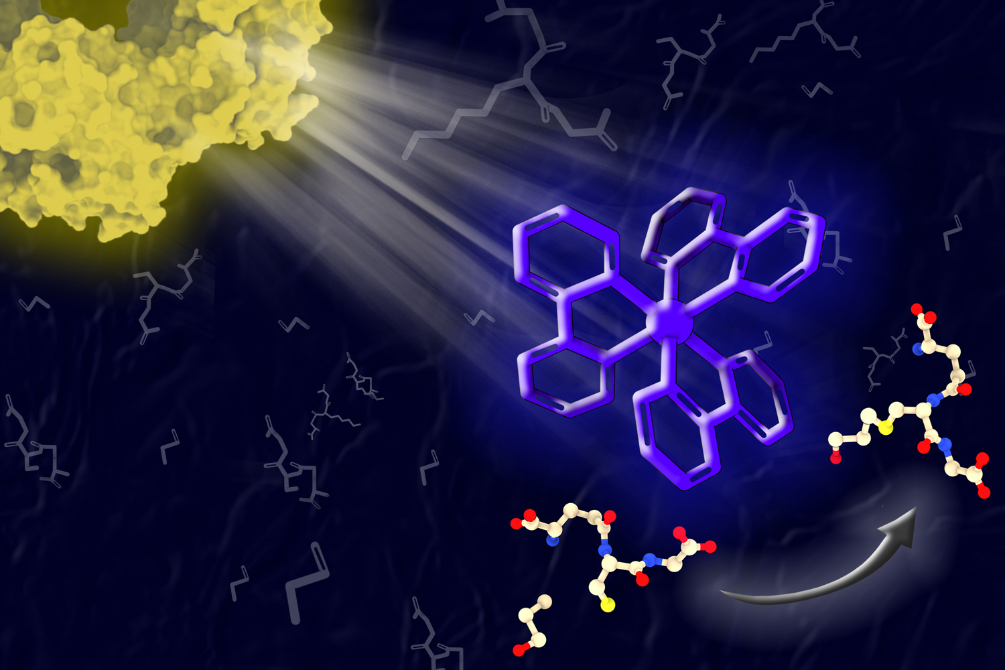
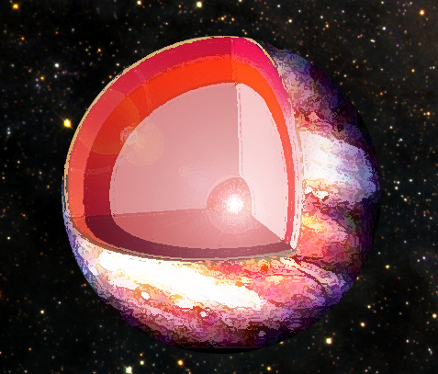
Global Goals
Photon Science FEL Applications
Renewable Energy Systems:
Study charge transport in solar cells and photocatalysts.
Probe photocatalytic water splitting and pollutant breakdown.
Warm Dense Matter:
Investigate matter under extreme temperature and density.
Relevant for astrophysics and fusion research.

Slide 7
Global Goals
Photon Science FEL Applications
Battery Technology and E-Mobility:
Real-time studies of electrolyte decomposition, interfacial reactions.
Nonlinear spectroscopy of solid-state batteries.
Structural Biology & Health:
Time-resolved imaging of living cells and biomolecular dynamics.
DNA damage, microbial behavior, astrochemistry simulations.

Slide 8
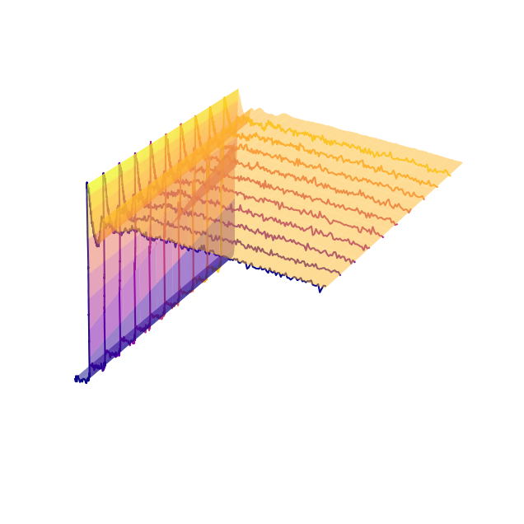
Experimental Techniques
Day-one techniques
Coherent Diffraction Imaging (CDI):
Lensless imaging of biological/non-crystalline samples.
“Diffraction-before-destruction” approach with fs pulses.
Single-particle imaging, pump–probe dynamics, 2D and 3D reconstructions.
X-ray Absorption Spectroscopy (XAS):
AQUA accessible energy range spans K, L and M edges, allowing XAS measurements on different elements.
“Ghost spectroscopy” and correlation-based methods—ideal for SASE FEL.
Time-resolved pump–probe studies of ultrafast processes.

Slide 9
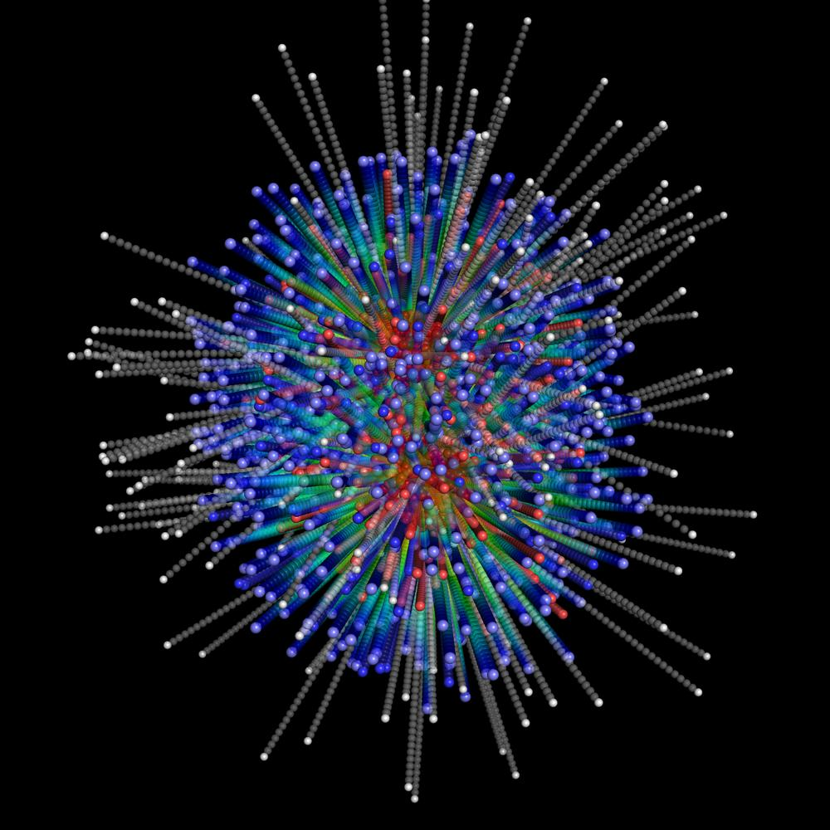
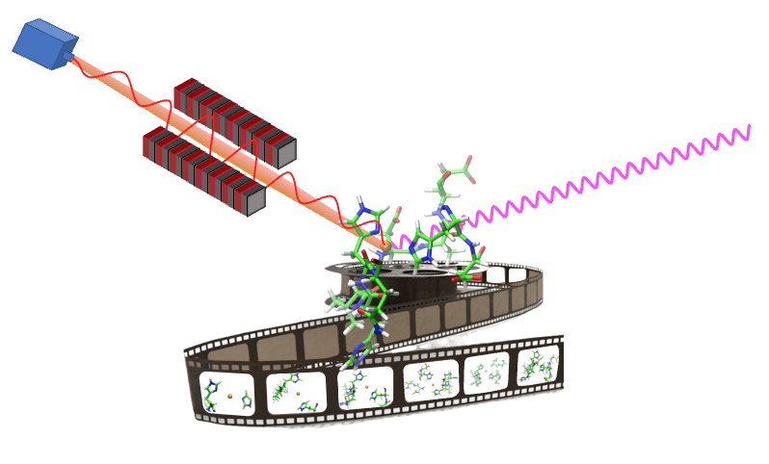
Experimental Techniques
Operational phase
Ion Spectroscopy:
Time-of-flight mass spectrometry,
Coulomb Explosion / Imaging / Fragmentation dynamics
Time-Resolved Approaches (for all the experimental techniques)
Laser–FEL pump–probe and split-and-delay schemes.
Capture of femtosecond reaction dynamics and transient states.

Slide 10
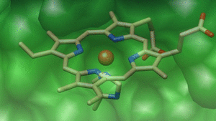
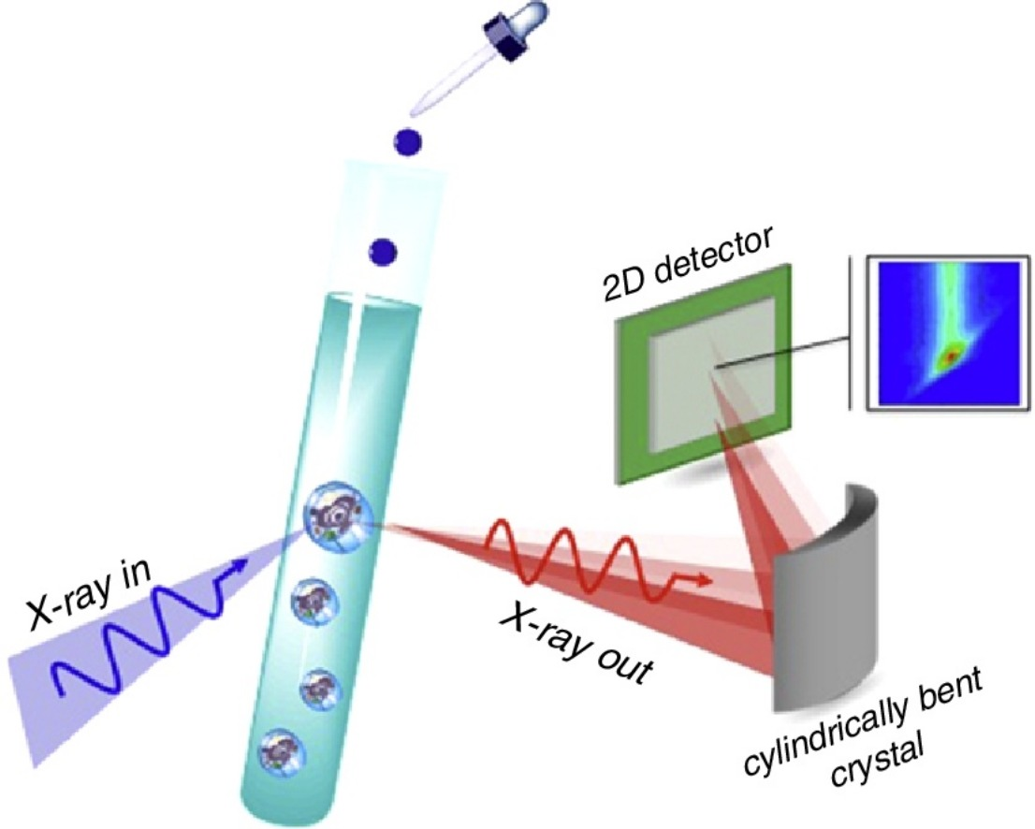
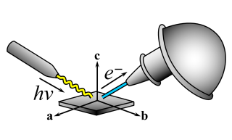
Experimental Techniques
Future developments
X-ray Emission Spectroscopy (XES) and advanced photon spectroscopies.
Photoemission Spectroscopy:
High-resolution chemical/electronic state mapping with monochromatic FEL.

Slide 11
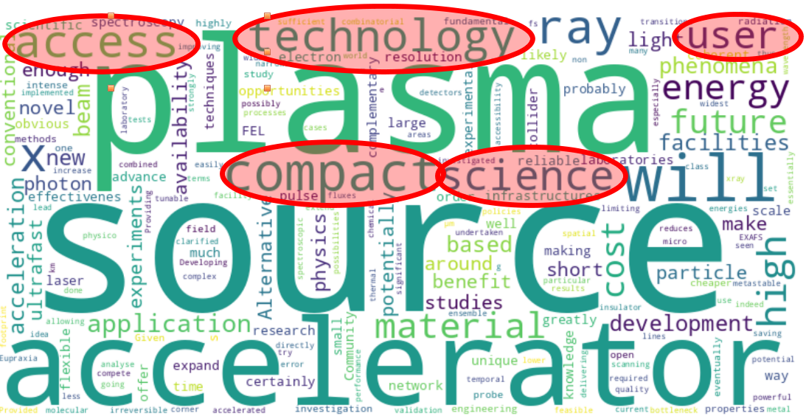
Planned Actions: (What will be done, by when.)
Enrich the scientific case by taking into account inputs from the EuPRAXIA community, and from the various photon science users’ communities

Slide 12
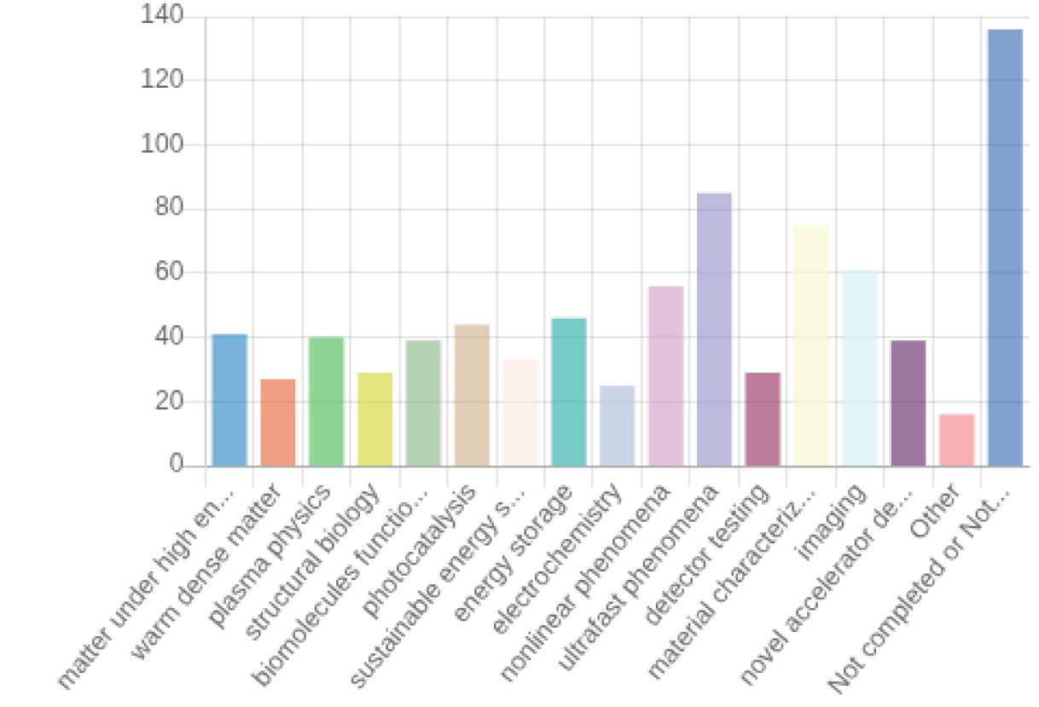
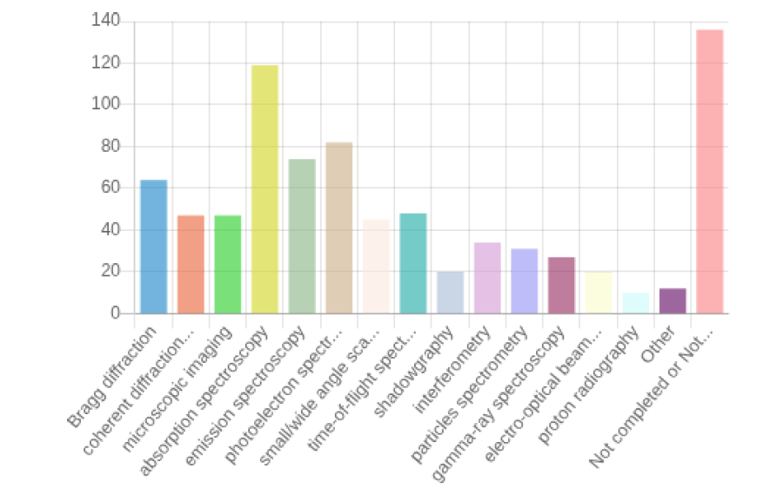
Planned Actions: (What will be done, by when.)
EuPRAXIA-PP WP5 survey on users’ demands: ongoing analysis
Scientific area Experimental technique

Slide 13
Planned Actions: (What will be done, by when.)
The TDR is ready, but in the short-, mid- and long term can be enriched by:
Deepening ties with local, national, and international communities
Expanding the scientific reach of the various users’ communities
Strengthening the partnerships with other FEL (and synchrotron radiation) facilities
Notes:
stability

