Slide 1
Chapter 13: Diagnostics
L. Avaldi, A. Biagioni, P. Bolognesir L. Carlini, J. Chiarinelli, A. Cianchi, M. Del Franco, F. Demurtas, A. Esposito, M. Ferrario, G. Franzini, F. Galdenzi , M. Galletti, A. Ghigo, L. Giannessi, A. Giribono, G. Latini, V. Lollo, S. Pioli, D. Quartullo, L. Sabbatini ,A. Stella, F. Stellato, C. Vaccarezza, A. Vannozzi, L. Verra, F. Villa,
INFN - Laboratori Nazionali di Frascati, Università degli Studi di Roma Tor Vergata and INFN, ISM-CNR, Area della Ricerca di Roma 1, Rome - Italy
This project has received funding from the European Union´s Horizon Europe research and innovation program under grant agreement No. 101079773
IX TDR Review Committee Meeting
June 16-18, 2025

Slide 2
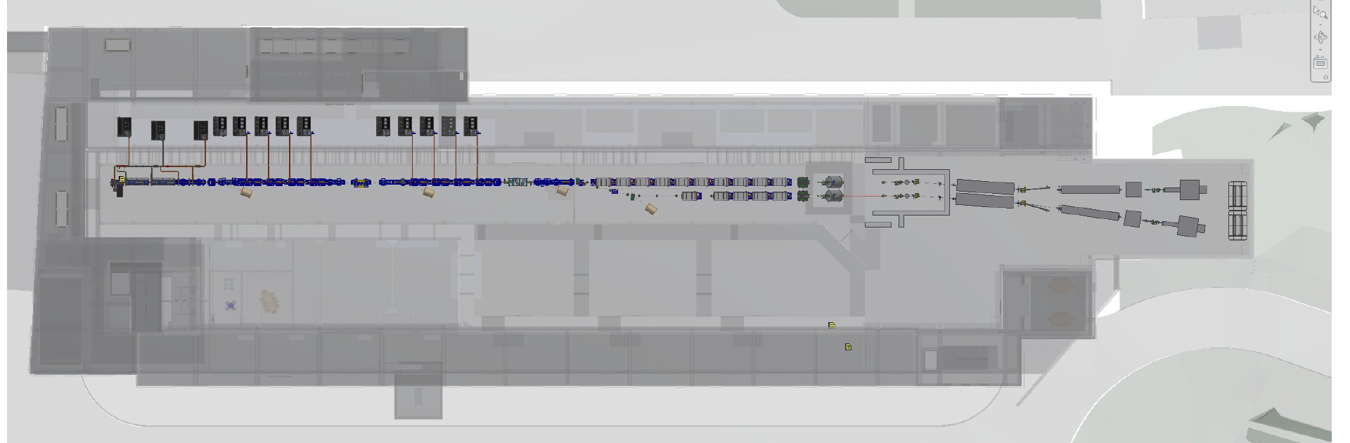
Our Area

Slide 3
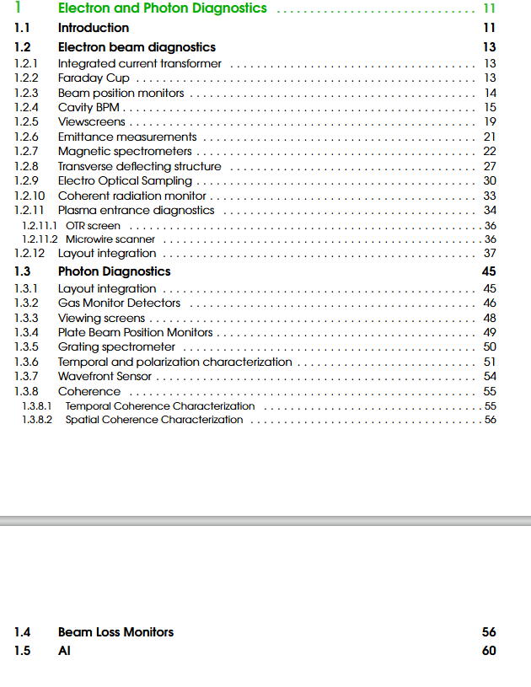
Diagnostics
The diagnostics have been designed to resolve and monitor every critical parameter of the electron beam and photon output, while remaining fully compatible with the unique characteristics of X-band linac and plasma acceleration
Compact geometry
Precise control of the trajectory
Extensive knowledge of 6D beam phase space
Increased jitter
To remember: An accelerator is just as good as its diagnostics.

Slide 4
Parameters to measure, range and resolution

Slide 5
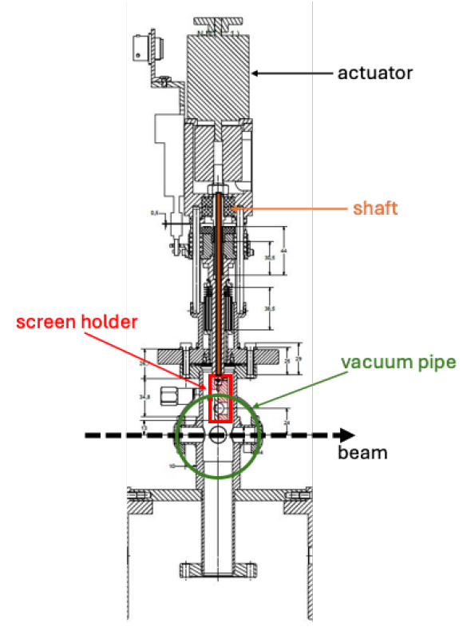
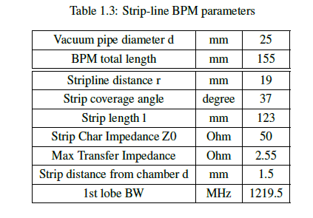
Drawings and tables
Tables and mechanical drawings are shown for most of the components

Slide 6
Achievements: Technological Readiness Level (Sub-Components)
Electron Beam Diagnostics
Photon Pulse Diagnostics
Sub - systems | TRL | Comments
Integrated Current Transformer | 9 | Commercially available (ICT Bergoz Instrumentation)
Stripline BPM | 7 | Prototype in SPARC_LAB linac
Cavity BPM | 7 | Already used in PSI
View Screens | 8 | In house design Already tested at SPARC
Emittance Measurements | 8 | Quadrupole scan + screen
Energy Measurement | 8 | Dipole + screen
PolariX | 7 | After injector and after plasma
EOS | 7 | Operational at SPARC
Coherent Radiation Monitor | 7 | Measurement of the coherent emission spectrum is a measurement of the form factor Info on the longitudinal bunch distribution from the signal’s amplitude (Pyrodetector)
Plasma Entrance Diagnostics | 5 | Design in the interaction chamber completed.
Sub - systems | TRL | Comments
Gas intensity monitor | 9 | Commercially available system
Wavefront sensor | 9 | Commercially available system
Photodiode | 9 | Commercially available system
Linear polarimeter | 9 | Commercially available system
Plate BPM | 9 | Commercially available parts, very standard design
Transverse coherence | 9 | Commercially available parts, very standard design
Longitudinal coherence | 8 | Commercially available parts, custom design
Grating spectrometer | 8 | Commercially available parts, custom design
Viewing screen | 8 | Commercially available parts, custom design
Radial ToF chamber | 7 | Custom design and parts, few detectors are working routinely in other facilities (e.g. PETRA @DESY)
Transient reflectivity ToA | 6 | Technology demonstrated in other FELs, optimization and standardization are still ongoing
Radial ToF chamber with THz streaking | 4 | Successful proof of concept and beamline tests at FLASH, now in the implementation phase at EuXFEL, but R&D is still ongoing

Slide 7
Pending Items: (What is still in progress or incomplete.)
On our side, the TDR has been completed and effectively addresses the challenges identified by the diagnostics by:
Defining the appropriate instruments to use
Specifying their optimal placement
Ensuring a high enough TRL to guarantee reliable operation
Maintaining a compact overall design
However, in particular, two items still need some R&D
Micro wire scanner
Photon bunch length

Slide 8
Planned Actions: (What will be done, by when.)
For electron diagnostics:
Prototyping a microwire scanner + measurements (likely at PSI or at Trieste)
For Photon Diagnostics:
Collaboration with PSI, DESY, and Fermi to develop instrumentation under the LEAPS collaboration.

Slide 9
Conclusions
The proposed diagnostic system is fully compatible with the overall design and objectives of the accelerator project.
It has been developed with careful attention to the specific constraints and operational needs of a compact accelerator operating in the X-band and driven by plasma-based technologies.
The layout is notably compact, ensuring minimal footprint and seamless integration with other subsystems. This is particularly important given the limited space and the high-gradient nature of plasma accelerators.
The vast majority of the proposed solutions rely on mature technologies with a high Technology Readiness Level (TRL), which ensures robustness, reproducibility, and ease of implementation.
For the two components that currently have a lower TRL, a clear and realistic R&D pathway has been identified.
This includes potential technical partners and integration tests within relevant experimental setups.
As a whole, the diagnostic suite not only supports the current performance targets but also provides a scalable framework for future developments in plasma-based accelerator platforms.

