Slide 1

Chapter 19: Magnets and Power Supplies
Lucia Sabbatini, Alessandro Vannozzi
INFN - LNF
This project has received funding from the European Union´s Horizon Europe research and innovation program under grant agreement No. 101079773
IX TDR Review Committee Meeting
June 16-18, 2025

Slide 2
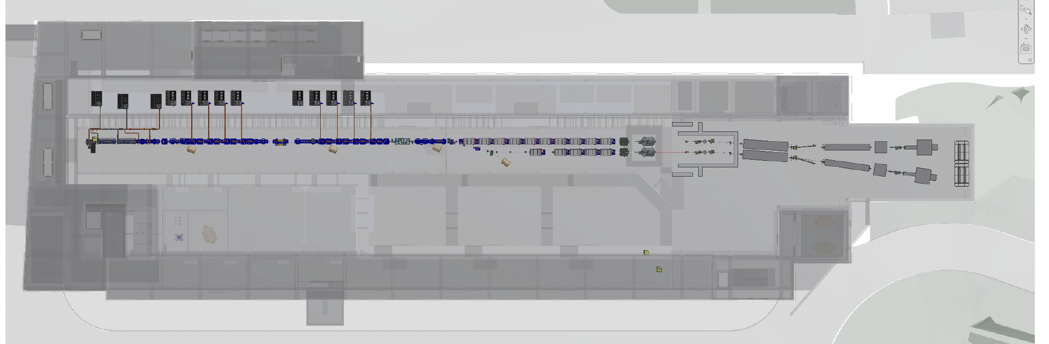
My Area

Slide 3
Chapter index
The magnets are described following the accelerator path, from the gun to the dump.
For each magnet, there is a brief description followed by a parameter table, especially those needed for defining the technical specifications.

Slide 4
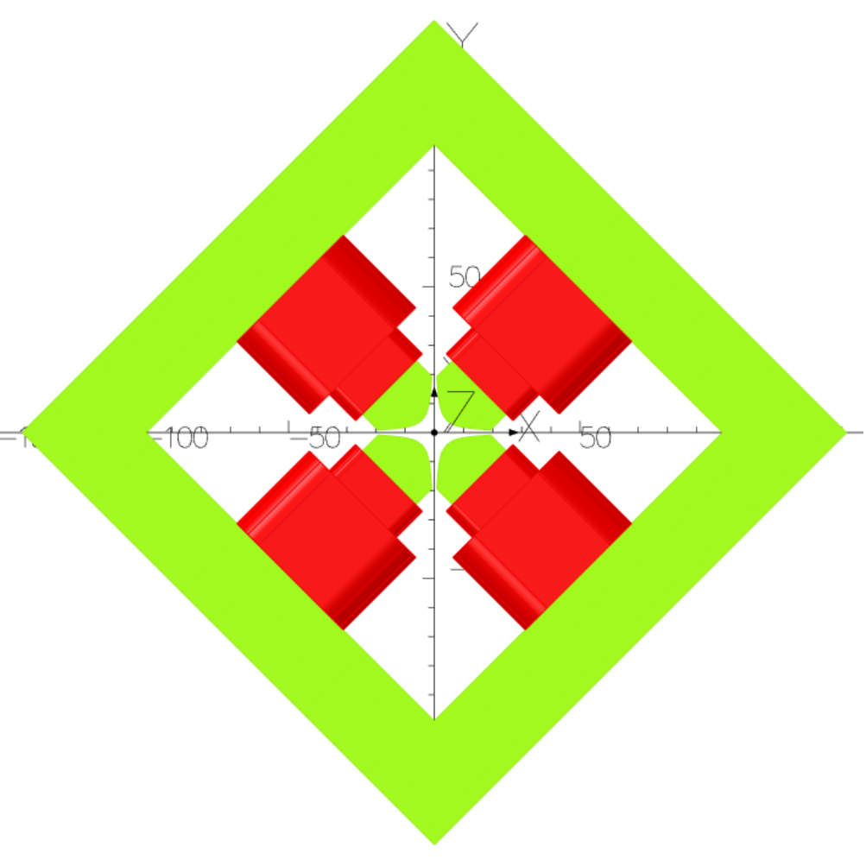
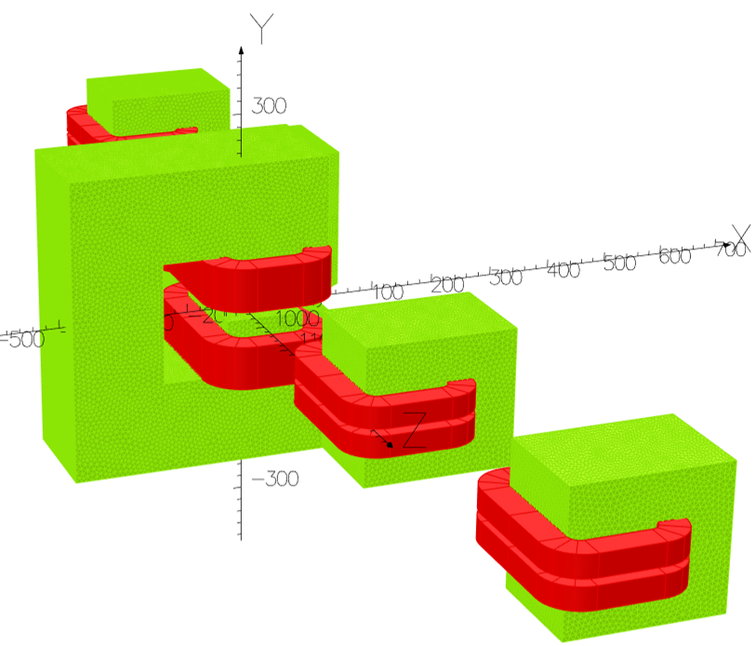
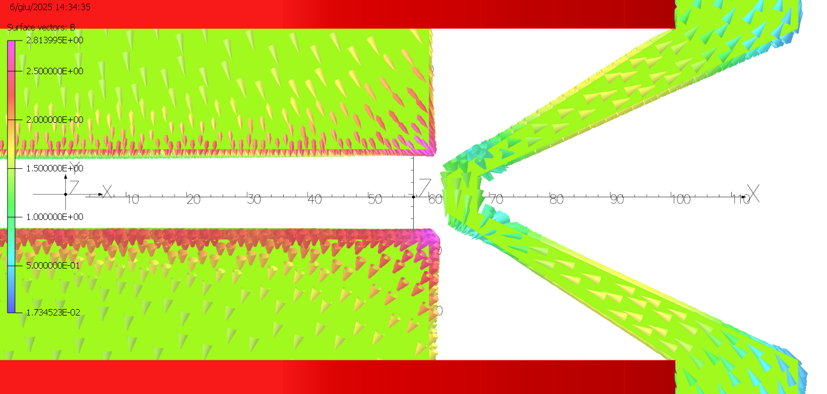
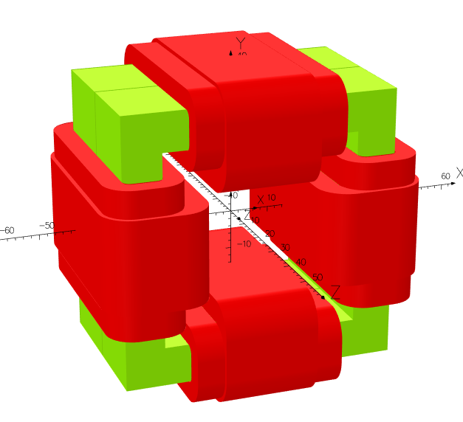
Global Goals:
3D electromagnetic design of all magnets
The goal is to develop a preliminary 3D design of all the machine's magnets, to ensure the feasibility of certain design choices, particularly with respect to longitudinal dimensions, and to prepare tables of technical specifications:
For “standard” magnets, a preliminary design is sufficient to define the main parameters, leaving some construction choices to the supplier.
For more critical magnets, a more detailed design review has been carried out, and the plan is to proceed to tender with stricter specifications.

Slide 5
Achievements:
Technological Readiness Level (Sub-Components)
Sub - systems | TRL | Comments
Magnets for the gun | 9 | Solenoid, quadrupole and steerers: already designed and successfully operating on the SPARC gun.
Accelerating sections solenoids | 9 | Experience gained with SABINA focusing solenoids. Only minor adjustment are required to decouple the mechanical support of the accelerating sections.
Steerers | 9 | Different types of steerers are foreseen in the machine (air-dominated or with iron yoke). The technology is well established.
Quadrupoles | 8 | Different types of quadrupoles are also included in the layout, including combined function quadrupoles with integrated steerers. The technology is well established.
Dipoles for chicanes | 8 | Standard dipoles with non-critical magnetic fields and parameters. May include magnetic shielding to reduce crosstalk. The technology is well established.
Magnets for the plasma section | 6 | PMQ designed based on similar implementations at other accelerators. A prototype, based on our specifications, to be built and tested.
Separator chicane | 7 | Four chicane dipoles and one septum magnet. The septum design is delicate, although the technology is well known.
Dump dipole | 9 | Optimization efforts are focused on minimizing the overall size.

Slide 6
Pending Items:
Magnet Descriptions
Descriptions for a few magnets are still pending, specifically:
Spectrometer
Quadrupoles
Table data
Magnetic and electrical parameters have already been defined for all magnets.
Few parameters are still missing in the tables and need to be completed.
Magnet Parameters Table
A comprehensive table with the main parameters of all magnets is to be inserted.
Power Supply Parameters Table
A table summarizing the main parameters of all power supplies is to be inserted.

Slide 7
Planned Actions:
FOR THE TDR
Weeks 25–26 (Late June)
Finalize the description of the remaining magnets.
Weeks 27 (Early July)
Complete the missing data for all magnets.
Weeks 28 (Mid July)
Compile summary tables for magnets and power supplies.
NEXT STEPS
Engineering design of selected (critical) magnets
Tunable PMQ prototypes development

Slide 8
Conclusions
In recent months, significant effort has been made to achieve the TDR objective.
A few minor parts still need to be completed on the TDR, but overall, the objective is considered to be achieved.
The work was carried out in constant collaboration with beam physics, taking into account the overall layout.

