Slide 1

Chapter 15: RF System
D. Alesini, M. Bellaveglia, B. Buonomo, F. Cardelli, C. Di Giulio, M. Diomede, L. Faillace, M. Ferrario A. Falone, A. Gallo, L. Piersanti, S. Pioli, B. Serenellini, S. Tocci
This project has received funding from the European Union´s Horizon Europe research and innovation program under grant agreement No. 101079773
IX TDR Review Committee Meeting
June 16-18, 2025

Slide 2
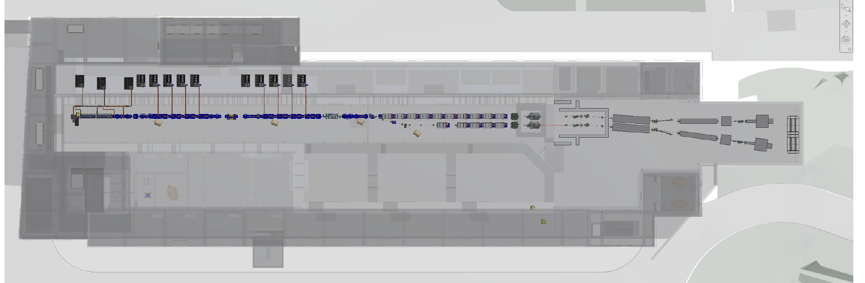
RF system is the backbone of the both machine injector and main Linac, with substantial hardware also installed in the technical gallery
My Area
A. Gallo, RF System, 9° EUPRAXIA@SPARC_LAB TDR Review meeting, LNF 16-18 June 2025

Slide 3
RF Chapter Index
RF systems
1.1 Introduction and general description
1.2 The S-band injector RF systems
1.2.1 The EuPRAXIA RF Gun
1.2.2 The Traveling Wave S-band accelerating sections
1.2.3 RF Power distribution network
1.3 The S-band and X-band RF power sources
1.3.1 RF source safety
1.4 Low Level RF systems
1.4.1 LLRF System Architecture and Challenges
1.4.2 R&D Efforts for X-Band and S-Band LLRF Systems
1.4.3 Key Features of the LLRF System
A. Gallo, RF System, 9° EUPRAXIA@SPARC_LAB TDR Review meeting, LNF 16-18 June 2025

Slide 4
Injector and Linac RF system
The RF system characteristics are described also in the Injector and Linac chapters
The RF chapter is devoted to complete the information with more emphasis on power sources, waveguide network and LLRF
The frequency of the injector RF is the EU S-band ( f = 2998,55 MHz ). It includes a standard 1,6 cells RF Gun, 2 accelerating structures 3 m long operated at medium gradient (nominal E = 21 MV/m , maximum E = 25 MV/m ) followed by 2 shorter sections 1,5 m long operated at high gradient (E = 35 MV/m )
The main linac is X-band ( f = 11994,2 MHz ) made of 16 sections about 0,9 m long each operated at E = 60 MV/m gradient.
A short linearizer SW X-band section and an x-y X-band deflector (Polarix) are also included in the injector baseline.
The TRLs for injector and linac RF are clearly different.
A. Gallo, RF System, 9° EUPRAXIA@SPARC_LAB TDR Review meeting, LNF 16-18 June 2025

Slide 5
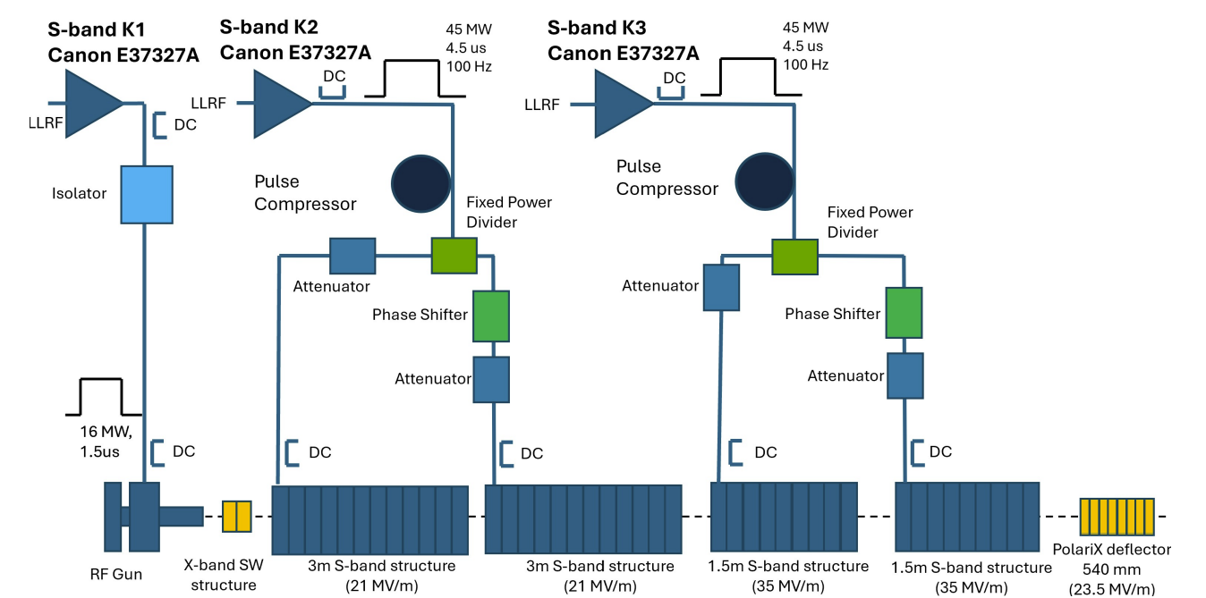
Injector RF system
A. Gallo, RF System, 9° EUPRAXIA@SPARC_LAB TDR Review meeting, LNF 16-18 June 2025

Slide 6
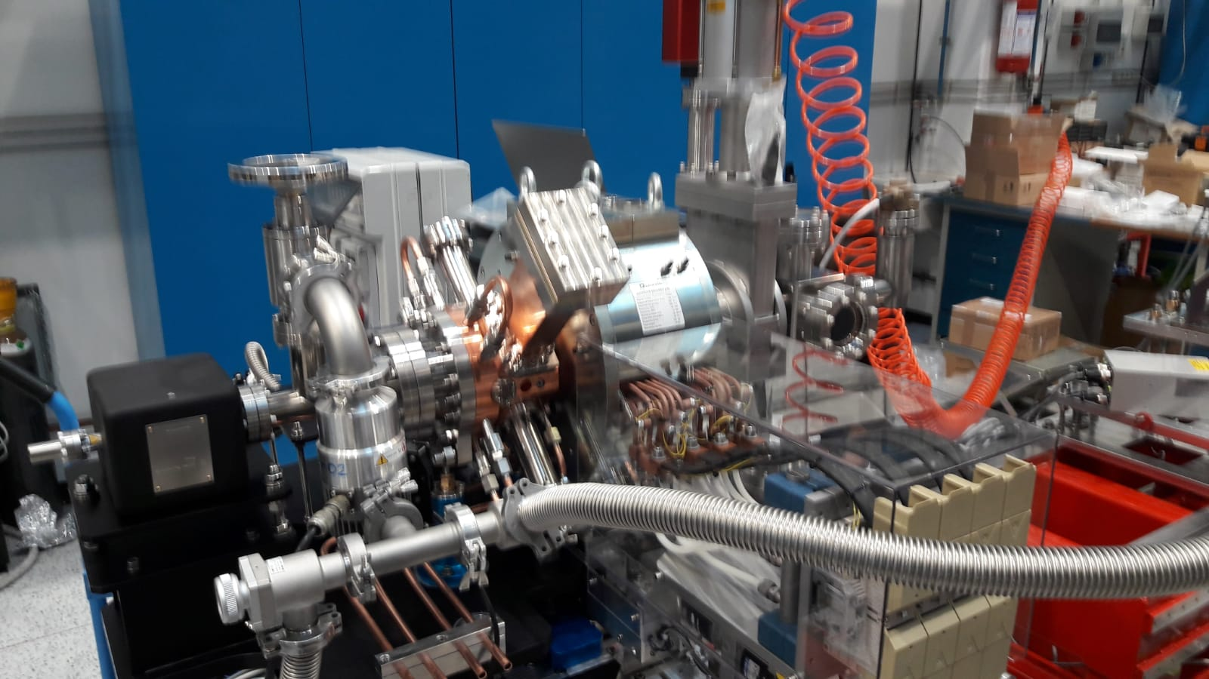
Injector RF system
The RF GUN
A novel construction technology has been proposed, adjusted and now routinely adopted at LNF, based on clamping with special gaskets instead of brazing of the various device components.
This approach has been proven to substantially simplify the manufacturing procedure, preserving the hard-copper characteristics that are instead compromised by the material softening at the brazing temperatures. LNF team has fabricated, tested and put in operation 5 of such devices of various frequencies in last few years, including one is EU S-Band frequency in operation at the CLEAR facility (CERN).
The EuPRAXIA@SPARC_LAB RF Gun will be essentially a copy of this already realized device.
A. Gallo, RF System, 9° EUPRAXIA@SPARC_LAB TDR Review meeting, LNF 16-18 June 2025

Slide 7
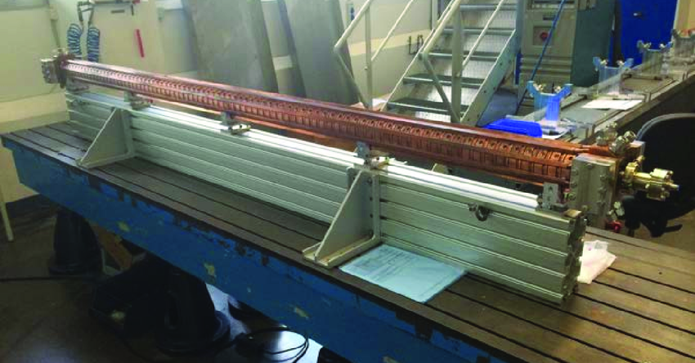
Injector RF system
PARAMETER | Structure lenght
 | 3 m | 1.5 m
Frequency [GHz] | 2.99855
Average acc. gradient [MV/m] | 25 | 35
Number of Structures | 2 | 2
Iris radius a [mm] | 10.9 | 9.2
Tapering of structure | 2π/3 C.I.
No. of cells | 88 | 44
Shunt impedance R [MΩ/m] | 58 | 63
Effective shunt Imp. R_{sh_eff} [MΩ/m] | 103.6 | 111.8
Peak input power in the structure [MW] | 102 | 93
Input power averaged over the pulse [MW] | 53 | 48
Average dissipated power [kW] | 4.6 | 4.2
P_{out}/P_{in} [%] | 25.6 | 25.5
Filling time [ns] | 1013 | 1012
Peak Modified Poynting Vector [W/μm²] | 0.67 | 1
Peak surface electric field [MV/m] | 88.7 | 121
Unloaded SLED/BOC Q-factor Q₀ | 150000
External SLED/BOC Q-factor Q_{E} | 20000
Required Kly input power per struct. (w/o att.) [MW] | 17.7 | 16.1
RF pulse [µs] | 4
Rep. Rate [Hz] | 100
S-Band accelerating sections
Standard technology worldwide diffused (including DAFNE and SPARC Linacs at LNF).
Different possible manufacturers available on the market.
A. Gallo, RF System, 9° EUPRAXIA@SPARC_LAB TDR Review meeting, LNF 16-18 June 2025

Slide 8
Injector RF system
Long section (3m)
Short section (1.5 m)
CI design + trapezoidal RF pulse
RF compressed pulse profile
RF compressed pulse profile
quasi-contant gradient profile
A proper choice of the iris dimension of a traveling wave constant impedance (TW CI) structure can balance the power attenuation with the increasing profile of the RF pulse, resulting in an almost constant (to the first order) accelerating gradient along the structure.
This design provides very good performances in terms of effective shunt impedance value and it simplifies the construction avoiding iris aperture modulation along the structure
accelerating gradient profile
accelerating gradient profile
A. Gallo, RF System, 9° EUPRAXIA@SPARC_LAB TDR Review meeting, LNF 16-18 June 2025

Slide 9
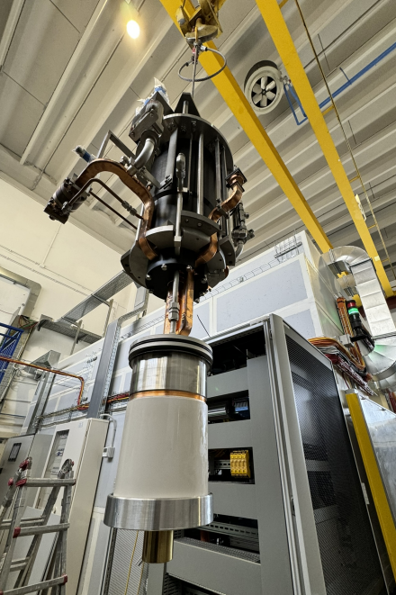
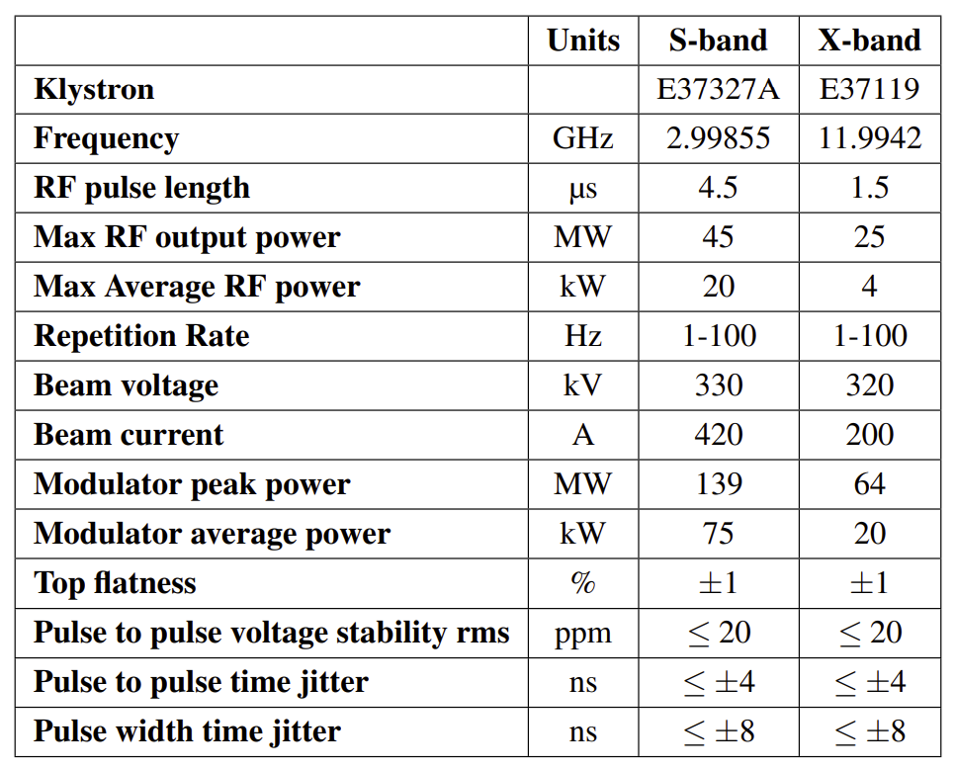
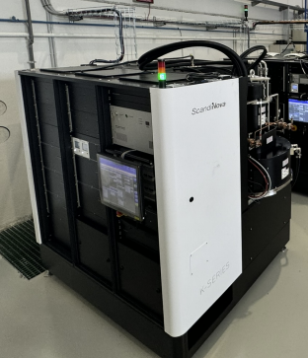
Injector and Linac RF power sources
CANON X-band klystron
2 complete X-band power stations already in house and preliminary tested at TEX facility
Scandinova Modulator
A. Gallo, RF System, 9° EUPRAXIA@SPARC_LAB TDR Review meeting, LNF 16-18 June 2025

Slide 10
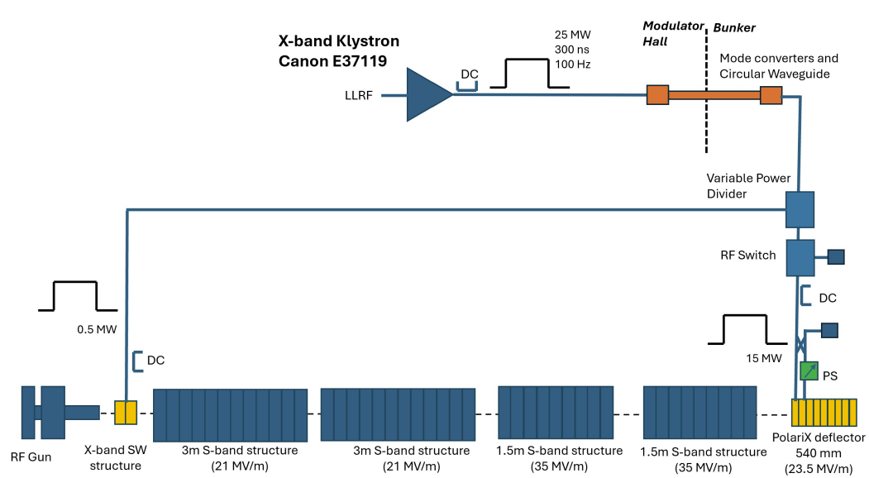
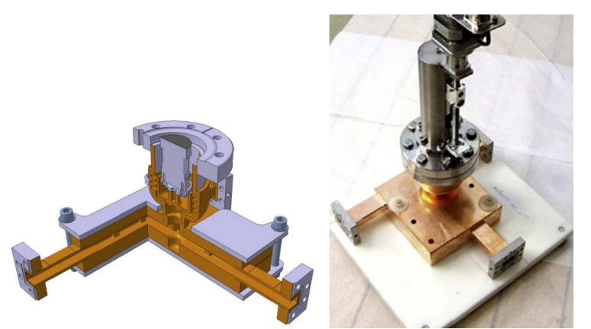
RF power distribution for X-band Linearizer and deflector
To feed one linearizer + 1 polarix with the same RF source, a variable power divider is needed. Along the PolariX line, an additional power divider terminated on an RF load will be interposed as an added RF switch,. Both the power divider and the RF switch are based on the variable attenuator design developed at CERN that has been successfully tested at high power. Alternatively, they can be implemented by combining the X-band phase shifter developed and used at PSI with two custom-designed 3 dB hybrids.
A. Gallo, RF System, 9° EUPRAXIA@SPARC_LAB TDR Review meeting, LNF 16-18 June 2025

Slide 11
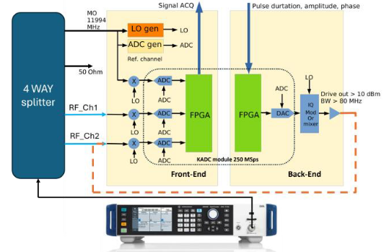
LLRF systems for S-Band and X-band Power Plants
LLRF systems have a huge impact on the machine performances.
S-band systems are in use in many existing linacs and are available on the market, but the phase stability specs required by our machine are extremely demanding, at the very edge or beyond the state of the art. Some promising R&D on intra-pulse phase lock around the power stations are ongoing at SPARC_LAB and will be lickely implemented in EuPRAXIA.
Native X-band LLRF platforms are not available yet on the market. Instrumentation Technologies (SVN) with the collaboration of INFN is prototyping a new commercial product. However, according with the beam dynamics requirements, the phase stability specs for the X-band linac are less demanding with respect to the injector.
EuPRAXIA X-band LLRF Prototype setup
EuPRAXIA LLRF Prototype Requirements
A. Gallo, RF System, 9° EUPRAXIA@SPARC_LAB TDR Review meeting, LNF 16-18 June 2025

Slide 12
Achievements:
Technological Readiness Level (Sub-Components)
Macro systems | TRL | Comments
Injector RF | 9 | S-Band injectors are widely used in many facilities including SPARC_LAB. S-Band technology is fully available in the market.
X-Band Linac | 6 | X-Band Linacs are relatively new. Impressive progress has been made and the final testing of the acc. section full prototype will upgrade the corresponding TRL level in the upcoming months.
X-band waveguide components | 6 | Technology demonstrated in other facilities and test benches but not widely and exactly at the same conditions
RF power system | 6 | X-Band RF power system has been already tested and operated in normal condition in the test-stand but the Canon tube selected for our module is a novel device lacking operational experience. The final operational test will prove the validity and reproducibility of the technical choices in the real setting
X- band LLRF | 6 | A commercial S-band system operating at X-band thanks to up/down converters made in house has been successfully operated at TEX. A brand-new X-band native platform is being developed in collaboration with industry.
A. Gallo, RF System, 9° EUPRAXIA@SPARC_LAB TDR Review meeting, LNF 16-18 June 2025

Slide 13
Pending Items:
(What is still in progress or incomplete.)
The chapter has not been delivered yet. However technical information is already completed and will be rapidly assembled.
Extra TDR forthcoming activities:
  S-band structures executive design
  S-band power compressor design and realization
  X-band special waveguide components (variable splitters, switches) executive design and realization
  Full power test of the prototype X-band RF station installed at the TEX test facility.
  Rf power test at Tex of the 1st X-band prototype structure recently brazed and successfully characterized on the bench.
  Validation of the LLRF X-band prototype module developed by Instrumentation Technology
The baseline for the S-band accelerating structure construction is the consolidated technology (brazing of the whole cell stack and couplers in large oven facilities). There are various possible providers (in EU Research Instruments GmbH or PSI, for example). We are also considering an R&D activity to extend to long sections the brazing-free fabrication technology developed for the RF Guns. This would be a very valuable technological step forward that could potentially simplify the device assembly, reduce the cost and improve the performances (hard copper characteristics preservation). However, this would also correspond to a higher risk since the technology is not proven on this scale of realizations, with a TRL substantially lower (≈5) with respect to consolidated manufacturing procedure (TRL=9).
Different tenders for procurement of LLRF, accelerating structures, RF power plants and waveguide network need to be started all in the next 12-18 months. This is an obvious step but also a huge and delicate commitment.
A. Gallo, RF System, 9° EUPRAXIA@SPARC_LAB TDR Review meeting, LNF 16-18 June 2025

Slide 14
Conclusions
Description of the machine RF systems is distributed among different TDR chapters, namely those dedicated to the Injector, the X-band linac and the general RF.
All the information reported in these chapters is consistent with the general requirements of the machine. In particular the RF specs have been defined and agreed upon deep discussion and various checks with the beam dynamics group. Logistics aspects have been discussed and agreed with the machine layout group.
In spite of being the first plasma acceleration-based user facility, the machine includes a very advanced RF linac making use of X-band technology on a large scale. One of the expected goals of this enterprise is to bring the TRL of this technology to the highest level. We are aware of the risks associated to this goal, but we believe that it is very well addressed thanks to the successful R&D ongoing at LNF facilities on this subject.
A. Gallo, RF System, 9° EUPRAXIA@SPARC_LAB TDR Review meeting, LNF 16-18 June 2025

