Slide 1
Chapter 14: Laser system
Maria Pia Anania (LNF)
This project has received funding from the European Union´s Horizon Europe research and innovation program under grant agreement No. 101079773
IX TDR Review Committee Meeting
June 16-18, 2025

Slide 2
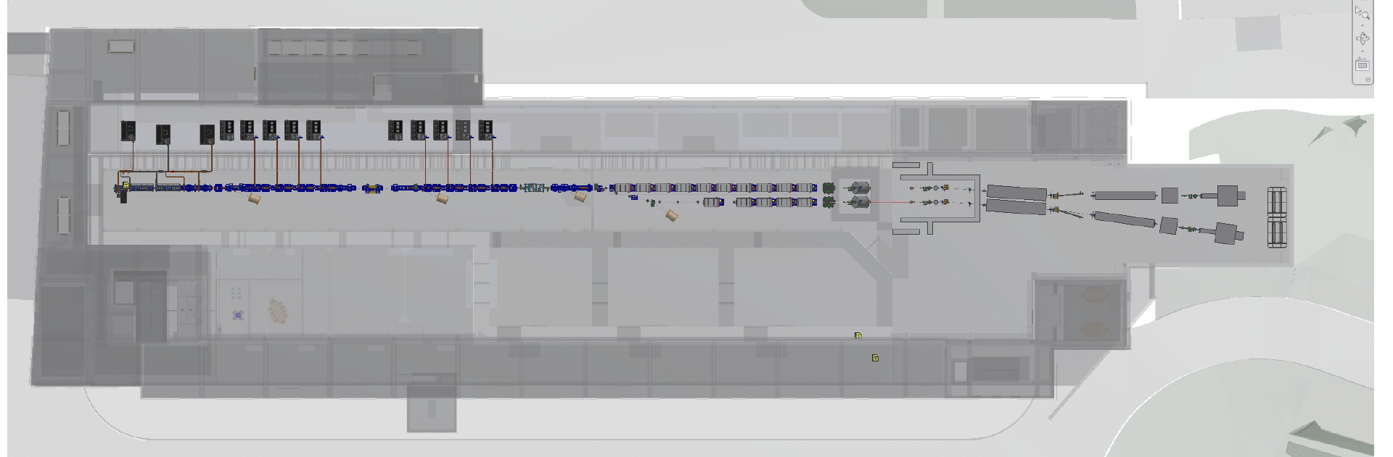
My Area
Mainly from cleanroom to photocathode, but there are also other beamlines arriving to the main diagnostic sections.

Slide 3
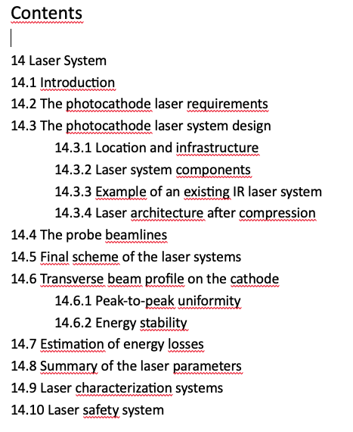
Describe your Chapter

Slide 4
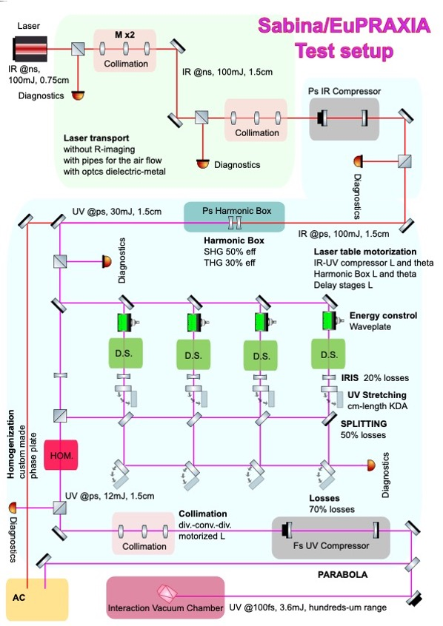
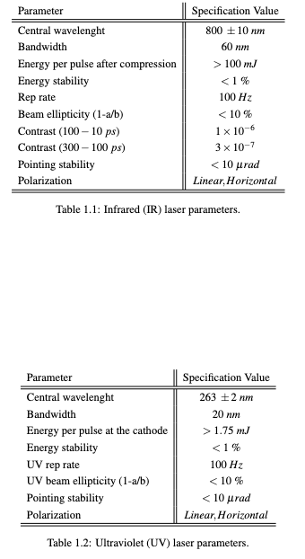
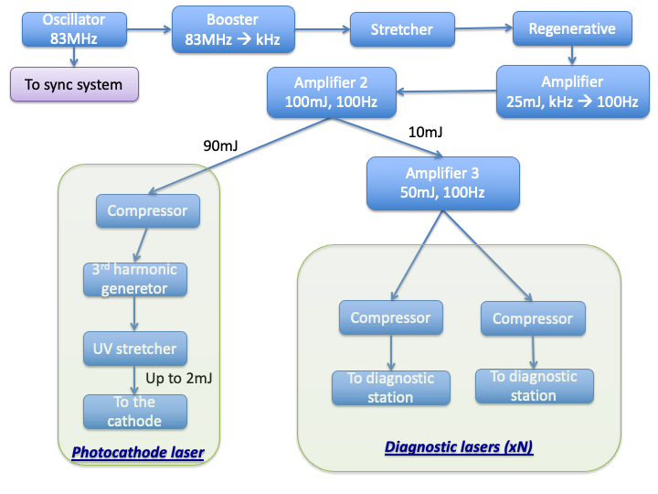
Global Goals: (Brief description of system objectives and specs)
For the COMB scheme, the laser system should be able to fulfill this requirements:
• Multiple beam overlapped;
• Variable spot sizes;
• Temporal flexibility;
• Transversal homogeneity (less than 10%);
• High energy stability (better than 1%).

Slide 5
Achievements: Technological Readiness Level (Sub-Components)
Sub - systems | TRL | Comments
Laser system | 9 | Photocathode laser is now a proven technology tested in real facilities (including SPARC_LAB). The systems are full available in the market almost as off-the shelf products
Looking at the single laser sub-systems:
Sub - systems | TRL | Comments
oscillator | 9 | Synch options – low noise oscillator are full available in the market almost as off-the shelf product (already bought 2 for SABINA and EuAPS)
100 Hz pumps | 9 | 100 Hz laser pumps are full available in the market as off-the shelf products
100 Hz amplificator | 9 | 100 Hz amplificators (including crystals) are full available in the market as off-the shelf products
100 Hz compressor | 9 | 100 Hz compressor is full available in the market as off-the shelf product
3rd Harmonic generator | 9 | 3rd harmonic generator is a full available product (mainly crystals)
UV stretcher | 9 | UV stretcher is full available in the market as off-the shelf products

Slide 6
Conclusions
Laser system
Capabilities are compatible with:
- Synchronization and stability demands set by global accelerator performance criteria;
Stability, homogeneity and flexibility (time and space) demands set by the photoinjector;

