Slide 1
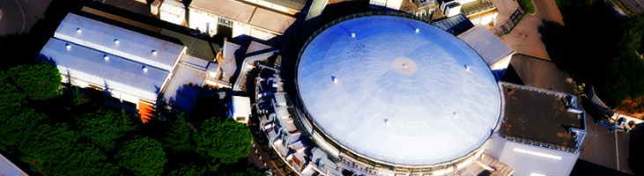
News from the Lab
Frascati National Laboratory
P.Gianotti

Slide 2
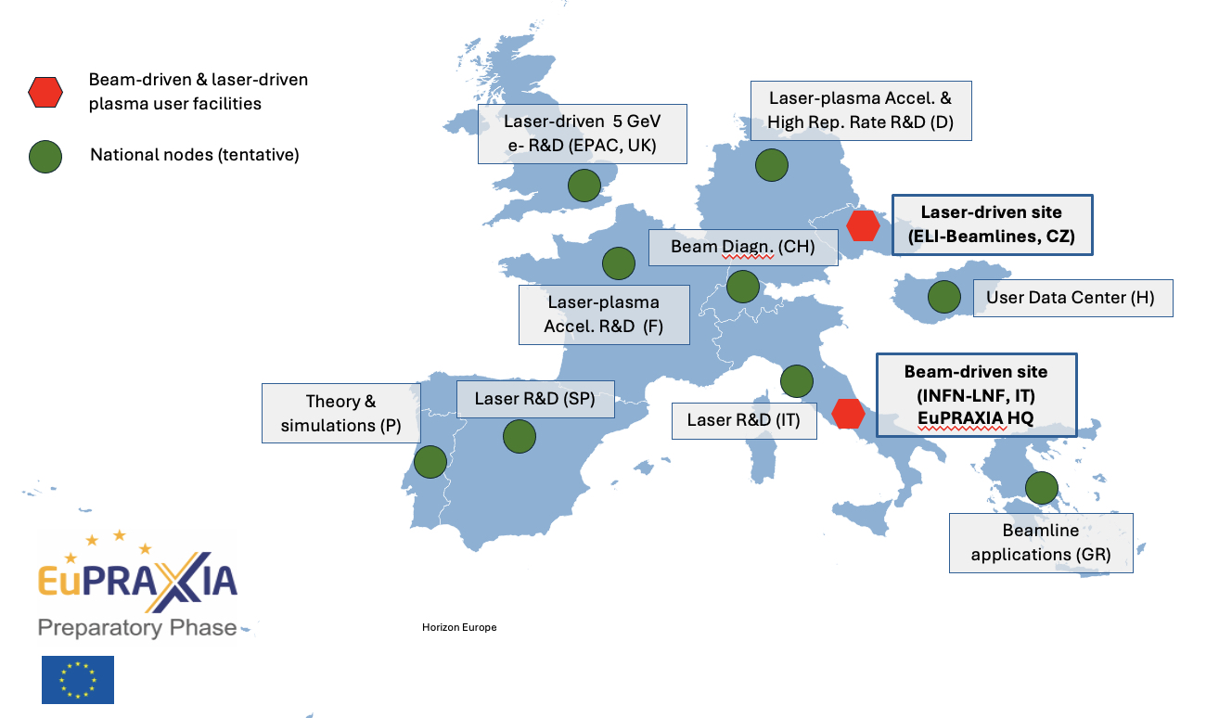
EuPRAXIA Consortium
EuPRAXIA selected ELI for the Laser-Driven Accelerator Site
The EuPRAXIA Consortium selected the ELI Beamlines Facility in Dolní Břežany, Czech Republic, as the site for the laser-driven plasma accelerator pillar. ELI Beamlines was selected for its infrastructure readiness, state-of-the-art laser systems, and comprehensive technical expertise.
EuPRAXIA also recognises the important roles of the other candidates for the second site, EPAC and CNR-INO.
EPAC will contribute to EuPRAXIA as a centre for R&D, focusing on advancing research towards achieving a high-quality 5 GeV electron beam. While CNR-INO will function as EuPRAXIA's National Node in Italy and laser test facility.
Courtesy P. Campana

Slide 3
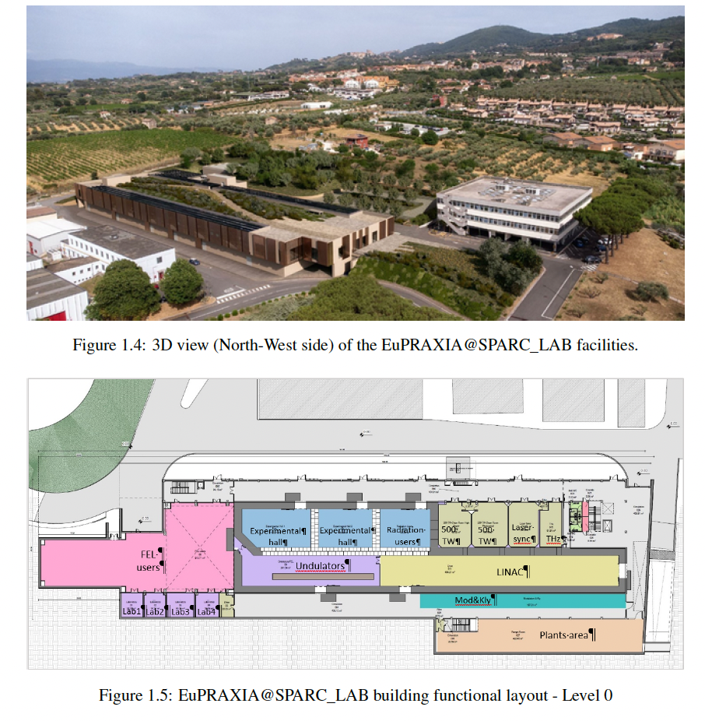
Civil infrastructure
The main infrastructure includes a new building of approximately 5,600 square meters, to house the accelerator, the FEL, various experimental areas, and supporting technical rooms.
At its maximum extension above ground, the building is approximately 140 m long and 45 m wide, with a narrowing to 36 m towards the north-west; it ends on the ground floor with a rectangular appendix measuring 21 m by 13 m completely underground.
This structure has been carefully engineered to accommodate complex equipment with stringent requirements on radiation shielding and vibration suppression.
Reinforced concrete walls and roofs, up to 2 meters thick, ensure safety and operational integrity, while structural joints isolate sensitive experimental spaces from mechanical vibrations.
Building construction is expected to start by the end of 2026 and to be completed in 3 years.
Courtesy U. Rotundo

Slide 4
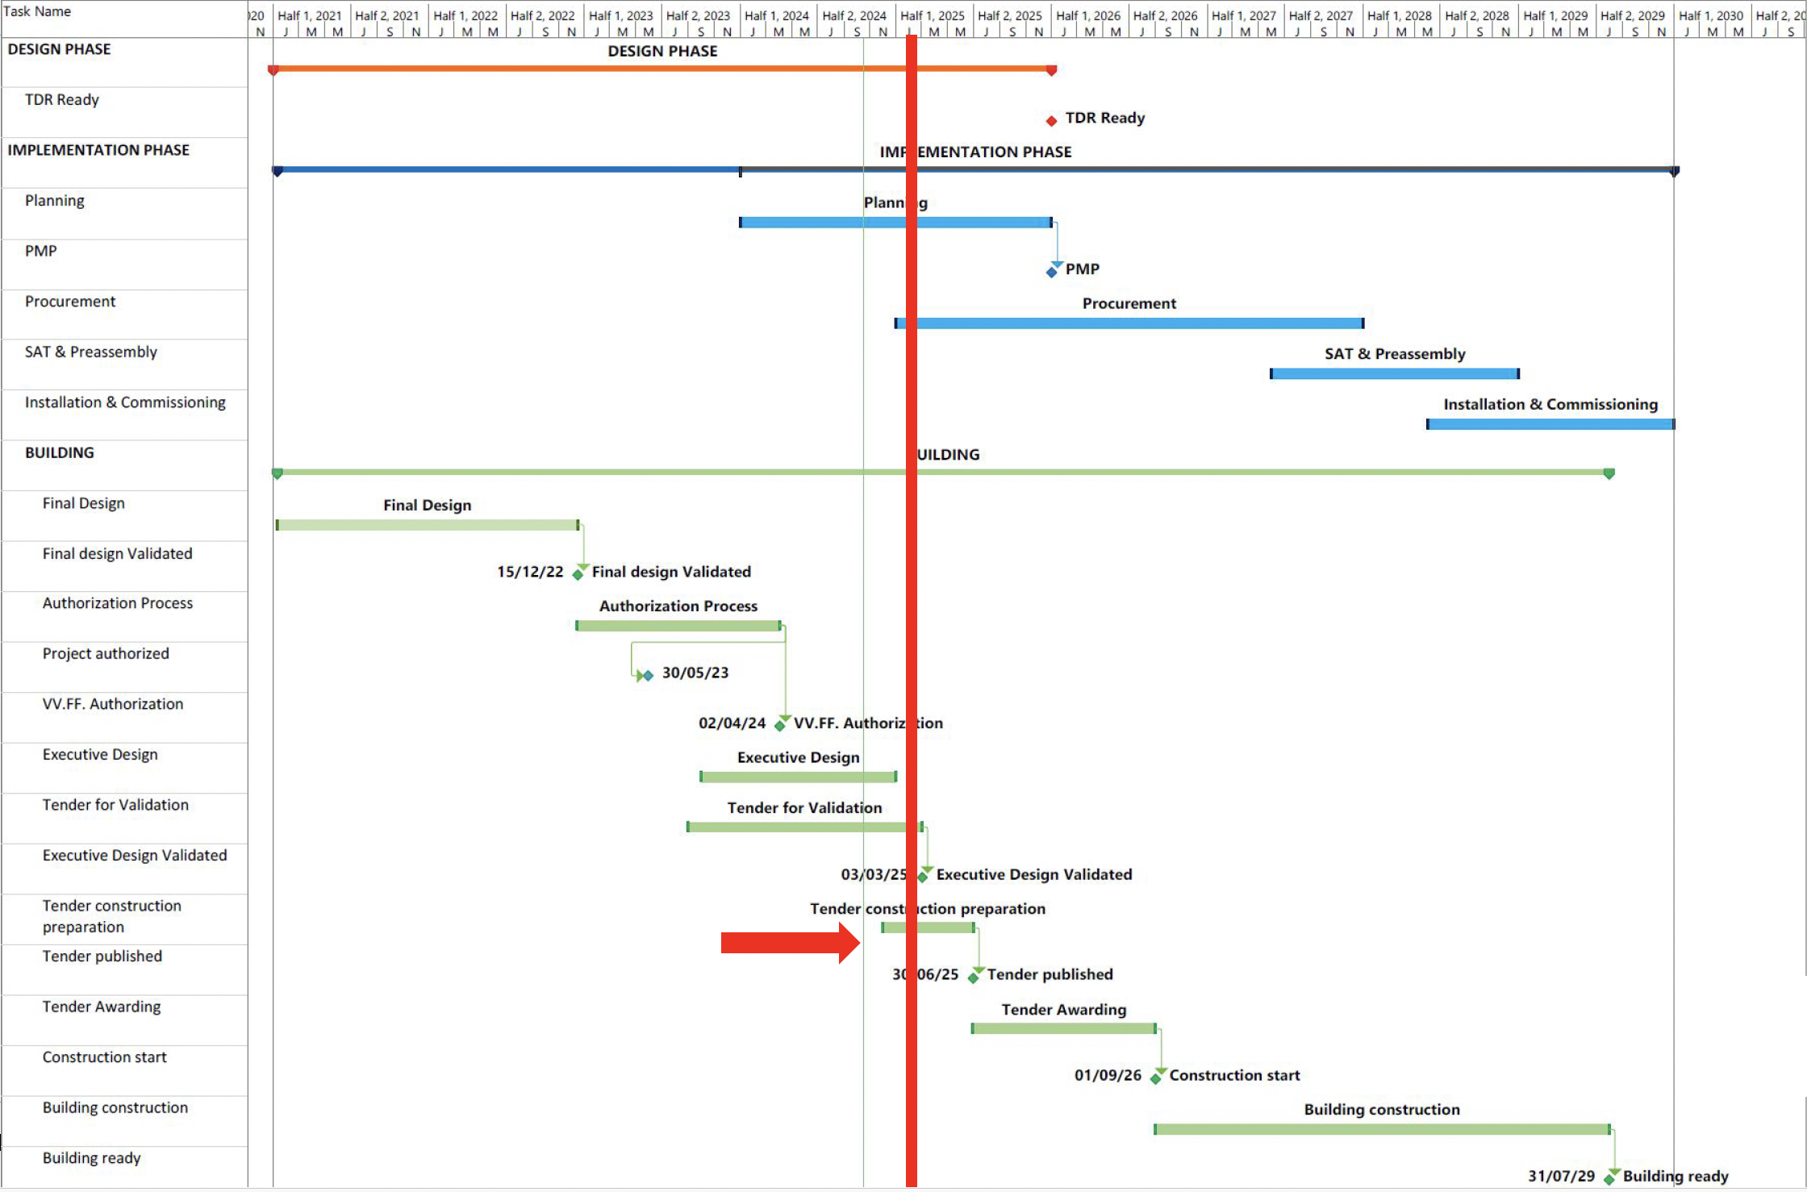
Courtesy S. Incremona
Notes:
We have some budget issues we are trying to solve with INFN management

Slide 5
Building tender ancillary procedures
There are also ancillary tender procedures for the cooling systems:
1. Award the service for detailed design, construction management, and health and safety coordination during execution. (DL e CSE (≈ 900 k€ )
2. Procurement of verification services (≈ 150 k€ )
3. Award of the works (≈ 6 M€ )
within June 2026
within September 2026
within September 2028
Courtesy S. Incremona

Slide 6
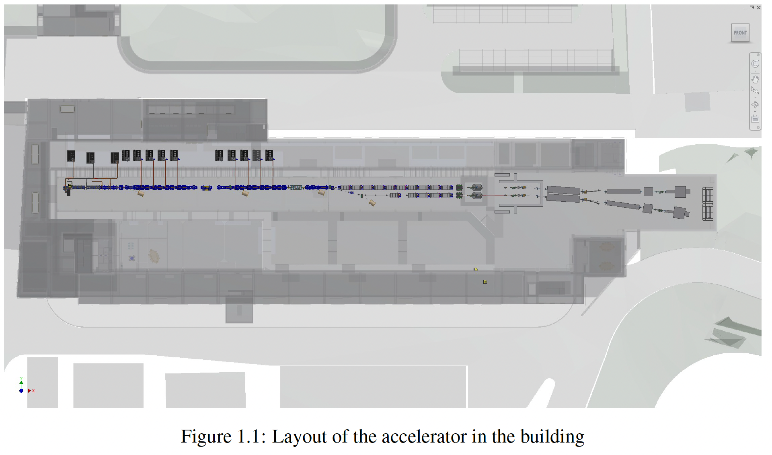
Machine layout
The facility aims to operate in two modes:
a full-RF mode for initial commissioning;
a hybrid RF+PWFA mode that serves as a demonstrator for plasma-driven FELs user operation.
The modularity and flexibility of the design are intended to support both immediate scientific applications and long-term technological development.
The facility is expected to begin operations in 2030
Courtesy M. Ferrario

Slide 7
Technological readiness
Macro systems | TRL | Comments
Injector | 9 | S-Band injectors are widely used in many facilities including SPARC_LAB. S-Band technology is fully available in the market.
X-Band Linac | 6 | X-Band Linacs are relatively new. Impressive progress has been made and the final testing of the acc. section full prototype will upscale the corresponding TRL level in the upcoming months.
Plasma Module | 5 | Extensive R&D has been made to validate the plasma capillary technology and solid results have proved the validity of the technical choice. A full system proven in a real environment is expected to be done in the next year
AQUA Undulators | 7 | Technology demonstrated in other facilities (FERMI, SwissFEL, etc.)
FEL Beamline | 8 | Most of the components of the photon beamline are implemented at other facilities are commercially available, few systems (needed only for a subset of possible experiments) are still in development
RF power system | 8 | X-Band RF power system has been already tested and operated in normal condition in the test-stand. The final operational test will prove the validity and reproducibility of the technical choices in the real setting
Laser system | 9 | Photocathode laser is now a proven technology tested in real facilities (including SPARC_LAB). The systems are full available in the market almost as off-the shelf products
General elements | 9 | Other elements (Control, mechanics etc) are based on standardized components daily used in other facilities and in other context (e.g. industrial context)
TRL LEVEL | TRL Description
TRL 1 | Basic principles observed – Scientific research begins to be translated into applied research and development (R&D).
TRL 2 | Technology concept formulated – The basic principles are explored and practical applications are identified.
TRL 3 | Experimental proof of concept – Active R&D is initiated, including analytical and laboratory studies to validate predictions.
TRL 4 | Technology validated in lab – Basic technological components are integrated to establish that they work together.
TRL 5 | Technology validated in relevant environment – The technology is tested in a simulated or relevant environment
TRL 6 | Technology demonstrated in relevant environment – A prototype system is tested in an environment similar to the operational one.
TRL 7 | System prototype demonstration in operational environment – A working prototype is demonstrated in a real operational setting.
TRL 8 | System complete and qualified – The technology is proven to work in its final form and under expected conditions.
TRL 9 | Actual system proven in operational environment – The technology is fully commercialized and operational in its intended setting.
Courtesy M. Ferrario

Slide 8
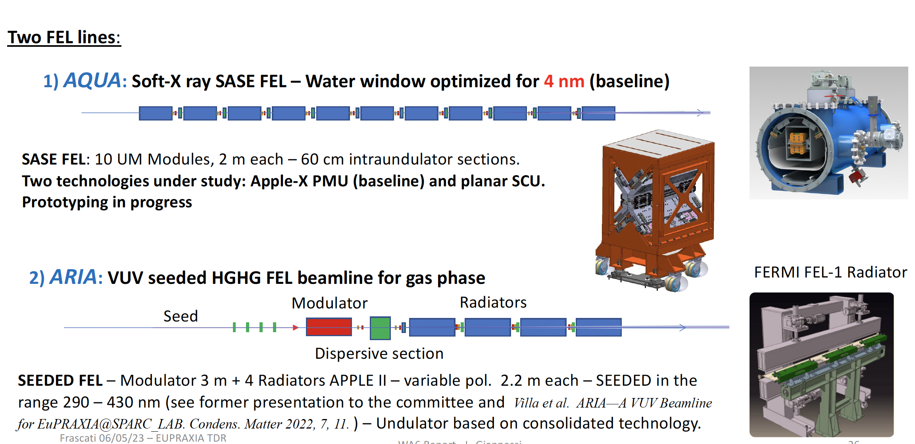
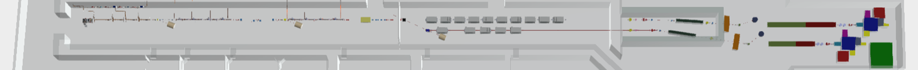
Beam lines
50-100
40 m
Courtesy L. Giannessi

Slide 9
SPARC_LAB activities
SPARC has been in operation till 21st March 2025. Several activities have performed:
Beam-based alignment of the new solenoid coils. Spent several dedicated weeks on this topic. Now everything is aligned on the reference trajectory.
Resonant plasma acceleration scheme. Test the plasma response using N drivers followed by a witness bunch. Interesting results obtained, paper prepared and submitted.
Plasma acceleration using a laser-generated filament. It represents an alternative to the HV discharge. The Run-1 highlighted several issues that have to be fixed for the Run-2.
EuPRAXIA-like working point. Test the SPARC injector to deliver the beam configuration as expected for the future EuPRAXIA facility. Some preliminary results obtained.
SPARC is now shutdown to allow the EuAPS installations in the bunker. We expect to restart operation by next September 2025.
Courtesy R. Pompili

Slide 10
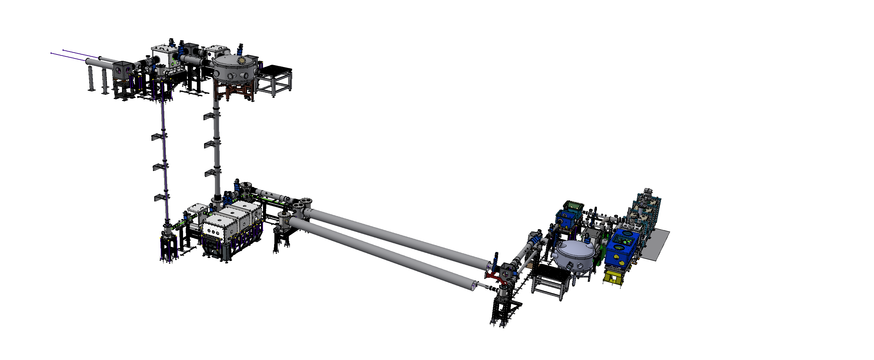
EuAPS status
EuAPS source is designed to operate in dual mode
  In the FLAME bunker to perform R&D on the laser and components, and fine-tuning
  In the SPARC bunker to give the beam to users
Outline of the Betatron source
FLAME PARADISE
Flame Laser upgrade and refurbishment are ongoing-> end in June
● Installation of transport lines in Flame bunker ongoing -> end in June
● Installation in SPARC bunker started -> end in mid July
● First shots expected before the summer vacation
● Source optimization and characterization -> Sept to mid Oct
● Pilot experiment -> before November 30th
FLAME HELL
S. Lauciani
SPARC Bunker
The construction is mainly on schedule, and we could foresee the first beam in early September, depending on the authorization procedure.
Risk mitigation strategy:
  In case of having only FLAME authorization before the end of the project we will run a small pilot experiment in FLAME hell.
Courtesy A. Cianchi

Slide 11
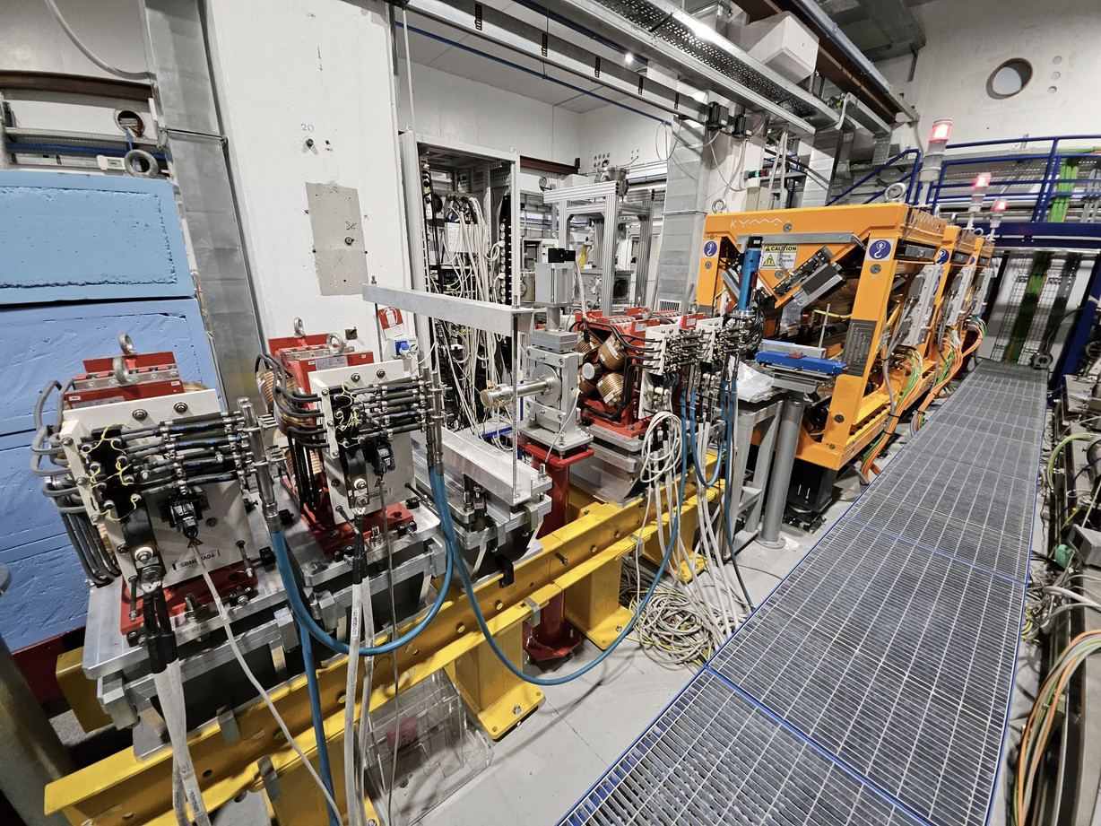
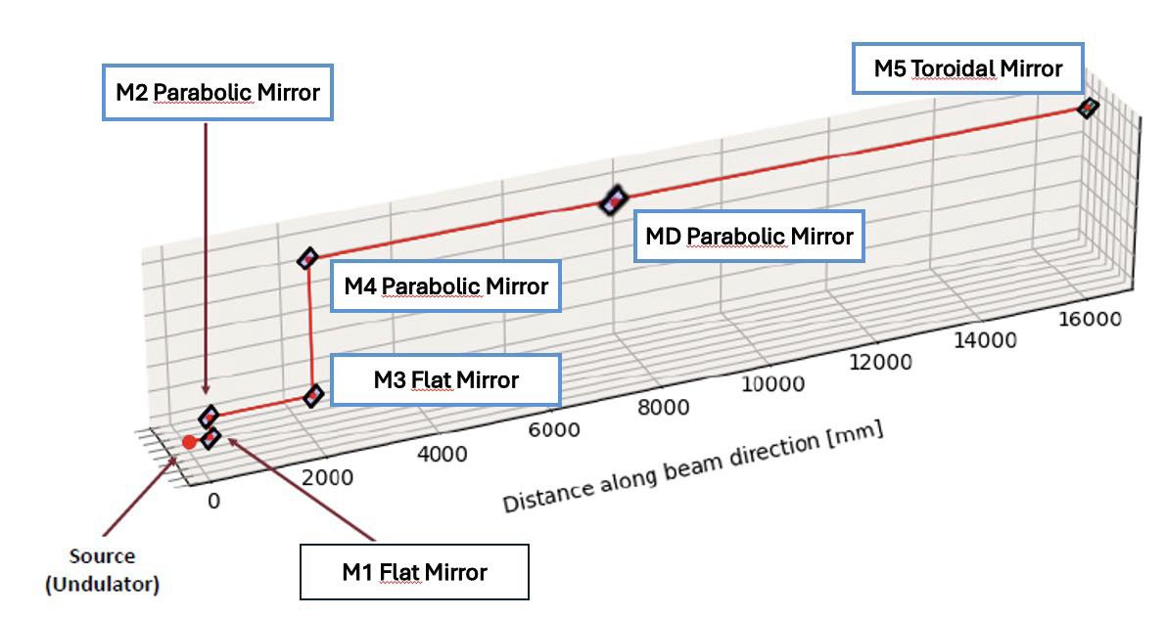
SABINA THz line status
The SABINA installations on the SPARC linac have been completed and a beam-based alignment has been performed to align the 24 coils on the beam trajectory.
The completion of SABINA installations only require the transfer line (up to the THz undulators) and the radiation transport pipe (up to the user area).
Our goal:
TESTING ELECTRON BEAM LINE BY SEPTEMBER
TESTING FIRST THz RADIATION BY EARLY 2026
Courtesy L. Sabbatini

Slide 12
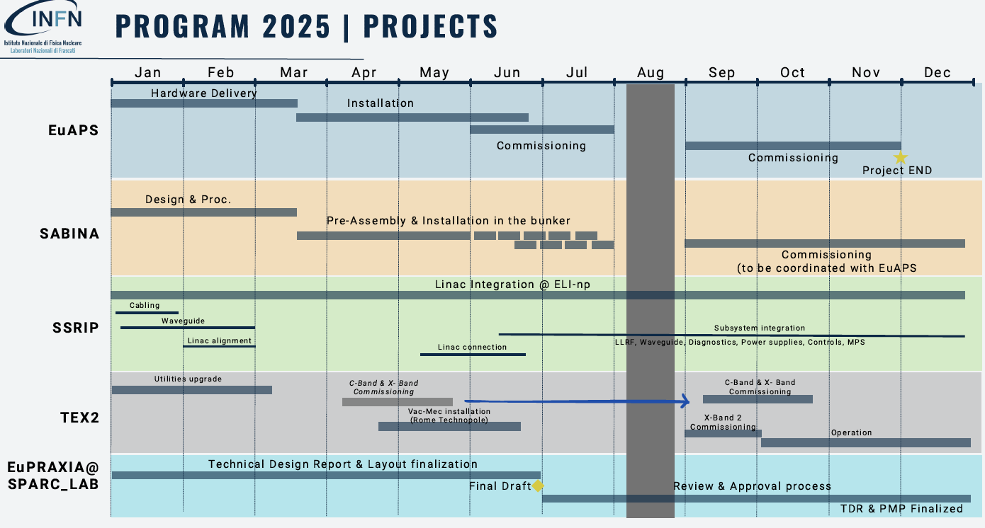
2025 Facilities plan
Courtesy A.Falone
A.Falone

Slide 13
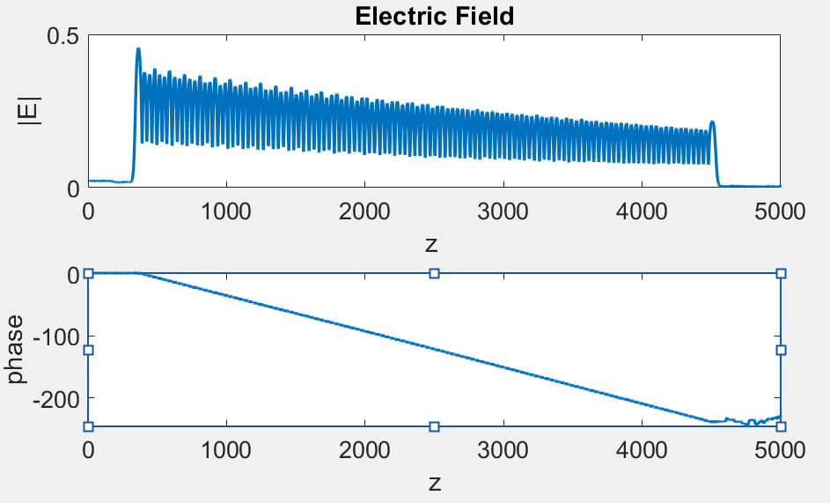
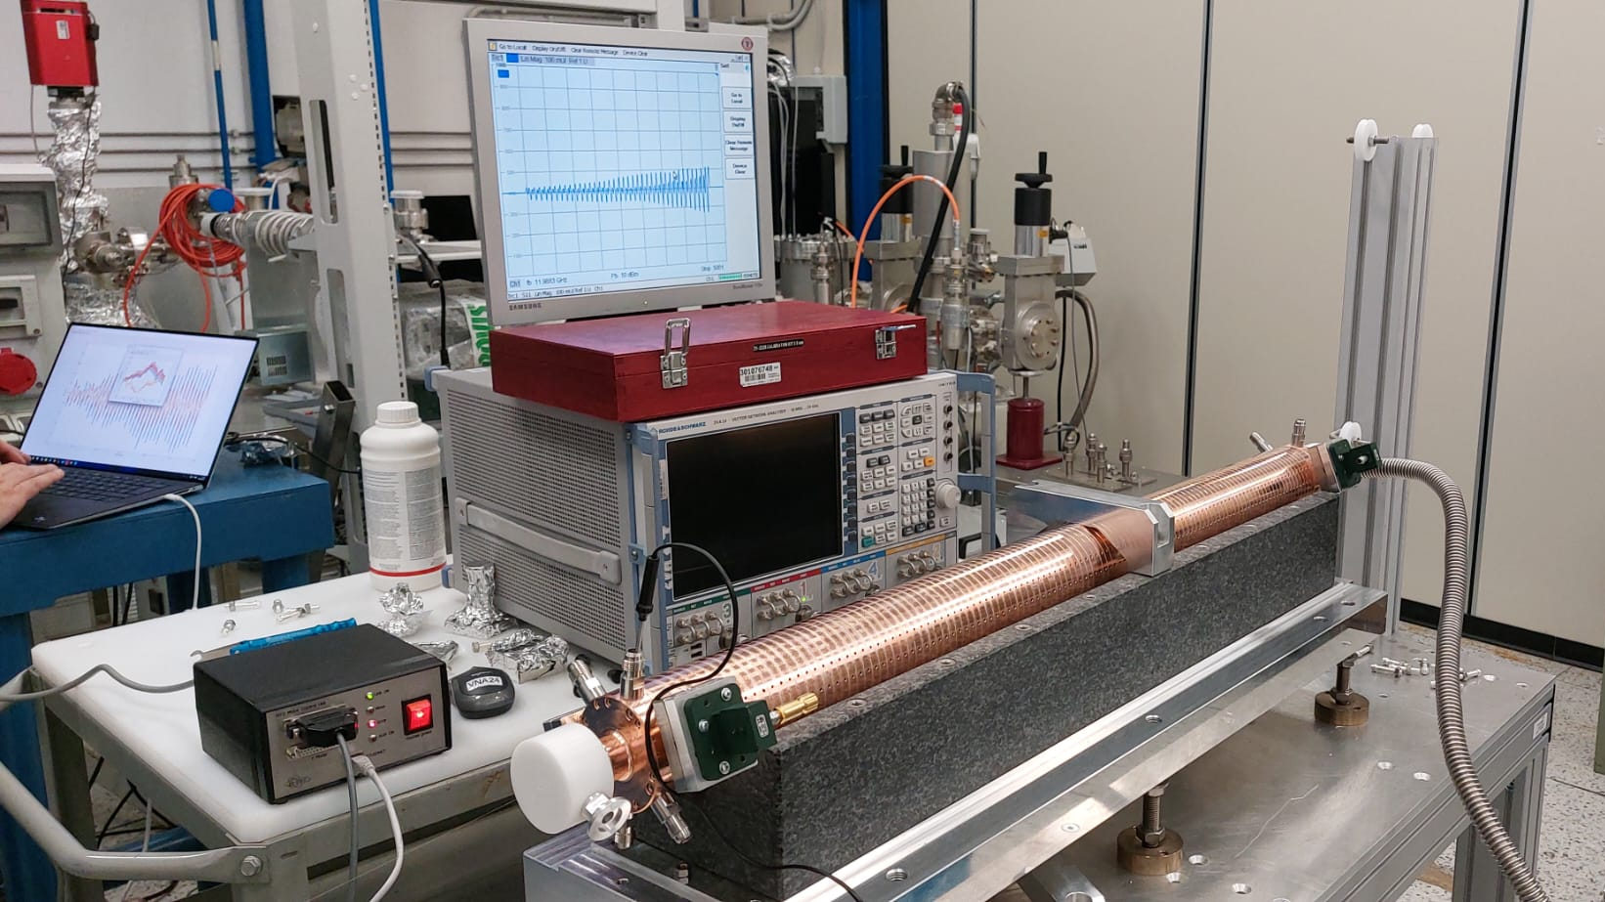
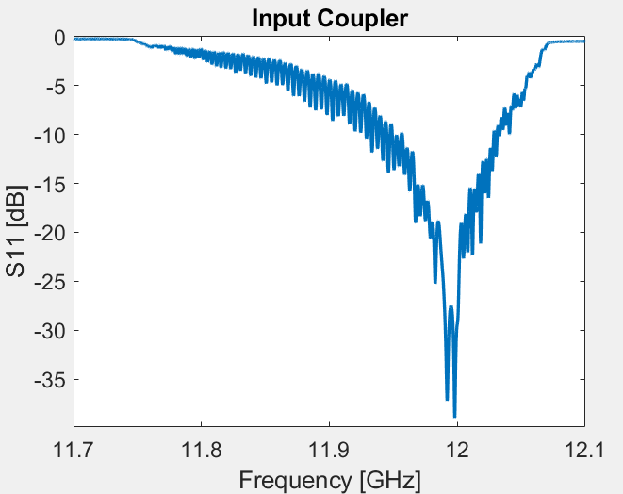
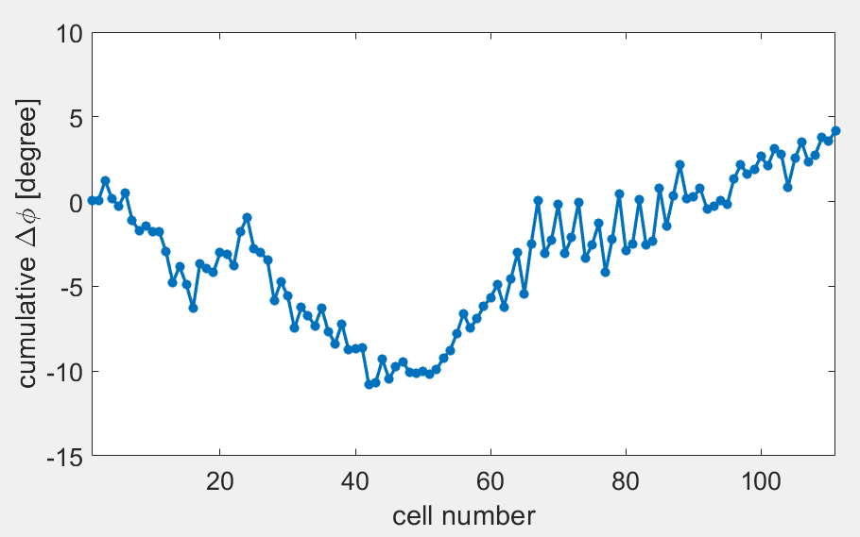
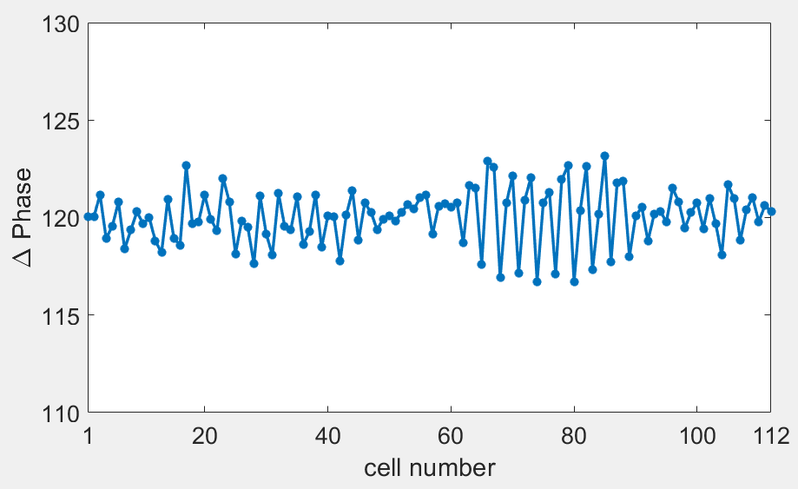
EuPRAXIA X band structure test
The vacuum test was successfully passed, and the RF measurements turned out to be very good, especially
considering that the structure was built without a tuning system, with micrometric precision machining of the accelerating cells.

Slide 14
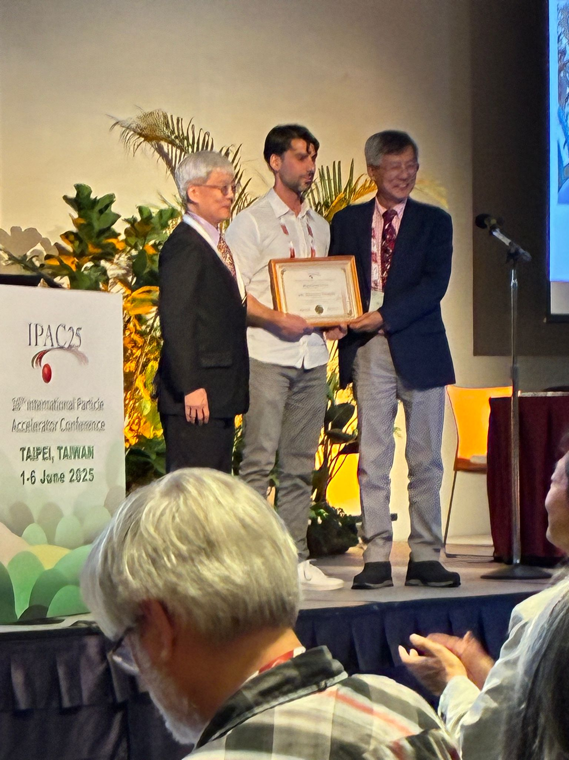
Hogil Kim Award from ACFA/IPAC’25
Riccardo Pompili received the Hogil Kim Proze for outstanding achievements in the early stages of his career in the field of accelerators.
The 'Hogil Kim' Award is one of 4 prizes awarded by the Asian Committee for Future Accelerators (ACFA) during the 16th International Particle Accelerator Conference (IPAC’25), held in Taipei (Taiwan) from June 1 to 6, 2025.
Riccardo's scientific career developed at the LNF, where he began working in 2009 while preparing his master’s thesis. Since 2015, he has been a member of the Accelerator Division staff. In 2023, he was promoted to Senior Researcher and took on the scientific coordination of the SPARC_LAB infrastructure and of the plasma work package of the EuPRAXIA@SPARC_LAB project.

Slide 15
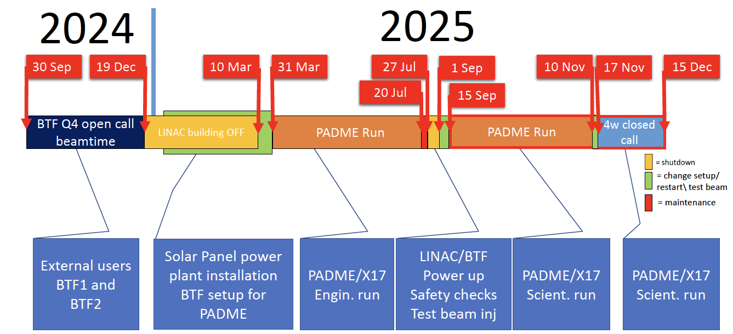
Beam Test Facility
Hall 1fully operational:
systems revamped and upgraded for PADME (mechanics, vacuum, new gas system, new DCS);
FLASH-VHEE detector community interested in having two run slots (Q4 2025);
Other requests from FIREBALL@LNF, EUROLABS, ASIF-2.
Hall 2 stand by:
Requests from 11 experiments
Necessary one week to be in operation for external user (DAQ and diagnostic)
Hall 1
Hall 2
Courtesy L.Foggetta

Slide 16

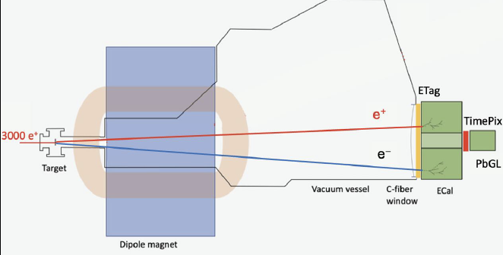
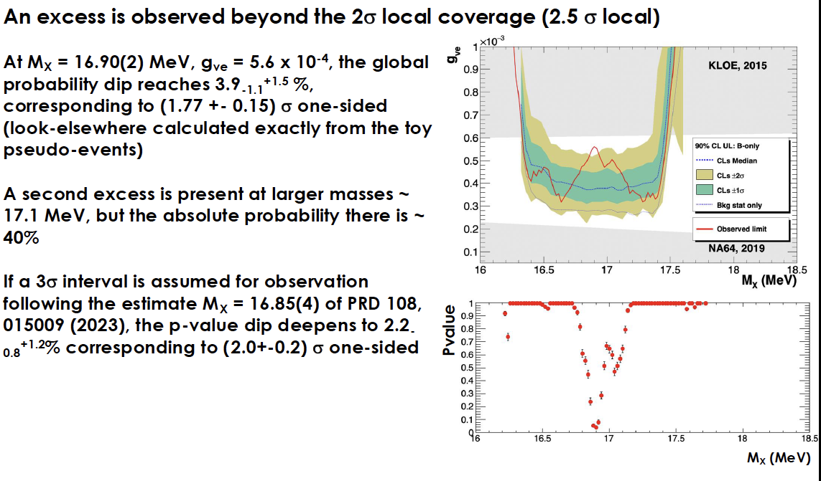
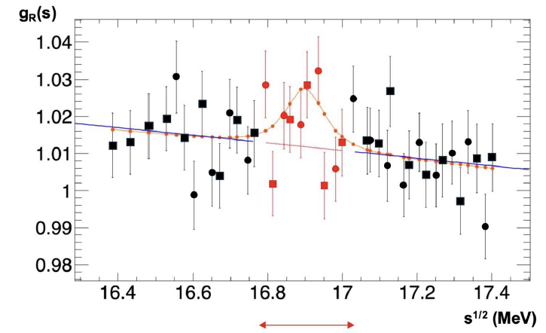
Results
PADME Detector

Slide 17
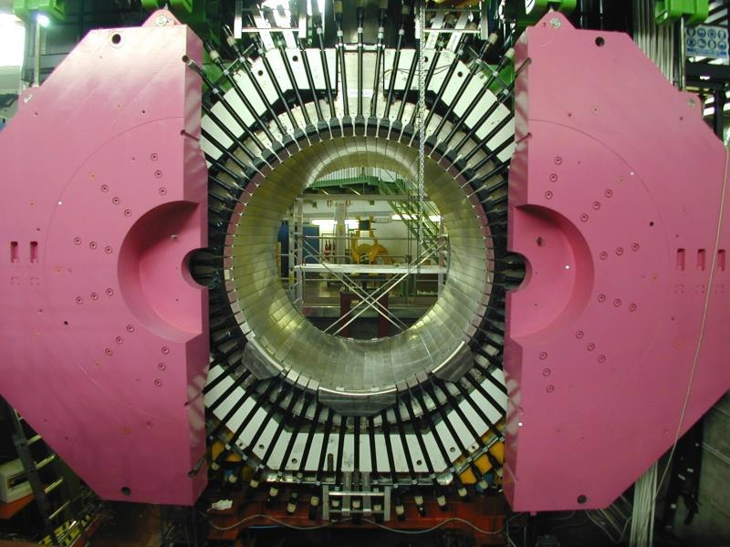
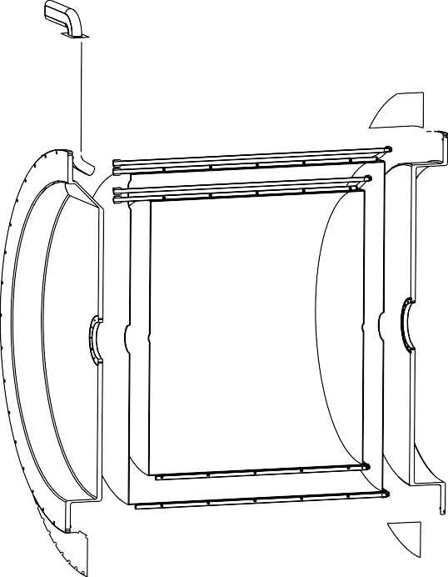

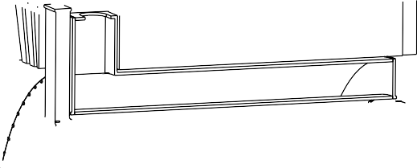




















The FLASH Project
2025
  Finuda decomissioning
  Design FLASH and R&D
  Formalization of FLASH Collaboration
2026
  Certification and maintenance of the cryogenic system and magnet
  Design FLASH
  Fabrication 500 MHz FLASH cavity prototype (Bonn University)
  Protoype characterization at 4K
2027
  Technical Design Report
  Call of tender for cavity cryostat and RF cavity
2028
  Start fabrication
2029
  FLASH commissioning
2030
  Data taking
2031
  End of GravNet project
C. Capoccia LNF

Slide 18

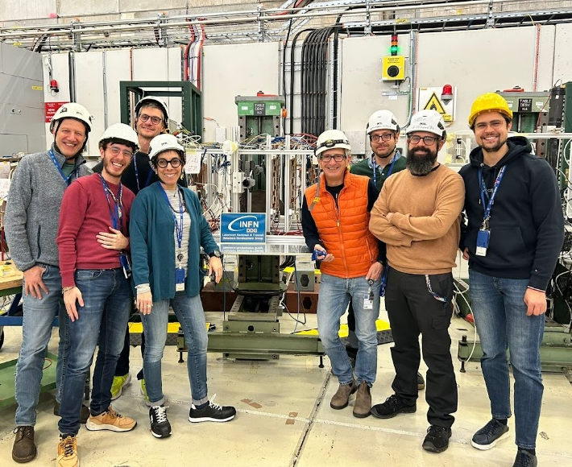
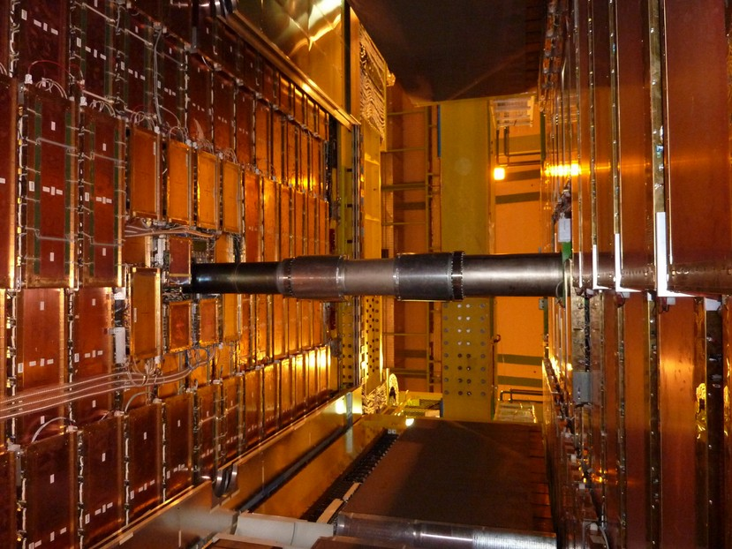

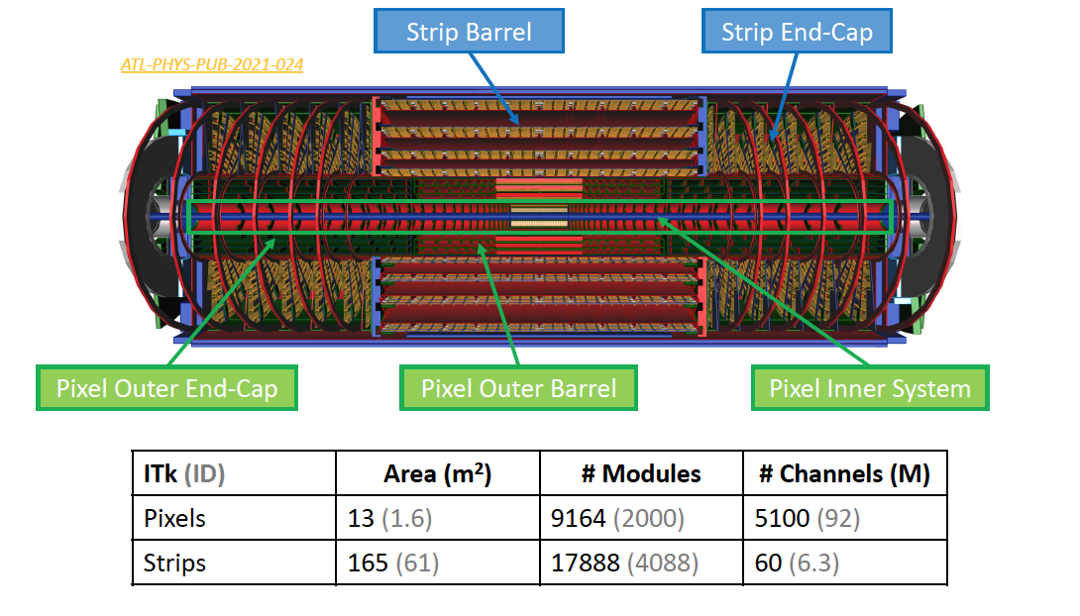

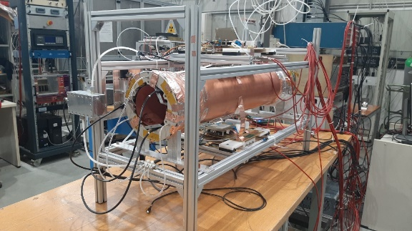
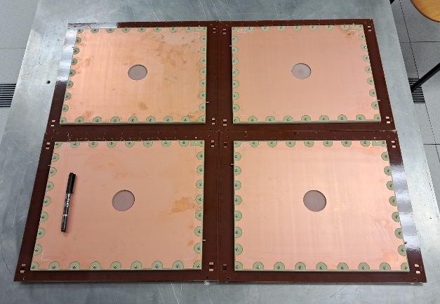

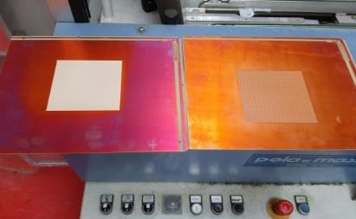
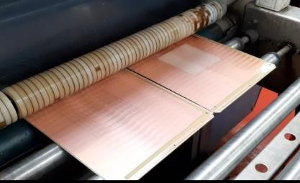
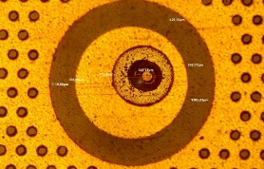
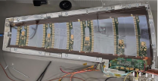

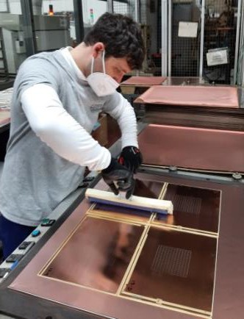
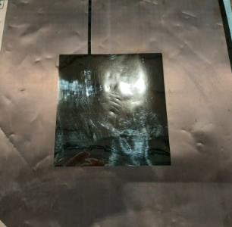
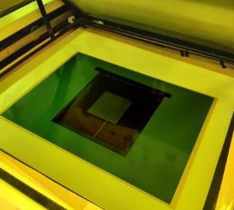
Detector Development Group Activities in HEP
LNF is responsible of the construction of one outer endcap of the ATLAS ITK Pixel detector.
Muon Detector at LHC
~6 m
~2 m
EURIZON – Cylindrical RWELL (EU - project)
LHCb – Muon Detector Upgrade with micro-RWELL at LHC
end-cap module
end-cap mechanical support
Technology Transfer to Italian Industry

Slide 19
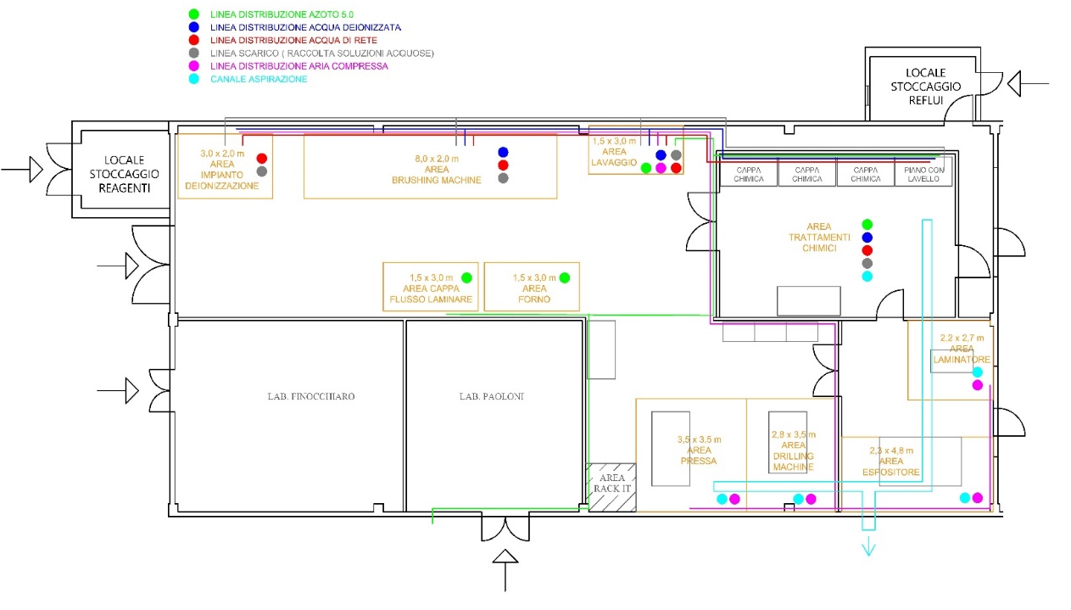


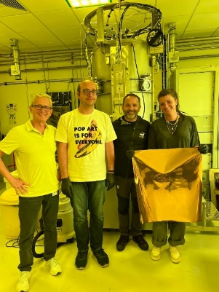

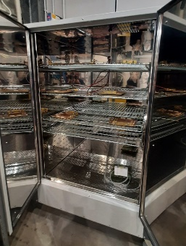

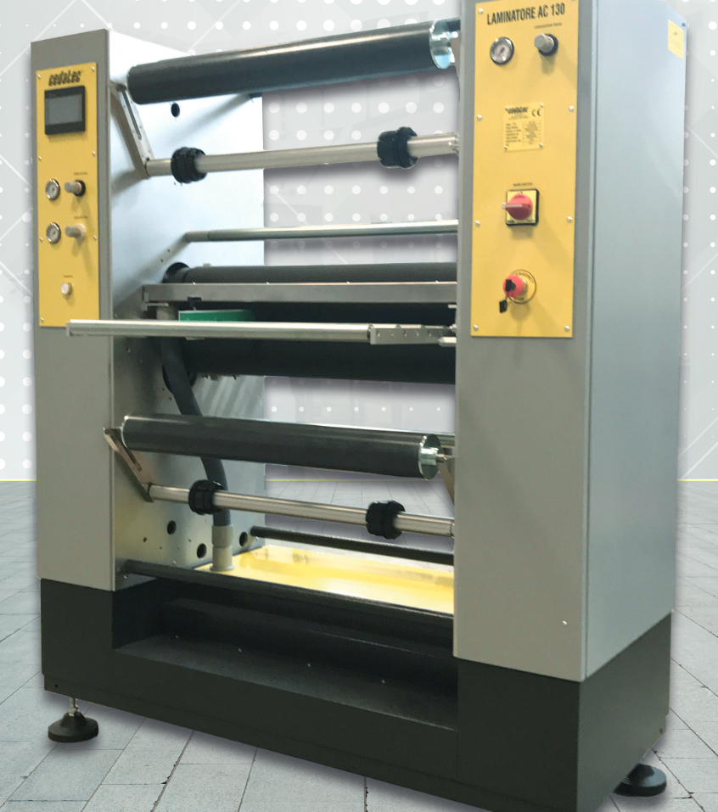
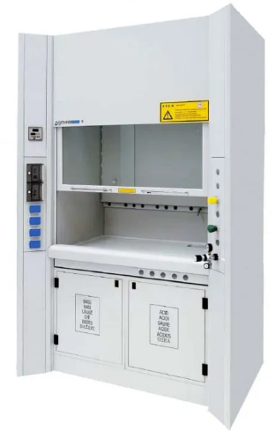
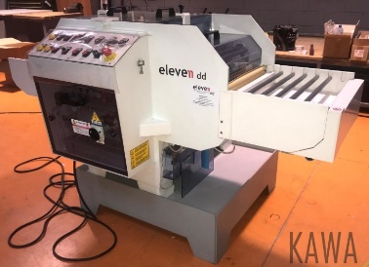
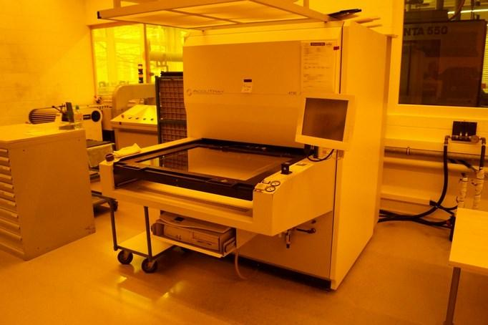
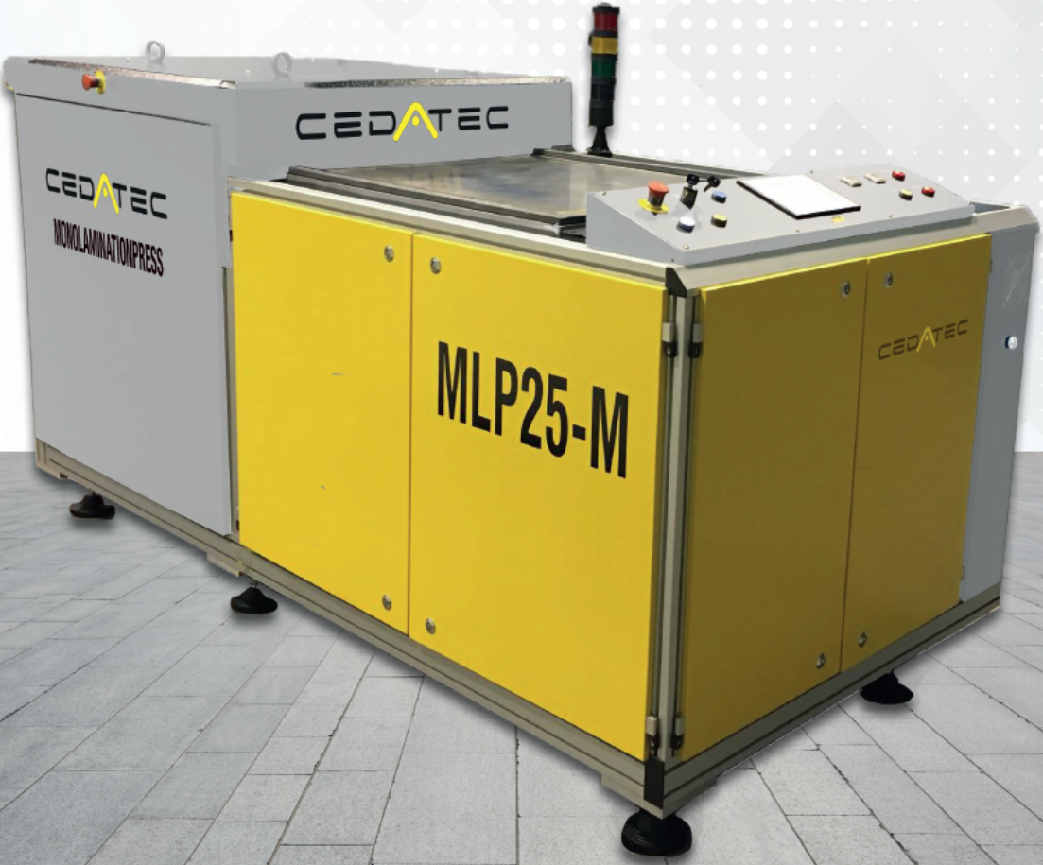
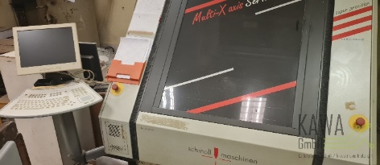
LNF - Workshop for detectors prototyping
Objectives
Develop innovative prototypes of MPGD layouts
Promote internal technological advancement at LNF
Establish strategic partnerships with research institutions (CERN) and industrial partners (ELTOS)
Integrate into a synergic network of international laboratories (Saclay, Bonn, JLAB, USTC-Hefei)

Slide 20
New Clean Rooms setup
Lab
DDG
Lab
nTOF

