Slide 1
EuPRAXIA@SPARC_LAB
Executive Summary
Massimo Ferrario
INFN-LNF
This project has received funding from the European Union´s Horizon Europe research and innovation program under grant agreement No. 101079773
IX TDR Review Committee Meeting
June 16-18, 2025

Slide 2
Introduction
The purpose of the EuPRAXIA@SPARC_LAB User Facility is to establish a research infrastructure that pioneers the use of plasma wakefield acceleration (PWFA) for driving a high-brightness Free-Electron Laser (FEL) in the soft X-ray regime.
Its first user beamline, AQUA, will deliver ultrashort femtosecond soft X-ray pulses within the biologically relevant “water window” spectrum, enabling real-time imaging, advanced materials development and investigation of chemical processes with unprecedented spatial and temporal resolution.
As one of the two core pillars of the pan-European Plasma Research Accelerator with eXcellence In Applications (EuPRAXIA) Research Infrastructure, EuPRAXIA@SPARC_LAB will be located at the INFN Frascati National Laboratories (LNF) and will serve a dual role as both a scientific instrument for users and a technological demonstrator. It will validate the integration of high-gradient plasma acceleration and X-band RF technology, into a user-grade light source, laying the groundwork for future compact user facilities. This will enhance their sustainability by significantly reducing the size, energy consumption, and operational costs typically associated with conventional accelerator-based light sources, making advanced photon science more accessible and environmentally responsible in the long term. The user facility is expected to begin operations in 2031.
By transitioning plasma-based accelerators from proof-of-concept to operational systems and validating them under real user facility conditions, EuPRAXIA@SPARC_LAB closes a critical gap in the technology readiness level (final TRL > 7) chain. This will position Europe at the forefront of global innovation in compact accelerators and strengthens its capacity to lead future high-energy physics, photon science, and interdisciplinary research programs. The inclusion in the ESFRI roadmap since 2021 marks the the strategic importance of the project at the European level.
The realization of the facility entails the construction of new buildings to host the accelerator systems, experimental halls, and support laboratories. This new infrastructure, to be built within the INFN LNF site, represents the project's first major challenge. From the outset, the design and construction will prioritize incorporating energy-efficient solutions, environmentally responsible materials, and infrastructure choices aligned with long-term ecological and operational resilience.

Slide 3
The TDR structure
The Technical Design Report (TDR) for the EuPRAXIA@SPARC_LAB facility presents a comprehensive technical framework for the construction and the scientific exploitation as user facility.
The TDR is structured to:
Define the scientific and technological objectives of the facility (Ch: Executive Summary, 27)
Outline the scientific use cases and user applications (Ch: 4)
Demonstrate feasibility through simulations and design studies (Ch: 5-6)
Deliver a technical description of all facility components (Ch: 7-23)
Establish technical readiness and assess potential risks (Ch: 24-25)
Support funding efforts and stakeholder engagement (Ch: 26)

Slide 4
The Executive Summary structure
This Executive Summary aims to provide a concise overview of the full TDR, tailored for funding agencies, institutional stakeholders, and expert reviewers. It distills the key content into an accessible format that emphasizes the facility’s maturity, technical feasibility, and scientific relevance. The summary is also intended to support informed decision-making and alignment with European research priorities and funding instruments, particularly those related to ESFRI and Horizon Europe.
Introduction
The pan-European EuPRAXIA Project
Plasma Acceleration
The EuPRAXIA Concept
The Italian Pillar: EuPRAXIA@SPARC_LAB User Facility
Machine Layout
Machine Expected Performances
Scientific Case and Applications
Project Cost and Timeline
Technical description of all facility components
The Building
The Machine
Conclusions and Future upgrades

Slide 5
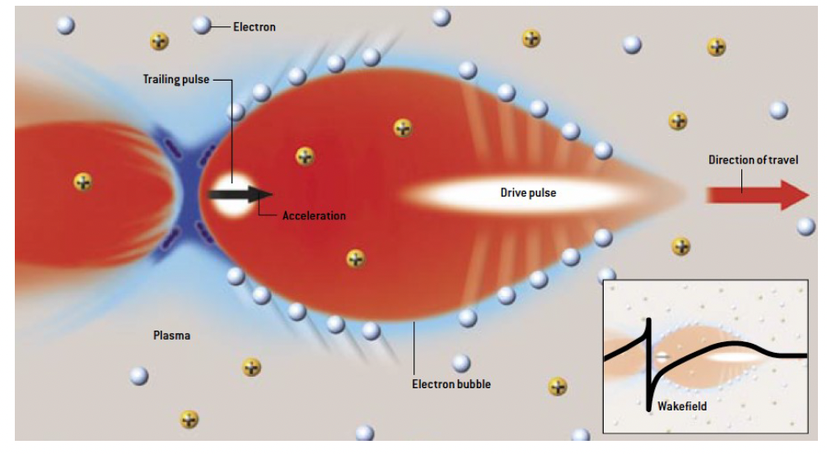
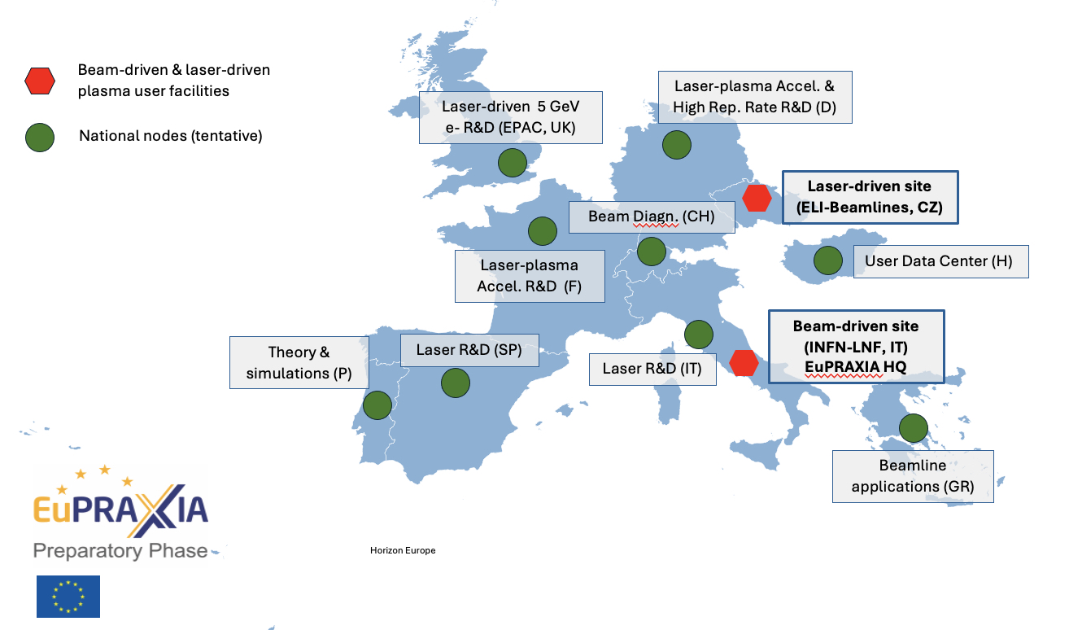
The pan-European EuPRAXIA Project
To match the dimensions of the plasma bubble—typically 100–300 µm in length and 10–30 µm in width—both the driver and witness beams must be significantly shorter and narrower than the plasma wavelength, while maintaining high charge densities. This demands beams of exceptional quality: ultrashort duration, low emittance, narrow energy spread, and high peak current. Achieving and maintaining these beam parameters represents one of the key technological challenges at the heart of the EuPRAXIA project.
The first EuPRAXIA User Site is under development at INFN- LNF in Italy. This site will host EuPRAXIA@SPARC_LAB, a plasma–beam-driven (PWFA) free-electron laser (FEL) user facility. The second User Site has recently been awarded to the ELI Beamlines facility in Dolní Břežany, Czech Republic, which will focus on the laser-driven (LWFA) branch of the project. Additional Nodes distributed across Europe will contribute to the two User Sites through R&D, component prototyping, training, and technical support.

Slide 6
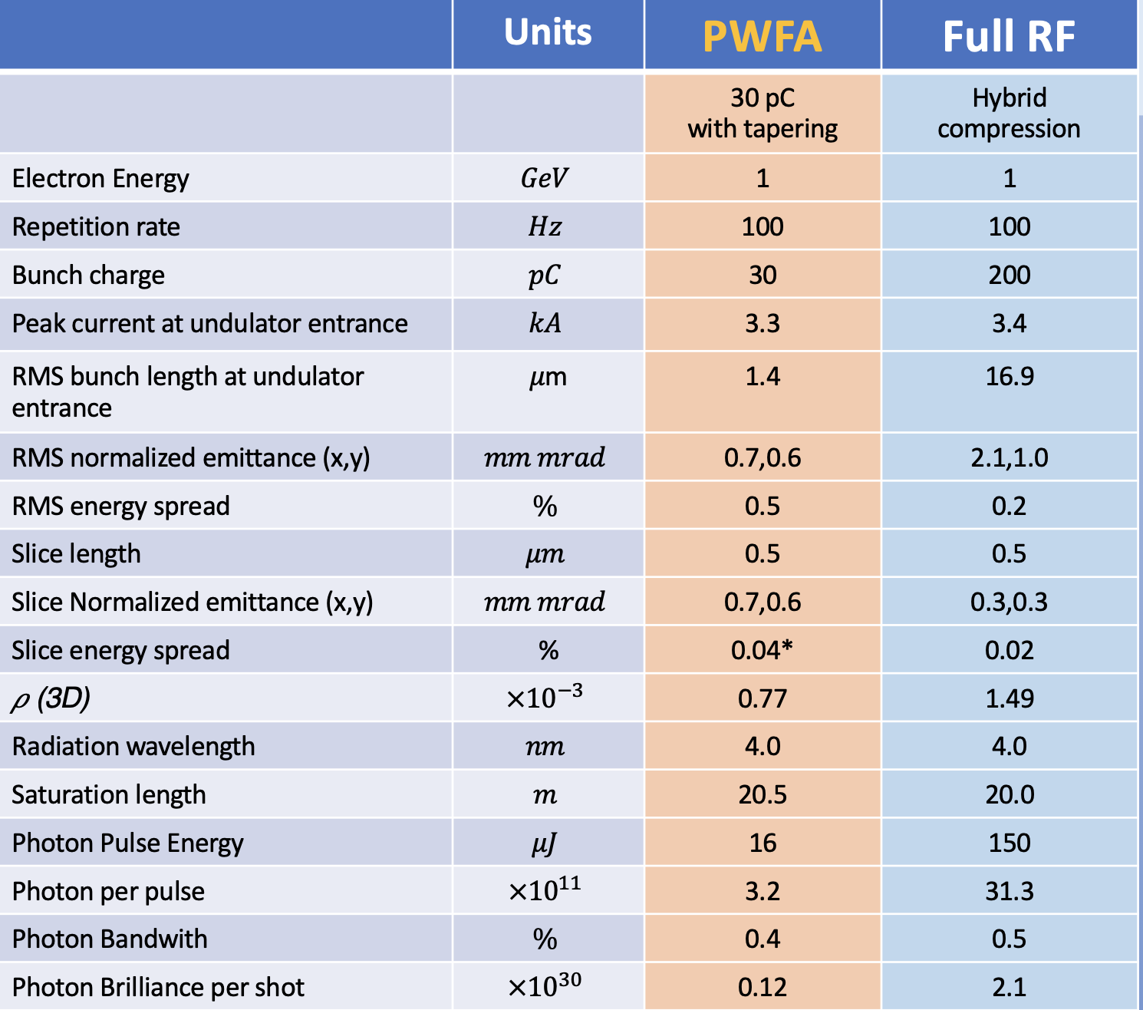
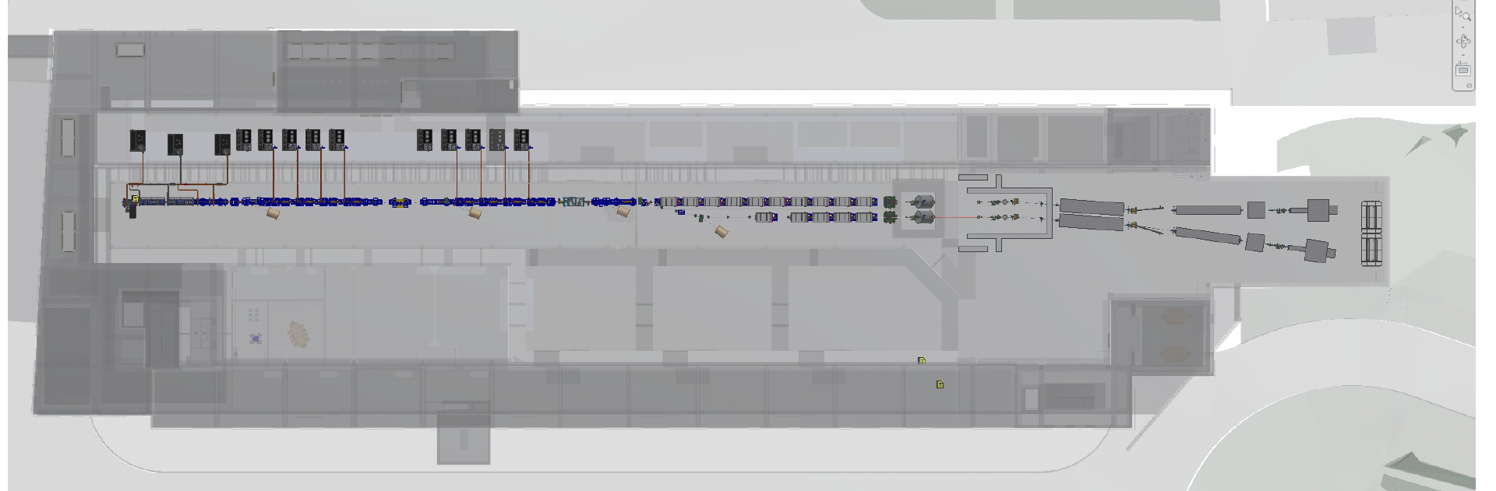
The Italian Pillar: EuPRAXIA@SPARC_LAB User Facility
The facility aims to operate in two modes: a full-RF mode for initial commissioning, and a hybrid RF+PWFA mode that serves as a demonstrator for plasma-driven FELs user operation. Full-RF mode user operation is also possible.
The facility is expected to begin operations in 2031
The choice of using a FEL as the first application has been determined by the fact that FELs are extremely sensitive to the quality of the electron beam, making them an ideal testbed to demonstrate the capabilities of plasma-based accelerators. In addition a plasma-driven FEL is immediately attractive to a broad scientific user base, facilitating the transition from accelerator R&D to real-world applications and justifying further investment.

Slide 7
The Italian Pillar: EuPRAXIA@SPARC_LAB User Facility
Facility | Location | Wavelength Range [nm] | Wavelength Range [nm] | Linac Length [km] | Electron Energy [GeV] | RF Band And Gradient [MV/m] | Key Features
Soft X-rays radiations
AQUA | Frascati, Italy | 4–10 |  | < 0.05 | 1.0 – 1.2 | X/Plasma 60/1000 | Compactness. Targets the water window; 3D bio-imaging.
FLASH | Hamburg, Germany | 4.1–45 |  | 0.2 | 1.25 | L 30 | Pioneering SASE FEL; test facility for RF Super-Conductivity and FEL technologies.
FERMI | Trieste, Italy | 10–100 |  | 0.15 | 1.67 | S 28 | Seeded FEL; high spectral purity in VUV–soft X-ray range.
Hard X-rays radiation
LCLS 1 | SLAC, USA | 0.13–6.2 |  | 1 | 14 | S 25 | First hard X-ray FEL; ultrafast imaging capabilities.
European XFEL | Hamburg, Germany | 0.05–4.7 |  | 2.1 | 17.5 | L 24 | High repetition rate; multiple beamlines.
SACLA | Harima, Japan | 0.06–0.2 |  | 0.4 | 8.5 | C 38 | More compact design; operates in hard X-ray regime.
SwissFEL | Villigen, Switzerland | 0.1–5.0 |  | 0.5 | 5.8 | C 28 | Two beamlines covering hard and soft X-rays.
PAL-XFEL | Pohang, South Korea | 0.06–4.5 |  | 0.78 | 10 | S 27 | Covers both hard and soft X-rays.
•Moderate Energy with High Impact: Operating at around 1 GeV, will deliver Soft X-rays radiation in the “water window”. This range is crucial for imaging biological specimens in aqueous environments without damaging or staining them, positioning AQUA as a valuable tool for structural biology, chemistry, and material science.
•Compact Design: With an accelerating length shorter than 50 meters, it is the most compact facility in the soft X-rays list, at least by a factor 3. This reflects its use of the combination of high-gradient X-band linac technology and plasma acceleration. Compact accelerator footprint reduces the need for large-scale infrastructure and land use.
•Technology Demonstrator: it will be also a strategic testbed for integrating advanced acceleration schemes and short period undulators into user-oriented FELs marking a paradigm shift toward compact and cost-effective light sources.

Slide 8
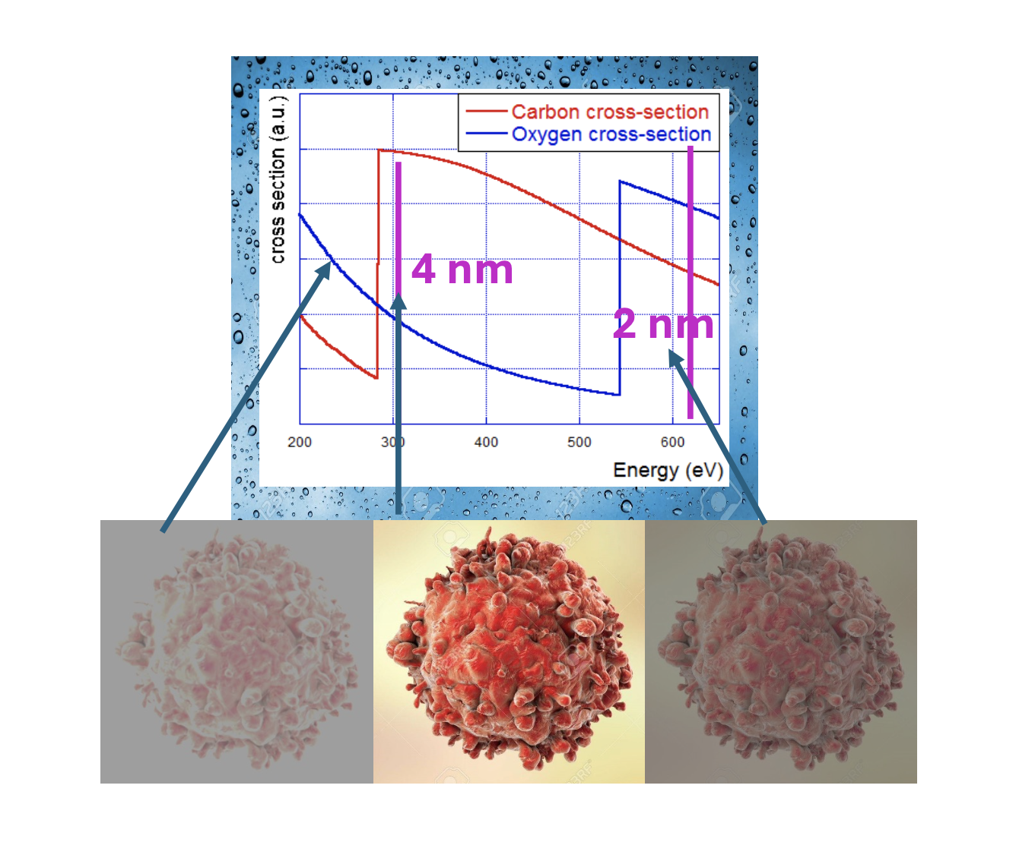
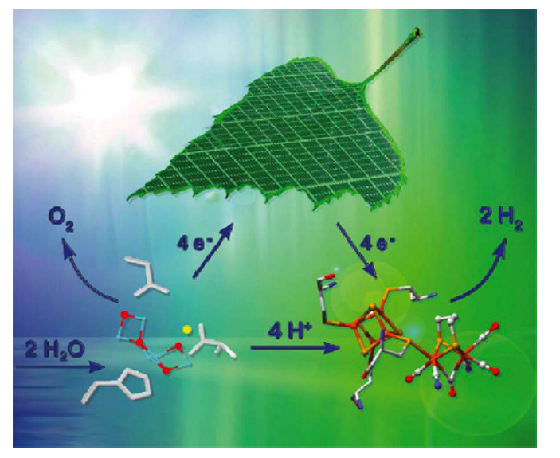
Scientific Case and Applications
Application Area | Scientific Focus | Techniques | Key Impact
Renewable Energy | • Charge transport in solar cells & catalysts • Photocatalytic H₂ production • PFAS/PClAS analysis | XAS, XES, PI-MS | • Efficient solar materials • Clean hydrogen production • Environmental remediation
Warm Dense Matter (WDM) | • Extreme temperature/density • Astrophysics & fusion | Time-resolved XAS, TR-XES | • Stellar/planetary modeling • Fusion research support
Battery Technology | • Ion migration & interfaces • Solid-state battery study | XAS, non-linear X-ray spectroscopy | • Safer, longer-life batteries • High energy density
Structural Biology | • Live-cell imaging • Cellular processes (stress, DNA damage) | CDI, XAS, CEI | • Real-time biomolecular studies • Disease mechanism insight
Health & Radiobiology | • DNA damage by radiation | X-ray pump–probe, photo-fragmentation | • Radioprotection • Cancer treatment improvement
Atmospheric Chemistry | • VOC/NOx oxidation • Aerosol dynamics | PI-MS, ion spectroscopy | • Pollution models • Climate studies
Astrochemistry | • Radiation chemistry in space • Organic molecule formation | XAS, photochemistry | • Space molecular evolution

Slide 9
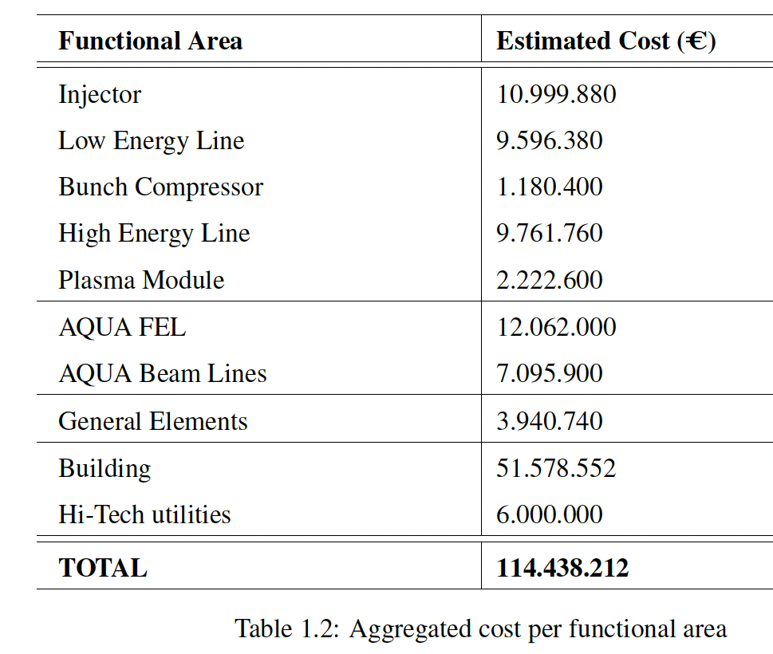
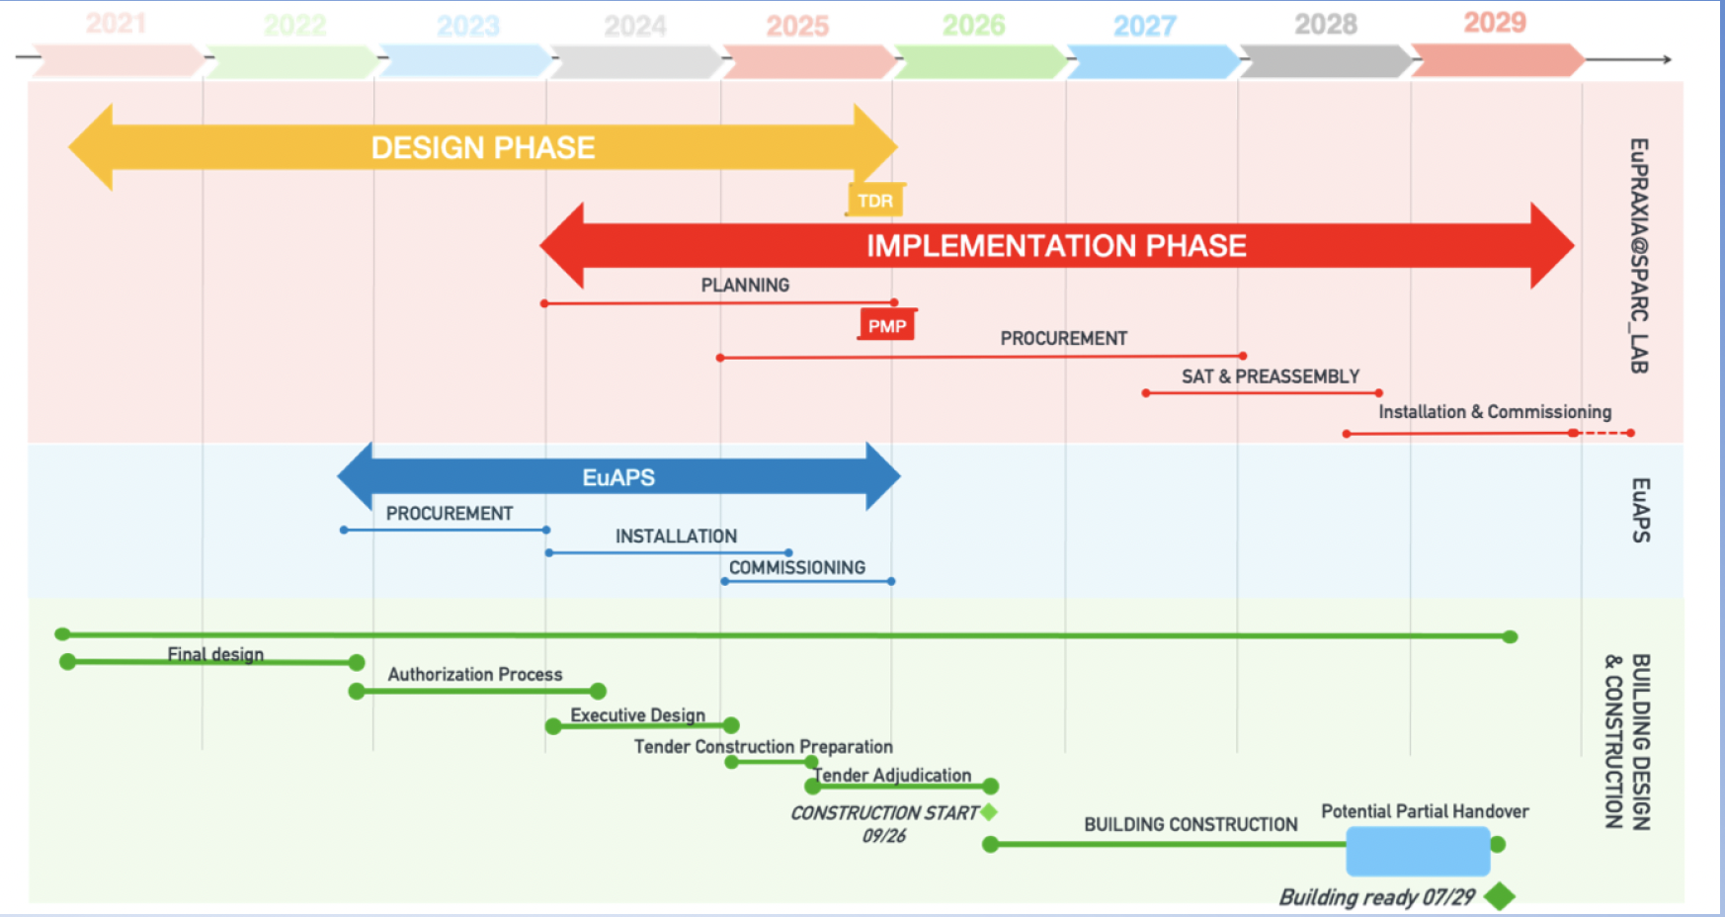
Project Cost, Timeline, and Management
As expected, the cost of the Plasma Module is significantly lower than that of the High Energy Line, almost one fifth, despite delivering the same energy gain, underscoring the economic advantage of plasma-based acceleration technologies in comparison to conventional radio-frequency systems.
The implementation timeline targets 2029 for building readiness and 2031 for minimum operational status, aligned with ESFRI Landmark designation requirements. EuAPS is expected to run as User Facility from 2026

Slide 10
Technological Readiness Level
Sub - systems | TRL | Comments
Injector | 9 | S-Band injectors are widely used in many facilities including SPARC_LAB. S-Band technology is fully available in the market.
X-Band Linac | 6 | X-Band Linacs are relatively new. Impressive progress has been made and the final testing of the acc. section full prototype will upscale the corresponding TRL level in the upcoming months.
Plasma Module | 5 | Extensive R&D has been made to validate the plasma capillary technology and solid results have proved the validity of the technical choice. A full system proven in a real environment is expected to be done in the next year
AQUA Undulators | 7 | Technology demonstrated in other facilities (FERMI, SwissFEL, etc.)
FEL Beamline | 8 | Most of the components of the photon beamline are implemented at other facilities are commercially available, few systems (needed only for a subset of possible experiments) are still in development
RF power system | 8 | X-Band RF power system has been already tested and operated in normal condition in the test-stand. The final operational test will prove the validity and reproducibility of the technical choices in the real setting
Laser system | 9 | Photocathode laser is now a proven technology tested in real facilities (including SPARC_LAB). The systems are full available in the market almost as off-the shelf products
General elements | 9 | Other elements (Control, mechanics etc) are based on standardized components daily used in other facilities and in other context (e.g. industrial context)
TRL LEVEL | TRL Description
TRL 1 | Basic principles observed – Scientific research begins to be translated into applied research and development (R&D).
TRL 2 | Technology concept formulated – The basic principles are explored and practical applications are identified.
TRL 3 | Experimental proof of concept – Active R&D is initiated, including analytical and laboratory studies to validate predictions.
TRL 4 | Technology validated in lab – Basic technological components are integrated to establish that they work together.
TRL 5 | Technology validated in relevant environment – The technology is tested in a simulated or relevant environment
TRL 6 | Technology demonstrated in relevant environment – A prototype system is tested in an environment similar to the operational one.
TRL 7 | System prototype demonstration in operational environment – A working prototype is demonstrated in a real operational setting.
TRL 8 | System complete and qualified – The technology is proven to work in its final form and under expected conditions.
TRL 9 | Actual system proven in operational environment – The technology is fully commercialized and operational in its intended setting.
Two dedicated test facilities, SPARC_LAB and PLASMA_LAB, are actively supporting the development and validation of plasma acceleration concepts, while the TeX facility is dedicated to high power testing of X-band performance. Achieving a Technology Readiness Level (TRL) above 7 for these subsystems will only be possible following the successful construction and operation of the EuPRAXIA@SPARC_LAB facility.

Slide 11
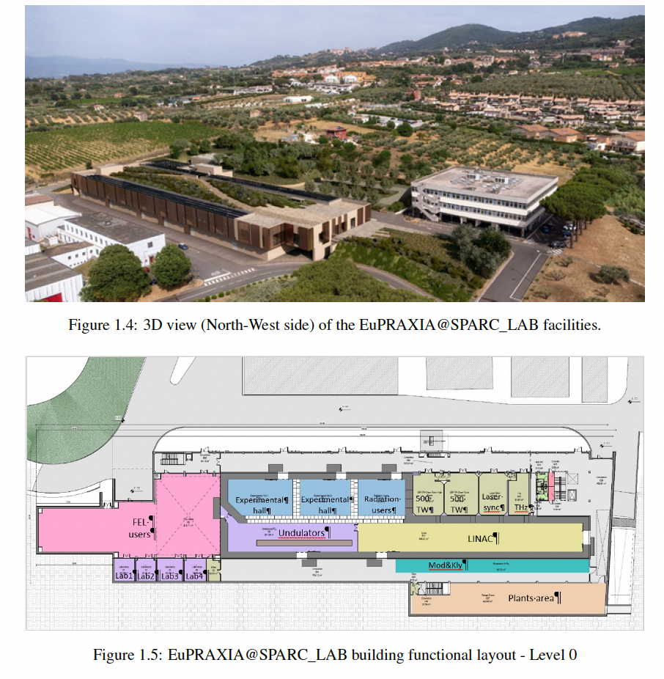
The Building
The maximum expected power demand of the project, used for the electrical installation design, is about 2.8 MVA for all the site.
The expected power consumption for the AQUA operation at 100 Hz repetition rate, delivering up to 1.2 GeV electron beams is 1.32 MW
Electrical loads | kW
RF Modulators | 575
Magnet PSU | 360
Laser | 15
Experimental users | 10
Vacuum, electronics and controls | 30
Cooling magnet + RF | 180
HVAC | 150
Total Expected power consumption | 1320

Slide 12
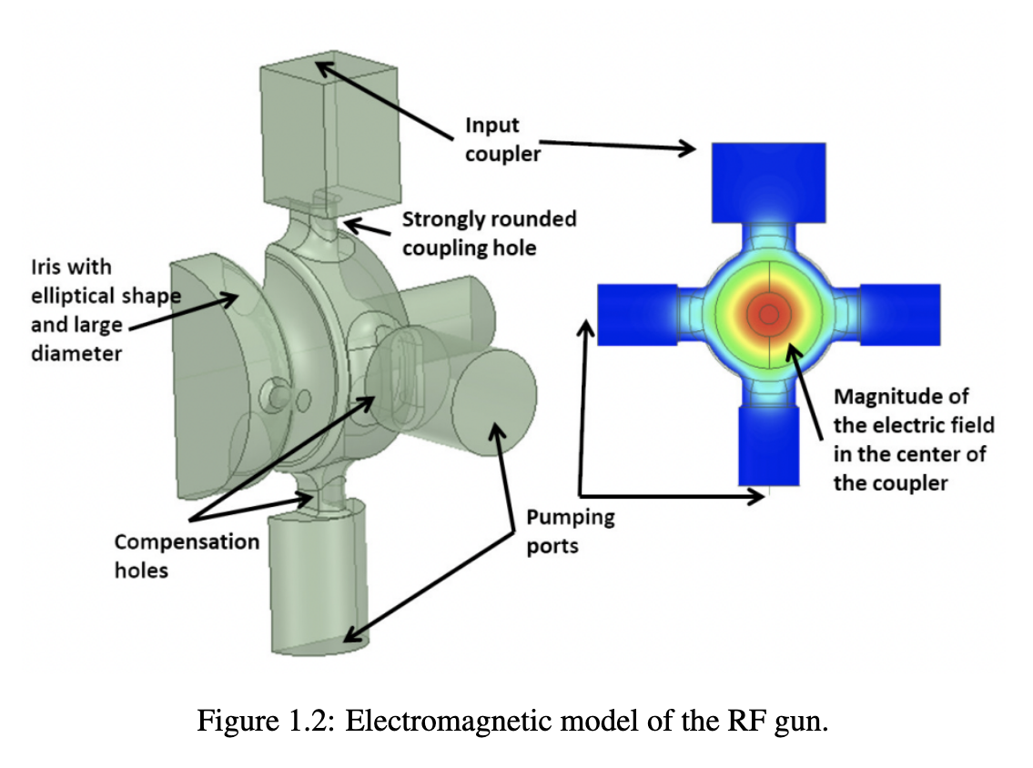
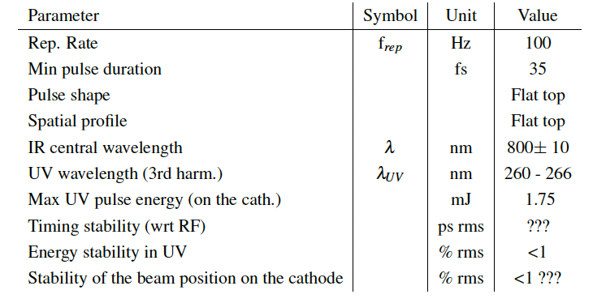
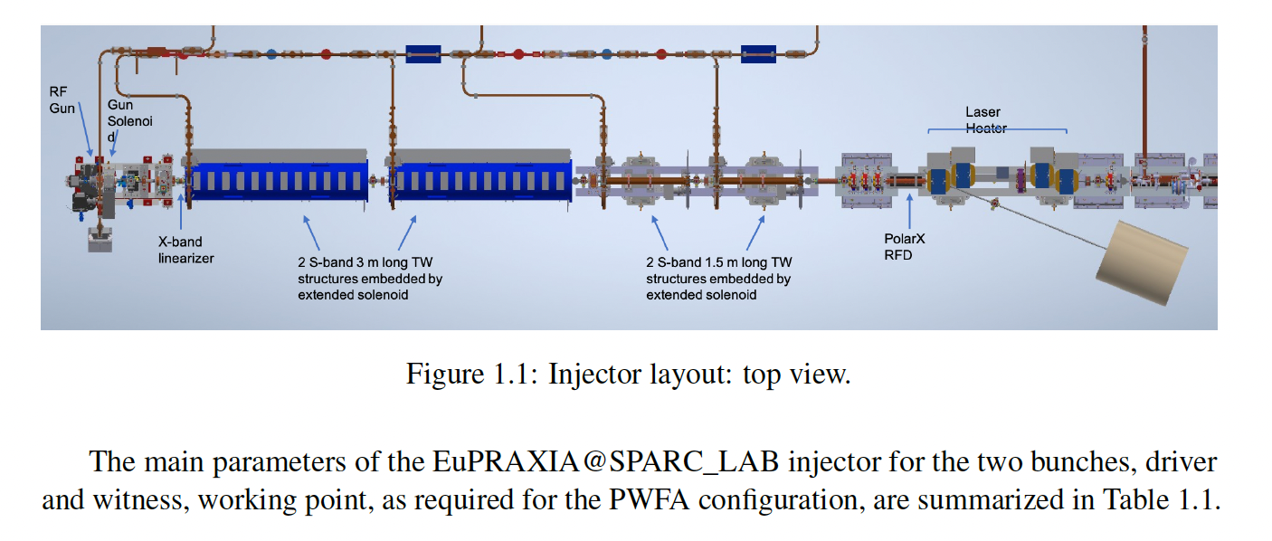
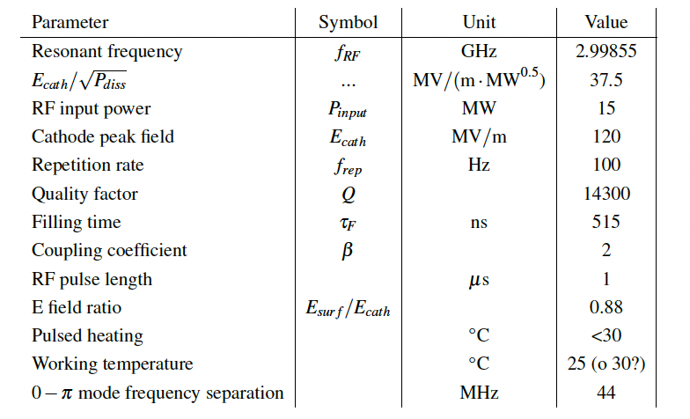
The Photoinjector

Slide 13
Sustainability
Eupraxia as R&D “revolution” of the acceleration efficiency -> Gallo ?
2. LNF campus greening strategies -> Ricci 3. Sustainability Regulation and duties -> Ricci &C 4. Building -> Incremona (da progetto) 5. HVAC-> Cianfrini/Cantarella 6. Process cooling -> Luminati/CianfriniCantarella 7. RF (modulatori, sezioni e guide d'onda) -> Cardelli +? 8. Magnet and PS -> Sabbatini/Vannozzi 9. Water management: DT (da progetto) 10. Waste management

Slide 14
IX TDR Review Committee Agenda – June 2025

Slide 15
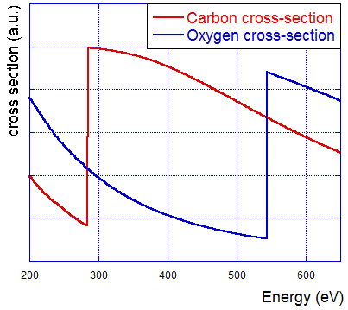
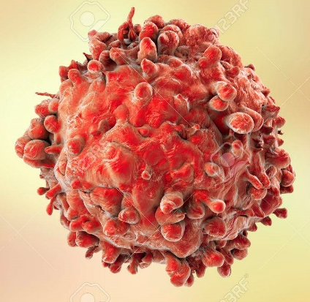
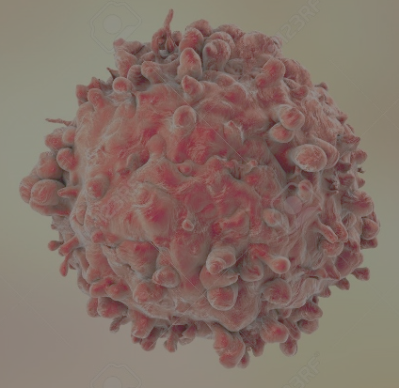
4 nm
2 nm

