Slide 1
Chapter 11: Photon Beamline
Fabio Villa (LNF)
on behalf of WP4 Photon beamlines group (M. Angelucci, A. Liedl, L. Spallino, F. Villa)
This project has received funding from the European Union´s Horizon Europe research and innovation program under grant agreement No. 101079773
IX TDR Review Committee Meeting
June 16-18, 2025

Slide 2
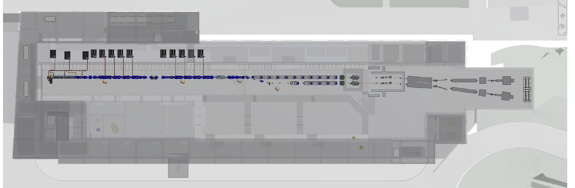
My Area

Slide 3
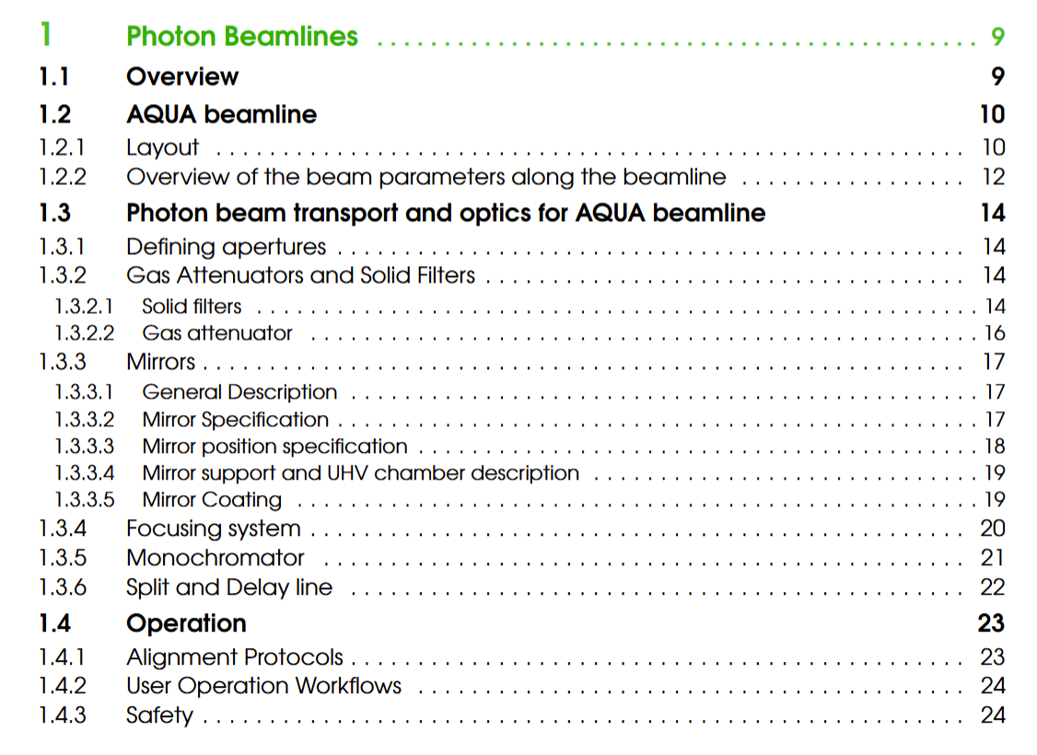
Describe your Chapter
Overview of parameters
and layout
Transport optics and pulse manipulation elements description
General beamline procedures
Beamline diagnostics are detailed in Chapter 13 (Electron and Photon Diagnostics)

Slide 4
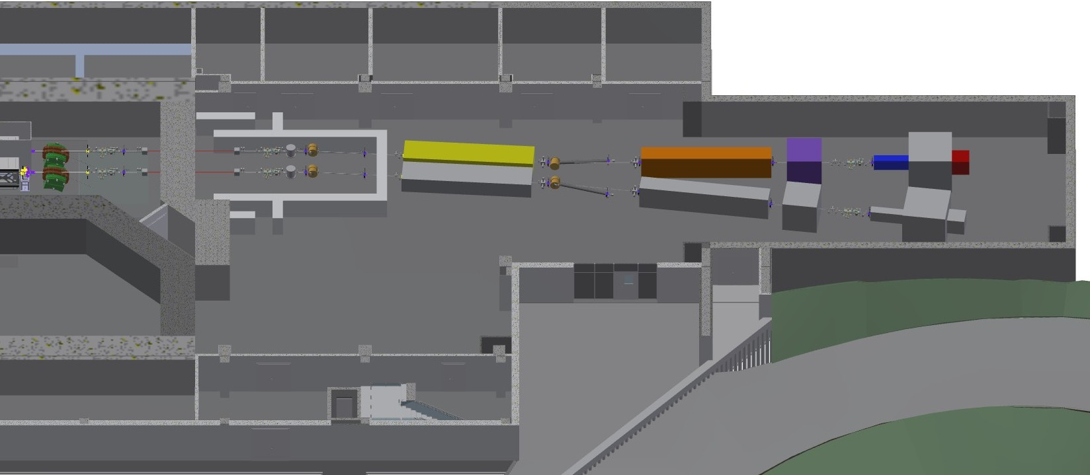
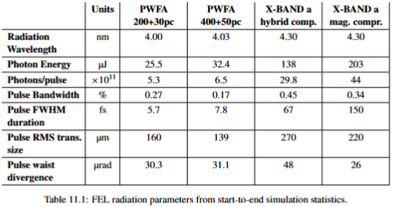
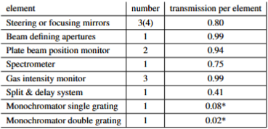
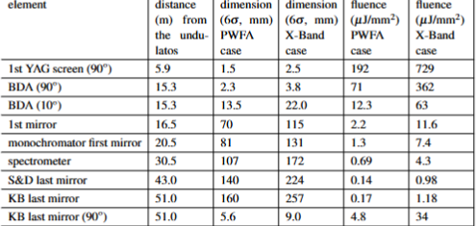
Global Goals:
Input FEL parameters (largest values from ch. 5)
Beamline Layout -
Element definition
GMD
GAbs
Mirr
GMD
FW
FW
BDA
Monochr
Spectrom
S&DL
Time
K-B foc
endstation
GMD
FWS
BPM
Photodiodes
YAGs (coherence)
Beamline transmission at 4 nm
Beam propagation
32% baseline at 4 nm, 13% with S&DLS, 1-2% with monochromator

Slide 5
Achievements: Technological Readiness Level (Sub-Components)
Sub - systems | TRL | Comments
Defining apertures | 9 | Components are commercially available, design is very standard
Solid filters | 9 | Components are commercially available, design is standard
Mirrors | 9 | Coating and substrates are commercially available for our minimum requirements, motors and vessels are commercially available. Design is standard. R&D on better surfaces and contamination removal is still ongoing
Focusing system | 9 | System is commercially available (e.g. from Elettra ILO)
Gas attenuator | 8 | Design and implementation of the gas system and the differential pumping are custom made for each facility, but they are running for many decades. Components are commercially available.
Split & delay line system | 6 | Each facility using the system has its own prototype design that is not yet standardized, ongoing R&D activities on alignment and reproducibility of automatic delay scan
Monochromator | 6 | Standard single grating monochromators are present in many FEL facilities, while dispersion compensating design (with possible exclusion of the system to reduce losses when not needed without altering the beamline path) is running in very few facilities (only 1 at DESY in our knowledge)
General elements | 9 | Vacuum and mechanical components of the beamline are commercial

Slide 6
Pending Items: (What is still in progress or incomplete.)
TRD is completed
After the TDR:
Differential pumping and mechanical drawings of all the elements will be detailed in a future technical document
Monochromator:
General layout of the system, capabilities, system dimension and cost estimation are asserted in the TDR
Defining the final layout of the system in a way that removing or inserting the system will not affect (much) the optical alignment of the beamline, choosing the final resolving power and pulse front tilt compensation will be done in a future document, as the system will be installed in a second phase only for a subset of experimental activities.
Split & delay line system:
General layout of the system, capabilities, system dimension and cost estimation are asserted in the TDR
Defining the final layout depending on experimental requirements (total time separation) and the methods and system for beam alignment during delay scans (important for delay accuracy and beamtime needed for a scan) will be done in a future document, as the system will be installed in a second phase only for a subset of experimental activities.

Slide 7
Dependencies / Risks: (Any blocking issues or critical path items.)
TDR: completed (change in parameters due to review may change some details in the numerical values)
After TDR:
Technical drawing realization (externalization may reduce the manpower required but at the cost of more money)
Significant changes in input parameters may require redesign of some elements (coatings, gas, mirror dimensions, focusing)
Procurement: many elements are present in the beamline (mitigation: order complete systems instead of parts)

Slide 8
Conclusions
The chapter describes the beamline layout and all the optical elements needed for transport and manipulation of the FEL pulse, defining the choices of the systems and giving photon parameters needed to plan possible user experiments (ch. 12 experimental endstation and ch. 4 scientific case)
A general guideline for alignment, user access and safety is reported in the last part of the chapter
The TDR chapter will be used as a baseline for future executive designs needed for procurement of the elements

