Slide 1
Chapter 10: Plasma accelerating module
A. Biagioni, R. Pompili, L. Crincoli, R. Demitra
INFN-LNF
This project has received funding from the European Union´s Horizon Europe research and innovation program under grant agreement No. 101079773
IX TDR Review Committee Meeting
June 16-18, 2025

Slide 2
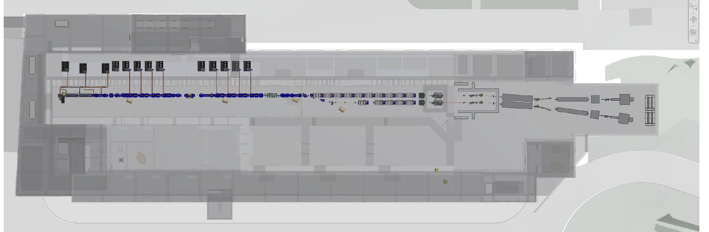
Area of interest
Plasma module

Slide 3
Chapter description

Slide 4
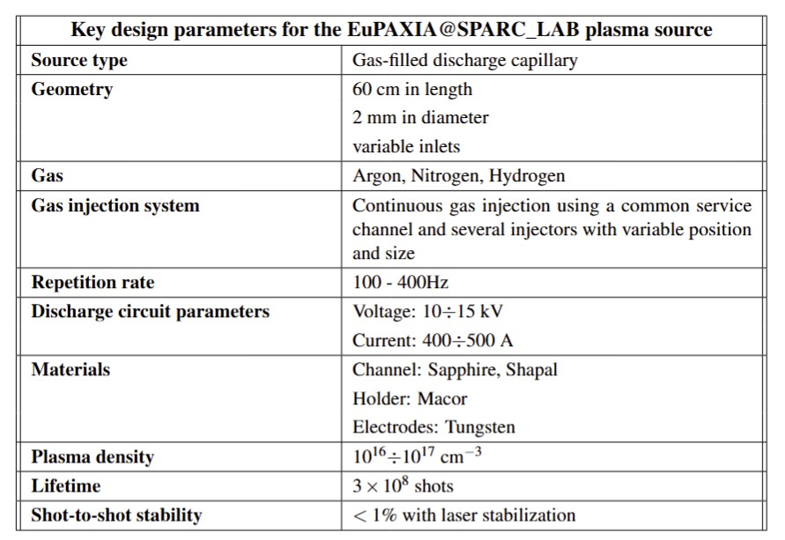
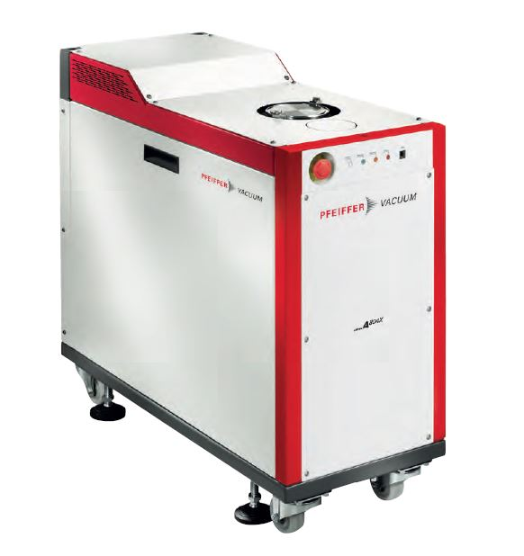
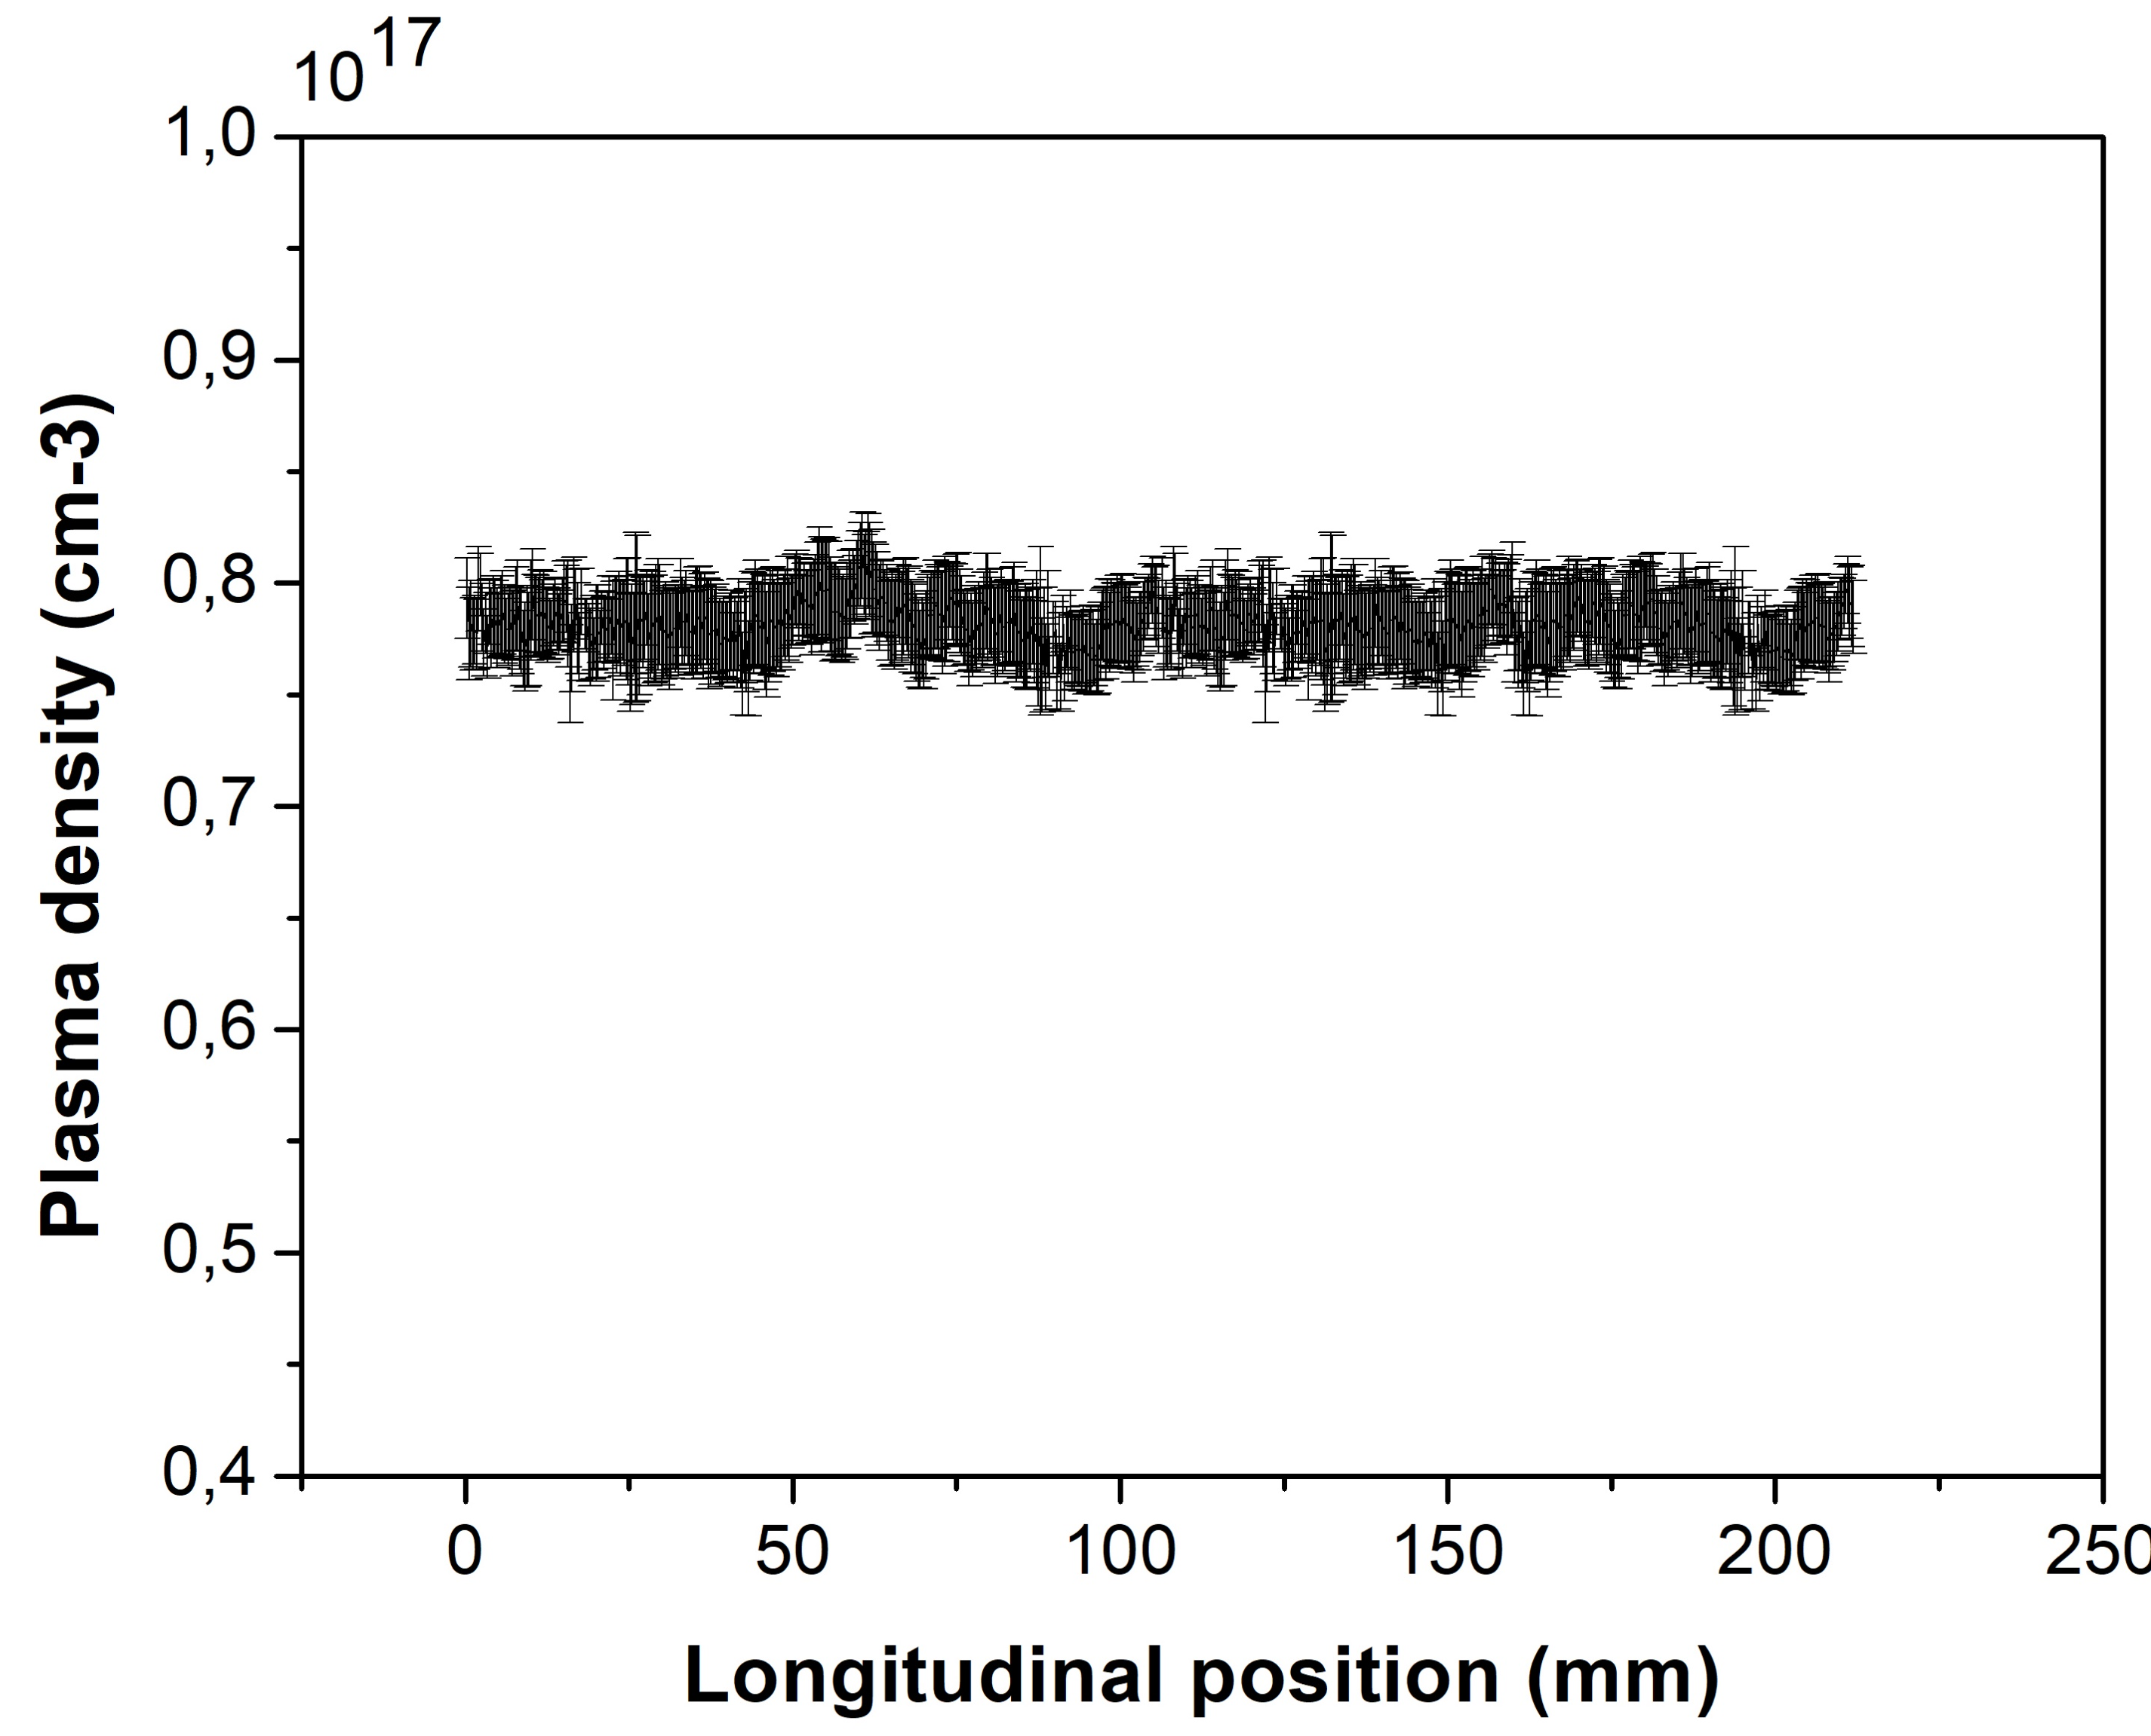
Global Goals:

Slide 5
Key points requested by the TDR committee
More detailed description of the prototype of the plasma source (gas-filled discharge capillary) was needed
Description of the vacuum system’s ability to sustain the gas flow required to produce the plasma was missing
The high voltage system used for ionizing the neutral gas and thus creating the plasma needed to be better described

Slide 6
Achievements: Technological Readiness Level (Sub-Components)
Plasma Module | 5 | Extensive R&D has been made to validate the plasma capillary technology and solid results have proved the validity of the technical choice. A full system proven in a real environment is expected to be done in the next year (Technology validated in relevant environment – The technology is tested in a simulated or relevant environment)
Sub - systems | TRL | Comments
Plasma chamber | 8 | Plasma chambers designed for differential pumping are widely used in many facilities, including SPARC_LAB. Actual system proven in operational environment (System complete and qualified – The technology is proven to work in its final form and under expected conditions)
Vacuum pumping system | 8 | Pumping systems appropriate to the gas quantities required for plasma formation in acceleration experiments have already been tested at the SPARC_LAB and other facilities.
HV source | 8 | The high voltage system to produce ionization of 60 cm long gas columns in thin capillaries has been fully designed and tested in the laboratory at the operating frequencies
Plasma source (Gas-filled capillary) | 5 | Extensive R&D has been made to validate the plasma capillary technology and solid results have proved the validity of the technical choice. A full system proven in a real environment is expected to be done in the next year
Magnetic separation | 5 | The separation chicane between the driver and witness in plasma accelerators has never been experimentally tested and, although it exists at the design level, it has not yet been technically implemented

Slide 7
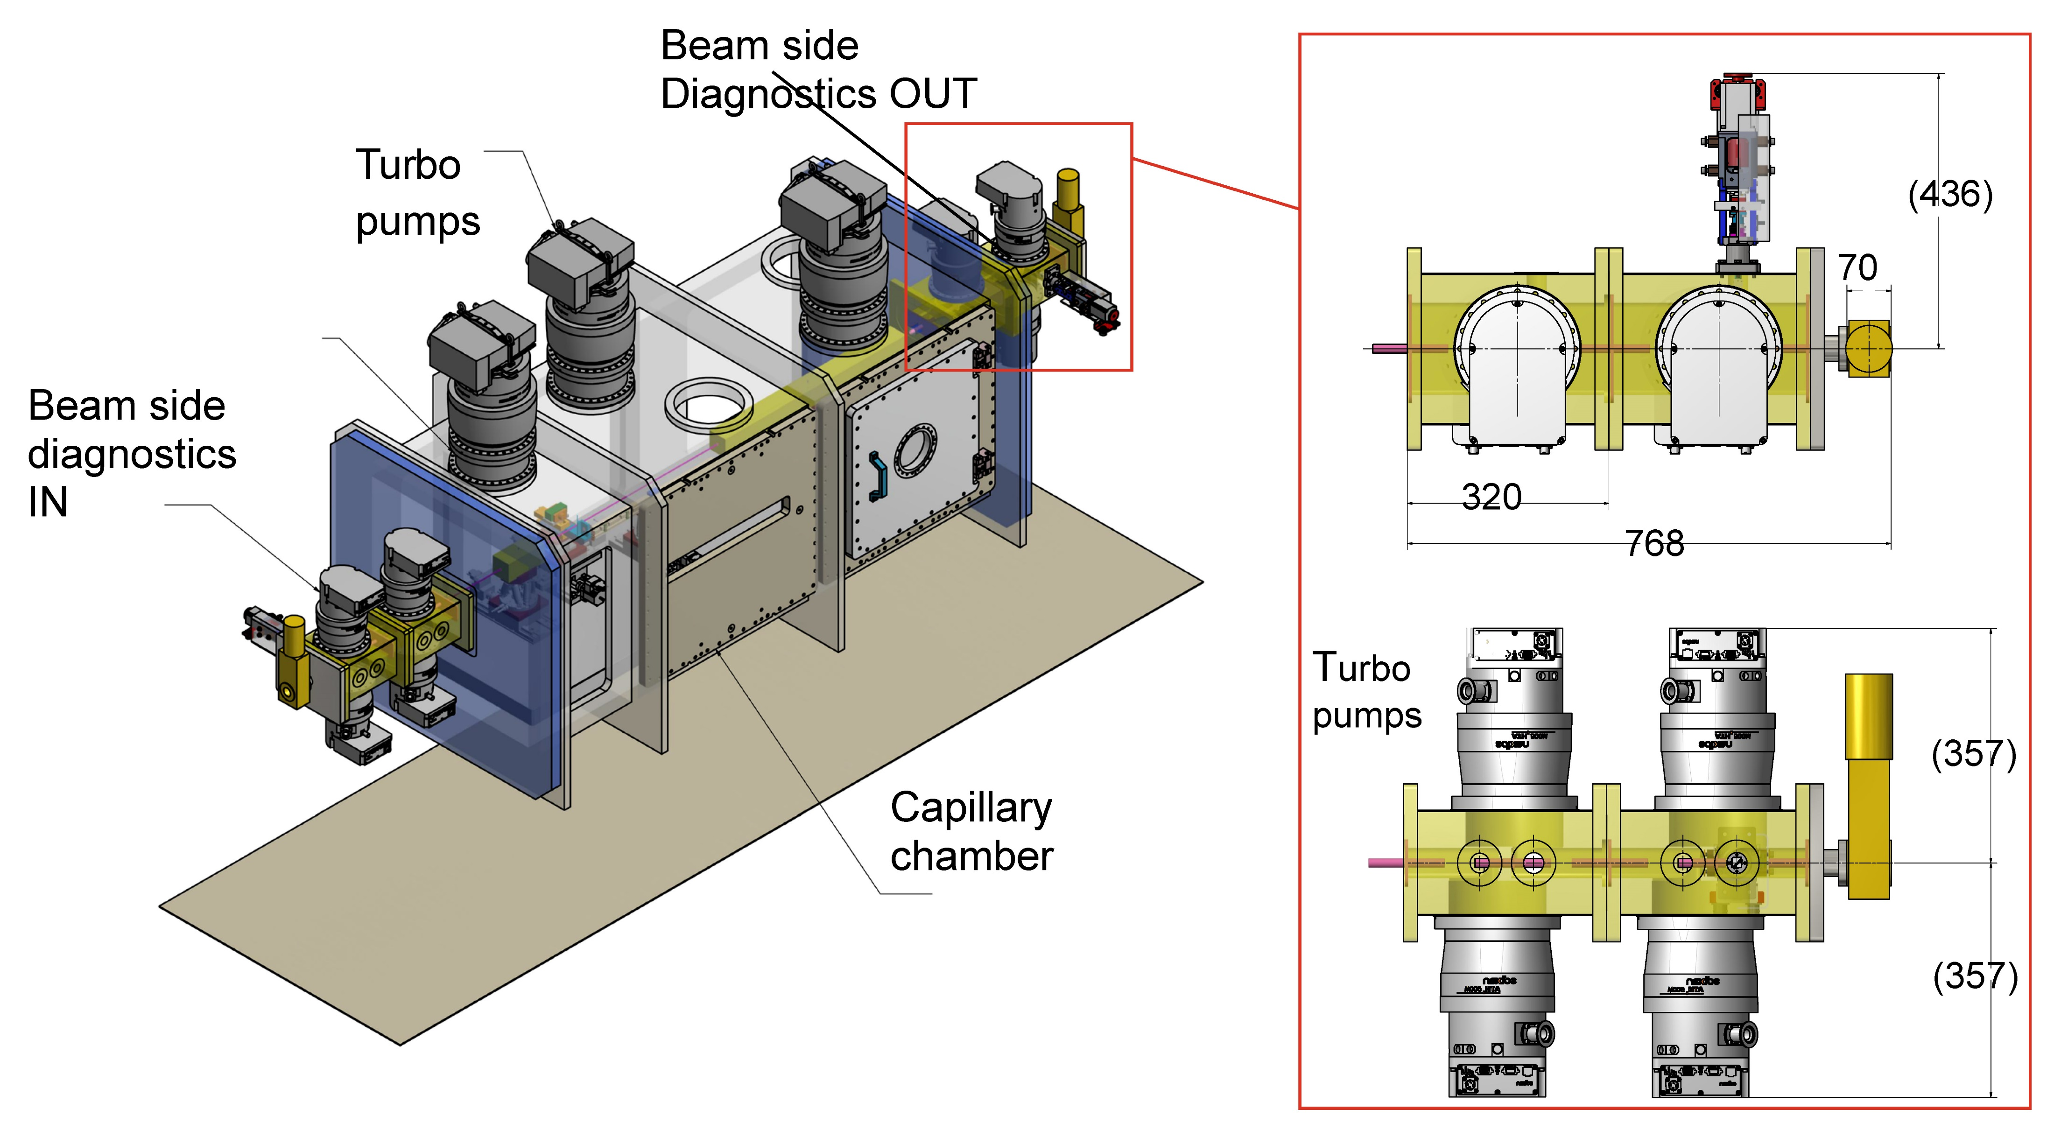
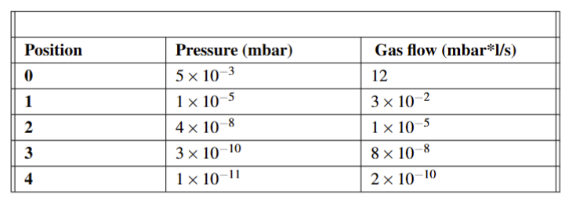
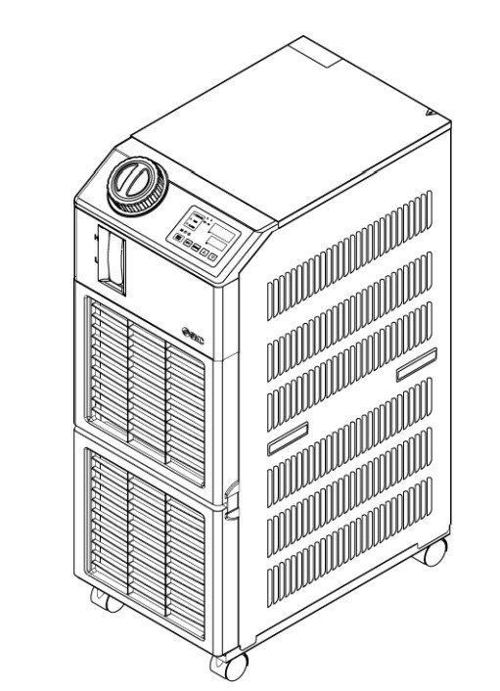
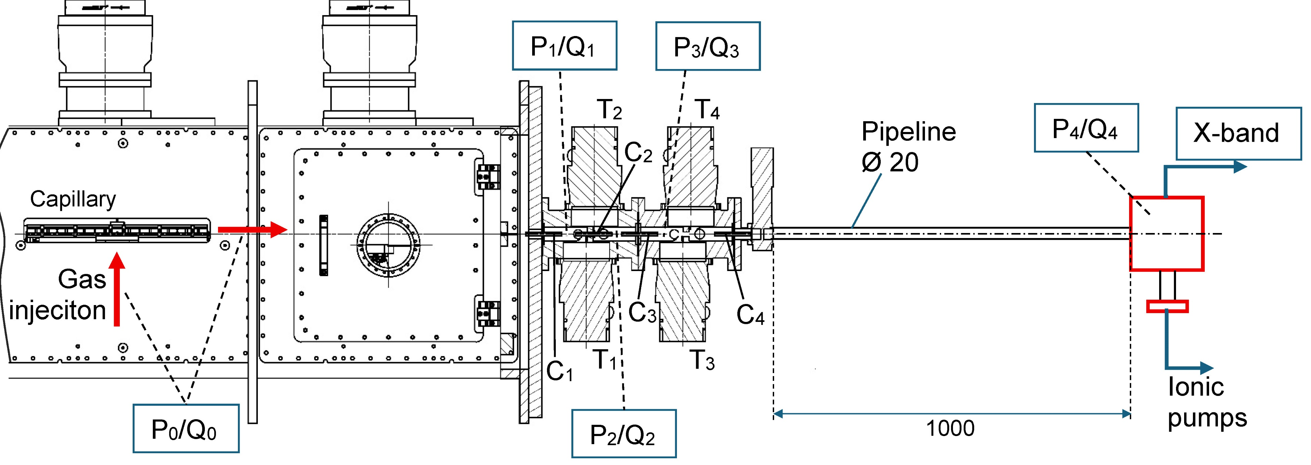
Achievements: 8-Technological Readiness Level (Plasma chamber and pumping system)
High amount of gas injected to work at 100-400 Hz repetition rate (15-20 mbar ·l/s)
Differential pumping system inside the side diagnostic chambers
X-band (5x10⁻⁹ mbar)

Slide 8
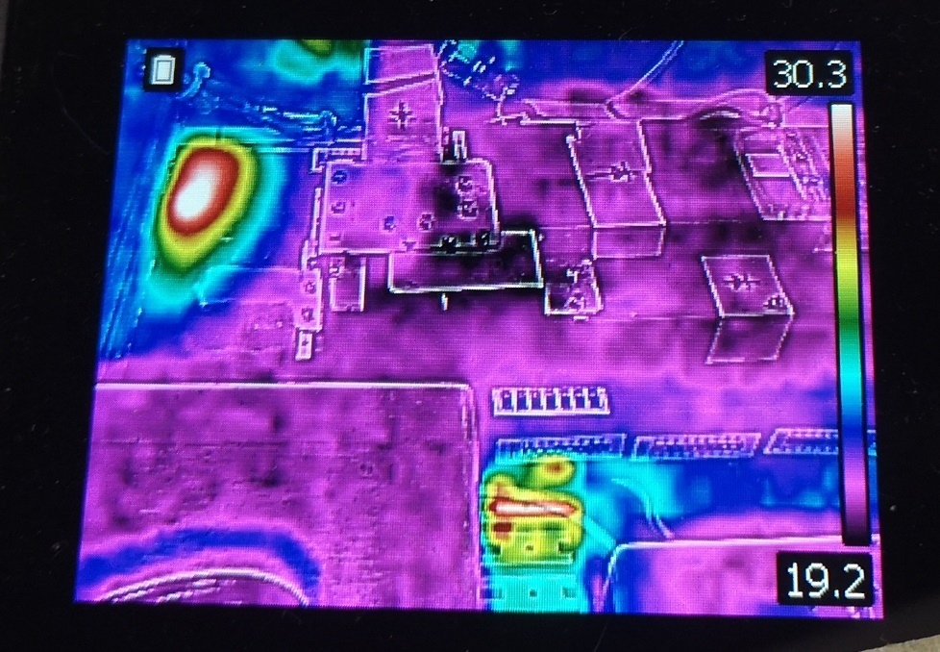
Achievements: 8-Technological Readiness Level (HV source)
60 cm long capillary
High voltage for plasma formation (Max 30 kV)
High current output for high repRATE (Max 150-200 mA)
Q=CV=10kV x 40nF = 0.4x10⁻³ C
t_{c} = dQ/I_{c} = 2 ms at 200 mA
Rep Rate <= 500 Hz
V = 10 – 15 kV
Ip = 400 – 500 A
Δt = 600 ns FWHM
HV-switch
In principle, there are no limitations to high repetition rate (>400 Hz) for HV generator and pulser but overheating problems could cause damages

Slide 9
Achievements: 5-Technological Readiness Level (Gas-filled discharge capillary)
Plastic prototype to test different parts of the plasma source
Laboratory testing for setting plasma formation parameters (voltage, currents, pressure, densities)
Partial testing of materials (2x10⁷ discharges) to work at high repetition rates
tests on a 40 cm long capillary to control the ramps (plasma channel geometry and gas distribution system) within the capillary as required by beam physics to achieve the acceleration targets (red profile has been used for beam dynamics simulations)

Slide 10
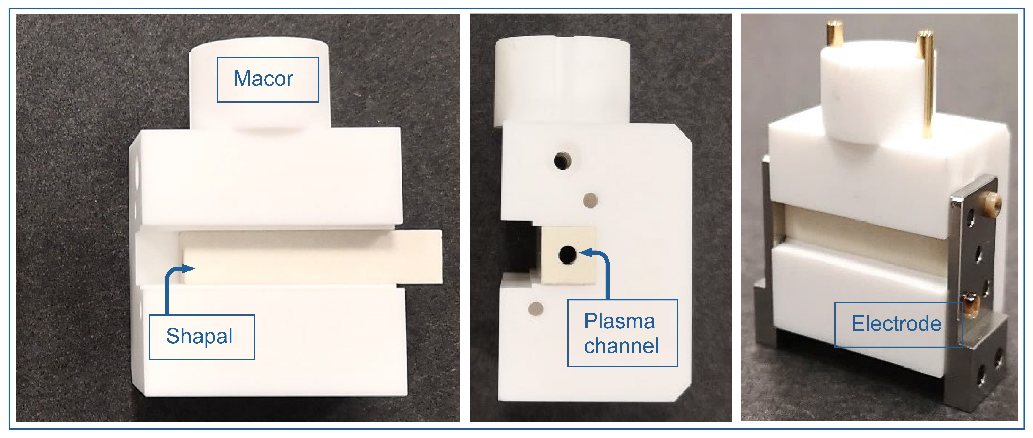
Planned Actions: 60 cm long capillary in Shapal/Macor to be tested
TDR completed
Production of the final prototype (60 cm long Shapal/Macor capillary)
Further resistance tests on the capillary with actual dimensions (60 cm) in a new plasma chambers similar to the final one
New electrode materials such as tantalum or tungsten (so far we have successfully tested molybdenum)

Slide 11
Dependencies / Risks (optional): (Any blocking issues or critical path items.)
Fields maps insertion in the codes for all magnetics elements (Magnets and power supplies)
Vacuum system has been designed and preliminary tests have been carried out in the Plasma laboratory but further tests have to be done with a differential system more similar to the final one

Slide 12
Conclusions
Plasma source specifications align with the beam parameters required for injector and linac performance
These specifications meet the requirements both for plasma source length (60 cm) and plasma densities (10¹⁶ -10¹⁷ cm⁻³), as well as the capability to control plasma ramps along the longitudinal dimension
The plasma chamber and differential pumping system make it possible to maintain the working pressures required (5x10⁻⁹ mbar) using X-band accelerating sections

