Slide 1



CMS Bari
Overview
Rosamaria Venditti
Team Leader
Bari University and INFN
On behalf of the CMS Bari group

Slide 2
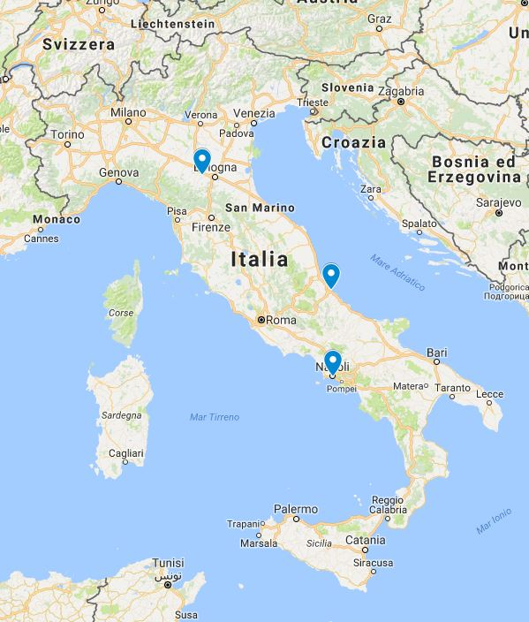
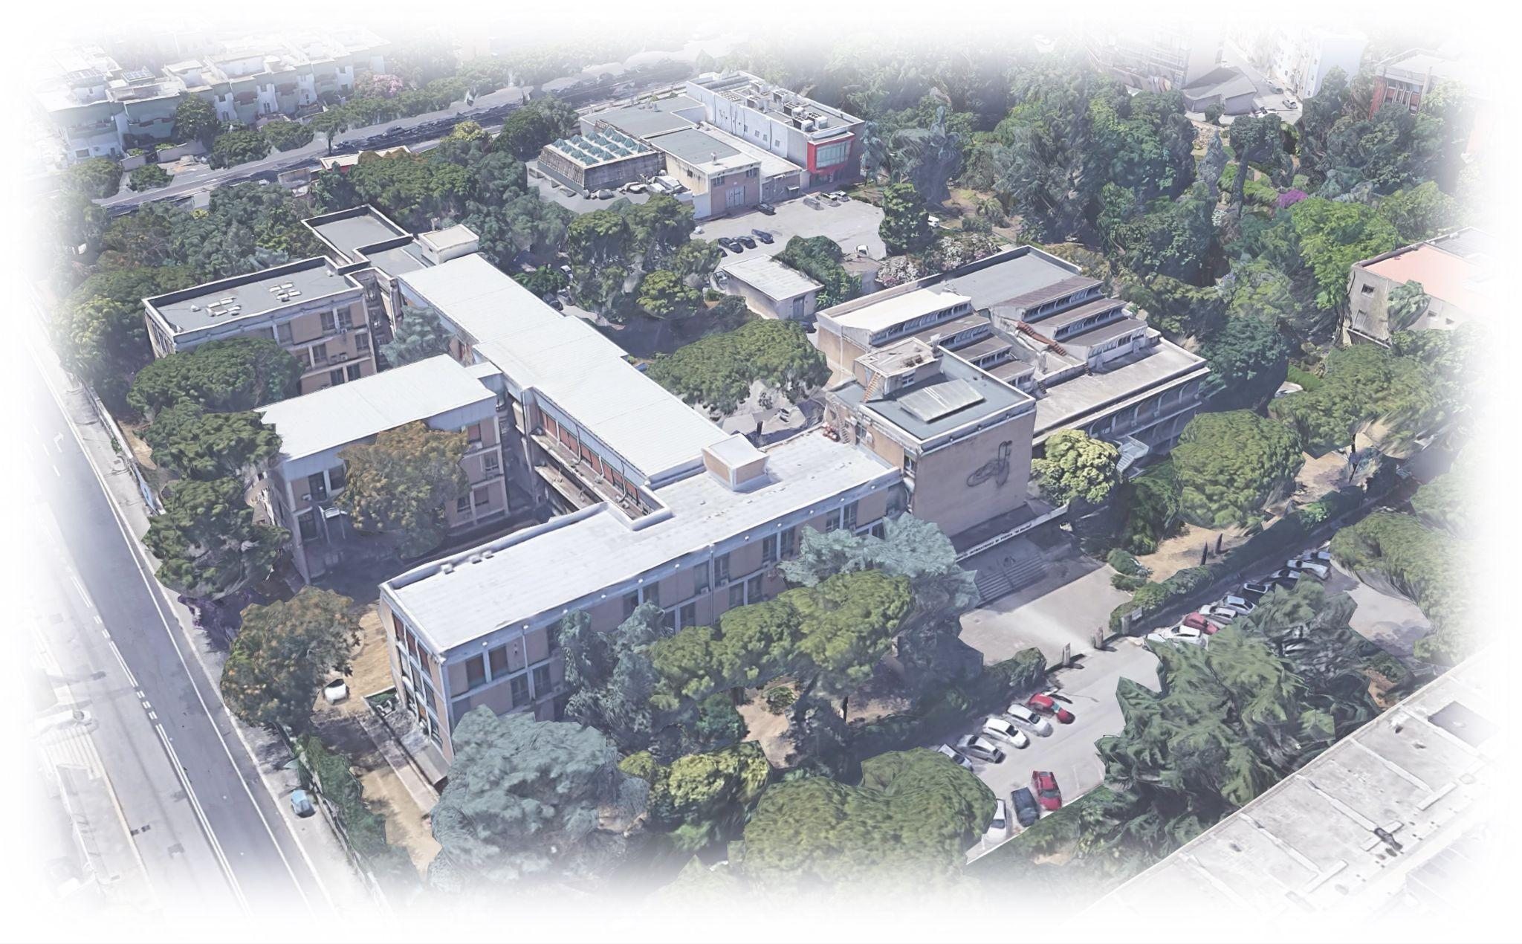
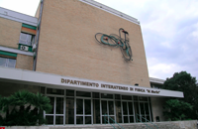
Welcome to Bari University
and INFN
CERN

Slide 3
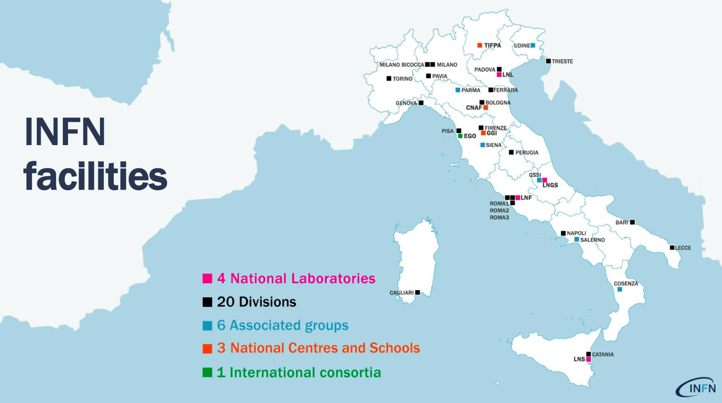

Slide 4


Slide 5

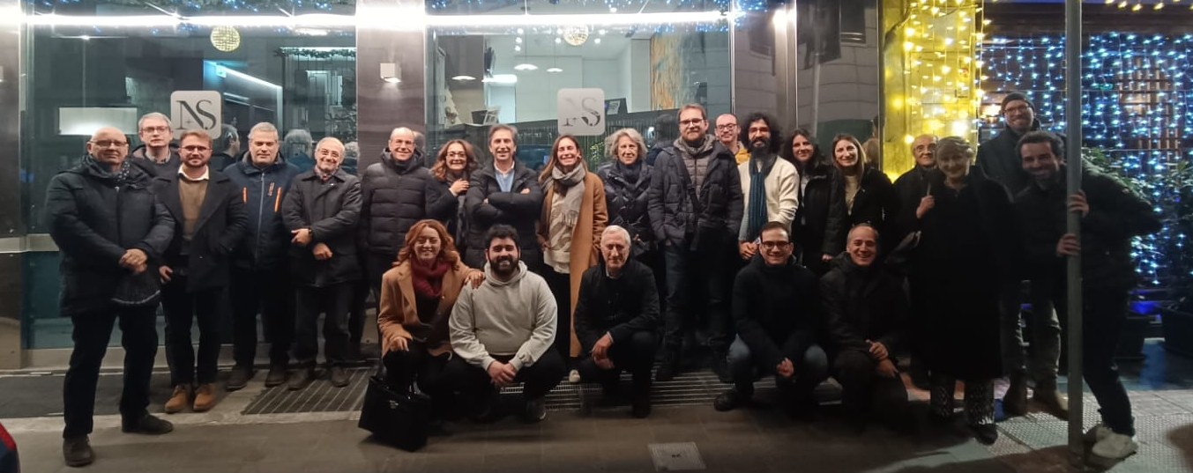
CMS Bari - The group
~40 people for a total of ~25 FTE
(45% staff, 30% PhD, 13% technologist, 13% postdoc)
In CMS since 1995

Slide 6
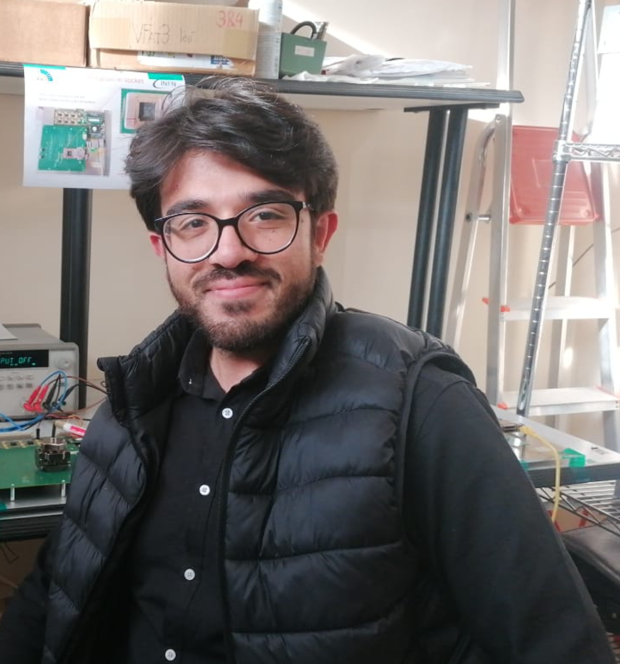
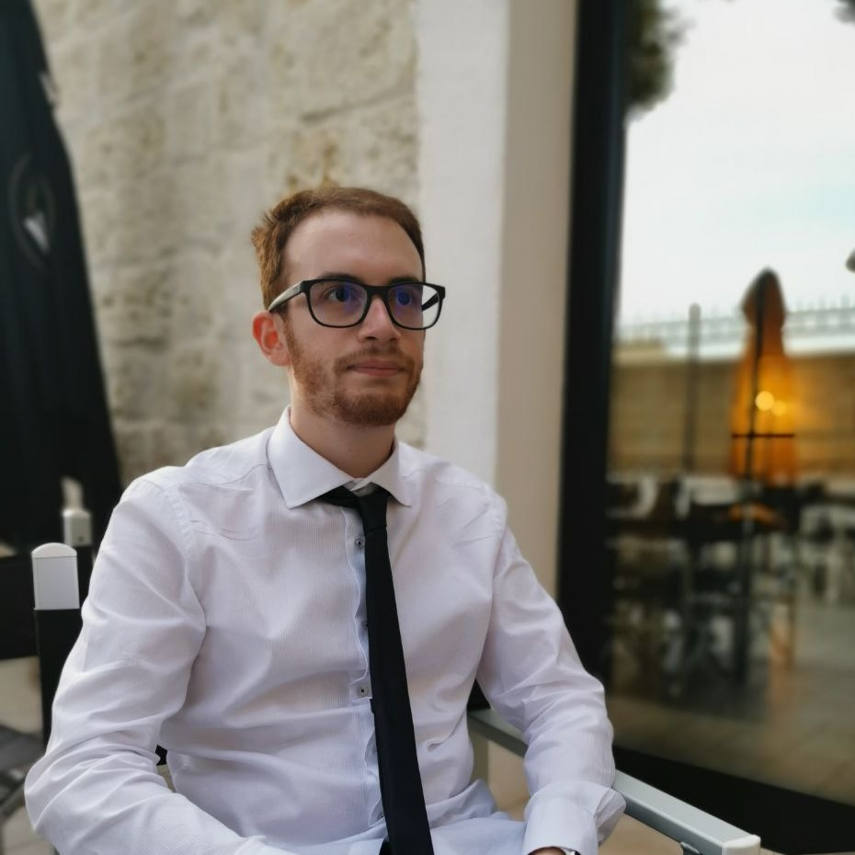
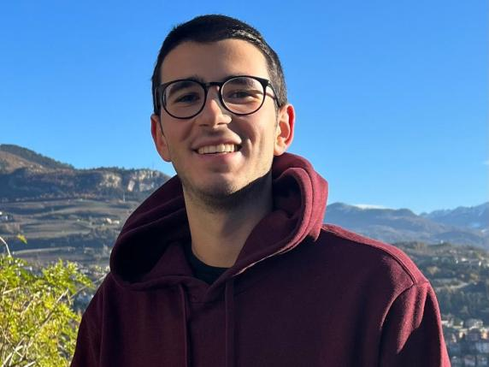
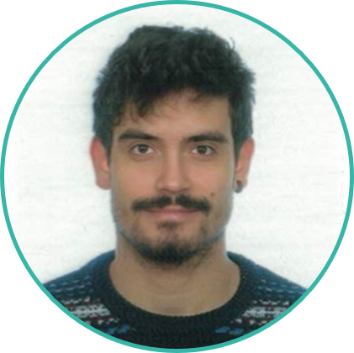
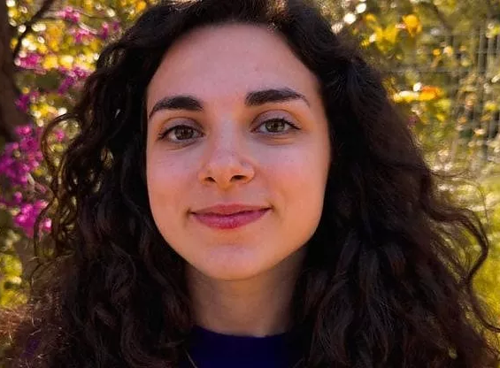

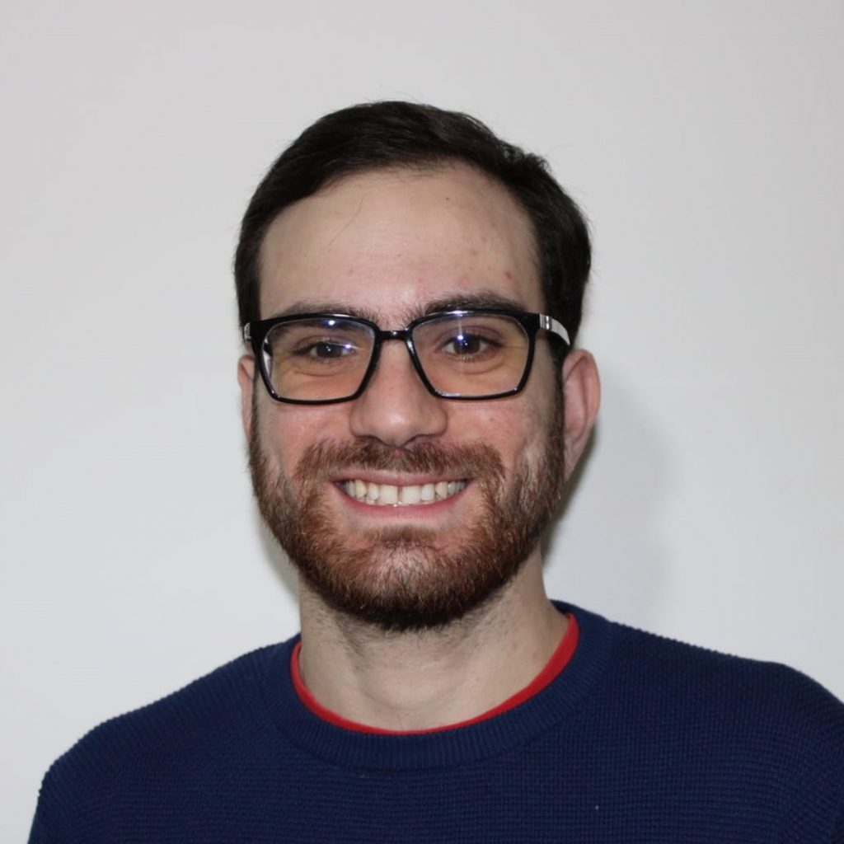
CMS Bari group: PhD
Muhammad Ali
Marco Buonsante
Felice Nenna
Nicola Ferrara
RPC
GEM
GEM
GEM
Donato Troiano
Lisa Generoso
Umit Sözbilir
GEM
Analysis
GEM but migrating to Tracker

Slide 7
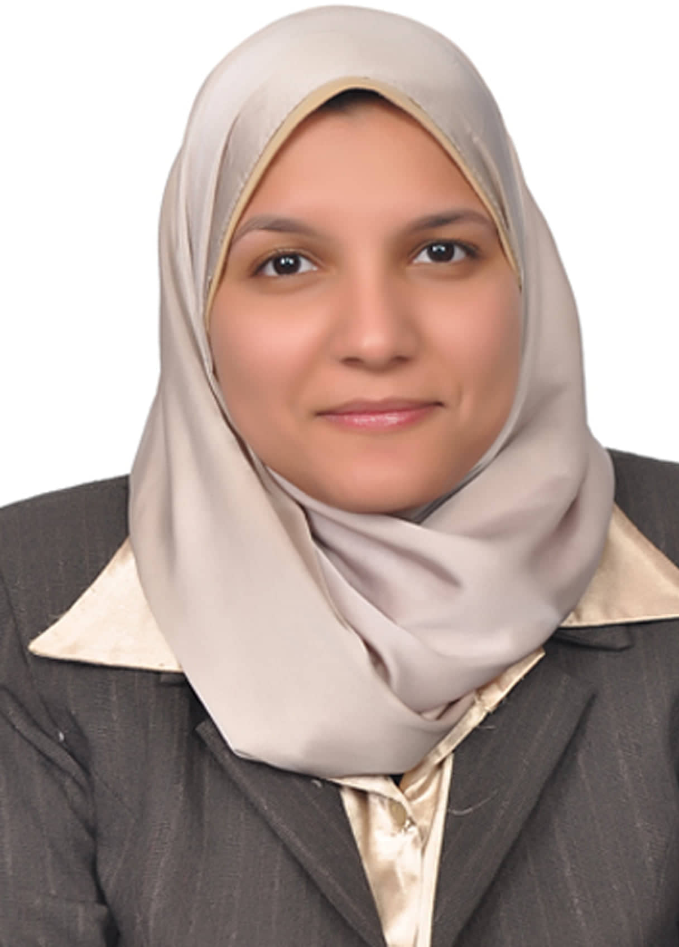
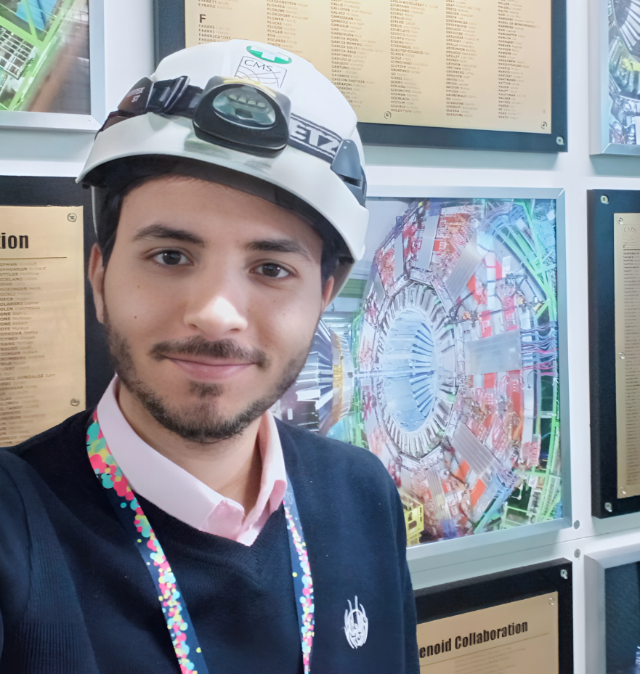
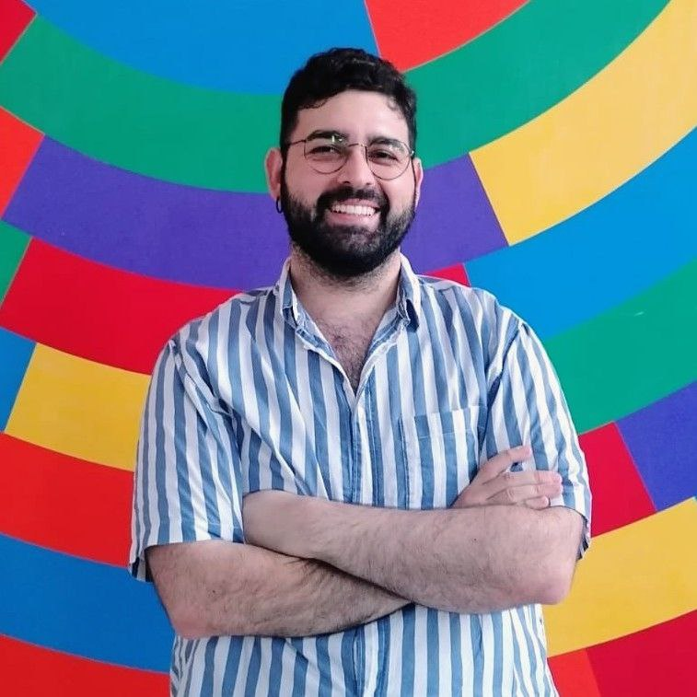
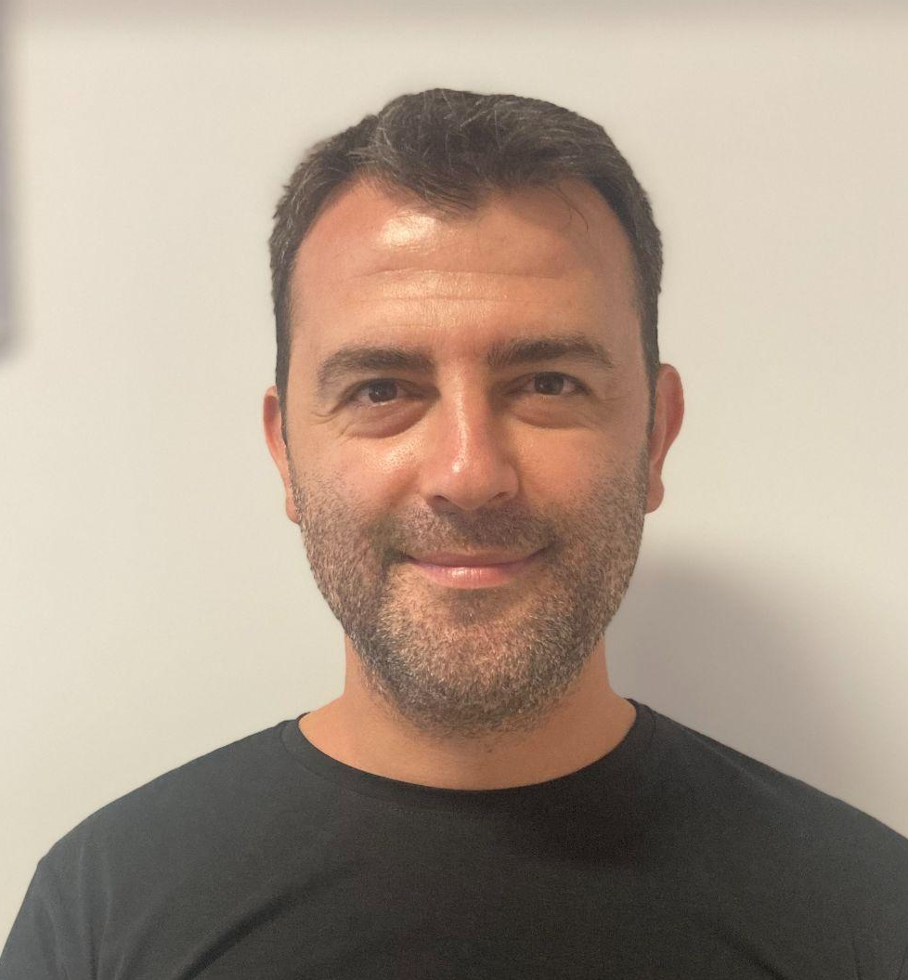
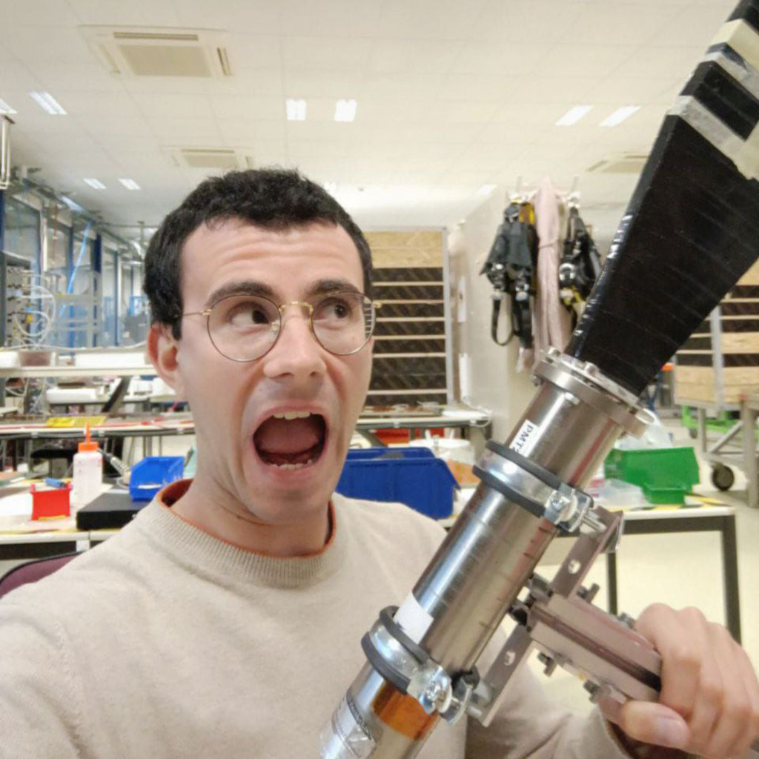
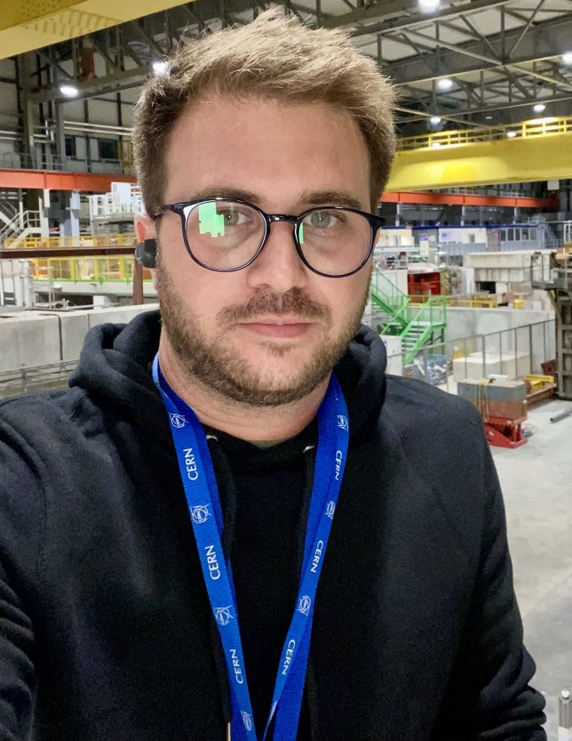
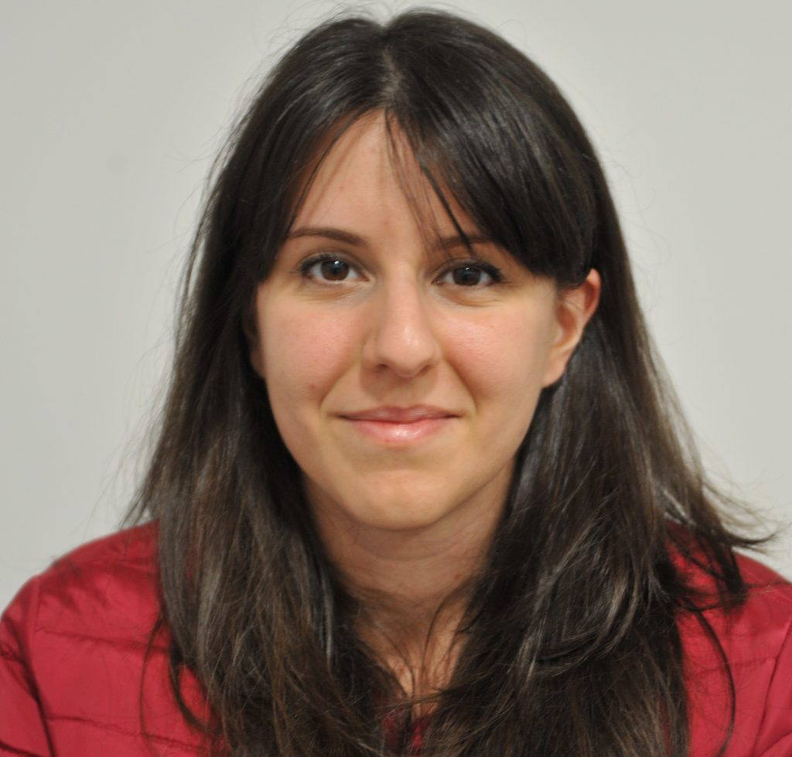
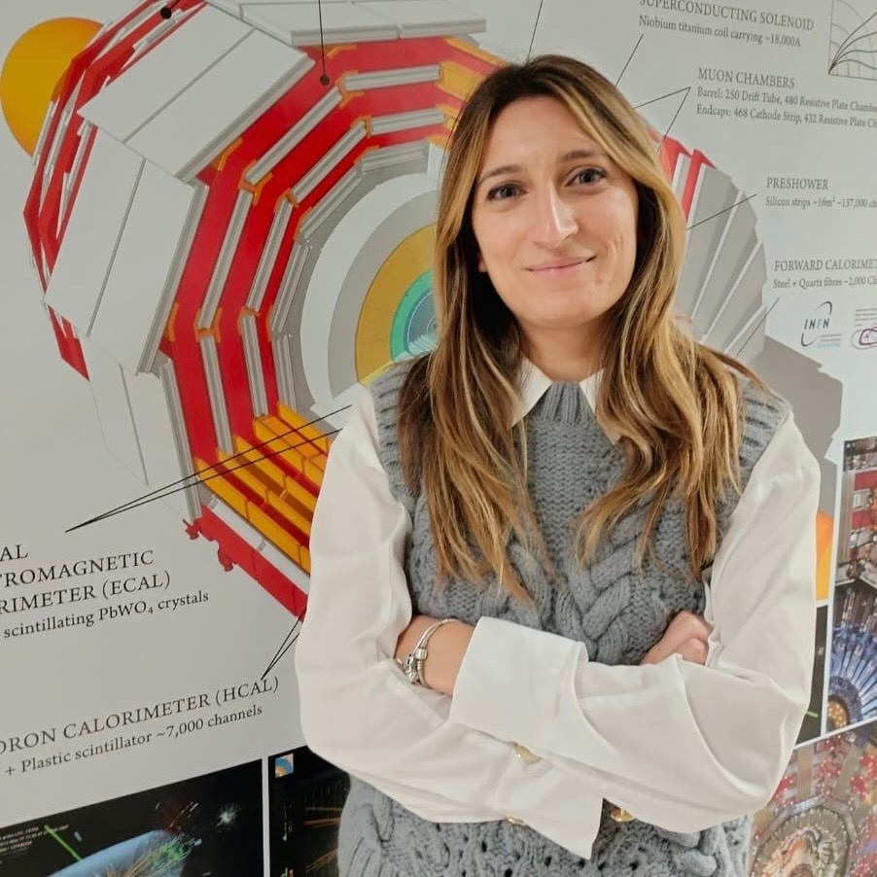
CMS Bari group: Post Doc
Walaa Elmetenawee
Vincenzo Mastrapasqua
Magdy Louka
Ilirjan Margjeka
Analysis
Analysis
Analysis
Tracker
Anna Stamerra
Dayron Ramos
Angela Zaza
Antonello Pellecchia
GEM
RPC
GEM
GEM

Slide 8
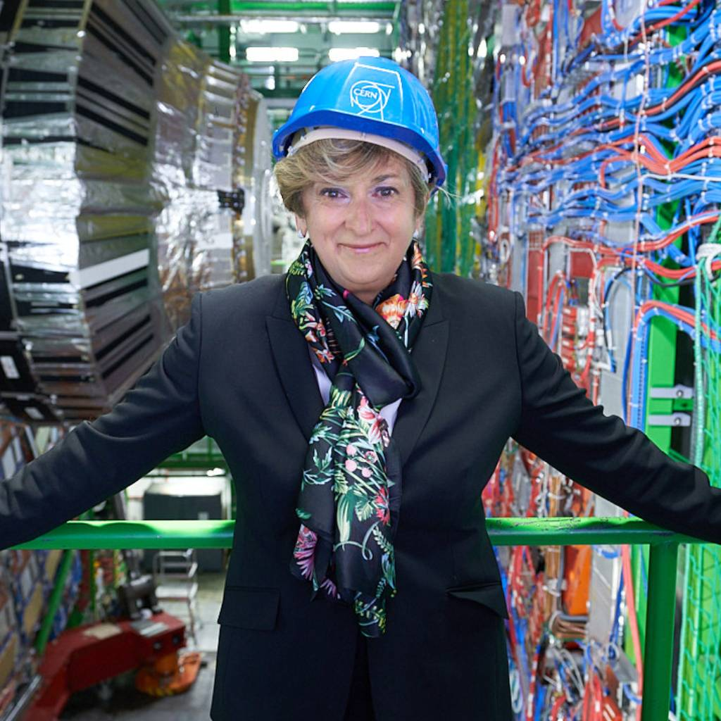
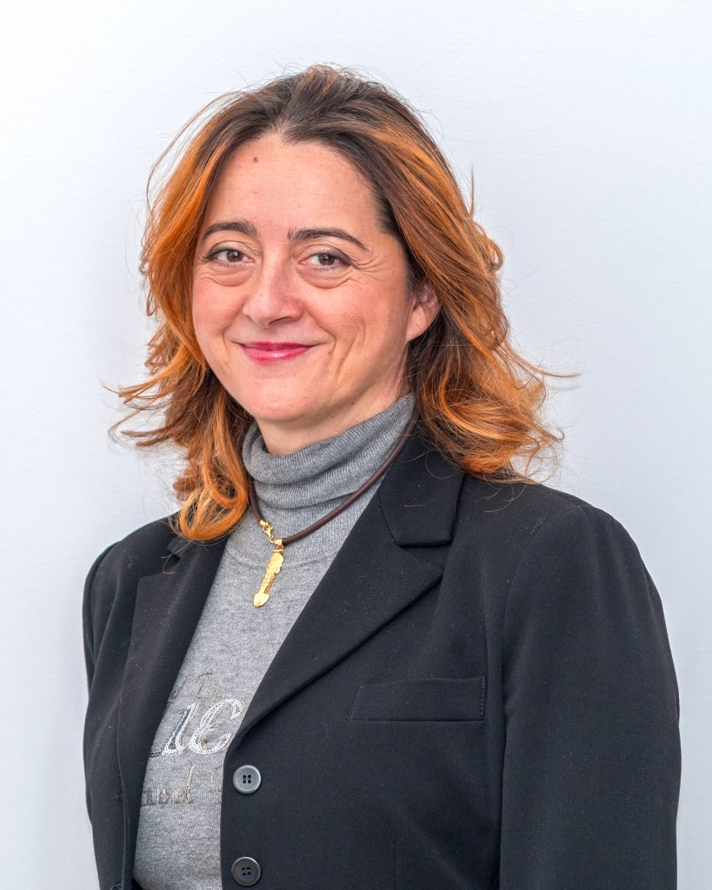
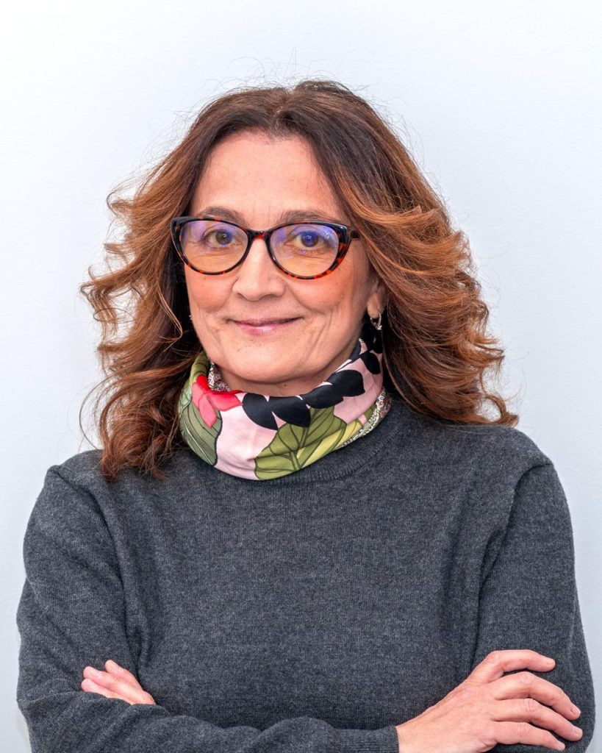
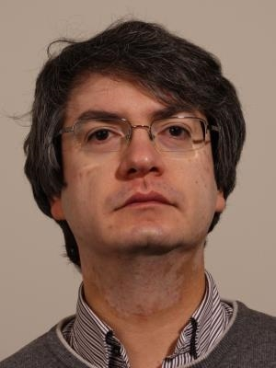
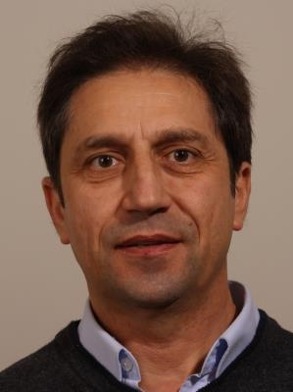
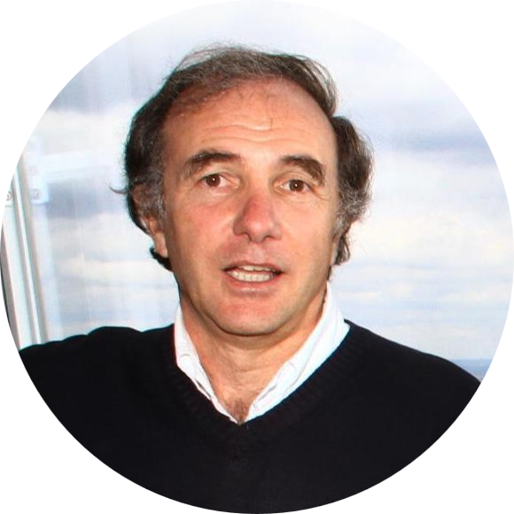
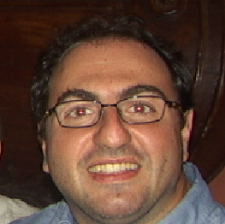
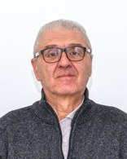
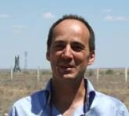
CMS Bari group
Lucia Silvestris
Gabriella Pugliese
Anna Colaleo
Salvatore My
Donato Creanza
Marcello Abbrescia
Nicola De Filippis
Francesco Cafagna
Giorgio Maggi
Giuseppe Iaselli

Slide 9
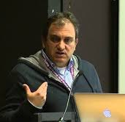
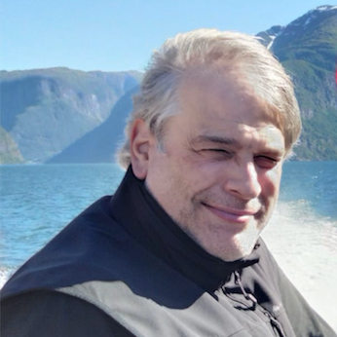
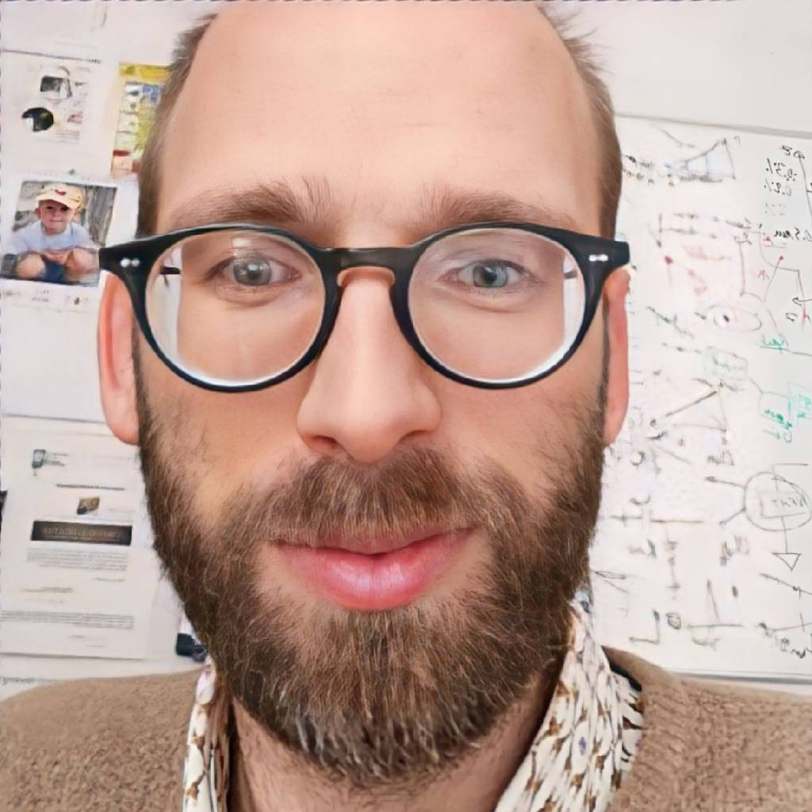
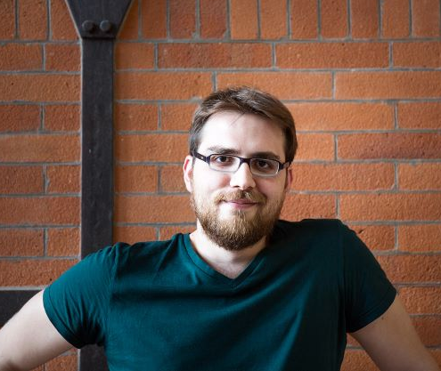
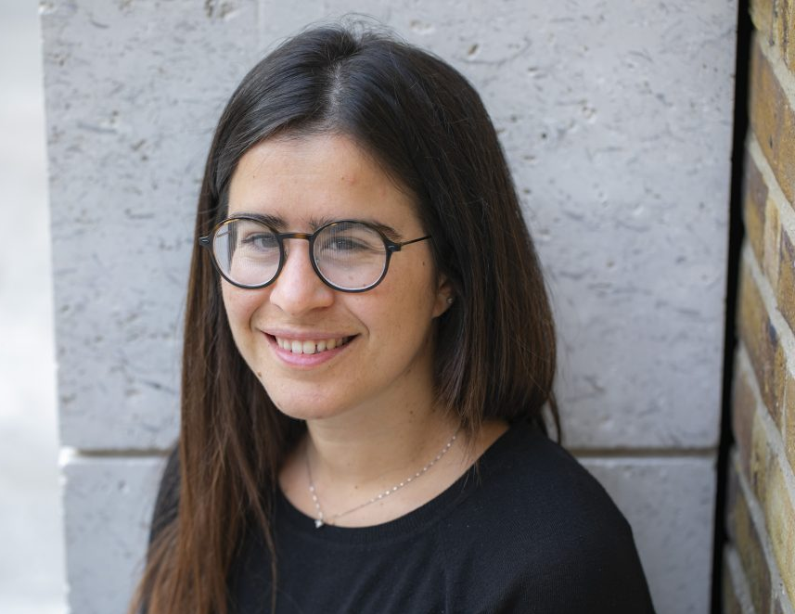
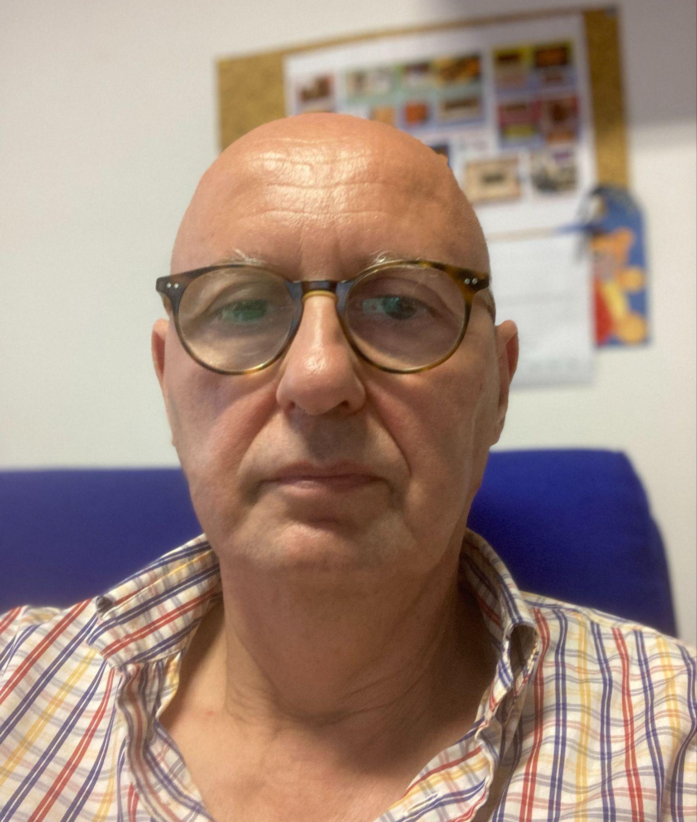
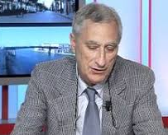
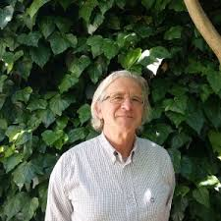
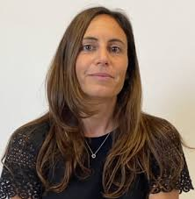
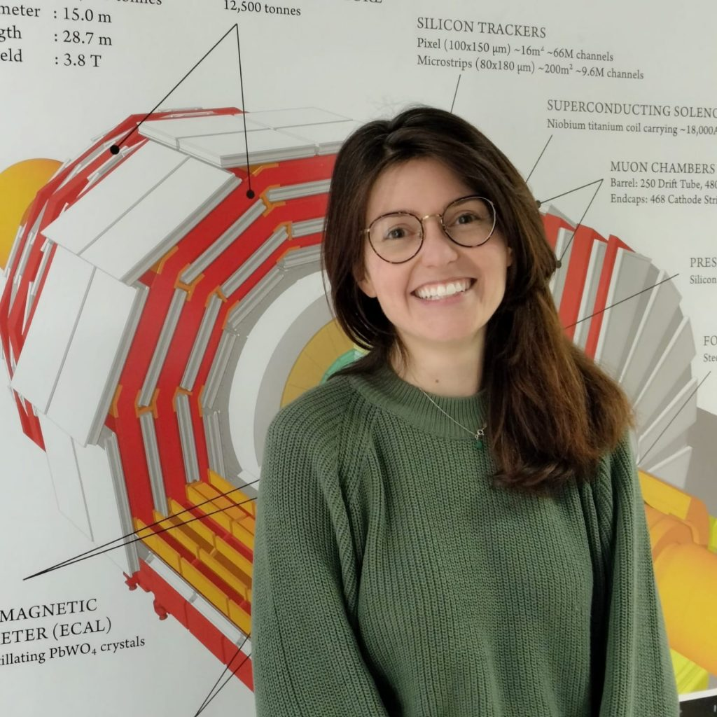
CMS Bari group
Marcello Maggi
Pompili Alexis
Piet Verwilligen
Luigi Longo
Raffaella Radogna
Rosamaria Venditti
Federica Simone
Luigi Fiore
Salvatore Nuzzo
Mauro de Palma

Slide 10
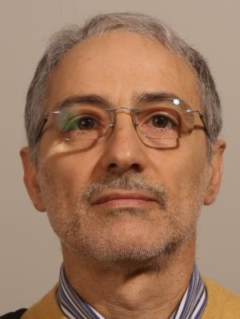
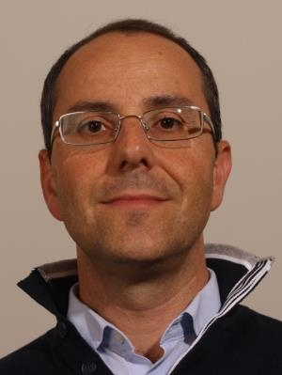

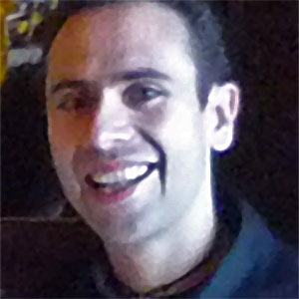
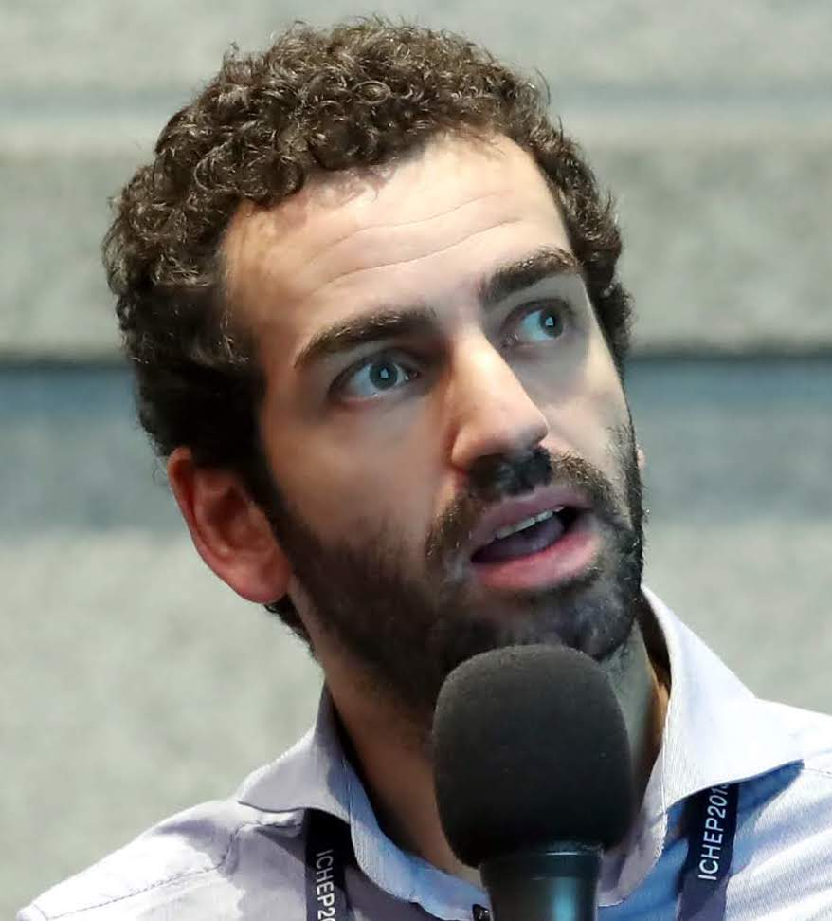
Technologists
De Robertis Giuseppe
Loddo Flavio
Licciulli Francesco
Donvito Giacinto
Cristella Leonardo
Electronics Service
Computing

Slide 11
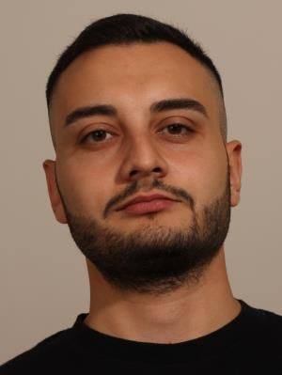
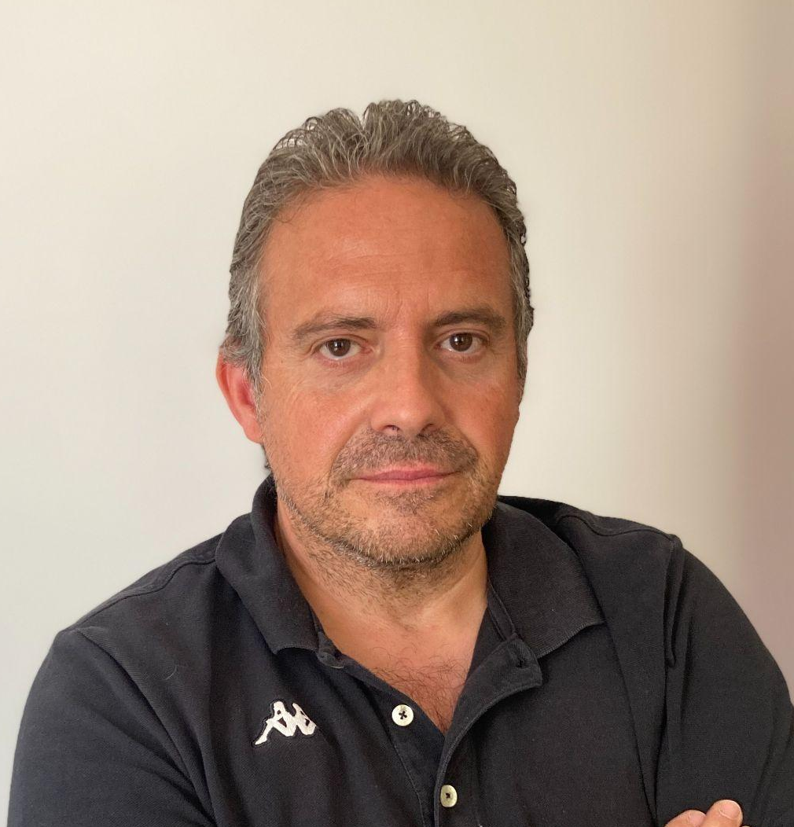
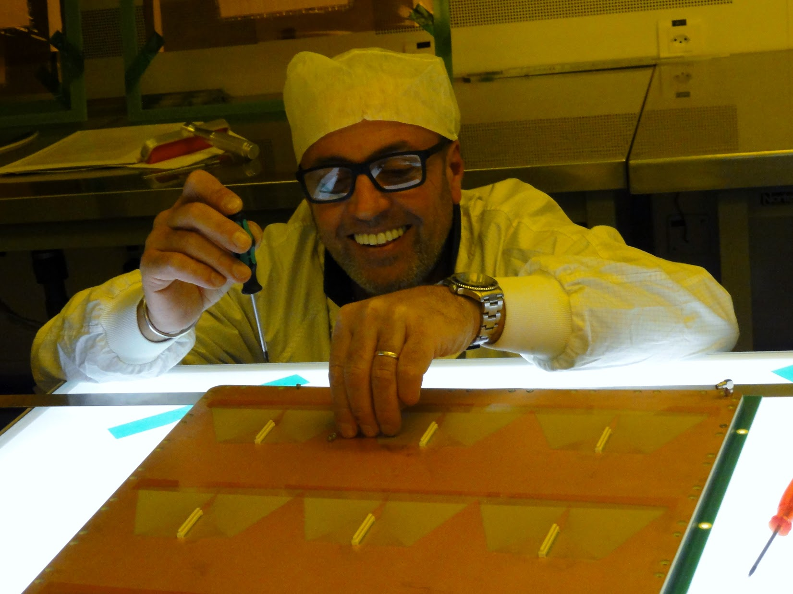
Technicians
Michele Franco
Mechanical Workshop
Sabino Martiradonna
Clean Room
Francesco Maiorano
Electronics Service
Giuliano Sala
Clean Room

Slide 12
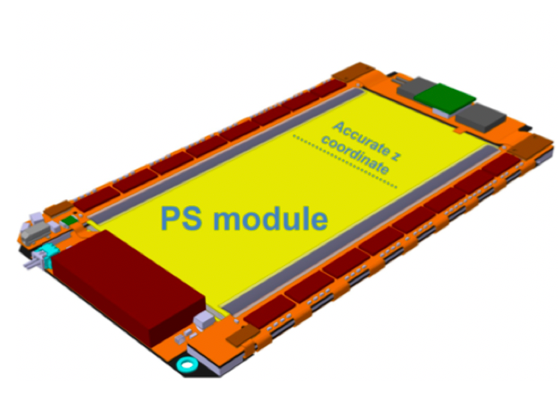
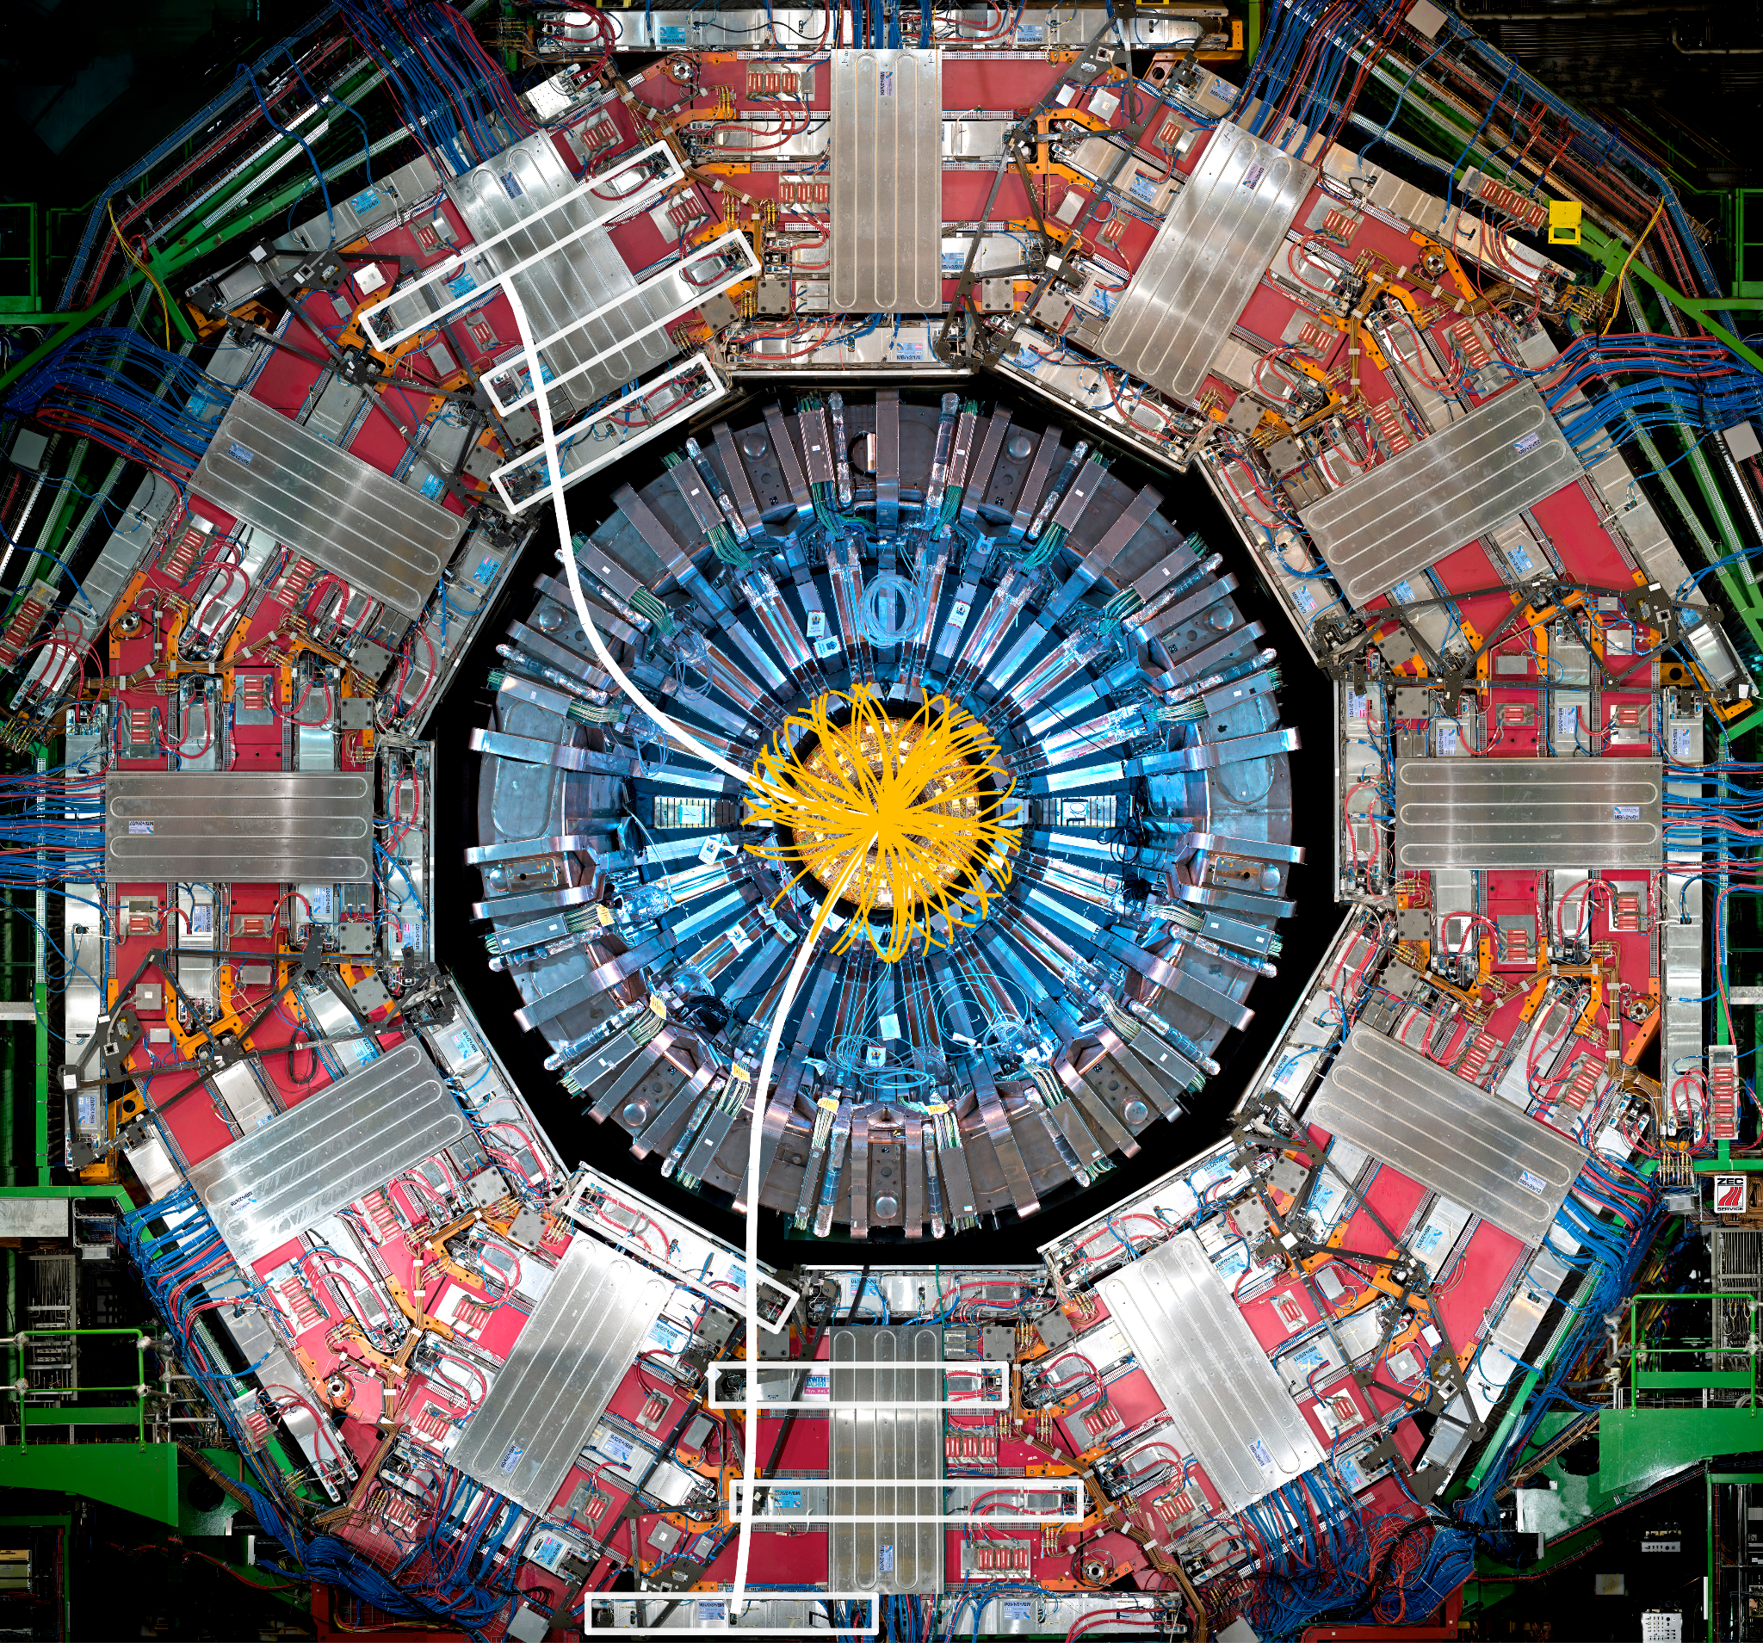
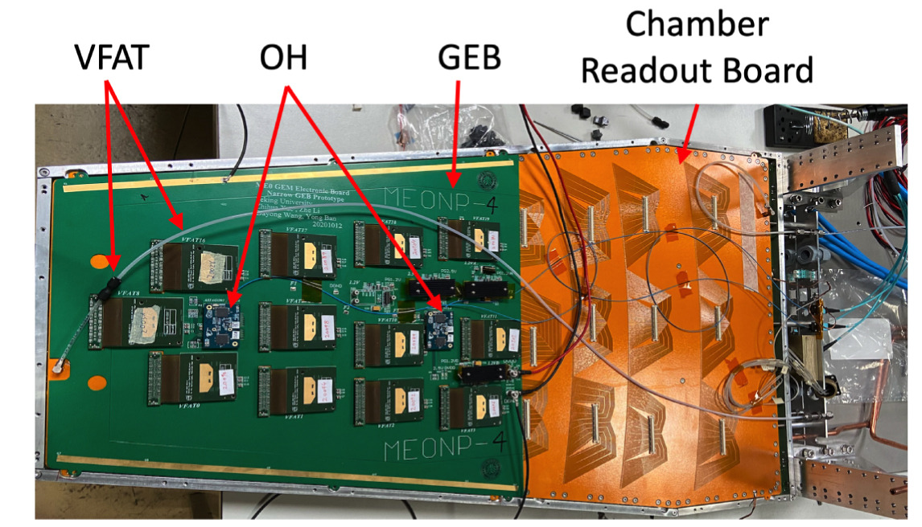
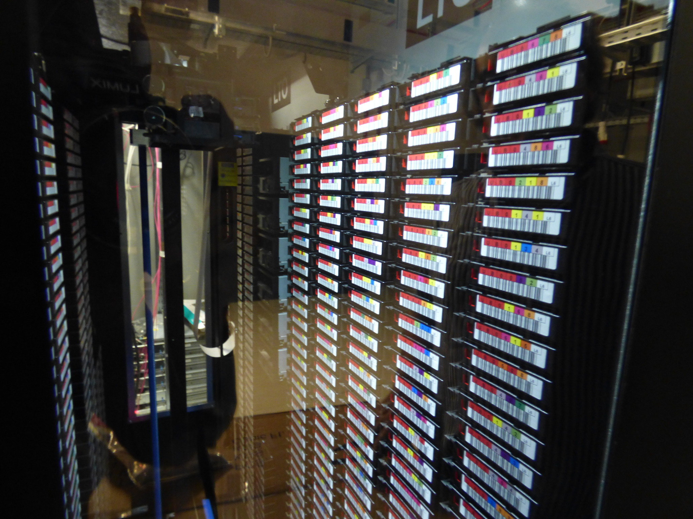
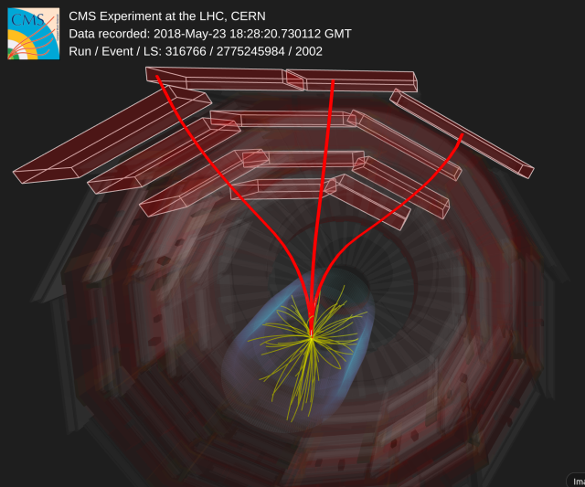

Activity summary
Run3 Operations
RPC
GE1/1
CT-PPS
GE2/1, iRPC demonstrators
Phase II Upgrade
Outer Tracker
ME0
Computing
Bari T2 maintenance and operations
Data Analysis
    Higgs, B-Physics
    Muon reconstruction
    Jet Flavor tagging
    Tracking at HLT
Outreach
https://www.liceoscacchibari.it/gli-studenti-eee-esplorano-il-cuore-dellesperimento-cms/

Slide 13




CMS Muon system
G. Pugliese (MUON System Manager L1)
Installation of CMS RPC (2004)
Installation of a new prototype of CMS RPC (2022)

Slide 14



RPC some history
Bari group involved in CMS double gap RPC since the CMS construction (several RPC Project Managers from Bari)
RPC design, front-end installation and final test
Test at ISR, installation in CMS, Operations, Online monitoring, performance
Muon Barrel RPC
70% tested in Bari
30% built in Bari

Slide 15


RPC ongoing activities
The Bari technicians were strongly involved in the development of the technique used for RPC leak repairs.
R&D on new eco-friendly gaseous mixtures for RPC operation (beam tests at GIF++)
Irradiation campaign for ageing studies of
  legacy RPC with HFO
  iRPC with CO2 .
Monte Carlo simulations of radiation dose at GIF++
iRPC efficiency for several gas mixtures
Photon flux simulation at GIF++

Slide 16



GE1/1 past and present activities
Bari group involved in CMS-GEM project since the beginning
GE1/1: TDR, prototyping, mass production (18 GE1/1 chambers produced and tested), installation, operations, performance, trigger integration
VFAT3 readout electronics development and testing
Significant contribution in terms of DOCs
Combined efficiency of two GE1/1 layers negative endcap
A.Pellecchia GEM Run Coordinator
F. Licciulli GEM Electronics Coordinator

Slide 17



ME0
L. Longo Hardware coordinator (L2)
P. Verwilligen Upgrade Coordinator (L2)
Involved in ME0 project since the beginning (TDR, prototyping, test beam, production)
ME0 Magnet Test
ME0 Stack Test beam at
GIF++
Measurement of segment timing, rate capability with a 6-layer stack at GIF++
Discharge rate in magnetic field
In Bari: 50 ME0 modules to be produced and tested by the end of 2026
  Dedicated and fully equipped clean room an lab
At CERN: construction of ME0 stack, electronics dressing and test at cosmic ray stand

Slide 18
ME0 module production
ME0 module production
1 day for assembly: 3physicists (or 2physicists + 1 technician)
1 week for full Quality controls before shipping to CERN
More details in Antonello and Anna’s Talk

Slide 19



CMS Trackersome history
Involved in the silicon module production since CMS construction
Production: 1926 TIB/TID and 429 TEC modules
Bonding and test of 414 TIB/TID modules
Production: BPIX Phase1 Upgrade 300 modules
TIB/TID integration and Tracker display
Wire-bonding
Electronic service:
Design and prototyping of module bias kapton circuits, Mother Cable, “medusa” cables
Production of 4000 TIB/TID bias circuits, 886 Mother Cables of 21 different design, 530 “ medusa” cables
Module ARC test
Thermal cycling test

Slide 20



CMS Tracker - PS modules
Fully equipped and dedicated clean room
Qualification visit to Bari PS production center successfully passed in 2024
Now ongoing
Outer tracker Pixel-Stip modules production started
Pipeline test to validate the full production workflow (ongoing in these days)
30 modules to be produced by the end of the 2025
2000 PS modules to be produced in 2026-2027 (3-4 modules/d)
PS module inspection
(clean room)
1000 modules to be produced by the end of 2027

Slide 21

PS modules production - the team
More details in Ilirjan’s Talk
4 modules/day - 10 days to build a module
3 technicians for glueing
1 technician wire bonding (+1 for backup)
1 physicist: coordination
2/3 physicist: metrology and test

Slide 22


CMS Phase II Pixel Readout
Pixel readout development for HL-LHC
Design activity
RD53 Project coordination (F. Loddo)
Chip floorplanning
Rad-hard 10 bit DAC
Analog bias network
Power distribution
Scan chain architecture
Sign off verifications for easier production testing
The final chips were successfully submitted to foundry in 2023 and are currently under mass production
Significant contribution from Bari (F.Loddo, G. De Robertis)
Past responsibility:
RD53 Project Engineer,
CMS Phase2 Inner Tracker ASIC project coordinator

Slide 23


CT-PPS
Support for TOTEM decommissioning and analysis (CMS TOTEM or CT-PPS analysis).
Online coordination:
  DAQ;
  Online software;
  Precision clock.
Participation to PPS2 DAQ development.
F. Cafagna PPS Online Coordinator
PPS2: 3D pixels read out by the CROC for tracking and LGADs read out by the ETROC for the timing.
  Contribution to the DAQ for both detectors readout.
lpGBT and VTRX+ tunnel link testbench for PPS2

Slide 24



Bari T2
Bari hosts a T2 in the computing center Recas, managed by INFN and University
Around 40’000 cores distributed over 450 nodes
16’000 TB of shared disk space on Lustre file system
HPC cluster: 20 servers, interconnected by Infiniband network
  256-392 cores + 4 GPU NVIDIA V100/H100/ server
Local
CMS
Running Jobs on RECAS in last 6 months
Central
CMS

Slide 25



Higgs Searches
Double Higgs searches
HH→bbµµ: [PhD thesis, B. D’Anzi]
HH→bbZZ(4l) res and non-res: [PhD thesis, M. Louka]
Differential cross section (res and non-res)
Higgs decays: VBF H→cc
2023 dataset, first HLT path with PNet [2024 PhD thesis: A. Zaza] → Upper limit on µ ~ 30
  Sensitivity comparable with ttH, VH
2024-2025, VBF parking dataset [PhD thesis: L. Generoso] → analysis ongoing
HH→bbZZ(4l)

Slide 26



B-Physics: rare decays and spectroscopy
Rare decays
LFV τ →3µ (HF channel): [past PhD thesis F. Simone, C. Aruta]
  Run2: Upper limit BR(τ →3µ) published on PLB
  Run3: preapproval of 2022+2023 (combined expected UL compatible with Belle)
  HL-LHC: muon acceptance and ID with ME0 [phD thesis Felice Nenna]
Contribution to the ESPP document
Bs→4µ and Eta’ →4µ [PhD thesis, M. Buonsante]
  2022-2024 inclusive double muon triggers
  30% improvement of the current world-best upper limit on the B0s(B0)→ 4µ
  Evidence of Eta’ → 4µ
F.M. Simone: BPH Rare decays Coordinator
Bottomonium Spectroscopy
[PhD thesis V. Mastrapasqua]
Bc lifetime [PhD thesis,U. Solibzir]

Slide 27




Object reconstruction
Offline: Muon identification, Jet flavor tagging [PhD thesis ongoing, D. Troiano], Tracking efficiency
R. Radogna: Muon POG Selection and Identification Coordinator
Z→bb with Particle Net DPNote 2024-055
Tight ID Muon Efficiency,
2023 data
CMS-DP-2024-019, CMS-DP-2024-023
2025 JINST 20 P04021
Trigger performance:
  Tracking
  B-Physics
  B-tagging
Run3 Trigger Performance, link to arxive

Slide 28


Outreach
CMS Masterclass
8 schools, 50 students
Art and science across Italy
~10 schools, 300 students
European Researchers Night

Slide 29


Slide 31



CMS-Bari TK: Technicians and non staff people
Pasquale*
Sabino
Giuliano
Pasquale Cariola* assembly, bonding (just retired)
Vito Porcelli assembly (Fellowship)
Sabino Martiradonna assembly, bonding
Maurizio Mongelli CAD design
Giuliano Sala assembly, bonding
Donato Troiano metrology, Module Test (Post-doc)

