Slide 1
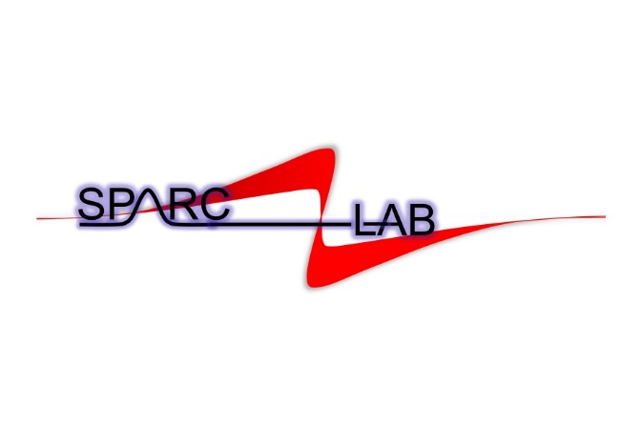

ALAN
Active pLAsma for beNding
Consiglio di Laboratorio | Presentazione preventivi 2026
Laboratori Nazionali di Frascati
14 luglio 2025
Angelo.Biagioni@lnf.infn.it
Angelo Biagioni | LNF-INFN | CdL 14 July 2025

Slide 2

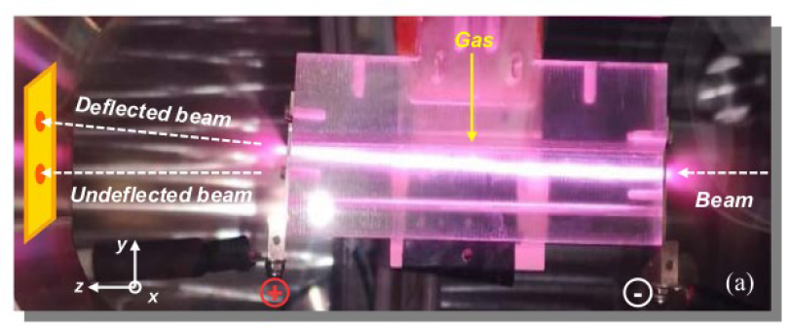
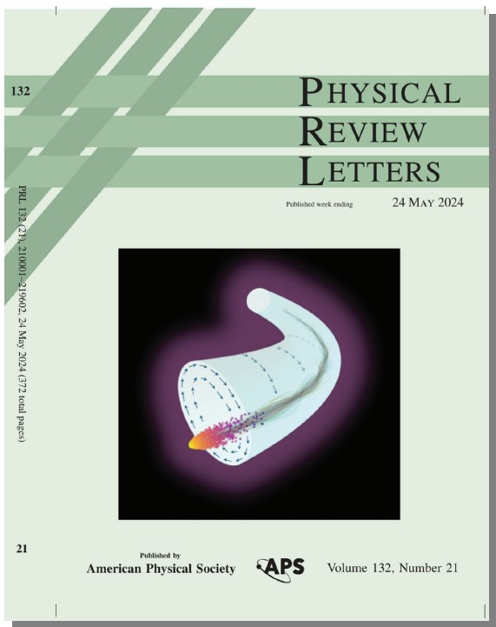
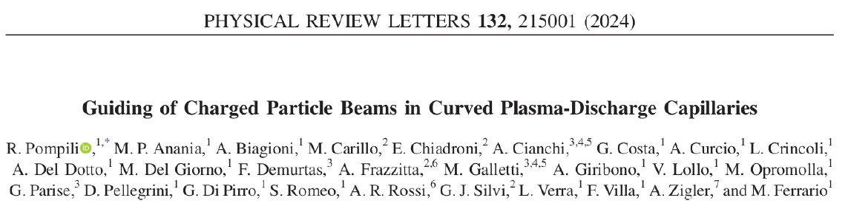
Active pLAsma for beNding (ALAN)
Guiding of charged particle beams in curved plasma discharge capillaries
Plasma
HV
Title: ALAN (Active pLAsma for beNding)
Research area: Accelerators (Plasma accelerators)
National responsible(LNF): Angelo Biagioni
Local responsible(INFN-Milano): Andrea Renato Rossi
Partecipants: LNF (Laboratori Nazionali di Frascati), INFN-Sezione di Milano
Total Budget: 195.000 € over a three-year period
Budget 2026: 60.000 €
Angelo.Biagioni@lnf.infn.it | 14 July 2025 | Page 2

Slide 3
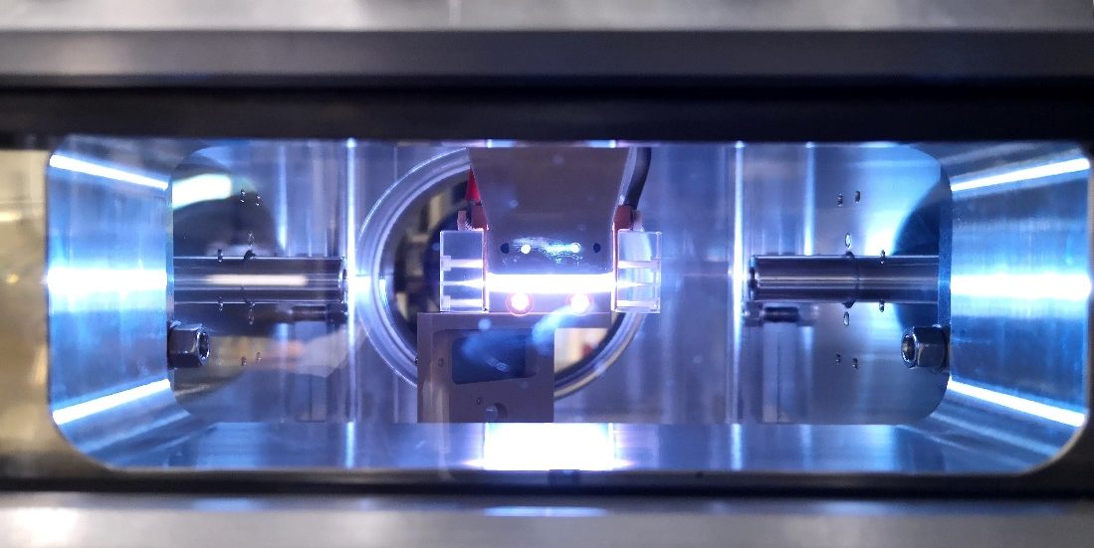
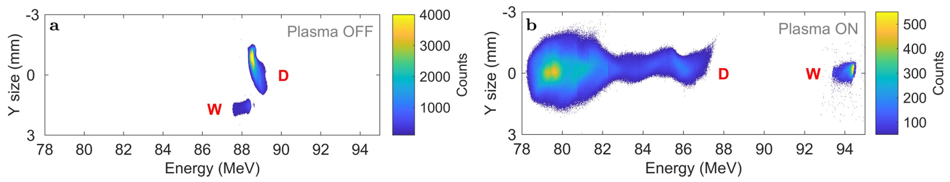
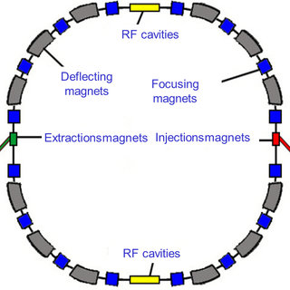
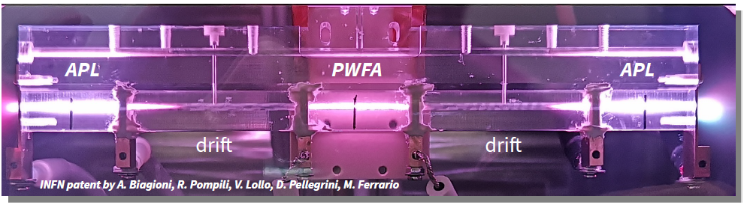
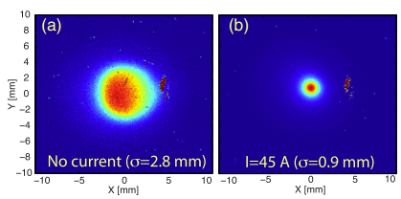
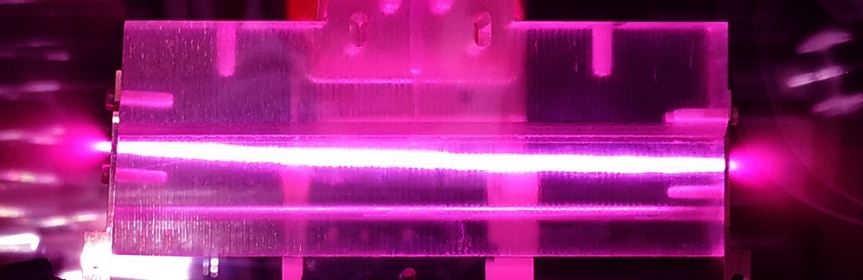
Active pLAsma for beNding (ALAN)_Motivations
Schematic of a typical accelerator
Plasma source
Plasma acceleration (EuPRAXIA)
An accelerator is made of
Accelerating cavities
Focusing magnets
Deflecting magnets
Plasma focusing
All-in-one Capillary
We can tremendously reduce the accelerator size using plasma accelerators. However, we still use conventional magnets to guide the beam
  → 2/3 of the 27 km long LHC ring is filled by magnets!
Can we reduce their size too?
2023: Patent (INFN-LNF) Nr. 102023000012714
We can tremendously reduce the accelerator size using plasma accelerators. We still use conventional magnets to guide the beam
2/3 of the 27 km long LHC ring is filled by magnets!
Can we reduce their size too?
Curved Capillary
Angelo.Biagioni@lnf.infn.it | 19 June 2025 | Page 3

Slide 4
Active pLAsma for beNding (ALAN)_Motivations
Why a plasma dipole?
  New proposal for plasma-based approach of compact, achromatic bending devices, paving the way for next-generation high-energy accelerators.
  Currently, in particle accelerators, the deflection of charged particle beams is accomplished using large electromagnets driven by high currents:
    high currents resulting in severe problems in terms of the thermal energy dissipation
    Large dimensions lead to high implementation costs
    The high costs of operation and implementation make these devices one of the most impactful elements in the design of particle accelerators.
    In the GeV to TeV energy range, these magnets occupy a considerable part of the accelerator footprint, as demonstrated by the Large Hadron Collider (LHC).
Plasma-based
bending devices
Conventional dipole
Angelo.Biagioni@lnf.infn.it | 19 June 2025 | Page 4

Slide 5
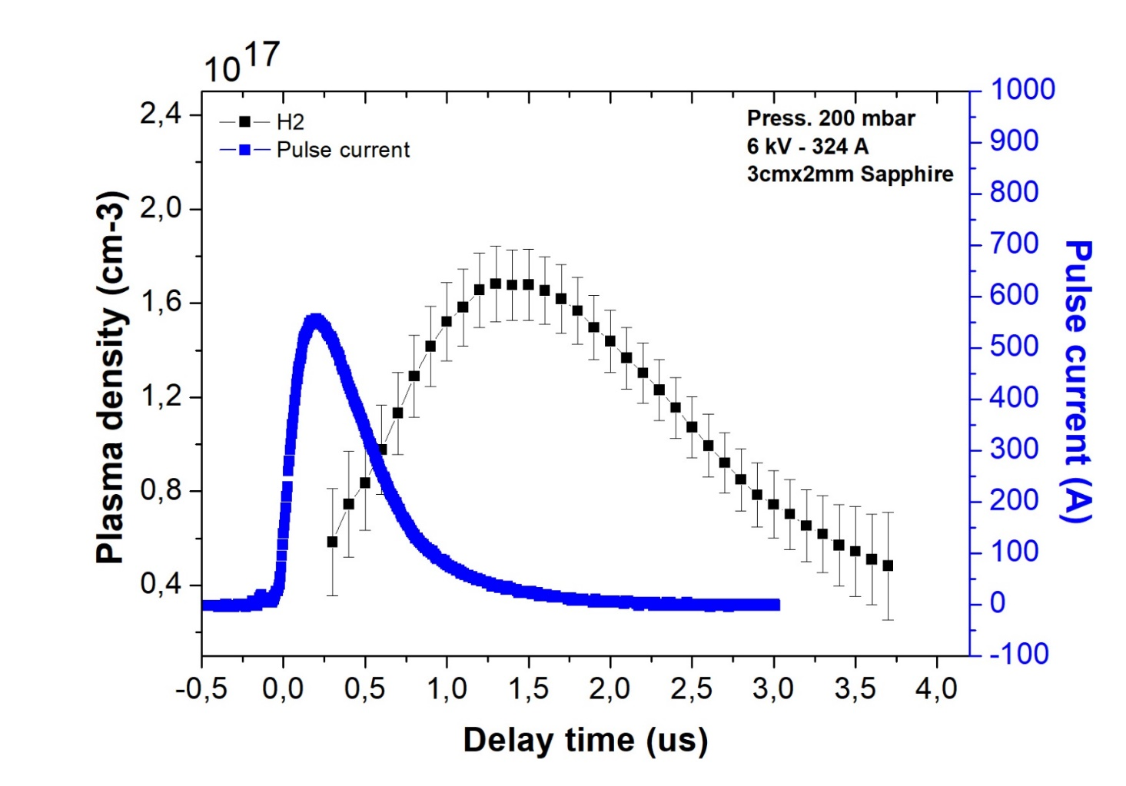
Active pLAsma for beNding (ALAN)_for EuPRAXIA
Time profile
Focusing/Bending
Energy increasing up to several GV/m
Focusing magnets on both input and output
EuPRAXIA@SPARC_LAB user facility
Plasma accelerating module
Plasma accelerating module
Bending Magnets
Focusing magnets
Plasma
dipole
Focusing magnets
Plasma focusing
Plasma focusing
FEL 1
Users
RF-Gun
FEL 1
Users
RF-Gun
RF-band
RF-band
FEL 2
e-beams have to be produced and prepared for plasma modules (hundreds of MV/m)
FEL 2
Time profile
Valid for plasma-based accelerators, maximum compactness as several components can be driven by the same HV-sources (EuPRAXIA@SPARC_LAB)
Can also be applied to conventional accelerators
Acceleration
Angelo.Biagioni@lnf.infn.it | 19 June 2025 | Page 5

Slide 6
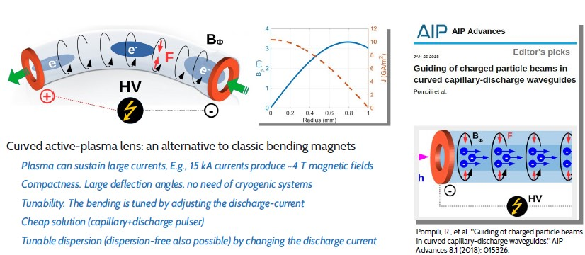
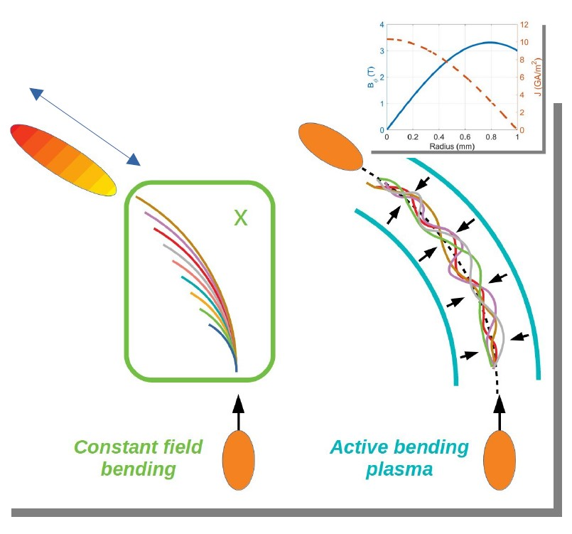
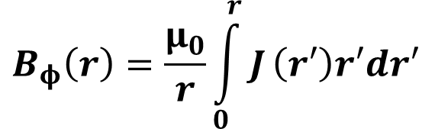
Active pLAsma for beNding (ALAN)_How it works
$$B_{φ}\left(r\right)=\frac{μ_{0}}{r}\int_{0}^{r}{J}\left(r′\right)r′dr′$$
Angelo.Biagioni@lnf.infn.it | 19 June 2025 | Page 6

Slide 7
Active pLAsma for beNding (ALAN)_Research activity
Requests for the use of Plasma dipoles
  Very high voltage pulses and especially currents (from few kA up to tens of kA)
  Design of HV systems to produce appropriate current pulses
        High peak currents
        short pulses to preserve capillary structures
  Capillary structure design
        Geometry of the plamsa source
        Studies on new materials that can withstand both high currents and, in the future, high repetition rates.
  These topics are closely linked to the EuPRAXIA project.
Cost reduction
Compactness
Low energy consumption
Angelo.Biagioni@lnf.infn.it | 19 June 2025 | Page 7

Slide 8
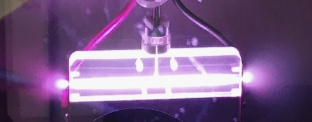
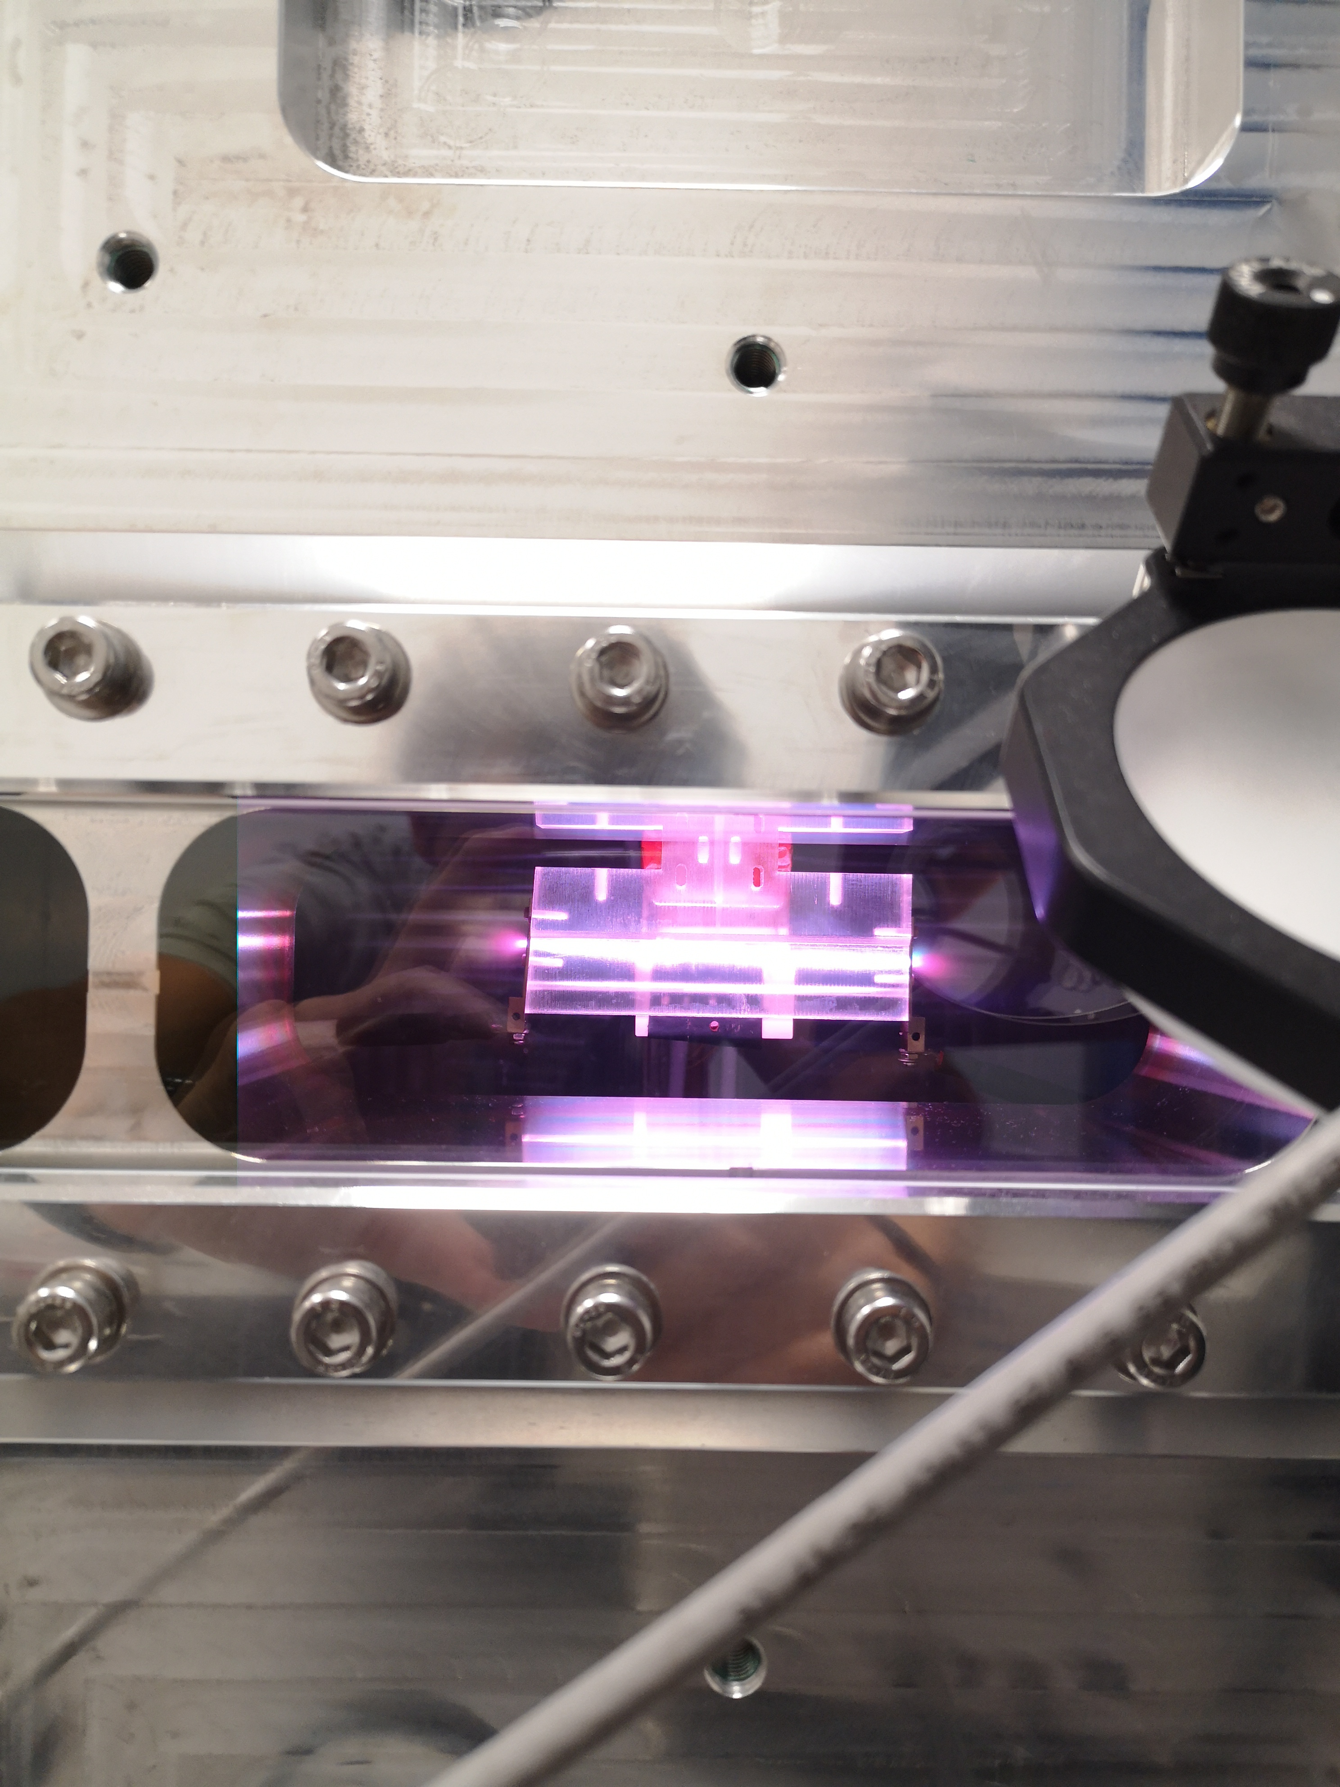
Active pLAsma for beNding (ALAN)_Research activity
HV generator
High voltage for plasma formation (Max 30 kV)
Acceleration/focusing
Q=CV=10kV x 40nF = 0.4x10⁻³ C
I=dQ/dt
V = 25 kV
Ip = 2.5 kA
Δt = 600 ns FWHM
Dipole
New design of the HV pulser
Materials
machining for curved channels in hard materials (ceramics)
V = 30-50 kV
Ip = 10-15 kA
Δt = 100 ns FWHM
Angelo.Biagioni@lnf.infn.it | 19 June 2025 | Page 8

Slide 9
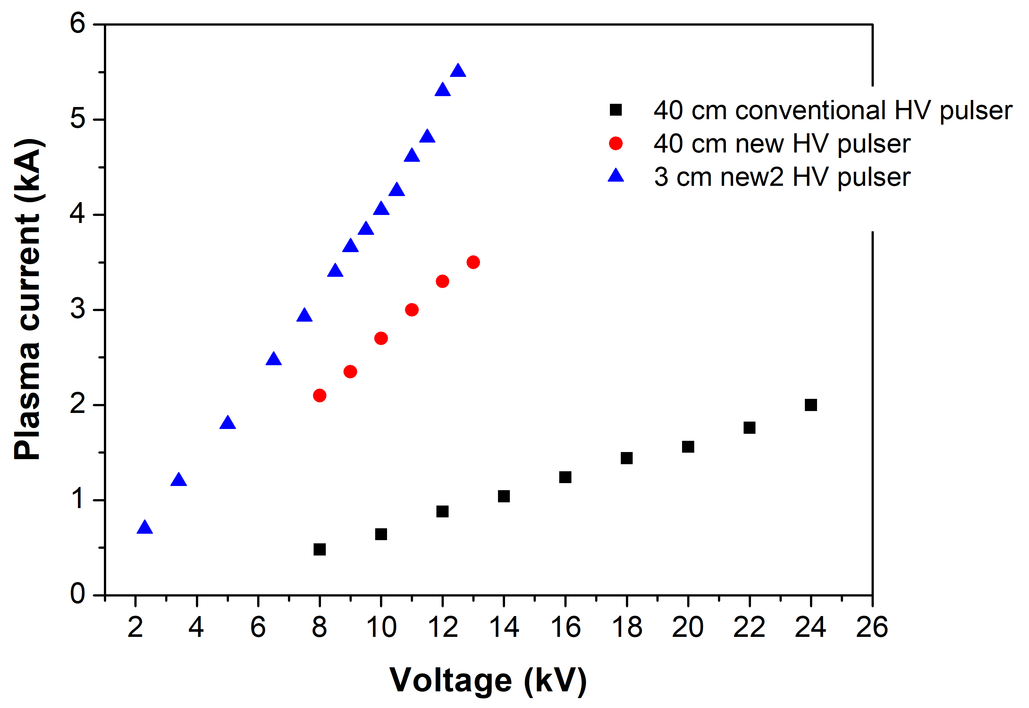
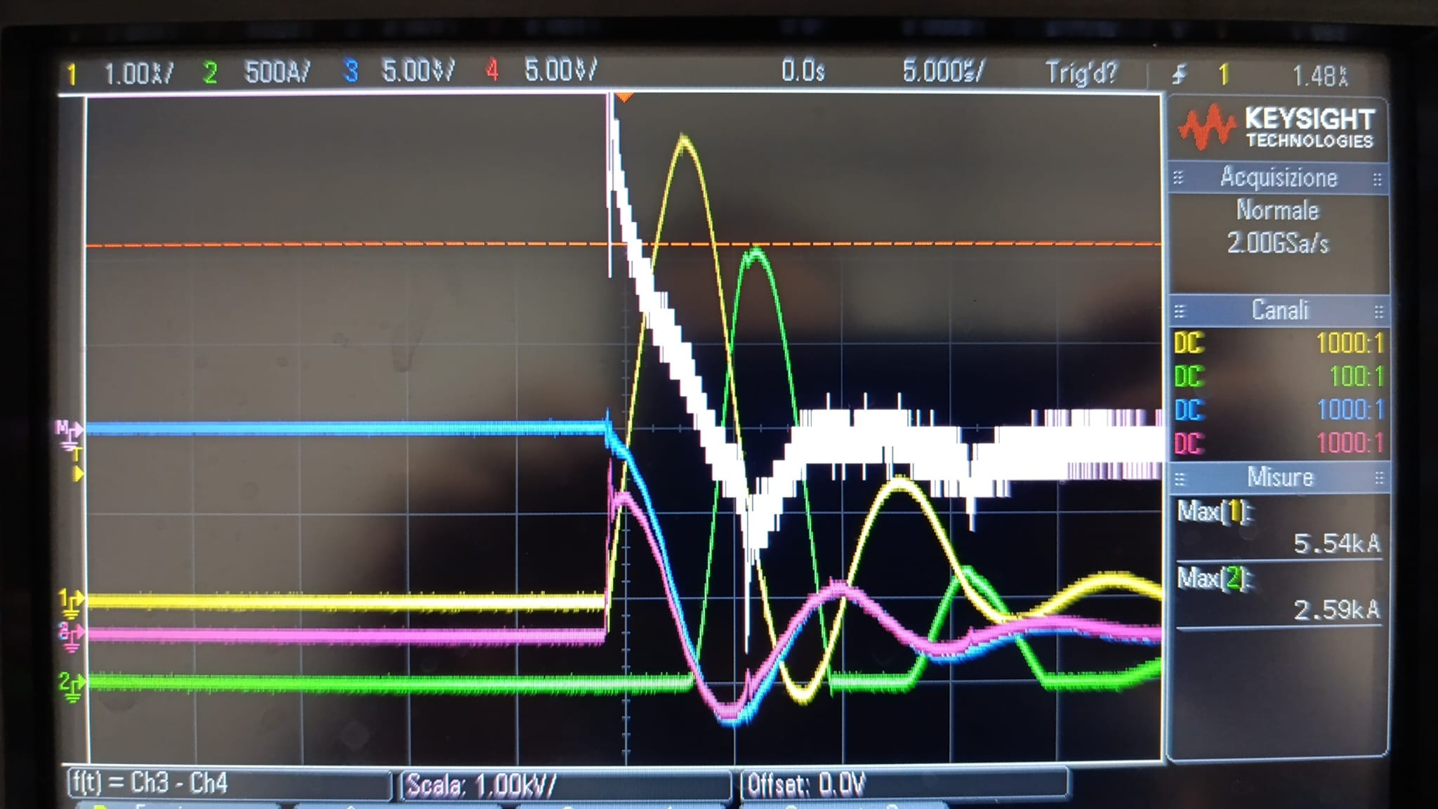
Active pLAsma for beNding (ALAN)_Research activity
Design of HV systems to reach very High currents
  3 cm long capillary
  Positive pick 5.54 kA
  Negative pick 2.5 kA
  C = 1 uF
  Δt > 5 us
3cm
40cm
40cm
Optimization of the current shape
Negative oscillations
C = 1 uF, Δt > 5 us Capillary damage
Angelo.Biagioni@lnf.infn.it | 19 June 2025 | Page 4/17
Angelo.Biagioni@lnf.infn.it | 19 June 2025 | Page 9

Slide 10
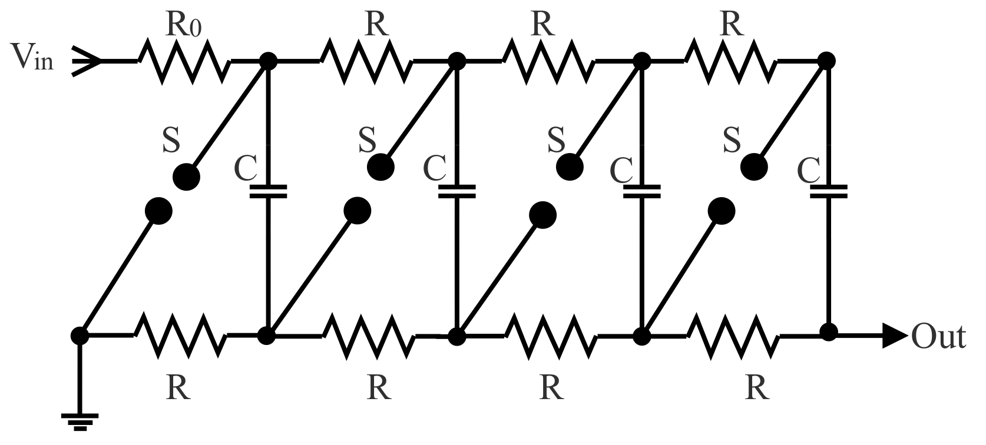
Active pLAsma for beNding (ALAN)_Research activity
  First goal: Design of HV systems to produce appropriate current pulses
HV pulses pulse from a low-voltage DC supply
Very short pulses (tens of ns)
charging N capacitors in parallel at Vc (output NVc)
Discharge N capacitors in series (short pulse)
Laser ignition for spark gaps
new high-voltage cable design to limit inductive effects (oscillations and pulse duration)
HV pulses/High currents pulse from a low-voltage DC supply
Very short pulses (tens of ns)
  Lower Thermal energy per pulse
  Higher repRATE/high peak
Marx generator
ABP
Angelo.Biagioni@lnf.infn.it | 19 June 2025 | Page 10

Slide 11
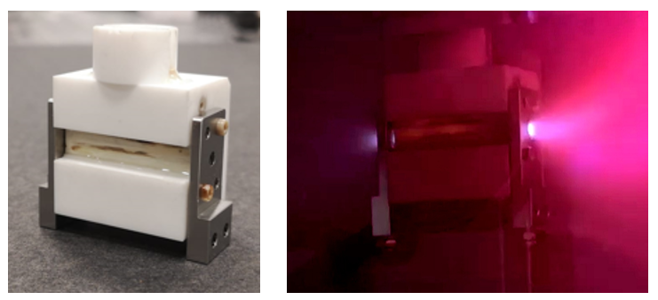
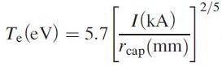
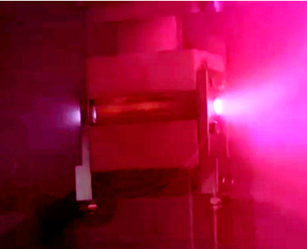
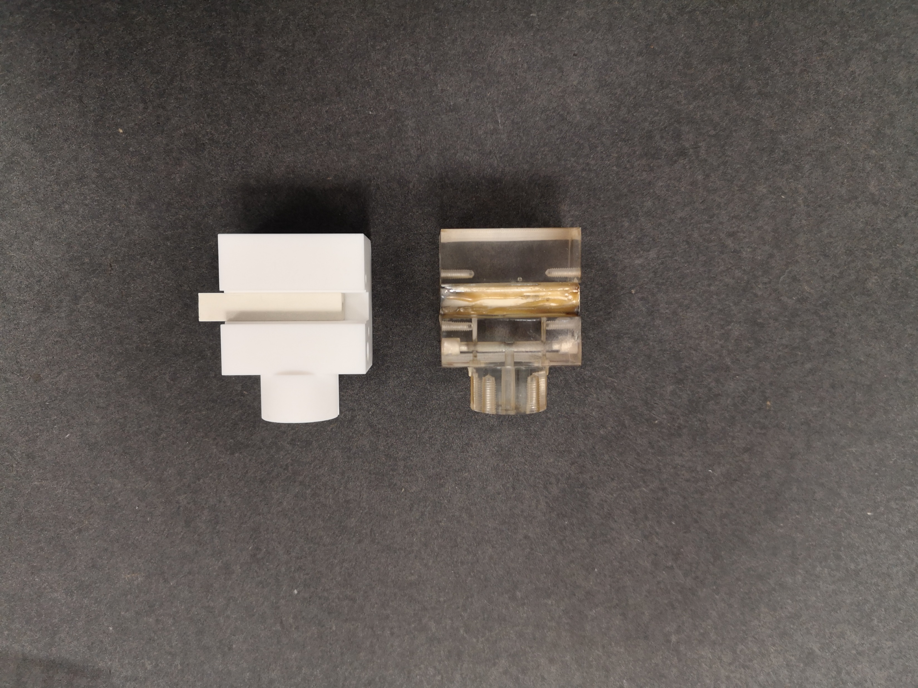
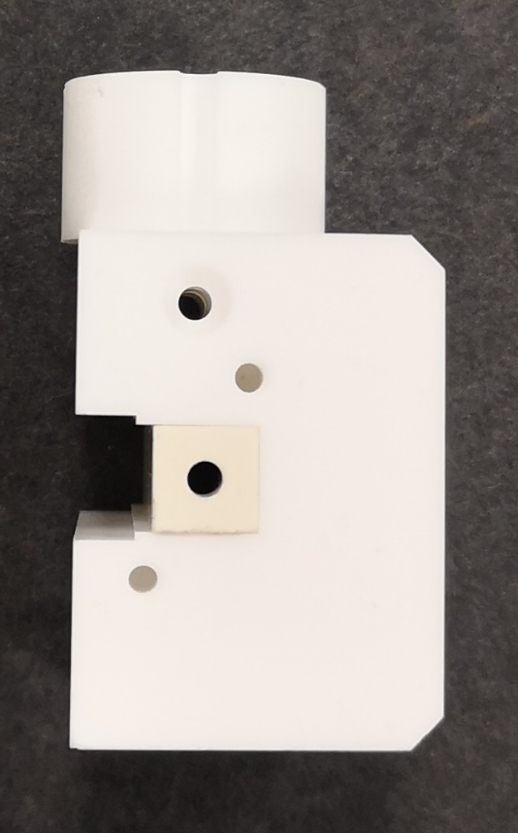
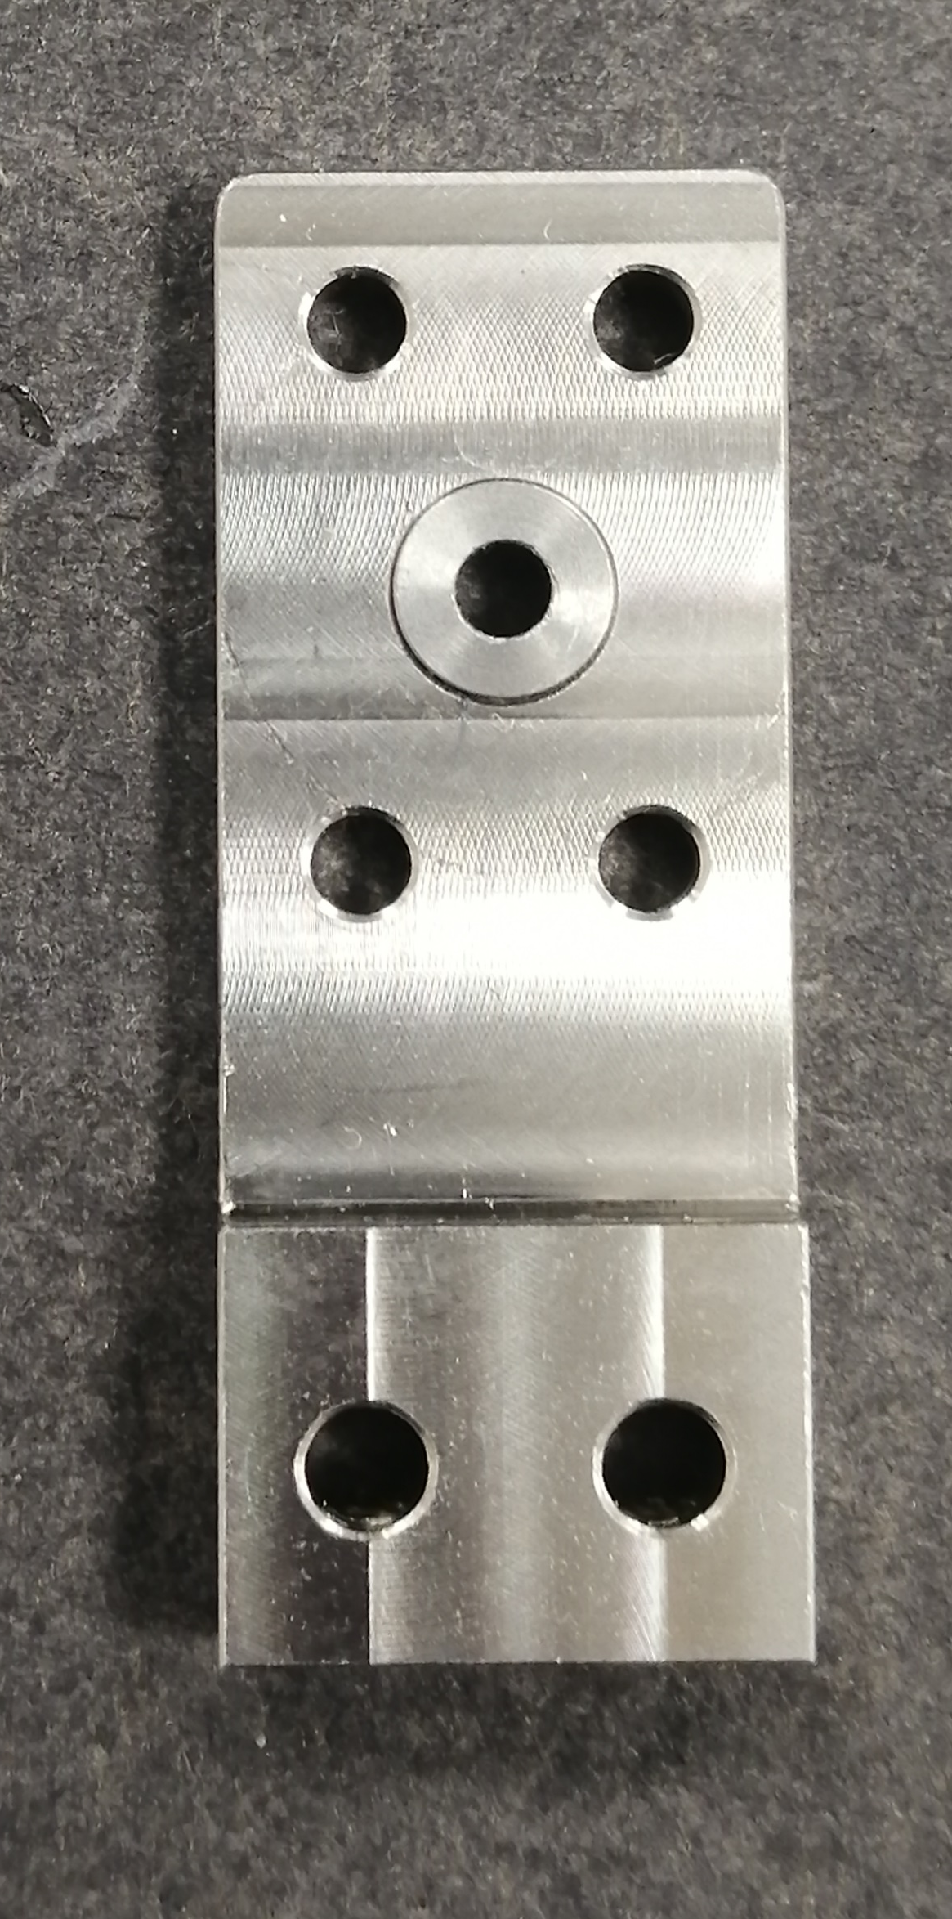
Active pLAsma for beNding (ALAN)_Research activity
  Second goal: Capillary structure design
First prototype of the ceramic capillary
High thermal conductivity
High max operating temperature
Good machinability, cost-effectiveness and availability for large geometries
New materials for electrodes
Capillary
Electrodes
Molybdenum
Tests on 3cm long-2mm diameter
Shapal
Stainless
steel
Macor
Angelo.Biagioni@lnf.infn.it | 19 June 2025 | Page 11

Slide 12
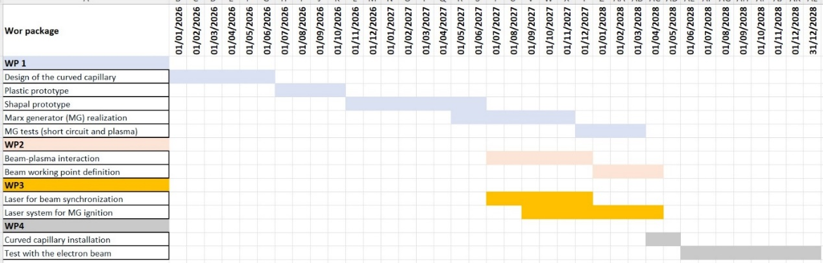
Active pLAsma for beNding (ALAN)_Project organization
Tab.6 Gantt chart of the ALAN project
Angelo.Biagioni@lnf.infn.it | 19 June 2025 | Page 12

Slide 13
Active pLAsma for beNding (ALAN)_Project organization
Unit | Work package | Researchers | FTE
1st Unit INFN-LNF
 | WP1 | Dr. Angelo Biagioni | 0.3
 |  | Dr. Lucio Crincoli | 0.2
 | WP3 | Dr. Mario Galletti | 0.3
 |  | Dr. Gemma Costa | 0.3
 |  | Dr. Maria Pia Anania | 0.3
 | WP4 | Dr. Riccardo Pompili | 0.2
 |  | Dr. Alessio Del Dotto | 0.2
 |  | Total INFN-LNF | 1.8
2nd Unit INFN-Milan
 | WP2 | Dr. Andrea R. Rossi | 0.3
 |  | Prof. Vittoria Petrillo | 0.1
 |  | Dr. Marcello Rossetti Conti | 0.15
 |  | Dr. Andrea Frazzitta | 0.5
 |  | Total INFN-Milan | 1.05
 |  | TOTAL | 2.85
Work Package | WP Leader | WP activity
WP 1 | Angelo Biagioni (LNF) | WP1 will lead the mechanical realization and characterization of the curved capillary and the HV sources for plasma formation.
WP 2 | Andrea R. Rossi (INFN-Milan) | The WP1 activity will be focussed on the study of the beam-plasma interaction, The WP1 will also pursue the definition of the SPARC_LAB accelerator working point.
WP 3 | Mario Galletti (LNF) | WP3 will work on the synchronisation of electron beam and plasma by means of a laser system. It will also study a laser system for triggering the discharge in the Marx generator.
WP 4 | Riccardo Pompili (LNF) | The activity of WP4 will cover the integration of the curved capillary and particle beam bending experiments in the SPARC_LAB accelerator
Angelo.Biagioni@lnf.infn.it | 19 June 2025 | Page 13

Slide 14
Active pLAsma for beNding (ALAN)_Project organization
Unit | Work package | Year 1 | Year 2 | Year 3
1st Unit INFN-LNF
 | WP1 | CapillariesP 10.000 | CapillariesS 15.000
 |  | Capillaries S 10.000 | MGprototype 40.000
 |  | Travel 5.000
 | Tot | 25.000 | 55.000 | 0
 | WP3 | Lenses 15.000 | Travel 5.000
 |  | Lens support 10.000
 | Tot | 25.000 | 5.000 | 0
 | WP4 |  | Capillary support 20.000 | Travel 10.000
 |  |  | Movements 15.000
 | Tot | 0 | 35.000 | 10.000
2nd Unit INFN-Milan
 | WP2 | C. equipment 5.000 | S. licence 10.000 | S. licence 10.000
 |  | Travel 5.000 | Travel 5.000 | Travel 5.000
 | Tot | 10.000 | 15.000 | 15.000
 | Sum | 60.000 | 110.000 | 25.000
195.000 €
Angelo.Biagioni@lnf.infn.it | 19 June 2025 | Page 14

Slide 15
Active pLAsma for beNding (ALAN)_Project organization
Risk | RPN | Mitigation
Durability of the capillary material | 3 | The use of ceramics with high thermal conductivity has so far, in experiments at SPARC_LAB, yielded excellent results regarding the life of discharge capillaries for repetition frequencies up to over 200 Hz. Capillary life is significantly extended by reducing the frequency of operation, so the ALAN device can be tested at low frequencies.
Plasma discharge stability | 2 | The use of an external laser system with remotely controlled optics improves the stability of the discharge trigger.
Reaching high peak currents with short pulse durations | 2 | A current peak of 15 kA is a relatively low value of the current obtainable with the Marx generator, this is used to achieve much higher values. The complexity of the circuit depends on the triggering system of its capacitor sections. Initially, even just three capacitors may be sufficient to achieve the parameters required by the ALAN design.
Synchronisation and triggering of the discharge in the Marx generator | 2 | Laser synchronisation of the Marx generator ignition can be more complicated than the classical method based on an auxiliary voltage pulse, although more stable and reproducible. However, the latter is the solution to be used initially for tests on ALAN device
Control of the electron beam parameters to be matched with plasma and discharge current | 1 | According to preliminary numerical simulations, the electron beam parameters must precisely match those of the plasma and discharge. Furthermore, advanced techniques such as machine learning could be employed to automatically adapt the electron beam parameters in response to the evolving state of the plasma, accounting, for example, for capillary wall erosion and resulting changes in plasma density.
Angelo.Biagioni@lnf.infn.it | 19 June 2025 | Page 15

Slide 16
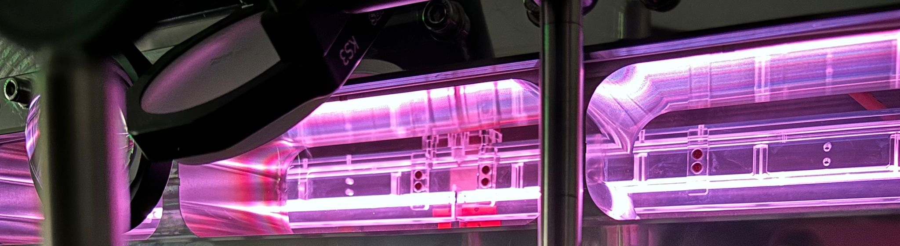
Thank you for your attention
Angelo Biagioni | INFN_LNF
Angelo.Biagioni@lnf.infn.it
Angelo.Biagioni@lnf.infn.it | 19 June 2025

Slide 17
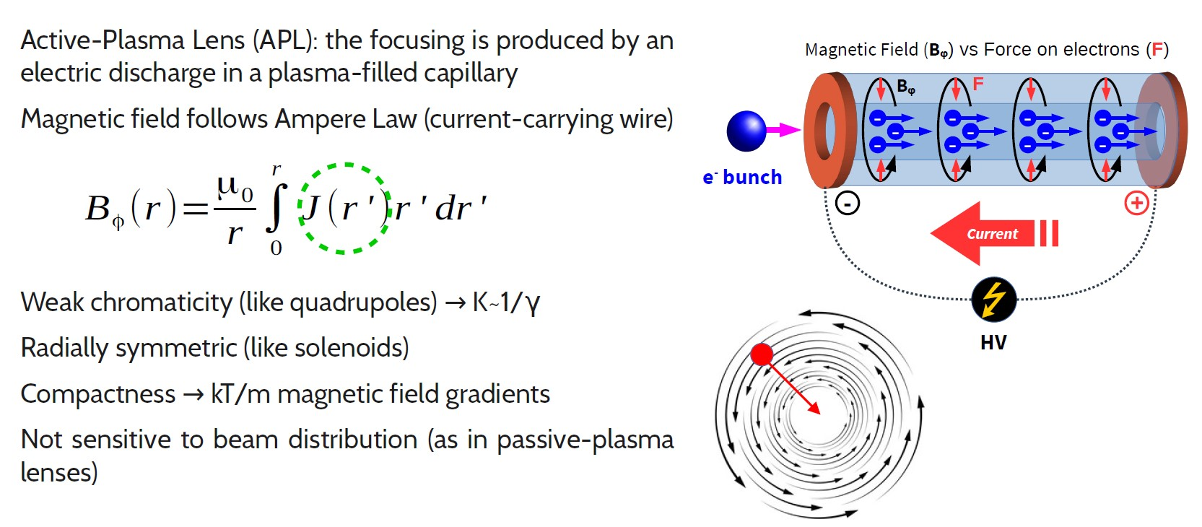
Active pLAsma for beNding (ALAN)_Motivations
Plasma lens
Angelo.Biagioni@lnf.infn.it | 19 June 2025 | Page 2

