Slide 1








Halbach Array for Rotational MOdulation of NdFeB Integrated Quadrupoles
Project Proposal to CSN5 for 2026
Alessandro Vannozzi

Slide 2


Context: PMQ for Plasma Acceleration
Laser Plasma Accelerators (LPA) have exhibited considerable promise through the utilization of plasma wakefields, enabling the attainment of gradients on the order of several GeV/cm
Beams entering in the plasma require for µm scale beams to be achieved in very compact (cm scale) focusing sections.
Beams exiting from plasma accelerator module show high divergence (few mrads) and high energy spread (few %) and need trasfer line to experimental station able to avoid chromatic effects convert in emittance dilution and/or charge losses through the downstream beamline
A strong focusing near the particle beam injection in the plasma and near the extraction from the plasma is the more reliable solution to handling these drawbacks. Plasma modules works in UHV environment: a compatibility it is crucial.
Currently there are two devices under investigation to fulfill the PA requirements:
  Permanent Magnet Quadrupole (PMQ) is the state of the art technology since it makes possible to provide very high gradients (up to hundreds of T/m) with very compact devices. The ones devoted to PA shows exotic design providing «online» tunable gradients in a wide range, in order to increase the machine energy acceptance. On the other side the «online» tunability led to undesired multipolar skew components , magnetic axis stability and higher transverse dimensions with respect to the constant gradient PMQ.
  Plasma Lens: not yet state of the art technology, APL are subjected to emittance degradation and charge reduction due to highly non-linear focusing arising from current discharge non-uniformity. For PPL focusing properties depend on the electron beam itself and can present aberrations.
The main purpose of this proposal is to overcome the tunable PMQ drawbacks, in particular reducing the multipolar skew components with more compact devices offering an energy acceptance higher than 40%.

Slide 3
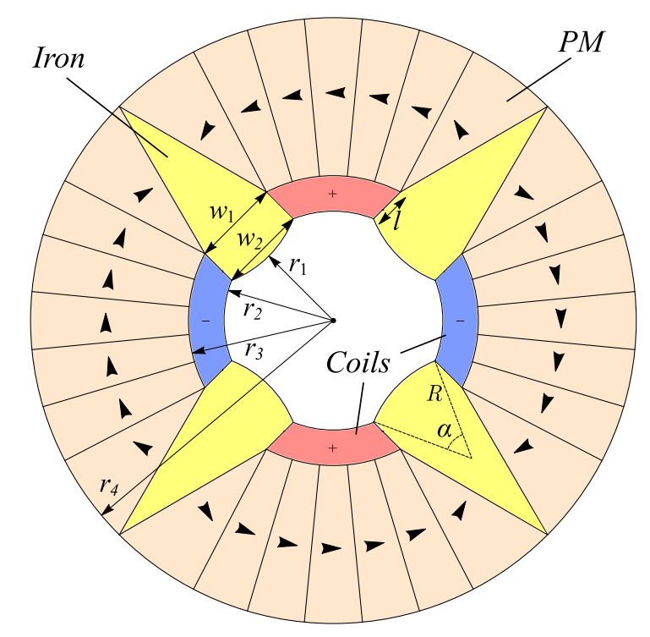
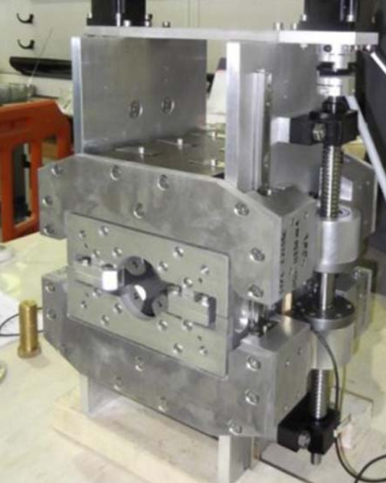
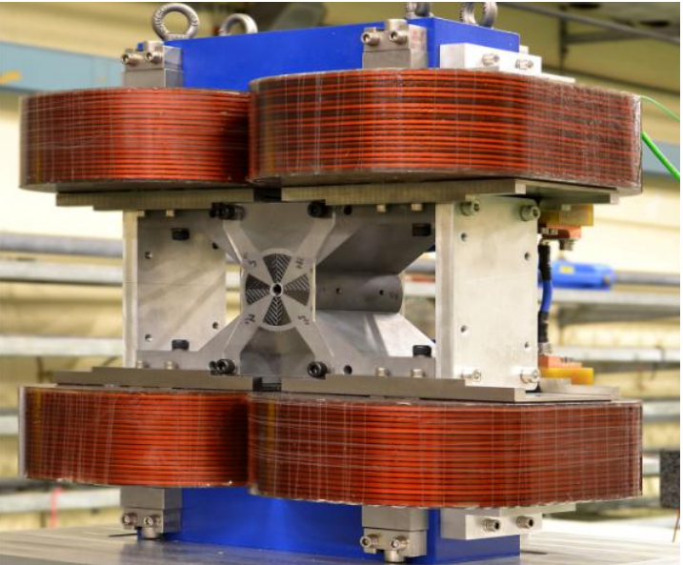
Context: PMQ Focusing Tuning Techniques
COMBINATION PERMANENT MAGNETS + NC Coils
BLOCKS SHIFT
a
b
Quadrupole for an interdigital H-mode drift tube linear accelerator (Peking Univ.)
QD0 for CLIC final focus
High-energy quadrupole prototype for CLIC at STFC
High-energy quadrupole design for CLIC at STFC at maximum (left) and minmum (right) gradient configuration.
 | PROJECT | Radius – WxHx L [mm] | Mean G | Tunability
a | Linac Acc. | 12,5- 40x40x - | 84 T/m | ±30%
b | CLIC | 4,13 – 436x 436x2700 | 338 T/m | ±55%
PROJECT | Radius – PM size (WxHx L) [mm] | Max G | Tunability
CLIC | 13,6 – 18x100x230 | 97 T/m | ±30%
Less power demand
Compatibility with Ultra High Vacuum environment
High field quality
Difficult tuning, dealing with high forces (tens kN)
Less compactness
Need transverse shift to adjust magnetic axis position on the beam
Easy tuning
Stability of magnetic axis for quadrupoles
Coils not compatible with Ultra High Vacuum environment
Necessity of electric power and possible water cooling
Less compactness

Slide 4
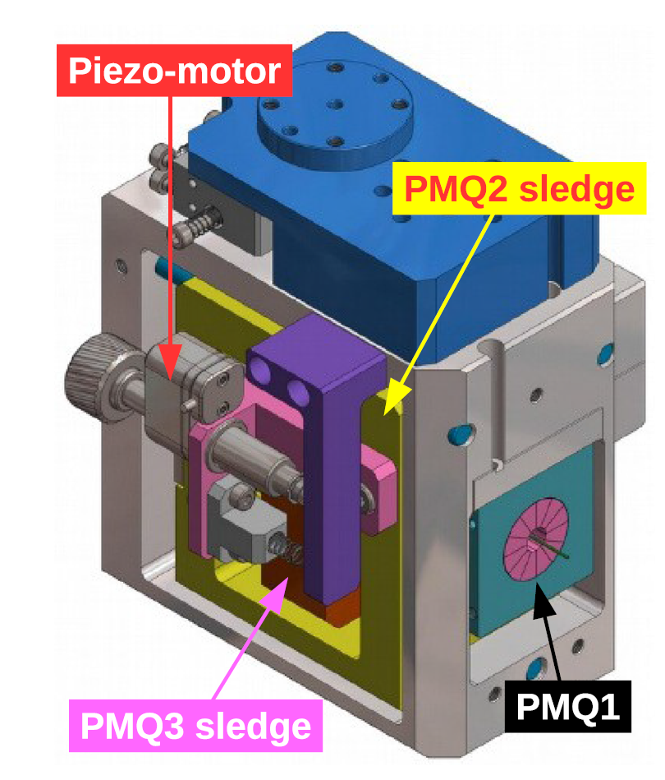
Context: PMQ Focusing Tuning Techniques
LONGITUDINAL SHIFT OF THE QUADRUPOLES
In the SPARC_LAB (LNF) test facility it is installed the COMB beam driven plasma acceleration experiment.
A focusing system of two PMQ triplets have been installed both upstream and downstream a plasma acceleration module where the tuning of the gradient is gained keeping the PMQ1 fixed on the main support, while the other two are held on two mechanical sledges that can be moved by two piezoactuators along the beam trajectories.
With this method is possible to tune the triplet focus length only for some% considering also the limited longitudinal space availability.
Magnets shifts vary the attractive force between magnets leading to possible errors in the longitudinal position shifting.
PROJECT | Radius – single PMQ size (WxHx L) [mm] | Max G | Tunability
SPARC_LAB | 3 – 40x40x10/20 | 520 T/m | ±2,5%
Mechanical layout of the PMQ movable system
@SPARC_LAB
Less power demand
Compatibility with Ultra High Vacuum environment
Very low tunability
Difficulties in positions reproducibility
Low longitudinal compactness

Slide 5
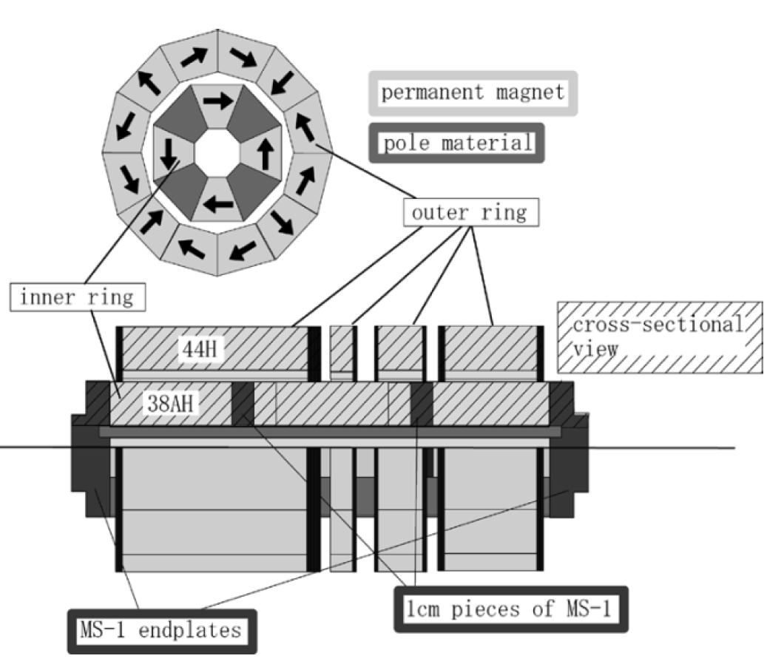
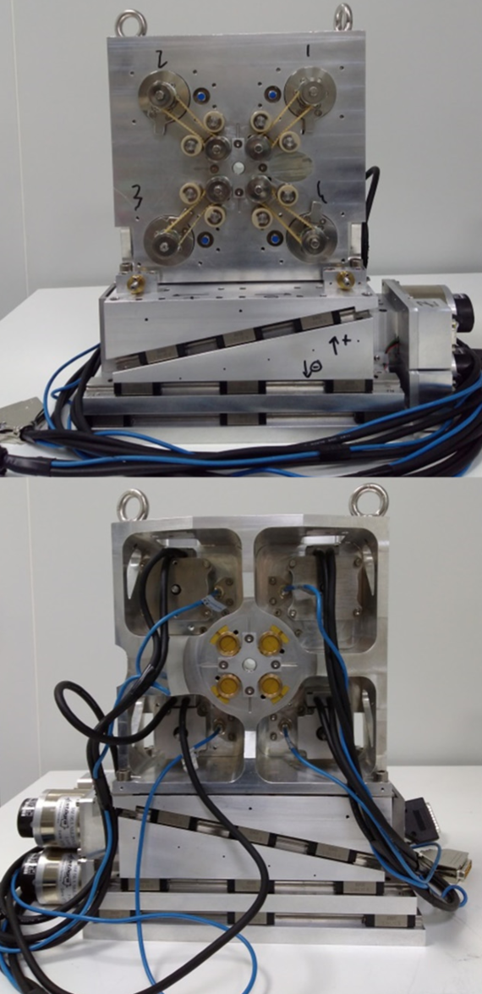
Context: PMQ Focusing Tuning Techniques
BLOCK ROTATIONS
a
 | PROJECT | Radius – WxHx L [mm] | Mean G | Tunability
a | Linear Collider | 10- 50x50x230 | 50 T/m | ±45%
b | SOLEIL | 6 – 100x100x100 | 160 T/m | ±22%
High compactness (particularly for QUAPEVA)
High Tunability
Compatibility with Ultra High Vacuum environment
Need transverse shift to adjust magnetic axis position on the beam
Kyoto / NIRS PMQ. Outer ring front (up) and side (down) views
b
Kyoto NIRS PMQ solution (a) shows a very high tunability but it can be reached by rotating single outer ring longitudinal section (highlighted in red). It needs at least longitudinal length of several cm.
Concerning QUAPEVA the tunability is lower than Kyoto NIRS, but still suitable for several applications, it could be more compact.
High compactness is a crucial allows to get closer the PMQ to the plasma injection and extraction.
QUAPEVA design has taken into account as design baseline for the HARMONIQ proposal.
QUAPEVAs for COXINEL facility (SOLEIL)

Slide 6
Halbach Array for Rotational MOdulation of NdFeB Integrated Quadrupoles (HARMONIQ) project proposal
The main goal of HARMONIQ is to realize and test TPMQs based on QUAPEVA design but optimized in terms of compactness and reduced multipolar skew components.
MAIN INNOVATIONS
Compactness: the optimized design allows to reduce the radial dimensions.
Unique gradient and tunability combination: from the litterature this design push forward the state of the art in terms of high gradients and high tunability offering an energy acceptance larger than 40%.
Reduced power cost: Very small power demand.
Reduced skew components with respect to QUAPEVA design.
Reduced production cost: PMQ performances feasible with NdFeB and AISI 1010 materials. Cost reduced compared with other solutions like FeCo alloy (higher saturation threshold) instead to AISI1010 (cheaper).
The parameters of the TPMQs will be tailored on the basis of EuPRAXIA project requirements for the beam based plasma acceleration.

Slide 7
TPMQ for EuPRAXIA Plasma Acceleration Module
In the Eupraxia linac the X-band booster upstream the plasma capillary is able to drive the electron beam up to 500 MeV, while in the plasma module it can reach an energy of about 1GeV.
Since the machine could work at several repetition rates, up to 400 Hz, this TPMQ solution show the advantage to work at any repetition rate with respect to other focusing techniques.
FODO quadrupoles have been foreseen in the layout to focus the beam close to the inlet and outlet of plasma capillary. The quadrupoles with “full length” and “half length” have been defined as long and short PMQ.
In details the EuPRAXIA layout foreseen a PMQ triplet upstream the plasma acceleration module and 13 magnets downstream the plasma module: a “short” PMQ for the first and the last magnet while all the others are “long” type
UPSTREAM PLASMA MODULE
DOWNSTREAM PLASMA MODULE
 | Short PMQ | Long PMQ
PARAMETER | Value | Value
Energy | 500 MeV | 500 MeV
Aperture Diameter | 7 mm | 7 mm
Average Gradient | 300 T/m | 300 T/m
Tunability | ± 10% (± 30 T/m) | ± 10% (± 30 T/m)
Magnetic Length | 55 mm | 100 mm
Integrated Gradient range | 16,5 ± 1,7 T | 30 ± 3 T
Distance Between PMQs | 10 mm | 10 mm
 | Short PMQ | Long PMQ
PARAMETER | Value | Value
Energy | 1GeV | 1GeV
Aperture Diameter | 7 mm | 7 mm
Average Gradient | 510 T/m | 510 T/m
Tunability | ± 17% (± 90 T/m) | ± 17% (± 90 T/m)
Magnetic Length | 17,5 mm | 35 mm
Integrated Gradient range | 8,9 ± 1,6 T | 17,85 ± 3,2 T
Distance Between PMQs | 40 mm | 40 mm

Slide 8


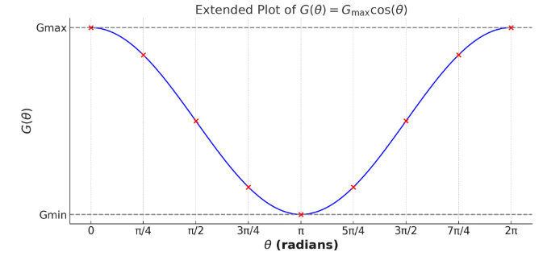
HARMONIQ Design Baseline
Each PMQ is composed by a 8 sector Halbach configuration surrounded by 4 NdFeB cylinders radially magnetized. Based on QUAPEVA design [1].
The fixed parts alternate NdFeB magnetized blocks with AISI1010 blocks that act as poles.
Gradient tuning by rotating the 4 cylinders around the longitdunal PMQ axis (parallel the beam direction).
Opposite rotation senses of cylinders reduce the skew quadrupole components w.r.t. the original QUAPEVA config. at a 50 % of gradient range.
Aiming to increase gradients it would be possible to change AISI 1010 blocks with FeCo ones. → higher costs ; FeCo activation?
LEGEND
AISI 1010 blocks
NdFeB blocks
Magnetization direction
Cylinders Rotation senses
[1] Marteau, F., et al. "Variable high gradient permanent magnet quadrupole (QUAPEVA)." Applied Physics Letters 111.25 (2017)

Slide 9
HARMONIQ Design Baseline
UPSTREAM PLASMA MODULE
Simulation campaign performed with Opera 3D software.
The integrated gradient range is taken as the simulations figure of merit. It comply the required range for all the design
The design is unique combination for tunability, compactness and gradient magnitude.
For downstream PMQ the dimensions grows up significantly. A more compact design have been proposed
 | SHORT TPMQ |  | LONG TPMQ
 | Requirements | Simulations | Requirements | Simulations
Energy | 500 MeV | 500 MeV | 500 MeV | 500 MeV
Aperture Diameter | 7 mm | 7 mm | 7 mm | 7 mm
Average Gradient | 300 T/m | 307 T/m | 300 T/m | 294 T/m
Tunability | ± 10% (± 30 T/m) | ± 12% (± 36 T/m) | ± 10% (± 30 T/m) | ± 14% (± 40 T/m)
Magnetic Length | 55 mm | 54 mm | 100 mm | 102 mm
Integrated Gradient range | 16,5 ± 1,7 T | 16.4 ± 1.75 T | 30 ± 3 T | 30 ± 4 T
(WxHxL) [mm] | - | 32x32x50 | - | 36x36x100
Weigth | - | 200 g | - | 400 g
DOWNSTREAM PLASMA MODULE
 | SHORT TPMQ |  | LONG TPMQ
 | Requirements | Simulations | Requirements | Simulations
Energy | 1GeV | 1GeV | 1GeV | 1GeV
Aperture Diameter | 7 mm | 7 mm | 7 mm | 7 mm
Average Gradient | 510 T/m | 433 T/m | 510 T/m | 492 T/m
Tunability | ± 17% (± 90 T/m) | ± 22% (± 94.5T/m) | ± 17% (± 90 T/m) | ± 19% (± 92 T/m)
Magnetic Length | 17,5 mm | 21 mm | 35 mm | 35 mm
Integrated Gradient range | 8,9 ± 1,6 T | 8,82 ± 1,7 T | 17,8 ± 3,2 T | 17,4 ± 3 T
(WxHxL) [mm] | - | 125x125x17 | - | 125x125x33
Weigth | - | 1,2 kg | - | 2,3 kg

Slide 10

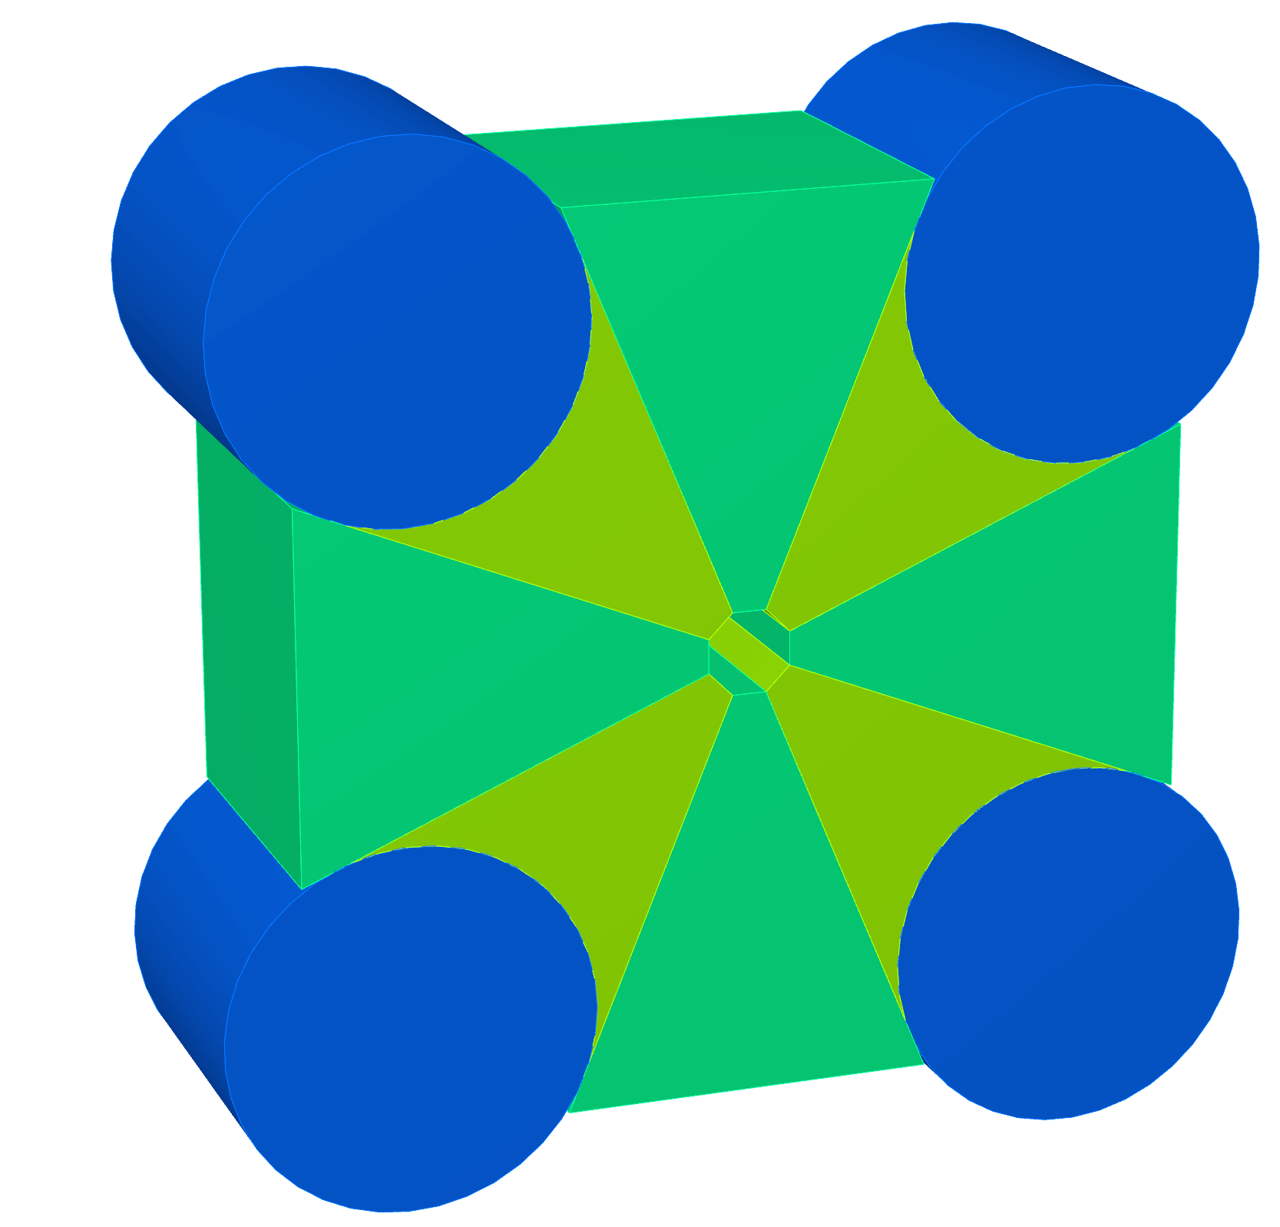
HARMONIQ «Compact» Design Baseline
For the downstream short quadrupole, a compact design has been done approaching the rotating cylinders towards the PMQ axis and shaping the AISI 1010 pole blocks to house them.
Higher gradients achieved with a more compact and lighter magnet.
 | Short Compact Design | Short Normal Design
PARAMETER | Value | Value
Energy | 1GeV | 1GeV
Aperture Diameter | 7 mm | 7 mm
Average Gradient | 495 T/m | 433 T/m
Tunability | ± 15% (± 72 T/m) | ± 22% (± 94.5T/m)
Magnetic Length | 23 mm | 21 mm
Integrated Gradient range | 11.385 ± 1.7 T | 8,82 ± 1,7 T
Overall Dimensions (WxHxL) | 45x45x20 mm | 125x125x17 mm
Weigth | 1,0 kg | 1,2 kg
LEGEND
AISI 1010 blocks
NdFeB blocks
NdFeB blocks
Magnetization direction
Cylinders Rotation senses

Slide 11
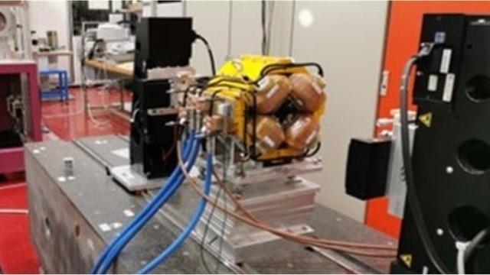
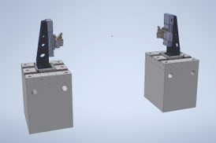

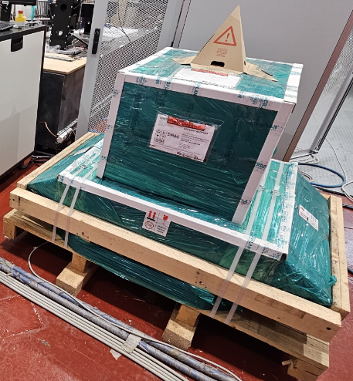
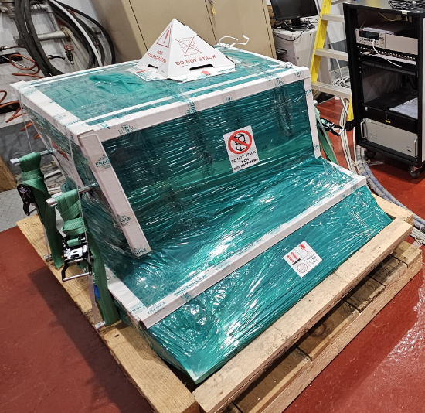


Methodology
Complete magnetic design with cross talks between magnets and completing a block stress preliminary analysis.
Beam Dynamics (BD) design validation inserting field maps and/or integrated harmonics in Elegant BD code where EuPRAXIA linac have been modelled.
Magnetic blocks and servomotors purchasing.
Mechanical design and production performed by CECOM srl company of one PMQ per type starting from the compact and the short design downstream the plasma.
Full magnetic characterization at LNF magnetic measurement facility by means of Single Stretched Wire (SSW) bench (available) and a Vibrating Wire (VW) bench (available from half of 2026) to crosscheck the magnetic axis position repeatability in the full range of gradient tuning. In this phase a INFN-Na support will be crucial for measurement data analysis.
BD validations of measured PMQs on the Eupraxia requirements
SSW bench @LNF Magnetic Measurement facility
VW3D view and granite blocks (down) @LNF Magnetic Measurement facility

Slide 12
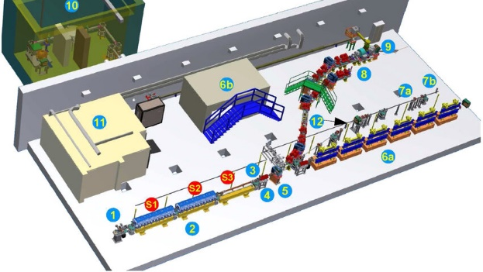

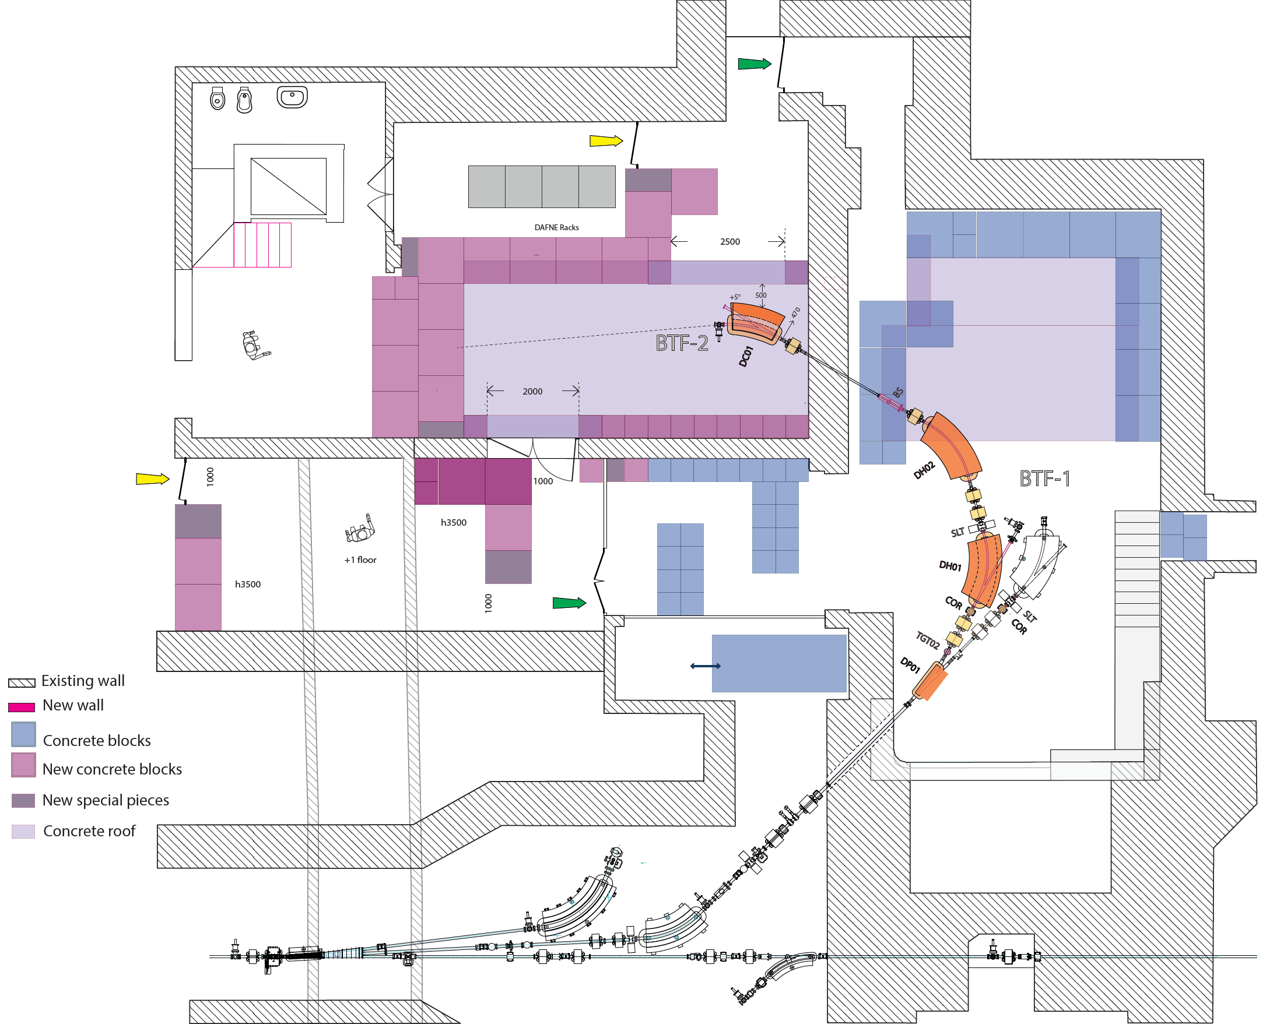
Methodology
Installation in an electron beam linac to check the PMQ performances on a real beam.
  Main candidate is SPARC_LAB linac @LNF where it will be available the EXIN line or it could be implemented in the COMB vacuum chamber.
  In alternative also the BTF @LNF. In this case a vacuum chamber and diagnostic station will be produced to host the PMQs and the diagnostic.
A preliminary check with Beam Dynamics machine teams will be done (respectively INFN-LNF and INF-MI who is in charge of STAR BD) for HARMONIQ implementation.
HARMONIQ machine installation will give the chance for a first machine implementation test of the Genetic Interface for OpTimising Tracking with Optics (GIOTTO) AI driven software to perform a PMQ magnetic axis beam base alignment and to test GIOTTO implementation under EPICS control system. The software will be developed by INFN-MI staff who made a dedicated proposal to CSN5
SPARC_LAB@LNF layout. Red arrows indicate HARMONIQ possible installation positions
BTF @LNF layout. Red arrow indicate HARMONIQ possible installation position

Slide 13
HARMONIQ Work Packages Breakdown
WP1 - Magnetic Design
Responsible: A. Vannozzi (LNF)
Staff: L. Sabbatini (LNF), A. Trigilio (LNF)
WP5 Mechanical Machine Integration and Installations
Responsible: A. Liedl (LNF)
WP2 - Magnetic Measurements
Responsible: A. Esposito (NA)
Staff: P. Arpaia (NA)
WP6 HARMONIQ implementation at SPARC_LAB
Responsible: R. Pompili (LNF)
WP3 - Servomotors Control
Responsible: S. Pioli (LNF)
Staff: G. Latini (LNF)
WP7 PMQs Beam Based Alignment with GIOTTO SW
Responsible: Illya Drebot (MI)
Staff: A. Bacci, E. Puppin (MI)
WP4 - HARMONIQ for EuPRAXIA Beam Dynamics Simulations
Responsible: A. Giribono (LNF) | Staff: C. Vaccarezza (LNF)
WP8 HARMONIQ implementation in BTF
Responsible: L. Foggetta (LNF)
Staff: B.Buonomo

Slide 14
Resources
Risorsa | Struttura | Ruolo | FTE
A.Vannozzi (RN) | LNF | Tecnologo | 0,5
L. Sabbatini | LNF | Tecnologa | 0,2
A.Trigilio | LNF | Assegnista | 0,2
P. Arpaia | NA | Prof. Ordinario Associato | 0,1
A.Esposito (RL) | NA | RTD A - Associato | 0,2
S. Pioli | LNF | Tecnologo | 0,1
G. Latini | LNF | Assegnista | 0,1
A.Giribono | LNF | Ricercatrice | 0,1
C. Vaccarezza | LNF | Tecnologa | 0,2
A.Liedl | LNF | Tecnologo | 0,1
R. Pompili | LNF | Ricercatore | 0,1
I. Drebot (RL) | MI | Ricercatore | 0,3
E. Puppin | MI | Prof. Ordinario Associato | 0,1
A. Bacci | MI | Ricercatore | 0,1
L. Foggetta | LNF | Tecnologo | 0,2
B. Buonomo | LNF | Tecnologo | 0,2
Ripartizione FTE
Struttura | FTE
LNF | 2,0
NA | 0,3
MI | 0,5
TOTALE | 2,8
During LNF Magnetic Measurement Facility measurements, there will be a support of the technical staff of Accelerator Division Electrical Engineering Service

Slide 15
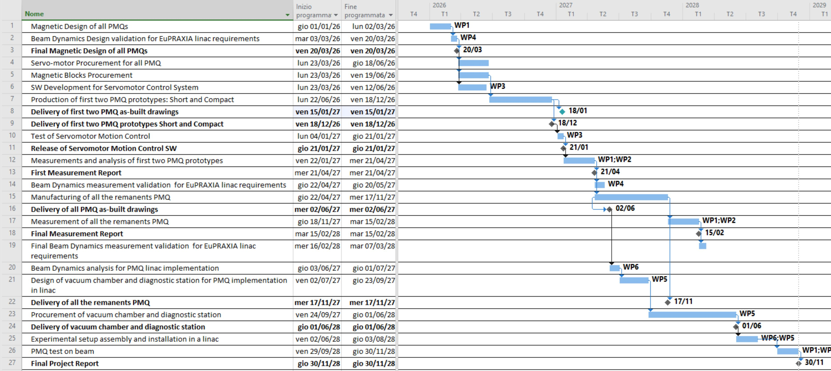
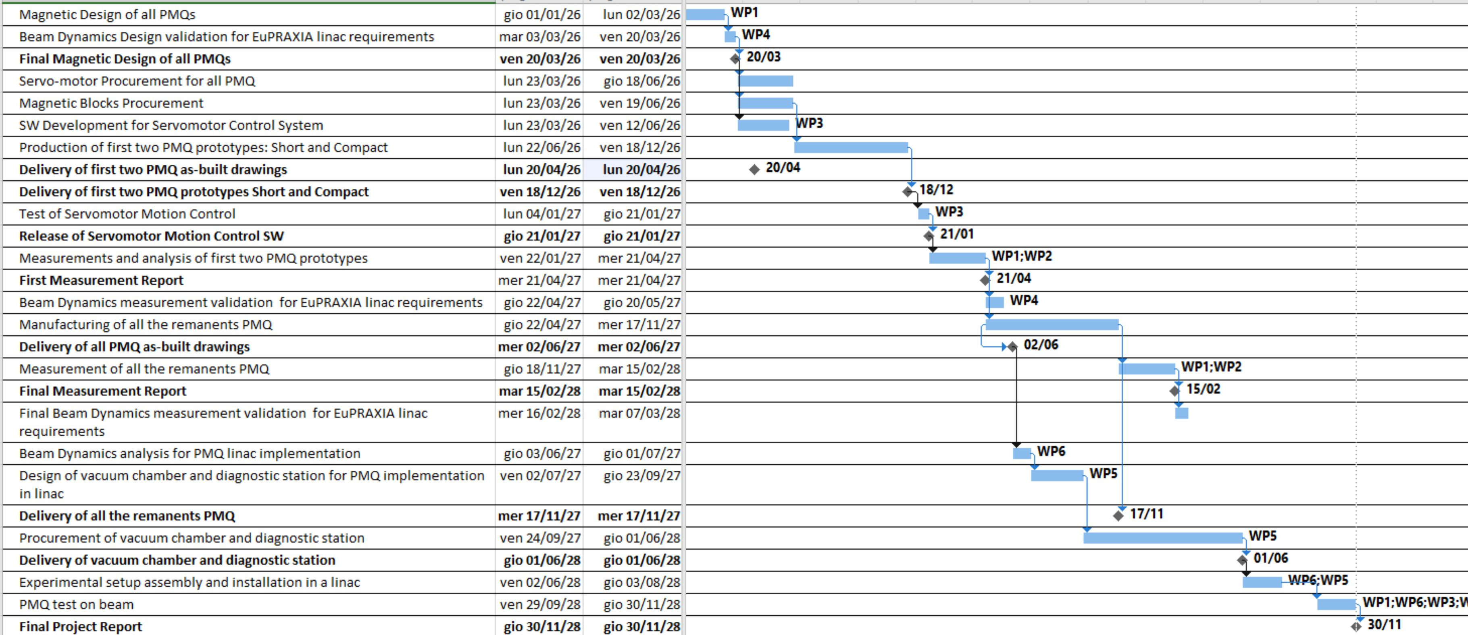

Gantt Chart
1st Year
2nd Year
3rd Year
1st Year
2nd Year
3rd Year
Milestones
Deliverables

Slide 16
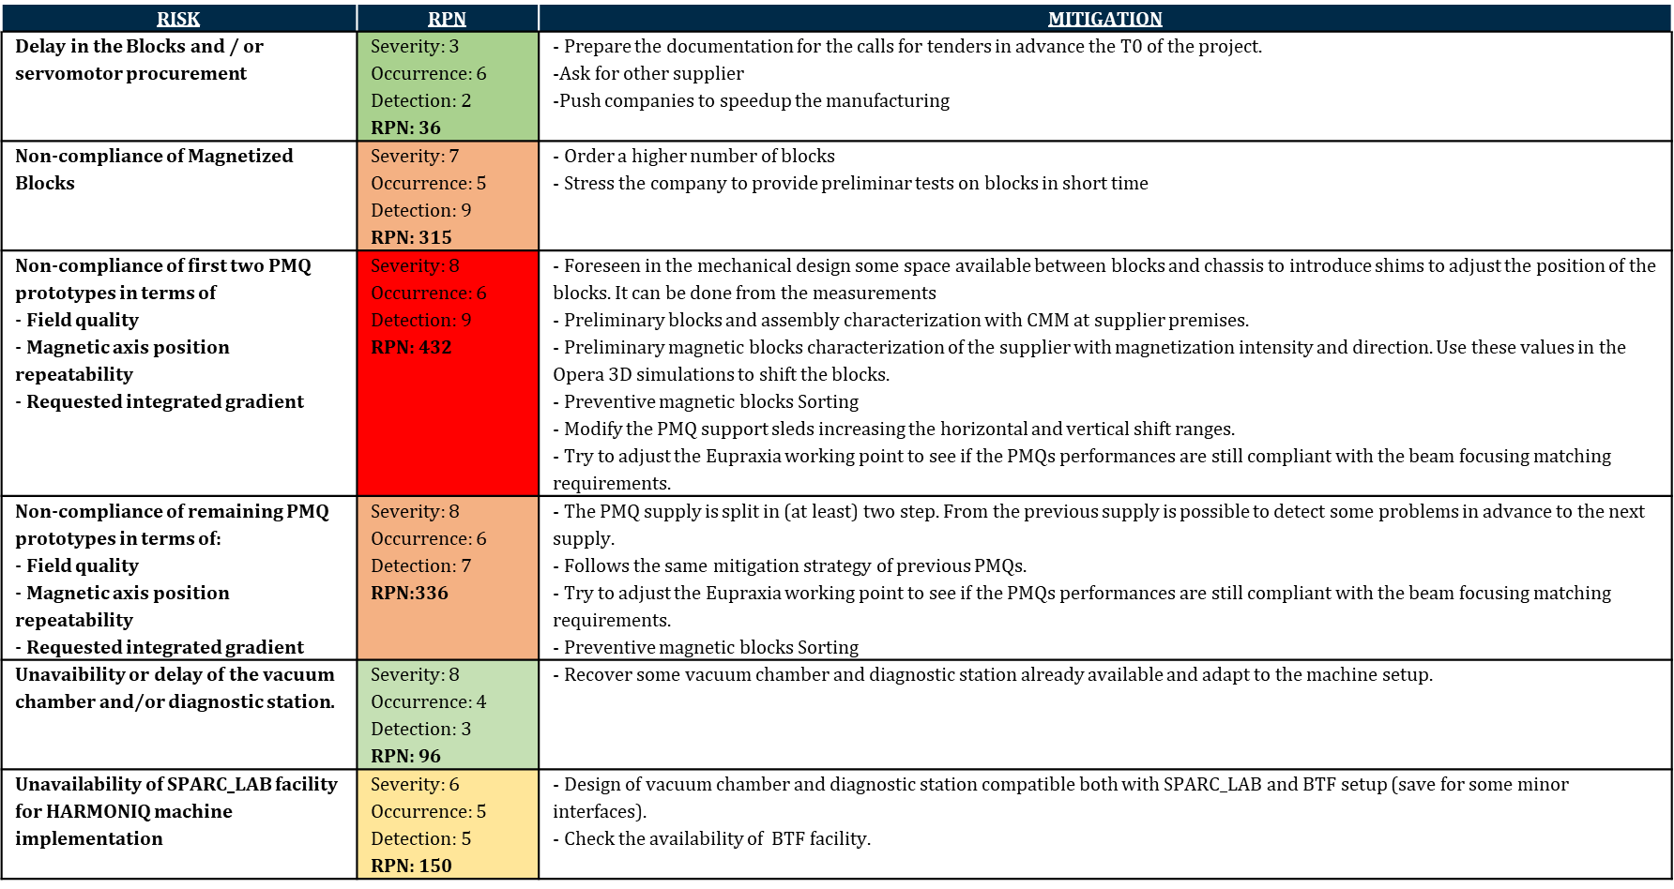
Risk Analysis

Slide 17
Cost Estimation
1st year
Item | Cost
PMQs Design Production and Assembly | € 74.000,00
Magnetic Blocks | € 13.000,00
Motors+encoders | € 37.000,00
Personal Computers | € 6.000,00
Missions | € 4.000,00
TOTAL | € 134.000,00
COSTS OVER 3 YEARS
Item | Cost
Motors+encoders | € 37.000,00
Magnetic Blocks | € 13.000,00
Personal Computers | € 6.000,00
PMQs Design Production and Assembly | € 171.000,00
Vacuum Chamber | € 30.000,00
Diagnostic Station | € 10.000,00
Missions | € 24.000,00
TOTAL | € 291.000,00
2nd year
Item | Cost
PMQs Design Production and Assembly | € 97.000,00
Missions | € 8.000,00
TOTAL | € 105.000,00
3rd year
Item | Cost
Vacuum Chamber | € 30.000,00
Diagnostic Station | € 10.000,00
Missions | € 12.000,00
TOTAL | € 52.000,00

Slide 18

Thank you for the attention

