Slide 1


ATLAS
Abritta Costa Igor, Albicocco Pietro, Antonelli Mario, Arcangeletti Chiara, Battisti Marco, Beretta Matteo Mario, Buadze Beka, Capitolo Emilio, Chubinidze Zaza, Croce Antonio, Dané Emiliano, Gardini Alessia, Gargana Riccardo, Gongadze Levan, Ligi Carlo, Liedl Andrea, Mancini Giada, Pileggi Giuseppe, Ponzio Bruno, Pudzha Dennis, Rosatelli Filippo, Testa Marianna, Tinti Gemma, Vilucchi Elisabetta, Gianmario Cesarini
Si ringraziano i tecnici del servizio vuoto e della metrologia della DA, e tutti i tecnici e progettisti della DT

Slide 2
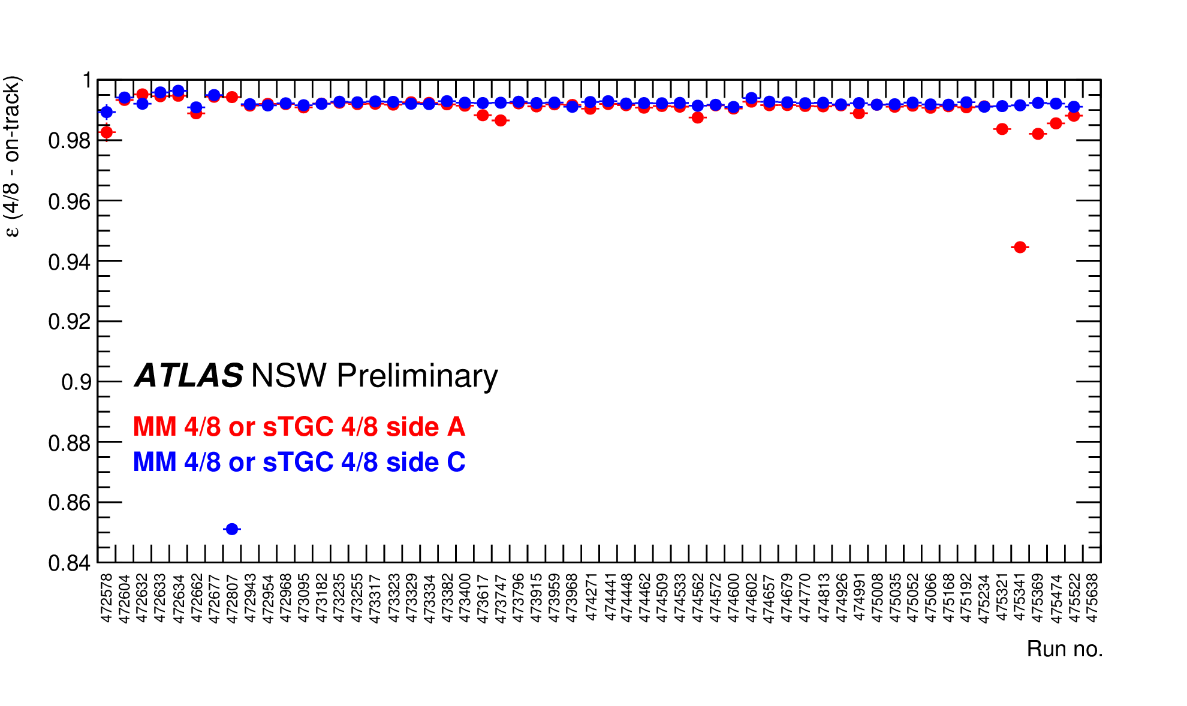
NSW Operation in ATLAS
M. Antonelli, G. Mancini, C. Arcangeletti
E. Capitolo, B. Ponzio, G. Pileggi
LNF still involved in operation and maintenance activity. Several responsibilities covered during the construction and installation phases
Micromegas HV status
Gas mixture with Isobutane → Only 1-2% channels are not working
NSW in Level-1 Trigger chain included: all sTGC Pad and MM sectors in since May 28th 2024
Fakes rate rejection ~11 kHz and Tigger efficiency up to 98%
Data Taking & Performance
DAQ stability very much improved: stable efficiency >95%
Track reconstruction is >99%

Slide 3
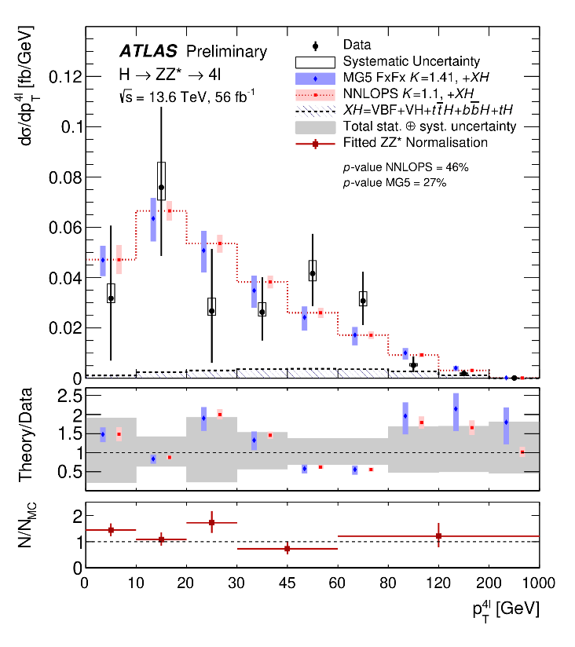
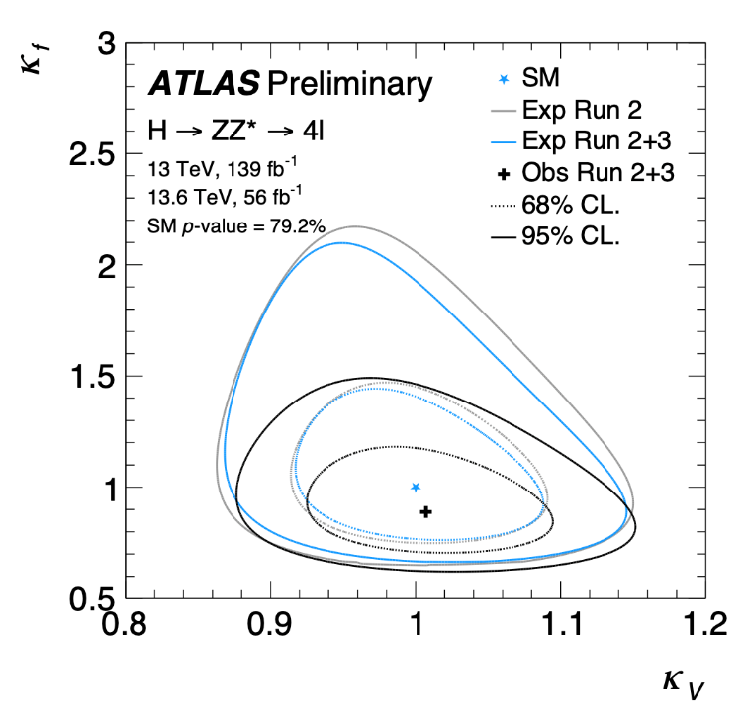
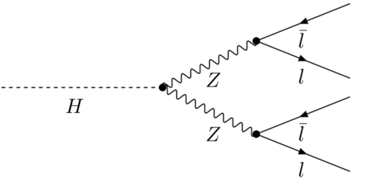
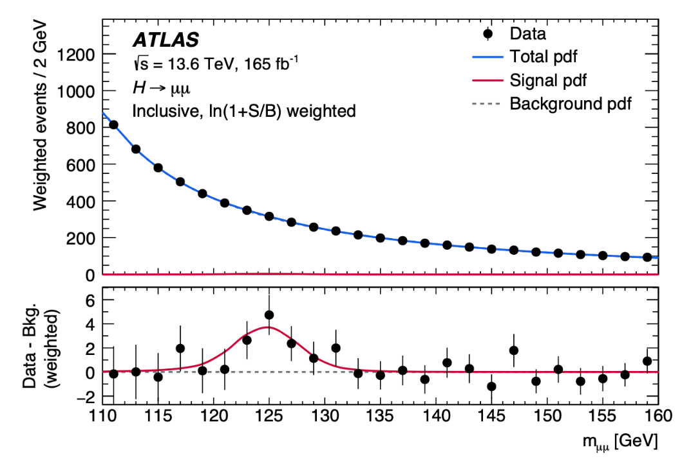
LNF activity on H→ZZ*→4l decay channel
First Run2+Run3 combined result!
*
H→µµ observed significance: 3.4𝜎 (exp. 2.5𝜎)
ATLAS-CONF-2025-002
LNF contribution
HZZ group convenership
  Focusing on performing measurements of the Higgs boson properties in the H→ZZ* decay channel at 13.6 TeV
    Differential and STXS measurements and BSM interpretation
  First ATLAS evidence of the H→µµ decay channel!
  Study of Quantum Entanglement in the Higgs decay in two vector bosons
C. Arcangeletti, G. Mancini
2507.03595 (submitted to PRL)
Notes:
Starting from the analysis, the Higgs to four lepton decay channel is called the golden channel since it has a fully leptonic final state and high lepton reconstruction efficiency allowing to be one of the main channel to perform precision measurements of the Higgs properties. And despite the low decay rate it has a very good signal over background ratio around 2, making the signal clearly identifiable over the main backgrounds. My work on this topic is dated back to 2017, so in the last years I gave several contributions in different analyses to probe the various Higgs boson properties, from the mass to the CP up to the cross-section and coupling measurements, covering leading roles as Analysis contact and paper editor, and now I am the current coordinator of the HZZ group in the ATLAS collaboration which aim to study the Higgs boson in this specific final state.
I will start the overview of my main contributions…

Slide 4
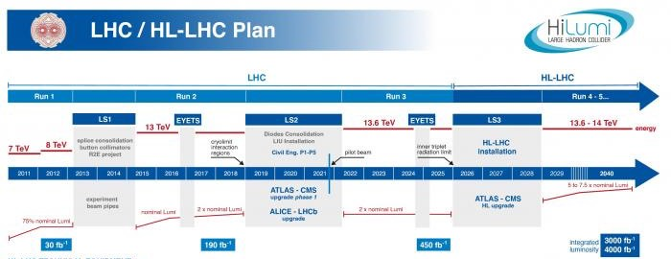

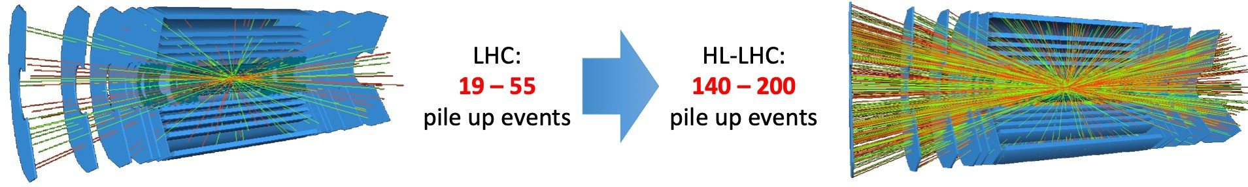
HL-LHC
The LHC will be upgraded to the High Luminosity-LHC (HL-LHC) to produce up to 4000 fb⁻¹ of integrated luminosity until 2040
Requirements for pixel detector at HL-LHC
Instantaneous conditions: pile-up, luminosity
High trigger rate: 1 MHz
High granularity: occupancy at 1 %
Luminosity
= 5-7.5 x 10³⁴ cm² s⁻¹
Integrated effects
Integrated luminosity x10
➔Radiation hard technologies
up to 2·10¹⁶ neq/cm²
LHC: Inner Detector (ID) system, TRT (gas detector) + Strips + Pixels
HL-LHC: New all-silicon Inner Tracker (ITk), Strips + Pixels
A replacement of the current ID detector is by far not enough!

Slide 5
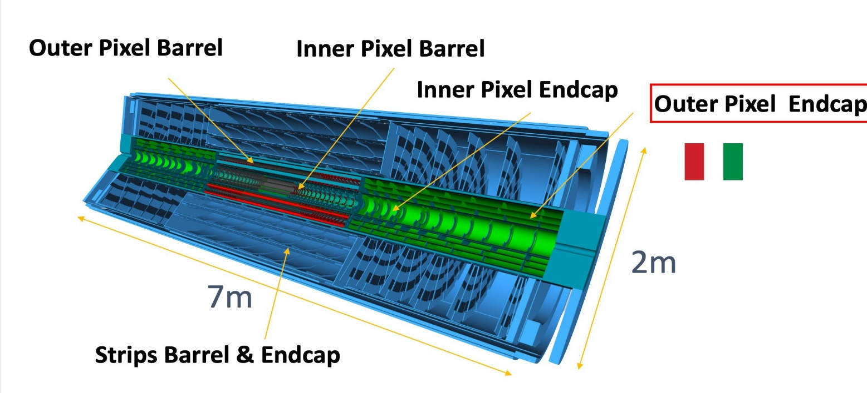
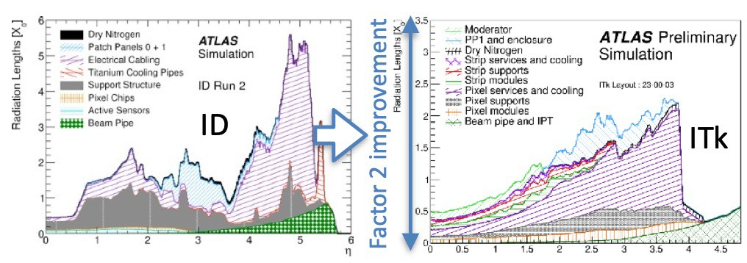
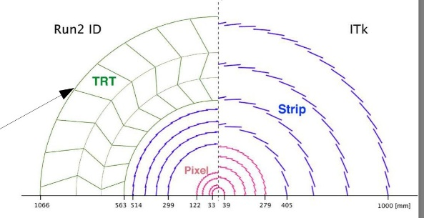
ITk : The New Inner Tracker
Italy will build one
Outer Pixel
All-silicon tracker
Endcap
ITk (ID) | Area (m²) | # Modules | # Channels (M)
Pixels | 13 (1.6) | 9164 (2000) | 5100 (92)
Strips | 165 (61) | 17888 (4088) | 60 (6.3)
Improved tracking
  Coverage up to |η|<4 (ITk) from |η|<2.5 (ID)
  Finer segmentation:
    50x50μm² or 25x100μm²
    ID: 50 × 400 μm² or 50 × 250 μm²
  Reduced material: Carbon Fibre structures, CO₂ cooling with thin Ti tubes walls, advanced serial powering, data link sharing
Radiation hardness:
  n-in-p pixel sensors (n-in-n for ID)
  Thinner sensor 100-150 μm (200-250 μm in ID)

Slide 6
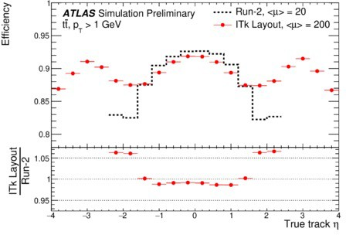
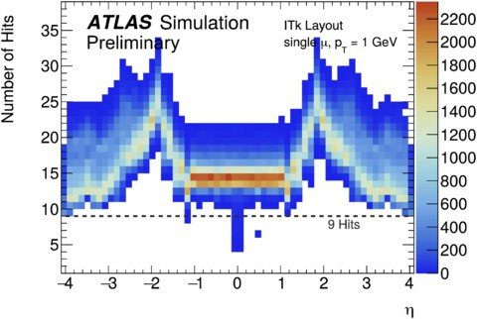
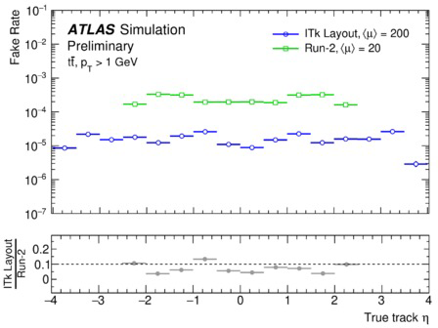
ITk Performances
Important LNF contribution to design and simulation,
for |η|<4 coverage and pixel size decision
ATL-PHYS-PUB-2019-014
ITk Pixel TDR
ITk Strip TDR
M.Testa
>9 silicon hits per track

Slide 7
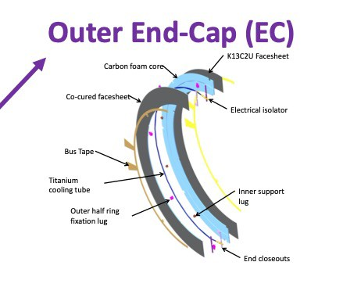
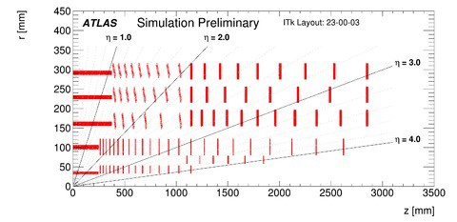
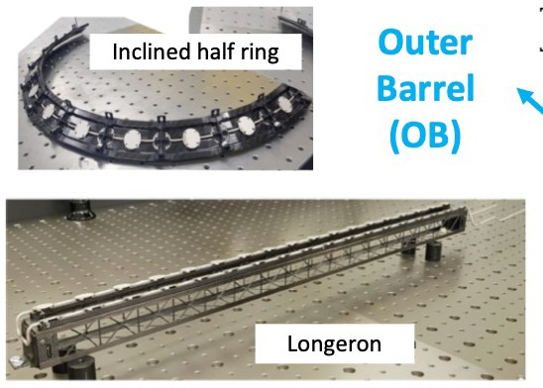
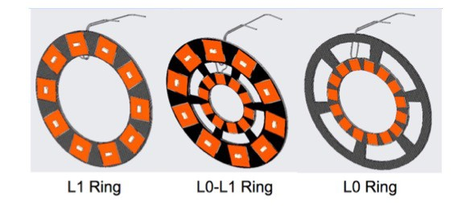
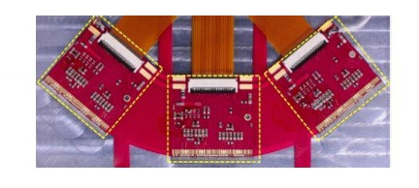
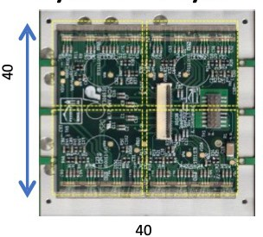
ITk Pixel Detector
Local supports: Different designs to support flat and inclined module mounting
Outer Endcap
Outer Barrel
L4 L3
L2
L1 L0
Inner System
Modules: two main module types, quad & triplet.
Triplet
Quad
Layer | Module type | Sensor type | Sensor thickness [um] | Pixel size [um²]
L0 barrel | Triplet | 3D n-in-p | 150 | 25x100
L0 rings | Triplet | 3D n-in-p | 150 | 50x50
L1 | Quad | Planar n-in-p | 100 | 50x50
L2-4 | Quad | Planar n-in-p | 150 | 50x50
IS to be replaced after 2000fb⁻¹ to reduce radiation damage.
L0 placed 34 mm from beam pipe.

Slide 8
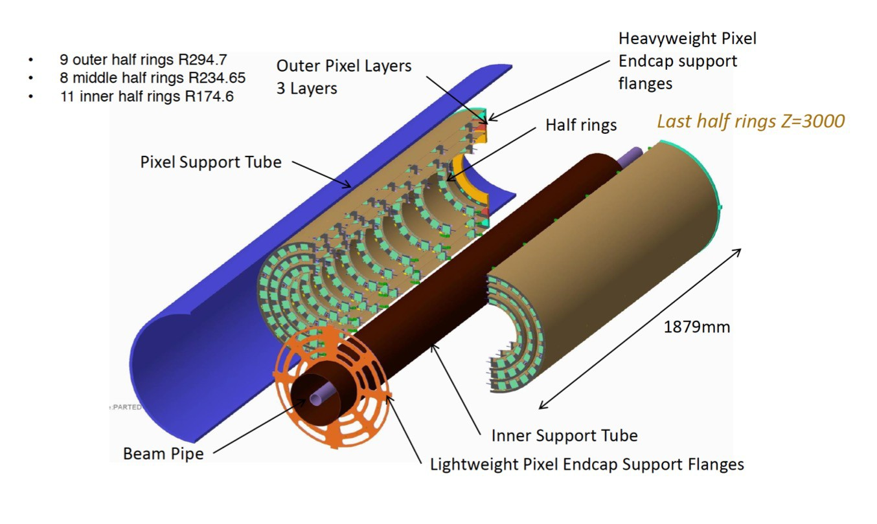
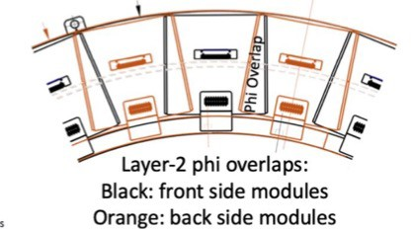
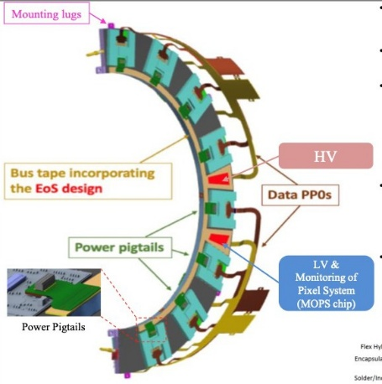
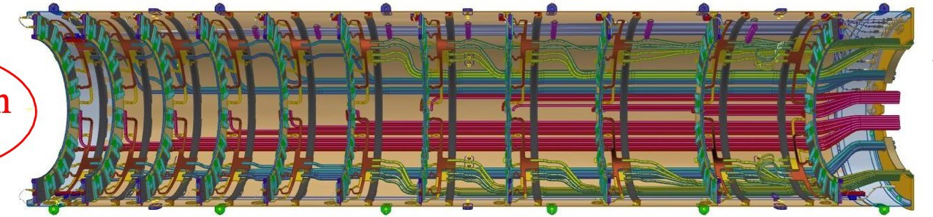
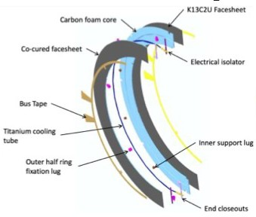
ITk Pixel Outer Endcap
Three layers of half-rings (HR) loaded into carbon fibre half- cylinders
HR are strategically placed in z to provide hermeticity in η
Modules on both sides of HR ⟂ to beampipe → Φ hermeticity
SI modules
>= 5 pixels overlap in φ.
Each HR side holds one serial-powering chain:
  16/22/26 Modules for Layer2/3/4
Cooling lines, data and electrical cables, run between outer rims of rings and inner surface of cylinder
Half-rings are C-foam / C-fibre “sandwiches” with embedded cooling pipe and fixation lugs
IP

Slide 9
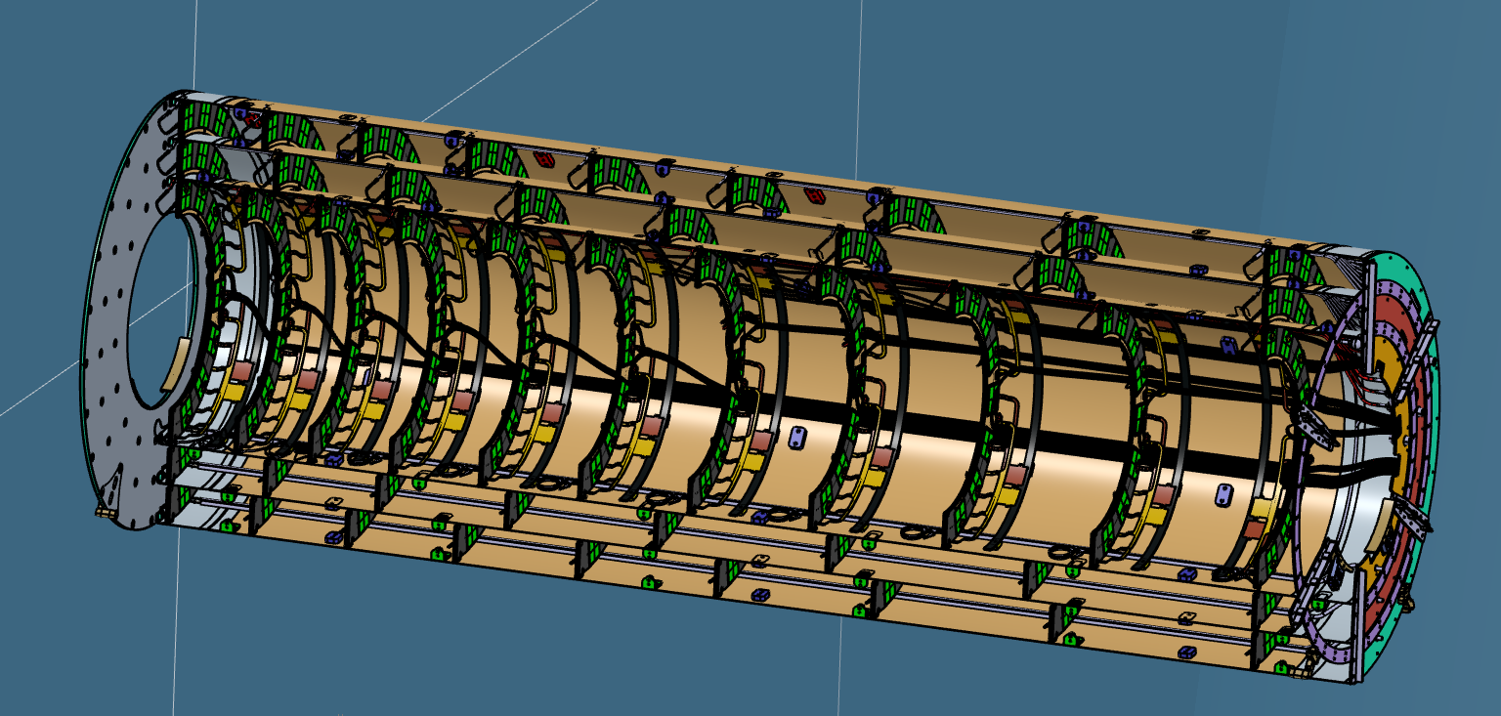
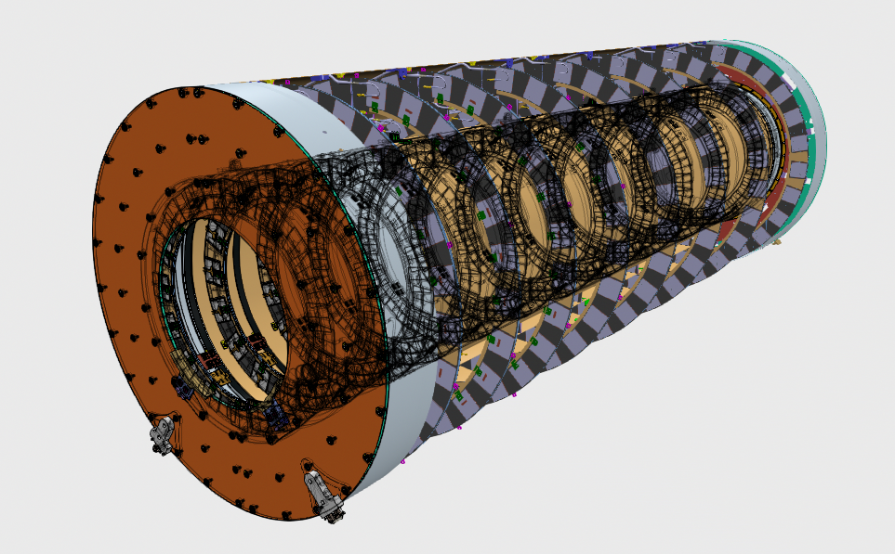
ITk Pixel Outer Endcap
IP FLANGE
(Low-z)
L2 HR: 11 per HS
L3 HR: 8 per HS
L4 HR: 9 per HS
Dimensions:
L4 diam: 750,2 mm
L3 diam: 528.1 mm
L2 diam: 408 mm
Length: 1888 mm
SERVICE FLANGE
(High-z)

Slide 10
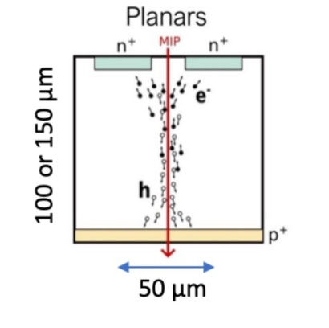
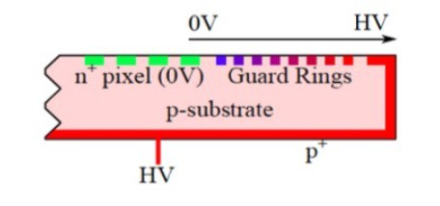
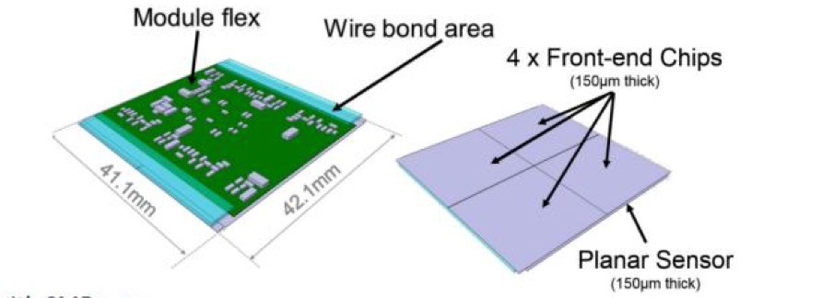
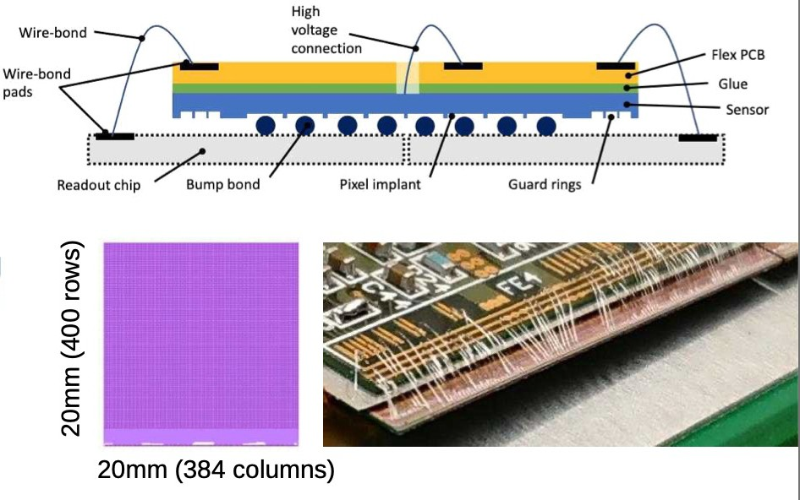
Sensor, Front-End Chip and Modules
Planar Sensor n-in-p
Front-End Chip by RD53 collaboration
  Read out trigger frequency at 1 MHz
  4 data lines at 1.28 Gbps
  Uplink sharing
  Rad-hard up to 500 MRad
  65nm technology
  Chip size: 400 x 384,
50x50 μm² pixels, 2.0 x 2.1 cm²
  Shunt-LDO regulator for serial powering
  8912 data links / endcap from modules to off-detector electronics
Modules: 4 FE chips bump-bonded to sensor
Cu-Kapton flex hybrid glued to sensor
for connection to power, slow controls and data distribution
  Wire bonds connect the flex to the FE chip(s)
  “pigtails” connecting modules to power / data
1172 modules/endcap

Slide 11
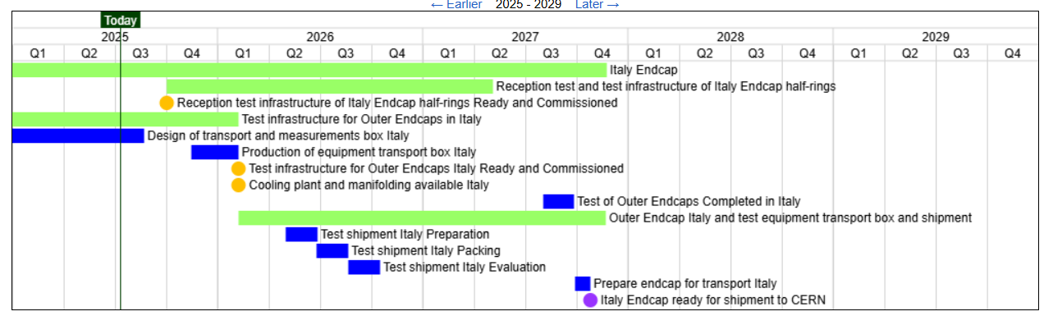
Schedule from the last statusing

Slide 12
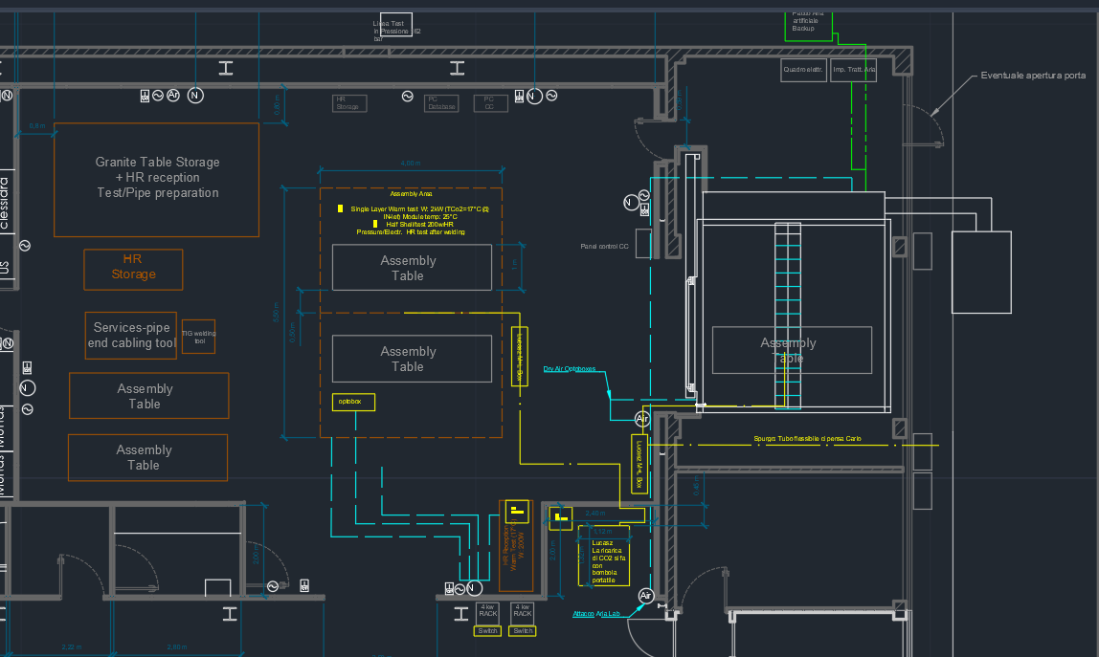
Camera Pulita ATLAS ITk
Sistema supplementare di essiccamento aria
Camera Climatica
Welding Machine
Impianto CO2 Luckacsz
M.Testa
E. Dané
G. Cesarini

Slide 13
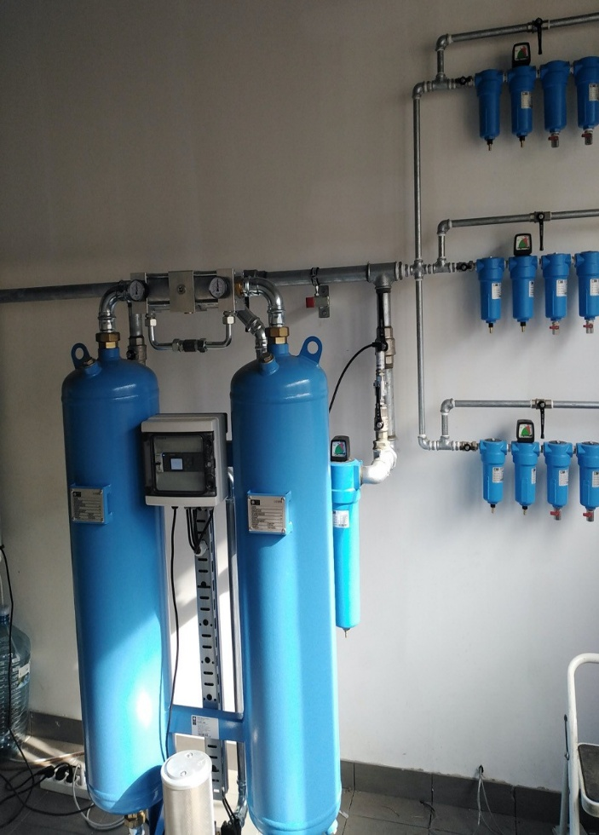
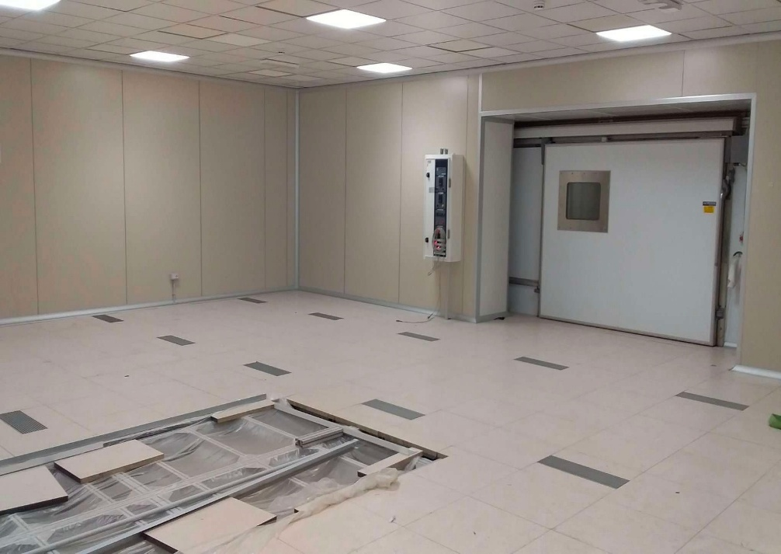
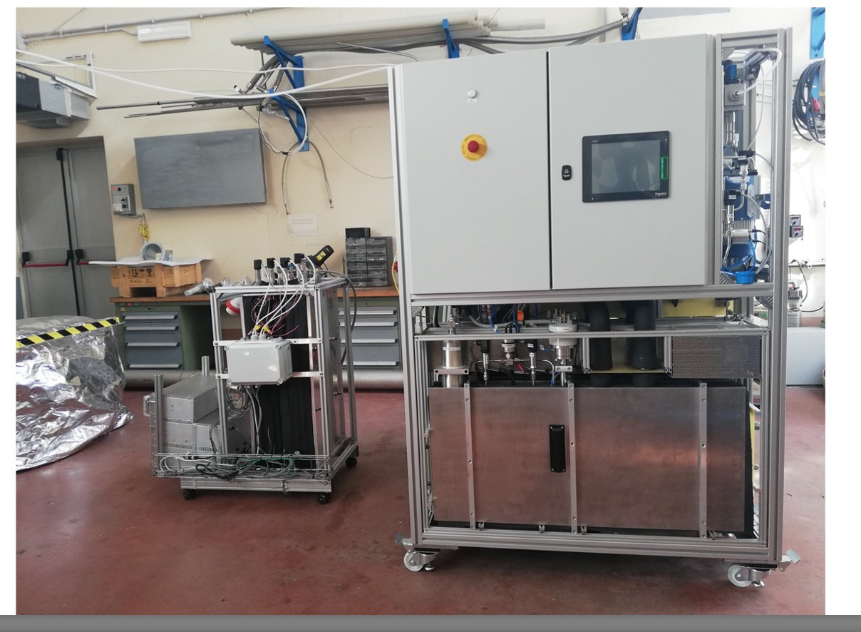
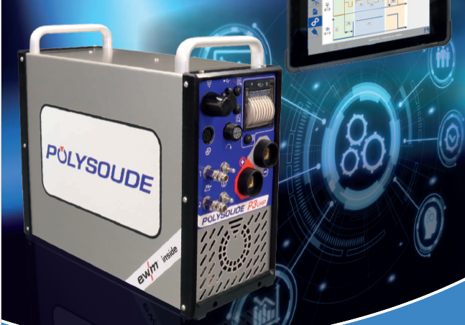
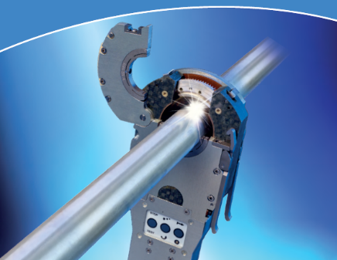
CO2 cooling LUCASZ
Light Use Cooling Appliance for Surfaces Zone
Dry air with dew point down to -70°C
Climatic Chamber
0
Constructed and commissioned in 2021 at DESY
Successful test with merging lines at LNF
➔ 20 g/s CO₂ flow
Successful Integration with interlock system
Orbital Welding Machine

Slide 14
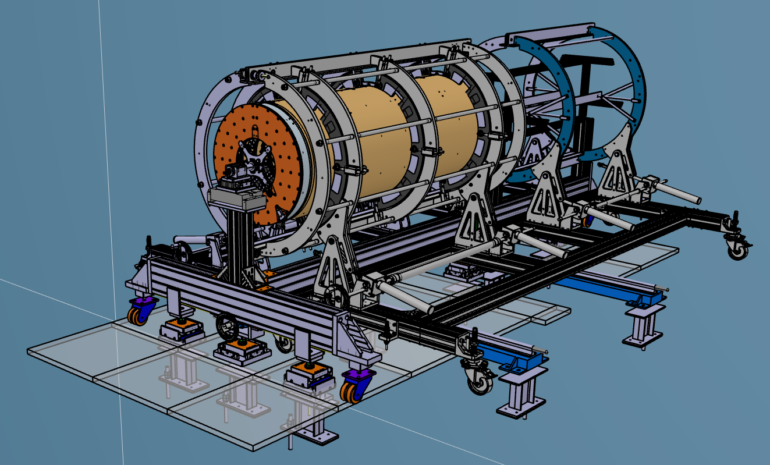
OVERVIEW OF THE SYSTEM
Filippo Rosatelli
Bruno Ponzio
Marco Battisti
Emilio Capitolo
Lorenzo Roscilli
Giuseppe Pileggi
Antonio Croce
Beka Buadze
Sandro Tomassini
Dario orecchini
LEFT CRADLE
RIGHT CRADLE
T-TROLLEY
3 SUBSYTEMS:
BASEMENT UNDER THE FLOATING FLOOR (PILLARS AND LATERAL RAILS)
T-TROLLEY
CRADLES
FLOATING FLOOR
y
LATERAL RAILS
x
z

Slide 15
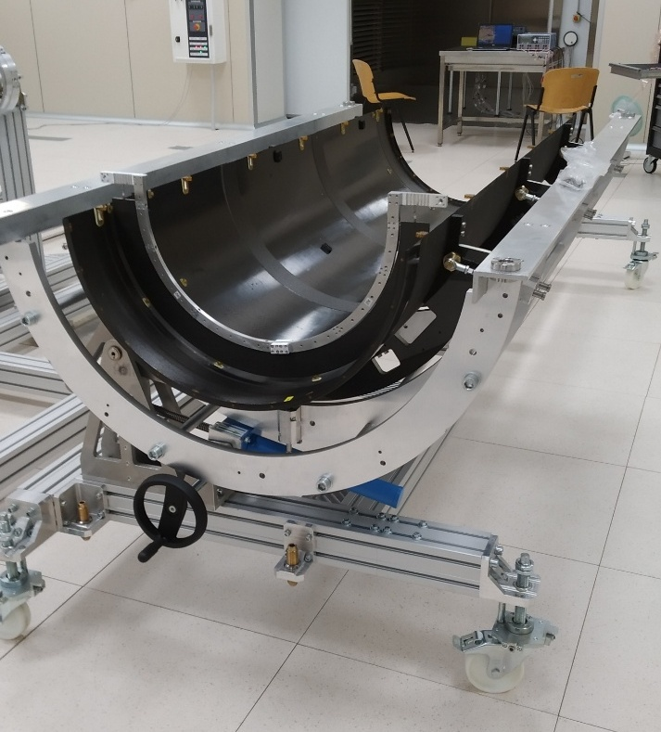
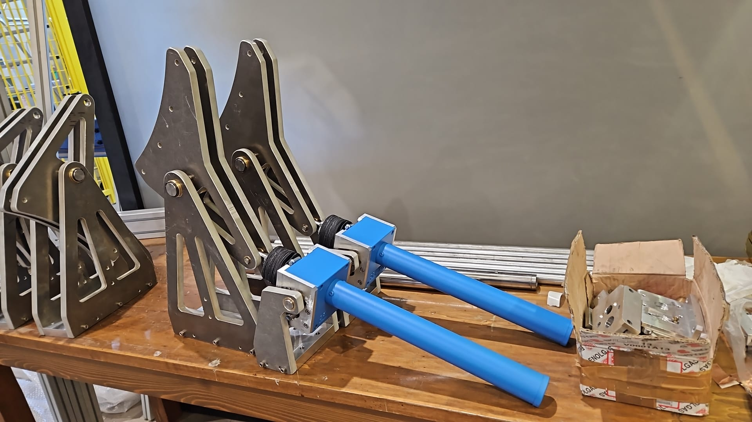
Material from Naples shipped to LNF, ready to be mounted
Missing the part of the service, the material is just arrived and some other parts are produced in LNF so we can start to add this part. The idea is to mount already closed the upper part of the cradle and then connect it to the bottom part. Missing the part of the connection between the cradles and carriages. Arriving these parts soon to perform some test.

Slide 16
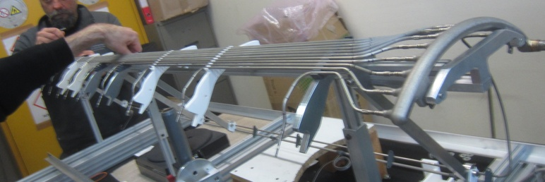
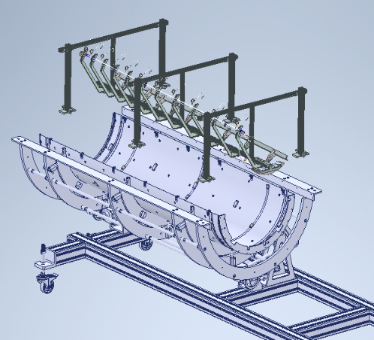
PIPE INSERTION TOOL
Assembly tool
Detector Manifold
Pipes
by Milan group

Slide 17
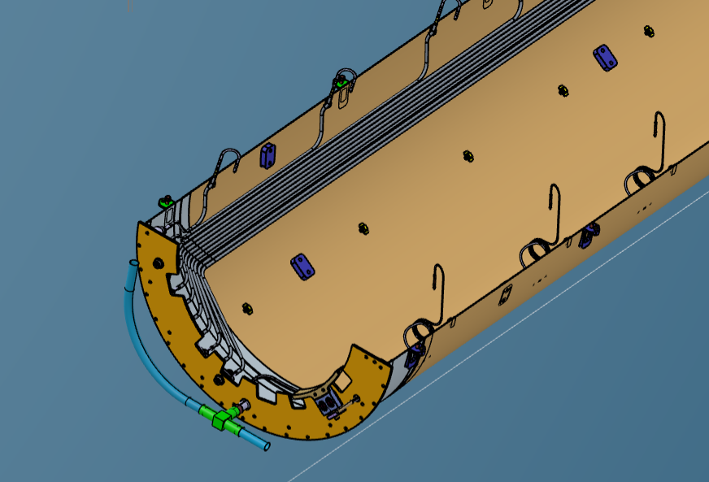
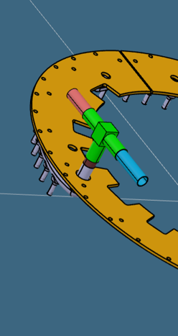
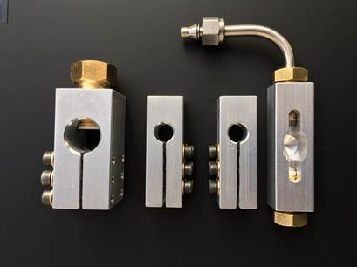
FIRST PP1 MANIFOLD WELDING
Once the pipes are in position the first welding for connecting the exhaust and inlet PP1 manifolds is performed
T part of the PP1 manifold
Temporary fitting o Fred fitting
First PP1 Manifold welding
L2 Rear Flange
Part of the detector manifold emerging in PP1 Area
PP1 Manifold Exhaust
Inlet
S. Coelli slides for welding details

Slide 18
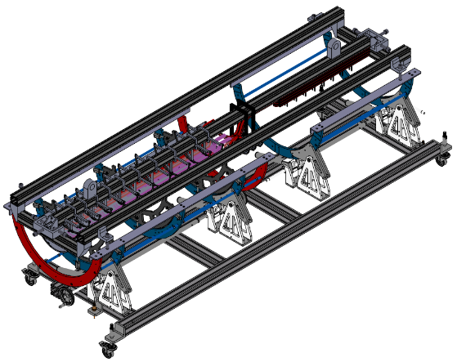
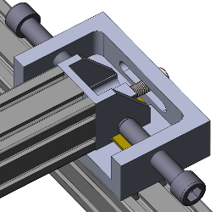
CABLE HARNESS INSERTION TOOL
The position of the cable harness is adjustable on the cradle. The plate at either end can slide on a low-friction interface
Horizontal position is adjusted by screws
by UK group
Support of cables in order to transfer to the integration tooling

Slide 19
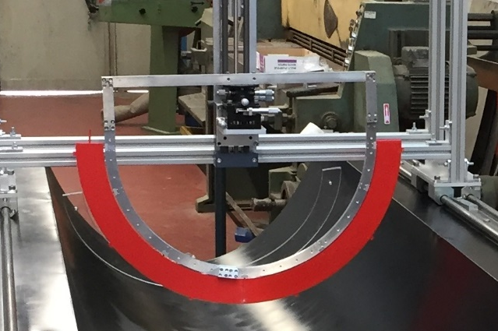
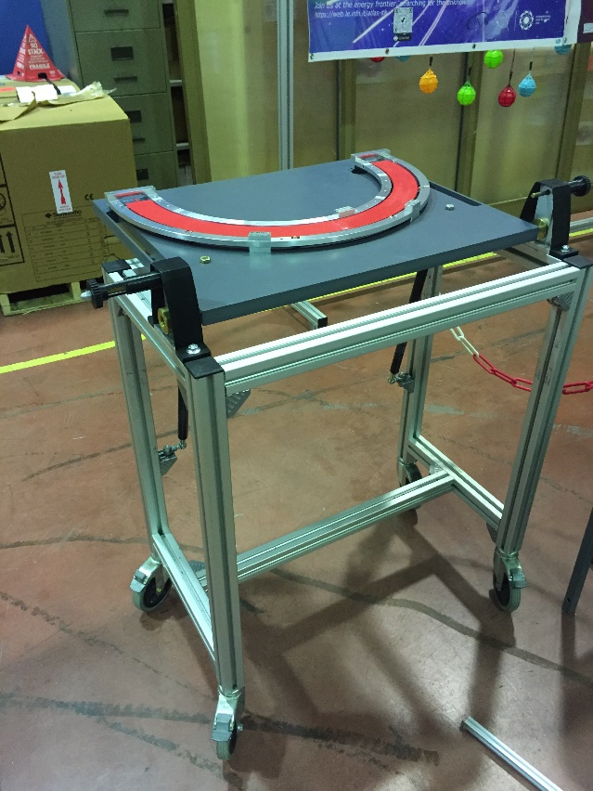
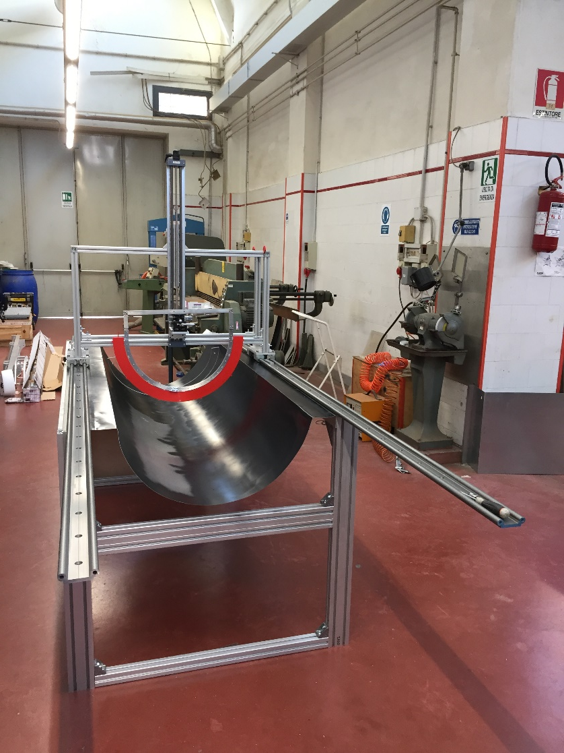

HALF RINGS INSERTION TOOL
Horizontal rails are positioned on the rotating cradle for movement along z axis. A vertical rail is devoted to move down the HR.
Y MOVEMENT
HR Orientation Tool
TILTING TABLE
RAILS
by Lecce group

Slide 20


Half-ring test after insertion
QC: measure the isolation resistance between the GND pad of bus-tape and the HS
Connect HR to pwr and data type-1 cables
Bus tape is grounded
Canbus shield

Slide 21




Half-ring welding
Three weldings per HR
1° exhaust welding 2° exhaust welding
1° inlet welding
Leak test, Pressure test 162 bar, Leak test
Temporary ground the pipes nearby HR to protect modules
After welding
Re-test connectivity one HR at the time after welding to check no damage to module or services
After welding LS is grounded through pipes

Slide 22


Slide 23


HALVES SHELLS MATING: ASSEMBLY PROCEDURE
STEP 1
STEP 2
Interlinks are connected: 6+6 pairs on upper and bottom side of the HSs
The 2 HS are mated by mean the 2 rotating cradles

Slide 24


HALVES SHELLS MATING: ASSEMBLY PROCEDURE
STEP 3
cross flange
spherical joint
STEP 4
The Low-z flange is connected to the L2 mated
Exploiting the spherical joint and the linear stages the cross-flange is oriented and adapted to the low-z flange position

Slide 25


STATUS OF T-TROLLEY
SERVICE TROLLEY
"HEADS"

Slide 26




Integration Heads
Low Z flange (A)
High Z flange (B)

Slide 27



HALVES SHELLS MATING: ASSEMBLY PROCEDURE
PP1 EhxuastManifold
STEP 5
Also the Head in High-z position is connected
Z-axis shift
cross flange
No clash between the PP1 Manifold and the cross flange
System of springs (not in the pic)
As can be seen in the figure there is no clash between the PP1 manifold and the detector support. By taking advantage of the 2 springs present in the lower arms of the cross-flange and the movement along the z axis allowed by the bearing, the detector support can be connected to the rear flange.

Slide 28

HALVES SHELLS MATING: ASSEMBLY PROCEDURE
STEP 6
The part of the services is connected to the "Totem"
Totem
Cables
In this position the load is still on the cradles. Exploiting the spherical joints of the head the detector is the first load transferred to the T-trolley, and after the services.

Slide 29







Test on complete Layer
Low impedance connection of the two HS
Ground layer to floor
Connectivity Test for complete layer
Low impedance connection from HS to floor
Twinax
Extentions
Use Lowe Power mode
Cooling through climate chamber
  Demonstrated with prototype
Optopanel
Optopanel
with T_{air} ~ - 35 C ( in bkp)
Helping with CO₂ cooling is still possible
LV lines:
chip register reading
MOPS reading of module V and T
braid
Climate chamber
Tlock
Data transmission:
  Uplink: digital scan and BERT
or external box
electrical break
GND
Downlink: Configure a FE in each module
CO ₂
HV lines:
PP2
plant ground
PS will have not enough sensitivity
Open point: strategy to be defined
GND

Slide 30

Connectivity Test on full endcap pre-shipping
Harness not present in picture
By mean the lifting system under the floating floor, the T-trolley is positioned on wheels and then can be moved into the Climatic Chamber for the final test.
Final test in the climate chamber
  Low power mode
  Cooling demonstrated with prototype with Tair ~ - 35 °C
  Helping with CO2 cooling is still possible

Slide 31



Solution with a smaller box
Optoboxes
Switch load system
4200 mm
Rail support
1660mm

Slide 32



Prototypes
The idea is to have the whole detector in a prototype/mockup version in in order to test the mating (empty), then the insertion of the piping, the insertion of the cables and the Half Rings, and then the mating with the populated HS and the PP1 manifold (see tomorrow talk) for each layers. Some HRs could have the piping to perform some welding test.
What we have so far:
Half Shell: we have one Half L4 (from Liverpool) and 2 L2 (from Aviacompositi).
Lugs: all printed in ULTEM (by Naples)
In production the tool for the positioning the lugs of the HS (by Giuseppe Pileggi LNF)
Half rings: 2 HRs per type (6 in total) made in LNF (E. Paoletti, R. Tesauro)
Lz flange: already printed (ABS)
Hz flange: Printed for L2 (ABS)
"Spider" Flange: Produced (F. Rosatelli)

Slide 33

QA Tests are foreseen to check the functionalities of the system:
Thermal Cycling on the HS connected to the rotating cradle
Thermal Cycling and functional test on the HS equipped with HRs
Cradle with HS
Climatic Chamber
6

Slide 34



Alignment test are scheduled to prove the position precision of the system
We performed some test for the mating of the cradles but problems raised up. Each part has not bad cylindrical shape but the mating of some part does'nt match, so we decide to simplify the system and check the alignment of the cradles once they are built. The rails now are one part instead being 2 parts in order to gurantee a better alignment.

Slide 35


System Test
Single and multi-module setup
High Speed data adapter board designed and
produced for Pixel community
DAQ with optical readout
Data Transmission test
Develop interlock logics
  NTC, cooling, power, environmental sensors
Develop of scalable DCS system
Z. Chubinidze, M. Gatta, M. Beretta, M. Testa
Z. Chubinidze
6

Slide 36








ITk Services
Power/DCS cables:
Design, Prototypes and Production
  Quality Control
  Thermo-mechanical cycles
Extension twinax data cables
  Design Prototypes and Production
  Data transmission test
P. Albicocco, M. Testa, Z. Chubinidze
6

Slide 37
Attività e assegnazioni CIF II Semestre 2025
Attività nel II semestre 2025:
Finalizzazione dei disegni delle parti mancanti
Finalizzazione del sistema di sollevamento
Produzione di alcune parti del tool di assemblaggio
Montaggio del tool di assemblaggio e test
Progettazione del sistema di Trasporto
Servizio | Reparto | Assegnato (m.u.)
SEM | Progettazione | 4,5
SEM | Costruzioni Meccaniche | 10
Supporto Esperimenti | Support Unit | 3
SPCM | Progettazione | 0,5
SPCM | Meccanica | 2

Slide 38
Richieste 2026
ATLAS FTE Totali: 11.25 (Fisici + Tecnologi)
 |  | Richieste (kEUR)
apparati | ATLAS Tier-2 | 212
consumo | ATLAS | 21
missioni | ATLAS | 162
consumo | Phase II - ITk | 34.5
apparati | Phase II - ITk core | 563
Servizi | Richieste stimate 2026 (person months)
Electronics and Automation Service (DR) | 12
Mechanics Service (DR) | 8 months x 4 persons
Detector Development and Experimental Activities Support Service (DR) | 10 months x 2 persons
Servizio Progettazione e Costruzioni Meccaniche (DT) | 4
Cryogenic System (DA) | 3
Vacuum (DA) | 5
Notes:
Starting from the analysis, the Higgs to four lepton decay channel is called the golden channel since it has a fully leptonic final state and high lepton reconstruction efficiency allowing to be one of the main channel to perform precision measurements of the Higgs properties. And despite the low decay rate it has a very good signal over background ratio around 2, making the signal clearly identifiable over the main backgrounds. My work on this topic is dated back to 2017, so in the last years I gave several contributions in different analyses to probe the various Higgs boson properties, from the mass to the CP up to the cross-section and coupling measurements, covering leading roles as Analysis contact and paper editor, and now I am the current coordinator of the HZZ group in the ATLAS collaboration which aim to study the Higgs boson in this specific final state.
I will start the overview of my main contributions…

