Slide 1
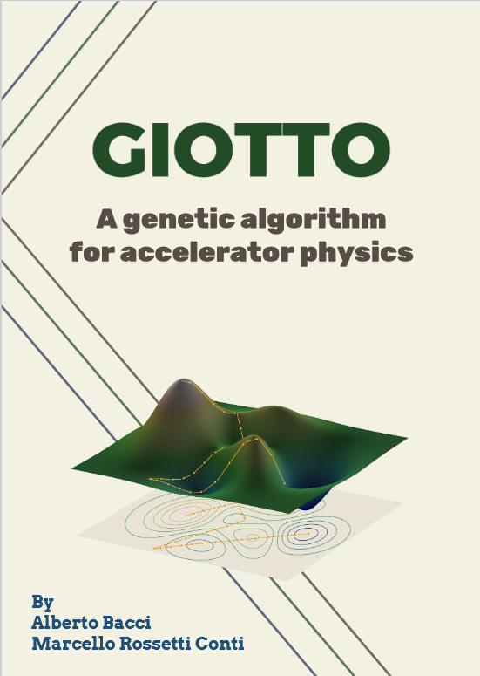
GIOTTO an AI optimizer for accelerators
Genetic Interface for OpTimizing Tracking with Optics
One of first AI codes for beam line design & optimization.
Solves complex multi-objective problems (correlated parameters, space-charge like) & statistical analysis (machine jitters studies).
Drives the beam dynamics PIC code ASTRA. Natively compatible with NameList std.
V. 13.0 for Linux & Windows, parallelized with MPI.
Successfully used in important projects, as:
Some contributions to publications:
New approach to space charge dominated beamline design – PRAB 26 (2023)
Two-pass two-way acceleration in a superconducting CW linac to drive low jitter x-ray FEL–PRAB 22 (2019)
Electron beam transfer line design for a plasma driven Free Electron Laser – NIM A 909 (2019)
Electron Linac design to drive bright Compton back-scattering gamma-ray sources – JAP 133 (2013)
Coming soon:
Innovative solutions for high-brightness low-energy ERL injector design: the BriXSinO approach
Notes:
The acronym stays for Genetic Interface for OpTimizing Tracking with Optics
GIOTTO is an AI optimizer based on a Genetic Algorithm developed in Milano by me and Alberto Bacci
Giotto drives ASTRA and potentially other simulators and postprocessors. We applied it on a variety of BD problems from plasma driven Free Electron Lasers Capture and Matching lines to Energy Recovery Linacs low energy injection design

Slide 2
GIOTTO proposal main objectives
• Integrate GIOTTO into accelerator Control Systems (as piloted in SPARC and STAR) to achieve, on the machine (or beamline), same performances as predicted by simulations.
• Enable chained optimizations including cavity design tools (e.g., Superfish, HFSS a/o CST) e.g. to improve: FCC positron capture; DC-gun/DLA matching (MICRON-->CODLAS) ; PWFA injector RF design + BD (Eupraxia)
• Statistical tools: the Knobs sensitivity MAP to identify knobs with behaviors hidden by complex correlations
• GIOTTO as an institutional project within INFN improved usability, broader dissemination, and tangible benefits for accelerator design and operation
INFN involved unities:
Budget allocation
• INFN-MI 20 k€ II-year 2x NVIDIA-RTX A 6000 + 10 k€ travel/y • INFN-LNF 30 k€, I-year 2x WS AMD 128 threads + 6 k€ travel/y • INFN-LNS 15 k€, I-year 1x WS AMD 128 threads + 6 k€ travel/y Total:131 k€
• INFN-MI (2 FTE) : RN – Alberto Bacci • INFN-LNF (1FTE) : RL – Anna Giribono • INFN-LNS (1FTE) : RL – Giuseppe Torrisi

Slide 3
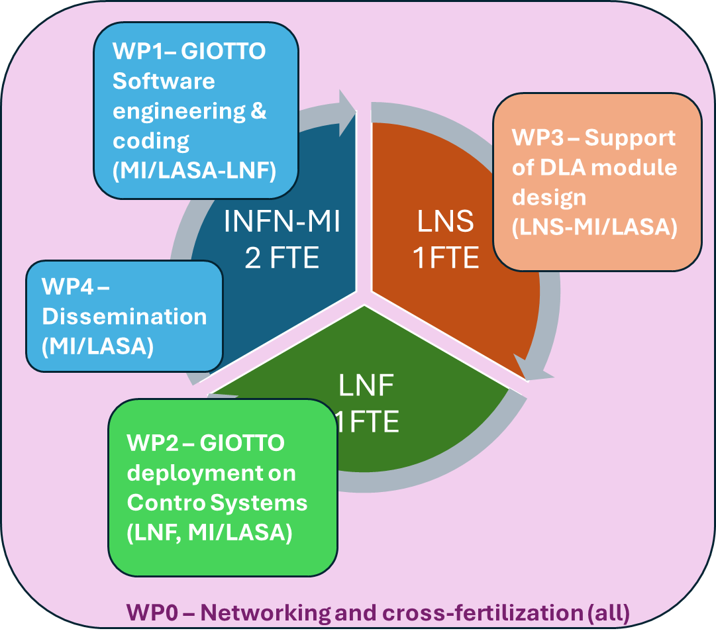
WP0 – Networking and cross-fertilization (All)
Resp. A. Bacci
WP1– GIOTTO Software engineering & coding (MI/LASA-LNF) 1.1 - Control System Version 1.2 - Classical Version
1.3 - RF Cavity design and BD seamless optimization 1.4 - Jitters sensitivity map study & development
Resp. M. Rossetti Conti
WP2 – GIOTTO tests on Control Systems (LNF, MI/LASA)
2.1 - Jitters analysis and optimization on WPs @ SPARC
2.2 - GIOTTO_CS test on @ STAR/SPARC/HARMONIQ Resp. A. Giribono
WP3 – Support of DLA module design (LNS-MI/LASA) 3.1 - DLA Cavity design and BD seamless optimization Resp. G. Torrisi
WP4 – Dissemination (MI/LASA)
4.1 - user-friendly interface
4.2 - dedicated website 4.3 - training course to broaden adoption
4.4 - Giotto Manual new version
Resp. A. Bacci & M. Rossetti Conti

Slide 4
Example of GIOTTO FCC positron capture beam-line optimization
Further Credentials

