Slide 1
Co-Propagating Dielectric Laser Accelerator Structures (CoDLAS)
Durata : 2 anni
Area: ACCELERATORI
Responsabile nazionale: Giuseppe Torrisi, INFN-LNS
Resp. Locale LNS: Giorgio Mauro
Unità partecipanti: LNS, MI, TO

Slide 2

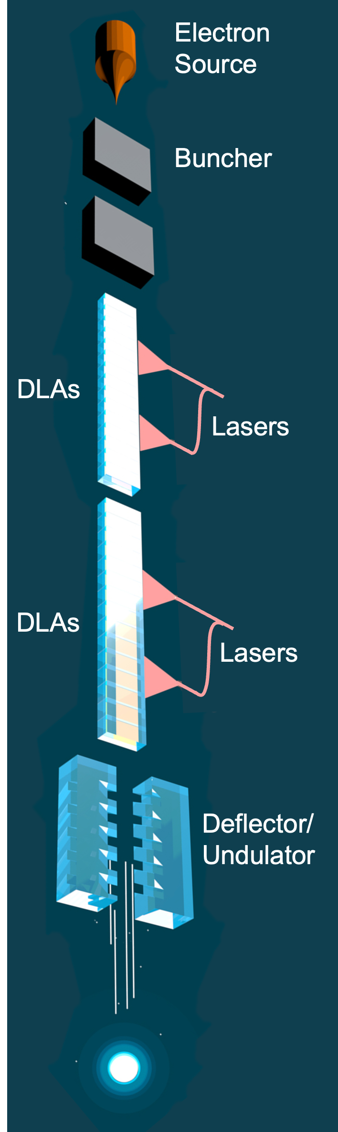
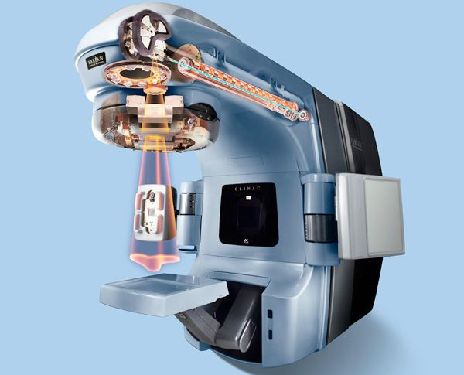
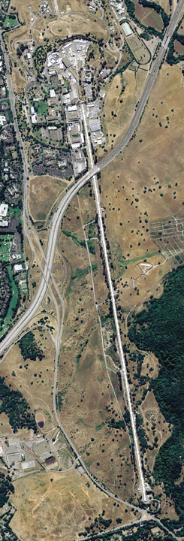
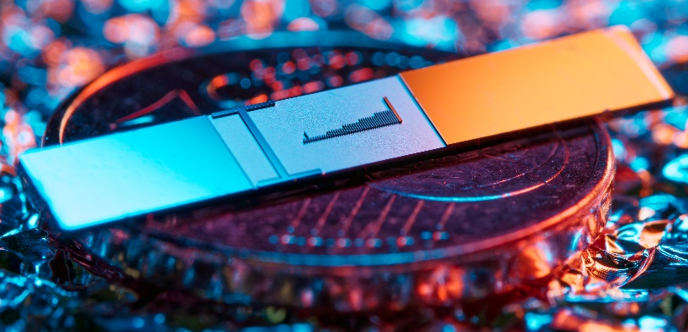

Introduction: On-chip particle accelerators
Conventional accelerators
Dielectric Laser Accelerators (DLAs)
SLAC
Table-top
(On-chip)
2-mile long
Miniturization
news.fnal.gov/2022/05/
Varian medical systems
Chlouba, T., et al. "Coherent nanophotonic electron accelerator." Nature 622.7983 (2023): 476-480.
m.indiamart.com
https://www6.slac.stanford.edu/about/contact-slac

Slide 3
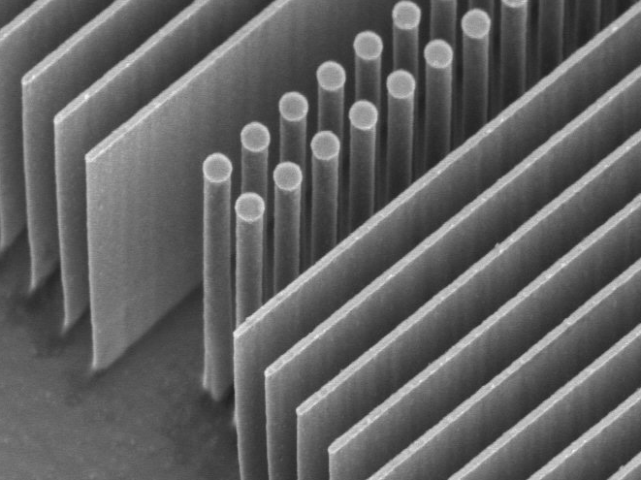
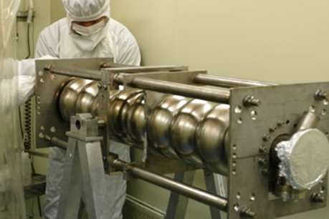
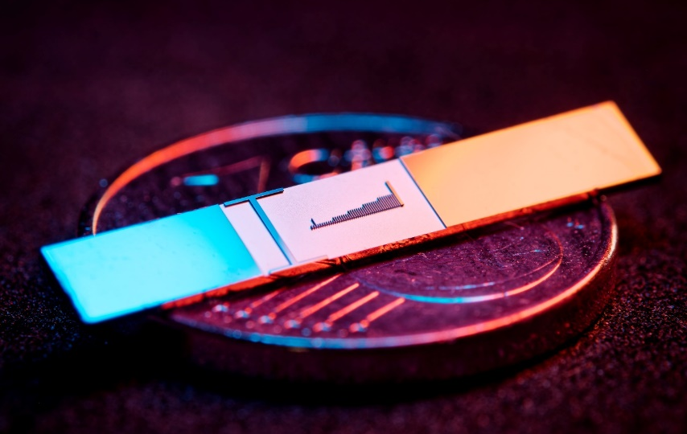
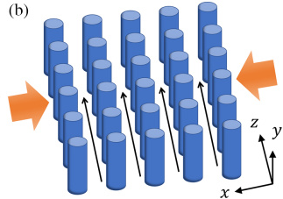

Why Dielectric-based Laser Accelerators (DLAs) ?
$$\text{1 }\text{μm}$$
Fermilab
Dielectric materials and optical frequencies
Higher damage threshold than metallic cavities
Higher gradients and smaller, miniaturized structures
Much stricter requirements on beam properties
Lower current
per channel
Laser
Laser
DLA
f=150 THz (λ=2 μm)
τ=6.6 fs
RR ~ kHz-MHz
>3 GV/m fields
Gradient >1 GeV/m
Physical aperture: ~200 nm
Emittance <100 pm rad (norm)
fA-pA
(in single channel)
RF
f=3 GHz
τ=333 ps
RR ~ Hz-kHz
<200 MV/m
25-50 MeV/m
~1cm
1 μm ~ 1 mm rad
nA-μA and larger
Multi-channel DLA:
Zhao et al., Photonics Research 8 10,
1586-1598 (2020)

Slide 4
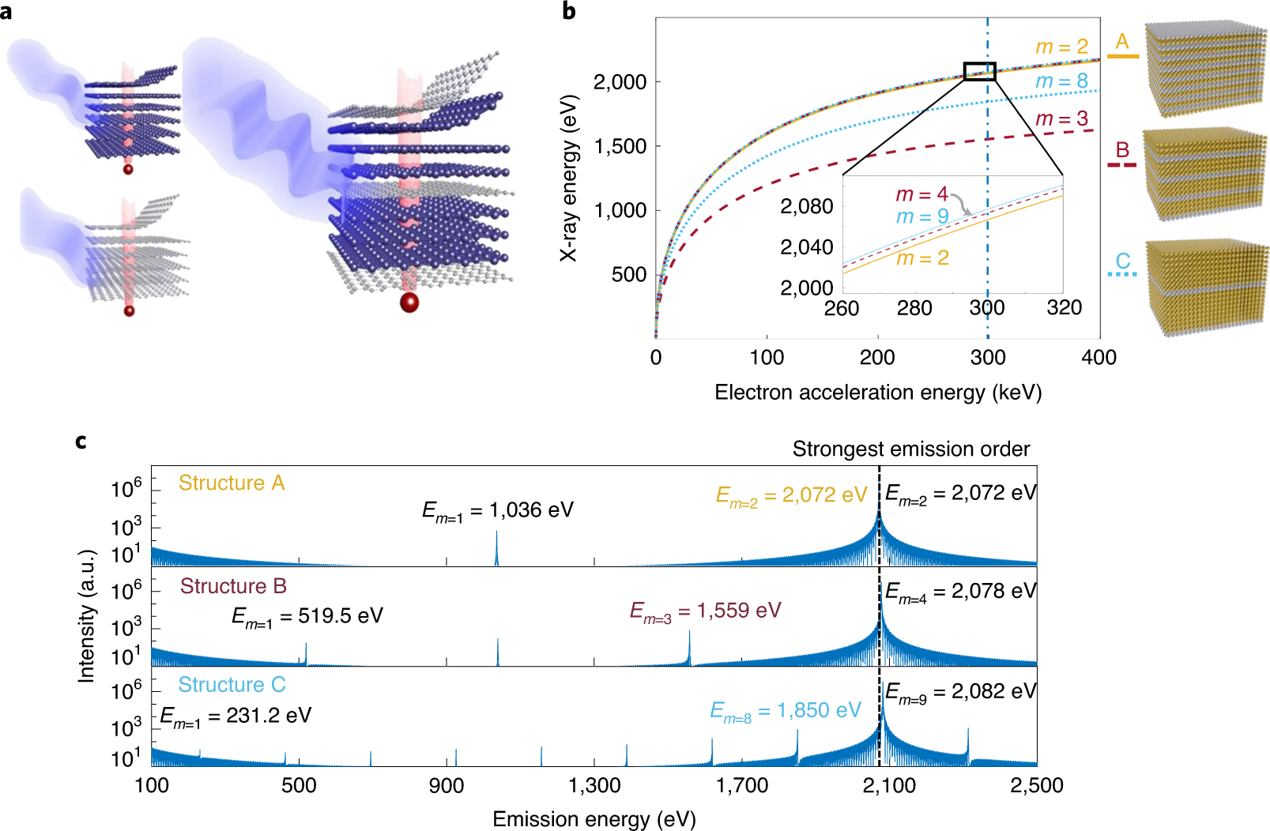
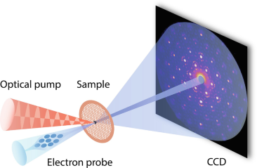
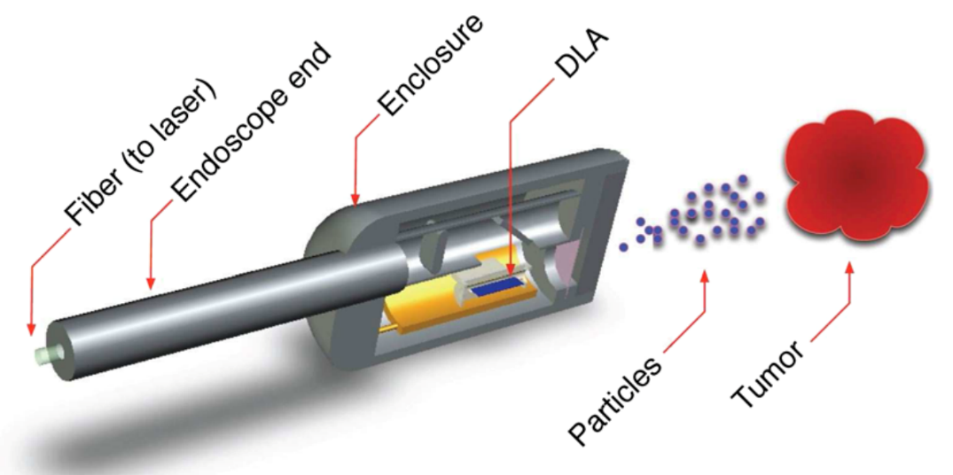
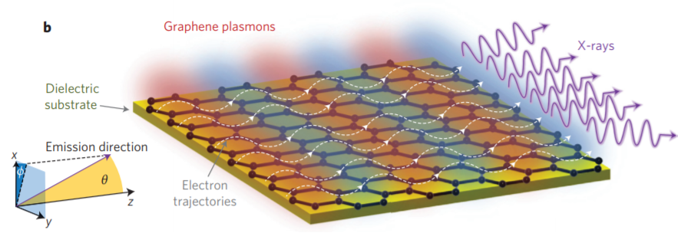

Potential applications of DLAs
Free-electron (X-ray) light sources
Ultrafast electron diffraction and microscopy
X-rays
van der Waals materials
Zong, A. (2021). Ultrafast Electron Diffraction. Springer, Cham.
$$e$$
Medical devices
Shentcis, Michael, et al." Nature Photonics 14.11 (2020): 686-692.
Wong, Liang Jie, et al. Nature Photonics 10.1 (2016): 46.
England, et al. Reviews of Modern Physics 86.4 (2014): 1337.

Slide 5




Other Applications
Electron compression
$$ω_{1} ω_{2}$$
Electron pulse
Optical resonator, e.g., DLA
Quantum sensing
$$ω$$
$$E$$
$$e$$
$$E$$
2-level atom
Modulation stage

Slide 6
CoDLAs Objectives
Design and fabrication of dielectric laser accelerator (DLA) structures optimized for co-propagating configurations, enabling efficient energy transfer to charged particles over extended interaction lengths.
Demonstrate laser coupling using co-propagating laser pulses in a sequence of dielectric structures and SEM-based electron injection setup preparation
Integrate advanced diagnostics for measurement of beam energy and transmitted charge.
Explore scalability of the design different particle species, including potential schemes for muon acceleration, leveraging the extended phase-matching offered by co-propagation.

Slide 7
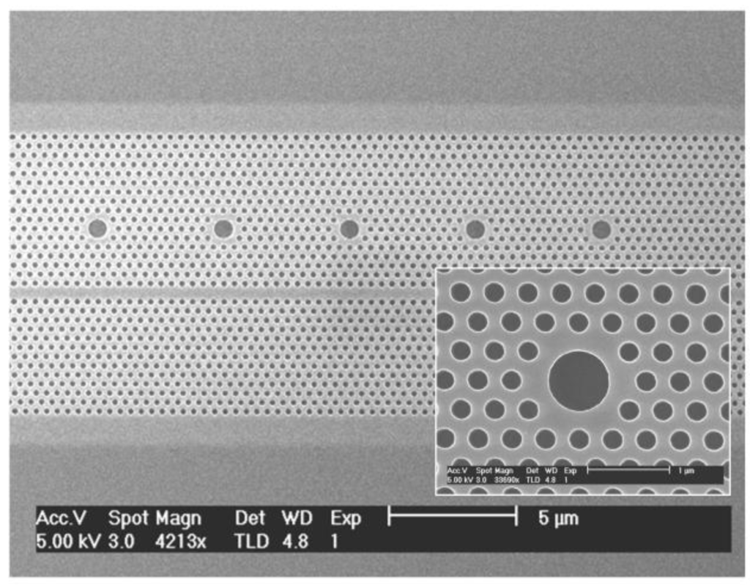
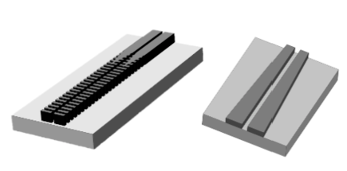
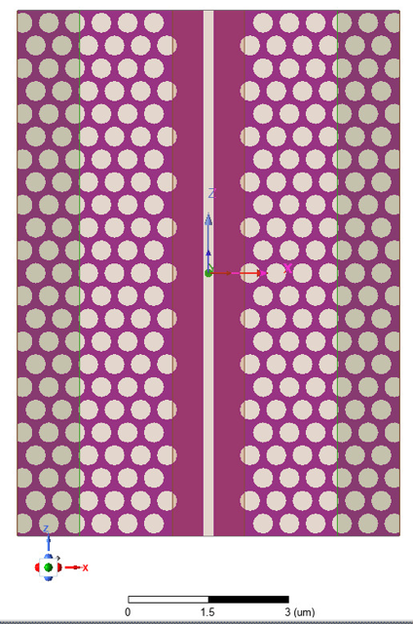
CoDLAS Experimental Concept: Sub-Relativistic DLA Testbench
https://www.mdpi.com/2304-6732/1/4/412
Goal: Test a cascade of dielectric structures to increase β from ~0.2 to ~1.
Strategy: progressive increase in β (v/c) from ~0.2 to ~1 using a modular structure chain:
1. High-Q cavities (β ≈ 0.2–0.3):
- Inspired by ACS Nano 2024 design (https://pubs.acs.org/doi/abs/10.1021/acsnano.3c11211)
- Efficient energy coupling and field confinement
2. Slot waveguides (β ≈ 0.4–0.75):
- Based on designs in Optics Express 2023 (https://opg.optica.org/oe/fulltext.cfm?uri=oe-31-23-38891&id=541361)
- Dielectric slots for field enhancement in sub-micron gaps
3. Hybrid Photonic Crystal (PhC)-slot waveguides (β ≈ 0.75–1):
- Slot formed by rib waveguides suspended by PhC membranes
- PhC ensures mechanical support & enhances field via bandgap confinement
Outcome/Deliverable: validate structure chain for increasing β,
targeting high-gradient acceleration (>100 MV/m) up to β ≈ 1.
Notes:
Objective of CoDLAS Experimental Campaign
The CoDLAS project aims to experimentally validate a sequence of dielectric accelerating structures designed for sub-relativistic electrons (β < 1), with the final goal of achieving high accelerating gradients and measurable energy gains across the full β-range up to β ≈ 1. This staged approach is necessary because standard scanning electron microscopes (SEMs) typically operate at initial electron energies of ~20 keV (β ≈ 0.26), which are too low to directly inject into relativistic dielectric laser accelerators.
To address this, we propose a modular acceleration strategy using a cascade of three complementary dielectric structures:
High-Q Resonant Cavities (β ≈ 0.2–0.3):
Based on designs such as those described in ACS Nano, 2024, these microcavities offer strong field enhancement and efficient coupling to low-β electrons.
Slot Waveguides (β ≈ 0.4–0.75):
Following the design concepts introduced in Optics Express, 2023, slot waveguides allow tight field confinement between closely spaced dielectric regions, suitable for accelerating mid-β electrons.
Hybrid Photonic-Slot Waveguides (β ≈ 0.75–1):
The final segment features slot waveguides suspended by a photonic crystal (PhC) membrane. The PhC structure serves two key roles:
(i) it mechanically supports the slot region;
(ii) it enhances field localization due to the photonic bandgap, which suppresses propagation outside the slot.
This structure is designed for operation with near-relativistic electrons, aiming to reach β → 1.
The CoDLAS experiment will test this full architecture in vacuum conditions with pulsed laser excitation, measuring both the transmitted beam energy distribution and gradient performance via diagnostics downstream of each section. This work will establish the first integrated test of sub-relativistic DLA scalability.

Slide 8
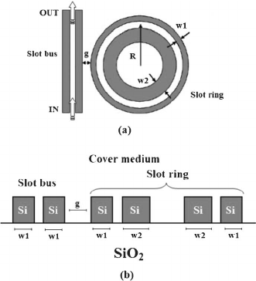
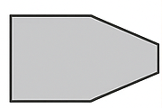
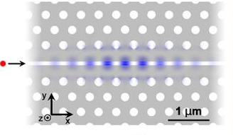
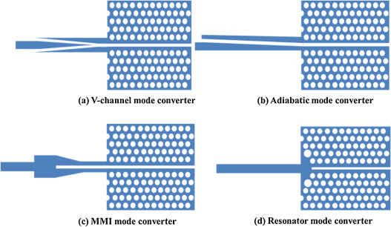
CoDLAS: Sub-Relativistic Nanophotonic DLA
Electron Beam
• Modified SEM / fs-triggered nanotip cathode
• 20 keV → β ≈ 0.27
Module Chain
  High-Q Cavities (β ≈ 0.2–0.3)
  Slot Waveguides (β ≈ 0.4–0.75)
  Hybrid Photonic-Slot (β ≈ 0.75–1)
  Energy Diagnostics
  • Dipole magnet → MCP / Retarding Field Analyzer
  • Direct measure of gradient & gain
Outcome:
Stepwise acceleration from β ≈ 0.27 → β ≈ 1, validating next-gen nanophotonic DLA platforms.
Electron
Source
High-Q Cavities
Slot Waveguides
Hybrid Photonic-Slot
e
Dipole
Modified SEM
20 KEV
MCP
Notes:
Objective of CoDLAS Experimental Campaign
The CoDLAS project will experimentally validate a staged sequence of dielectric laser accelerator (DLA) modules for sub-relativistic electrons (β < 1), targeting high accelerating gradients and measurable energy gain from 20 keV up to near-relativistic energies. Our design leverages recent advances in nanophotonic DLAs:
High-Q Resonant Cavities (β ≈ 0.2–0.3)
Drawing on “Coherent nanophotonic electron accelerator” (Nature 622, 476 2023) and the sub-relativistic APF DLA concepts of Broaddus et al. (arXiv Oct 2023), these microcavities combine ultra-high optical Q with precisely engineered coupling to low-β electrons.
Slot Waveguides (β ≈ 0.4–0.75)
Informed by “Imaging the field inside nanophotonic accelerators” (Nat. Commun. 14, 3687 2023) and the Optics Express designs, these structures confine the laser field in sub-wavelength slots to boost mid-range β electrons.
Hybrid Photonic-Slot Waveguides (β ≈ 0.75–1)
Building on recent photonic-crystal-suspended designs reported in Phys. Rev. Lett. and Review of Scientific Instruments (laserphysik.nat.fau.de), plus the high-field slot devices of Appl. Phys. Lett. 116, 161106 (2020), we suspend the slot region in a triangular‐lattice PhC membrane. The bandgap both localizes the accelerating mode and provides mechanical support, enabling near-relativistic β.
A 20 keV pulsed beam (β ≈ 0.27) is generated by a modified SEM or fs-triggered nanotip cathode and injected into the cascade. Each module is driven by a synchronized 1 µm, few-fs laser pulse. Downstream, a dipole magnet disperses the beam by energy, and a Microchannel Plate (or Retarding Field Analyzer) records the spectrum. This setup will unambiguously demonstrate stepwise β-ramping and pave the way for compact, high-gradient nanophotonic accelerators.

Slide 9
Electron Beam Requirements for DLA Injection
Parameter | Typical Value | Notes / Source
Energy | 10–100 keV | [England, McNeur, Kozák]
Norm. Emittance | ≤ 1–2 nm·rad | Required for sub-micron DLA apertures
Spot size (RMS) | ≤ 200 nm | Beam must stay within evanescent field
Bunch Duration | < 100 fs (ideally < 10 fs) | Enables sub-cycle synchronization
Energy Spread | < 1% (target < 0.1%) | Minimizes phase slippage
Bunch Charge | 1–10 fC | Avoids space-charge distortion
Sync. Jitter (Laser) | < 10 fs | Critical for phase-locked interaction
Distance from Grating | ≤ 100 nm | Field strength drops exponentially
Rep. Rate | ~1–100 MHz | Compatible with ultrafast laser systems
References
England, R. J. et al. Dielectric Laser Accelerators, Rev. Mod. Phys., 86, 1337–1389 (2014).
Kozák, M. et al. Optical gating and streaking of free electrons with sub-optical cycle precision, Nat. Commun., 8, 14342 (2017).
McNeur, J. et al. Miniaturized electron source based on DLA and nanotip emitter, J. Phys. B, 49, 034006 (2016).
Peralta, E. et al. Demonstration of laser-driven acceleration in a silicon dielectric structure, Nature, 503, 91–94 (2013).
Leedle, K. et al. Dual pillar dielectric laser accelerator, Opt. Lett., 40(18), 4344–4347 (2015).
Cesar, D. et al. Attosecond high-gradient acceleration, Nat. Commun., 9, 634 (2018).
Sears, C. et al. Production and characterization of attosecond microbunched electron beams, Phys. Rev. ST Accel. Beams, 11, 101301 (2008).
Notes:
The electron beam for injection into the DLA must exhibit sub-micrometer transverse dimensions (σ < 200 nm), ultra-short duration (τ < 100 fs), and energy ranging from 10 to 100 keV, with normalized emittance ≤ 1 nm·rad. A bunch charge of 1–10 fC ensures minimal space charge effects, while synchronization to the optical driver must be better than 10 fs. Energy spread below 0.1% and alignment within 100 nm from the grating surface are required to guarantee efficient coupling to the optical mode.

Slide 10
Biblio Overview

Slide 11
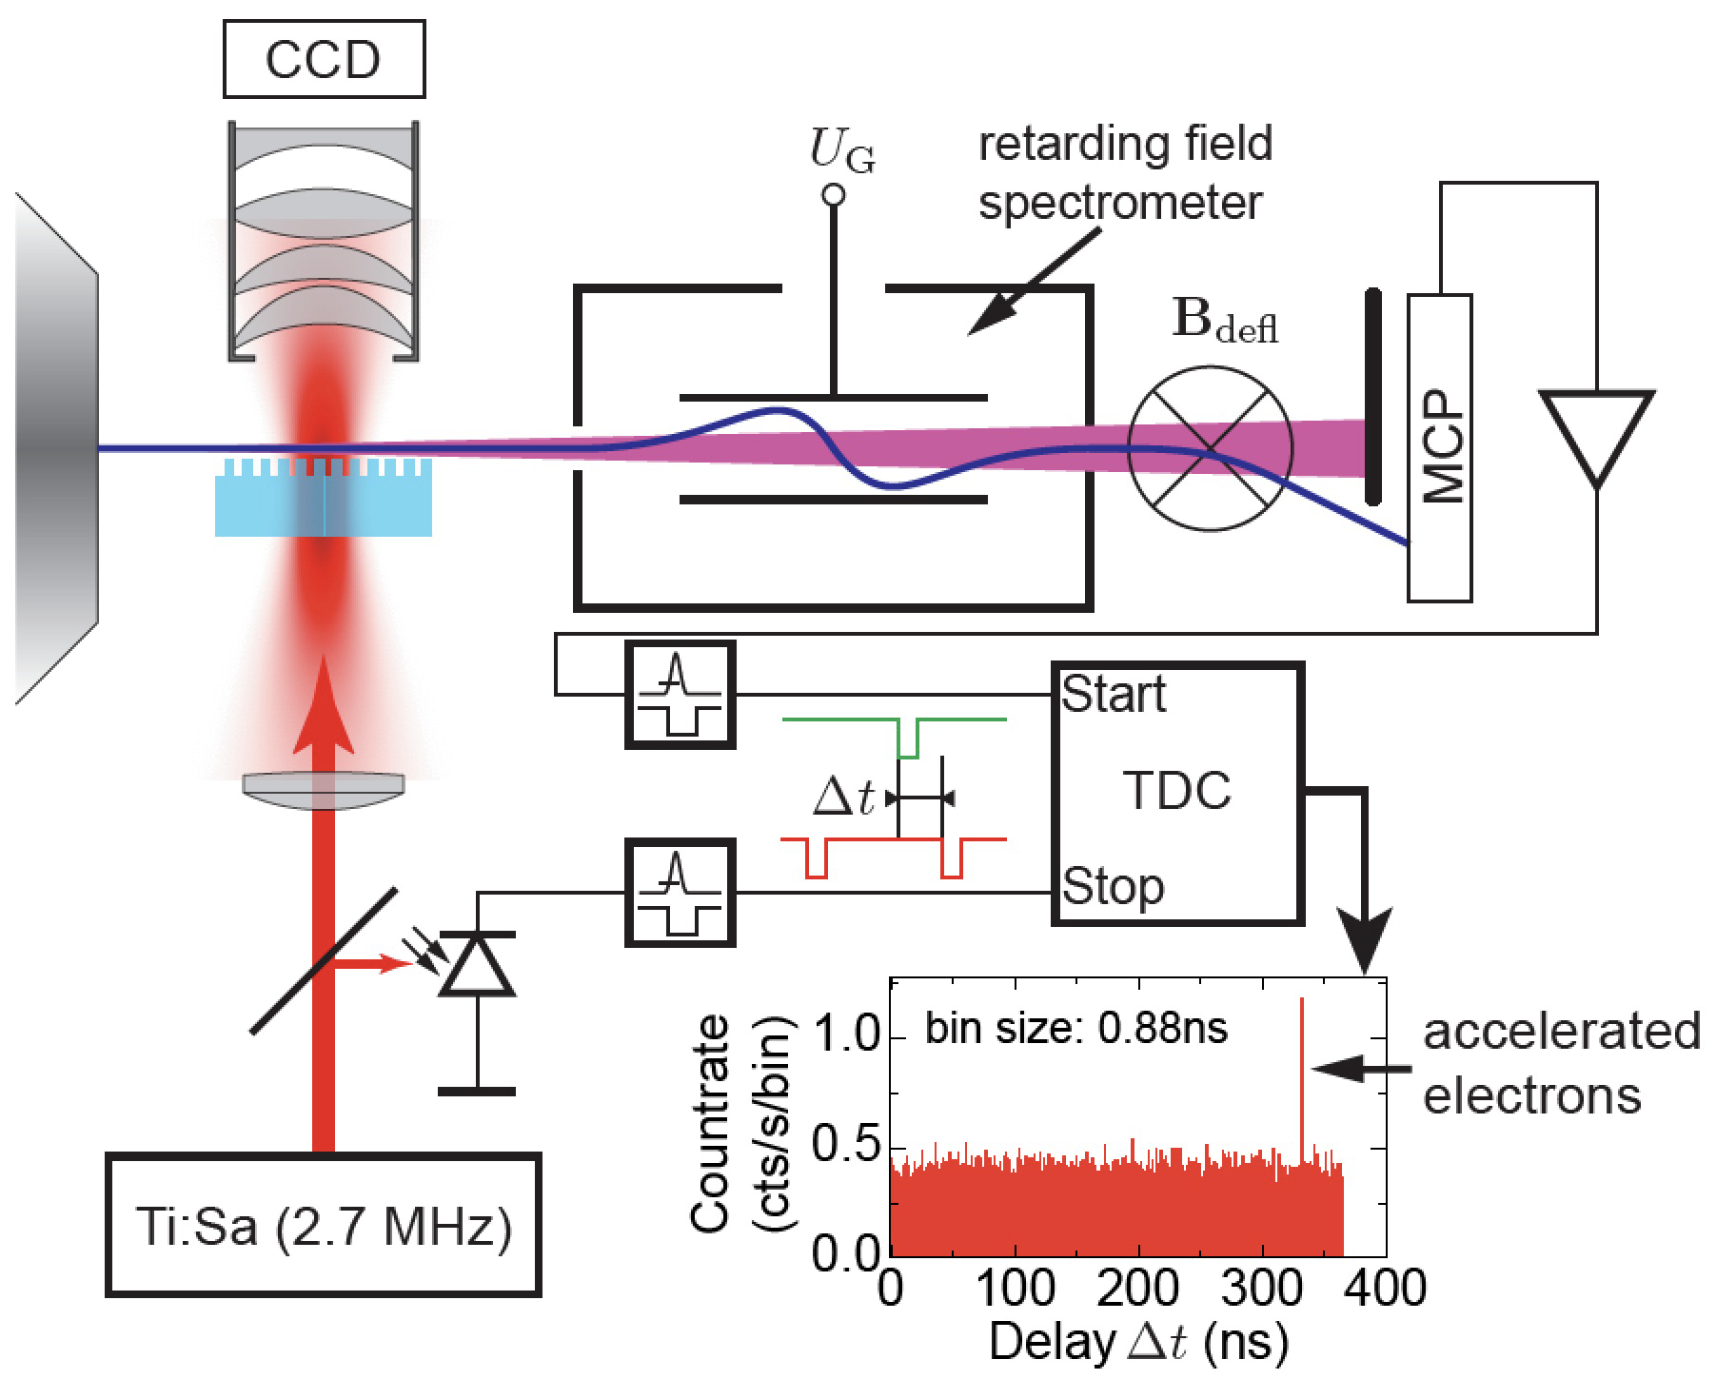
Breuer and Hommelhoff, Phys. Rev. Lett. 111, 134803 (2013)

Slide 12
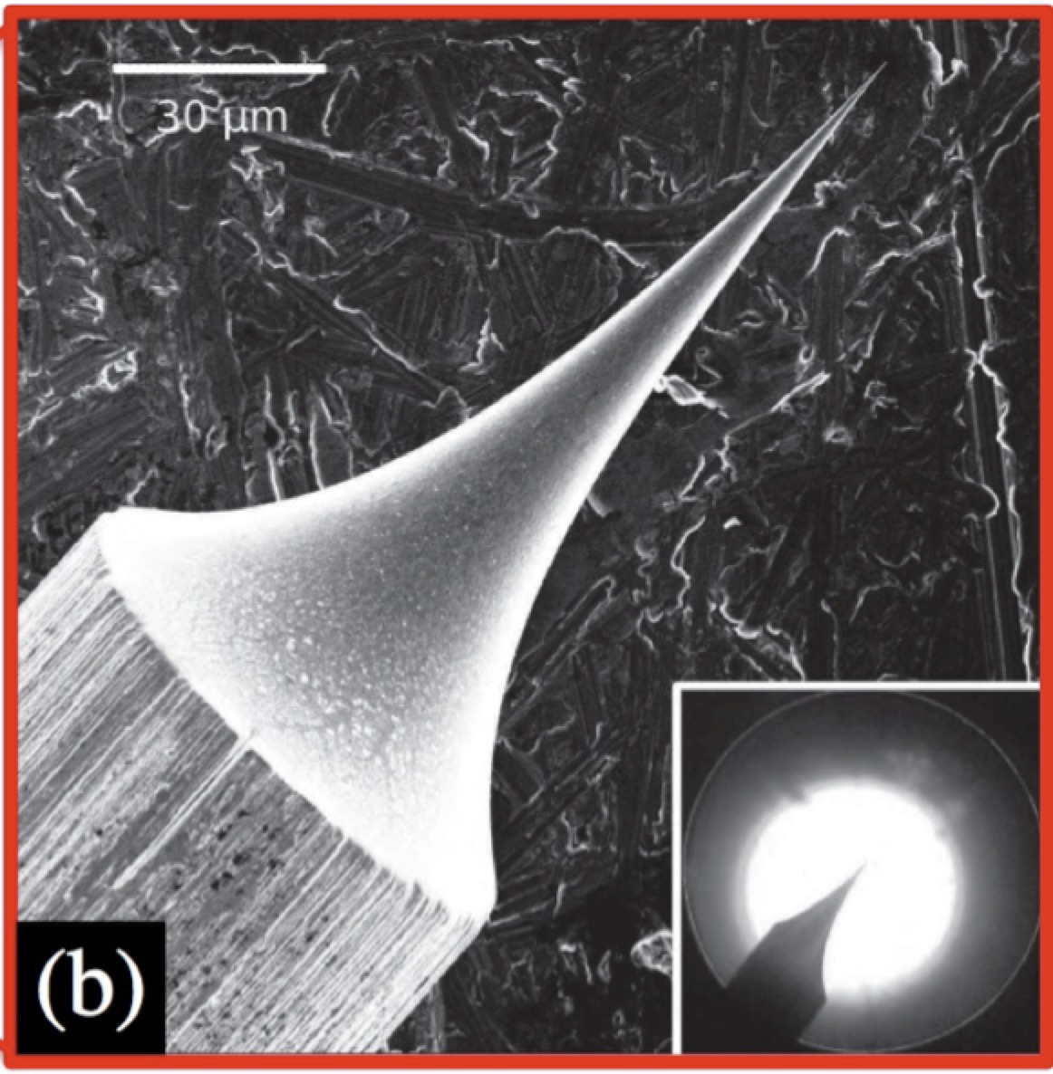
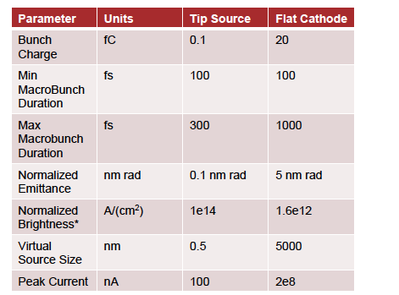
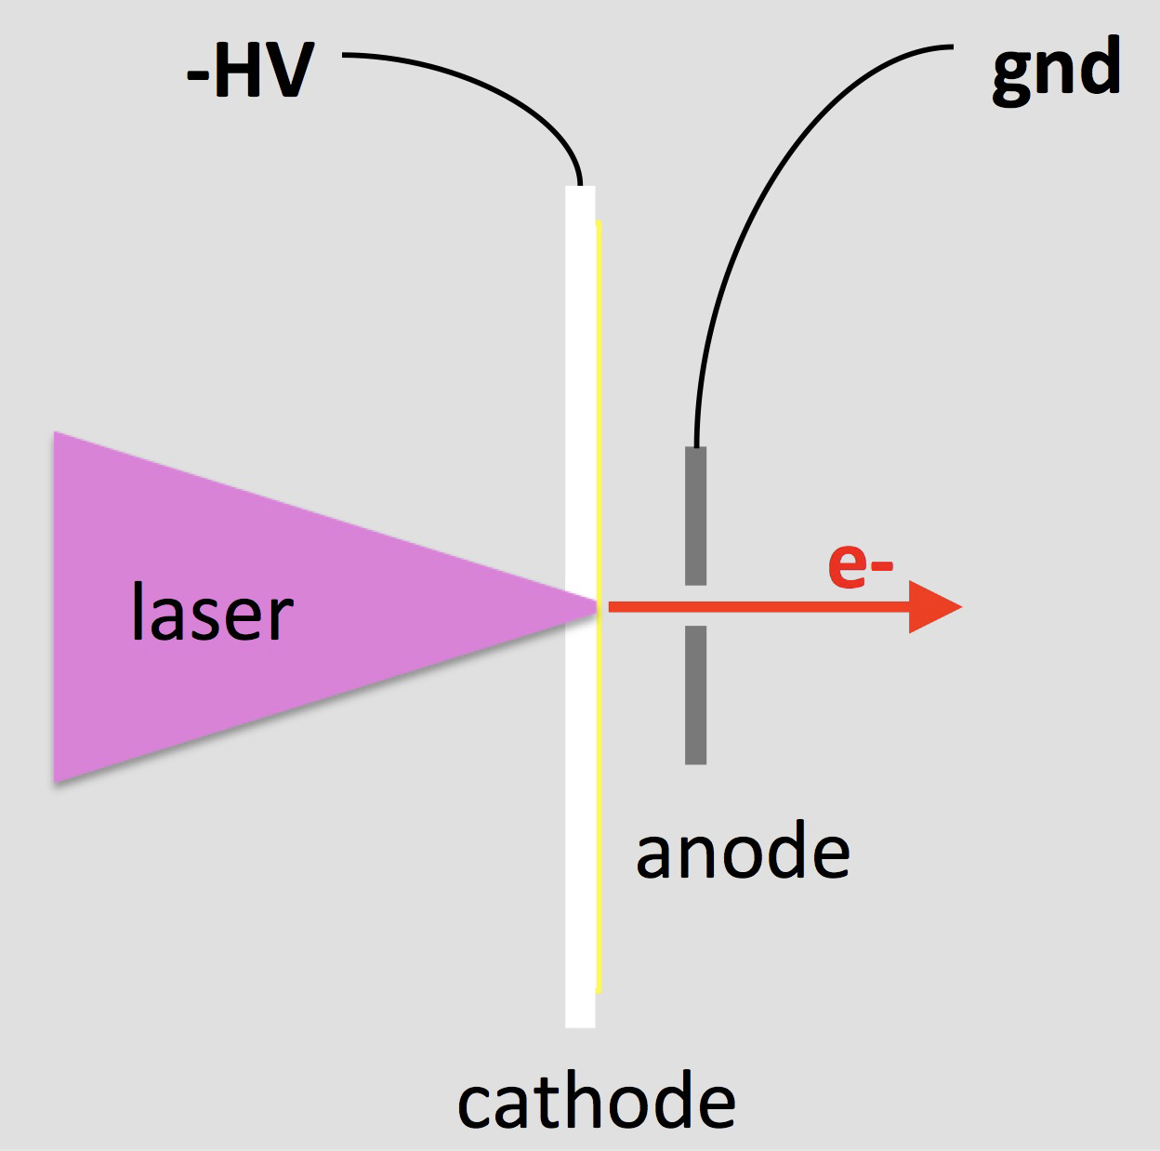
Flat Cathode and Tip Based Sources
Tip Source
Flat Cathode

Slide 13
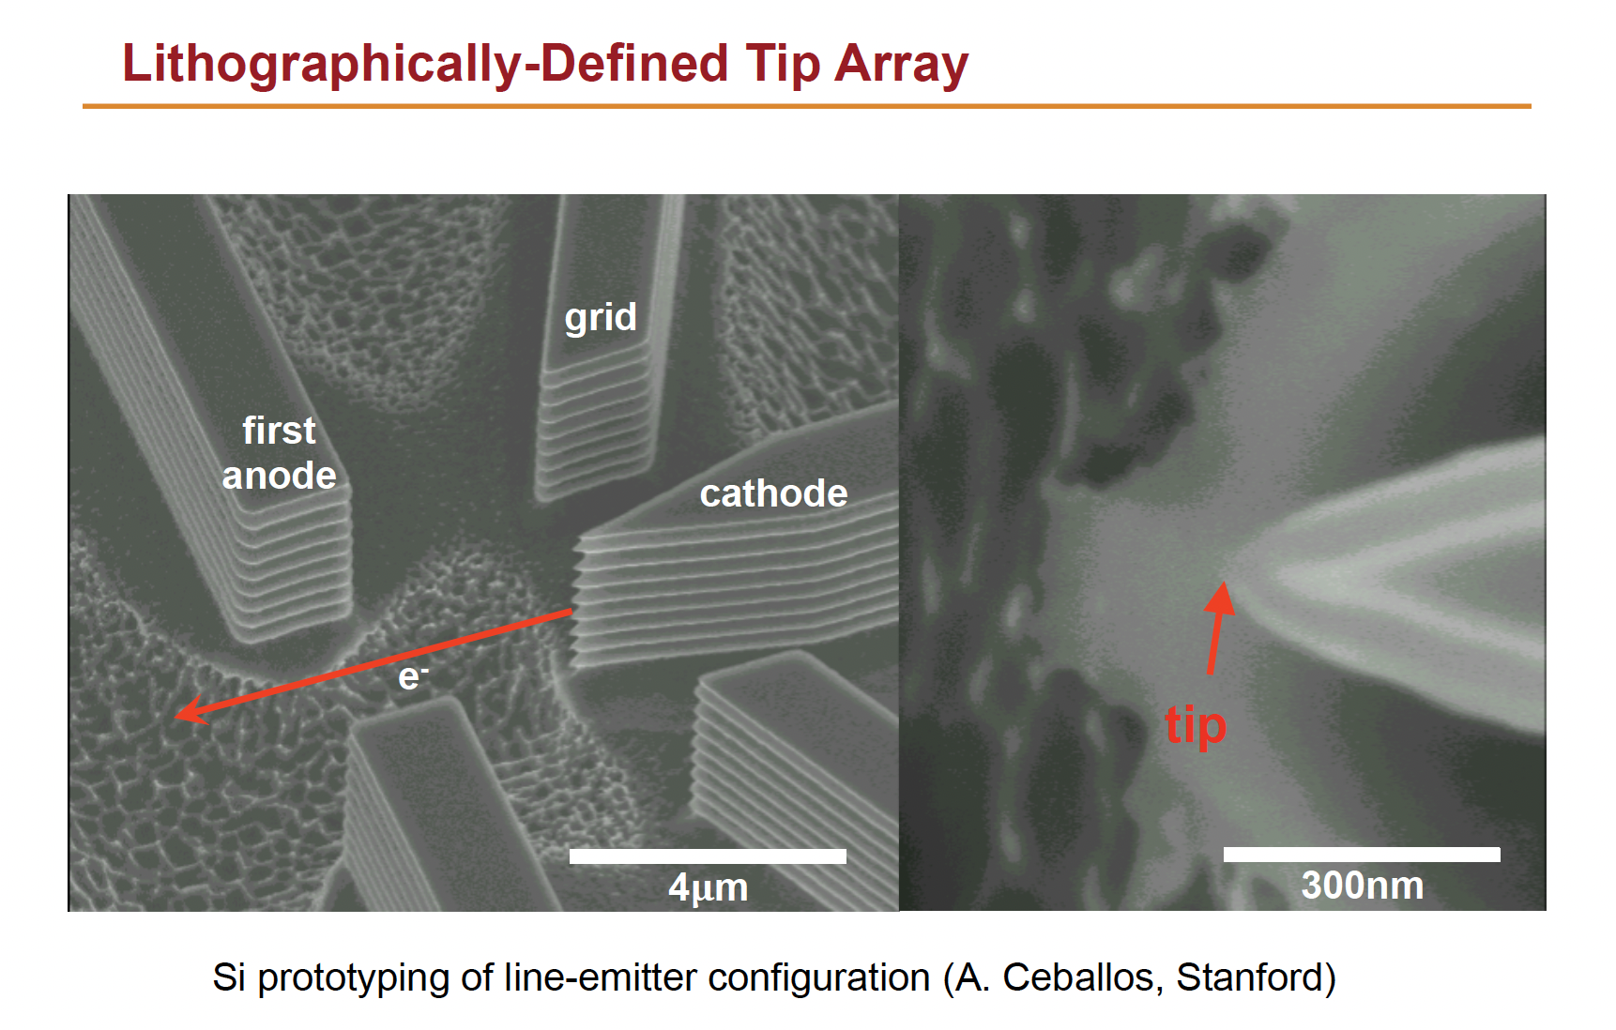
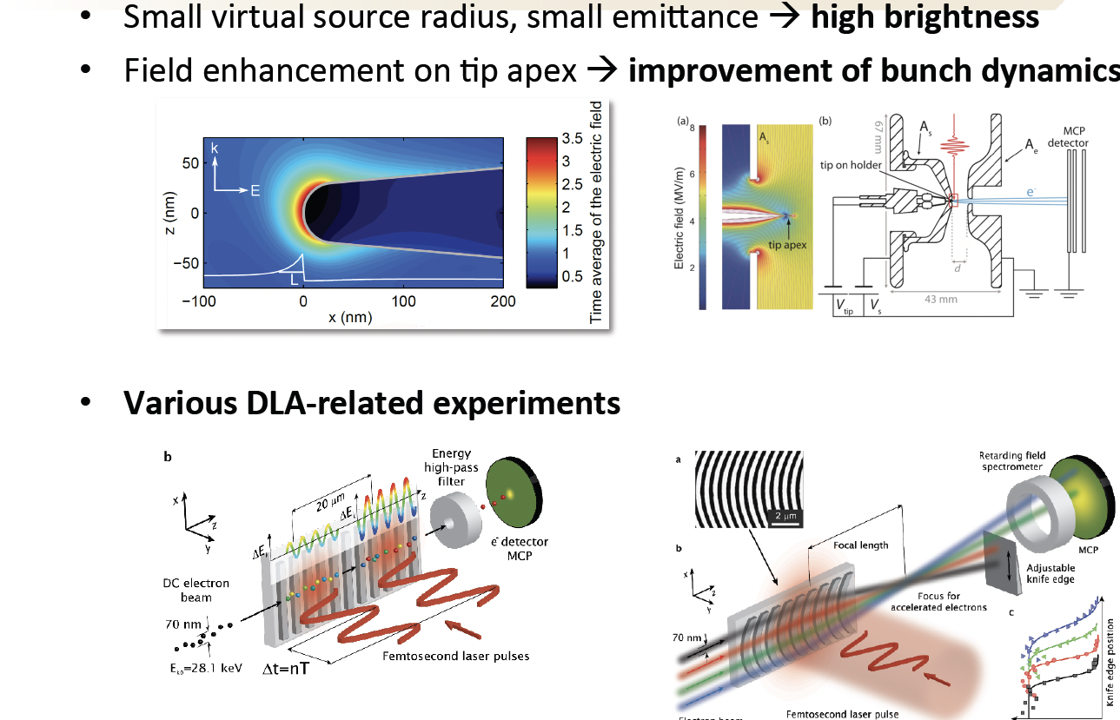
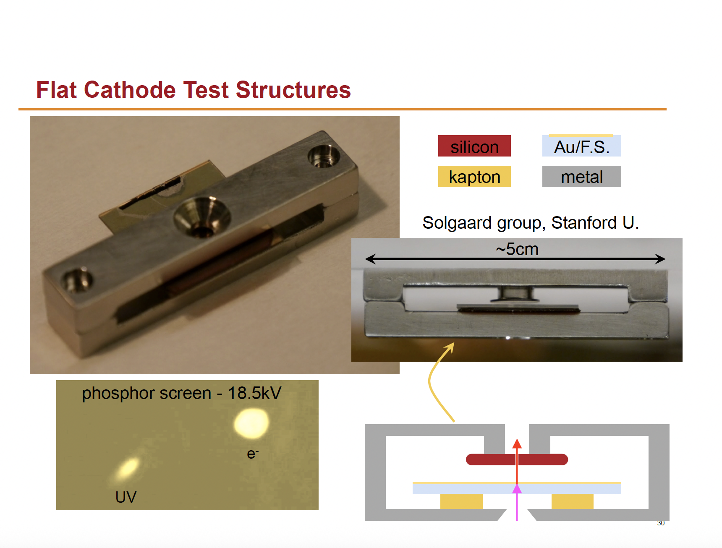

Slide 14
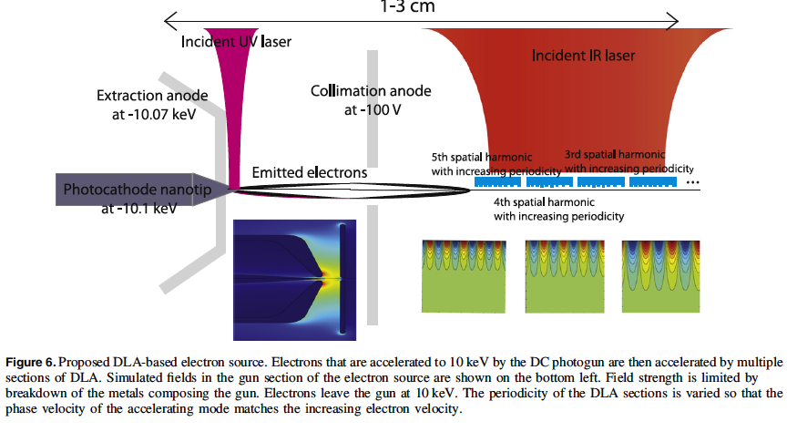
J. Phys. B: At. Mol. Opt. Phys. 49 (2016) 034006 J McNeur et al

Slide 15
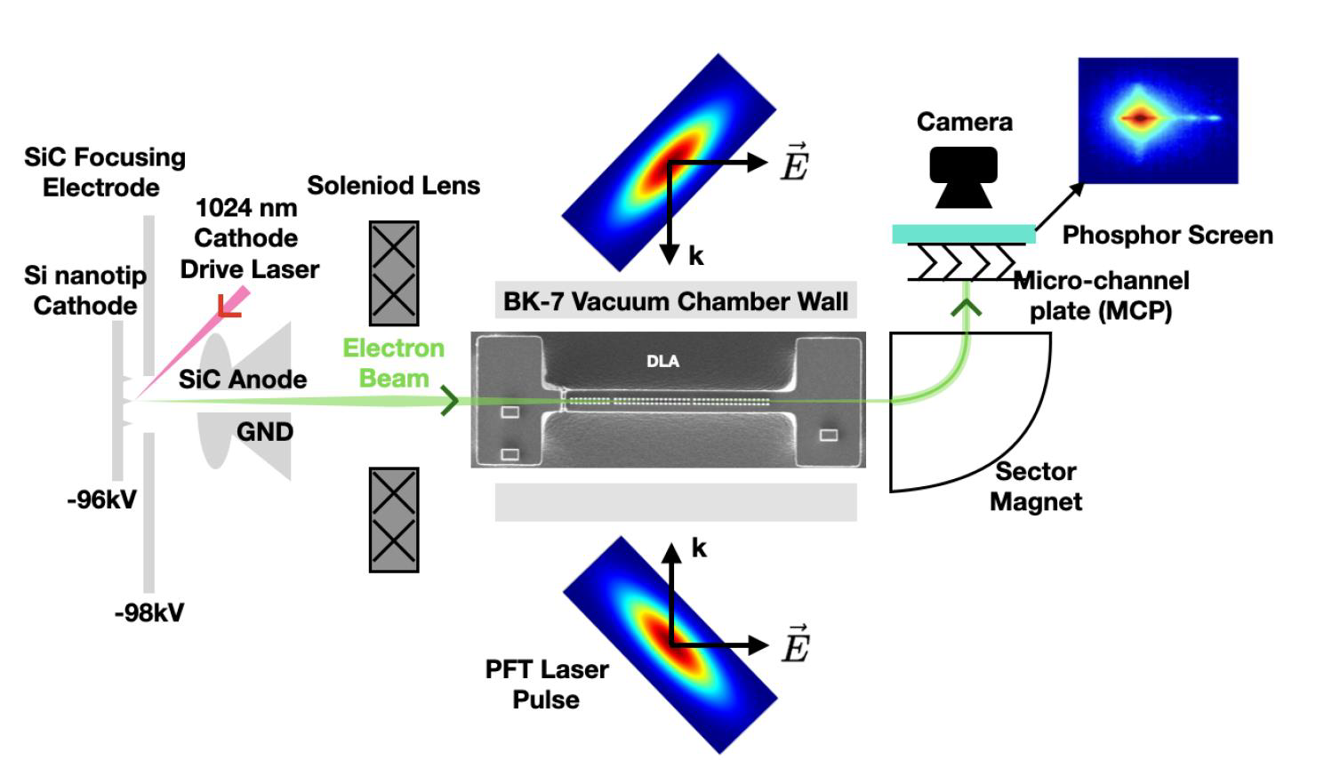
Experimental setup in Stanford
Broaddus, P., Egenolf, T., Black, D. S., Murillo, M., Woodahl, C., Miao, Y., ... & Solgaard, O. (2023). arXivpreprintarXiv:2310.02434.

Slide 16
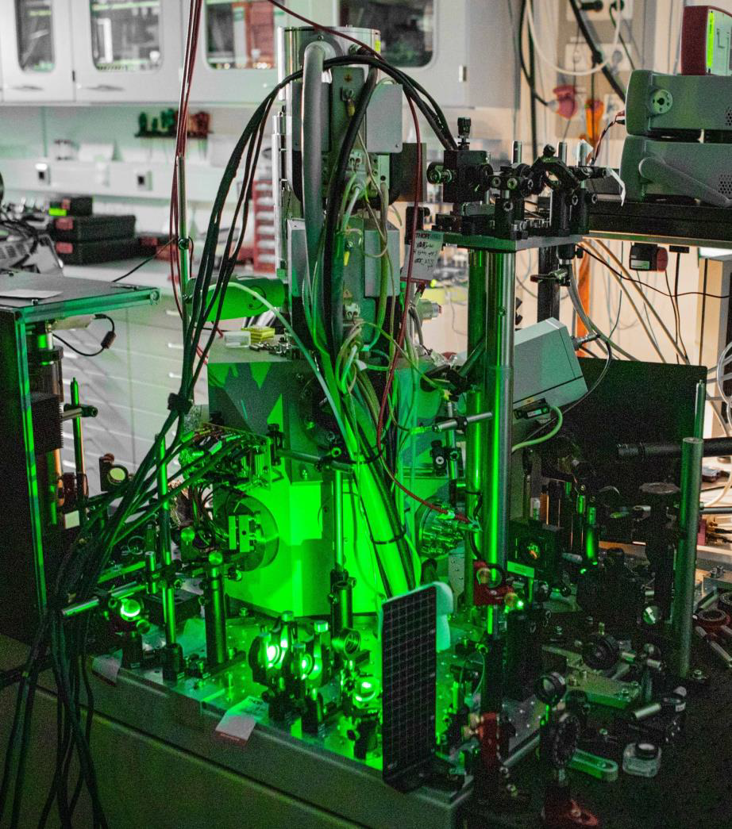
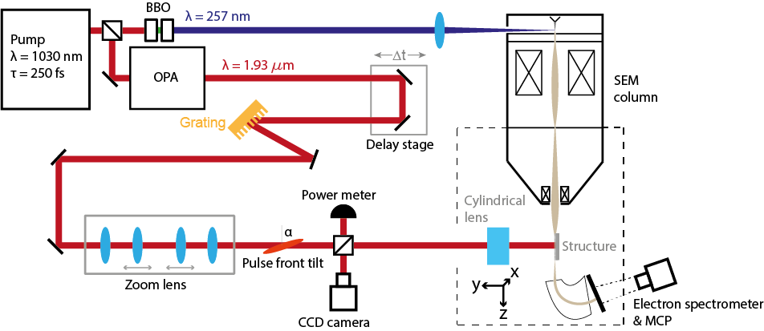
Scanning electron microscope(SEM) –0.5 –30 keV electrons(ß= 0.32)
•Electron emission triggered by UV (257 nm) laser pulse
•Synchronized with accelerator driving pulse (1.93 μm) inside the chamber
•Detection by MCP and magnetic spectrometer
T. Chlouba*, R. Shiloh*, S. Kraus*, L. Brückner*, J. Litzel, P. Hommelhoff, Nature, 622(7983), 476-480.
Notes:
Extended | Schematics of the experimental setup. Ultraviolet
(UV) laser pulses of 257 nm wavelength (blue) and infrared (IR) laser pulses
of 1.93 μm wavelength (red) are generated in an optical parametric amplifier
(OPA) and fourth harmonic generation setup (two BBO crystals). The UV pulses
are focused onto the SEM cathode tip to generate electron pulses that are
injected into the nanophotonic structure. The IR pulses are diffracted at a
grating and imaged with a cylindrical zoom lens system to generate a pulse
front tilt of α at the structure. The pulse-front-tilted beam is focused in
x-direction onto the structure with a cylindrical aspheric lens of 20 mm focal
length. The time delay between IR pulses and electron pulses is adjusted with a
motorized delay stage. A home-built magnetic spectrometer is used to measure
the electron energy. The energy spectrum is recorded by imaging the microchannel
plate (MCP) detector screen with a camera.

Slide 17
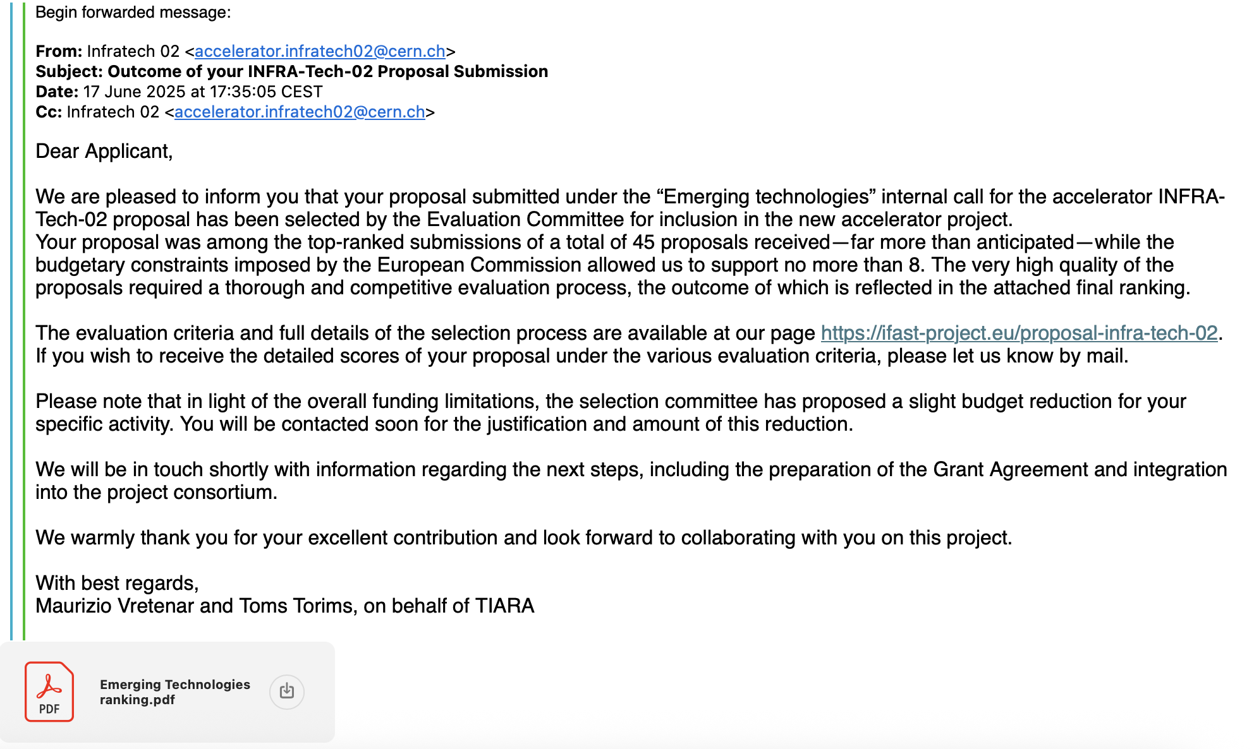
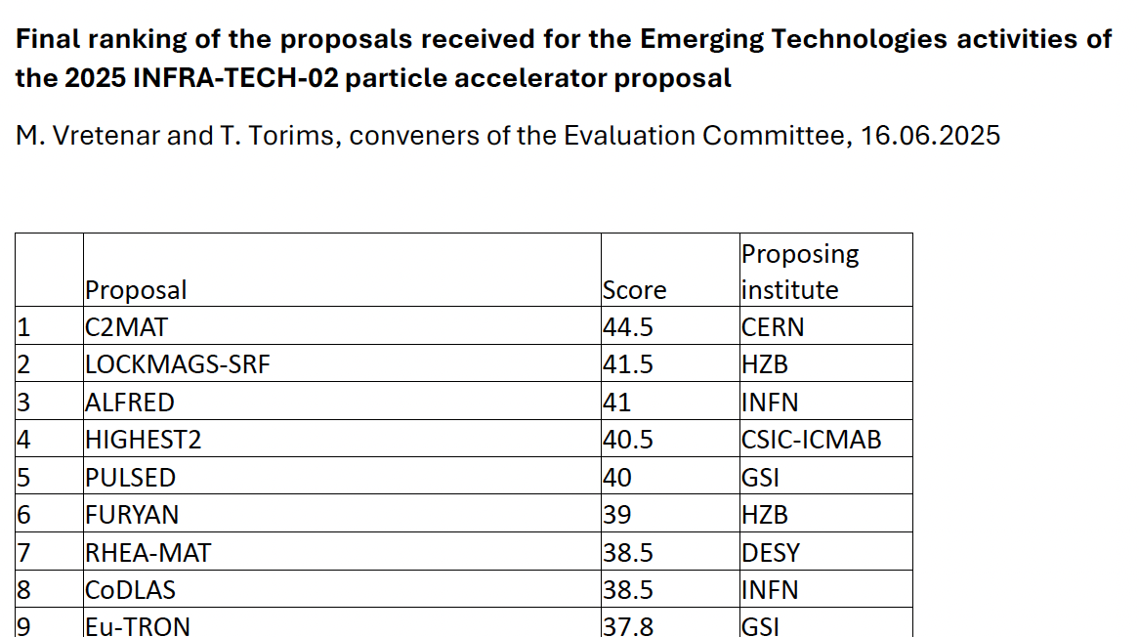
IFAST2: CODLAS selected to be included
- CoDLAS (Co-Propagating Dielectric Laser Accelerator Structures). INFN, PSI, FAU/Munich University, THALES, SenSiC GmbH [Convener: Giuseppe Torrisi]
Abstract
Dielectric Laser Accelerators (DLAs) use infrared lasers and nanostructured dielectrics for compact, high-gradient acceleration. We will design and test co-propagating DLA structures with electron beams in sub-relativistic and relativistic regimes. For muons, we will use longer wavelengths (~100 µm) and gradients >1 GV/m for rapid acceleration before decay. In addition to accelerating particles, we also will explore the use of dielectric structures to couple fields from relativistic bunches to photonic integrated circuits for beam diagnostics.

Slide 18
CoDLAs_GR5 Objectives
Rafforzare la leadership e le competenze INFN (LNS, Torino, Milano), valorizzando anche la collaborazione con l’ INRIM, il CNR e una solida compagine universitaria rappresentata da UniCT, UniBS, Reggio Calabria, UniMoRe, e PoliMI.
2) Sviluppare prototipi innovativi e tecnologie, focalizzandosi su scale e e approcci tecnologici diversi da quelle di CoDLAs, attraverso l’impiego di metodi di fabbricazione all’avanguardia e materiali innovativi forniti da INRIM e dal centro del CNR PiQuET;
3) Realizzare un testbench INFN con caratteristiche uniche e peculiari, diverse rispetto a quelle del setup di IFAST2.0 che sfrutterà quanto già presente a Erlangen (FAU) per la caratterizzazione delle strutture acceleranti.

Slide 19
CoDLAs Organization
The CoDLAS project is structured into three tightly integrated Work Packages (WPs)
addresses the fabrication of dielectric structures, evaluation of manufacturing constraints and morphological analysis (e.g., SEM, AFM, profilometry)
WP2 (Torino):
Fabrication and morphological characterization
Structures
design
Manufactured
Structures
WP1 (LNS, Milano)
EM design and numerical modeling of accelerating structures
WP3 (LNS, Milano)
Experimental Validation and Performance Benchmarking
feedback
focuses on the electromagnetic design of dielectric accelerating structures and the numerical modeling of beam dynamics.
focuses on the experimental characterization of the fabricated structures. It includes optical benchmarking
The project adopts a closed-loop development strategy, where experimental results guide continuous improvement of structure design, maximizing the alignment between theoretical models and real-world performance.

Slide 20
SEM Electron Sources
Field Emission Guns (FEG): Tungsten nanotips with nanometer-scale curvature radius, providing high brightness and ultra-low emittance
Thermionic Sources: Tungsten filaments or LaB₆ crystals, operating at 1–30 keV, with spot sizes from ~1 nm to 1 μm
Electromagnetic Lenses: Precise beam focusing and control down to nanometer scale
Connection to Sub-Relativistic DLA Requirements
Energy Range: SEM electron energies typically 10–30 keV, matching the 10–100 keV range needed for sub-relativistic DLA injection [Broaddus et al., 2024; Kozák et al., 2017]
Emittance & Spot Size: FE sources and SEM optics achieve normalized emittance ≤1–2 nm·rad and spot sizes ≤200 nm, crucial for injection into sub-micron DLA apertures [Broaddus et al., 2024]
Bunch Charge: SEM beams have very low current, compatible with few-fC bunch charges required to minimize space-charge effects in DLAs [Broaddus et al., 2024]
Experimental Evidence
Broaddus et al. (2024): Use FE-like nanotip sources to accelerate 96 keV electrons with energy gains up to 23.7 keV, maintaining low emittance and sub-micron spot size
Kozák et al. (2017): Highlight nanotip sources as essential for achieving the ultralow emittance and energy spread required in sub-relativistic DLA experiments
References:
Broaddus et al., Phys. Rev. Accel. Beams 27, 041302 (2024)
Kozák et al., arXiv:1611.09558
SEM electron source and optics fundamentals
If you want, I can also prepare a slide with schematic diagrams of SEM electron sources and a parameter comparison chart with DLA requirements. Would you like me to proceed?

Slide 21
LNS equipment

Slide 22
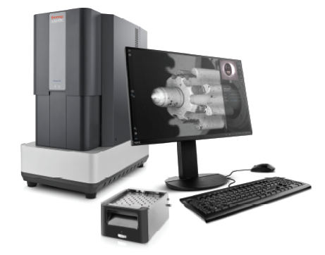
OUR SEM (suitable?) @INFN-LNS
Phenom XL G2 Desktop SEM
Category | Specification
Max Sample Size | 100 × 100 mm, height up to 40–65 mm (36 × Ø12 mm stubs)
Beam Source | CeB₆ thermal emitter, high brightness, long life (~1500 h)
Resolution | < 10 nm
SEM Magnification | 160× to 200,000×
Acceleration Voltage | Selectable: 4.8–20.5 kV (stepwise or continuous modes)
Spot Size | Optimized for low-voltage imaging and high contrast on non-conductive samples
Detectors | - BSD (Backscattered Electron Detector) – standard - SED (Secondary Electron Detector) – optional, for high-resolution surface/topography imaging
Time to Image | ~40 seconds (optical < 5s; SEM mode ~60s)
Imaging Resolution | 960×600 up to 7680×4800 px (TIFF, PNG, BMP, JPEG)
Stage Travel | Up to 100 × 100 mm with full motorized XY stage
Automation | Python-based scripting via Phenom Programming Interface (PPI)
Environmental Range | 15–30 °C, 20–80% humidity
Vacuum Modes | Low, medium, and high vacuum compatible

Slide 23
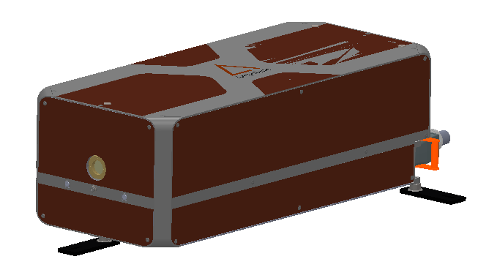
Our Laser: SATSUMA X- 28W/ 280μJ
- Center wavelength: 1030 nm +/- 2 nm
- Spectral width: < 3 nm FWHM
- Average power: > 28 W
- Maximum energy: > 280 uJ at 100 kHz
- Repetition frequency: from single shot to 40 MHz (tunable on the fly)
- Pulse picker (PP): from 100 kHz to 40 MHz ( 40MHz /n, where n is an integer)
- External modulator( MOD): from single shot to 2 MHz/F_pp
-Integrated external modulator (MOD, i.e. AOM)inside laser head for pulse attenuation (0 to 100% transmission)
-External trig or Gate mode by applying an external TTL signal on MOD
- Pulse duration: < 400 fs adjustable up to 10 ps
-Burst mode offered by default: from 2 to hundreds of pulse inside a burst
-Extra option (payable): Femtotrig/FemtoBurst/GHzBurst option
- M² < 1.2
- Astigmatism: < 25 %
- Circularity of beam at waist: > 87% Beam diameter
- Beam diameter: 4.5 mm +/- 0.5 mm
- Long-term stability: < 0.5 % rms over 12h
- Pulse-to-pulse stability: < 1% rms
- Pointing stability: < 15 urad rms
- Cooling: water/water chiller included
- Dimension: 730x310x230 mm
Notes:
Both SatsumaX-50W and SatsumaX-28W have a tunable rep rate: from single shot to 40MHz. Both of them has a nominal frequency of 100kHz, which means
For f_rep > 100kHz, average power remains the same 50W or 28W. Pulse energy E = average power / f_rep.
For f_rep <= 100 kHz, pulse energy remains the same 500µJ or 280µJ. The average power P = E_fixed* f_rep.

Slide 24
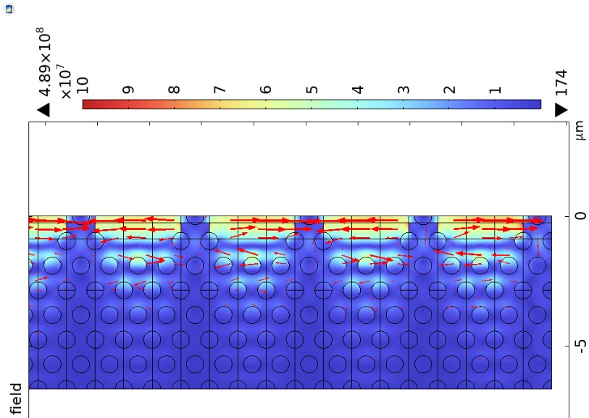
LNS Task
Light Coupling Strategies in Multi-Stage Nanophotonic Accelerators
LASER
LASER
side-coupled bus waveguide
Silicon Strip-to-Slot
Mode Converters
Electron
Source
High-Q Cavities
Slot Waveguides
Hybrid Photonic-Slot
e
Modified SEM
20 keV

Slide 25
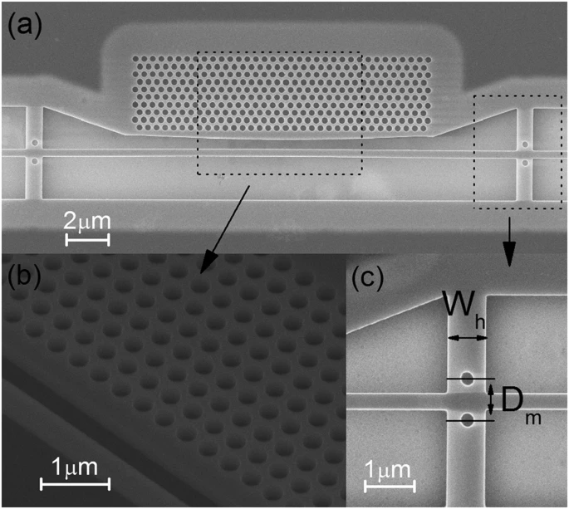
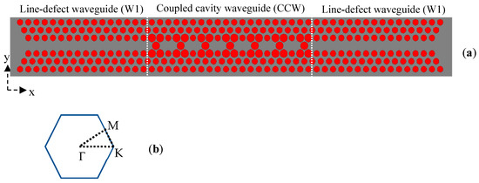
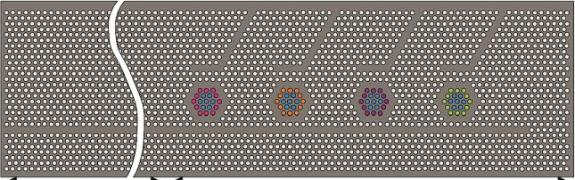
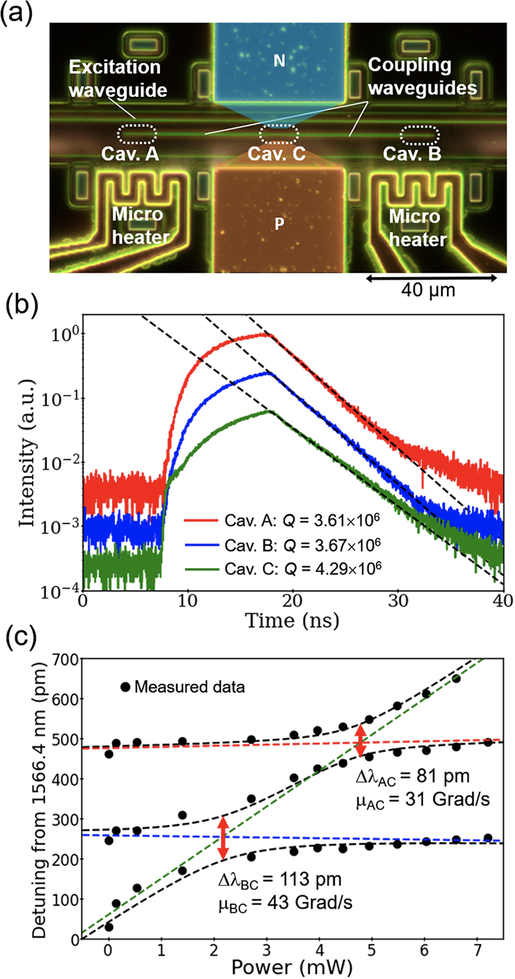
LNS TASK
Light Coupling Strategies in Multi-Stage Nanophotonic Accelerators
High-Q Cavities
https://www.nature.com/articles/srep26038
High-Q side-coupled semi-2D photonic
crystal cavity, Jianhao et al., Scientific Reports | 6:26038 | DOI: 10.1038/srep26038
PROPOSED SOLUTIONS: side-coupled bus waveguide
Jannesari, R.; Pühringer, G.; Stocker, G.; Grille, T.; Jakoby, B. Design of a High Q-Factor Label-Free Optical Biosensor Based on a Photonic Crystal Coupled Cavity Waveguide. Sensors 2024, 24, 193. https://doi.org/10.3390/s24010193
https://www.sciencedirect.com/science/article/pii/S2211379723009580
Design and fabrication of a coupled high-Q
photonic nanocavity system with large coupling
Coefficients, https://doi.org/10.1364/OE.513508
Journal ˝ 2024

Slide 26
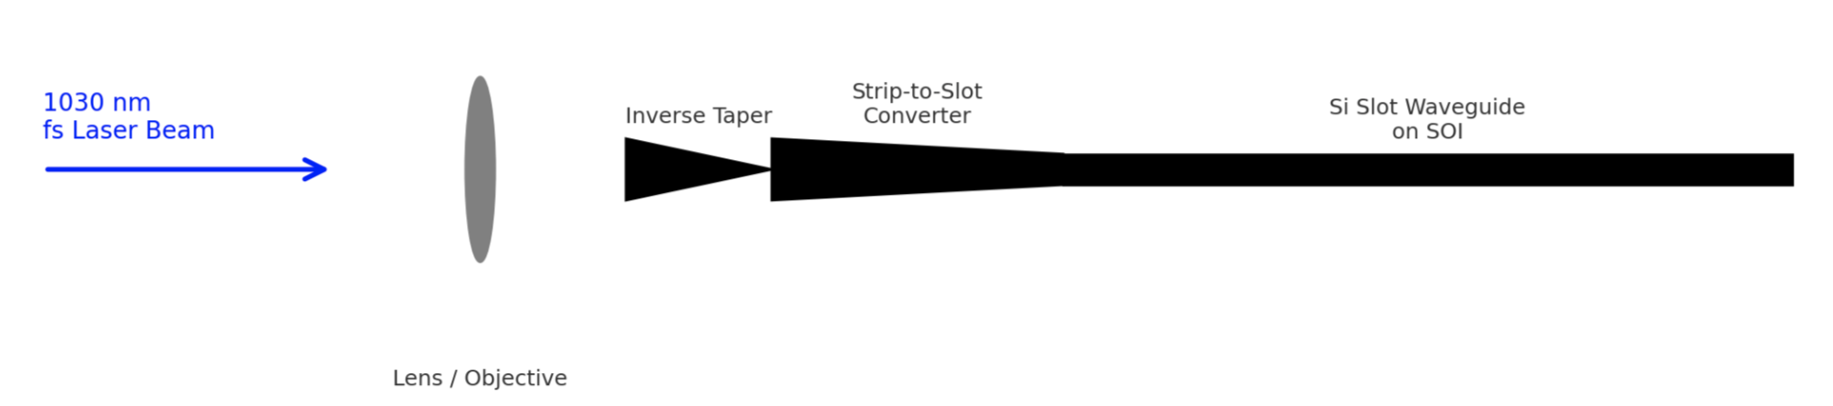
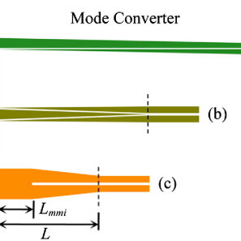
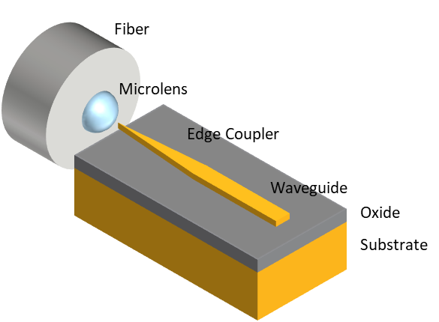
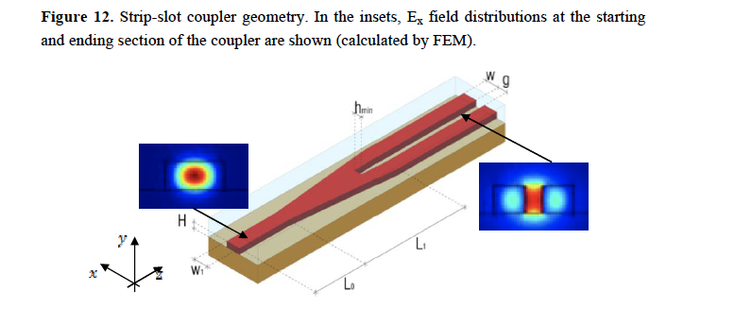
LNS TASK
Light Coupling Strategies in Multi-Stage Nanophotonic Accelerators
Slot Waveguides
Low-Loss Silicon Strip-to-Slot Mode Converters DOI: 10.1109/JPHOT.2013.2239283
Optical Beam Transport & Coupling System
1. Vibration-Isolated Optical Table
- Stable platform, anti-vibration, 1.5 × 1 m
2. Beam Steering & Alignment
- High-reflectivity mirrors (HR)
- Precision mirror mounts
3. Beam Shaping & Focusing
- Achromatic/aspheric lenses
- 4. Power Control & Monitoring
- Beam splitters
- Variable attenuators
- Optical filters
5. Fine Positioning
- Motorized/piezo XYZ stages
- Sub-micron adjustment for precise coupling
6. In-line Diagnostics
- Beam profiler/camera
- Power meter
7. Safety & Accessories
- Laser safety shields/barriers
- Laser safety goggles
- Mounts, breadboards
Estimated Budget: €25,000
https://optics.ansys.com/hc/en-us/articles/33444674330131-Fiber-to-Chip-Edge-Coupler-with-a-Microlens
https://www.mdpi.com/1424-8220/12/3/2436

Slide 27
Budget (LNS)
Year |  | Cost |  | Notes
1 | Licenze | 15 k€ |  | CST e COMSOL: modeling
 | Missioni | 2 k€ |  | @FAU: SEM experimental setup Analys
 | CONSUMO | 20 k€ |  | Optics for laser coupling
TOT |  | 37 k€

Slide 28
FTE INFN-LNS
Name | FTE
Giuseppe Torrisi | 20
Giorgio S. Mauro | 20
David Mascali | 5
P. Cirrone | 5
G. Cosentino | 5
S. Tudisco | 5
G. Sorbello | 20
T. Isernia | 20
R. Palmeri | 20
S. Pavone | 20
N. Salerno | 20
TOT | 160

Slide 29
INFN-TO Activities
WP2: Nanofabrication & Structural Analysis
INRiM & PoliTO contribute to CoDLAS via access to PIQUET Lab, an advanced micro/nano-fabrication hub.
Key available technologies (More info: piquetlab.it ):
Electron Beam Lithography (EBL)
Nanoimprint Lithography (NIL)
RIE / ICP Etching
PVD / ALD Thin Film Deposition
SEM, AFM, Profilometry
XRD & Raman Spectroscopy
prototyping and high-precision morphological validation of dielectric structures.

Slide 30
FTE INFN-TO
INFN-TO
Name | FTE [%]
Simone Marasso, CRN-Parma, PoliTO | 25
Eleonora Cara, INRIM | 25
Mario Malerba, INRIM | 25
Alessio Verna, INRIM | 25
Rita Rizzoli, CNR-IMM, Bologna | 10
Valentina Bertana, PoliTO | 10
TOT | 120%

Slide 31
FTE INFN-MI
INFN-Milano
Name | FTE [%]
Alberto Bacci | 20
Andrea Rossi | 10
Marcello Rossetti Conti | 10
C. De Angelis | 30
Giuseppe Della Valle | 50
Andrea Locatelli | 40
Luca Vincetti | 40
TOT | 200

Slide 32
INFN-TO (and BO) From MICRON_GR5
(2022-2024)

Slide 33
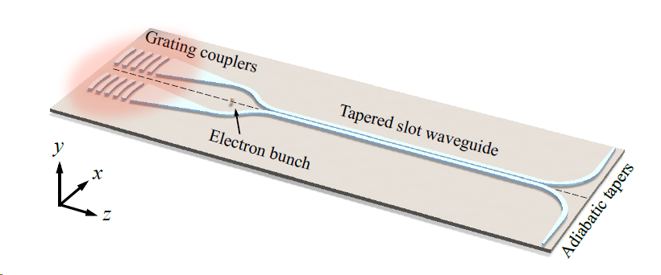
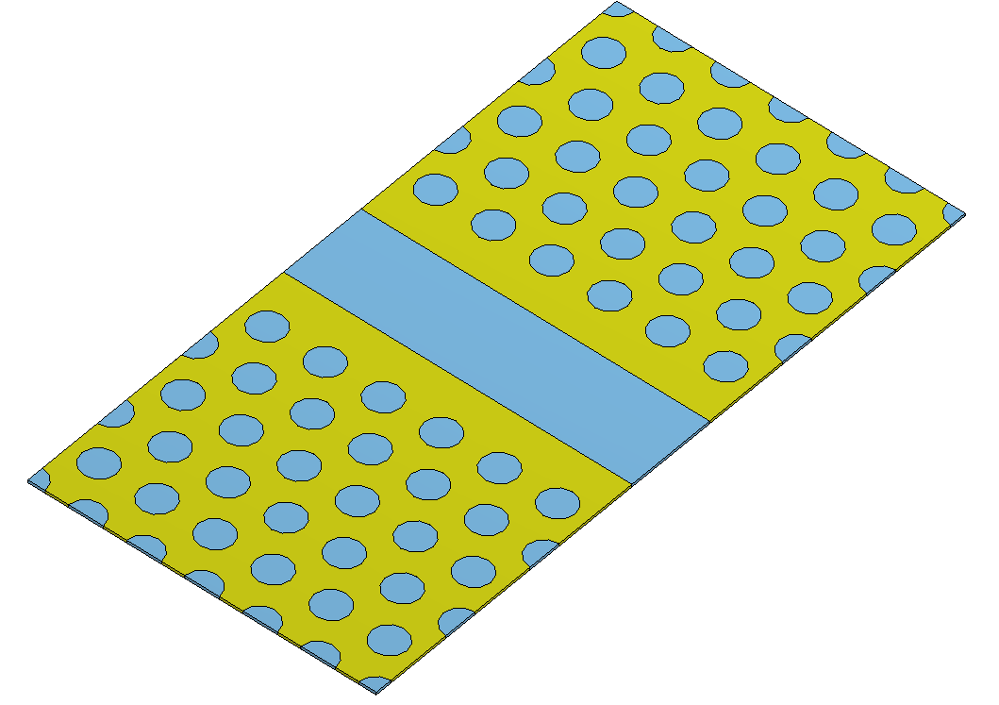
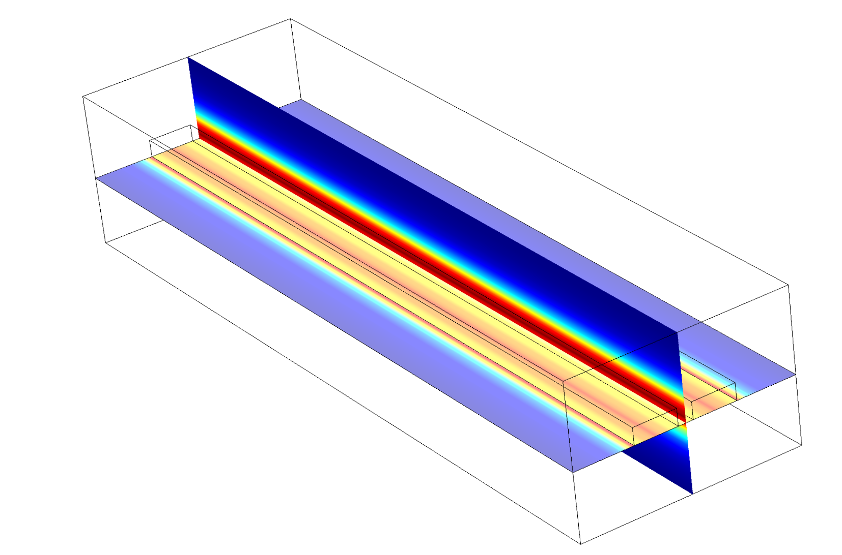
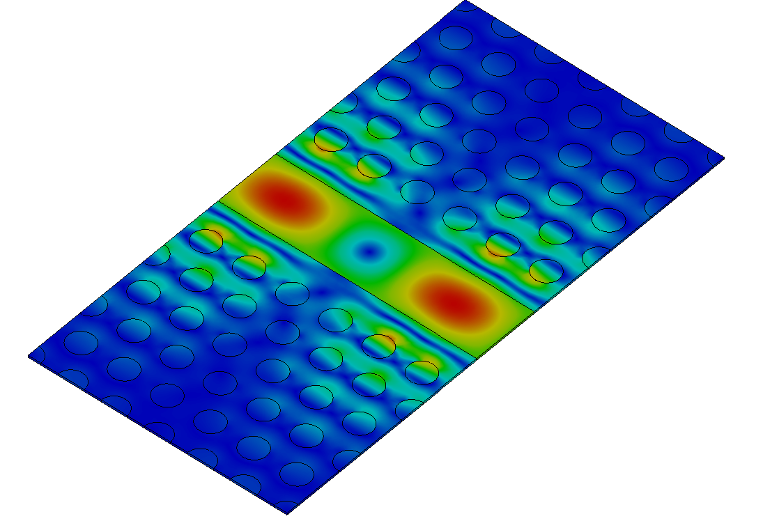
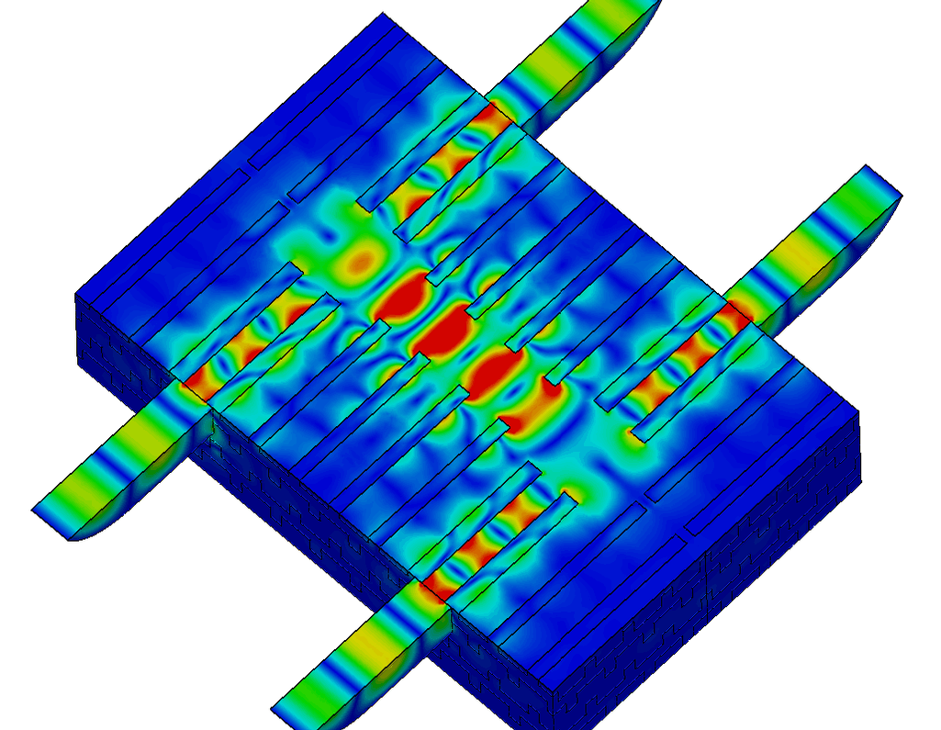
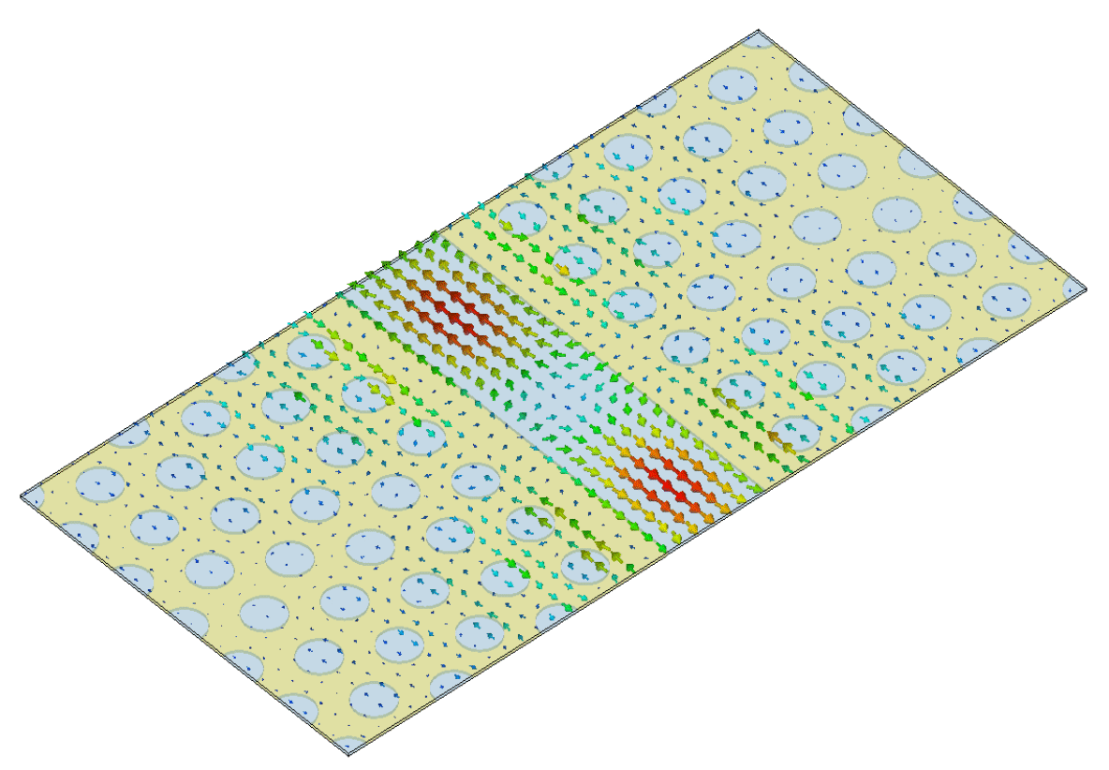
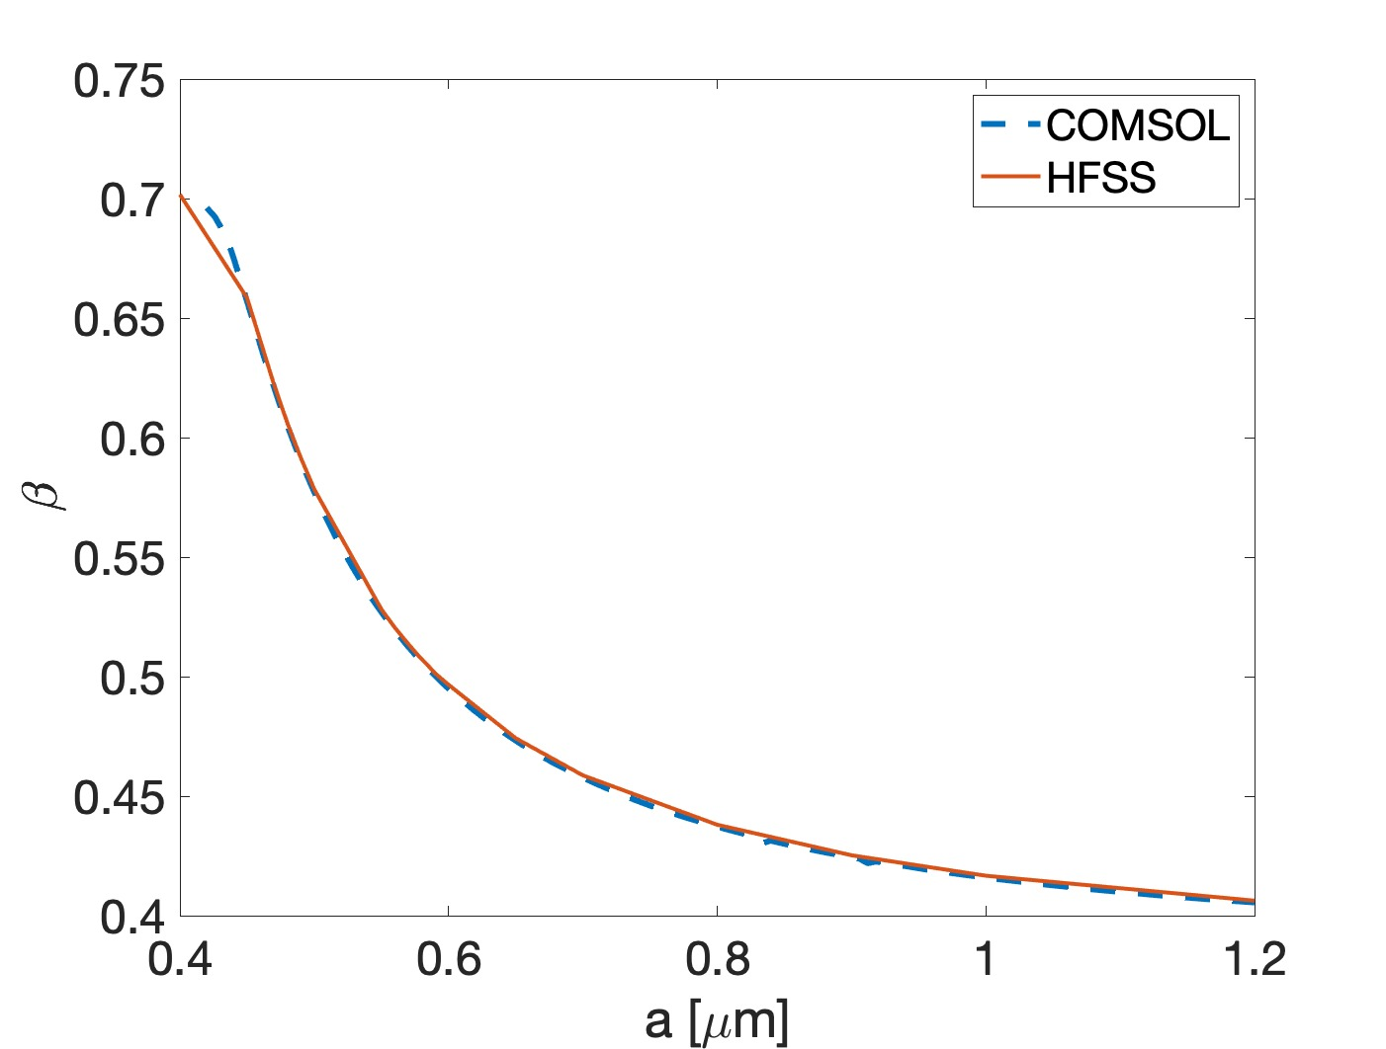




MICRON Dielectric structures
1) Slotted waveguide
[$0.4<β<0.75$]
2) 2D PhC waveguide
[$β=0.7−1]$
3) Woodpile
[$β=1]$
$E0 \sim$ 1 GV/m
@ P_{INJ} = 500 W

Slide 34



Structures object of the study
Fabrication of the same structure in 3 different sizes working at 3 different wavelegths:
5μm x 2μm x 5μm (λ = 1.55 μm) Two Photon Polymerization (TPP)
25μm x 16μm x 10μm (λ = 5 μm) Two Photon Polymerization (TPP)
16mm x 11mm x 7mm (λ = 3.3 mm) Stereolithography (SL)
Laser nanoFab
M4D System by Laser nanoFab
Custom SL printer by Microla Optoelectronics

Slide 35



Two Photon Polymerization (TPP)
Two-photon absorption is exploited to induce radical polymerization if an appropriate wavelength is employed based on the photoinitiator
The focal point of the LASER can be moved in any direction within the resin.
NIR (780 nm -2500 nm) LASER
Photoresin is transparent to NIR, cross-linking will occur only within the focal volume → voxel
This happens only at the beam focal point!

Slide 36
TPP structure working @ 5 µm
Fabrication:
- Femtobond resin
TPP of 1.6x positive structure (to compensate successive shrinkage)
With base

Slide 37





Dielectrics Summary
Complete modeling of >250 MV/m, Woodpile, PhC, and slot waveguide
Refined technique that enhanced the printing accuracy: better results in terms of structure features preservation.
Employed material: FemtoBond resin.
Direct polymerization of the “final” positive structure followed by a pyrolysis to obtain a dielectric material with the final desired properties.

Slide 38

Stereolithography (SL)

Slide 39




SL structure working @ 3.3 mm
Fabrication:
Commercial resin Bison-Zircolite
Printing of ½ structure
Results:
Polymerization along Z-axis is reduced
Accuracy on XY plane to improve
High viscosity resin
Filler: 3 mol% Yttria-stabilized Zirconia at approximately 80%wt. with respect to resin weight
Z-axis

