Slide 1
ASTERIX (Accelerating STructures made of multiplE sectoRs In X-Band)
Responsabile Nazionale (L. Faillace, LNF), Resp. Locale LNS (Giuseppe Torrisi)
3 anni (2025-2027)
Units: LNF, LNS, Roma1
Esperimenti in CSN5 correlati:
MICRON (2022-2024)
DEMETRA (LNF/LNS)
ARYA (2020-2023)
Dedicated PhD student from China
External Collaborators: V. Dolgashev (SLAC), Tetsuo Abe (KEK)
Letter for machine time from TEX facility at LNF

Slide 2
Obiettivi generali
The Accelerating gradient is the key parameter
for the design, construction and cost of future linear accelerators
Linacs must be reliable and cost-effective
Intense and systematic research (SLAC/INFN/KEK/CERN/Tsinghua Uni) on high-gradient accelerating RF structures started with the investment for the construction of normal-conducting linear colliders, new generation X-FELs, etc.
In order to be feasible the design of linear colliders posed a minimum value on the accelerating gradient → 100 MV/m.

Slide 3
Obiettivi generali
Framework of a continuous more-than-two-decade-long collaboration on the study of RF structures with increasing accelerating gradients and the RF breakdown physics: SLAC (USA), INFN-LNF and KEK (Japan)
Study of various geometries, materials, surface processing techniques and technological developments of advanced accelerating structures working in X-band (11 – 12 GHz):
  This research is strongly required by a demand for ever more advanced accelerating structures, with accelerating gradients well-above 100 MV/m, since higher efficiency and robust manufacturing play a major role for the next generation of linear particle accelerators for research;
  These structures are made of hard copper and hard copper alloys → better high-gradient performance;
  Different geometries, e.g. “open-type” structures (two halves, four quadrants, etc.)
  Alternative “braze-free” joining techniques, e.g. EBW and TIG welding.
Applications: existing and new-generation X-FELs, such as EuPRAXIA@SPARC_LAB [17]), industrial, and medical applications.

Slide 4
Obiettivi generali
The main goal of this experiment is the design, fabrication and high RF power testing of four-quadrants (“open-type”) X-band RF accelerating structures made of hard copper, joined and vacuum sealed by using TIG welding (“braze-free” technique) in order to achieve higher accelerating gradients (>100 MV/m), higher efficiency, as well as cost-effective and robust manufacturing.
→difference from state-of-the-art: to realize a practical (meter-long) linac for real linear accelerators.
OBJECTIVES:
Radiofrequency (RF) Design and Wakefields/High-Order Modes (HOMs) Characterization and Optimization of a multi-cell, meter-long, TW X-band RF cavity made out of hard copper with an open-type geometry:
  Structures for single-bunch and multi-bunch operation;
  Four quadrants for the cancellation of the dipole and quadrupole EM field components, detrimental for the beam dynamics;
  Mechanical engineering for joining with TIG welding;
  RF power couplers will be integrated four-port mode-launchers [LNS/LNF] for compact power coupling and cancellation of the dipole and quadrupole field components;
  Secondary vacuum chamber through the gap of the quadrants for improved pumping speed and easy insertion of HOM absorbers (if used for multi-bunch operation).
Fabrication of small-scale prototypes and full-scale structure for single-bunch operation (option for subsequent material R&D);
Low RF power tests (“cold-test”) of prototypes and full-scale structure at the LATINO Laboratory, INFN-LNF;
High RF-power tests of prototypes and full-scale structure at the TEX facility, INFN-LNF.

Slide 5
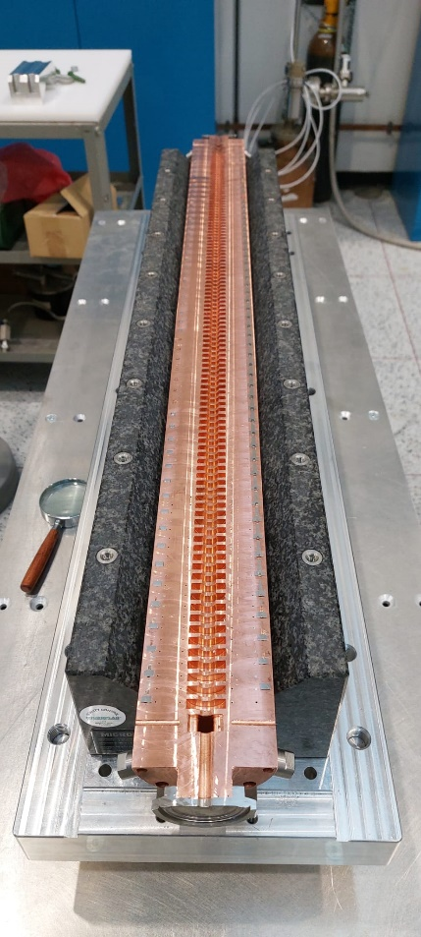
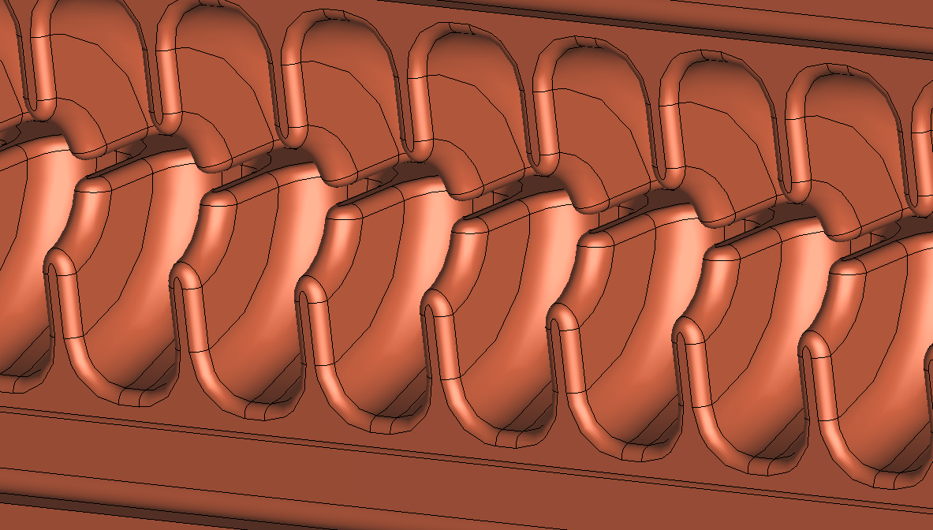
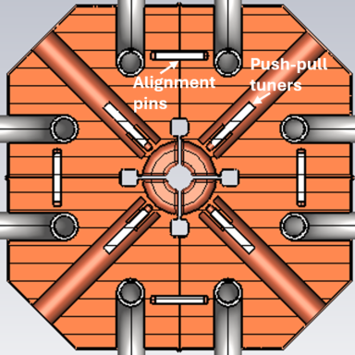
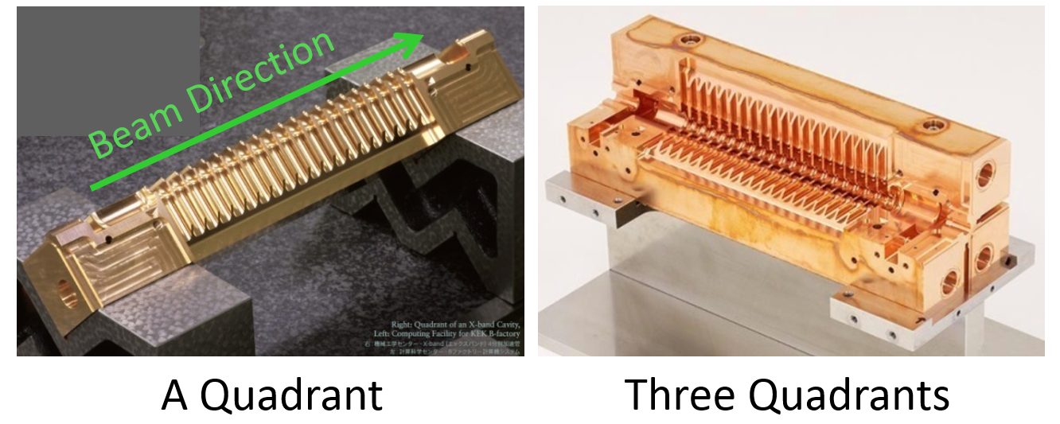
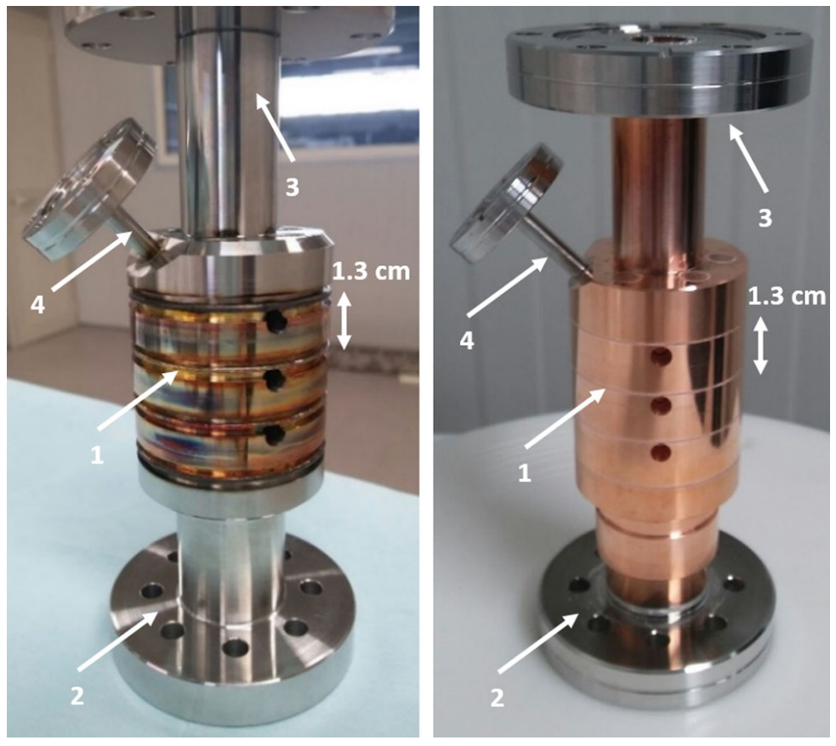
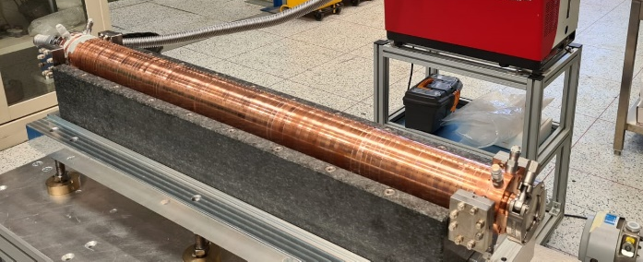
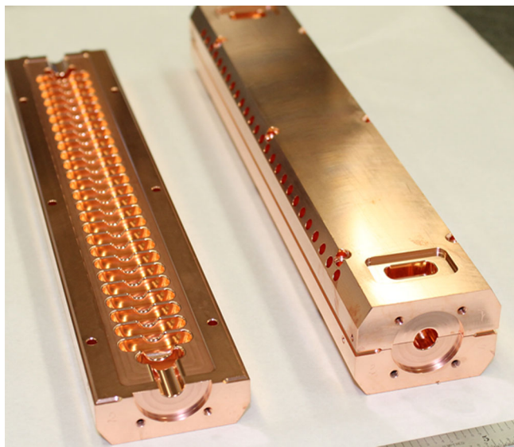
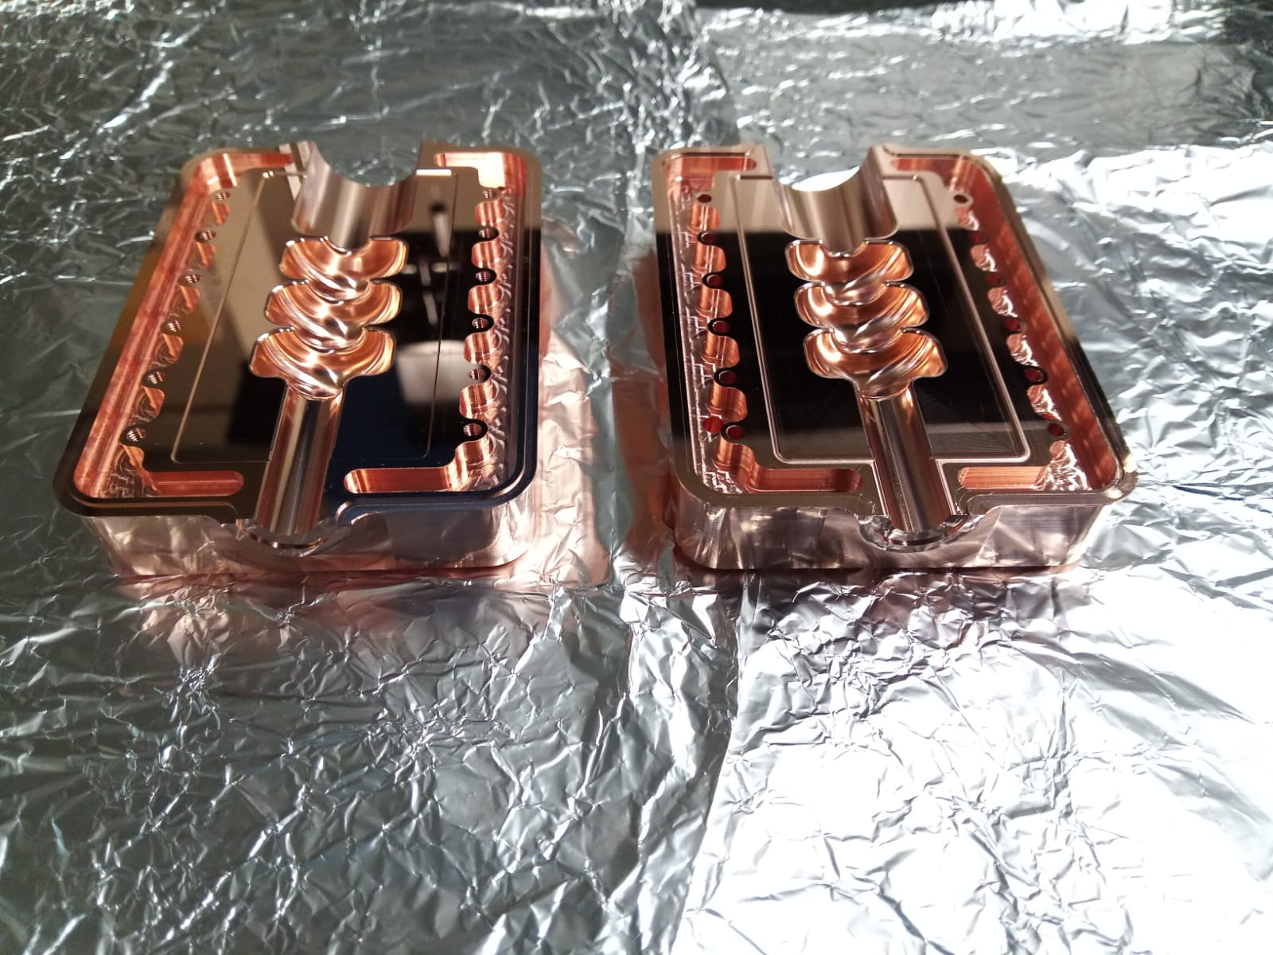
«Closed»
RF current flows through
joints (brazing,
diffusion bonding, welding)
Regular or pillbox-like cells
Examples:
«Open»
RF currents never cross joints
Chocke-mode cavity
Multi-sector
Examples:
RF current flow
RF current flow
Beam axis
NO joints
joint
Joints away from RF surfaces
INFN-LNF
DEMETRA
ARYA (1xtwo halves and 2xfour quadrants)
KEK
Brazed
EuPRAXIA, INFN-LNF
Welded
INFN-LNF
DEMETRA
3x quadrant-structures fabricated and sent to SLAC and KEK for high-power testing
CLIC-G-OPEN

Slide 6
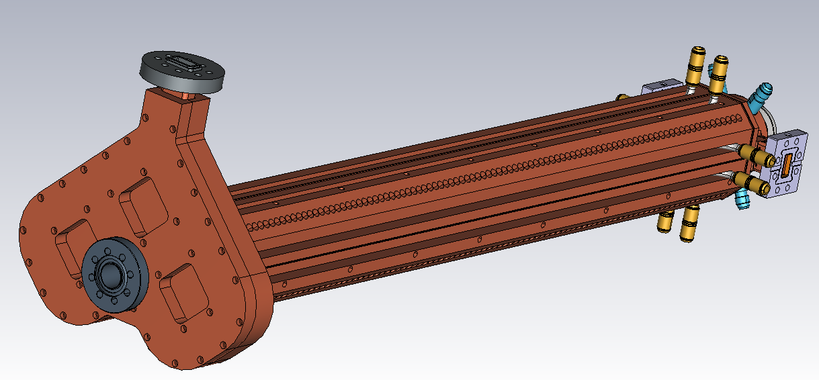
Attività
Full TW multi-cell X-band structure
TIG-welded
4-quadrants
«open-type»
Cooling channels
90 cm
Integrated
mode-launcher
TIG welding joints
Fabrication out of hard copper
Increase in vacuum pumping speed
Overall reduction of the fabrication costs
Easy insertion of HOM absorbing materials
tuners
27 cm

Slide 7
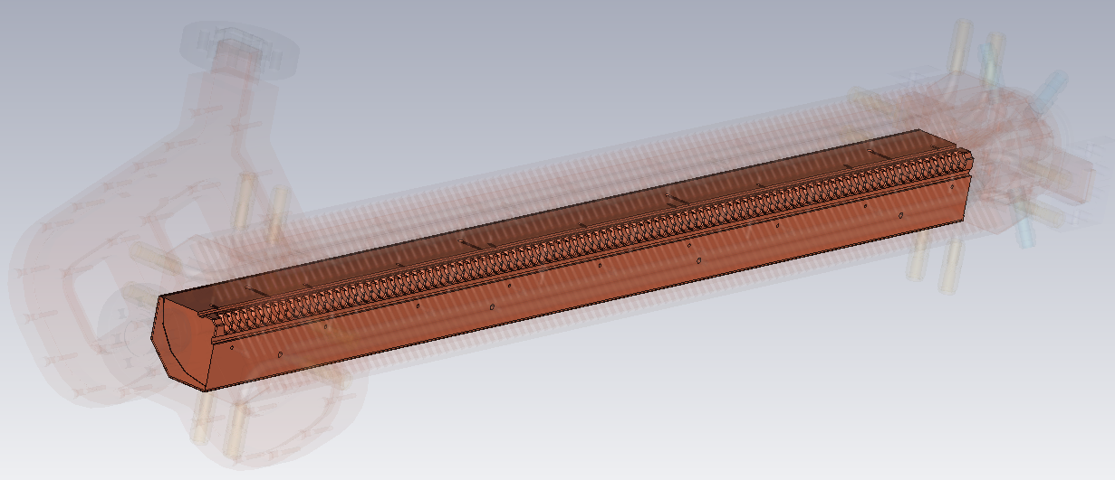
Full TW multi-cell X-band structure
Secondary vacuum chamber (extra pumping, easy insertion of HOMs absorbers in multi-bunch operation,…)
Single quadrant
TIG welding joints
Alignment pins

Slide 8
WP1
WP2
LNF
Roma1
LNS
RF multi-cell Cavity Design
RF mode launcher
RF Testing
High power tests
Low-power tests
WP4
WP3
Diagnostics
Data Acquisition
Wakefields/HOMs
WP0
PM, networking and Cross-fertilization

Slide 9
Working Packages and Tasks
WP1 RF Design, Engineering and Fabrication of the multiple-sector RF cavity (LNF, LNS, Roma1)
Local Responsible: F. Cardelli
Task1.1 RF design of the multiple-sector RF cavity (LNF)
Task1.2 Vacuum System Desing of the RF cavity (LNF)
Task1.3 Engineering and fabrication of the RF cavity, and mode-launcher from WP2 (LNF)
WP2 RF Design, Engineering and Fabrication of the RF power mode launcher (LNS, LNF, Roma1)
Local Responsible: G. Torrisi
Task2.1 RF design of the RF power mode launcher (LNS)
Task2.2 Fabrication the RF power mode launcher (LNS)
WP3 Wakefields/HOMs Characterization and Optimization (Roma1, LNF, LNS)
Local Responsible: L. Ficcadenti
WP4 RF low- and high-power testing at INFN-LNF (LNF, Roma1, LNS)
Local Responsible: L. Piersanti, S. Pioli
Task4.1 Low-power RF testing at LATINO Lab at INFN-LNF (LNF)
Task4.2 High-power RF testing at TEX facility at INFN-LNF (LNF)
Task4.3 Diagnostics and data acquisition (LNF)

Slide 10
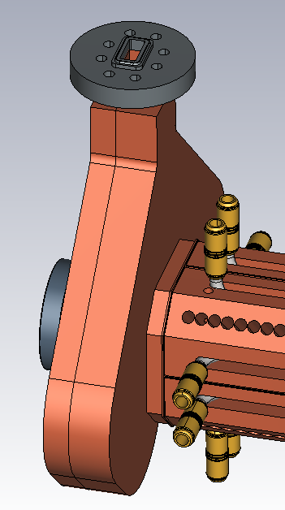
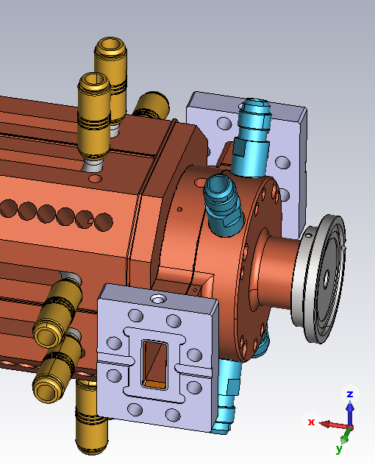
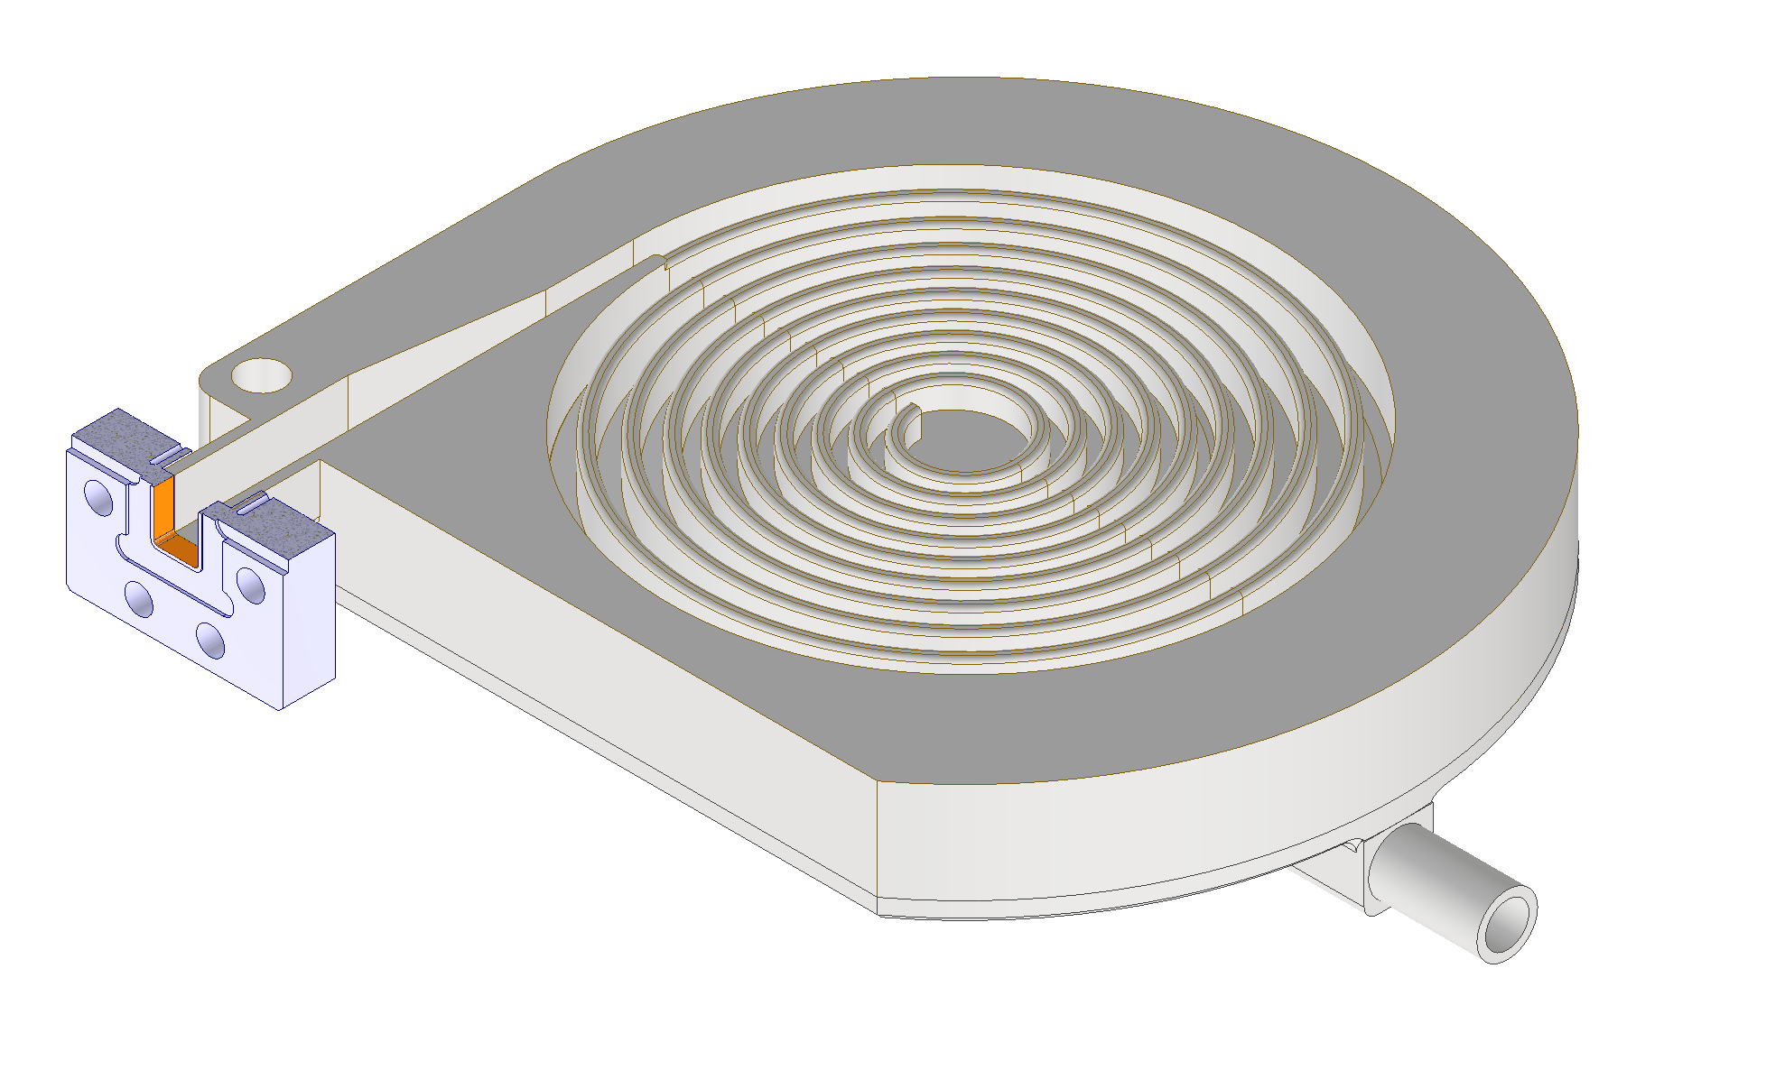
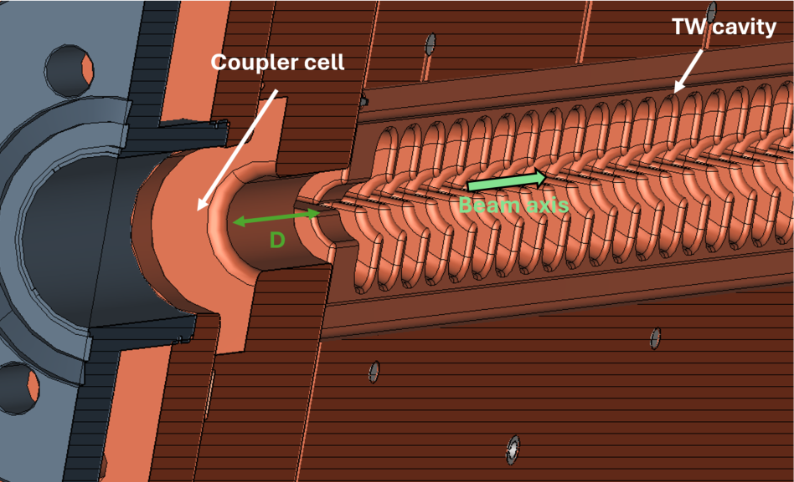
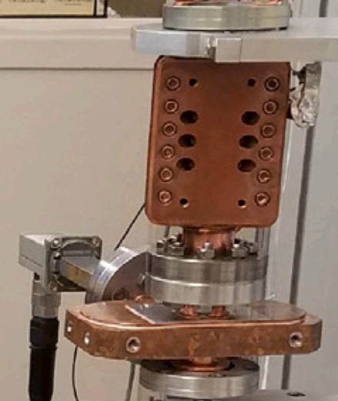
-WP2 RF Design, Engineering and Fabrication of the RF power mode launcher (LNS)
Close collaboration with WP1 and WP3
Mode launcher:
  Single and double four-port mode launchers;
  Input mode launcher and two output spiral loads;
  “open” launcher as HOM-free RF power coupler.
Integrated:
  Ideally D → 0
  D > 0
Stand-alone, separate mode launcher:
  Connected to the multi-cell TW cavity through an RF flange.
X-band high-power metallic load

Slide 11
2025 LNS ACTIVITY
Milestone 1: RF and Wakefields/HOMs Optimization Design

Slide 12
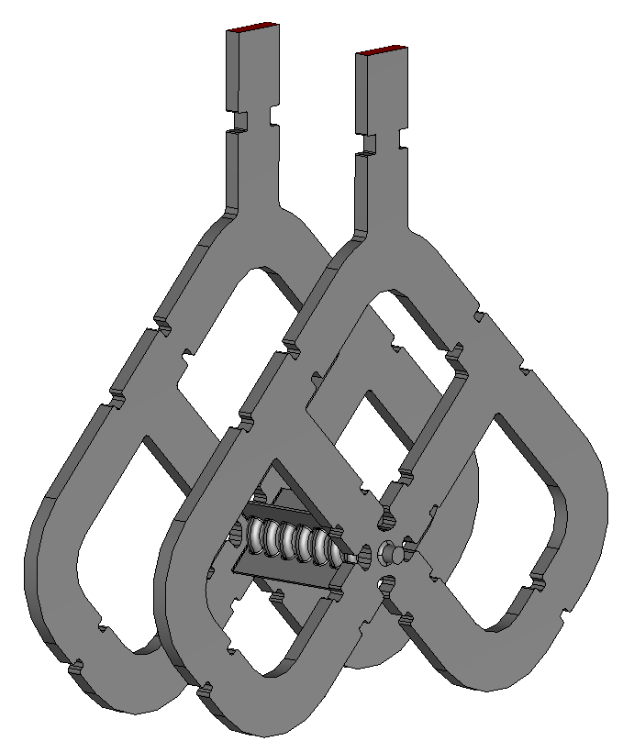
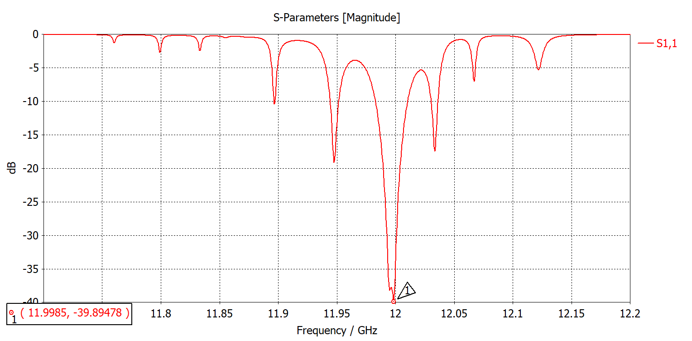
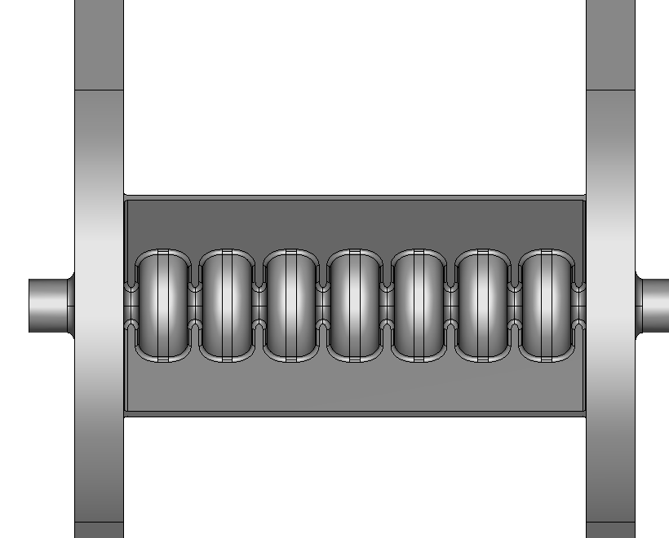

Struct + S11(9 cells only)
TW accelerating structure working in the TM01-$\frac{2}{3}π$ mode.
Full structure will be composed of 120 cells.
9-cell structure S11
G.S. Mauro courtesy

Slide 13
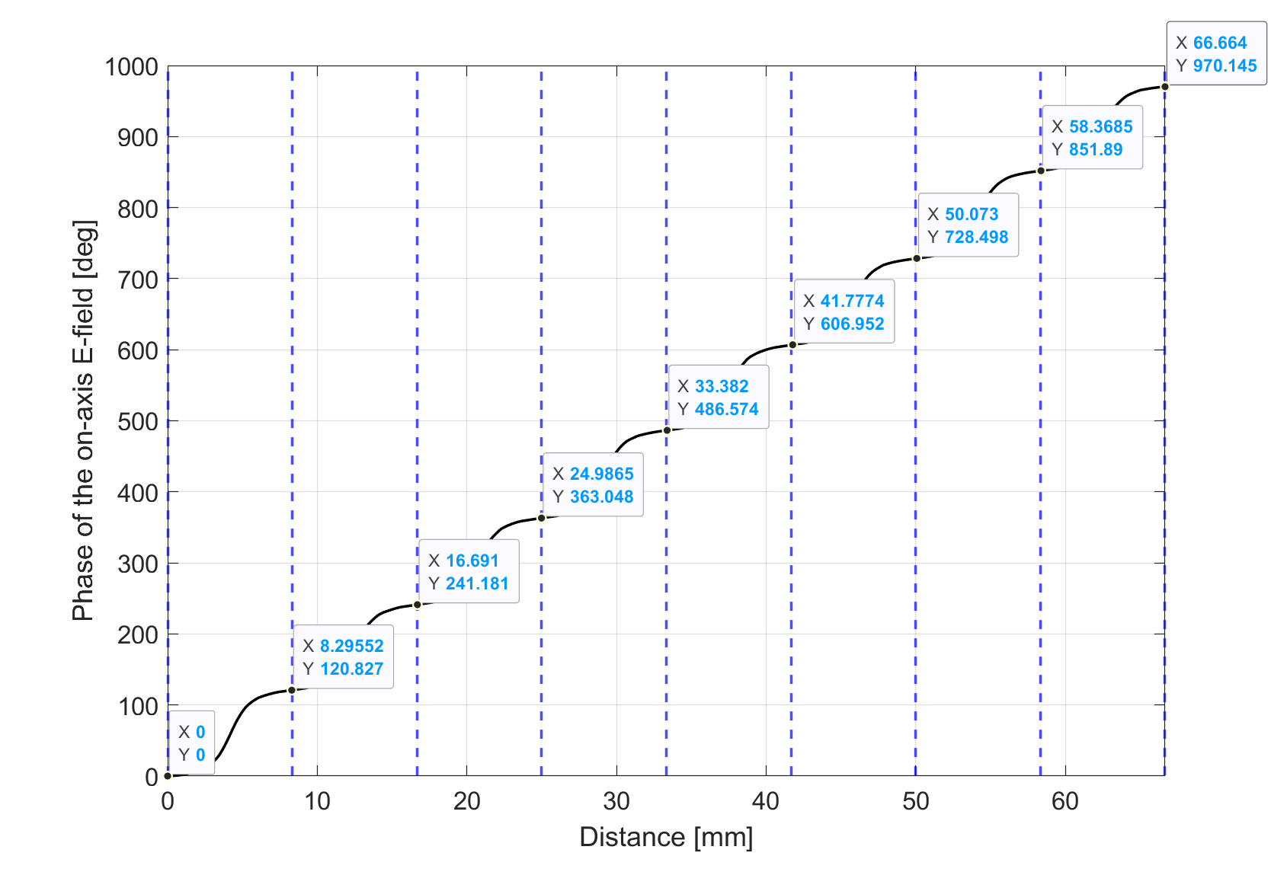
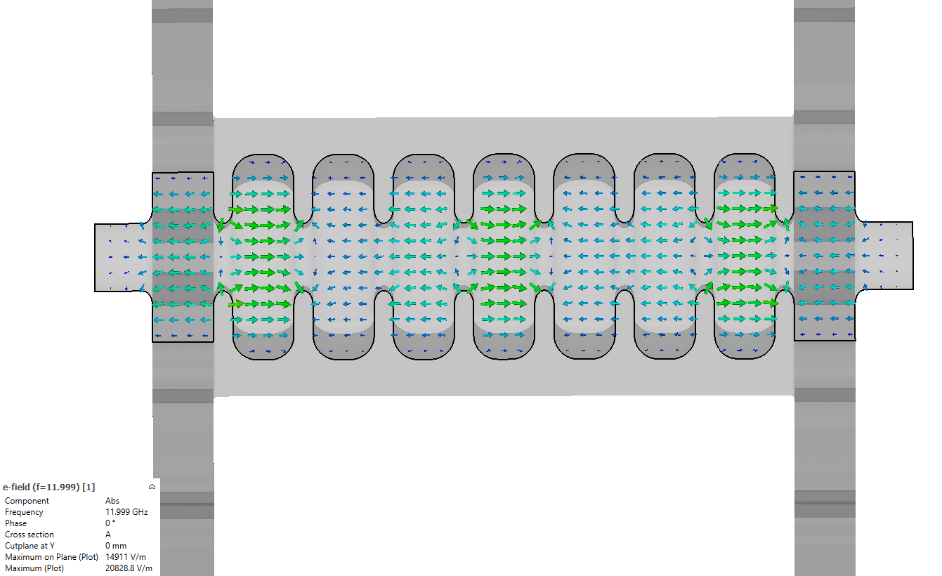
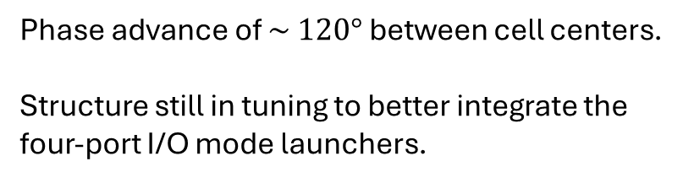
Fields + phase adv.
Phase advance of $\sim 120°$ between cell centers.
Structure still in tuning to better integrate the four-port I/O mode launchers.
G.S. Mauro courtesy

Slide 14
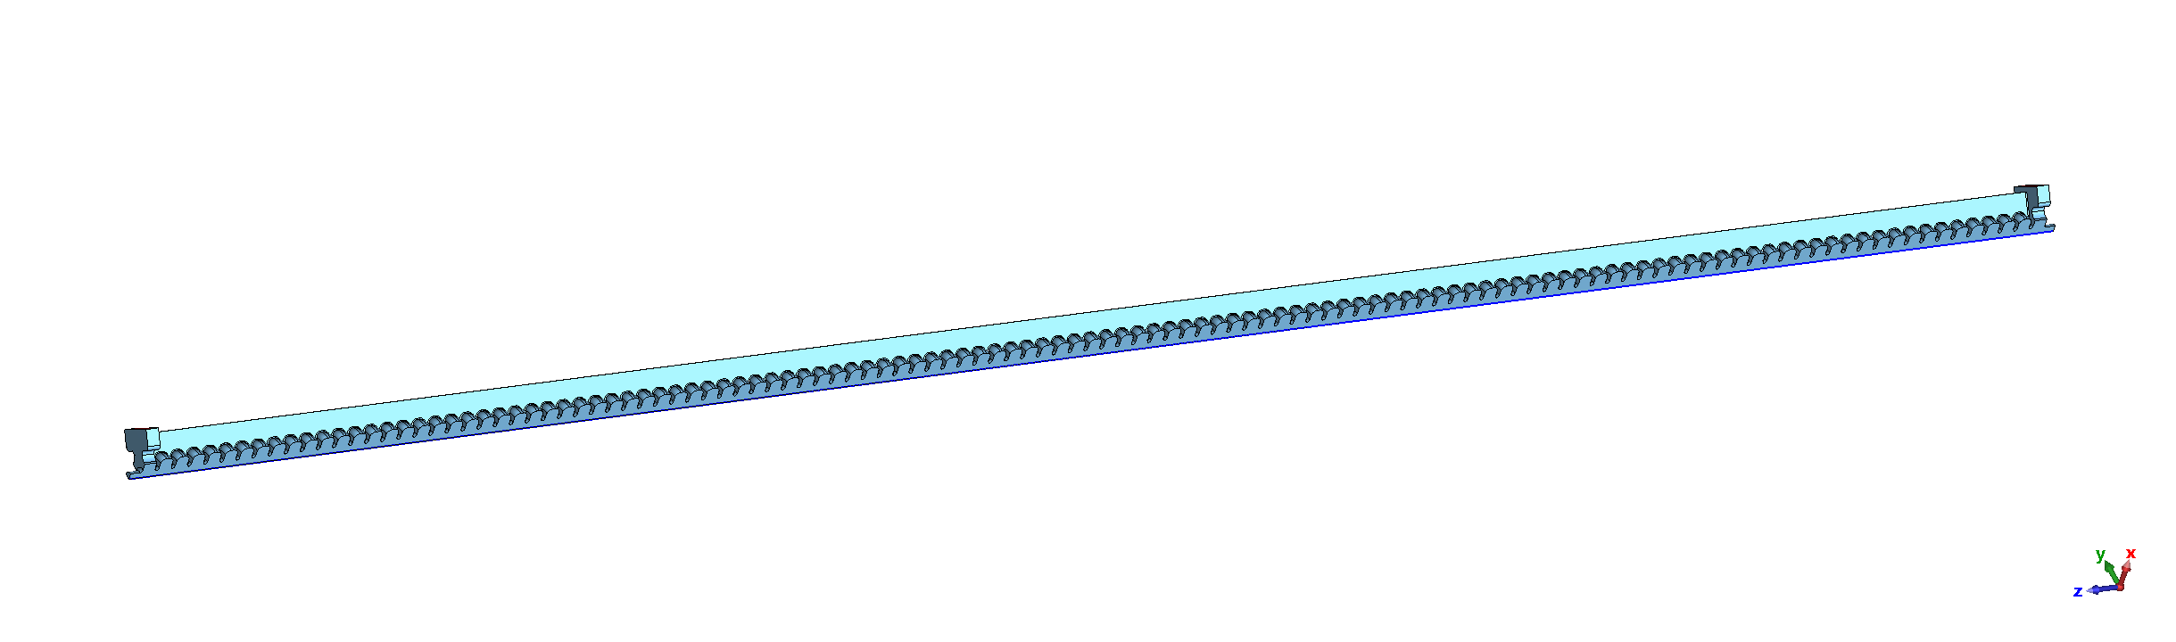
Full struct without ML

Slide 15

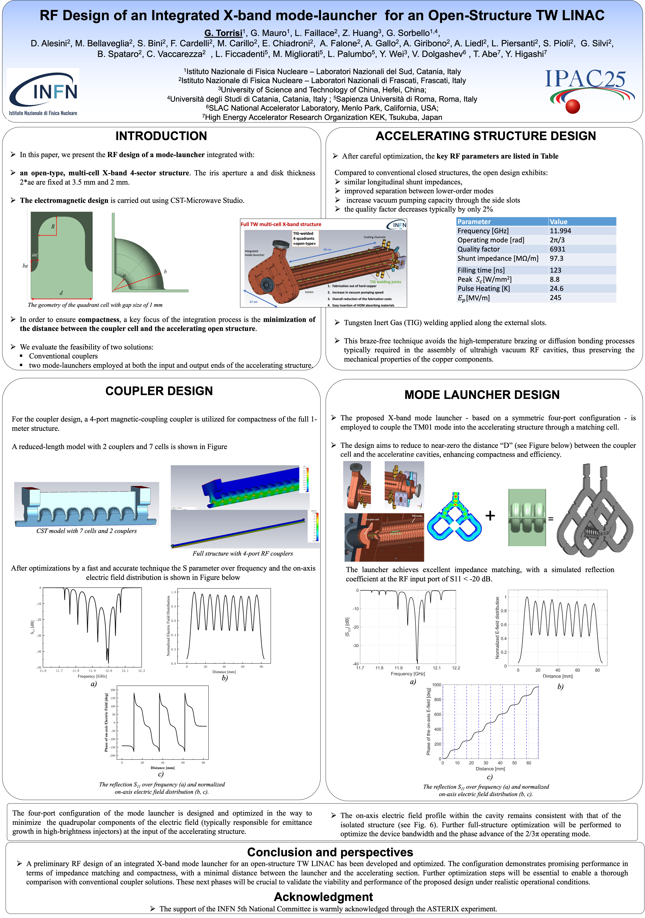
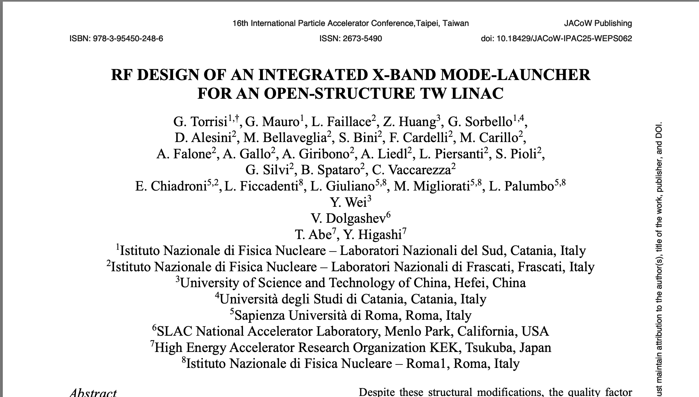

Slide 16
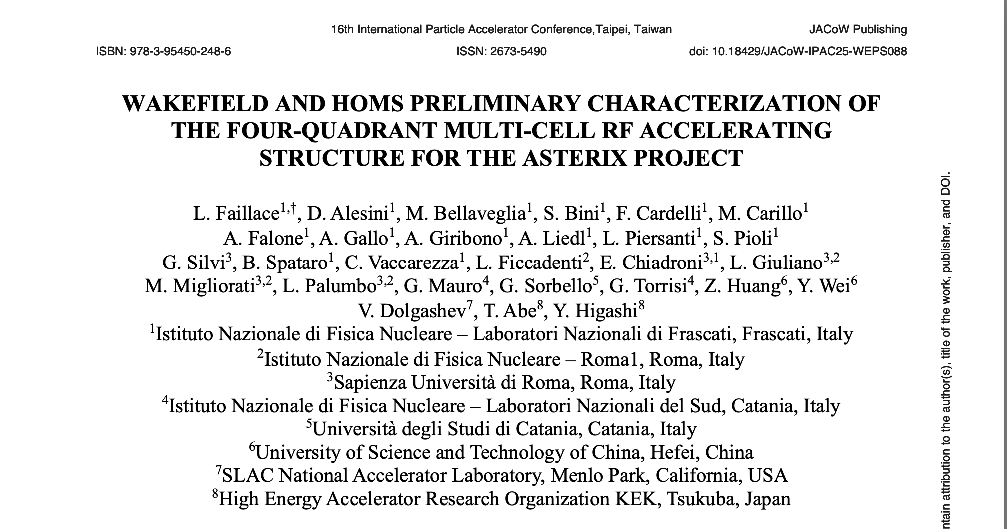
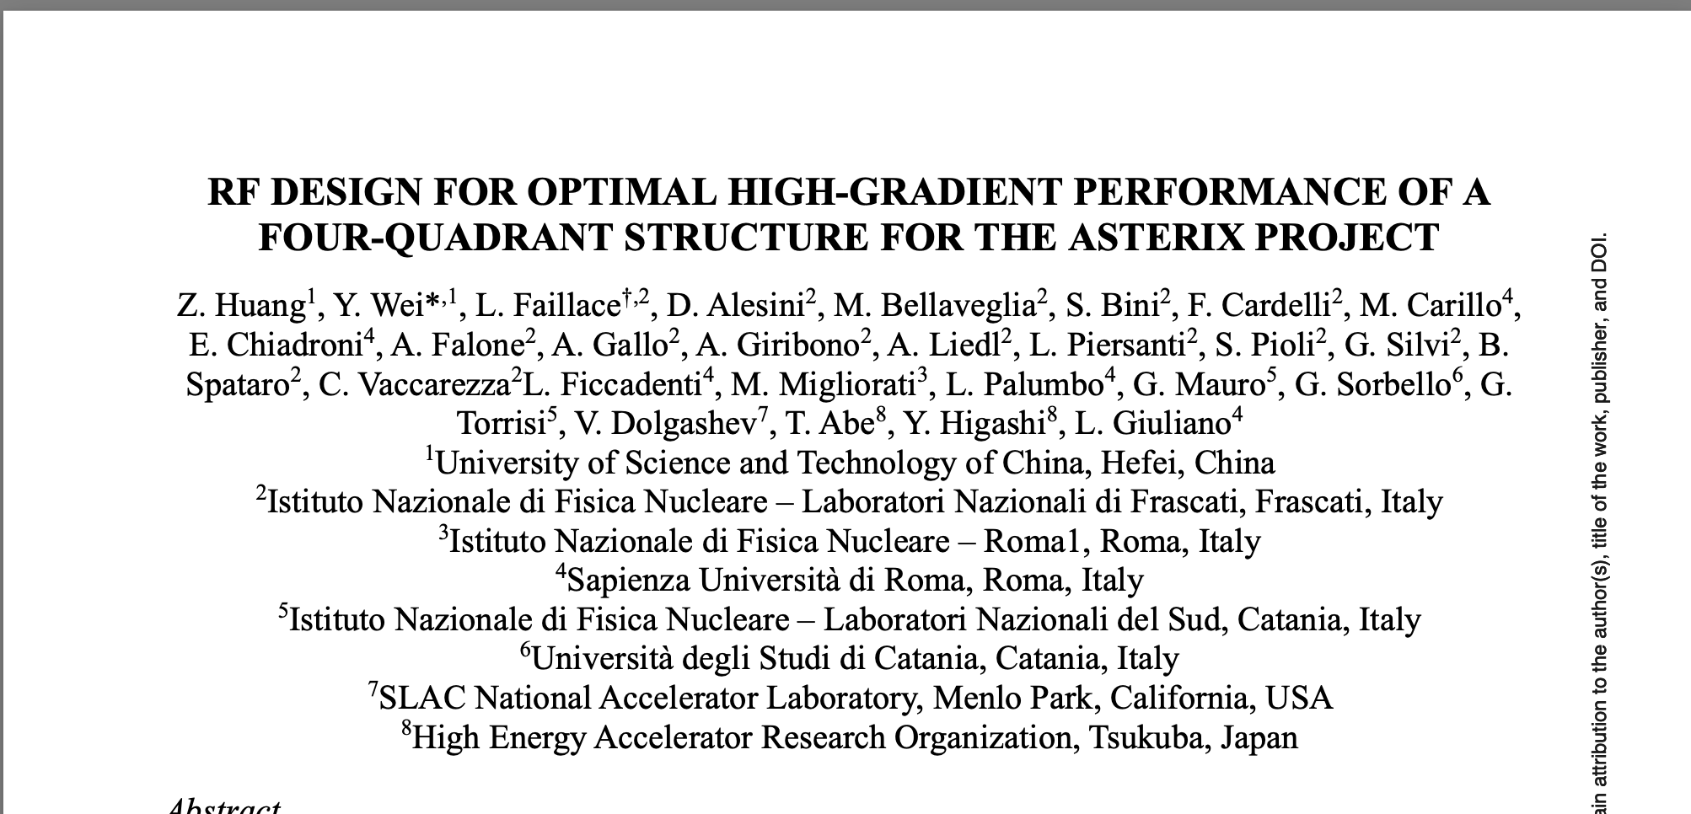

Slide 17
Budget (LNS)
Year |  | Cost |  | Notes
2 | Software-CST | € 16,000.00 |  | simulazioni RF coupler design
 | Missions | € 4,000,00 |  | Partecipazioni misure sui primo prototipi sia a bassa @ COMEB che alta potenza RF a TEX (LNF)
TOT |  | € 20,000.00

Slide 18
FTE
LNS | FTE
G. Torrisi (RL) | 10
D. Mascali | 5
G. Mauro | 10
G. Sorbello | 20

