Slide 1
New Generation Super Attenuator for Einstein Telescope
The NGSA project aims to develop an improved seismic isolation system for the Einstein Telescope. Started in 2022, this INFN-funded initiative involves research units from INFN Pisa, Naples, and Cagliari.
DD

Slide 2
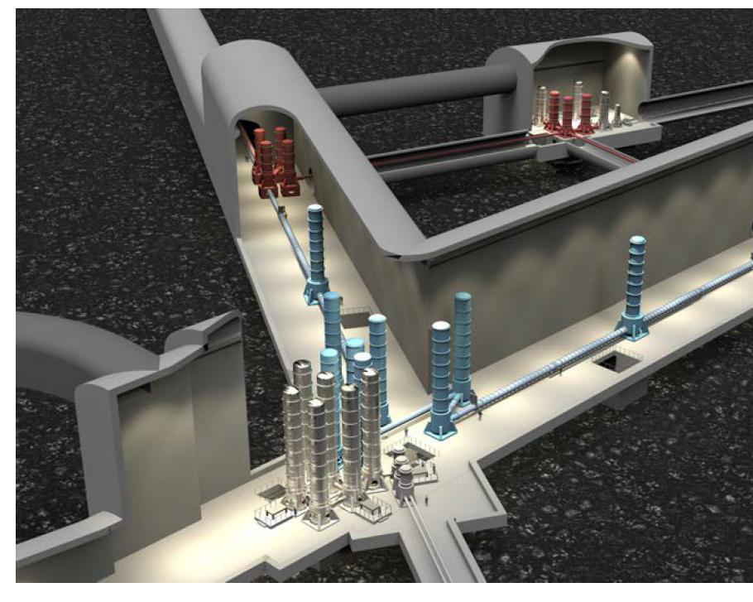
Scientific Goals
Improve Sensitivity
Extend detection band to lower frequencies (2-3 Hz).
Optimize Height
Keep total SA length around 10-12m instead of 17m.
Reduce Seismic Noise
Enhance isolation performance for ET's underground operation.

Slide 3
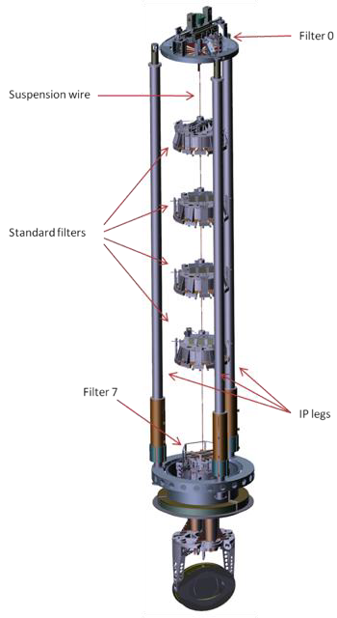
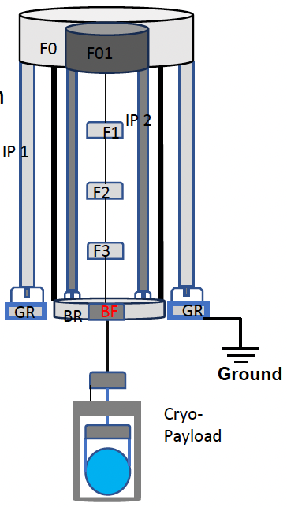
Project Organization
Research Approaches
Traditional Solution (SA)
1
WP1: Simulation
Optimized Superattenuator with AdV architecture and improved nMAS.
Optimization of Superattenuator configurations using OCTOPUS software.
Simulations show promising results for 11-12m configurations.
2
WP2: Magnetic Anti-Spring
Development of new MAS with rare-earth magnets for vertical attenuation.
3
WP3: NIP Prototype
Development of Nested Inverted Pendulum prototype at PlaNET laboratory.
Innovative Solution (NIP-SA)
Two-stage Nested Inverted Pendulum with enhanced horizontal pre-isolation.
4
WP4: Control Systems
Feedback control application using LabView-based electronics.
1:2 scale prototype under development at PlaNET Laboratory.

Slide 4
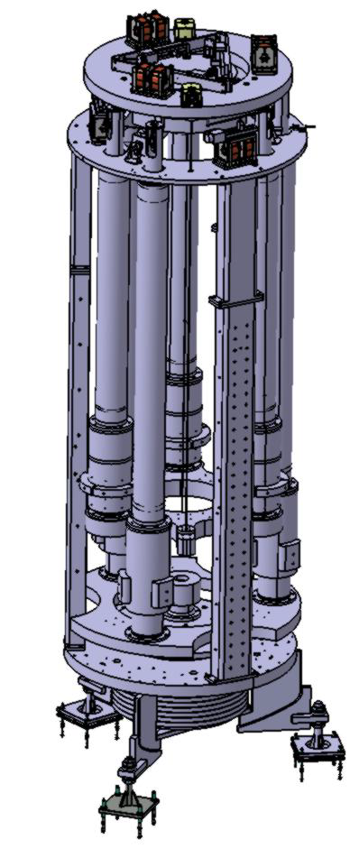
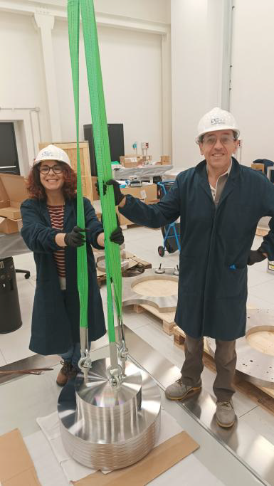
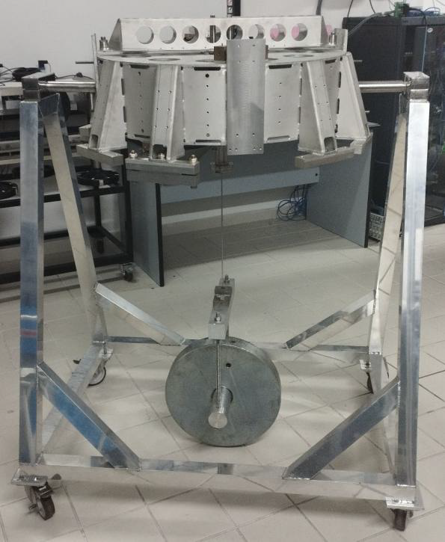
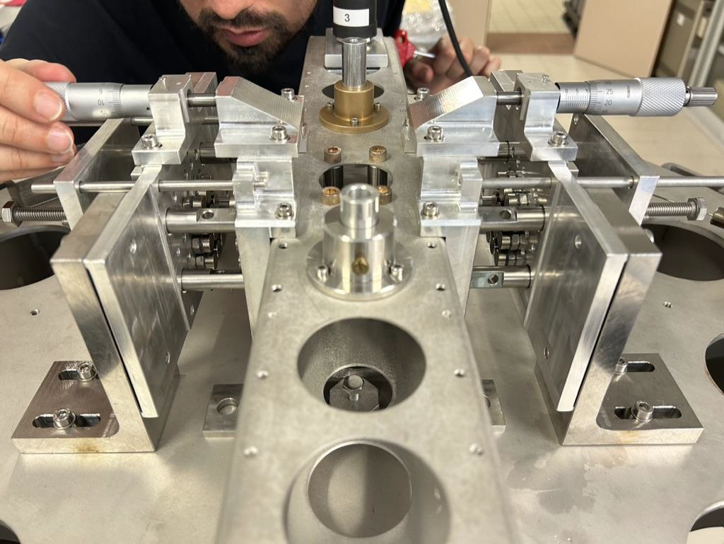
Status
Traditional Solution (SA)
Innovative Solution (NIP-SA)
A NIP prototype (in 1:2 scale) is under development and will be tested for checking reliability and performance
A new cross-bar, based on nMAS has been designed and a first prototype is under preparation to be used in a long Superattenuator (about 14 m high) for CAOS facility (at Perugia University).

