Slide 1
Ferrara INFN Infrastructure
Andrea Mazzolari
01/07/2025

Slide 2
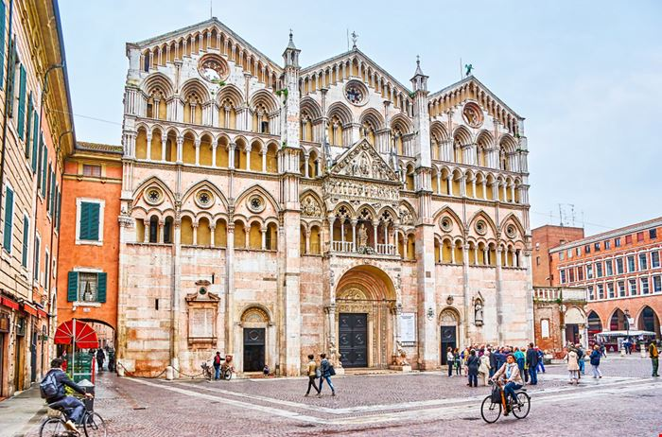
Ferrara
Ferrara is one of the most fascinating and distinctive cities in northern Italy. Located in the heart of the Po Valley, it combines a prestigious past—especially under the rule of the House of Este—with a vibrant cultural present.
Its historic center has been designated a UNESCO World Heritage Site for its remarkably preserved Renaissance urban planning and the harmonious integration of architecture, city layout, and landscape.

Slide 3
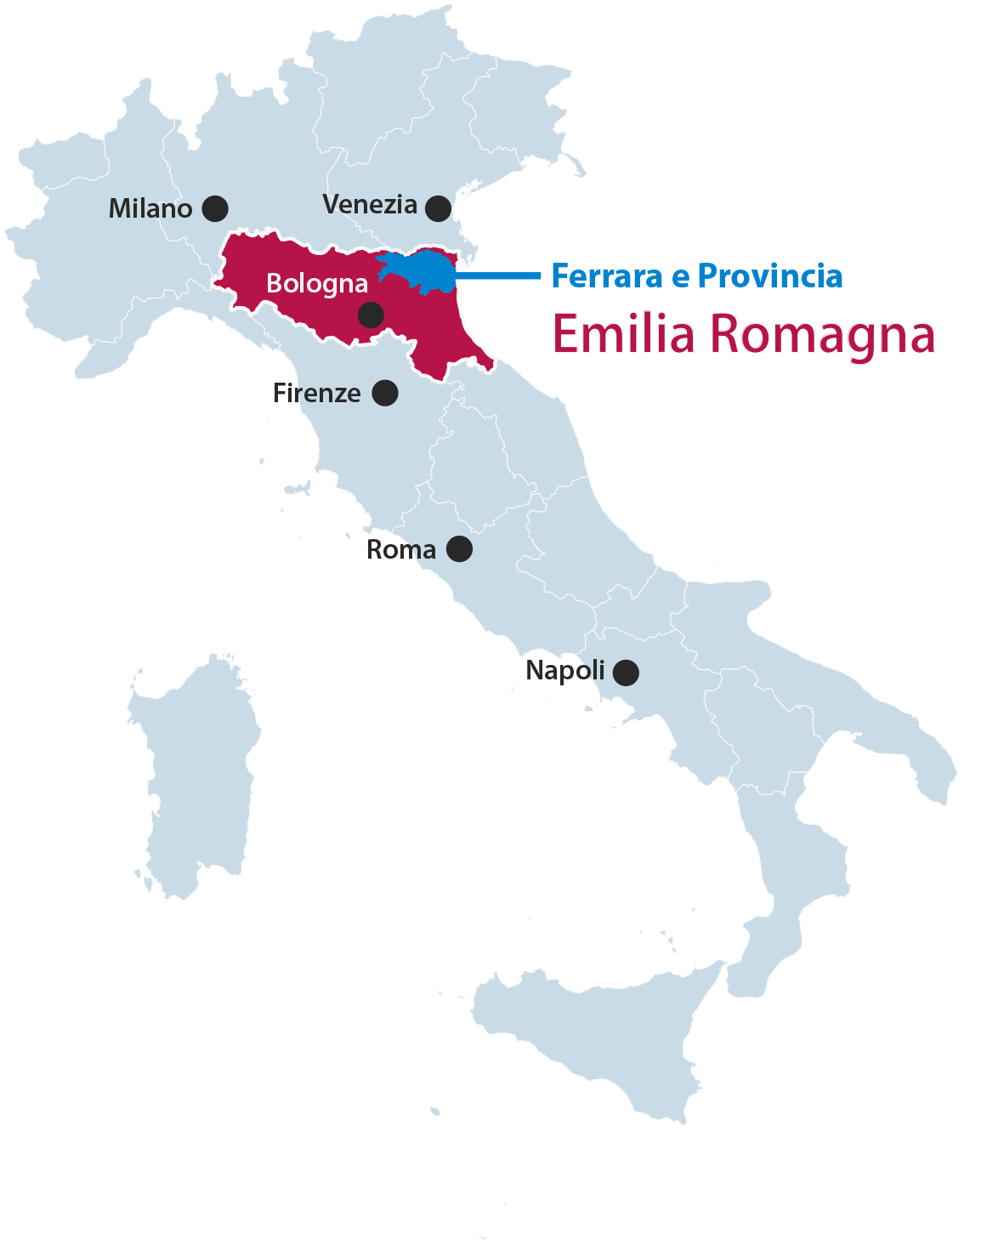
Ferrara
Ferrara is located in the Emilia-Romagna region, in the eastern part of the Po Valley, about 50 km northeast of Bologna and not far from the Adriatic Sea. It lies in a completely flat area, along a historical branch of the Po River, and is part of a territory rich in nature, including the nearby Po Delta Park.
Its geographical location allowed it to thrive in the Middle Ages and Renaissance as a trade and cultural center. Today, Ferrara is one of Italy’s most bicycle-friendly cities, thanks to its extensive network of cycling paths and its compact urban layout—fostering a sustainable and people-oriented lifestyle.

Slide 4
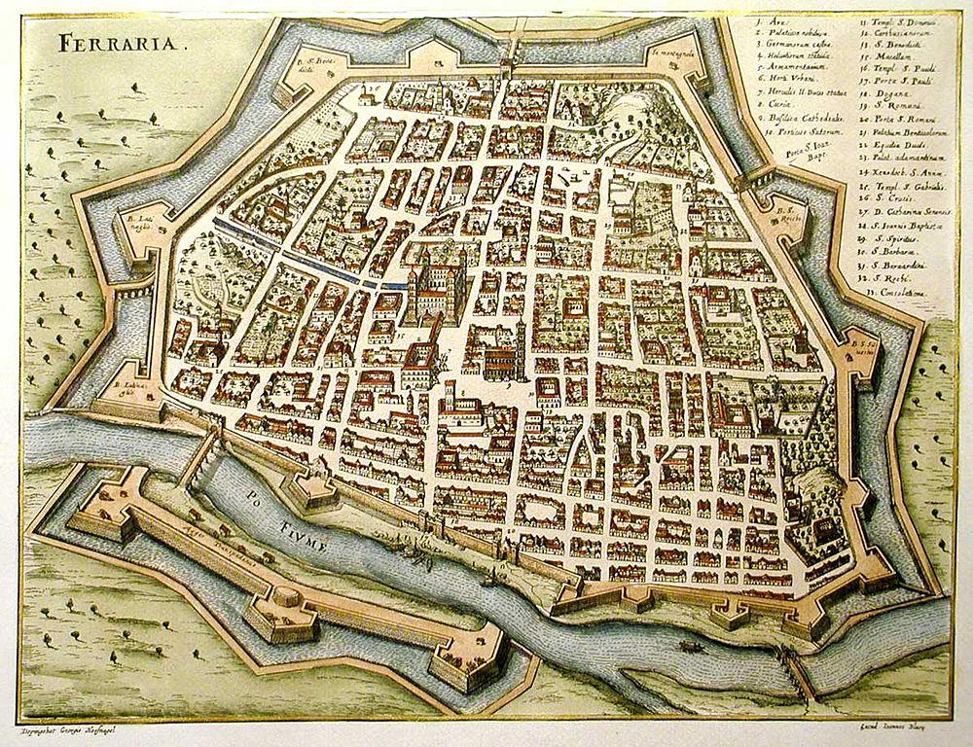
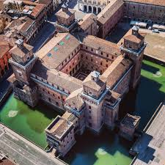
Ferrara
The origins of Ferrara date back to Roman times, but the city’s true development began in the Middle Ages when it came under the rule of the Este family—one of Europe’s most powerful dynasties. The Este governed Ferrara for over three centuries, transforming it into a flourishing Renaissance capital, home to artists, architects, and scholars.
Many of the city’s most iconic buildings were built during this period. After the Este duchy was absorbed into the Papal States in the late 16th century, Ferrara lost its political autonomy but preserved its strong cultural identity. Following Italy’s unification in the 19th century, Ferrara became an integral part of the national state and continued to distinguish itself through its commitment to education, literature, and the arts.

Slide 5
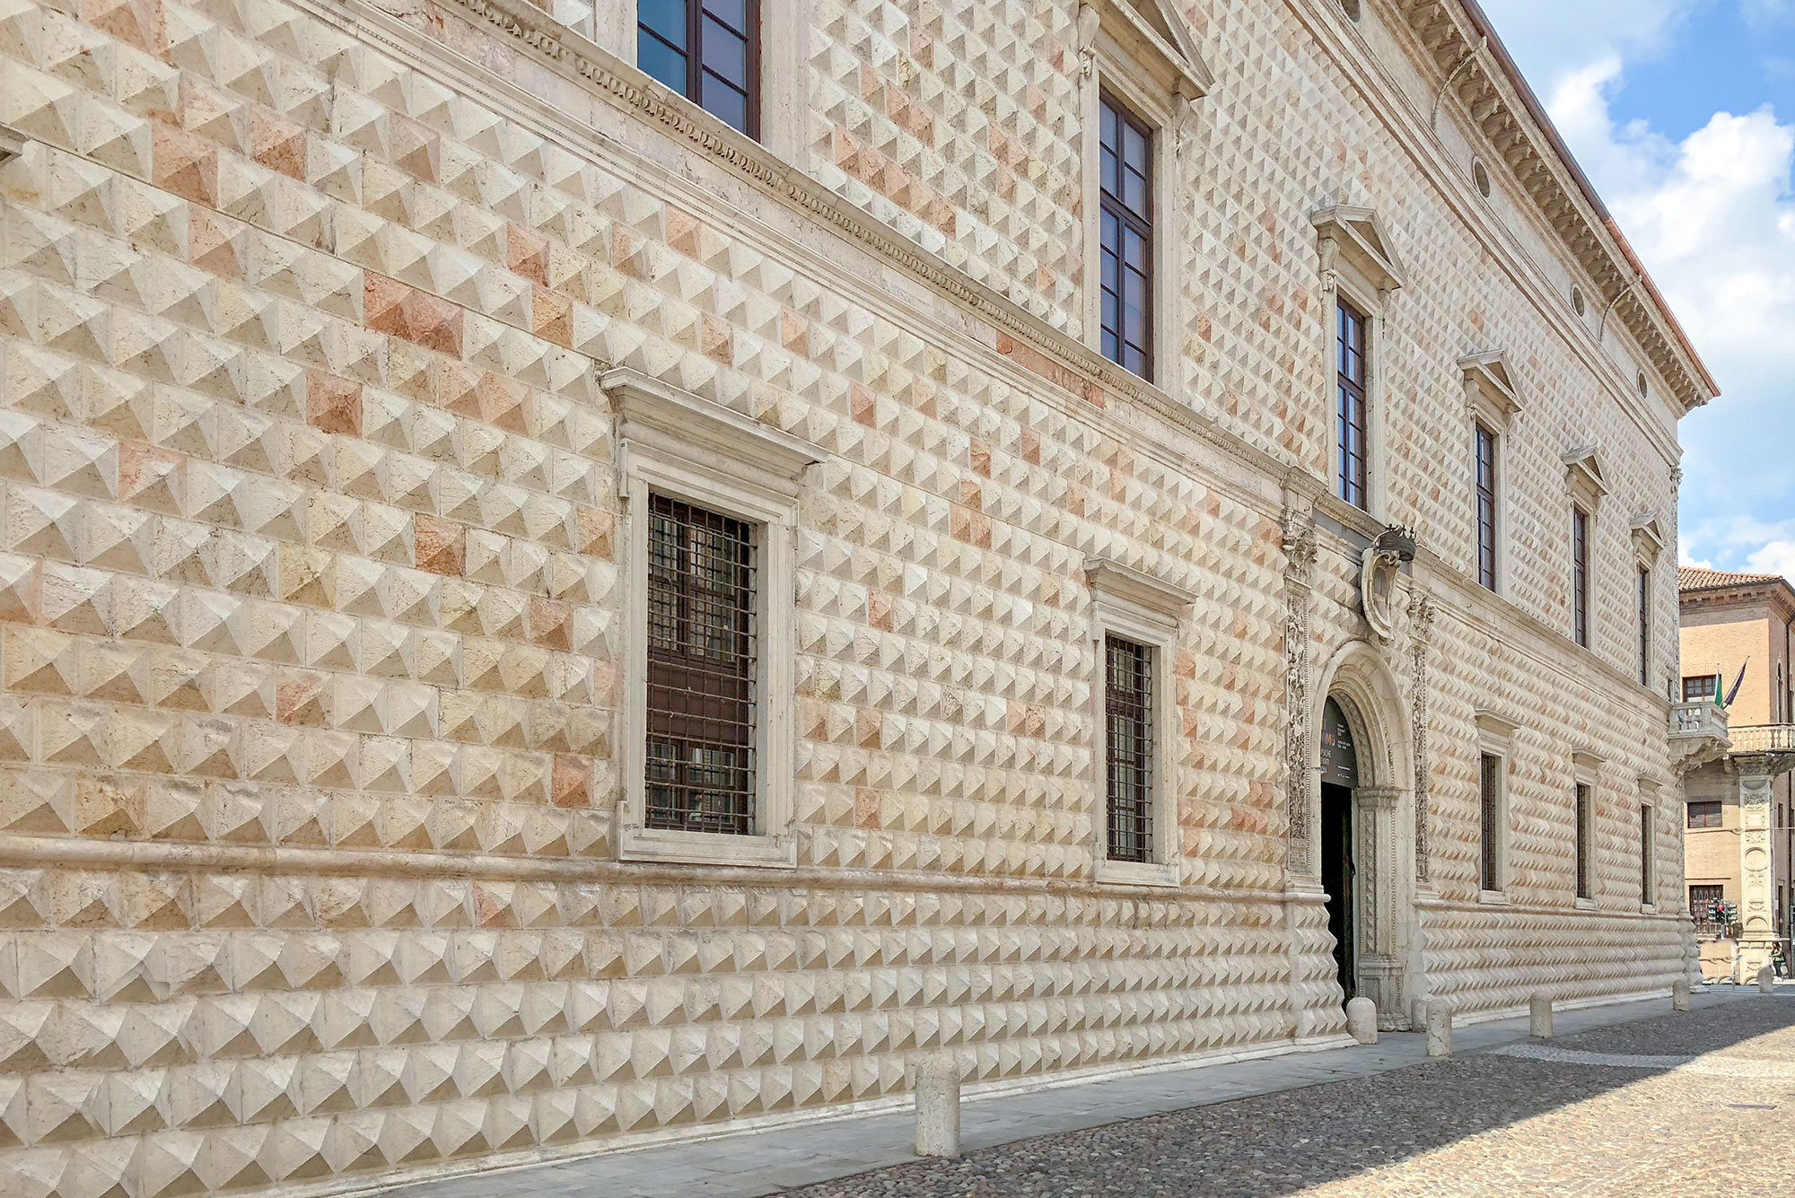
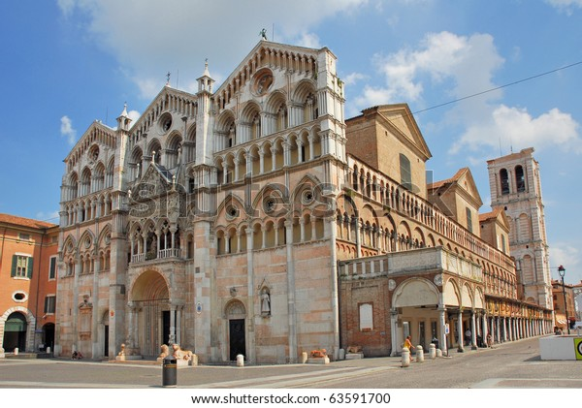
Ferrara
Ferrara is an architectural treasure trove.
The Este Castle, built in 1385 as a fortress and later converted into a ducal residence, is the city’s symbol, complete with towers, a moat, and drawbridges.
Nearby stands the Cathedral of Saint George, begun in the 12th century, which features a striking blend of Romanesque and Gothic elements.
The Palazzo dei Diamanti is another iconic building, renowned for its unique diamond-shaped marble façade and now home to the National Art Gallery and prestigious exhibitions. The city also boasts the Quadrivio degli Angeli, the medieval Via delle Volte
Over 9 km of remarkably preserved Renaissance walls, which today serve as a green walking and cycling path surrounding the city.

Slide 6
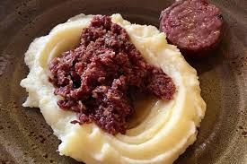
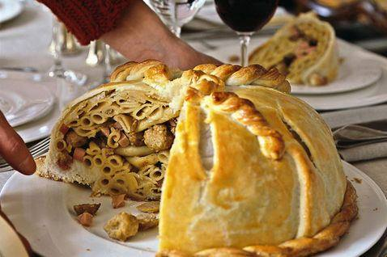
Ferrara
Ferrara’s culinary tradition
Reflects its historical richness and Renaissance roots. One of its most iconic dishes is cappellacci di zucca—handmade pasta filled with sweet pumpkin, Parmesan cheese, and nutmeg, usually served with butter and sage or meat ragù. The salama da sugo is a spiced, aged pork sausage slowly cooked and served with mashed potatoes: a robust and highly distinctive dish celebrated in local food culture.
The pasticcio ferrarese is a unique preparation that combines sweet and savory: pasta frolla (shortcrust pastry) filled with baked macaroni, béchamel, mushrooms, and meat sauce.
The city’s symbolic bread, known as coppia ferrarese, features a twisted shape and a crisp crust, and has earned PGI (Protected Geographical Indication) status.

Slide 7
Relationships
2x
We are a team operating in internal environments mainly on activities related to crystals design, manufacturing and characterizations.
Channeling, x-ray, medical physics, astrophysics, etc…
Active in channeling field since 2000
2x
CSNI
CSN II
CSN V
Pathfinder
INFN
Ferrara
RISE
Marie Curie

Slide 8
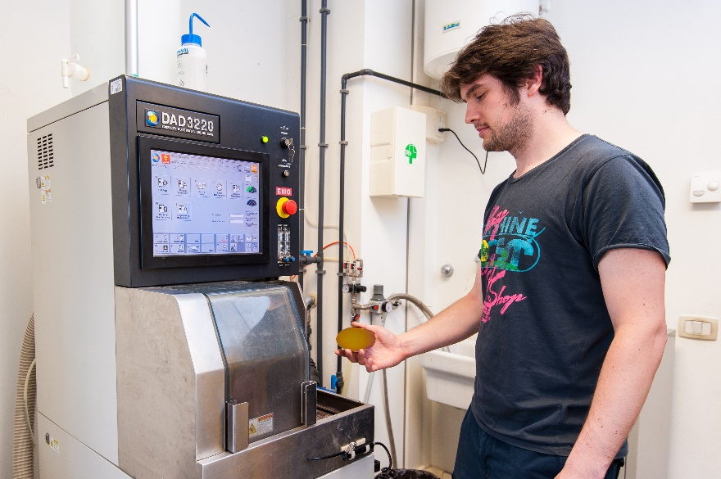
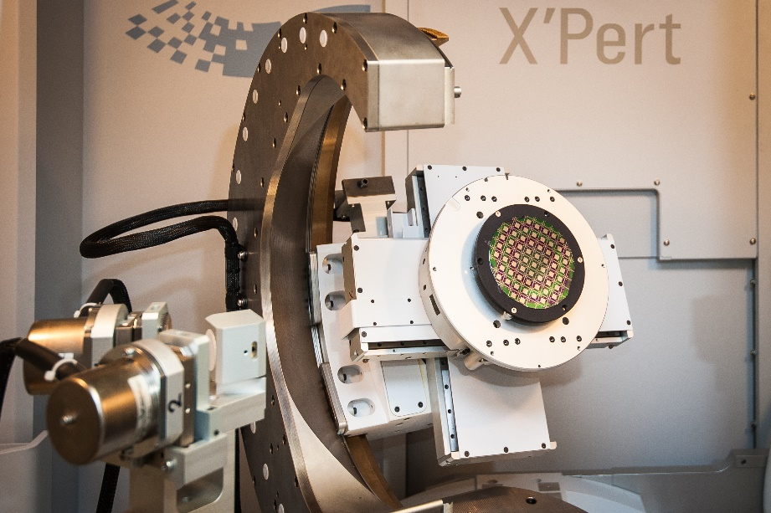
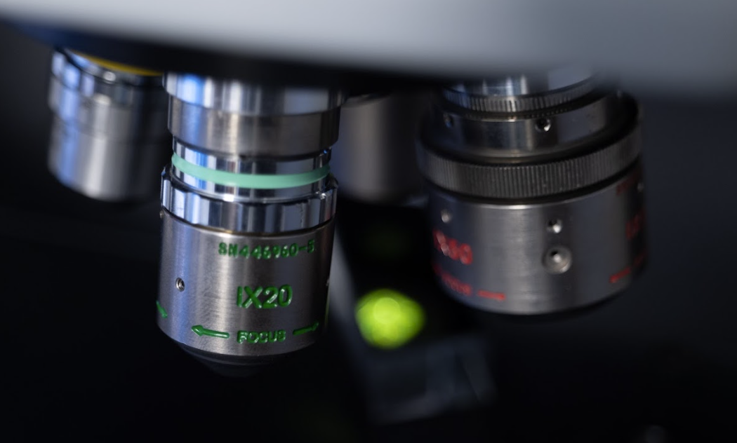
INFN infrastructure
Laboratory fully equipped for silicon micro and nanomachining
ISO4 certified clean room (130 m²)
High-resolution x-ray diffraction
Dicing and polishing equipment
White light and Fizeau inteferferometers

Slide 9
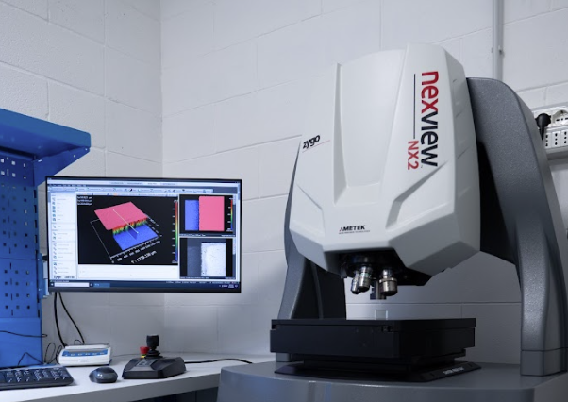
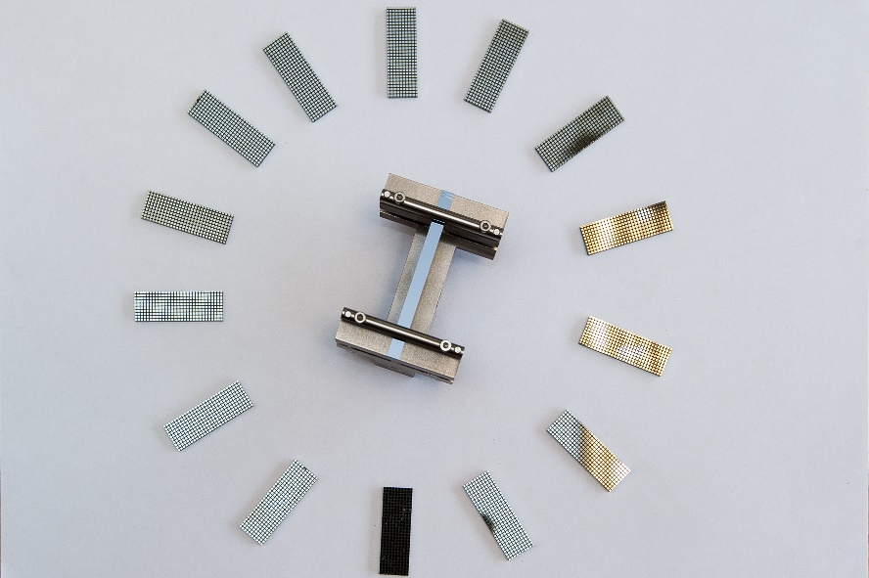
INFN infrastructure
Laboratory fully equipped for silicon micro and nanomachining
Fotolitography
Equipment for silicon chemical etching
Nanoimpringing

Slide 10
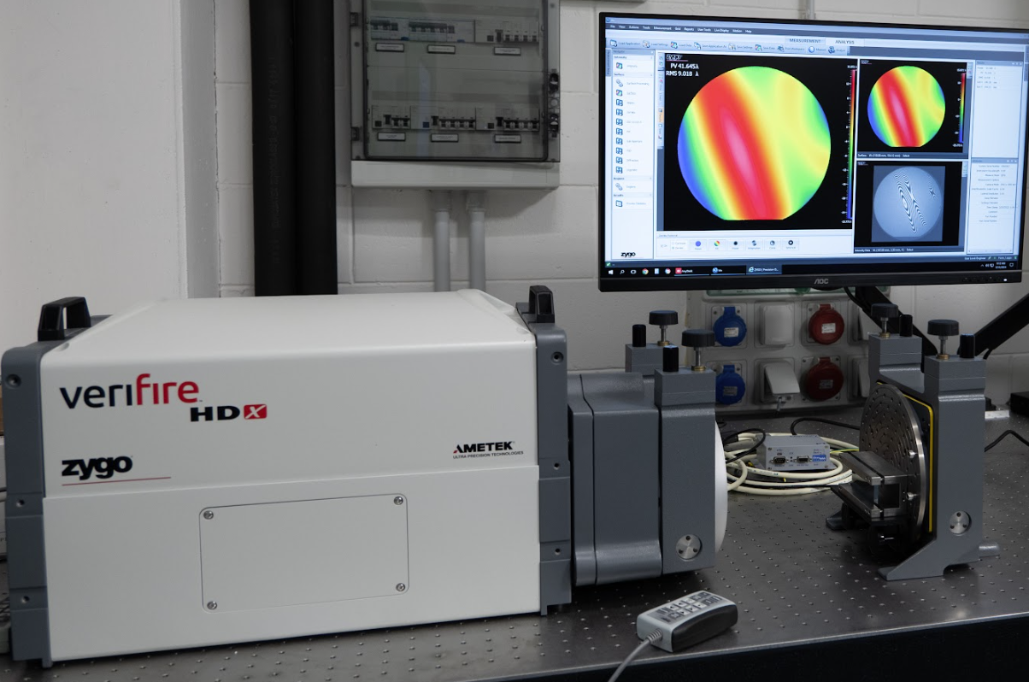
OPTICAL INTERFEROMETRY
Laser interferometry is a high-precision optical technique used to detect extremely small displacements or deformations. By splitting a coherent laser beam and recombining it after it travels along different paths, the resulting interference pattern reveals variations at the nanometer scale.
This method is widely used in fields such as material testing, precision metrology, and gravitational wave detection, due to its exceptional accuracy and non-contact nature.

Slide 11
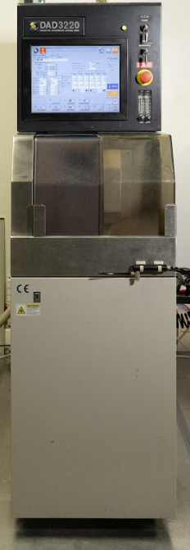
DICING TECHNOLOGIES
Blade dicing is a widely used technique for cutting semiconductor wafers, optical substrates, and other brittle materials. It employs a high-precision rotating blade, typically embedded with diamond particles, to physically slice the material along predefined lines (scribe streets).
This method offers:
High throughput and scalability for mass production
Good edge quality, especially for silicon and glass
Compatibility with various wafer thicknesses and coatings
Proper control of spindle speed, feed rate, and cooling (via deionized water) is essential to minimize chipping, cracking, and thermal stress during processing.

Slide 12
HIGH RESOLUTION X-RAY DIFFRACTION
HRXRD is a powerful analytical technique used to investigate the structural properties of single crystals, epitaxial layers, and thin films with angstrom-level precision. By measuring the angular position and shape of X-ray diffraction peaks, HRXRD provides information on:
Lattice parameters and strain
Crystal quality and defects
Layer thickness and composition in epitaxial structures
Mosaicity and curvature of bent crystals
Due to its non-destructive nature and high angular resolution, HRXRD is widely applied in semiconductor technology, X-ray optics, and advanced materials research to optimize growth processes, monitor structural uniformity, and assess mechanical deformations.

Slide 13
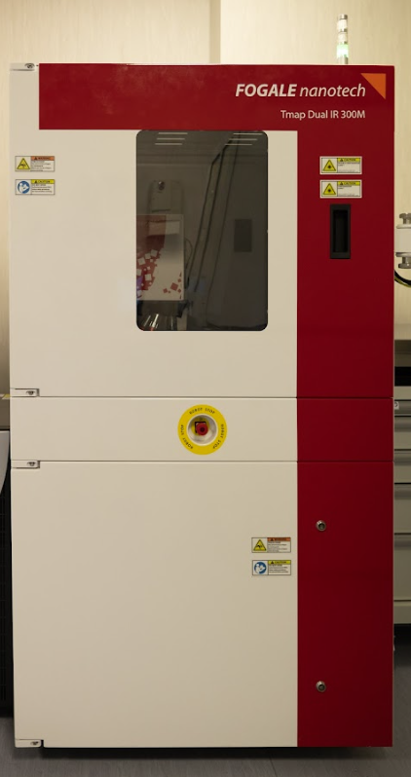
INFRARED INTERFEROMETRY
The FOGALE TMAP-4 uses infrared low-coherence interferometry to measure thickness, uniformity, and bonding quality in transparent or semi-transparent materials, such a:
SOI wafers and glass stacks.
Key features:
Full-wafer 2D thickness maps
Sub-micron resolution
Detection of bonding voids and layer irregularities
Fast, vibration-free, non-destructive measurements
Widely used in semiconductor and MEMS fabrication for process control and quality assurance.

Slide 14
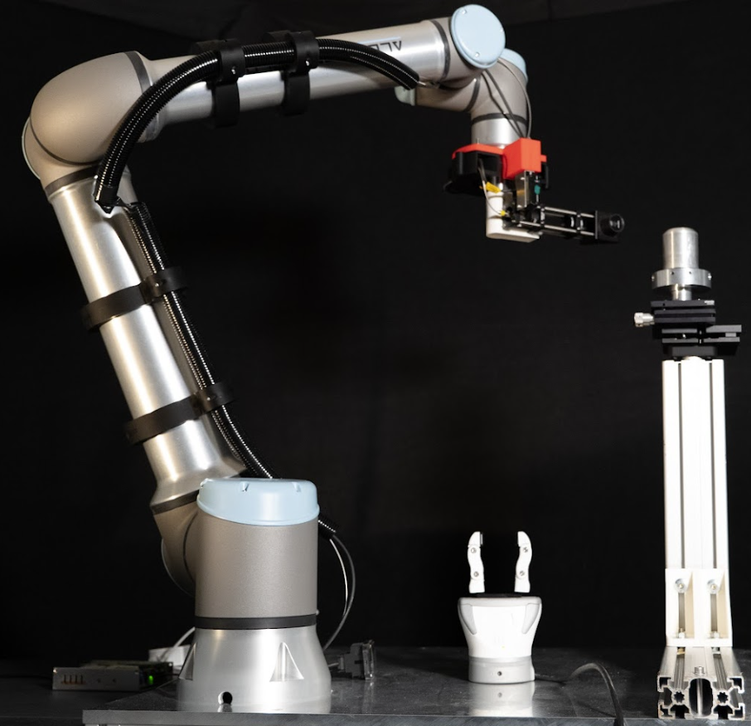
COLLABORATIVE ROBOT
Collaborative robots, or cobots, are robotic systems designed to work safely alongside human operators, without the need for physical barriers. Unlike traditional industrial robots, cobots are equipped with force-limiting sensors, vision systems, and intuitive programming interfaces that enable real-time responsiveness and shared workspaces.
Key advantages include:
Enhanced flexibility in small-batch production and variable tasks
Improved safety through integrated collision detection
Ease of integration in existing processes of crystals machining
Rapid deployment and reduced programming time
Cobots are increasingly used in assembly, inspection, machine tending, and packaging, particularly in sectors requiring adaptability, such as electronics, medical devices, and advanced manufacturing.

Slide 15
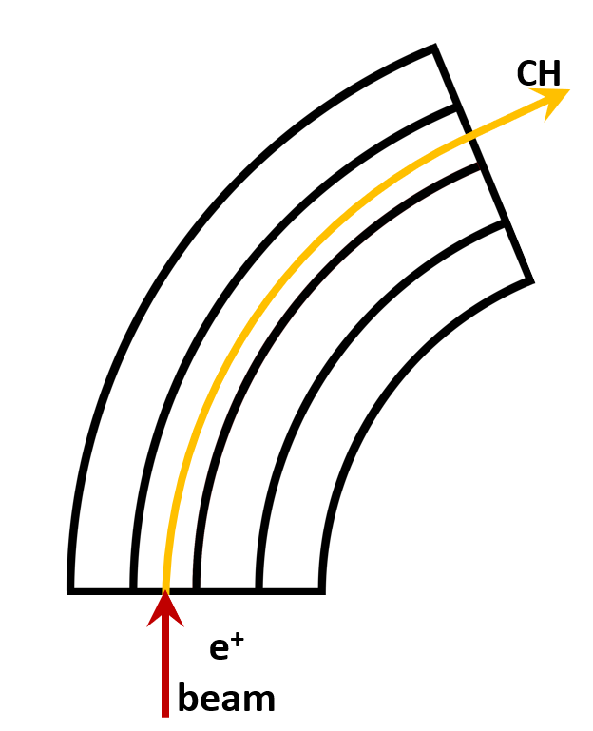
CHANNELING IN BENT CRYSTALS
@ Amorphous:
@ Planar channeling
Atomic crystal plane
+
e
e⁻

Slide 16
Experimental scheme
*
A first «short» crystal is used to extract the circulating beam halo
Extract beam hits a target generating short-living particles
A second «long» crystal collects a fraction of generated particles and channel them inducing spin precession
*D. Mirarchi et al., Eur. Phys. J. C (2020) 80 :929

Slide 17
Crystals for beam extraction
Thickness along the beam: 4.0±0.1 mm
Height < 55 mm.
Weight < 150 g
Channeling plane: (110)
Channeling axis: <111> or <110>
Miscut for planar channeling: < 10 μrad.
Torsion: < 1 μrad/mm
Bending angle: 50-55 μrad
Dislocation density < 1 cm²
Specifications defined in collaboration with CERN

Slide 18
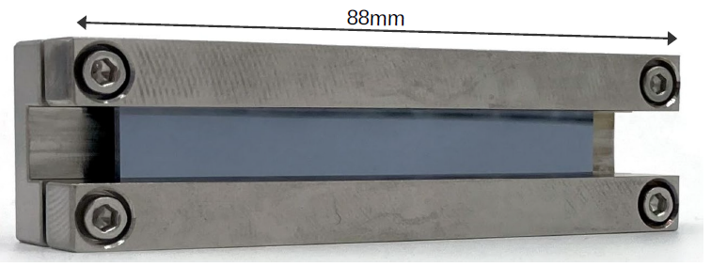
Manufacturing of «long» crystals
Manufaturing and characaterization approach similar to the one used for «short» crystals.
Special care must be paid to uniformity of bending radius.
Mechanical imperfections and bending approach results in non-uniform bending radius.

Slide 19
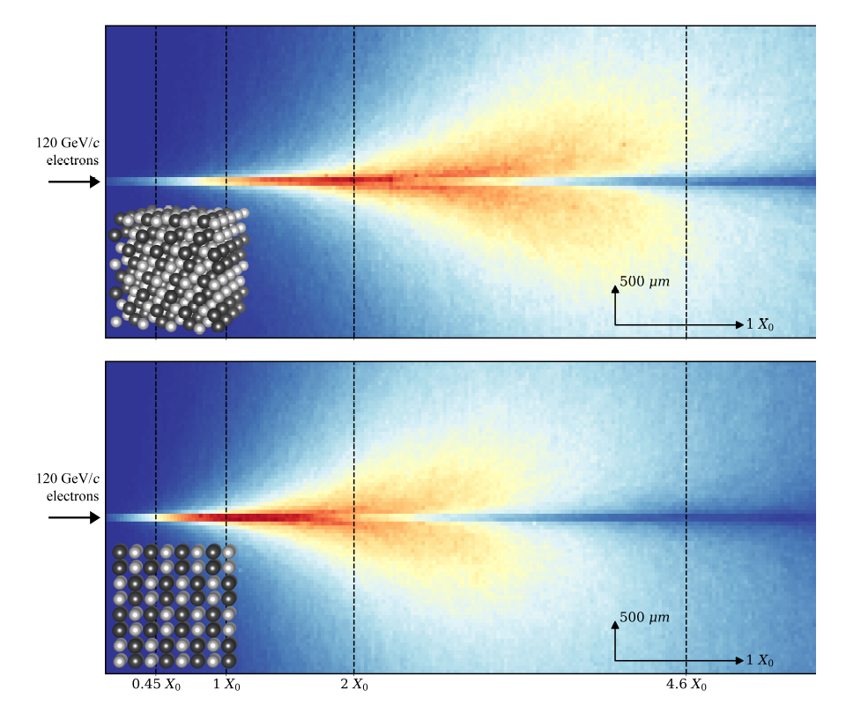
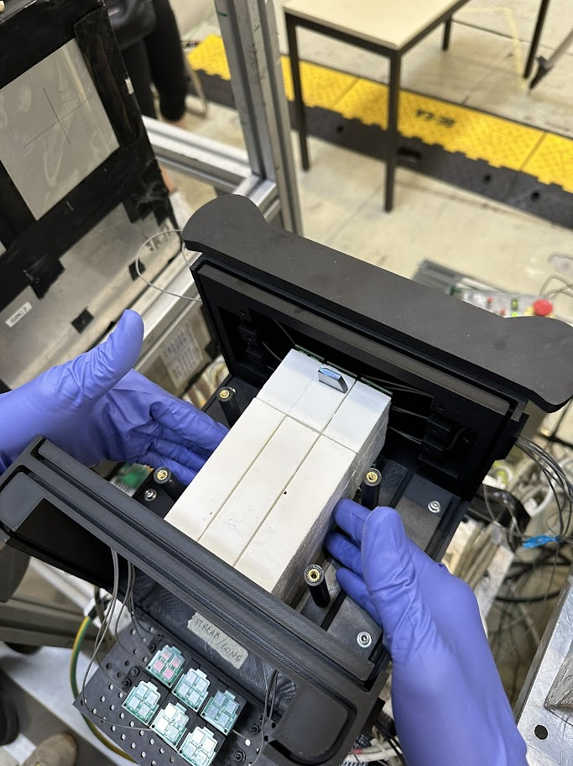
The ORiEnted calOrimeter (OREO) project
Scintillator crystals widely used for ECAL, but lattice effects are usually neglected.
A High Energy e/γ impinging along the crystal axis experiences a high Lorentz-contracted electric field which accelerate the shower development.
OREO is an ECAL made by one oriented layer of ~5 X₀ and one non-oriented of ~11 X₀. Each layer consist in a 3X3 matrix of PWO crystals (CRYTUR Type-UF)
Key features of OREO:
Improved shower containment ⇒ better energy resolution
Enhanced pair-production probability ⇒ Higher γ-detection efficiency ⇒ ideal for γ vetoes
Insensible to hadrons ⇒ Higher γ/hadrons discrimination
ORIENTED
11X₀ 5X₀
NON
ORIENTED
ORIENTED
11X₀ 5X₀
NON
ORIENTED

Slide 20
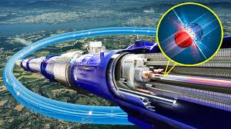
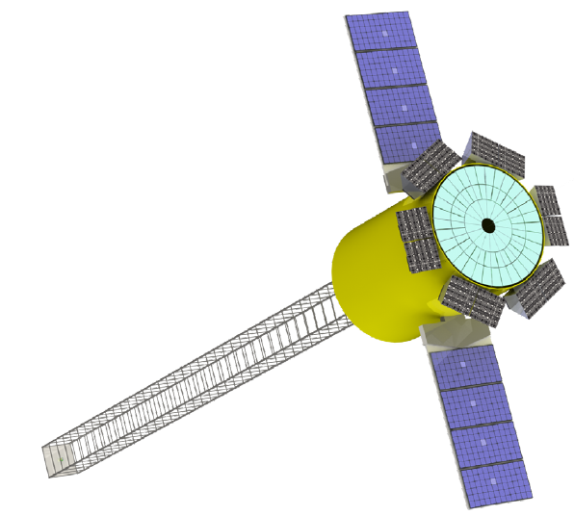
BOND-CRYSTAL BOND
Setting INFN as leader in crystal assisted manipulation of radiations
CERN
Sincrotroni
ESRF (Francia)
XFEL (Germania)
Lund University (Svezia)
ELETTRA (Italia)
University of Saskatchewan (Canada)
BOND technology
Trasferimento tecnologico
CINEL (Italia) – Industria
Astrofisica
INAF (Italia)
Università degli studi di Trieste (Italia)
Notes:
In the passage of a particle through matter, it can hit an atomic nucleus and transfer to it part of its kinetic energy. The particle then is scattered off and what we can measure is the recoil of the nucleus.
This process is used to search for particles of Dark Matter, an unknown form of matter which is not visible and fills the Universe.
For 20 years we have searched for particles with a mass of around 100 GeV, driven by the theory and by the experimental feasibility, but since these particle has so far eluded discovery, the community has also started looking for lighter particles with a mass of around 1 GeV or below.
The same process can be used to detect neutrinos through their coherent scattering off nuclei. This interaction has been proposed to exploit neutrinos produced in the combustion of nuclear reactors to monitor them from safe distances for non-proliferation
purposes, which would be the first application of neutrinos outside academia, and to perform precision tests of the standard model of particle physics,
in this graph one can see the interaction rate as a function of the recoil energy in black, and the computed contributions from a neutrino magnetic moment, which would represent a BSM contribution

Slide 21
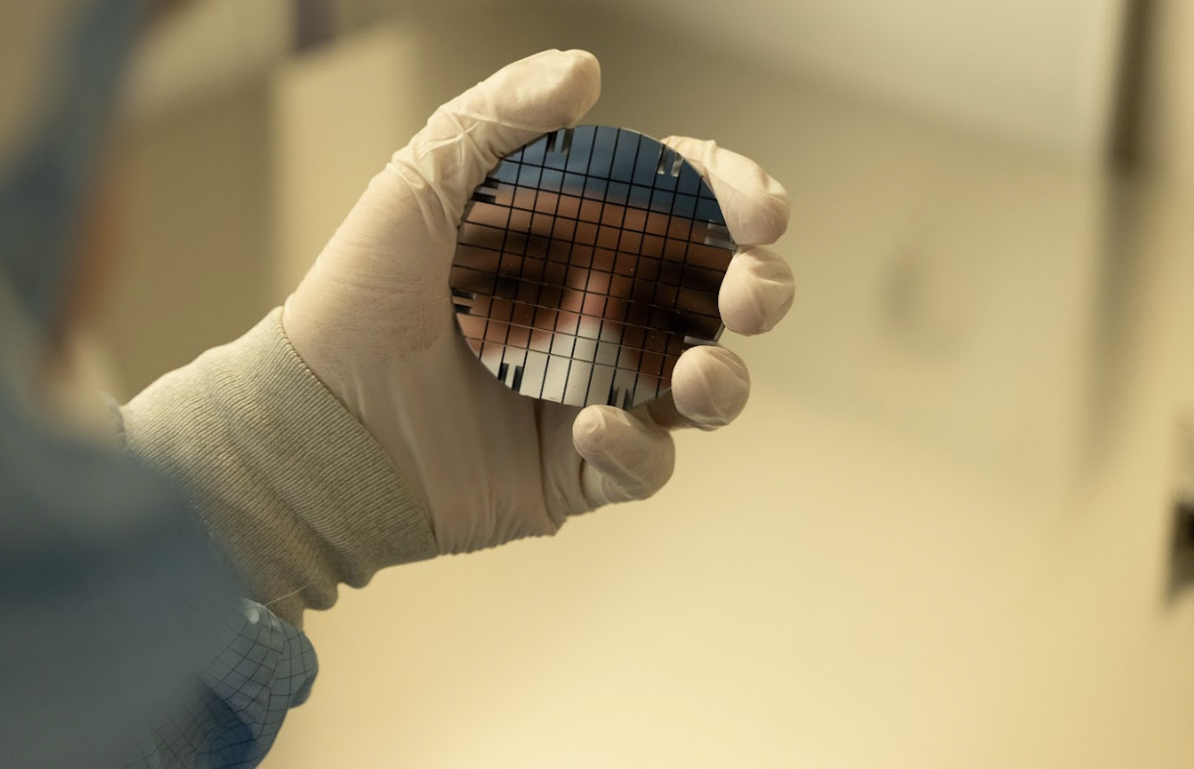
BULLKID-DM ☺
See talk from
L. Malagutti

