Slide 1
Experience in
KAGRA Construction
with Japanese Companies
Prof. Takayuki TOMARU
National Astronomical Observatory of Japan @ Osaka Expo. 2025, Italian Pavillion

Slide 2

KAGRA
2.5th Generation GW telescope
in Japan

Slide 3
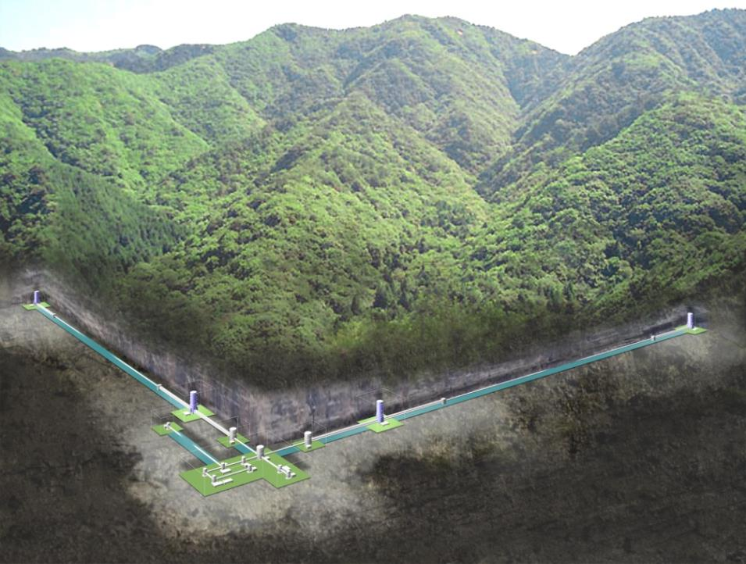
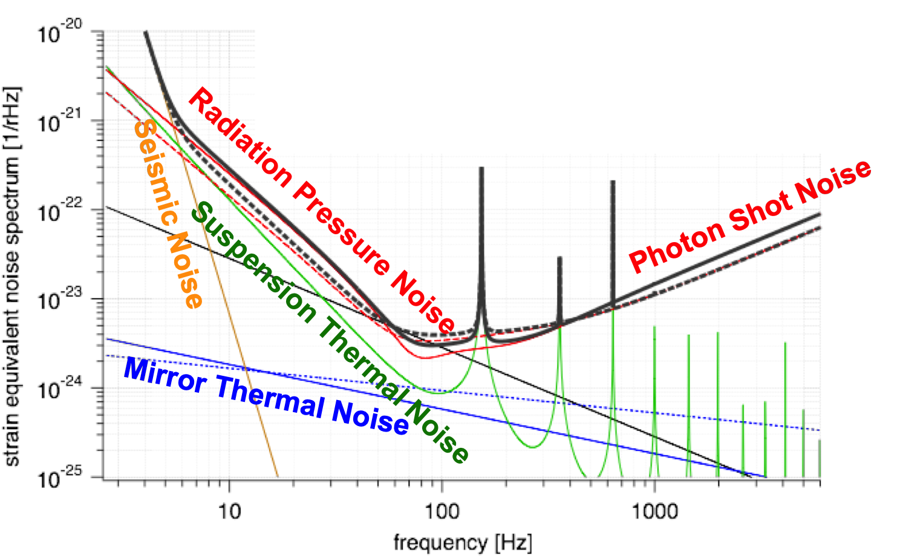
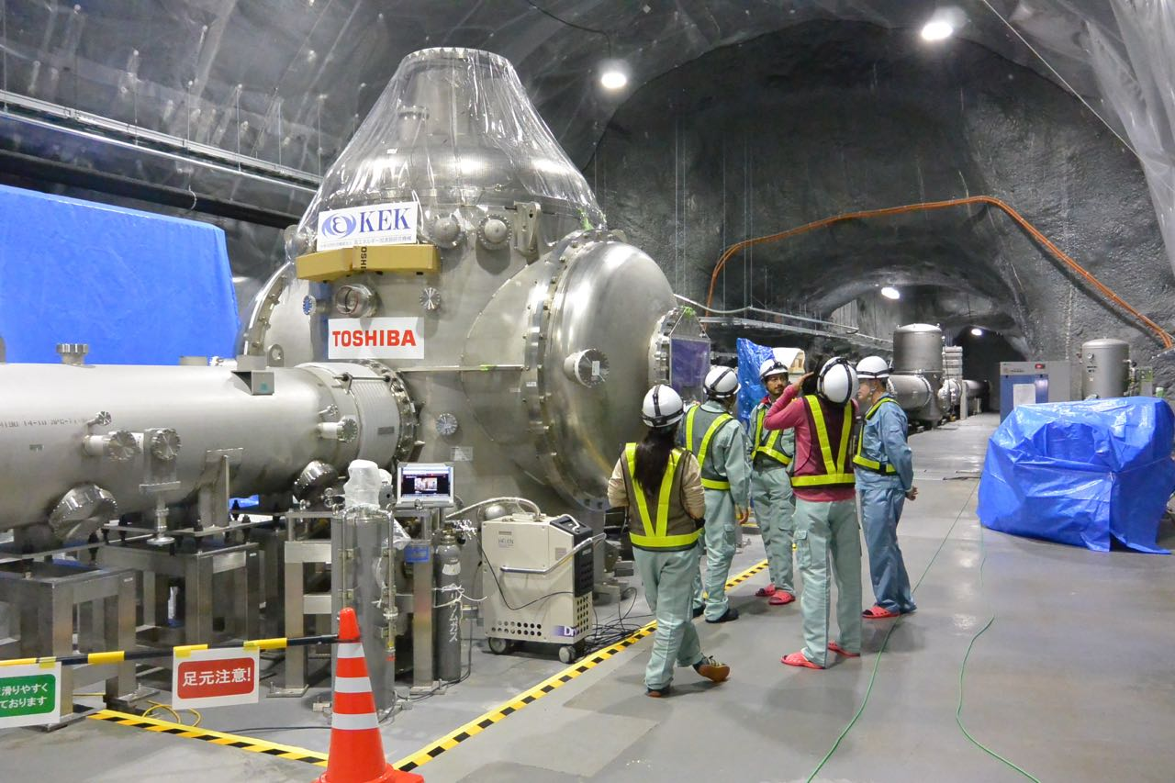
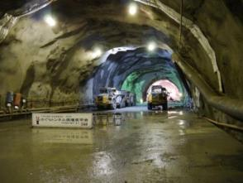
Cryogenic Mirror
Reduce Thermal Noses
Reduce Vibration Noises
Underground

Slide 4
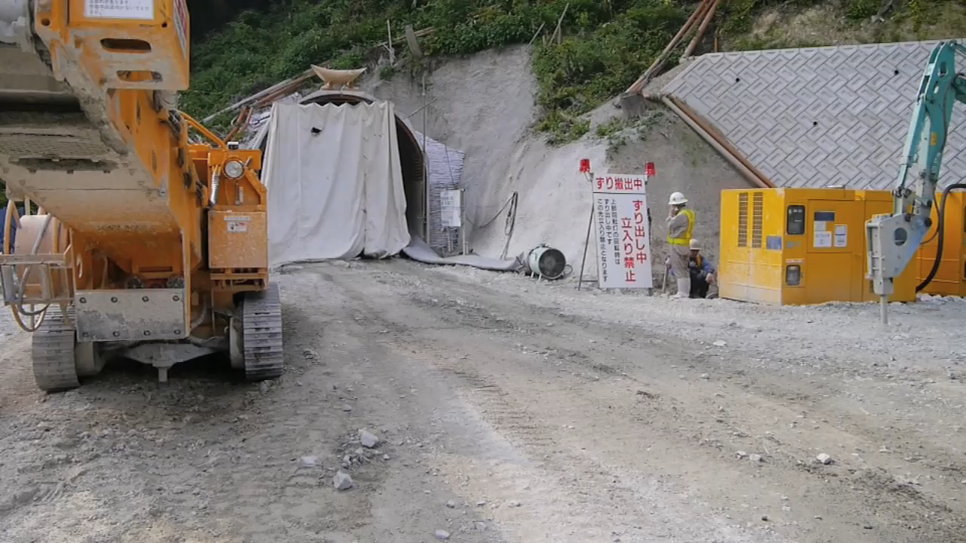
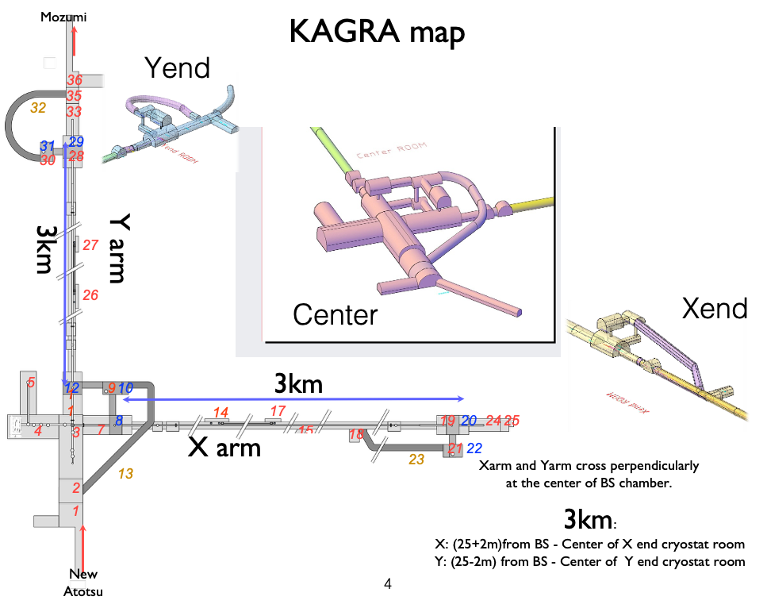
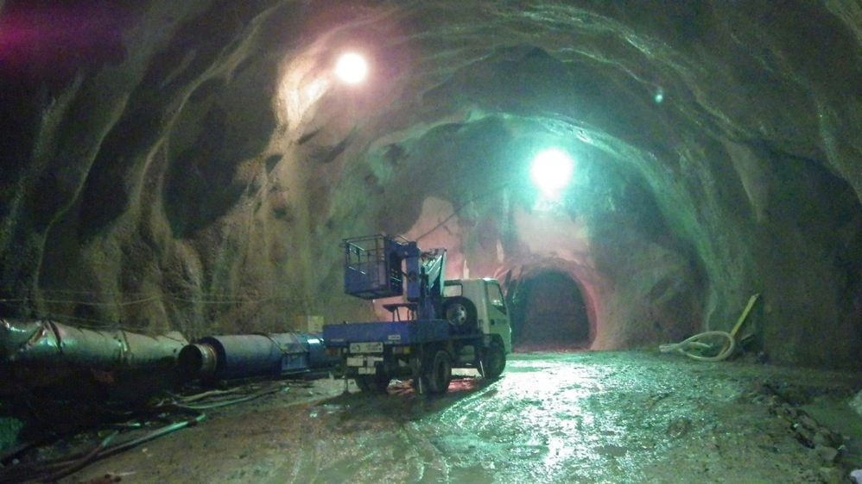
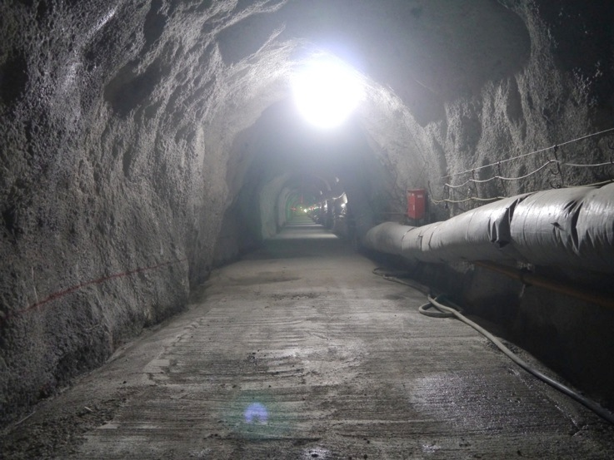
1. Tunnel Excavation
Contractor: Kajima Corporation
NATM method
+ new Austrian Tunneling method
From 2012 to 2014
Total cutting length: 7,697 m

Slide 5
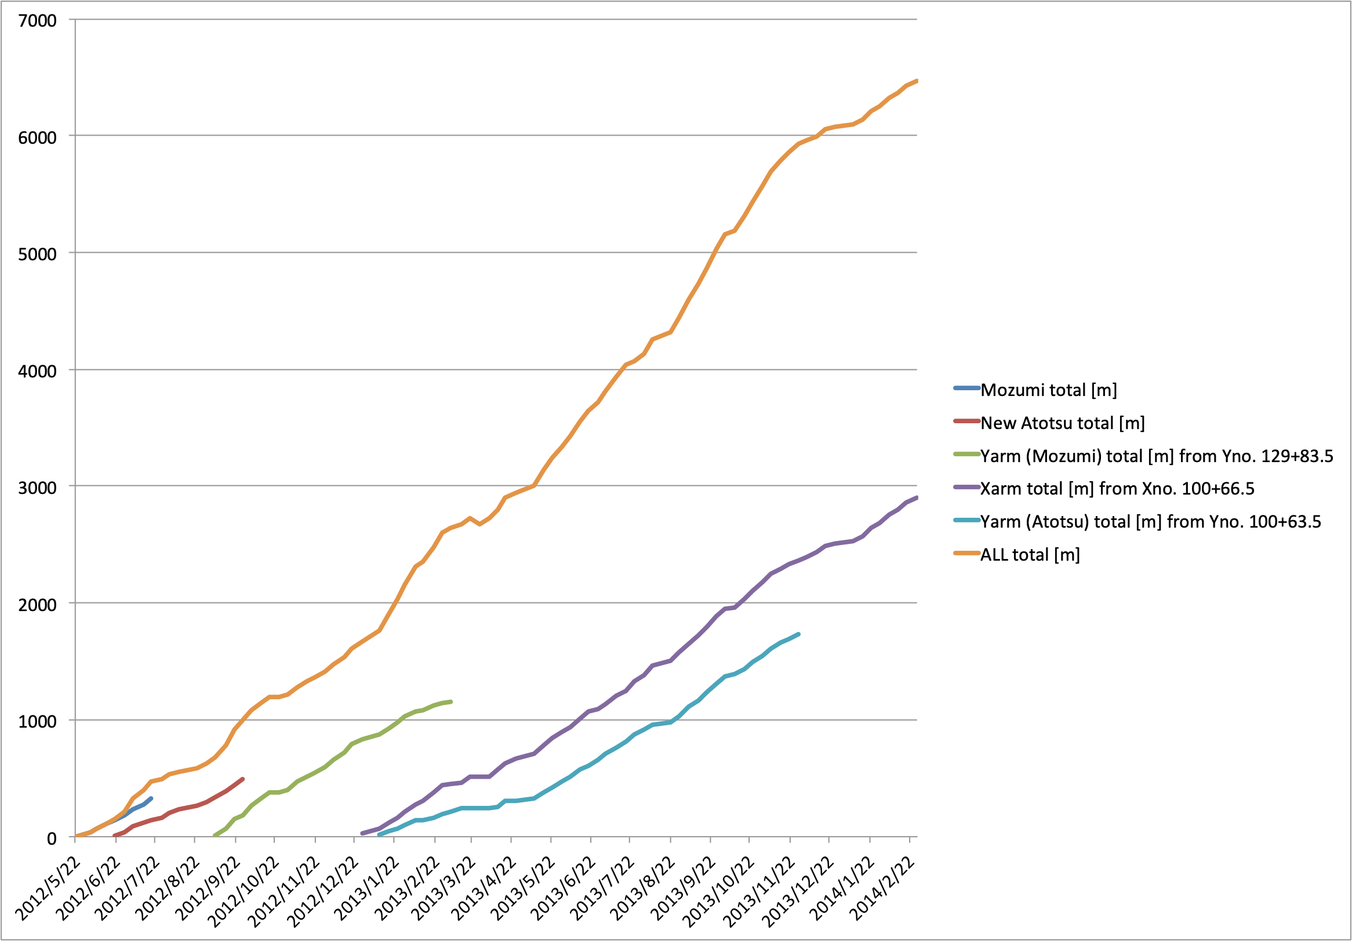
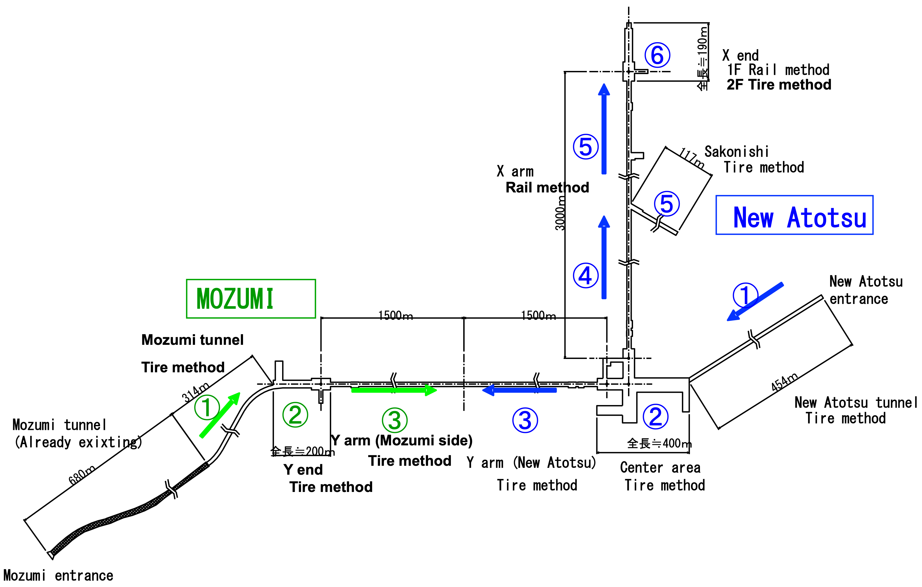
Maximum Drilling Speed
2013/9/1-30
Xarm: 359.4m
Yarm(down slope): 301.2m
Total: 660.6m
359 m/month
Japan Record
Xarm
3000m/14month=210m/month
Not including experiment rooms.
Notes:
this figure shows progress of the excavation except for the experiment rooms.
this purple line indicates the progress of Xarm. According to this result, excavation speed of one party is about 200m/month.
i like to emphasize the progress in the last september, they achieved more than 300m both arm and Yarm. according the company, this values are Japanese record using natm method.

Slide 6
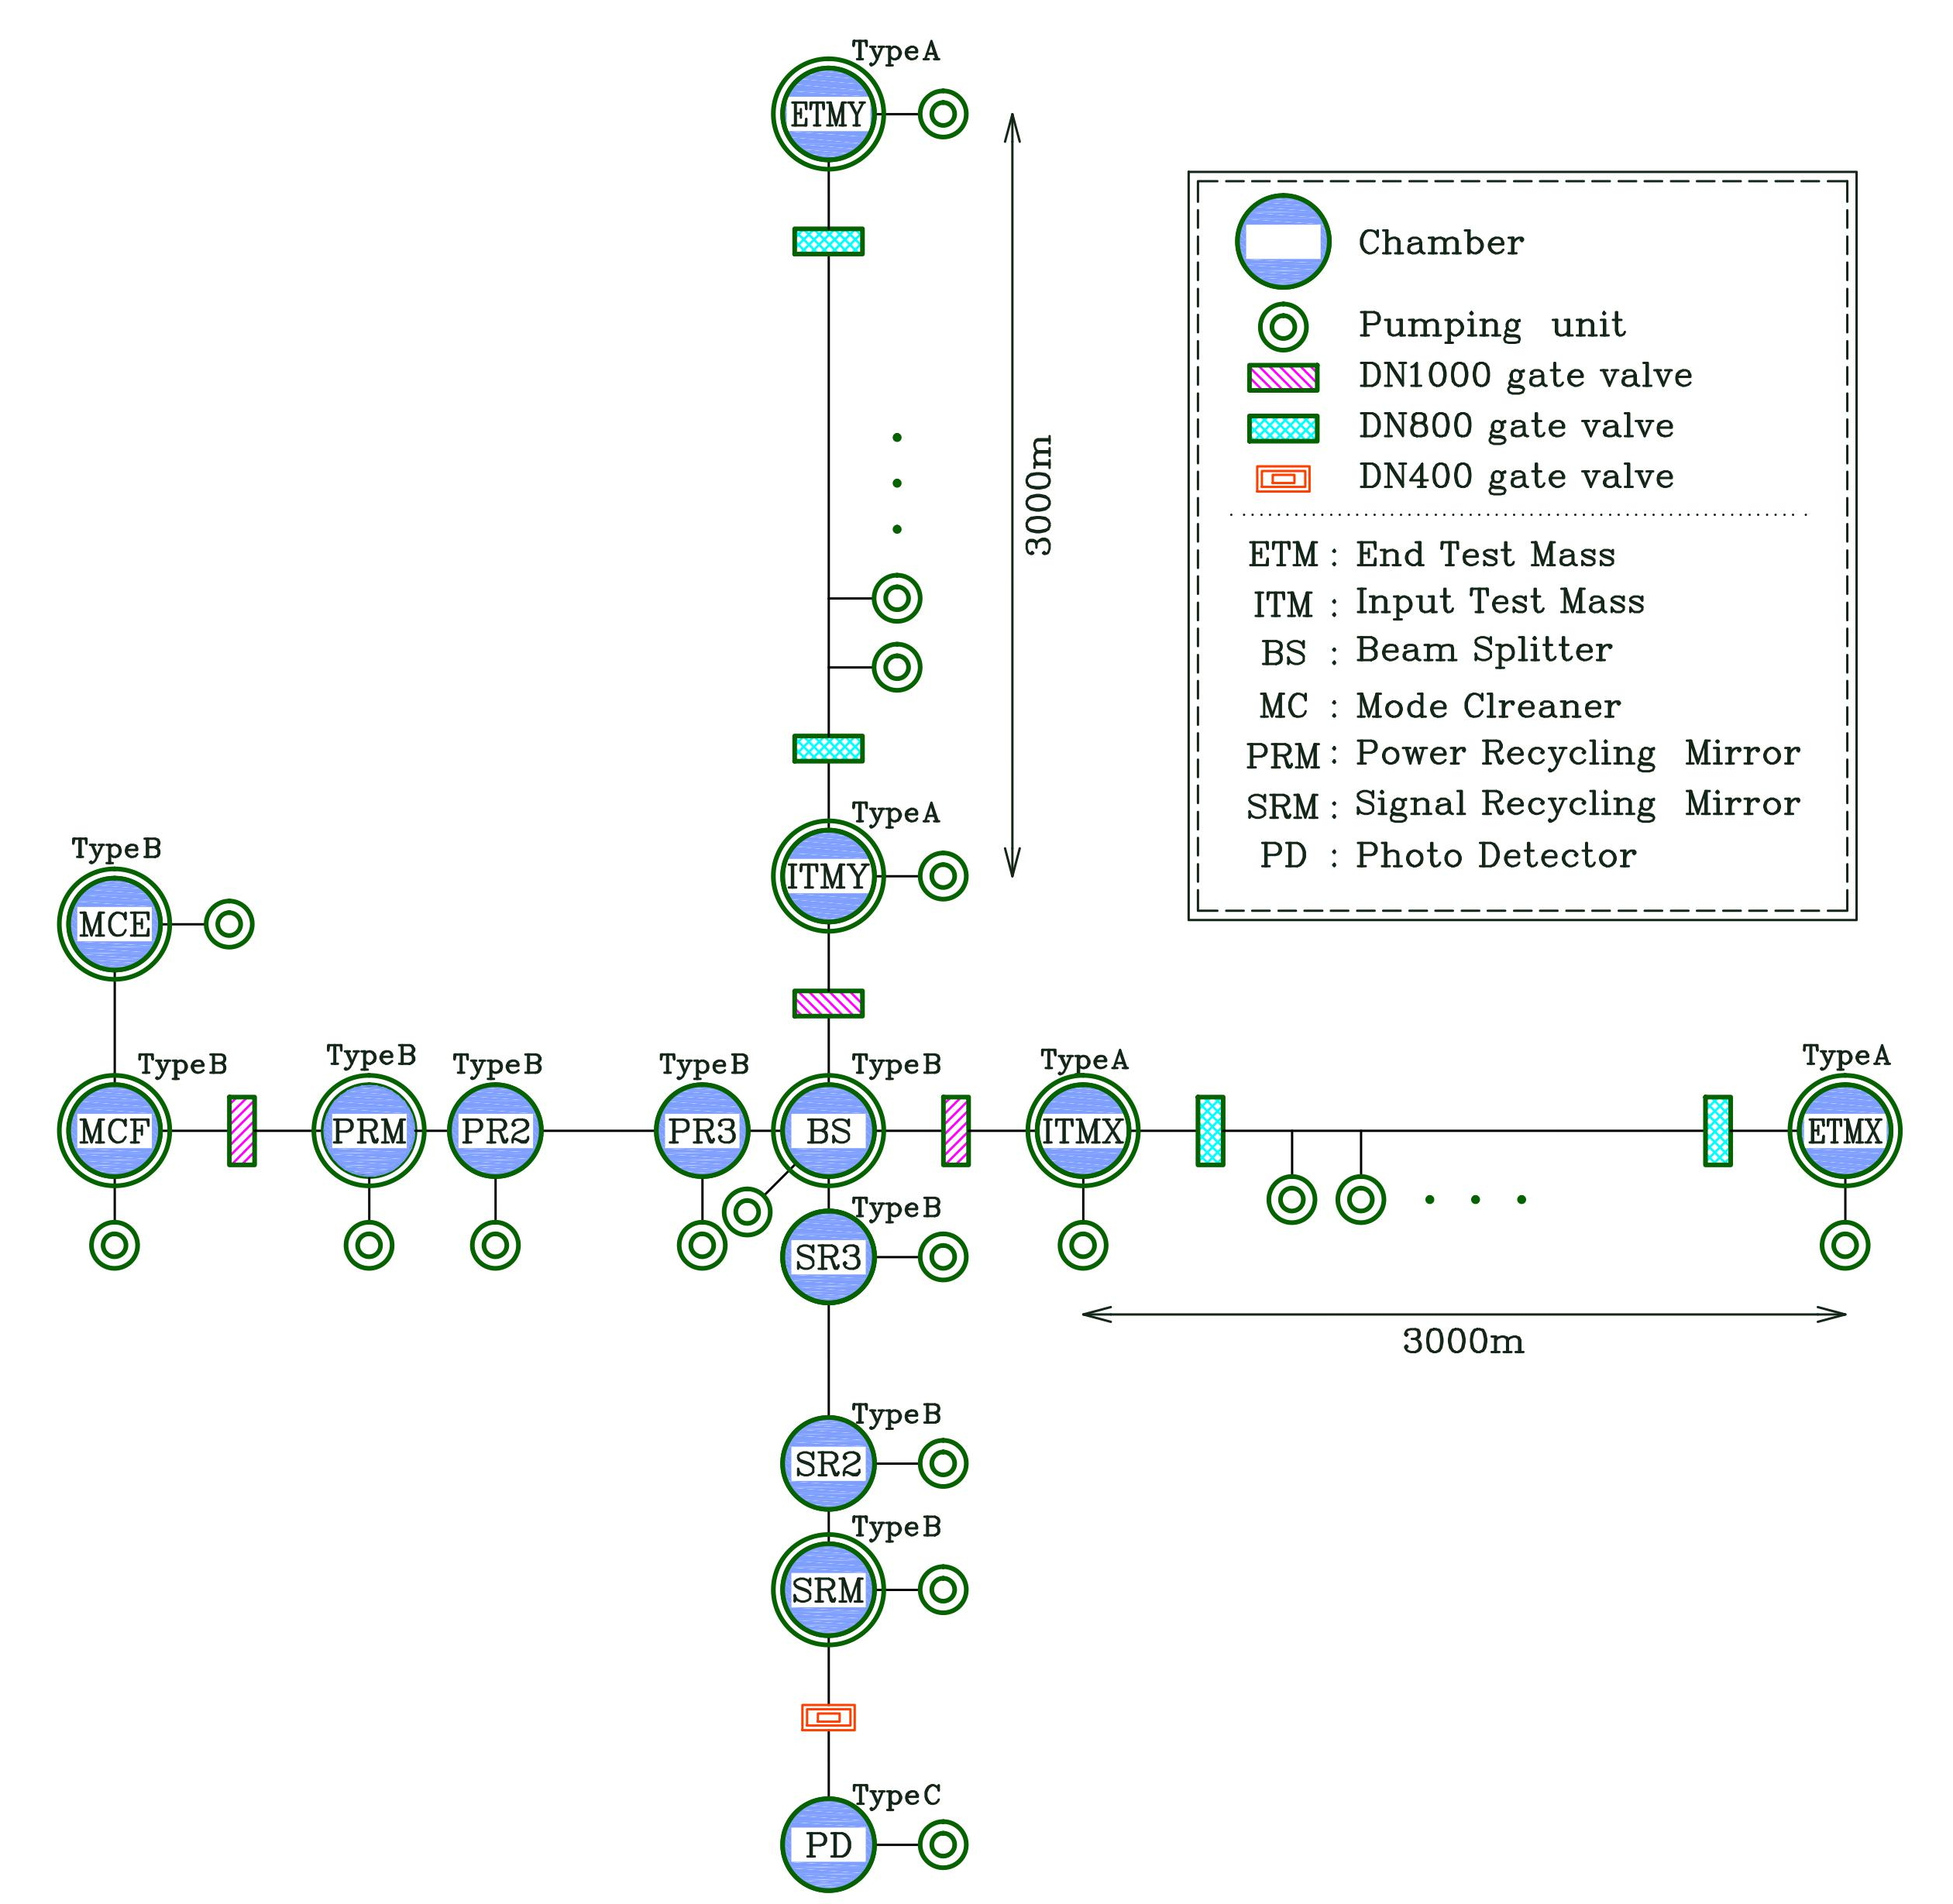
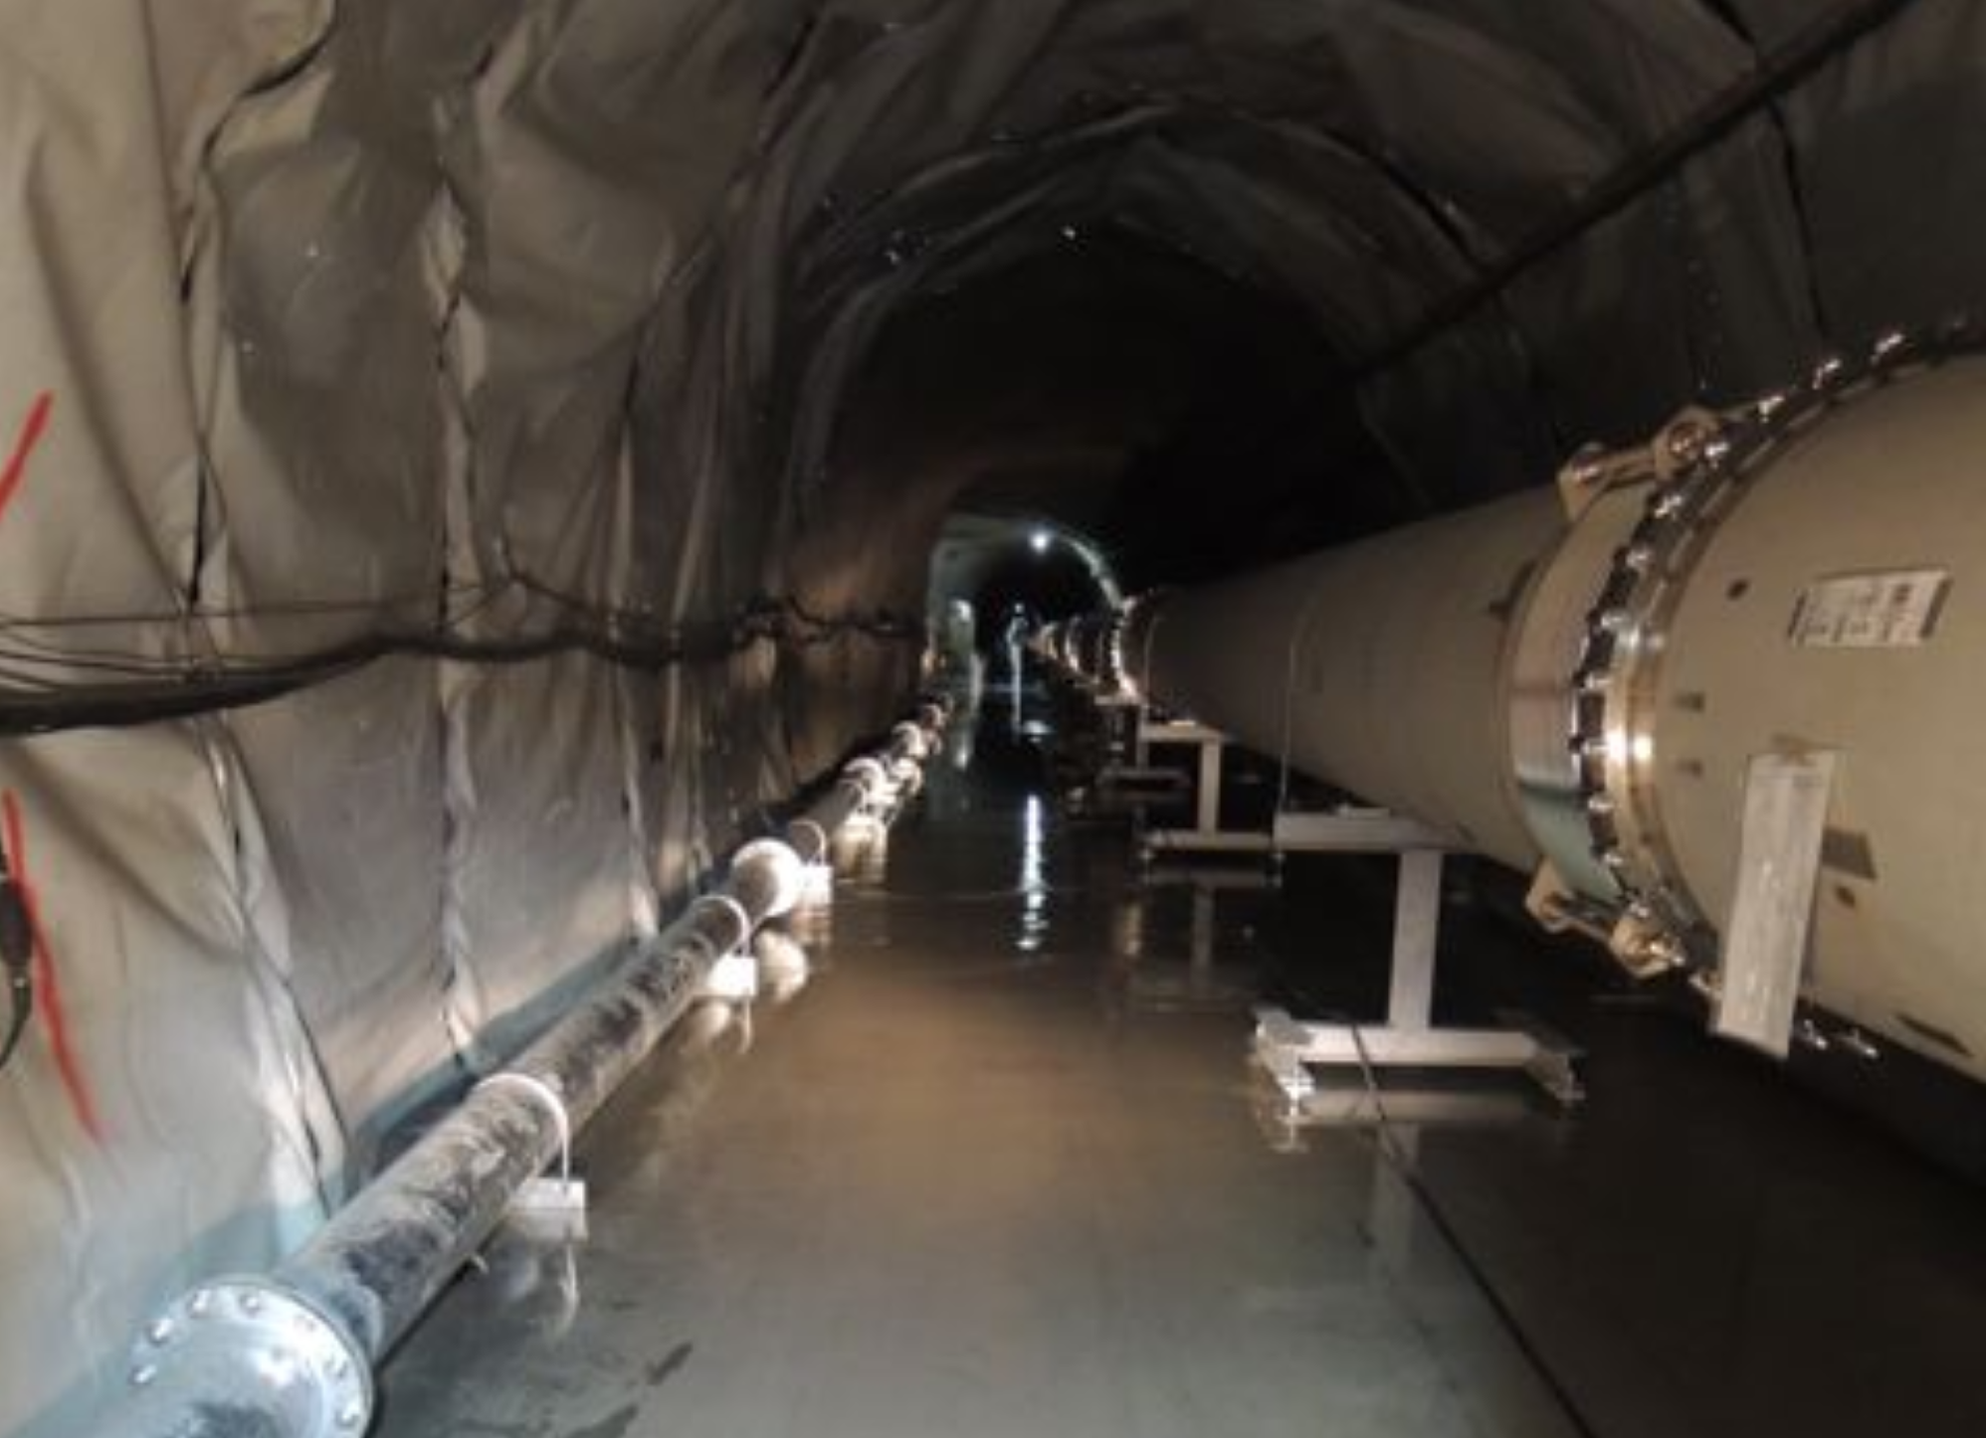
2. Ultra-High Vacuum System
Manufacturer: Mirapro Co. Ltd.
Applying accelerator vacuum technology
• 3km x 2 Beam Tubes,
Φ800mm x L12m, 500 tubes
• 10 Major Vacuum Tanks
• 4 Main Cryostats
Design Vacuum Pressure: 10⁻⁷ Pa
Total Inner Volume：
~ 3,000 m³
Total Surface Area：
~ 15,000 m²

Slide 7
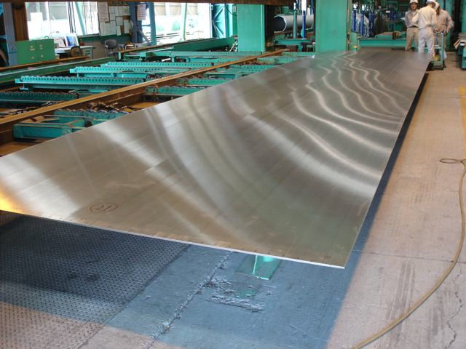
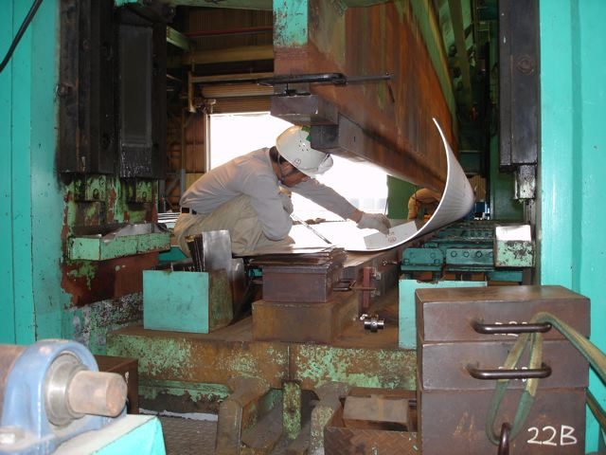
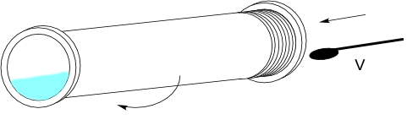
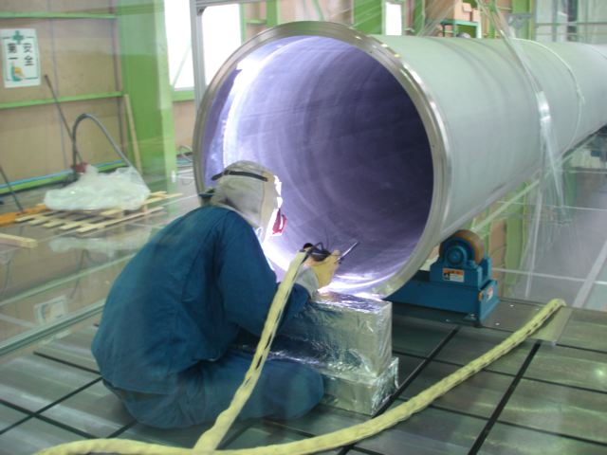
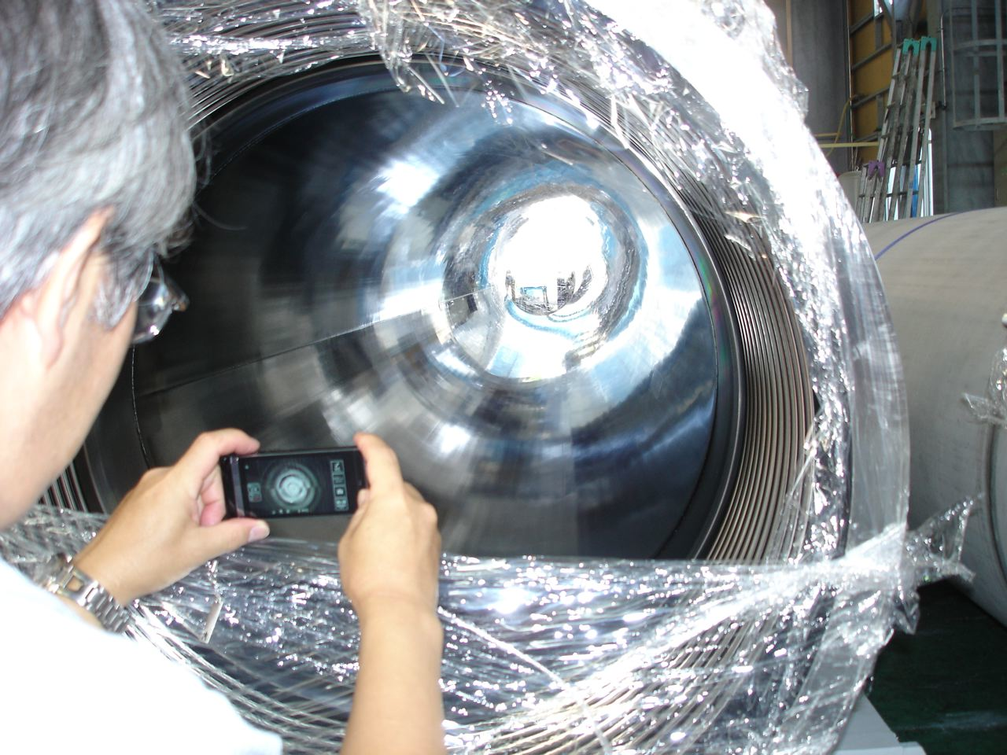
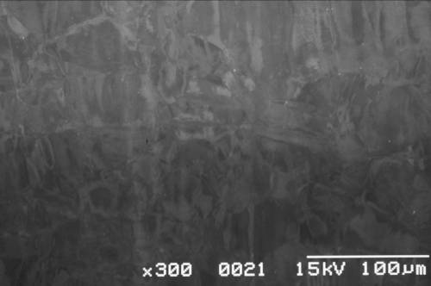
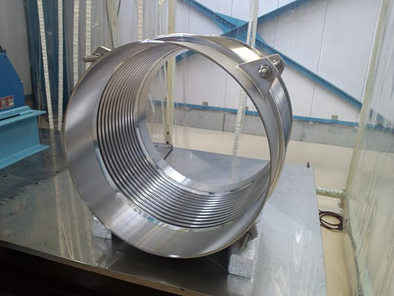
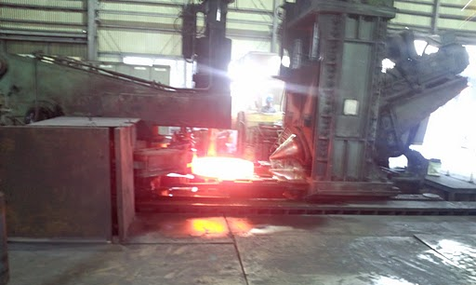
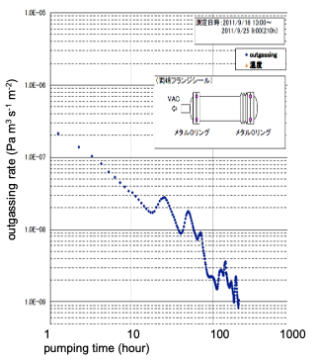
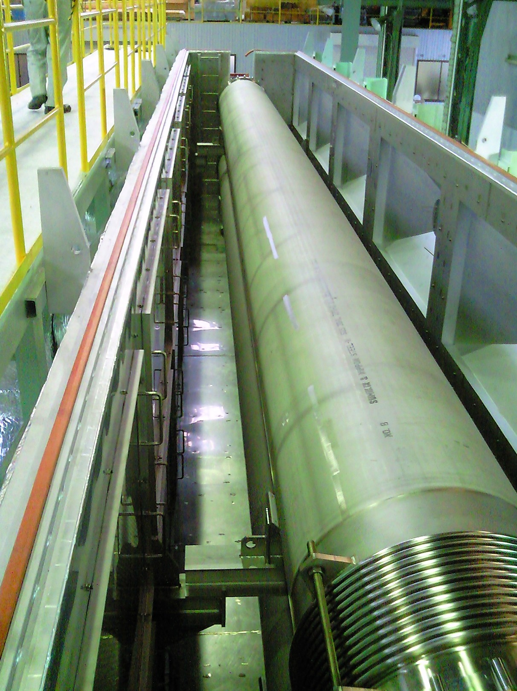
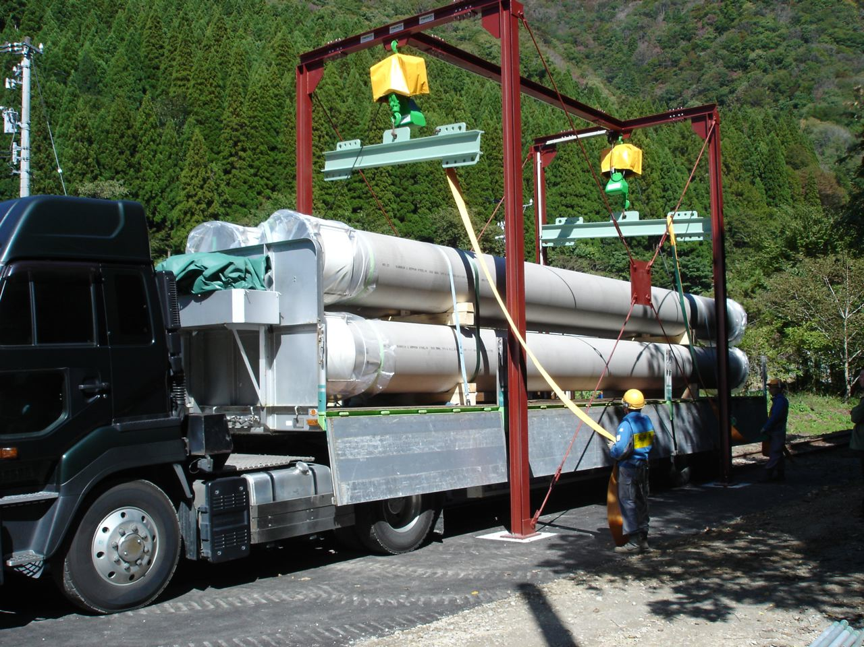
Electrolytic Polishing (EP) and Rinsing
with ultra pure water; Rmax 2.5 μm
tube forming; SS304L, 8 mm thick, Rmax 8 μm finished
flange; SS F304, Rotary forging
TIG-weld Assy
removing 25 μm of outermost layer
hydro-formed bellows;
SS316L, 0.6 mm thick, chemical polished
vacuum baking
at 200°C for 20 hrs
Outgassing Rate:
~ 10⁻⁹ Pa m³ s⁻¹ m⁻²
for pumping time
of 100 hrs.
storage in the tunnel of
Kamioka mine railway
@ Factory

Slide 8
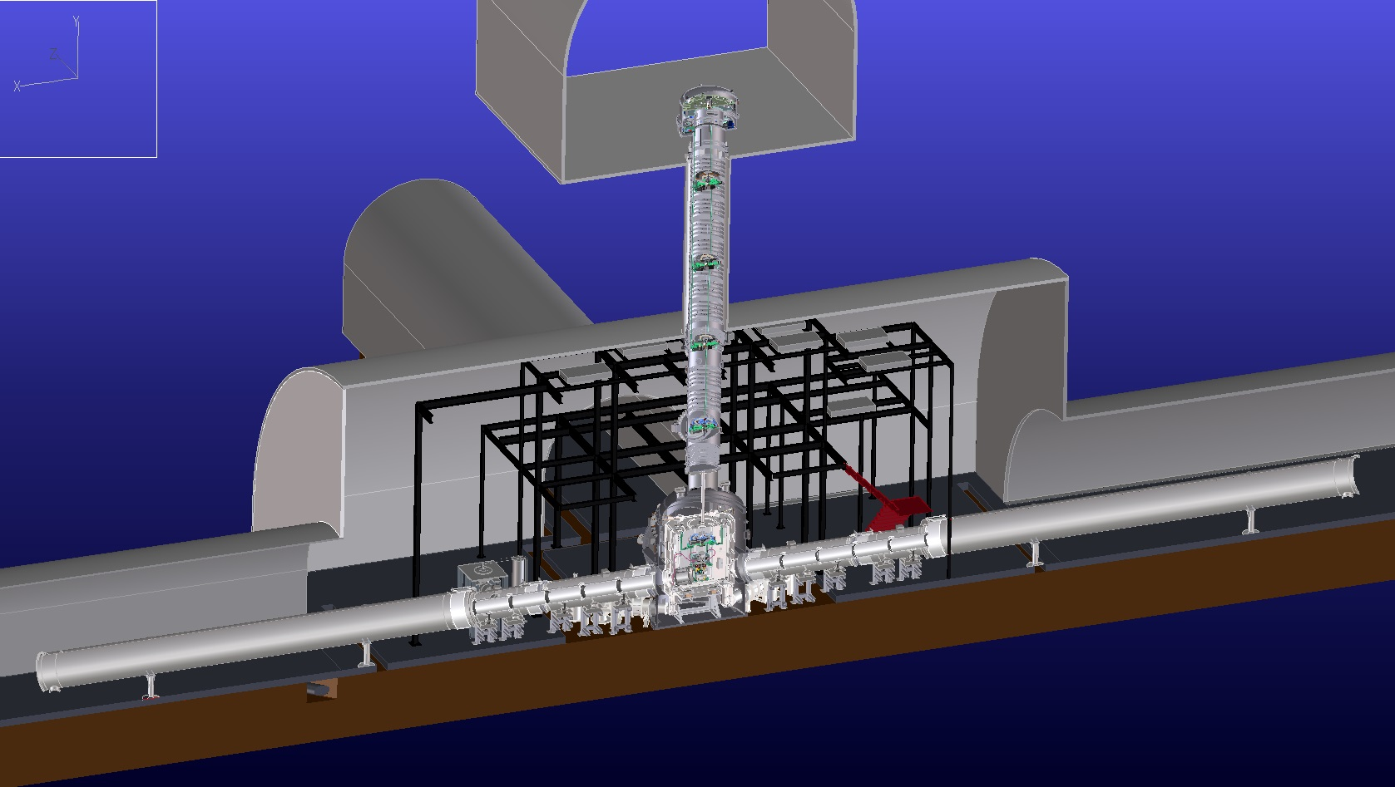

Upper Floor
3. Cryogenic System
Main mirror positions
Vibration Isolator @ room temperature
14m
Cryogenic part
Arm tunnel
Bottom Floor

Slide 9
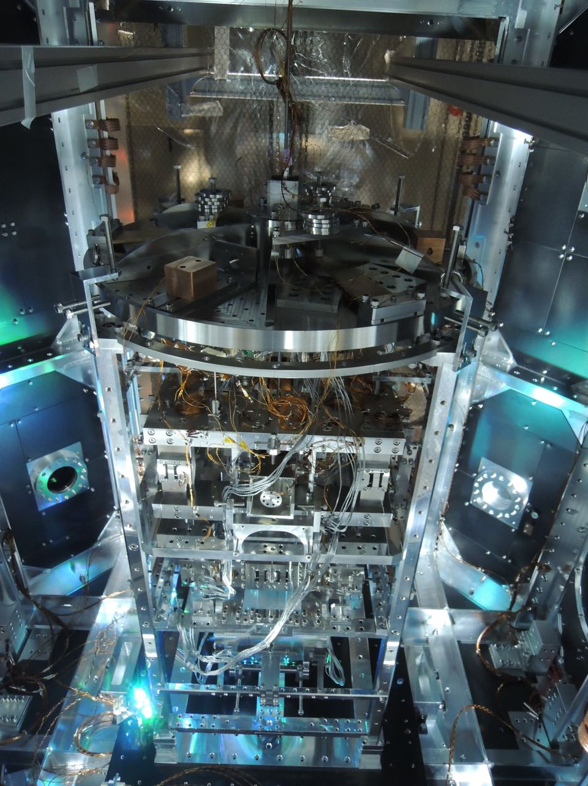
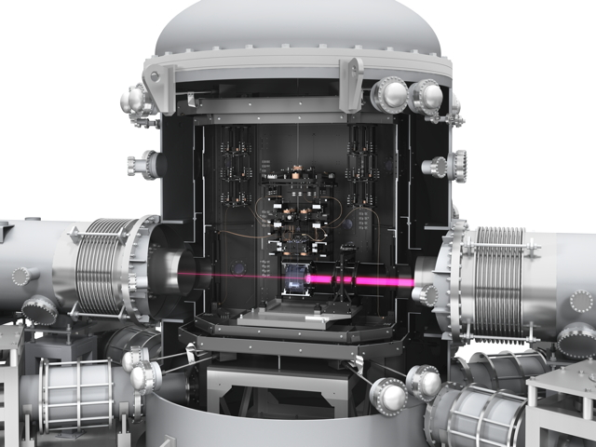
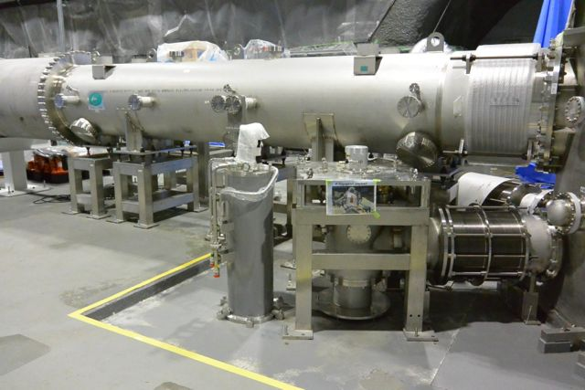
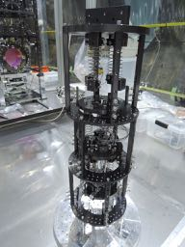
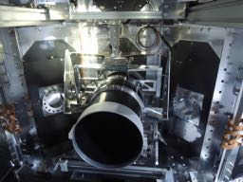
Cryogenic Payload
Ultra-small Vibration Cryocooler
TOSHIBA
Sumitomo Heavy Industries
Jecc Torisha
VIC International
Sumitomo Chemical
Etc.
Black Coating on
Wide-Angle Baffle
Heat-Link
& its Vibration Isolator
Asahi Precision

Slide 10
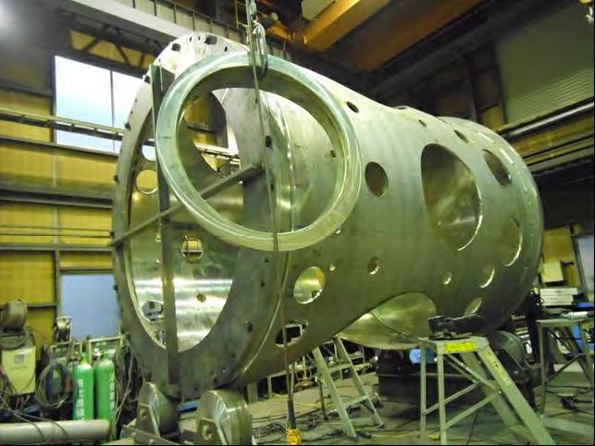
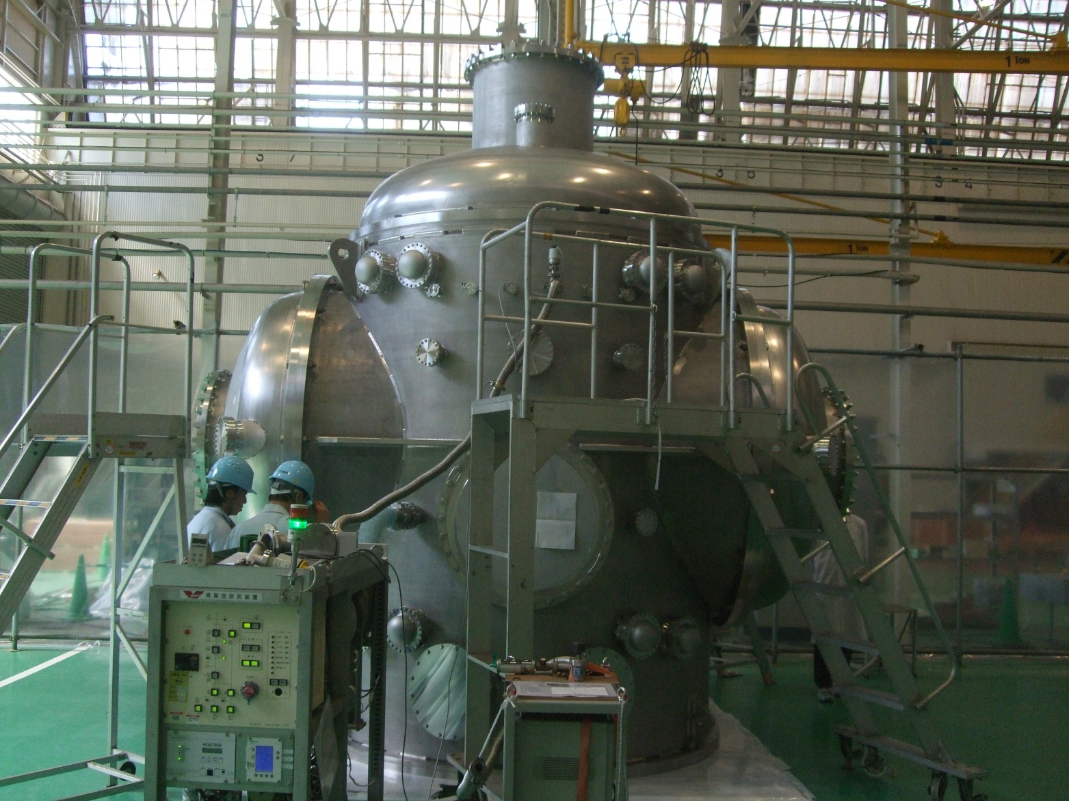
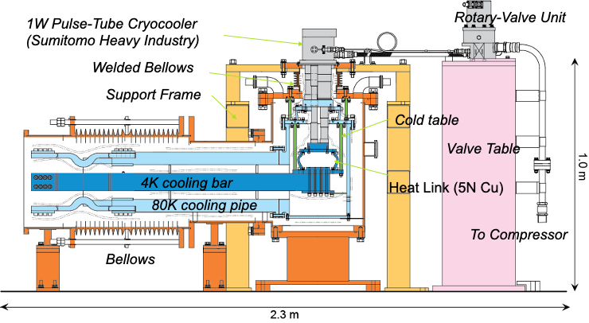
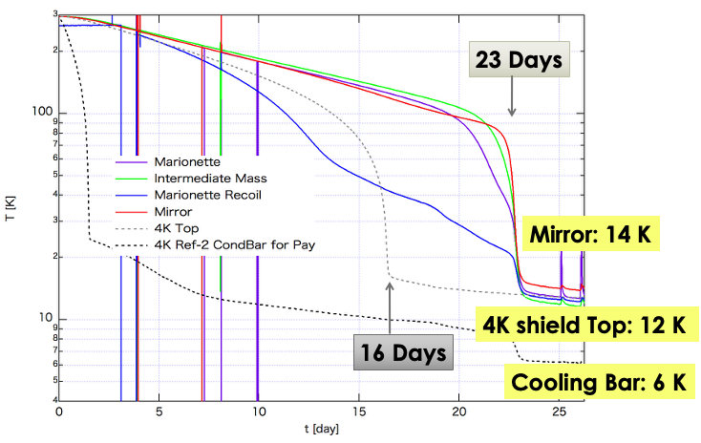
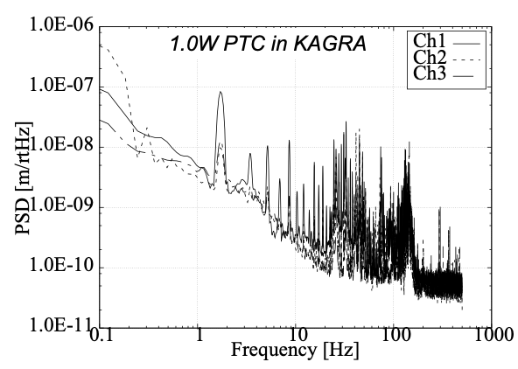
Main Cryostat
Ultra-low Vibration Cryocooler
Manufacture: Toshiba Energy Systems
Manufacture: Sumitomo Heavy Industries
& Jecc Torisha
Φ2.6m, H3.6m
Aug, 26, 2017
@KAGRA
Joint research btw
KEK and SHI
nm level vibration
was realized

Slide 11
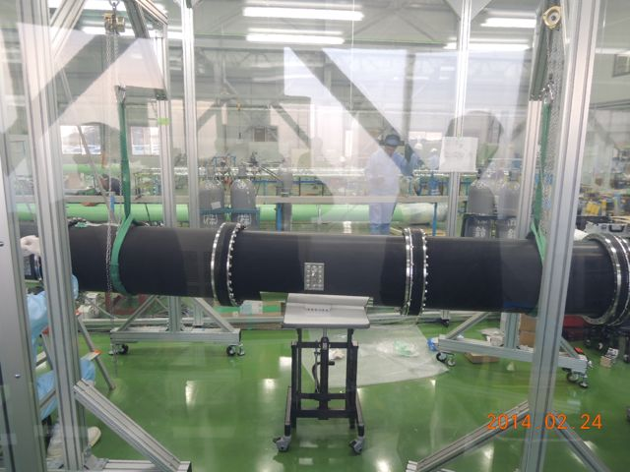
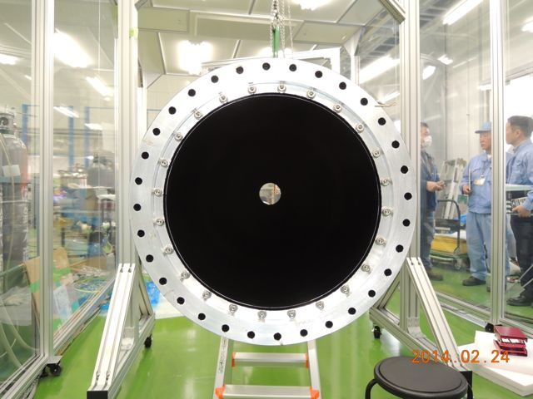
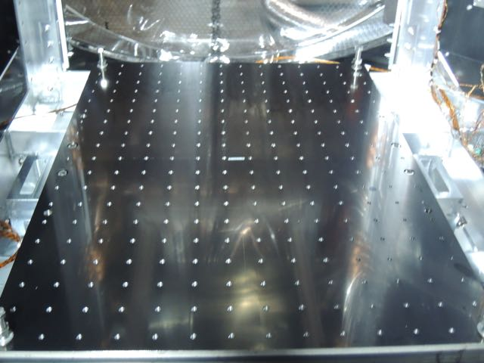
Heat Link
Black Coating (Solblack)
Manufacture: Sumitomo Chemical
+ Arai + Noge Elec. + Furukawa Power Sys.
Coater: Asahi Precision
6N ultra-pure Al: Joint research btw
KEK and Sumitomo Chemical
Non-magnetism
Solblack coatings

Slide 12
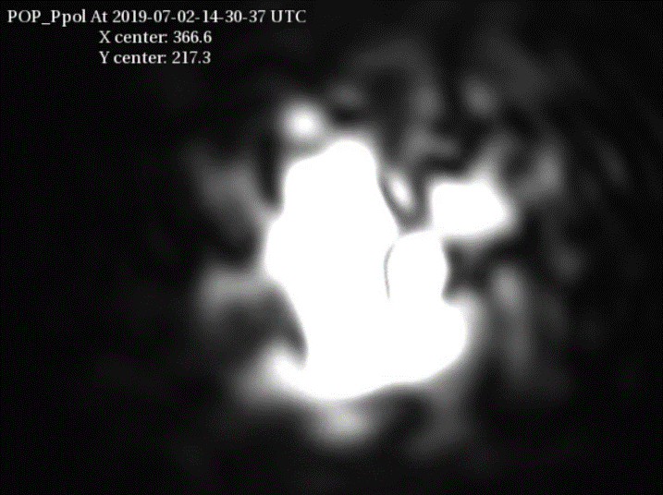
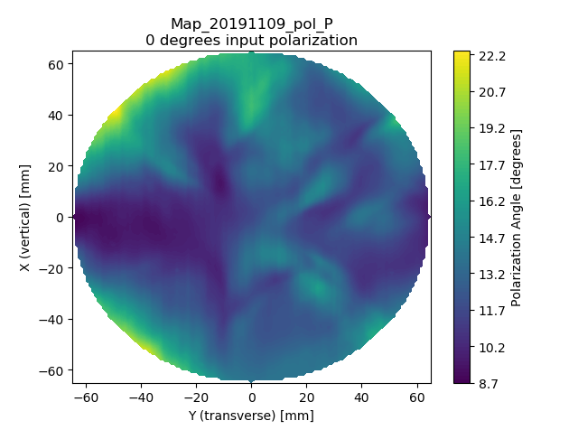
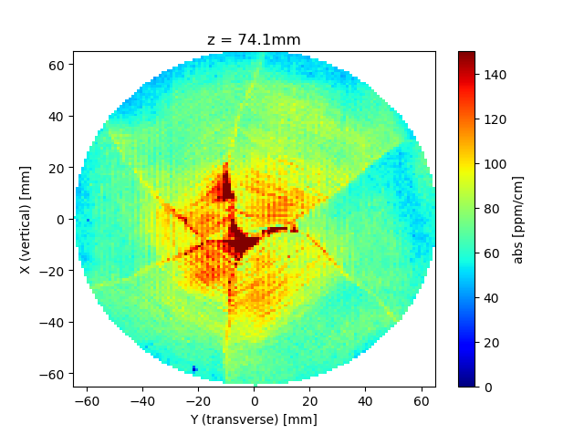
3. Sapphire Mirror (ITM) Reproduction
Unexpectedly, large birefringence and optical absorption were found
in the sapphire single crystal, and KAGRA decided to recreate ITM.
Birefringence Map
Optical Absorption Map
ITM
Φ22cm x L15cm, 23kg
With the cooperation of the Korea Astronomy and Space Science Institute,
we were able to obtain large, high-quality crystals (Aztec, Korea).
However, there are many challenges involved in ultra-precise polishing of
large sapphire crystals, so we began looking for a new polishing company.

Slide 13
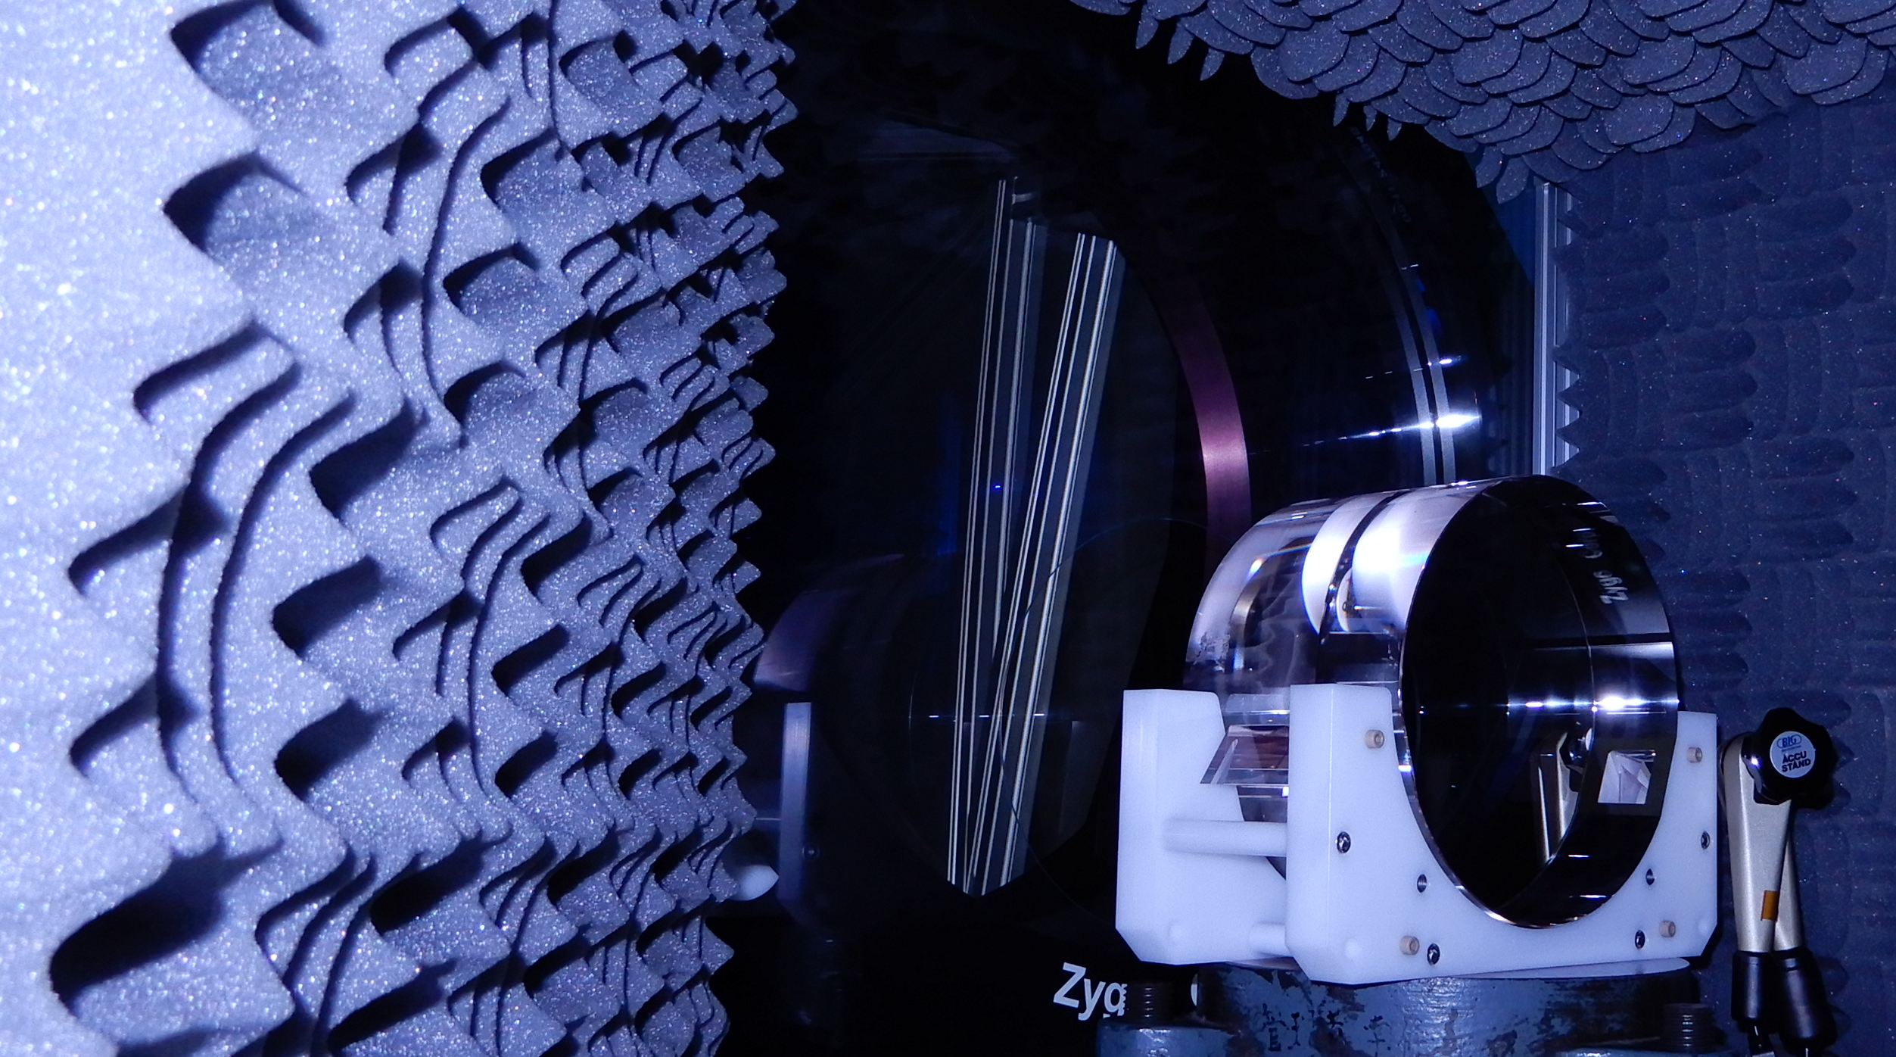
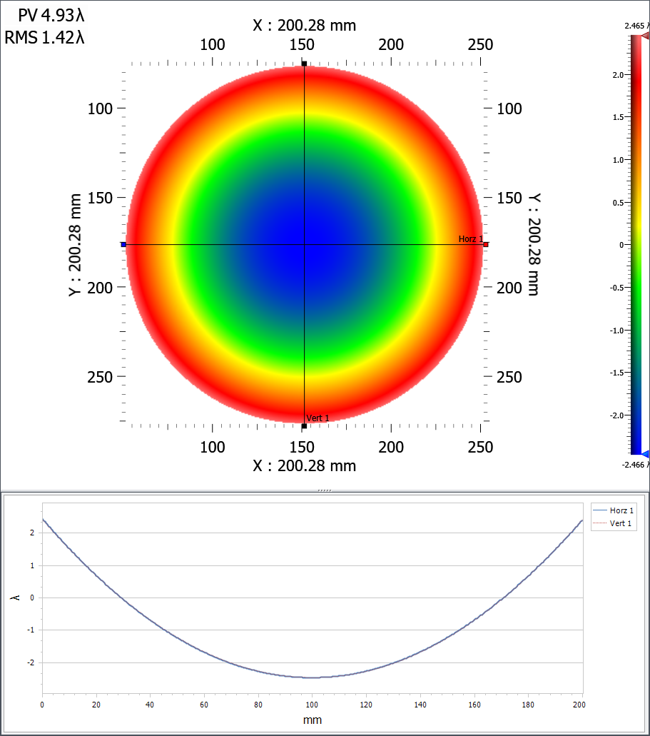
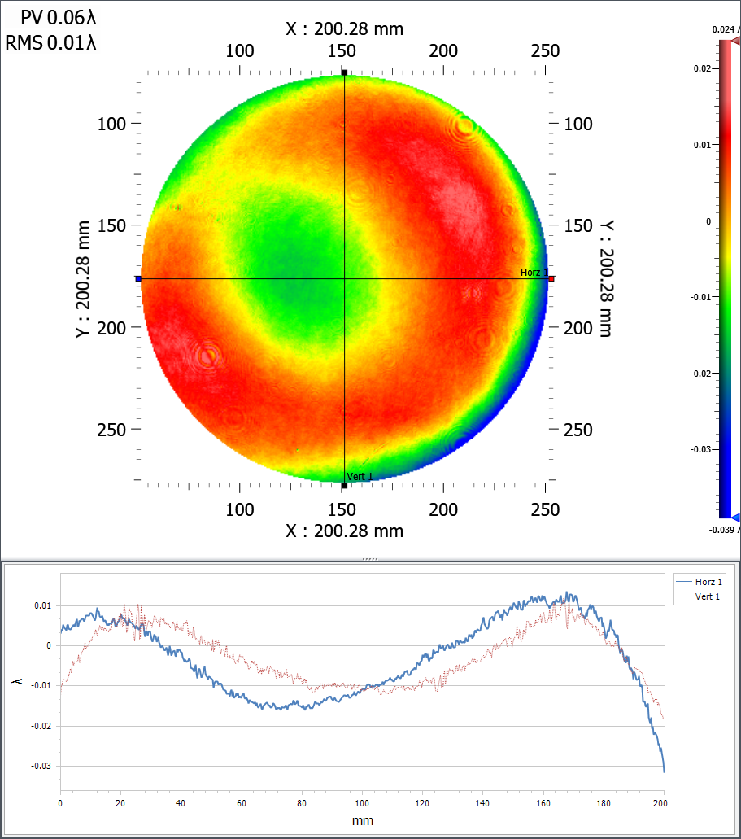
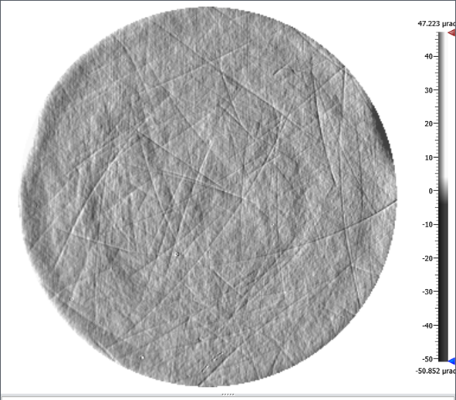
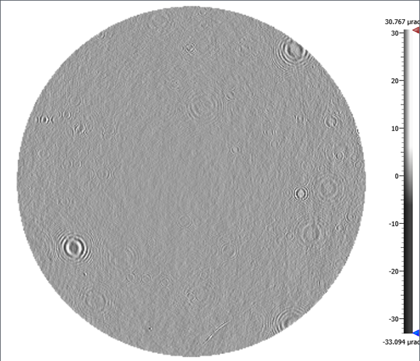
KAGRA ITM High Precision Polishing
by Nikon
Sapphire Mirror
Measurement
Zygo TF(12inch)
Diameter: Φ220
Effective Diameter: Φ200
Surf1:
Curvature radius 1.9km(Concave)
Surf2:
Curvature radius nominal flat
ITM
Surface Measurement Configuration
Surface Accuracy
In the middle of polishing
Scratch Removal
4.9λp‐v
0.01λrms
Initial
In the middle of polishing
Power
W/O Power

Slide 14
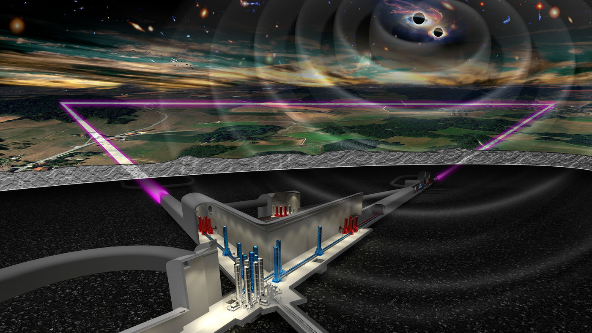
Towards Einstein Telescope
The experience of KAGRA and that of Japanese companies will be of great value to ET.
10km arms
Underground
Triangle Shape
3 High Freq. Telescope
+ 3 Low Freq. Telescope
Cryogenic Mirror
Maximum Observable Distance for BH-BHs
After
from Big Bang
We can see the edge of Universe…

