Slide 1




The socio economic impact of Einstein Telescope
The future large research infrastructure for the gravitational waves in Europe
Alberto Masoni – INFN Research Director
Responsible for Sardinia of Einstein Telescope Infrastructure Consortium Project

Slide 2

Acknowledgements
Luigi Guiso - AXA Professor Einaudi Institute for Economics and Finance
Raffaele Marras – Advisor to the President of the Sardinia Autonomous Region
Marco Pallavicini – INFN Vice President
References: The Ambrosetti House
G7 Large Research Infrastructures. Synergies and Impact on science and society https://www.ambrosetti.eu/en/innotech-hub/g7-large-research-infrastructures/?utm_source=event&utm_campaign=qrcode

Slide 3
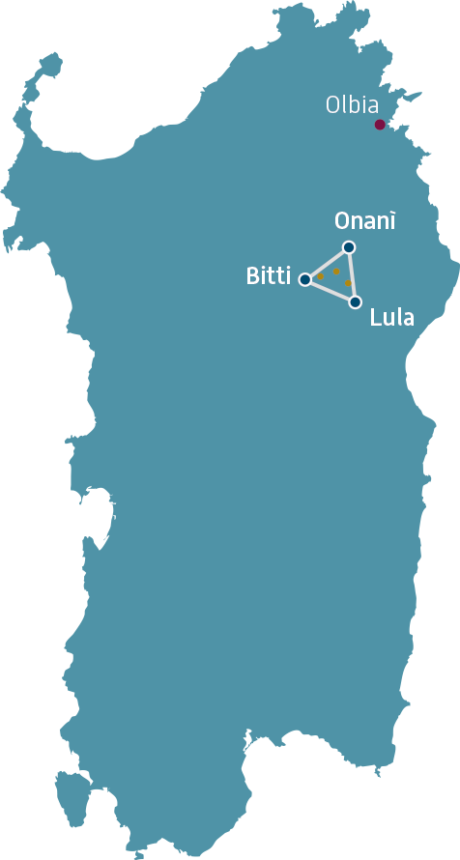

The Impact
Large Research Infrastructures have a significant economic impact. Estimate for G7 LRIs is about 540 bln USD (CAPEX+OPEX) over the last 50 years
Japan hosts three major Research Rnfrastructures. One of them, KAGRA, dedicated to Gravitattional waves
Einstein Telescope will be the largest research infrastructure approved for the next 10 years within the program of the European Strategy Forum for Research Infrastructures
Italy candidates Sardinia to host this infrastructure

Slide 4
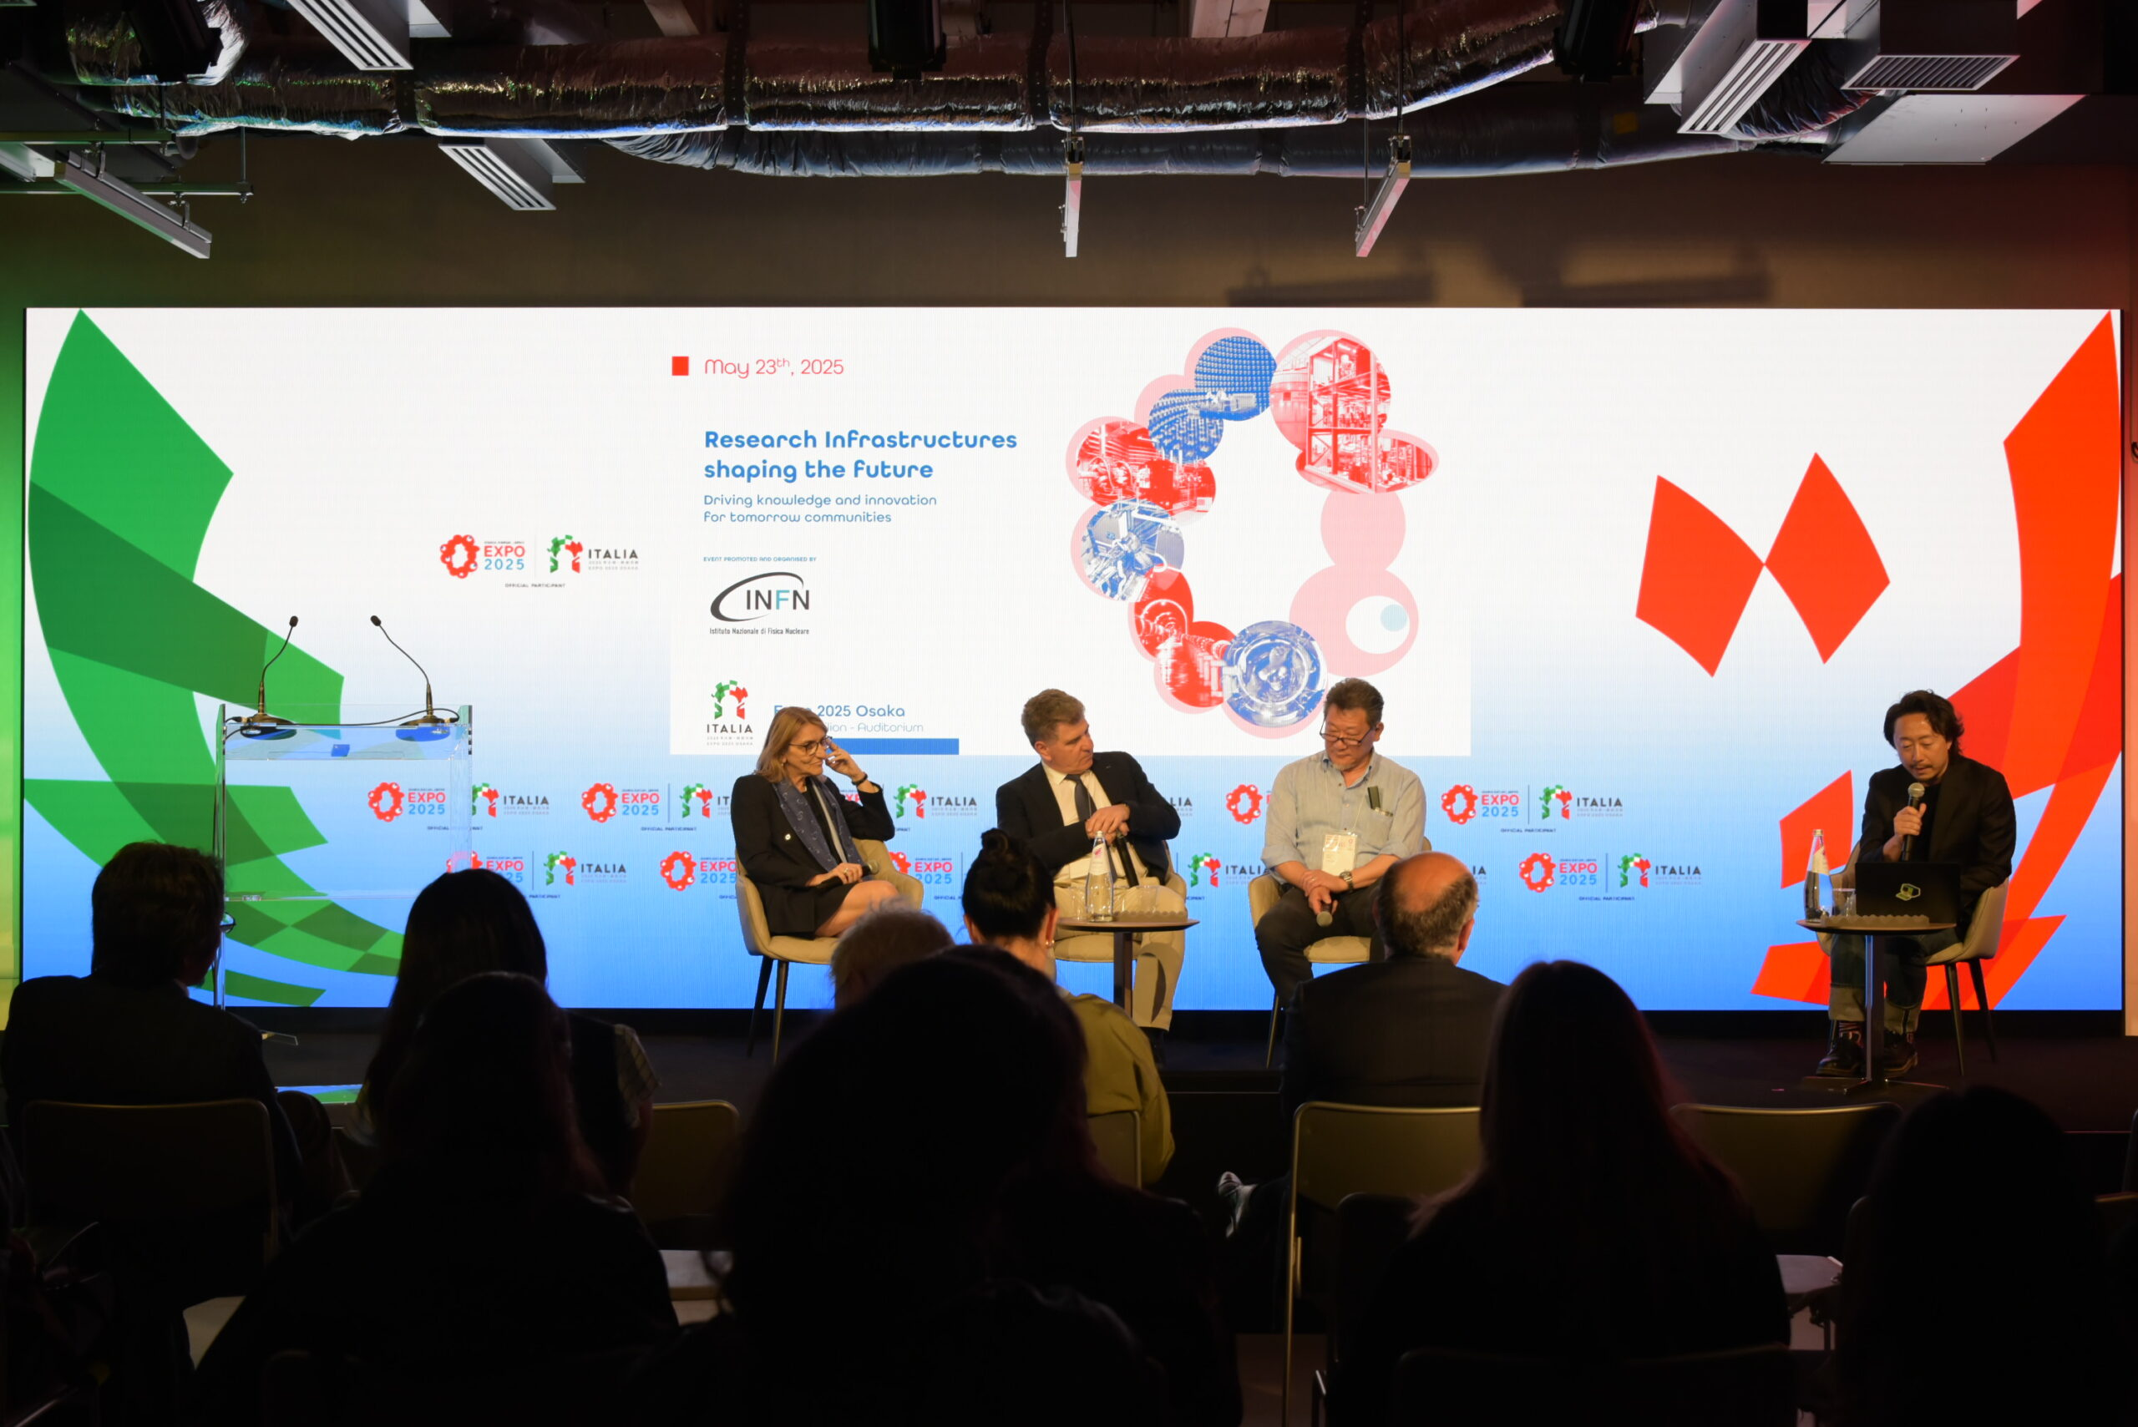
Major research infrastructures and Italy-Japan collaboration in fundamental physics at Expo2025 Osaka
The Italy Pavilion at Expo2025 Osaka hosted the event Research infrastructures shaping the future. Driving knowledge and innovation for tomorrow’s communities on May 23, promoted and organised by INFN (the Italian National Institute for Nuclear Physics)

Slide 5

The G7 Event in Sardinia
During the Italian Presidency of the G7 the Italian Minister of University and Research, Anna Maria Bernini promoted a G7 event dedicated the socio-economic impact of large research infrastructures
The event was held in Sardinia, near Nuoro, close to the area proposed to host the ET site
The Event was organized by INFN and the Italian Ministry of University and Research

Slide 6
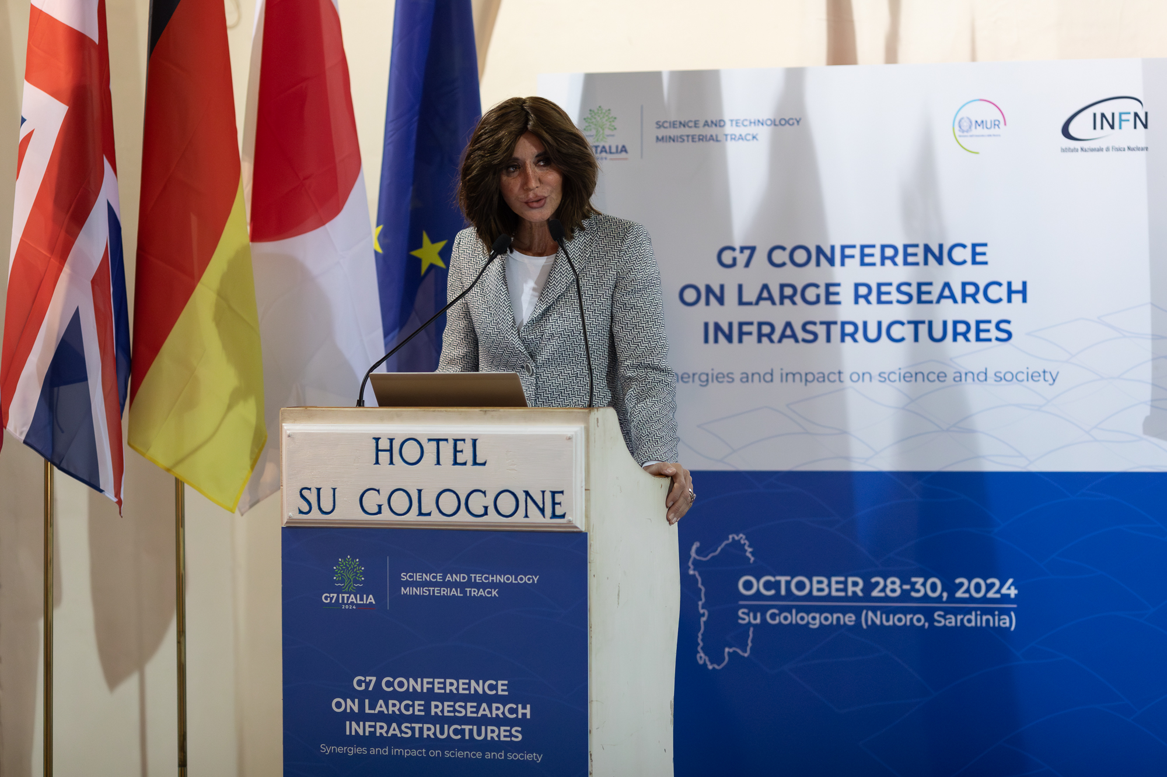
The G7 Event in Sardinia
The Greatest Thinghs are said in Silence
Grazia Deledda
Nuoro 1871-Rome 1936
Nobel prize for Literature in 1926
Italian Minister Anna Maria Bernini at the G7 Event

Slide 7

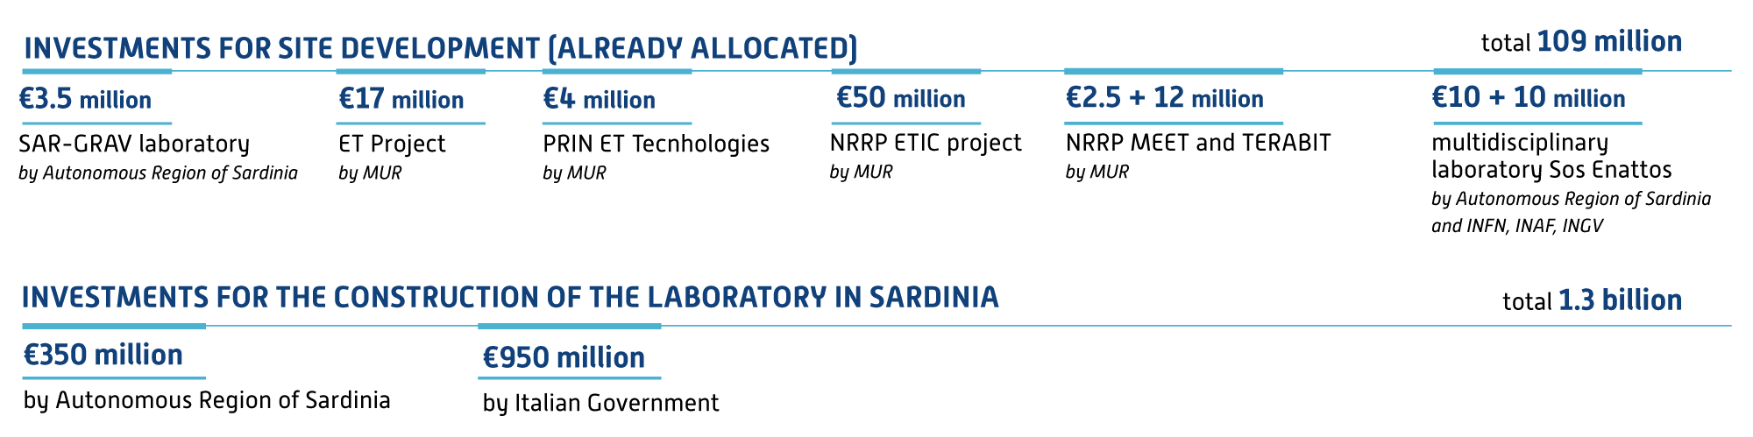
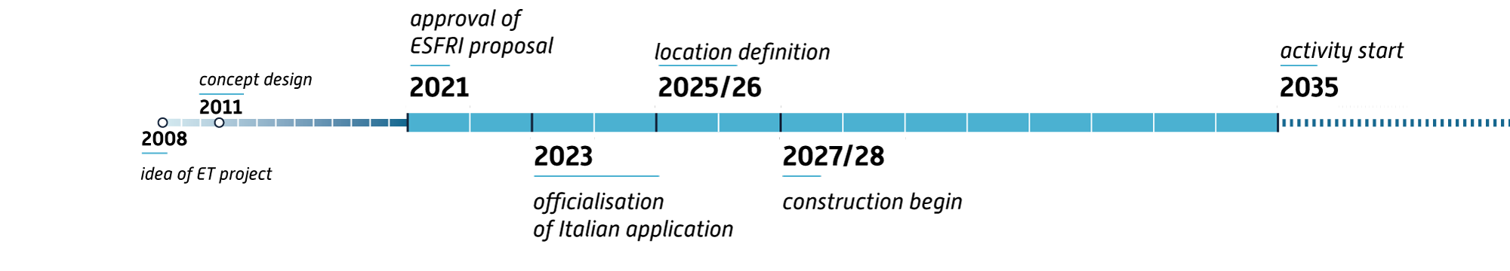

Investments (available or committed)
Updated now to 168 million
Geometry and location(s) definition
Desirable
Timeline
(to be defined yet)
>2036
Construction begin ?

Slide 8
Evaluating the Economic Effects of ET
G7 Conference on Large Research Infrastructures
Luigi Guiso
(EIEF)

Slide 9
Economic impacts
Distinguish two phases: Construction phase and Operation phase
Construction phase
  Effects of the ET construction expenditures on overall production, value added and employment
Operation phase
  Effects of annual running costs for ET on overall production, value added and employment
  Social effects of ET activity and its spillovers
    Scientific production and discoveries (e.g. proxied by n. of publications)
    Human capital and skill development (visitors, doctoral programs)
    Technological spillovers on suppliers (knowledge and technology transfer)

Slide 10
Construction phase: estimated costs
System | year 1 | year 2 | year 3 | year 4 | year 5 | year 6 | year 7 | year 8 | year 9 | year 10 | Total
Site | 180.8 | 210.9 | 210.9 | 178.3 | 178.3 | 79.5 | 0.0 | 0.0 | 0.0 | 0.0 | 1038.8
Vacuum | 0.0 | 9.8 | 16.3 | 16.3 | 19.5 | 22.8 | 58.6 | 71.6 | 71.6 | 39.1 | 325.4
Cryogenics | 0.0 | 0.0 | 0.0 | 0.0 | 12.0 | 18.0 | 18.0 | 6.0 | 6.0 | 0.0 | 60.0
Suspensions | 0.0 | 0.0 | 0.0 | 0.0 | 26.3 | 39.5 | 39.5 | 13.2 | 13.2 | 0.0 | 131.7
Optics | 0.0 | 0.0 | 0.0 | 0.0 | 0.0 | 1.2 | 1.8 | 1.8 | 0.6 | 0.6 | 6.1
Total | 180.8 | 220.7 | 227.2 | 194.5 | 236.1 | 161.0 | 117.9 | 92.6 | 91.4 | 39.7 | 1,562
    Hypothesis : Baseline Triangular; Time to build ET: 10 years
    Total costs: 1.5 billion, spent over 10 years

Slide 11
Operation phase: estimated costs
 | Total Annual Cost (M €) | Total Costs over 30 Years (M€)
Procurement of Goods & Services | 45 | 1,344
Labour | 14 | 411
Total | 59 | 1,735
    Hypothesis : Baseline Triangular; Time to scrapping ET: 30 years
    Total costs: 1.7 billion, spent over 30 years, 58 million per year

Slide 12
Impacts (million euros)
Construction phase
 | Average annual | Total on 10 years
Total Output | 581 | 5,818
Total Indirect and induced Effects | 426 | 4,256
Toral Value Added | 220 | 2,197
Total Employment (N. FTE workers) | 3,320 | 33,221
Output multiplier | 3.3
Operational phase
 | Average annual | Total over (30-years
Total Output (M€) | 204 | 6,126
Total Indirect and induced Effects (M€) | 146 | 4,390
Total Value Added (M€) | 80 | 2,387
Total Employment (FTE) | 185
Output Multiplier | 3.53
    Construction phase:
    effects are front loaded; Multiplier 2.7
    3,320 additional workers per year
    Construction phase:
    main sectors impacted construction and manufacturing
    Local effects, about 60%
    Construction phase:
    L-shape alternative, about 25% smaller

Slide 13
Beneficiaries
As a starting point we identified the possible beneficiaries of the research facility. We highlight the impacts and provide (very conservative) estimates that ET will have on:
The scientific community
Young scholars
Firms (especially suppliers)
The society overall
Focus on most relevant dimensions/channels

Slide 14
Overall combined social impact
Type of impact | Value (million)
Scientific Impact | 108
Skills development | 32
Technological spillovers | NA
Scientific attractiveness | 140
Total (over 30 years) | 280
Tech spillovers: in report we discuss qualitative evidence from a survey on a sample of firms involved in INFN public procurement collaborations
  - 1/3 report increase in sales beyond those due to direct procurement
  - Report acquisition of new technical and managerial competencies and market knowledge
  - Acquisition of new customers and entry in new market (the research market)

Slide 15
L-shaped alternative
Constructions phase
Costs is about 25% lower for each location
Hence effects (given linear technology) during the construction face will be 25% lower in each location but 50% higher compared to the triangle solution
But multiplied by 2
Operational phase
Technology not linear, 2L likely to generate more/better scientific output, hence effects larger than that in the one triangle solution

Slide 16
R&D Effects on Productivity Growth
ET will trigger R&D investments by all EU participating countries
A conservative estimate estimate is 30/40 million Euros per year
R&D will affect Total factor Productivity Growth in Europe as a whole
Assuming R&D expenditures fall on manufacturing we estimate an increase in EU value added by 46/62 million per year (holding constant any effect of higher TFP on labor and capital)
Net of R&D investment effect is 16/22 million, or 480/660 million over the life of ET

Slide 17
Environmental impact
Area designated for the ET infrastructure holds significant environmental value
The construction phase will present the greatest challenges for integrating the infrastructure into such a pristine area.
Once operational, the project should not pose significant environmental issues
A plan is under development to make sure the infrastructure integrates seamlessly with the existing landscape, minimizing environmental impact

Slide 18
In Summary
168 million euro already invested for the site in Sardinia
1.3 billion euro committed by the Italian and the Sardinian Government
A total estimated cost for the construction of about 2 billion euro
An overall economic impact estimated at over 6 billion euro
Thank you very much for your attention
ありがとうございます
Alberto Masoni – INFN Research Director
Responsible for Sardinia of Einstein Telescope Infrastructure Consortium Project

