Slide 1


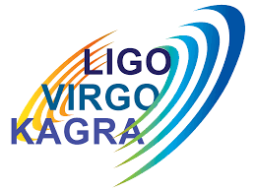
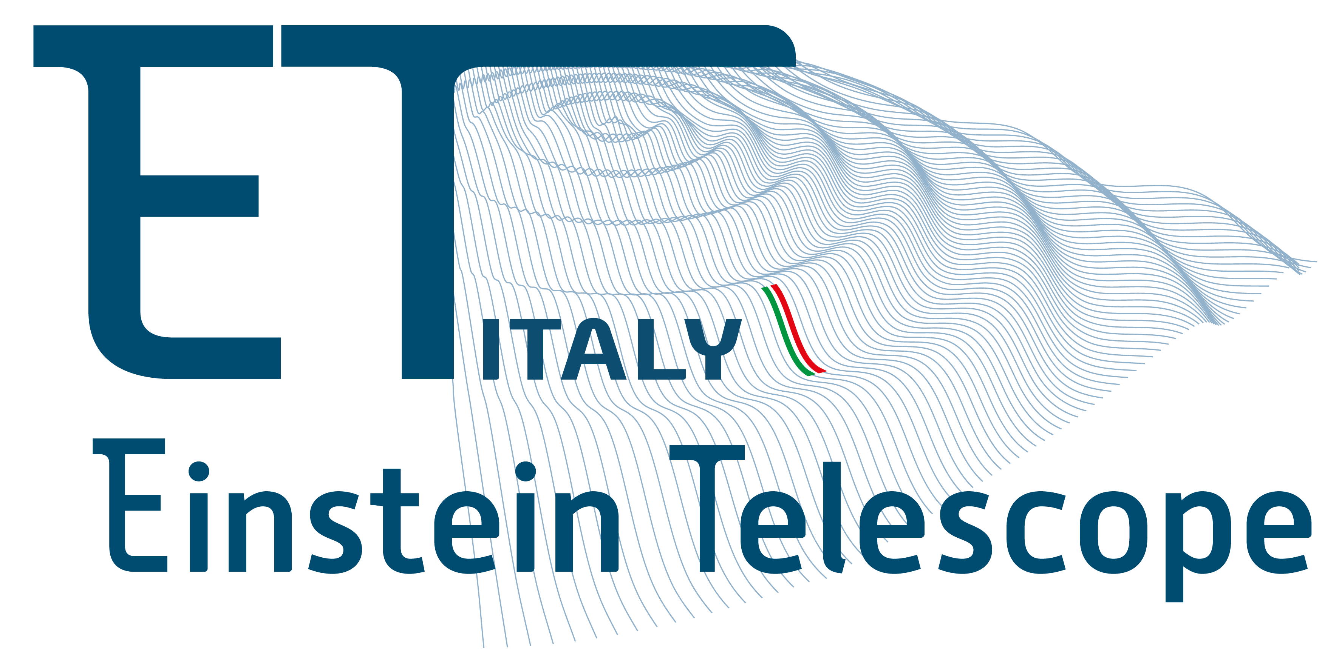

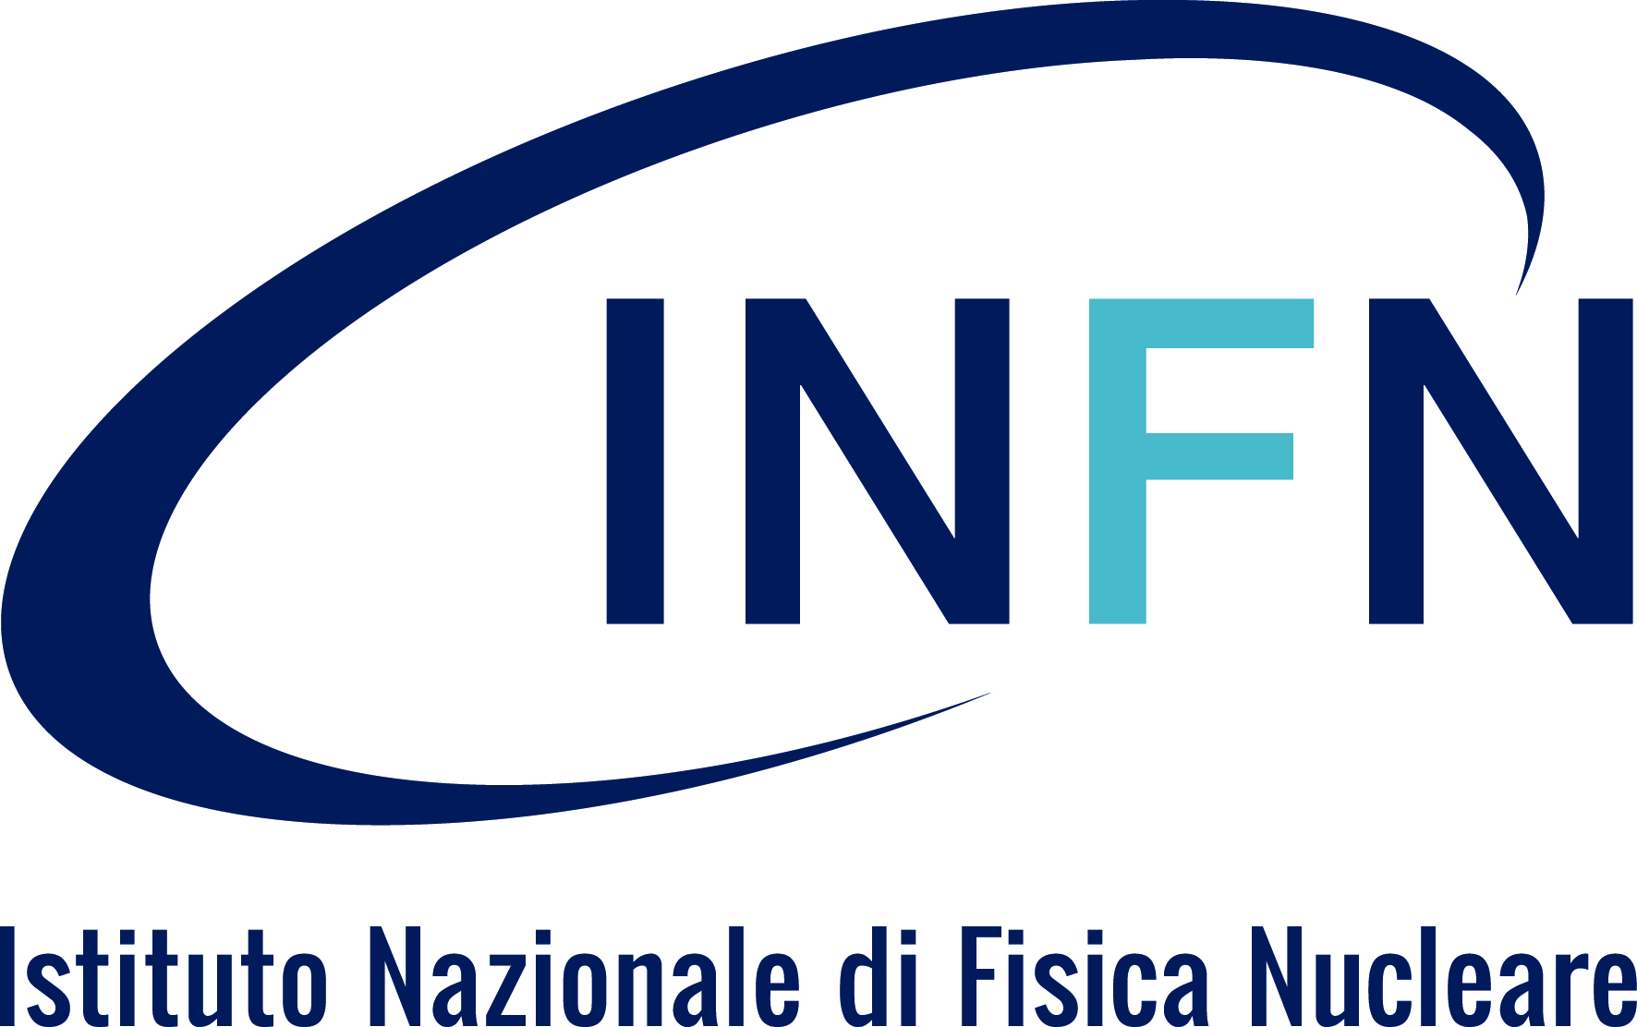

Italy-Japan Collaboration in LVK and the Einstein Telescope
Scientific Synergies in Gravitational-Wave Astronomy
Helios Vocca – Università degli Studi di Perugia and INFN

Slide 2
A Growing Scientific Collaboration
• LVK = LIGO + Virgo + KAGRA
• Einstein Telescope (ET): third-generation detector
International cooperation is key to success

Slide 3
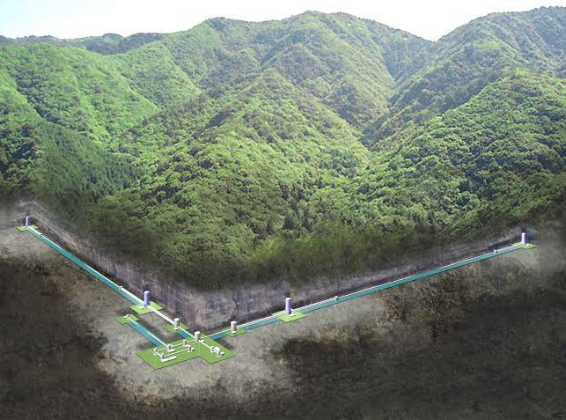
KAGRA: Japan’s Flagship Detector
• Located in the Kamioka mine, Japan
• First underground, cryogenic GW detector
• Operational since 2020
• Innovations in seismic isolation and cryogenics
KAGRA represents a major step forward in gravitational-wave detection. Built underground to reduce seismic noise, and using cryogenic sapphire mirrors to reduce thermal noise, it has set a benchmark for future detectors. The experience gained from KAGRA is vital for next-generation observatories like the Einstein Telescope.

Slide 4
Japan in LVK: From KAGRA to the Global Network
• Cryogenic technology (sapphire mirrors)
• Seismic isolation expertise
• Contributions to quantum noise reduction
• Participation in observing runs and data analysis
Japan has become a crucial player in the LVK collaboration. Its contributions go beyond hardware: from cutting-edge cryogenic technology to quantum noise mitigation strategies and robust seismic isolation. These efforts enhance the entire network's ability to detect faint signals from across the universe.

Slide 5
Italy in LVK: Legacy, Leadership, and Innovation
• Virgo: Europe’s first GW interferometer, located near Pisa
• INFN leadership: coordinating Virgo and major role in ET design
• Seismic isolation and vacuum systems: global benchmarks
• Advanced optics and mirror suspensions
• Data analysis and computing infrastructure (EGI, CNAF)
• Educational and outreach leadership (ETIC, ARC)
Italy has been a cornerstone of the LVK collaboration since the early days of Virgo. Through the leadership of INFN and pioneering technical developments in isolation systems and optics, Italy has shaped the success of second-generation detectors. Italian teams also play major roles in data analysis, detector commissioning, and outreach, building a solid foundation for the Einstein Telescope and future global collaborations.

Slide 6
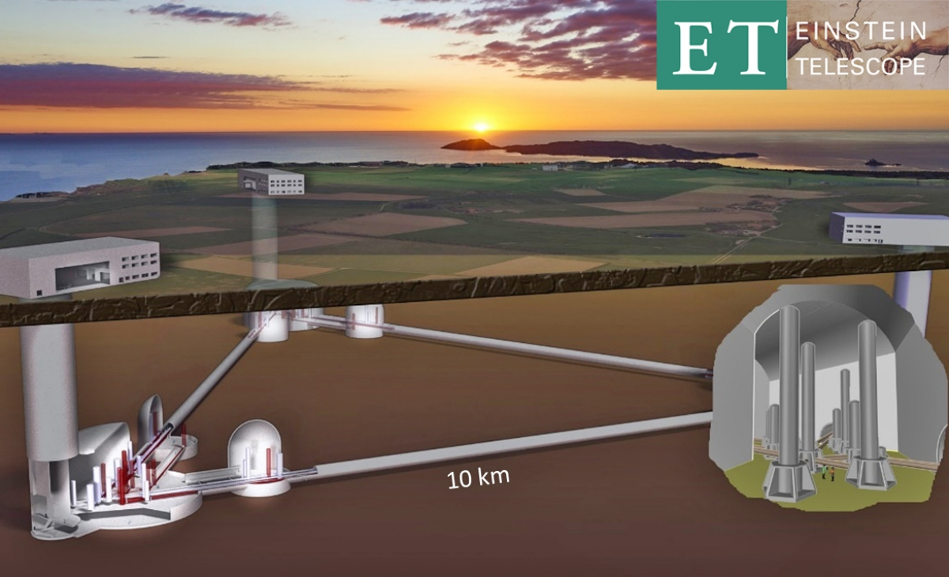
The Einstein Telescope: Europe’s Next Step
• ET: underground third-generation GW detector
• Site candidate: Sardinia, Italy
• R&D via infrastructures ongoing in Europe
• Demands cutting-edge cryogenics and isolation
As Europe develops the Einstein Telescope, Japan’s expertise in underground infrastructure and cryogenic systems offers invaluable know-how. The synergy between Italy and Japan will be essential to meet the demanding sensitivity requirements of third-generation detectors.

Slide 7
Italian and Japanese GW collaborations: a longstanding history
Examples of recent projects for staff exchanges:
Italy
• ELITES - ET-LCGT Telescopes: Exchange of Scientists: 2012-2017
• NEWS - New windows on the universe and technological advancements from trilateral EU-US-Japan collaboration: 2017-2023
• PROBES - Probes of new physics and technological advancements from particle and gravitational wave physics experiments. A cooperative Europe - United States - Asia effort: 2022-2026
• GRAVITY - New Technologies for Next-Generation Gravitational-Wave Detectors: 2026-2030
Japan
• Core-to-Core Program: FY2013-2017
• Core-to-Core Program: FY2018-2023

Slide 8
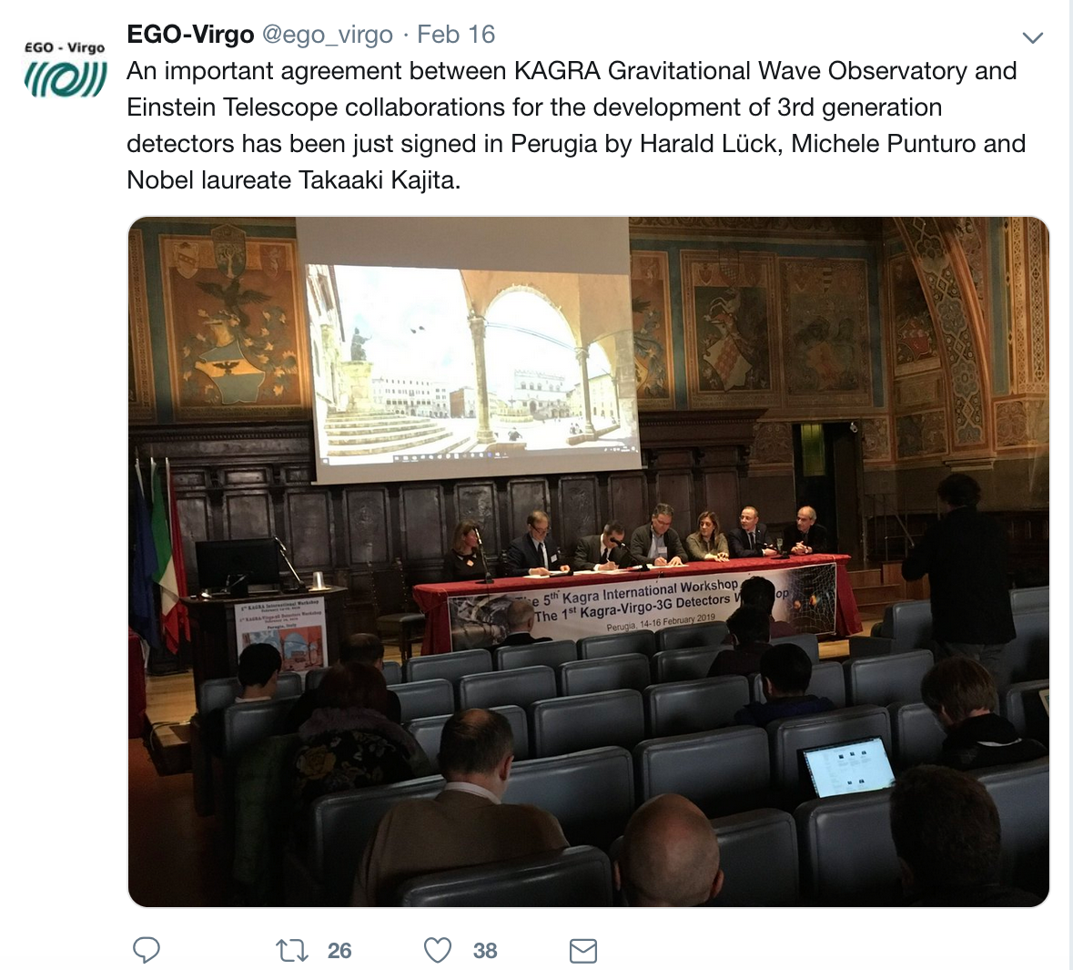
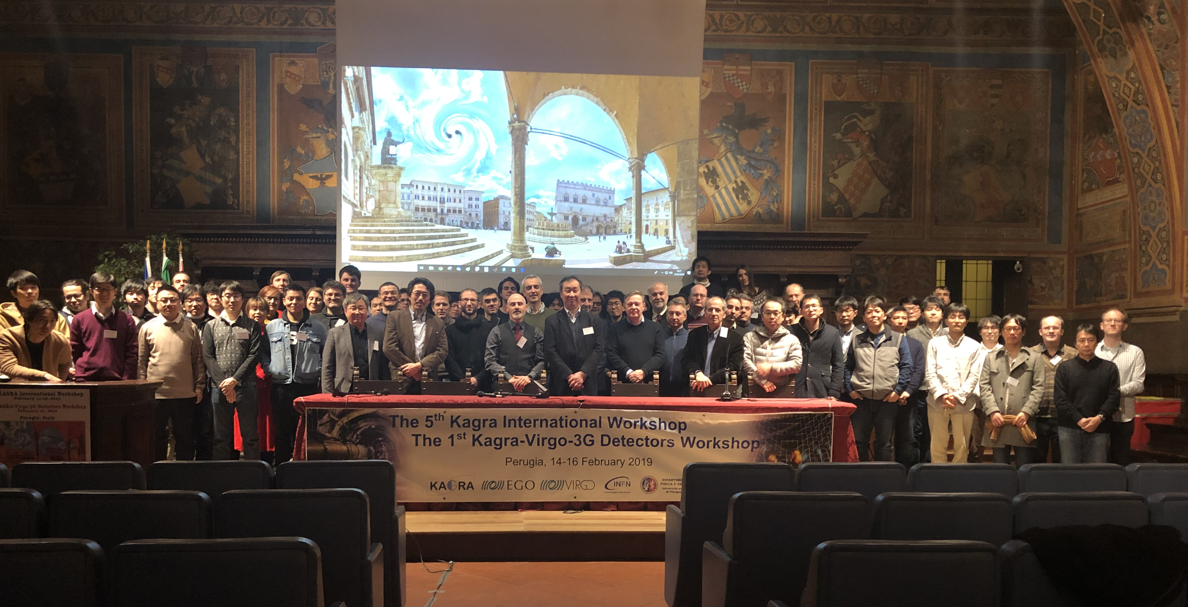
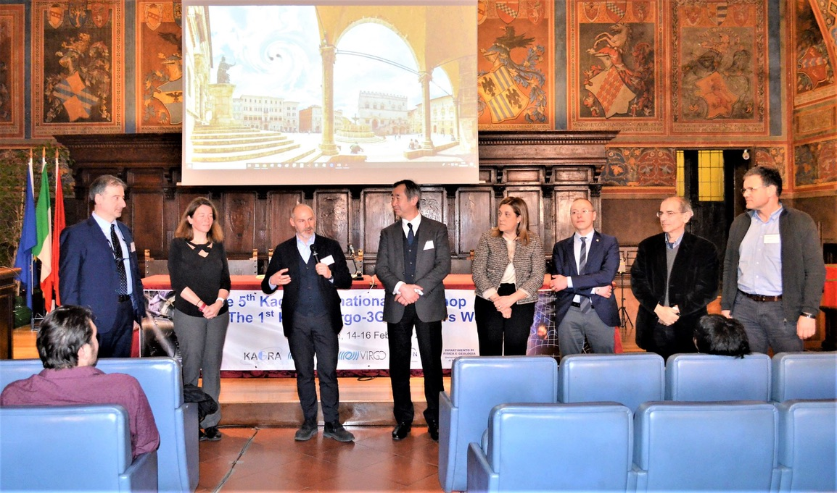
How Japan Can Contribute to ET
• Leverage KAGRA’s cryogenic experience
• Underground construction and infrastructure
• Quantum-enhanced sensing
• Shared R&D and joint innovation
15/02/2019:
Agreement between KAGRA and ET signed in Perugia

Slide 9


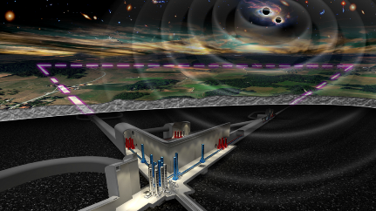

ETIC – Einstein Telescope Infrastructure Consortium
Next Generation EU
Investment focused on ET enabling technology and Sardinian site candidature support
Leaded by INFN,
Partners:
11 Universities
INAF and Italian Space Agency
Budget 50M€ approved
Start of the project:
1st January 2023
(30 Months)
Discussion ongoing with the Italian Government on an Italian share toward ET realization
INFN – GE
Genova University
INFN-BO
Bologna University
INFN-PD
Padova University
INFN-PG
Perugia University
INFN – TO
INFN-LNGS
GSSI
Vanvitelli University
INFN – PI
Pisa University
INAF-Adoni
ASI-Matera
INFN – RM1
La Sapienza University
INFN – RM2
Tor Vergata University
INFN – NA
Federico II University
INFN – LNS
ET
INFN – CA
Cagliari University

Slide 10
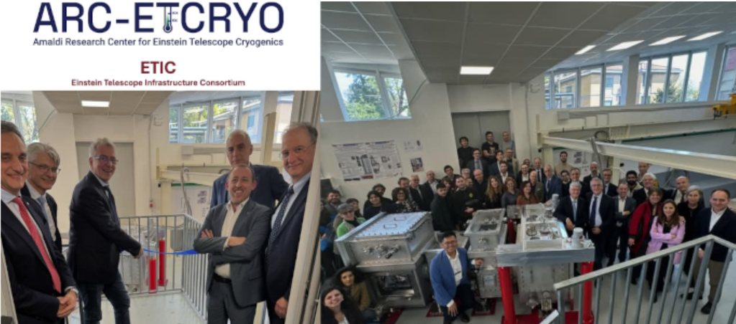
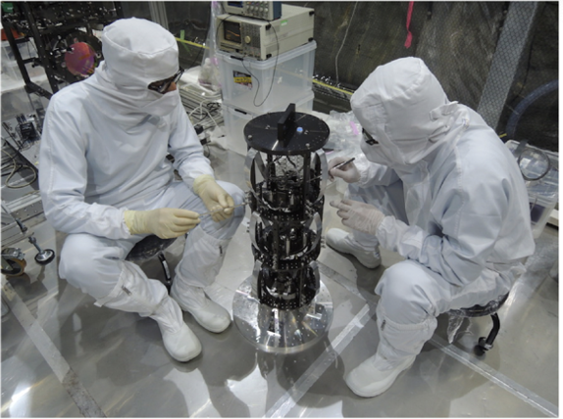
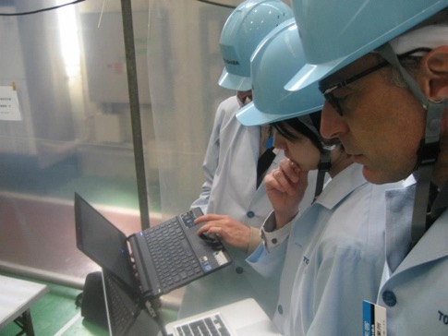
The Amaldi Research Center (ARC)
Based at Sapienza University of Rome
Engagement in ET design and data analysis
Collaboration and exchanges of researchers with Japan started in the eighties.
Specific involvement in ET Cryogenics implementation (cryostats and payloads)
System prototype close to ET 1:1 scale, 600 kg suspended cold mass cryofluid-free
ET R&D on
stiff and elastic structures (for mechanical suspensions) with
High Thermal conductivity AND Low mechanical dissipation
Crystalline materials for mechanical suspensions (special focus on Al₂O₃)
Soft structures (for pure thermal conduction links)
Pure metals with high thermal conductivity
High emissivity coatings for cryogenics
Thermal radiation Superinsulation
Mylar-free systems
Vibration Cryogenic position control sensing systems

Slide 11
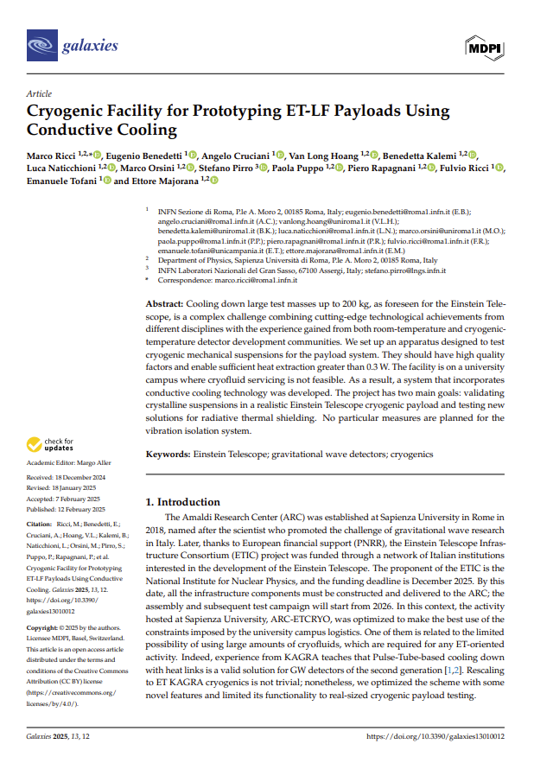
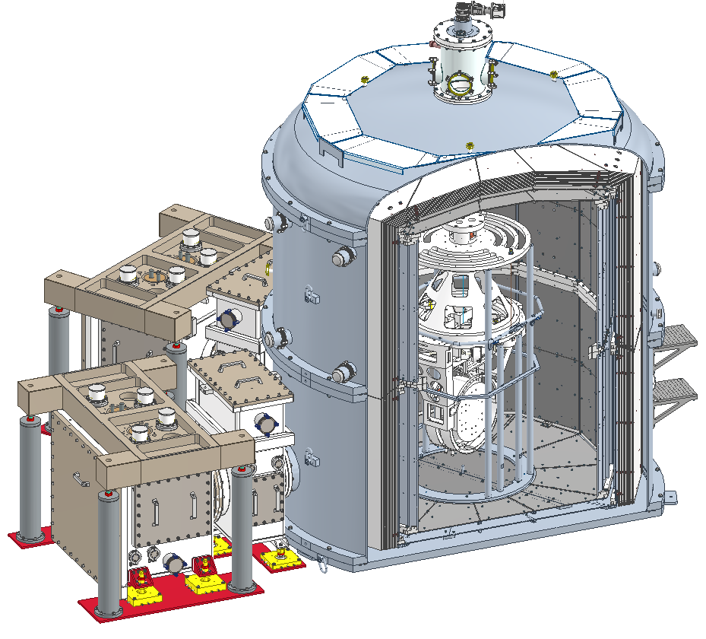
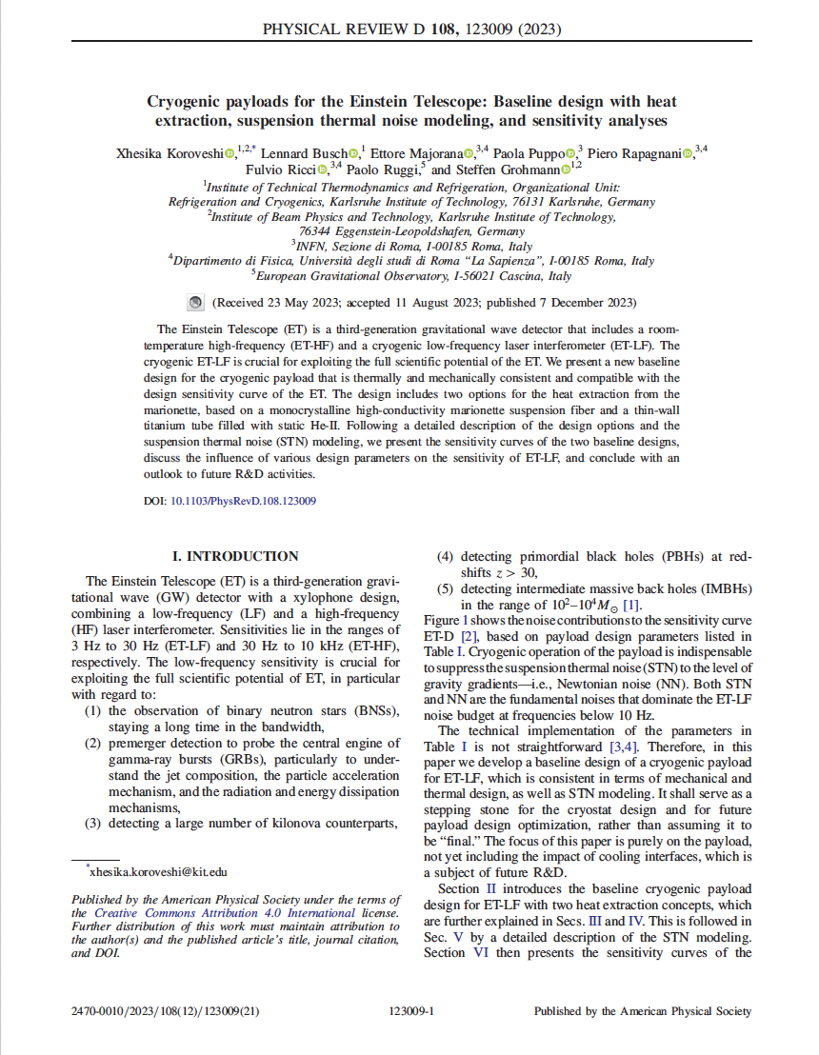
Cryostat C75 @ ARC-ETCRYO
3 m
Top Technical Chamber
Pulse Tube Refrigeration
Lines
Rigid Multi-Layer
Outer Thermal Shield
Inner Thermal Shield
Payload
3 m
5

Slide 12
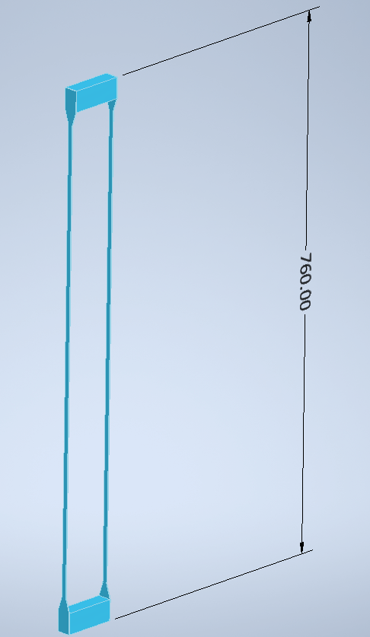
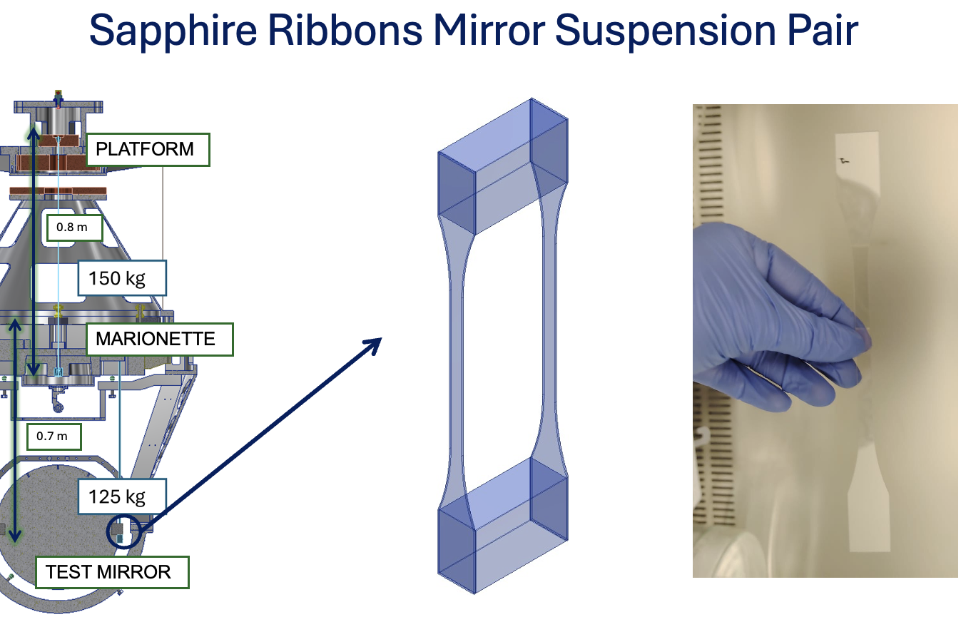
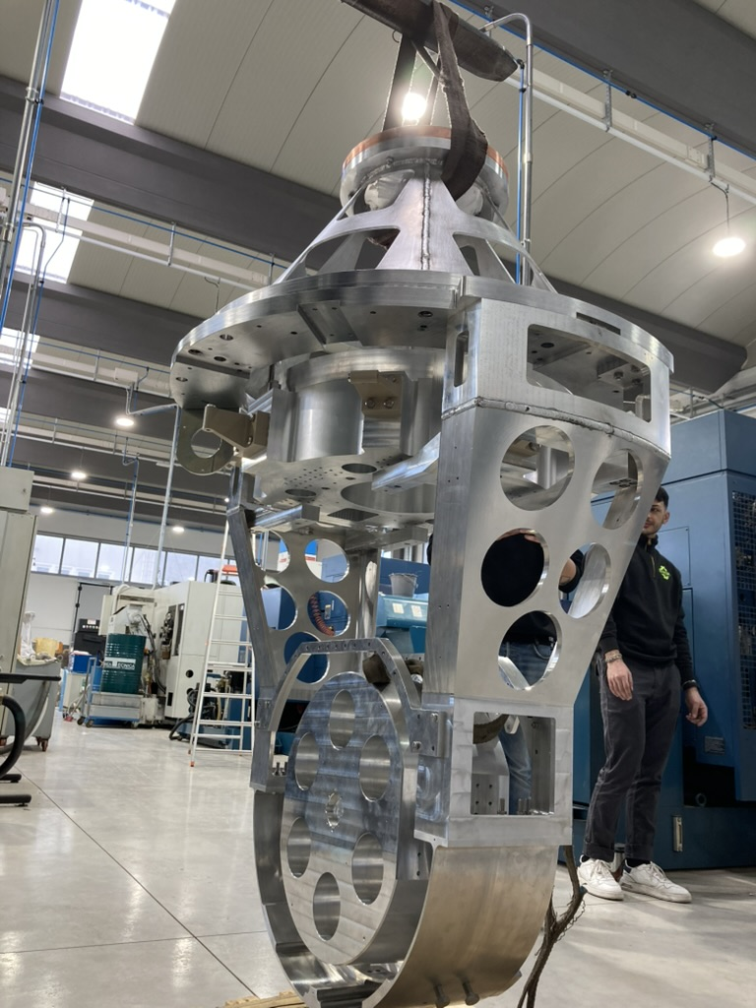
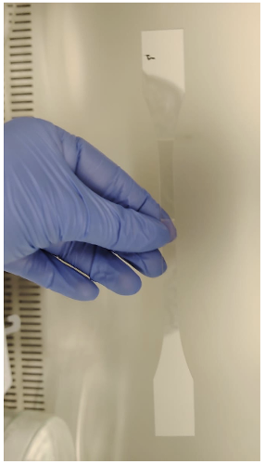
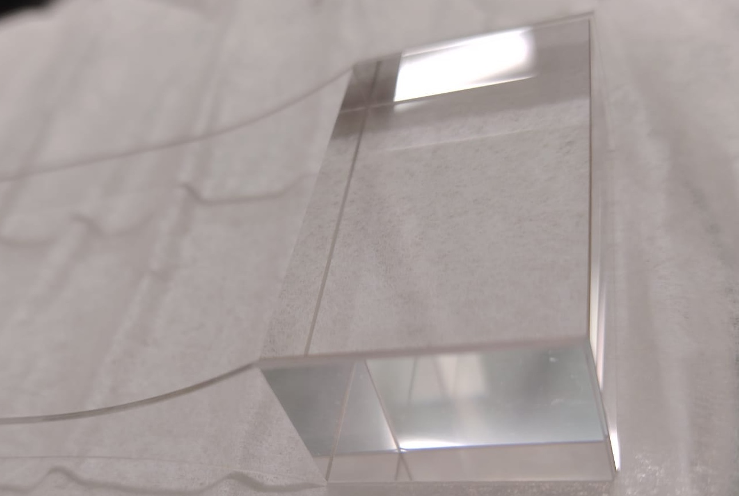
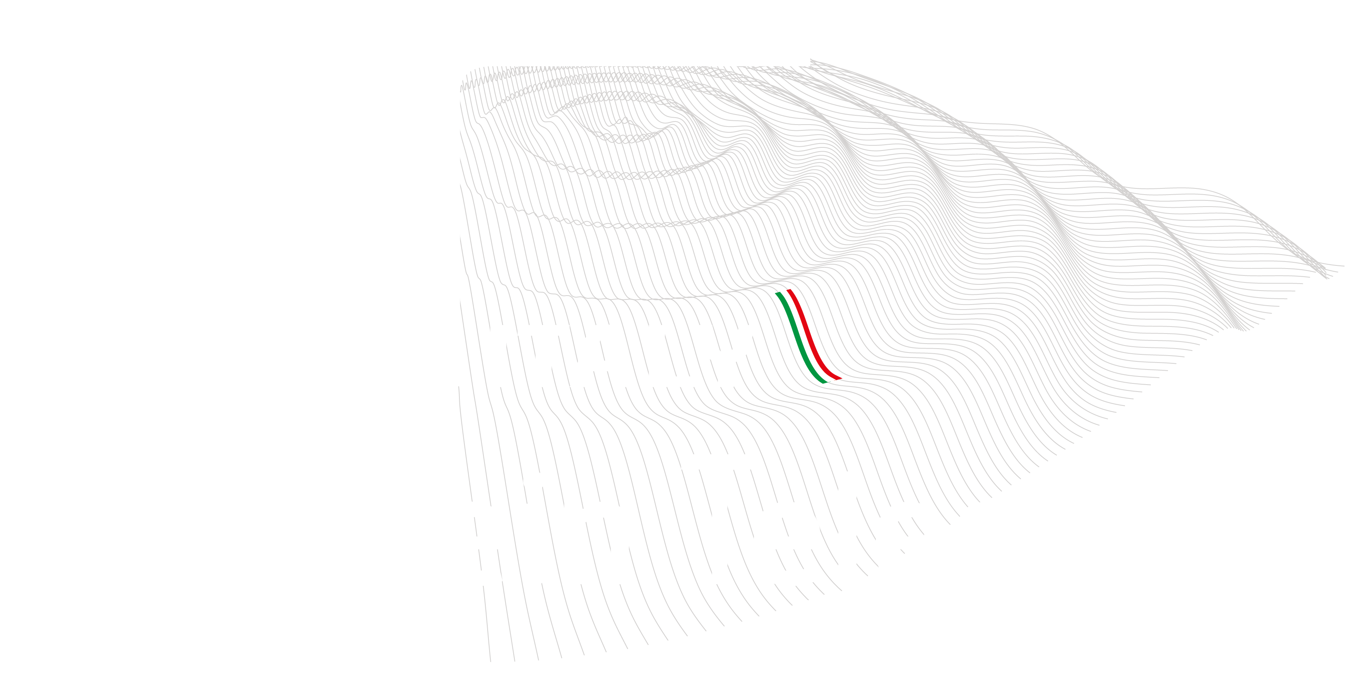
PROTOTYPING SAPPHIRE USE
FOR LOW DISSIPATION MECHANCIAL SUSPENSIONS CLOSE TO 1:1 SIZE
Missione 4 • Istruzione e Ricerca - ETIC

Slide 13
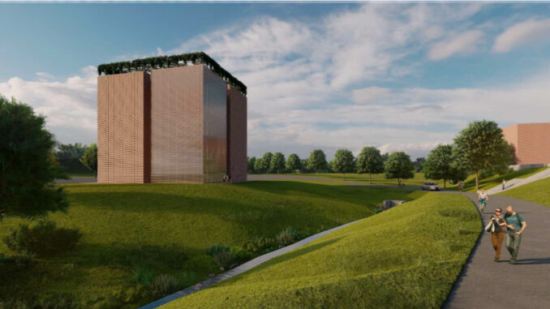
CAOS – Centro sulle Applicazioni per le Onde gravitazionali e la Sismologia
• Based at University of Perugia
• International lab on GW and seismology
• Expertise in optics, metrology, seismic isolation and instrumentation
• Active in ET-related projects
The CAOS Laboratory is becoming a key infrastructure for developing and testing technologies for gravitational-wave and seismology applications. With facilities such as 15-meter suspension towers, CAOS supports the development of low-noise technologies relevant to the Einstein Telescope and broader scientific challenges.

Slide 14
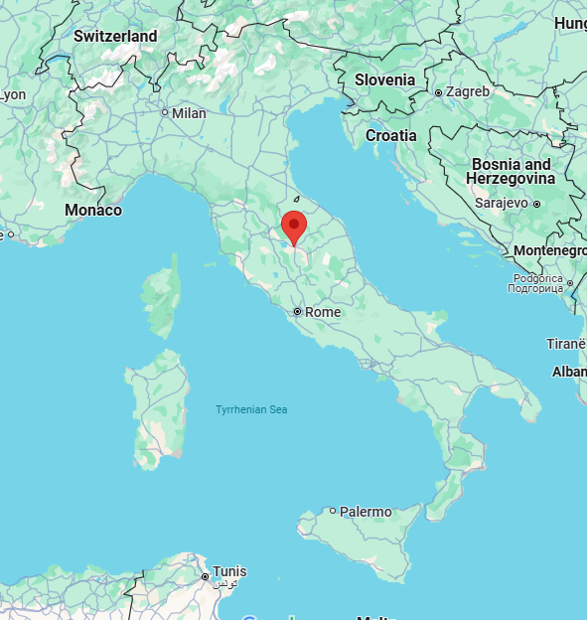
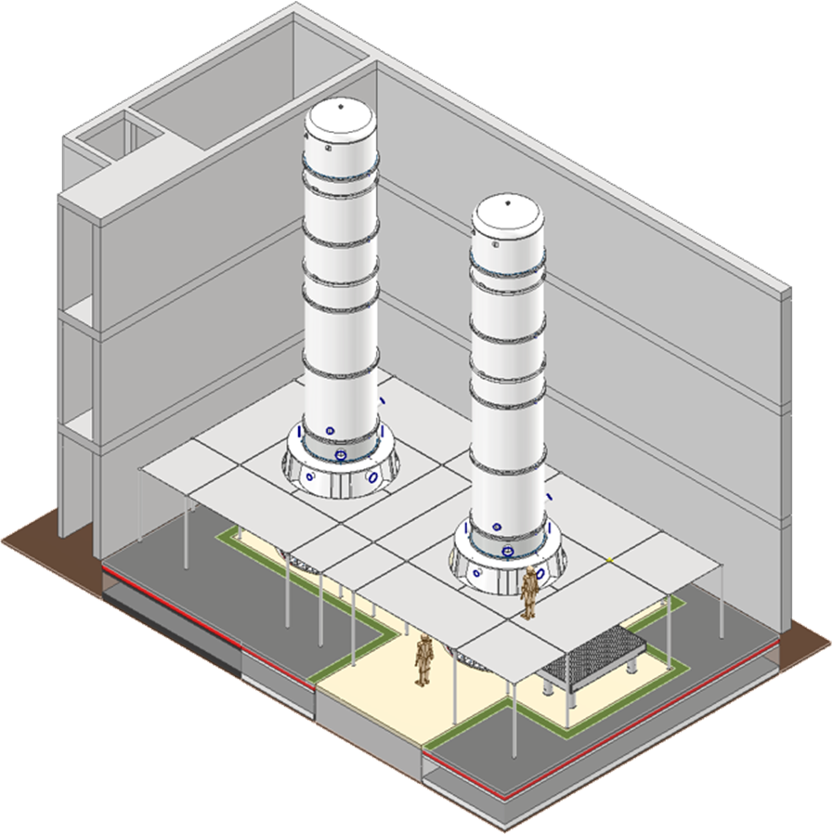
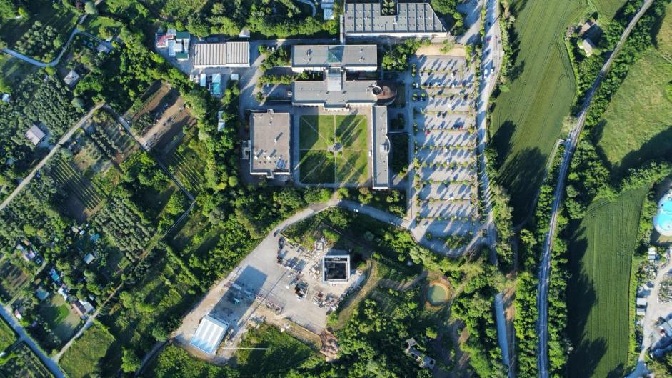
What is CAOS
CAOS is one of the ETIC infrastructure facilities, located in Perugia.
This unique international facility specialises in developing new seismic filtering technology and low-noise controls using full-size ET vacuum towers and superattenuators (SAs).
The expertise acquired at CAOS will contribute to the development of technology for third-generation gravitational wave detectors, as well as having applications in other fields, particularly seismology and early warning systems.

Slide 15
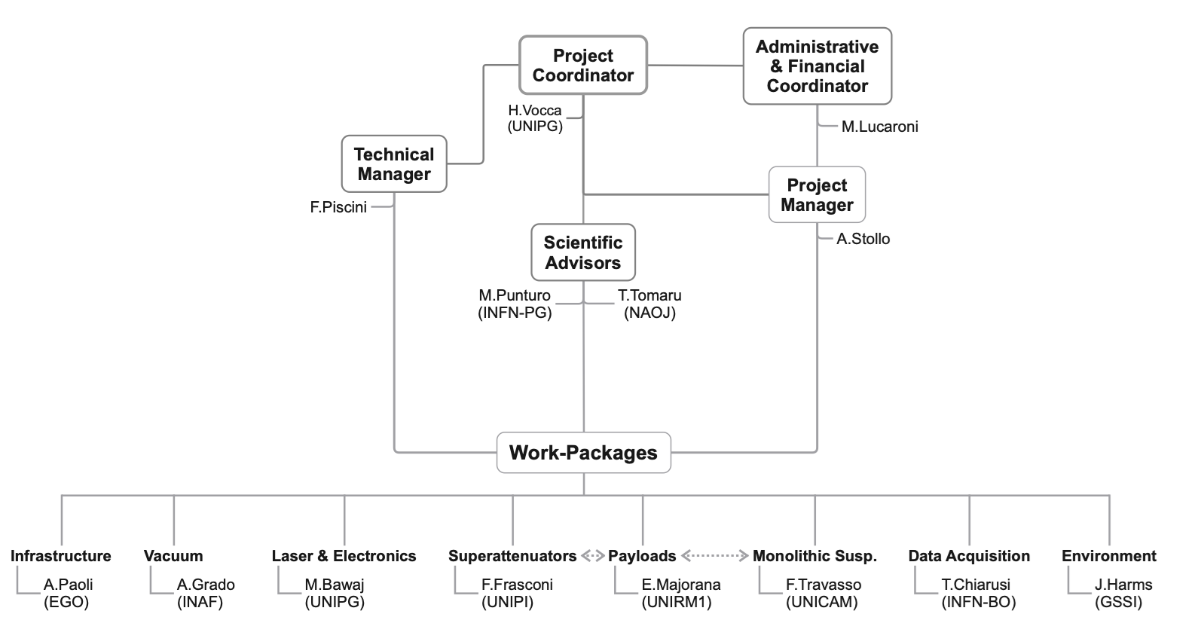
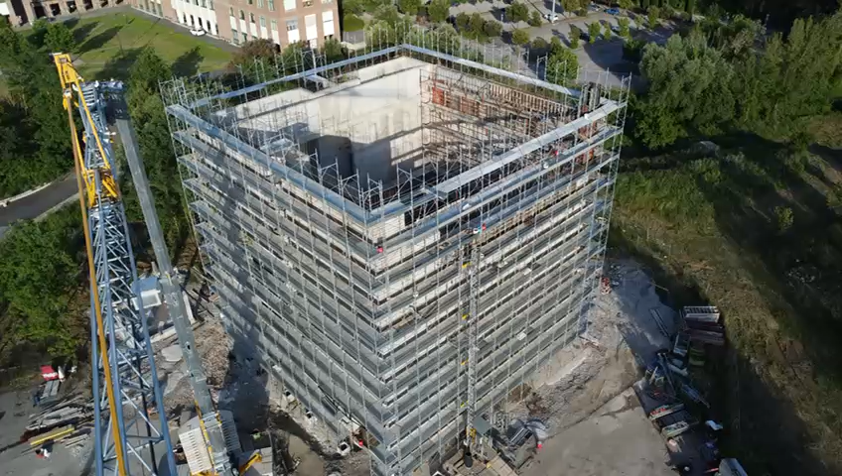
Although the laboratory belongs to the Physics and Geology Department at UNIPG, its proximity to the Mechanical and Electronics Engineering Department will make it an attractive destination for young people, new collaborations and new ideas.
In these days EGO and UNIPG are signing an agreement for directly collaborating in CAOS and the next step is to include in this also ICRR and NAOJ
Organisation chart
(UNIPG)

Slide 16

Toward a Unified Gravitational-Wave Community
• Italy and Japan are strategic partners
• LVK as strong foundation
• ET offers new frontier for cooperation
• Investing in shared science, training, and discovery
Shared Vision – Shared Future
The collaboration between Italy and Japan in gravitational-wave science exemplifies the power of shared vision and mutual respect. Together, through projects like KAGRA, ARC, CAOS, and the Einstein Telescope, we are building the foundations for discoveries that will reshape our understanding of the universe.

Slide 17

Thank You!

