Slide 1
Italy-Japan Collaboration
Towards
the Einstein Telescope
Prof. Takayuki TOMARU,
Prof. Tatsuki Washimi
National Astronomical Observatory of Japan @ Osaka Expo. 2025, Italian Pavillion

Slide 2
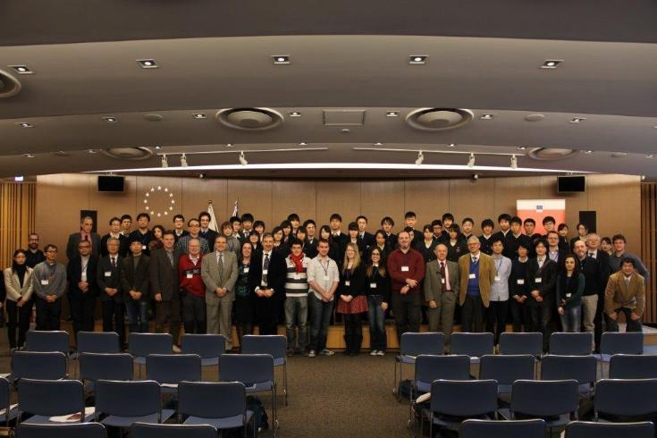
ITALY-JAPAN Collaboration
Collaboration Program (Italy)
ELITES - ET-LCGT Telescopes:
Exchange of Scientists (2012-2017)
1st ELiTES General Meeting: Oct. 3-4, 2012
2nd ELiTES General Meeting: Dec. 4-5, 2013
3rd ELiTES General Meeting: Feb. 9-10, 2015
4th ELiTES General Meeting: Dec. 2-3, 2015
5th ELiTES General Meeting: Feb. 8-10, 2017
@European Union Delegation at Japan
NEWS - New windows on the universe and technological advancements
from trilateral EU-US-Japan collaboration (2017-2023)
PROBES - PROBES of new physics and technological advancements from
particle and gravitational wave physics experiments. A cooperative Europe –
United States - Asia effort (2022-2026)
GRAVITY - New Technologies for Next-Generation Gravitational-Wave
Detectors (2026-2030)

Slide 3
ITALY-JAPAN Collaboration
Collaboration Program (Japan)
Core-to-Core Program (Japan): FY2013-FY2017
Core-to-Core Program (Japan): FY2018-FY2023
These programs involve international research collaborations with a wide range of countries,
but Italy was one of the main target countries.
LoI / MoU
Einstein Telescope Collaboration & KAGRA Collaboration (LoI): Feb., 2019 –
Perugia Univ. – NAOJ – ICRR (MoU): Jan. , 2023 –

Slide 4
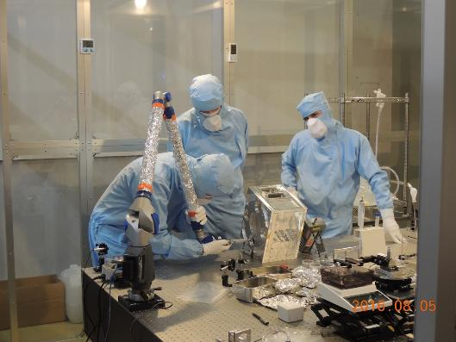
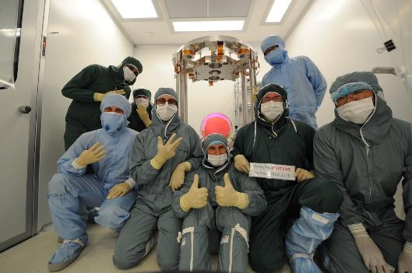
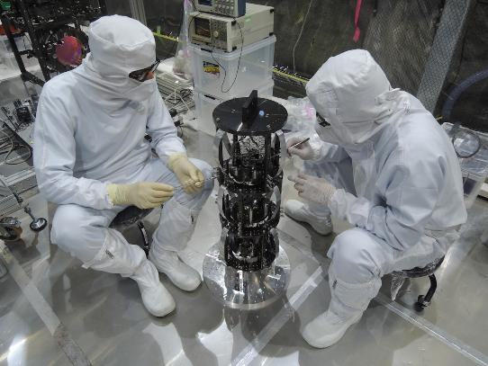
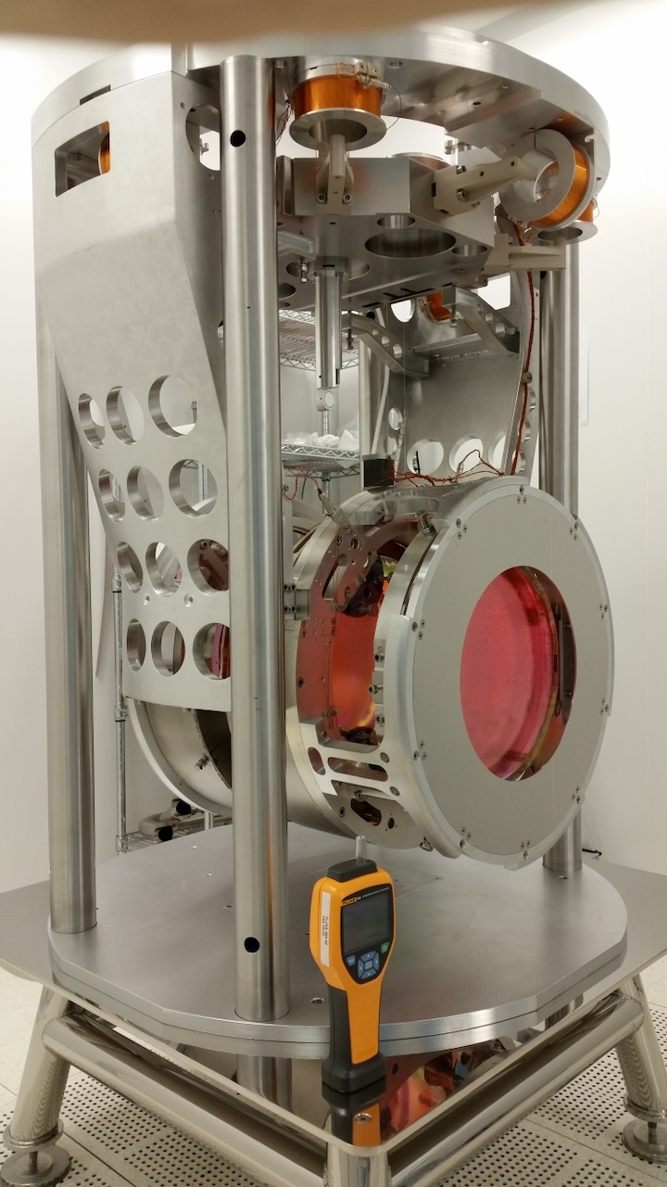
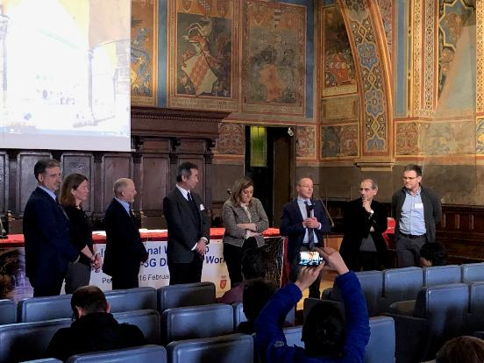
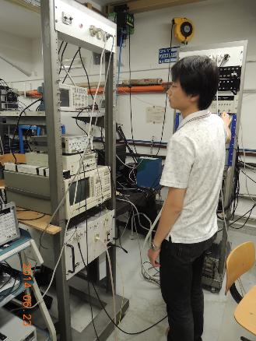
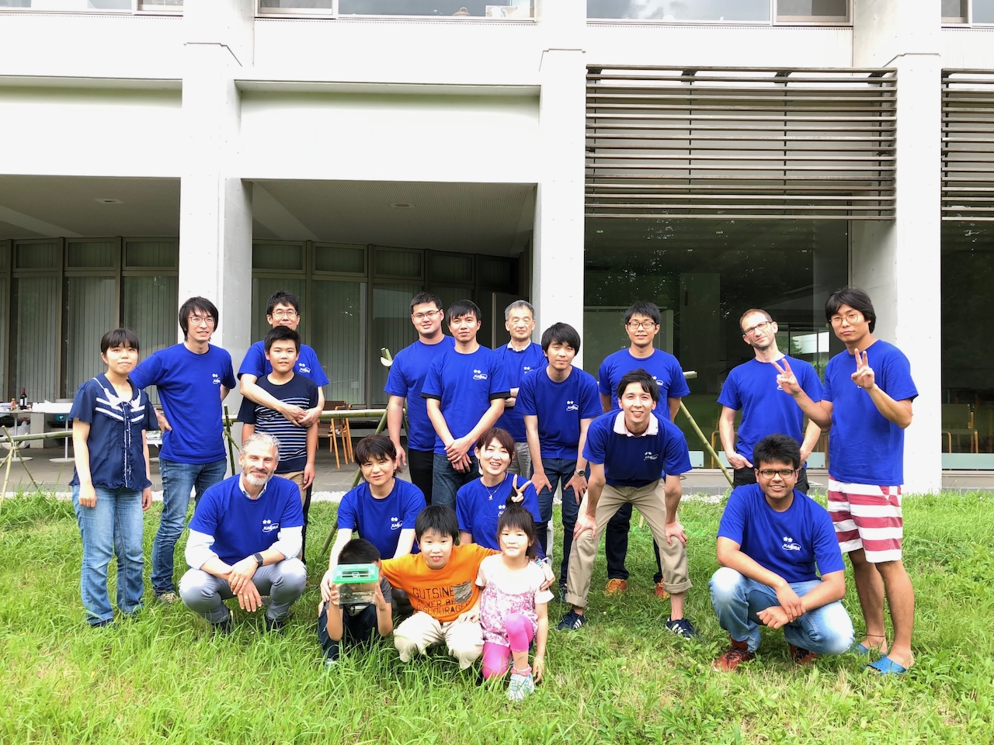
Contributions From ET to KAGRA
HCB by KAGRA & Perugia
Virgo’s Payload
HL VIS by KAGRA & Roma
KAGAR International Workshop
@Perugia
Sapphire Q measurement @ Roma Univ.
Nagashi-Somen Party @KEK

Slide 5
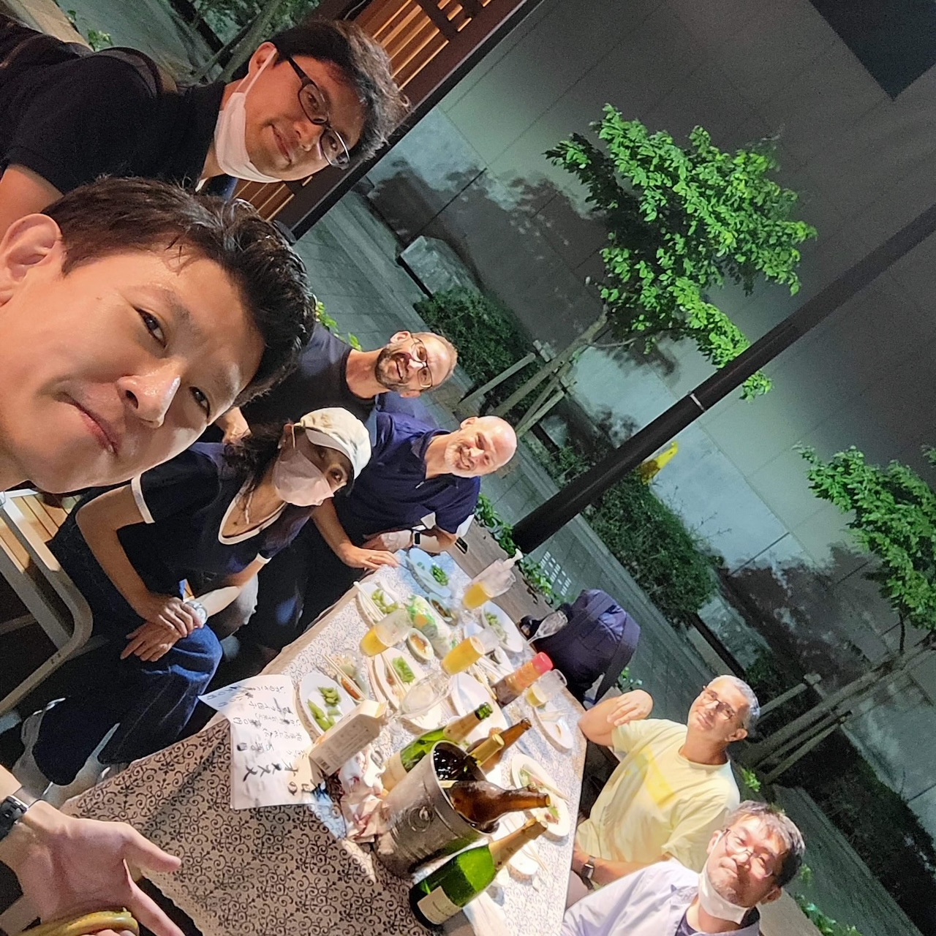

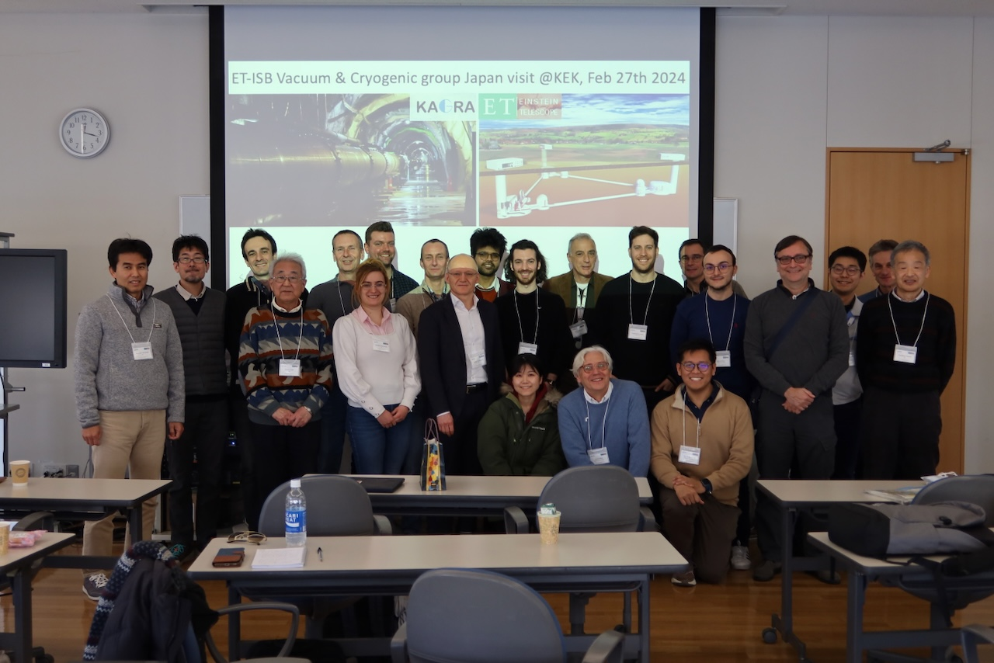
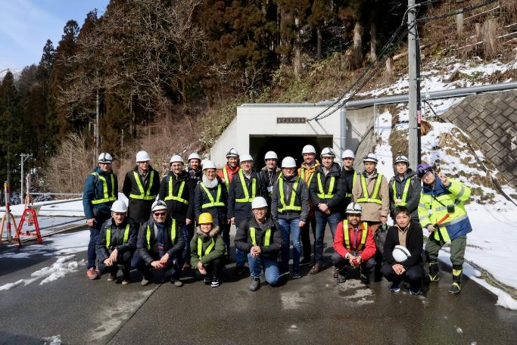
Contributions From KAGRA to ET
ICRR Inter-University
Research Program
CAOS

Slide 6
Very Soft 6N Al Stranded Cable as Heat-link
In cooperation with KAGRA, we are currently working on the production of an
ultra-soft heat link with large thermal conductivity for the ET test cryostat being
developed at the University of Rome.

Slide 7
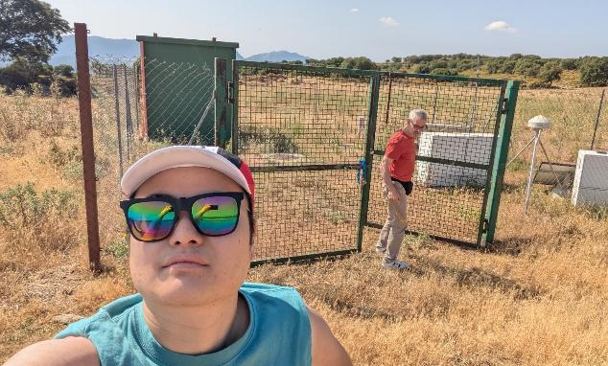
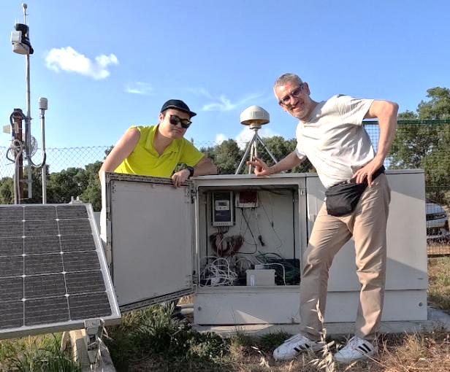
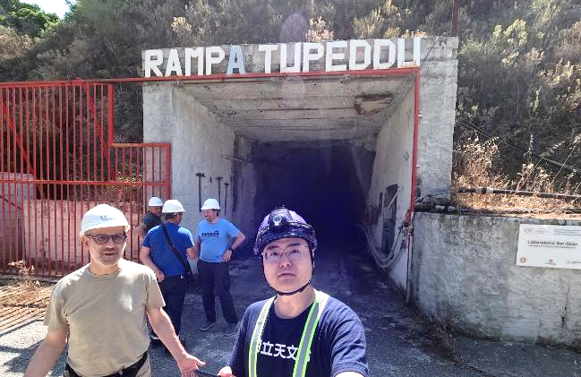
SPB/SCB Works @ Sardigna
T. Washimi is at Sardinia just now!
P2
P3
Sos Enattos

Slide 8
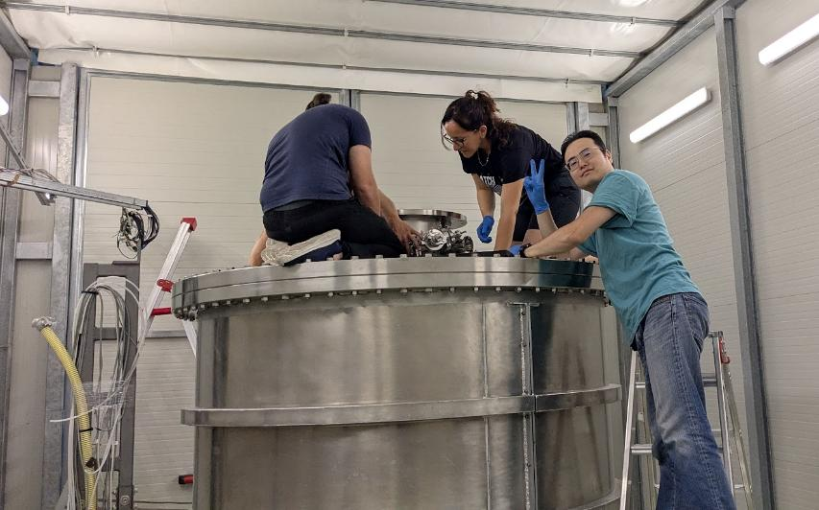
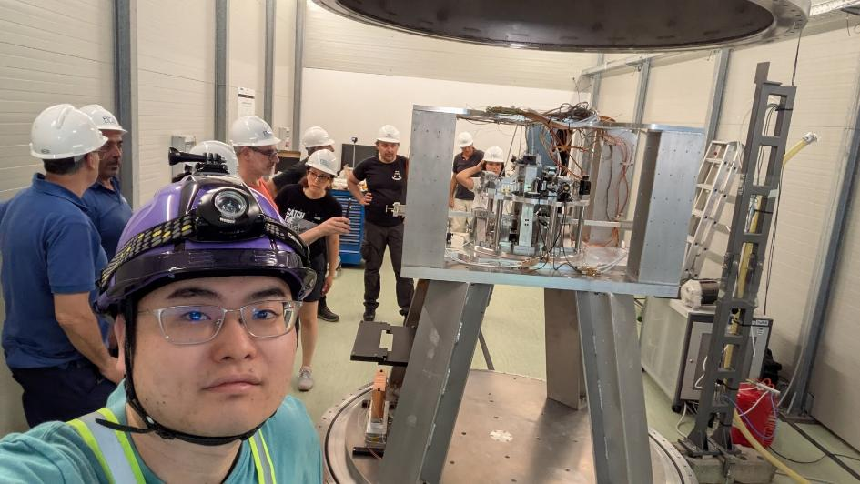
SPB/SCB Works @ Sardigna
ARCHIMEDES Experiment at Sar-Grav Lab

Slide 9
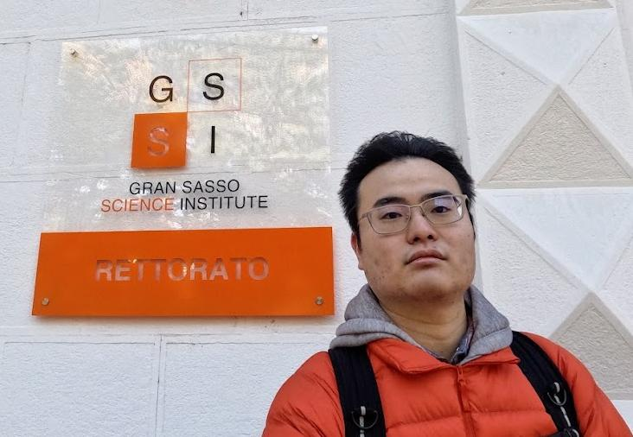
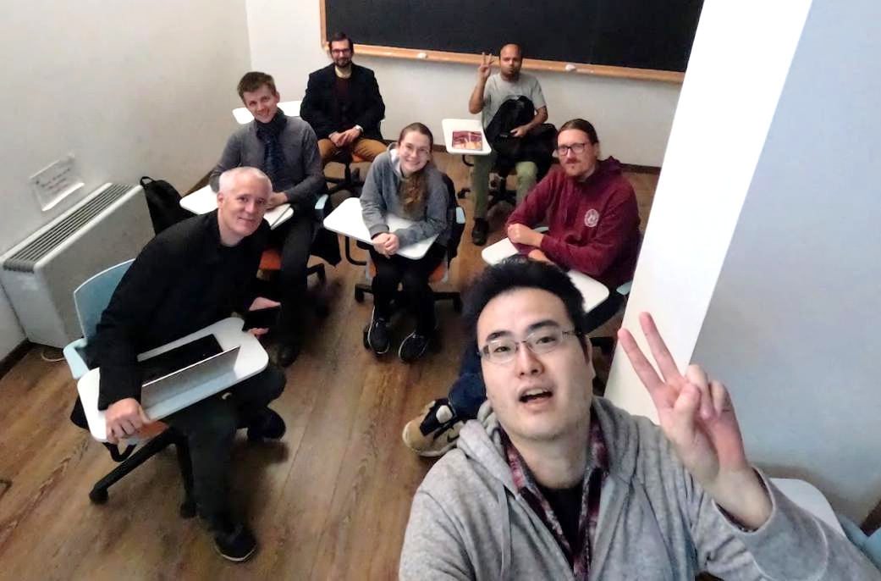

SPB/SCB Works @ GSSI
2022-11-08
@GSSI
Seminar of KAGRA
Discussion of the NN

Slide 10
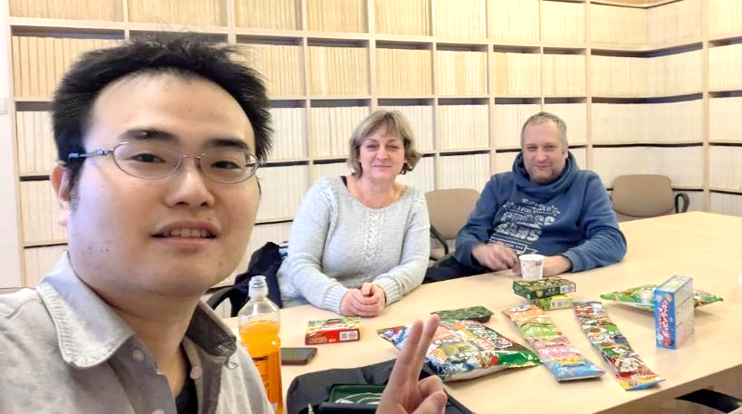
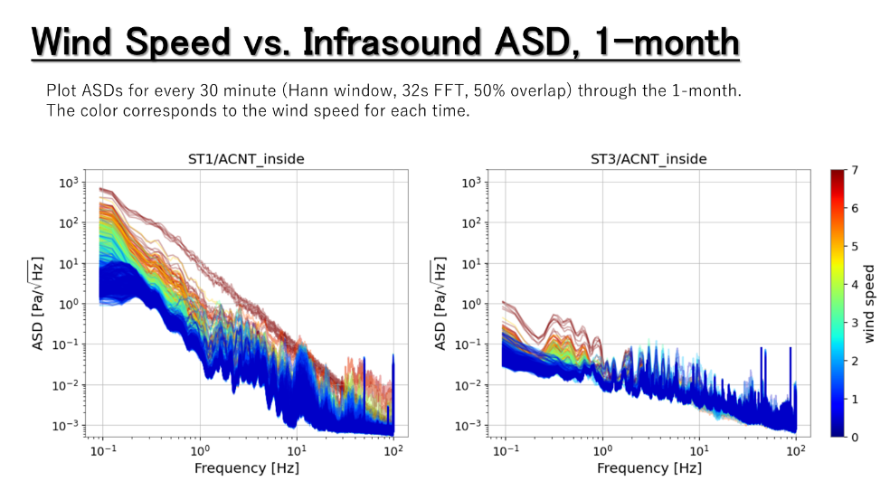
SPB/SCB Works @ Poland
Measurements
@ Sos Enattos
Discussion
@ U.Warsaw
Analysis of infrasound data of Sos Enattos, operated by the Poland group
D. Rosińska
M. Suchenek
T. Washimi
TW’s analysis

Slide 11
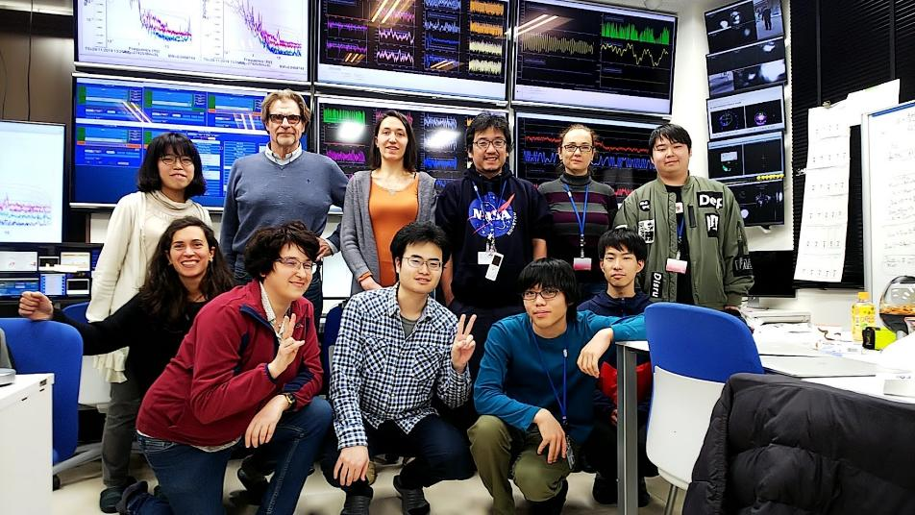
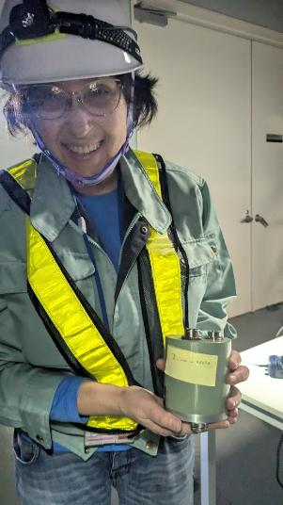
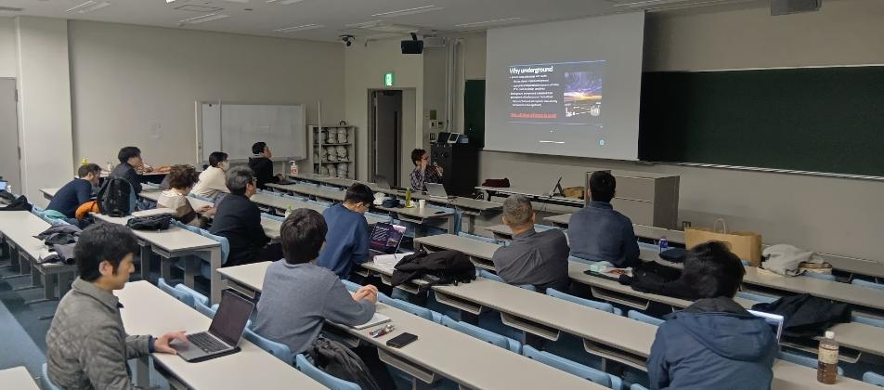
ET SPB/SCB and Virgo Members Works @ KAGRA

Slide 12
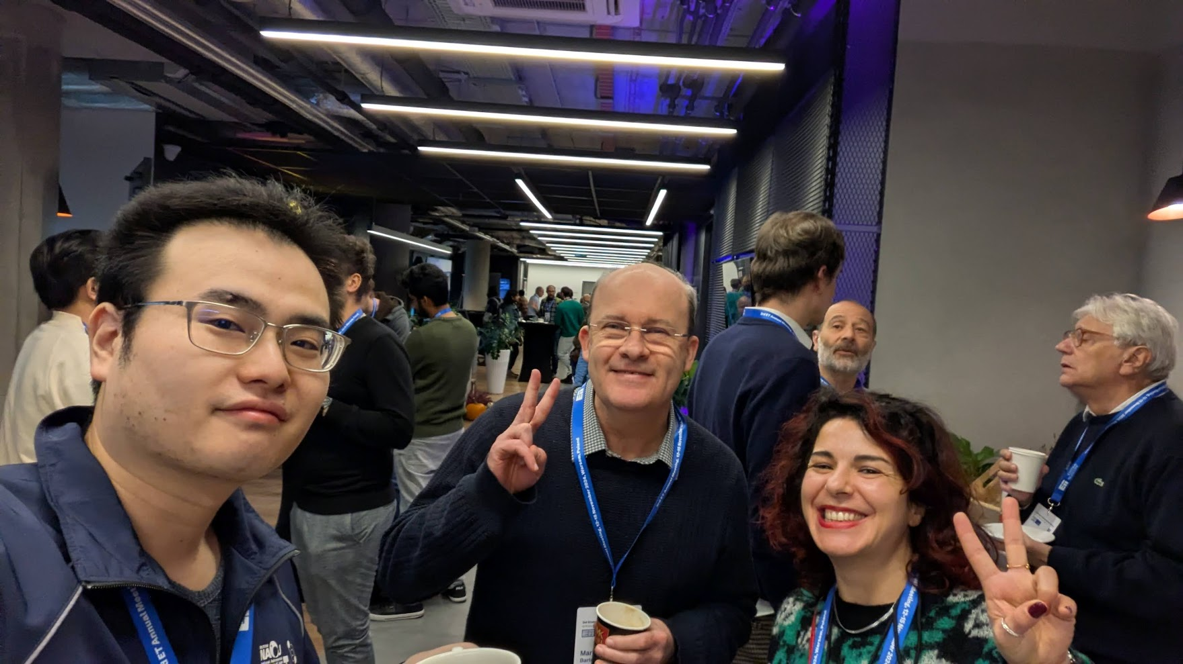
2024-11-12, the 3rd ET annual meeting @ Warsaw
Tatsuki Washimi (NAOJ)
Mark Andrew Barton (U.Glasgow)
NAOJ in 2014-2019
Lucia Trozzo (INFN-NA)
ICRR in 2018-2020

