Slide 1

The ETIC project: the Italian candidacy
Monique Bossi
25/06/2025
http://www.einstein-telescope.it
Einstein Telescope Infrastructure Consortium (ETIC - IR0000004)
PNRR M4, C2, Investimento 3.1

Slide 2

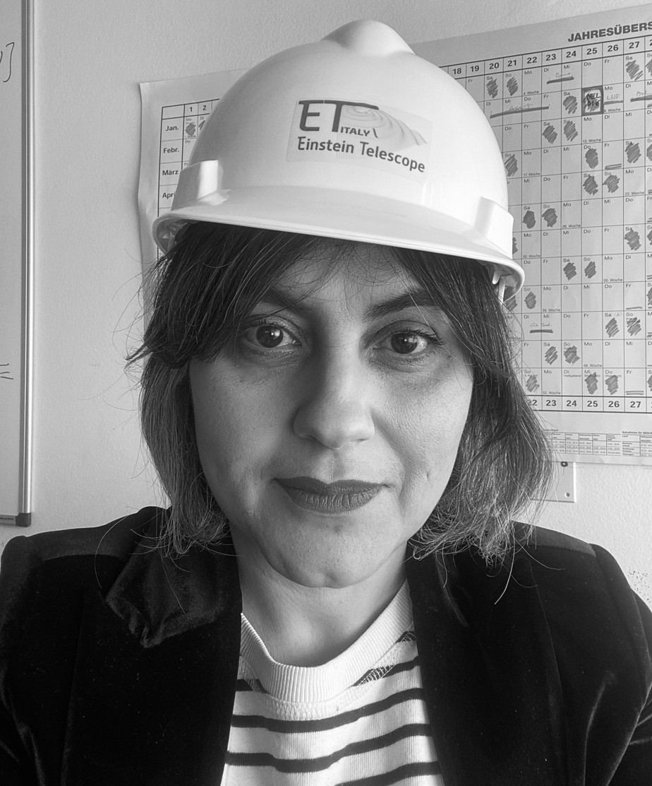

«Managing the Lifecycle of a Research Infrastructure» RItrainPlus CPD courses pilot 2nd Edition
Monique Bossi – ET casestudy – 09-10-2024
Who I am – Monique Bossi
National Institute for Nuclear Physics
Expertise – Research Infrastructure policy and management*
Main relevant roles
2023-on: ETIC Infrastructure manager and «Comitato di Gestione di Einstein Telescope»
2021-2023: Technical Secretariat of the Research Minister(s) cabinet
2018 – 2021 «EU Research Infrastructure for Heritage Science» interim – BGR
2010 -2020 Programme Committee for Research Infrastructures (H2020 and FP7)
*Executive MBA in Management of Research Infrastructure
Einstein Telescope Infrastructure Consortium (ETIC - IR0000004)
PNRR M4, C2, Investimento 3.1

Slide 3
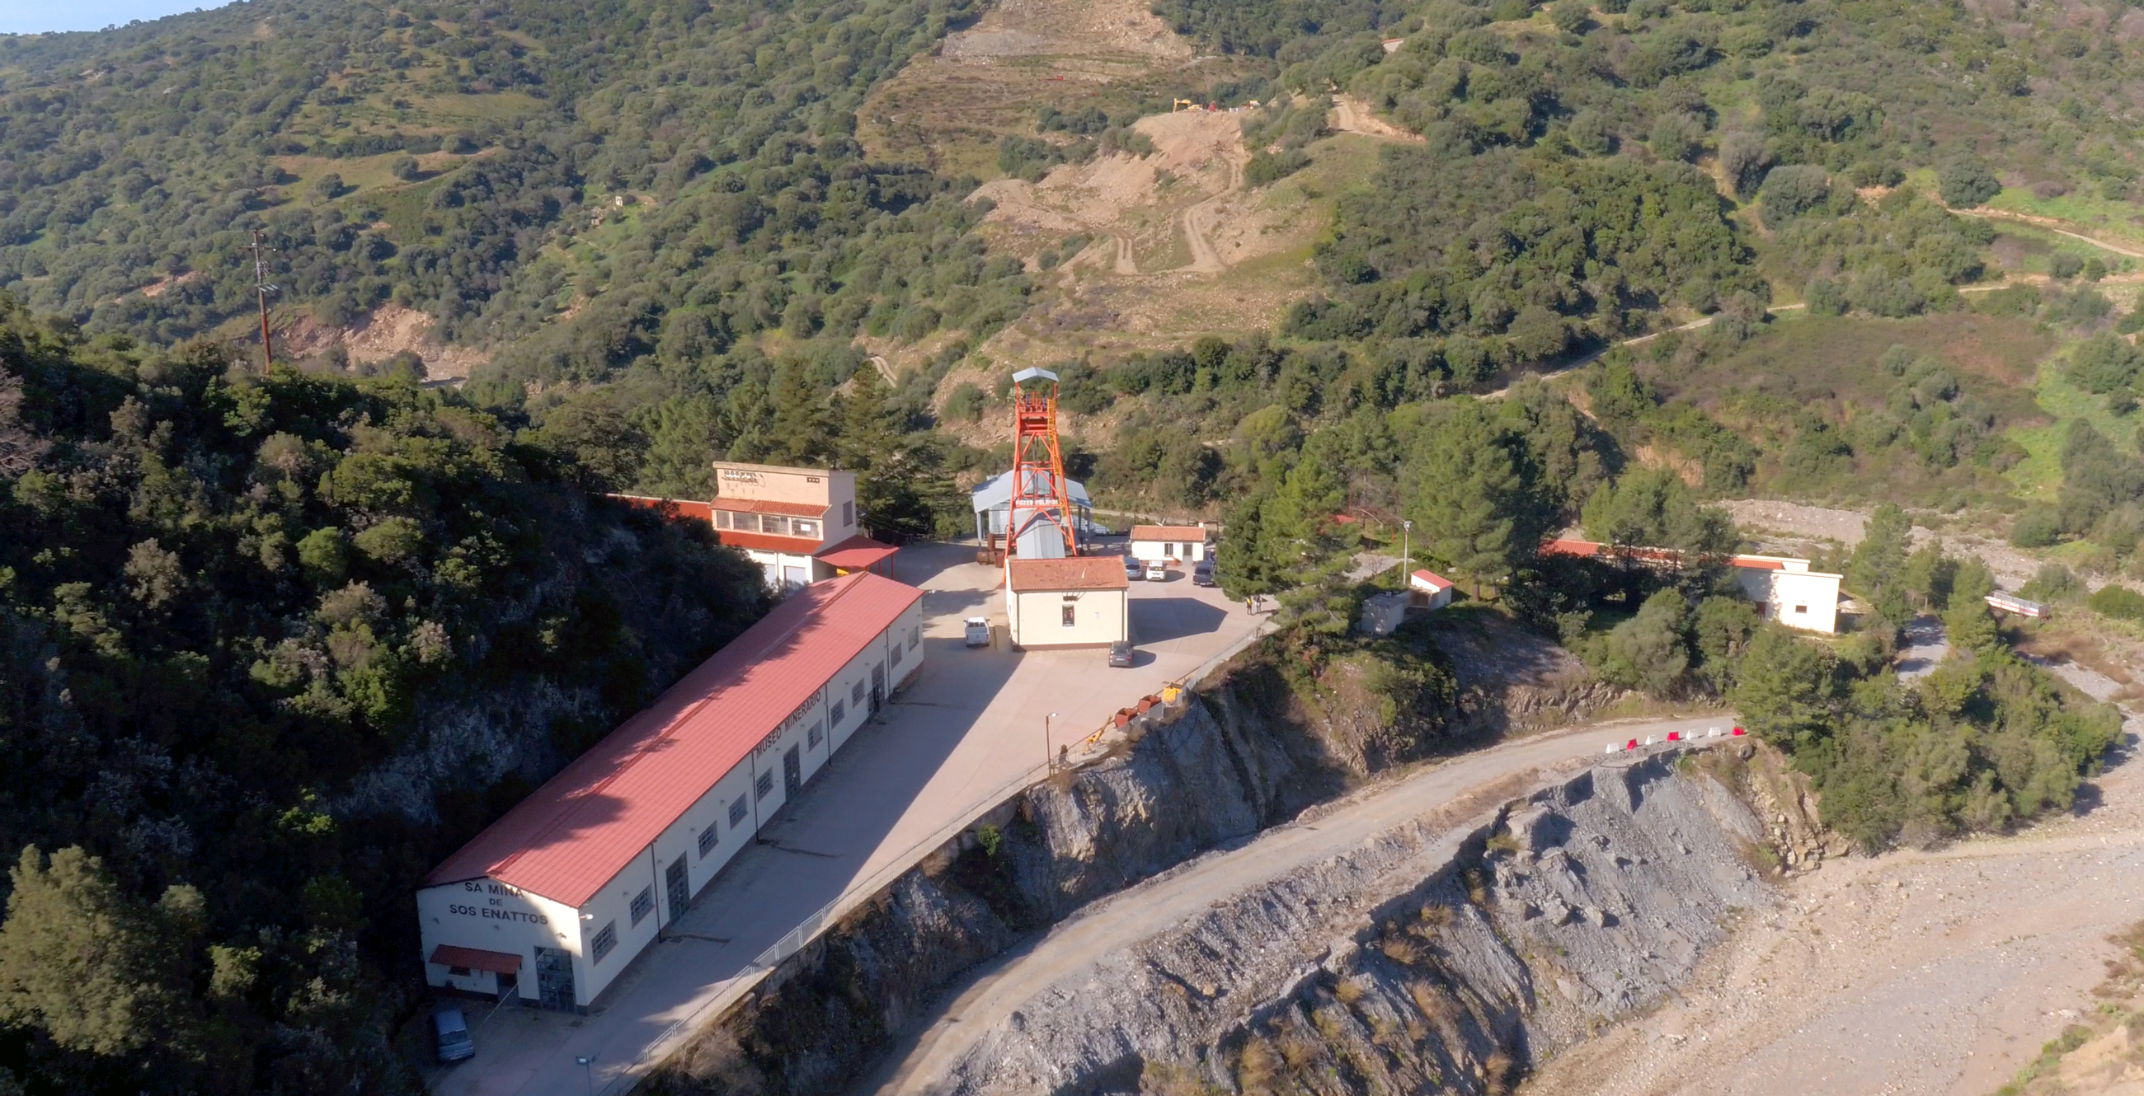
«Managing the Lifecycle of a Research Infrastructure» RItrainPlus CPD courses pilot 2nd Edition
Monique Bossi – ET casestydy – 09-10-2024
Outline
The Italian candidacy to host ET
Team for ET in Italy
National projects
Regional Commitment
Regional projects
The Sos Enattos mine area
© EGO/INFN
Einstein Telescope Infrastructure Consortium (ETIC - IR0000004)
PNRR M4, C2, Investimento 3.1

Slide 4
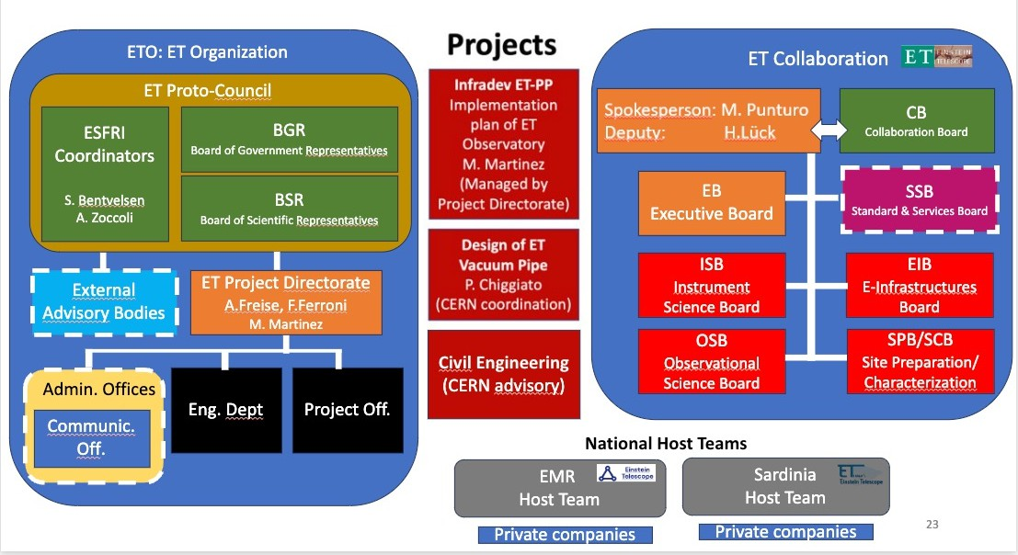


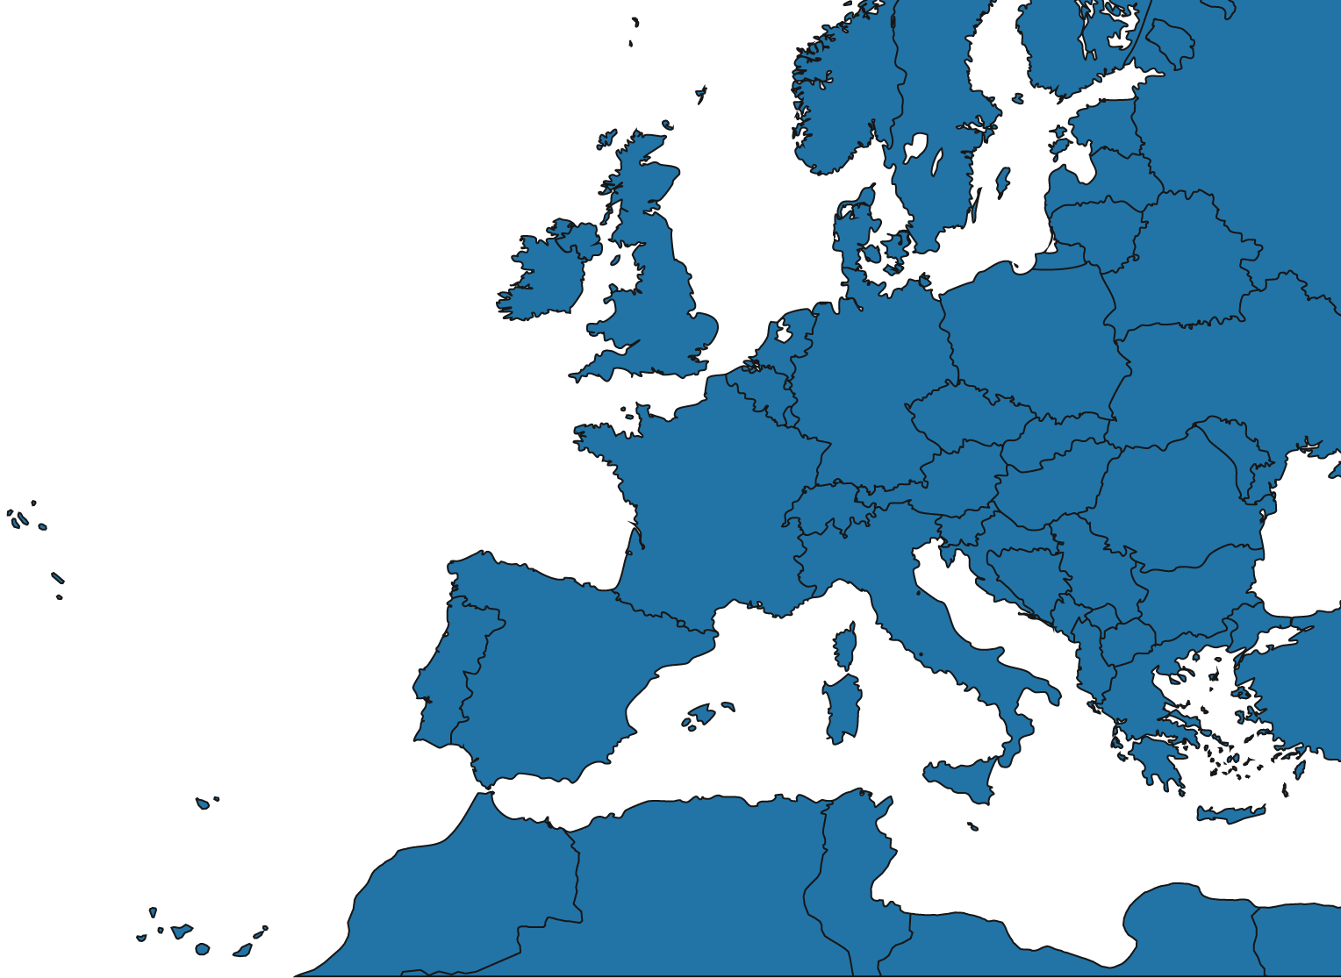

The ET national host teams
Lusatia (Saxony, D)
Euroregio Mose-Rhine (NL, B, D)
Sos Enattos (Sardinia, I)
Einstein Telescope Infrastructure Consortium (ETIC - IR0000004)
PNRR M4, C2, Investimento 3.1

Slide 5
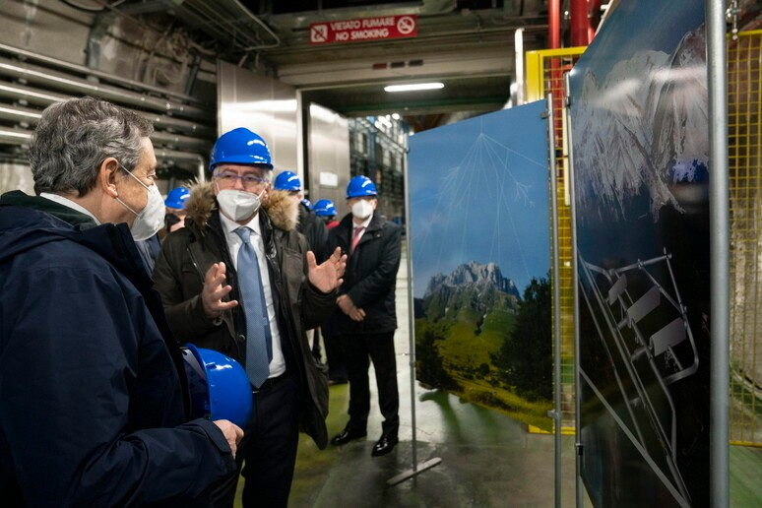
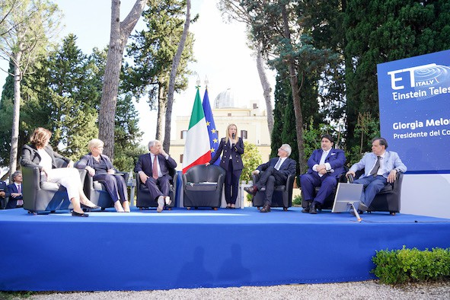
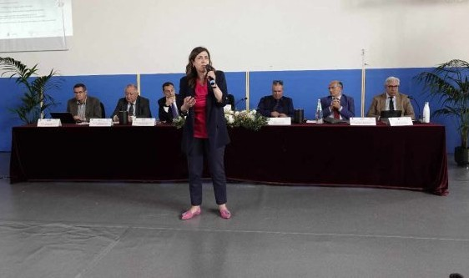
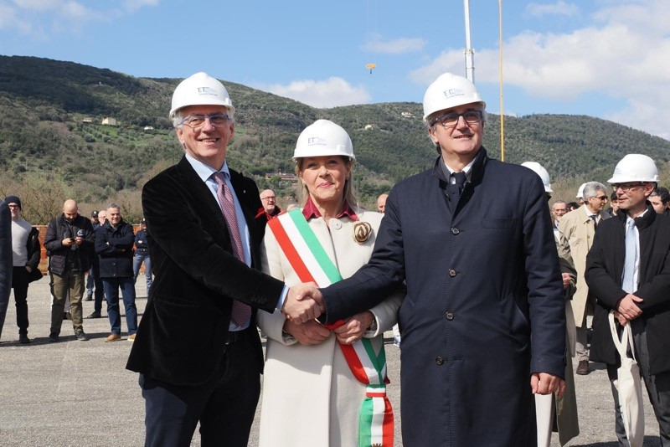
The Italian candidacy to host ET
Long standing political commitment and financial support
National funded projects: 70M€∼
National funds: approximately 950M€ for 10 years planned for construction (if in Italy)
Regional funds: 350M€ (if in Italy) + 30M€∼
RPOs/Universities investments: 15M€∼
Pime Minister Draghi
© 2022 ANSA
Prime Minister Meloni, Minister Bernini and President Solinas
© 2023 INFN
President Todde
© 2024 cagliaripad
Municipality of Perugia
© 2024 INFN
Einstein Telescope Infrastructure Consortium (ETIC - IR0000004)
PNRR M4, C2, Investimento 3.1

Slide 6
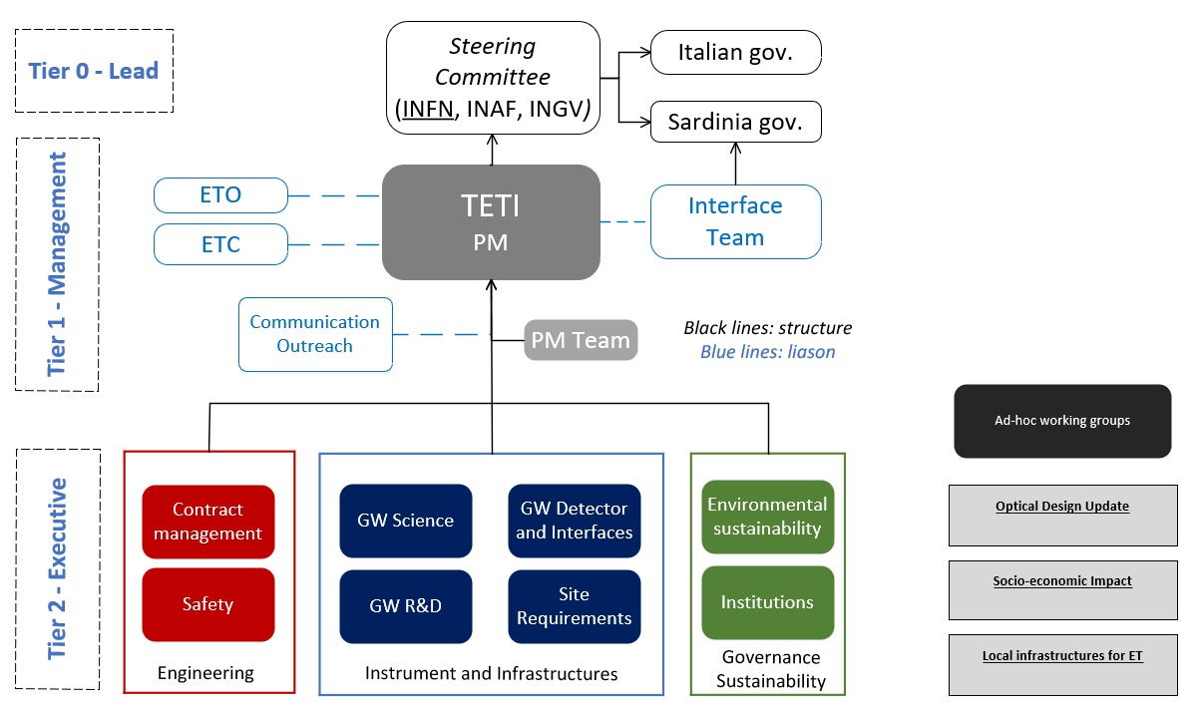

TETI: Team for ET in Italy
Operational structure with the scope of supporting Italy's candidacy to host the Einstein Telescope detector in Sardinia
Mandate
Ensuring the success of all the activities necessary to support the Italian application, giving a technical, managerial and financial reference to the project
TETI reports to a supervisory structure the Institutes and Universities involved in ET-Italia
TETI will maintain close and fruitful contact with the coordinators of ETO and ETC
Close coordination with the control room set up by the Sardinia Region
Credits to G. Bisoffi
Einstein Telescope Infrastructure Consortium (ETIC - IR0000004)
PNRR M4, C2, Investimento 3.1

Slide 7
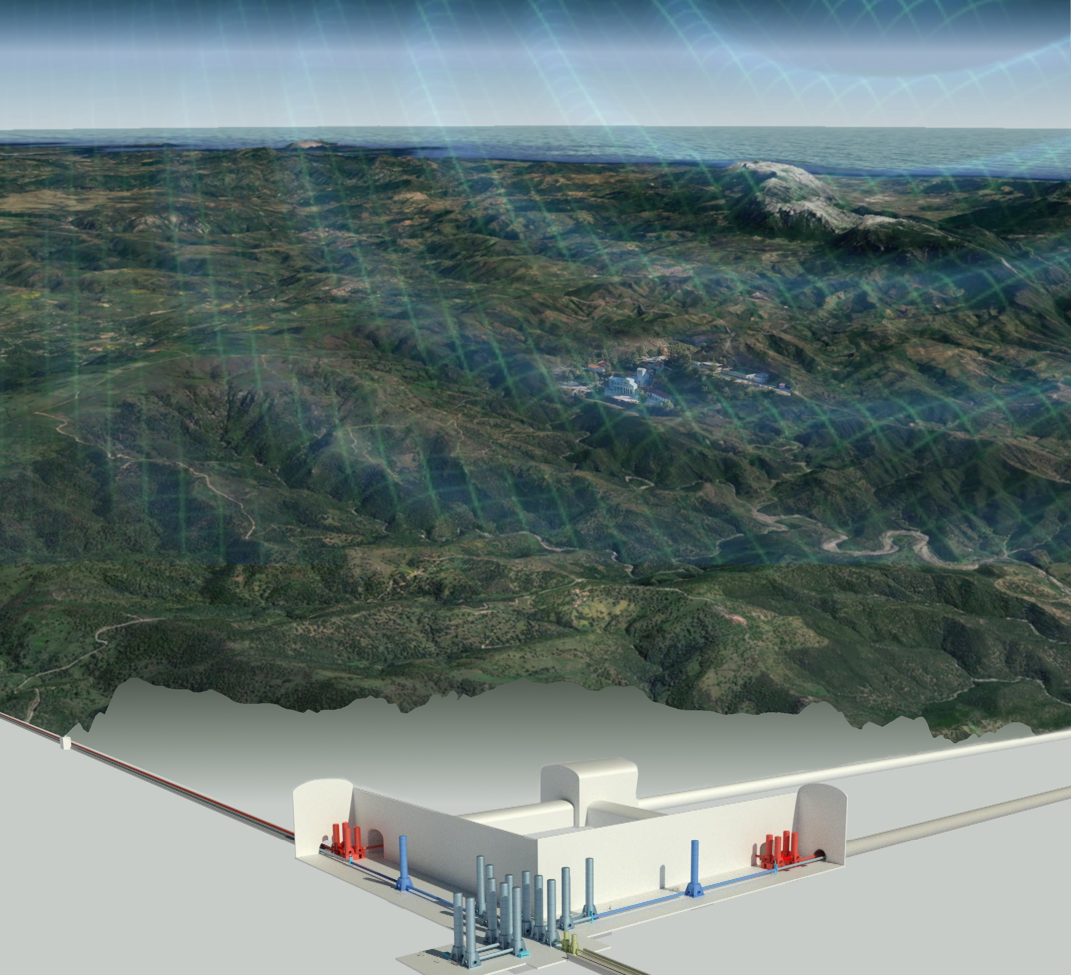

National projects:
The technical and economic pre-feasibility
The study will investigate multiple and different aspects:
the geology of the selected area,
the optimal location and depth of the observatory vertices
excavation and construction techniques,
material management,
environmental impact,
costs.
The contract, worth over 12M€, has been awarded to a consortium of Italian companies operating internationally, led by Rocksoil spa.
Funded through the ETIC project (Einstein Telescope Infrastructure Consostium) the feasibility study, expected to be delivered by 2025
©INFN/Laboratori Nazionali del Sud
Einstein Telescope Infrastructure Consortium (ETIC - IR0000004)
PNRR M4, C2, Investimento 3.1

Slide 8
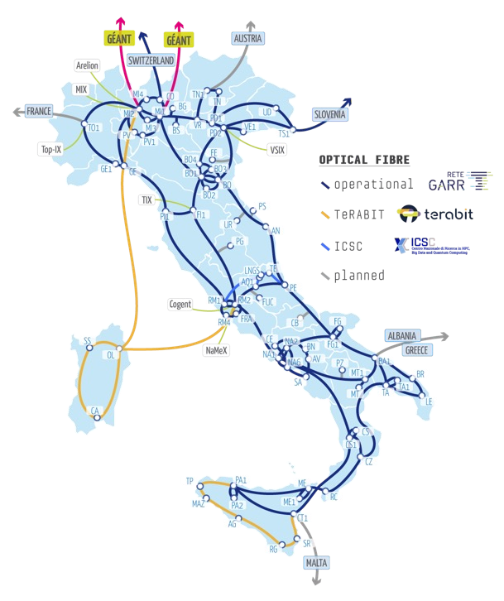

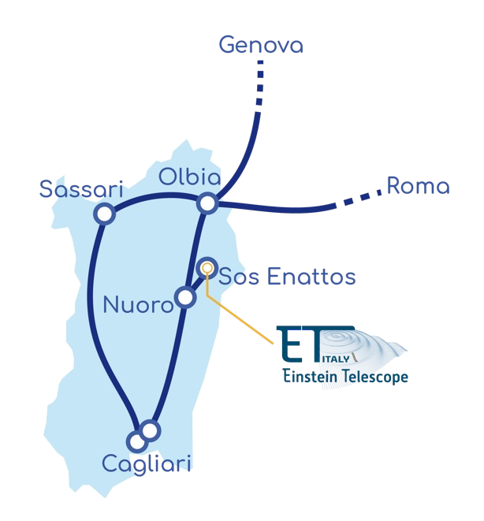

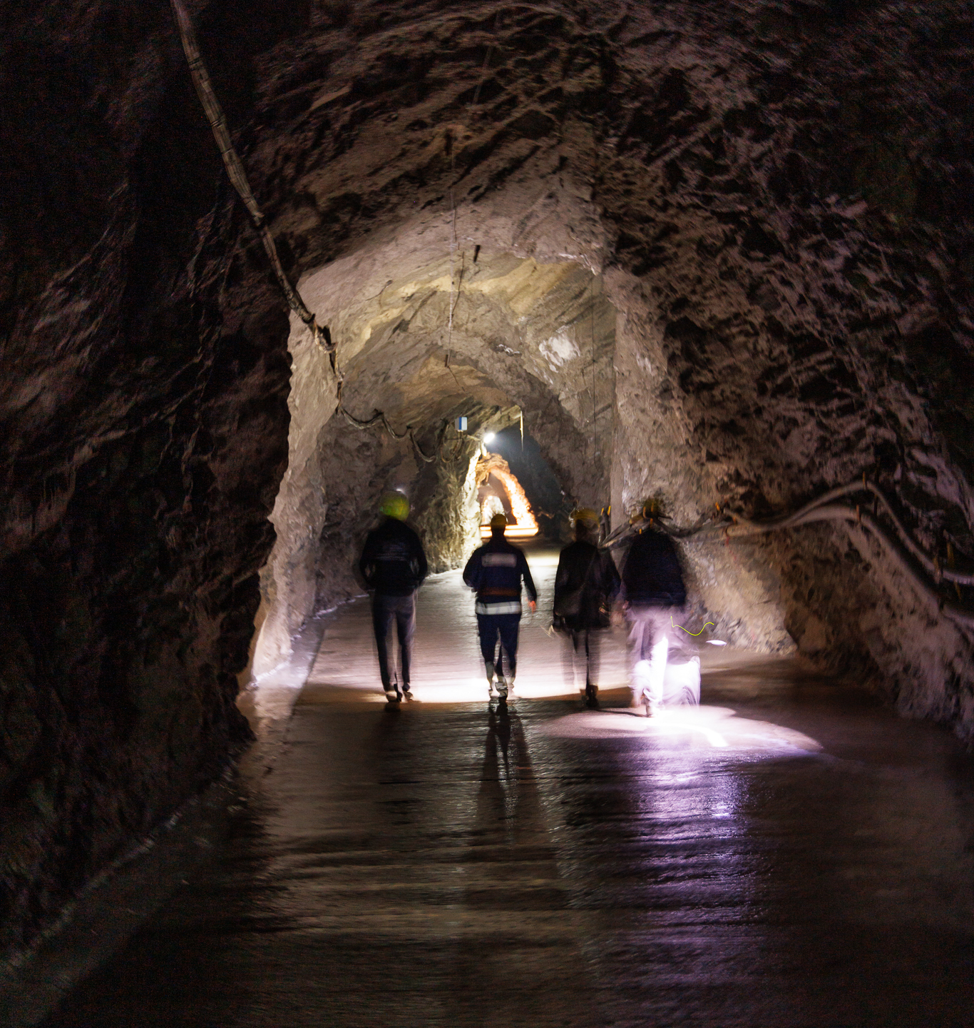


n 4
National projects:
scientists and technologies
project »ETIC» 50M€ for the upgrade/construction of R&D Research Infrastructures and laboratories and the pre-feaseability study
project : 13 M€ to create a digital research infrastructure that integrates a high-performance network with HPC resources including research infrastructures and laboratories in Sardinia*
project: 2,7M€ to build the Sardinia Faber infrastructure, a new
underground geophysical observatory at the Sos Enattos mine
*Plus 1M€ from Sardinia Region to connect Sos Enattos to the main network
©INFN, Marco Sallese
Einstein Telescope Infrastructure Consortium (ETIC - IR0000004)
PNRR M4, C2, Investimento 3.1

Slide 9
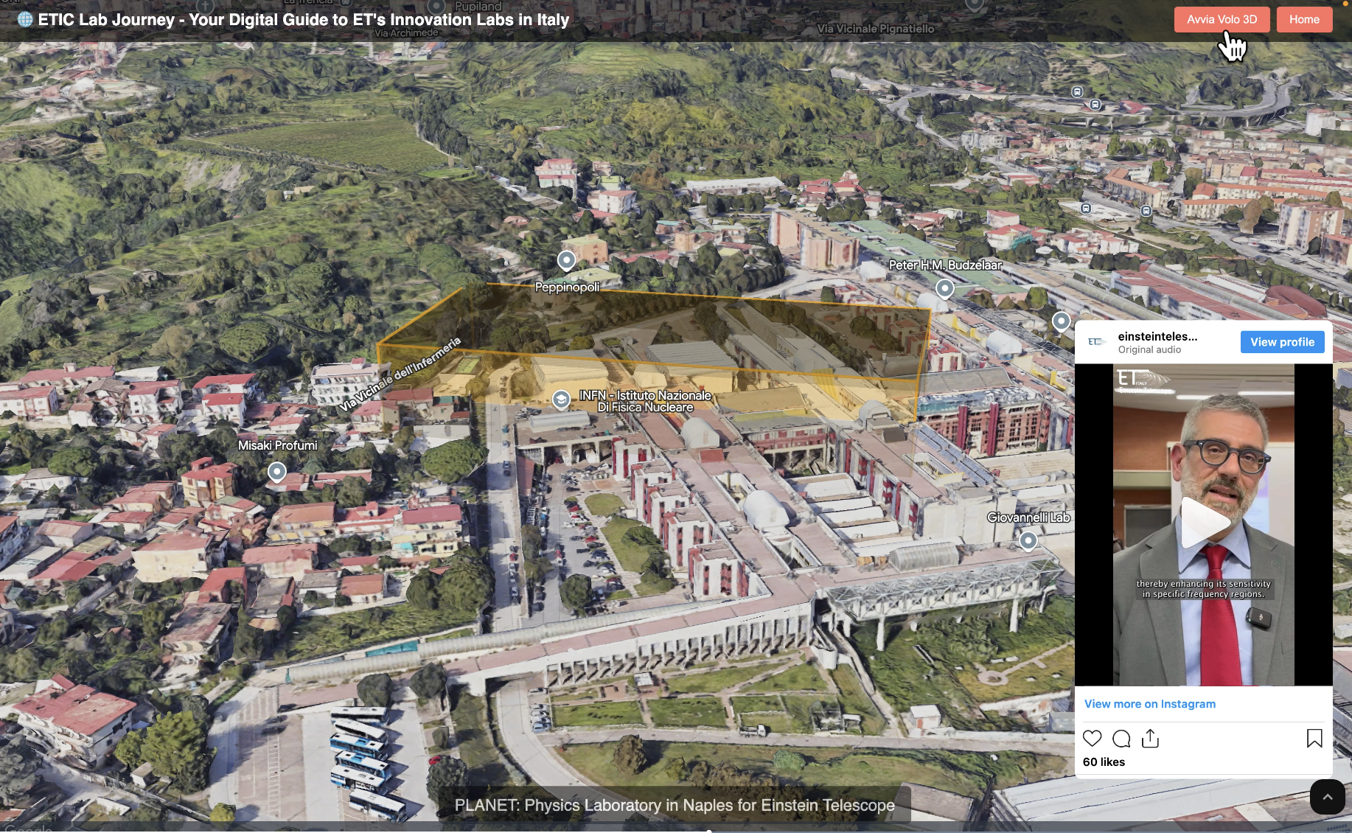
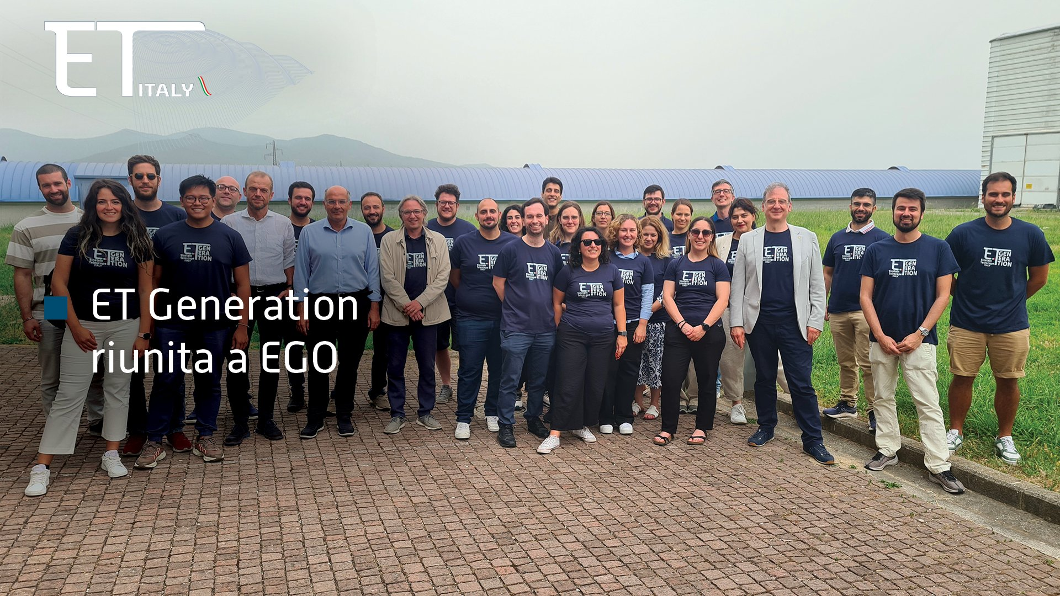
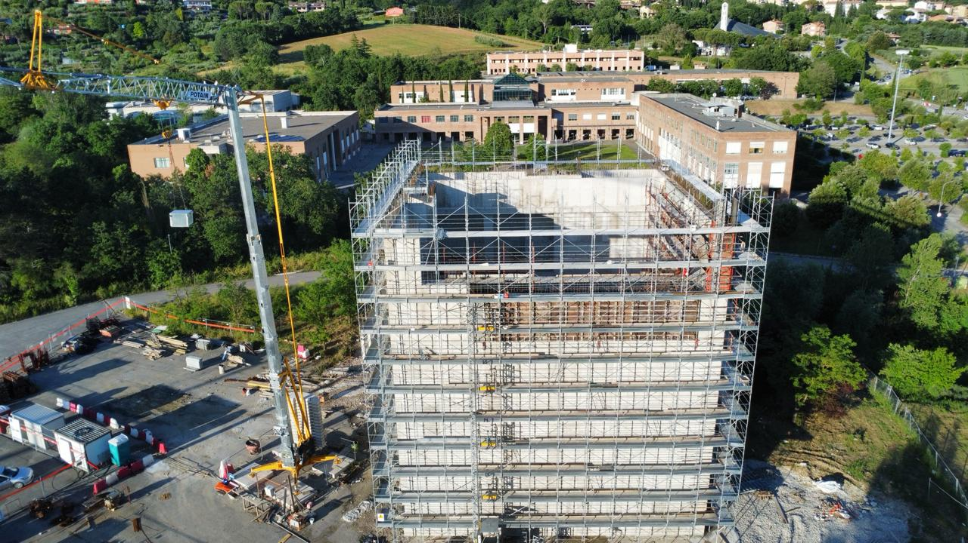
The ETIC Laboratories
The ETIC people
Optics, Electronics and Photonics
CoMET (Padua)
GALILEO (Genoa)
PLANET (Naples)
AiLoV-ET (Rome)
ETICO2 (Cagliari)
ADONI (Florence)
DIFAET (Bologna)
PisaET-IR@CISUP (Pisa)
Vacuum and Cryogenics
ARC-CRYO-ET (Rome)
CALATIA (Caserta)
Suspensions and Interferometric large facilities
CAOS (Perugia)
GEMINI (Gran Sasso labs.)
PLANET (naples)
SAMANET (Pisa)
Computing & Data Acquisition
BETIF (Bologna)
CTLAb (INFN-TO)
Suspensions and Interferometric large facilities
ET_3G LAB (Rome and Sos Enattos)
AT_LAB (Cagliari)
Staff
Recruited: 47 (Scientists, engineers, Managers)
Investment: 5,31M€
PhDs
Recruited: 10 Students
Investment: 0,53M€
Credits: Giuseppe Greco
https://pandora.infn.it/public/b29743
Credits: Helios Vocca
©INFN
Investment: 30M€ env.
Einstein Telescope Infrastructure Consortium (ETIC - IR0000004)
PNRR M4, C2, Investimento 3.1

Slide 10

The regional commitment
Mission | Amount (M€) | Year
SAR GRAV 1 - ET Sun Lab) | 3,5 | 2017 - 2023
Communication and outreach | 0,5 | 2023
Rehabilitation of rural roads | 2,9 | 2023
Urban planning (local area) | 0,2 | 2024
Roadway and dam engineering for SUnLab | 20 | 2025
Sologo industrial area | 8 | 2025
Micro urban hubs and awareness raising | 2 | 2025
ET Construction (if in Sardinia) | 350 | -
*A prerequisite for the Steering Committee is the Program Agreement with local authorities, signed on March 20, 2025 (including capital municipalities, Project Area municipalities, Unions of Municipalities, and Mountain Communities of the Nuoro area and/or adjacent to the project)."
Credits: R. Marras
Einstein Telescope Infrastructure Consortium (ETIC - IR0000004)
PNRR M4, C2, Investimento 3.1

Slide 11

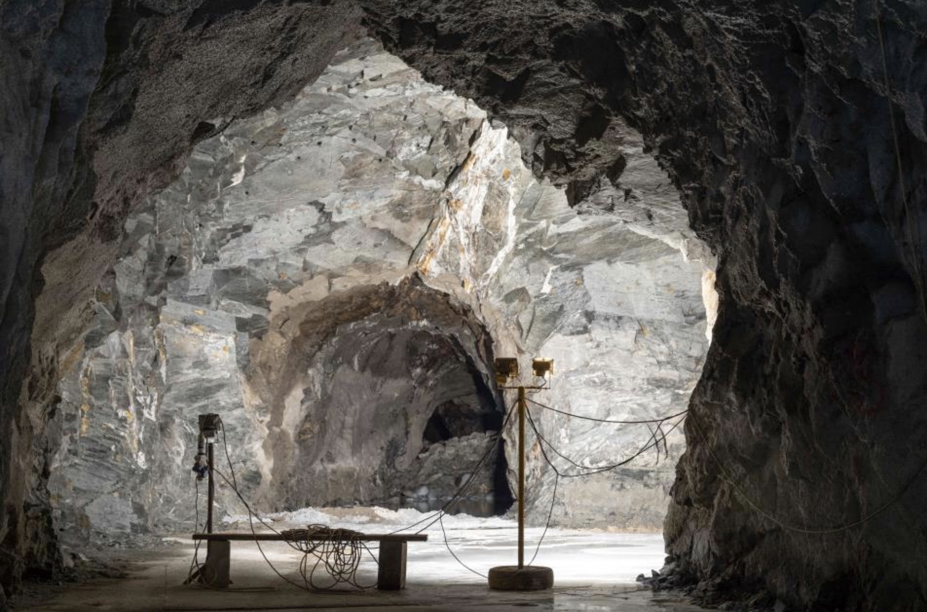
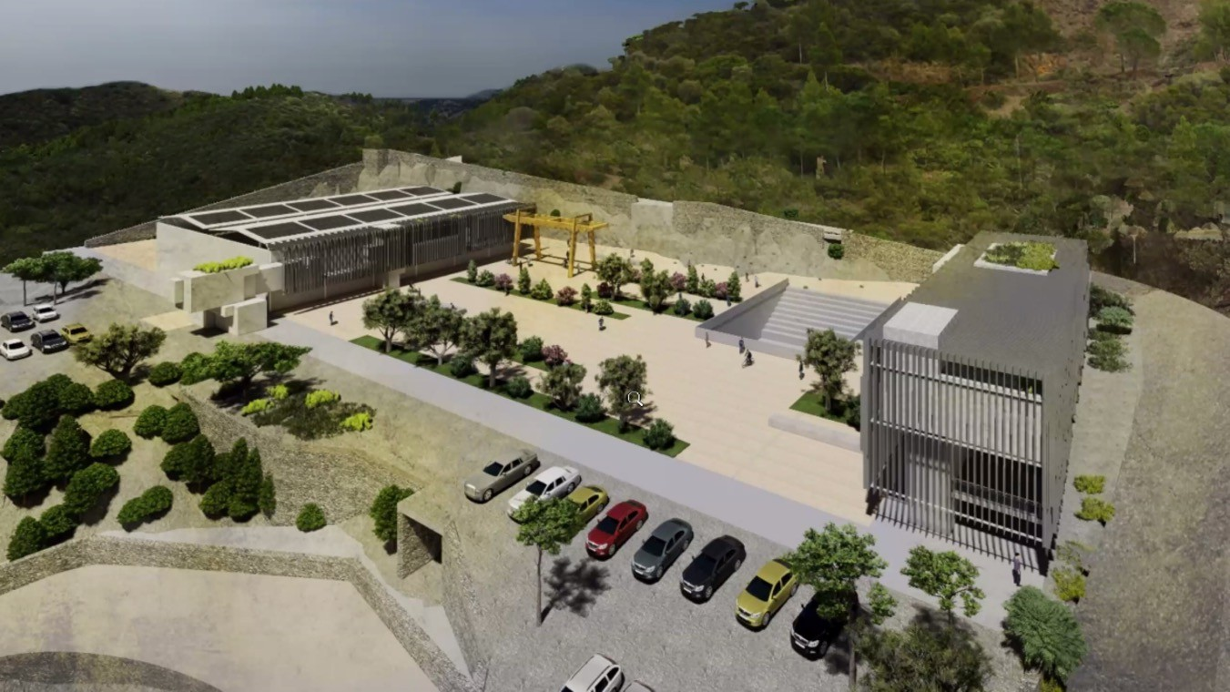





Regional projects:
From SARGRAV to ET SUnLab
The Sardinia Underground Laboratory (SUnLab is the upgrade of the SarGrav Lab.
It’s a joint co-funded laboratory hosting seismic experiments, test of ET technology solutions and incubator
The Earth Observatory and the optical telescope for astrophysics. Training and outreach facilities including the ET visitor centre
Total funds 20 M€: 10M€ from the Sardinia and 10M€ from RPOs
In 2017 SARGRAV recieved 3,5 M€ from Reg. Sardinia for the charaterization of the Sos Enattos area as candiate site.
In 2018 the Min. for Research and University MUR together with Reg. Sardinia and the RPOs signed an MoU to provide 17 M€ for testing RTD developments.
Credits: INAF mediai
Credits: Massimo Faiferri
Einstein Telescope Infrastructure Consortium (ETIC - IR0000004)
PNRR M4, C2, Investimento 3.1

Slide 12
Conclusions
Bringing the Einstein Telescope to Sardinia: A Vision for Science and the Future
Italy is working to bring one of the world’s most advanced scientific projects to Sardinia.
The proposed site, Sos Enattos, is the ideal site to host ET. Investments are in place to put it at the center of this major international scientific effort.
Benefits go beyond science. Hosting the Einstein Telescope would bring new jobs, investment, and opportunities to local communities, helping to grow the economy and inspire future generations.
This is more than a research project—it's a chance to make Sardinia a key part of Europe’s scientific future.
https://www.g7italy.it/it/riunione-ministeriale-su-scienza-e-tecnologia/
ありがとう ございます
Einstein Telescope Infrastructure Consortium (ETIC - IR0000004)
PNRR M4, C2, Investimento 3.1

