Slide 1


The ICARUS experiment at Fermilab
Alberto Guglielmi
INFN Padova
H2020, M. Sklodowska-Curie
R&I No. 822185, 858199, 101003460, 101081478
June 4th 2025

Slide 2
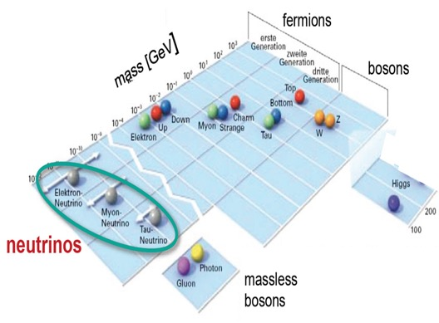
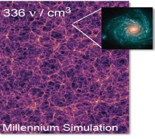
The high energy frontier
The discovery of Higgs bosons has completed the Standard Model (SM) of elementary particles that describes the fundamental matter components and their interactions
  3 different neutrinos; ν_{e} ν_{μ} ν_{τ} , m_{ν} < eV oscillating ν_{α} -> ν_{β}
νs: the most abundant massive particles in the Universe, 336 ν/cm³
neutrino masses and flavor oscillations represent today a main experimental evidence of physics beyond SM. Being some of their fundamental properties still unknown, νs are naturally one of main portals towards beyond-SM physics.
The incredible smallness of ν masses compared to other elementary fermions points to some specific scenario awaiting to be elucidated.

Slide 3

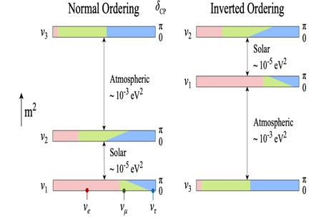
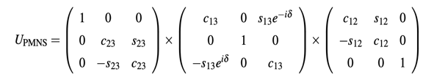
Neutrino oscillations
2 neutrino ν_{α} -> ν_{β} over a distance L: lepton flavor violation process described by the mass states ν₁, ν₂ mixing probability as a function of |Δm²|= m₁² - m₂² mass difference and sin² 2θ coupling amplitude
λ = 4 Ε_{ν}/ Δm² : ν oscillation length, E_{ν} ν−energy
2 different small mass-difference regimes of oscillations have been discovered with:
- solar ν osc Δm²₂₁ ~ 8 x10⁻⁵ eV² and
- atmospheric ν osc Δm²₃₁~2.5 x10⁻³ eV²
+ sub-leading νμ -> νe
  -> 3ν oscillation coherent picture: lepton-mixing matrix of Pontecorvo-Maki-Nagatawa-Sakata, 3 mixing angles + 1 CP-violating phase
C_{ij}: cos θ_{ij} S_{ij}: sin θ_{ij}
sin² 2θ₁₂~ 0.3, sin² 2θ₂₃~ 0.5, sin² 2θ₁₃~ 0.1 determined in 20 years experiments !
but ν mass hierarchy ? δ_{CP} matter-antimatter asymmetry ?

Slide 4
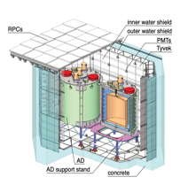
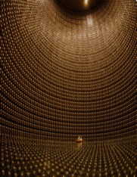
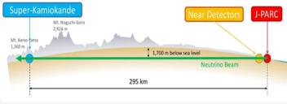
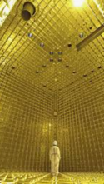
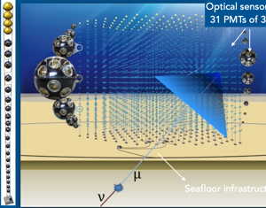
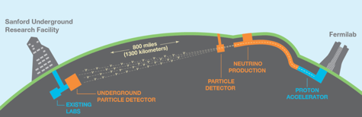

Present neutrino saga…
Still open questions: mass hierarchy, δ_{CP}, ν mass and Dirac/Majorana ν ?
  Several ongoing experiments/projects addressing neutrinos with nuclear reactors, radioactive sources, neutrino beams from proton accelerators and cosmic νs with large ice/water Cherenkov counter telescopes
SK: Atmospheric/solar νμ −> ν_{τ} , ν_{e}
Reactors:
Reno, Daya Bay ,…Juno
…subleading νμ −> ν_{e}
T2K--> Hyper-K + NuMI, NovA LBL
KM3NeT-ARCA cosmic νs
DUNE Liquid Argon program

Slide 5

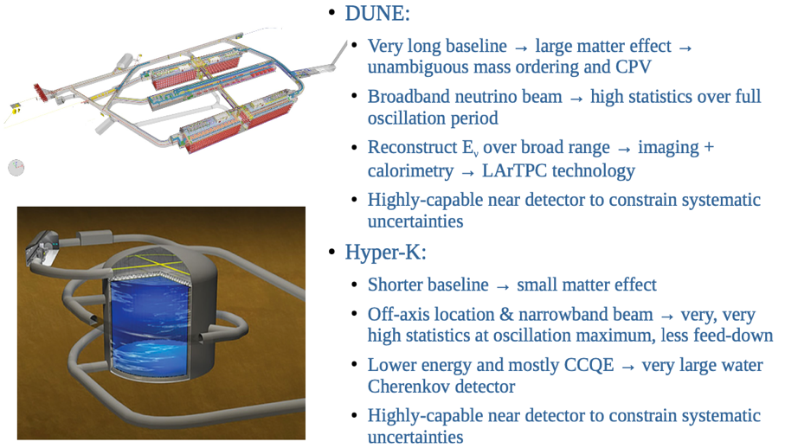
Matter-antimatter asymmetry?
Mass hierarchy, δ_{CP} will be solved by DUNE, HK comparing νμ−>νe oscillation in νμ and anti-νμ beams:
4x 17 kt LAr-TPC, 1.2 -> 2 MW proton beam
260 kt water-Ch, 1.2 MW proton beam

Slide 6
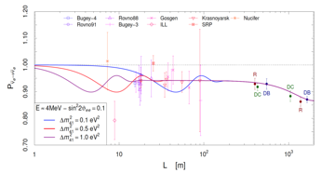
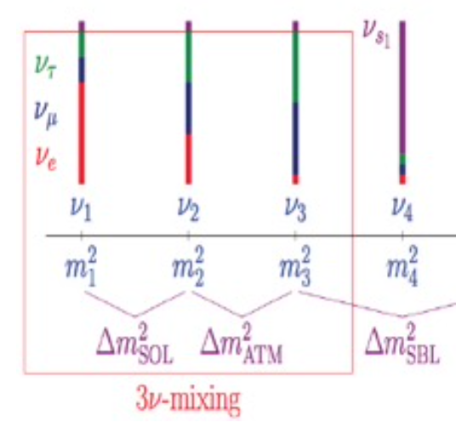
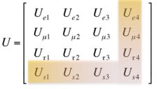
Persisting anomalies in the neutrino sector
    Despite the well-established 3-flavour ν mixing, several anomalies collected so far hinting to additional ν states driving oscillations at small distance with Δm²_{new}~1 eV², small sin²2θ_{new} :
    anti−νe appearance: in anti-νμ accelerator LSND experiment where anti-νe -> e⁺ + n with neutron resulting n + p into d + γ.
    νe disappearance: SAGE, GALLEX experiments with Mega-Curie K-capture calibration sources showing an observed/predicted R = 0.84±0.05, recently confirmed at 4σ by BEST exp.
    anti-νe disappearance of near-by nuclear reactor experiments RAA, R = 0.934±0.024, but poor knowledge of U fuel processes consumption
observed/predicted rate
…pointing to sterile ν hypothesized by Bruno Pontecorvo in a 1957 seminal paper…
Bruno Pontecorvo

Slide 7
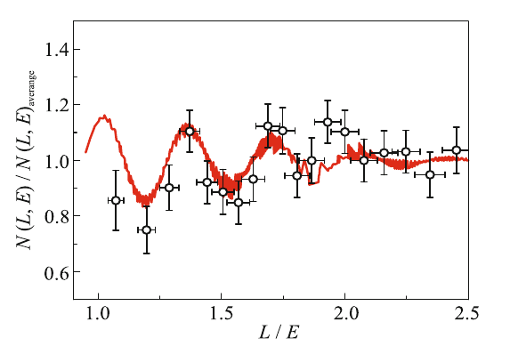
New evidence for oscillations of sterile neutrinos at reactor ?
In 2019 Neutrino-4 experiment (A.P. Serebrov et al.) at Dimitrovgrad SM-3 reactor gave evidence of neutrino oscillation into sterile-νs showing a disappearance signal with a clear L/E ~ 1-3 m/MeV modulation
Neutrino-4
Jetp Lett. 116, 669–682 (2022)
3 years data taking moving the segmented liquid scintillator detector from 6.4 to 11.9 m from reactor core in 24 steps:
Neutrino signal compared with expectation for Δm²~ 7.25 eV², sin²2θ ~ 0.26 as a function of L/E
Reactor On - Off : 223 events/day with Signal/Background ~ 0.54
Δm₁₄² = 7.25± 1.09 eV² with sin² (2θ₁₄) = 0.26 ± 0.08 stat ± 0.05
sterile ν as candidate for Dark Matter ? a quite obvious contribution due to the high density of relic sterile-νs with 𝑚𝜈₄ = 2.7 eV.
Combined analysis: Neutrino-4 (P.R. D 104, 032003, 2021), GALLEX, SAGE and BEST
Δm₁₄² = 7.3 eV² sin² (2θ₁₄) = 0.36 at 5.8 σ C.L. (A.P. Serebrov et al. arXiv:2302.09958)

Slide 8
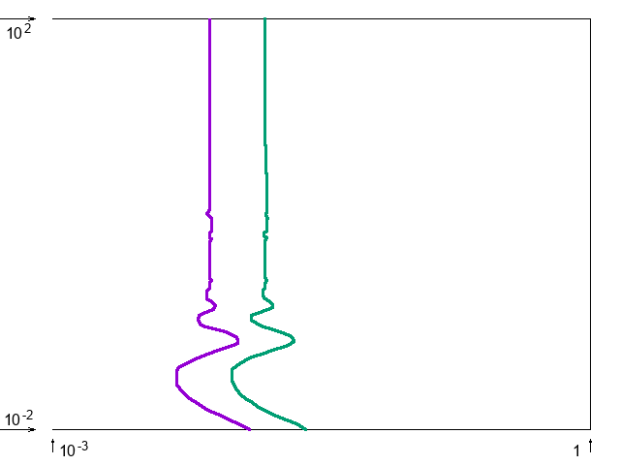
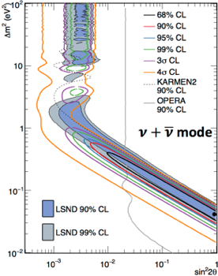
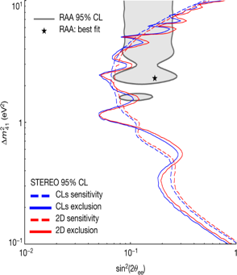
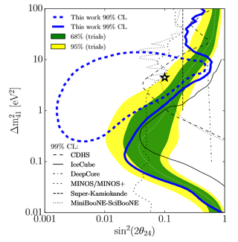
  Several experiments at accelerators and reactors to study “ν anomalies” both in appearance/disappearance:
    Large part of LSND parameters excluded by ICARUS and OPERA ν_{μ} -> ν_{e} at CNGS ν beam; MiniBooNE ν_{μ} -> ν_{e} at FNAL low energy νe event excess not confirmed by MicroBooNE
    Recent anti-ν_{e} measurement at reactors: study of fuel burnup cycle from Daya Bay, RENO STEREO to reconstruct contribution of main isotopes: hint of sterile 𝜈 reduced to 1 𝜎;
    No evidence in νμ disapp. exps (IceCube, NOνA, MINOS/MINOS+,T2K)
ν_{μ} -> ν_{e}
IceCube
Phys.Rev.Lett. 125 (2020) 14, 141801
OPERA 90% CL
KARMEN2 90% CL
MiniBooNE ν+ν
4σ
3σ
99%
95%
STEREO
Nature 613,
257–261 (2023)
90%
68%
ICARUS 90% CL
99% CL

Slide 9
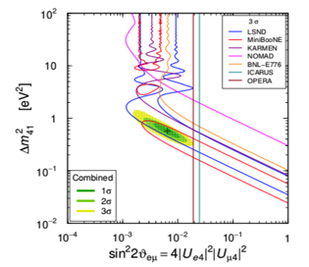
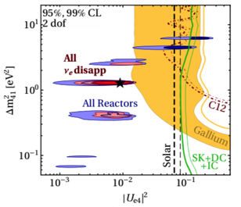
A long-standing puzzle in neutrino oscillation sector
  Clear tension between appearance/disappearance experiments characterized by different neutrino detection techniques and ν energy spectra:
(anti-)ν_{μ} → ν_{e} Appearance
(anti-)ν_{e} Disappearance
(arXiv:2106.05913)
    Measuring both ν app./disapp. in the same experiment with a detector with an optimal neutrino identification/backgr rejection is mandatory
    Far to near detector neutrino spectra comparison: crucial for the control of backgr and beam/detector systematics.

Slide 10
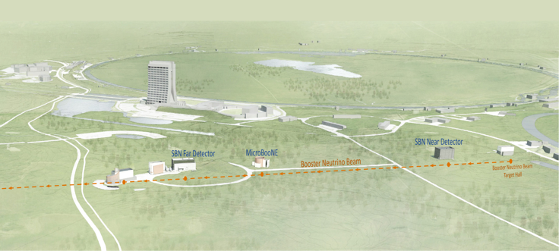


Short Baseline Neutrino (SBN) at FNAL BNB and NuMi beams: a definitive answer to sterile neutrinos ?
ICARUS
600m baseline
470t active volume
data taking
SBND
110 m baseline
112t active volume
Data taking started
BNB
φ(ν)/MeV/m²/10⁶ POT
NuMI ~ 6º off-axis
BNB on axis
  ICARUS and SBND LAr-TPC’s installed at 600 and 110 m from the BNB target, searching for sterile-ν oscillations both in appearance and disappearance channels.
  High-statistics ν-Ar cross-section measurements and event identification/reconstruction studies:
    10⁶ evt/y in SBND <1 GeV from Booster (Eν ~ 0.8 GeV)
    10⁵ evt/y in ICARUS >1 GeV from 6⁰ off-axis NuMI (Eν~2 GeV)
BNB

Slide 11
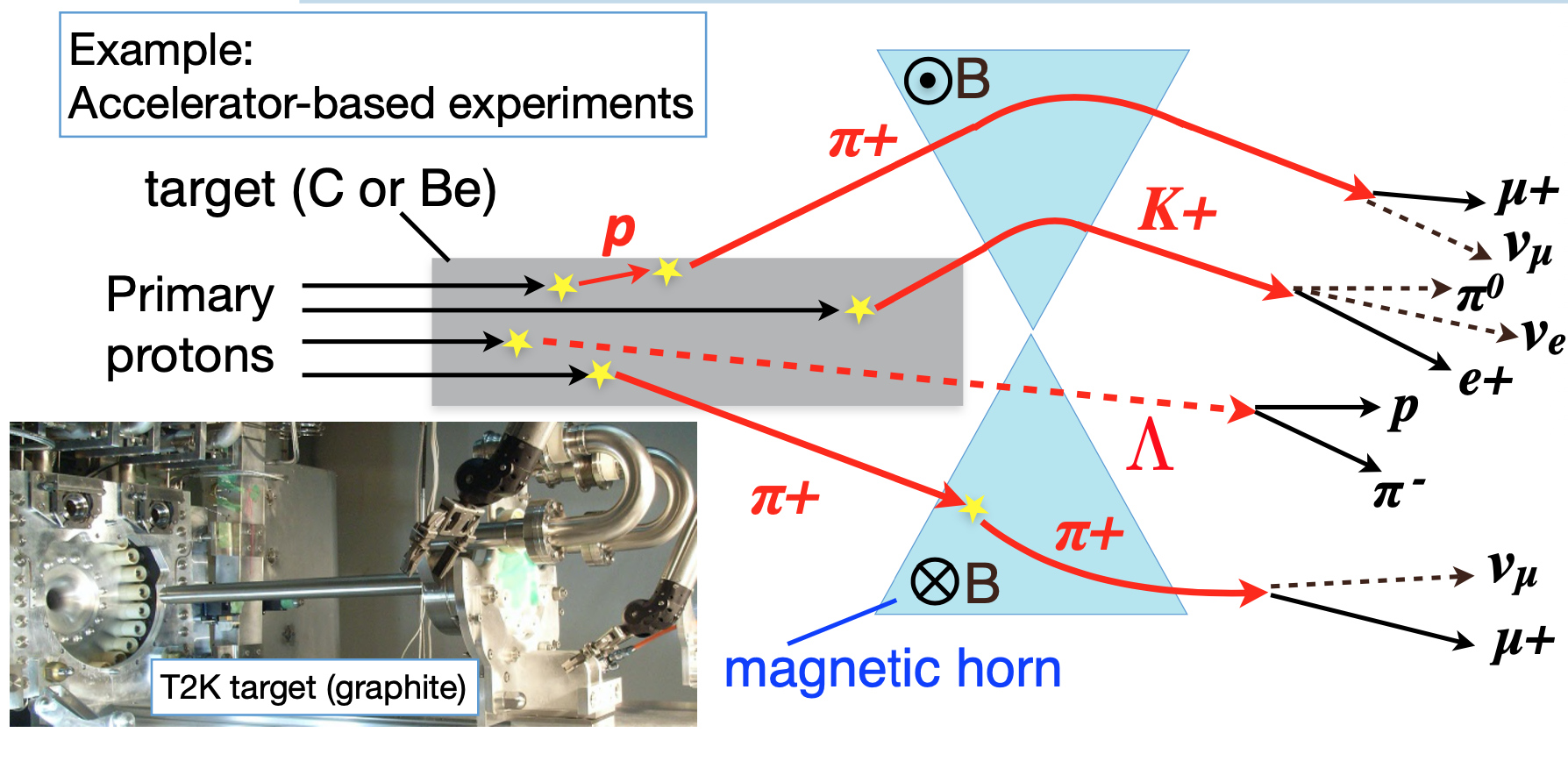
BNB neutrino beam
    8 GeV protons on Be target, ∼5×10¹² p/spill, 1.6 μs spill: 81 x 2 ns bunches 19 ns apart, ~5 Hz.
    Positive (negative) secondary particles are focused (defocused) by a magnetic horn according to I circulation versus.
    50 m decay tunnel where focused mesons propagate/decay producing neutrino.
ν
Be target
83.7%
5.86%
93.6%
15.7%
Anti-neutrino beam: secondary negative particles are focused by reversing the Horn current
0.52+0.05%
0.4+0.2%

Slide 12
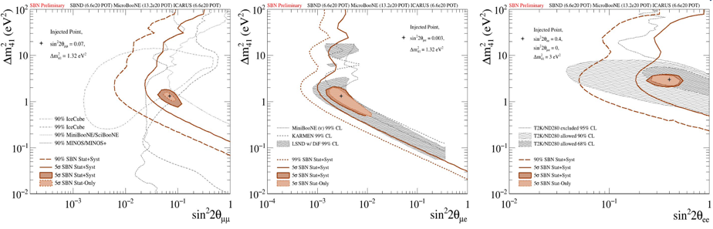
SBN Program: sterile neutrino sensitivity, 3 years (6.6 x10²⁰ pot)
Combined analysis of events collected far by ICARUS at far site and by SBND at near using the same LAr-TPC event imaging technology greatly reduces the expected systematics:
      High νe identification capability of LAr-TPCs rejecting NC event background;
      “Initial” BNB beam composition and spectrum provided by SBND detector.
νμ disappearance
νe appearance
νe disappearance
5σ coverage of the parameter area relevant to LSND anomaly
Probing the parameter area relevant to reactor and gallium anomalies.
Unique capability to study neutrino appearance and disappearance simultaneously

Slide 13
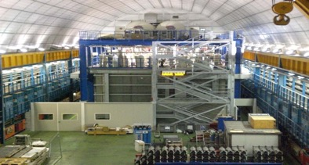
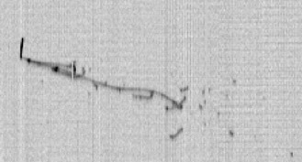
The remarkable evolution of ν-detectors: the ICARUS LAr-TPC
Liquid Argon Imaging technology LAr-TPC, an ‘’electronic bubble chamber’’ to unambiguously reconstruct each ionizing track in complex neutrino events, was first proposed by C. Rubbia in 1977 as an alternative to Cherenkov detectors:
A long R&D culminated in the first large-scale successful experiment ICARUS-T600, 0.76 kt ultra-pure LAr at Gran Sasso INFN Lab exposed underground to CNGS ν beam investigating sterile neutrinos!
      Tracking device: 3D event topology with Δx ~ mm, e- by charged particles can drift undisturbed for meters with E_{D}= 0.5 kV/cm if LAr is sufficiently pure
      Full sampling homogeneous calorimeter: E measurement by charge signal integration;
      Measurement of local energy deposition dE/dx: remarkable e/γ separation, 0.02 X₀ sampling, Χ₀=14 cm, a powerful PID by dE/dx vs range. Momentum of not contained μ is measured by Multiple Coulomb Scattering
      Scintillation light by charged particles provides fast signals for timing/triggering.
T300
T300
atmospheric ν_{e} neutrino
… paving the way for Long-Baseline DUNE experiment!
Notes:
CERN

Slide 14
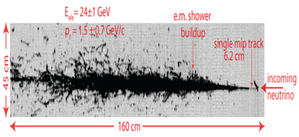

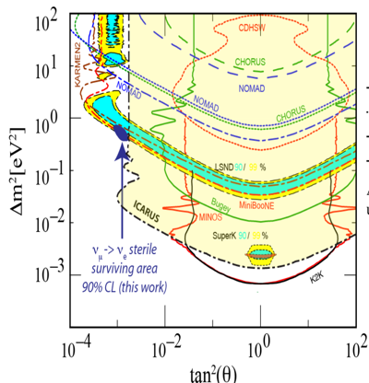
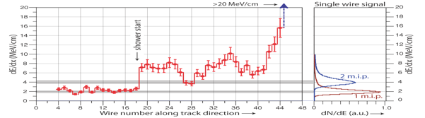
ICARUS T600: a powerful detector for neutrino experiments
    ICARUS concluded in 2013 a successful 3 years long run exposed to CNGS beam and cosmic rays with several physics/technical achievements:
      Demonstrating the unique LAr-TPC capability to identify νe and reject πº background
      Performing with OPERA a sensitive search for νμ ->νe appearance constraining LSND and MiniBooNE νe signals to a narrow region, EPJ C (2013) 73:2599
CNGS νe CC
Collection
Single mip
Evolution from single e-mip to EM shower is evident from dE/dx on individual wires.

Slide 15
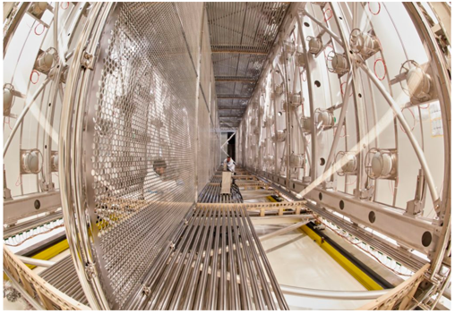
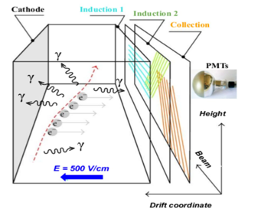
ICARUS at Fermilab
2015-18: extensive overhauling in view of shallow depth operations at Fermilab to explore Δm² ~ 1 eV² region and fix the sterile neutrino question.
2 modules, 2 TPC chambers per module with a central cathode (1.5 m drift, E_{D}= 0.5 kV/cm);
3 readout wire planes per TPC, 54000 wires at 0, ± 60⁰, 3 mm pitch, in total;
360 8” photomultipliers, TPB coated, to detect the scintillation light;
LAr/GAr purified by copper filters and molecular sieves for water absorption.
Structure of one module with 2 TPC chambers
Wires planes
Central cathode
E-field cage
PMTs
Notes:
CERN

Slide 16
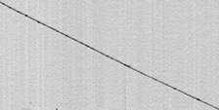
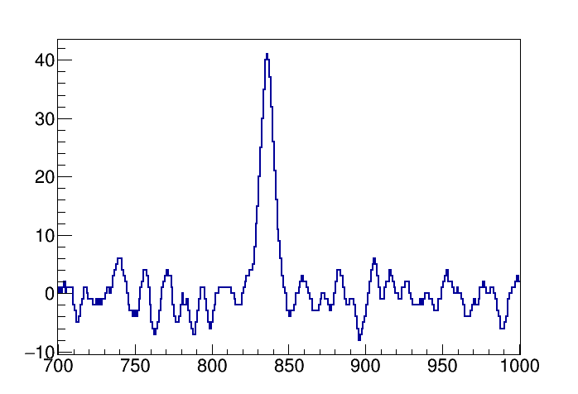

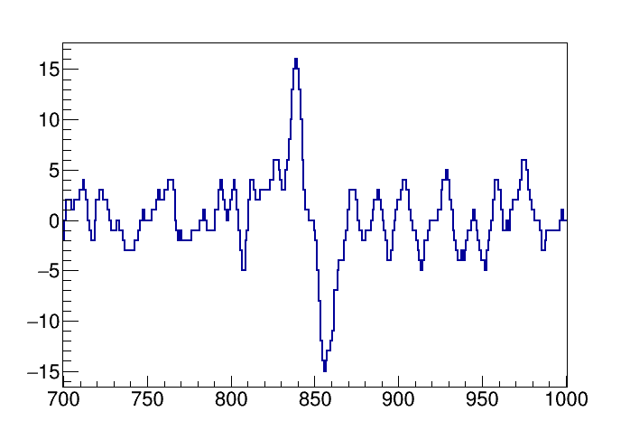
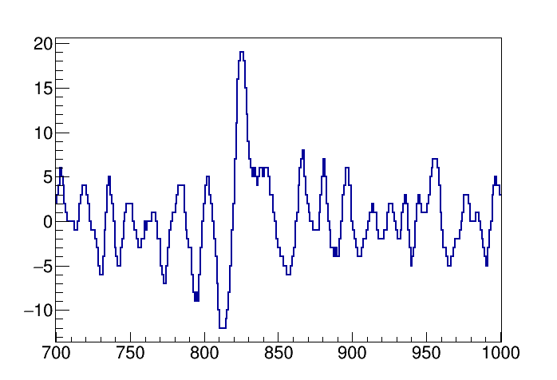
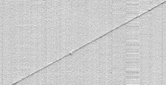
TPC wire readout
54000 chs: front-end based on analogue low noise, charge sensitive pre-Amp;
Signal shaping ~1.3 μs matching e- transit time between Induction-1, 2 and Collection wire planes (3 mm apart) improving hits position resolution;
Compact layout with both analog/digital electronics in a single board.
Collection
10 liter mini-crate on a feed-through hosting 9 boards (576 wires).
0.75 m Wires
Induction-2
Wire signal [ADC]
ICARUS Signal to Noise ratio
0.8 m Drift direction
0.45 m Wires
Induction-1
    S/N > 10 in Collect./Ind-2 views for mip vertical μs tracks.
1.1 m Wires
Time [t-sample]
Recorded cosmic muon track: bipolar shape of e-signals traversing wire planes recognized in Inducion.-1, 2 views.

Slide 17
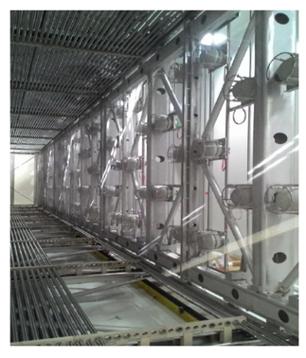
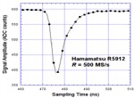

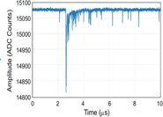

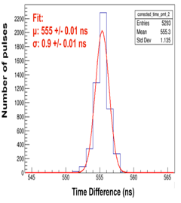
Upgrade of the light collection system
360 Hamamatsu 8“ PMT (5% coverage, 15 phe/MeV) installed behind the wire planes, 90 PMTs per TPC chamber:
  Continuous read-out, digitization, discrimination and waveform recording of PMTs signals (V1730 digitizers);
  PMT signals sampled every 2 ns, recorded in 10 µs windows.
V1730 Digitizer
Global
Trigger
PMT
Trigger
Logic
LVDS
Data
recording
(10 μs)
Argon scintillation light
Optical
Link
A3818
N. of pulses
  PMT gain equalized at ~ 0.45 10⁷±1% with λ ~ 405 nm laser and measuring ~4 mV PMT response to single photoelectron;
  PMT timing to Trigger signal with 1 ns resolution by laser to perfectly determine the time of collected events.
Δt = t_{PMT} – t_{TRIGGER} (ns)

Slide 18
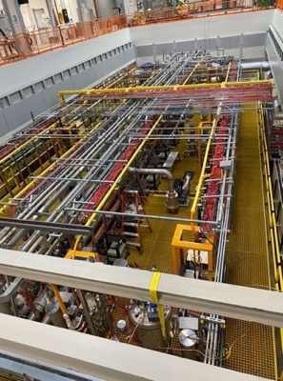
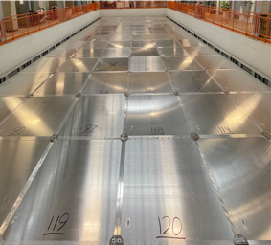
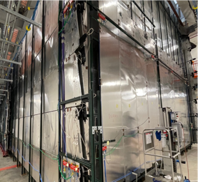
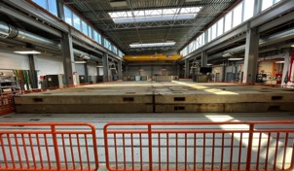
Cosmic-ray background mitigation in ICARUS
ICARUS exposed in a pit to cosmic rays: electrons produced by γ’s via Compton Scatt./Pair Prod. can mimic a genuine ν_{e} CC event:
  Cosmic μs entering ICARUS are identified in time/position by 4π Cosmic Ray Tagger (CRT) ~1000 m² double-layer scintillation bars equipped with SiPMs surrounding LAr-TPCs;
Top CRT
Side CRT
  Cosmic γ’s and neutrons suppressed by 2.85 m concrete overburden installed above CRT.

Slide 19
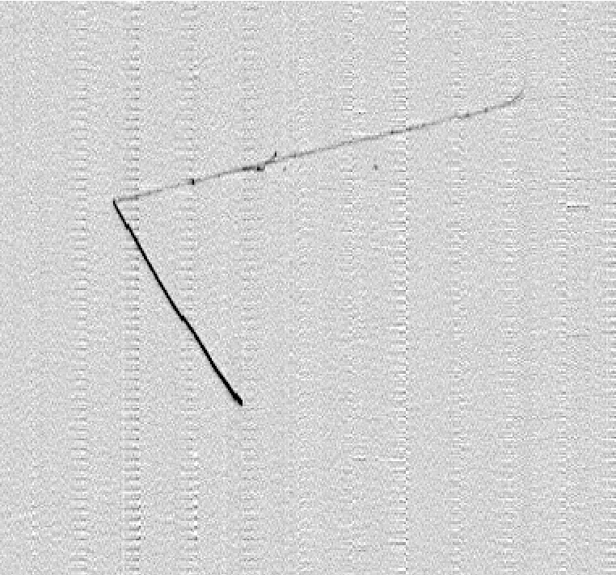
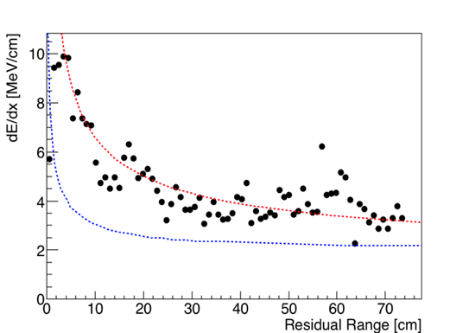
First collected neutrino events: a BNB QE νμ CC candidate
Selection of ν_{e} events
COLL
  Neutrino interaction vertex well inside the active LAr volume. Two tracks are produced:
    Track 1: downward going muon candidate, exiting on bottom (confirmed by δ rays)
    Track 2: stopping proton.
Beam direction
Track 1 L = 75 cm
Muon with δ−rays exiting on the bottom
0.9 m Drift direction
ICARUS Preliminary
Track 2 L = 74 cm
Stopping proton
Measured dE/dx along track 2
1.2 m Wires
From the study of dE/dx vs range, track 2 is compatible with a proton: E_{DEP}~ 340 MeV, E_{K} =370 MeV (if evaluated from range).
Expected dE/dx vs range for muon, proton

Slide 20
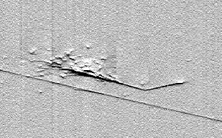
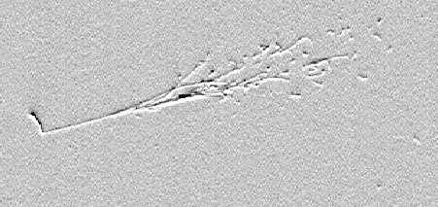
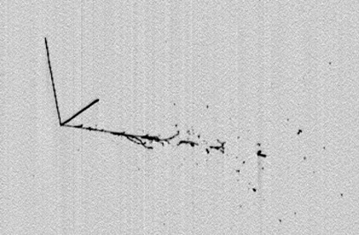
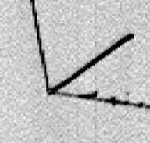
NuMI νe CC candidates
Selection of ν_{e} events
IND1
IND2
QE νe CC event contained candidate, E_{DEP}~870 MeV:
  proton candidate is upward going/stopping L= 13 cm;
  e-shower is downward going.
Electron
0.7 m Drift direction
0.5 m Drift direction
Proton
Proton
Electron
Overlapped cosmic track
0.7 m Wires
Beam direction
1.0 m Wires
COLL
  νe CC event candidate fully contained in active LAr, E_{DEP}~830 MeV:
    The electron shower, E_{DEP}~570 MeV is downward going;
    Track 1: upward going, stopping proton candidate, L = 23.7 cm; Track 2: stopping hadron, L = 33.4 cm.
Track 2
Track 1
0.92 m Drift direction
Electron
1 m Wires
Slide# : 20

Slide 21






LAr-TPC vs Cherenkov?
MiniBooNE: 800 ton liquid scintillator, primarily Cherenkov light by 1280 PMTs
difficult e/γ separation: π⁰ background!
Proton
ICARUS LAr-TPC ν_{e} atmosph. neutrino event
Electron
superb e/γ separation and
π⁰ background rejection
35 cm
Notes:
CERN

Slide 22


ICARUS operations and data collection @FNAL
ICARUS data taking for physics started in June 2022: 3 physics runs completed since then + fourth run ongoing since December 2024.
  Steady data taking with excellent stability at BNB rates > 4Hz, >90% live time.
  Highly pure liquid argon: free electron lifetime τ_{e} ≈ 7-8 ms ->full track detection efficiency in the 1.5 m drift, ~1 ms.
  Trigger: light signal registered by 4 PMT pairs in a 6 m detector slice in coincidence with BNB (1.6 μs), NuMI (9.5 μs) beams
Cosmic μ
Collected PoT | BNB (FHC) positive focusing | NuMI (FHC) positive focusing | NuMI (RHC) negative focusing
RUN-1 (Jun-Jul 22) | 0.41 10²⁰ | 0.68 10²⁰ | -
RUN-2 (Dec 22-Jul 23) | 2.06 10²⁰ | 2.74 10²⁰ | -
RUN-3 (Mar –July 24) | 1.36 10²⁰ | - | 2.82 10²⁰
RUN-4* (Dec 24 –today) | 2.58 10²⁰ | - | -
TOTAL | 6.41 10²⁰ | 3.42 10²⁰ | 2.82 10²⁰
ν
μ from ν

Slide 23



ICARUS performance: timing
Rejection of incoming cosmics by means of time-of-flight between external CRT and inner PMT s.
Reconstruction of BNB, NuMI beam bunch structures: neutrino event time (PMTs only) w.r.t the proton beam extraction time (RWM counters) after cosmics rejection (CRT) and ν flight distance correction.

Slide 24




ICARUS performance: calibration
Signal response Coll. and Ind2 (Data/tuned MC) in 3 track angular bins
TPC wires signals have been accurately characterized and modeled in Monte Carlo
Detector response is calibrated with cosmic μ and p from 𝜈 interactions including a new angular dependent ellipsoidal recombination model (EMB)
Area normalized electronic Wire signal
Modified Birks’ law taking into account the angle between the track and the drift coordinate (Modified Box Recombination)
time [μs]
dE/dx vs residual range for μ and p used for PID
Angular dependence of
recombination β parameter
JINST 20 P01033 (2025)

Slide 25


SBN Near detector: SBND at 110 m from target
Two LAr-TPCs with central Cathode, 112 t LAr active volume equipped with cold electronics;
Photon detection systems of scintillation light produced by charged particles in LAr;
The cryostat is surrounded by a Cosmic Tagger system for cosmic ray rejection.
Started data taking: December 2024

Slide 26
ICARUS Research Program
The SBN program is addressing the question of sterile neutrinos with the BNB beam comparing ν_{e} and ν_{μ} interactions at different distances from target as measured by ICARUS and SBND LAr-TPCs.
  ICARUS is initially focused on standalone program before joint analysis with SBND:
  Investigation of ν_{μ} disappearance with BNB ν beam, later complemented by the study of ν_{e} disappearance with off-axis NuMI beam, addressing Neutrino-4 claim;
  Study of ν_{e}, ν_{μ} events from off-axis NuMI beam, to measure ν-Ar interaction cross sections and optimize ν reconstruction/identification in an energy range of interest for DUNE;
  Exploit the off-axis NuMI beam to investigate sub-GeV Beyond Standard Model signatures: signal box opened for μμ decay channel;
ICARUS established a blinding policy to ensure robust and unbiased interpretation of the collected data; analyses are initially validated with a subset of collected data.

Slide 27


ICARUS search for Neutrino-4 claims at FNAL
Remarkable ICARUS similarities to NEUTRINO-4 allow to settle sterile-ν claims with well-defined QECC νµ, νe fully contained events:
  Oscillations should produce disappearance pattern of νµ in BNB and νe in NuMI in the same L/E ~ 1-3 m/MeV range but with events collected with ~100 times the energy;
  L/Eν effect mostly related to Eν with L large/~constant for both BNB and NuMI 6⁰ off-axis where νe are mostly produced by kaons decaying close to target at ~800 m distance.
Prediction for Neutrino-4 best fit (black) at BNB
Expected measured νμ oscillation pattern with statistical errors (red)
Δm²₁₄=7.25 eV², sin²2θ₁₄=0.26
Prediction for Neutrino-4 best fit (blue) at NuMI
Expected measured νe oscillation pattern with statistical errors (red)
νμ survival oscillation probability at Booster: ~8500 QE events with >50 cm contained μ track, ~8.4 x 10¹⁹ pot ΔE/E ~3 %.
νe survival oscillation probability at NuMI: ~ 5200 QE events with contained E.M. shower, ~9 x 10²⁰ pot .
Analysis complemented with a beam-off event sample (collected in parallel with the beam on) will allow to observe the Neutrino-4 modulation!

Slide 28





ν_{μ} event selection for disappearance analysis at BNB
  Fully contained νμCC events with 1μ+N protons are studied requiring:
    PMT light signal inside 1.6 μs p beam spill window correlated with TPC tracks with no CRT signal;
    A muon (L_{μ} > 50 cm) and at least one proton track with E_{K} > 50 MeV (L_{p} > 2.3 cm) fully contained and identified by PID scores based on dE/dx;
    No additional p, γ.
    Residual cosmic backgrounds < 1%
  Two independent analysis streams, respectively based on:
    Pandora: pattern recognition algorithm
    SPINE: Machine Learning-based (ML) reconstruction code
  A visual selection of ν candidates is used to validate the event selection/reconstruction.
Momentum in the transverse plane (MeV/c)
Eν~1.4 GeV
400
  Global event kinematics obtained from range measurement of μ and p.
$\vec{p}$_{Tμ}
200
$\vec{p}$_{TMiss}
$\vec{p}$_{Tp}

Slide 29




1μNp analysis – event selection results
Data-MC agreement within systematics for all studied event kinematic variables in ∼10% of RUN-2 data analyzed (2·10¹⁹ pot): ⁻
Normalized Entries
BNB
Pandora based analysis⁻ ~50% efficiency for the signal: (~34 k events for 3.89 10²⁰ pot)
BNB
Reconstructed neutrino Energy [GeV]
Total transverse momentum p_{T} [GeV/c]
ICARUS Work in progress
Normalized Entries
BNB
BNB
SPINE ML based analysis >50% efficiency for the signal: (~42 k events for 3.89 10²⁰ pot)
Reconstructed neutrino Energy [MeV]
Total transverse momentum p_{T} [MeV/c]
Next analysis steps: enlarge the control sample, full dataset unblinding foreseen soon.

Slide 30




Neutrino Interactions from NuMI off axis at ICARUS
Excellent statistics to measure ν-Ar cross section for quasi-elastic, resonance and deep inelastic scattering, for both electron and muon neutrinos:
      CC events/6 10²⁰ PoT : ν_{μ} 332,000 and ν_{e} 17,000.
Neutrino energy spectrum from NuMI at ICARUS covers the 1st oscillation peak and good coverage of the relevant phase space for DUNE experiment.
$ν$_{μ}, $\overline{ν}$_{μ} from NuMI at ICARUS
$ν$_{e}, $\overline{ν}$_{e} from NuMI at ICARUS
Oscillation probability at DUNE
NuMI MC
NuMI MC
Available data ~3.42 10²⁰ PoT for physics analysis now

Slide 31


Neutrino CC 0π cross section analysis results: NuMI beam
First analysis targets 1μ Np 0π events
  Signal: 1μ with p_{μ} > 0.226 GeV/c + >1 proton with 0.4< p_{μ} <1 GeV/c, no π±, π⁰ in the final state
  Flux, interaction model and detector systematics included
  Angles and transverse kinematics observables are expected to encode to Initial and Final State effects
Major background: events with undetected/misidentified pions
  Event control-sample with π± candid. studied to characterize this backg (requiring secondary μ-like track): good agreement between 15% data/MC
Results for the full dataset soon !

Slide 32


BSM searches with NuMI
Models involving dark particles coupling to SM particles through Scalar Portal Interactions:
  Higgs Portal Scalar (HPS) → Scalar dark sector particles, undergo mixing with Higgs boson
  Heavy QCD axion (ALP) → Pseudoscalar particles, undergo mixing with pseudoscalar mesons
Scalar Decays in μ⁺μ⁻ with RUN2 NuMI beam.
  Scalar mass 𝑀_{𝜇𝜇} peak reconstructed with 2 stopping μ;
  Signal expected at small angle w.r.t. beam 𝜃_{𝑠} < 5°

Slide 33


BSM searches with NuMI:results
Scalar Decays in μ⁺μ⁻: results
  9 candidates found to be compared with 8 backg MC events expectation (from 𝜈μ​ CC coherent π prod.):
no significant new physics signal
Phys. Rev. Lett. 134, 151801
https://arxiv.org/abs/2411.02727

Slide 34
What next
ICARUS is smoothly running since June 2022, exposed to BNB and NuMI beams, already collected > 6 x 10²⁰ pot with BNB and ~ 3 x 10²⁰ pot with NuMI both positive and negative focusing.
The ICARUS data taking foreseen to continue for ~ 3 years together SBND near detector operational since December 2024.
ICARUS only is carrying on several analyses with data collected before the start of the joint operation within SBN: ν_{μ} disappearance with BNB (Neutrino-4 claim), ν−Ar cross section measurements with NuMI and search for sub-GeV dark matter, interesting results expected soon!
Exciting ICARUS time: new INFN contributions are welcome !

Slide 35
ICARUS Collaboration at SBN
P. Abratenko¹⁹,N. Abrego-Martinez³, F. Akbar²³, L. Aliaga Soplin²⁴, M. Artero Pons¹⁵, W.F. Badgett⁵, L.F. Bagby⁵, B. Baibussinov¹⁵, B. Behera⁴, V. Bellini⁷, O. Beltramello², R. Benocci¹³, J. Berger⁴, S. Bertolucci⁶, M. Betancourt⁵, K. Biery⁵, M. Bonesini¹³, T. Boone⁴, B. Bottino⁸, J Bremer², S. Brice⁵, V. Brio⁷, C. Brizzolari¹³, J. Brown⁵, H.S. Budd²³, A. Campani⁸, A. Campos²⁷, D. Carber⁴ , M. Carneiro¹, I. Caro Terrazas⁴, H. Carranza²⁴, R. Castillo Fernandez²⁴, S. Centro¹⁵, G. Cerati⁵, M. Chalifour², A.Chatterjee²⁶, D. Cherdack²¹, S. Cherubini¹¹, N. Chitirasreemadam²⁵, M. Cicerchia¹⁵, T. Coan¹⁸, A. Cocco¹⁴, M. R. Convery¹⁷, L. Cooper-Troendle²², S. Copello¹⁶, A. De Roeck², S. Di Domizio⁸, D. Di Ferdinando⁶, L. Di Noto⁸, M. Diwan¹, S. Dolan², S. Donati²⁵, R. Doubnik⁵, F. Drielsma¹⁷, J. Dyer⁴, S. Dytman²², C. Fabre², A. Falcone¹³, C. Farnese¹⁵, A. Fava⁵, N. Gallice¹, C. Gatto¹⁴, M. Geynisman⁵, D. Gibin¹⁵, A. Gioiosa²⁵, W. Gu¹, M. Guerzoni⁶, A. Guglielmi¹⁵, G. Gurung²⁴, S. Hahn⁵, H. Hausner⁵, A. Heggestuen⁴, B. Howard⁵, J. Hrivnak², C. James⁵, W. Jang²⁴, Y.-J. Jwa¹⁷,L. Kashur⁴,W. Ketchum⁵, J.S. Kim²³, D.H. Koh¹⁷, J. Larkin¹, G. Laurenti⁶,Y. Li¹, G. Lukhanin⁵, C. Mariani²⁷, C. Marshall²³, S. Martynenko¹, N. Mauri⁶, A. Mazzacane⁵, K.S. McFarland²³, D.P. Mendez¹, A. Menegolli¹⁶, G. Meng¹⁵, O.G. Miranda³, D. Mladenov², N. Moggi⁶, N.Montagna⁶, A. Montanari⁶, C. Montanari^{5,b}, M. Mooney⁴, G. Moreno Granados³, J. Mueller⁴, M. Murphy²⁷, D. Naples²², T. Nichols⁵, S. Palestini², M. Pallavicini⁸, V. Paolone²², L. Pasqualini⁶, L. Patrizii⁶, L. Paudel⁴, G. Petrillo¹⁷, C. Petta⁷, V. Pia⁶, F. Pietropaolo^{2,a}, F. Poppi⁶, M. Pozzato⁶, A. Prosser⁵, G. Putnam²⁰, X. Qian¹, A. Rappoldi¹⁶, G.L. Raselli¹⁶, R. Rechenmacher⁵, S. Repetto⁸, F. Resnati², A.M. Ricci²⁵, E. Richards²², A. Rigamonti², M. Rosemberg¹⁹, M. Rossella¹⁶, P. Roy²⁷, C. Rubbia⁹, M. Saad²², S. Saha²², G. Savage⁵, A. Scaramelli¹⁶, D. Schmitz²⁰, A. Schukraft⁵, D. Senadheera²², S.H. Seo⁵, F. Sergiampietri², G. Sirri⁶, J. Smedley²³, J. Smith¹, A. Soha⁵, L. Stanco¹⁵, H.Tanaka¹⁷, F. Tapia²⁴, M. Tenti⁶, K.Terao¹⁷ , F. Terranova¹³, V.Togo⁶, D.Torretta⁵, M.Torti¹³, R. Triozzi¹⁵, Y.T. Tsai¹⁷, T. Usher¹⁷, F.Varanini¹⁵, S. Ventura¹⁵, M.Vicenzi¹, C. Vignoli¹⁰, P. Wilson⁵, R.J. Wilson⁴, J. Wolfs²³, T. Wongjirad¹⁹,A.Wood²¹, E. Worcester¹, M. Worcester¹, H. Yu¹, J. Yu²⁴, A. Zani¹², J. Zennamo⁵, J. Zettlemoyer⁵, S. Zucchelli⁶, M. Zuckerbrot⁵
1. Brookhaven National Lab., USA
2. CERN, Switzerland
3. CINVESTAV, Mexico,
4. Colorado State University, USA
5. Fermi National Accelerator Lab., USA
6. INFN Bologna and University, Italy
7. INFN Catania and University, Italy
8. INFN Genova and University, Italy
9. INFN GSSI, L’Aquila, Italy
10. INFN LNGS, Assergi, Italy
11. INFN LNS, Catania, Italy
12. INFN Milano, Milano, Italy
13. INFN Milano Bic. and University, Italy
14. INFN Napoli, Napoli, Italy
15. INFN Padova and University, Italy
16. INFN Pavia and University, Italy
17. SLAC National Accelerator Lab., USA
18. Southern Methodist University, USA
19. Tufts University, USA
20. University of Chicago, USA
21. University of Houston, USA
22. University of Pittsburgh, USA
23. University of Rochester, USA
24. University of Texas (Arlington),USA
25. INFN Pisa and University, Italy
26. Ramanujan Faculty Phys. Res. India
27. Virginia Tech Institute
12 INFN groups, 12 US institutions, CERN, 1 Mexican institution, 1 Indian Institution
Spokesperson: C. Rubbia, GSSI
a On Leave of Absence from INFN Padova
b On Leave of Absence from INFN Pavia

Slide 36
Importante impegno dei gruppi INFN nello studio dei neutrini, in particolare nello sviluppo della TPC ad argon liquido con ICARUS al Gran Sasso ed ora al Fermilab impegnati sia nell’hardware TPC, PMT, CRT,Trigger, che nel software e nell’analisi dati finalizzata allo studio delle oscillazioni.
Il gruppo di Pisa e’ attualmente impegnato nella ricostruzione e analisi degli eventi di neutrino oltre che nella data production; in particolare:
  Miglioramento degli algoritmi di tracking e sviluppo algoritmi per la misura del momento dei muoni basati sul Multiple Coulomb Scattering: Alessandro M. Ricci, Giovanni Chiello e Namitha Chitirasreemadam, Simone Donati;
  Improving lo Slow Control: Antonio Gioiosa
  Data production: Alessandro M. Ricci e A. Gioiosa
Grande opportunita’ per i giovani: ICARUS: un giardino fiorito … DUNE: la prospettiva prossima
Giardino adronico (E. Iarocci)

