Slide 1





CH4rLiE
Associate Professor. Dr. Daniele Dondi
Director in Laboratory of Radiation Chemistry and EPR Spectroscopy
Department of Chemistry, University of Pavia, 27100, Italy.
Wednesday, May 28th, 2025

Slide 2
SEM images of Z5 molecular sieves

Slide 3
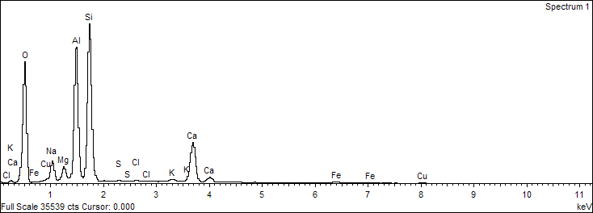
SEM EDS of Z5 molecular sieves
Elements | Weight percentage
O | 51.3%
Si | 14.50%
Al | 20.13%

Slide 4
SEM images of Z5 grinded

Slide 5
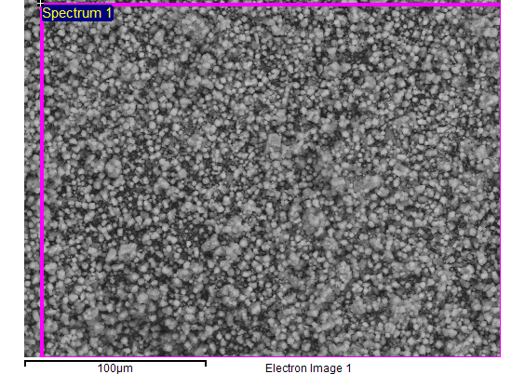
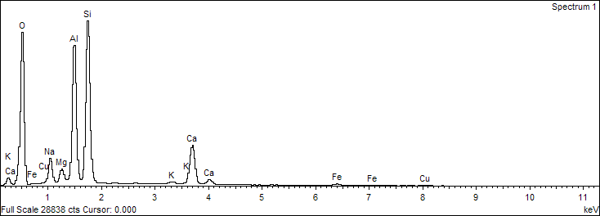
SEM EDS of Z5 grinded
Elements | Weight percentage
O | 54.65%
Si | 13.65%
Al | 18.80%

Slide 6
SEM images of Z5-C 20%

Slide 7
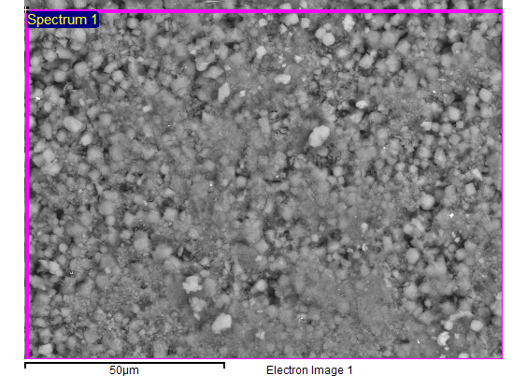
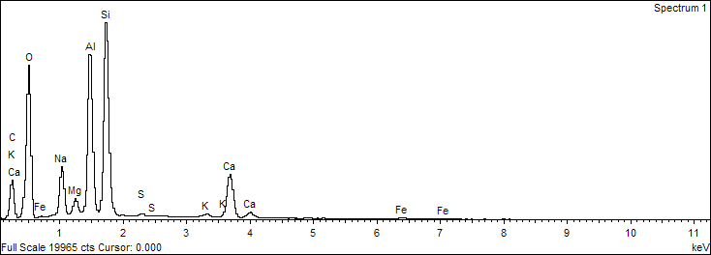
SEM EDS of Z5-C 20%
Elements | Weight percentage
O | 46.37%
Si | 14.76%
Al | 10.96%
C | 15.79%

Slide 8
26g of prepared Z5C20% TGA
Carbon Content 12.2%

Slide 9
TGA comparison between 10g to 26g
Carbon content (10g)- 13.6%
Carbon content (26g)- 12.2%

Slide 10
Current Work
Multiple synthesis of
  UCSB-9 Zeolite- 3g
  TUT-100- 1.7 g
Next steps
Continuing preparation of USCB-9 zeolite, and TUT-100.
New granulation trial.

Slide 11
Acknowledgement
Thank you

