Slide 1
Preparation of ATLAS input to the European Strategy
Aleandro Nisati

Slide 2
“European Strategy for Particle Physics”
At appropriate intervals, at most every 5 years, the European Strategy Session of Council will re-enact the process aimed at updating the medium and long-term European Strategy for Particle Physics, by setting up a Working Group, the European Strategy Group (ESG), similar to the Strategy Group in 2005/2006. The ESG will be a Working Group of Council which will cease to exist each time Council has adopted the new medium and long-term Strategy. The remit of the ESG will be to establish a proposal for the European Strategy Session of Council to update the medium and long-term European Strategy for Particle Physics.
Council, September 2007
For more details on this see:
http://europeanstrategygroup.web.cern.ch/EuropeanStrategyGroup/welcome.html

Slide 3
ESG: Mandate
The remit of the ESG is to establish a proposal for an Update of the medium and long-term European Strategy for Particle Physics, for approval by the Council. It is proposed that the proposal will take the following elements into account:
the Update of the European Strategy for Particle Physics shall in particular aim at:
enhancing the visibility of existing European particle physics programmes;
increasing collaboration among Europe's particle physics laboratories, institutes and universities;
promoting a coordinated European participation in global projects and in regional projects outside Europe;
encouraging knowledge transfer to other disciplines, industry, and society.
The proposal shall include a review of the implementation of the 2006 Strategy, as well as of the structures and procedures currently in place with regard to the Strategy.
The proposal shall outline priorities following a thematic approach, with special emphasis on future large infrastructures/projects, including preparatory steps for a next project at CERN after LHC in a global context, and consider time scales and resources. It shall also consider possible future participation by CERN in experiments outside the Geneva Laboratory as part of the Strategy implementation.

Slide 4
ESG: composition and schedule
Members of the ESG are one delegate from each Member State, CERN DG, representatives of major European National Labs, Strategy Secretariat members, and invited delegates from candidates for accession, observer states and other relevant organizations (about 46 total; see also backup for details)

Slide 5
Call for submission
As part of the Update of the European Strategy for Particle Physics, the European Strategy Preparatory Group welcomes submissions on issues related to the strategy from individual physicists, from groups of scientists representing a community (an experiment, a topic of theoretical research, etc.) as well as from Institutions and Organizations (funding agencies, ministries, etc).
Each input document should be self-contained (no external links except in the references), less than 15 pages and in PDF format.

Slide 6
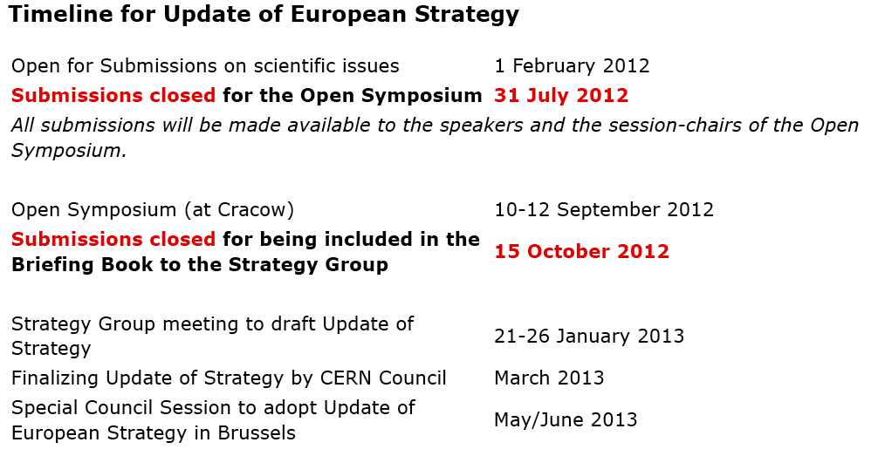
timeline
Everyone is encouraged to attend the Open Symposium, to be held on 10-12 September 2012 at Cracow, where ample time within each session will be dedicated for discussion and input from the floor.

Slide 7
outline
The purpose of this activity is to collect input from the Collaboration for the ES
I suggest the following “baseline proposal” for ES strategy input from ATLAS, meant to encourage discussion within the Collaboration
Strategy for the luminosity upgrade of LHC, HL-LHC, up to L∼ 5x10**34 cm⁻² s⁻¹ ;
Connection with the Upgrade working group
Strategy for the energy upgrade of LHC: HE-LHC (30 TeV)
In both cases, it would be useful to address input for two scenarii:
A: the 2012 data will confirm the excess see in γγ at m_{γγ} ~ 126 GeV
B: the 2012 data will exclude the esistence of a SM Higgs boson in the entire mass range
Workplan
Kick-off meeting on April 18th
Workshop in May

Slide 8
HL-LHC strategy
Assume that in 2012 the excess at m=125 GeV will be confirmed to be a new resonance
The primary goal will be then to establish whether it behaves as the Higgs boson predicted by the Standard Model, or whether BSM physics is present
➔ need to measure the physics properties:
Mass
Width
Couplings to fermions and bosons ←
Spin and parity

Slide 9
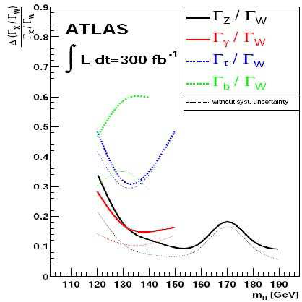
Higgs couplings
n_{x} = σ • Γ_{x}/Γ
→ can measure ratio of partial widths with no model dependence:
n_{x}/n_{y} = Γ_{x}/Γ_{y}
for channels with the same production process
Can obtain a relative precision of about 20% (m=125 GeV, L=300/fb)
M/ Duhrssen, ATLAS-PHYS-2003-030

Slide 10
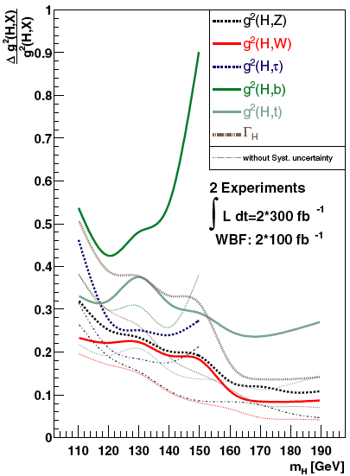
Higgs couplings
Fit Higgs couplings using all possible final states and injecting some theory assumption, i.e. Γ_{V} ≤ Γ_{V}SM (V=W,Z)
Δg²_{VV}/g²_{VV} can be determined with an uncertainty of ~ 20% (2x300/fb)
Δg²_{bb}/g²_{bb} can be determined with an uncertainty of ~ 40% (2x300/fb)
Find the optimal point in the luminosity-pileup plane to perform the best measurements in particular for H→bb and H→ττ?

Slide 11
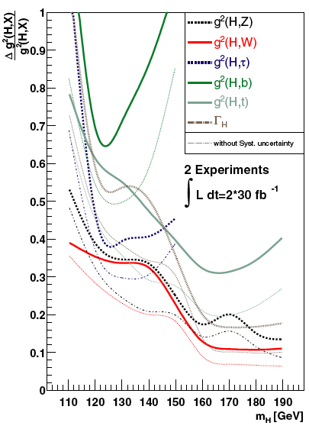
Higgs couplings with up to 2012 data
Fit Higgs couplings using all possible final states and injecting some theory assumption, i.e. Γ_{V} ≤ Γ_{V}SM (V=W,Z)
Δg²_{VV}/g²_{VV} can be determined with an uncertainty of ~ 35% (2x30/fb)
Δg²_{bb}/g²_{bb} can be determined with an uncertainty of ~ 65% (2x30/fb)

Slide 12
Search for rare H decays
Very high luminosities will be crucial to search for rare Higgs decays, and compare their rate to SM predictions
Examples: H→μμ (BR=10⁻⁴), H→Zγ (BR=few 10⁻³)
Significances: H→μμ: 300/fb: 3σ; sLHC: ~7σ
Also, searches for Higgs boson(s) beyond SM

Slide 13
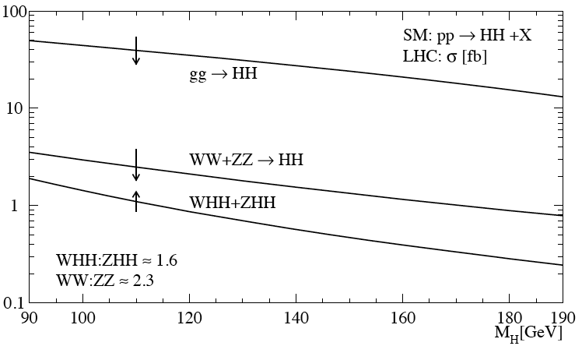
Higgs self-couplings
A complete verification of the Standard Model prediction requires the measurements of the Higgs self-couplings.
Trilinear and quartic interactions
Direct trilinear interaction: H*→HH
SM: g = 3m²_{H}/v
Processes of interest: gg → HH, VBF qq→qqHH, associated production (ttH,VH)
Most interesting final state so far studied: HH→WWWW→lνjj lνjj
http://arxiv.org/abs/hep-ph/9904287v1
ggF cross section: ~30/fb
Quartic interactions (SM: g = 3m²_{H}/v²): very likely not feasable at the LHC/HL-LHC, but it is worth to review this process as well
study HH scattering (?) or perhaps it is better to study three-Higgs boson final states (?)

Slide 14
WW scattering
If there is no light Higgs boson (Scenario B), then new physics process must exist to hold the VV (V=W,Z) scattering cross section that, in SM would diverge
Example: VV resonances at ~TeV mass
If there is light Higgs boson it is also very important to measure the VV scattering and compare it to the SM prediction
Measure the rate of V-pair with large invariant mass
Search for structures in this distribution
Expected cross sections are small, integrated luminosities as large as 3000/fb are needed

Slide 15
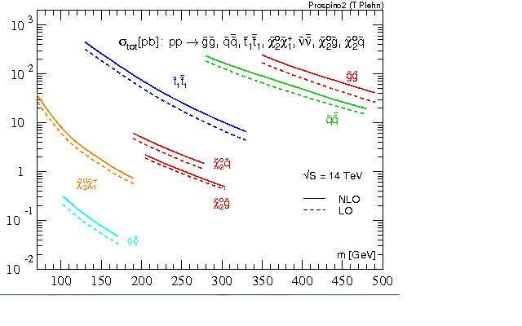
SUSY
Reach on squark – gluino masses for √s=14 TeV and L~200 fb⁻¹: ~2.5 TeV
It can be extended up to ~ 3 TeV with L~2 ab⁻¹;
For √s=14 TeV L=100 fb⁻¹ the reach is close to m~4 TeV
Perform SUSY searches for the third generation, in particular stop (still “low” cross-section at masses ~ 500 GeV)
Search for direct (electroweak) slepton and gaugino production (very low cross section, need large statistics data samples)
Mass | MSTW2008 | CTE6.6
400 GeV | 2.34 pb | 2.19 pb
600 GeV | 0.24 pb | 0.23 pb
1 TeV | 0.008 pb | 0.008 pb
See Monica D’Onforio talk at the Upgrade Workshop (Standford)

Slide 16
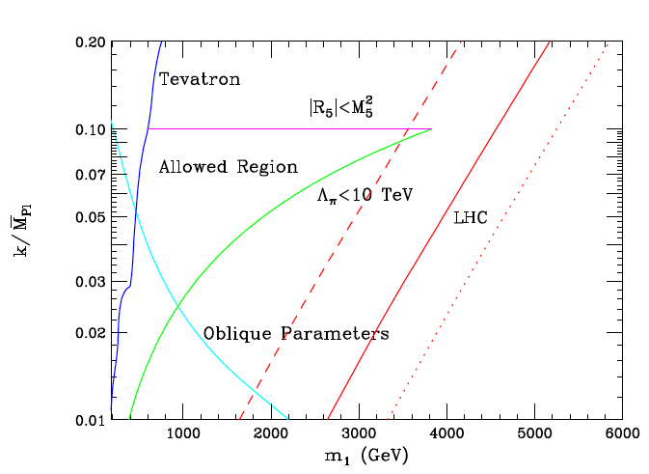
Extra Dimensions: Randall-Sundrum
Models with extra-dimensions aim to solve the hierarchy problem by allowing the gravity scale to be close to the EW scale in a n+δ dimension Universe
The presence of these additional dimensions produce new phenomena involving gravitons. Gravitons can decay to lepton pairs, Z-boson pairs etc
High luminosity samples with sLHC can extend the sensitivity to RS KK excitation by ~ 1 TeV (almost regardless the compactification factot k/M_{Pl}
ATLAS √s=7 TeV; L=1/fb

Slide 17
The next future: LHC @ 30 TeV ?
the physics programme of a hadron collider in the LHC tunnel with the unprecedented energy of √s~30 TeV would extend the one from LHC/sLHC
Higgs sector (SM and MSSM)
SUSY
BSM signatures (examples: Extra-dimensions, Technicolor, leptoquarks, etc)

Slide 18
The next future: LHC @ 30 TeV ?
Benchmark processes: basic proposal:
Higgs couplings
Higgs: self-couplings, trilinear and quartic
Higgs: measurement of rare decay modes
Higgs: search for rare decays
Higgs: search for Higgs boson(s) beyond SM
VV scattering
SUSY: signatures based on MET; stop and sbottom direct production
Exotics: examples: Extra-Dimensions: RS; but also compositeness, etc.
Workplan
Consider benchmark processes
Tools: use particle-level MC programs, perform analysis studies with truth 4-vectors
Consider only main [irreducible] background(s)
Write a document to collect and illustrate the results

Slide 19
BACKUP SLIDES

Slide 20
HL-LHC – simulation studies
Use fast simulation – if possible, AF-I
Parametrize pileup & detector effects of basic physics objects using existing full simulation samples (or that can be realistically produced very quickly)
Electrons, photons and muons: parametrize efficiency losses due isolation cuts (as a function of pu)
Jets: JES and JER ?
B-tagging: parametrize efficency and fake rate as a function of pt and pu
Tau: B-tagging: parametrize efficency and fake rate as a function of pt and pu
Otherwise use particle-level generators and apply correction factors to account for basic detector and pile-upu effects
Benchmark processes:
Higgs couplings
Higgs: self-couplings (trilinear and quartic)
Higgs: measurement of rare decay modes
VV scattering
SUSY: signatures based on MET; stop and sbottom direct production
Extra-Dimensions: RS; + ADD??

Slide 21
ESG: composition
The European Strategy Group (ESG) Members
Member States Austria Prof. A.H. Hoang Belgium Prof. W. Van Doninck Bulgaria Prof. L. Litov Czech Republic Prof. J. Chyla Denmark Prof. J.J. Gaardhoje Finland Prof. P. Eerola France Prof. E. Augé Germany Prof. S. Bethke Greece Prof. P. Rapidis Hungary Prof. P. Levai Italy Prof. R. Petronzio Netherlands Prof. S. De Jong Norway Prof. A. Read Poland Prof. A. Zalewska Portugal Prof. G. Barreira Slovakia Dr L. Sandor Spain Prof. C. Pajares Sweden Prof. B. Asman Switzerland Prof. K. Kirch U.K. Prof. J. Butterworth
CERN Director General Prof. R. Heuer Major European National Laboratories CIEMAT C. Lopez DESY J. Mnich IRFU Ph. Chomaz LAL A. Stocchi NIKHEF F. Linde LNF U. Dosselli LNGS L. Votano PSI L. Rivkin STFC-RAL J. Womersley
Strategy Secretariat Members Scientific Secretary (Chair) Prof. T. Nakada SPC Chair Prof. F. Zwirner ECFA Chair Dr M. Krammer Repres. EU Lab. Directors' Mtg Dr Ph. Chomaz
Invitees Candidate for Accession Romania Dr S. Dita Associate Member in the pre-stage of Membership Israel Prof. E. Rabinovici
Observer States India Prof. T. Aziz Japan Prof. Sh. Asai Russian Federation Prof. A. Bondar Turkey Prof. Dr M. Zeyrek United States Prof. M. Shochet EU Dr R. Lecbychová ApPEC Dr S. Katsanevas Chairman FALC Prof. Y. Osaka Chairman ESFRI Dr B. Vierkorn-Rudolph Chairman NuPECC Prof. G. Rosner Scientific Assistant Prof. E. Tsesmelis

Slide 22
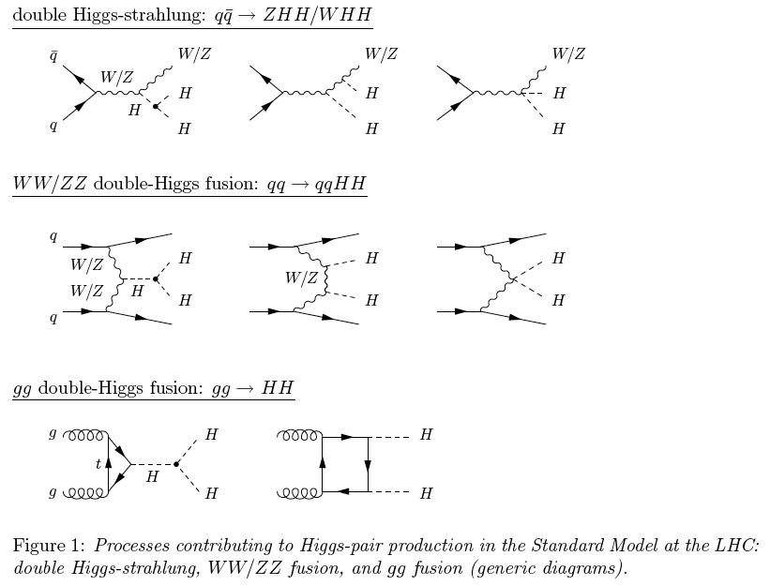
HH production in SM

Slide 23
HHH production

