Slide 1
M.A.D project collaboration meeting
SABRE MC simulation
for PMT characterization
Rome, 22/05/2025
By Chemseddine ANANNA

Slide 2
V4.11
Simplified G4String interfaces and implementation with C++11/17.
Removed obsolete/std::string synonym member functions and deprecated non-std::string member functions, replacing with new free functions in G4StrUtil namespace. Might require user code adaptation where G4String functions are explicitly used.
Major update the G4PhysicsVector and related classes; introduced new public access methods; removed obsolete unused methods; introduced possibility to use different Spline methods.
Removed deprecated classes G4LPhysicsFreeVector and G4PhysicsLnVector; redirect G4PhysicsOrderedFreeVector to G4PhysicsFreeVector.
New version of G4PhysicsModelCatalog, the catalog of physics models. Introduced a modelID (a unique integer for each physics model, with close values for similar/related physics models), besides an index (the position in a vector) and the name (string) of the model. C++17 is the minimum ISO C++ Standard required to compile Geant4 and all applications using it.
Multithreading support is now enabled in the build of Geant4 by default.
CMake 3.16 is the minimum version required to build Geant4.

Slide 3
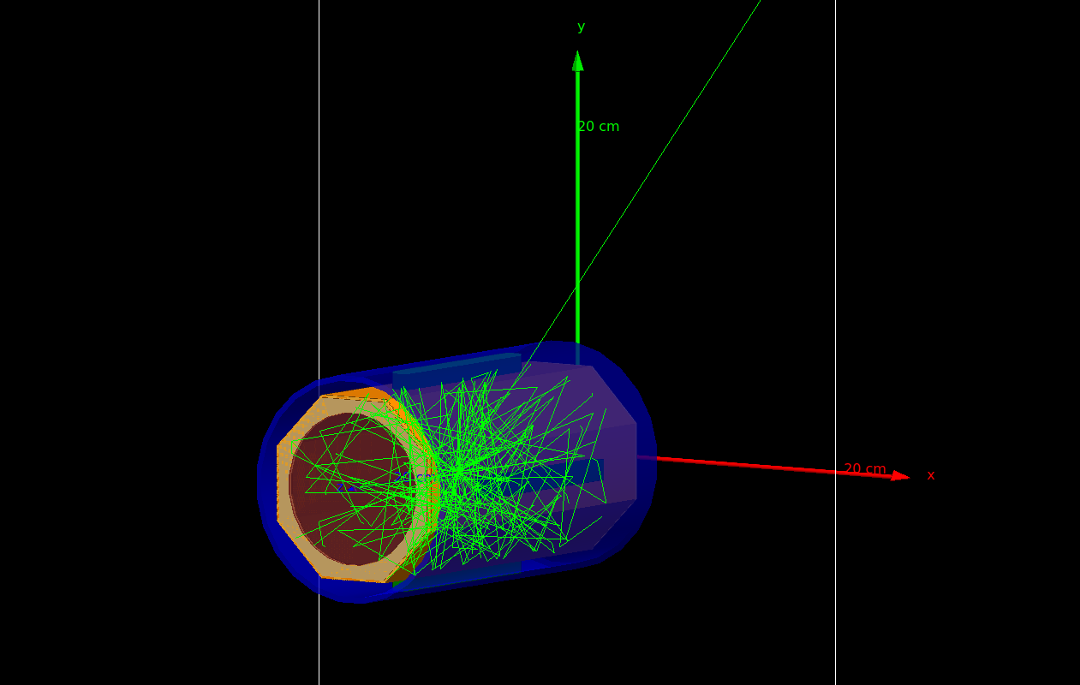
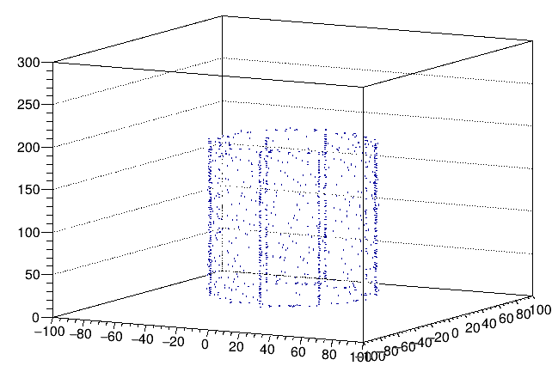
What is it about
The detector geometry and physics fully rebuilt using Geant v4.11. ->Latest and greatest (compatibility issues)
All unnecessary components are removed -> Compact code suitable for multiple users/didactical purposes.
Optimization of contaminants decay within complex geometries (PTFE wrapping…). -> Efficient simulation for local execution
Optical photons collection in SbKCs(?) photocathodes after optical pads interaction -> reconstruction of the expected PMT signal (W.I.P.).

Slide 4
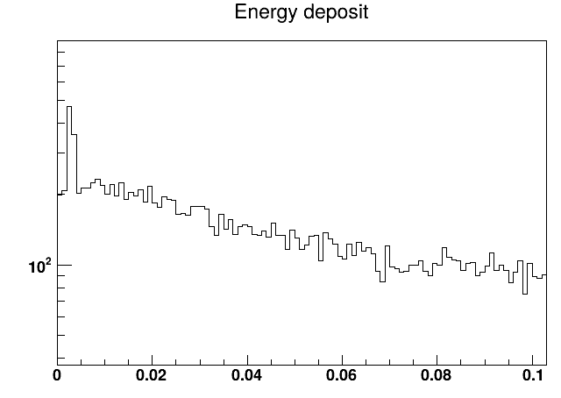
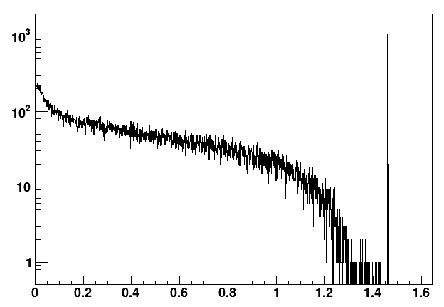
Preleminary results
⁴⁰K spectrum
1460.83 keV

Slide 5
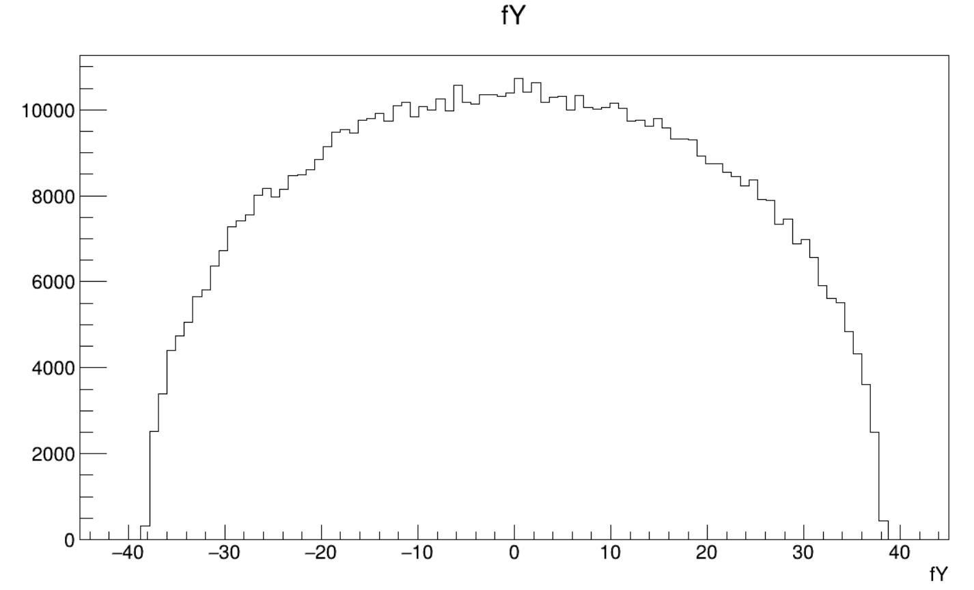
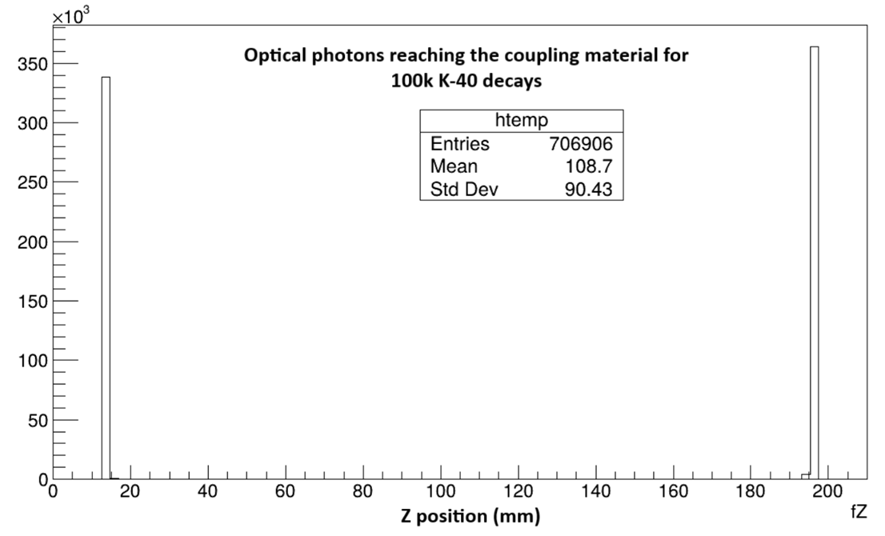
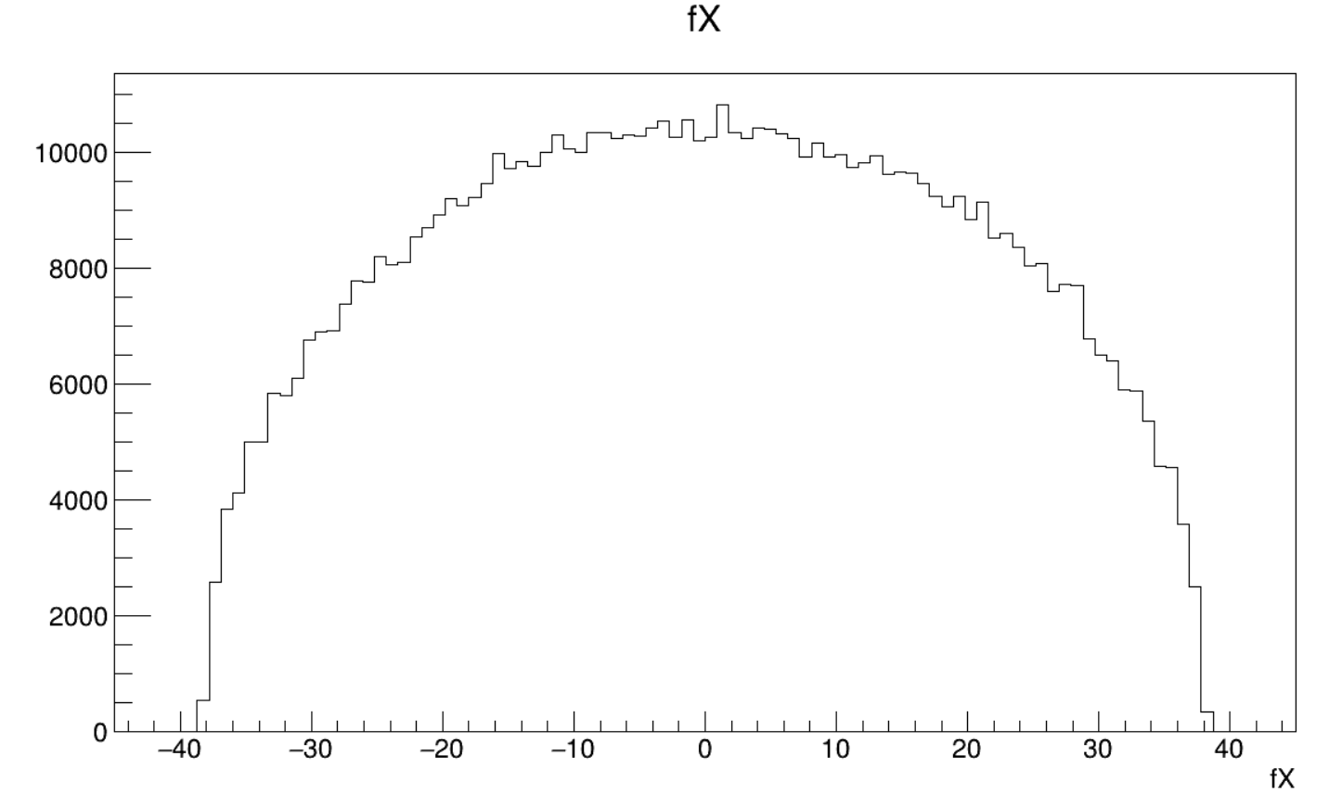
Preleminary results
Optical photons

Slide 6
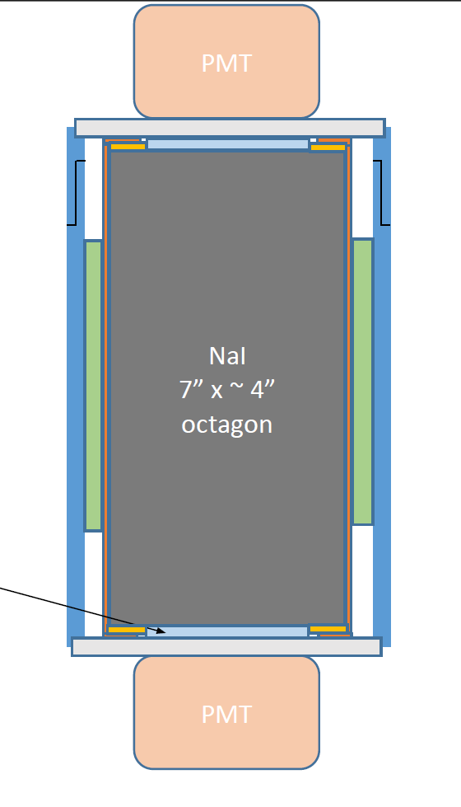
Outlook
Adding further components of the detector.
Possible introduction of contamination distributions resulting from the crystal growth (N.F. after Z.R.)
Reconstruction of alpha-emitters energies and Assessment of the quenching by particle-type.
Simulating PMT signal using the optical photons light from the crystal (optical).
Getting an estimation of the PMTs efficiency to be compared with upcoming measurements in Lecce.
Signal waveforms reconstruction for possible M.L. use.

Slide 7
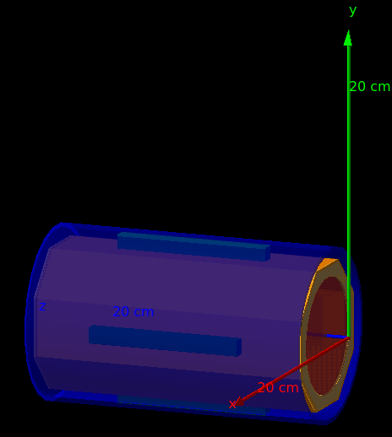
Any suggestions ?

