Slide 1
Crystal growth
Aldo Ianni
SABRE Collaboration meeting
Roma July 22nd, 2025

Slide 2
Since last meeting
A new crystal grown from COSINE200 powder
Performed several attempts to run a successful ZR
Improved understanding of ZR process to optimize the powder purification (see Daniele’s talk)

Slide 3
Crystal from COSINE200 powder
Received 15 kg of powder in-kind from COSINE Collaboration
Powder screening only at LSC by ICP_MS
Powder | ³⁹K [ppb] | ⁸⁸Sr [ppb] | ⁸⁵Rb [ppb] | ¹³³Cs [ppb] | ¹³⁸Ba [ppb] | ⁶⁵Cu | ²⁰⁸Pb [ppb]
in-kind Cosine-100 | 12.5 | <0.8 | <0.3 | 6 | 1.2 | 82±3.5 | 0.6
Astro Grade | ~4-18 | 0.3 | < 0.4 | < 1 | 3.6 | 79.4±2.8 | ~1
Note: LNGS has now the same spectrometer used at LSC. So, soon we can perform assay at LNGS with same
sensitivity

Slide 4
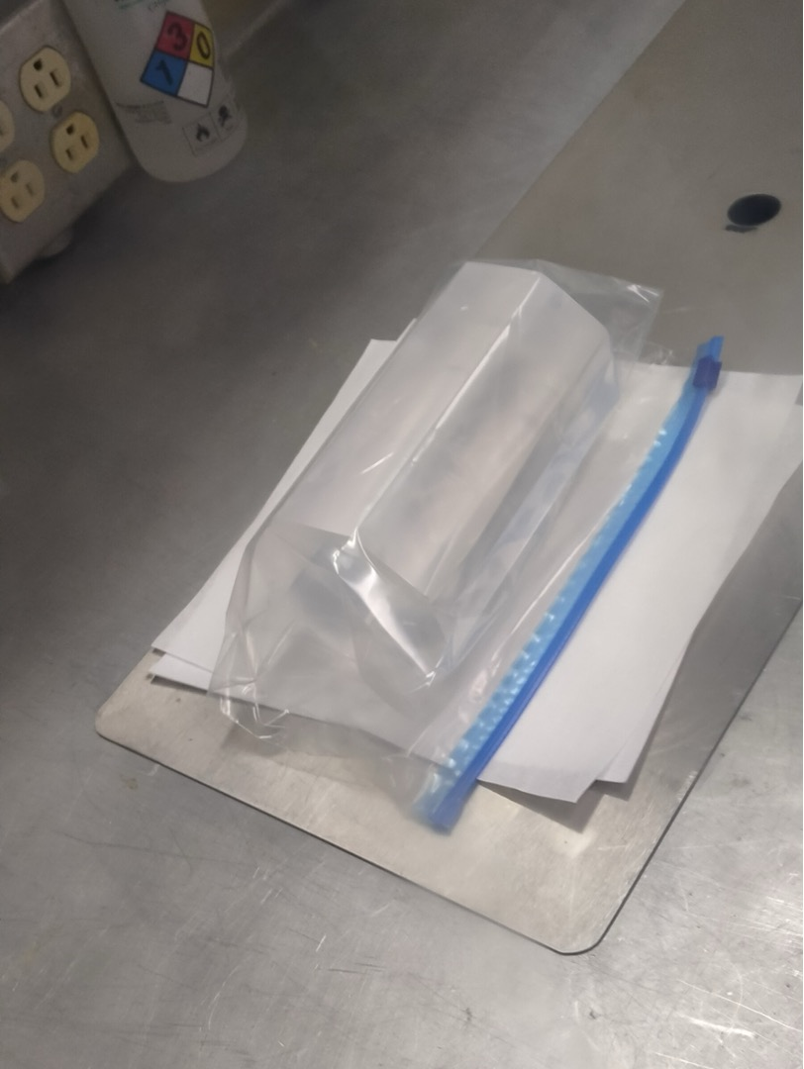
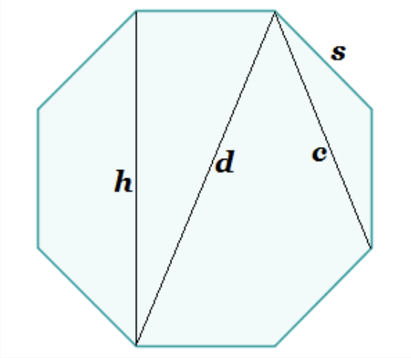
Crystal from COSINE200 powder
Mass: 3.65 kg
Dimensions: 152 mm length, 89.1 mm octagon side to side (h)
Copper enclosure dimensions: 162 mm length, 114.3 mm diameter, thickness: 2.75 mm

Slide 5
Summary of runs and tests for ZR
Run ID | date | tempertature of NaI during SiCl4 Celsius | minutes SiCl4 | vacuum after SiCl4 | gm of SiCl4 used (g) | gm of NaI | ampoule dimensions | prement location | premelt result | Final result | Comments | powder | NaOH certificate analysis | SiCl4 required
NAI-ZR-003 | 11/13/23 | 400-800 | 60+ | no | ? | 900 | 36x40 mm x 24" | RMD | ingot loose | ZR successful | ampoule sealed with SiCl4 inside. Purple liquid iodine visible inside ampoule. | MKCC0371 | 275 ppm | 290 mg
NAI-ZR-004 | 1/30/24 | 400 | 25 | yes | ? | 900 | 36x40 mm x 24" | RMD | ingot loose | ZR successful | good run | MKCC0371 | 275 ppm | 290 mg
NAI-ZR-005 | 8/29/24 | 400 | 15 | yes | 6.3 | 3342 | 48x52 mm x 48" | RMD | ingot loose | Explosion | Explosion maybe due to vacuum leak
NAI-ZR-006 | 11/15/24 | 400 | 10 | yes | 5.7 | 3785 | 48x52 mm x 48" | Mellen | ampoule cracked | No ZR | cracking probably due to sticking during early premelt in ZR, most of powder recovered
NAI-ZR-007 | 4/4/25 | 400 | 30 | yes | 16 | 3000 | 48x52 mm x 48" | Mellen | ampoule cracked | No ZR | cracking probably due to sticking during premelt in ZR, bigger container was used for SiCl4
NAI-ZR-008 | 4/28/25 | 400 | 10 | yes | 10 | 2500 | 48x52 mm x 48" | RMD | ampoule cracked | No ZR | cracking due to sticking during cooling after premelt, bigger container was used for SiCl4

Slide 6
Next
A new powder sample already drying
The repaired ampoule (large one) back at RMD next week
A new procedure should be submitted by SABRE for next test
What test

Slide 7
Commissioning of ZR equipment
ZR run | Date start | Date stop | Ampoule | Astrograde powder lot number | Loaded mass [gr] | ZR speed [mm/h] | Number of Passes
1 | 29-set-23 | 10-oct-23 | C coating | 76650 | 893 | 38 | 26
2 | 15-oct-23 | 6-nov-23 | C coating | 76650 | 900 | 50 | 51
3 | 4-gen-24 | 19-gen-24 | with SiCl₄ | MKCC0371 | 900 | 50 | 60
4 | 18-mar-24 | 8-apr-24 | with SiCl₄ /gas removed prior to ZR | MKCC0371 | 900 | 50 | 56

Slide 8
Summary of data from different crystals
* results from PoP run, PoP-dry run and run with only 30 cm Cu shielding in Hall B
** from ²⁴¹Am (59.6 keV)
 | Astro Grade powder | Mass [kg] | LY** [pe/keV] | ³⁹K [ppb] powder (Seastar) | ³⁹K [ppb] crystal (tip/tail) PoP | ²¹⁰Pb [mBq/kg] | Rate ROI [1,6]keV | ²¹⁴Bi-²¹⁴Po [ppt] (²³⁸U/ ²²⁶Ra) | ²¹²Bi-²¹²Po [ppt] (²³²Th)
NaI-31 | MKBW4911V | 3.00 | 9 | 8.0 | 18.5±0.7 14.6±3.0 | 1.02±0.07 | 2.74±0.03 | _ | _
NaI-33* | MKCC0371 | 3.40 | 11 | 4.3 | 4.1±0.6 2.1±1.4 | 0.51±0.02 | 0.95±0.05 | 0.47±0.05 | 0.40±0.07
NaI-35 | MKCC0371 | 4.36 | 9 | 4.3 | 8.0±1.0 | 0.53±0.01 | 1.26±0.03 | 0.18±0.03 | -
NaI-37 | 113065 | 4.35 | 7.8 | 17.7 | 8.0±0.7 | 0.79±0.01 | 2.57±0.05 | 0.61±0.05 | 0.27±0.06
NaI-40 | 76650 |  |  | 6.7 | 5.8±0.6 | _ | _ | _ | _
NaI-41 | 76650(80%)+MKCC0371 | 4.27 | 10 | 6.8 | 7.4±1.0 | 0.60±0.02 | 1.8±0.4 | 0.48±0.05 | 0.39±0.07

Slide 9
Funding 2025

Slide 10
2024 |  | 2025 | PO completed or under work | Allocated | New PO foreseen
Powder 50kg Funding CSN2 | 100.7 k€ | Powder 100 kg. Funding CSN2 | 220 k€ | PE machining: 25 k
Crystal from Korean powder + packaging + ICP-MS Funding PRIN-PNRR | 96 k€ | CAEN digitizer Funding CSN2 | 28.8 k€ | Outfitting experimental area: 45 SJ
NaI-42. Funding CSN2 | 34.5 k€ |  |  |  | RMD: one extra crystal
 |  |  |  |  | ZR

Slide 11
Funding 2026
From TDR
120k for enclosure (x7)
55k for PMTs (x10)
20k for labour and porterage
35k external reinforcement structure, lifting tools
20k GN2 consumption, CR chemicals, glove box
40k transport
No crystal production funded in 2025
Estimated 265k (x10)
We have been funded
342k for powder (this estimation included VAT)
145k for ZR

