Slide 1
Tofprad update
Giacomo Traini

Slide 2
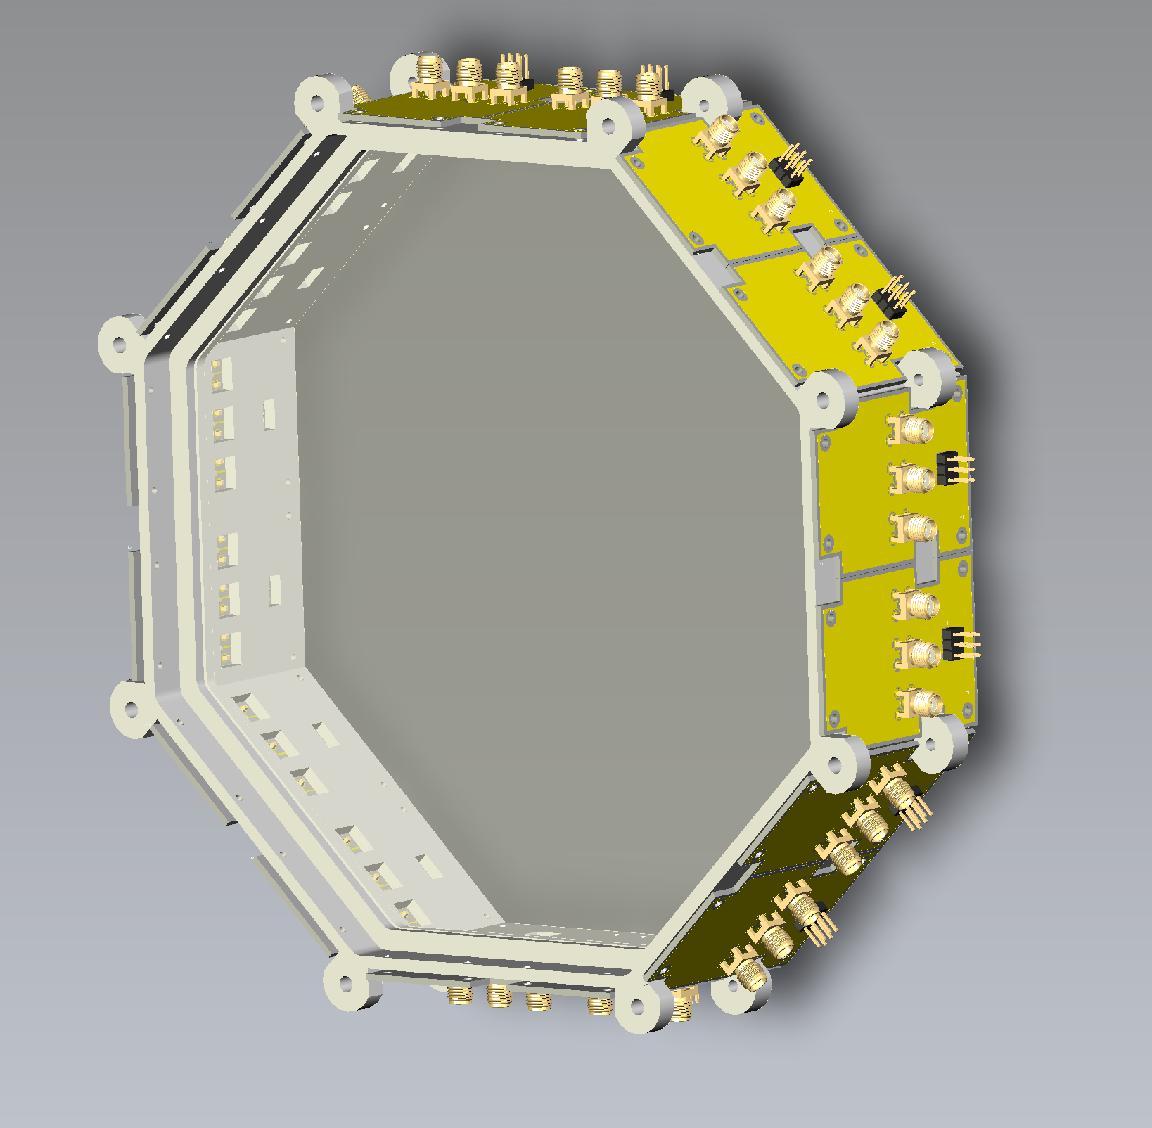

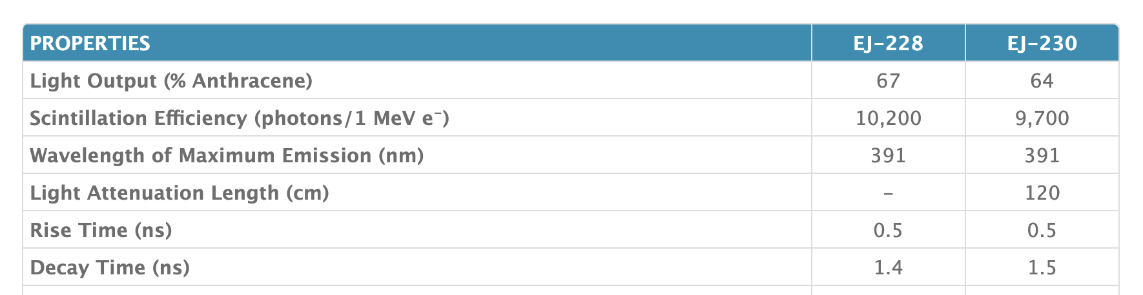
New start detector design
Design cryteria:
  Goal: resolution <100 ps with protons
  Larger area wrt the FOOT version
  Octagonal shape (less perimeter to cover with same ”useful area”)
  Increase light production ( 6 mm thickness vs 2 mm) and collection with respect to the current version (~95% of perimeter vs ~30%)
  Best scenario: provide x,y position of protons and avoid second tracker
~20 cm

Slide 3

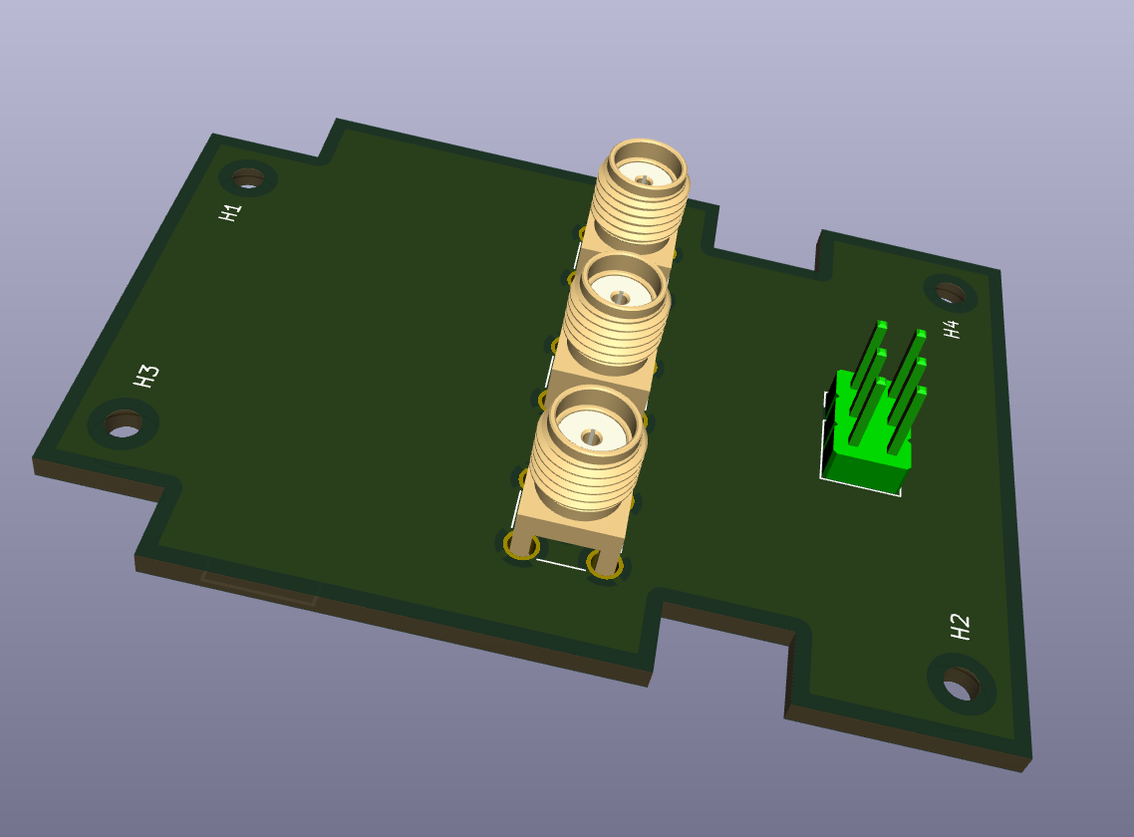
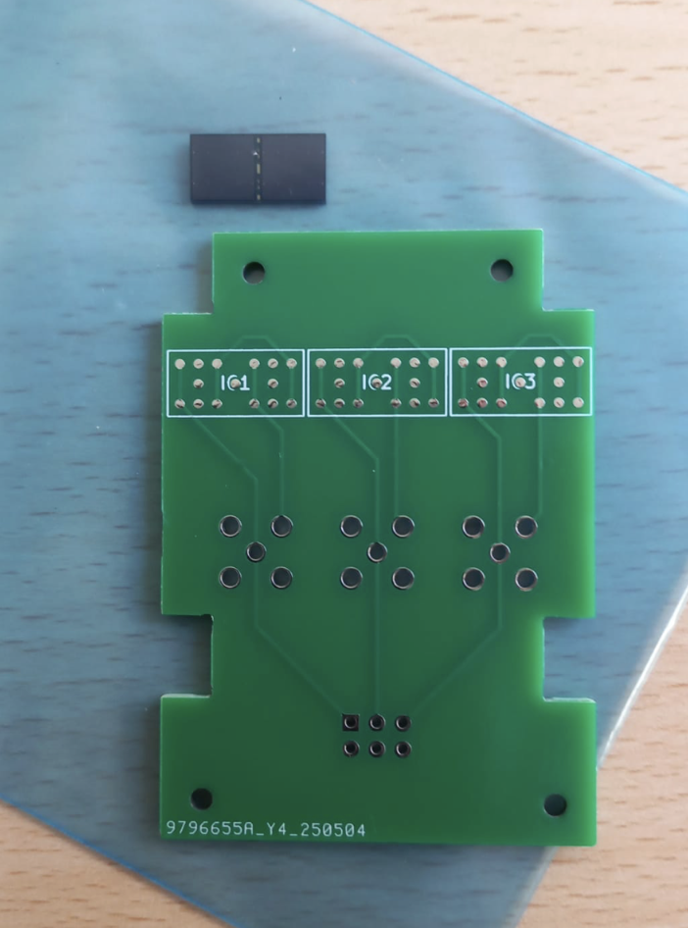
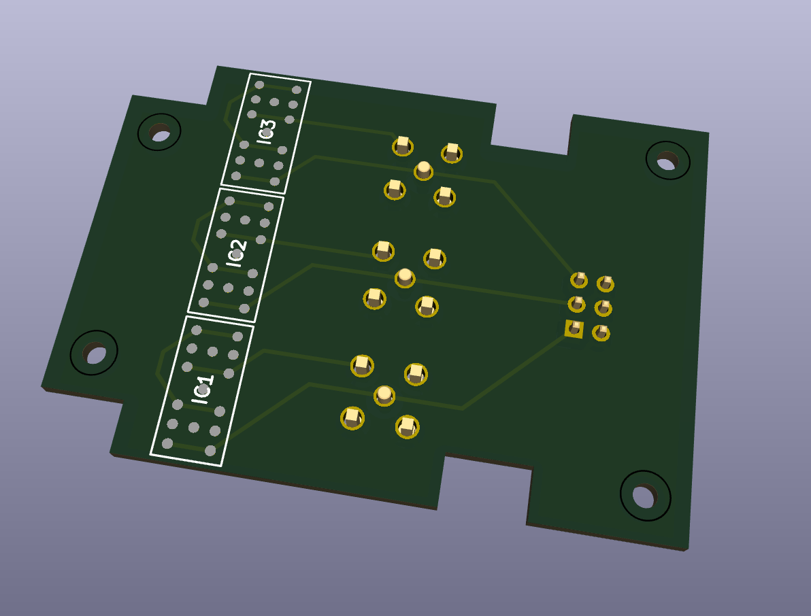
Read-out electronics
SiPM 6x6 mm² by Broadcom: ordered 60 (6 SiPM x8 sides + some spare), 22 already arrived, the rest in July.
48 channels formed by SiPM couples connected in series
Custom PCB (no active element, thought to be connected to WaveDAQ for SiPM bias and readout though SMA cables )
Ordered SMA cables (delivery expected in 2-3 weeks)
Additional connector for future upgrades (CAEN board?)

Slide 4
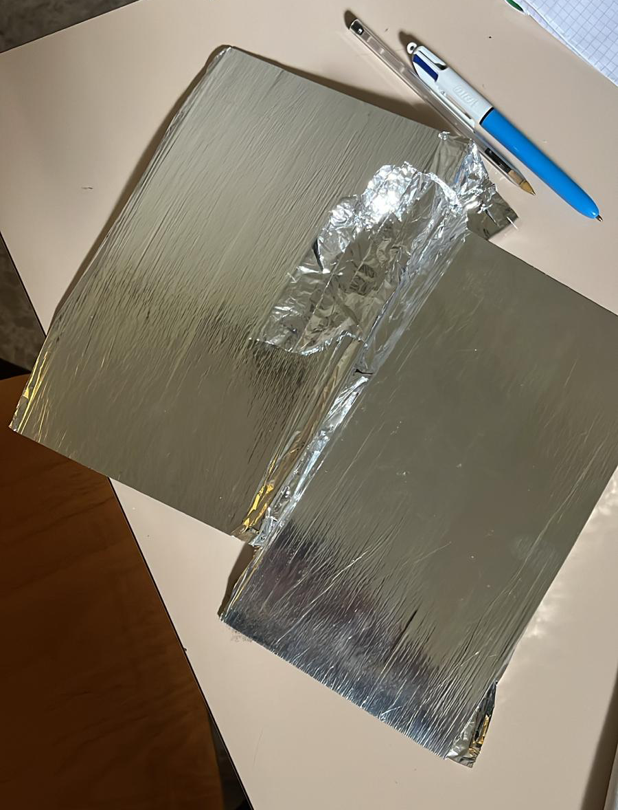
Trackers
Fiber planes (1 mm side), surface ~ 10x10 cm²
Mylar covering to reduce cross-talk between planes
Marco Magi will provide to cut the planes and design the frame
Electronics from Pisa (presumably not ready for CNAO)

Slide 5
Test @ CNAO
Shift: 7 June (22.00-6.00), 8 June (22.00-4.00)
Octagon with reduced thickness (1 mm), read-out just for 4 sides. The scintillator sample is cutted and polished by Marco Magi from a squared, old scintillator that we already have in lab
The final scintillator has been bought from Eljen with octagonal shape, hoping a better polishing on the side…
Logistic:
How many people? How much money we have?
Roma van is available
Tentative schedule:
  Thursday 5th June, arrive @ Pisa in the evening
  Friday 6th June, travel + mounting
  Saturday 7th June: waiting for the beam + beam
  Sunday 8th June: waiting for the beam + beam
  Monday 9th June: dismounting + travel

