Slide 2
Contents
Acceleration and Speed of Light
Evolution of proton/ion acceleration
Pulsed SRF becomes a major actor
Back to CW

Slide 3
Contents
Acceleration and Speed of Light
Evolution of proton/ion acceleration
Pulsed SRF becomes a major actor
Back to CW

Slide 4
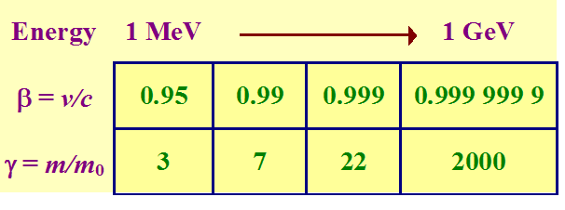
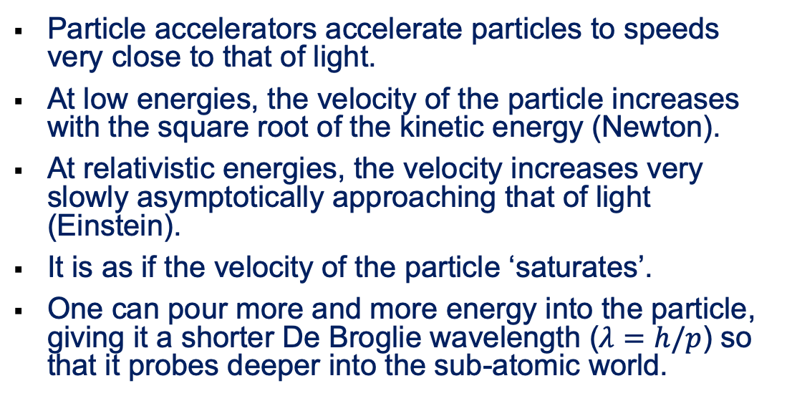
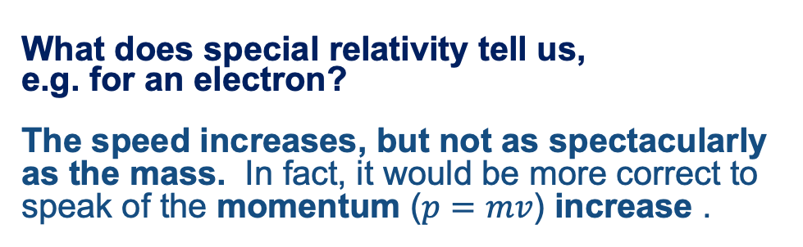
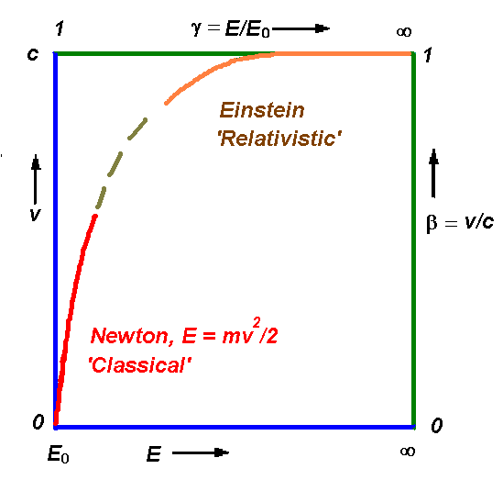
Particle Acceleration
Particle accelerators accelerate particles to speeds very close to that of light.
At low energies, the velocity of the particle increases with the square root of the kinetic energy (Newton).
At relativistic energies, the velocity increases very slowly asymptotically approaching that of light (Einstein).
It is as if the velocity of the particle ‘saturates’.
One can pour more and more energy into the particle, giving it a shorter De Broglie wavelength ($λ=h/p$) so that it probes deeper into the sub-atomic world.
What does special relativity tell us,
e.g. for an electron?
The speed increases, but not as spectacularly as the mass. In fact, it would be more correct to speak of the momentum ($p=mv$) increase .

Slide 5

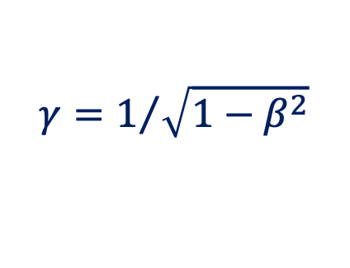

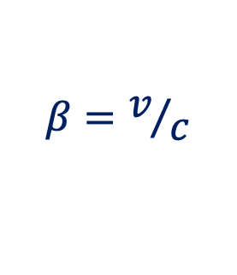



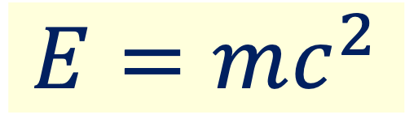

Energy and Mass
$$m=γm_{0}$$
$$E_{0}=m_{0}c^{2}$$
$$E=mc^{2}$$
$$γ=1/{\sqrt{1−β^{2}}}$$
$$β=v/c$$
Momentum
Kinetic energy
$$p=mv=γm_{0}v≈γm_{0}c$$
When $v≈c$
$$W_{k}=E−E_{0}=\left(γ−1\right)m_{0}c^{2}$$
Speed of light: c ≡ 2.99792458 ⋅ 10⁸ ms⁻¹
Energy unit: 1 eV = 1.6021 ⋅ 10⁻¹⁹ J
Electron rest energy: E₀ = 0.511 MeV
Proton rest energy: E₀ = 938 MeV

Slide 6
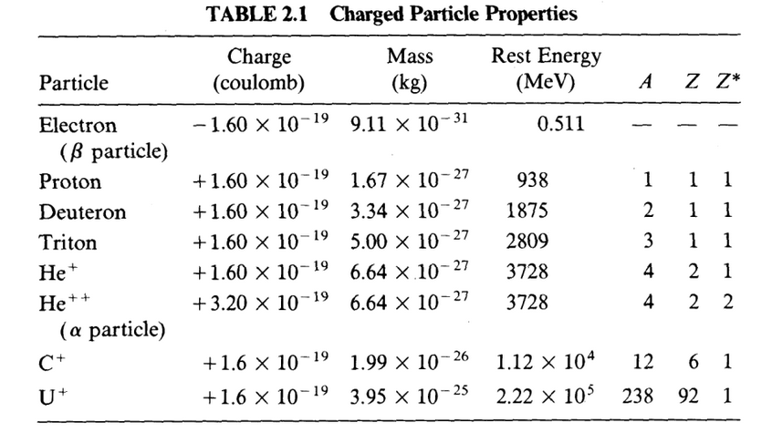




Properties of some charged particles
The electronvolt, eV, is the amount of (kinetic) energy gained by one elementary charge e moving across an electric potential difference of one volt.
$$1 e∗1 V=1 eV$$
$$1 C∗1 V=1 J$$
$1 e=1.6021∗{10}^{−19}$ C
$1 eV=1.6021∗{10}^{−19}$ J

Slide 7
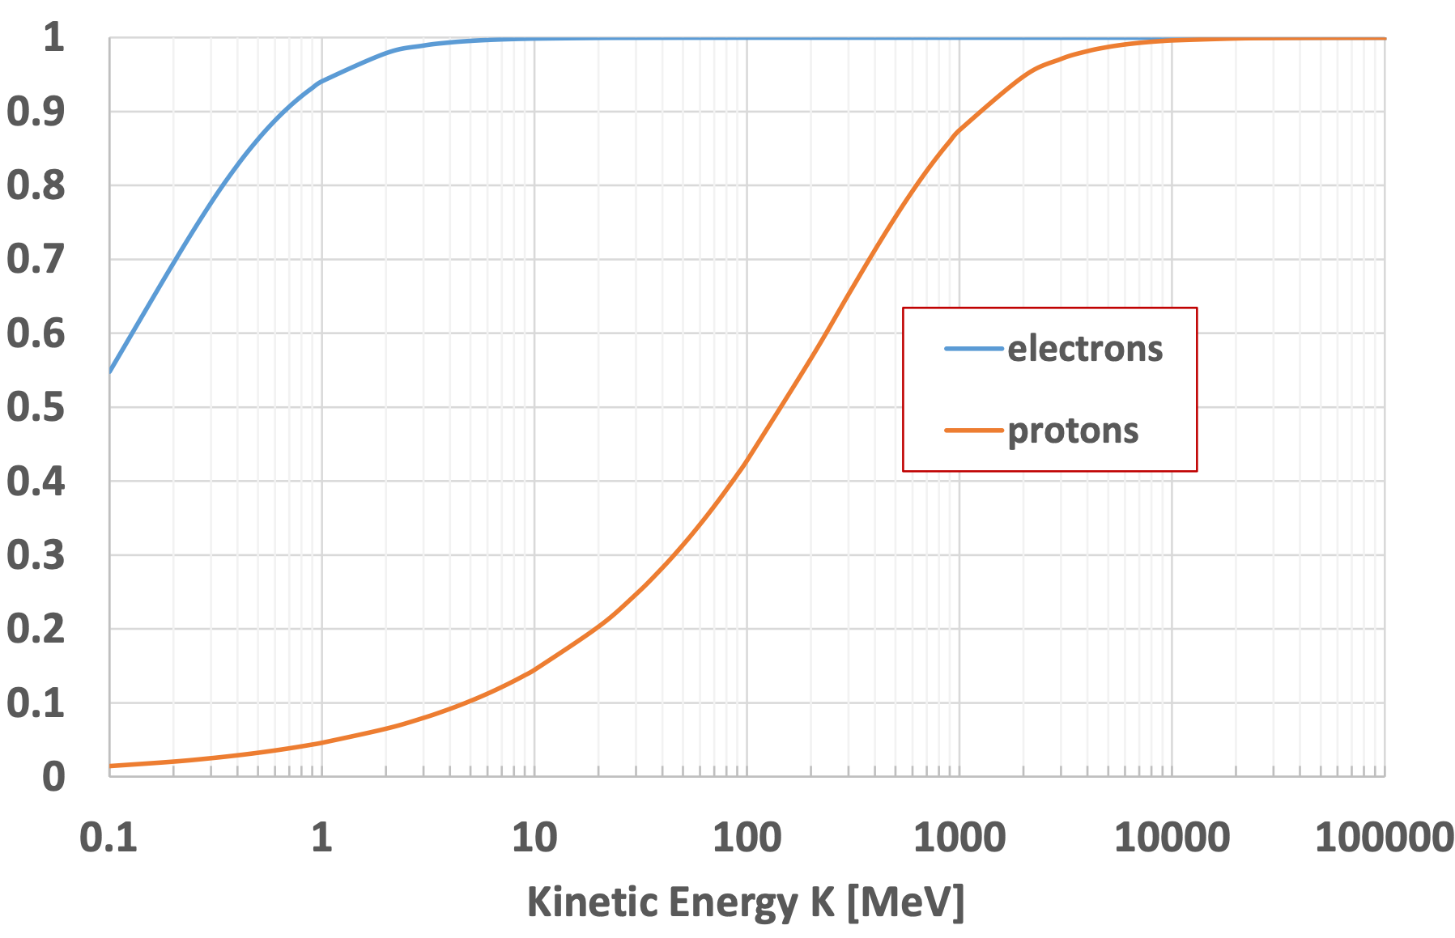
Speed Increase and its Saturation
E_{0, electron} = 0.511 MeV
E_{0, proton} = 938 MeV
β = v/c
E_{0, electron}
E_{0, proton}

Slide 8
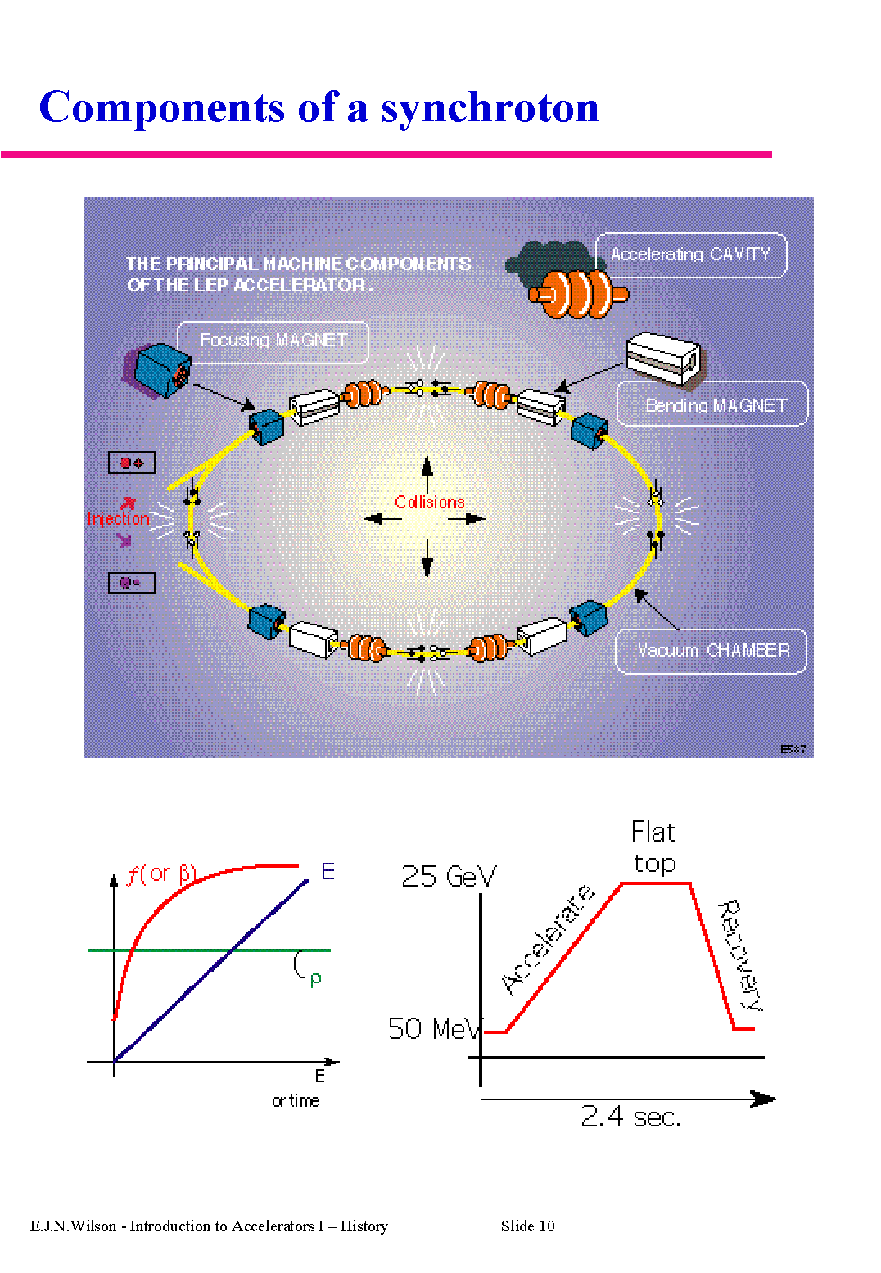
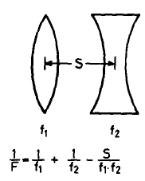
RF acceleration: Synchrotron at $β≈1$
Cyclotron: constant B
Synchrotron: constant ρ
Accelerating cycle
Strong focusing concept
The LEP Example
For v ≈ c
E [GeV] ≈ 0.3 B [T] ·ρ [m]

Slide 9
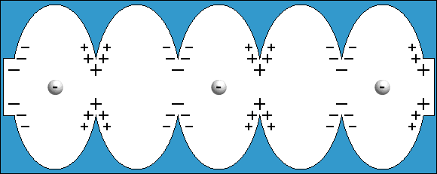
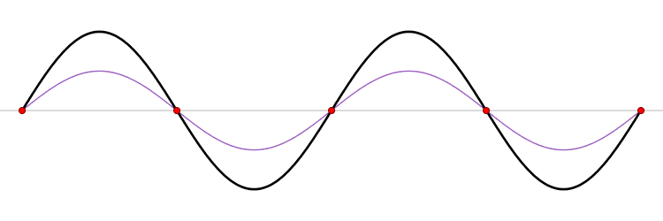
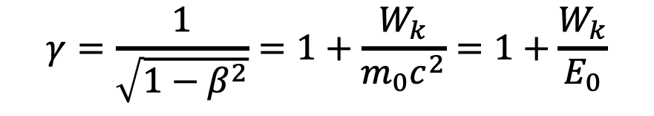
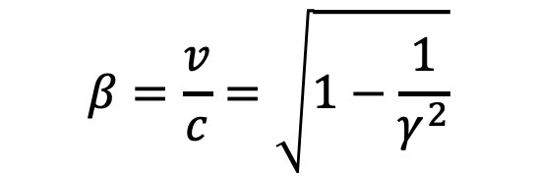
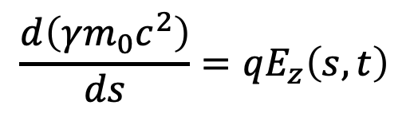
RF Acceleration - Electrons
For electrons the life is easier. A few MV are sufficient to stabilize their speed, close to the speed of light.
The particles of the beam need to be localized in bunches and properly phased with respect to the field so that the beam is gaining energy
$$β=\frac{v}{c}=\sqrt{1−\frac{1}{γ^{2}}}$$
$$\frac{d\left(γm_{0}c^{2}\right)}{ds}=qE_{z}\left(s,t\right)$$
$$γ=\frac{1}{\sqrt{1−β^{2}}}=1+\frac{W_{k}}{m_{0}c^{2}}=1+\frac{W_{k}}{E_{0}}$$
Standing Wave
TM₀₁₀ mode

Slide 10
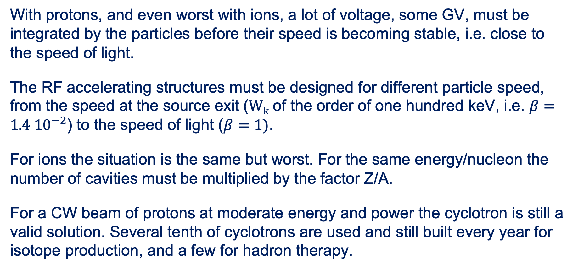
RF Acceleration – Protons (and ions)
With protons, and even worst with ions, a lot of voltage, some GV, must be integrated by the particles before their speed is becoming stable, i.e. close to the speed of light.
The RF accelerating structures must be designed for different particle speed, from the speed at the source exit (W_{k} of the order of one hundred keV, i.e. $β=1.4 {10}^{−2}$) to the speed of light ($β=1)$.
For ions the situation is the same but worst. For the same energy/nucleon the number of cavities must be multiplied by the factor Z/A.
For a CW beam of protons at moderate energy and power the cyclotron is still a valid solution. Several tenth of cyclotrons are used and still built every year for isotope production, and a few for hadron therapy.

Slide 11
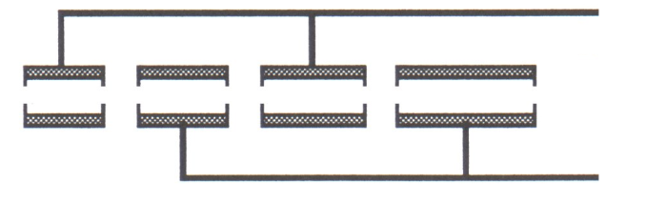
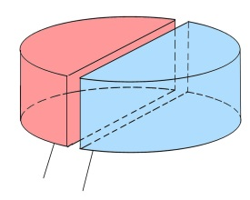
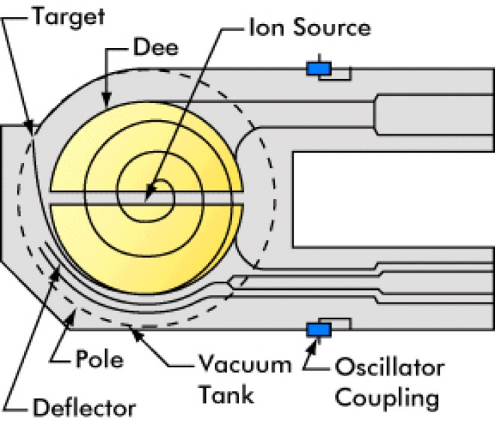
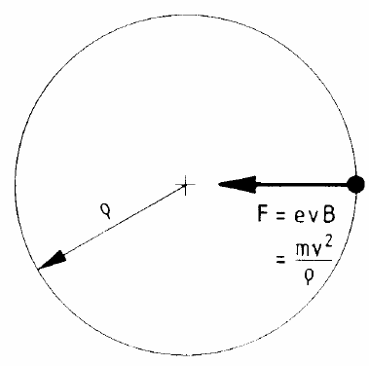
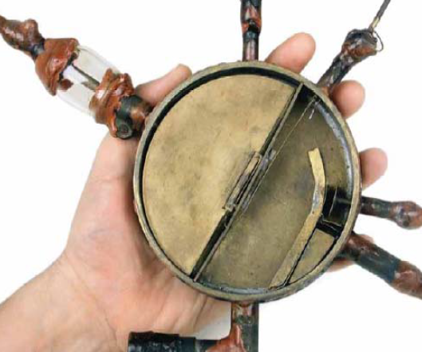
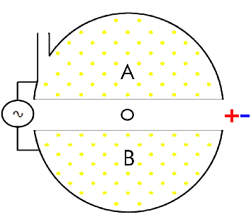
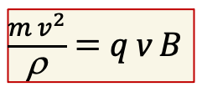
Cyclotron for moderate Energy
Folded Wideroe Linac in a constant magnetic field
$\frac{{m v}^{2}}{\text{r}}$ = q v B
For m and B = constant
also f_{rev} = constant
E_{c} /A [MeV] = K_{cycl.} (Z/A)²

Slide 12
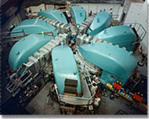
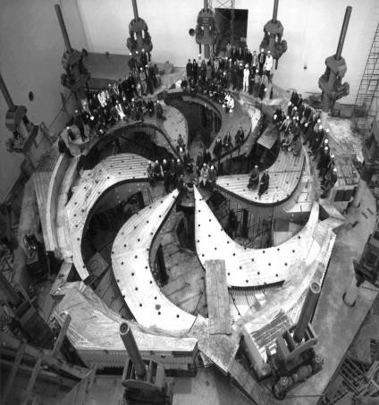
The Big Ones: PSI & TRIUNF
accelerating cavity sector magnet
PSI: K=590 Cyclotron,
2.5 mA, 590 MeV, P_{beam} > 1MW
TRIUNF: K=500 Cyclotron,
0.2 mA, 500 MeV, P_{beam} > 100 kW

Slide 13
Contents
Acceleration and Speed of Light
Evolution of proton/ion acceleration
Pulsed SRF becomes a major actor
Back to CW

Slide 14
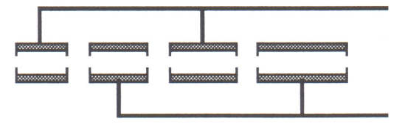
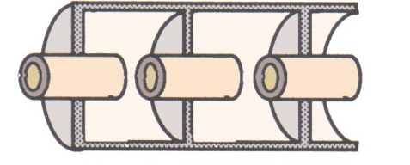
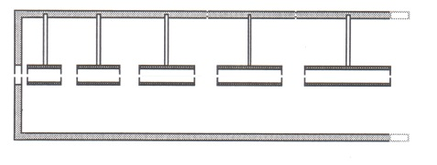
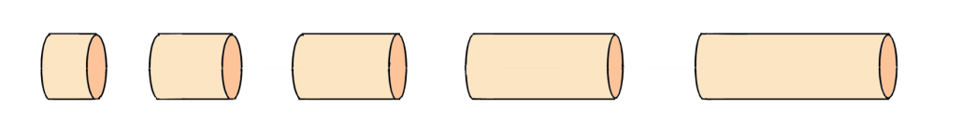
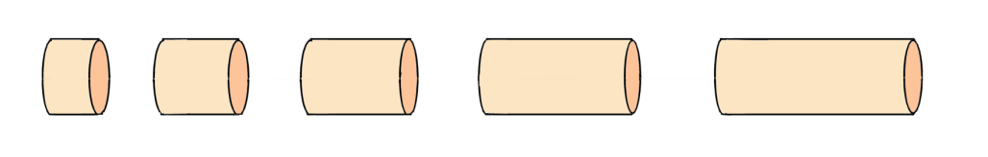
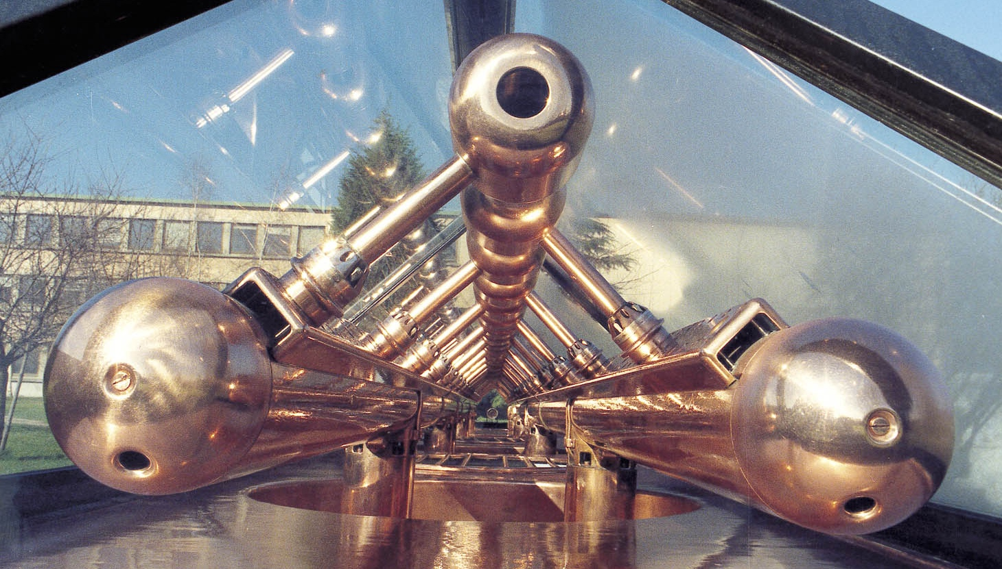
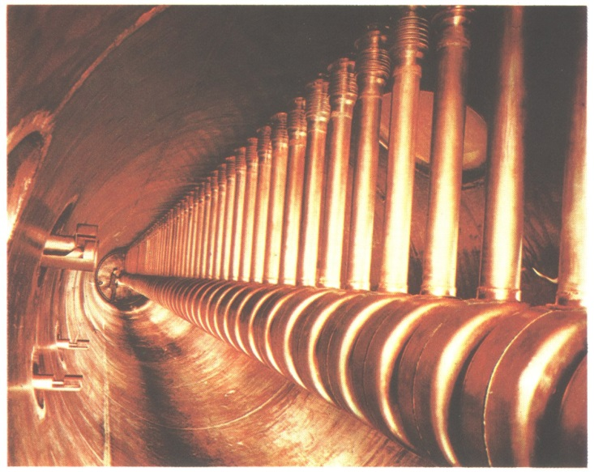
French Linear Accelerators in 1946
π mode
2π mode
Historical examples: a Wideroe type structure
(ALICE heavy ion injector, IPN Orsay)
A drift tube linac (DTL – Alvarez type)
(Saturne, CEA Saclay)

Slide 15
Since seventies RFQ is a main actor
From the exit of the source and up to a few hundreds of MeV, the proton (ion) beam is slightly relativistic, its speed practically follows the classical mechanics lows and it’s proportinal to the square root of the energy.
In a DTL (Drift Tube Linac) to maintain the synchronism with a certain frequency, the length of the drift tubes should doubles each time the beam energy change by a factor of four.
It turns out that a DTL is not performing efficiently when the injection energy is too low (50-100 keV). The non-trivial effort of developing sources at higher voltage (200 kV and above) was partially overcoming this problem.
The invention of the Radio Frequency Quadrupole, RFQ, gave a bright solution to this problem, smoothly transforming the CW, low energy, beam from the source to a few MeV bunched beam, ready for the injection into the DTL.

Slide 16
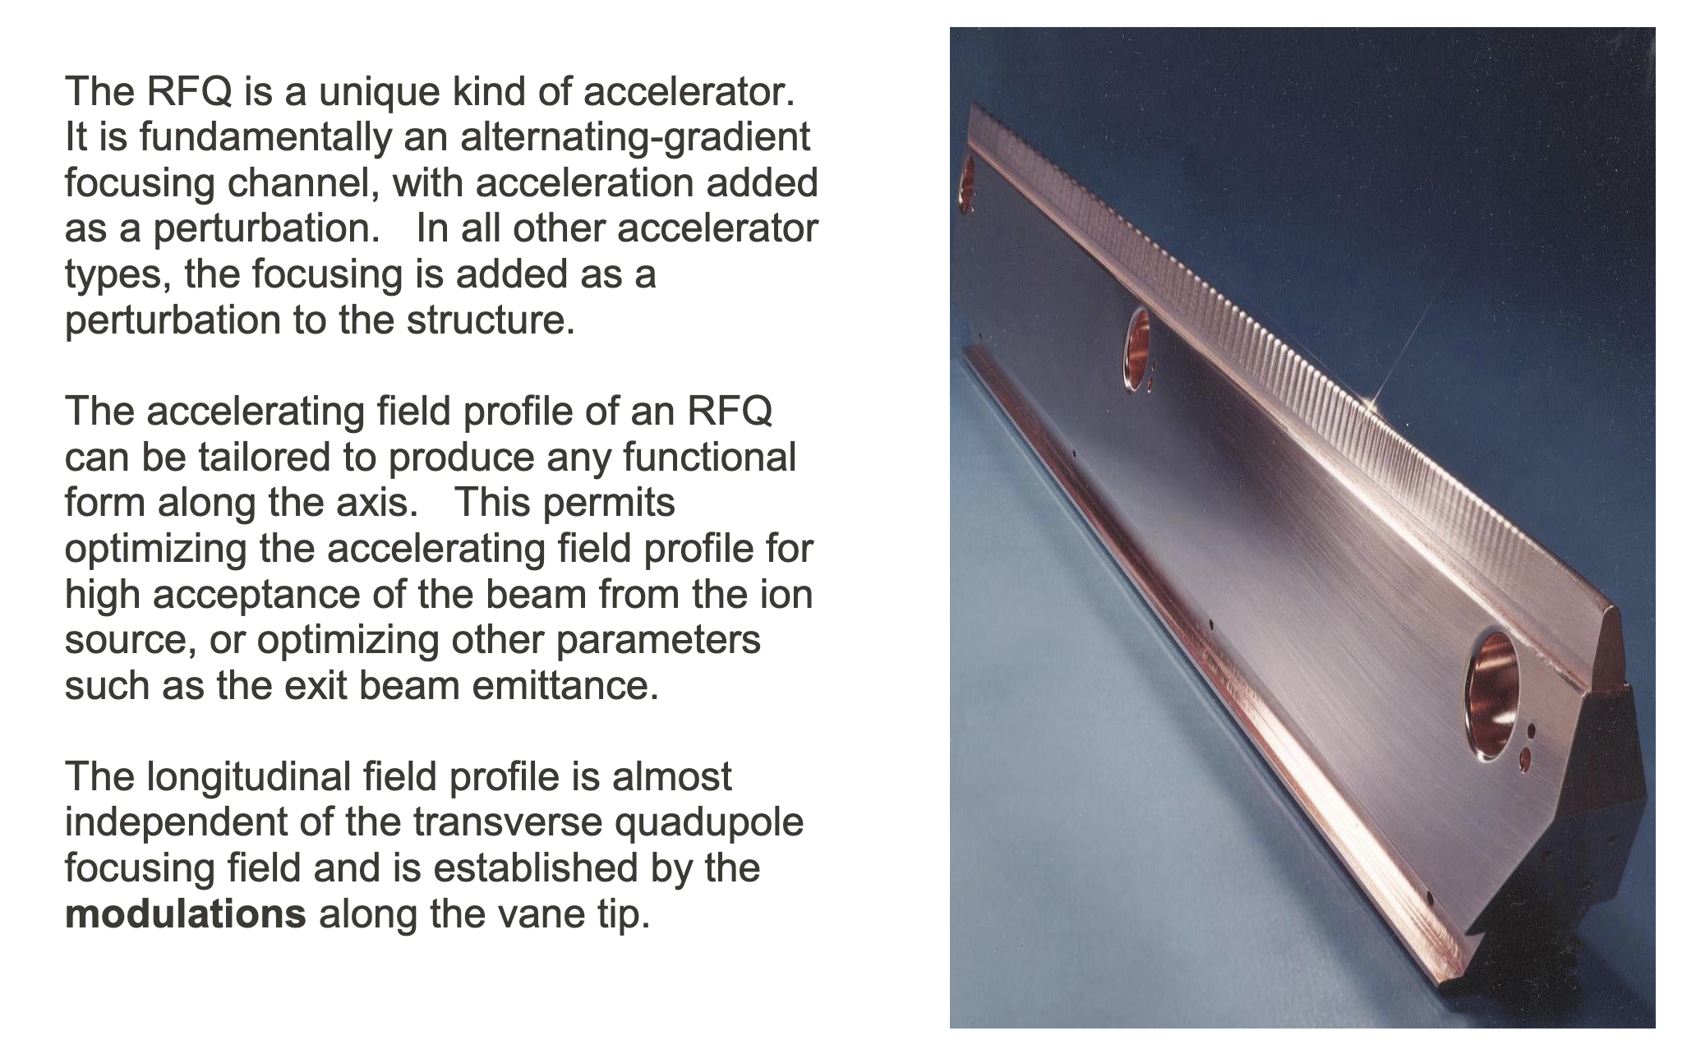
About the RFQ - 1
1970
RFQ invented by:
I. M. Kapchinsky and Vladimir Teplyakov
From SNS CDR

Slide 17
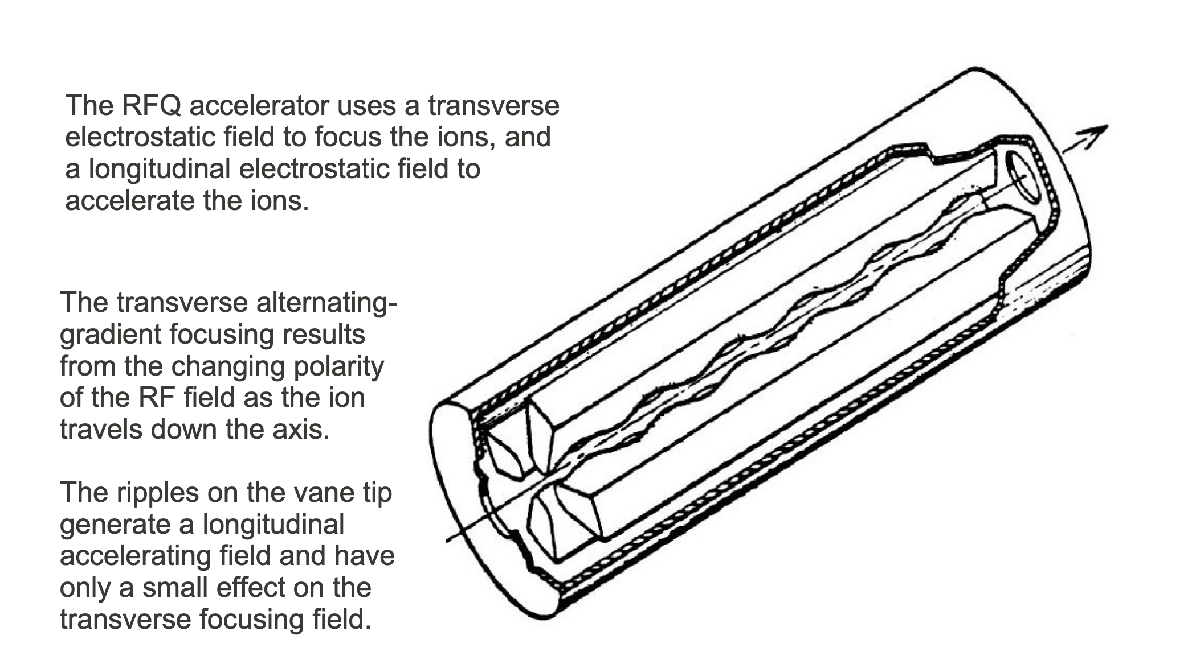
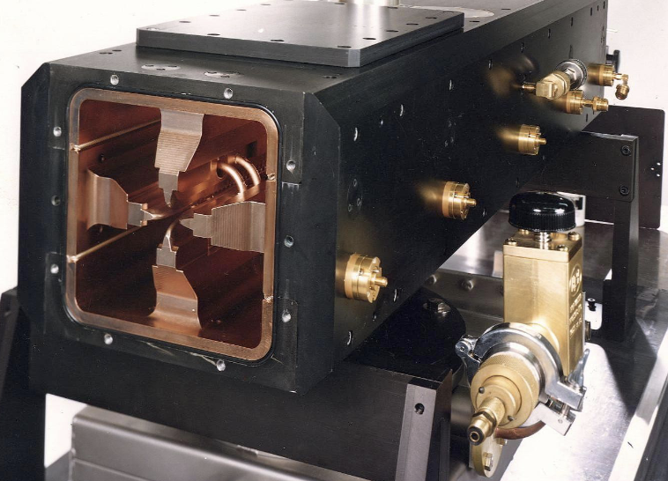
About the RFQ - 2
From SNS CDR

Slide 18
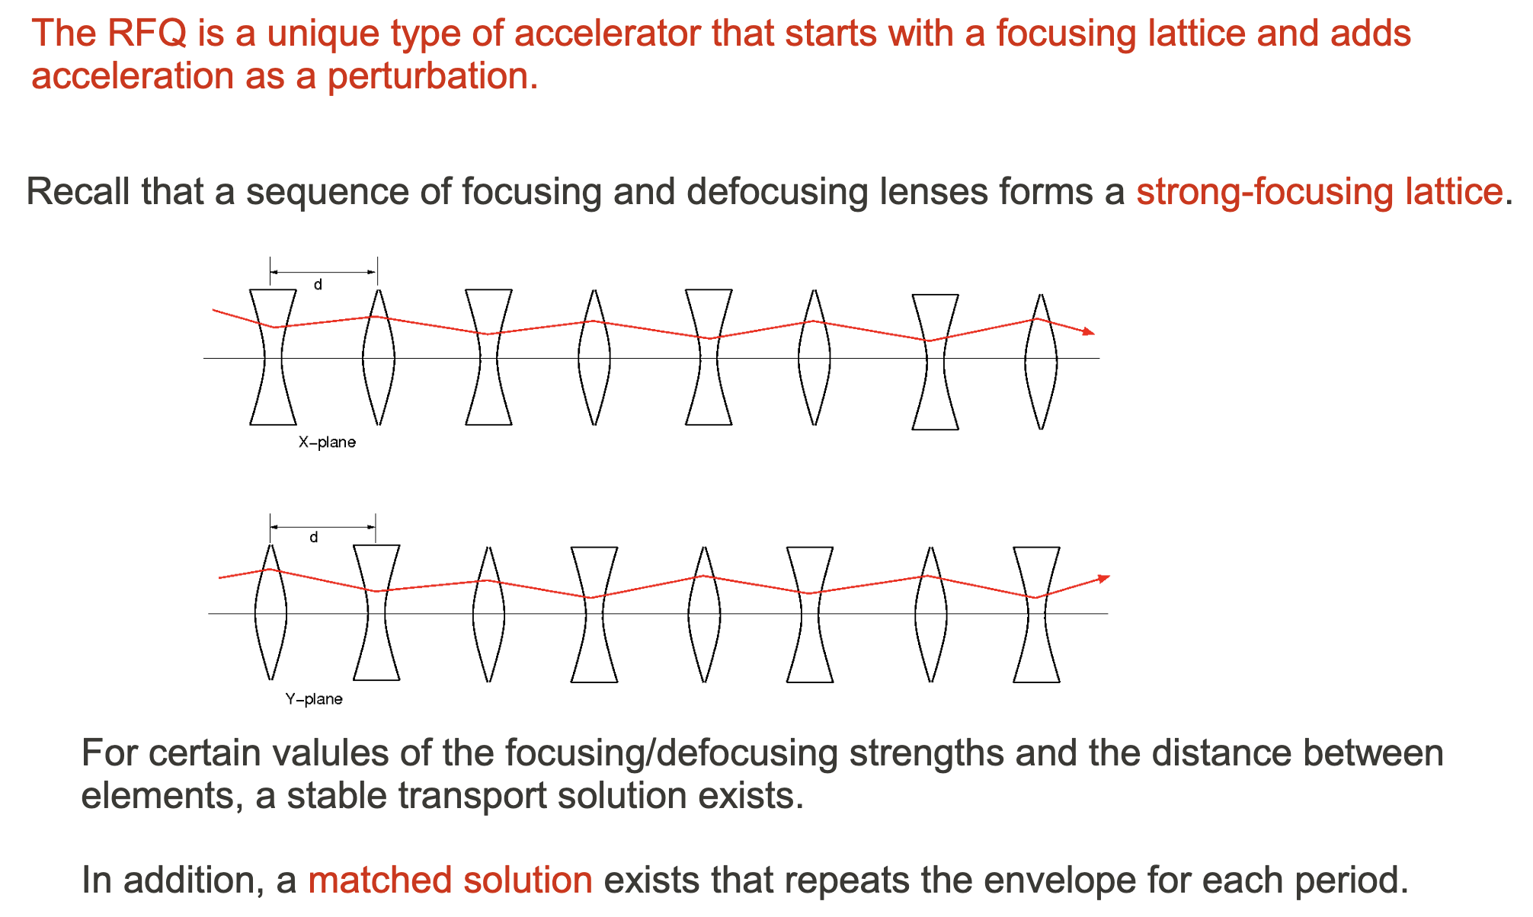
About the RFQ - 3
From SNS CDR

Slide 19
RFQ Technological Problems for CW
RFQ is great but to be efficient needs very high electric field to have adequate focussing forces and to reduce the length
For several years RFQ have been designed and built just for pulsed operation with a modesf duty factor < 1%.
As a consequence RFQs were mainly develotted for low energy proton and ions accelerators for nuclear physics, Good alternative to Tandem and Van der Graaf DC accelerators
First CW RFQ, called LEDA, developped at Los Alamos for the APT/ATW projects at the end of past century. Nominal parameters:
LEDA was switched off after ca. 100 hours of succesfull operation !!!
Since then a few CW RFQs have been designed and operated with currents of tenths of mA. The best examples are the two RFQ developped by IHEP and IMP for the CADS project
  H⁻ Injection energy: 75 keV
  Output Energy 6.7 MeV
  CW current >100 mA
  Beam Power >670 kW
  Total RF power > 2 MW
  Cooling power 1.5 MW

Slide 20
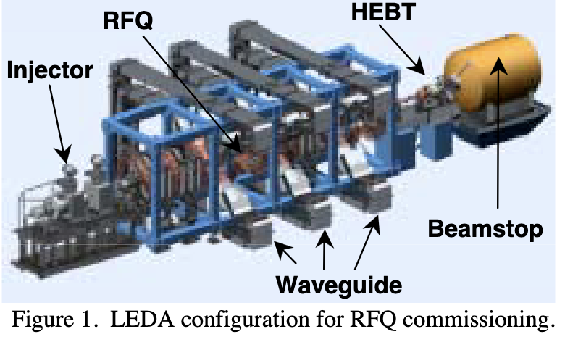
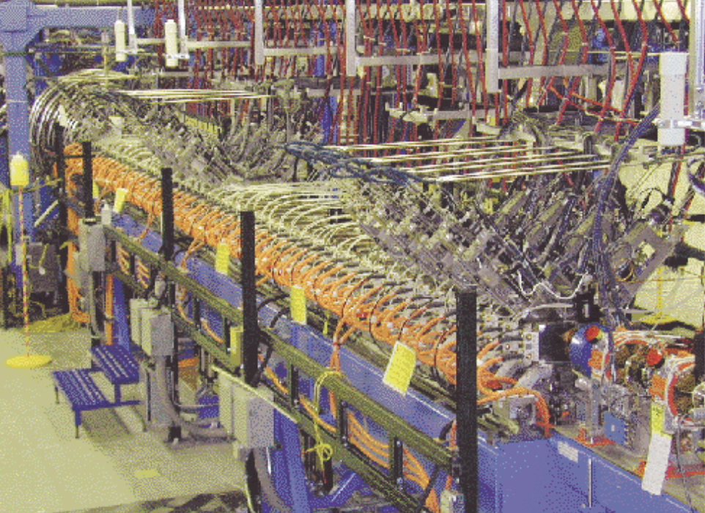
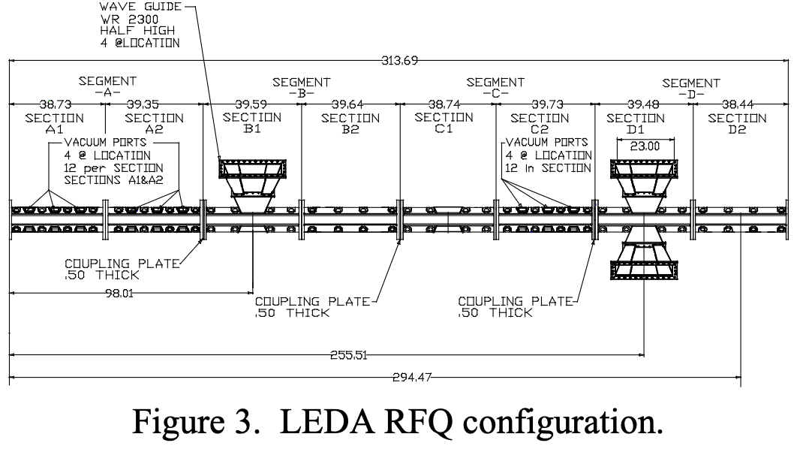
The LEDA RFQ at Los Alamos

Slide 21
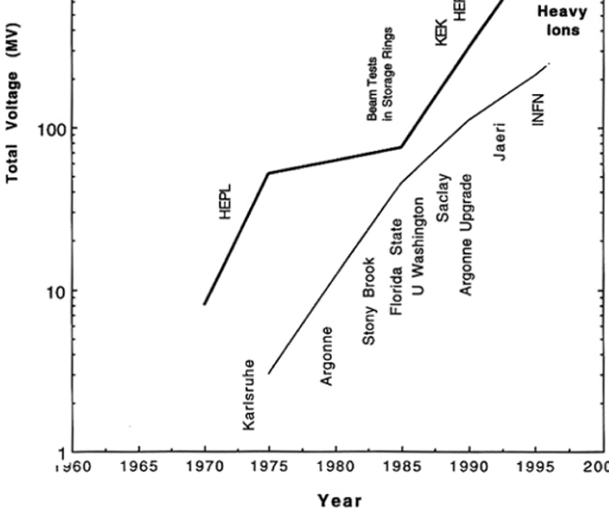
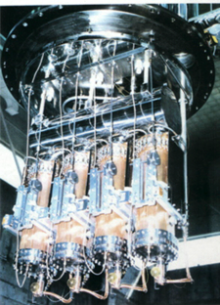
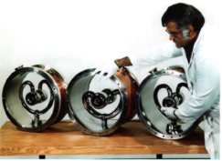
Normal Conducing Linac until mid-nineties
A part of a few CW, low current, ion accelerators, SRF was not considered until mid nineties for high power, non-fully relativistic, proton beams.
Up to mid-nineties all the high intensity proton linacs that have been built were pulsed and normal conducting.
Their scope was substantially that of injecting moderate energy beams (few hundreds of MeV) into large synchrotons (as PS, SPS, TEVATRON, etc.) for high energy collisions.
SRF ion accelerators

Slide 22
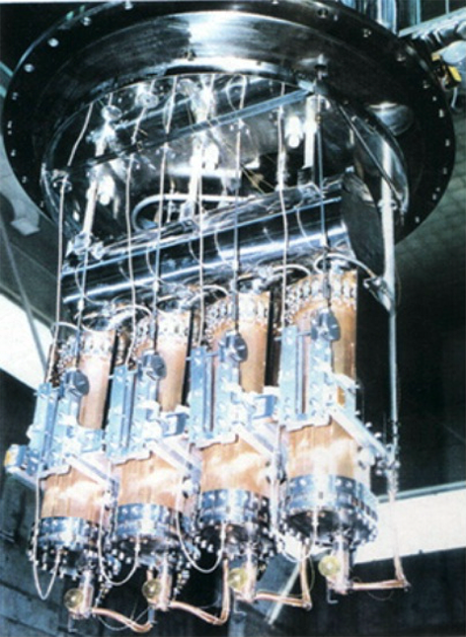
In parallel a few SRF CW Linacs for Ions
  New Projects in the nineties
    Stony Brook
    JAERI,
    Washington University
    Argonne upgrade,
    Legnaro
  Improved cavity designs
  Higher accelerating fields, limited by:
    Microphonics
    No beam vacuum separation
Group of four Quarter-wave cavities for the JAERI Heavy-ion Linac

Slide 23
Contents
Acceleration and Speed of Light
Evolution of proton/ion acceleration
Pulsed SRF becomes a major actor
Back to CW

Slide 24
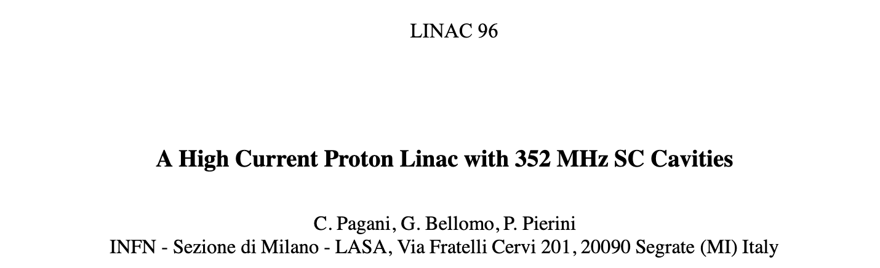
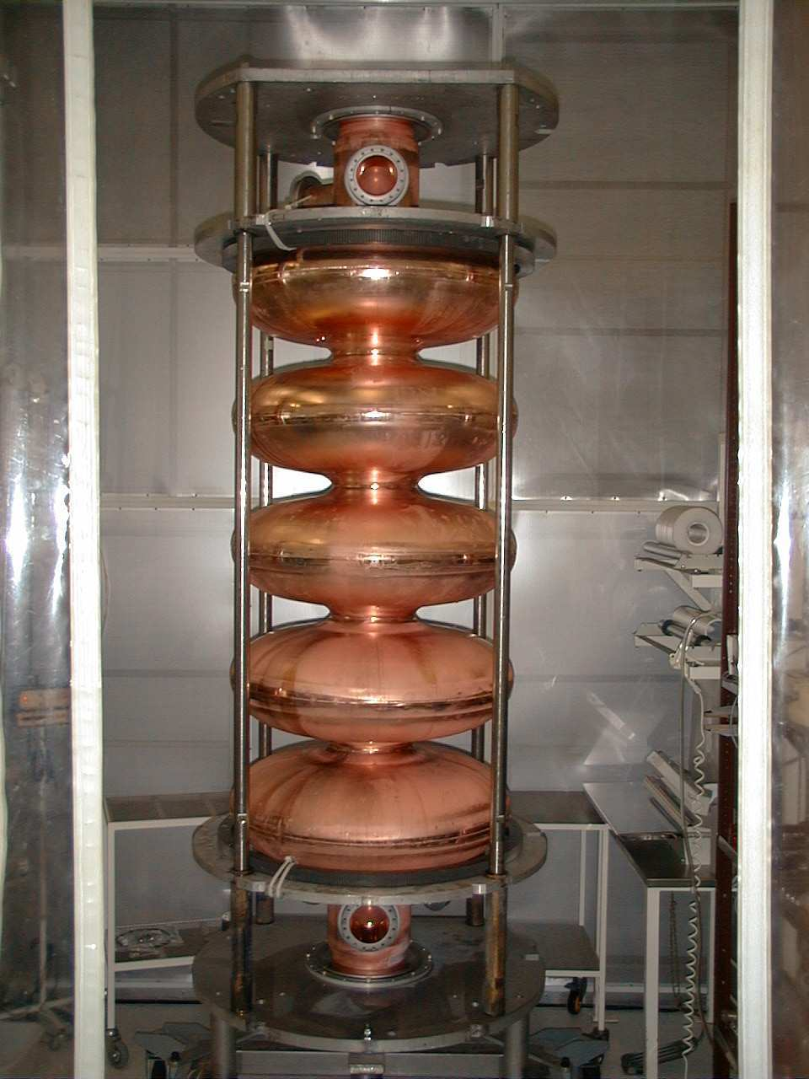
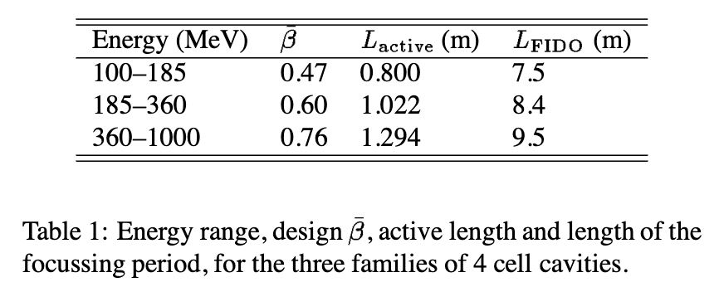

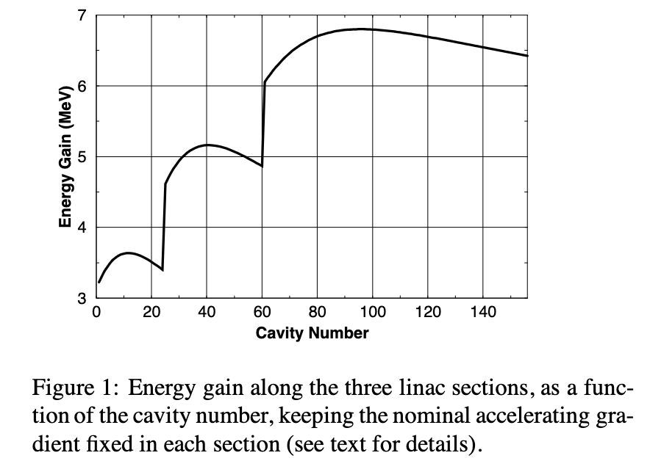
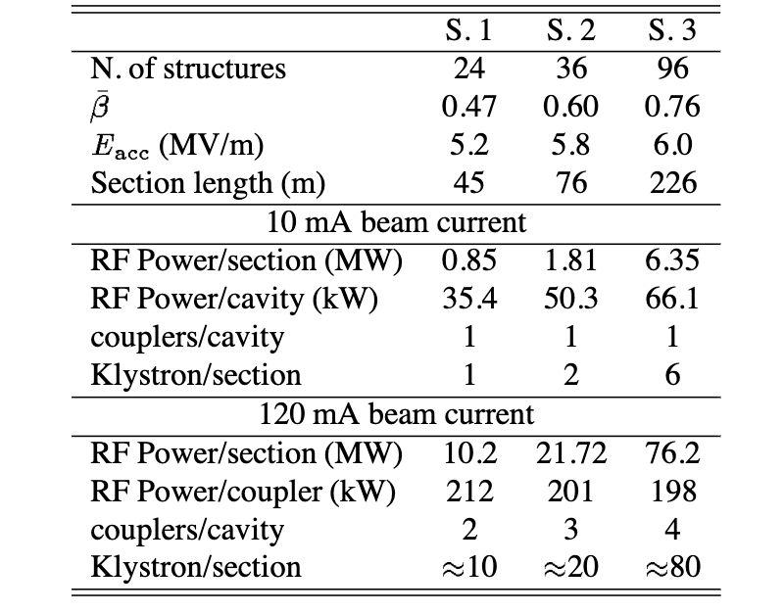
Pioneering Proposal for SRF above 100 MV
β = 0.85 done with CERN

Slide 25
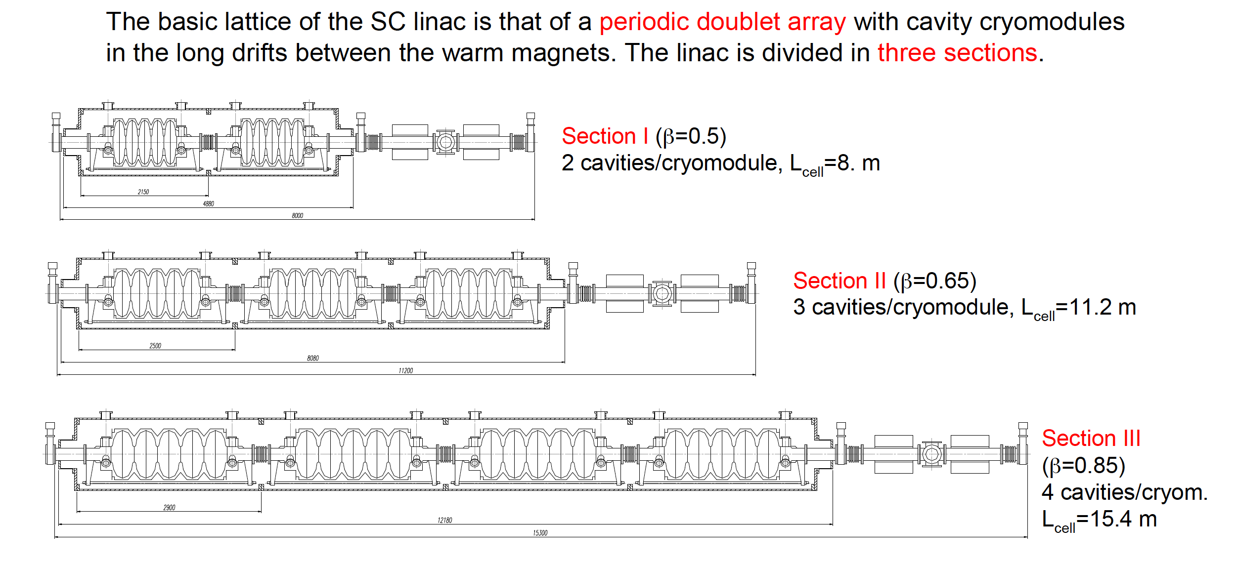
The TRASCO Project as in 1998

Slide 26

European ADS: EUROTRANS conclusion
The conceptual design of ADS accelerator once frozen: a highly-modular SC linac
Several R&D activities have been successfully performed, leading to design choices & recommendations

Slide 27


Elliptical Cavity Issues for β < 1
elliptical cavities have seen designs starting at β ≥ 0.5 for cw application (β ≥ 0.6 ffor pulsed for high energy acceleration (SNS, ESS)
Elliptical cavities have intrinsic problems for lower velocity acceleration – in π mode the cell to cell distance is βλ/2 but the diameter is ~0.9 λ so cell length/diameter~ β/2 and the cavity starts to look like a bellows – mechanical stability, multipacting and low RF efficiency are all issues
Bob Laxdal - Non Elliptical Cavities
SRF 2017

Slide 28
European ADS pushed other projects
Brookhaven National Lab
December 6-8, 1999
SNS – ASAC Meeting
Proton SRF Activities in Europe
Carlo Pagani
INFN Milano-LASA & University of Milano
ISTITUTO NAZIONALE DI FISICA NUCLEARE
SEZIONE DI MILANO

Slide 29
SNS and RIA acknowledged our contribution

Slide 30




SNS β = 0.61 6-cell, 805 MHz

Slide 31



SNS RFQ & Drift Tube Linac (DTL)
NC
SC
RFQ
DTL

Slide 32

SNS CCL: Coupled Cavity Linac
NC
SC
CCL

Slide 33

EU Spallation Neutron Source, ESS
ESS Parameters
Max Energy | 2 GeV
Average beam power | 5 MW
Peak beam power | 125 MW
Peak beam current | 62.5 mA
Pulse length | 2.86 ms
Repetition rate | 14 Hz
Energy from SC sections | 96 %

Slide 34

INFN LASA Contribution to ESS
NC
SC
INFN-LASA contribution
INFN LASA In-Kind contribution
  Design and qualification of the 6-cell cavities for the Medium β Section
  Fabrication of 36 complete cavities in the industry, following a build-to-print strategy
  Cavities delivered ready for the cold test.
    Analogous strategy as for the XFEL
  Cold test in a qualified infrastructure (DESY).
  Delivery at CEA ready for the cryomodule assembly.
  First cavity, ready for the cold test by November 2018
  Delivery rate: 2 cav/3 weeks

Slide 35









From Design to Prototypes and Production
F=1742.4 MHz
Max R/Q=23Ohm
Qext=9.6×10^5
HOM analyses
RF measures
LFD from cavity simulator
Dynamical analyses: natural modes
Dumb-Bells
Cell shape design

Slide 36
About the Transit Time Factor
The energy gain of the particle depends on:
The accelerating field
The operating synchronous phase
The velocity mismatch between the particle velocity and the synchronous velocity in the cavity
For high N values the Transit Time Factor is too narrow, i.e. The cavity works efficiently in a small velocity range
Compromise between space efficiency and velocity acceptance
E_{acc} is limited by peak fields!

Slide 37


Low beta designs start to be considered
Transit Time Factor
At the RFQ exit $β=0.07÷0.12$ and its variation with energy is less dramatic
2 gaps SRF cavities can be a good choice
RF frequency can be higher and cavities with efficient and stable geometries can be developped
Cavities either for pulsed and CW operation are then designed and fabricated in different labs
Multiple gaps (n) will increase the total voltage gain since V_{eff} = E_{acc}* L_{act} and L_{act} =. n* β $λ$/2
But the velocity acceptance of the transit time factor is reduced as n increases

Slide 38












A few of the many cavities for low beta
Others designs that I don’t like because of fabrication problems

Slide 39
Contents
Acceleration and Speed of Light
Evolution of proton/ion acceleration
Pulsed SRF becomes a major actor
Back to CW

Slide 40


CADS asks for CW: ADS project in China
IMP is the leading institute to carry out the research in cooperation with a number of participants.
Injector II, 162.5 MHz - IMP
Injector I, 325 MHz - IHEP
Y2011-2016, 1.78 B CNY
“Strategic Technology Pilot Project” of CAS
Key technology R&D
Stage 1 - 10 MW_{t}
Stage 2 - 500 MW_{t}

Slide 41

Injector I at IHEP
35 keV
3.2 MeV
5 MeV
5 MeV
Ion soure, 35 keV
RFQ
  frequency 325 MHz, 3.2 MeV,
RF power 280 kW, four couplers
SRF cryomodules
  Frequency 325 MHz, 2 K operation
  Spoke beta = 0.12, E_{peak} = 32 MV/m, V_{acc} = 0.78 MV
  7 Spokes and 7 solenoids per modulez

Slide 42



CADS Injector II at IMP
SRF cryomodules
  Frequency 162.5 MHz, 4.5 K
  HWR beta = 0.1, E_{peak} = 25 MV/m, V_{acc} = 0.78 MV
  6 HWRs and 6 solenoids per module
RFQ
  frequency 162.5 MHz, 2.1 MeV,
  RF power 100 kW, 2 couplers

Slide 43







PIP-II at Fermilab
An 800-MeV superconducting H⁻ Linac; CW-compatible
Beam transport of 800-MeV H⁻ from the SRF Linac to the Booster
Modifications to the Booster, Main Injector, and Recycler Ring to enable >1MW power on LBNF target
Associated conventional facilities
Main Inj/Recycler
Transfer Line
SRF Linac
Booster

Slide 44





















PIP-II SRF CW Linac, 2mA, 800 MeV
Five Types of Cryomodules
Elliptical
HB650 X 4
24 Cavities
650 MHz
Cryoplant
Elliptical
LB650 X 9
36 Cavities
650 MHz
Single Spoke
SSR2 X 7
35 Cavities
325 MHz
Single Spoke
SSR1 X 2
16 Cavities
325 MHz
CDS
HWR
8 Cavities
162.5 MHz
833 MeV
H- Ion source
516 MeV
177 MeV
RFQ
32 MeV
10 MeV
PIP-II Linac, state of the art SRF accelerator.
The highest energy and highest power CW proton linac.
2.1 MeV

Slide 45






The PIP-II Superconducting RF Systems
2023
2023
2021-22
5.9 m
5.3 m
5.5 m
9.9 m
6.5 m
2022
Single Spoke
SSR1
β=0.22 Q₀ =0.82x10¹⁰
Single Spoke
SSR2
Half Wave Resonator
β=0.11 Q₀ =0.85x10¹⁰
Elliptical
LB650
β=0.61 *Q₀ =2.4x10¹⁰
Elliptical
HB650
β=0.47 *Q =0.82x10¹⁰
0
β=0.92 *Q =3.3x10¹⁰
0

Slide 46



INFN contribution to PIP-II
INFN firstly provided a novel RF design for the LB650 cavities, fully plug compatible with the Fermilab technical interfaces and performances specifications.
Cavity design meets the CW RF performance requirements
INFN contribution aims to cover the needs of LB650 section, and this includes:
38 SC cavities required to equip 9 cryomodules with 2 spares, delivered as ready for string assembly.
Qualification via vertical cold-test provided by INFN through a qualified cold-testing infrastructure acting as a subcontractor
Compliance to the PIP-II technical management plans and interfaces: System Engineering, Project Review, Quality Assurance and Risk Management.
PIP-II LB650 Project Specifications
Acc. Gradient | 16.9 MV/m
Q₀ | 2.4 10¹⁰
RF rep rate | 20 Hz to CW
Beta | 0.61
Low-Beta (LB650, b=0.61) cryomodule
RT
SC
Cryomodule picture is a courtesy of Nicolas Bazin, CEA, France

Slide 47


INFN LB650 cavity challenges
The successful cavity design from INFN-LASA is the result of an interplay of multiple, state-of-the-art competences in electromagnetic, mechanical and technical domains.
PIP-II LB650 cavities are among the key scientifical challenges of the project:
an unprecedented quality factor is required for these resonators.
Accelerating and High-Order Modes must be assessed so that neither instabilities nor additional cryogenic losses are posing critical issues.
PIP-II operational scenario is an uncharted territory in terms of detuning control, and this requires deep understanding of Lorentz Force detuning, pressure sensitivity and mechanical leading parameters as rigidities, yield limits, stresses.
Detailed finite element analysis to evaluate compliancy to ASME codes.
INFN LB650 for PIP-II, cold cavity
β_{geometric} | 0.61
Frequency | 650 MHz
Number of cells | 5
Iris diameter | 88 mm
Cell-to-cell coupling, k_{cc} | 0.95 %
Frequency separation π-4π/5 | 0.57 MHz
Eq. diameter - IC | 389.8 mm
Eq. diameter - EC | 392.1 mm
Wall angle – Inner-End cells | 2 °
Effective length (10*L_{hc}) | 704 mm
Optimum beta β_{opt} | 0.65
E_{peak}/E_{acc} @ β_{opt} | 2.40
B_{peak}/E_{acc} @ β_{opt} | 4.48 mT/(MV/m)
R/Q @ β_{opt} | 340 Ω
G @ β_{opt} | 193 Ω
Inner cells stiffening radius | 90 mm
External cells stiffening radius | 90 mm
Wall thickness | 4.2 mm
Longitudinal stiffness | 1.8 kN/mm
Longitudinal frequency sensitivity | 250 kHz/mm
LFD coefficient k_{ext} at 40 kN/mm | -1.4 Hz/(MV/m)²
Pressure sensitivity k_{ext} at 40 kN/mm | -11 Hz/mbar
Maximum Pressure VM stress at 50 MPa | 2.9 bar
Maximum Displacement VM stress at 50 MPa | 1.5 mm
Monopoles under cut-off and Machine Lines. For ref. accelerating mode:
20 W ~ (R/Q)Q_{L}² ~ 3e16
High Order Modes analyses.
Last mode in 3rd monopole passband,
-6.5 MHz away from 10th ML

Slide 48


Thank you for your attention

