Slide 2
Contents
SRF Concieved for CW Operation
TESLA Technology developped for Pulsing
What’s needed to go back to CW
CW interpretation of the TESLA Technology

Slide 3
Contents
SRF Concieved for CW Operation
TESLA Technology developped for Pulsing
What’s needed to go back to CW
CW interpretation of the TESLA Technology

Slide 4
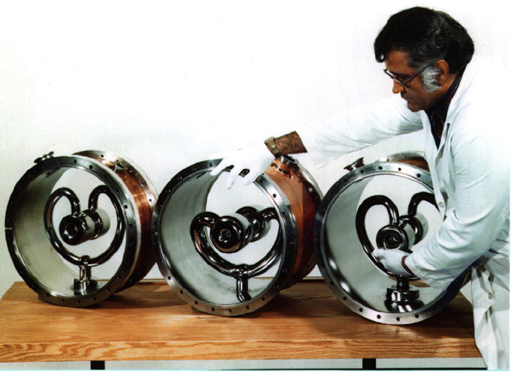
SRF Conceived for CW Operation
Stanford University
HEPL: Electron Linac for FEL
First multicell electron cavity: β = 1
Argonne National Labs
ATLAS: Heavy-ion Linac
Originated at Caltech for β ~ 0.1

Slide 5
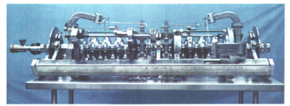
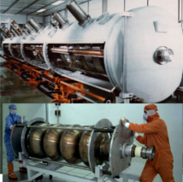
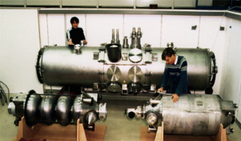
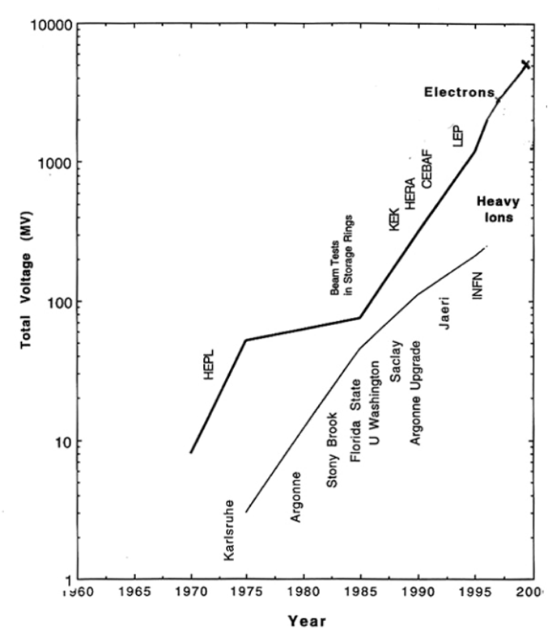
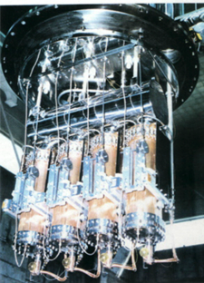
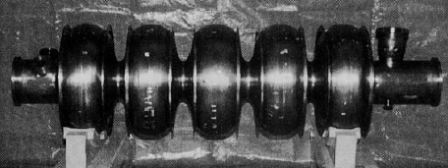
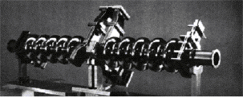
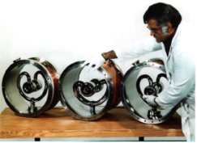
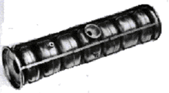
Before TESLA all Project asked for CW
“Livingston Plot” by Hasan Padamsee

Slide 6
Superconducting RF vs NC-RF
Power dissipated on the cavity walls to sustain the field is:
ambient pressure boiling He
Good, but the gain of up to 6 order of magnitudes is not guaranted and it’s not for free:
Cryogenics
Material & Surface Science
Clean Technology
……
superfluid helium

Slide 7
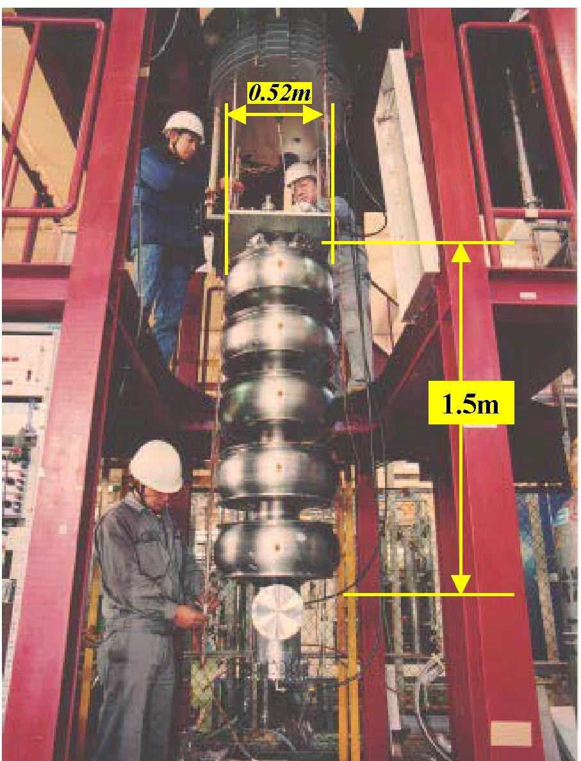
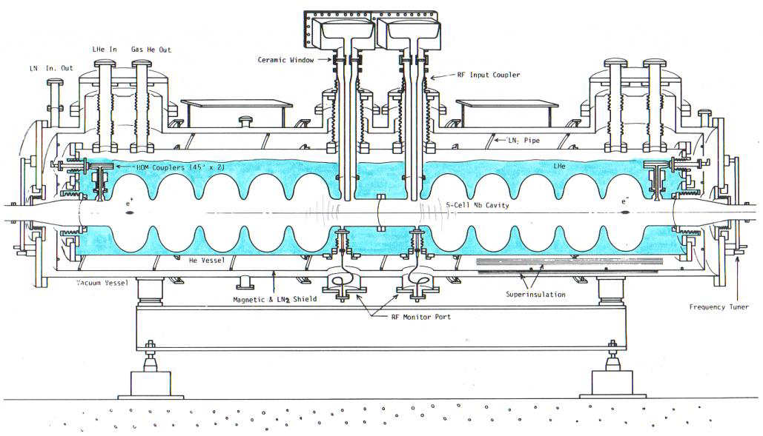
First Industrial Production in Japan (1988 – 1995)
The first mass-production of SRF Cavities in the world
SRF Cavity for TRISTAN at KEK
Bulk-Nb - 508MHz - 5-Cell Cavity
32 SRF cavities were fabricated by Mitsubishi and operated in TRISTAN

Slide 8
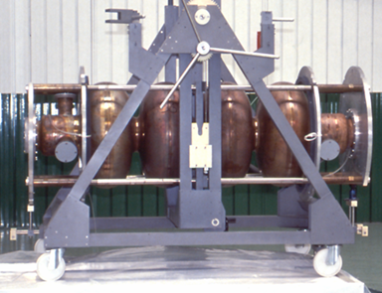
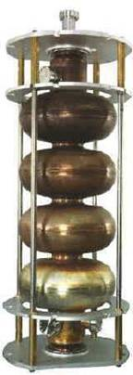
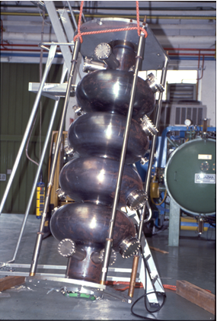
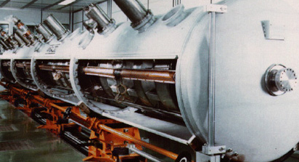
LEP-2 Cavities for CERN in Industry

Slide 9
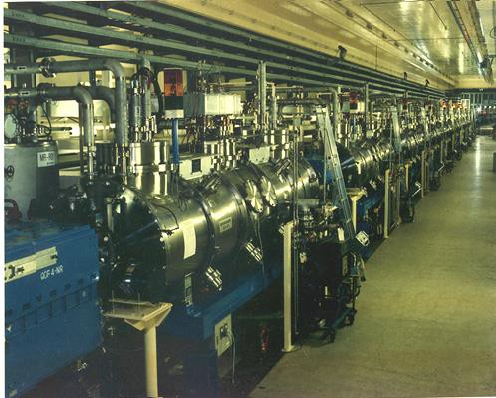
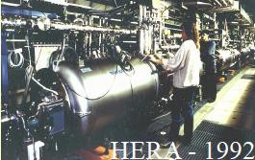
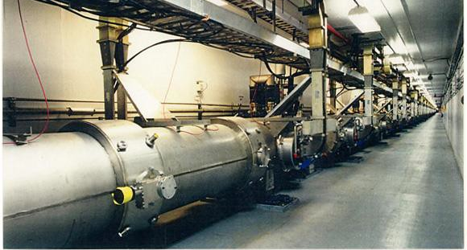
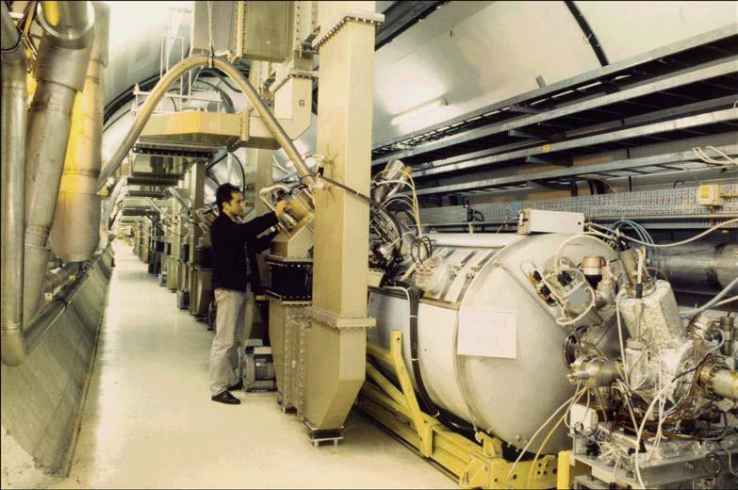
Installed Cryomodules at TESLA time
TRISTAN - 1986
LEP-II - 1998
CEBAF - 1995

Slide 10
Contents
SRF Concieved for CW Operation
TESLA Technology developped for Pulsing
What’s needed to go back to CW
CW interpretation of the TESLA Technology

Slide 11
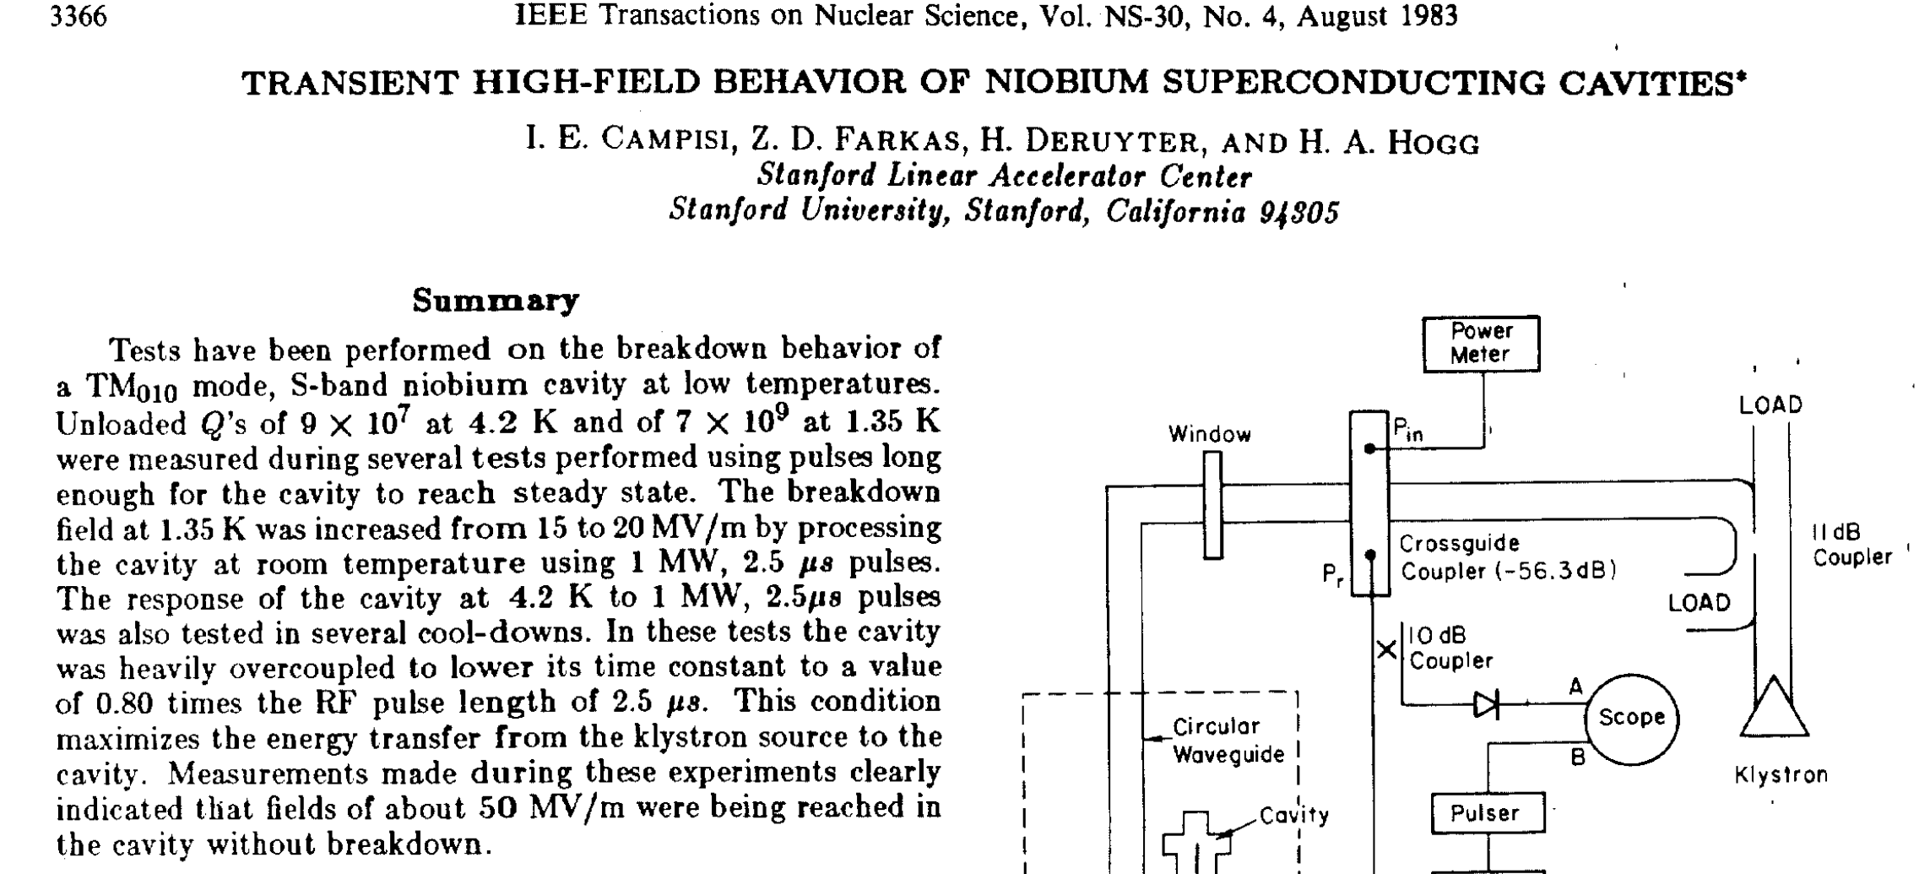
First Pulsing in 1983 by Campisi & Farcas

Slide 12
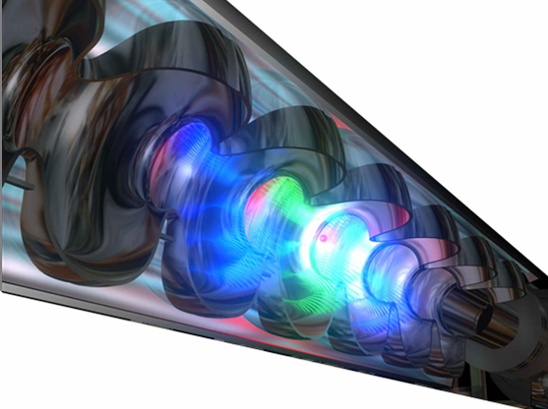
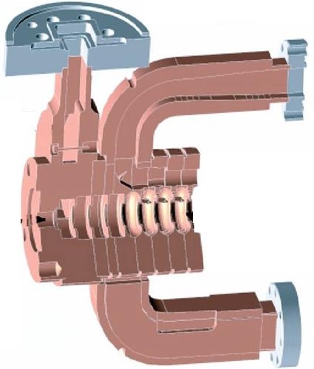

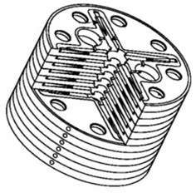

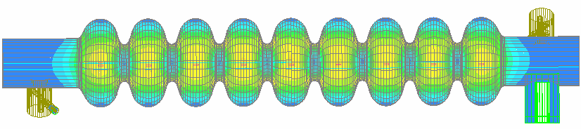

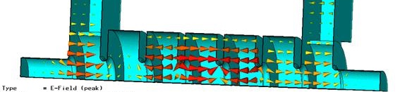
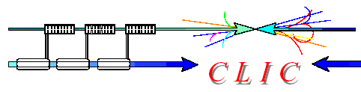
In spite of technology ILC Linacs are pulsed
ILC Competing Technologies in the nineties
1.3 GHz - Cold
SC Standing wave
NC Traveling wave
π mode
11.4 GHz - Warm
30 GHz-Warm

Slide 13
Luminosity is Proportional to Beam Power
C. Pagani - ISLC08 - Lecture 1
Oak Brook, October 20, 2008
L = Luminosity
N_{e} = # of electron per bunch
σ_{x,y.} = beam sizes at IP
IP = interaction point
n_{b} = # of bunches per pulse
f_{rep} = pulse repetition rate
P_{b} = beam power
E_{c.m.}= center of mass energy
Parameters to play with
Reduce beam emittance (ε_{x} .ε_{y} ) for smaller beam size (σ_{x}.σ_{y} )
Increase bunch population (N_{e} )
Increase beam power
Increase beam to-plug power efficiency for cost

Slide 14
Pulsed Operation for Conversion Efficiency
All the LCs must be pulsed machines to improve Plug Power to Beam Power conversion efficiency. As a result:
duty factors are small
pulse peak powers can be very large
C. Pagani - ISLC08 - Lecture 1
Oak Brook, October 20, 2008
<1 µs-1ms
<10-200 ms
RF Pulses
100 m - 300 km
Bunch Train
……
1-300 nsec
…………………....
gradient
with further input
Beam Loading
without input
accelerating field pulse:
filling
loading

Slide 15

TESLA Collaboration: Origin and Mission
Develop SRF for a TeV Linear Collider
  Increase gradient by a factor of 5
  Reduce cost per MV by a factor 20 (New cryomodule concept and Industrialization)
  Make possible pulsed operation
Major advantages vs NC Technology
  Higher conversion efficiency: more beam power for less plug power consumption
  Lower RF frequency: relaxed tolerances and smaller emittance dilution

Slide 16
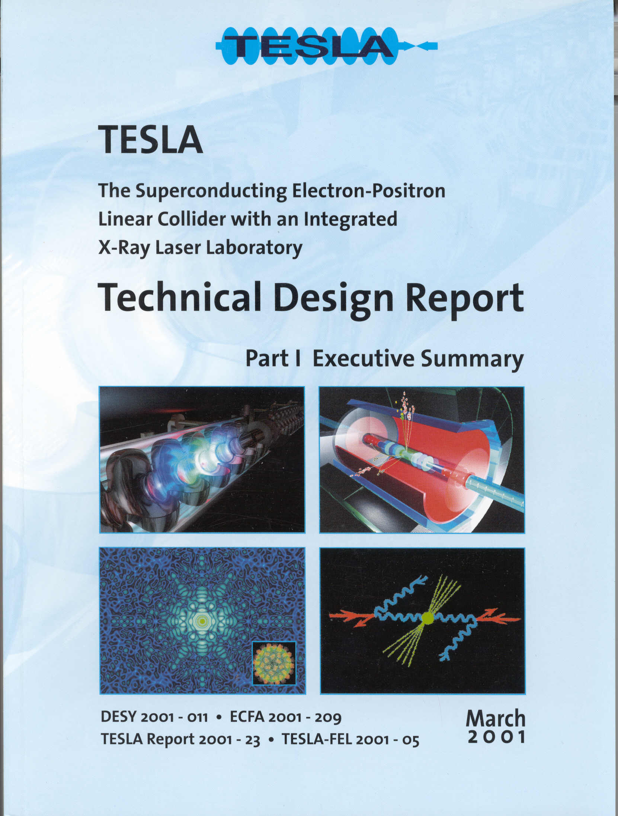
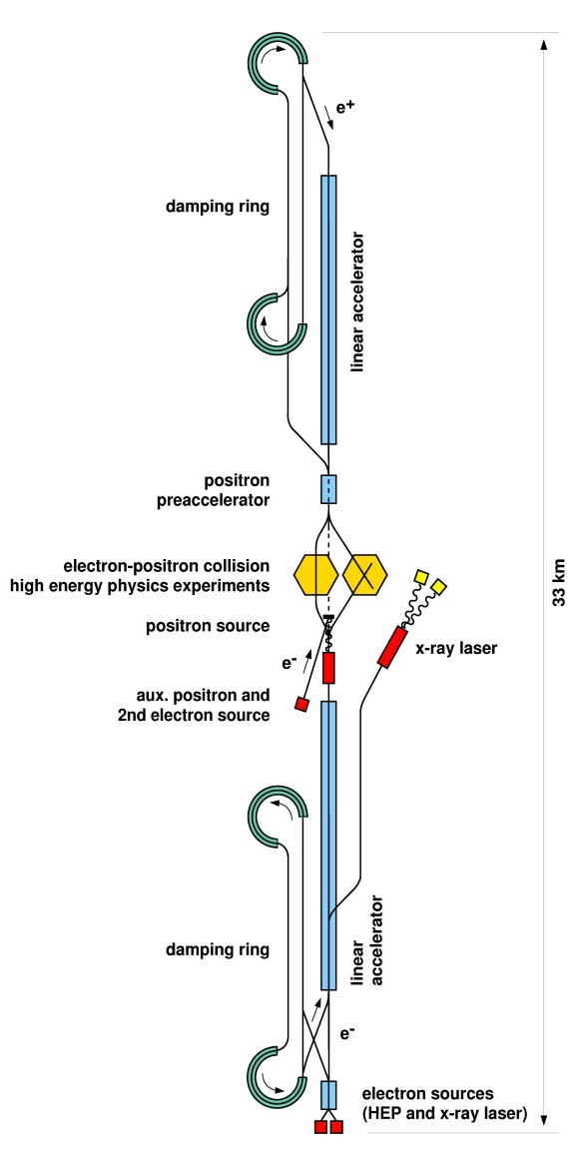
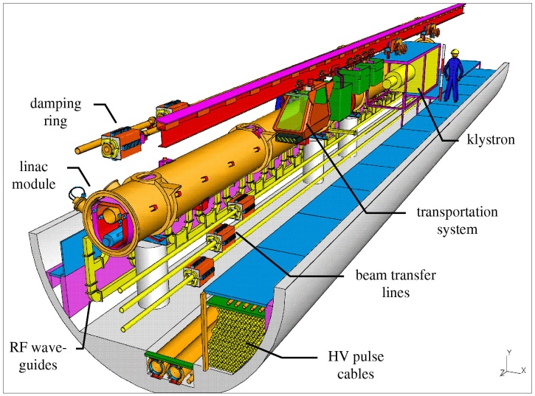
TESLA Technical Design Report: March 2001
As in the TDR
Updated tunnel cross section

Slide 17
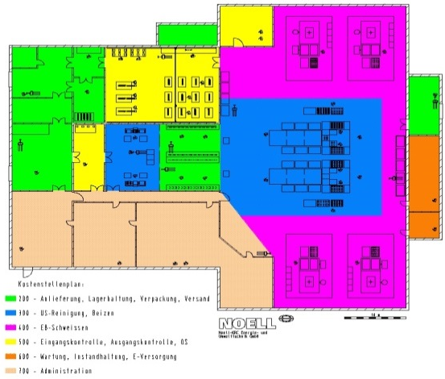
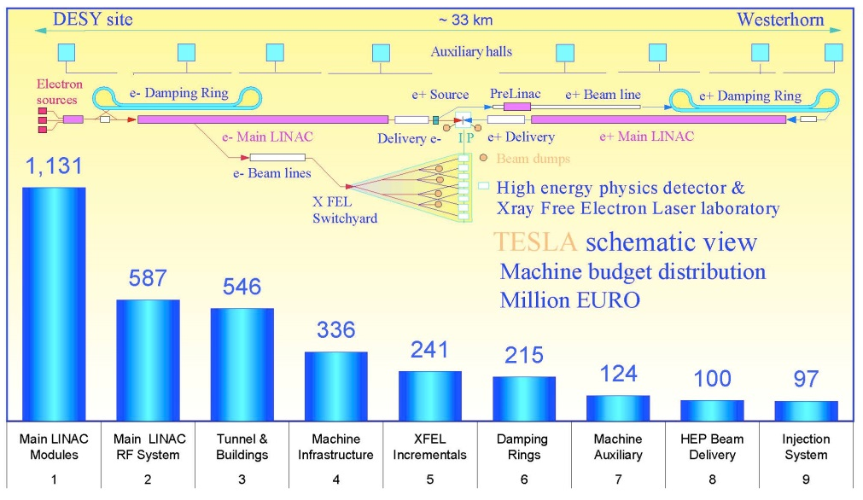
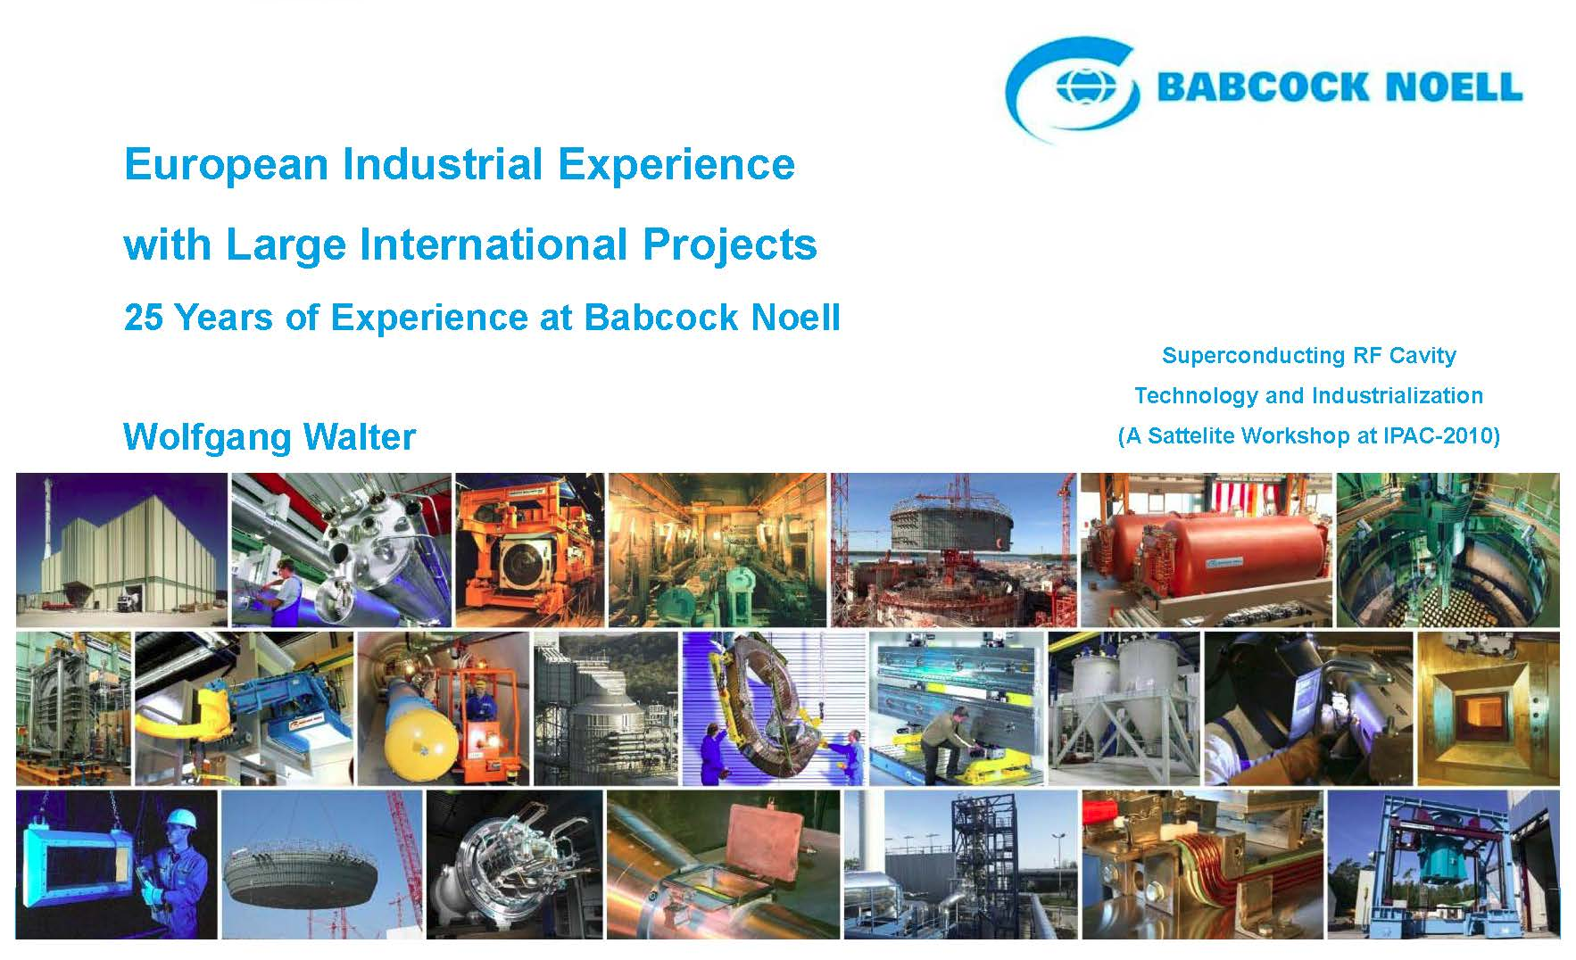
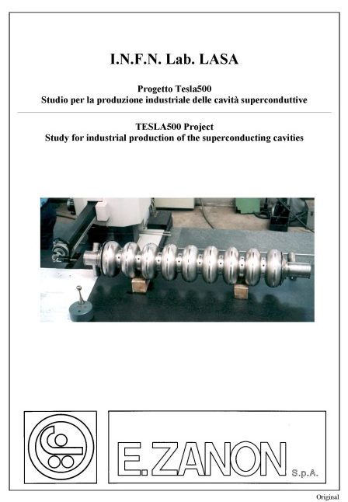
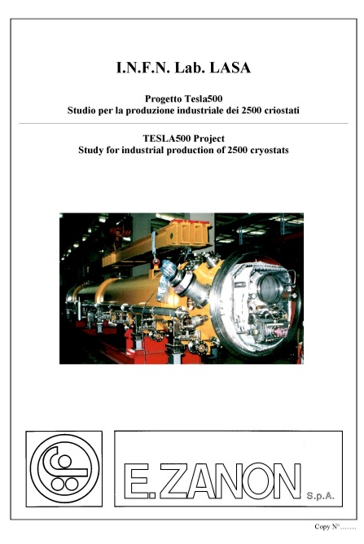
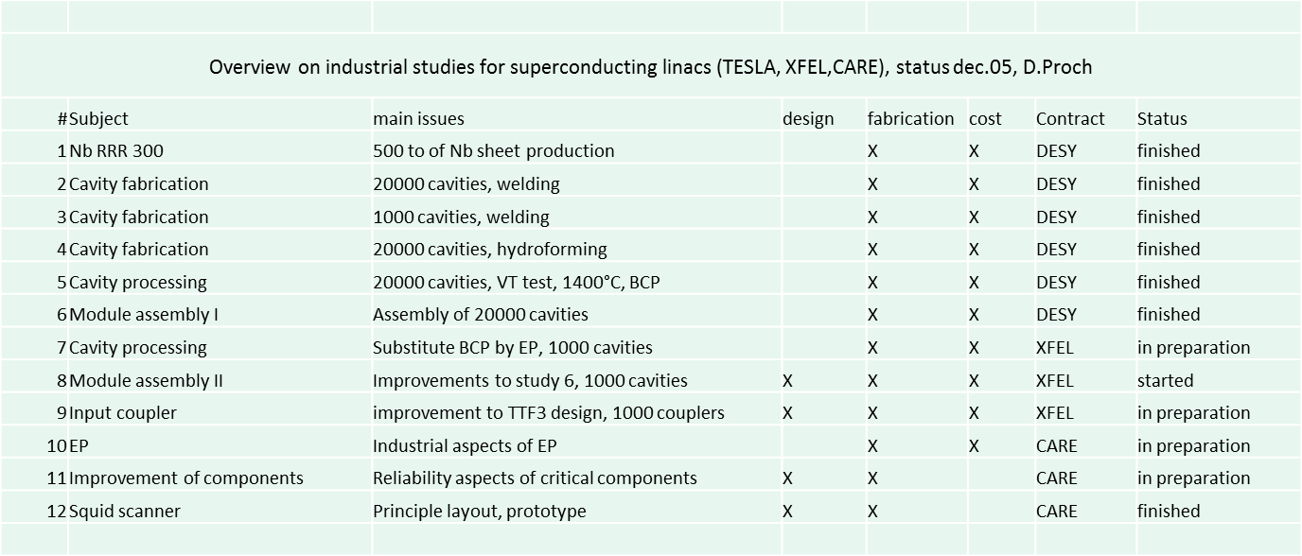
Industrial Studies for TESLA TDR & E-XFEL

Slide 18
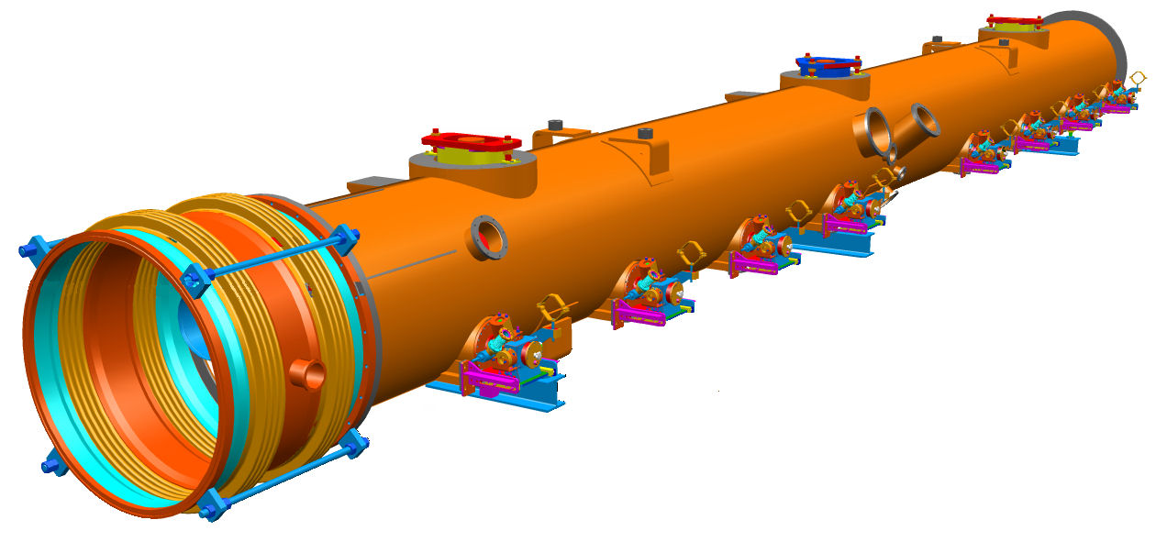
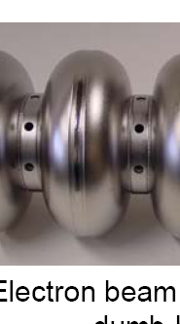
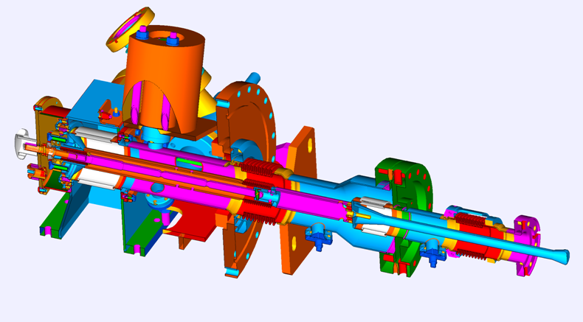
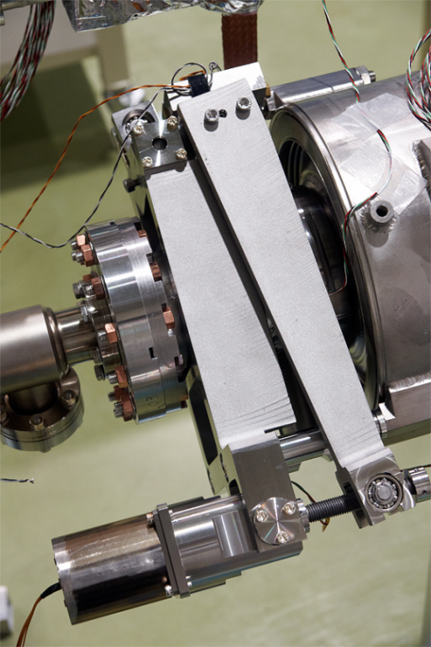
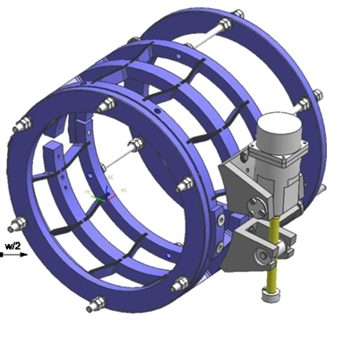
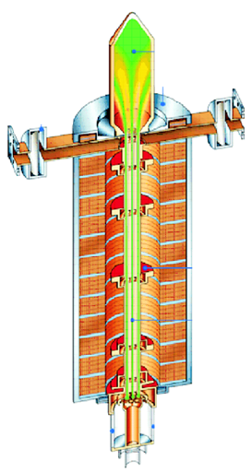
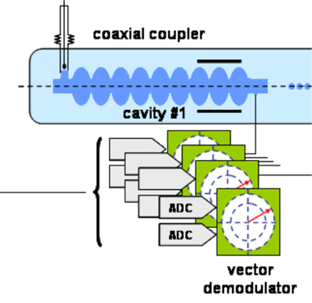
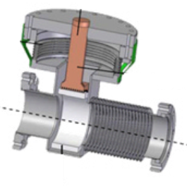
TESLA/XFEL Accelerator Components
cavities
Cryomodule
TESLA Technology
coupler
Tuners
LLRF
RF
HOMs

Slide 19
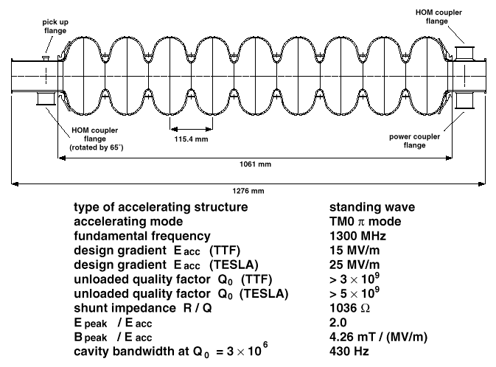
The TESLA SRF Cavity, 1.3 GHz, 9-cell
Large number of cells with minimum reasonable bore radius for FF and tuning Odd number of cells with sligthly different end groups for trap modes
Large wall angle and round equator for surface treatments and multipatoring
2 HOM coupler to extract dangerous modes excited by the beam (1% DF)
Stiffening rings for Lorentz Forces, mechanical rigidity and eigen modes
New fabrication strategy required

Slide 20
Contents
SRF Concieved for CW Operation
TESLA Technology developped for Pulsing
What’s needed to go back to CW
CW interpretation of the TESLA Technology

Slide 21
From Pulsed EuXFEL back to CW
Duty Factor, DF is goin from 1% to 100%
Dynamic Cryo-losses follow DF if cavity parameters stay unchanged
But dynamic cryo-losses are also:
  proportional to E_{acc}²
  inversely proportional to Q₀
The reducttion of peak current and bunch charge require different RF sources but they are not affecting the cryo-power
    Beam current: from several mA peak to < 0.2 mA
    Buch charge, N_{e} : from several nC to < 0.2 nC
A new set of working parameters is needed for CW, but utilising as much as possible all the technology already developped and qualified in the framework of the TESLA Collaboration.

Slide 22
Operating EuXFEL in CW
Just changing the pulsed Klystrons with CW RF Sources and adapting coupling and control electronics, the existing EuXFEL design, based on the TESLA pulsed machine, would be modest because of a few bottle neck:
    Limited installed cryo-power
    Cryo-strings of 12 cryomodules served by a JT valve (240 W limit)
    Insufficient HOM cooling
Eacc < 7 MV/m < 6 GeV with ca. 100 Cryomodules
Building a new machine with a larger cryo-plant, the TESLA design can perform much better thank to a few simple adjustment addressed to overcome the major bottle neck while mantaining all the key technologies.
Eacc > 16 MV/m > 8 GeV with ca. 70 Cryomodules

Slide 23
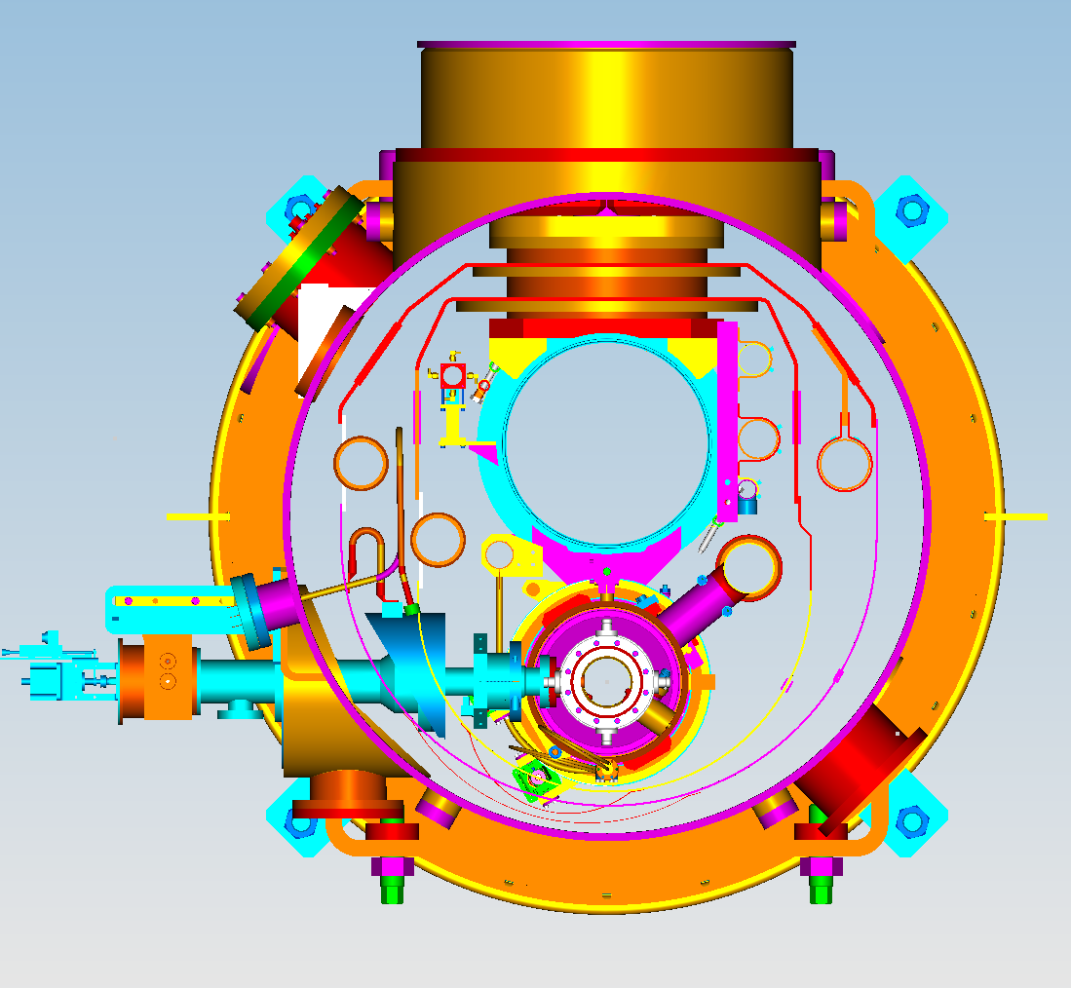
Limitations of the actual XFEL Module - 1
The XFEL main linac consists out of 7 cryo strings,
every string includes 12 cryo modules,
every cryo module contains 8 cavities.
2.2 K forward
2 K, Gas Return Tube
5 K forward
80 K, Return
40 K forward
8 K, Return
2-phase tube:
240 W (20 W/cryomodule) is the estimated limit for one cryo string.
Heat load at 2K for each cryomodule must not exceed 20 W.
W.- D. Möller, J. Sekutowicz|

Slide 24
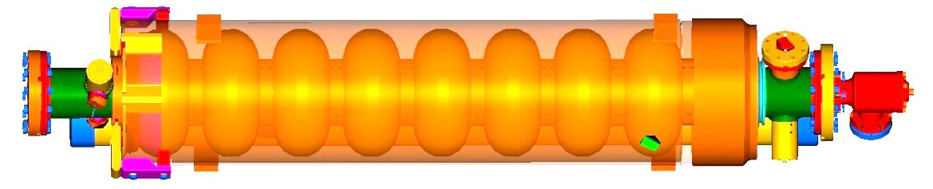
Limitations of the actual XFEL Module - 2
Each cryomodule houses 8 cavities
  Cavity was designed for ca. 1% DF.
  End groups (FPC and HOM couplers) are cooled by means of heat conduction.
FPC
HOM coupler
HOM coupler
Dissipation on the HOM coupler antennas is the main sources of the heat for the end groups.
W.- D. Möller, J. Sekutowicz|

Slide 25
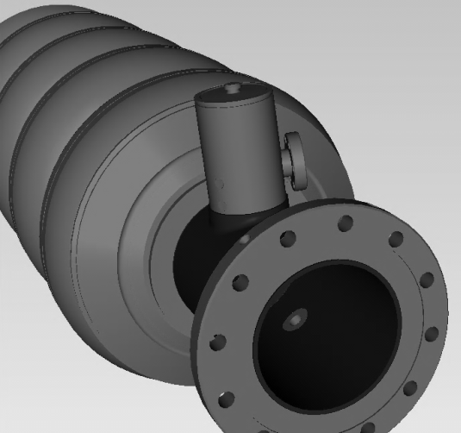
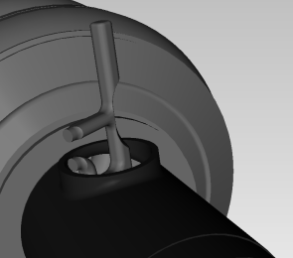
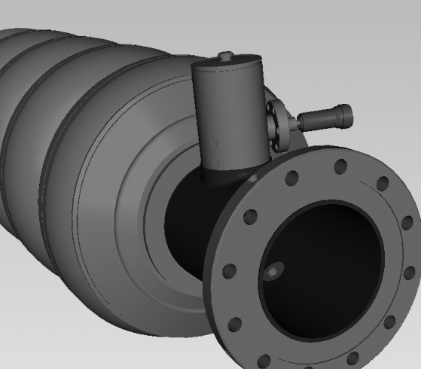

Limitations of the actual XFEL Module - 3
Experience with vertical tests (cavities immersed in the superfluid bath):
Without HOM antennae:
E_{acc} up to 45 MV/m in the CW mode
With HOM antennae:
E_{acc} up to 13 MV/m in the CW mode
Heating of the HOM couplers must not lead to quenching of the end-cells.
W.- D. Möller, J. Sekutowicz|

Slide 26
A few guidelines for TESLA based CW XFELs
Don’t tuch the cavity design and fabrication metodology
Improve surface treatment for higher Q₀ (lower surface resisstance, R_{s})
Mantain the ancillaries (power couipler, tuner, etc) whenever possiblle
Re-design cryogenic distribution to allow higher heat load at 2 K.
  1 JT valve per module, i.e. up to > 20 W/cavity
  Slightly increase the size of the 2 phase pipes accordingly
Implement touls needed for high Q₀:
  Implement magnetic hygiene around the cavities
  Improuve 2 K distribution for fast cool-down
Suppress the lower part of the 5 K schield not needed for CW operation
Remember that a 50% marging is normally added in all cryogenic plants

Slide 27
Contents
SRF Concieved for CW Operation
TESLA Technology developped for Pulsing
What’s needed to go back to CW
CW interpretation of the TESLA Technology

Slide 28


TESLA / E-XFEL 1.3 GHz cavity
Pulsed RF up to 10 Hz repetition rate.
  1.4 ms RF pulse length
Longitudinal stiffness at about 3 kN/mm
Required coarse tuner sensitivity at 1 Hz/step level
Long piezo stacks required to provide LFD compensation.
  500-600 Hz detuning expected
  About 2 μm stroke at the cavity

Slide 29


Dumb-bells & Stiffening Rings

Slide 30






Cavity Fabrication Steps
Half cells are shaped by deep drawing.
Dumb bells are assemled by EB welding.
After proper cleaning eight dumb bells and two end group sections welded by EBW together

Slide 31




Different EBW Strategies
E-beam
E-beam
E-beam
Vert. Pos. EBW: lap joint (recess) e.g. RI, CERCA, Sciaky
EBW: butt joint (e.g. JLab, PAVAC)
Horiz. Pos. EBW: lap joint (recess) DESY, AES, E.Zanon

Slide 32






Test Pieces for PAD Qualification
Test piece (TP) is composed by 2 cell with helium vessel, representing all pressure bearing parts and welding seams. It is built using the same welding parameters that will be used in the series production. Two EBW machines/company. Consequently, two test pieces had been built per company.

Slide 33

Intermediate Steps for Frequency and Length

Slide 34









EDMS for Storing Data and Communication
EDMS
Fabrication
Cavity-DB
Phys. Part
Files
Fabrication structure. Subassembly parts related. Procedure related
Inspection sheets for quality management
Statistical analysis
All XFEL SC cavity documents (specifications, protocols, PED data etc.) recorded in EDMS. RI and E. Zanon have an access (to relevant data only)

Slide 35





Sources of dynamic detuning, Pulsed & CW
The Lorentz force detuning, LFD
  Lorentz force on shielding currents on cavity walls induced by electromagnetic fields, equivalent to EM radiation pressure.
  μm level complex deformation of the cavity shape
  Detuning amplitude scales as E_{acc}², forward
  power instead as E_{acc}⁴!
  Depends on both cavity stiffness and on external stiffness
  Time-varying for pulsed operations
  Repetitive, synchronous to RF pulses
Microphonics, MP – Crucial for CW
  Stochastic, strongly correlated to He bath pressure fluctuations
  Low amplitude, about 30 Hz rms
  Main harmonics coming from the cryomodule environment are contributing:, typically pumps and any other vibrating element

Slide 36



E-XFEL Piezo assisted Tuner, OK for CW
Double asymmetric leverage
  lateral on the tank, on pick-up side
  Modified at DESY from the original CEA Saclay design
  Modified after TTF at DESY, now cavity is stretched by the tuner: cavity spring force is added to piezo preload
Cold stepper motor drive unit
  Harmonic Drive reduction gear
  Screw-nut coupling to generate the linear motion
Cold piezo actuators
  Two stacks in a single preloading frame, to gain redundancy and also to profit of the spare one as a mechanical sensor

Slide 37
LLRF Based on Vector-sum not for CW
A single RF sorce feeding multiple cavities is possible also for CW, but because of the moderate power of few kW required for each cavity, independent SSA sources are usually preferred
Conversely
The possible E-XFEL upgrade to CW would use the vector-sum scheme with one IOT per module
FPGA
μTCA system

Slide 38

Power Coupler is OK but can be simplified
TTF III Coupler has a robust and reliable design
Succesfully installed in the European XFEL
Pending problems
Long processing time: ~ 100 h
Excessive flexibility and High cost
Critical assembly procedure

Slide 39

Very Robust Cryomodule Design

Slide 40









TESLA →XFEL→ILC module design criteria
High filling factor
  maximize real estate gradient/cavity gradient
    long cryomodules/cryo-units, short connections
Moderate cost per unit length
  simple design, based on reliable technologies
  low static heat losses in operation
Effective cold mass alignment strategy
  room temperature alignment preserved at cold
Effective/reproducible assembling procedure
  clean room assembly just for the cavity string
  minimize time consuming operations (cost /reliability)
Cry 1
Cry 2
Cry 3
1st Module in TTF I
Module 1 & 2 in TTF I
Module 1, 2 & 3 in TTF II
Module 4 & 5 in TTF II

Slide 41


Cryomodule & Assembly as Crucial as Cavity
Three cryomodule generations to:
improve simplicity and performances
ensure precise alignment
minimize the cost
“Finger Welded” Shields
Reliable Alignment Strategy
Sliding Fixtures @ 2 K
Required plug power for static losses < 5 kW / (12 m module)

Slide 42






The INFN Cryomodule for XFEL & ILC

Slide 43

TTF Cryomodule Performances

Slide 44


EuXFEL Cross Section - Pulsed
Support Post
Pressurized He feeding
HeGRP & System backbone
WPM
Shield cooling return pipes
Shield cooling pipes
Thermal shields
Two phase line
Sliding support
Coupler port
Helium tank

Slide 45
Some of the TESLA/XFEL specific features
Pulsed operation
  High field dominant wrt minimum losses
  Lorentz force detuning impact the cavity design
  Active fast tuner required for high field
  High peak power coupler for high current
CW operation for XFELs (low average current)
  High Q, low losses, dominant wrt maximum field
  Microphonics can be crucial
  Active fast tuner considered for low current
  High average power coupler for high current
Other TESLA/ILC dependent features
  Very high filling factor : interconnections, tuner, magnets, etc
  Very low static losses : long cryo-strings

Slide 46

LCLS-II: TESLA Cryomodule adapted to CW
J.N. Galayda @ Linac2014

Slide 47

LCLS-II Cavity in its titanum He Vessel
Marc Ross @ SRF 2015

Slide 48


LCLS-II Cryomodule and TESLA/Eu-XFEL
T. Peterson et al. @ SRF 2015

Slide 49

Cavity Beamline String and Supports
T. Peterson et al. @ SRF 2015

Slide 50
Cryogenic Circuits in the Cryomodule
T. Peterson et al. @ SRF 2015

Slide 51

LCLS-II Cryomodule Flow Scheme

Slide 52


LCLS-II adapted for Fast Cooldown
Fast Cool Down Flow: Returns to GHRP
G. Wu et al | SRF 2017
Fast Cool Down Flow: Bottom Inlet

Slide 53


LCLS-II Sensors on Prototypes
Cernox sensor
45-deg tilted fluxgate sensor
Cernox sensor
Helium Return
Helium Inlet
Cernox sensor
Transverse fluxgate sensor measuring transverse field
Cernox sensor
Four Cavities Fully Instrumented

Slide 54


LCLS-II: Overall Cryomodule Performance
Successful demonstration of the first large scale nitrogen doped SRF cavity production by Industry
Demontration of the beneficial effect of fast cooldown for rising Q₀ by flux expulsion
Dan Gonnella at TTC 2020

Slide 55

Single Thermal Shield for large 2-Phase pipe
T. Peterson et al. @ SRF 2015

Slide 56

Connection Details close to E-XFEL
T. Peterson et al. @ SRF 2015

Slide 57

Power Coupler Design and Integration
Marc Ross @ SRF 2015

Slide 58



New Split Quad Conduction Cooled
Marc Ross @ SRF 2015

Slide 59





Reviewed Piezo.assisted Tuner
Marc Ross @ SRF 2015

Slide 60


The LCLS-II Cryomodule – Tuner Ports
Marc Ross @ SRF 2015

Slide 61


Thank you for your attention

