Slide 1


Design of a multi-function ASIC for reading out large SiPM-based systems
Università di Siena & INFN Sezione di Pisa
Giorgio Chiarelli, Martina Cucinotta, Sandra Leone, Fabio Morsani, Fabrizio Scuri
FCC Pisa , May 29, 2025

Slide 2
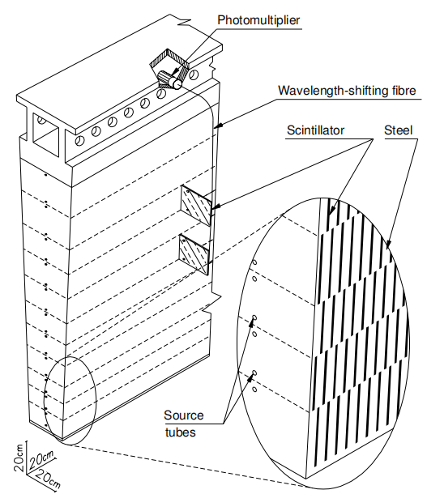
Introduction
The idea of developing a new device for handling analog inputs from a multichannel photo-sensor arose from TileCal need to enhance readout granularity for the HL-LHC era by replacing single-anode PMTs with MA-PMTs, while minimizing the increase in digital readout channels.
Unfortunately, the timing and commitment of the institutes in the upgrade phase of the experiments for HL-LHC make it impossible to enhance the readout granularity of TileCal during the high luminosity phase.
Still, the concept remains valuable for future calorimeters
that will benefit from a fully configurable readout system.
FCC Pisa, May 29, 2025
Martina Cucinotta
2

Slide 3
Just a few examples
1) All calorimeters
Configurable sums of energy deposit would allow to use the same device for defining trigger towers in different regions (barrel/forward/end-cap) and for different calorimeter sections (e.m./hadronic).
FCC Pisa, May 29, 2025
Martina Cucinotta
3

Slide 4
Just a few examples
1) All calorimeters
Configurable sums of energy deposit would allow to use the same device for defining trigger towers in different regions (barrel/forward/end-cap) and for different calorimeter sections (e.m./hadronic).
2) E.M. homogeneous calorimeters, like Calice/CMS, with SiPM readout
Spatial separation of e.m. energy deposits obtained by tuning with energy (p_{T}) the size of readout cells would improve detection of isolated photons and reconstruction of energy clusters produced by electrons from decays of boosted bosons.
FCC Pisa, May 29, 2025
Martina Cucinotta
4

Slide 5
Just a few examples
1) All calorimeters
Configurable sums of energy deposit would allow to use the same device for defining trigger towers in different regions (barrel/forward/end-cap) and for different calorimeter sections (e.m./hadronic).
2) E.M. homogeneous calorimeters, like Calice/CMS, with SiPM readout
Spatial separation of e.m. energy deposits obtained by tuning with energy (p_{T}) the size of readout cells would improve detection of isolated photons and reconstruction of energy clusters produced by electrons from decays of boosted bosons.
3) Hadron sampling calorimeters à TileCal (ALLEGRO HCAL barrel), with SiPM readout
Dynamics definition of Regions of Interest (ROIs) for energy deposits would improve both the separation of small radius jets and the definition of the contour of merged jets in hadronic decays of boosted particles.
FCC Pisa, May 29, 2025
Martina Cucinotta
5

Slide 6
General architecture for the new device
The solutions currently available on the market involve the digitization of all channels *
*MUSIC ASIC architecture
FCC Pisa, May 29, 2025
Martina Cucinotta
6

Slide 7
General architecture for the new device
Advantages:
The solutions currently available on the market involve the digitization of all channels *
Apply digital filters to dump the noise
*MUSIC ASIC architecture
FCC Pisa, May 29, 2025
Martina Cucinotta
7

Slide 8
General architecture for the new device
Advantages:
The solutions currently available on the market involve the digitization of all channels *
Apply digital filters to dump the noise
Avoid problems of signal synchronization
*MUSIC ASIC architecture
FCC Pisa, May 29, 2025
Martina Cucinotta
8

Slide 9
General architecture for the new device
Advantages:
The solutions currently available on the market involve the digitization of all channels *
Apply digital filters to dump the noise
Avoid problems of signal synchronization
Apply digital weights in the digital sum of different channels
*MUSIC ASIC architecture
FCC Pisa, May 29, 2025
Martina Cucinotta
9

Slide 10
General architecture for the new device
Advantages:
The solutions currently available on the market involve the digitization of all channels *
….but the cost of such a device could be unaffordable due to the very large number of channels to be digitized
Apply digital filters to dump the noise
Avoid problems of signal synchronization
Apply digital weights in the digital sum of different channels
*MUSIC ASIC architecture
FCC Pisa, May 29, 2025
Martina Cucinotta
10

Slide 11
General architecture for the new device
Advantages:
The solutions currently available on the market involve the digitization of all channels *
….but the cost of such a device could be unaffordable due to the very large number of channels to be digitized
Apply digital filters to dump the noise
Avoid problems of signal synchronization
Apply digital weights in the digital sum of different channels
We want to invert the concept flow chart:
first make an analog sum of selected subsamples of readout channels, than convert only the desired sum(s)
The challenge is to avoid distortions of the time profile in the resulting analog sum and to keep at the same time all configuration flexibility that the other concept allows.
*MUSIC ASIC architecture
FCC Pisa, May 29, 2025
Martina Cucinotta
11

Slide 12
Features and general architecture for the new device
The key feature of this device, which differentiates it from existing commercial devices, is its ability to perform the analog summation of any configurable subset of input channels
Martina Cucinotta
FCC Pisa, May 29, 2025
12

Slide 13
Features and general architecture for the new device
The key feature of this device, which differentiates it from existing commercial devices, is its ability to perform the analog summation of any configurable subset of input channels
Let’s introduce the building block diagram for a new concept device with full scalability:
Martina Cucinotta
FCC Pisa, May 29, 2025
13

Slide 14
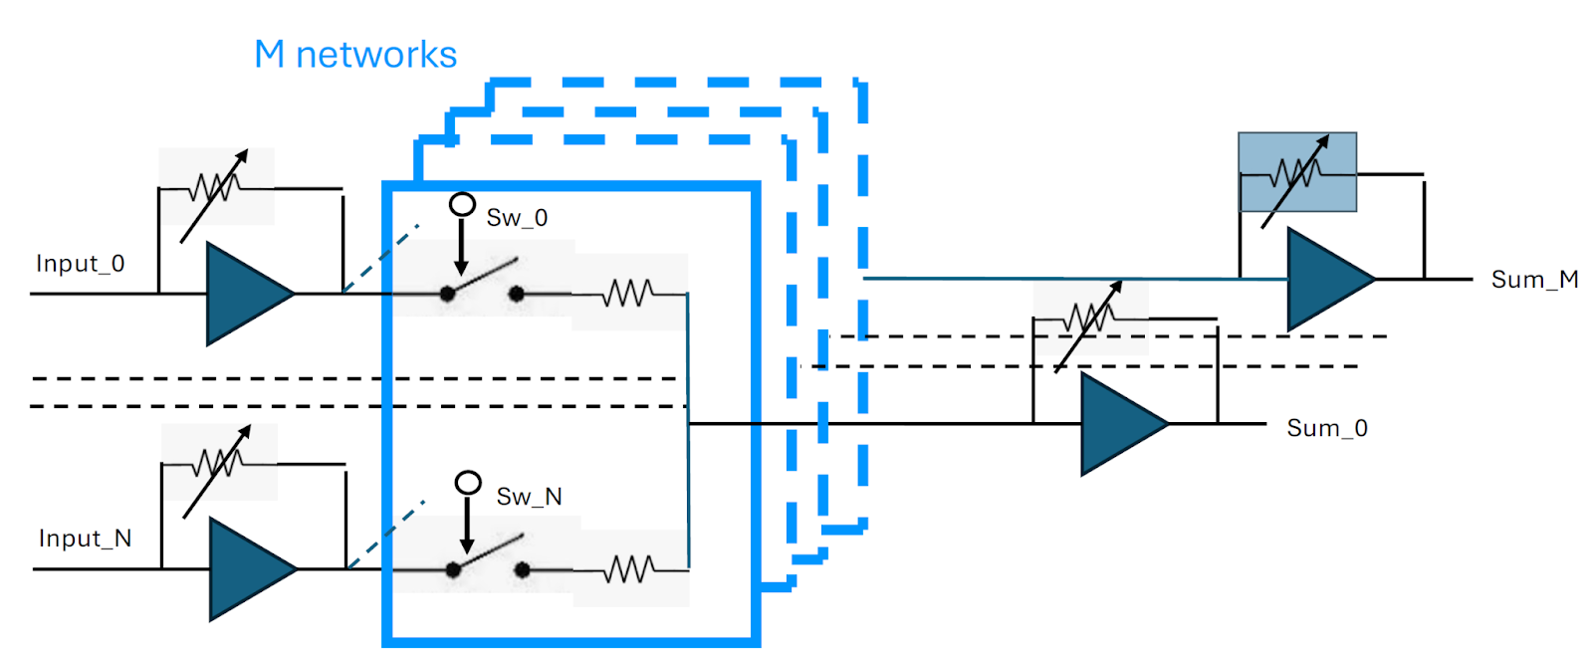
Features and general architecture for the new device
The key feature of this device, which differentiates it from existing commercial devices, is its ability to perform the analog summation of any configurable subset of input channels
Let’s introduce the building block diagram for a new concept device with full scalability:
1) A first stage with variable gain fast (2 GHz BW) amplifiers to allow for input weighting,
M networks
Martina Cucinotta
FCC Pisa, May 29, 2025
14

Slide 15
Features and general architecture for the new device
The key feature of this device, which differentiates it from existing commercial devices, is its ability to perform the analog summation of any configurable subset of input channels
Let’s introduce the building block diagram for a new concept device with full scalability:
1) A first stage with variable gain fast (2 GHz BW) amplifiers to allow for input weighting,
2) A second stage with M equal resistive networks with N fast analog switches remote controlled (N is the number of analog inputs, M is the number of analog sums),
M networks
Martina Cucinotta
FCC Pisa, May 29, 2025
15

Slide 16
Features and general architecture for the new device
The key feature of this device, which differentiates it from existing commercial devices, is its ability to perform the analog summation of any configurable subset of input channels
Let’s introduce the building block diagram for a new concept device with full scalability:
1) A first stage with variable gain fast (2 GHz BW) amplifiers to allow for input weighting,
2) A second stage with M equal resistive networks with N fast analog switches remote controlled (N is the number of analog inputs, M is the number of analog sums),
3) A final stage performing the M analog sums with variable gain fast amplifiers to cope with the dynamical range of the user selected ADC.
M networks
Martina Cucinotta
FCC Pisa, May 29, 2025
16

Slide 17
Features and general architecture for the new device
The key feature of this device, which differentiates it from existing commercial devices, is its ability to perform the analog summation of any configurable subset of input channels
Let’s introduce the building block diagram for a new concept device with full scalability:
1) A first stage with variable gain fast (2 GHz BW) amplifiers to allow for input weighting,
2) A second stage with M equal resistive networks with N fast analog switches remote controlled (N is the number of analog inputs, M is the number of analog sums),
3) A final stage performing the M analog sums with variable gain fast amplifiers to cope with the dynamical range of the user selected ADC.
What was done?
A prototype for this type of readout with high-bandwidth integrated circuits was designed, built and tested at INFN Pisa.
M networks
Martina Cucinotta
FCC Pisa, May 29, 2025
17

Slide 18
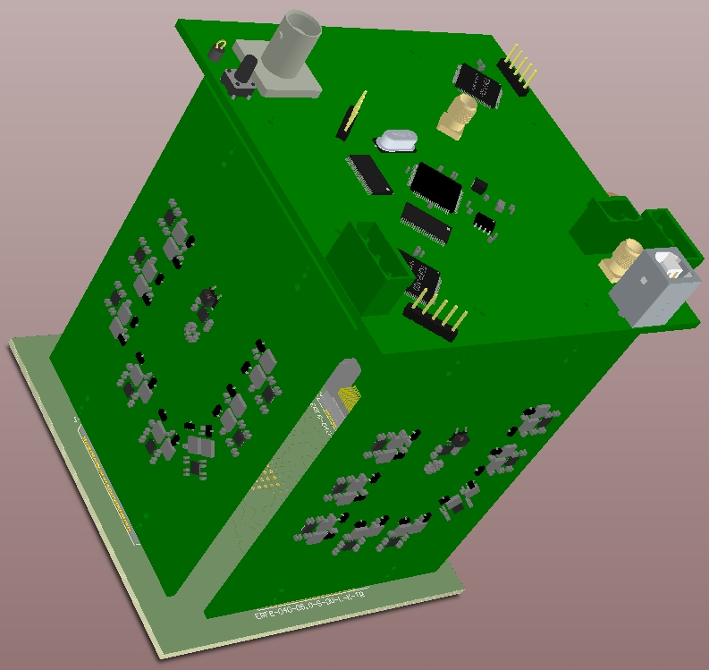
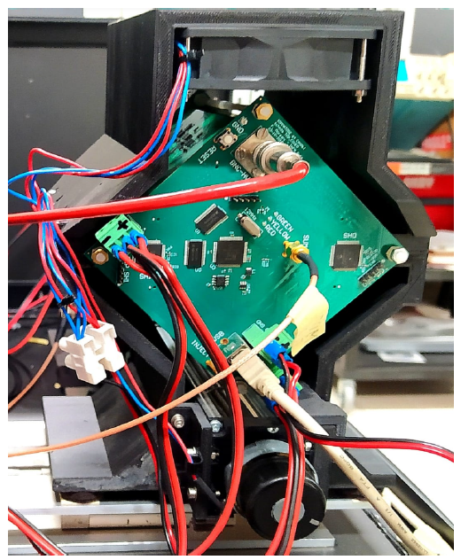
Prototype description
Designed and developed by Dr. Fabio Morsani
The system is composed by 6 Printed Circuit Boards (PCBs), built with high-bandwidth Integrated Circuits (ICs).
As a first proof of feasibility no constraint on system dimensions, nor on power consumption (25 W) was applied.
The 6 PCBs are arranged to form the faces of a parallelepiped with a square base and are assembled inside a metal support structure which also houses a cooling system.
Martina Cucinotta
FCC Pisa, May 29, 2025
18

Slide 19
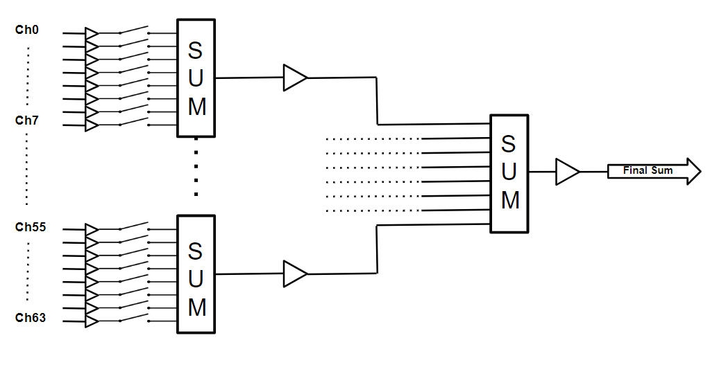
Description of the prototype functioning (I)
Circuit schematic of the prototype
Σ
Σ
Σ
Martina Cucinotta
FCC Pisa, May 29, 2025
19

Slide 20
Description of the prototype functioning (II)
Circuit schematic of the prototype
Σ
Σ
Σ
Channels are first amplified with a configurable gain in a range between -6 dB and 26 dB (first amplification stage, equalization).
Martina Cucinotta
FCC Pisa, May 29, 2025
20

Slide 21
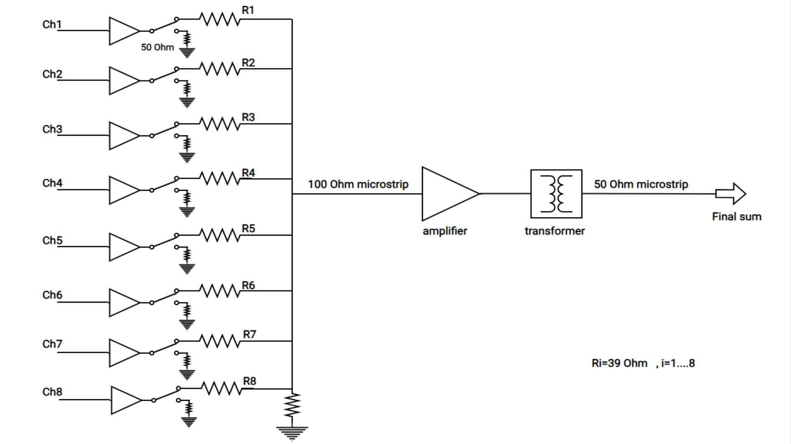
Description of the prototype functioning (III)
More info: The switches enabling the channels to enter the analog sum are SPDT switches (Single Pole, Double Throw) with a bandwidth of 3 GHz and high isolation. In the OFF mode, a 50 Ω resistor is switched onto the output line to ensure minimal reflections of any backward-propagating signal from the summing network.
Circuit schematic of the prototype
Σ
Σ
Σ
The channels participating in the final sum are activated via switches.
Martina Cucinotta
FCC Pisa, May 29, 2025
21

Slide 22
Description of the functioning (IV)
Circuit schematic of the prototype
Σ
Σ
Σ
The 64 amplified readout channels are fed to eight 8-channel resistive summing networks.
Martina Cucinotta
FCC Pisa, May 29, 2025
22

Slide 23
Description of the prototype functioning (V)
Circuit schematic of the prototype
Σ
Σ
Σ
The output of each 8-channel network is amplified before being fed into a resistive network for the final sum.
Martina Cucinotta
FCC Pisa, May 29, 2025
23

Slide 24
Description of the prototype functioning (VI)
Circuit schematic of the prototype
Σ
Σ
Σ
The final analog sum can be further amplified to match the dynamic range of the ADC used for signal digitization. The gains of the three steps are configurable in a range from -6 to 26 dB.
Martina Cucinotta
FCC Pisa, May 29, 2025
24

Slide 25
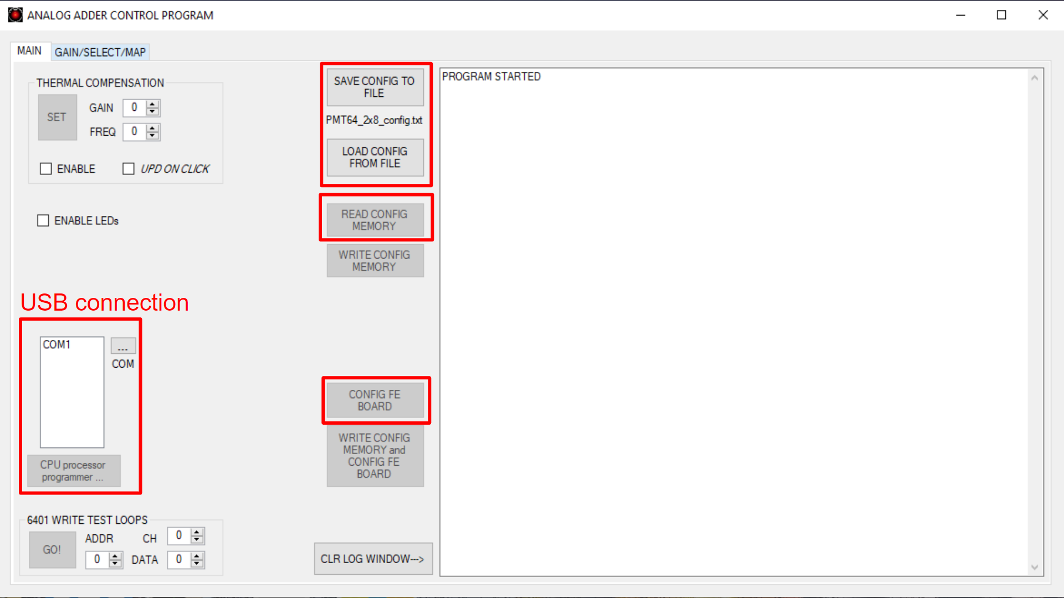
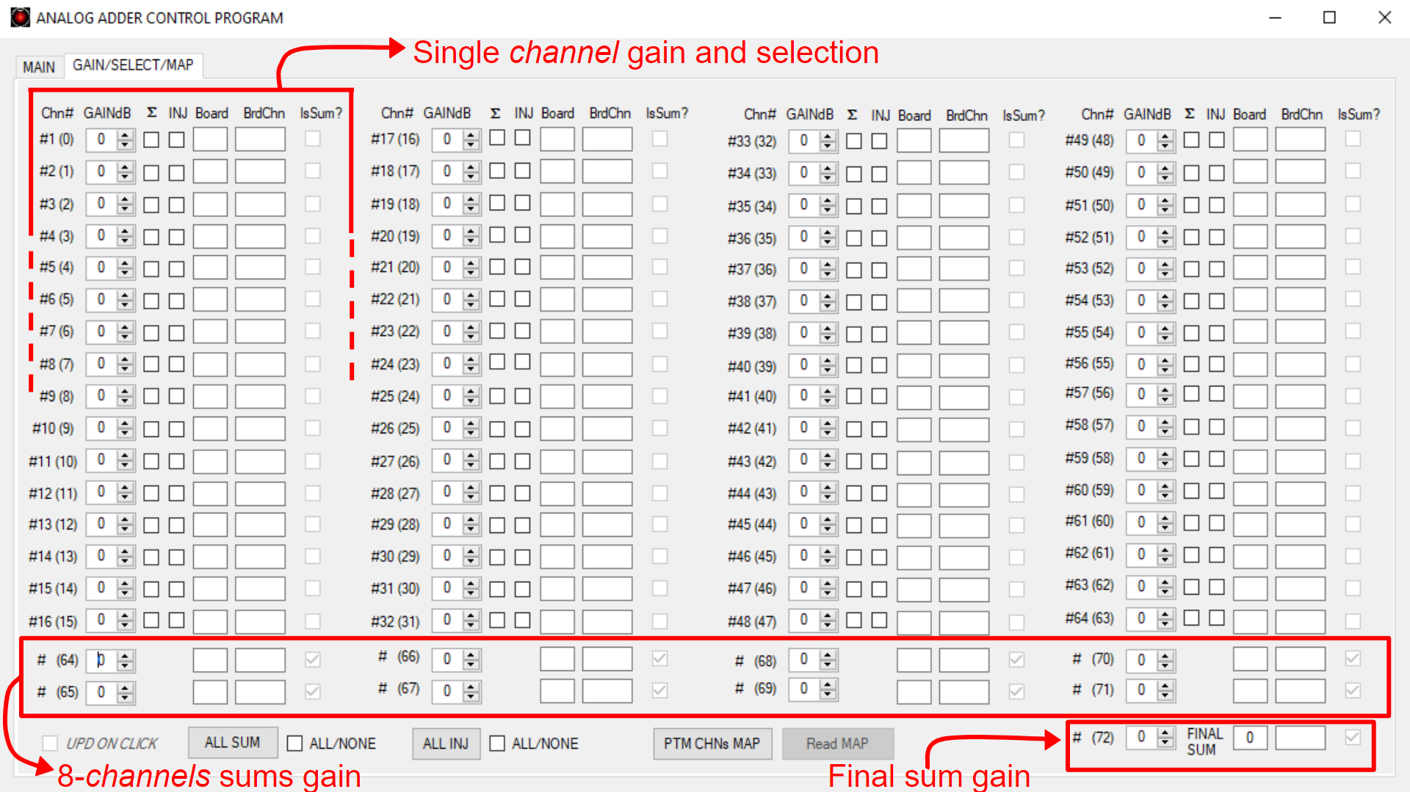
GUIs
The selected channels and all amplifications can be set through a GUI, allowing to establish USB connection with the prototype and to upload the selected configuration for the final sum.
Σ
Σ
Σ
Martina Cucinotta
FCC Pisa, May 29, 2025
25

Slide 26
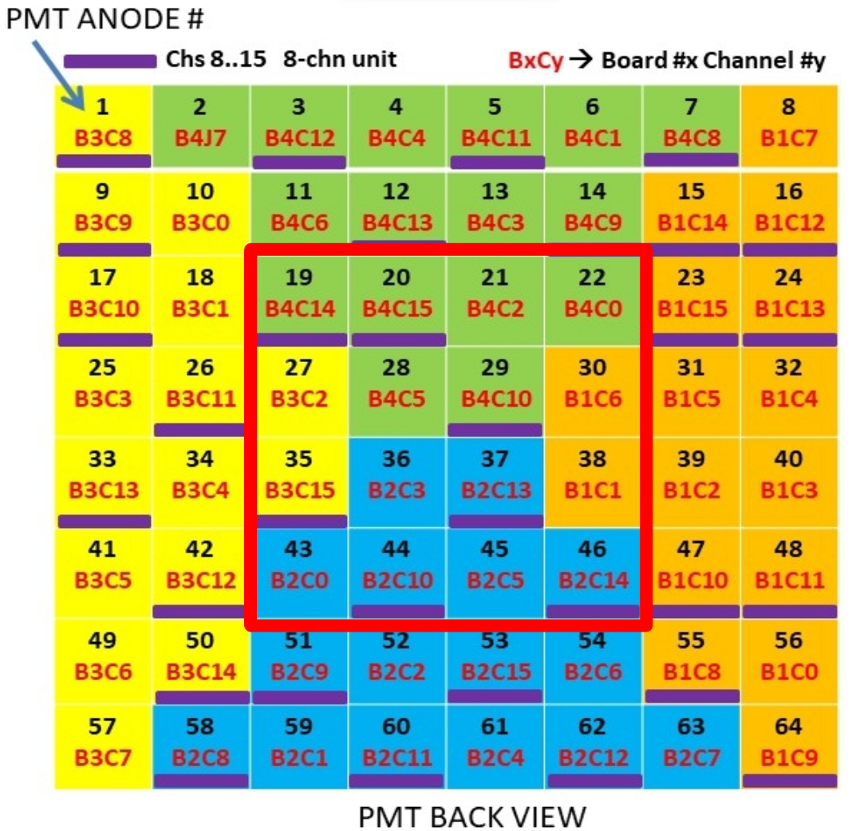
Prototype tests: introduction
The prototype has been tested in Pisa in terms of pulse shape stability and linearity of the analog sum of an arbitrary number of channels.
Various tests were done with two different experimental setups:
  test of the 16 central readout channels injecting an input signal
  test of the readout system using a MAPMT and a laser system
Martina Cucinotta
FCC Pisa, May 29, 2025
26

Slide 27
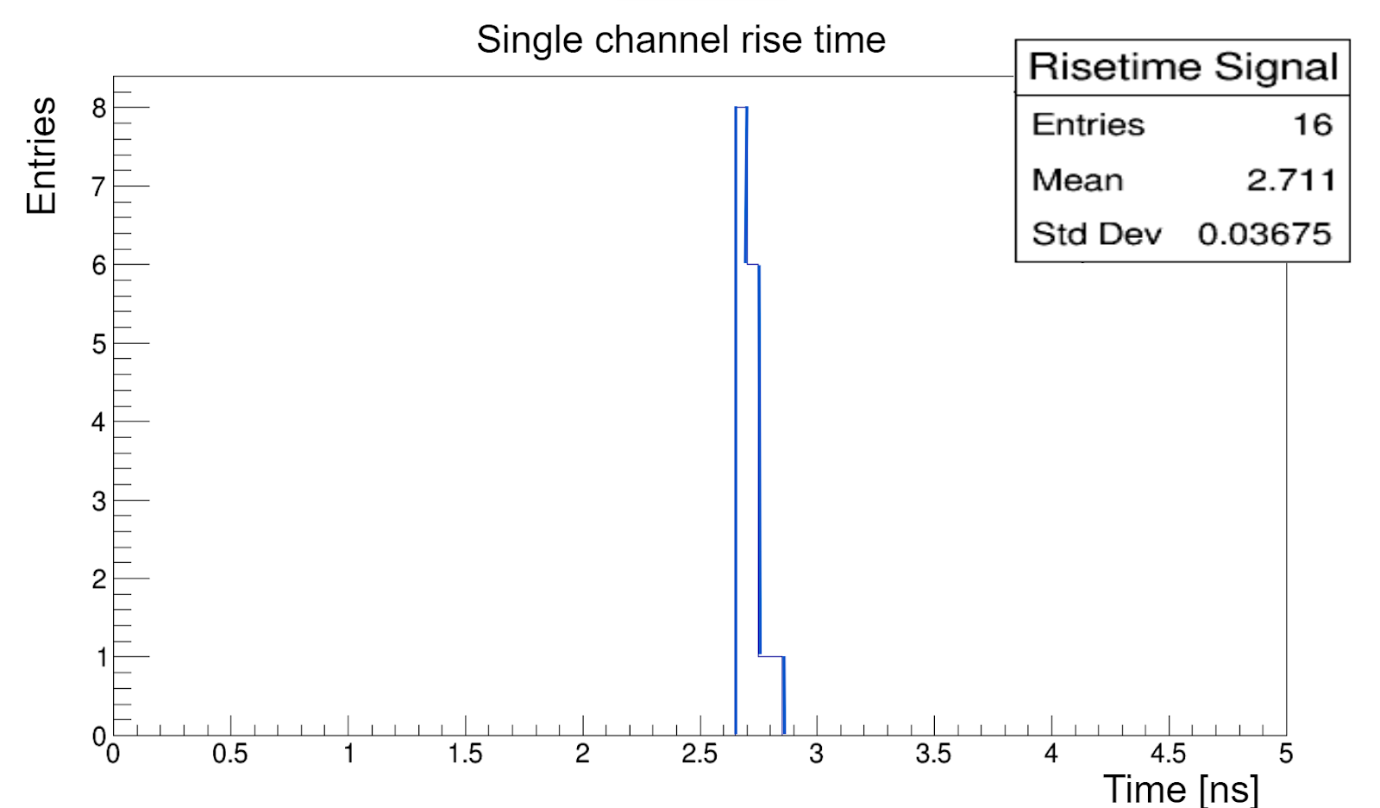
Prototype tests results
The readout prototype guarantees pulse shape stability and linearity in the analog sum of the signals ( rise times ∼ 2.7 ns);
Single channel rise time distribution
Martina Cucinotta
FCC Pisa, May 29, 2025
27

Slide 28
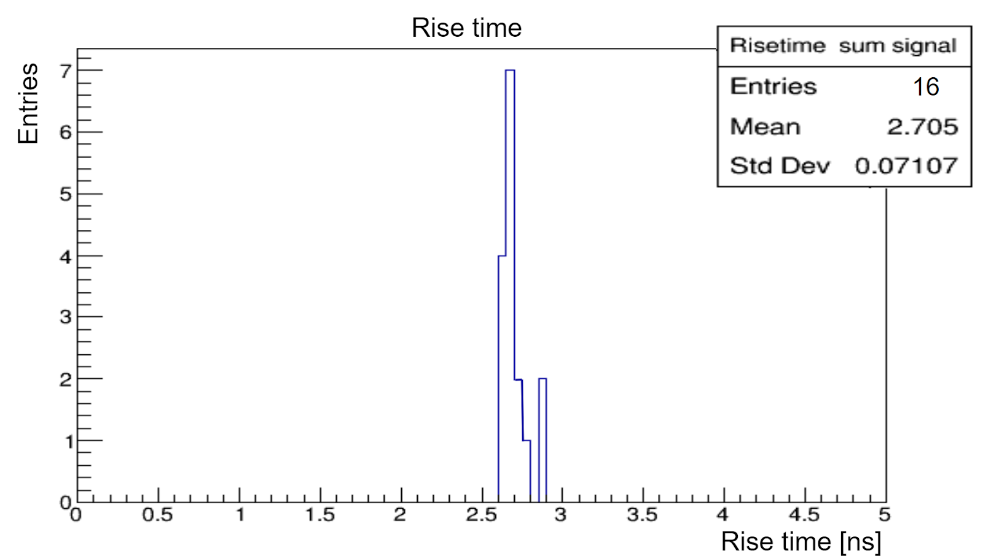
Prototype tests results
The readout prototype guarantees pulse shape stability and linearity in the analog sum of the signals ( rise times ∼ 2.7 ns);
The resistive summing networks do not alter the shape of the outputs;
Single channel rise time distribution
Distribution of the rise time of the analog sum for an increasing number of channels
Martina Cucinotta
FCC Pisa, May 29, 2025
28

Slide 29
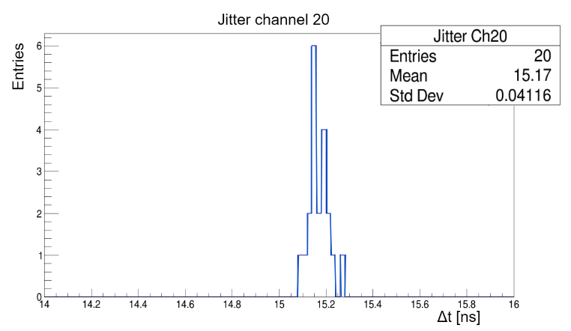
Prototype tests results
The readout prototype guarantees pulse shape stability and linearity in the analog sum of the signals ( rise times ∼ 2.7 ns);
The resistive summing networks do not alter the shape of the outputs;
Jitter time ∼ 40 ps, good data transmission;
Single channel rise time distribution
Distribution of the rise time of the analog sum for an increasing number of channels
Channel 20 Δt distribution for jitter estimation
Martina Cucinotta
FCC Pisa, May 29, 2025
29

Slide 30
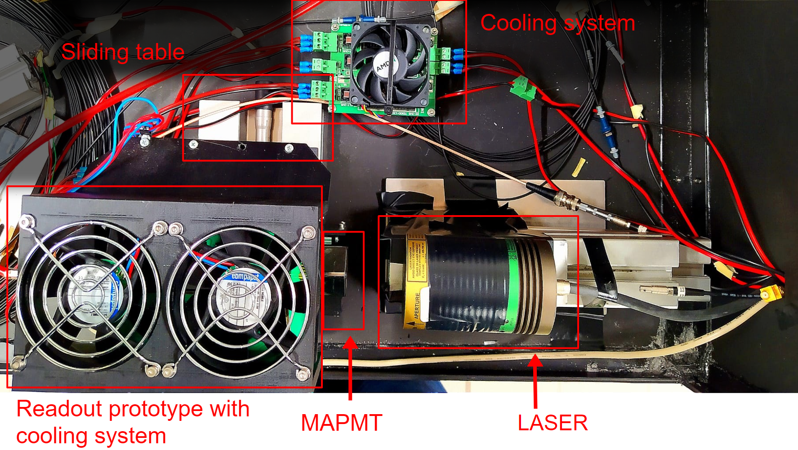
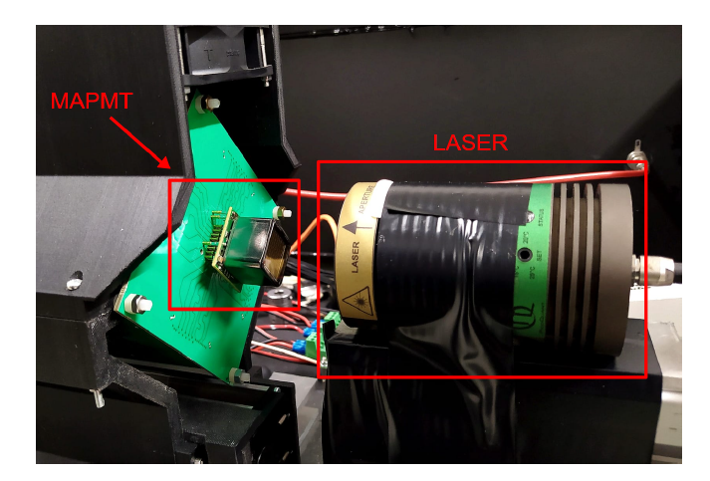
Tests with a MAPMT and a laser
Observed coupling effects between channel testing the prototype with a MAPMT, whose channels are excited with a laser.
Martina Cucinotta
FCC Pisa, May 29, 2025
30

Slide 31
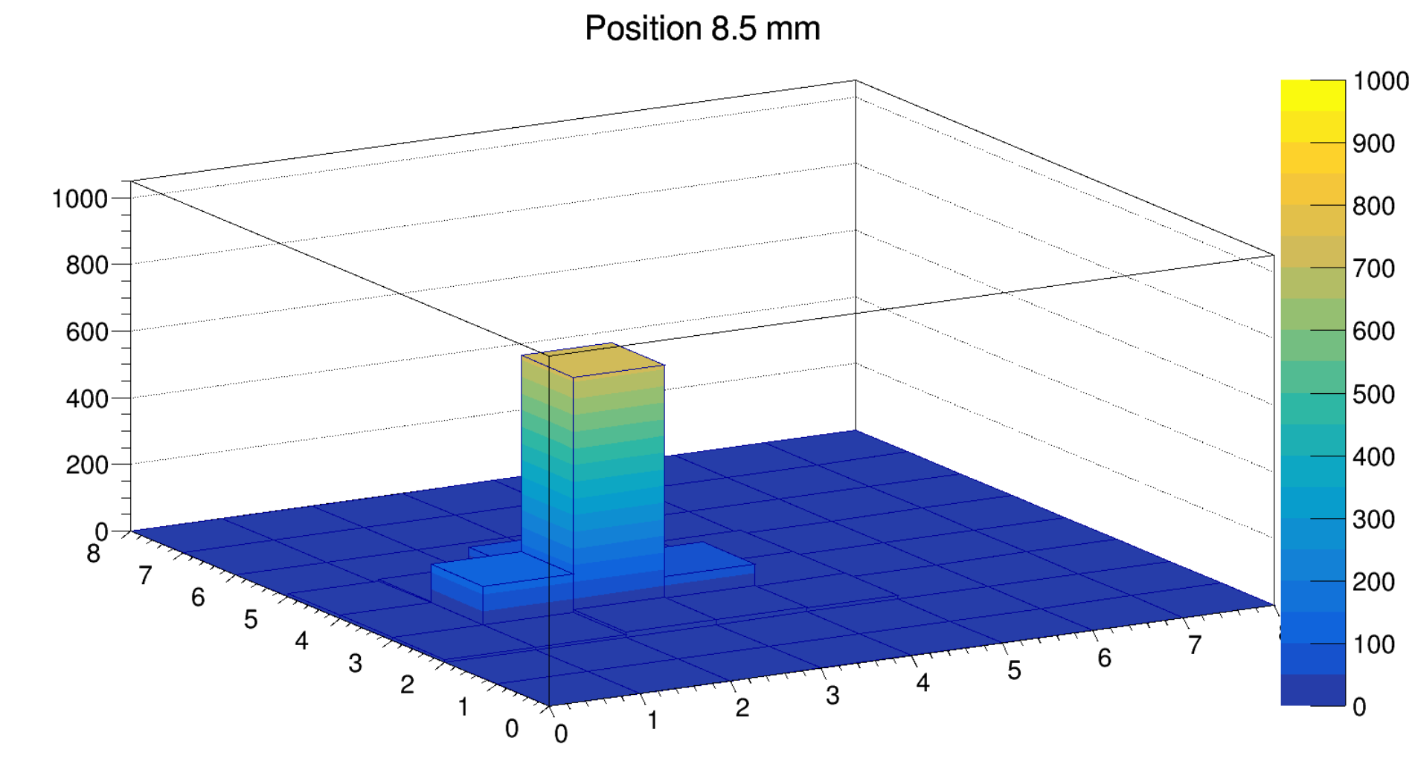
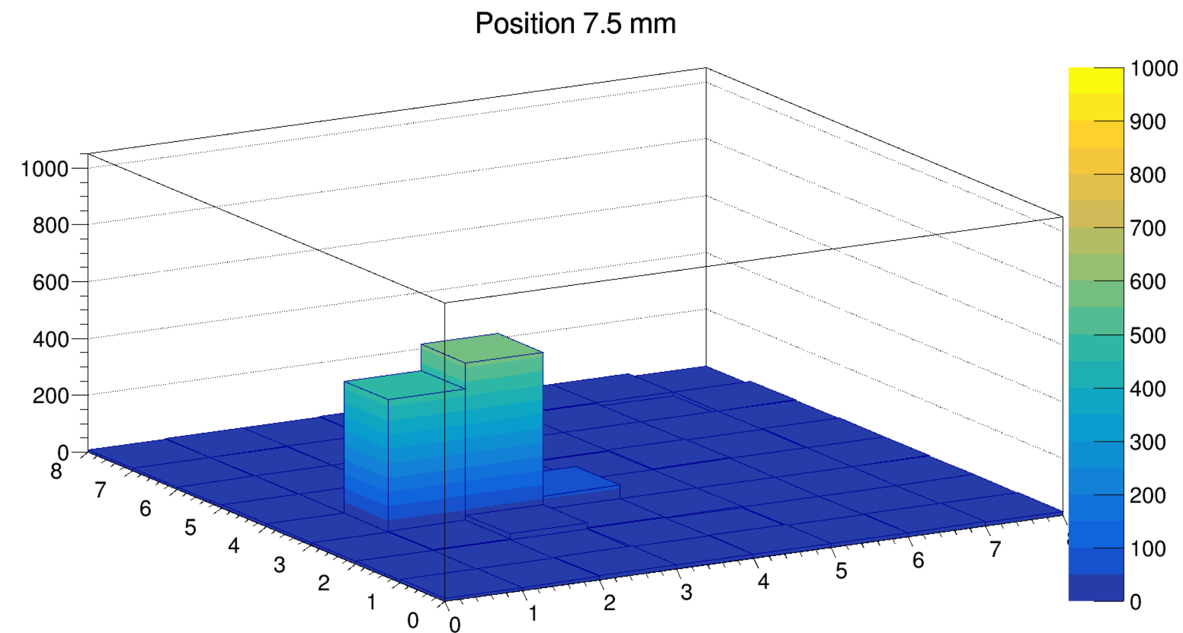
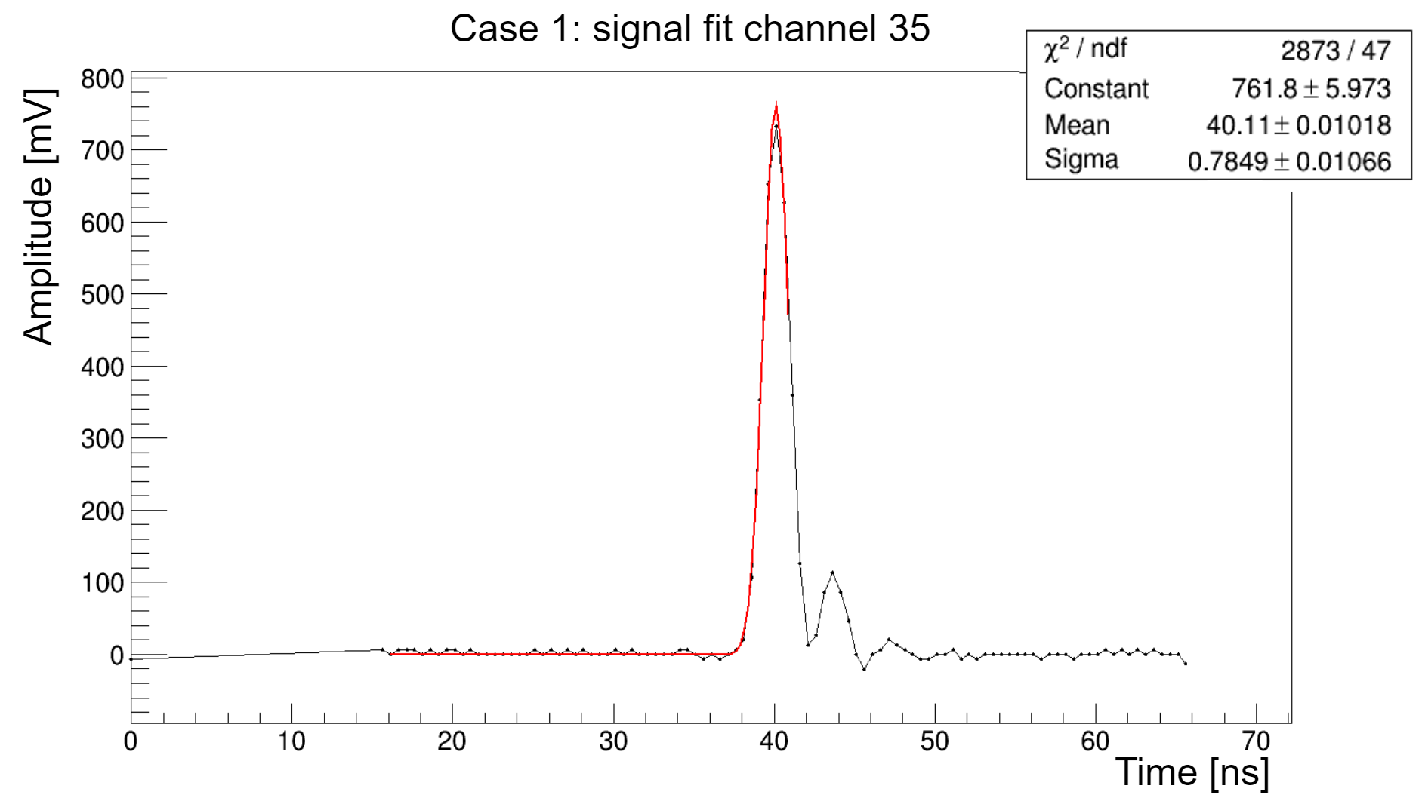
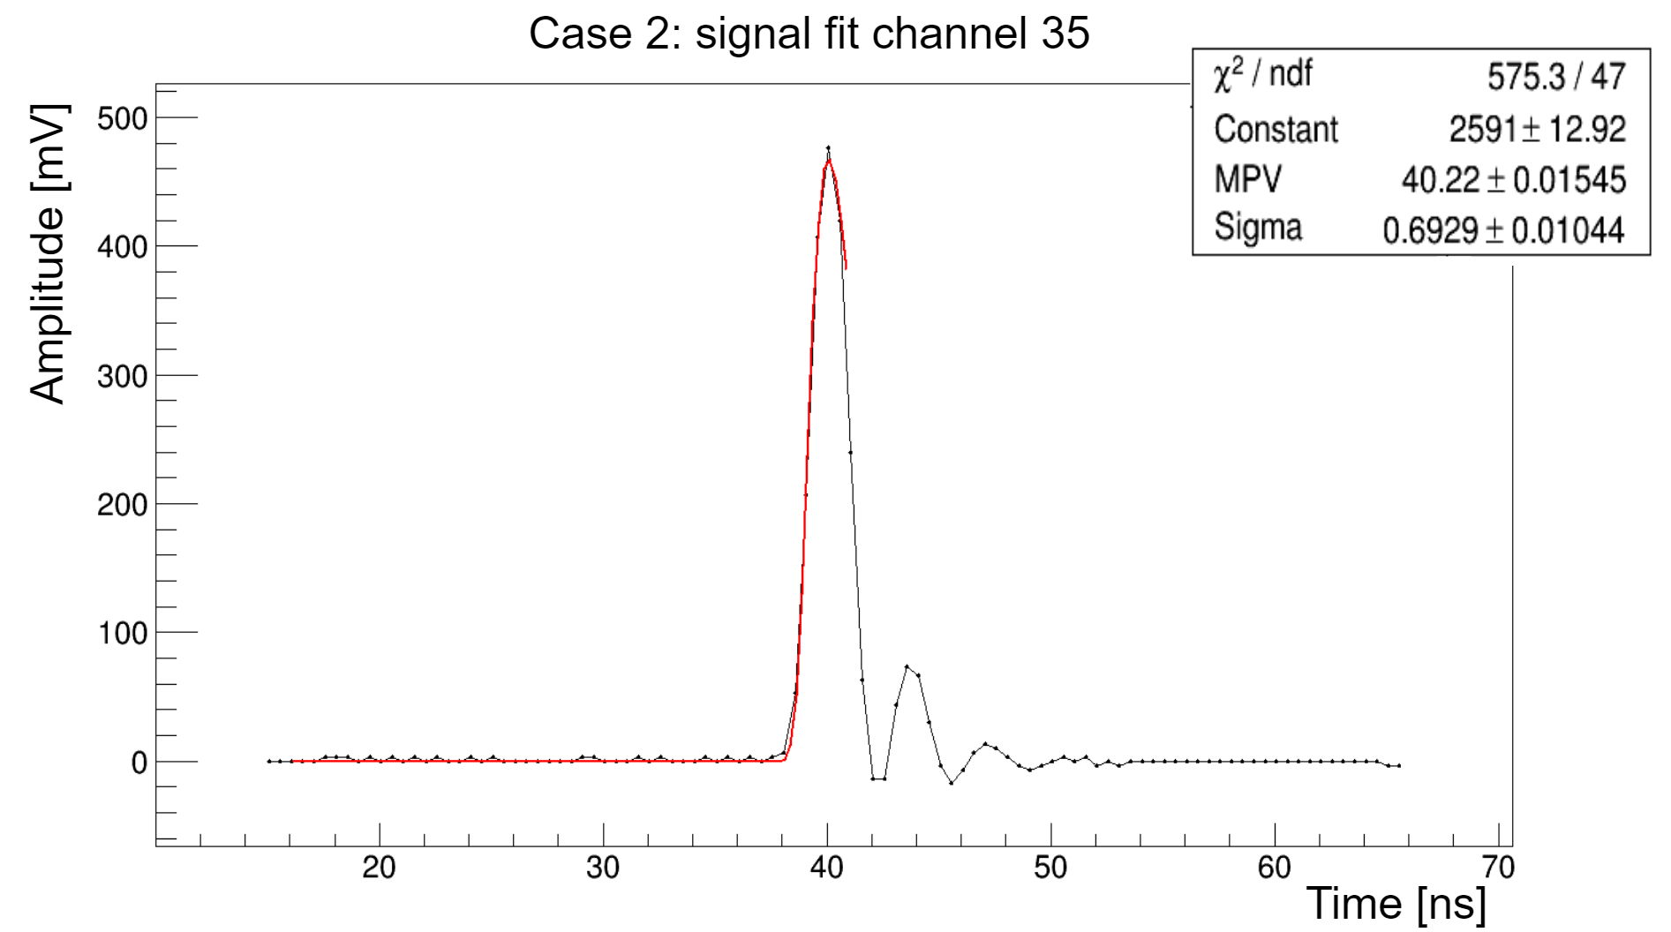
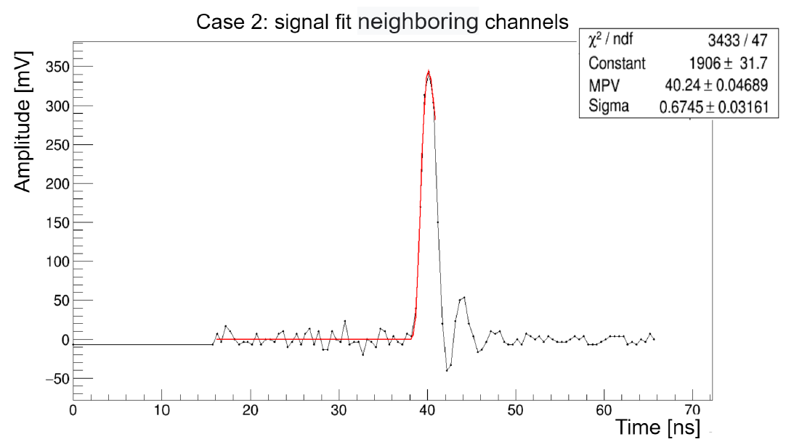
Two specific cases
1.
2.
The laser spot is centered on a given anode pixel of the MAPMT.
The laser spot is almost equally shared on two adjacent channels.
t_{Ch35} = 1.324 ns
t_{Ch35} = 1.029 ns
t_{sum}(10) = 0.890 ns
Observed coupling effects between channel → minimal effect that does not alter the correct functioning.
Martina Cucinotta
FCC Pisa, May 29, 2025
31

Slide 32
Ongoing activities

Slide 33
A new analog ASIC
The aim is to design a new ASIC device to readout multi-channel photodetectors, with the same features as the prototype, namely based on the equalization and on the analog sum of a programmable number of channels.
The idea is to design a first basic prototype for an ASIC 64-channels version of the device.
SiPM
Equalization
+
signal calibration
Σ
Amplification to match the ADC dynamic range
Analog sum in successive stages
Charge injection
Analog ASIC
Martina Cucinotta
FCC Pisa, May 29, 2025
33

Slide 34
A versatile analog ASIC
The basic version can be enriched with additional features to meet the needs of future users.
For example: signal timing optimization, two amplification level and charge integration for ALLEGRO HCAL
SiPM
Σ
Equalization
+
signal calibration
Two or more amplification
level based on the input signal
Amplification to match the ADC dynamic range
Analog sum in successive stages
Charge injection
+
+
Signal timing optimization
Charge integration
Analog ASIC
Martina Cucinotta
FCC Pisa, May 29, 2025
34

Slide 35
Interested italian institutes
Italian institutes | Field of interest
INFN Pisa | Architecture development
Università di Siena | Architecture development
INFN Torino | ASIC design
INFN Pavia | Interface to HiDRa application
INFN Milano e Università dell’Insubria | Interface to HiDRa application
We are working to form a collaboration of Italian institutes interested in the development of a 64-channel ASIC version of this device.
At this stage, we are defining the potential roles of the institutions within the collaboration and identifying the ASIC characteristics based on the readout requirements of the relevant DRD6 projects.
The table represents a possible division of tasks if the project moves forward. The institutions are already officially part of DRD6.
International institutes | Expertise
CERN | ALLEGRO project
Prague, Uni Bergen/ Gottingen, FOTON | SiPM readout
University of Valencia | RF amplifiers for SiPM readout
Martina Cucinotta
35

Slide 36
Conclusions and next steps
A prototype of a new analog device for the readout of SiPMs has been designed and tested by INFN Pisa. The tests on the prototype yielded excellent results in terms of pulse shape stability, linearity and time stability in the case of summing an arbitrary number of channels.
Encouraged by the results of the prototype we want to propose an ASIC with the same features for reading 64-channel SIPMs.
To gain hands-on experience, we initiated the first tests last week focused on the readout of a single SiPM.
Next steps:
Conduct tests on individual channels of the prototype using a single-channel SiPM (FBK);
Design a PCB that allows the prototype input to be adapted to a 64-channels SiPM (Hamamatsu S13361-3050AE);
Test the 64-channel SiPM with the prototype, also in preparation for a possible test beam in 2028, should the ASIC not be ready by then.
Martina Cucinotta
FCC Pisa, May 29, 2025
36

Slide 37
Backup

Slide 38
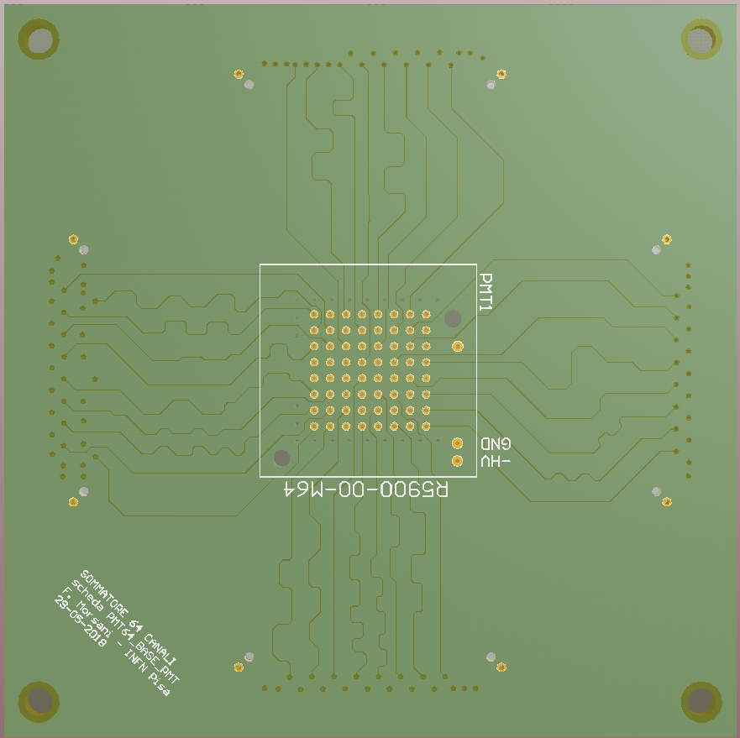
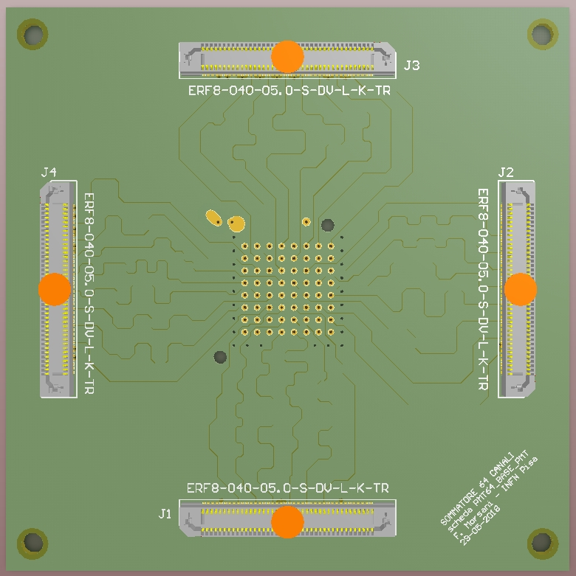
Prototype description (1)
Board-to-board connector
First base board
(front and back)
The prototype is designed to host a 64-channel MAPMT with a sensitive area of 18 × 18 mm² and an anode pitch of 2.54 mm.
Martina Cucinotta
FCC Pisa, May 29, 2025
38

Slide 39
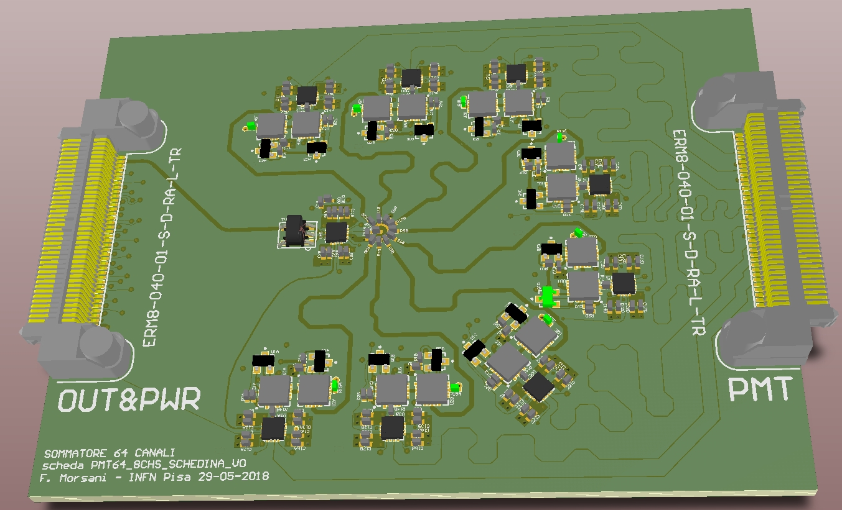
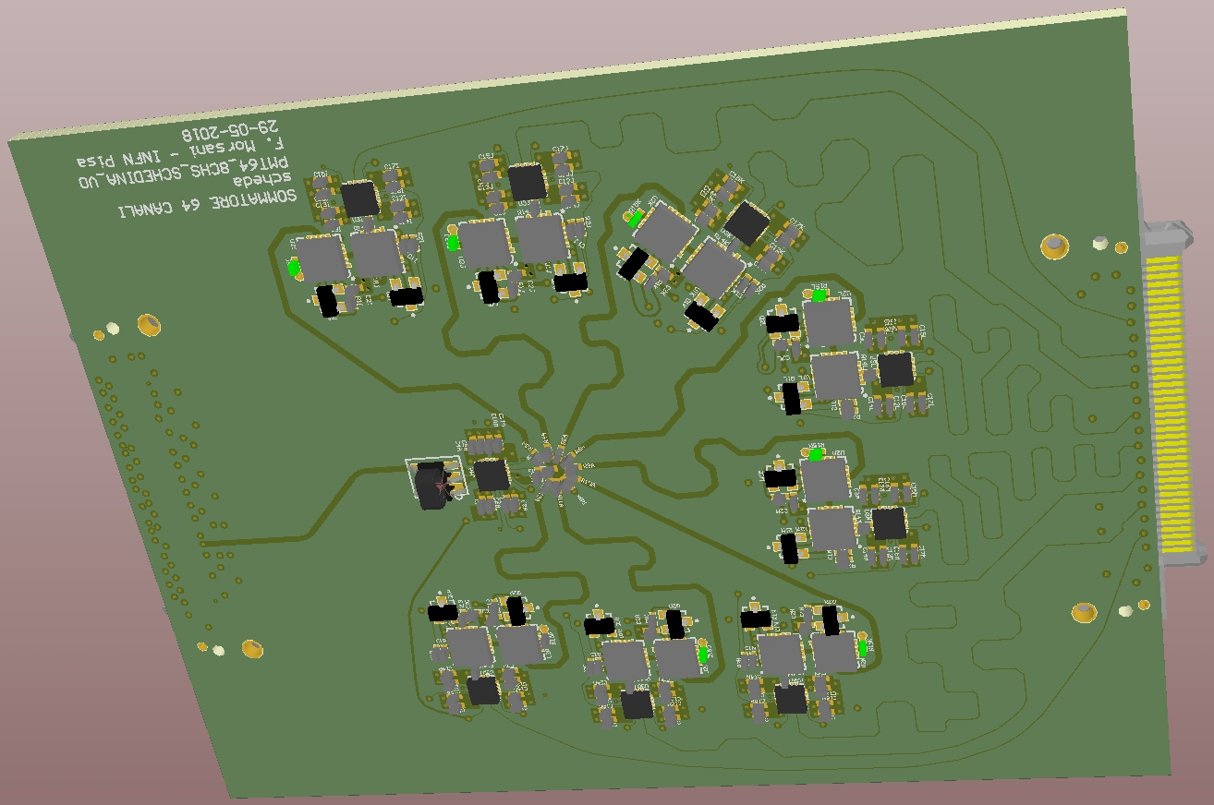
Prototype description (2)
Lateral board
8 single-channel amplification systems
1 resistive network to perform analog sum of 8 channels
Martina Cucinotta
FCC Pisa, May 29, 2025
39

Slide 40
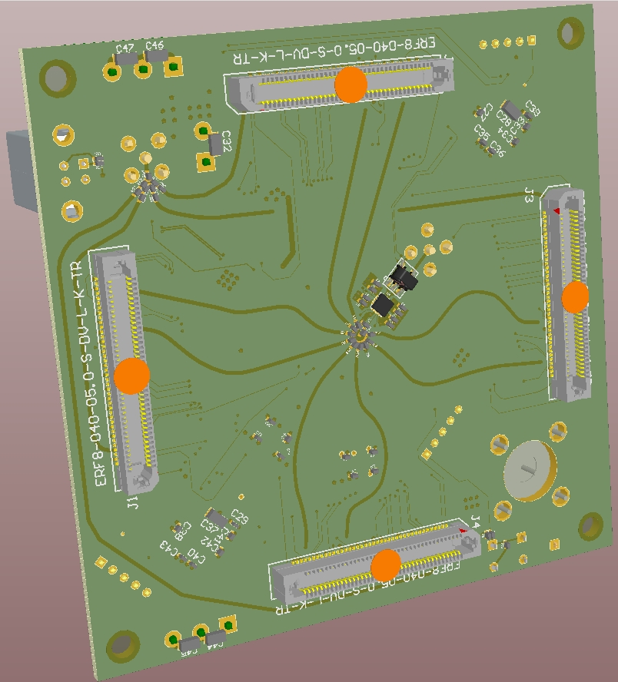
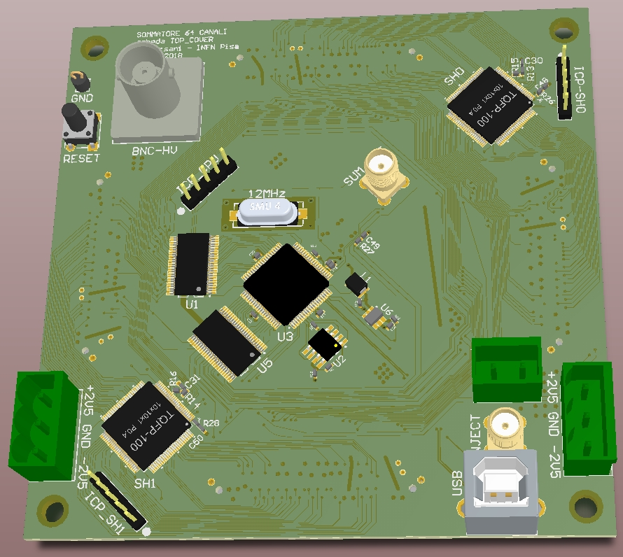
Prototype description (3)
Second base board
(front and back)
Final sum stage (final resistive network + amplifier)
Microcontroller and logic level shifters
USB interface
BNC-HV
Martina Cucinotta
FCC Pisa, May 29, 2025
40

Slide 41
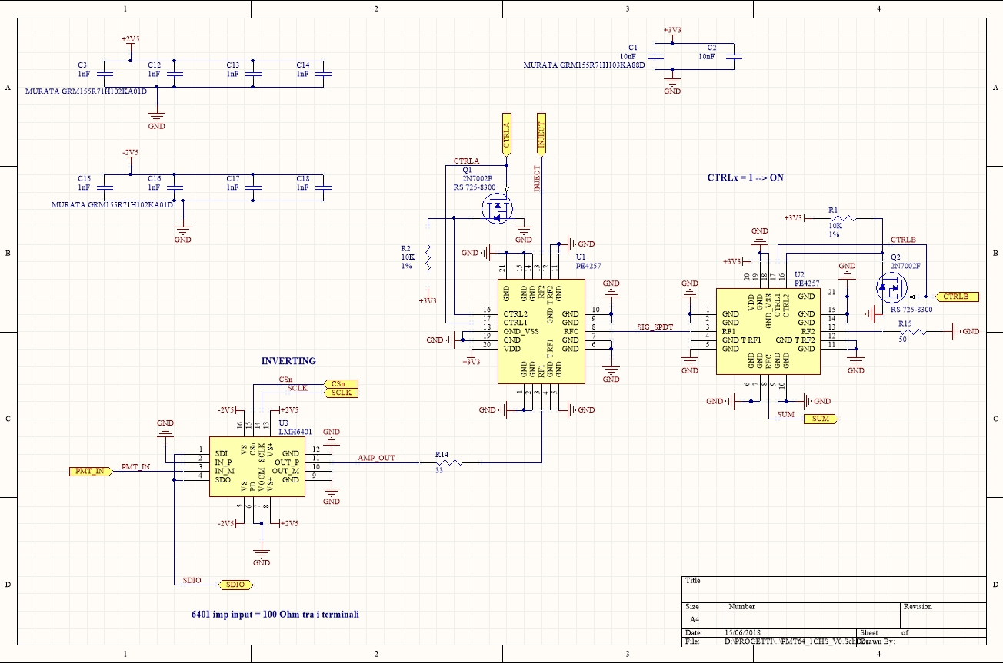
Single channel amplification circuit
Switch
Amplifier
Martina Cucinotta
FCC Pisa, May 29, 2025
41

Slide 42
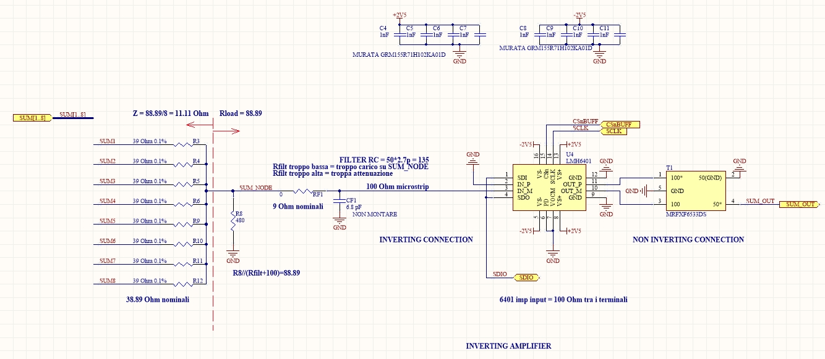
8-channels summing network
Amplifier
Transformer
Martina Cucinotta
FCC Pisa, May 29, 2025
42

Slide 43
Prototype tests: introduction
The prototype has been tested in Pisa in terms of pulse shape stability and linearity of the analog sum of an arbitrary number of channels.
Various tests were done with two different experimental setups:
test of the 16 central readout channels injecting an input signal
test of the readout system using a MAPMT and a laser system
Martina Cucinotta
FCC Pisa, May 29, 2025
43

Slide 44
Readout prototype tests with signal injection

Slide 45
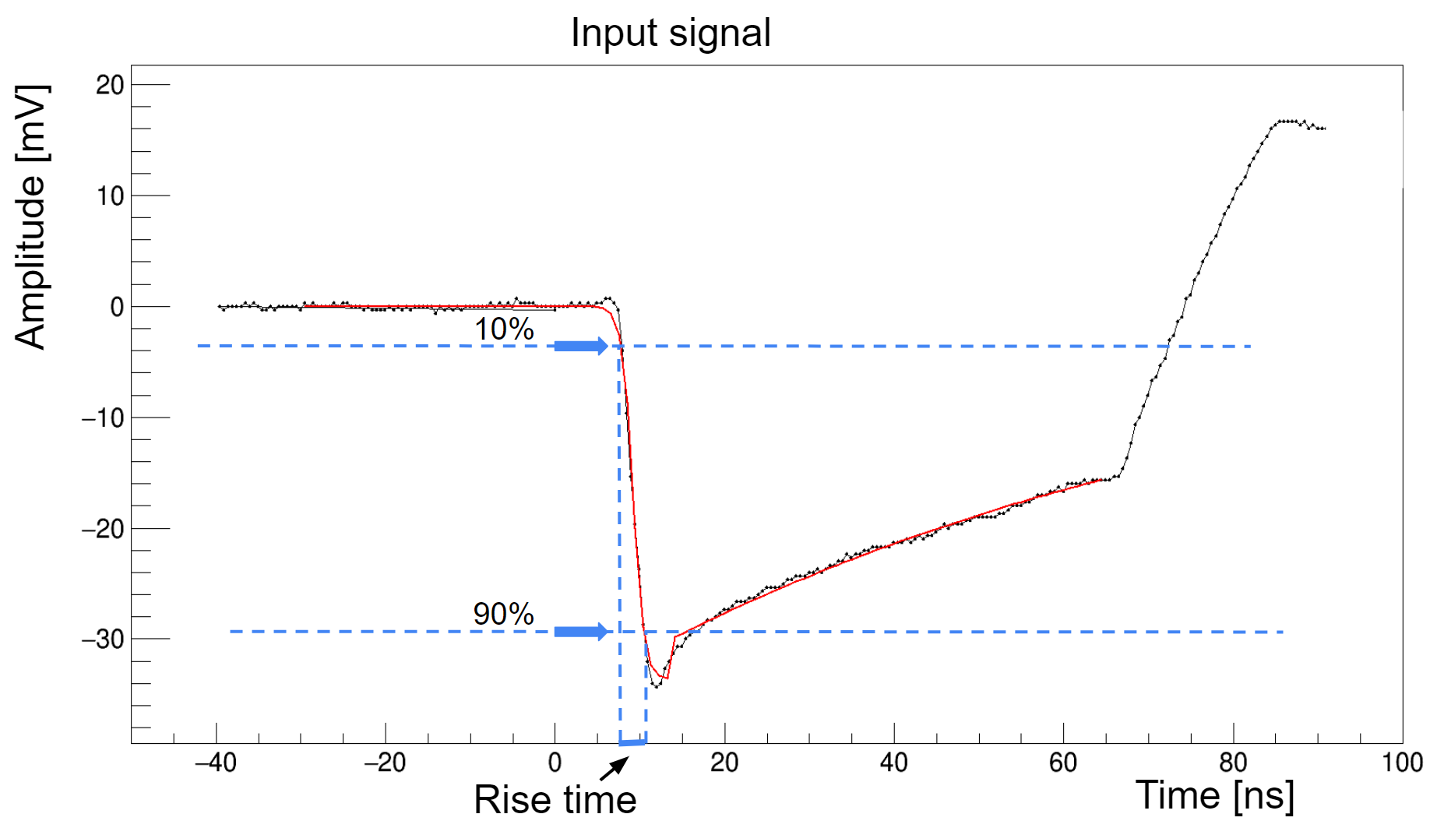
Input signal
Input signal used to test the 3 readout prototype amplification stages.
Generated by differentiating a square pulse with a 60 pF capacitor to simulate the signal produced by a PMT.
Martina Cucinotta
FCC Pisa, May 29, 2025
45

Slide 46
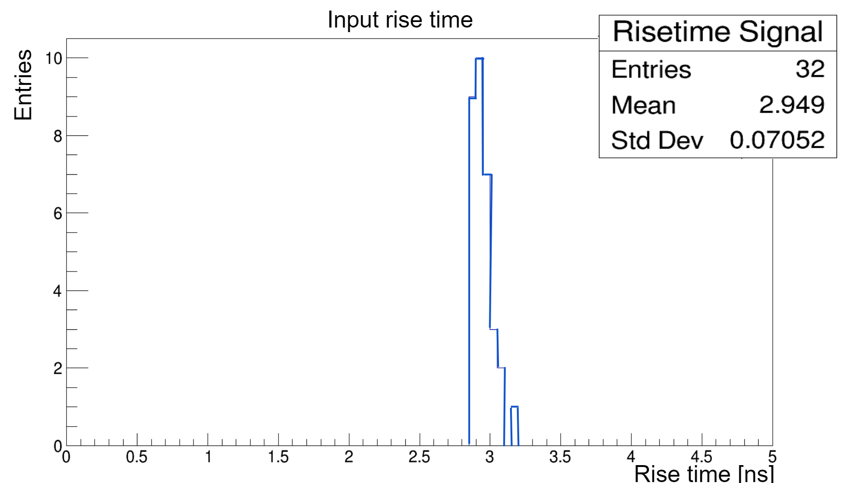
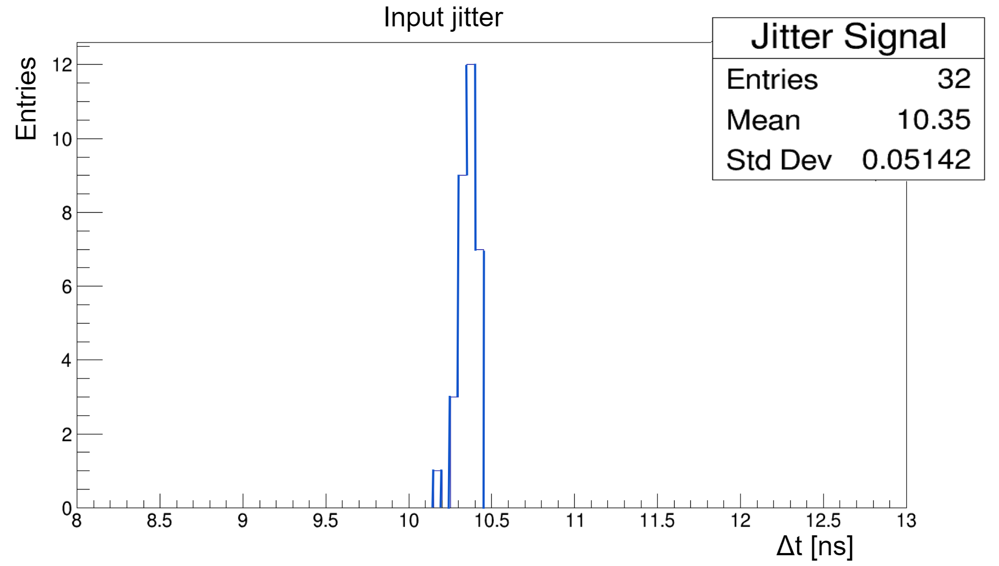
Input signal
Input signal used to test the 3 readout prototype amplification stages.
Generated by differentiating a square pulse with a 60 pF capacitor to simulate the signal produced by a PMT.
Martina Cucinotta
FCC Pisa, May 29, 2025
46

Slide 47
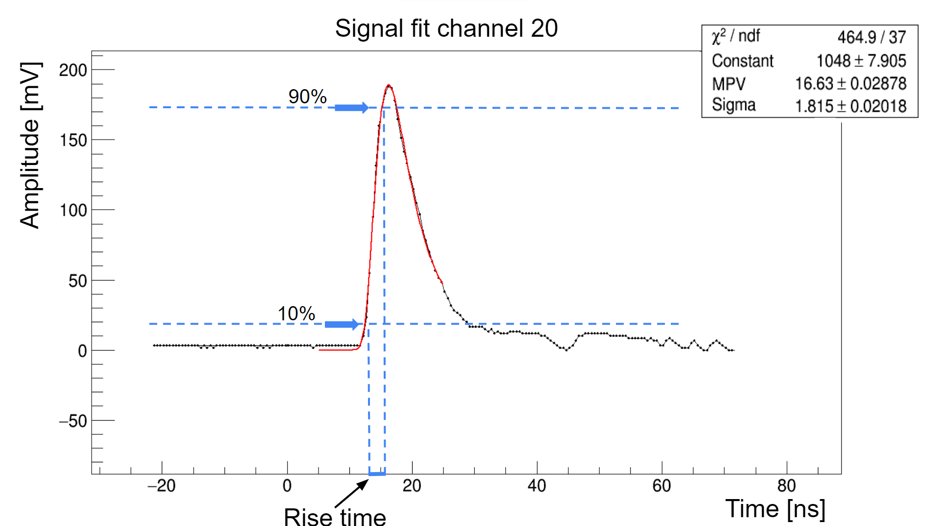

Single channel output signals: rise time
Landau fit function to calculate the amplitude and the baseline of the signal for the rise time evaluation.
Output signal rise times are ∼ 2.7 ns.
Martina Cucinotta
FCC Pisa, May 29, 2025
47

Slide 48
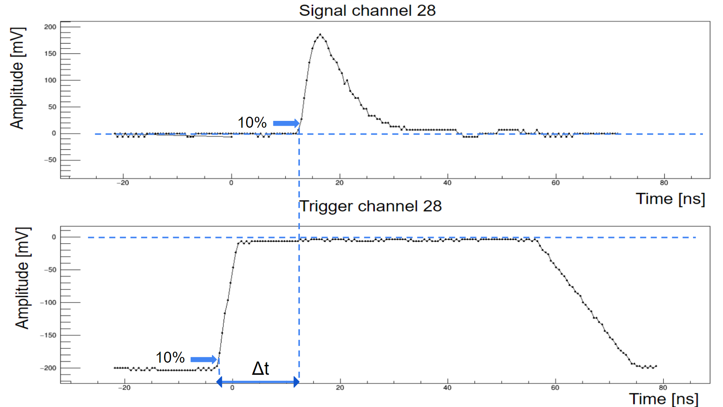
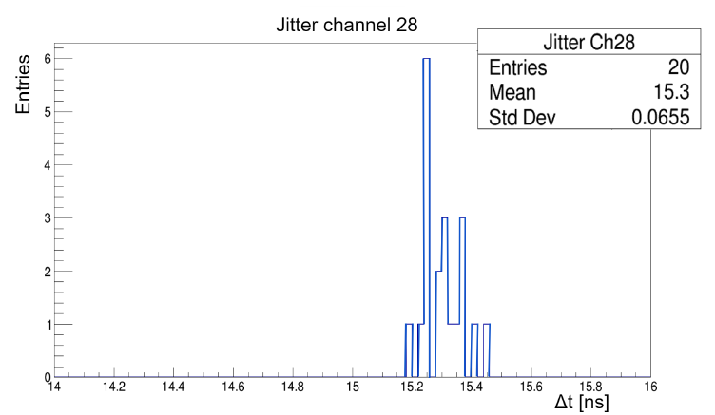
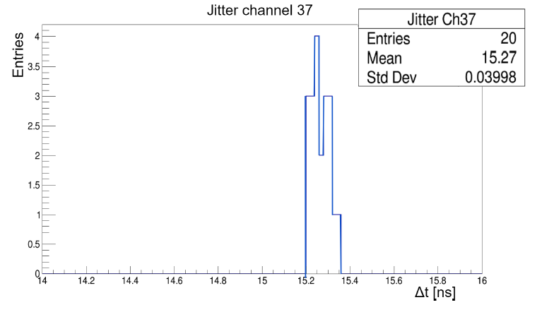
Single channel output signals: jitter time
Amplitude [mV]
Jitter values ∼ 50 ps.
Good temporal stability for this type of readout system;
Output jitter compatible with the input jitter → good data transmission through the readout prototype.
Amplitude [mV]
Martina Cucinotta
FCC Pisa, May 29, 2025
48

Slide 49
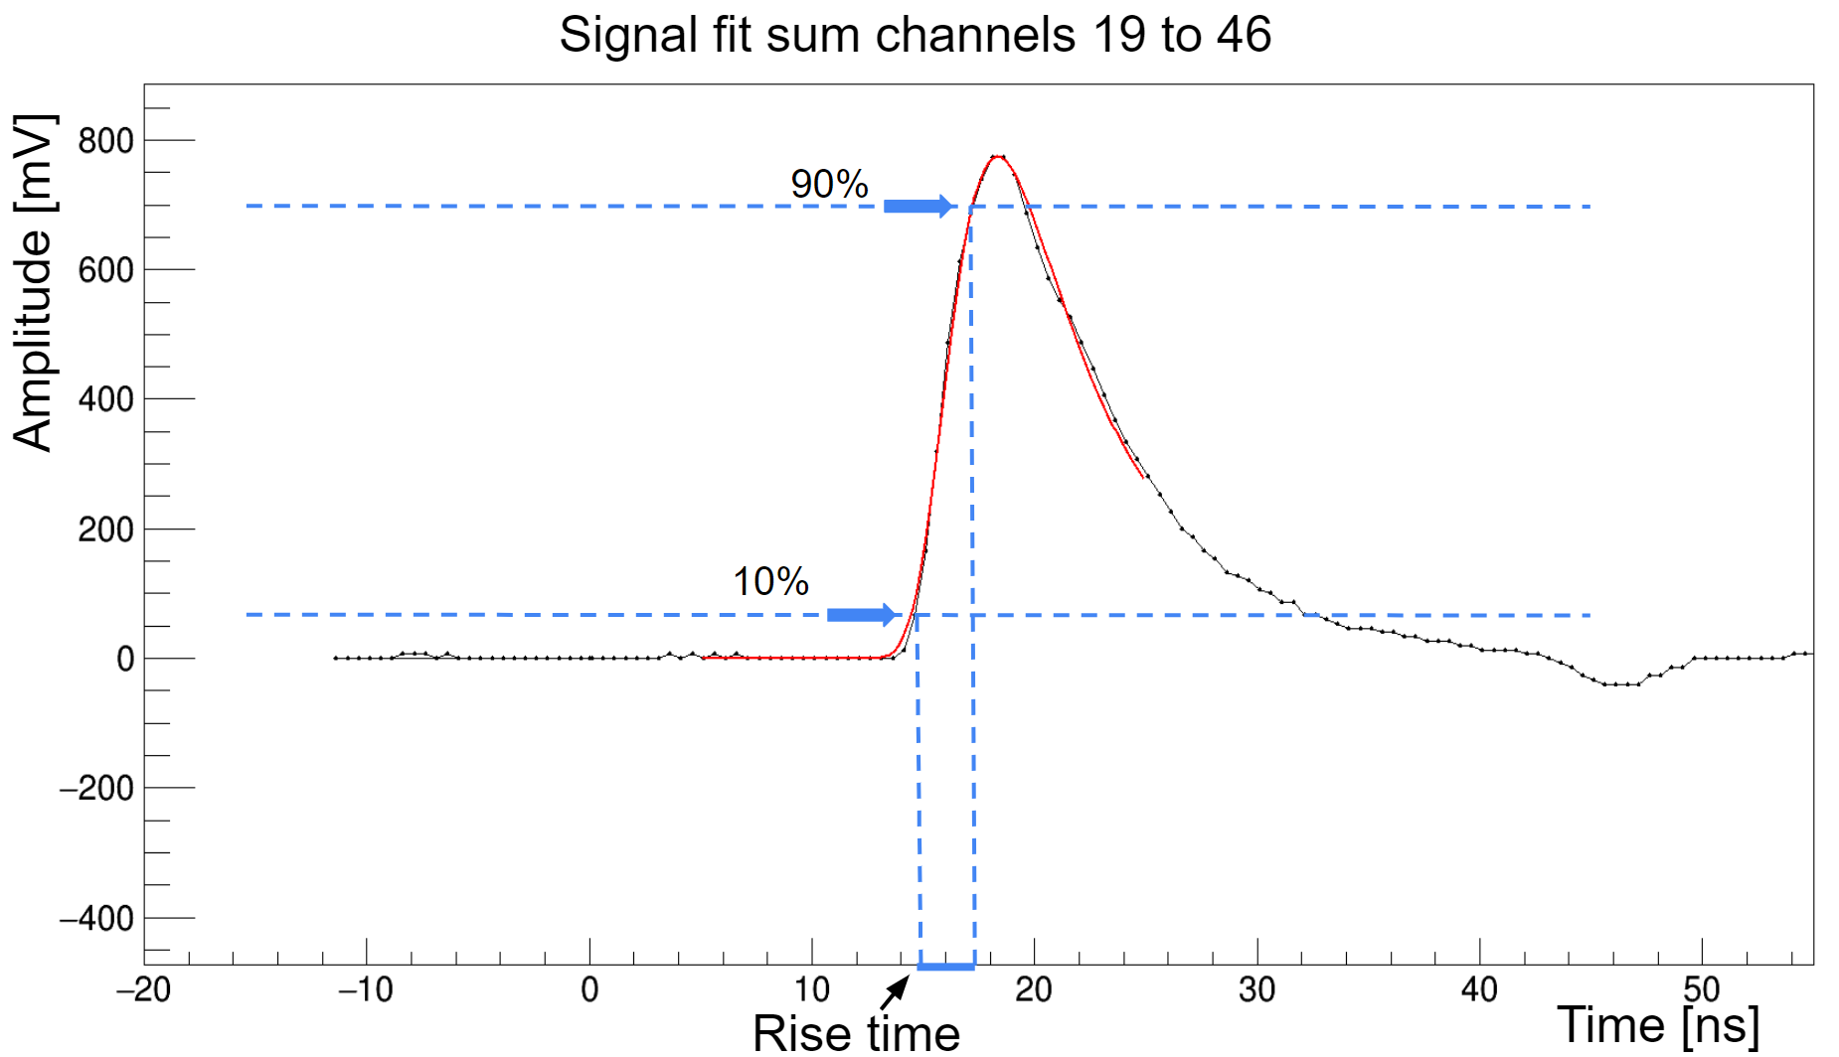

Signal stability as a function of the number of channels
Sum signal of the 16 tested channels
Rise time value compatible within one standard deviation with the rise time of the individual channels.
The operation carried out by the resistive networks to sum the analog signals does not alter the shape of the outputs.
24
Martina Cucinotta
FCC Pisa, May 29, 2025
49

Slide 50
Readout prototype tests with a MAPMT and a laser system

Slide 51
Test with MAPMT and laser: experimental setup
Martina Cucinotta
FCC Pisa, May 29, 2025
51

Slide 52
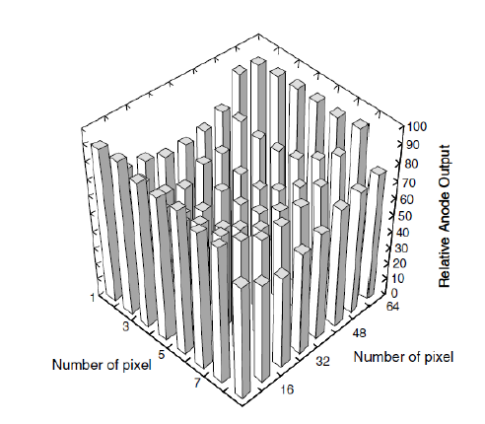
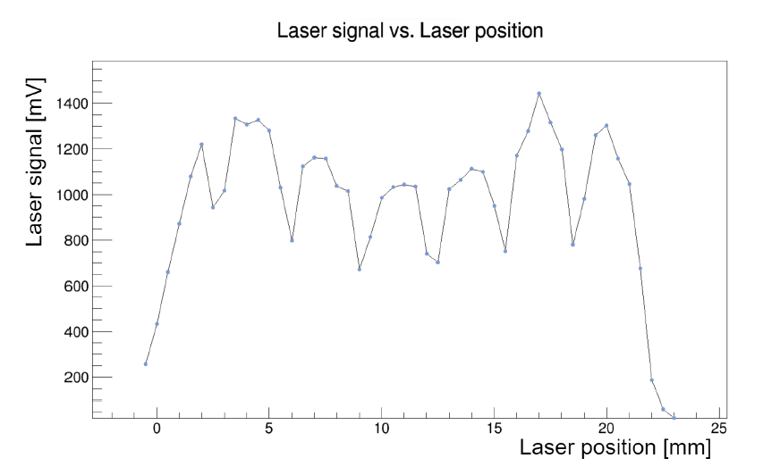
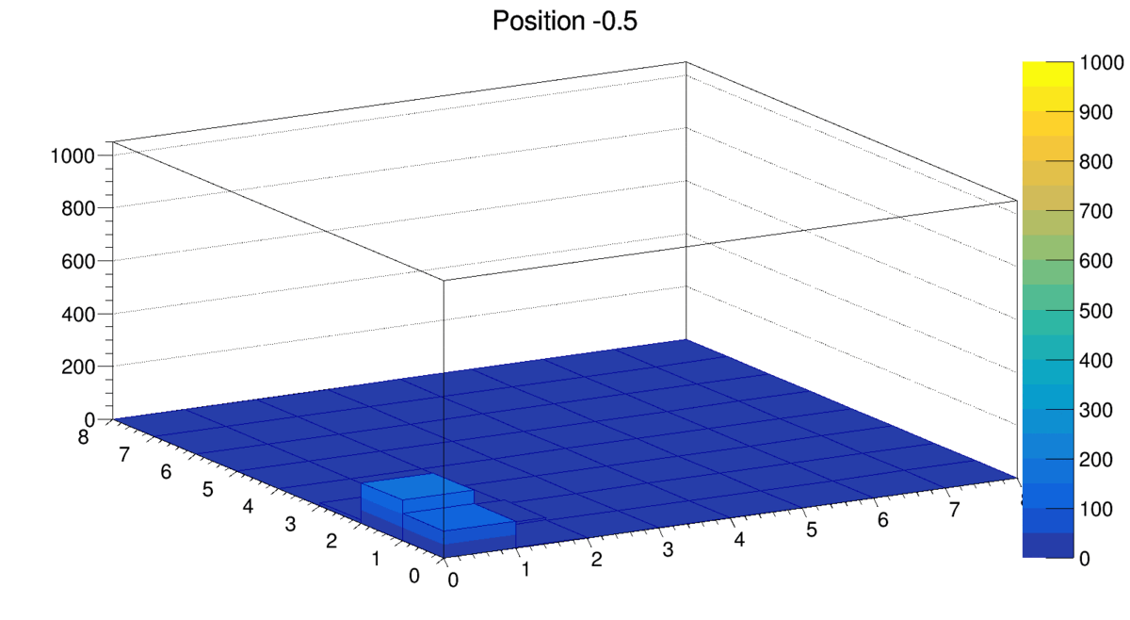
Scan of the MAPMT photocatode with a laser system
The beam spot moves along the photocathode diagonal.
Acquired the signal amplitudes for all 64 channels across 48 positions of the laser spot along the diagonal.
Spot dimensions and optical crosstalk → the laser signal spreads in more than 1 channel.
Martina Cucinotta
FCC Pisa, May 29, 2025
52

Slide 53
Prototype tests conclusions
The readout prototype guarantees shape stability, in the analog sum of the signals ( rise times ∼ 2.7 ns);
The resistive summing networks do not alter the shape of the outputs;
Jitter time ∼ 51 ps, good data transmission;
Observed coupling effects between channel → minimal effect that does not alter the correct functioning.
More information: https://etd.adm.unipi.it/t/etd-02052024-191133/
Martina Cucinotta
FCC Pisa, May 29, 2025
53

Slide 54
Two specific cases
The laser spot is centered on a given anode pixel of the MAPMT.
The laser spot is almost equally shared on two adjacent channels.
1.
2.
Martina Cucinotta
FCC Pisa, May 29, 2025
54

Slide 55
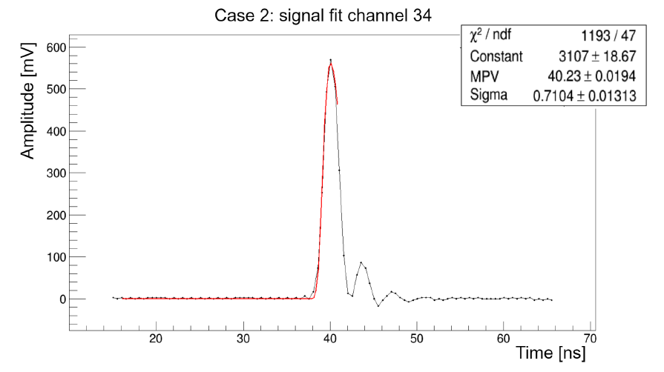
Single channel signals
1.
2.
t_{Ch34} = 1.055 ns
t_{Ch35} = 1.324 ns
t_{Ch35} = 1.029 ns
The rise time of Ch35 is larger when it alone receives the most signal relative to the case when the signal is almost equally shared between Ch34 and Ch35.
Martina Cucinotta
FCC Pisa, May 29, 2025
55

Slide 56
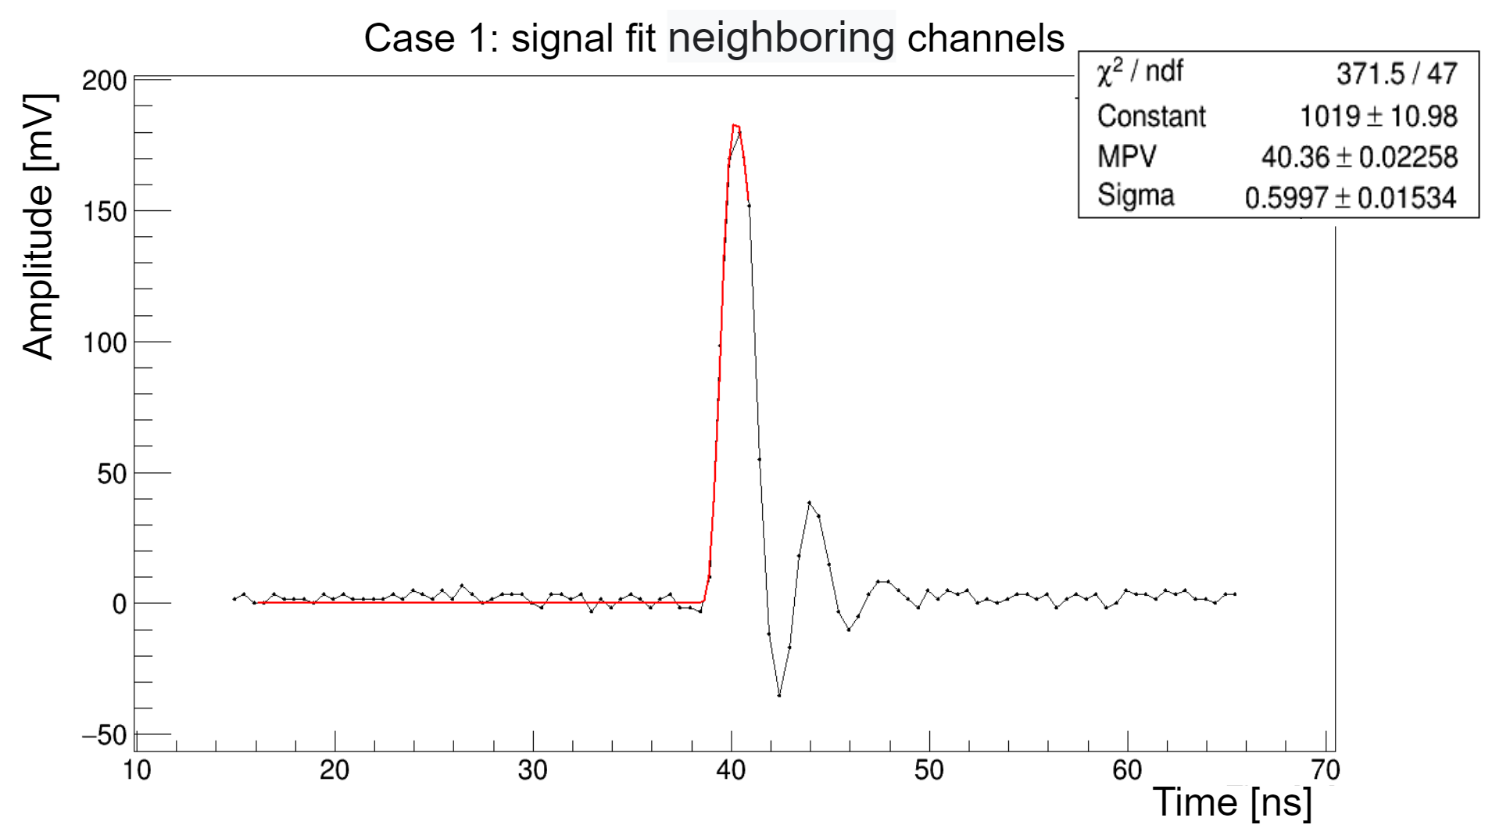
Analog sum of neighbouring channels
1.
2.
t_{sum}(8) = 1.002 ns
t_{sum}(10) = 0.890 ns
In both cases the signal rise time is larger for individual channels detecting the main part of the signal relative to the sum of the neighbouring channels.
Martina Cucinotta
FCC Pisa, May 29, 2025
56

Slide 57
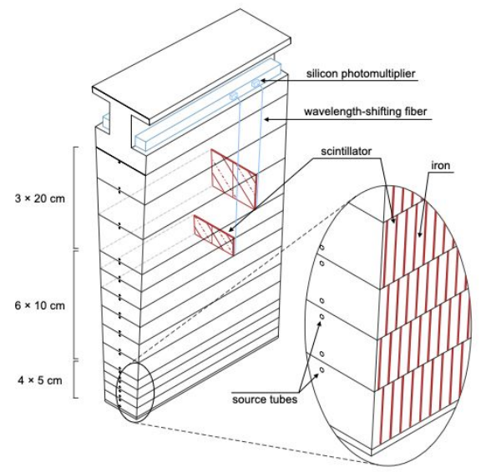
ALLEGRO HCAL
A possible application of this device is the ALLEGRO HCAL barrel, which involves a readout system based on tile + fiber + SiPM.
Design based on alternating steel and scintillator layers ( 5 mm absorbers, 3 mm scintillators)
Barrel:13 radial layers
Endcap: 6 / 9 / 22 radial layers
128 modules in 𝜙, 2 tiles per module
Δ𝜙 = 0.025
Δη= 0.022 (grouping 3-4 tiles)
Performance studies ongoing
Potential application in any calorimeter with SiPMs, which are expected to be widely used in future calorimeters.
Martina Cucinotta
FCC Pisa, May 29, 2025
57

Slide 58
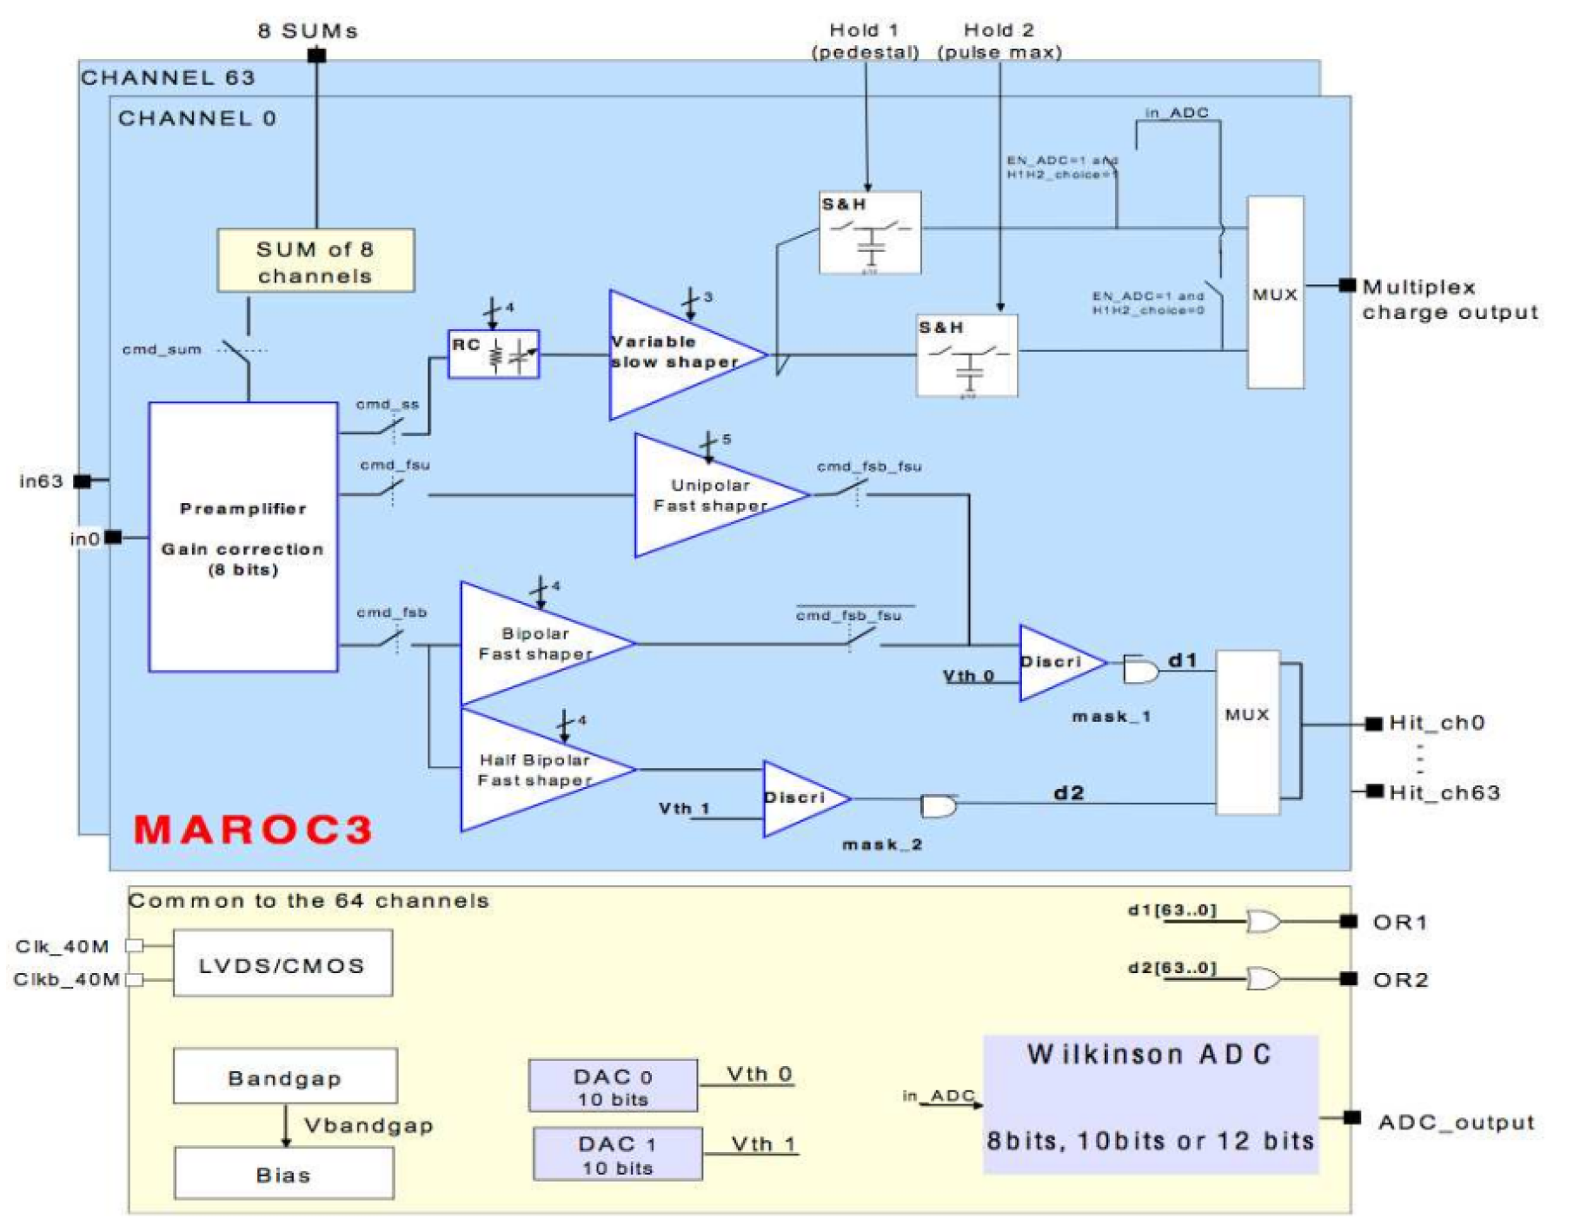
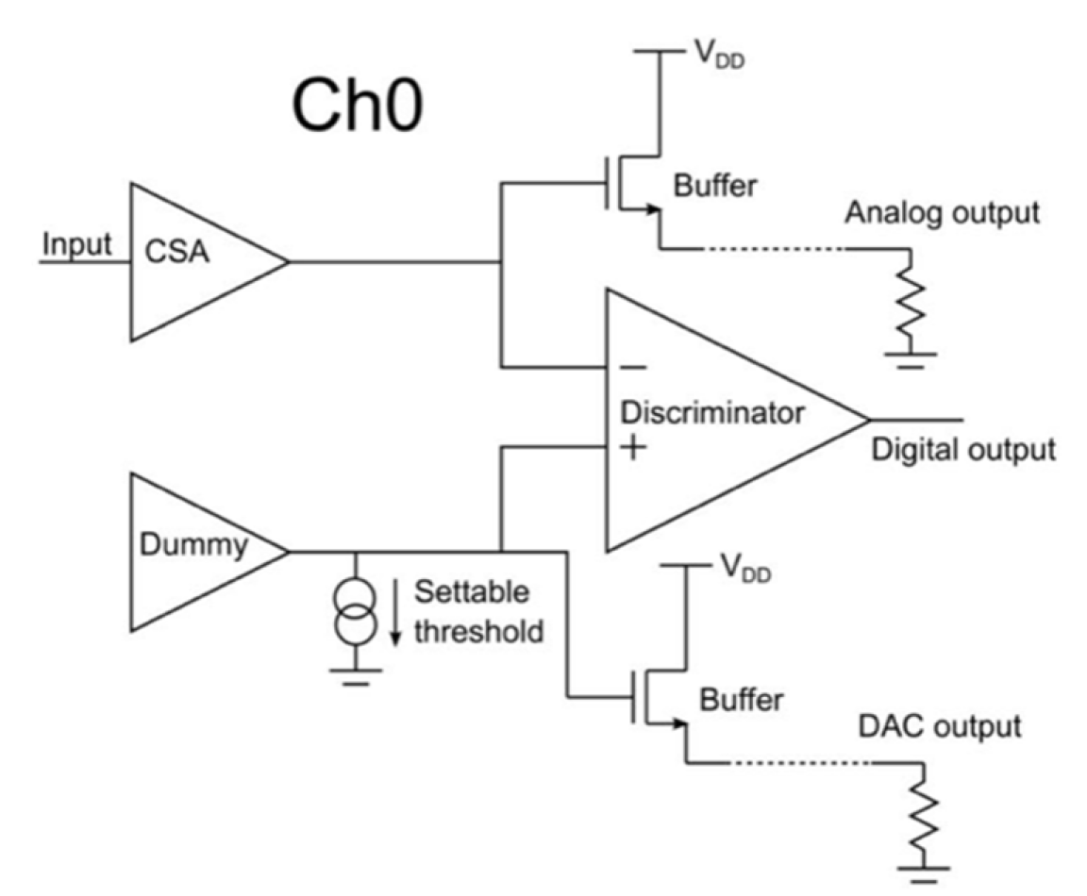
Readout systems on the market
The device we want to design offers broader functionality than similar existing readout systems.
Multi-AnodeReadOut Chip (MAROC3)
64-channels readout, AMS SiGe 0.35 μm technology. Maximum amplification up to a factor 4.
More info: https://www.weeroc.com/~documents/route%3A/download/132/
CLARO8
8-channels readout, 0.35 μm CMOS technology. CLARO8 provides mainly digital output signals, has only 4 gain settings and does not allow to sum the channel signals.
More info: https://ieeexplore.ieee.org/stamp/stamp.jsp?tp=&arnumber=7891728
FCC Pisa, May 29, 2025
Martina Cucinotta
34

