Slide 1
Scintillating fiber tests
F. Bedeschi.
Dual Readout prototype,
May 29, 2025
OUTLINE
Dual Readout in IDEA
General on HiDRa2
Equipment
First results

Slide 2
Dual Readout in IDEA
~7 λ – 70 M fibers

Slide 3
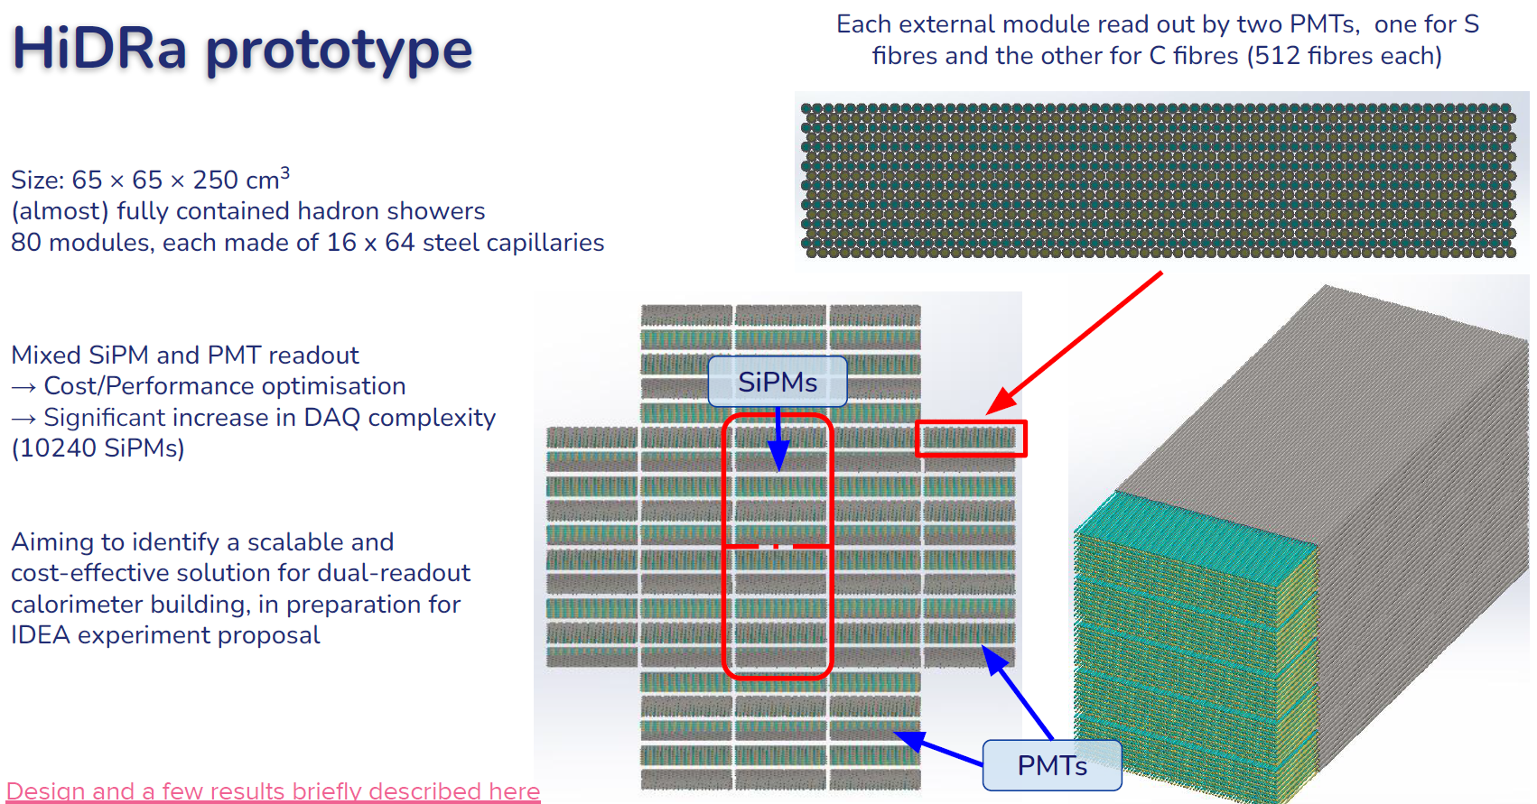
The HiDRa

Slide 4
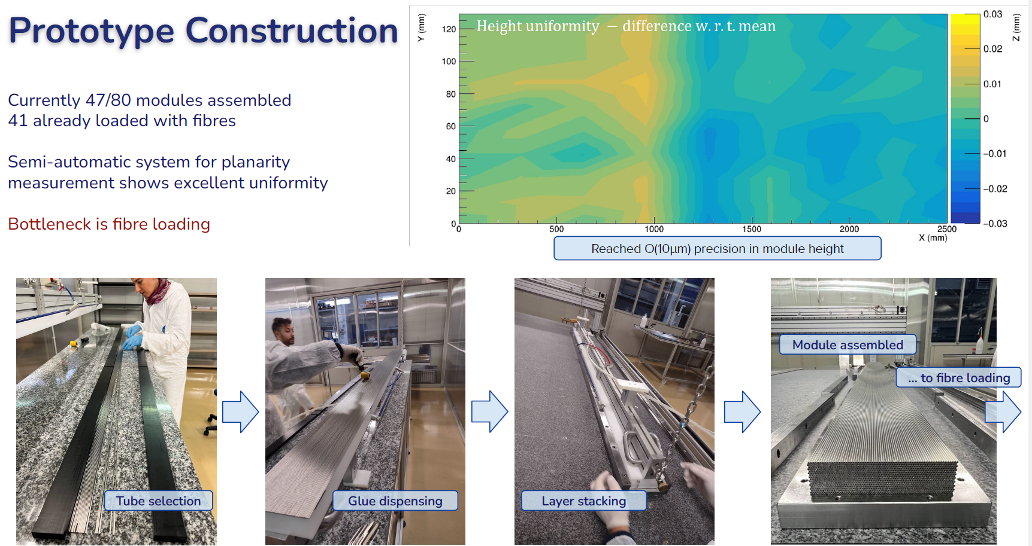
Construction

Slide 5
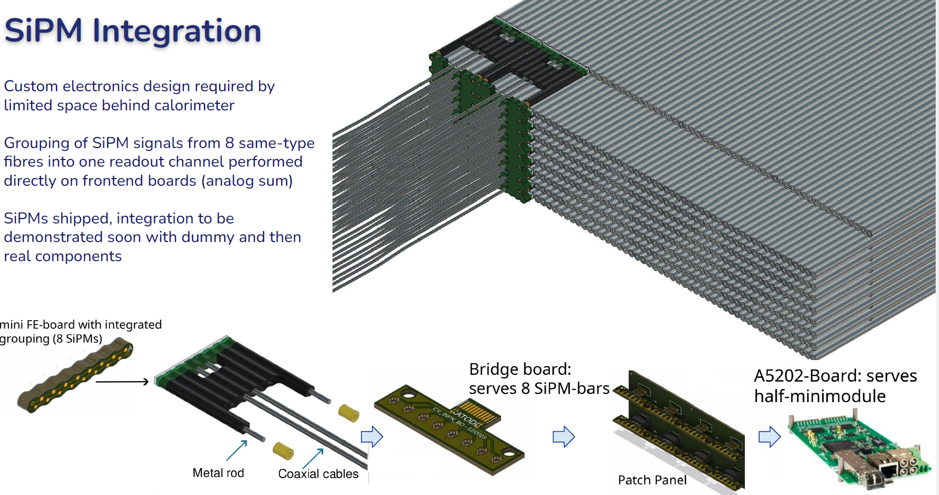
SiPM integration

Slide 6
Fiber cutting & testing in Pisa
Cut fibers from spool to 2.7 m length
  Gigantic effort! → Bought cutting machine
Characterize scintillating BCF-12 fibers from Luxium:
  Attenuation vs wave length
  Cross-check signals/fits
Measurement procedure
  ~ 20 min/fiber
  Measure only 6 fibers/spool (1 km)
    2 fibers at start of spool (S1, S2)
    2 fibers in the middle (M1, M2)
    2 fibers at the end (E1, E2, E3)
  All in all ½ day/spool

Slide 7
Equipment
Long black box for measurements – Inside:
  Grooved plastic to host fiber under test
  Meter stick along groove to locate position along fiber
  Optical coupling of fiber to clear quartz fiber
Outside:
  Thorlabs spectrometer connected to laptop for DAQ
Light sources:
  UV lamp 365 nm

Slide 8
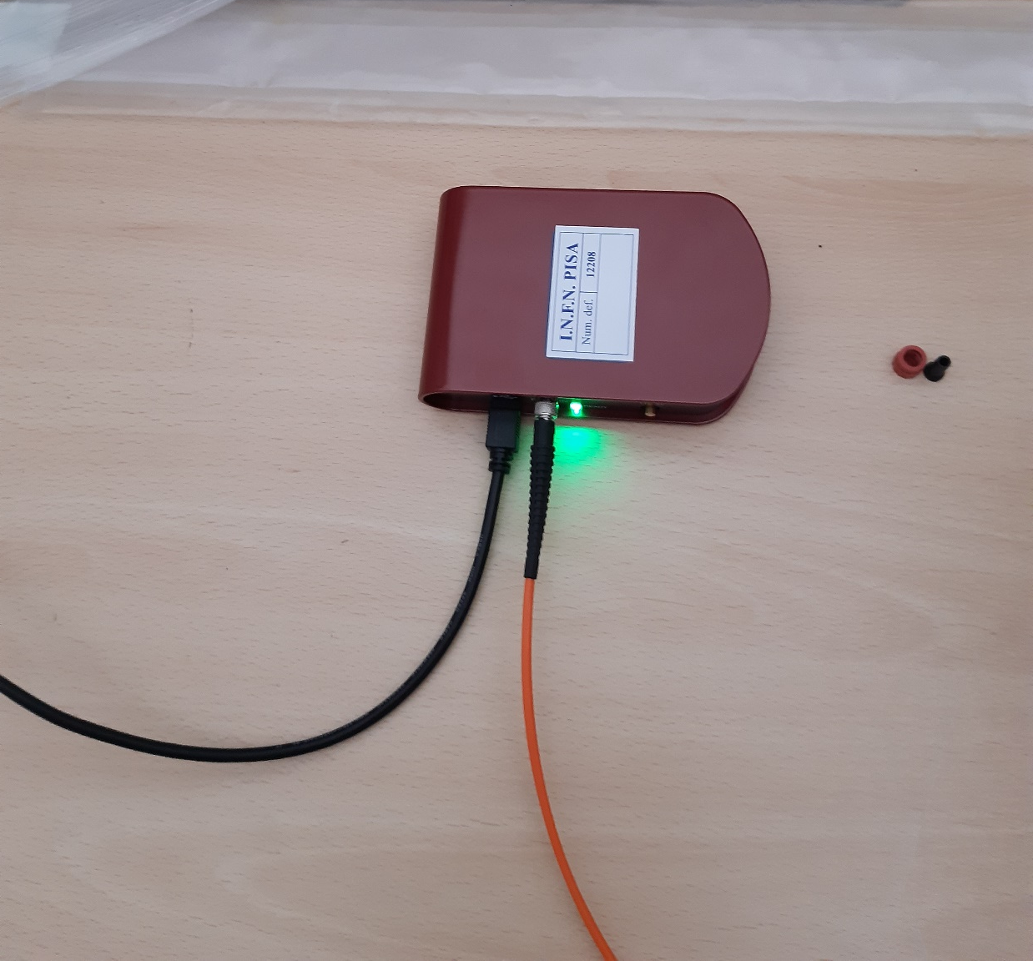
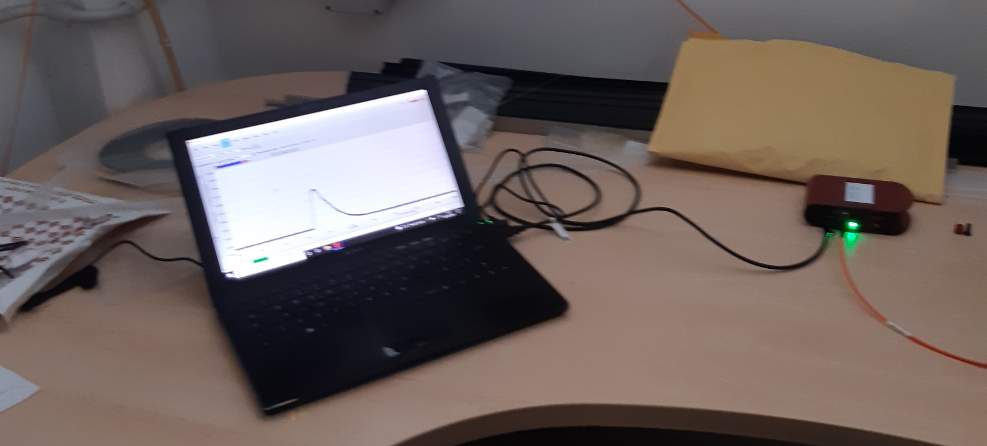
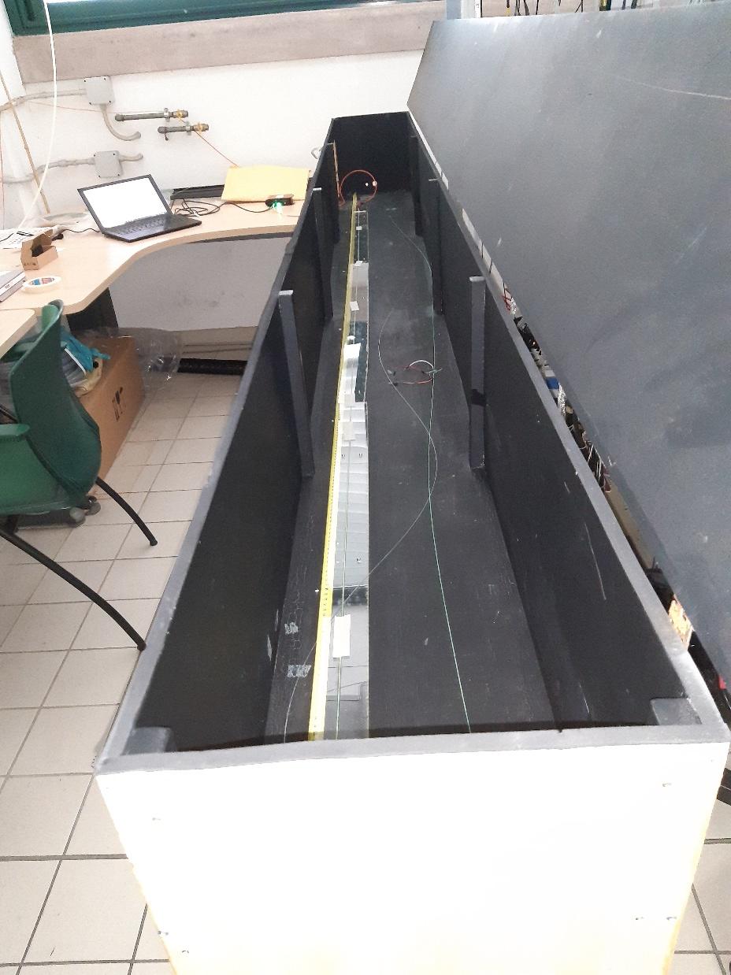
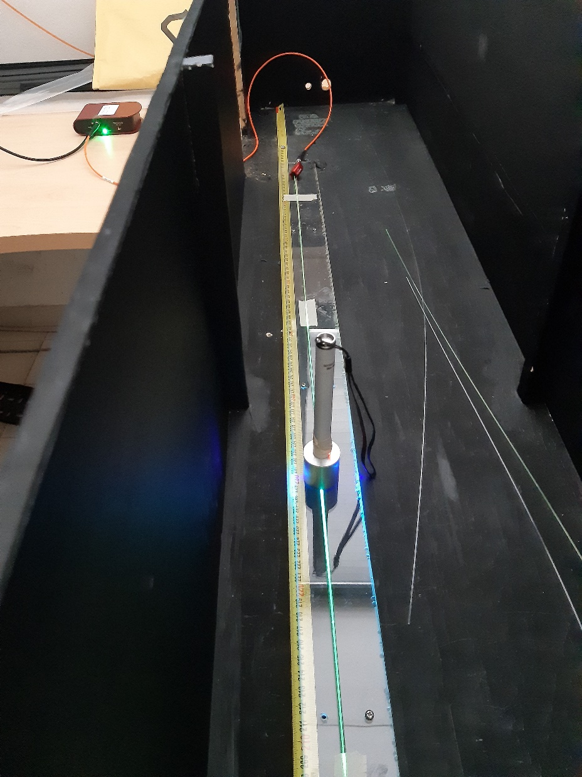
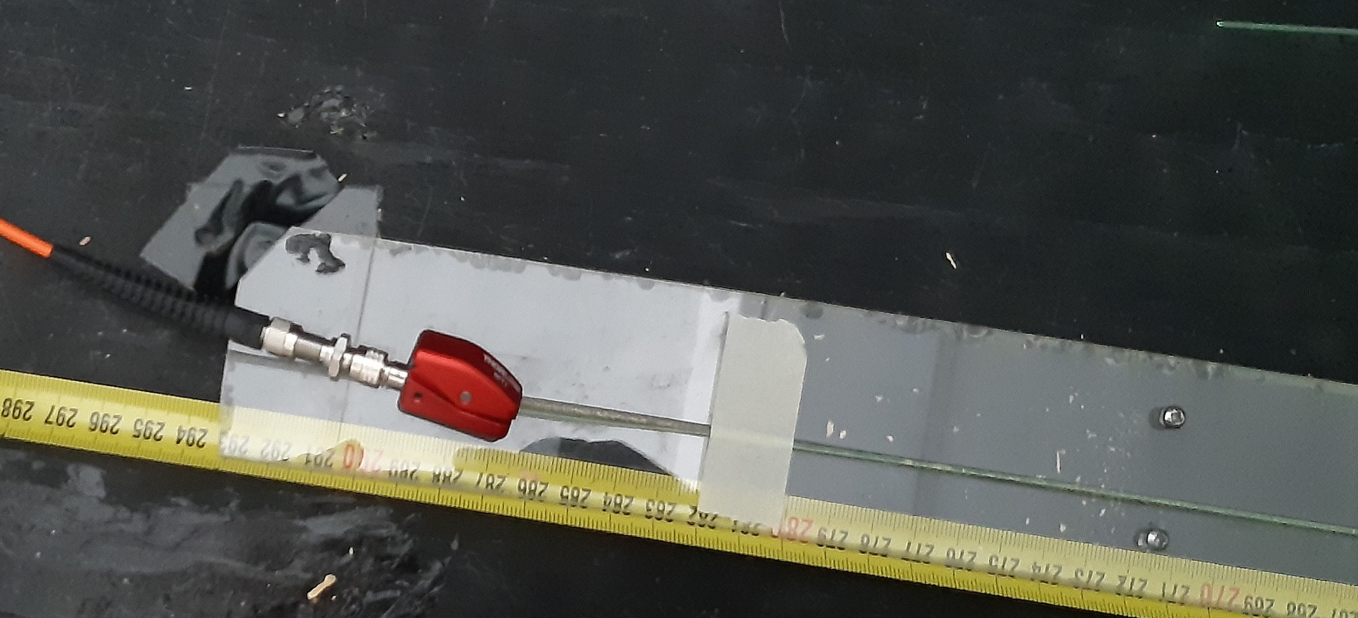
Equipment
The box
The meter
Coupling
Spectrometer
DAQ

Slide 9
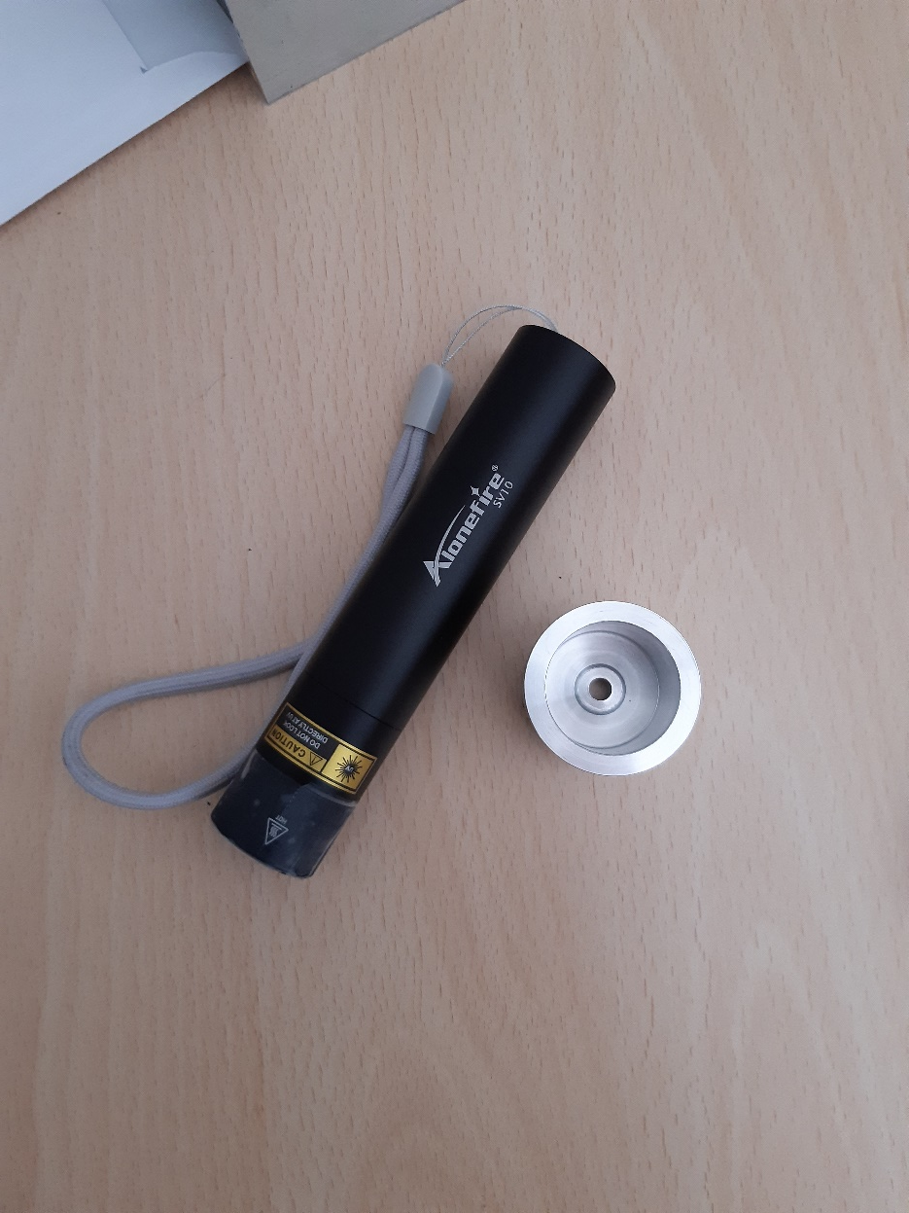
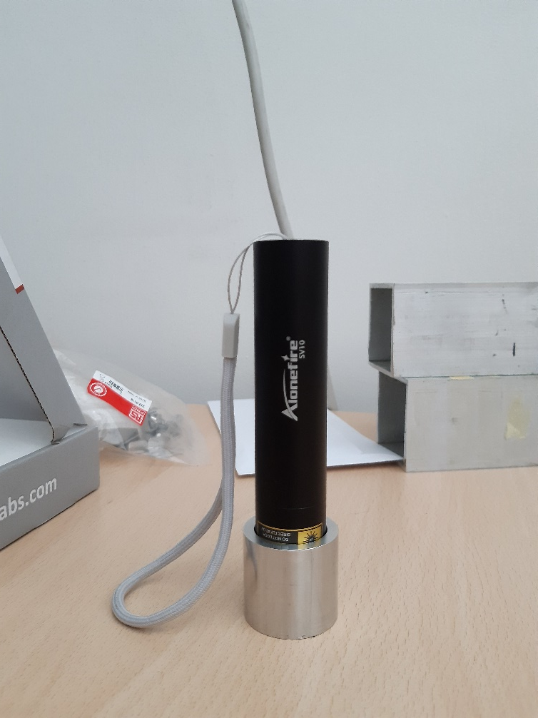
Source
UV lamp 365 nm

Slide 10
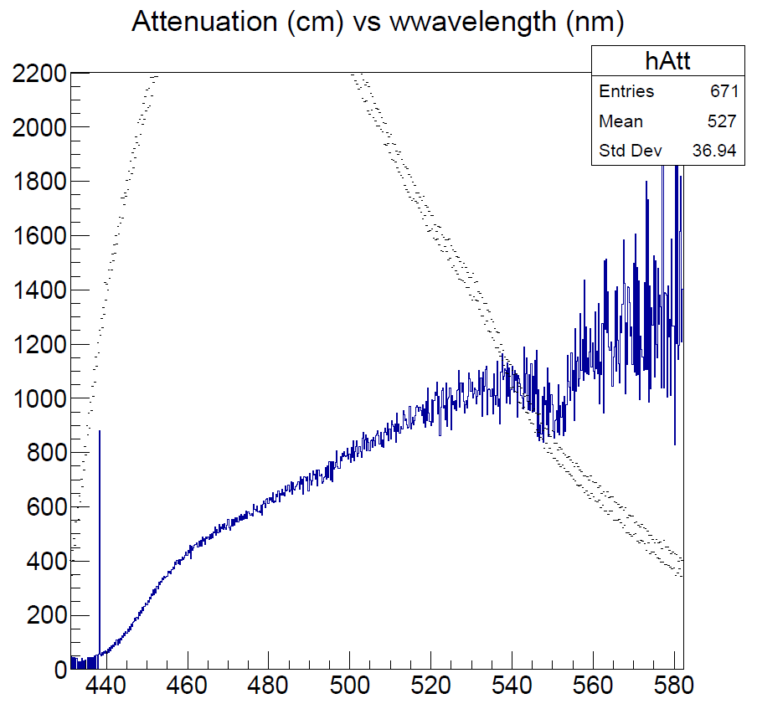
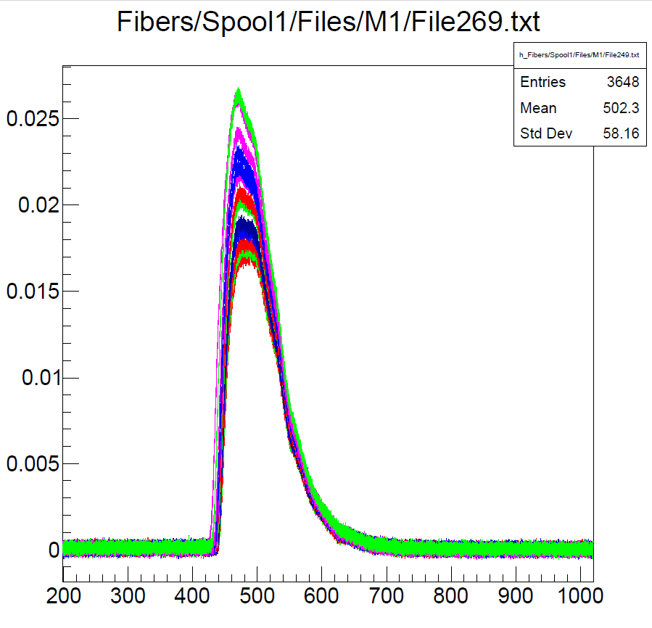
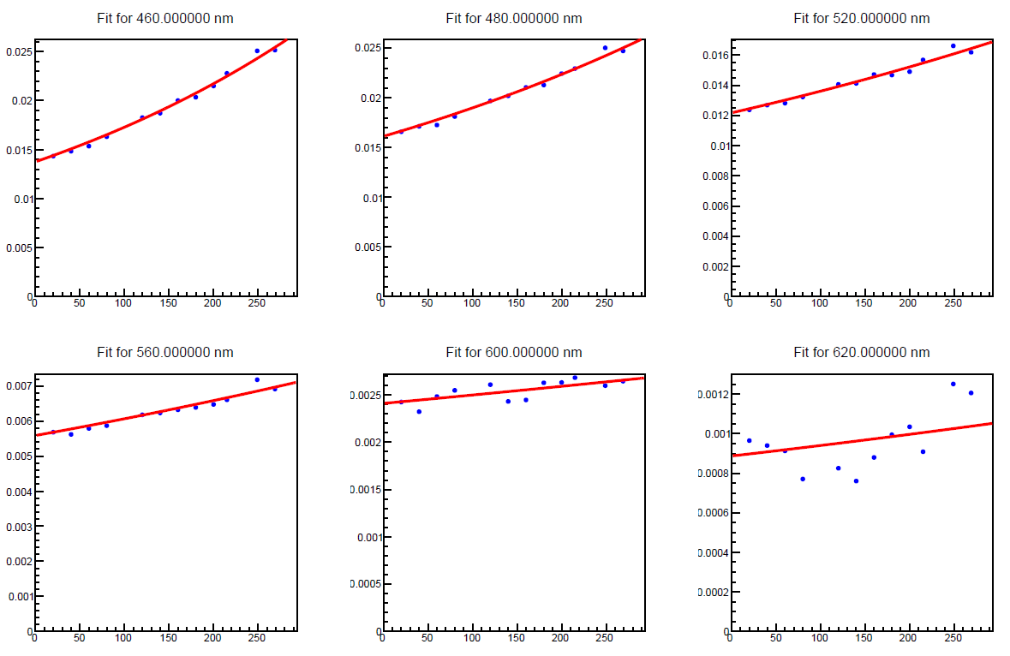
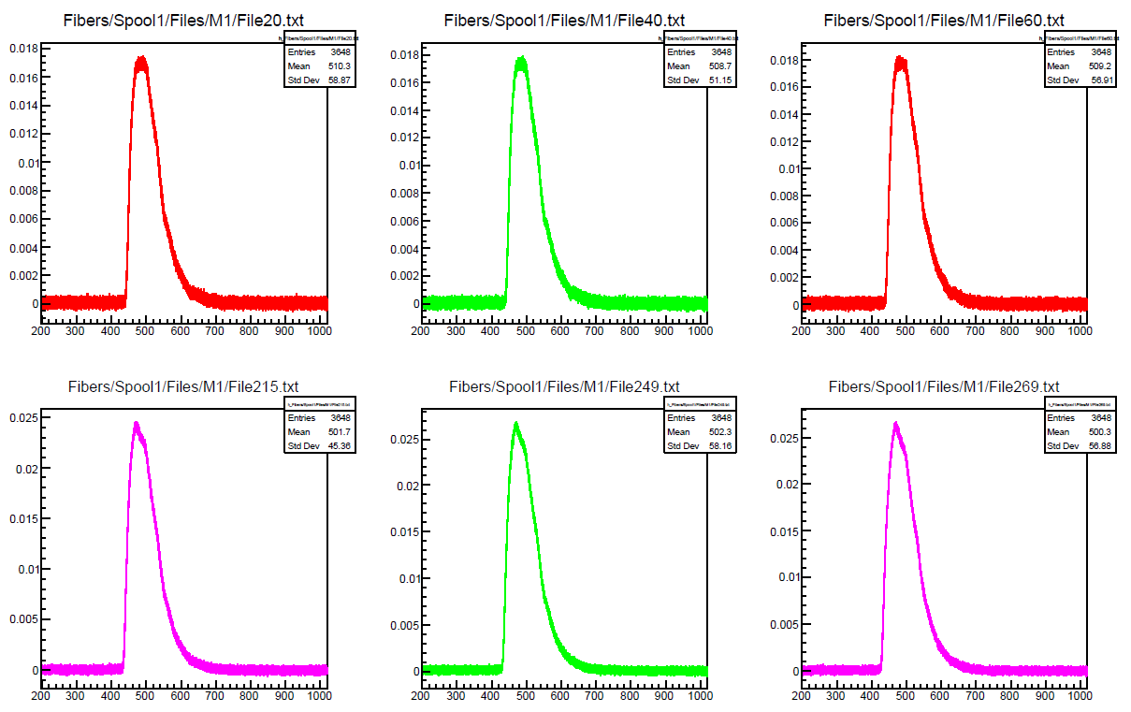
Example: M1
Signals
Fits
Attenuation

Slide 11
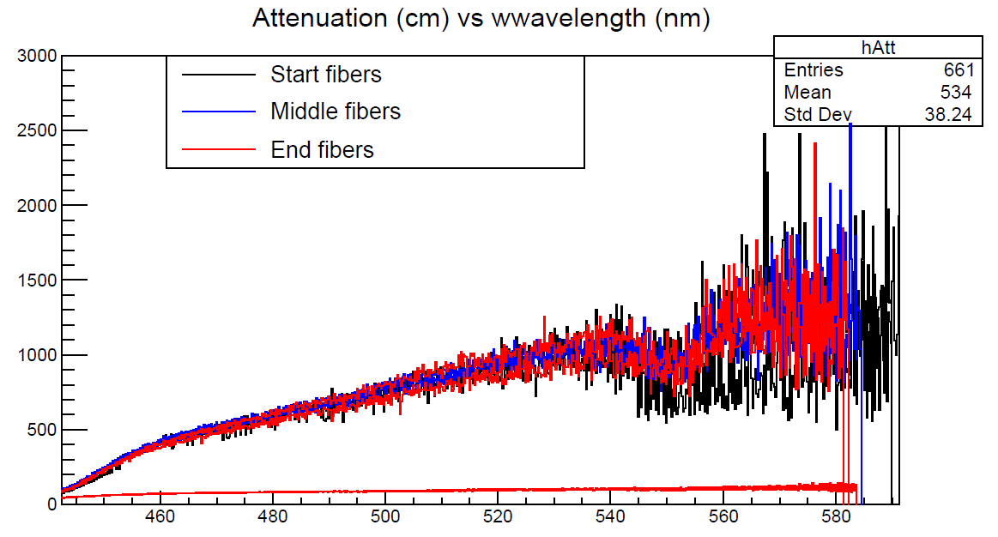
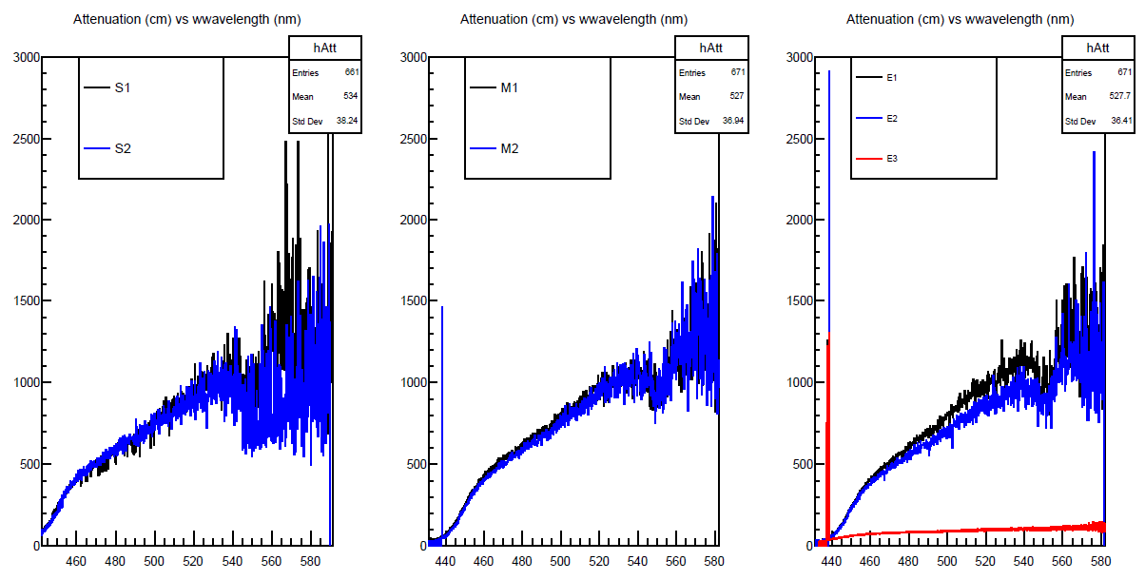
Summary plots
Good consistency – one problem fiber

Slide 12
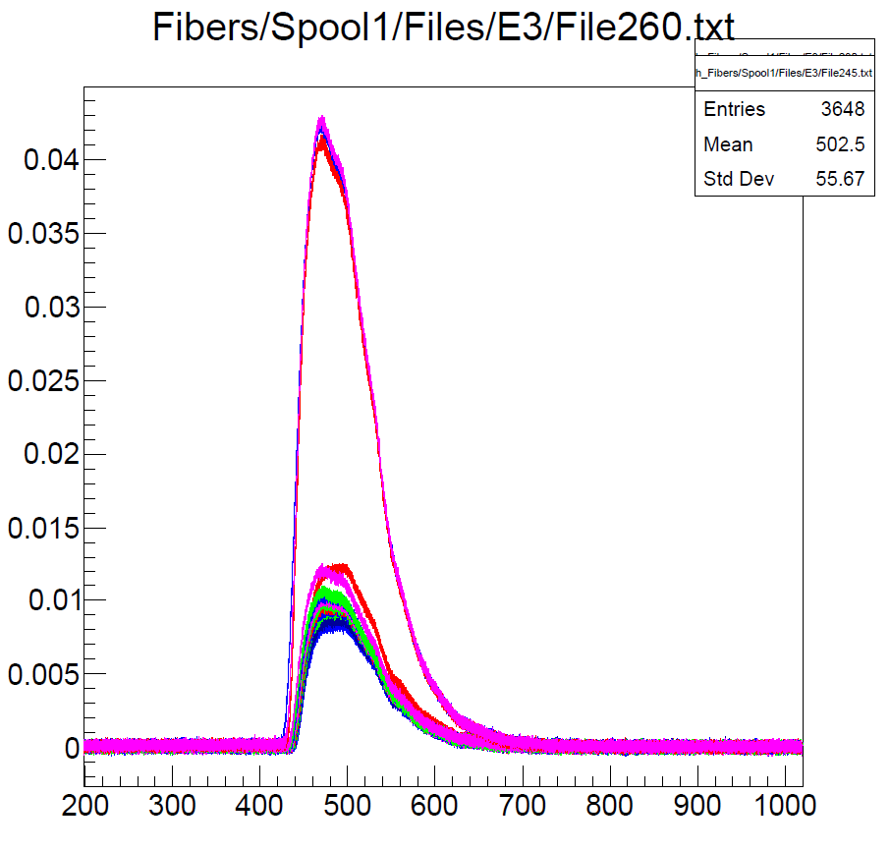
Problem fiber E3
Large intensity step after one specific position
  Microcrack found
  Problem affects ~ few %

Slide 13
Current status and plans
Test on beam with partial modules (PMT only) in 2023-24
All modules nearly complete
SiPM and boards available
  Tested on mockup
New test beam at CERN planned for summer 2025

Slide 14


