Slide 1



Diagrammatic Monte Carlo for Structure and Reaction Calculations
Stefano Brolli^{1,2}, Carlo Barbieri^{1,2}, Enrico Vigezzi²
¹Dipartimento di Fisica “Aldo Pontremoli,” Università degli Studi di Milano, Milan, Italy.
²INFN, Sezione di Milano, Milan, Italy.

Slide 2
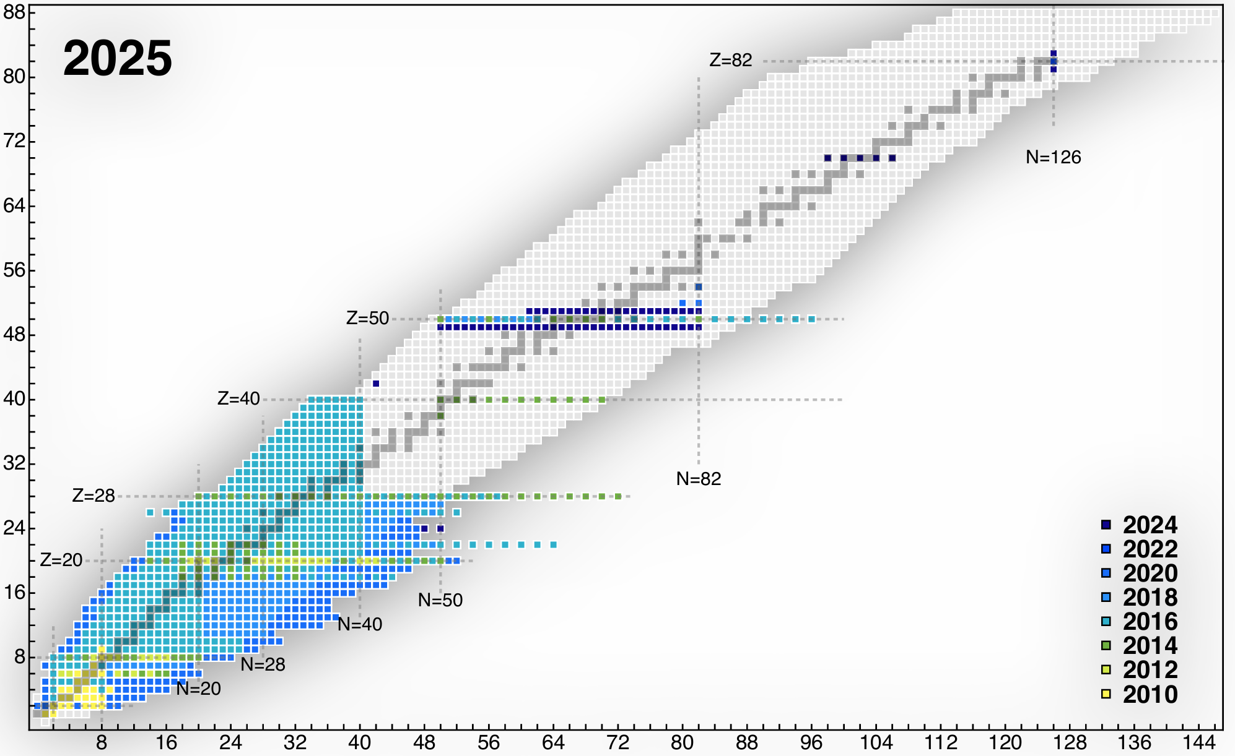
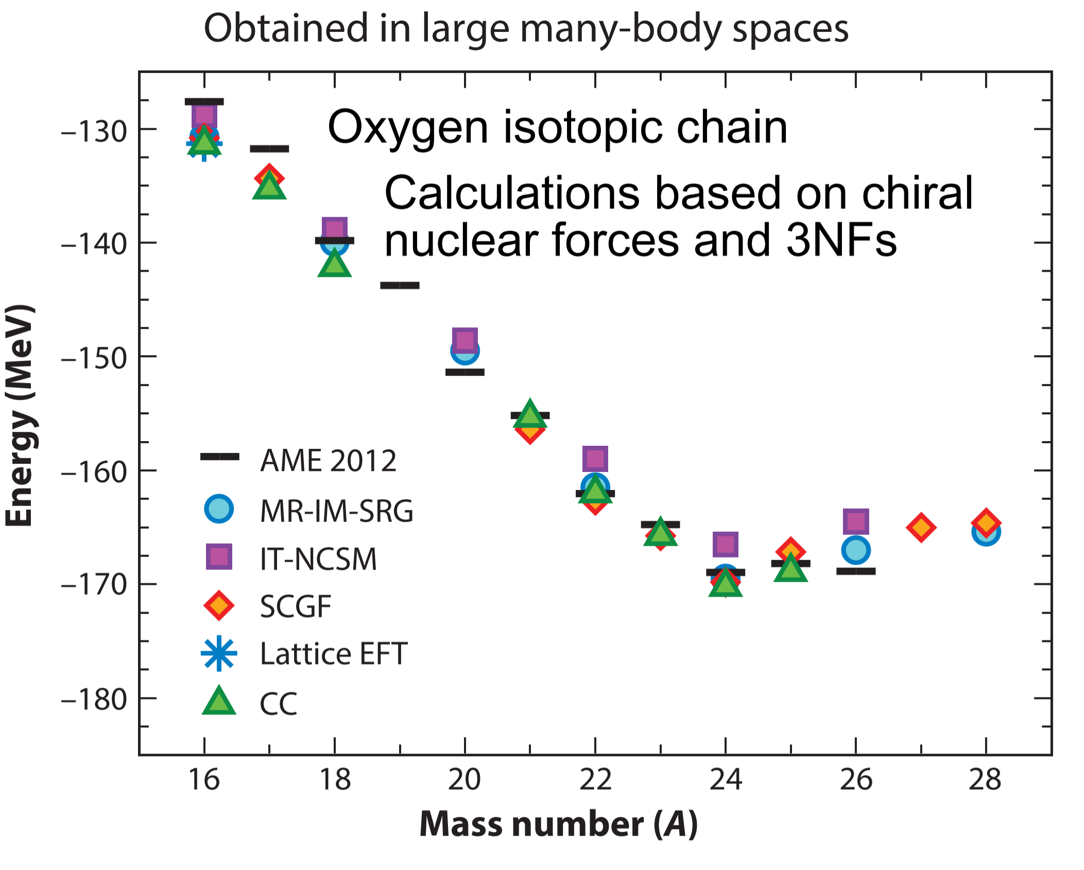

Ab initio structure calculations
Medium-light mass nuclei (and a few heavy ones) are well described.
Many-body methods (SCGF, NCSM, MBPT, IMSRG, CC, …) agree on ground state structure.
Most of the uncertainty comes from the Hamiltonian.
More recently: push for heavy and deformed nuclei.
Z
N
Hergert, A Guided Tour of ab initio Nuclear Many-Body Theory, Front. Phys. 8 (2020)
Hebeler et al., Annu. Rev. Nucl. Part. Sci. (2015)

Slide 3
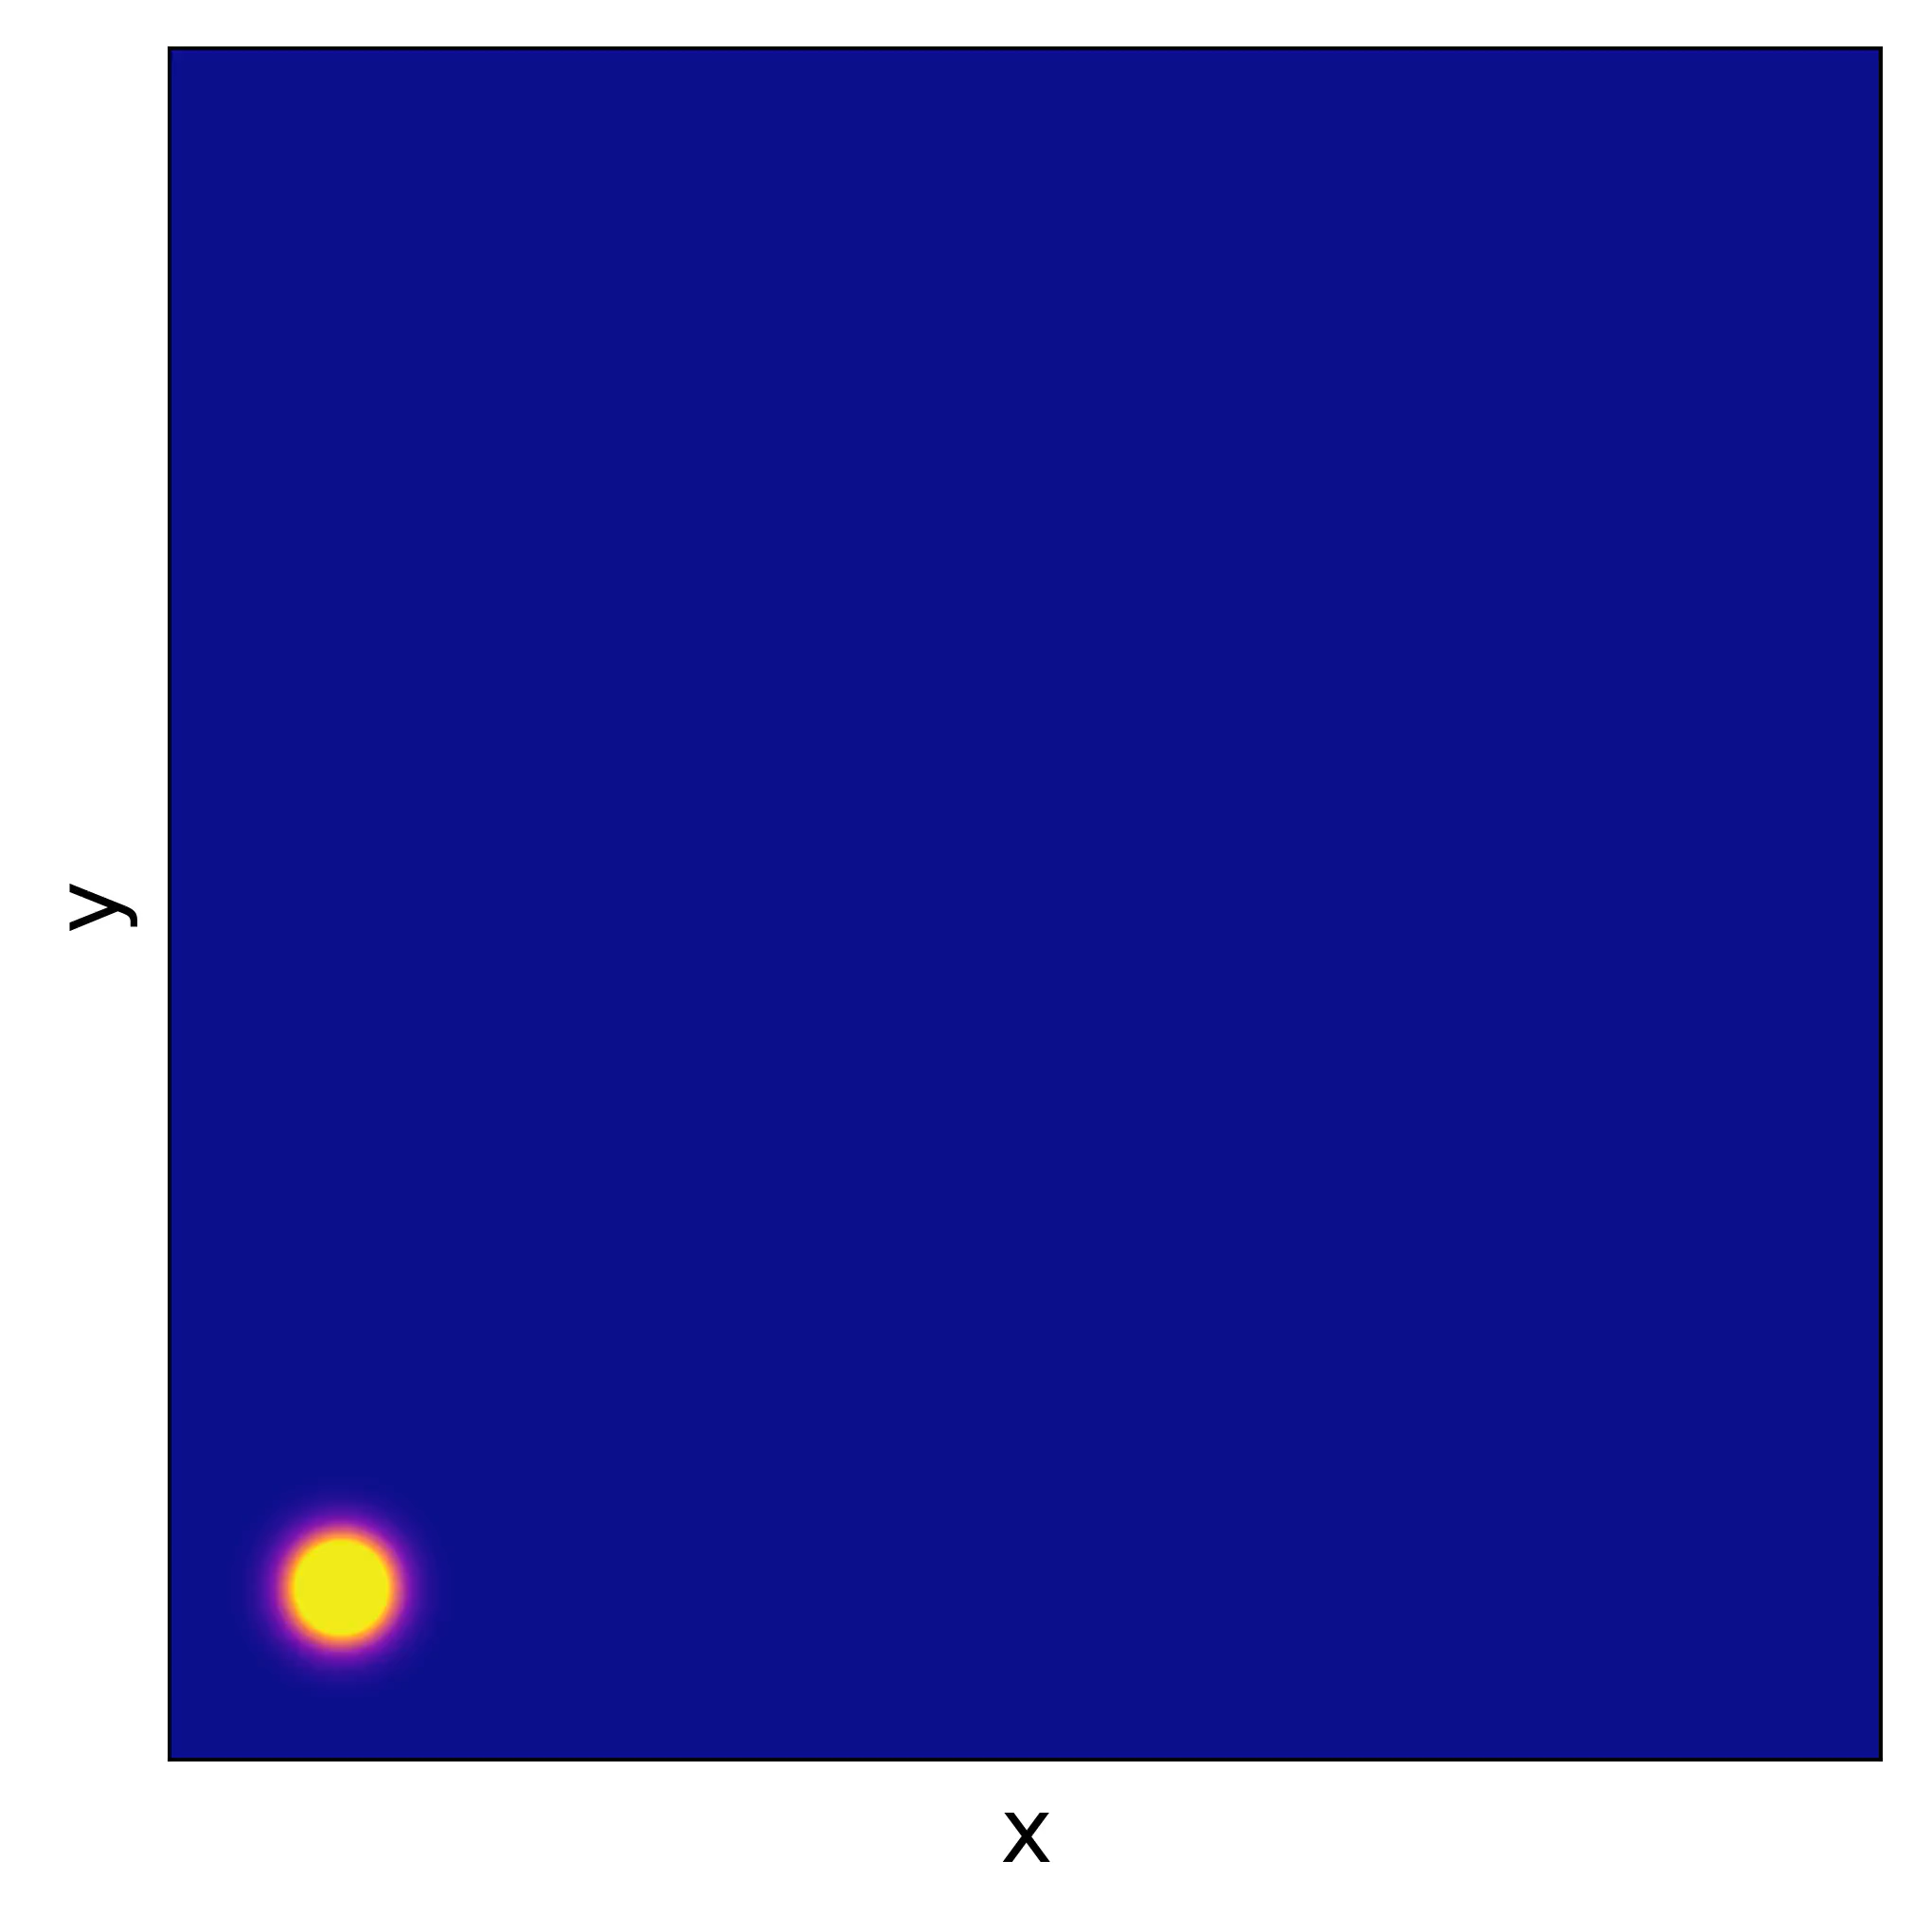
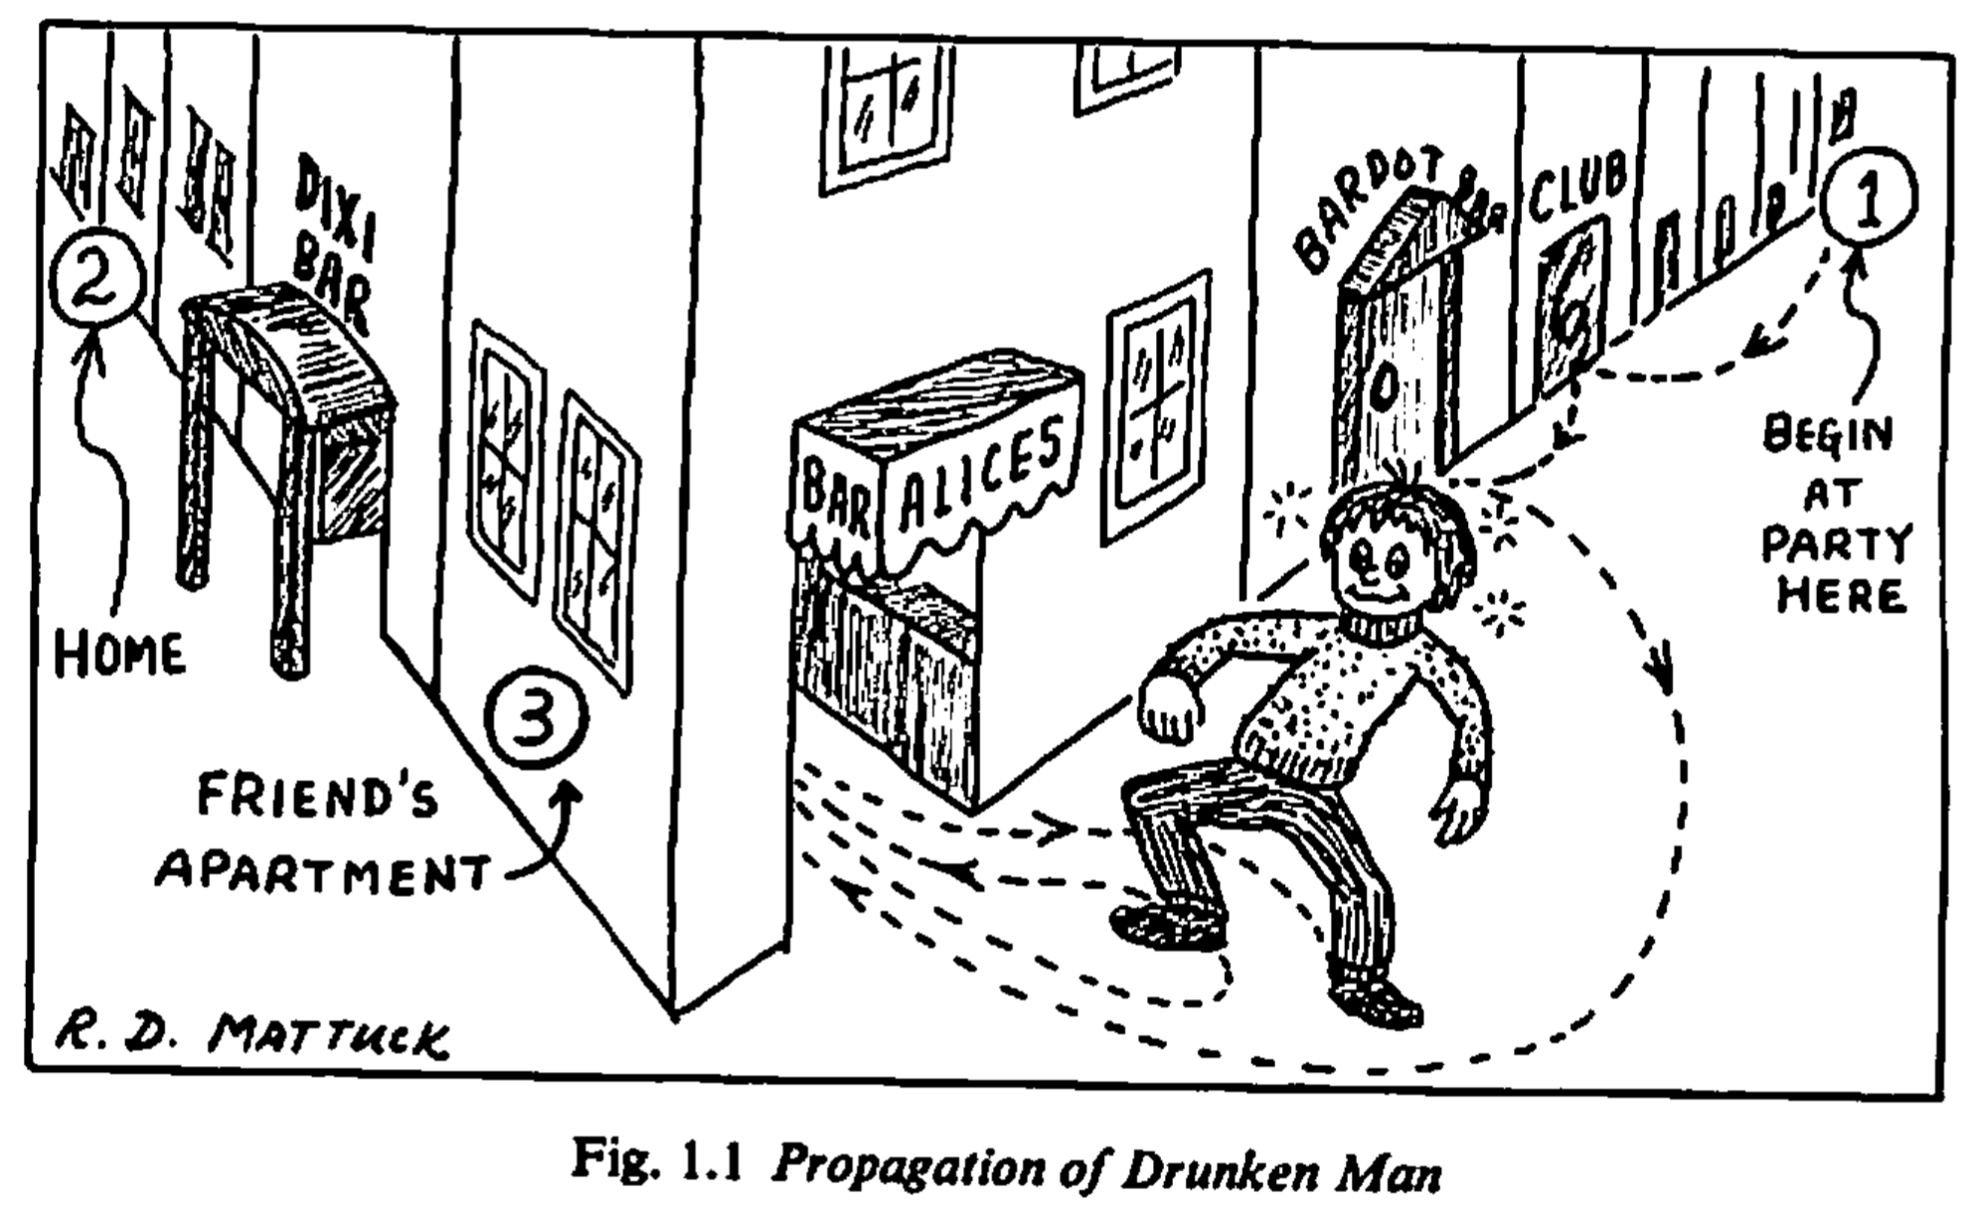
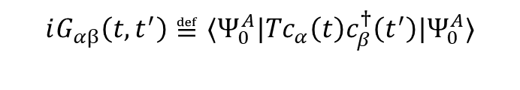
Self-consistent green’s function
$$iG_{αβ}\left(t,t^{′}\right)≝⟨Ψ_{0}^{A}|Tc_{α}\left(t\right)c_{β}^{†}\left(t^{′}\right)|Ψ_{0}^{A}⟩$$
Mattuck, A Guide to Feynman Diagrams in the Many-Body Problem (1992)

Slide 4
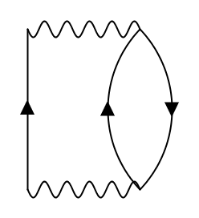
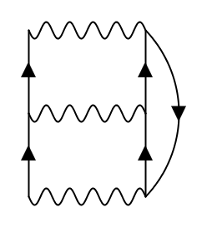
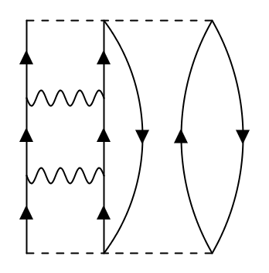
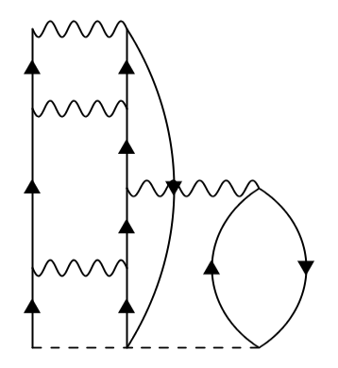
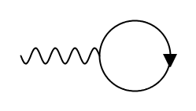
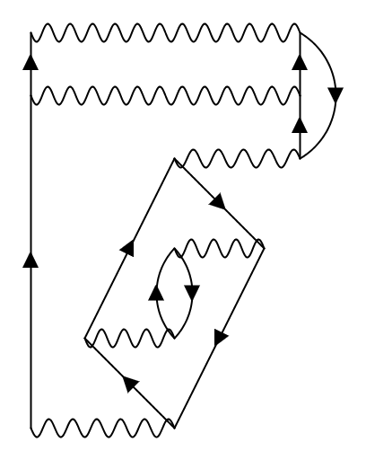
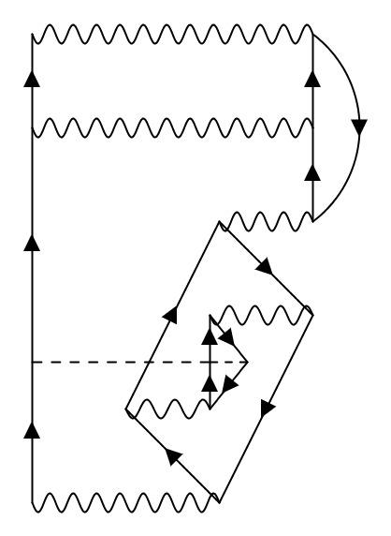
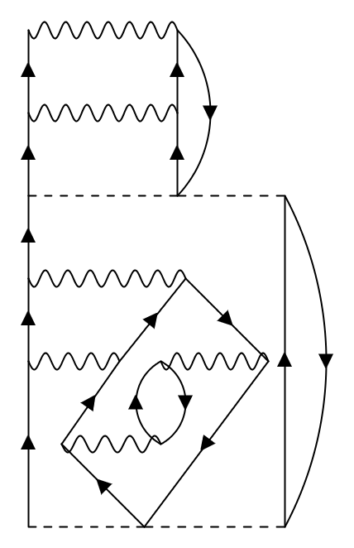
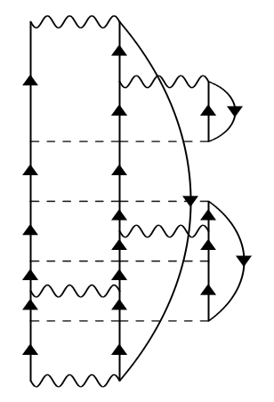









dyson equation
$$G_{αβ}\left(ω\right)=G_{αβ}^{\left(0\right)}\left(ω\right)+G_{αγ}^{\left(0\right)}\left(ω\right)Σ_{γδ}^{⋆}(ω)G_{δβ}(ω)ω)$$
Irreducible self-energy
Unperturbed propagator
$$Σ^{⋆}$$
$$=$$
$$+$$
$$+$$
$$+$$
$$+$$
$$+$$
$$+$$
$$+$$
$$+$$
$$+$$
$$+ …$$

Slide 5
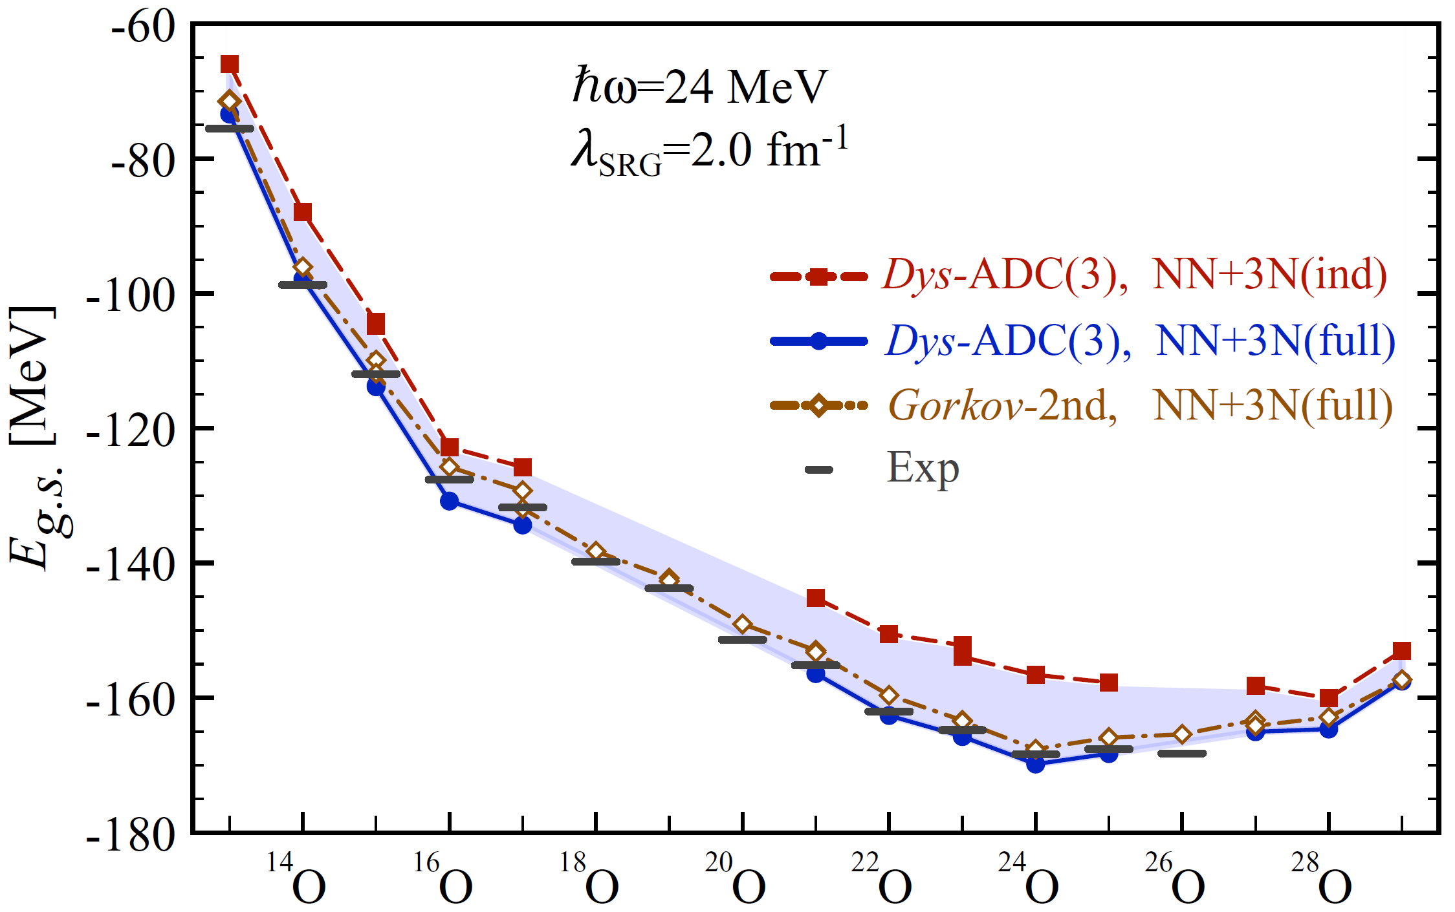
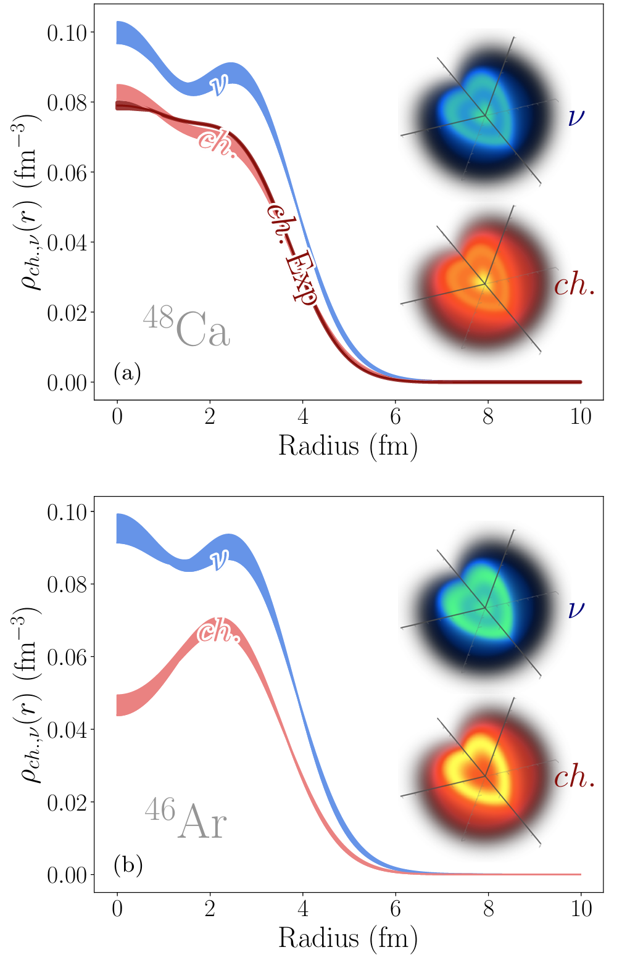
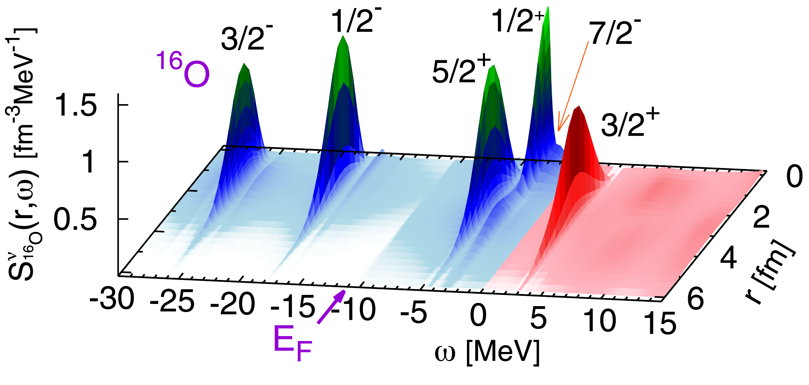
Structure information
Brugnara et al., arXiv: 2506.23228v2 (2025)
Cipollone et al., Phys. Rev. C, 92, 014306 (2015)

Slide 6
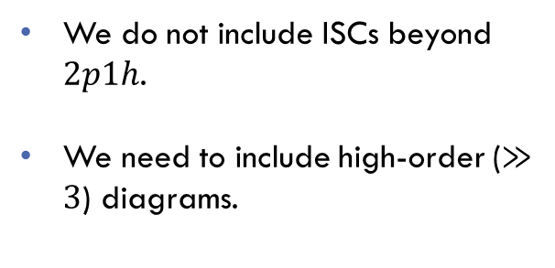
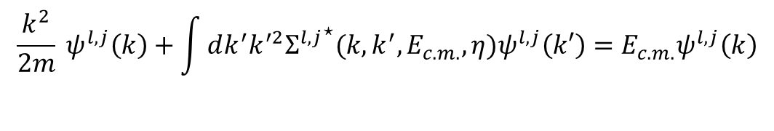
Optical potential
E
$$\frac{k^{2}}{2m} ψ^{l,j}\left(k\right)+\int{dk^{′}k^{′2}{Σ^{l,j}}^{⋆}(k, k^{′}, E_{c.m.},η)ψ^{l,j}\left(k′\right)}=E_{c.m.}ψ^{l,j}\left(k\right)$$
We do not include ISCs beyond $2p1h$.
We need to include high-order ($≫3$) diagrams.
A+1
Notable work towards high-order diagrams:
C. Drischler et al., Phys. Rev. Lett. 122, 042501 (2019)
P. Arthuis et al., Comp. Phys. Comm. 240, 202 (2019)
E_{F}
A-1
Idini et al., Phys. Rev. Lett., 123, 092501 (2019)

Slide 7
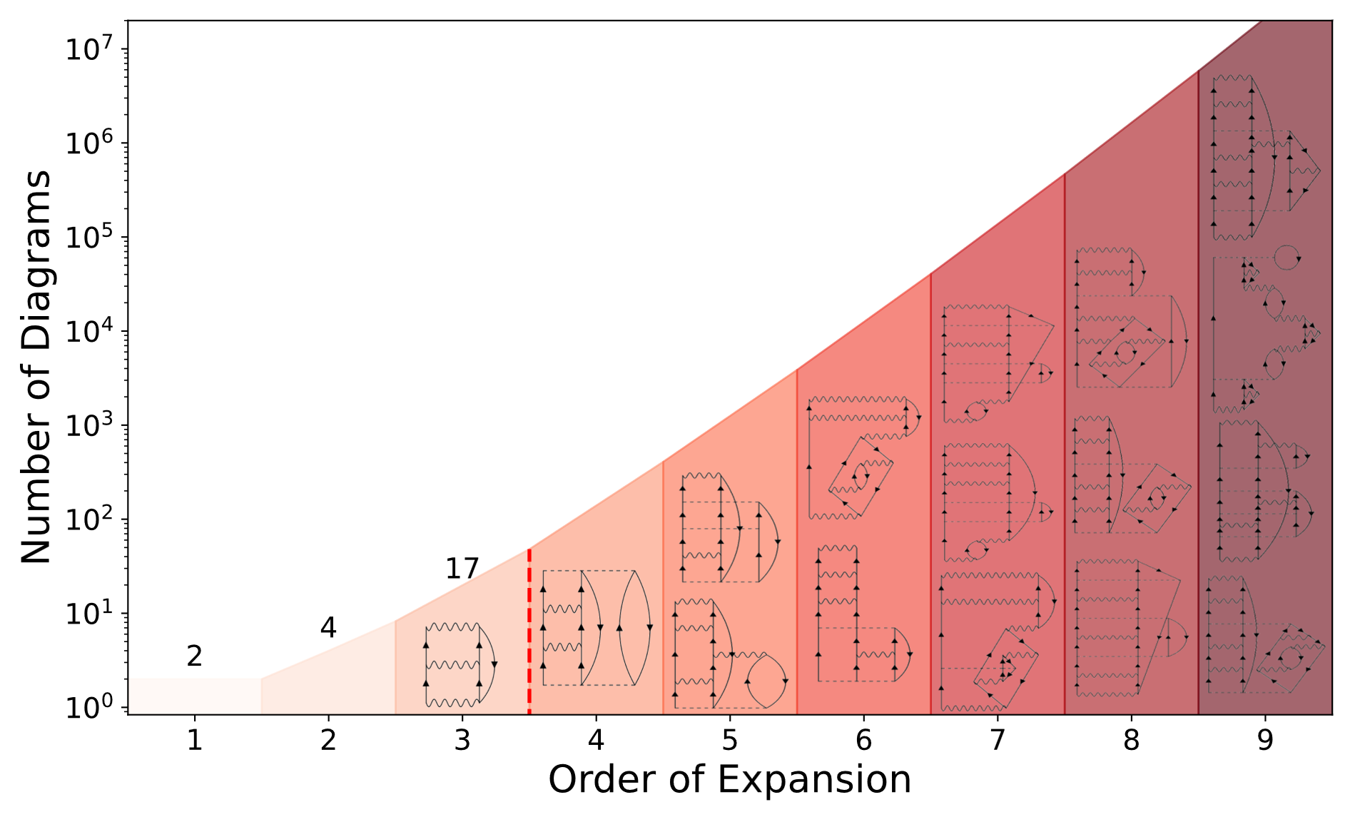
Sampling the diagrammatic space

Slide 8
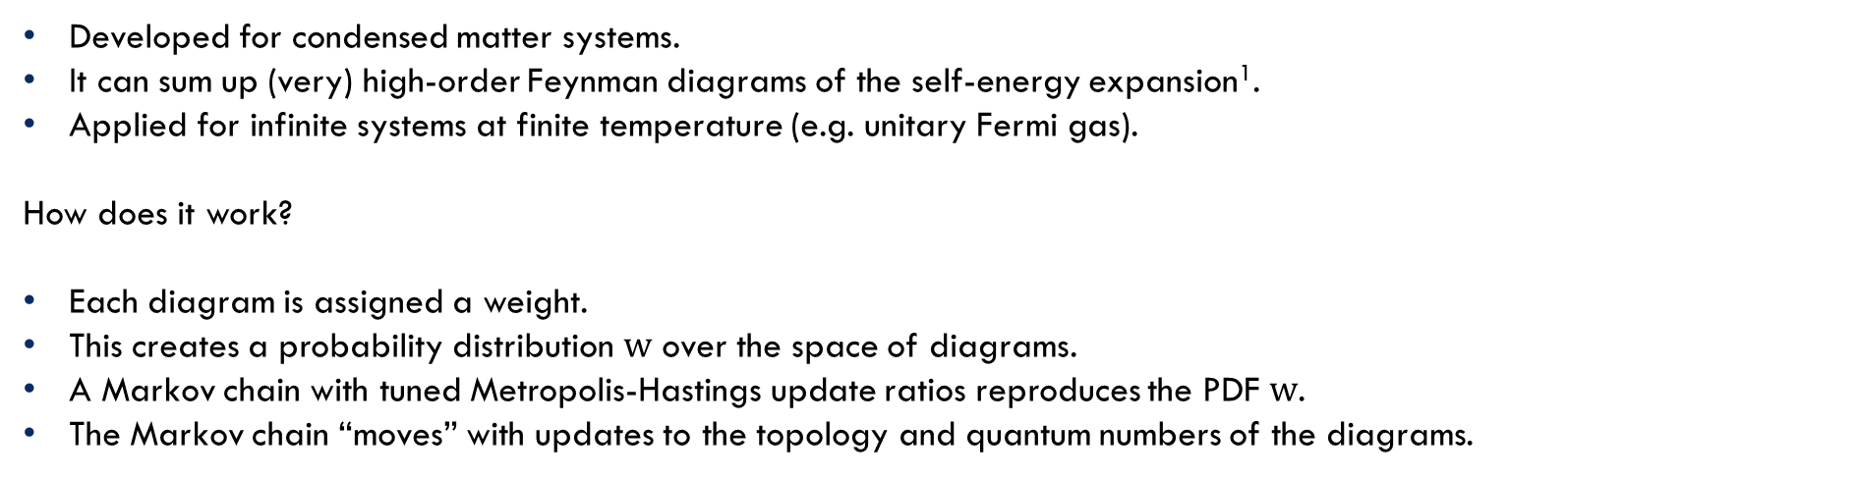
Diagrammatic monte carlo
Developed for condensed matter systems.
It can sum up (very) high-order Feynman diagrams of the self-energy expansion¹.
Applied for infinite systems at finite temperature (e.g. unitary Fermi gas).
How does it work?
Each diagram is assigned a weight.
This creates a probability distribution $w$ over the space of diagrams.
A Markov chain with tuned Metropolis-Hastings update ratios reproduces the PDF $w$.
The Markov chain “moves” with updates to the topology and quantum numbers of the diagrams.
Can it work for nuclear systems?
1. DiagMC included diagrams up to order 9 for the unitary Fermi gas, see K. Van Houcke et al., Phys. Rev. B., 99, 035140 (2019)

Slide 9
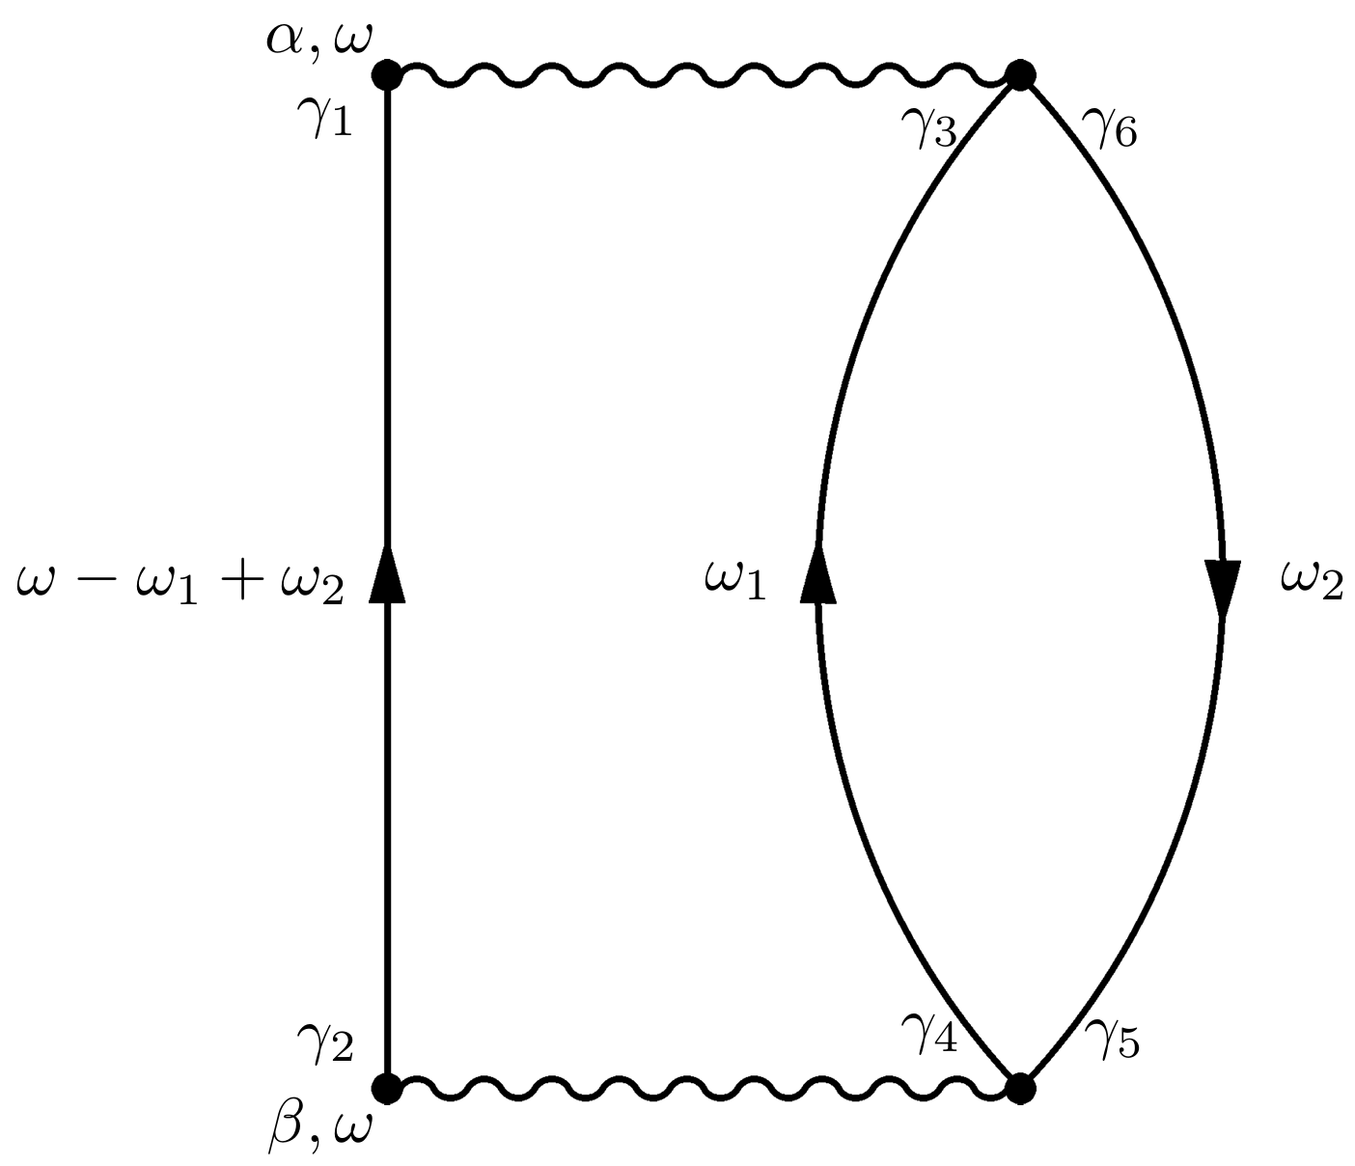


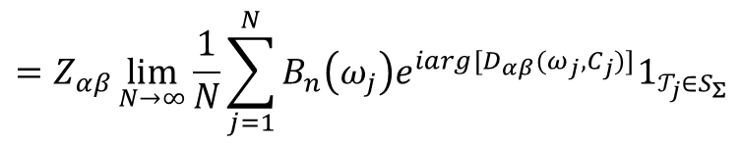
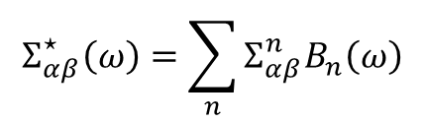
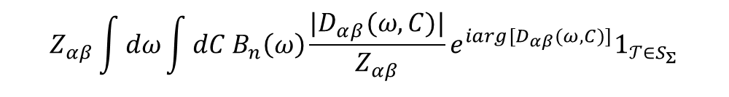
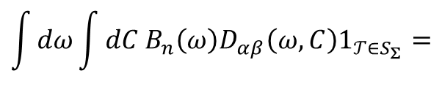

A Bit of mathematical machinery
$$Σ_{αβ}^{⋆}\left(ω\right)=\sum_{n}{Σ_{αβ}^{n}B_{n}\left(ω\right)}$$
$$Σ_{αβ}^{n}=\int{dω B_{n}\left(ω\right)Σ_{αβ}^{⋆}\left(ω\right)}$$
Basis functions
$$C =(𝒯; γ_{1}, …,γ_{n}; ω_{1},…,ω_{m})$$
Topology
Internal single-particle quantum numbers
Internal
frequencies
Diagrams of the self-energy expansion
Normalization factor
$$\int{dω}\int{dC{ B}_{n}\left(ω\right)D_{αβ}\left(ω,C\right)1_{𝒯∈S_{Σ}}}=$$
$$Z_{αβ}\int{dω}\int{dC{ B}_{n}\left(ω\right)\frac{|D_{αβ}(ω,C)|}{Z_{αβ}}e^{iarg[D_{αβ}(ω,C)]}1_{𝒯∈S_{Σ}}}$$
$$Σ_{αβ}^{n}=$$
$$=Z_{αβ}\lim_{N→∞}{\frac{1}{N}\sum_{j=1}^{N}{{B_{n}\left(ω_{j}\right)e}^{iarg[D_{αβ}(ω_{j},C_{j})]}1_{𝒯_{j}∈S_{Σ}}}}$$
$w_{αβ}\left(ω, C\right)$, probability distribution function

Slide 10
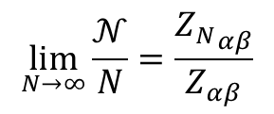
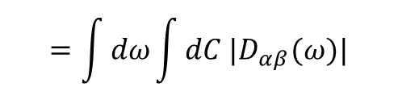
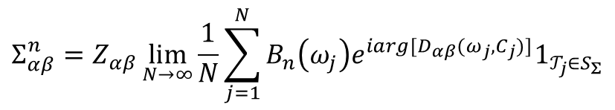
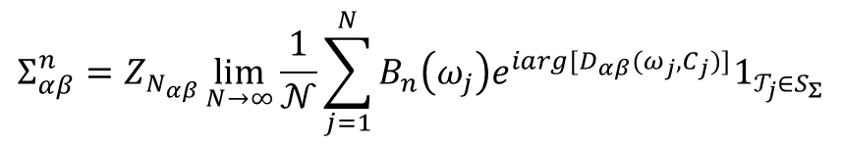
Dealing with $Z_{αβ}$
$$Σ_{αβ}^{n}=Z_{αβ}\lim_{N→∞}{\frac{1}{N}\sum_{j=1}^{N}{{B_{n}\left(ω_{j}\right)e}^{iarg[D_{αβ}(ω_{j},C_{j})]}1_{𝒯_{j}∈S_{Σ}}}}$$
$$=\int{dω}\int{dC |D_{αβ}(ω)|}$$
If the weight of a subset $S_{N}$ of diagrams is known (${Z_{N}}_{αβ}$), we can use the number of times $S_{N}$ is visited ($𝒩$) to compute the normalization.
$$\lim_{N→∞}{\frac{𝒩}{N}}=\frac{{Z_{N}}_{αβ}}{Z_{αβ}}$$
$$Σ_{αβ}^{n}=Z_{N_{αβ}}\lim_{N→∞}{\frac{1}{𝒩}\sum_{j=1}^{N}{{B_{n}\left(ω_{j}\right)e}^{iarg[D_{αβ}(ω_{j},C_{j})]}1_{𝒯_{j}∈S_{Σ}}}}$$

Slide 11
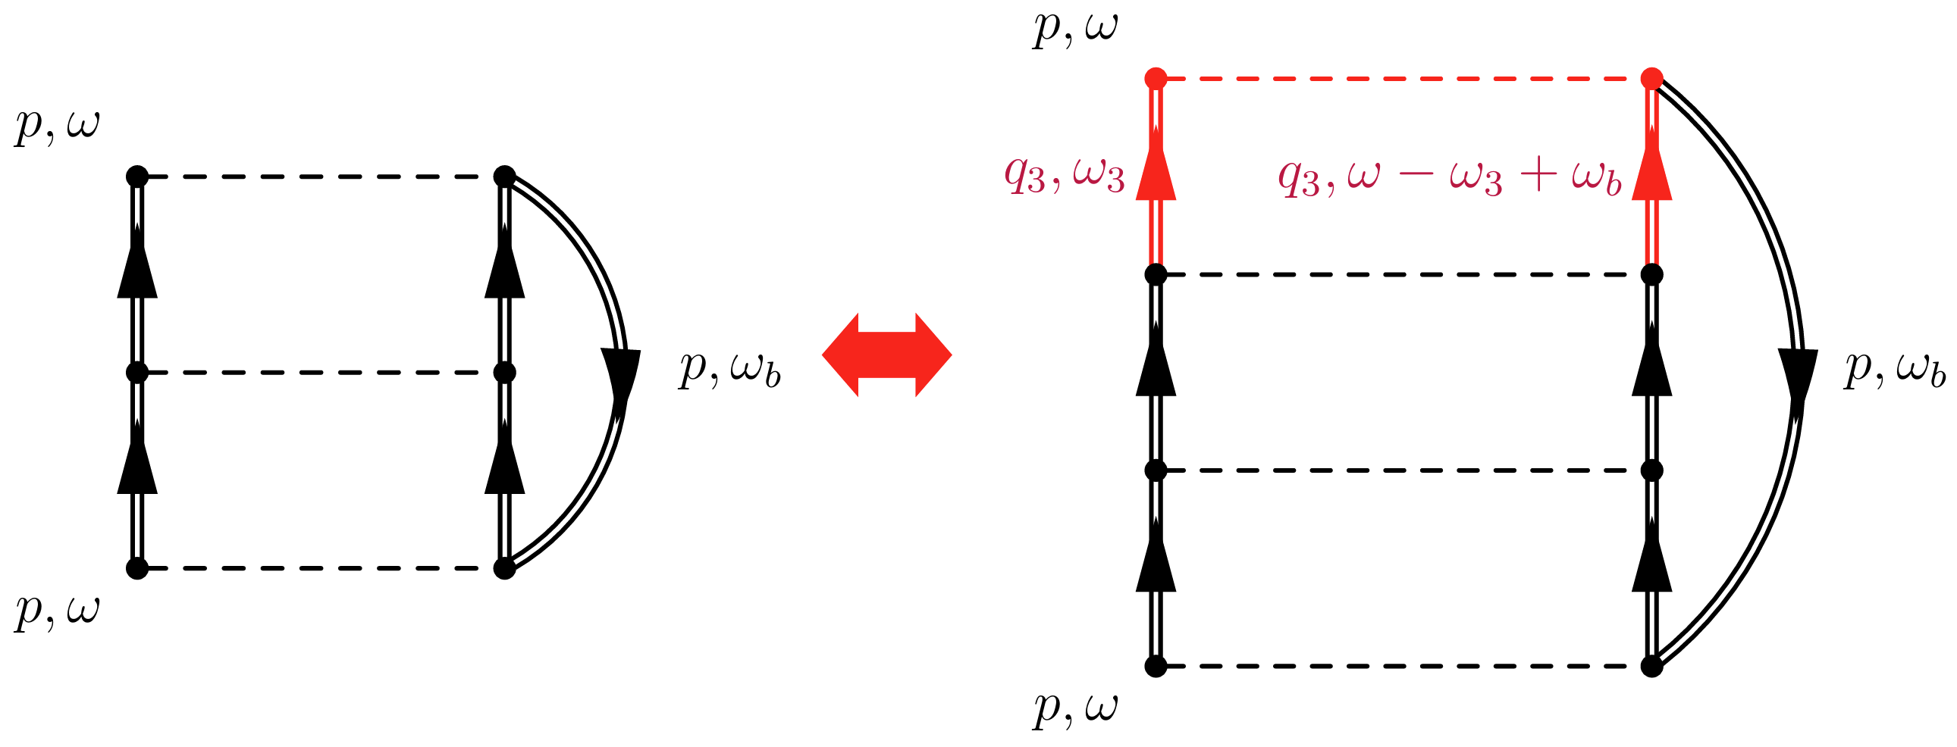
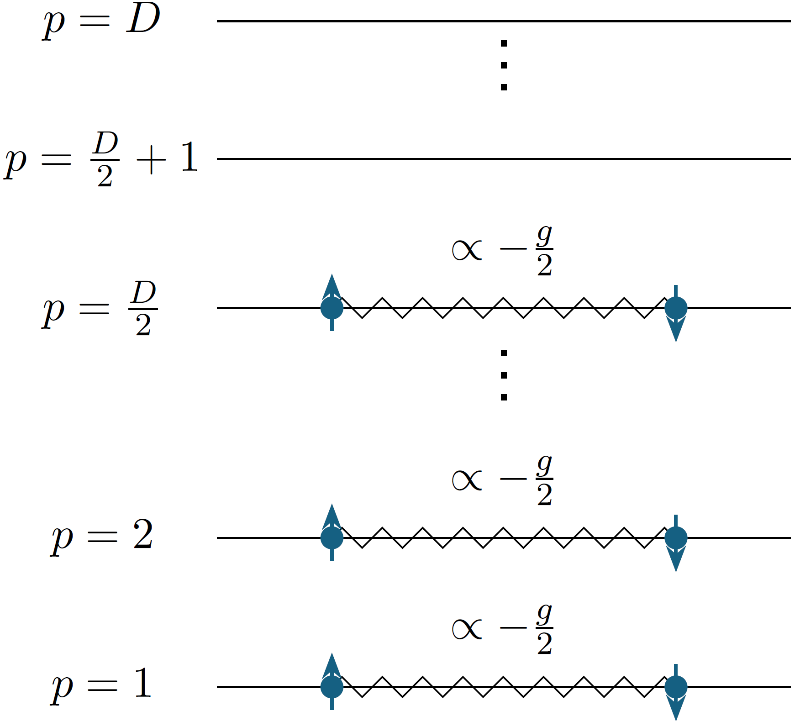
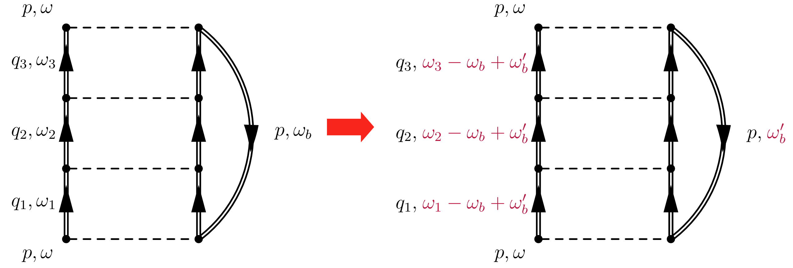
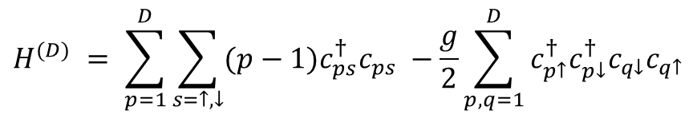
Richardson model
$$H^{(D)} = \sum_{p=1}^{D}{\sum_{s=↑,↓}{(p−1)c_{ps}^{†}c_{ps} }}−\frac{g}{2}\sum_{p,q=1}^{D}{c_{p↑}^{†}c_{p↓}^{†}c_{q↓}c_{q↑}}$$

Slide 12
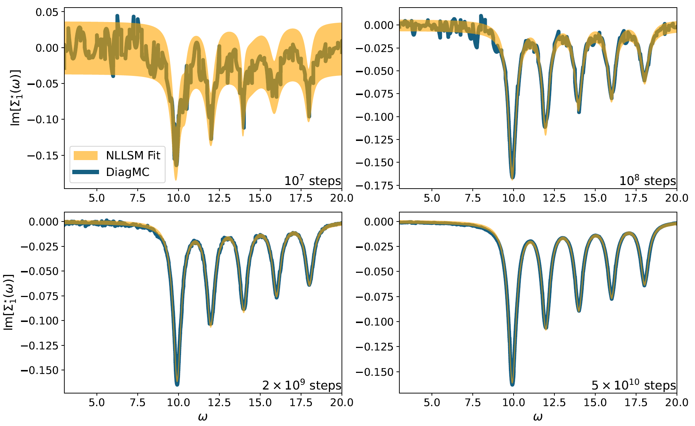

Richardson model: Self-energy
$$g=0.3$$
$$η=0.1$$
$$D=10$$
SB, C. Barbieri, and E. Vigezzi, Phys. Rev. Lett. 134, 182502 (2025)

Slide 13
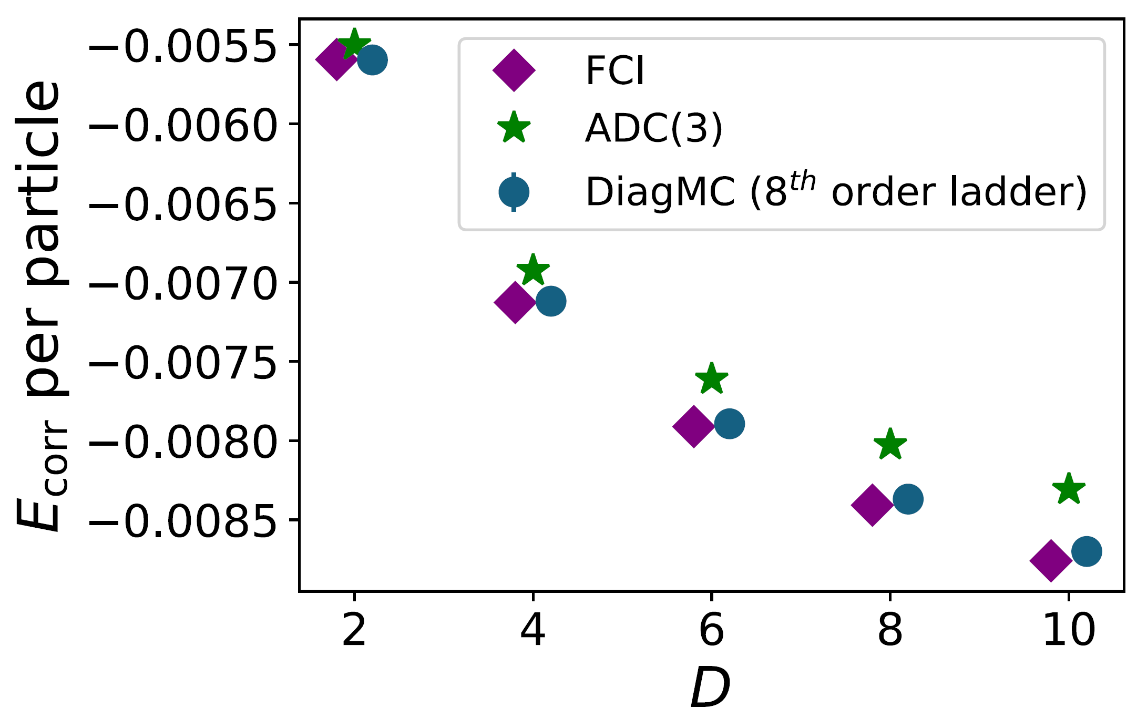
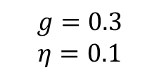
Richardson model: Ground state energy
(at half filling)
(state of the art in NP)
$$g=0.3$$
$$η=0.1$$
(Dimension of the model space)
SB, C. Barbieri, and E. Vigezzi, Phys. Rev. Lett. 134, 182502 (2025)

Slide 14
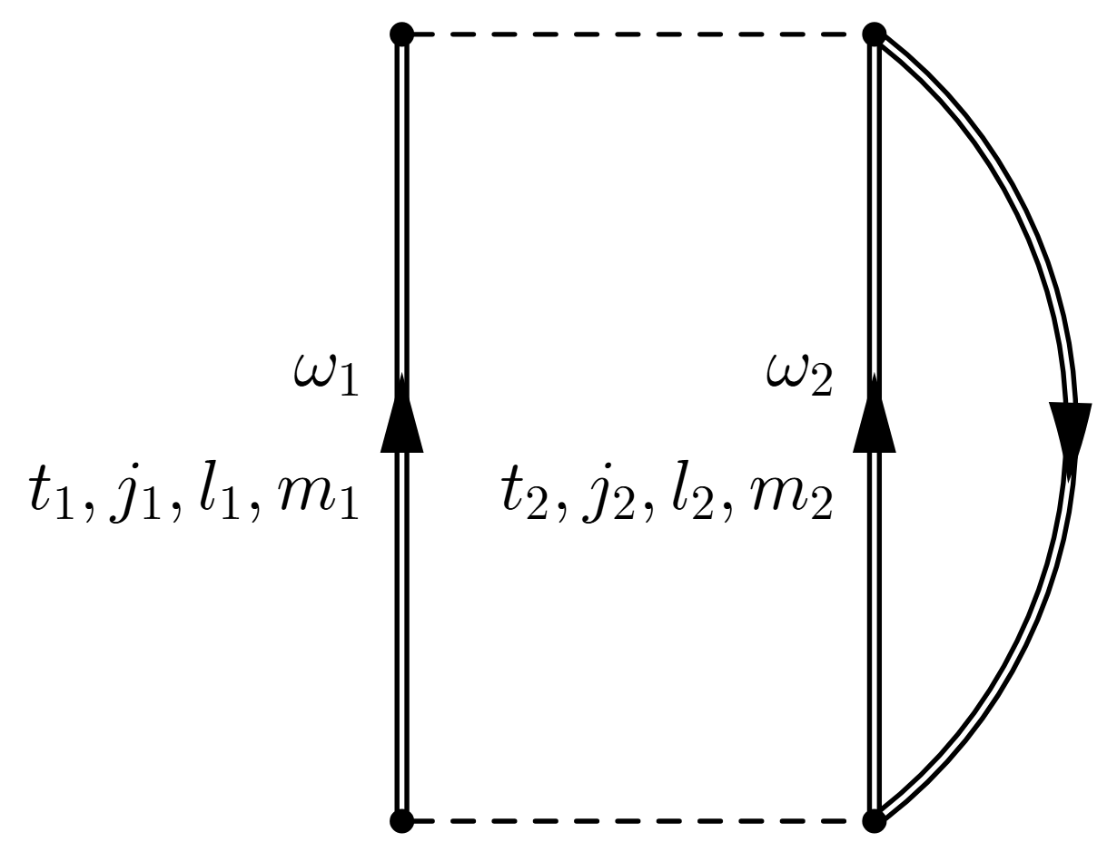
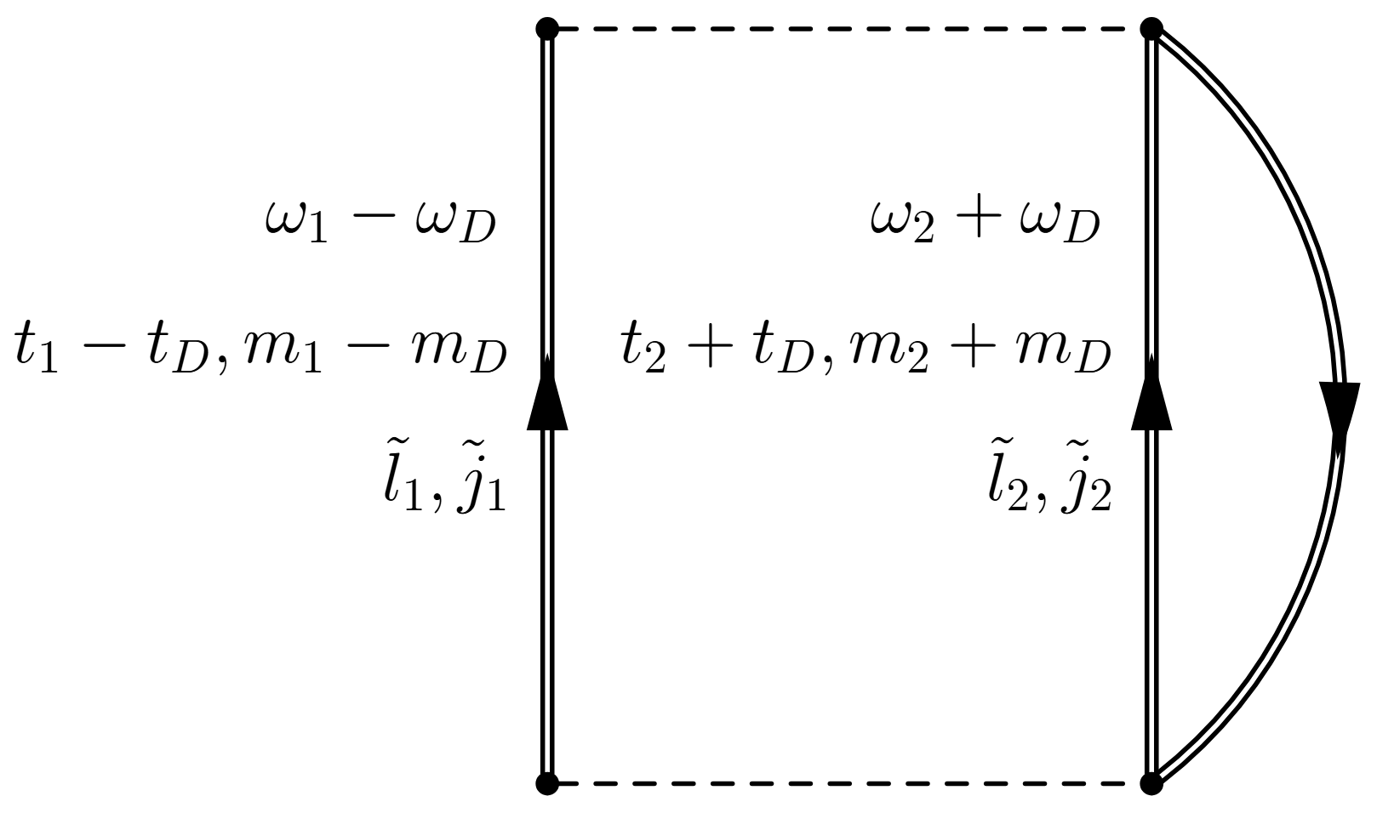
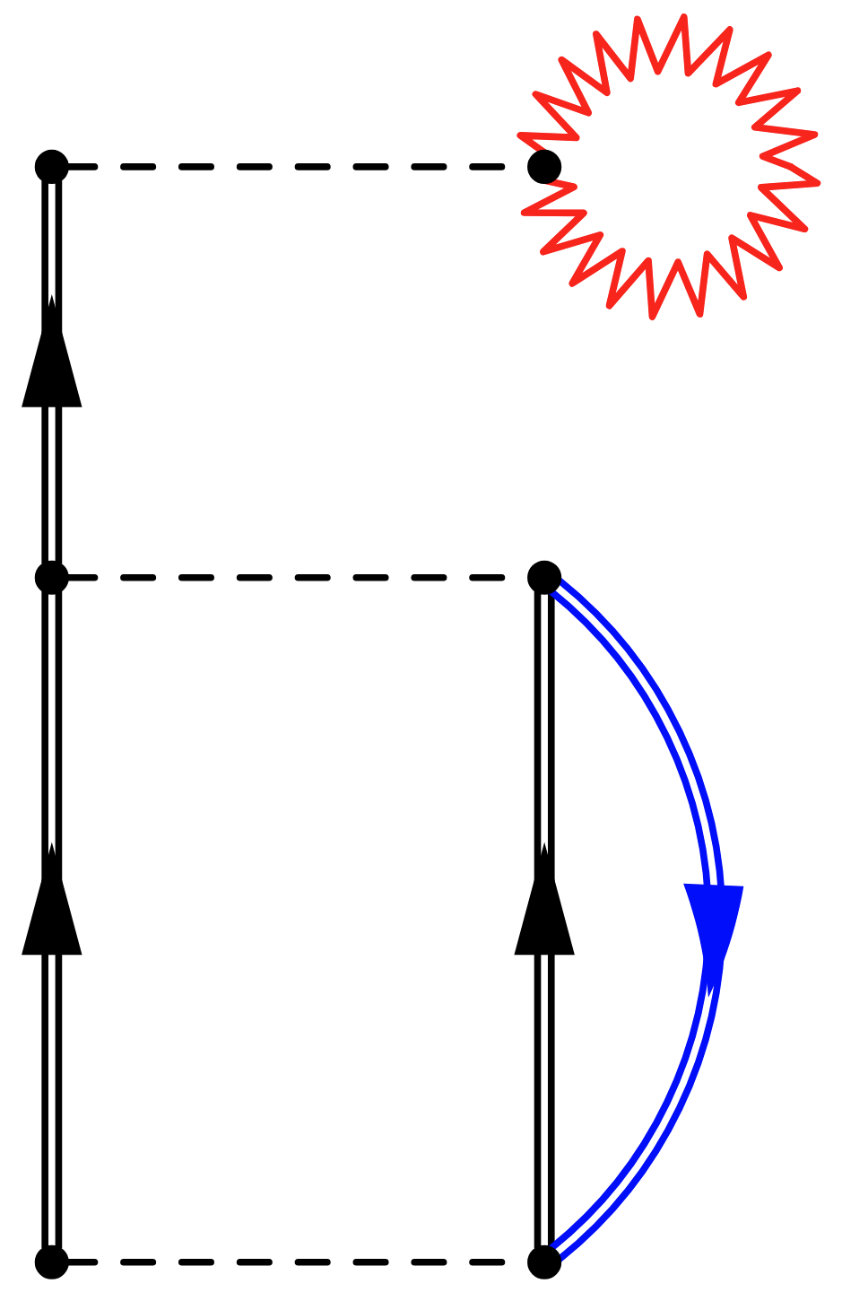
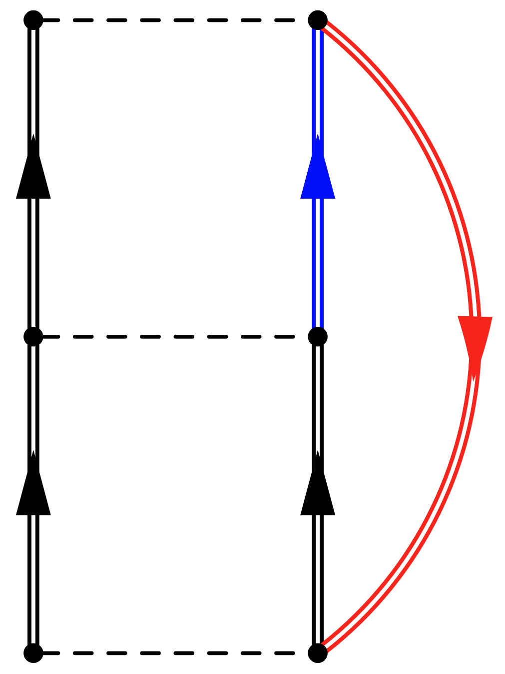
Chiral potentials
To our knowledge DiagMC calculations with such difficult potentials have never been attempted.
They require a much more complicated updating scheme that can keep track of all the conservation laws at each vertex.

Slide 15
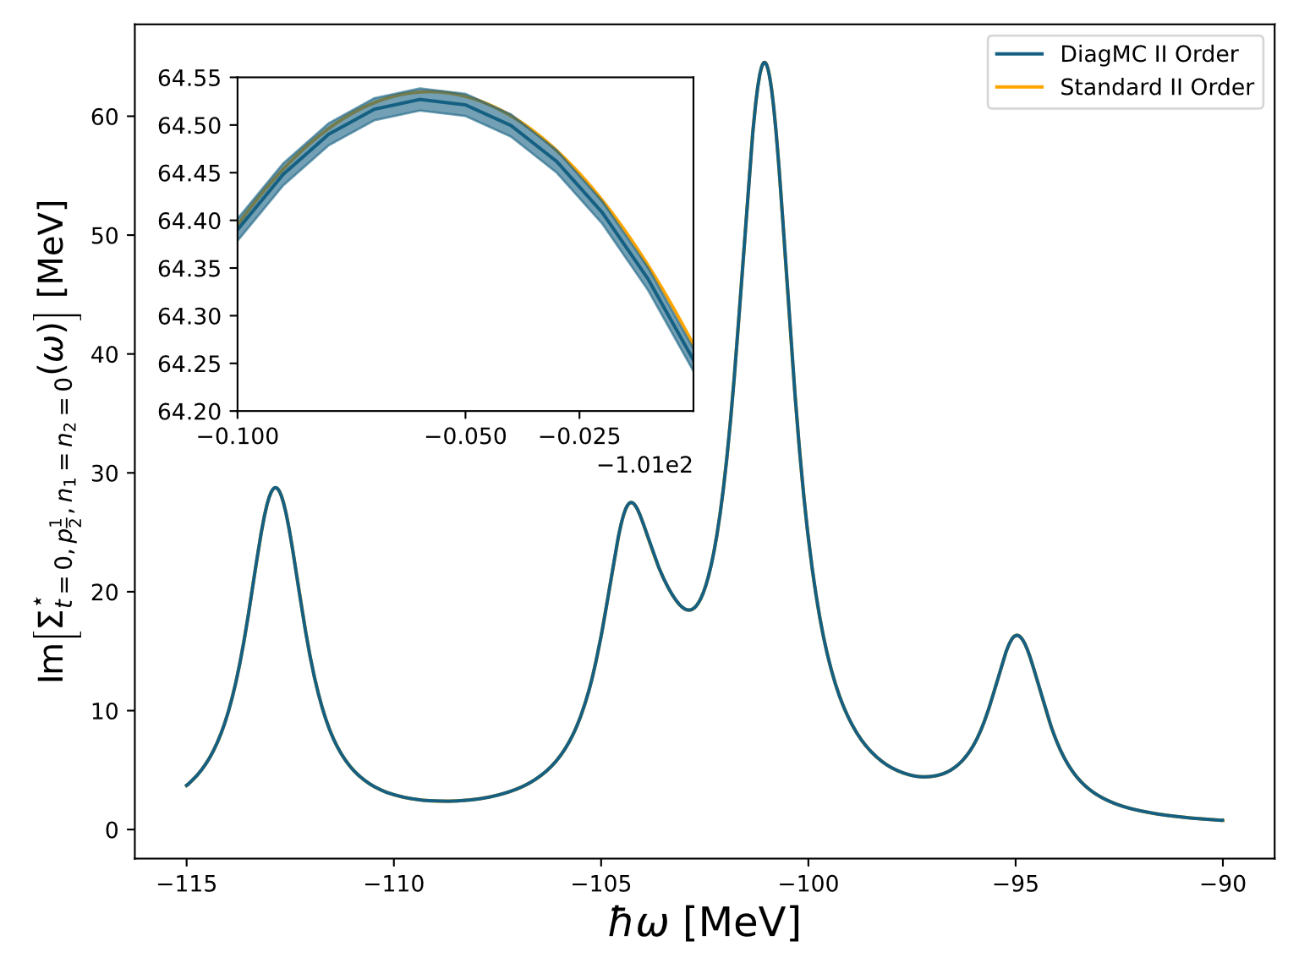

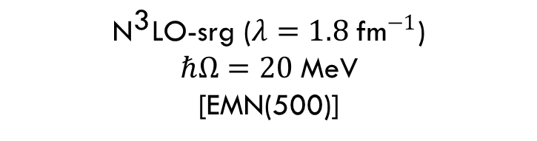
Second order results
¹⁶O
${\text{N}}^{\text{3}}\text{LO}$-srg ($λ=1.8 {\text{fm}}^{−1}$)
$$ℏΩ=20 \text{MeV}$$
[EMN(500)]
$$N_{max}=2$$

Slide 16
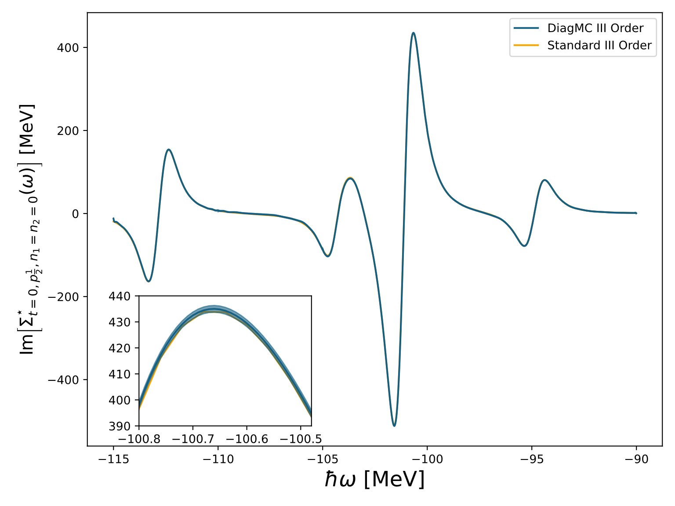

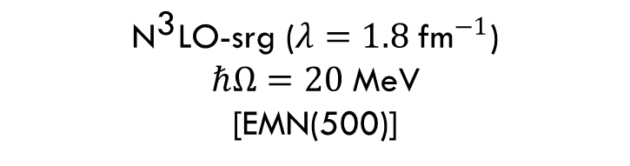
Third order results
¹⁶O
${\text{N}}^{\text{3}}\text{LO}$-srg ($λ=1.8 {\text{fm}}^{−1}$)
$$ℏΩ=20 \text{MeV}$$
[EMN(500)]
$$N_{max}=2$$

Slide 17
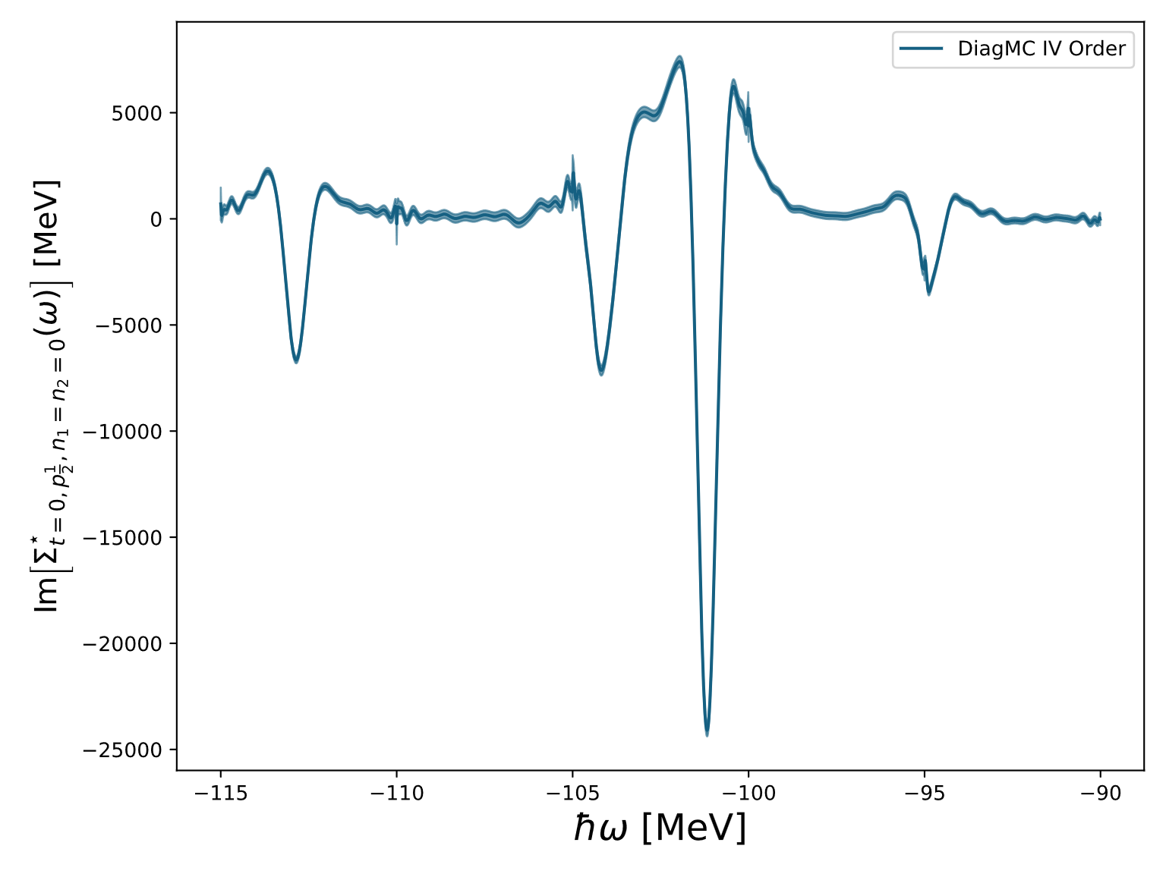
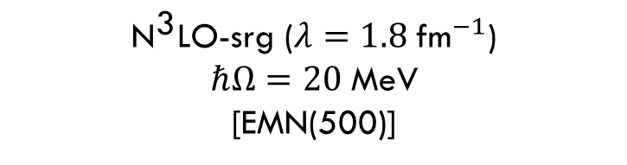
fourth order results
¹⁶O
$$N_{max}=2$$
${\text{N}}^{\text{3}}\text{LO}$-srg ($λ=1.8 {\text{fm}}^{−1}$)
$$ℏΩ=20 \text{MeV}$$
[EMN(500)]

Slide 18
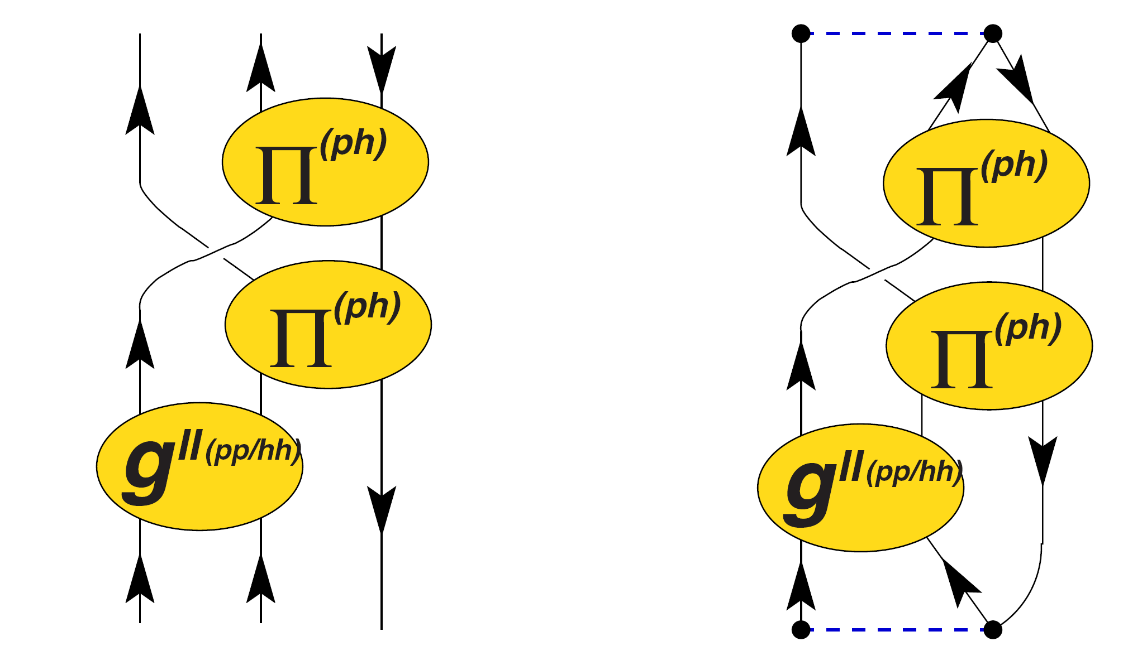
Recovering causality
Resummation techniques (Borel resummation)
ADC-like schemes natively retain causality
Already used in solid state physics
State of the art techniques in nuclear physics, never integrated with DiagMC
Particle-vibration couplings
$$Σ_{αβ}^{⋆}(ω)=Σ_{αβ}^{\left(∞\right)}+M_{α,r}^{†}\frac{1}{ω−{\left[E^{>}+C\right]}_{r,r^{′}}+iη }M_{r^{′},β}+N_{α,s}\frac{1}{ω−{\left[E^{<}+D\right]}_{s,s^{′}}−iη }N_{s^{′},β}^{†}$$
Mean field

Slide 19
Thank you
stefano.brolli@unimi.it

Slide 20
BACkup:

Slide 21
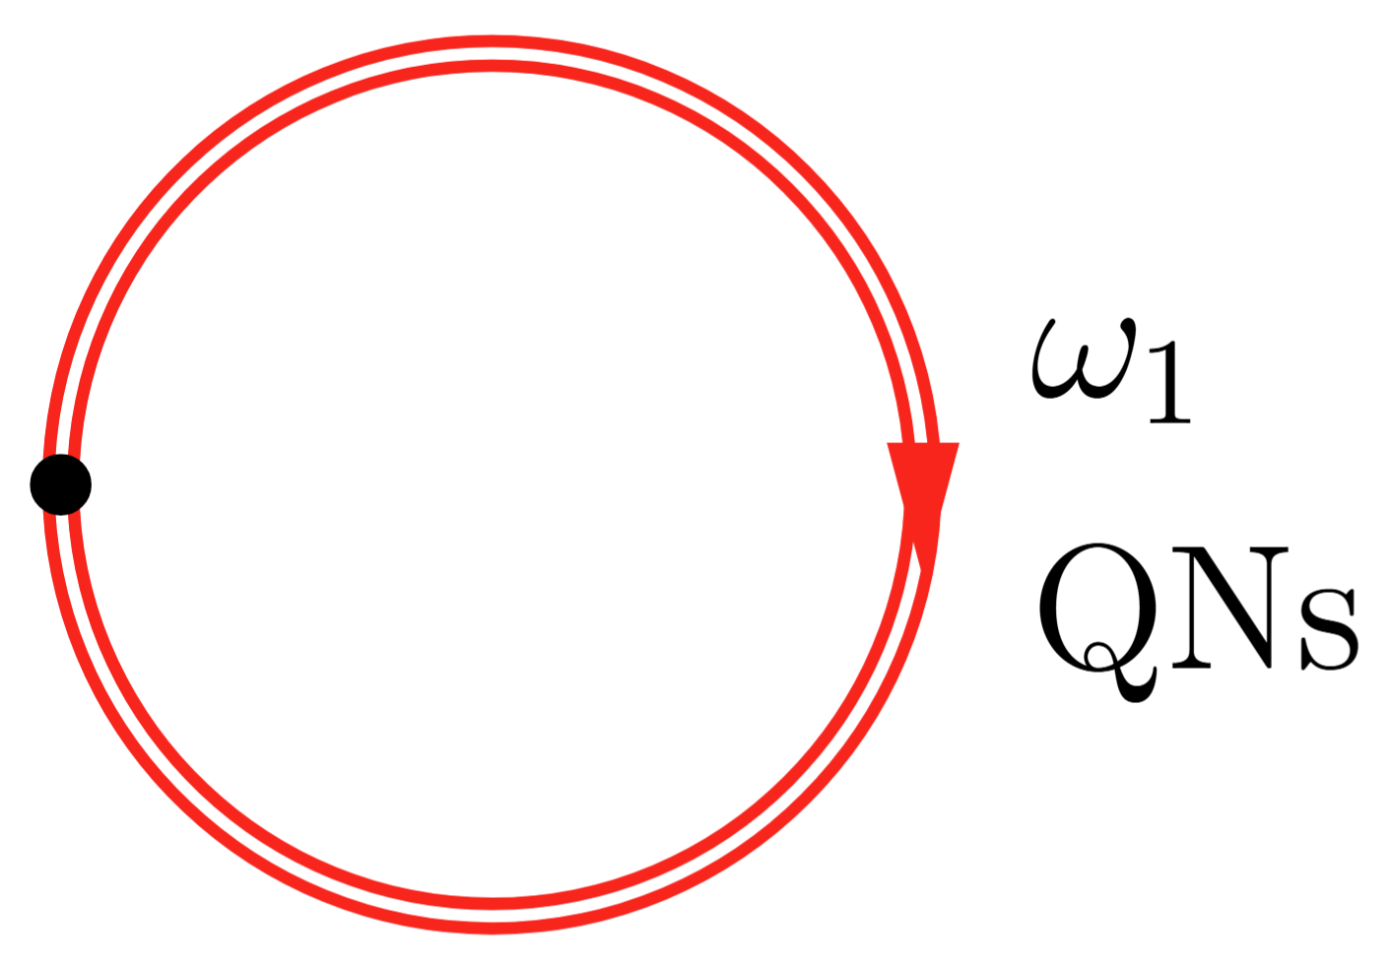







Normalization sector
Self-closing propagators need convergence factors $e^{iω_{1}η}.$
They can be included automatically at all orders by using a HF reference propagator.
$$≝\frac{iA}{ω_{1}^{2}+γ^{2}}$$
We choose as normalization sector:
$$+$$
$$+…+$$

Slide 22




Basis functions
$$Σ_{αβ}^{n}=Z_{N_{αβ}}\lim_{N→∞}{\frac{1}{𝒩}\sum_{j=1}^{N}{{B_{n}\left(ω_{j}\right)e}^{i arg[D_{αβ}(ω_{j},C_{j})]}1_{𝒯_{j}∈S_{Σ}}}}$$
$B_{n}\left(x\right)$ are normalized Legendre polynomials.
Recursion formulas are used to generate higher order $Σ_{αβ}^{n}$during the sampling.
$$A_{j}≝e^{i arg⁡[D_{αβ}(ω_{j}, C_{j})]}1_{𝒯_{j}∈S_{Σ}}$$
$${ (n+1)A}_{j}B_{n+1}\left(ω_{j}\right)=\left(2n+1\right)ω_{j}A_{j}B_{n}\left(ω_{j}\right)−nB_{n−1}(ω_{j})$$
Now we expand up to order $∼25$ with bins of size 5 MeV.
Currently exploring higher orders and other basis functions. Maybe other polynomial basis (e.g. Chebyshev) have better performance.

Slide 23

Richardson model: finite regulator error
SB, C. Barbieri, and E. Vigezzi, Phys. Rev. Lett. 134, 182502 (2025)

Slide 24

Number of basis functions

Slide 25


How perturbation theory breaks causality
$$Σ_{αβ}^{⋆}(ω)=Σ_{αβ}^{\left(∞\right)}+M_{α,r}^{†}\frac{1}{ω−{\left[E^{>}+C\right]}_{r,r^{′}}+iη }M_{r^{′},β}+N_{α,s}\frac{1}{ω−{\left[E^{<}+D\right]}_{s,s^{′}}−iη }N_{s^{′},β}^{†}$$
At third order, the terms that break causality have the form:
$${\left(M^{I}\right)}_{αr}^{†}\frac{1}{ω−E_{r }^{>}+iη }C_{r,r^{′}}^{I}{\frac{1}{ω−E_{r^{′} }^{>}+iη }M}_{r^{′},β}^{I}$$
ADC(n) builds the following expression from the PT results by matching terms
$${\left(M^{I}\right)}_{αr}^{†} \frac{1}{ω−{\left[E^{>}+C^{I}\right]}_{r,r^{′}}+iη }M_{r^{′},β}^{I}$$

Slide 26
updates of the Richardson model

Slide 27


Change $ω$
$$q_{Cω}=\frac{{|G}_{p}\left(ω_{b}−ω+ω^{′}\right)|}{{|G}_{p}\left(ω_{b}\right)|}$$

Slide 28


Change internal frequencies
$$q_{ω int}=\frac{L(ω_{b})}{L(ω_{b}′)}\frac{{|G}_{p}\left(ω_{b}′\right)|}{{|G}_{p}\left(ω_{b}\right)|}\prod_{j=1}^{order−1}{\frac{|G_{q_{j}}(ω_{j}−ω_{b}+ω_{b}′)|}{|G_{q_{j}}(ω_{j})|}}$$

Slide 29



Change sp quantum numbers and frequencies
Chosen along a uniform distribution on the integers $[1, D]$
Chosen along a Lorentzian function
$$q_{q, ω}=\frac{L(ω_{2})}{L(ω_{2}^{′})}\frac{|G_{q_{2}^{′}}\left(ω_{2}^{′}\right)G_{q_{2}^{′}}(ω−ω_{2}^{′}+ω_{b})|}{|G_{q_{2}}\left(ω_{2}\right)G_{q_{2}}(ω−ω_{2}+ω_{b})|}$$

Slide 30




Add/remove Rung
Chosen along a uniform distribution on the integers $[1, D]$
Chosen along a Lorentzian function
$$q_{Add}=\frac{\left|g\right|}{4π}\frac{D}{L\left(ω_{3}\right)}\left|G_{q_{3}}\left(ω_{3}\right)G_{q_{3}}\left(ω−ω_{3}+ω_{b}\right)\right|$$
$$q_{Rem}=\frac{1}{q_{Add}}$$

