Slide 1
Long term perspectives for novel neutrino sources:
The beta-beam and the Neutrino Factory

Slide 2
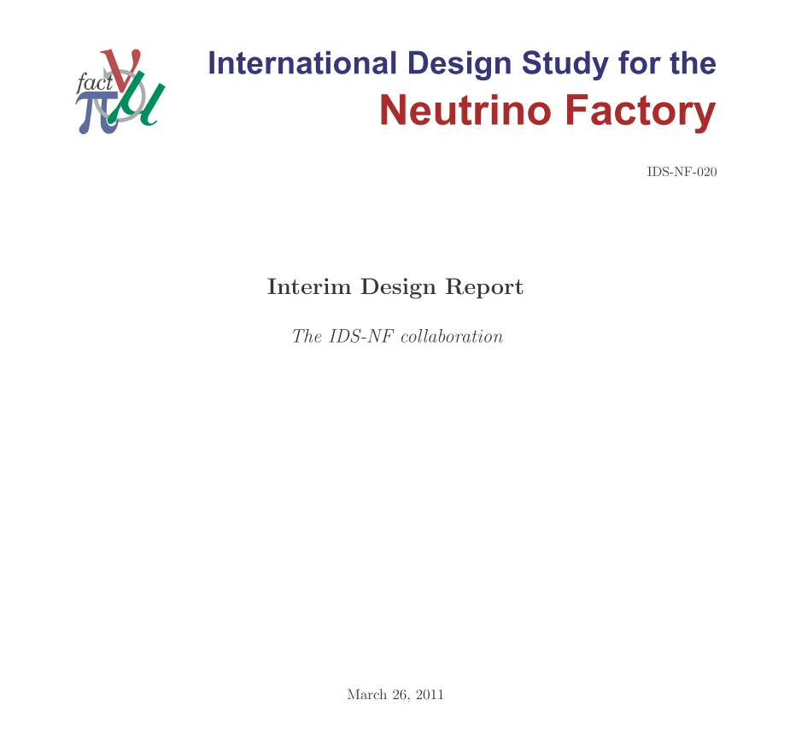
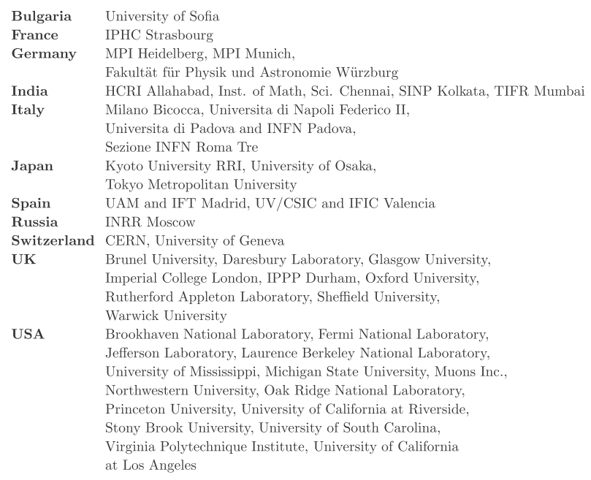
Acknowledgements:
Many thanks to those who provided information or material:
  And in particular the International Design Study for the Neutrino Factory (the IDS-NF) collaboration and the EUROnu collaboration
136 authors, 48 Institutes:
See also:
https://www.ids
ICFA Beam
Dynamics
-
nf.org/wiki/FrontPage/Documentation/IDR
Newsletter
55
:
72
-
78
,
2011

Slide 3


EUROnu
IDS-NF
R. Edgecock
I. Efthymiopoulos
E. Wildner
SB
BB
NF
K. Long

Slide 4
Prologue
Long term perspectives for novel neutrino sources:

Slide 5
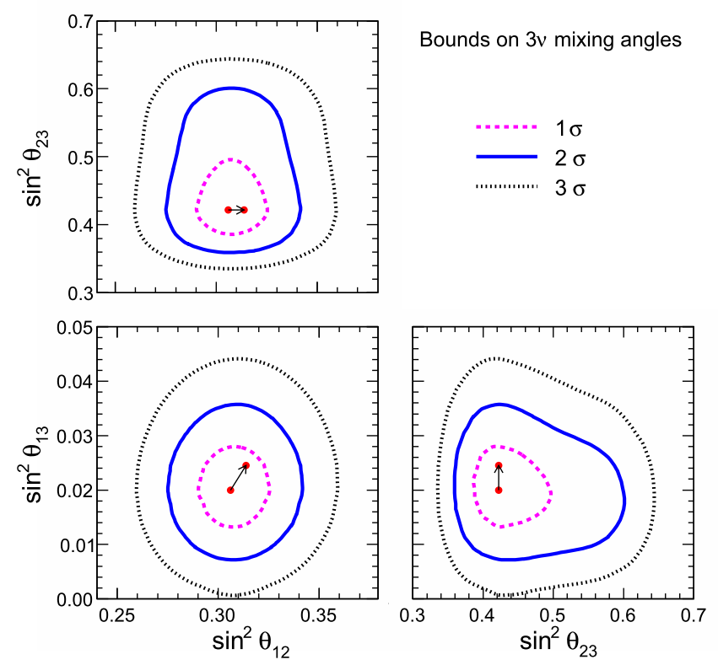
Standard Neutrino Model:
NNN11
Global analysis, including T2K and MINOS data:
  Evidence for θ₁₃ > 0 at 3σ
Exciting new data!
If confirmed, makes discovery of CP violation possible:
  Almost certainly at the Neutrino Factory
Increases motivation for precision determination of parameters and search for “non-standard effects”
Fogli, Lisi, Marrone,
Palazzo, Rotunno
[2011]
Notes:
The Double Chooz collaboration, by measuring the "disappearance" of electron antineutrinos, presents hints for oscillation also involving the third angle with the following value: sin^2(2theta_13) = 0.085 +/- 0.051. The probability given by preliminary results that there is no oscillation is only 7.9%.

Slide 6
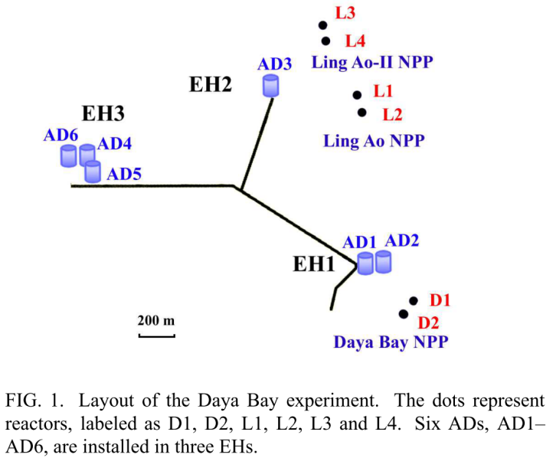
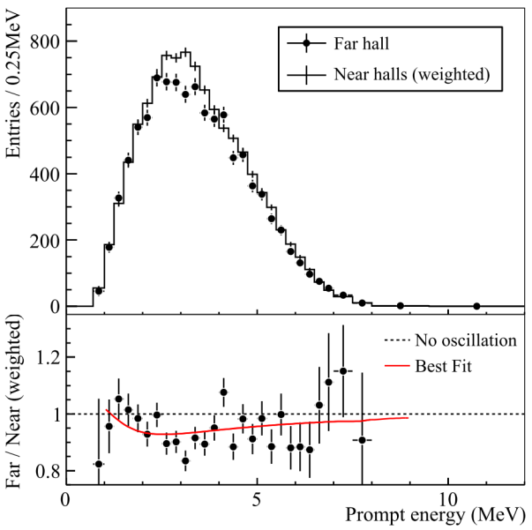
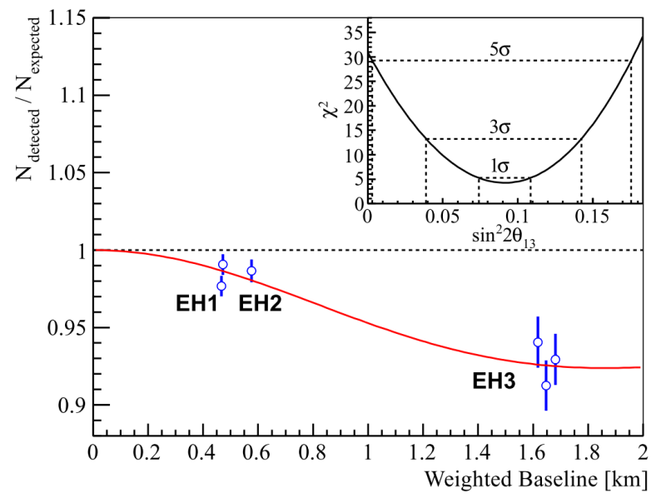
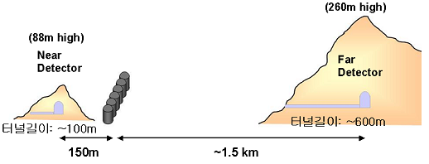
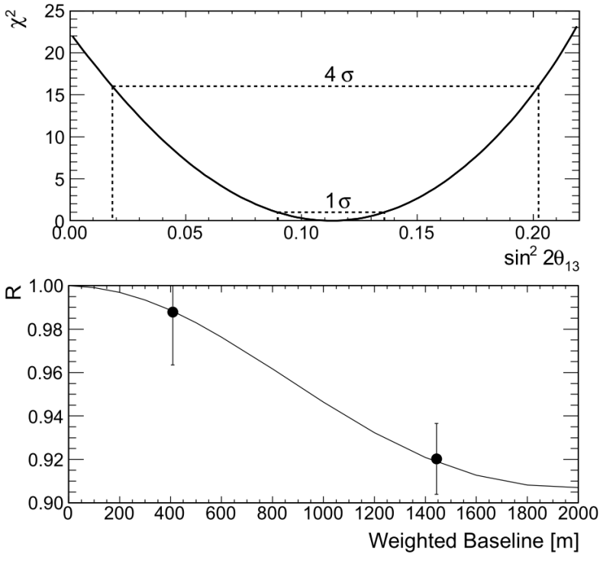
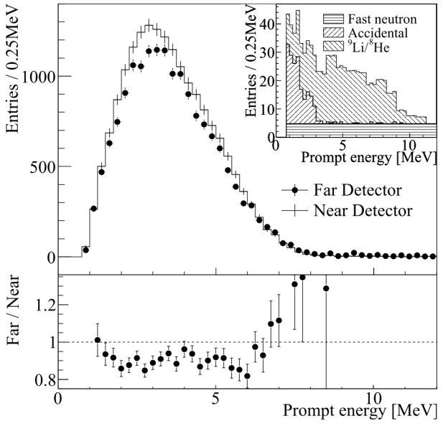
Daya Bay and RENO:

Slide 7
Standard Neutrino Model:
Global analysis, including T2K and MINOS data:
  Evidence for θ₁₃ > 0 at 3σ
Exciting new data!
Confirmed!
discovery of CP violation possible:
  Almost certainly at the Neutrino Factory
Increases motivation for precision determination of parameters and search for “non-standard effects”
Notes:
The Double Chooz collaboration, by measuring the "disappearance" of electron antineutrinos, presents hints for oscillation also involving the third angle with the following value: sin^2(2theta_13) = 0.085 +/- 0.051. The probability given by preliminary results that there is no oscillation is only 7.9%.

Slide 8
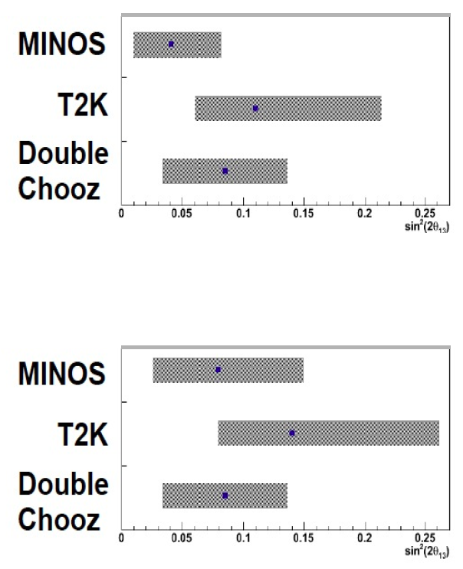
Recent results:
Normal
arXiv:1111.330
Machado et al.
Normal
arXiv:1111.330
Machado et al.
arXiv:1111.330
Machado et al.
Inverted
Inverted

Slide 9
The case for exquisite sensitivity:
Precision measurements are essential to:
  Complete the “Standard Neutrino Model” (SνM):
    Discover the mass hierarchy
    Search for (and discover) leptonic CP-invariance violation
  Establish the SνM as the correct description of nature:
    Determine precisely the degree to which θ₂₃ differs from π/4
    Determine θ₁₃ precisely
    Determine θ₁₂ precisely
  Search for deviations from the SνM:
    Test the unitarity of the neutrino mixing matrix
    Search for sterile neutrinos, non-standard interactions, …
What determines the goal for sensitivity and precision?
  Sensitivity:
    Definitive discovery!
      Must have sensitivity of at least “5σ”
      To resolve the LSND/miniBOONE “suite of anomalies” may set the bar higher!
  Precision:
    Field presently led by experiment;
      Too many, or too few, theories;
    Goal to determine parameters with a precision comparable to that with which the quark-mixing parameters are known
Notes:
Peroration:
Goals of the presentation:
Show sensitivity and precision of the beta beam and neutrino factoru
Show maturity of R&D
Demonstrate that there are short-term contributions, especially nuSTORM

Slide 10
Contents:
Beta beam
Neutrino Factory
Sensitivity and precision
Opportunity for short term contributions
Conclusions

Slide 11
Beta beam
Long term perspectives for novel neutrino sources:

Slide 12
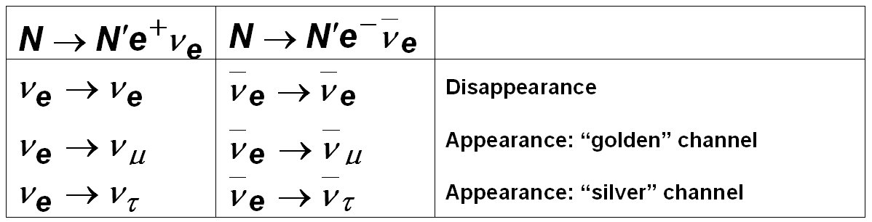
Beta beam; principle:
Search for
effects beyond
the SνM
T study (and ν_{μ} xsec meas.) requires super beam
CERN baseline scenario: exploits existing infrastructure
  Flux (ions circulate separately)
    ⁶He ( ν_{e}): 2.9 × 10¹⁸ ion decays/straight/year
    ¹⁸Ne (ν_{e}): 1.1 × 10¹⁸ ion decays/straight/year
  MEMPHYS: 400 kT fiducial water Cherenkov
    At Frejus: 130 km matched to <E_{μ}> ~ 400 MeV
  Sensitivities:
    Combine with atmospheric neutrino data
    Full simulation (including energy spectrum, NC and atmospheric background, etc.)

Slide 13
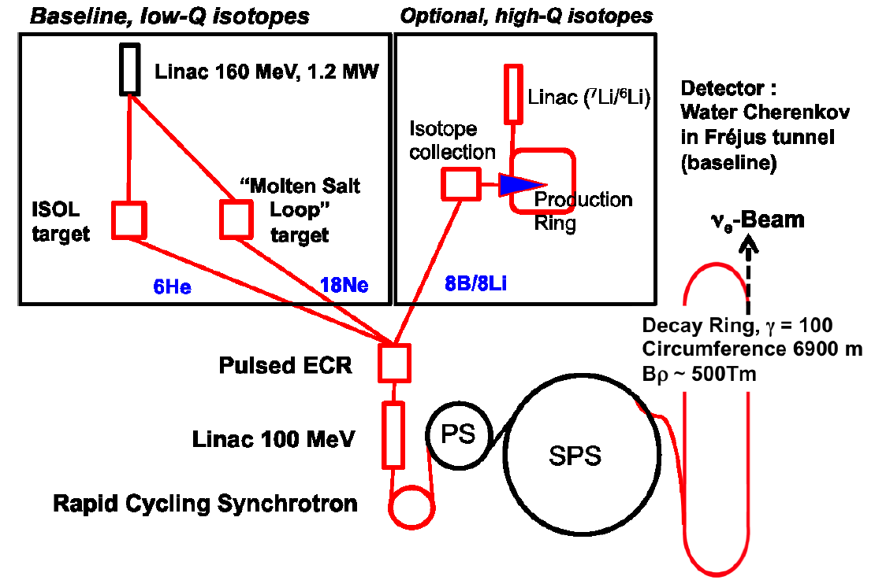
CERN baseline scenario:
Baseline:
  ⁶He; Q=3.5 MeV
  ¹⁸Ne; Q=3.3 MeV
Option:
  ⁸B; Q=13.9 MeV
  ⁸Li; Q=13.0 MeV

Slide 14
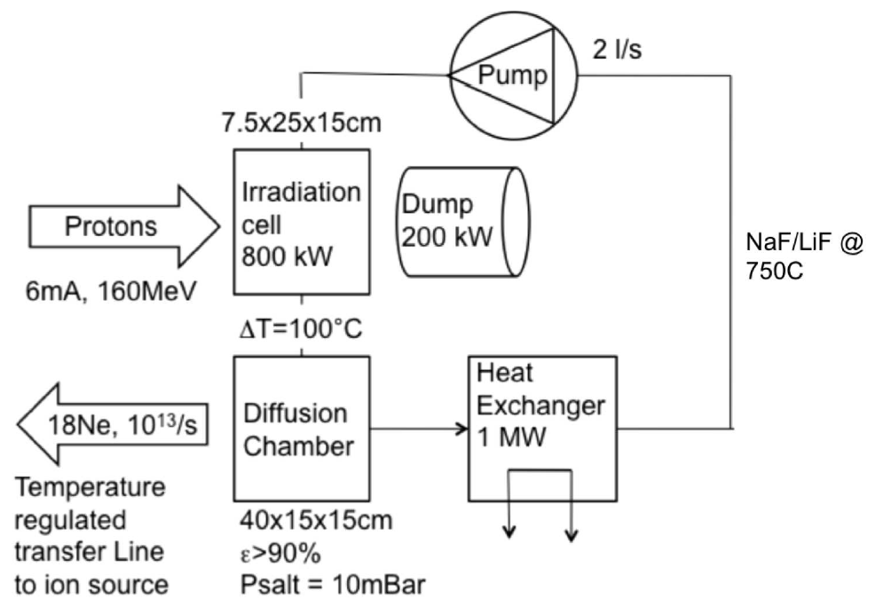
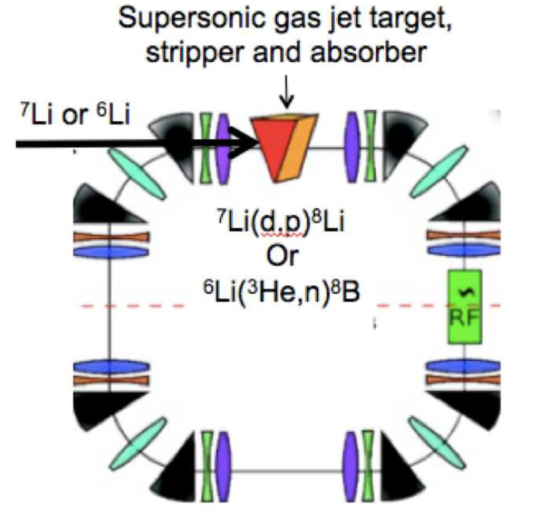
Isotope production rates:
Baseline:
  ⁶He:
    200 kW SPL, ISOL:
      5 × 10¹³ s⁻¹
  ¹⁸Ne:
    1 MW Linac 4, molten NaF target:
      1 × 10¹³ s⁻¹
Option:
  ⁸B and ⁸Li production from an internal target in a Li storage ring
    Super-sonic gas-jet or liquid Li target;
      ⁸B: 0.08 × 10¹³ s⁻¹
      ⁸Li: 0.1 × 10¹³ s⁻¹

Slide 15
Neutrino Factory
Long term perspectives for novel neutrino sources:

Slide 16
Neutrino Factory concept:
Search for
effects beyond
the SνM
IDS-NF baseline Neutrino Factory:
  Accelerator facility:
    10²¹ useful decays/yr
    10 GeV stored-muon energy
    2000 km source-detector baseline
  Neutrino detectors:
    100 kT magnetised iron neutrino detector (MIND)
    Near detector and ring instrumentation suite to:
      Determine flux
      Measure cross sections
      Perform detailed neutrino-scattering physics programme

Slide 17
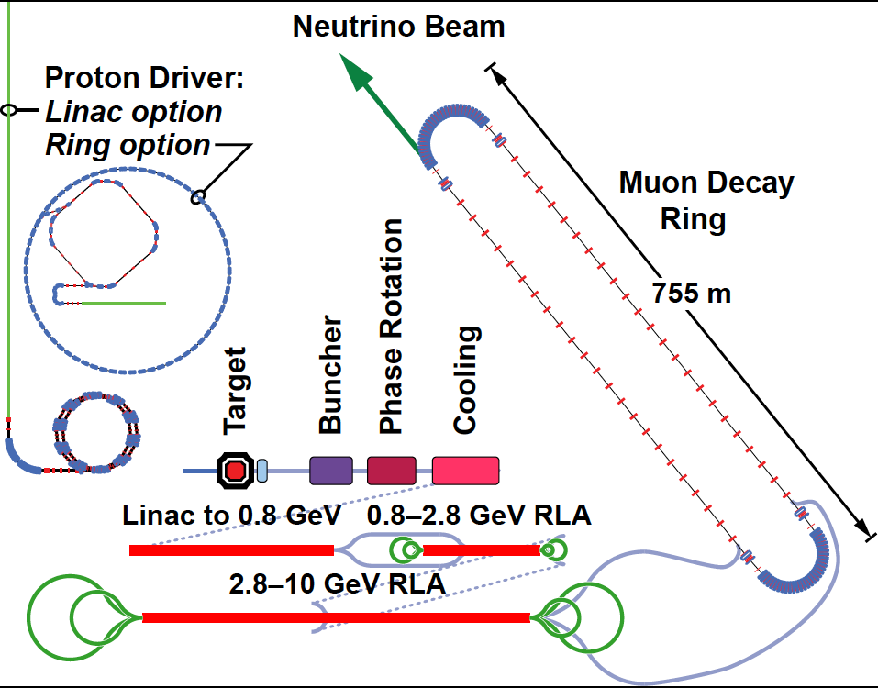
Beta-beam and Neutrino Factory:
Optimise discovery potential for CP and MH:
  Requirements:
    Large ν_{e} (ν_{e}) flux
      Detailed study of
      sub-leading effects
Unique:
    (Large) high-energy
    ν_{e} (ν_{e}) flux
      Optimise event rate at
      fixed L/E
      Optimise MH sensitivity
      Optimise CP sensitivity

Slide 18
Critical issues:
High-power (multi-MW), pulsed, proton source
  And particle-production target to match
Phase-space compression of muon beams:
  Short muon lifetime requires novel technique:
    Ionization cooling: proof-of-principle experiment, MICE
Rapid acceleration:
  Exploit time dilation to suppress muon decay
  Fixed Field Alternating Gradient Acceleration
    Novel magnet technology allows acceleration without magnet ramp
    Proof of principle:
      EMMA: under study at the Daresbury Laboratory

Slide 19
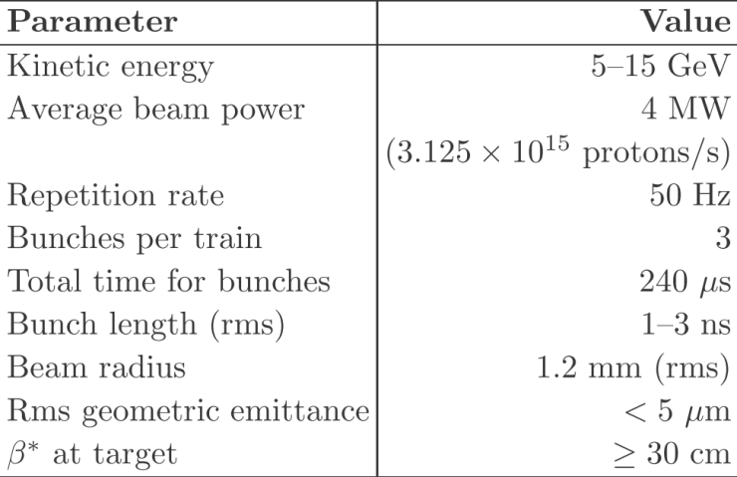
Proton driver:
Garoby, Gollwitzer, Thomason
Challenges:
  High power; short
  proton-bunch length
  at ~10 GeV
IDS-NF approach:
  Consider two
  ‘generic’ options:
    LINAC:
      Possible development
      option for SPL (CERN)
      or Project-X (FNAL)
      Requires accumulator &
      compressor rings
    Rings:
      Development option for J-PARC or RAL or possible ‘green-field’ option
      Requires bunch compression

Slide 20
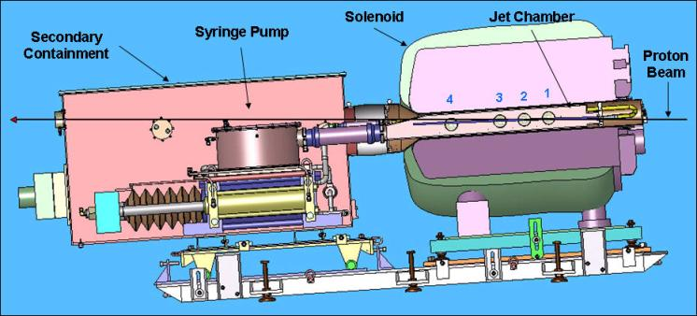

Baseline target: proof of principle: MERIT:
‘Disruption length’: 28 cm
‘Refill’ time: 14 ms
  Corresponds to 70 Hz
Hence:
  Demonstrated operation at:
    60 kJ × 70 Hz = 8 MW
20 m/s liquid Hg jet in 15 T B field
Exposed to CERN PS proton beam:
  Beam pulse energy = 115 kJ
  Reached 30 tera protons at 24 GeV

Slide 21
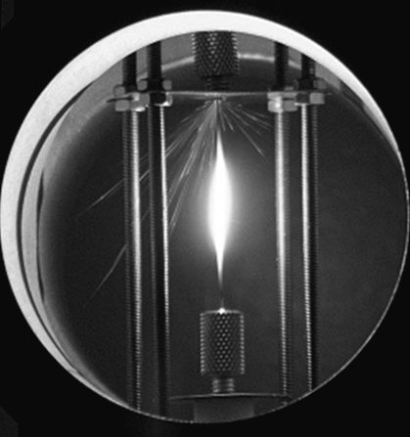
Solid and powder jet-targets:
Solid target:
  Lifetime limitation from beam-induced shock:
    Investigated using rapid rise-time (kicker) power supply and thin wire
  Measurements imply:
    2 cm diameter tungsten rod will survive > 10 yrs
  Measurements of properties of W and Tn being prepared for publication
  Working on rod-exchange mechanism
R. Edgecock,
R. Bennett,
G. Skoro
Tungsten-powder
jet:
  (Jet) advantage:
    Avoids issue of
    shock
  (Solid) advantage:
    Avoids issue of Hg handling
  ‘Bench-test’ system under evaluation
  Proof of principal system under consideration
C. Densham
et al.

Slide 22
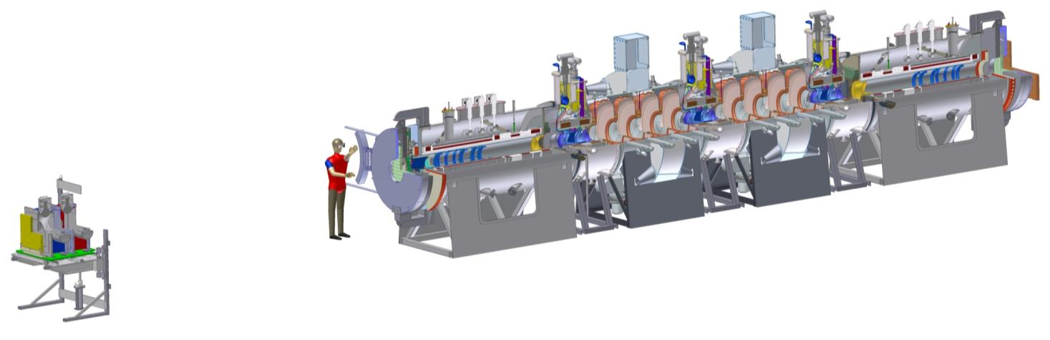
MICE:
ISIS
RAL
MICE

Slide 23
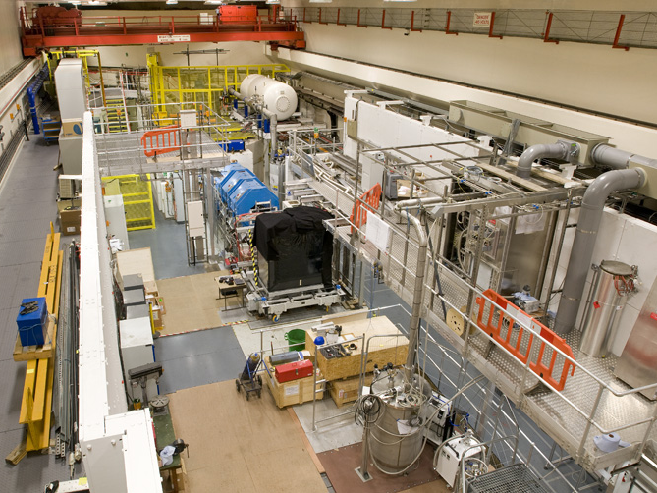
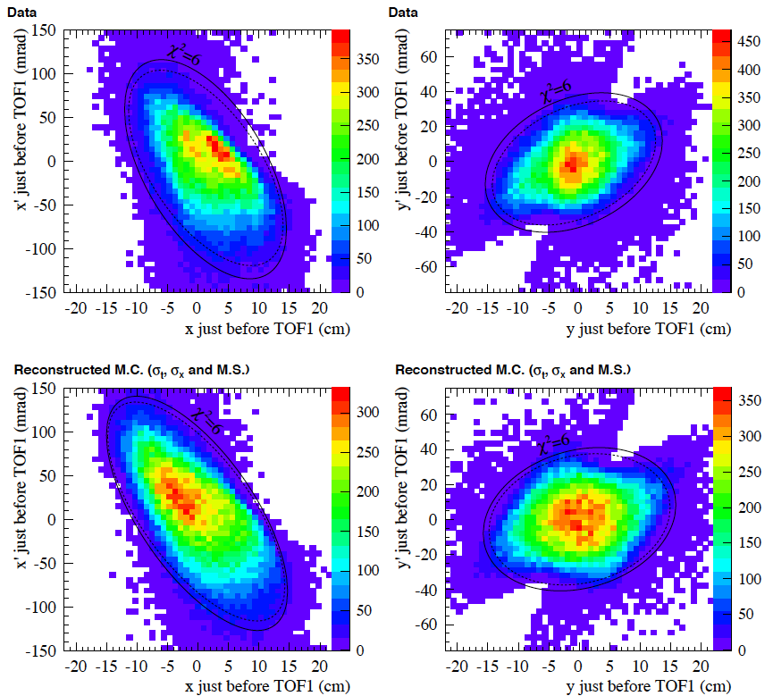
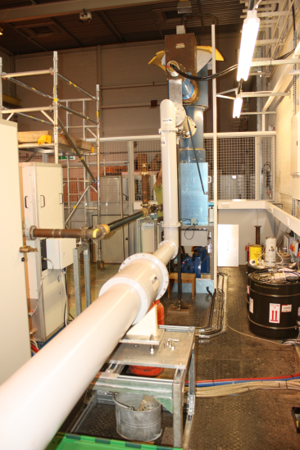
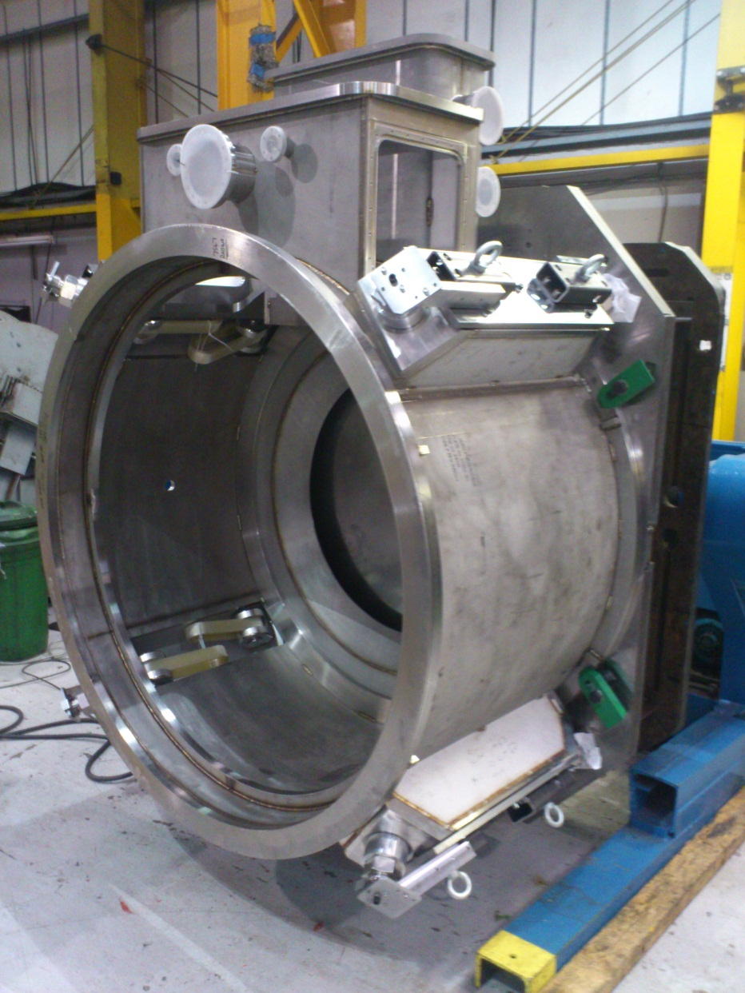
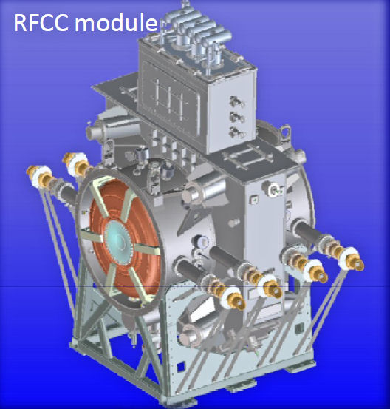
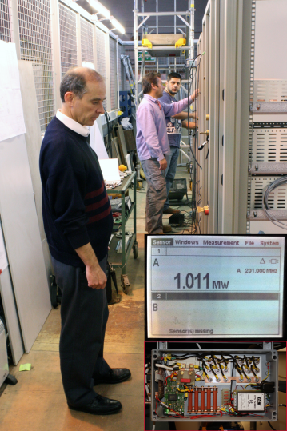
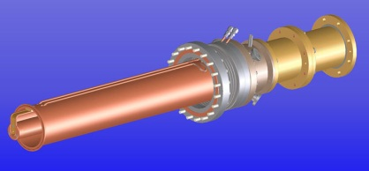
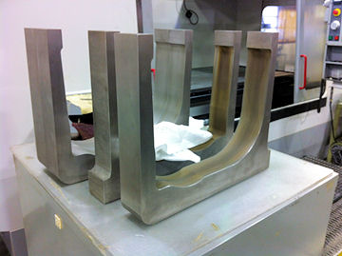
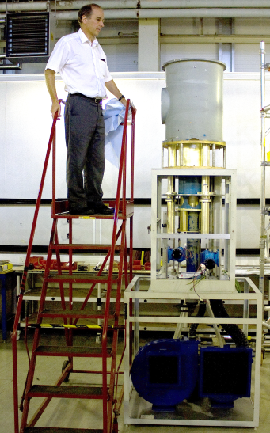
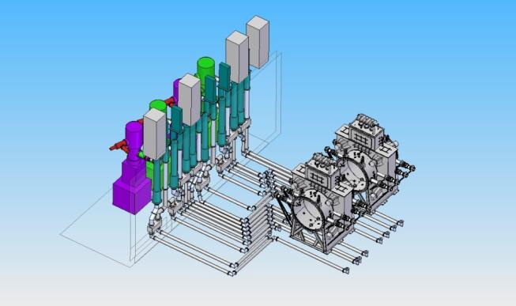
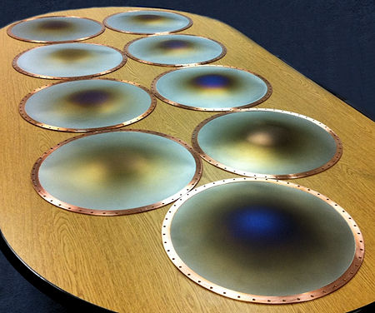

Slide 24
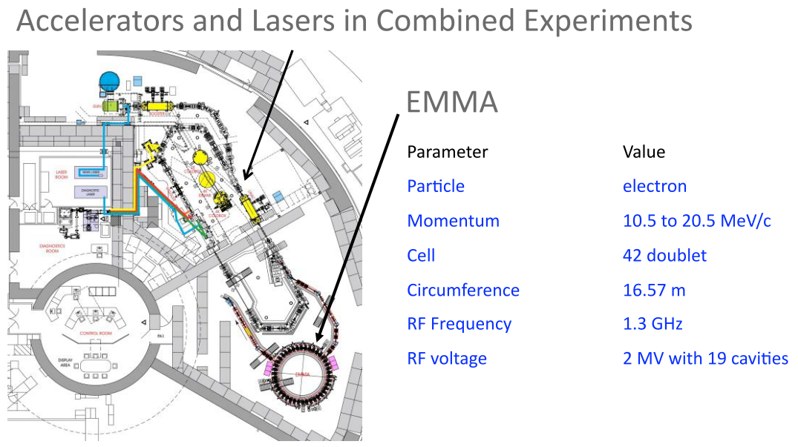
Muon acceleration: proof of principle:
EMMA at Daresbury Laboratory
  Electron Model of Muon Acceleration
    Aka:
      Electron Model of Many Applications
DL, RAL, CI, BNL,
TRIUMF, FNAL, JAI
CERN, GRENOBLE

Slide 25
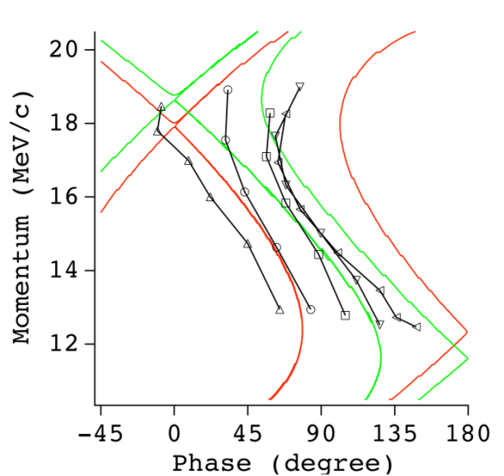
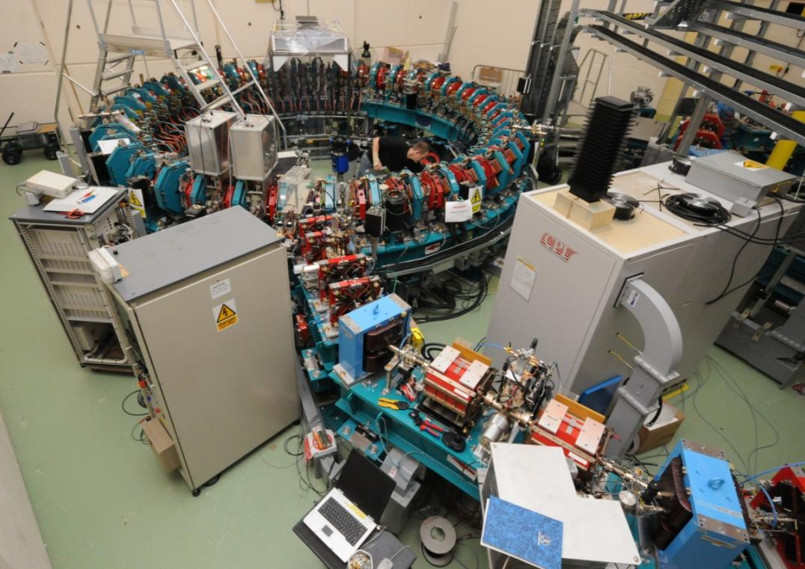
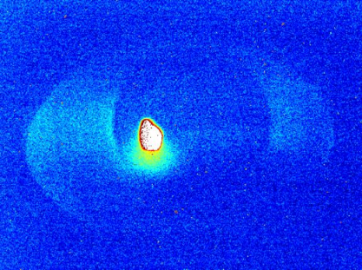
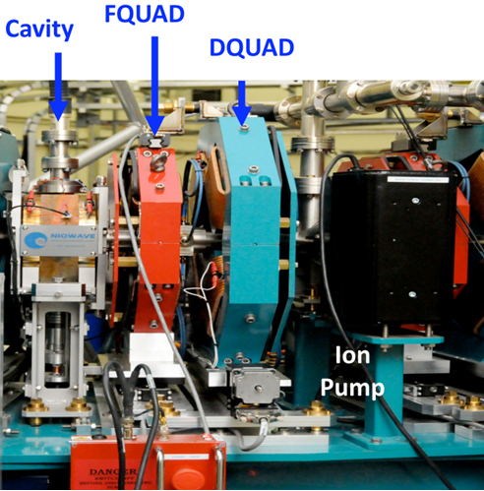
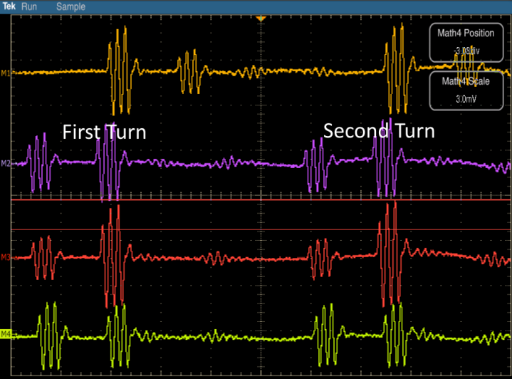
Extraction

Slide 26
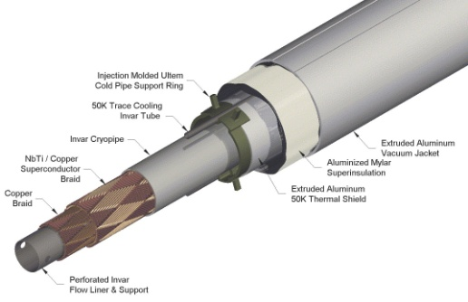
Magnetized Iron Neutrino Detector (MIND):
IDS-NF baseline:
  Intermediate baseline detector:
    100 kton at 1500—2500 km
  Appearance of “wrong-sign” muons
  Toroidal magnetic field > 1 T
    Excited with “superconducting transmission line”
  Segmentation: 3 cm Fe + 2 cm scintillator
  50-100 m long
  Octagonal shape
  Welded double-sheet
    Width 2m; 3mm slots between plates
Bross, Soler, Bayes, Cervera

Slide 27
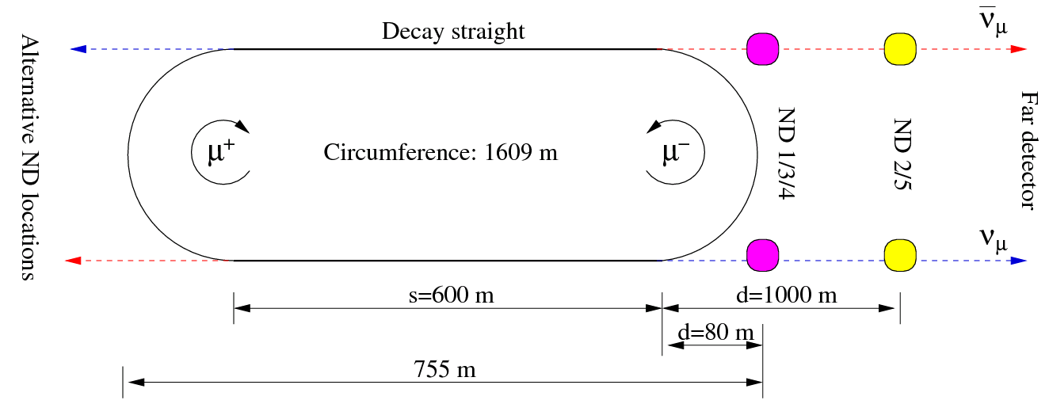
Near detectors:
Morfin, Tsenov
Near detector missions:
  Neutrino flux (<1% precision) and extrapolation to far detector
  Charm production (main background) and taus for Non Standard Interactions (NSI) searches
  Cross-sections and other measurements (ie PDFs, sin²θ_{W})

Slide 28
Sensitivity and precision
Long term perspectives for novel neutrino sources:

Slide 29
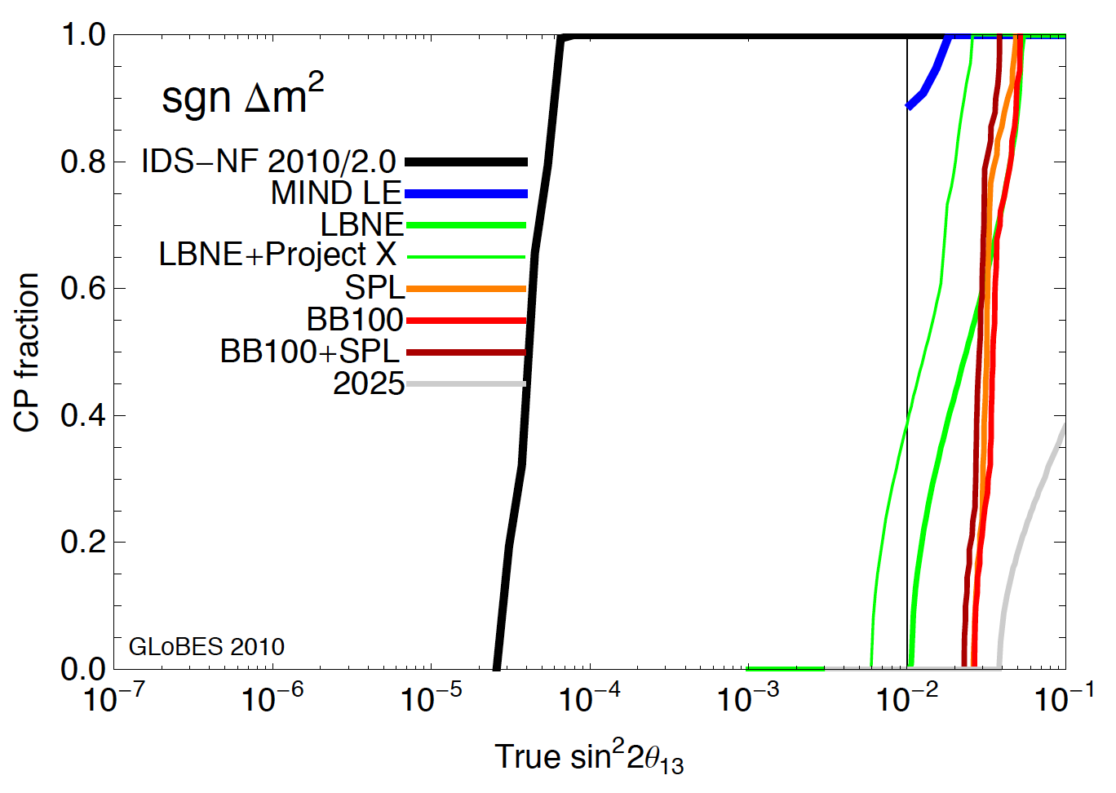
Comparison:
IDS-NF IDR: arXiv:1112.2853v1
5σ
At 10⁻¹, LBNO (LBNE) “sufficient” for MH

Slide 30
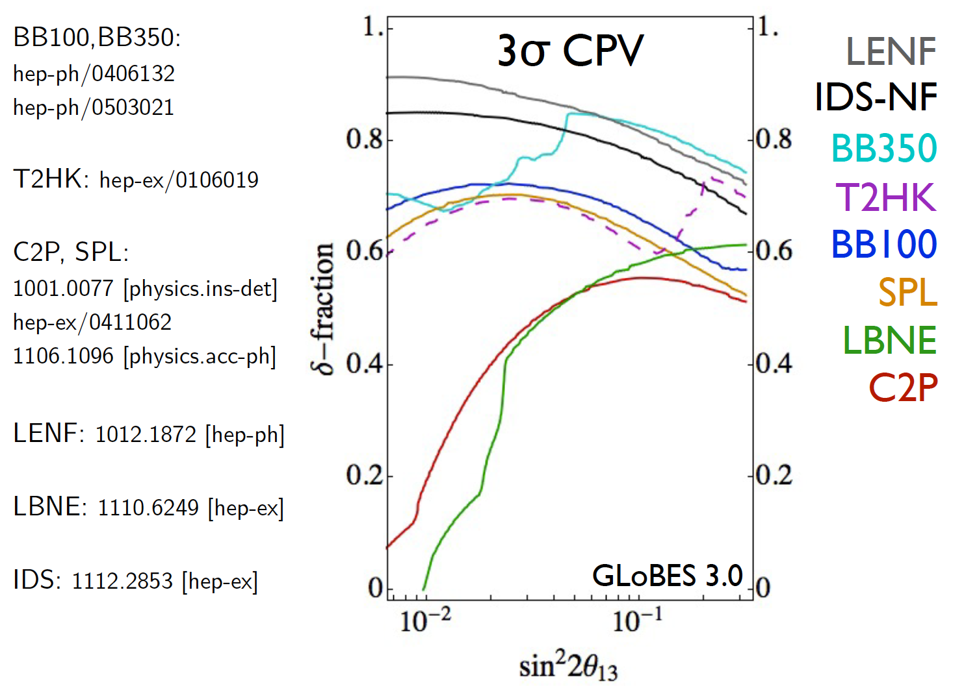
Comparison:
P. Coloma, IDS-NF#8:
https://www.ids-nf.org/wiki/GLA-2012-04-18/Agenda
Even at 3σ, SB is 50/50, insufficient;
Neutrino Factory significantly better

Slide 31
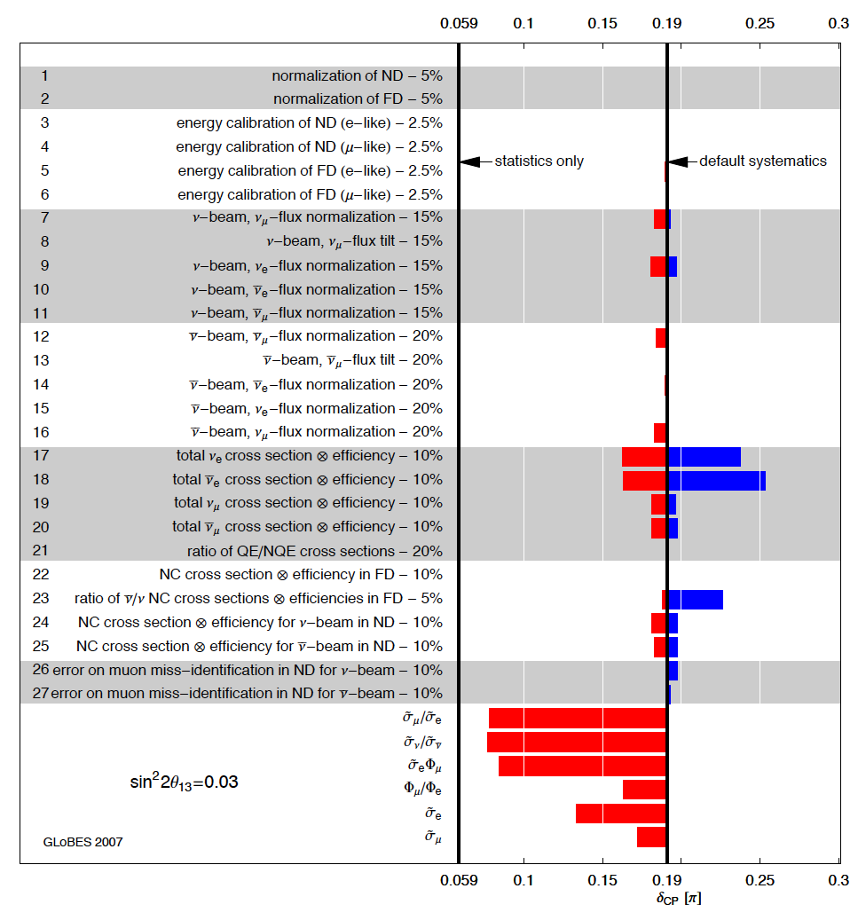
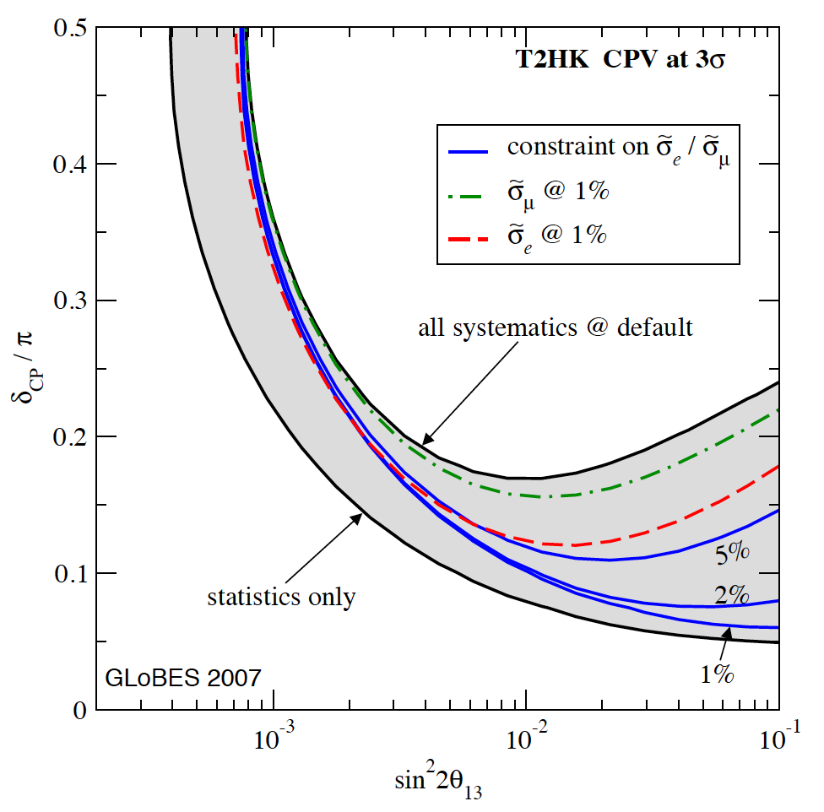
Systematic uncertainties:
T2HK, a case study:
  Narrow-band beam
  Near and far detector
— critical at large θ₁₃
Huber, Mezzetto, Schwetz,
arXiv:0711.2950v2

Slide 32
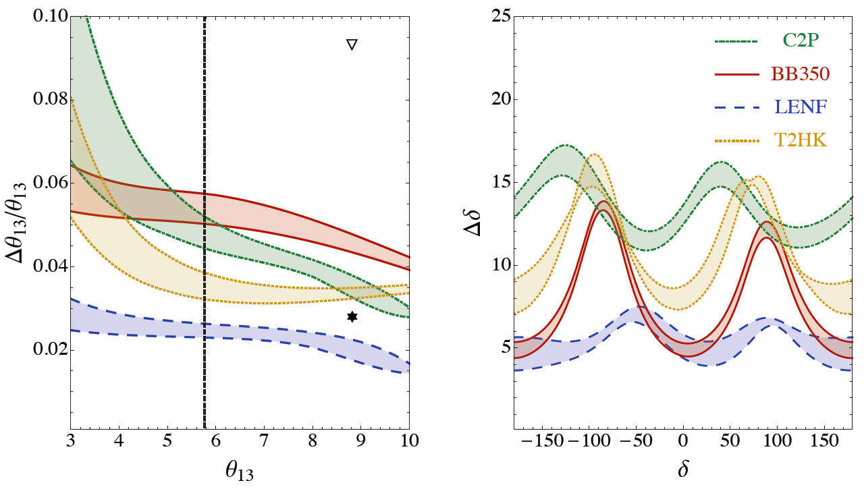
Comparison with alternatives:
P. Coloma, A. Donini, IDS-NF#8
P. Coloma, A. Donini,
E. Fernandez-Martinez,
P. Hernandez
Neutrino Factory offers best precision:
  Issue now is control of systematic effects

Slide 33
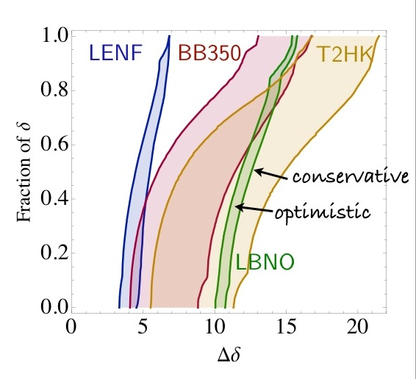
Comparison:
P. Coloma, IDS-NF#8:
https://www.ids-nf.org/wiki/GLA-2012-04-18/Agenda
C2PY: wide-band beam; advantageous
Neutrino Factory best

Slide 34
Opportunity for short term contribution
Long term perspectives for novel neutrino sources:

Slide 35
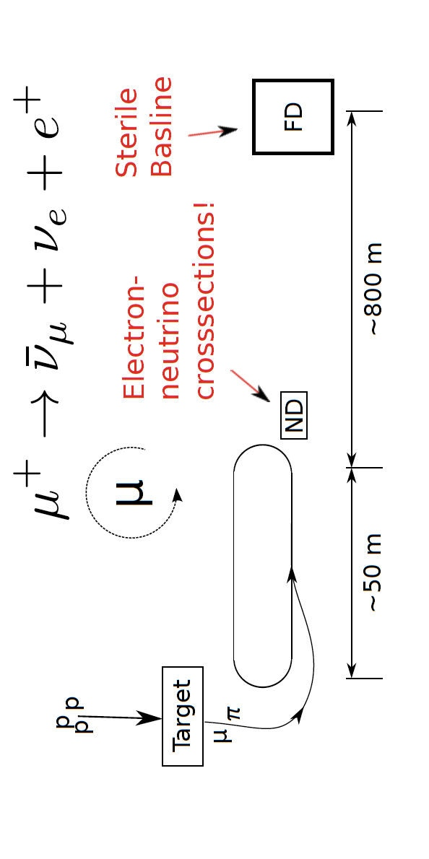
Neutrinos from Stored Muons: nuSTORM
100 kW Target Station
  Assume 60 GeV proton
    Fermilab PIP era
  Be target
    Optimization on-going
  Li Lens or horn collection after target
Collection/transport channel
  Two options
    Stochastic injection of π
    Kicker with π → μ decay channel
    At present NOT considering simultaneous collection of both signs
Decay ring
  Large aperture FODO
  Racetrack FFAG
  Instrumentation
    BCTs, mag-Spec in arc, polarimeter
Bross, et al

Slide 36
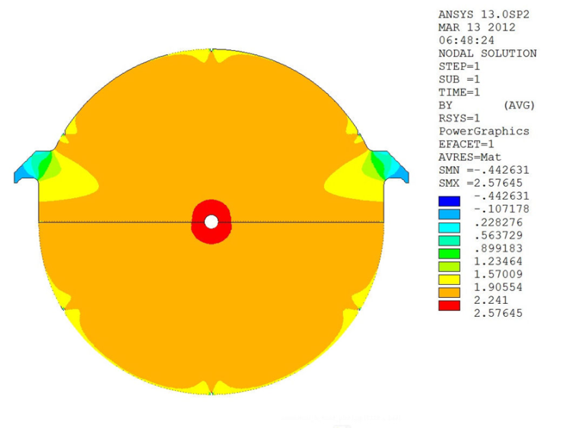
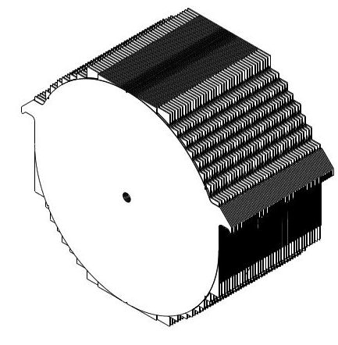
Conceptual design:
Magnetized Iron
  1 kT fiducial volume
    Following MINOS ND ME design
    1 cm Fe plate
    5 m diameter
  Utilize superconducting transmission line for excitation
    Developed 10 years ago for VLHC
  Extruded scintillator +SiPM

Slide 37
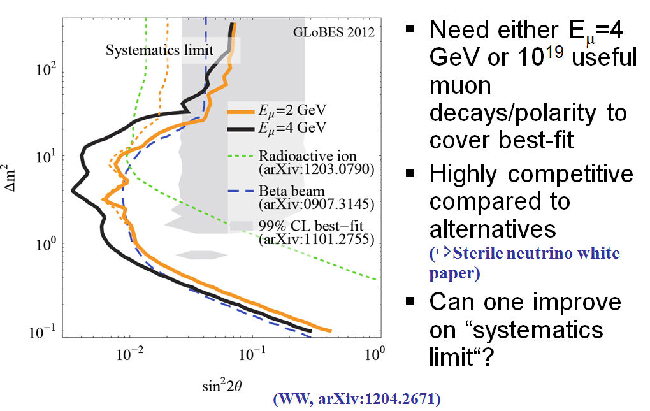
Sensitivity:
Tunnel, appearance
Sterile
neutrino
search
Winter, disappearance

Slide 38
Cross sections:
Unique opportunity to measure electron-neutrino cross sections
Also, measure muon-neutrino cross sections
Full set of neutrino-scattering physics:
  QCD
  Structure functions &
  form factors
  Electroweak
  …
Concept for detector:
  Straw tracker,
  EM Calor, TRD and
  μ spectrometer
  Meets all needs for ND
  Detector technology
  exists
  Costed
Mishra, IDS-NF#8

Slide 39
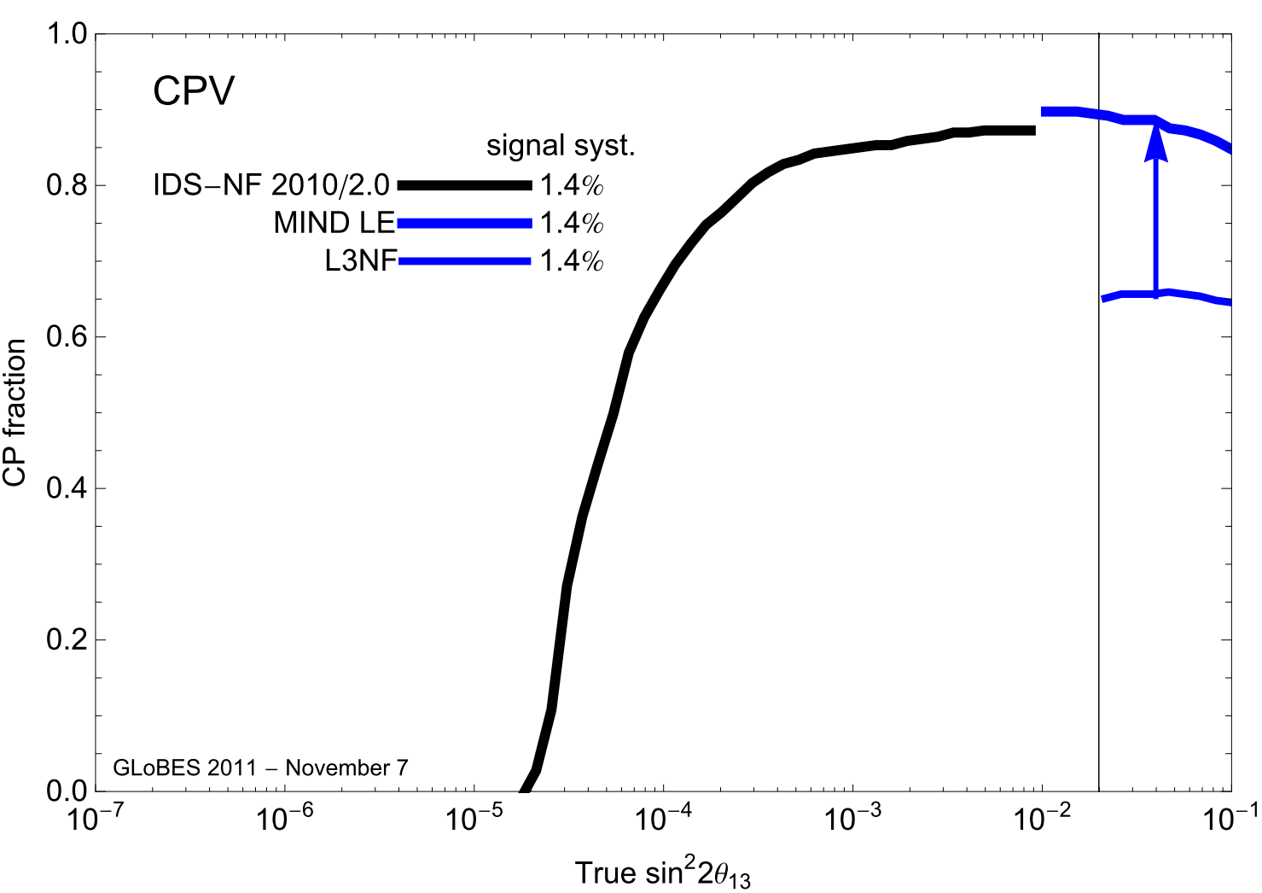
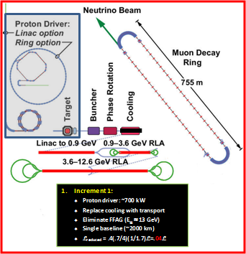

Slide 40
Conclusions
Long term perspectives for novel neutrino sources:

Slide 42
Conclusions:
Measurement of θ₁₃ emphasises:
  5σ discovery sensitivity:
    Mass hierarchy;
    CP-invariance violation;
  Precision measurement of neutrino oscillations
Beta-beam:
  Sensitivity and precision competitive with super-beams
  Baseline:
    ⁶He production rate sufficient; ¹⁸Ne production under-study (CERN & LPSC)
    ⁷Li(d,p)⁸Li and ⁶Li(³He,n)⁸B under study (Aachen, CERN, GSI, Legnaro, UCL, Argonne)
    Conceptual design, including costing, will be published in EUROnu final report
Neutrino Factory:
  Unique; meeting the “5σ” sensitivity and precision goals;
  Mature:
    Key hardware issues addressed, or being addressed by R&D programmes;
    Conceptual design documented in IDS-NF IDR
      Costing in preparation for EUROnu final report and IDS-NF RDR
  Outstanding opportunity to contribute in the short term: nuSTORM
      Essential cross section measurements;
      Sterile-neutrino search
  Incremental approach to full Neutrino Factory conceivable
Altogether, an exciting programme!

