Slide 1
Attività Pisa Silici RD_FCC

Slide 2
Studio del vertex detector
Inner vertex:
studio del supporto conico, air cooling channels e integrazione con la beampipe

Slide 3
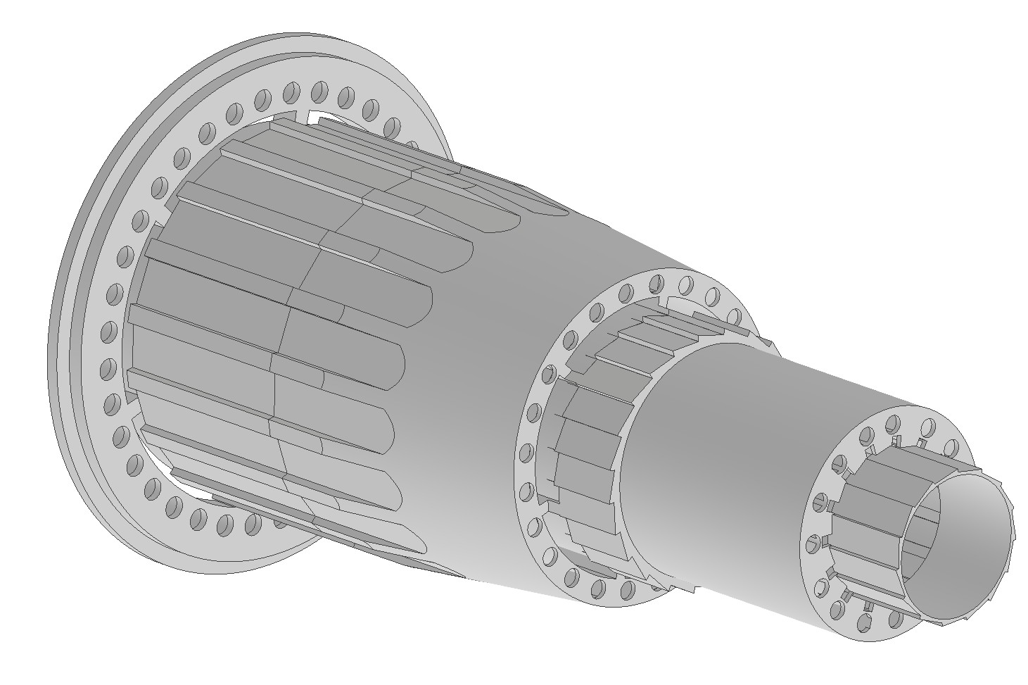
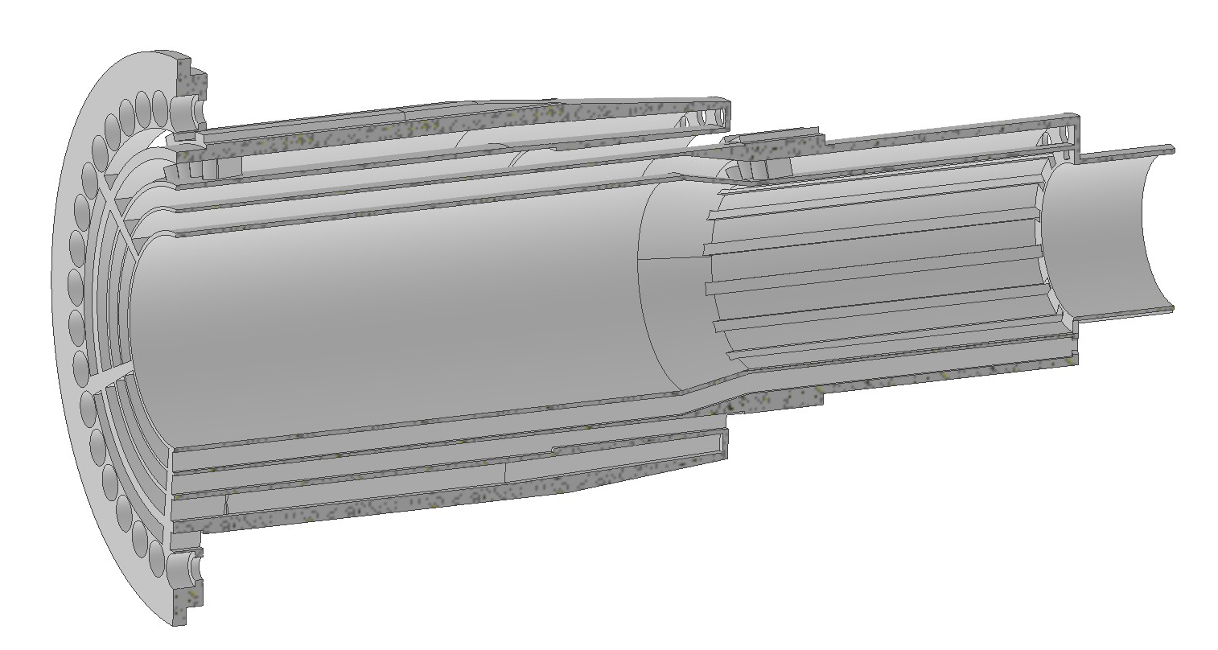
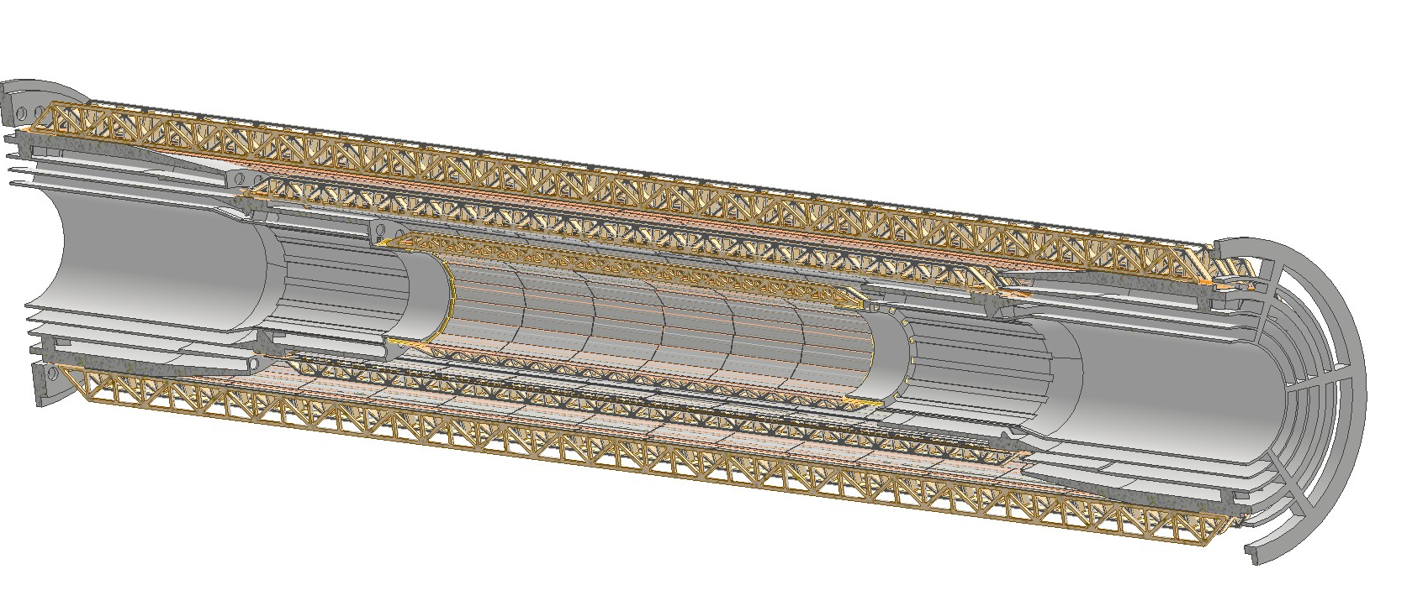
AIR
INLET
SUPPORT
Air cooling system to keep at a stable and uniform manageable temperature the silicon detectors
AIR
OUTLET
SUPPORT
3D printed support with integrated air ducts
(High Temp Resin)
Layer 3
Layer 2
Layer 1
Bus
Bus
3 separated ducts one for each of the layers
Aerodynamic fairing at the stave mounting screw locations
Split support for assembly
IP
Front view

Slide 4
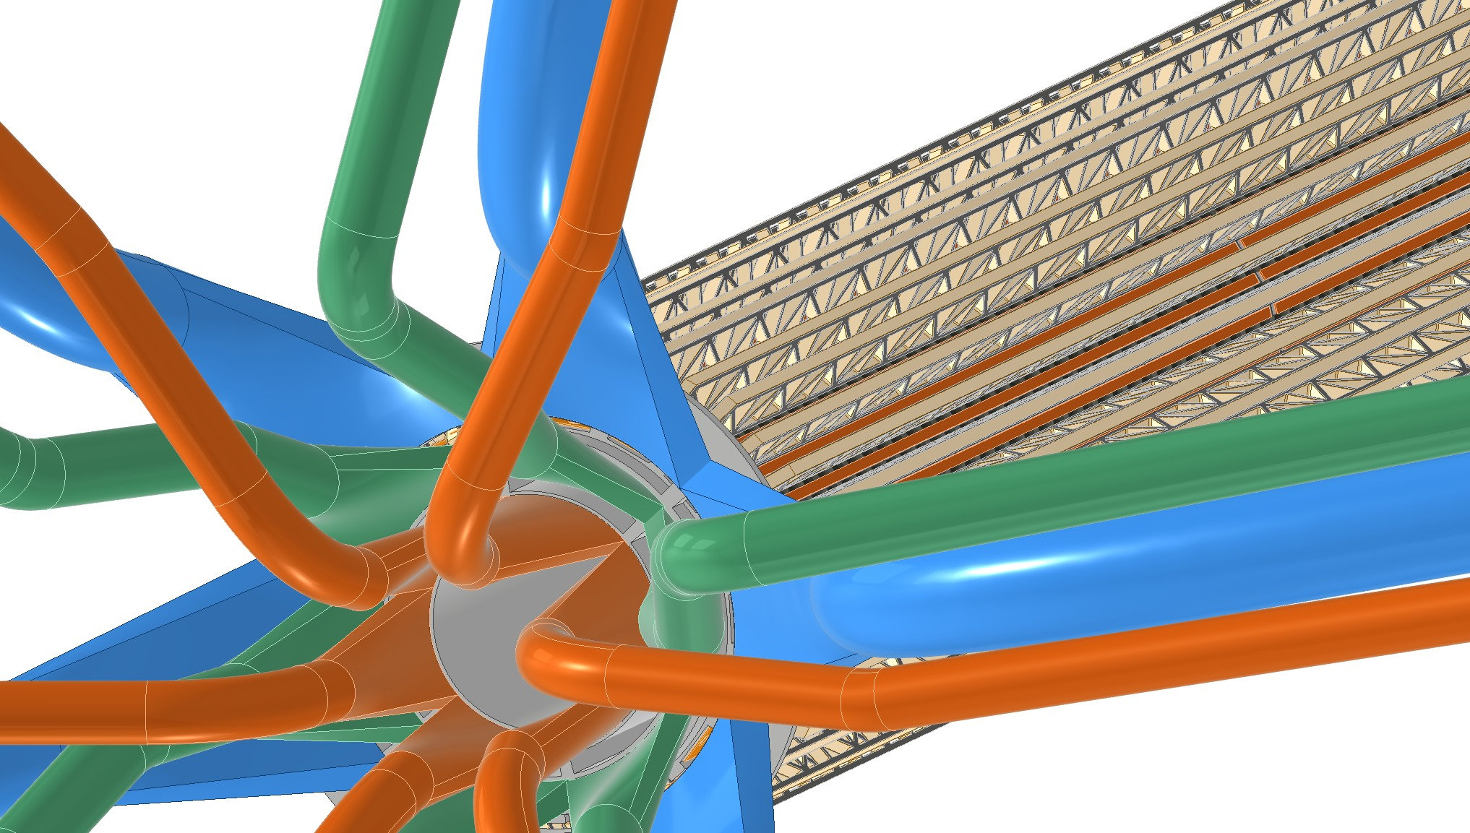
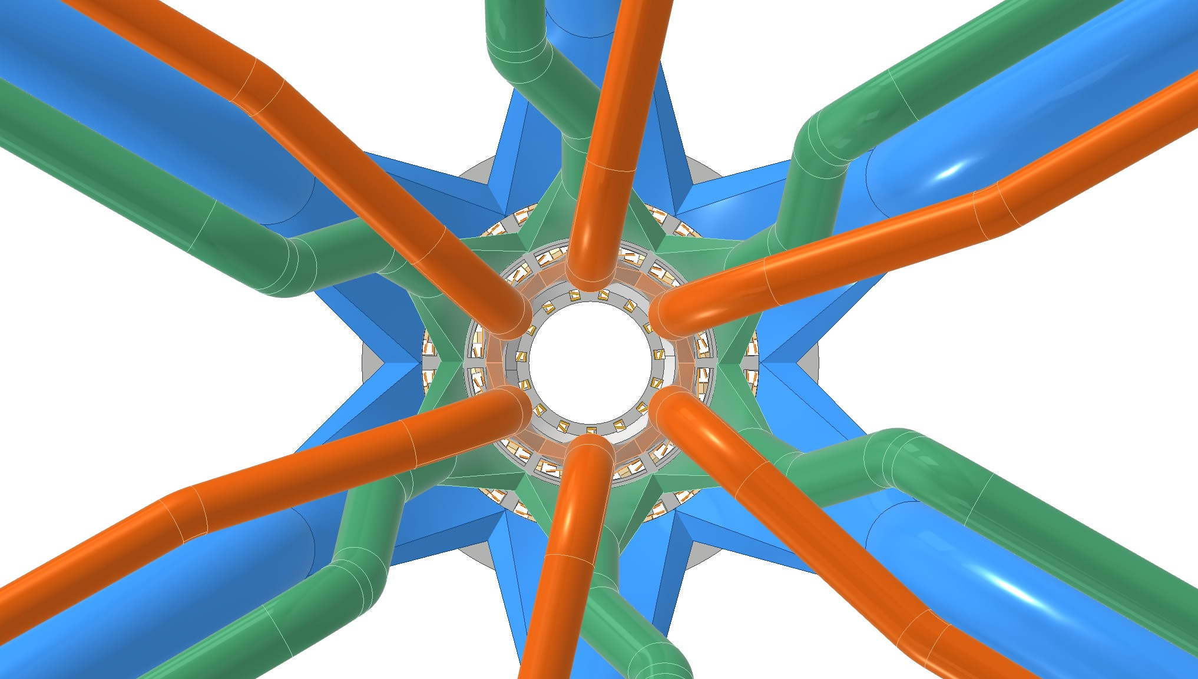
Diffusers
IP
Cables inlet/outlet
Layer 3 ducts
Layer 2 ducts
Layer 1 ducts
Rear view
6 sectors of 60° for each of the three indipendently powered layers
Diffusers included in the 3D printed support with hose connection
Need to be optimized in terms of length and pitch angle to allow for easy cables routing

Slide 5
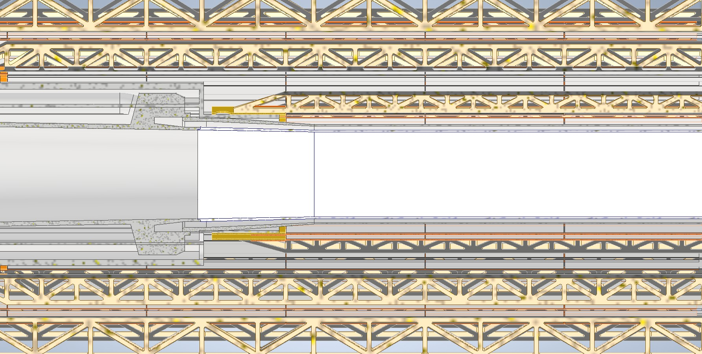
Problema di integrazione con la beampipe
Outer jacket
A I R
PARAFFIN
A I R
Due possibili soluzioni allo studio:
1) modifica della lunghezza della beam pipe → impedenze dei fasci da ricalcolare
2) soluzione integrata per il layer 1 → permette di andare 2 mm più vicini in raggio

Slide 6
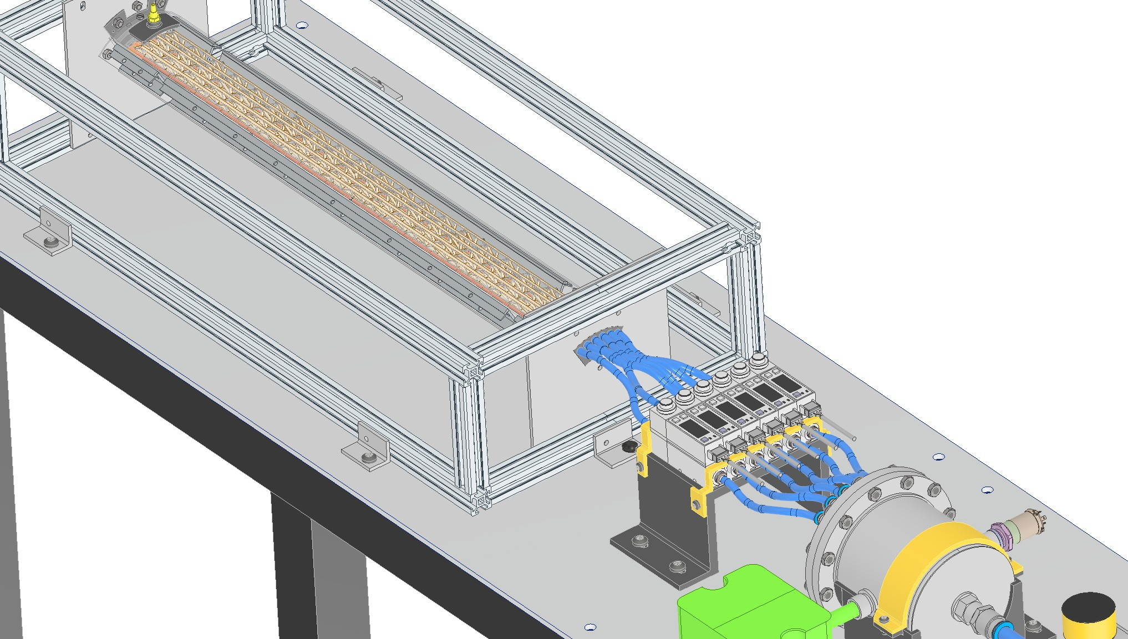
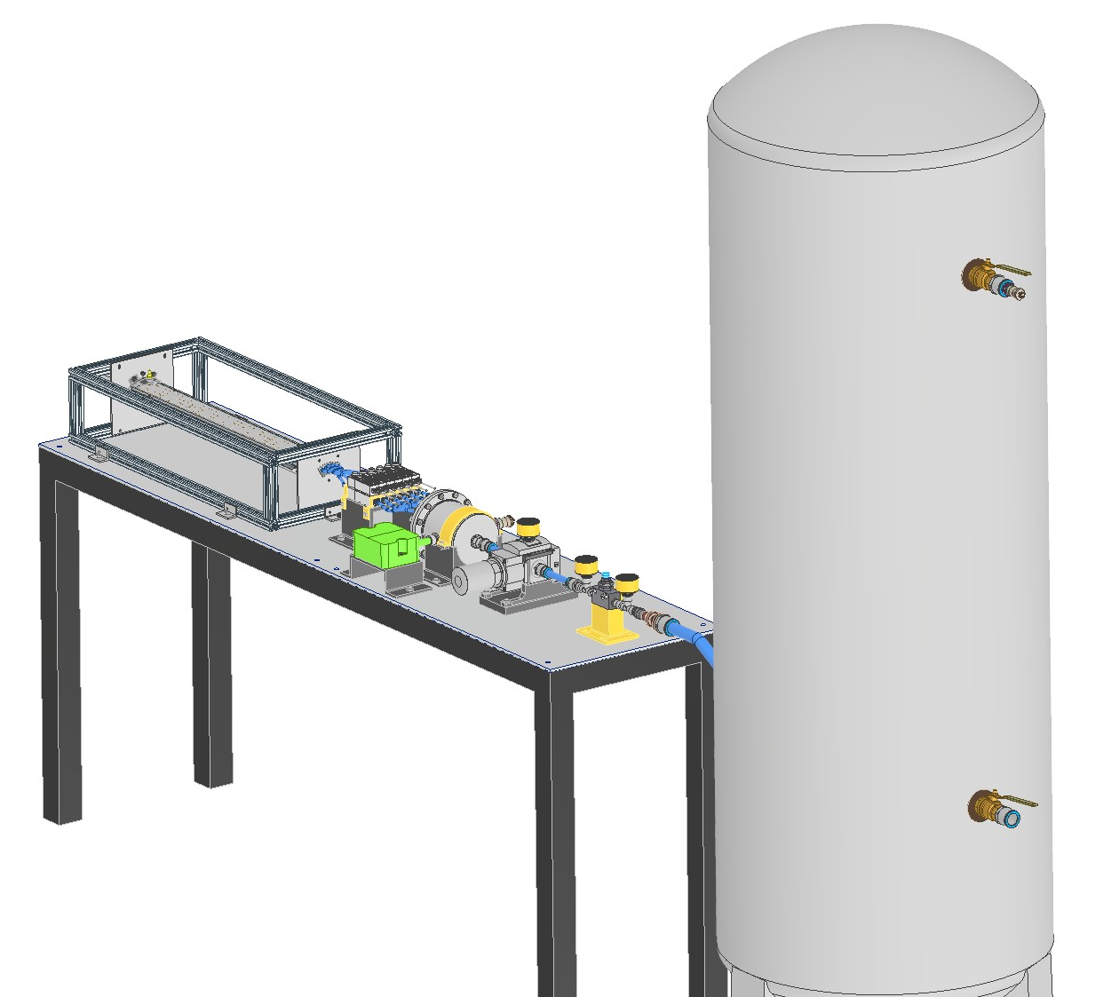
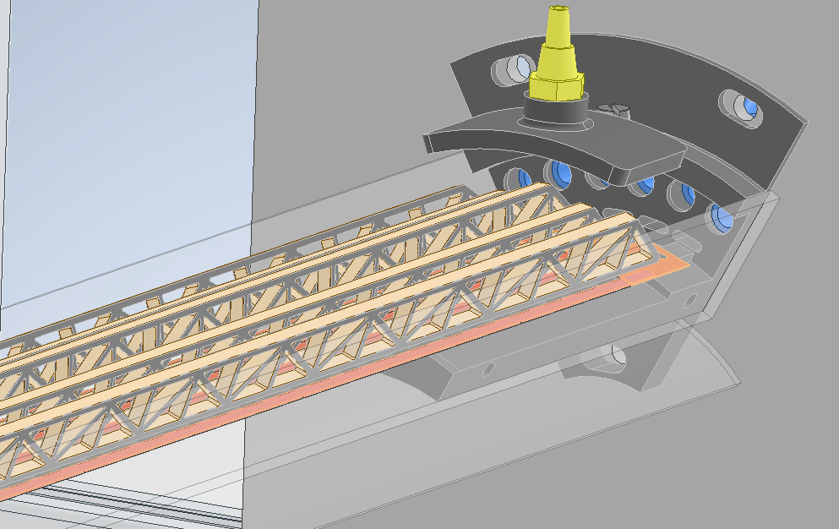
Studio dell’air cooling con il tunnel del vento
First test on a 60° circular sector of layer 3 including five staves
Next test on the same circular sector with all three layers

Slide 7
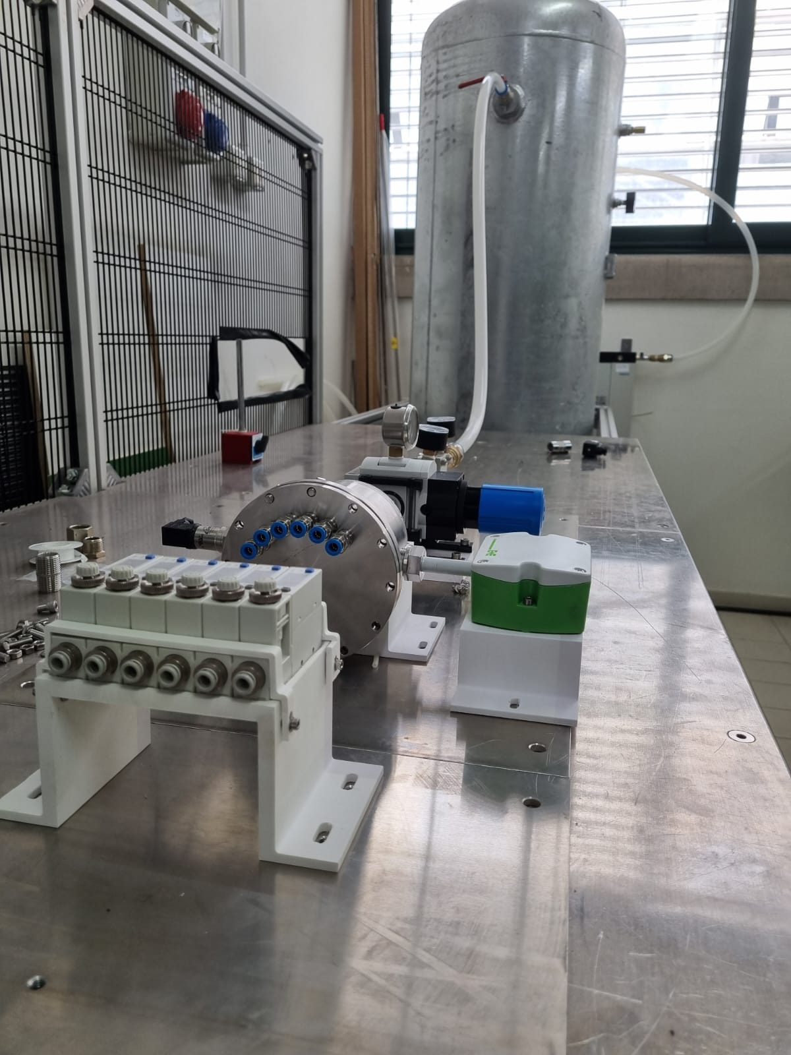
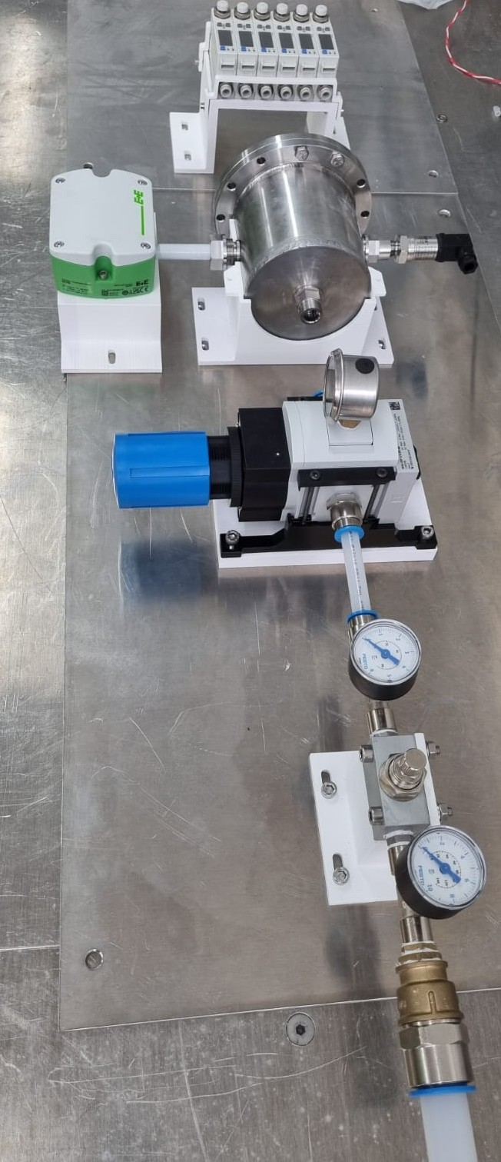
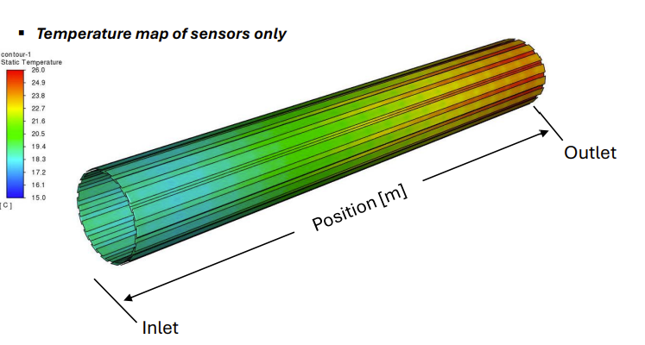
See ‘Vertex Detector Cooling simulations’, Baldinelli, Turrioni
https://indico.cern.ch/event/1439509/contributions/6289579/attachments/2995130/5276700/Baldinelli.pdf
Compressed air system under installation in Pisa

Slide 8
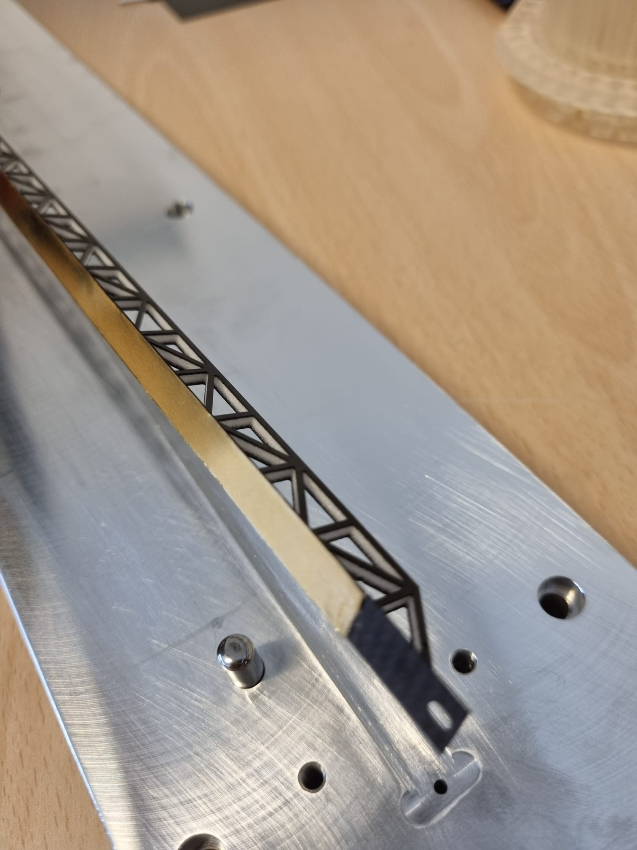
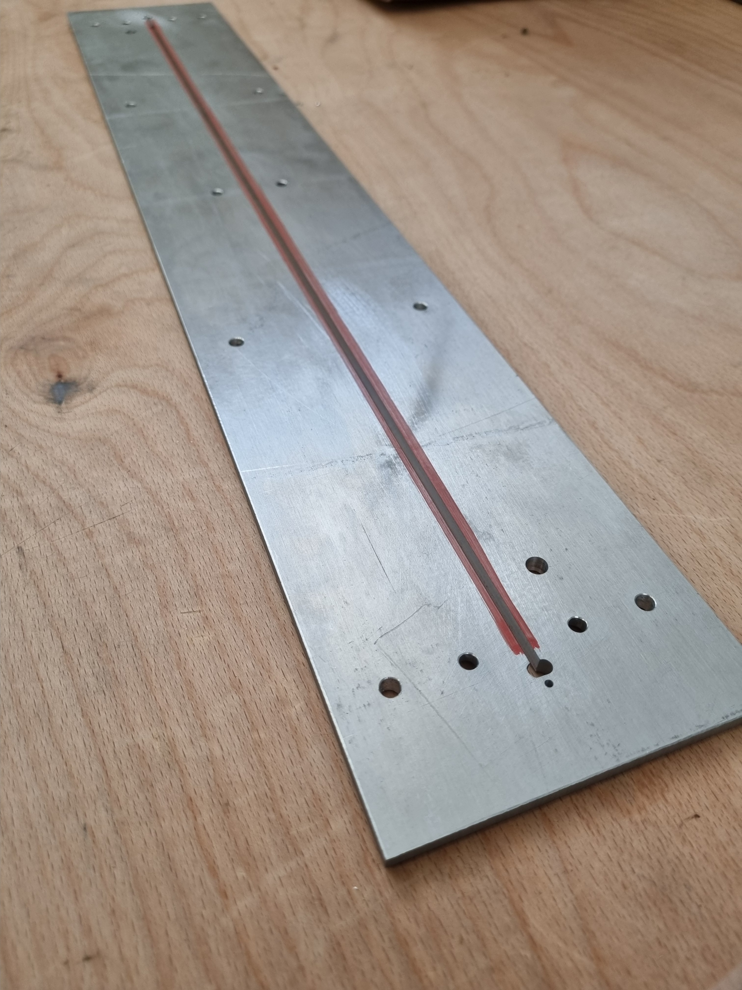
Maschera superiore per incollaggio
Trave con piattina

Slide 9
Outer vertex and disks mockup
Per il mockup stiamo definendo il support tube e l’ancoraggio dell’outer tracker e dischi

Slide 10
Positioning of the Inner and Outer Vertex
X,Y,Z
setting
Angular,Z
setting
Supporting Rib

