Slide 1
^{7th} Pre-PAC workshop for AGATA@LNL
INFN, Laboratori Nazionali di Legnaro
10-11, JULY 2025
BADGE
Please wear your badge to enter the Labs
and at all times during the Workshop.
You can drop it off at the desk, at the end of the Workshop

Slide 2
^{7th} Pre-PAC workshop for AGATA@LNL
INFN, Laboratori Nazionali di Legnaro
10-11, JULY 2025
Wi-Fi
Please, use your EDUROAM account

Slide 3
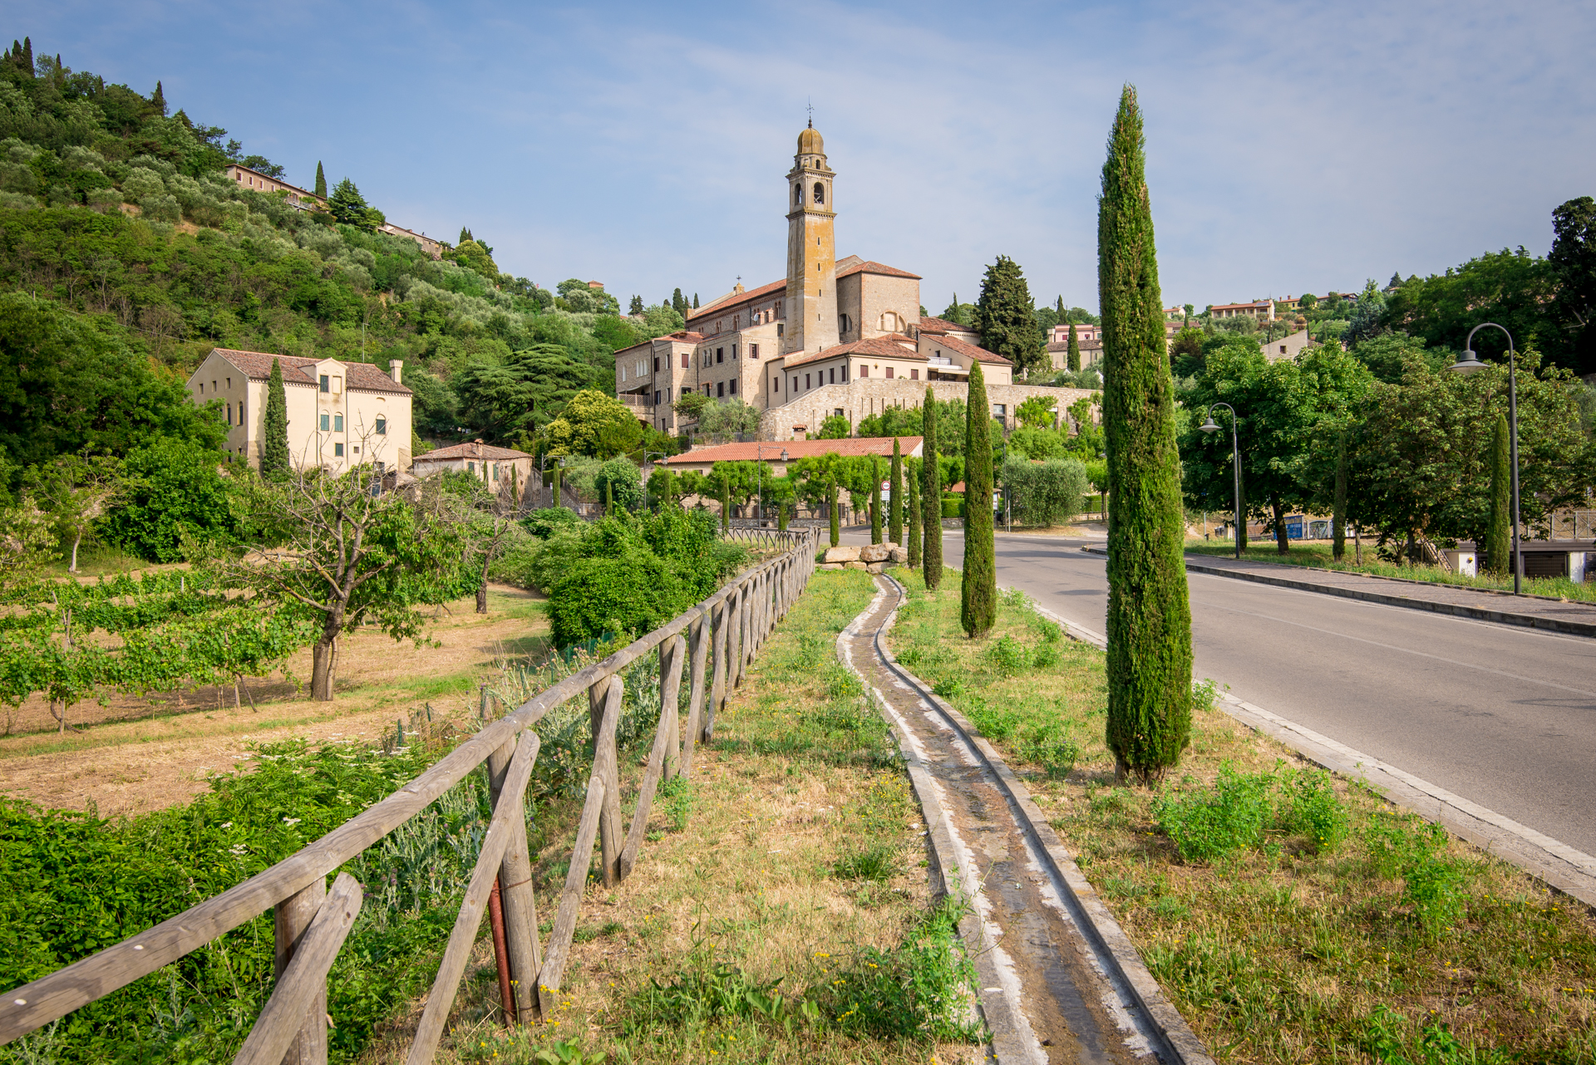
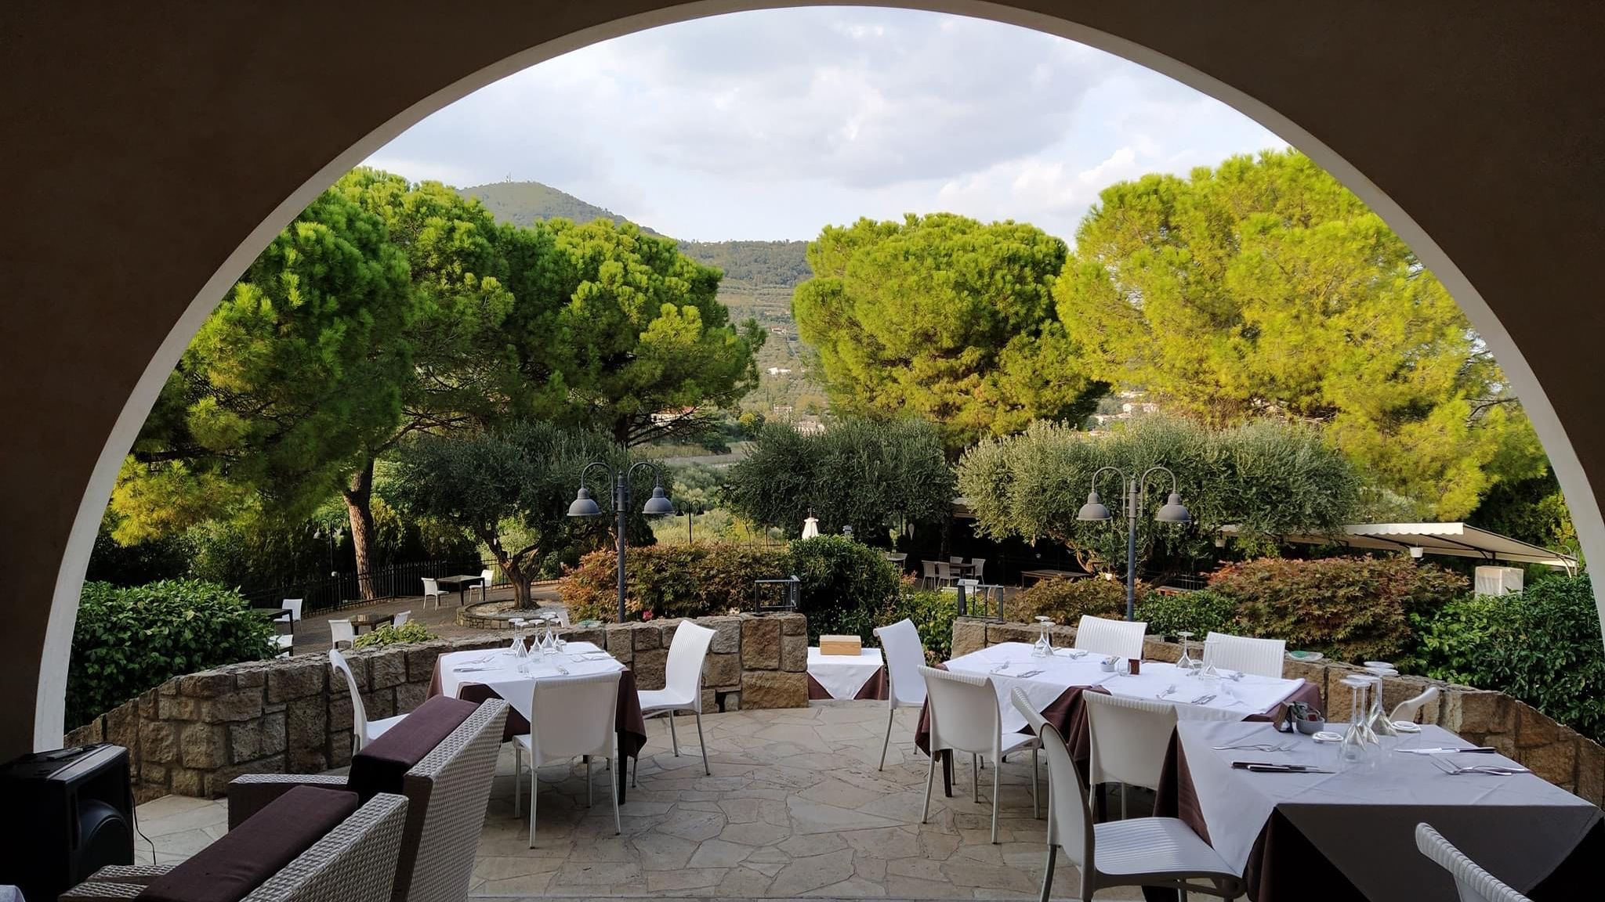
^{7th} Pre-PAC workshop for AGATA@LNL
INFN, Laboratori Nazionali di Legnaro
10-11, JULY 2025
WORKSHOP DINNER
Thursday, 10th July 8:30 p.m.
Restaurant «Il Canzoniere»
(Arquà Petrarca)

Slide 4
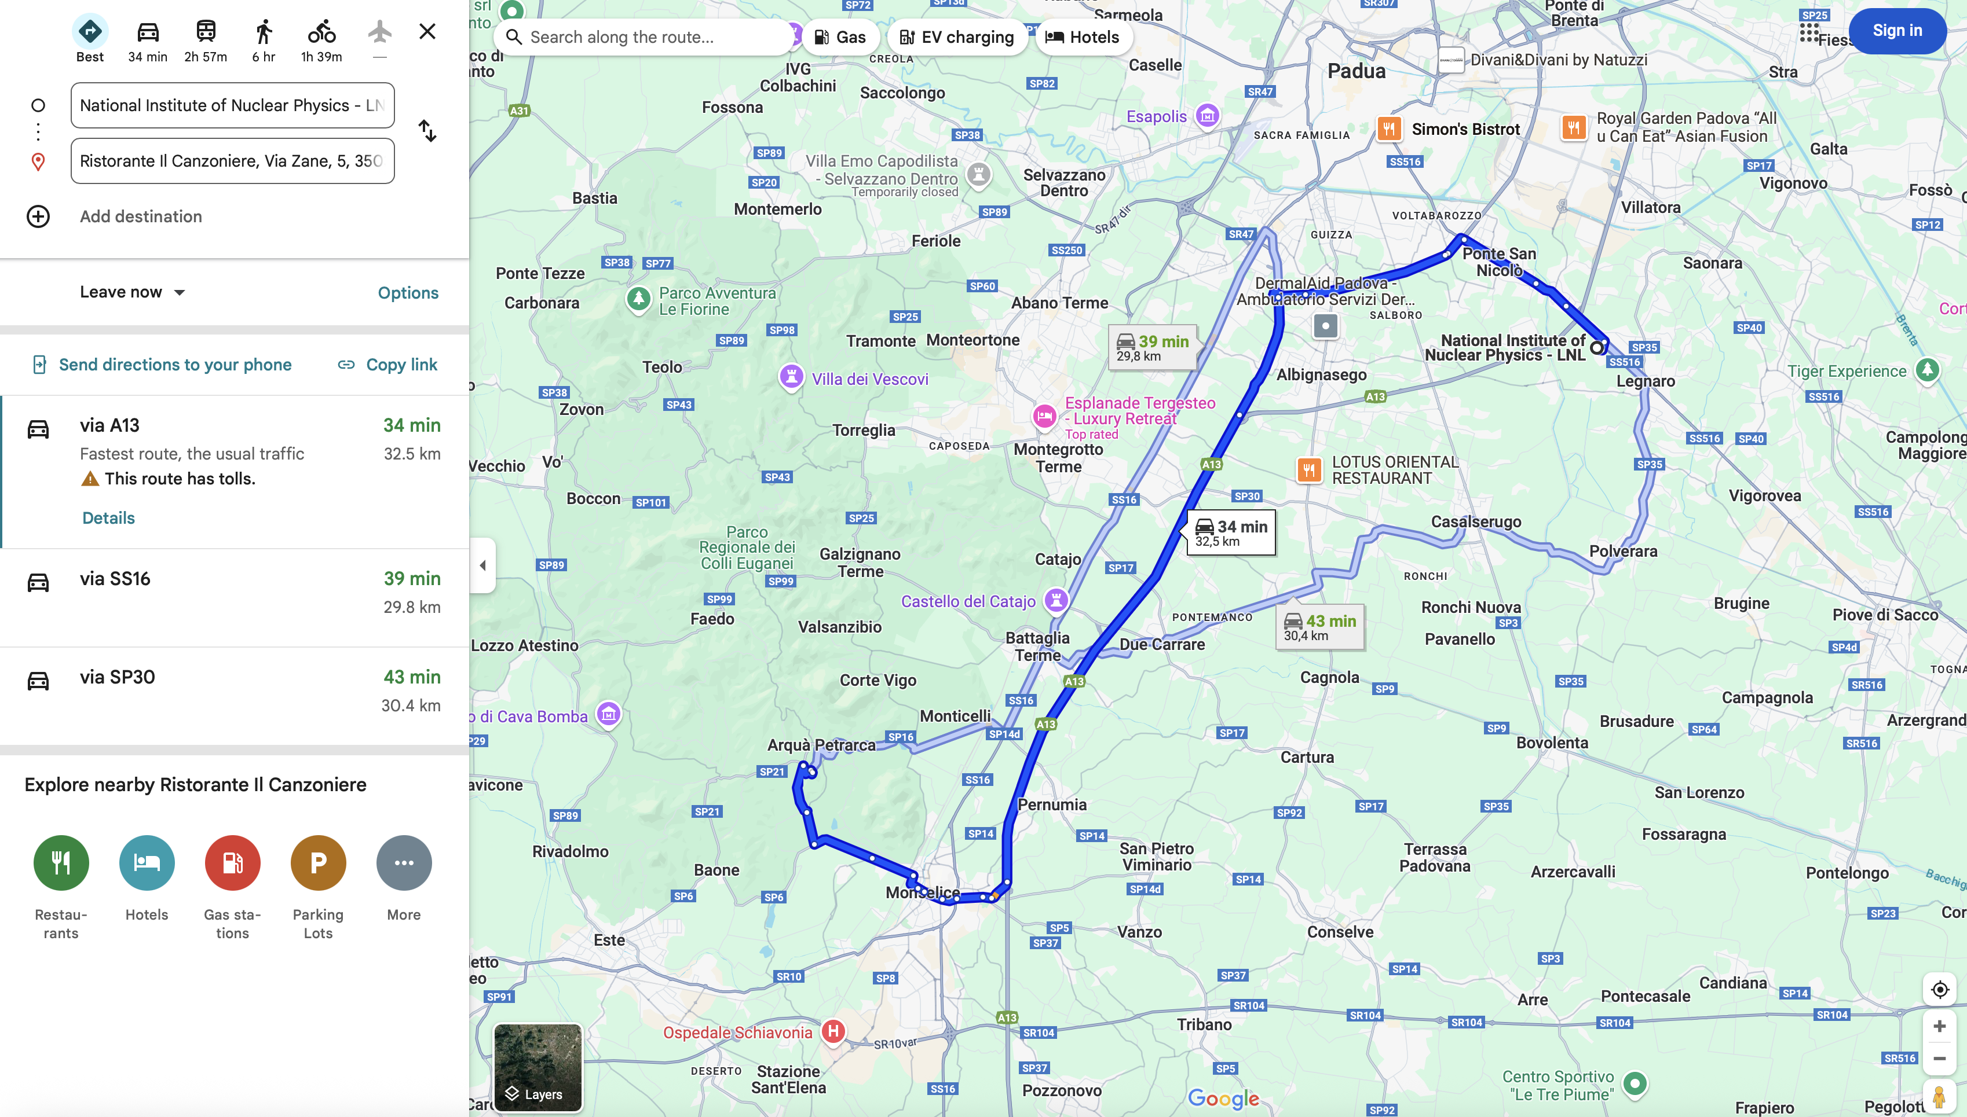
^{7th} Pre-PAC workshop for AGATA@LNL
INFN, Laboratori Nazionali di Legnaro
10-11, JULY 2025
WORKSHOP DINNER
We will go by car leaving from LNL around 19:30
Drivers:
Filippo Angelini (x4)
(Giovanna Benzoni (x4))
Simone Bottoni (x4)
Giacomo de Angelis (x4)
Franco Galtarossa (x2)
Alain Goasduff (x4)
Daniele Mengoni (x4)

