Slide 1
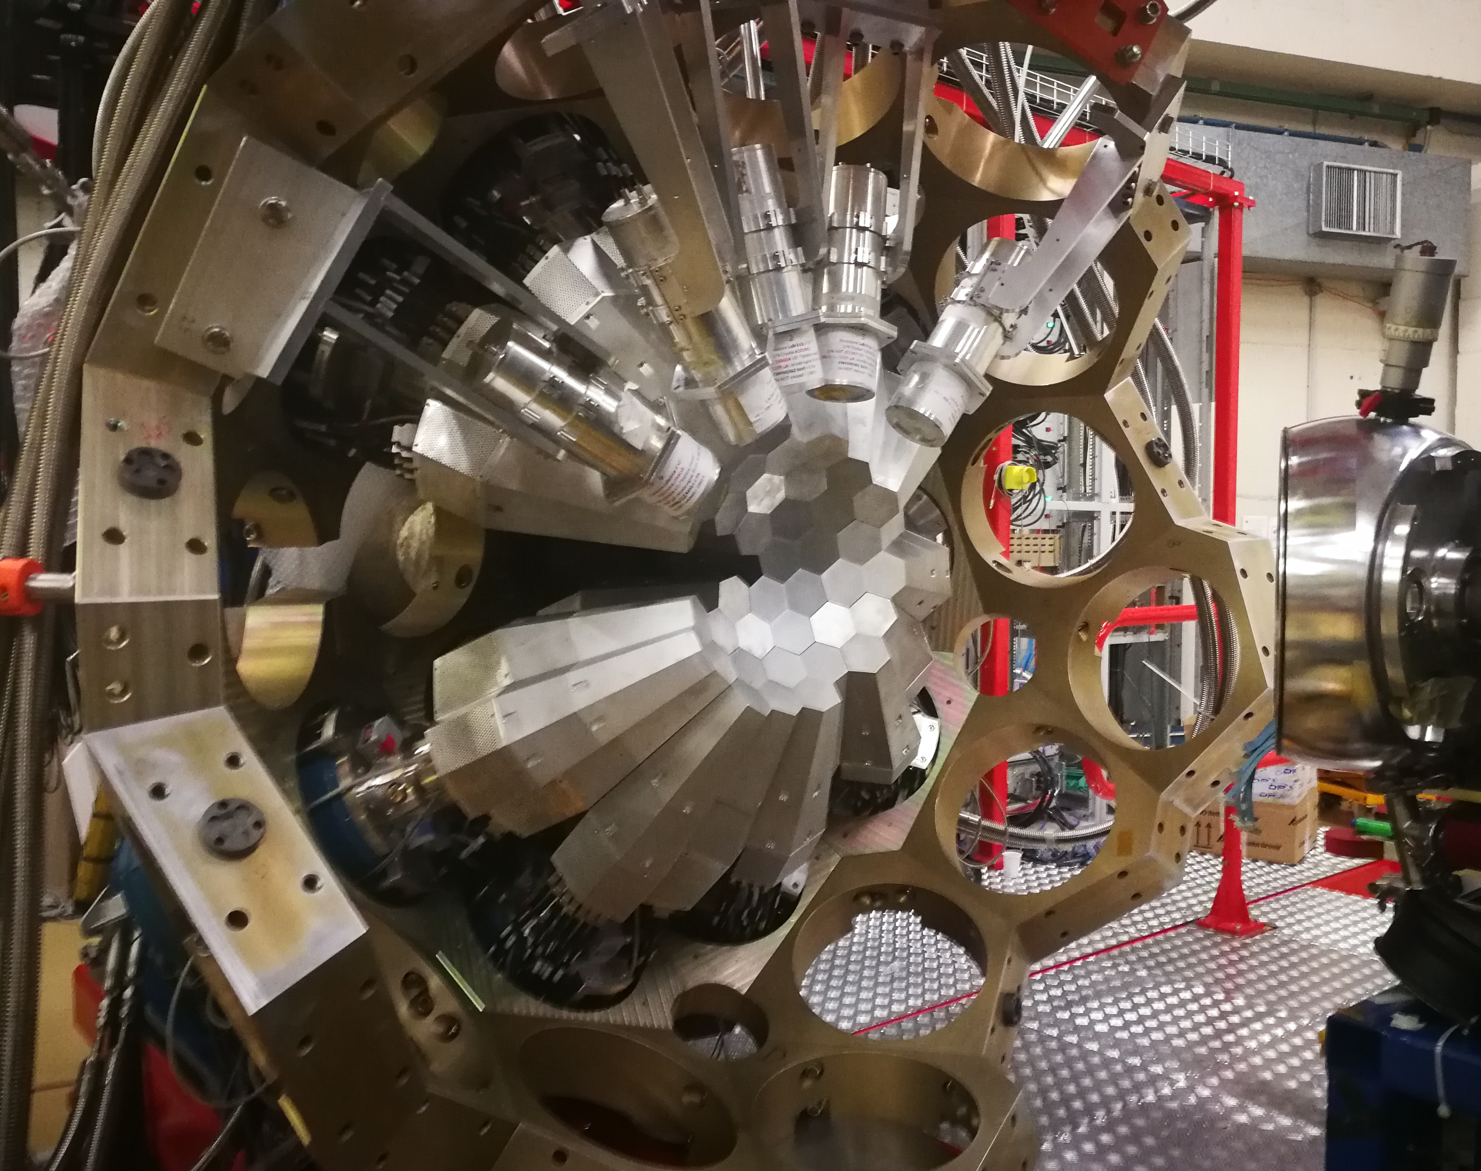
AGATA Status
AGATA 7th pre-PAC
July 10-11 2025
A. Goasduff

Slide 2
Future Campaign
Last Pre-PAC PRISMA-AGATA 10-11 July 2025
 | Jan. | Feb. | Mar. | Apr. | May | Jun. | Jul. | Aug. | Set. | Oct. | Nov. | Dec.
2025 |  | TANDEM |  |  |  | TANDEM |  |  |  | TANDEM
2026 | TANDEM |  | TANDEM/PIAVE-ALPI |  |  |  |  | MOVE TO 0 DEG
2027 |  | PARIS? NEDA? |  |  |  |  |  |  |  | NEDA? PARIS?
2028 |  | NEDA? PARIS? |  |  |  |  |  | MOVE TO GANIL

Slide 3
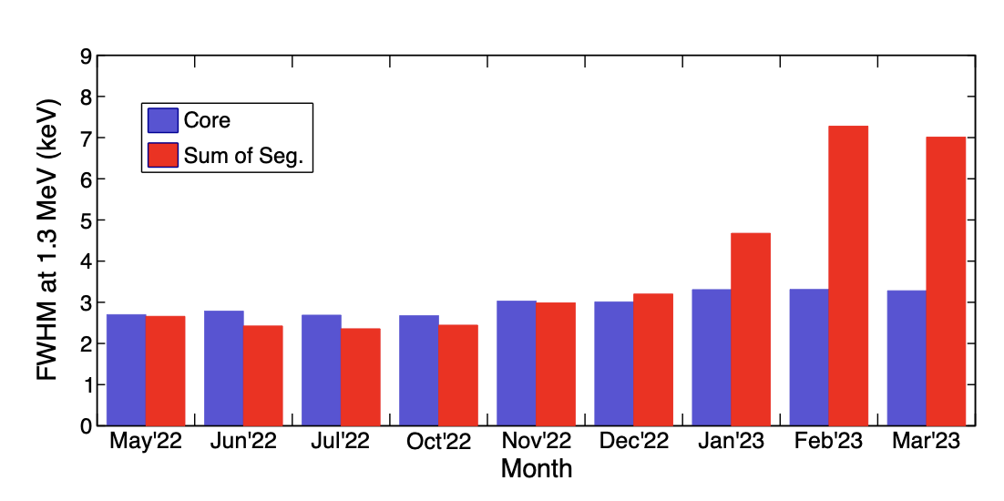
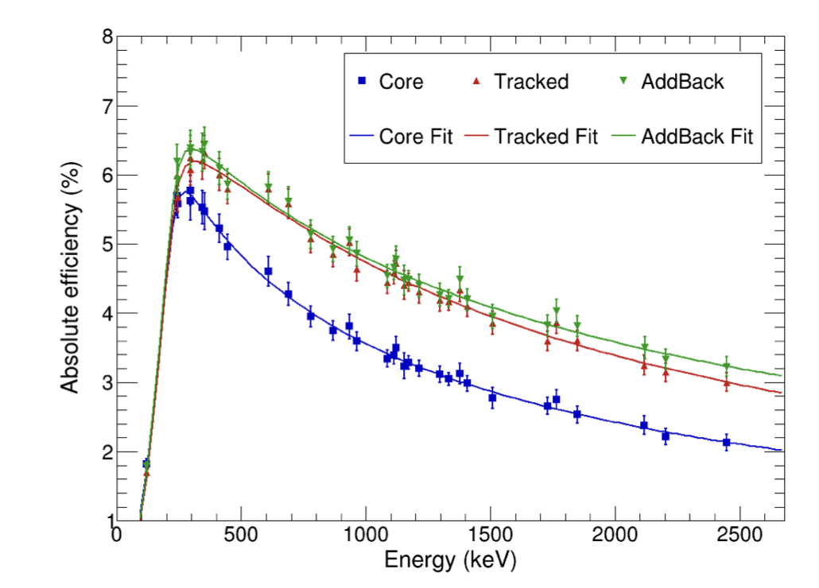
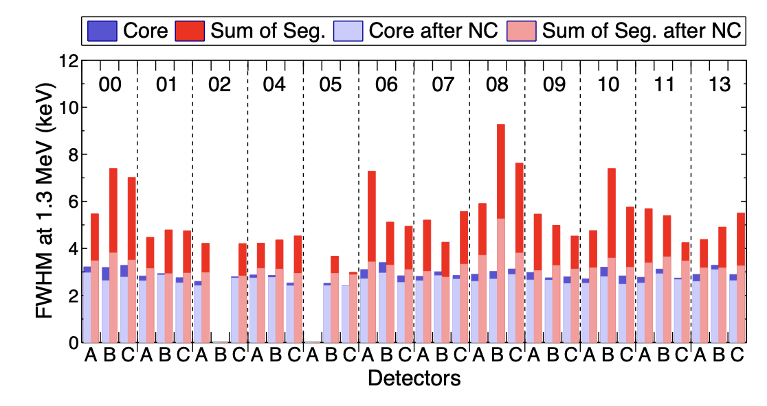
AGATA PERFORMANCES
Courtesy of R.M. Perez Vidal – J. Pellumaj

Slide 4
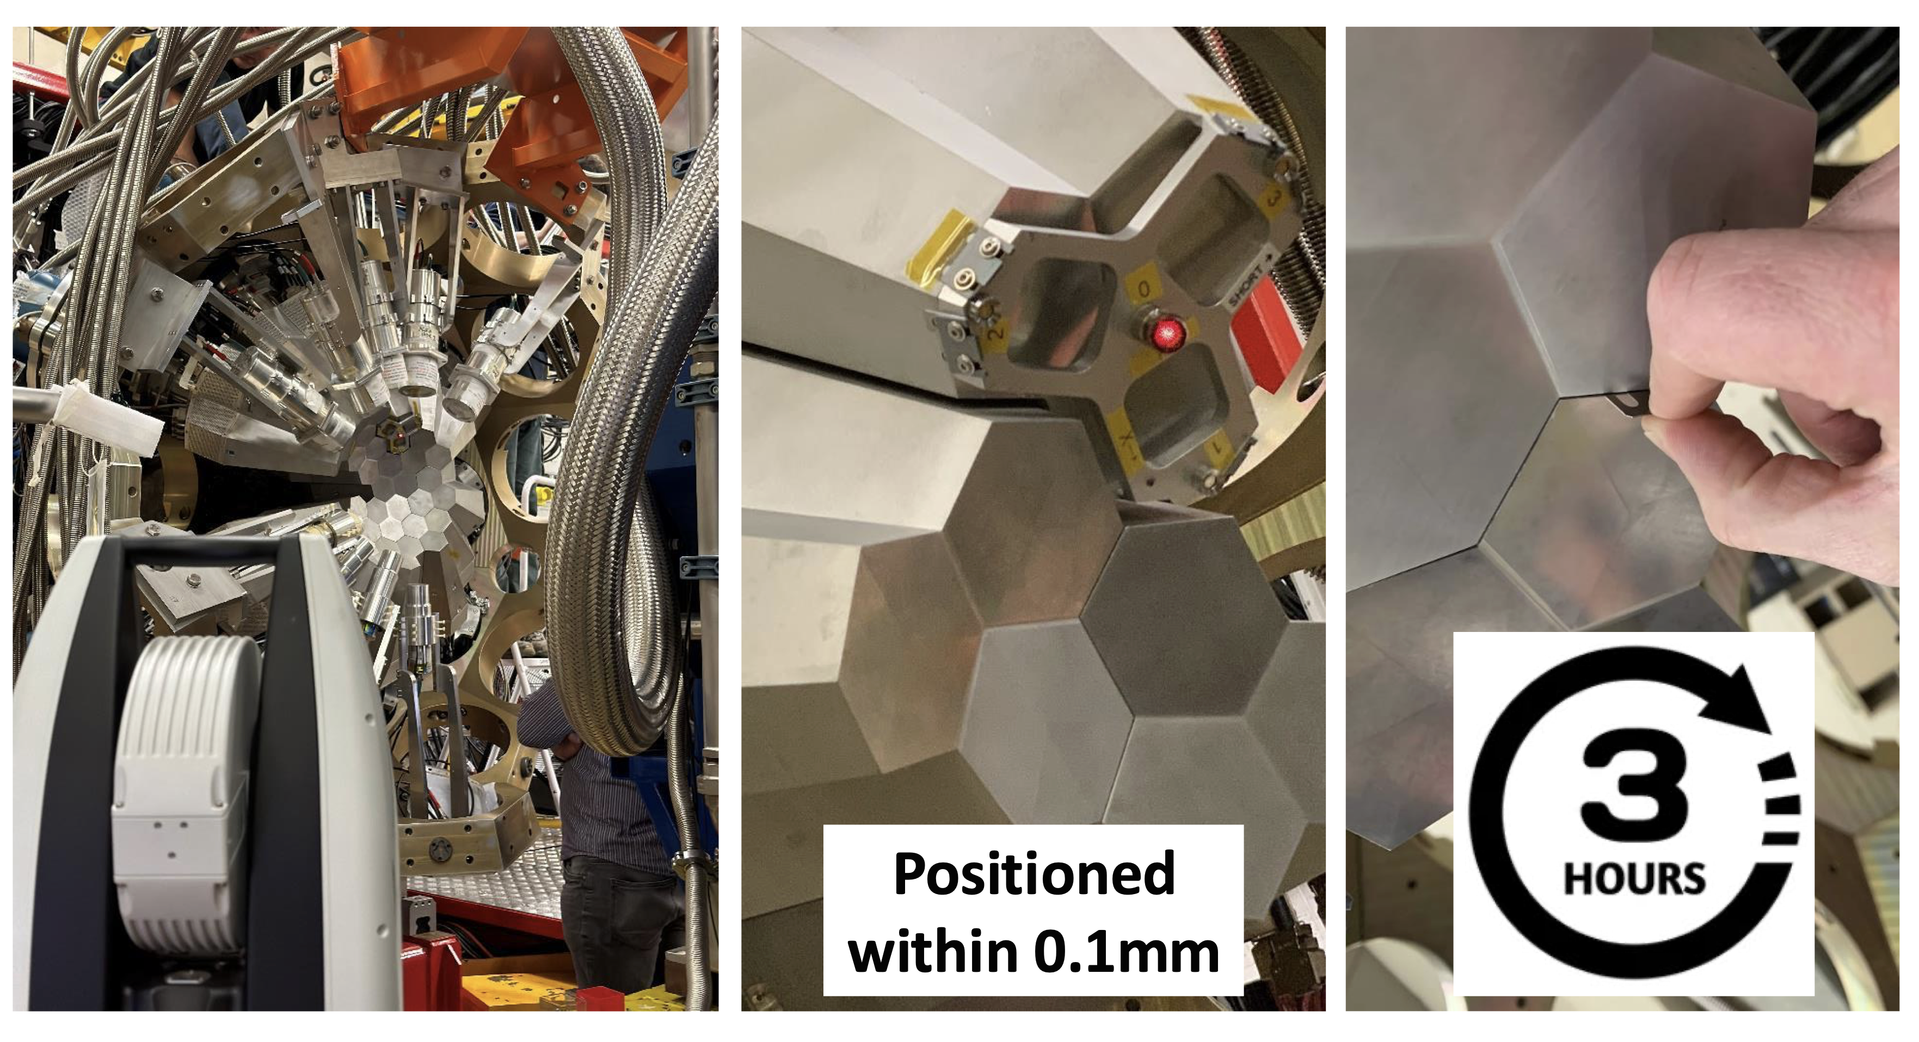
AGATA Detectors replacement
Courtesy of W. Raniero, D. Scarpa

Slide 5
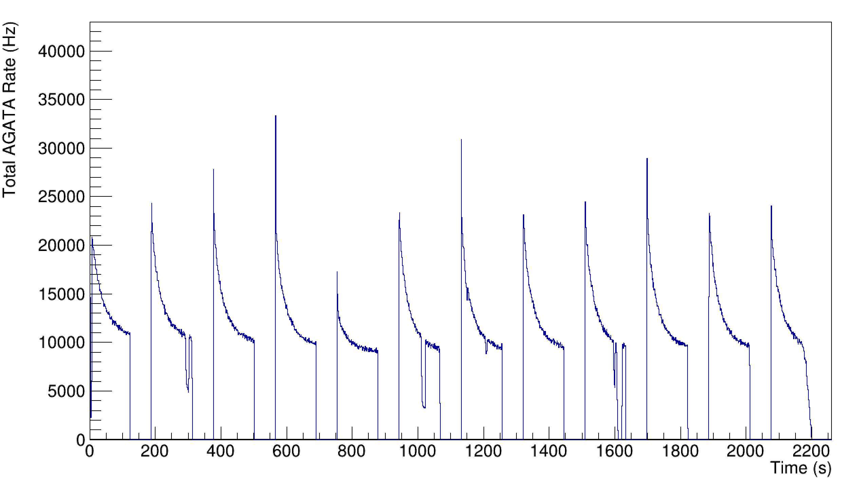
Electronics
New hardware trigger for ancillary detectors / external gate
Acting directly on the local trigger of the ATC crystals
Suppression of the dead-time due to the AGAVA for Si detectors
Possibility to condition the AGATA acquisition with beam-on/beam-off
Working on fold determination
Available V1 channels: 33 crystals (11 ATC)
V2 electronics:
Production (ADC boards / PACE / STARE / mechanics) on track
Data transmission tests through complex network infrastructures tested at IJCLab
Validation of the PACE data processing firmware on-going
Integration of the new electronic in the GTS in progress

Slide 6
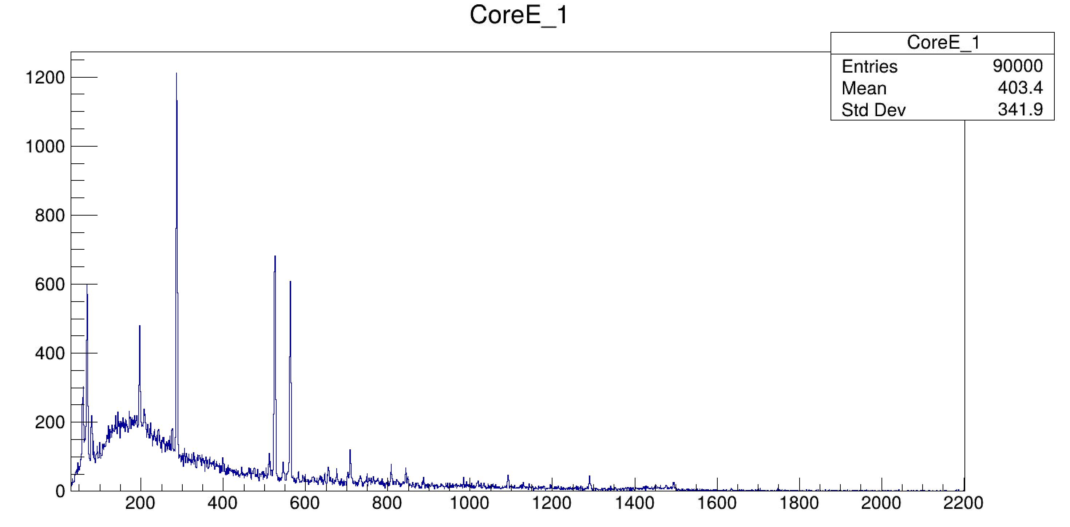
Electronics
First in-beam data taken with the V2 LNL - June 2025

Slide 7
DAQ & Near-line
Upgrade of the disk system
From 120 TB to 300 TB avaible for experiment
New nearline servers: (gain of factor 10 on replay time)
10 Gbps connection to the disk
Test at the end of July of the nearline replay with docker-swarm (IP2I Lyon / G. Baulieu)
New metadata automatic generation:
HV status
Detector rates
DSS status
Electronic status

Slide 8
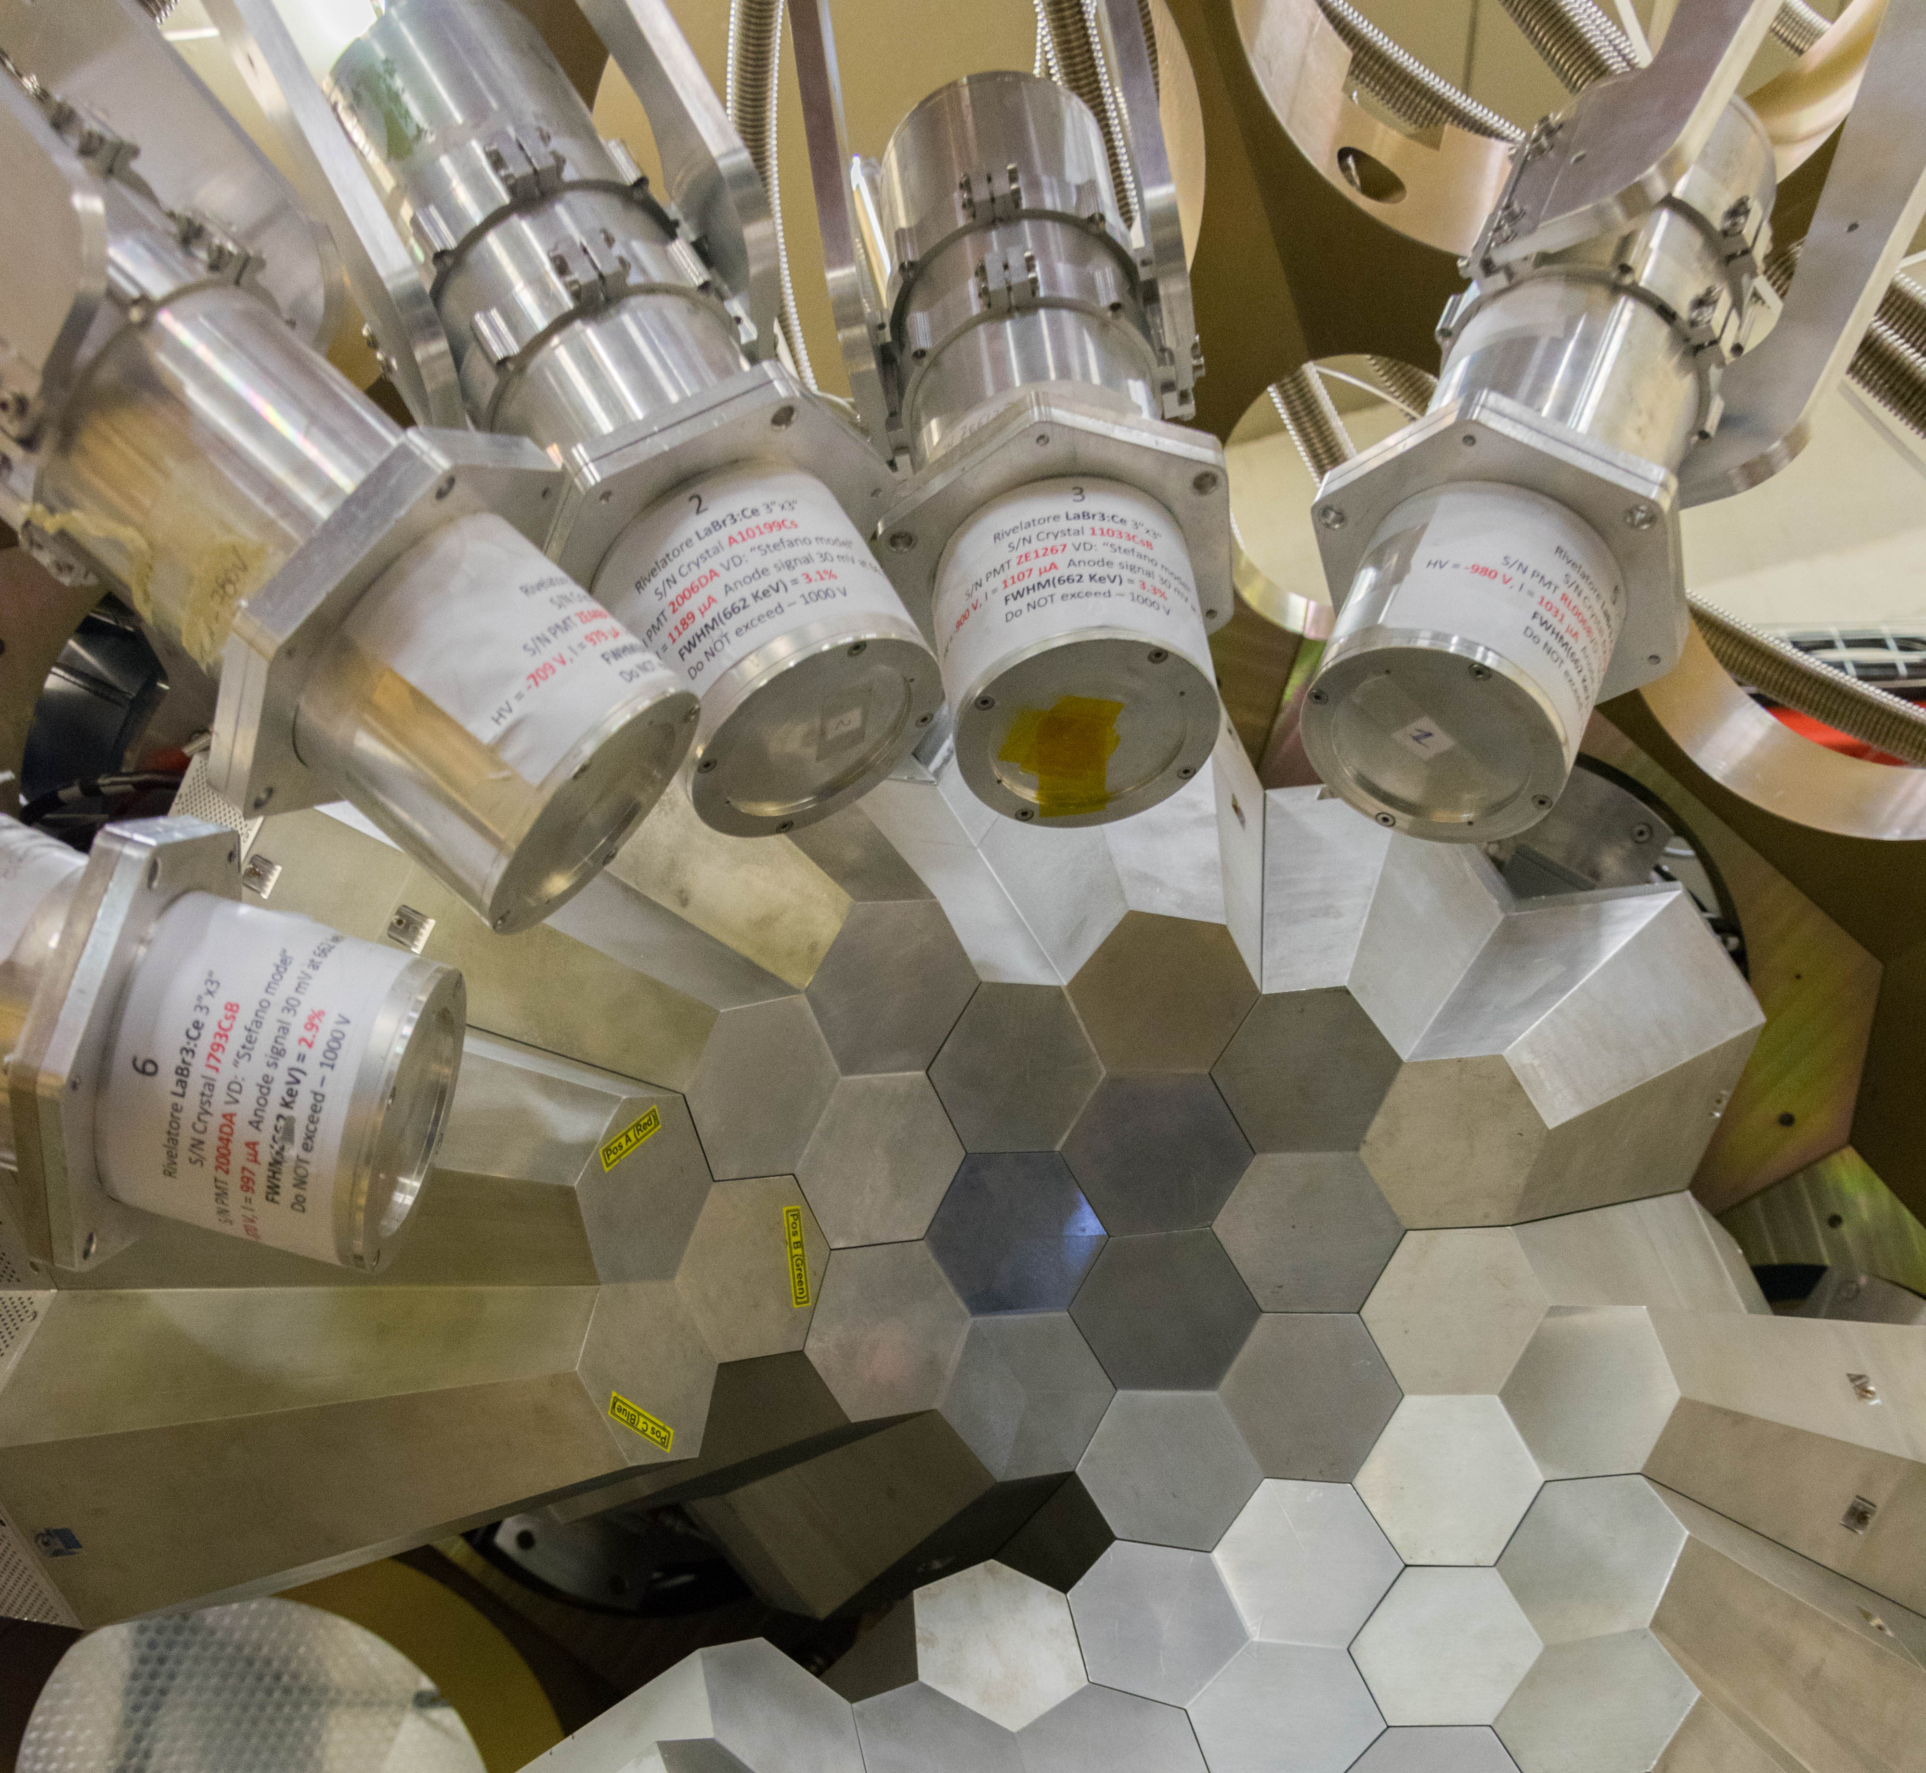
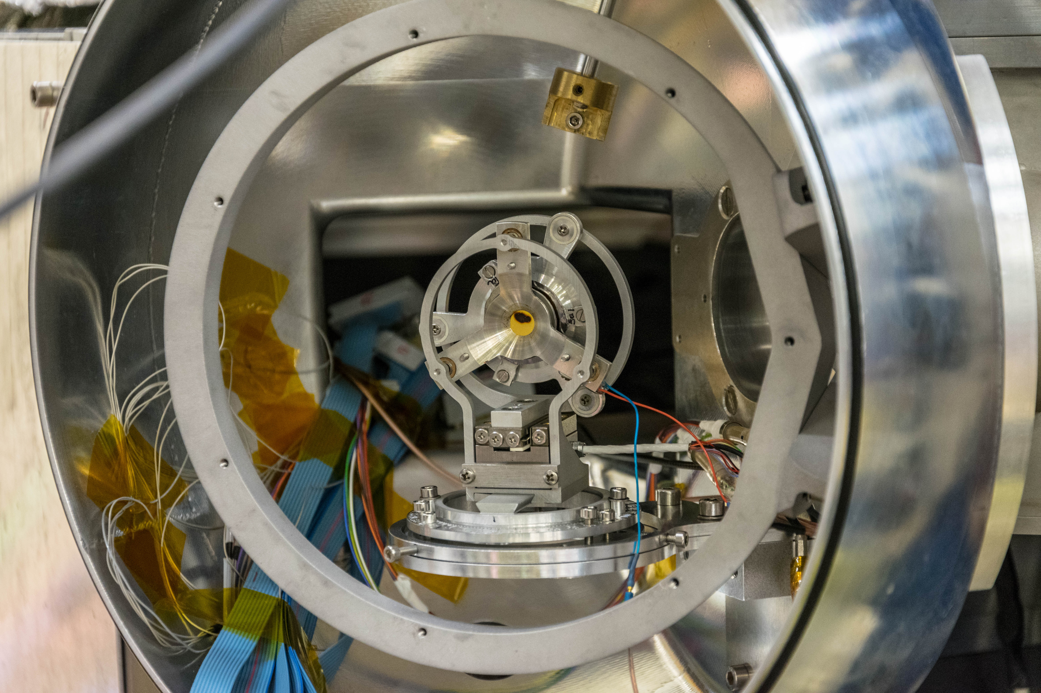
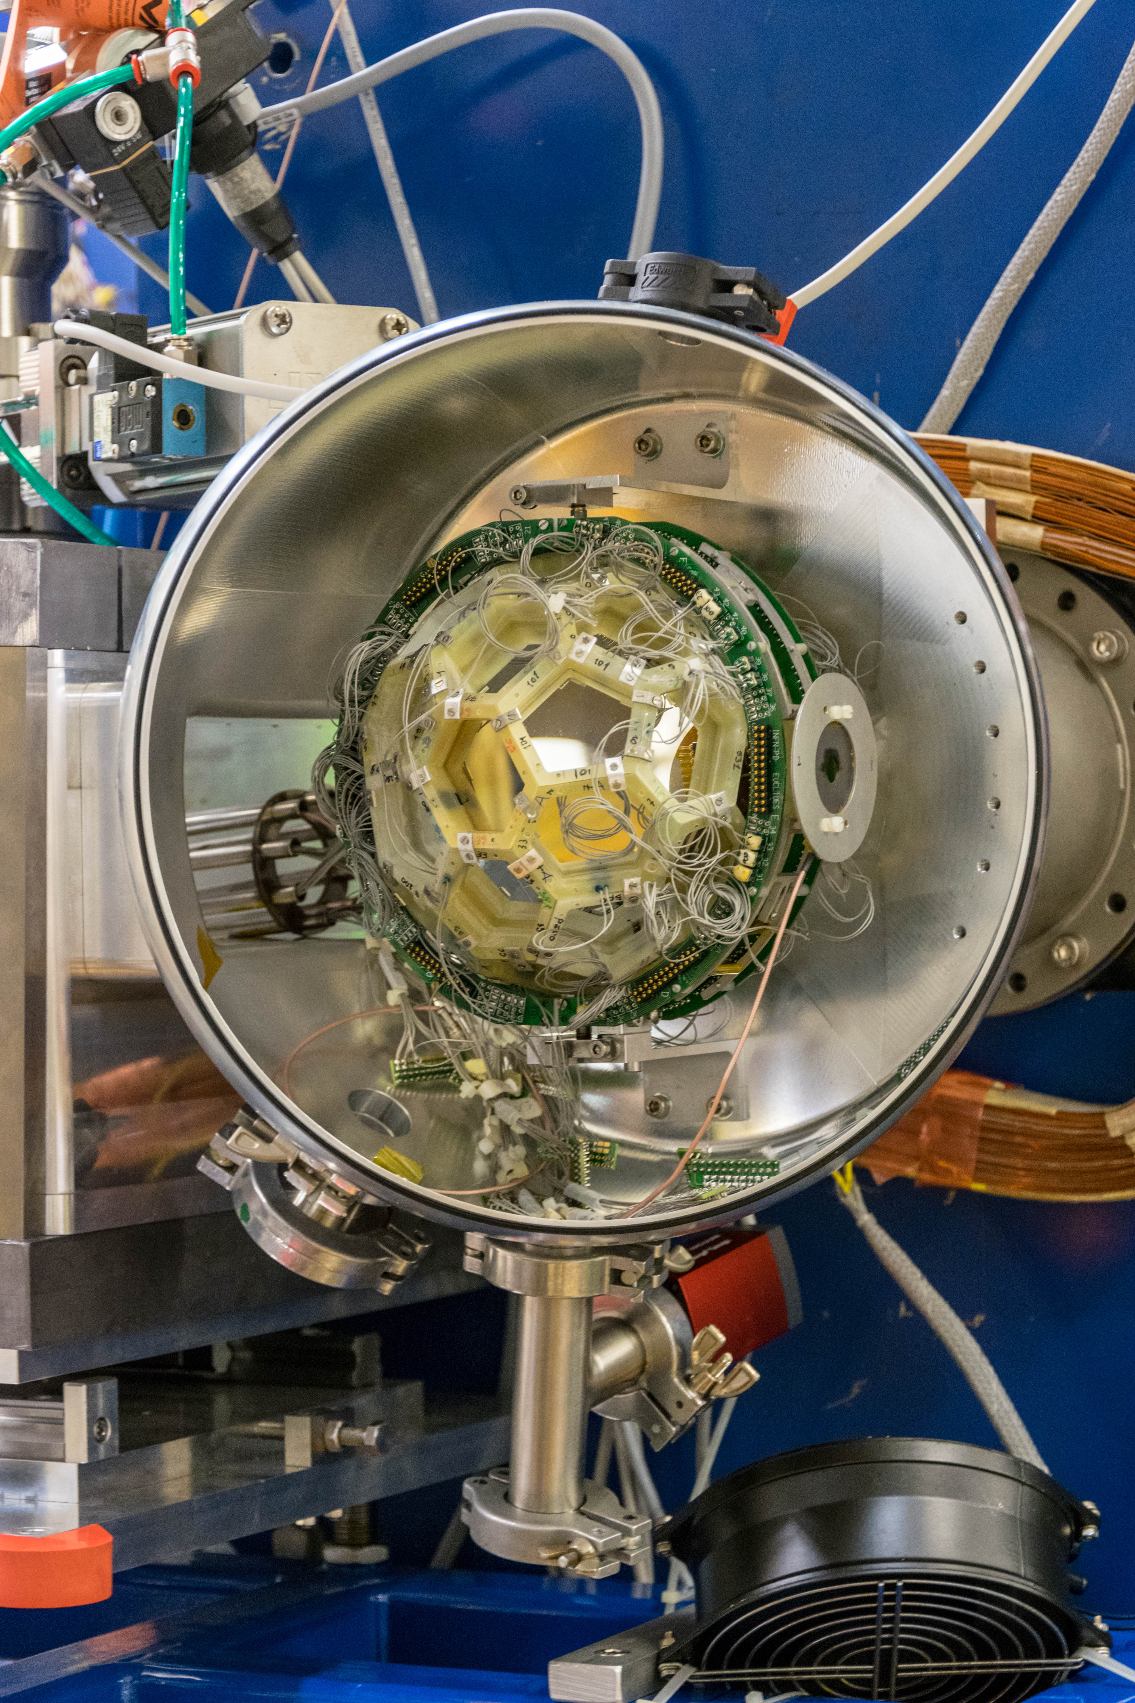
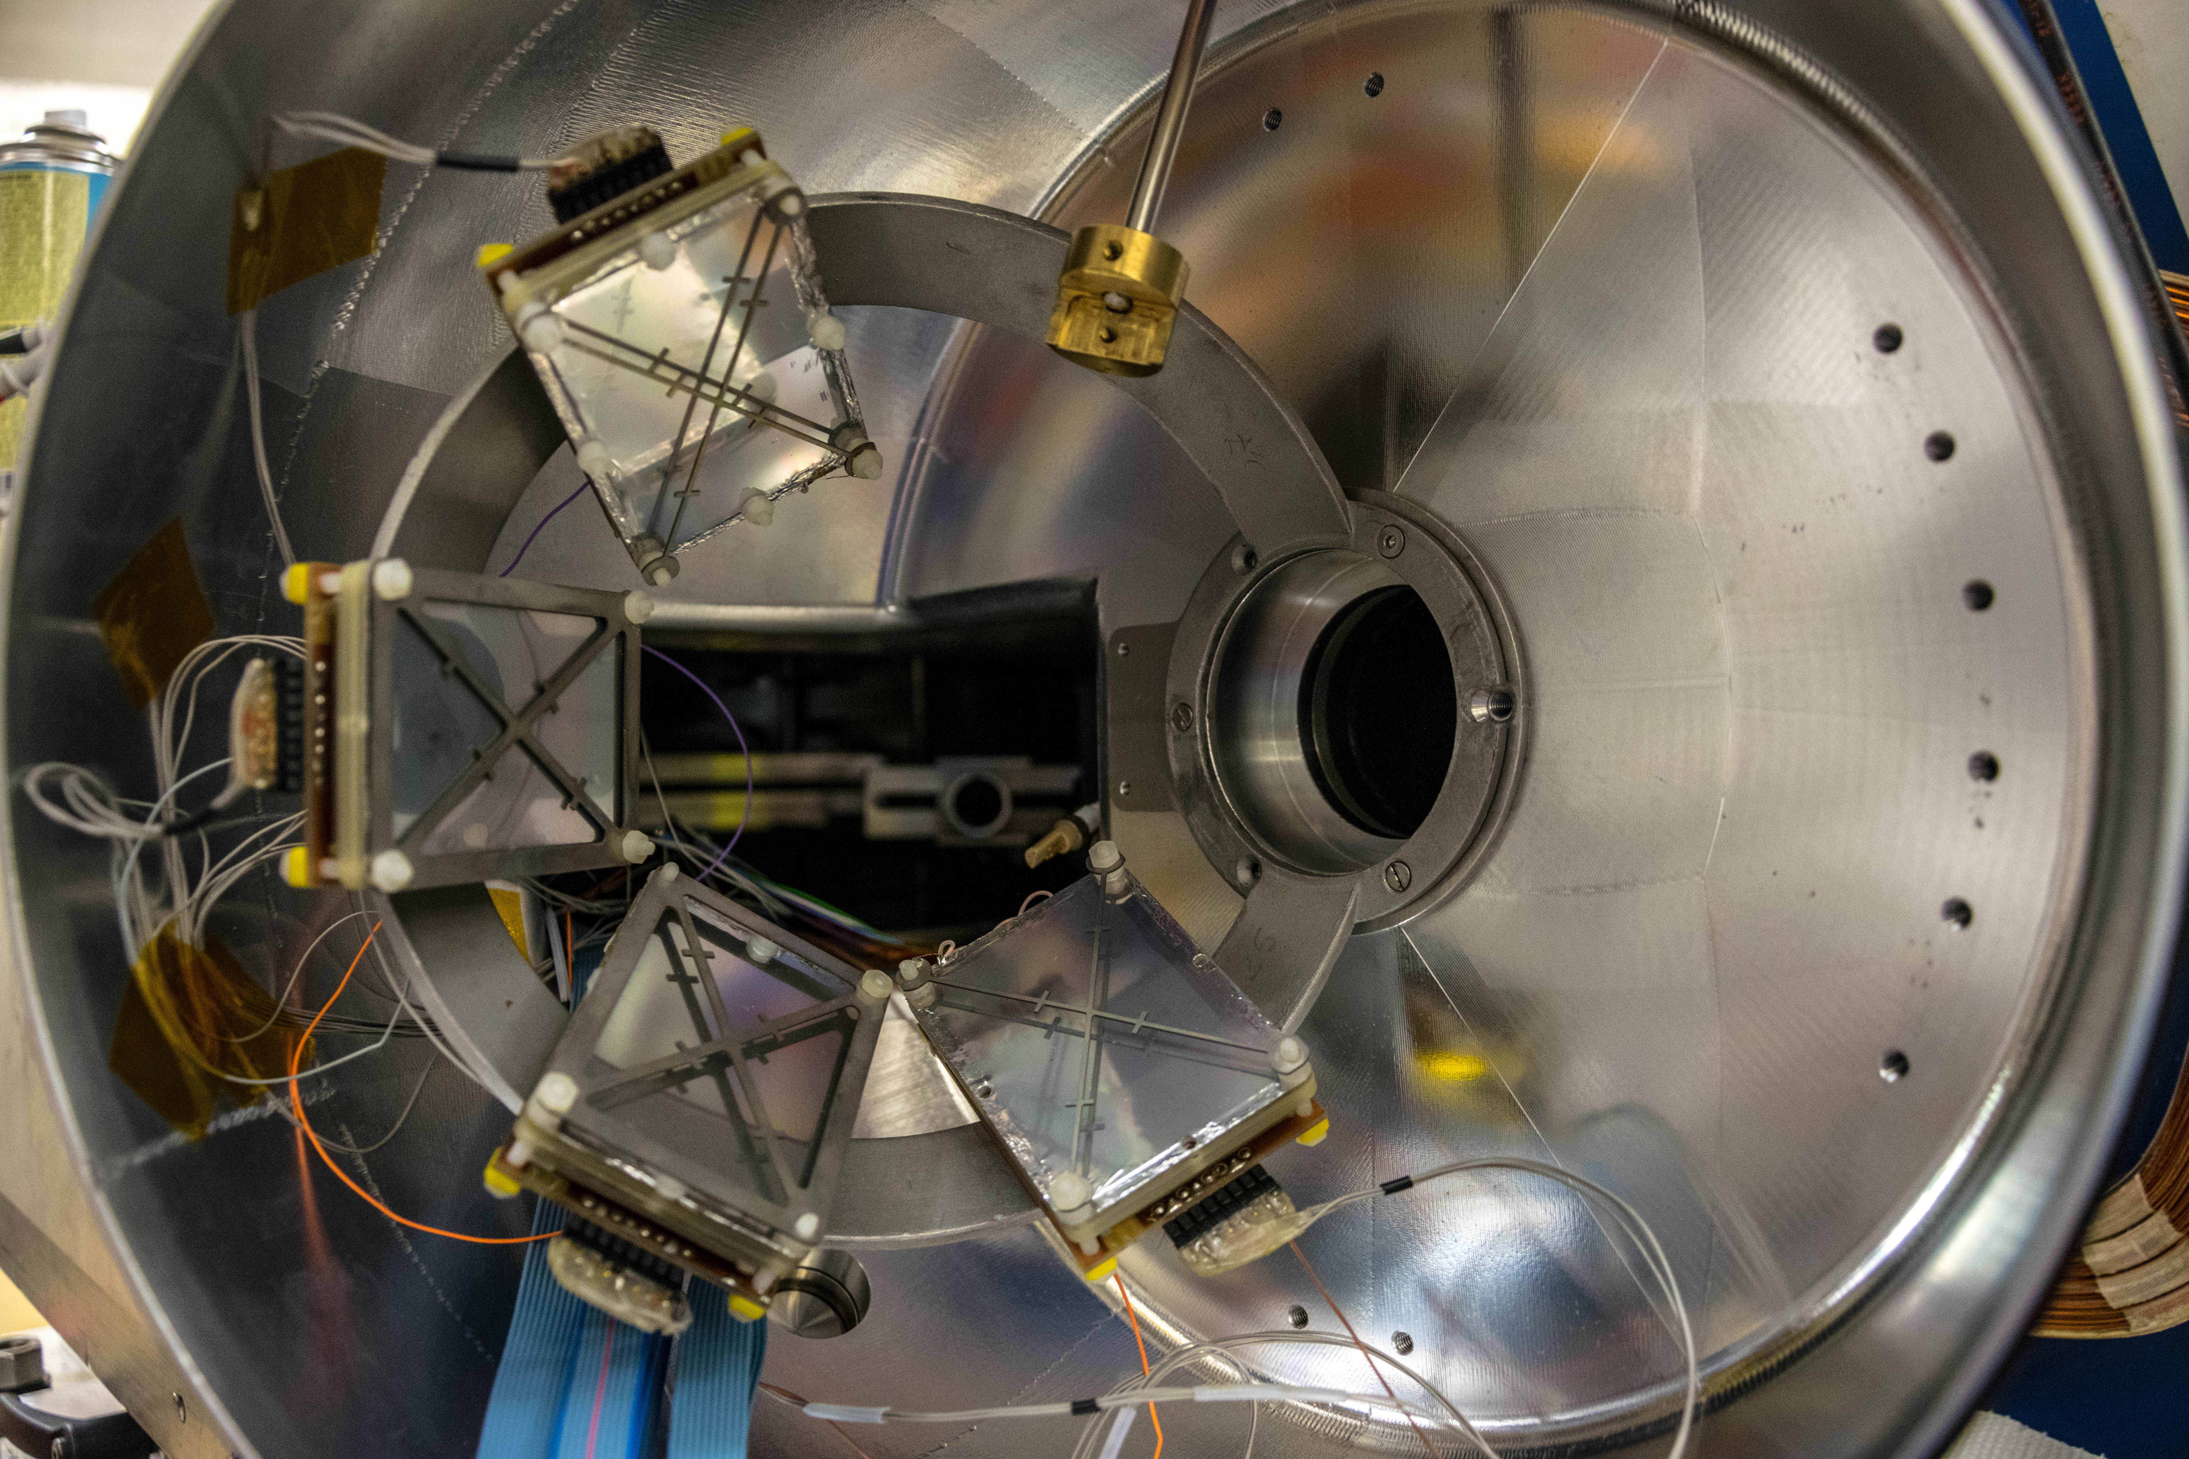
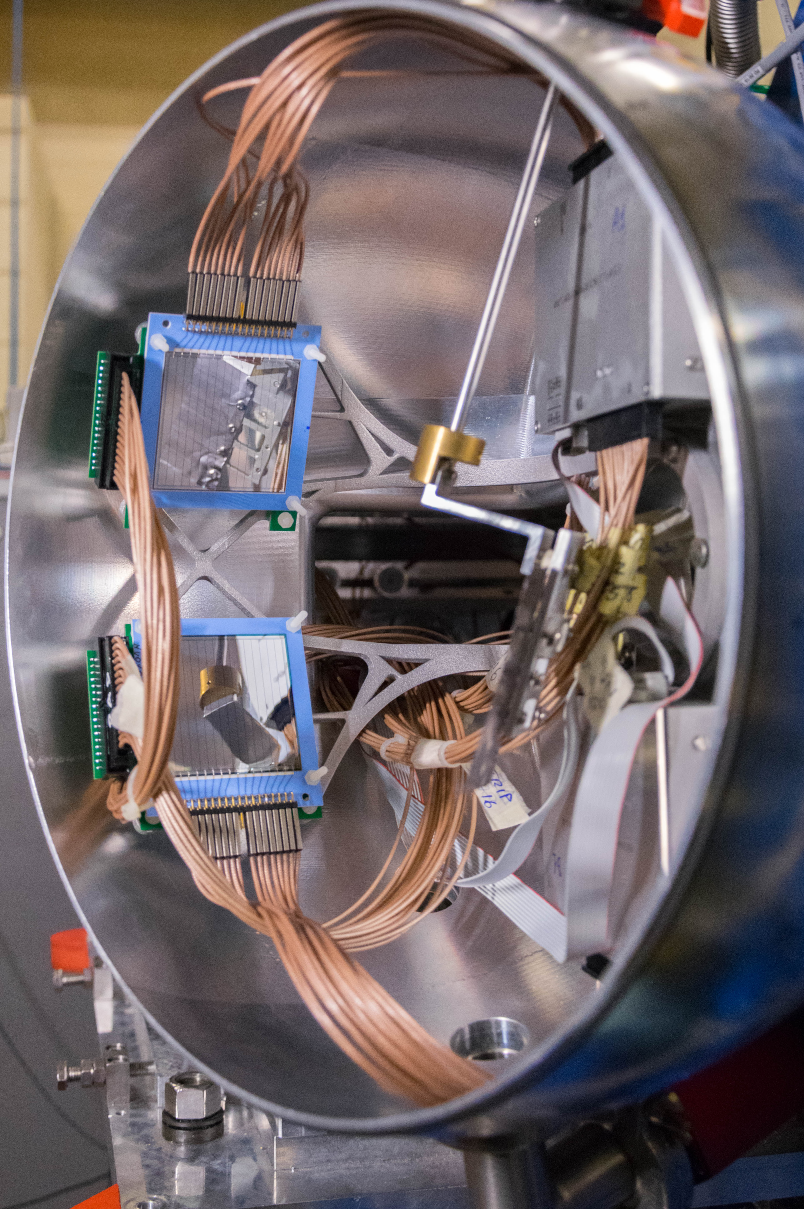
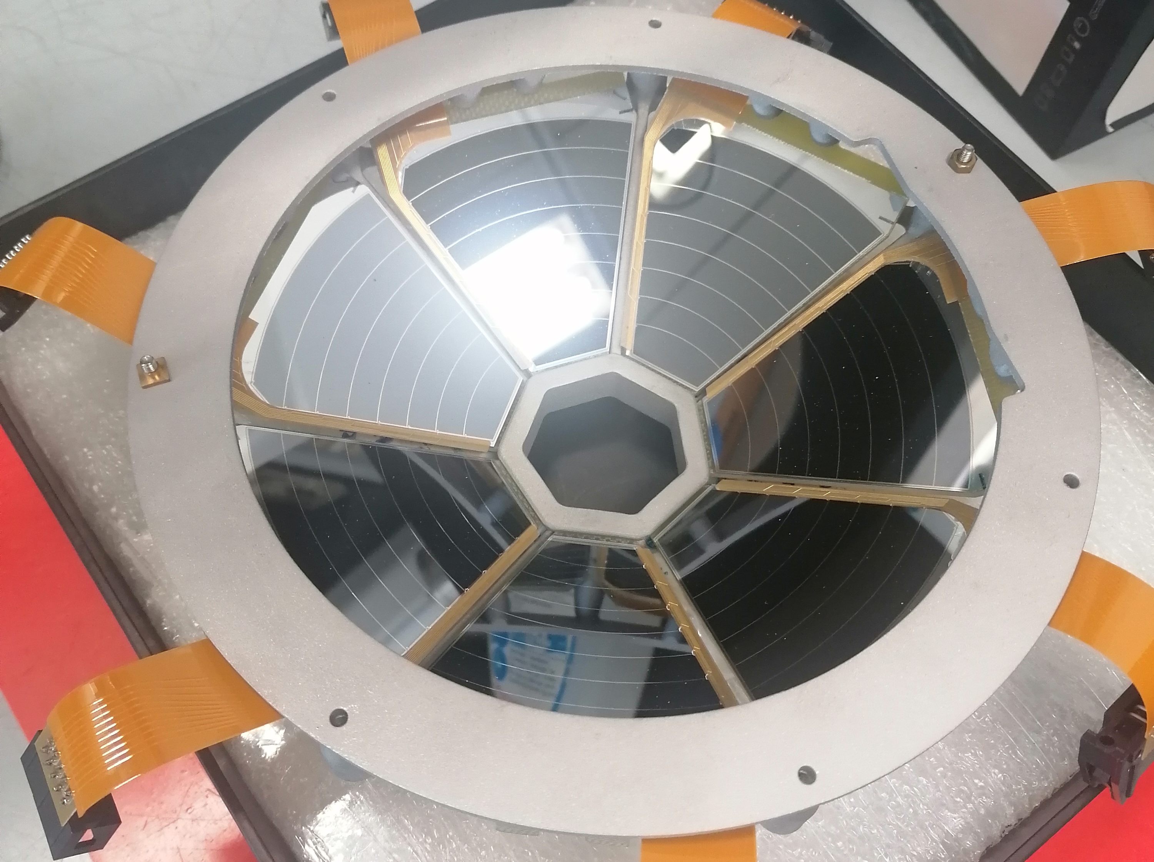
A wealth of Complementary detectors
Heavy ions:
PRISMA
SPIDER
DANTE
OSCAR
Light charged particles:
SPIDER
EUCLIDES
SAURON
Lifetimes
Plungers
Scintillators
LaBr₃
Light RIB from EXOTIC
Courtesy of M. Balogh

Slide 9
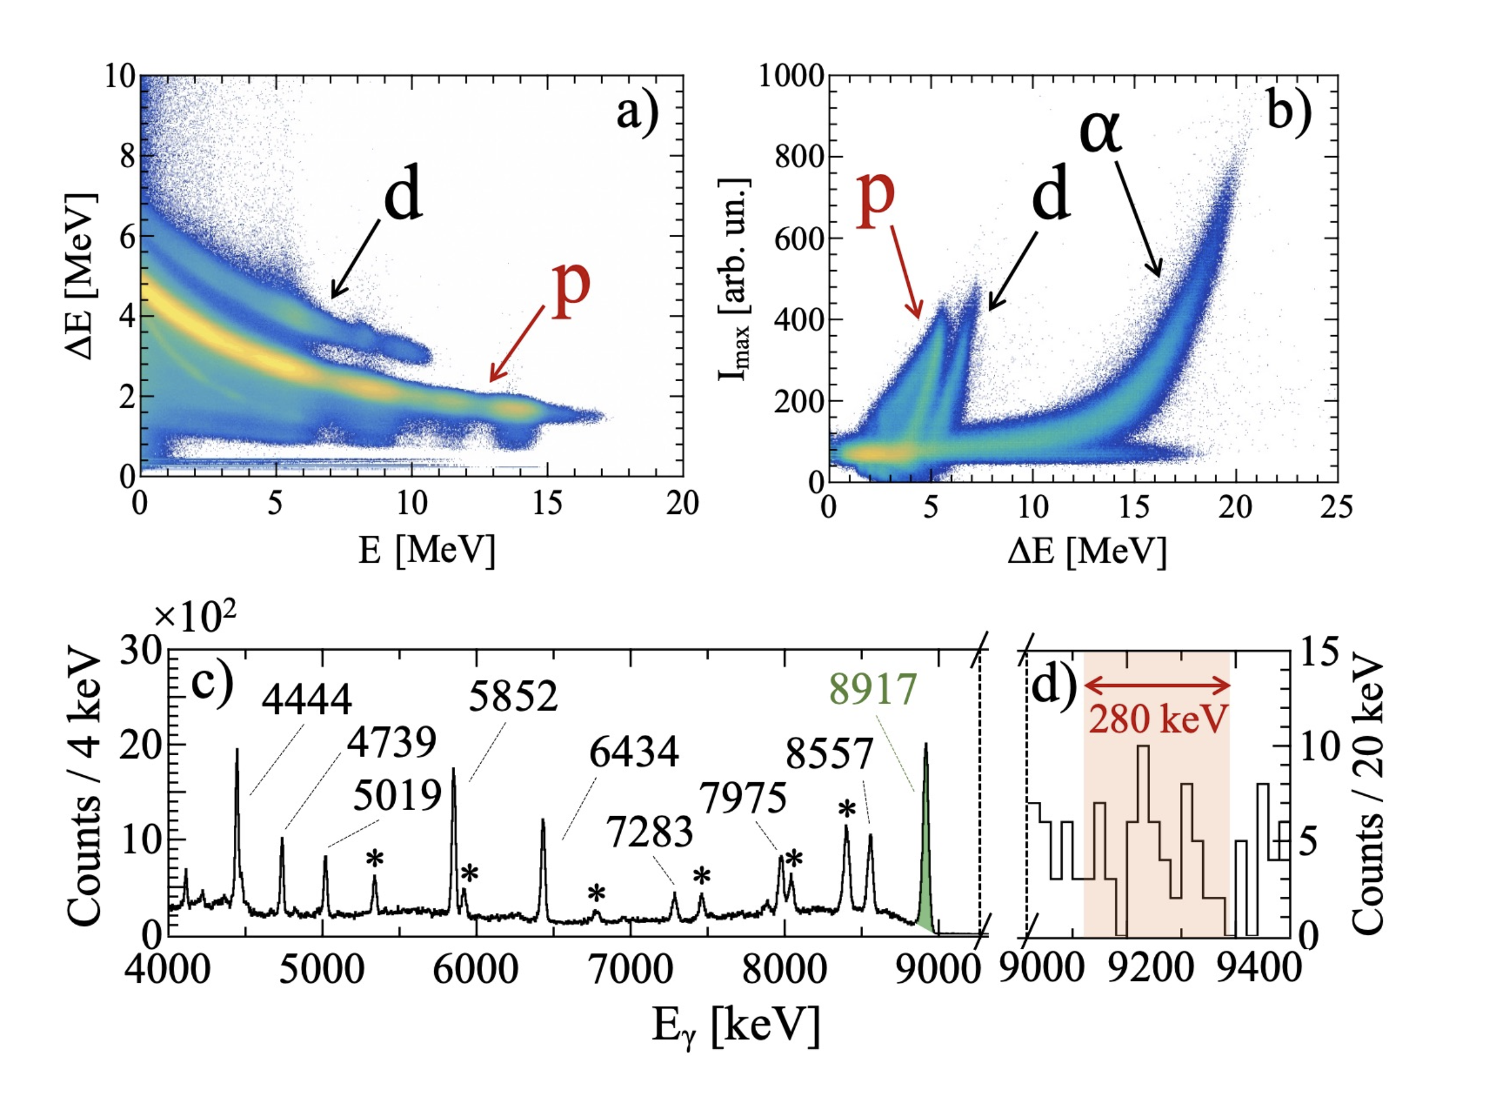
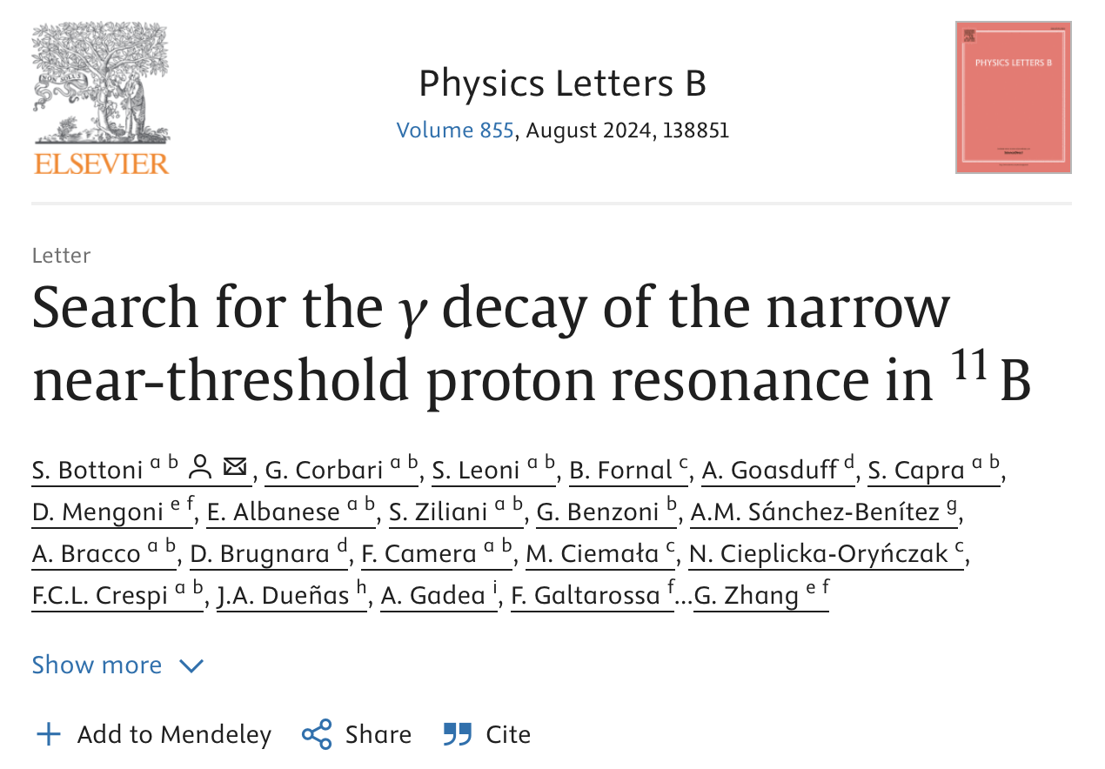
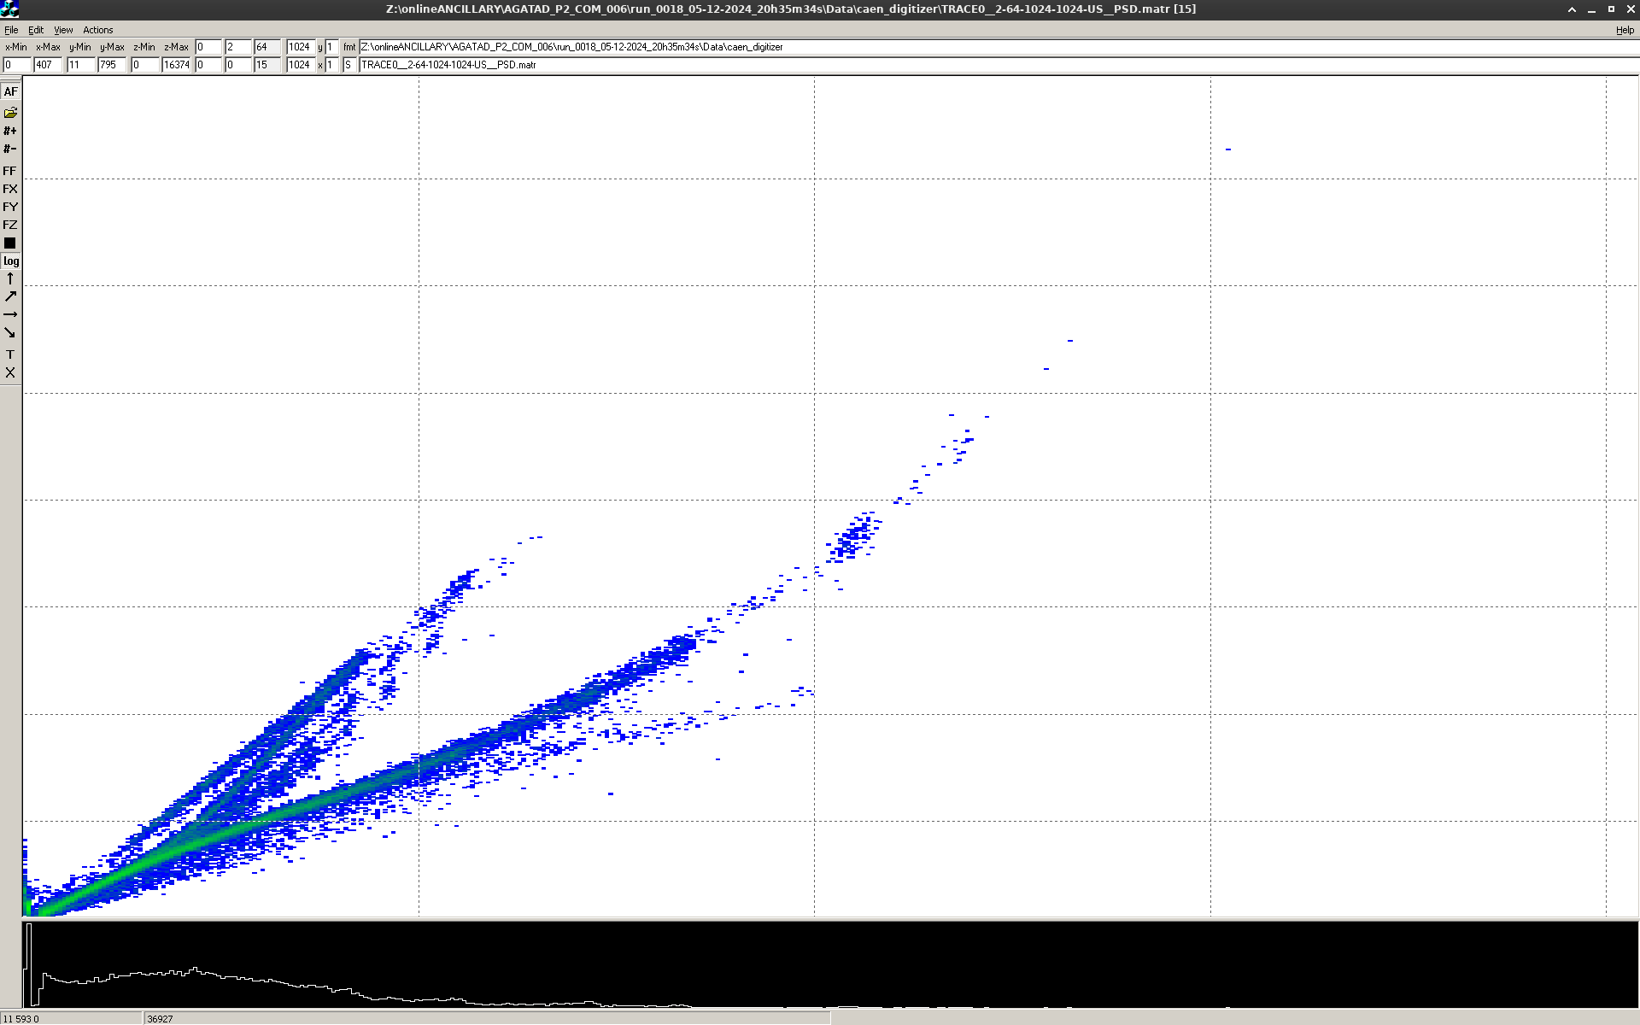
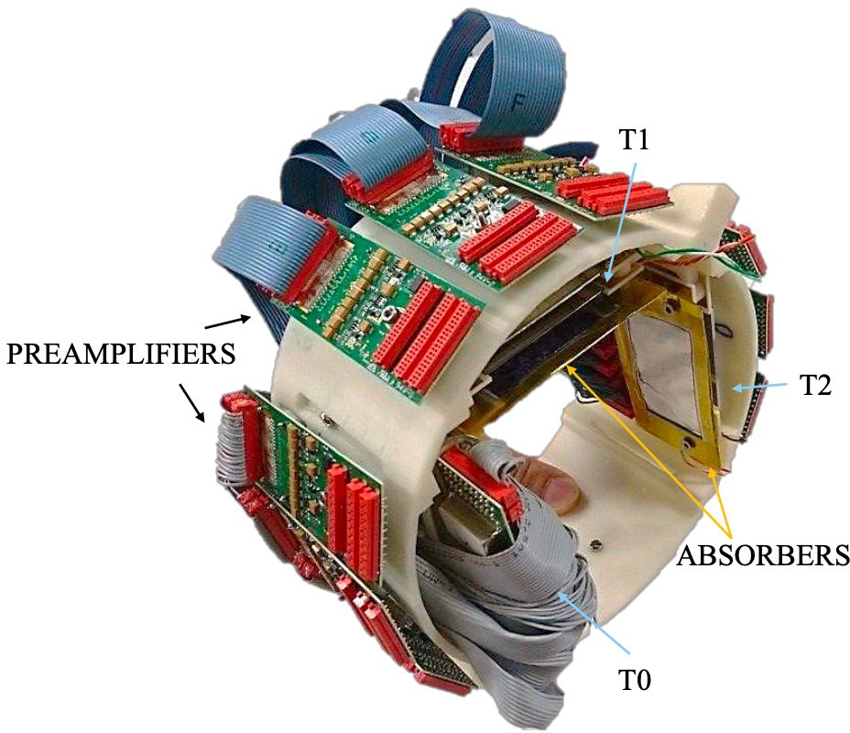
2025/2026 New additions
Online results of the dec-2024 test on PISOLO

Slide 10
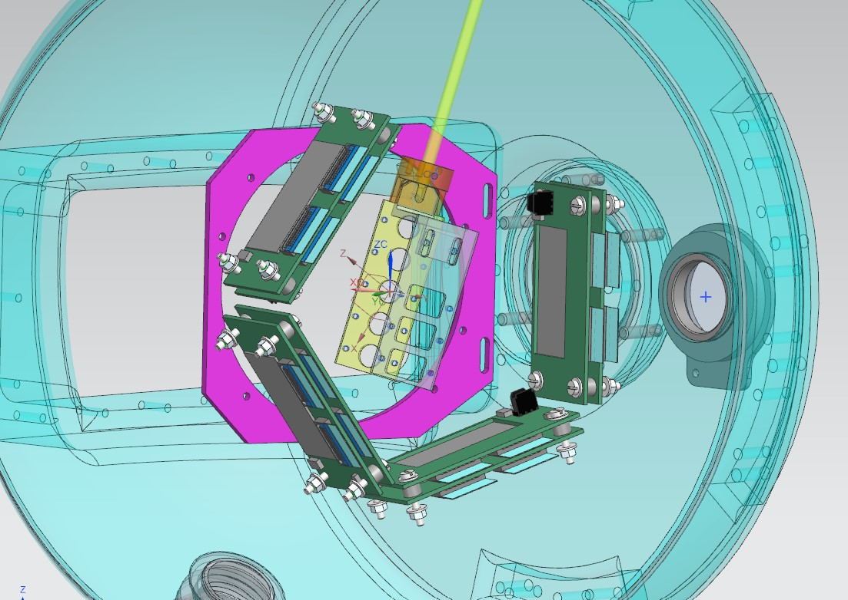
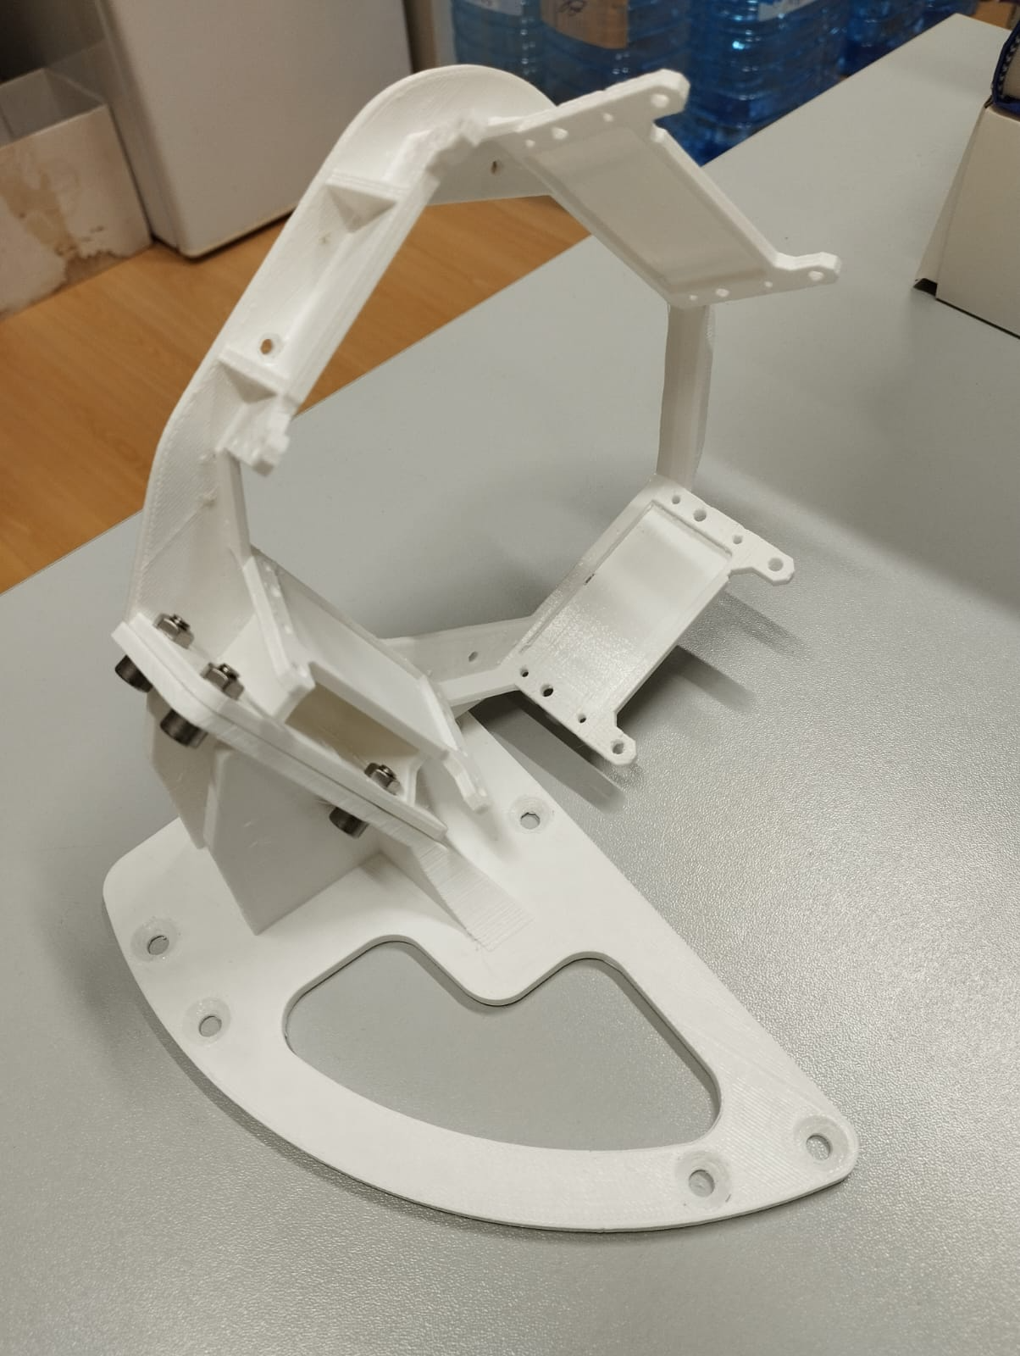
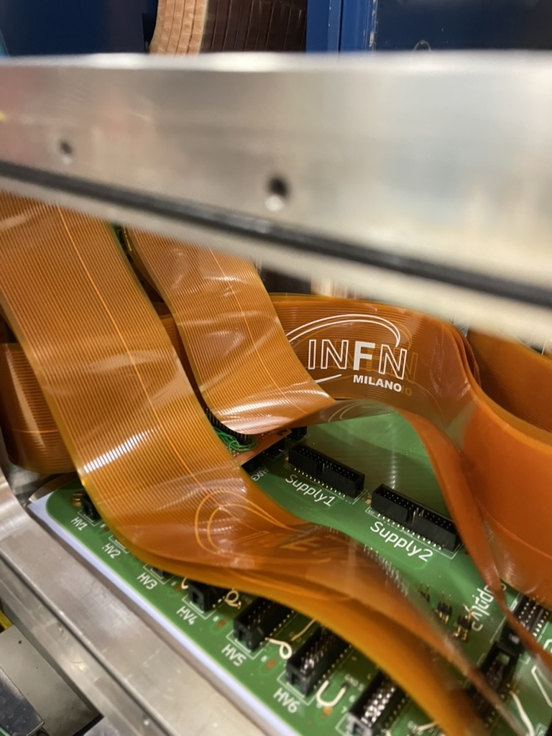
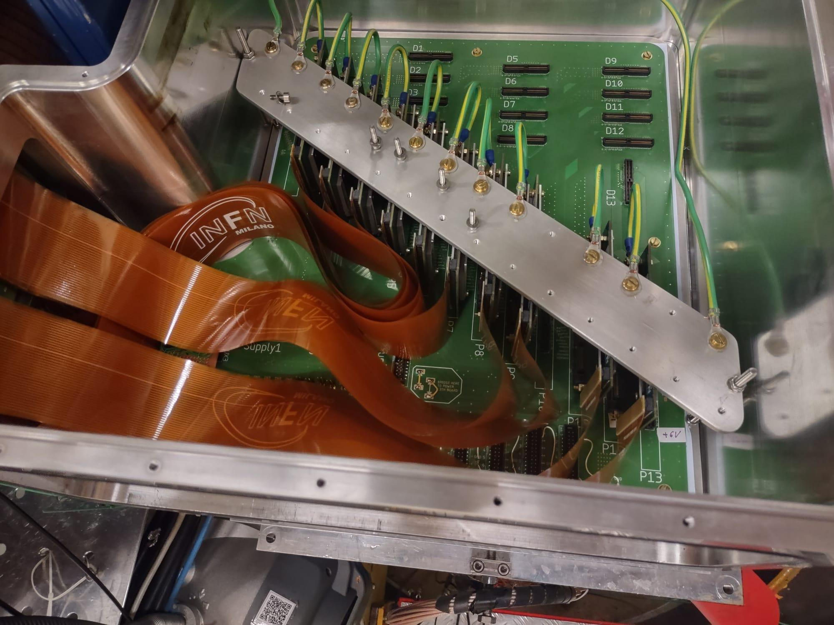

Slide 11
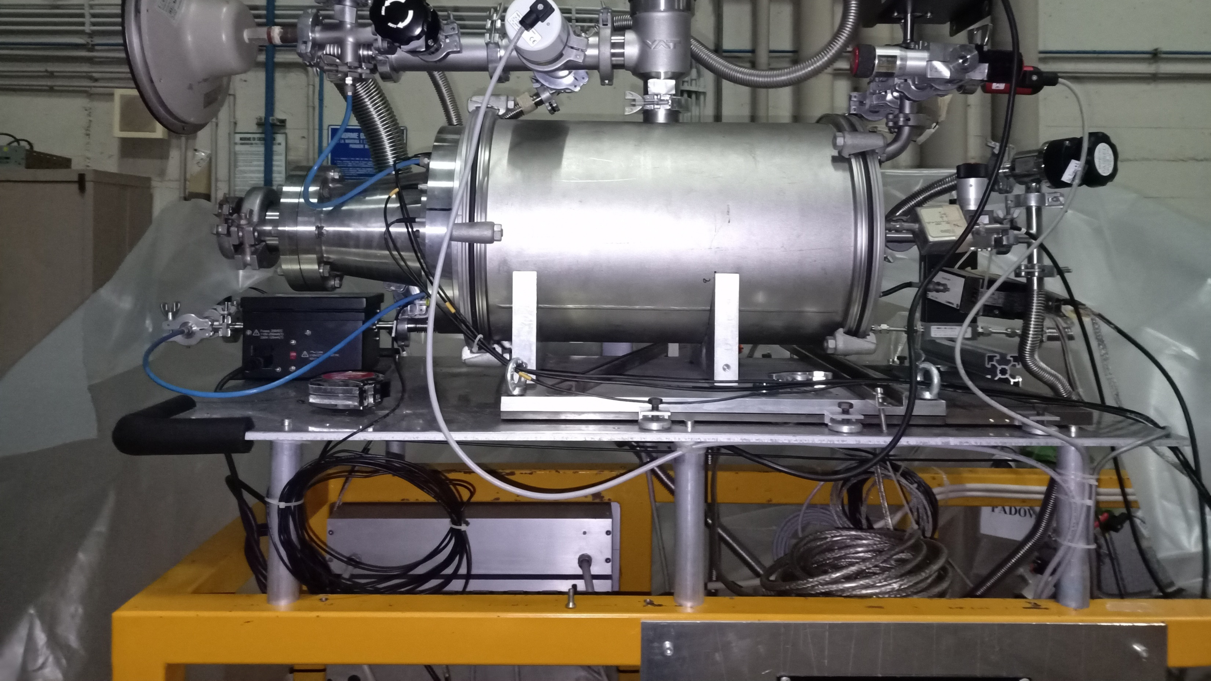
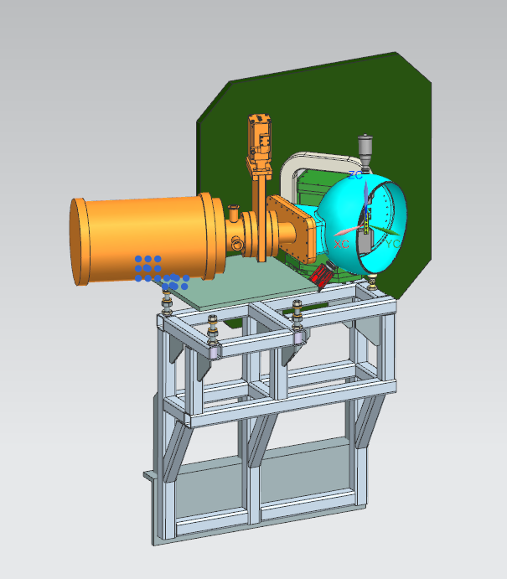
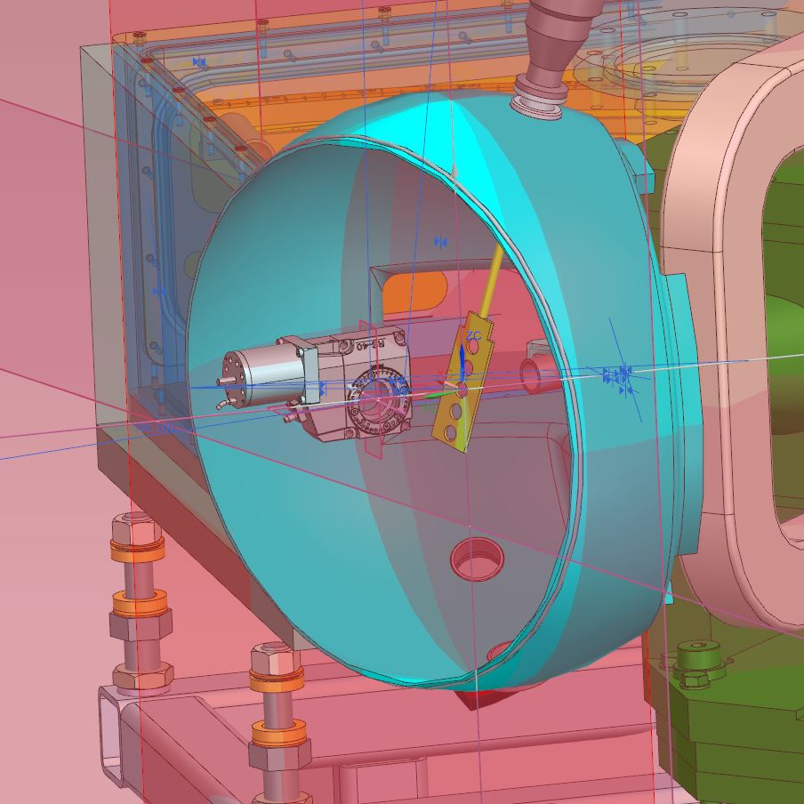
Installation of the PRISMA second arm and rotating target for experiments with Uranium beams in 2026
SECOND ARM INTEGRATION
ROTATING TARGET MOTOR
Mechanical integration in the existing AGATA-PRISMA set-up studied in collaboration with the PD design office (M. Rampazzo).
Realization of the connection parts in charge of the PD workshop (L. Ramina).
The work will be finalized in 2026

Slide 12
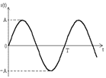
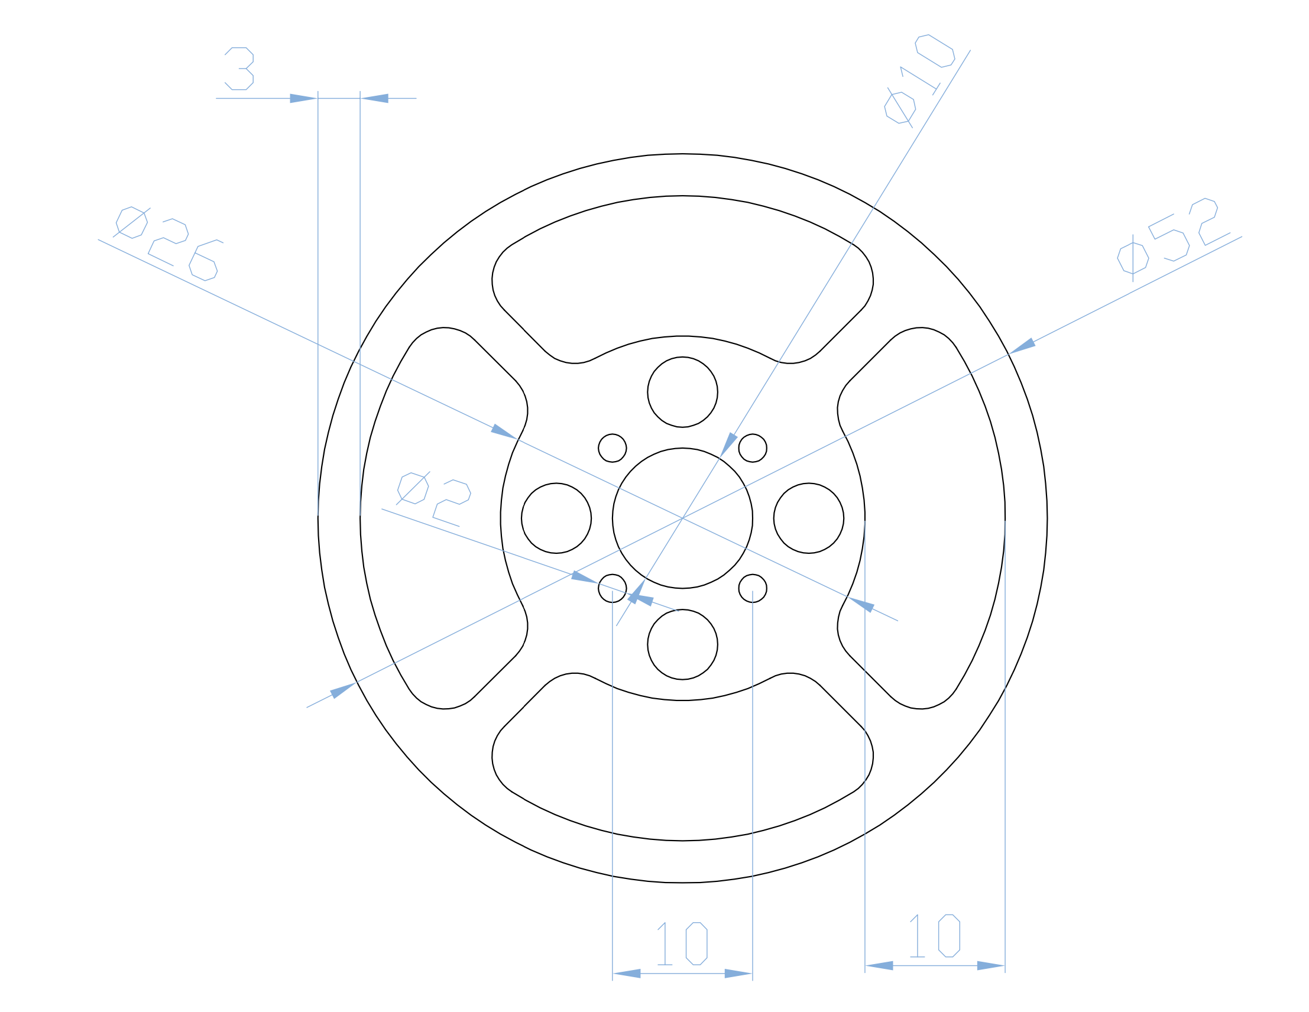
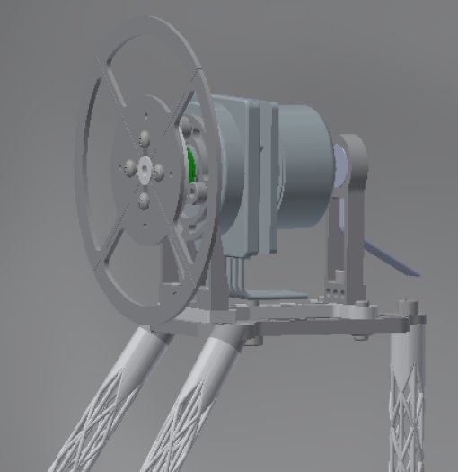
The 2026 campaign with the ALPI beams: Last AGATA-PRISMA OPPORTUNITY
Inclusion of the 2 new devices:
PRISMA Second arm
Rotating target for intense heavy beams (²⁰⁸Pb, ²³⁸U)
syncronization 5 Hz
beam
²³⁸U

Slide 13
The Zero degree campaing
2026-2028

Slide 14
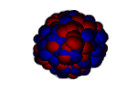
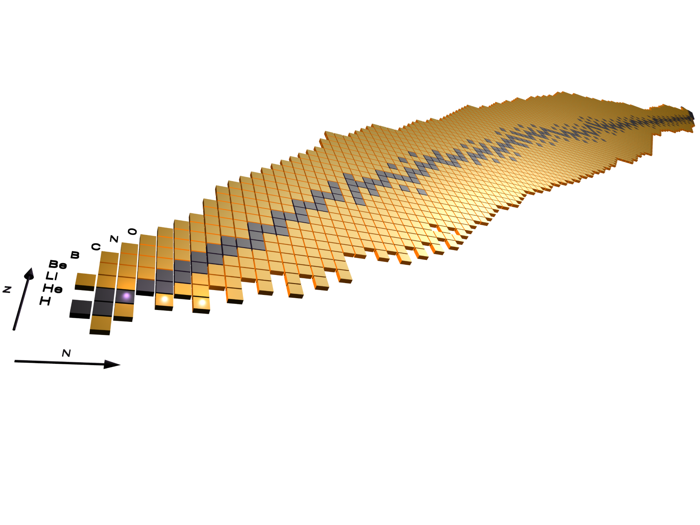
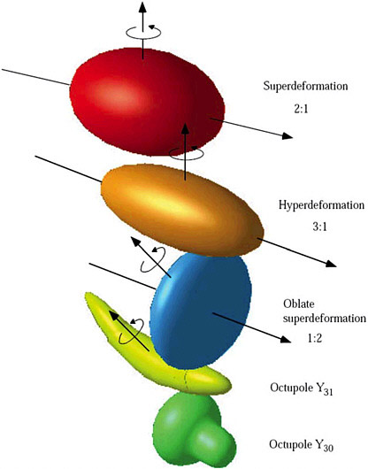
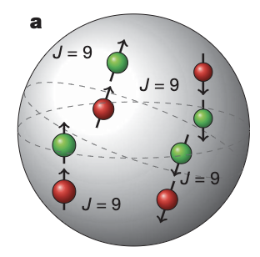
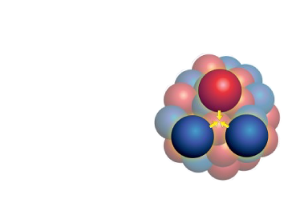
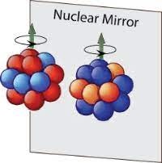
The future zero degree campaign
Hot rotating nuclei, GDR,
superdeformation, high-spin states…
Isospin symmetry, proton neutron pairing and spectroscopy of N~Z nuclei
Reactions relevant for astrophysics, structure of ¹²C, three-body force ¹⁶C

Slide 15
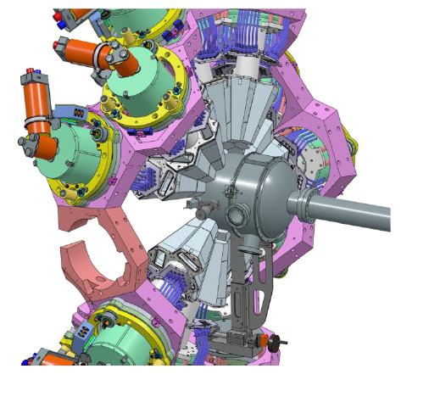
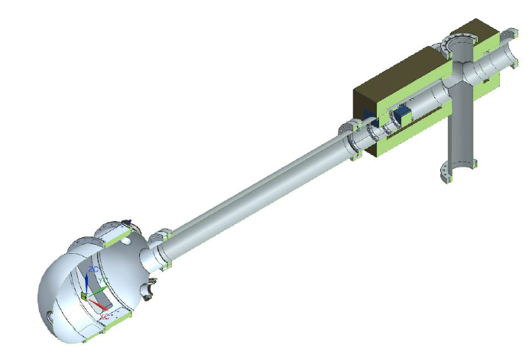
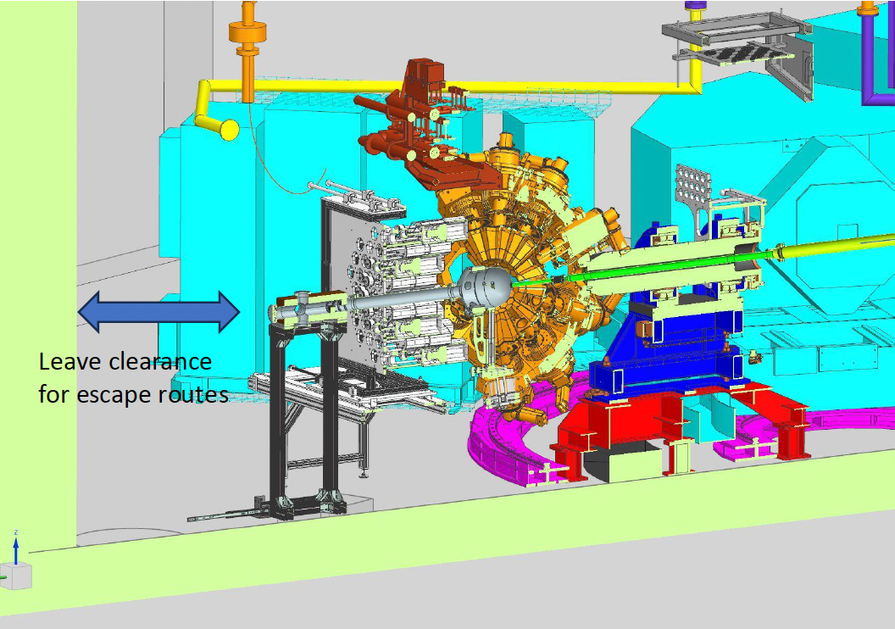
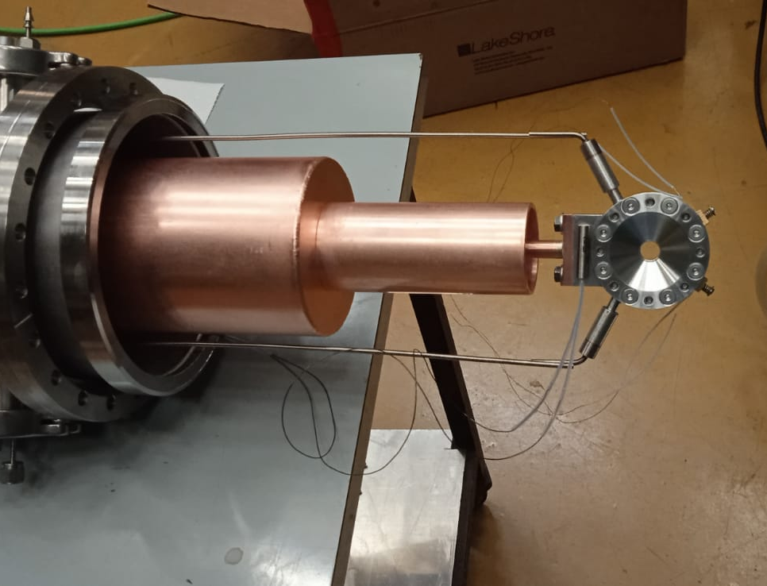
Status of the zero degree campaign
Mechanical design have been finalized.
Production of the new AGATA support has been made.
All infrastructure (LN2, …) is finalized
Production of the new reaction chamber and beam dump is on-going
Integration of the ancillaries and new target system on-going

Slide 16
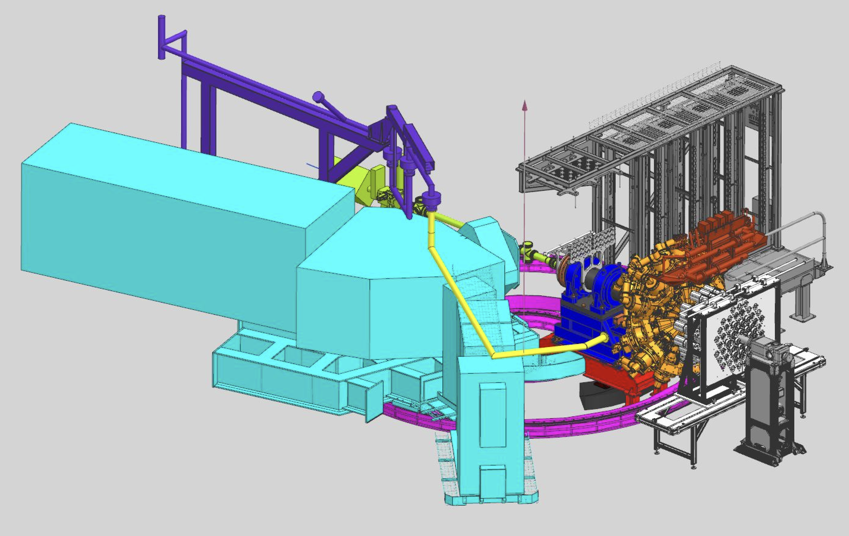
Zero degree campaign “bulky” ancillaries
NEDA Neutron Detector Array
54 liquid scintillator cells
50 cm from the target
Neutron discimination:
PSA
Time of flight
Digital electronics compatible with AGATA
DAQ integration is on-going
J.J. Valiente Dobón, Nucl. Inst. Meth. A 927 (2019) 81

Slide 17
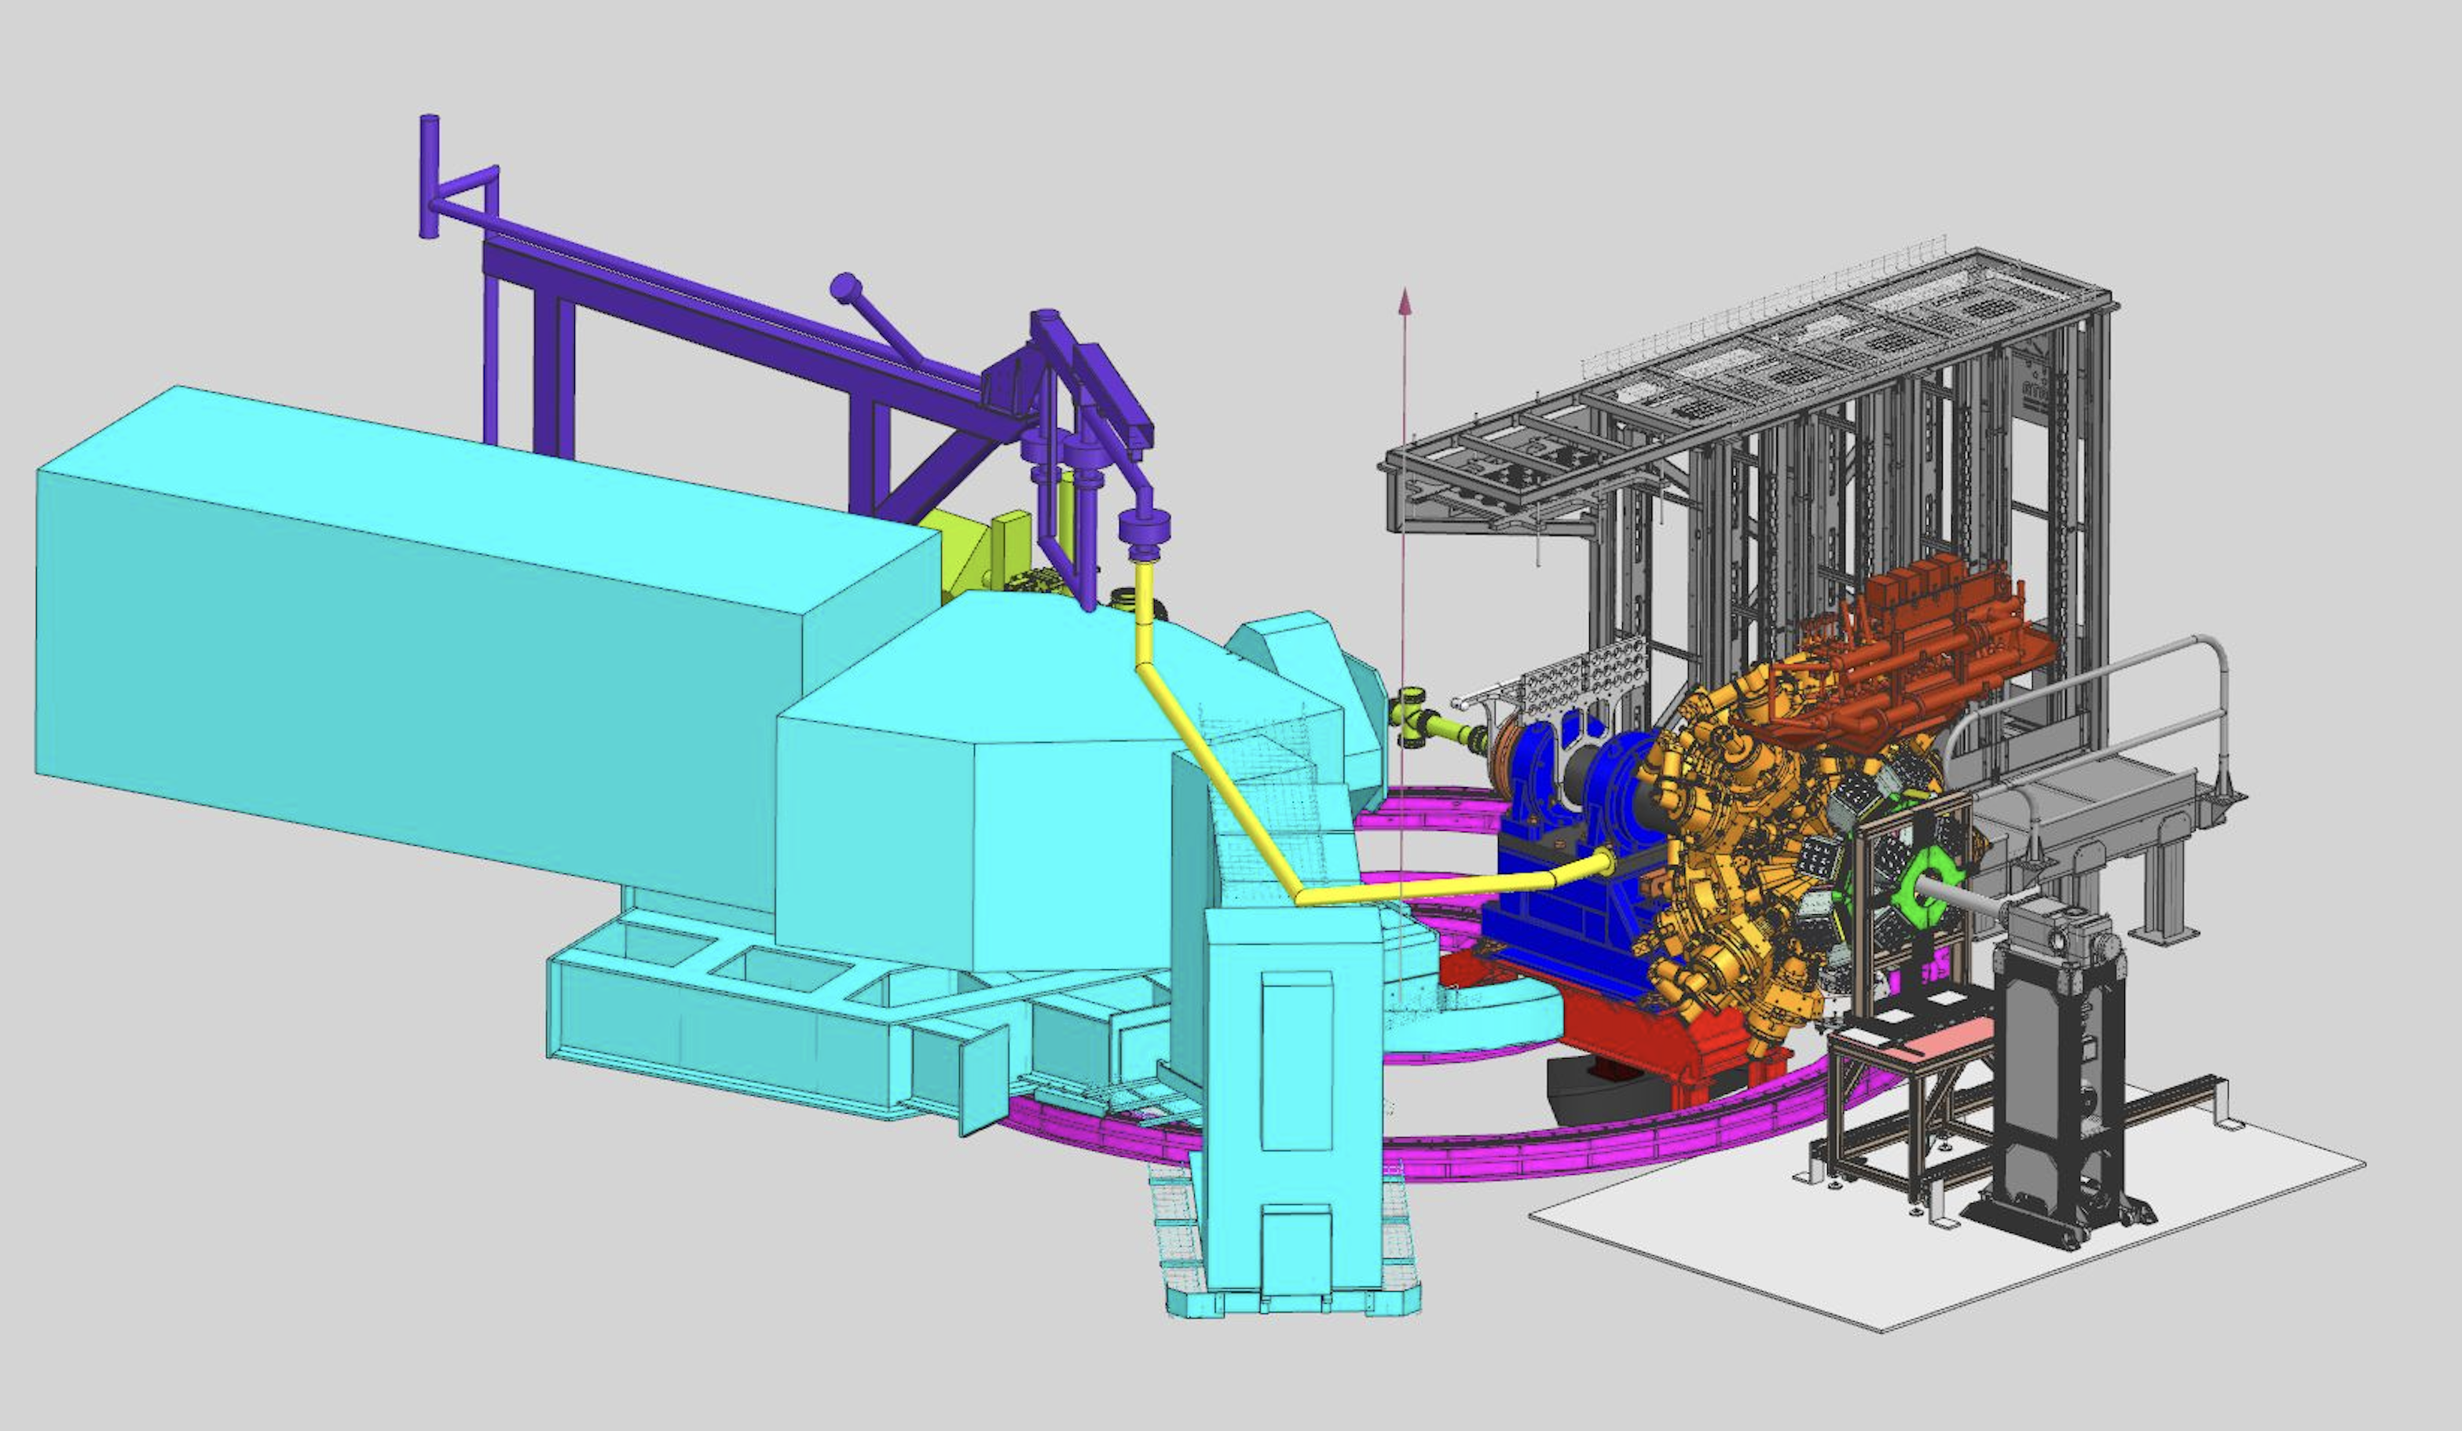
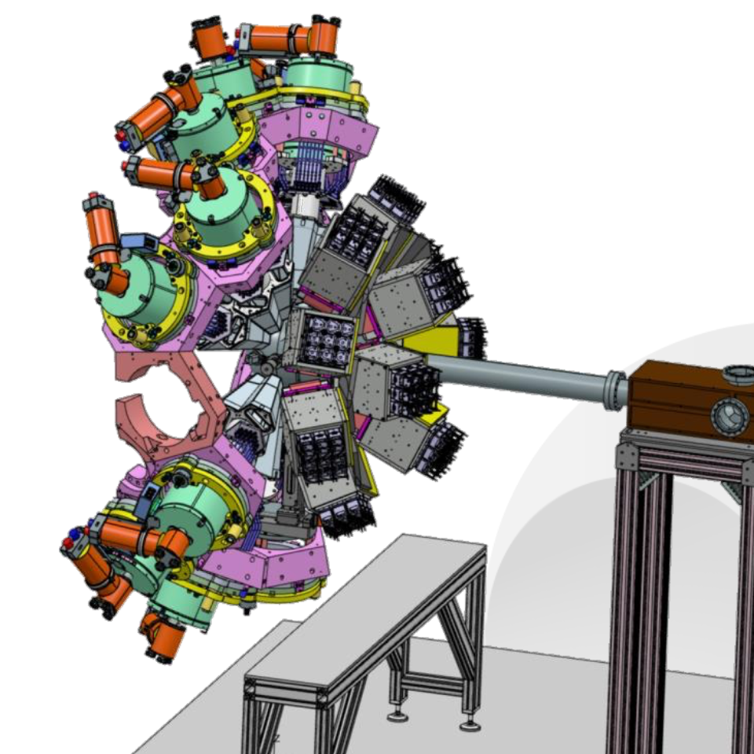
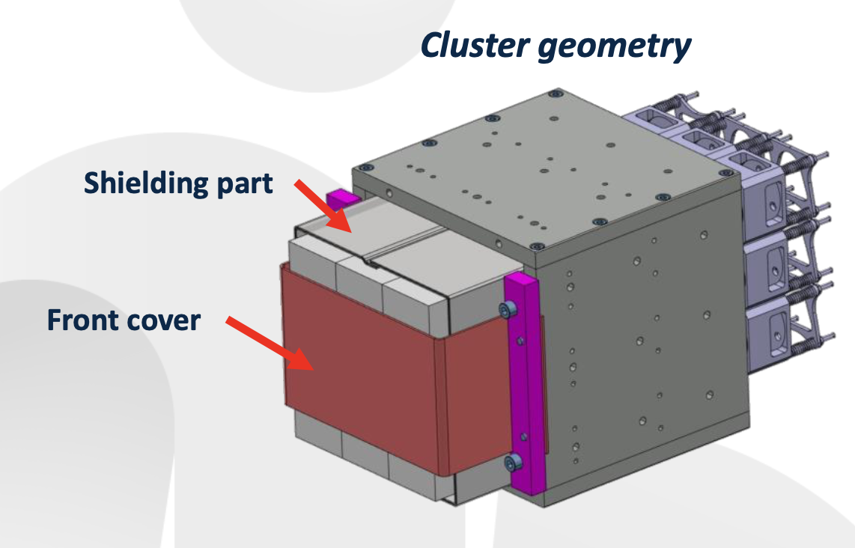
Zero degree campaign “bulky” ancillaries
PARIS phoswich array
10 cluster made of 9 phoswiches
2 rings at forward angles:
6 clusters at 60 degrees
4 clusters at 15 degrees
Same electronics than present LaBr₃ – fully integrated
http://paris.ifj.edu.pl

Slide 18
Conclusions
The official end of the LNL campaign is set to mid-2028
New complementary detectors will be installed to fully exploit the next campaign beams
The zero degrees campaign will be divided in two sub-campaign: PARIS – NEDA
Preparation of the two is on-going
Order of the sub-campaign will be driven by
Availability of the two arrays
Users requests
Strong collaboration with well established and documented procedure for data analysis.

Slide 19
Thank you
Alain.goasduff@lnl.infn.it
http://gamma.lnl.infn.it
https://www.agata.org

