Slide 1
LNL Accelerator Status E. Fagotti

Slide 2
Outline
SPES
PTA operation and status
PIAVE-TANDEM-ALPI availability

Slide 3
Outline
SPES
PTA operation and status
PIAVE-TANDEM-ALPI availability

Slide 4
SPES phased approach
SPES
Phase 2A:
RIB production
SPES Phase 4: Radioisotopes production
SPES Phase 3:
Charge breeder + MRMS + RFQ
SPES Phase 5:
RIB selection
SPES Phase 1
SPES Phase 2A
SPES Phase 2B
SPES Phase 2B:
LERIB
SPES Phase 3
SPES Phase 1:
Cyclotron and BL2
SPES Phase 4
SPES Phase 5
Other

Slide 5
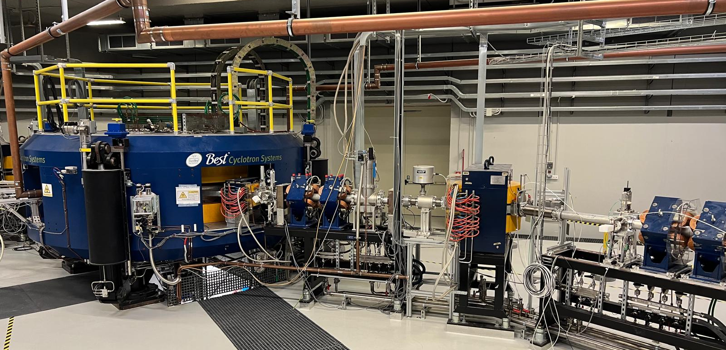
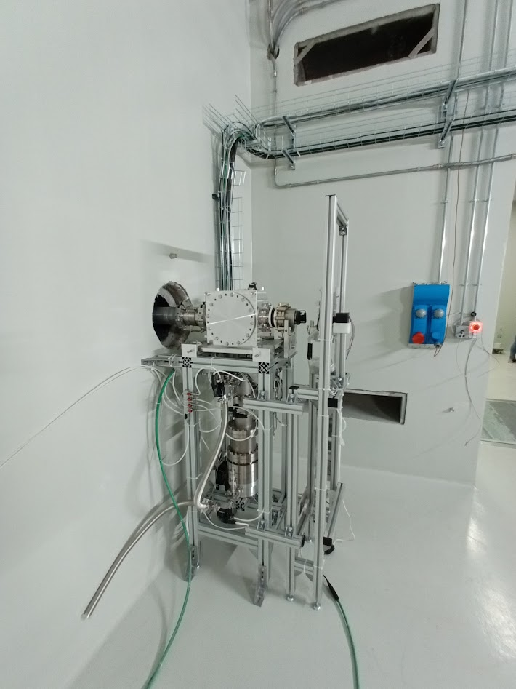
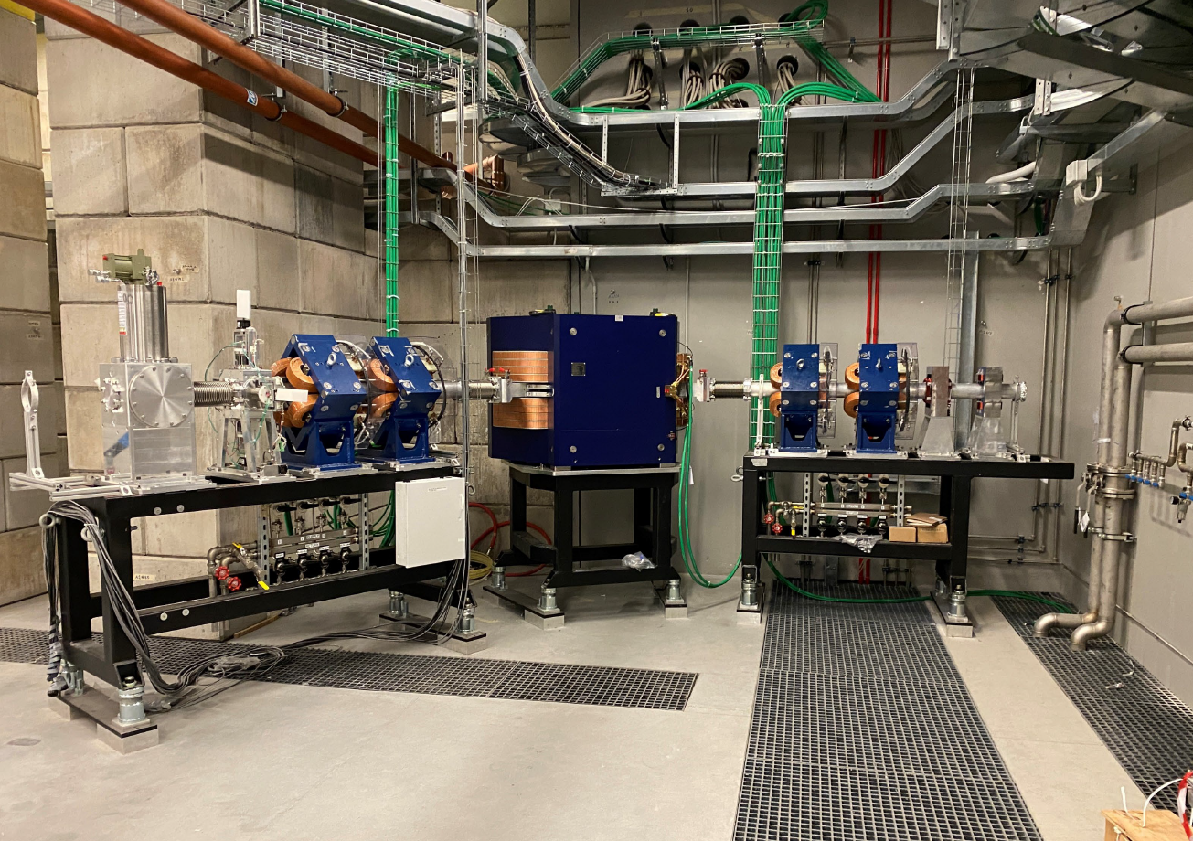
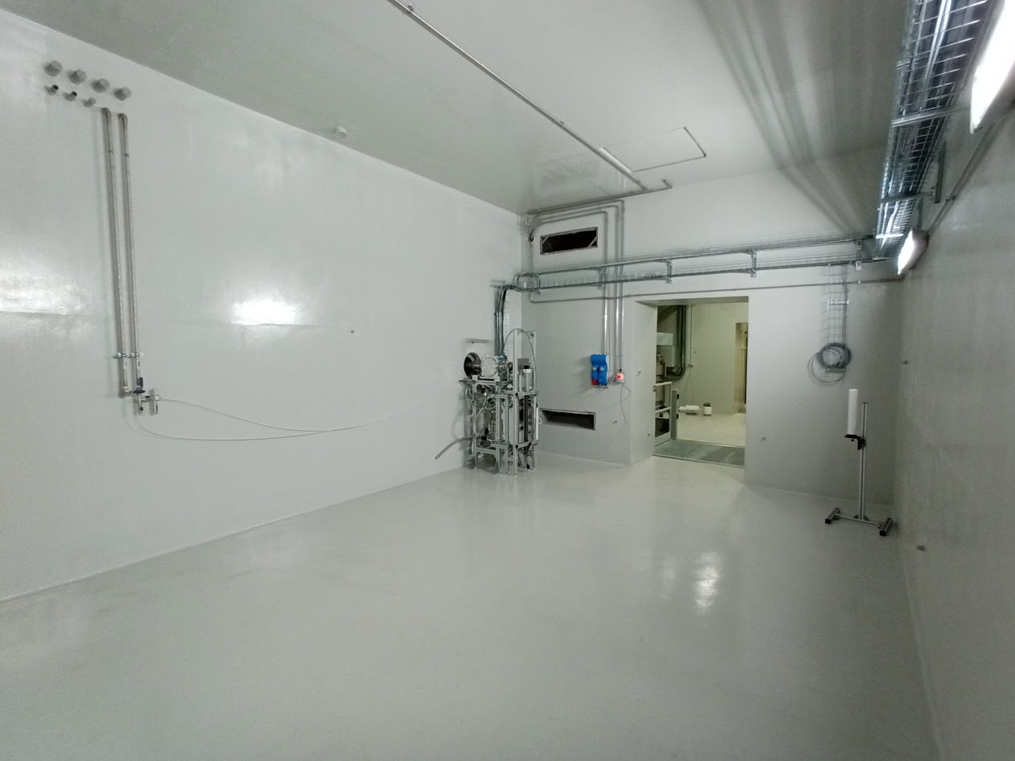
Phase 1 at completion: beam delivered May 2024
SPES-driver
Phase 1
SPES ISOL2
Phase 1 completed: cyclotron delivered to LNL
Target station tested.

Slide 6
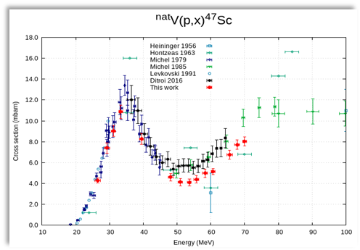
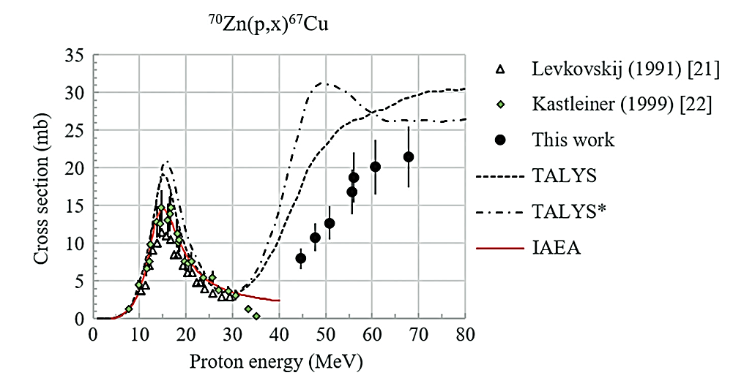
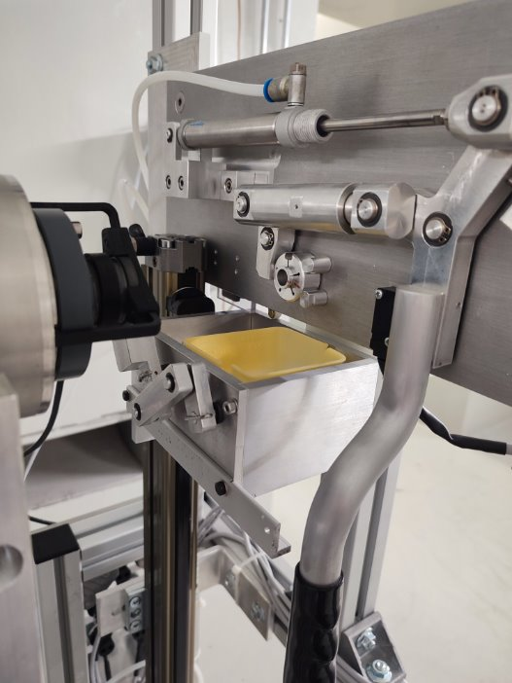
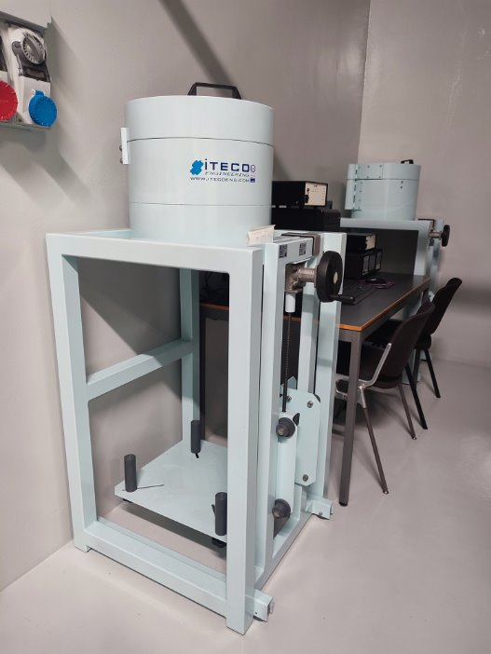
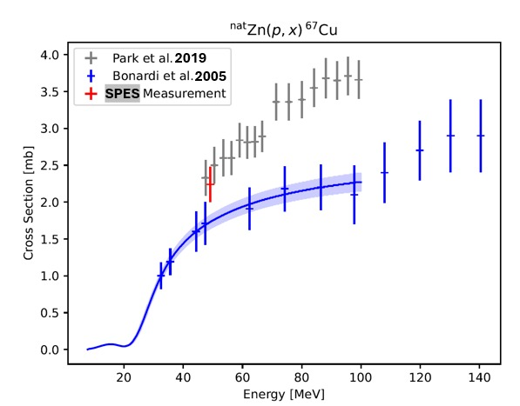
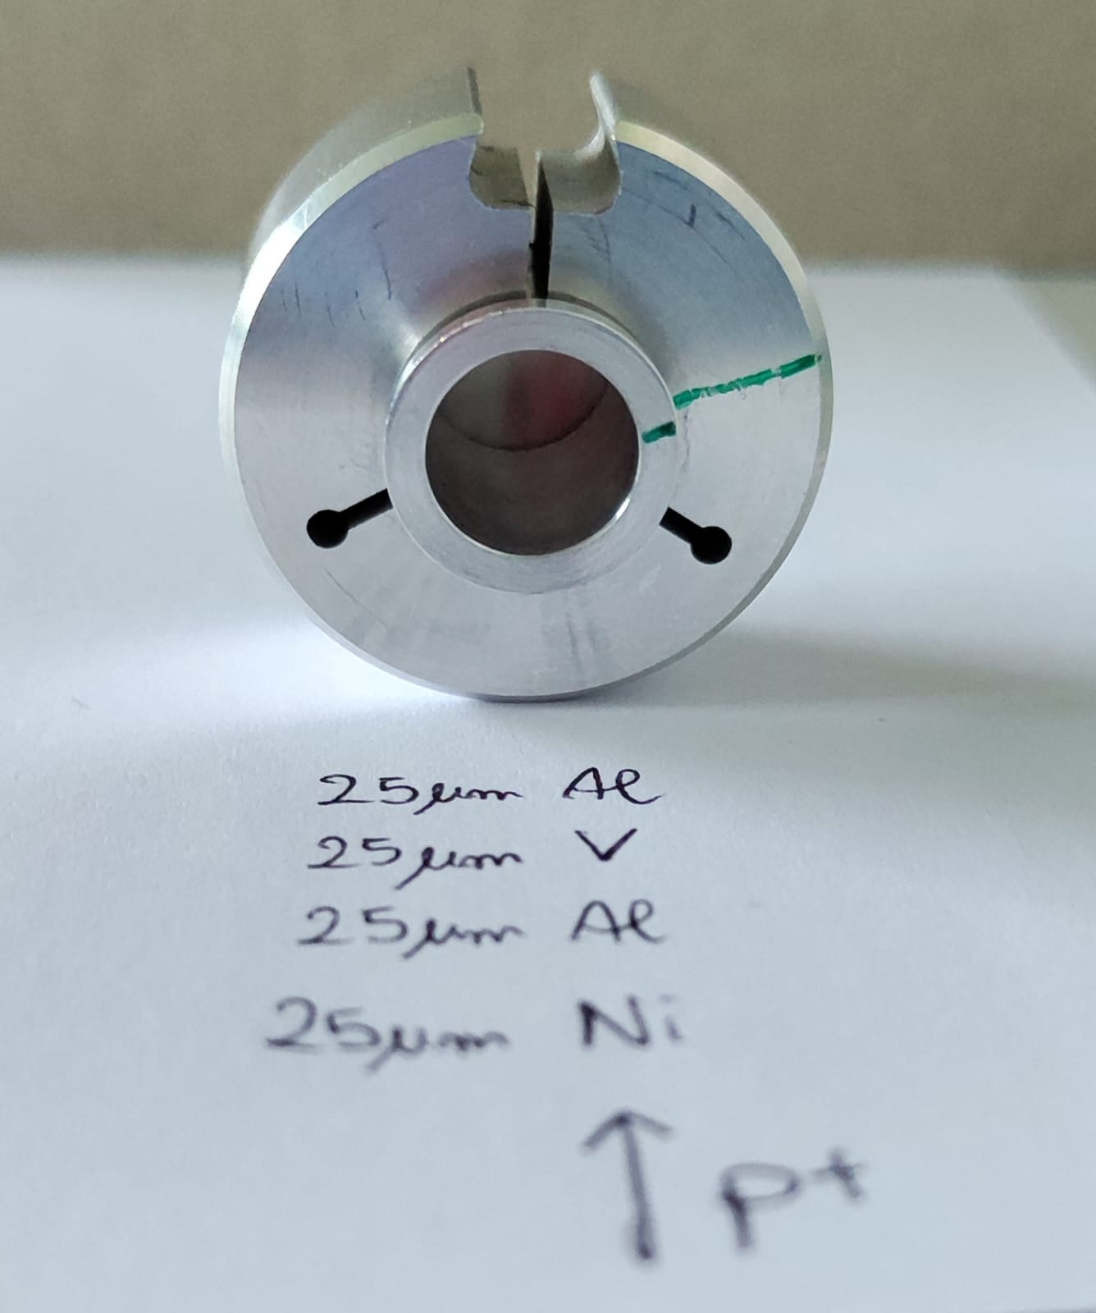
Three irradiation runs with 35, 50 and 70 MeV proton beams
Beamline characterization process using IAEA monitor reactions https://www-nds.iaea.org/medical/monitor_reactions.html
^{nat}Al(p,x)^{22/24}Na
^{nat}Ni(p,x)⁵⁷Ni
^{nat}Ti(p,x)⁴⁶Sc
Remeasuring xs for ⁶⁷Cu production route
⁶⁸Zn(p,x)^{67/64}Cu
⁷⁰Zn(p,x)^{67/64}Cu
Remeasuring xs for ⁴⁷Sc production route
^{nat}V(p,x)⁴⁷Sc
70 MeV max
70 MeV max
Beam
Production cross section value of the ^{nat}Zn(p,x)⁶⁷Cu nuclear reaction

Slide 7
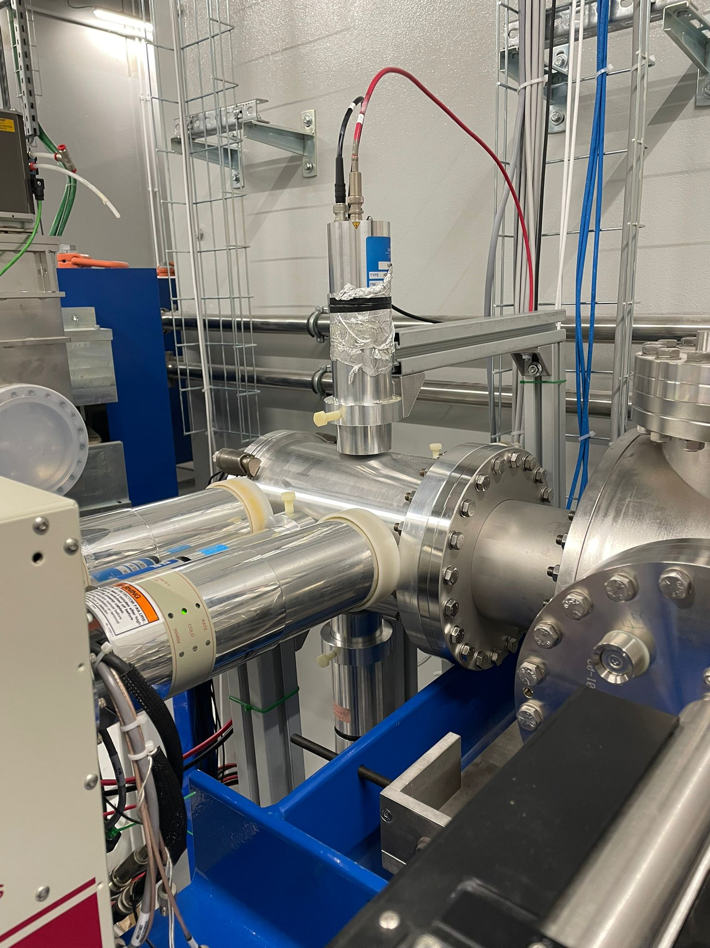
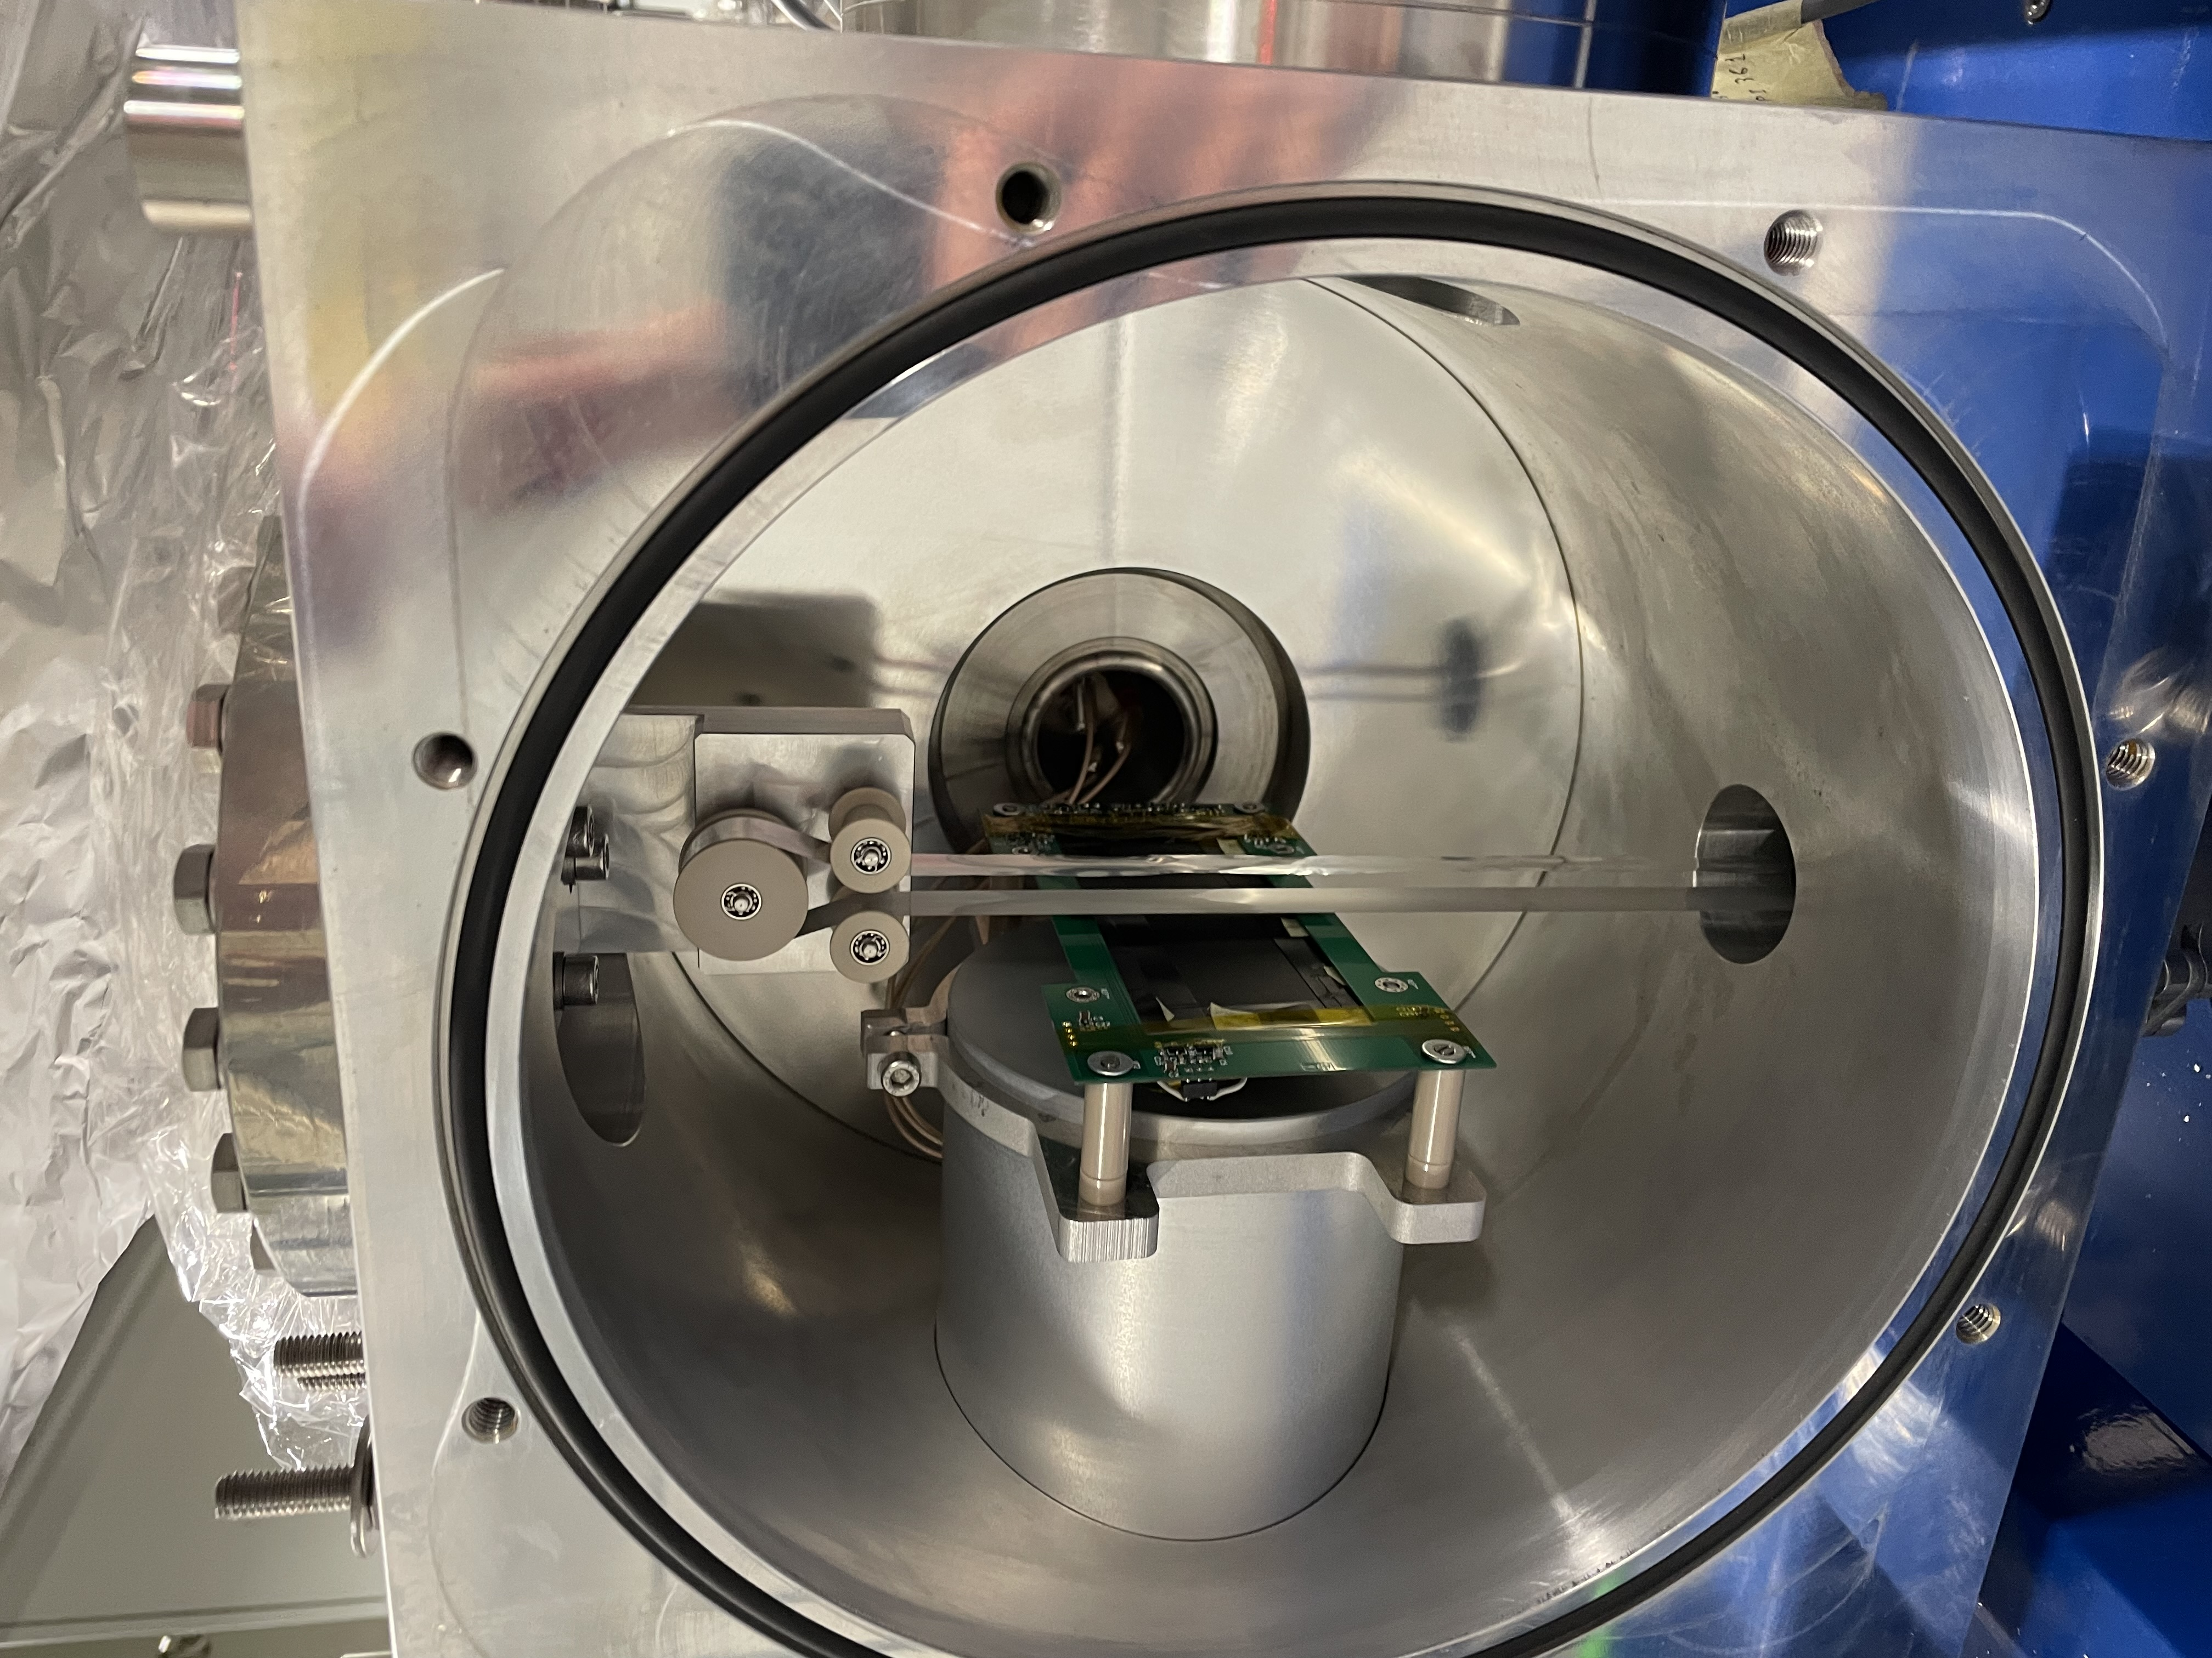
Phase 2: RIB commissioning of the ISOL machine
Phase 2a
TIS
Phase 2b
TIS
RIB
RIB
Completed 11/2024
Completed 04/2025

Slide 8
Phase 2A: RIB commissioning of the ISOL machine
Phase 2a
TIS
Phase 2b
TIS
RIB
RIB
Completed 11/2024
Completed 04/2025

Slide 9
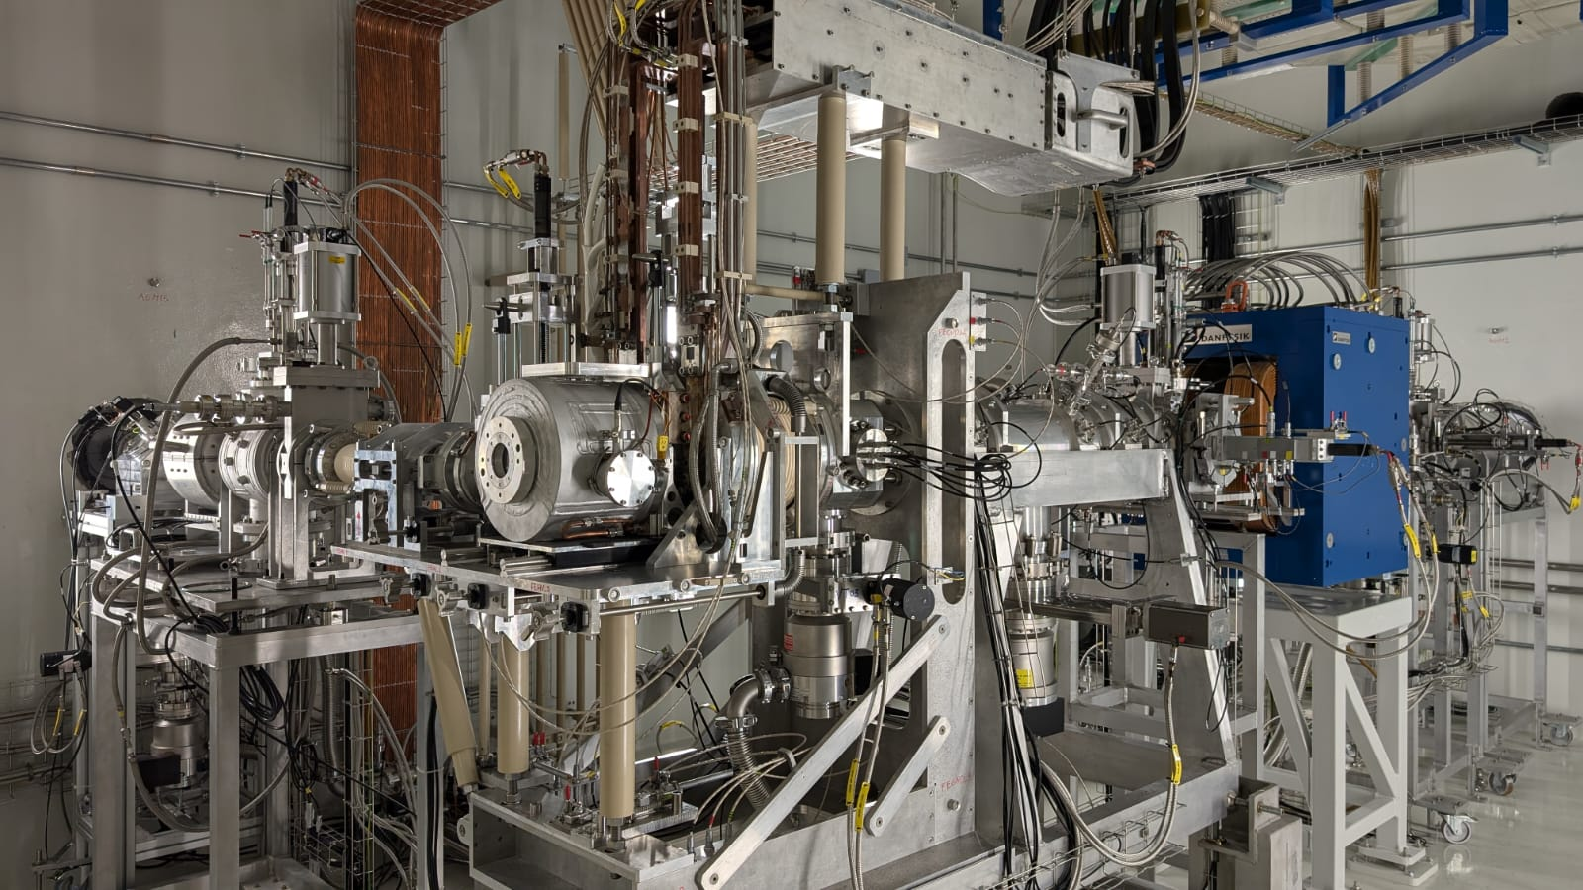
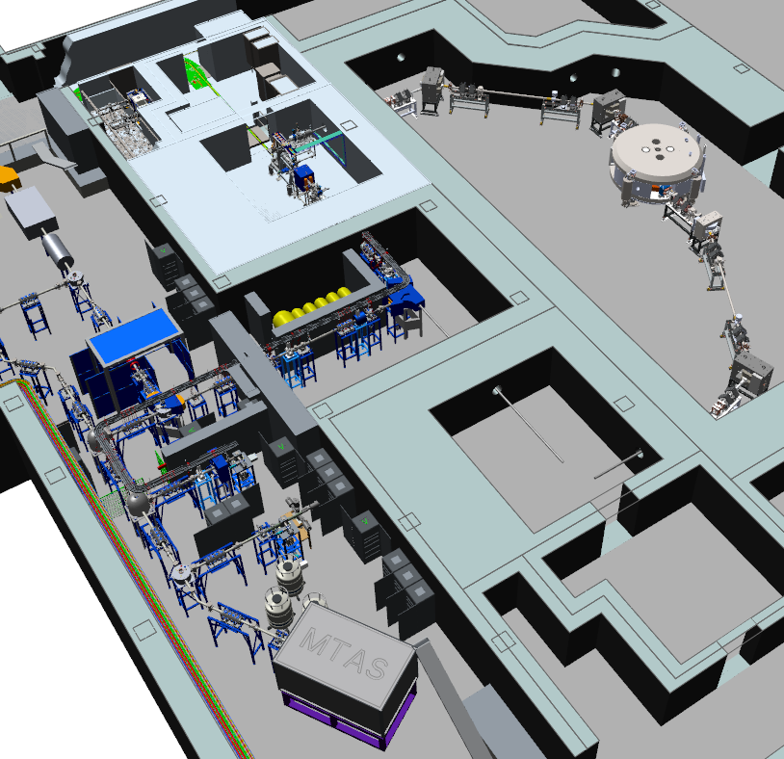
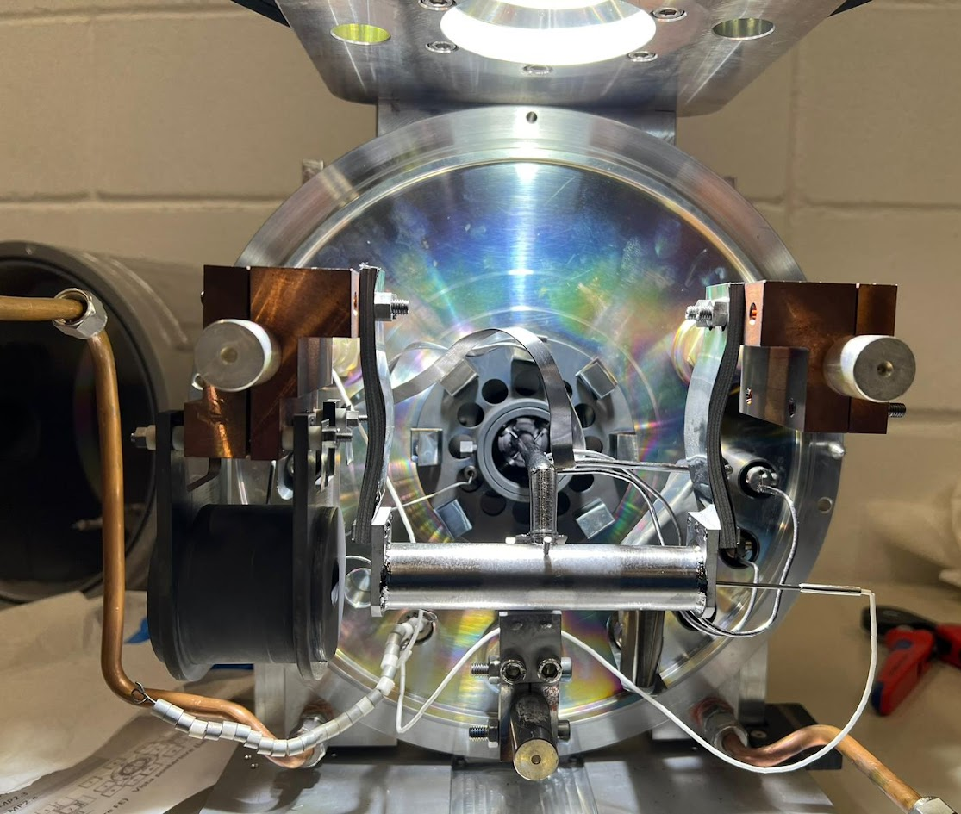
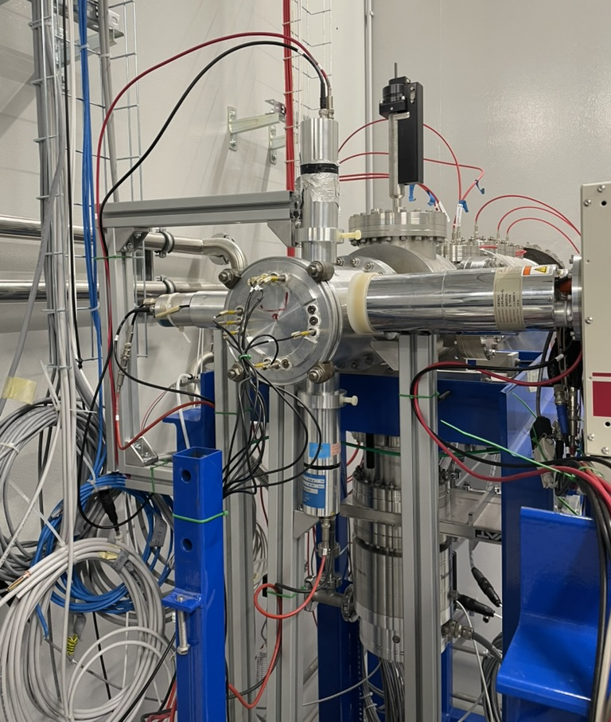
Phase 2A: RIB commissioning of the ISOL machine

Slide 10
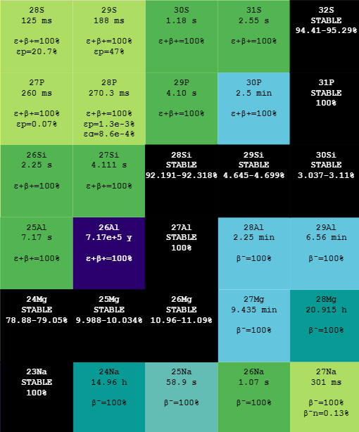
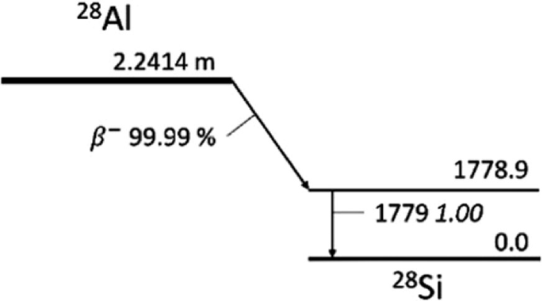
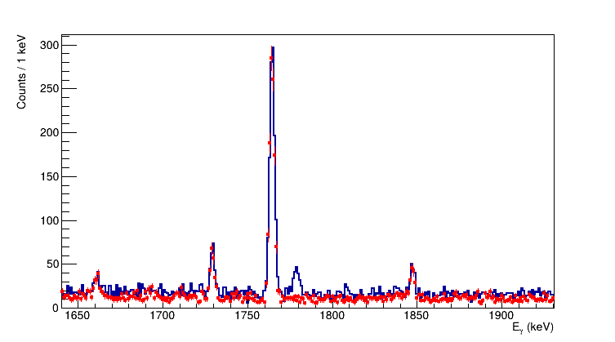
Phase 2A: First RIB production
HPGe spectrum in coincidence with beta signal
²⁸Si: 2⁺→0⁺
Beam ON

Slide 11
Phase 2B: RIB commissioning of the ISOL machine
Phase 2a
TIS
Phase 2b
TIS
RIB
RIB
Completed 11/2024
Completed 04/2025

Slide 12
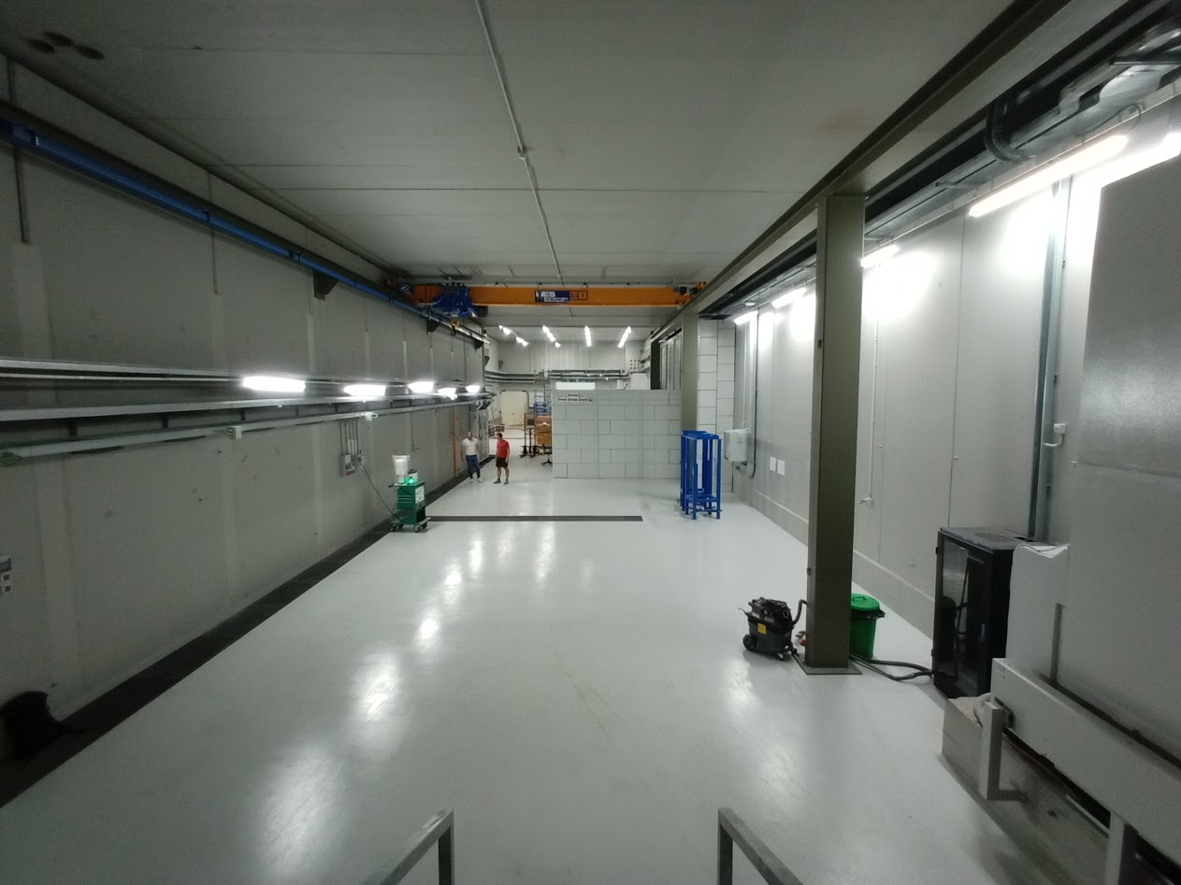
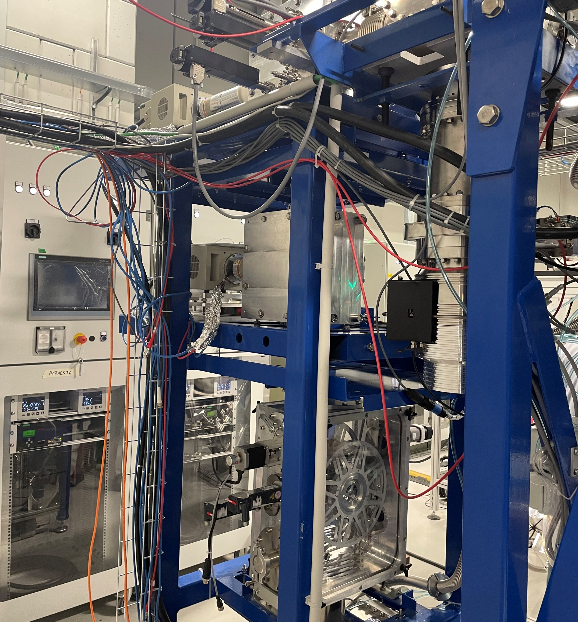
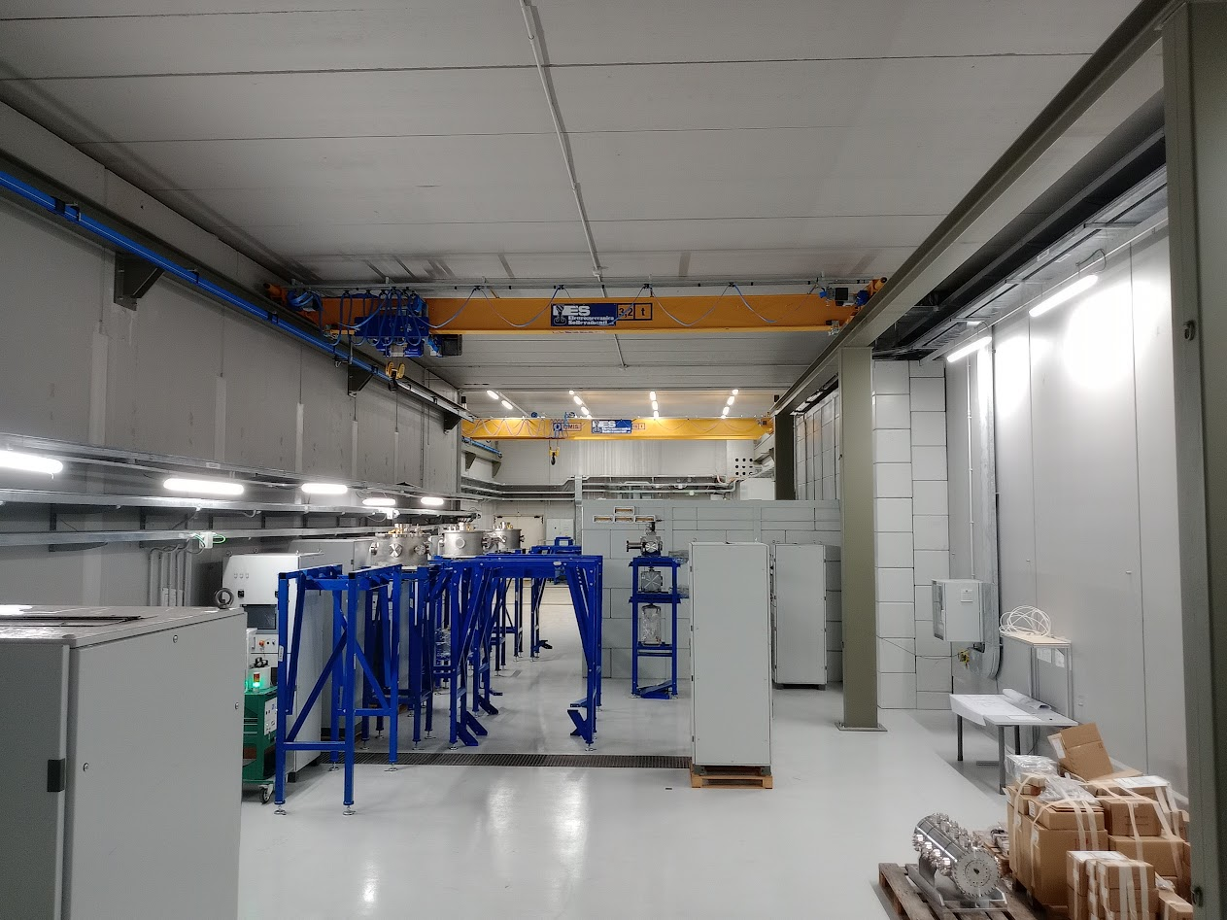
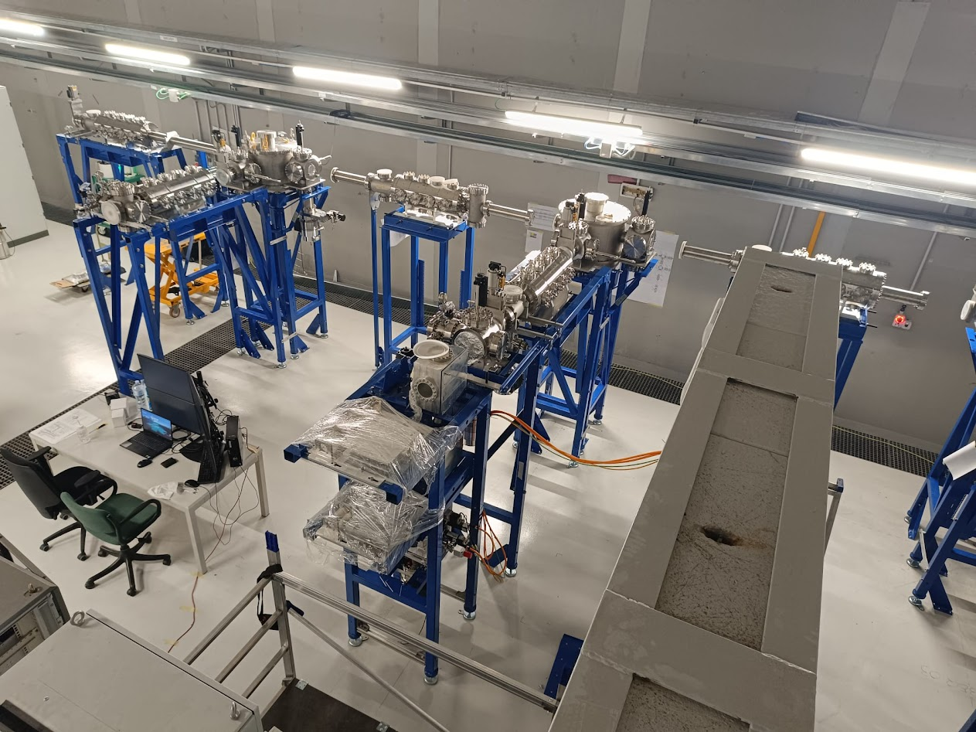
Phase 2B: LERIB (Low Energy Radioactive Ion Beam) transport line
May 2024
June 2024
July 2024

Slide 13
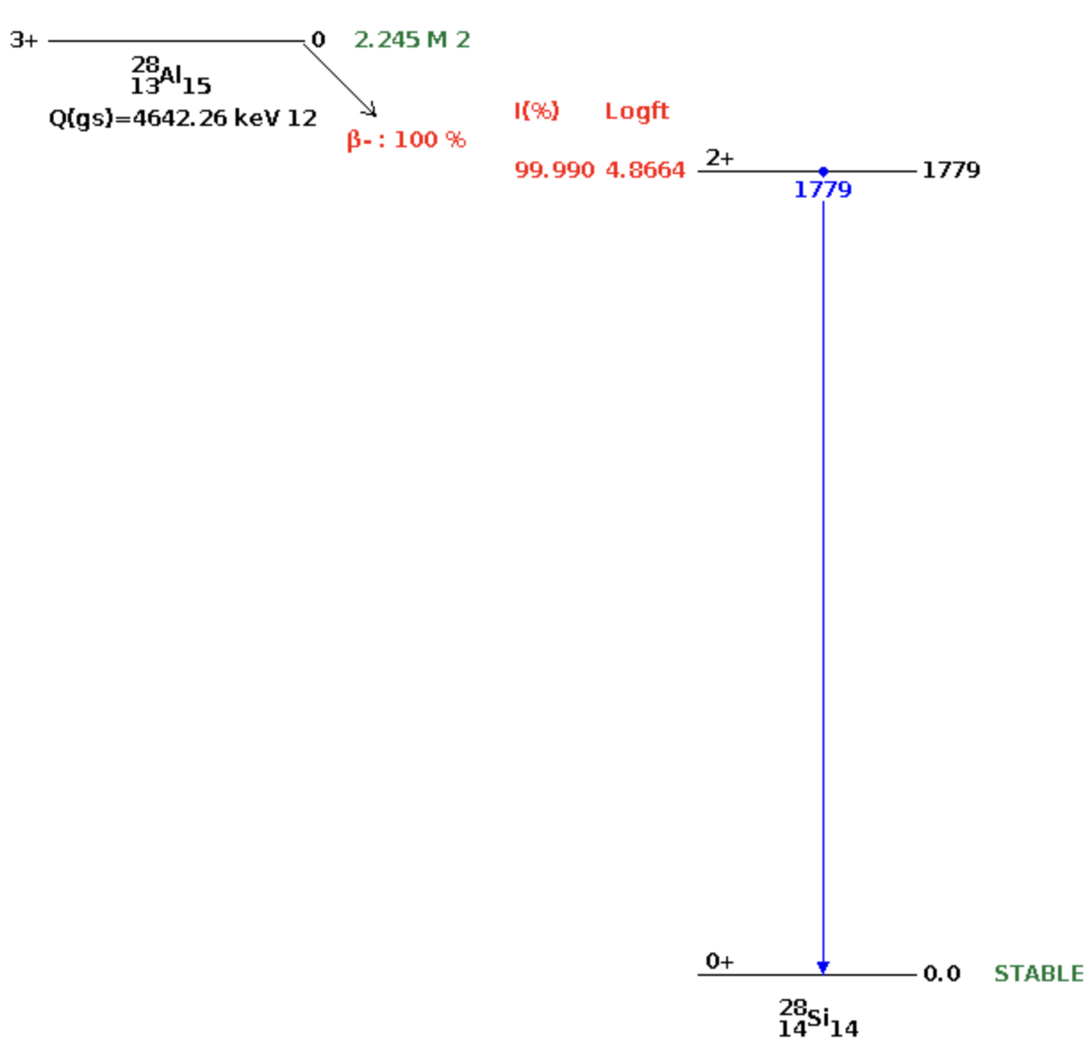
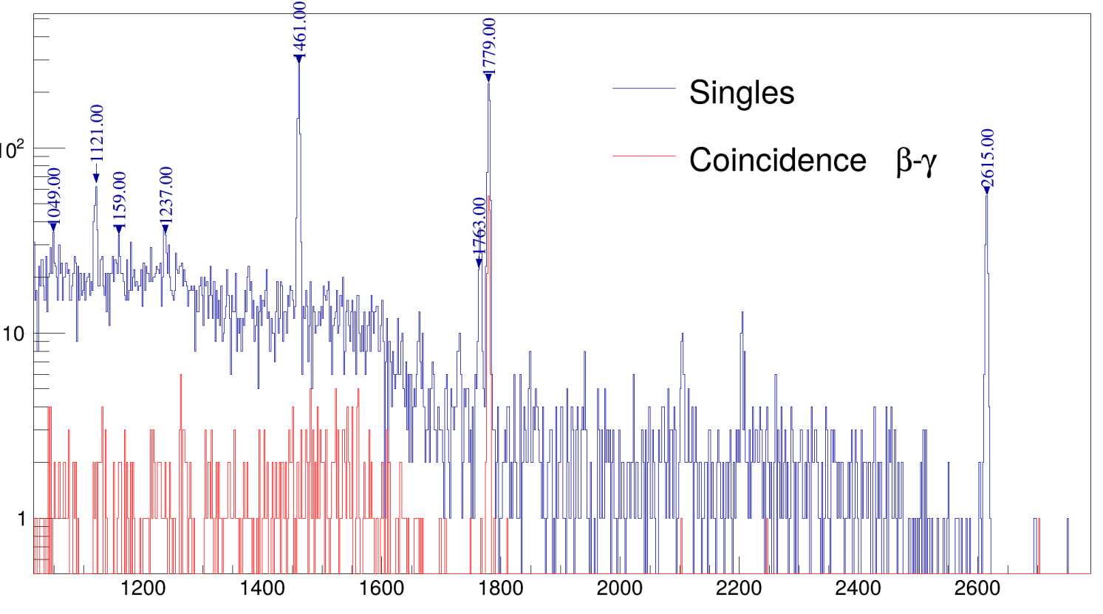
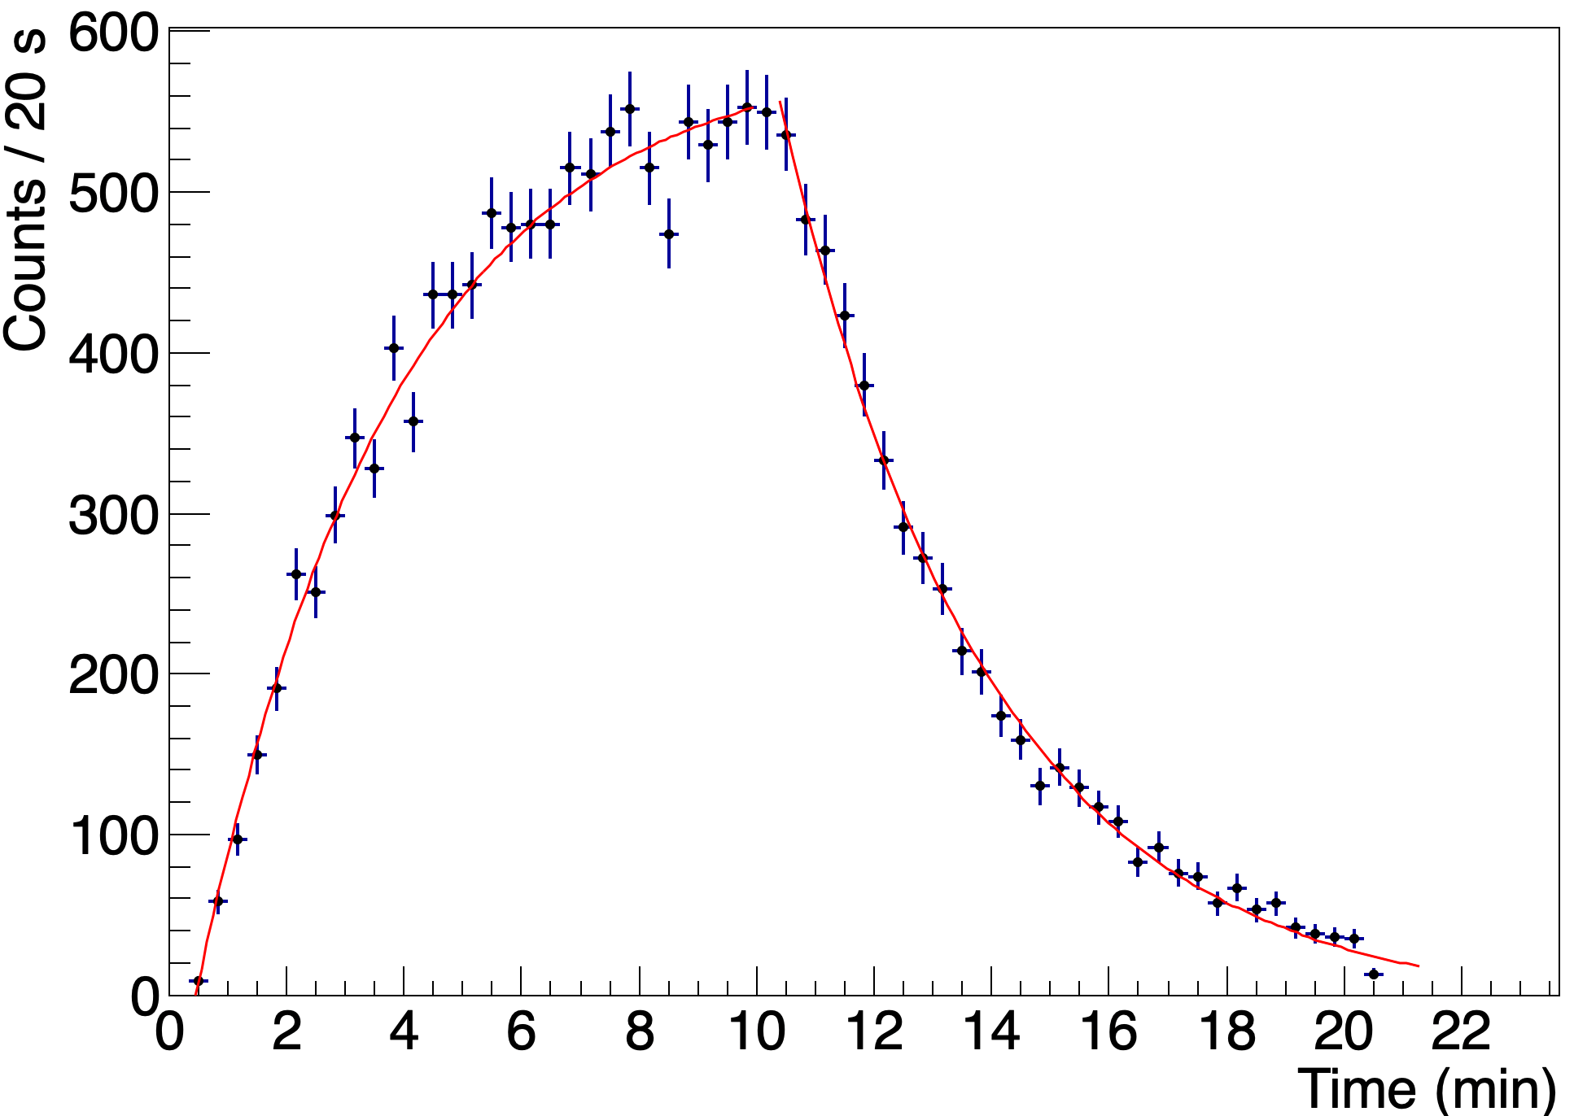
Phase 2B: First RIB analysis at tape station
HPGe
Moving tape
Mass 28 - ²⁸Al
t_{1/2}=2.25 min
Beta plastic scintillator
(temporary arrangment)

Slide 14
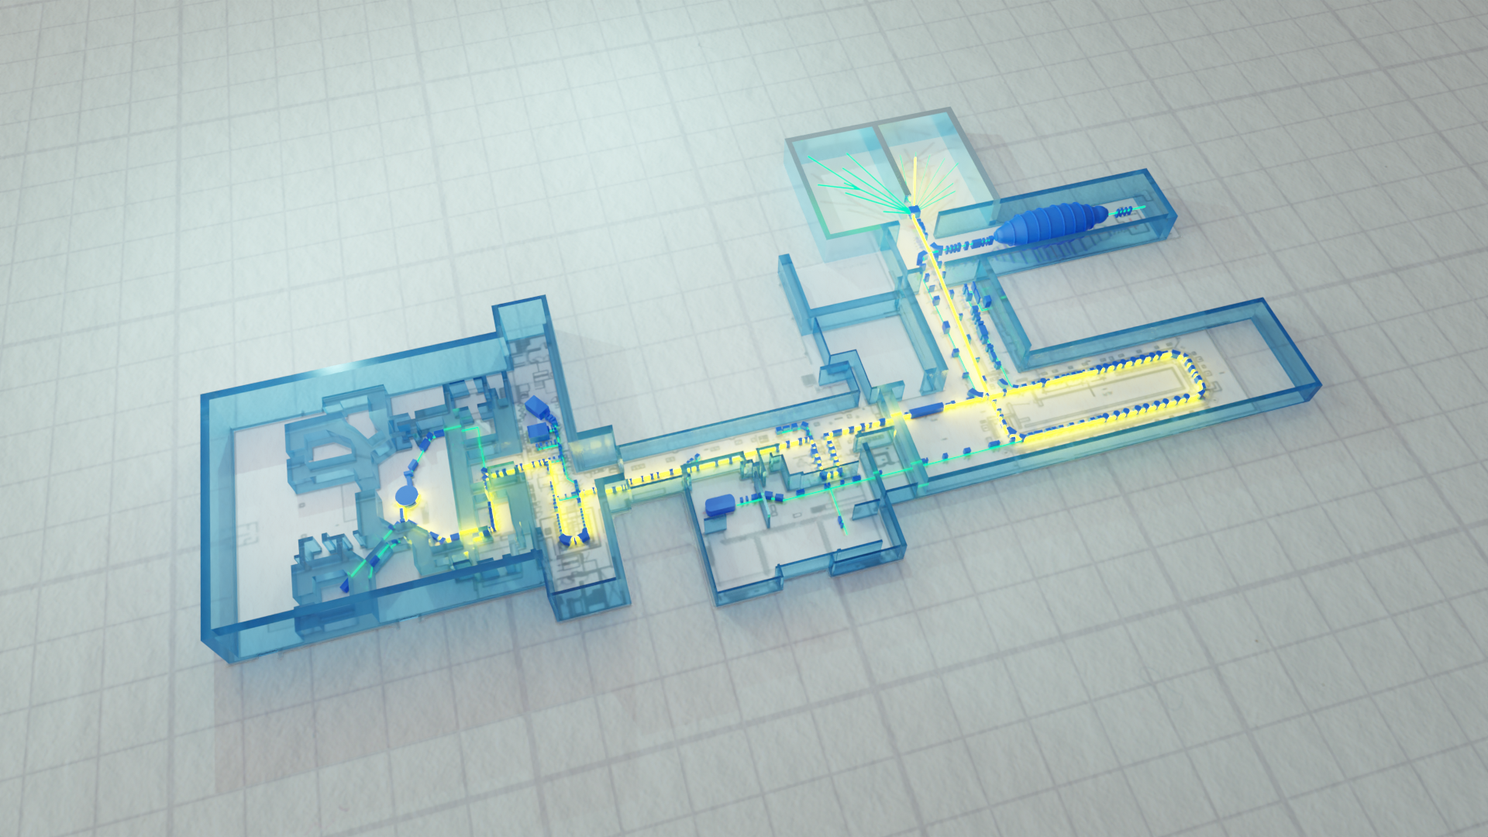
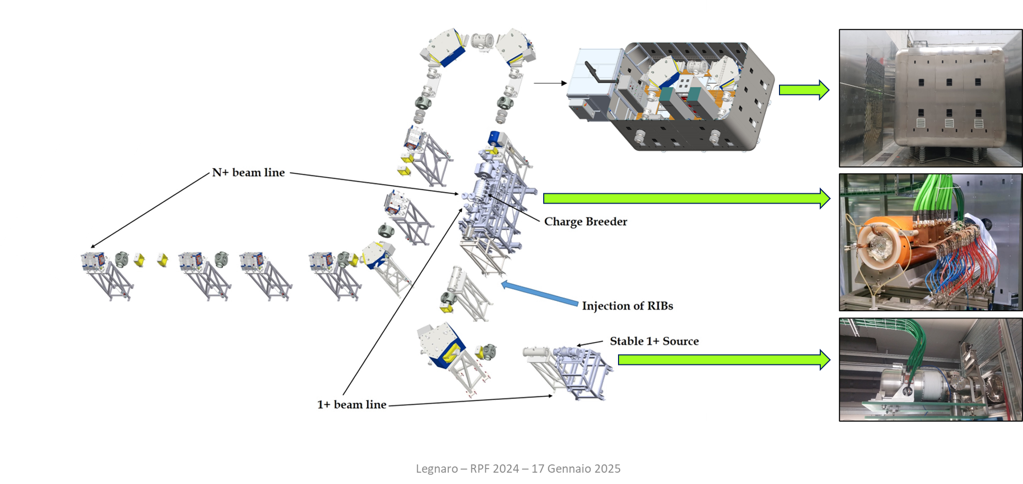
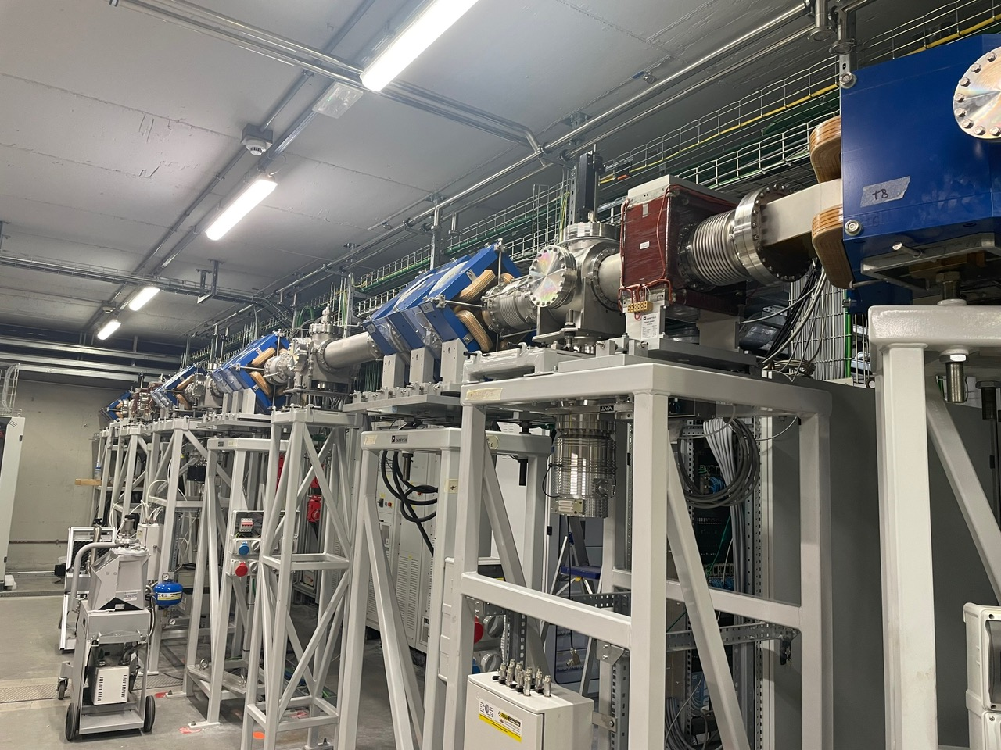
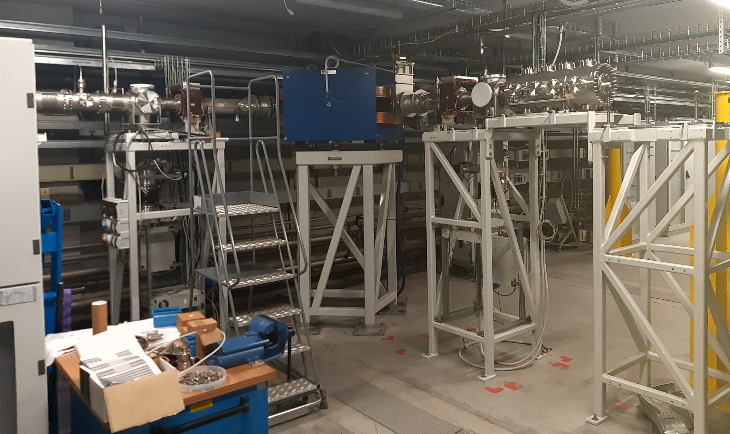
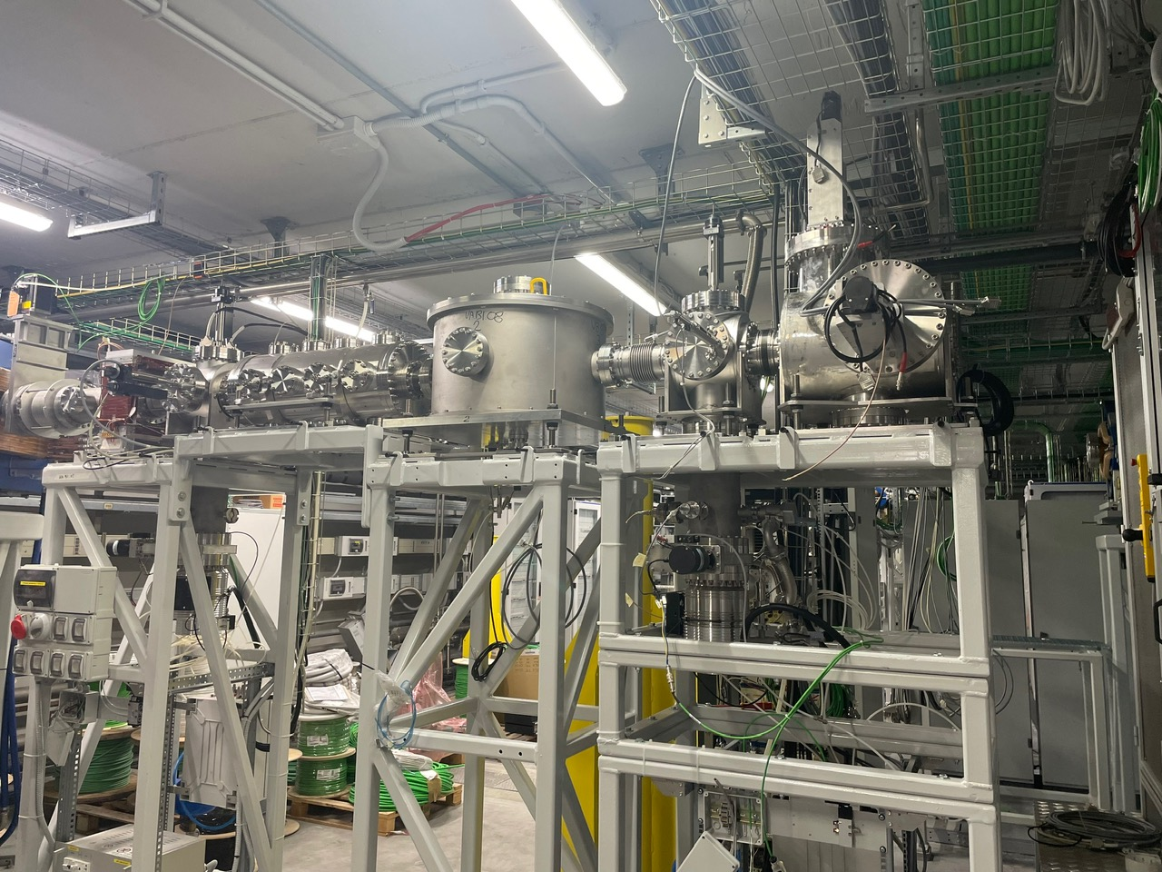
Phase 3: 1⁺ injector + Charge Breeder + Medium Resolution Mass Spectrometer + RFQ

Slide 15
Phase 3A: 1⁺ injector + Charge Breeder + Medium Resolution Mass Spectrometer

Slide 16
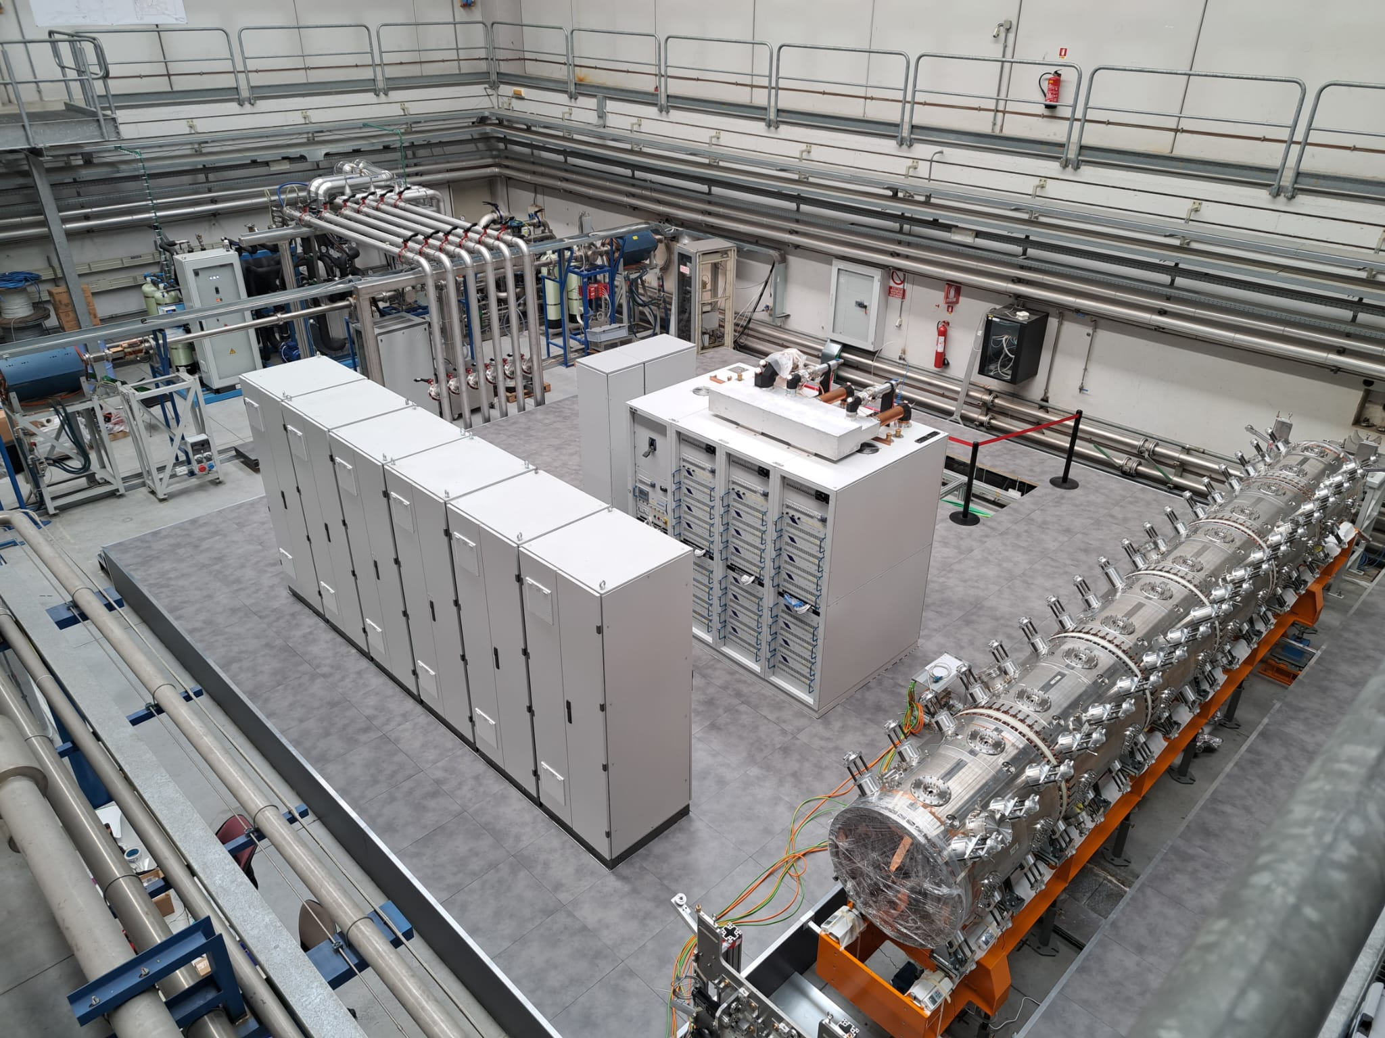
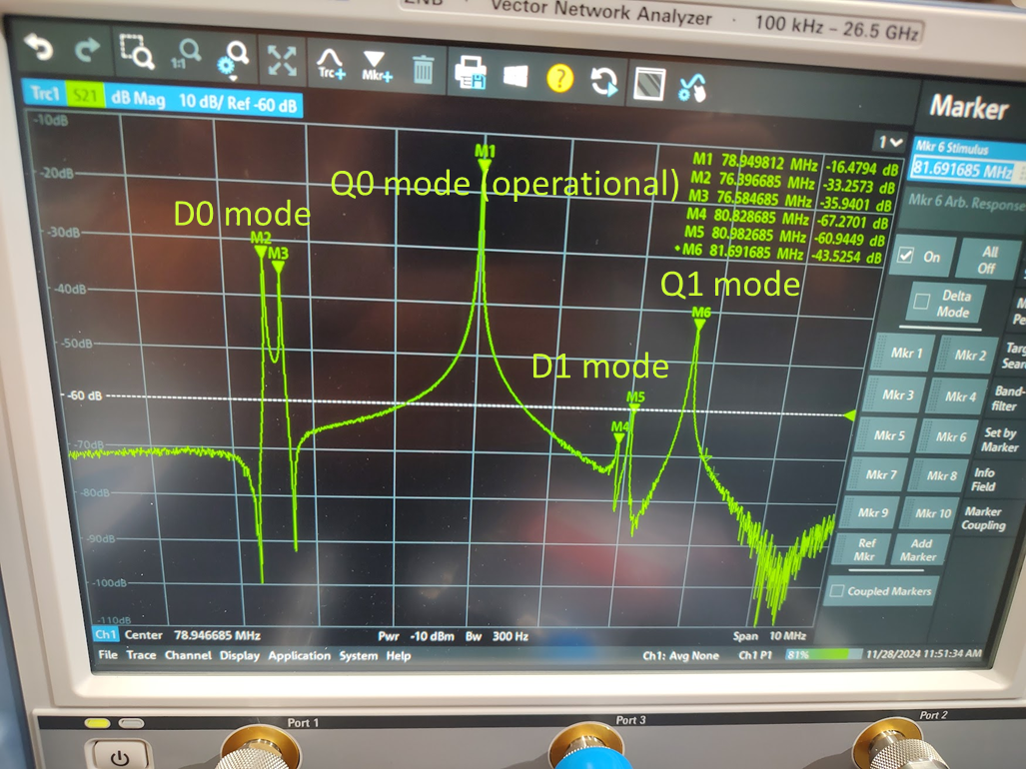
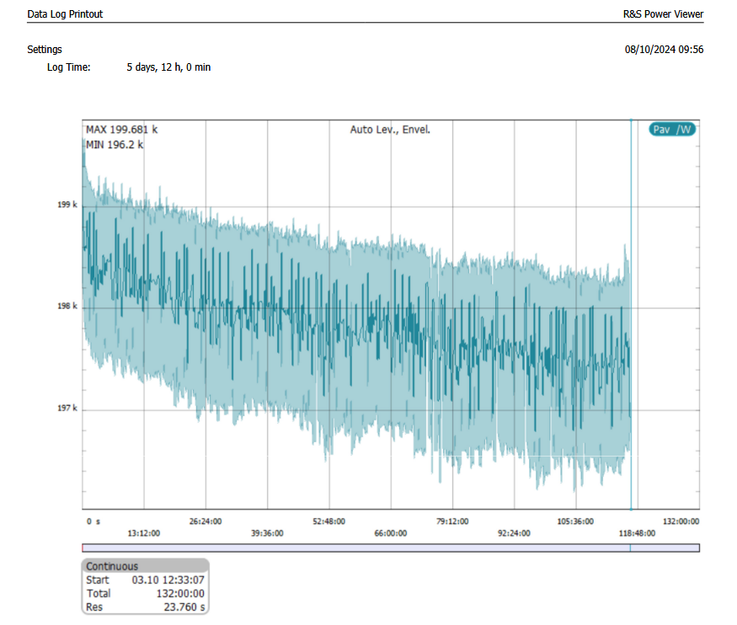
Phase 3B: Radio-Frequency Quadrupole
RFQ tuning results:
Q₀ mode is at 78.94 MHz
Differences with simulated values less than 0.4% for all modes
Dipole-free zone around Q₀ [-2.45 MHz, 1.97 MHz]
Q₀ = 14000 (70% of 2D value) will improve with final tuners and plates
High power test results:
201 kW @ 0 dBm
Efficiency = 66.1%
1 dB BW >= 1 MHz
Linearity of ± 0.943 dB in CW in the range [20 kW, 180 kW]
Long run test for 117 hrs successfully completed

Slide 17
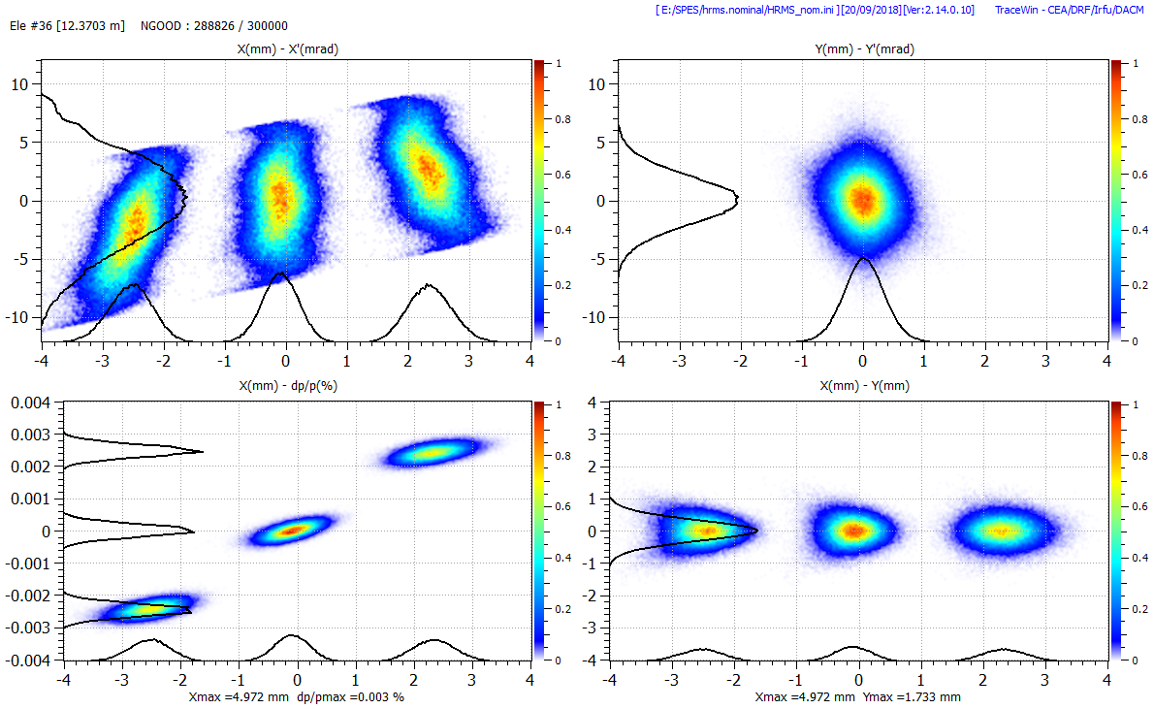
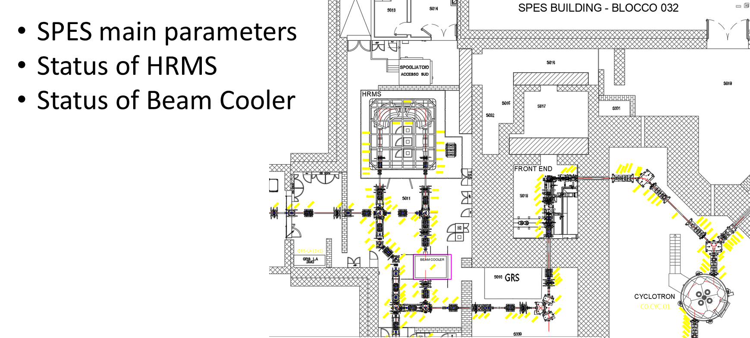
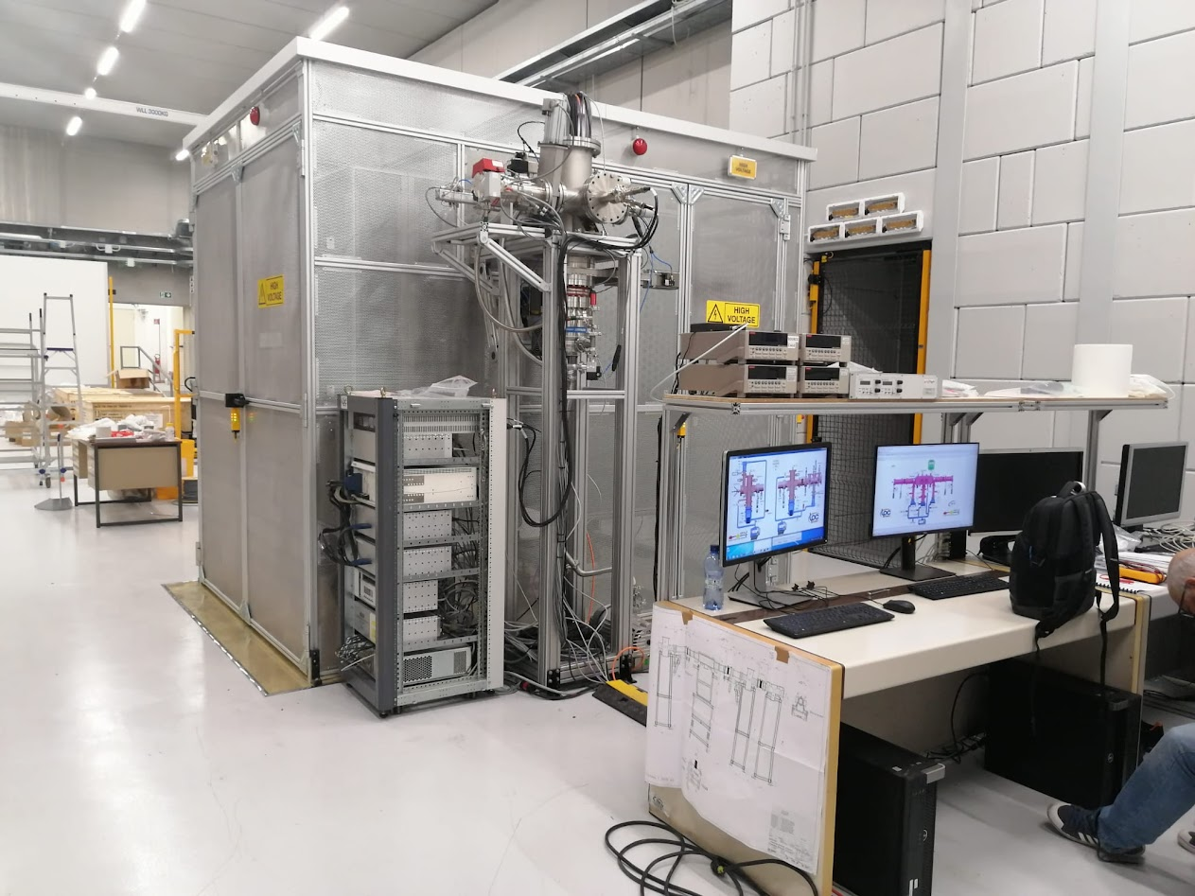
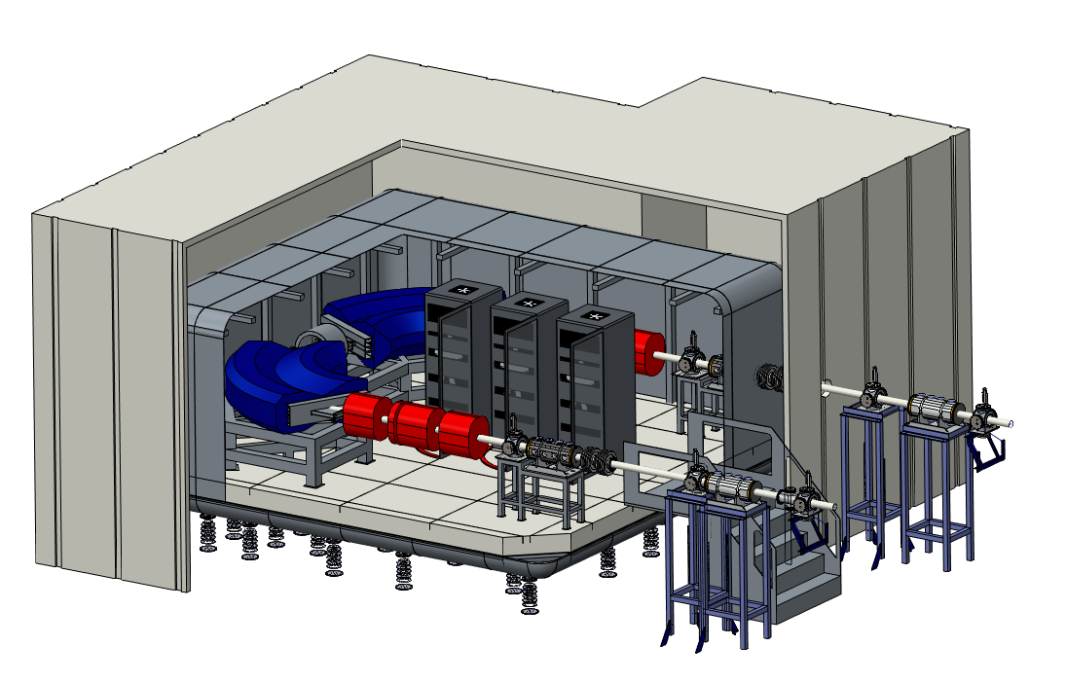
Phase 5: Beam Cooler + HRMS
+$\frac{1}{20000}$
-$\frac{1}{20000}$
+$\frac{1}{20000}$
-$\frac{1}{20000}$
+$\frac{1}{20000}$
1 eV
-$\frac{1}{20000}$
Beam cooler

Slide 18
Outline
SPES
PTA operation and status
PIAVE-TANDEM-ALPI availability

Slide 19
Global Beam on Target @ LNL

Slide 20
AGATA Beam on Target @ LNL

Slide 21
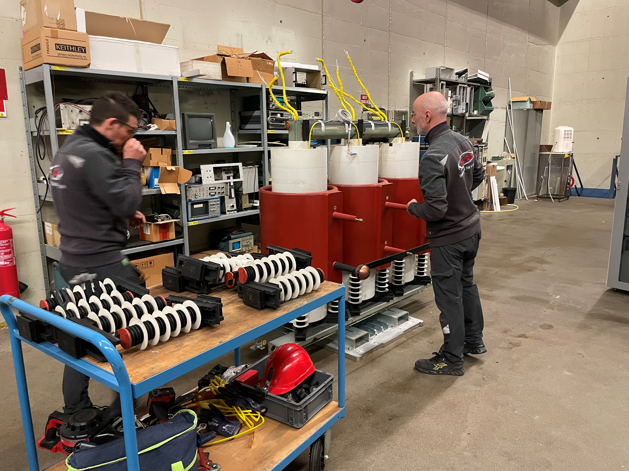
TANDEM & Injector status
Laddertron chain reached 6750 hrs with reduced degradation
7300 hrs operation will be reached by the end of July
Till now, 1011/1424 hrs operation reserved for AGATA
513 hrs unscheduled maintenance, all related to the injector
The injector recovered performance after transformer maintenance and vacuum pump replacement
New injector ionizers arrived at the end of June. The bake-out process will give us the first information on the feasibility of Ca and Mg shifts. In any case, a Ca beam test will be needed before the green light Ca and Mg beams

Slide 22
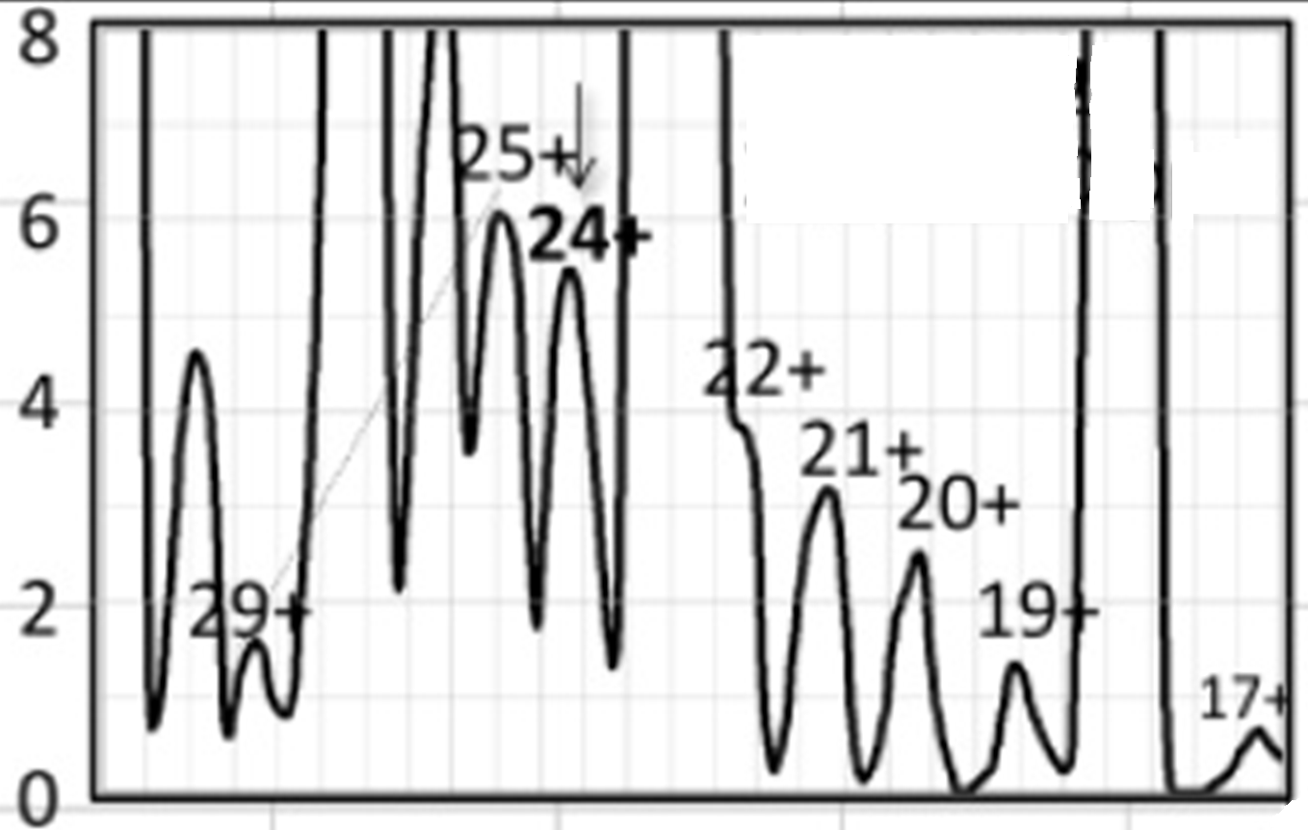
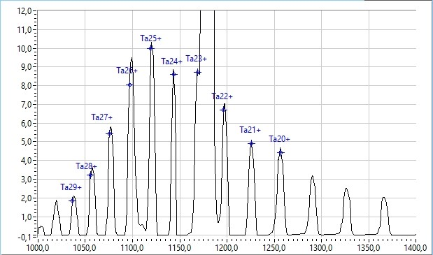
PIAVE-ALPI status: ECR upgrade
URANIUM COULD BE PRODUCED ONLY BY SPUTTERING BUT…
IT CANNOT BE TESTED AS A CONVENTIONAL BEAM SO….
HOW CAN WE DEDUCE ITS FEASIBILITY?
5.5 µA
¹⁸¹Ta
Uranium by sputtering @ GANIL
32+
0.7 µA
Another beam produced with the same technique
9 µA
¹⁸¹Ta @ LNL
THE LNL ECR SOURCE WAS ABLE TO PRODUCE Ta INTENSITIES COMPARABLE (IF NOT HIGHER) THAN THOSE PRODUCED AT GANIL. IT IS THEN REASONABLE TO EXPECT THAT THE PRODUCTION OF 500 nA OF U³²⁺ WITH THE SAME TECHNIQUE IS FEASABLE.

Slide 23
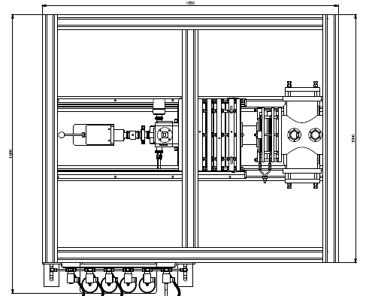
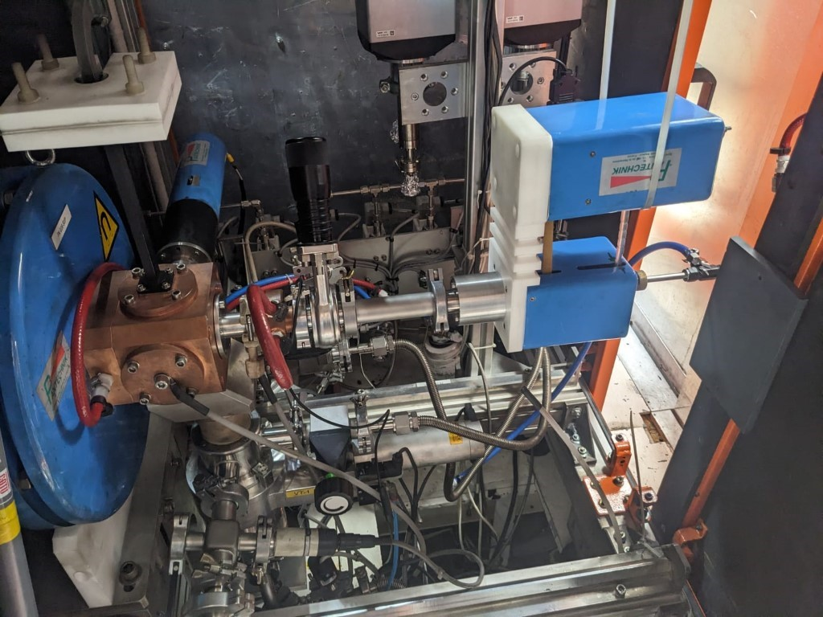
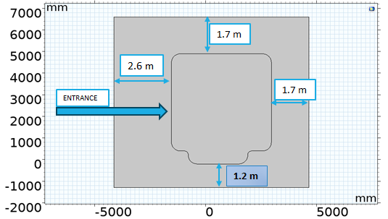
ECR needed upgrades
To dismount safely the sputtering system with U a further piece with a valve must be installed
Sputtering system connected to LEGIS
IN THIS CONDITION THE SPUTTERING SYSTEM CANNOT BE CONTAINED IN THE SOURCE BOX
THE EXECUTIVE PROJECT FOR THE PLATFORM MODIFICATION IS READY. RESEARCH OF QUALIFIED COMPANIES TO PUT IT IN PRACTICE IS ONGOING
THE SOURCE BOX THEN THE HV PLATFORM MUST BE ENLARGED BY 50 cm

Slide 24
PIAVE - ALPI maintenance
PIAVE-ALPI maintenance will start after summer:
Vacuum upgrade of the low-beta section
Tuners’ vacuum connection special maintenance
Valve boxed upgrade
PIAVE and ALPI conventional maintenance

Slide 25
Outline
SPES
PTA operation and status
PIAVE-TANDEM-ALPI availability

Slide 26
PTA availability
TANDEM operation will go on, as scheduled, till August 1st
A fast maintenance is foreseen in September, but there will be a delay related to the stripper foils replacement. Users’ shifts will start again on October 6th
Next December, Laddertron will overcome 9500 hours of operation. If and only if the January 2026 maintenance confirms Laddertron’s acceptable status, we will proceed with the same configuration till April 3rd.
On April 13th, the PIAVE-ALPI operation will be resumed, and new Uranium beams will be available. All shifts requiring Uranium beams will be grouped. At the end of the Uranium campaign, some days will be needed to replace the ECR plasma chamber. It is highly recommended to schedule the uranium campaign at the end of the experimental campaign to minimize risks related to the above-mentioned operation
No PTA beam is foreseen between the end of July 2026 and the end of December 2026

Slide 27
Thank you

