Slide 1
Concluding remarks
7th AGATA pre-PAC LNL July 10-11 2025
Magda Zielińska Alain Goasduff

Slide 2
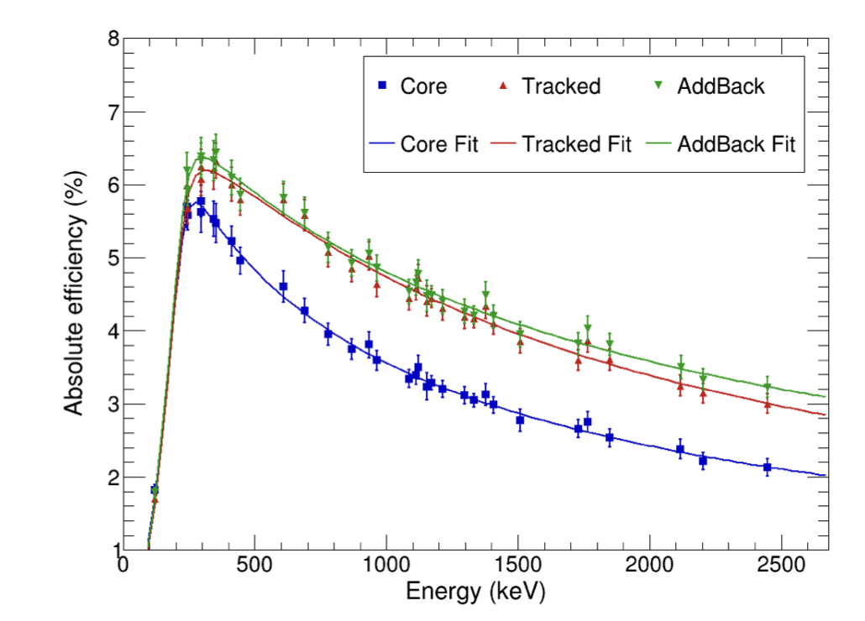
Summary
PAC will be held at LNL from October 8 to 10
https://www.lnl.infn.it/en/pac-2/
Submission deadline: first week of september (tbc.)
BEAM:
Available beams: https://www.lnl.infn.it/wp-content/uploads/Fasci_TAP.pdf
In case of doubts: PACbeams@lnl.infn.it
TARGET:
For target made at LNL contact: massimo.loriggiola@lnl.infn.it and lorenzo.loriggiola@lnl.infn.it with alain.goasduff@lnl.infn.it in cc
For self provided targets be ready with all the characteristics to answer the potential question from the LNL TAC / PAC
AGATA:
Consider 11 ATC only with the efficiency curve available on the pre-PAC indico page for the beam time request estimation
Maximum local trigger rate recommended 50 kHz / crystal
Maximum validate rate ( == data on disks) 4.5 kHz / crystal
ANCILLARY:
please contact the local persons in charge of the detector!

Slide 3
LNL Ancillary responsible persons
Ancillary coordinator: daniele.mengoni@pd.infn.it
Plunger: filippo.angelini@studenti.unipd.it
AGATrace: stefano.capra@mi.infn.it
SPIDER: naomi.marchini@fi.infn.it
SAURON: matus.balogh@lnl.infn.it, elia.pilotto@studenti.unipd.it
PRISMA: franco.galtarossa@pd.infn.it, lorenzo.corradi@lnl.infn.it
DANTE: kseniia.rezynkina@pd.infn.it
EXOTIC: sara.pigliapoco@pd.infn.it, marco.mazzocco@unipd.it

