Slide 1
Surface Technology and Superconductivity Service
INFN Legnaro National Laboratories
May 13, 2025
Collaboration meeting
Dorothea Fonnesu - fonnesu@infn.it

Slide 2
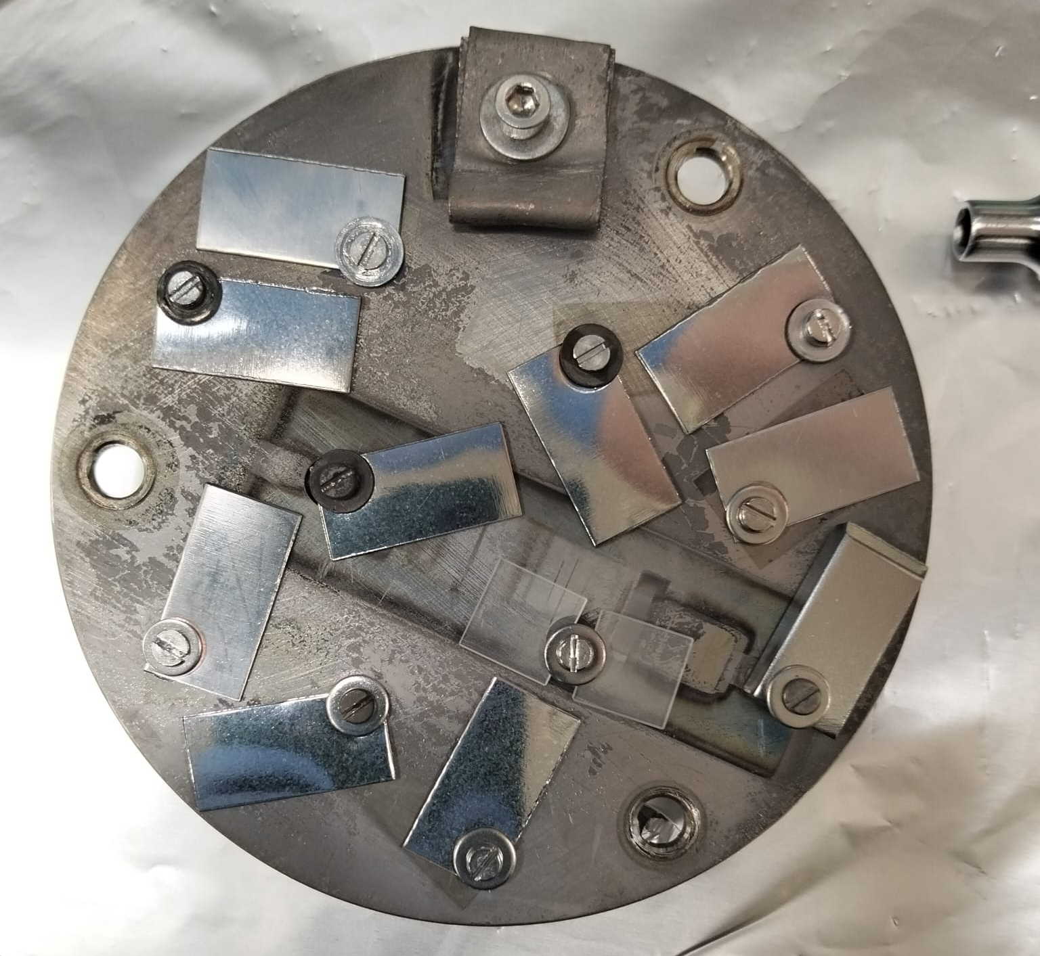
Outline
Nb₃Sn/Cu state of the art at LNL
Nb₃Sn activities for SuperMAD
New dedicated coating system
Currently ongoing
Next steps

Slide 3
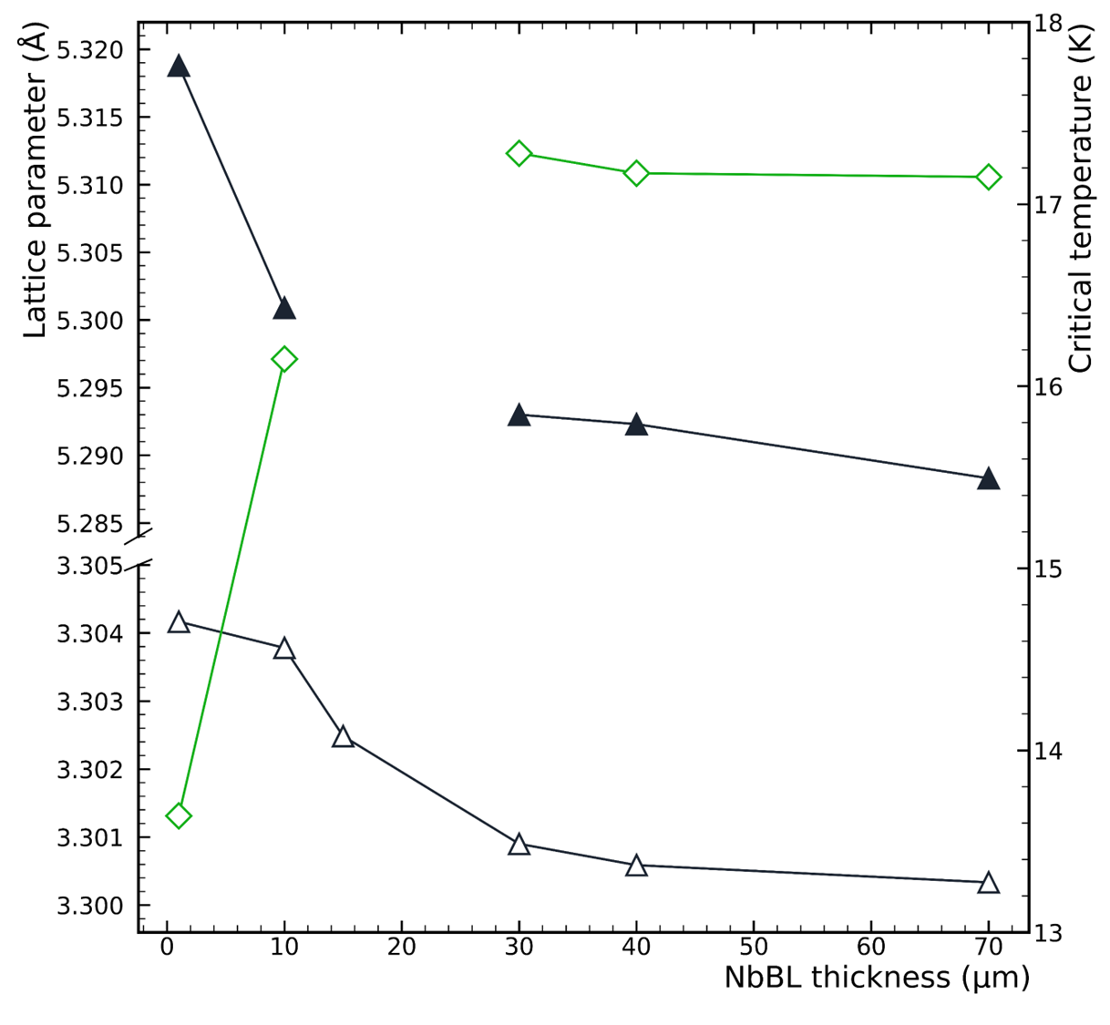
Nb₃Sn/Cu state of the art at LNL
Optimized recipe:
Low cathode power < 20 W
Deposition pressure 2 x 10⁻² mbar
No annealing
Deposition temperature 600 ºC – 650 ºC
NbBL thickness = 30+ μm
NbBL thickness plays a major role:
A thicker NbBL promotes the formation of the A15 phase (see T_{c}): accomodation effect
30+ µm is the “saturation” thickness
650 °C
Nb₃Sn
NbBL
D. Ford

Slide 4
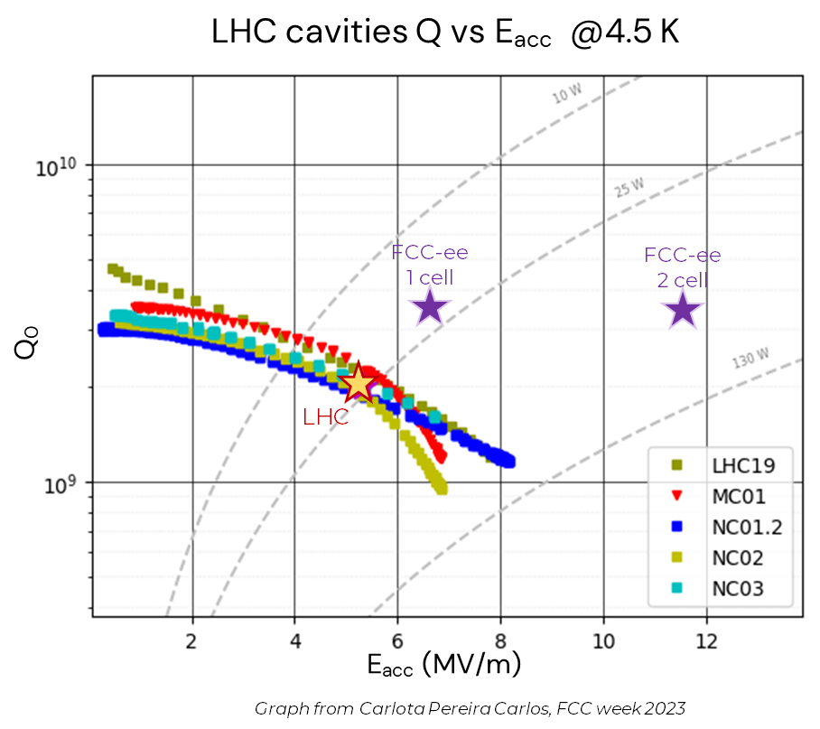
Nb₃Sn/Cu state of the art at LNL
Comparison to LHC baseline: Q₀ vs. E_{acc} @ 4.5 K
G = 216 Ω
QPR Nb₃Sn/Nb bulk
Equivalent to
Q₀ ~ 9 x 10⁹
@ 5 MV/m
@4.5 K
(O. Kugeler, S. Keckert)
Quadrupole Resonator (QPR)
test of Nb₃Sn/bulk Nb
coating according to optimized recipe
LHC cavities: Nb/Cu 400 MHz

Slide 5
Nb₃Sn activities for
WP1: Superconducting Materials
Conversion Power
DCMS deposition recipe with nominal T_{c} ready and successfully RF tested (QPR) Proceed with:
R&D on pulsed-MS deposition to improve material superconducting AC performances in high DC magnetic field
Parallel investigation of parameters toward improvement of current recipe, with goals: decreasing NbBL thickness, lowering T_{dep}
$$P_{aγ→γ}=g_{αγγ}^{2}\frac{ρ_{a}}{m_{a}}B^{2}ω_{0}VC\frac{Q_{a}Q_{c}}{{Q_{a}+Q}_{c}}$$
Reminder (Nb₃Sn):
Q and B
Medium Performances at Very High B field
V and C
Direct Deposition via PVD
Easy Scalable Technology
Technology Readiness Level
Medium-High: Cavity prototypes already made

Slide 6
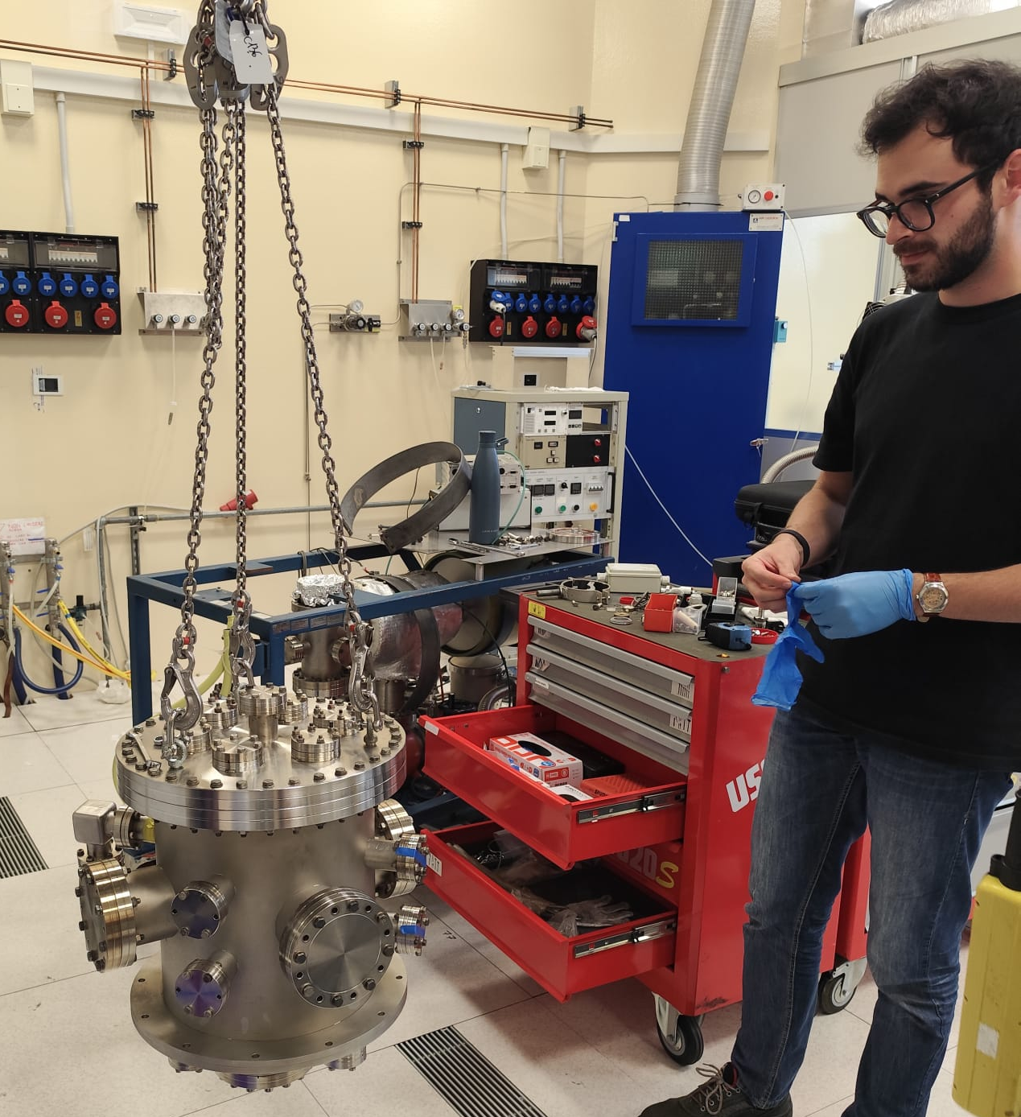
New dedicated coating system
New sputtering system:
fully dedicated to pulsed-MS depositions
2” magnetron with commercial stoichiometric single Nb₃Sn target
operated in DCMS: T_{c} = 17.5 K for Nb₃Sn/Al₃O₂ substrate (*) → demonstrates we have good control over system → demonstrates reproducibility of DCMS recipe (4” system)
More results:
*M. Lazzari’s MSc thesis
(*)
Sn-rich islands observed on DCMS samples

Slide 7
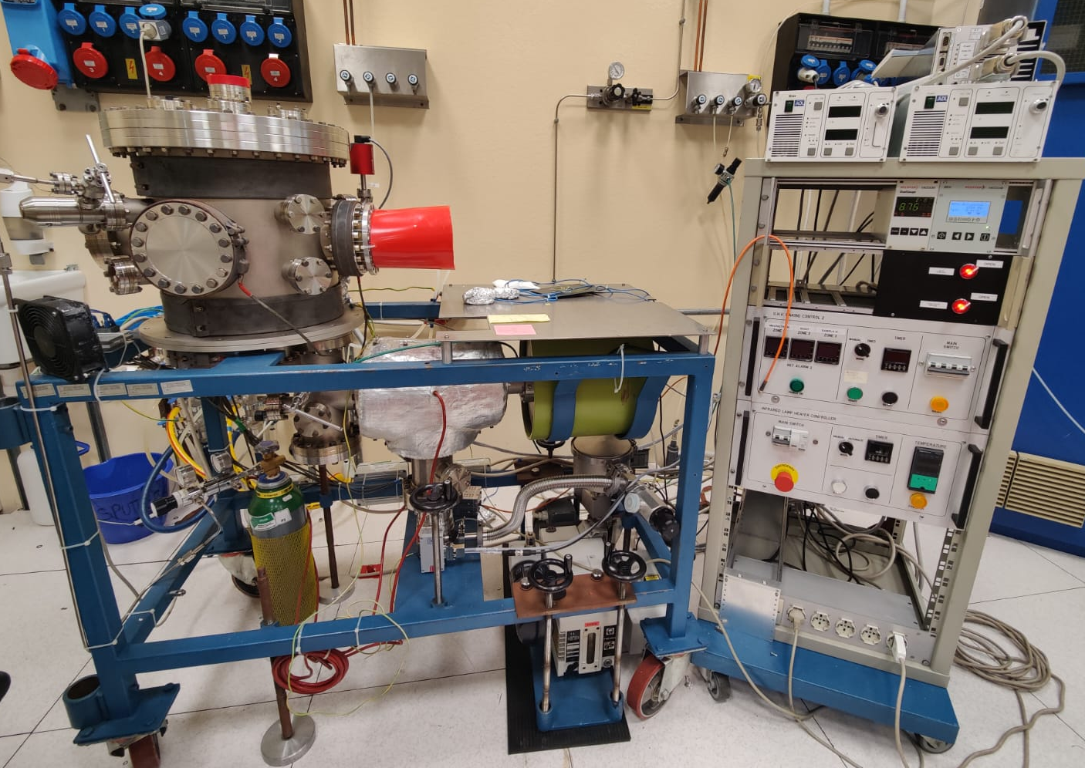
Currently ongoing
With new sputtering system being operational:
1x MSc student fully dedicated to it (E. Cremonesi)
deposition runs are resource- and time-consuming
improve/assess pulsed-MS process robustness
identify/confirm most influential parameters with minimal # of runs
→ T_{c} and a oriented DOE: 9 runs with T_{dep}, f, p, P (NbBL thickness is intrinsic)
preparation of first batches of NbBLs (2 μm, 16 μm, 30 μm)
first run prepared, baking done and deposition starting today 🤩
NbBL-2 (2)
NbBL-16 (1)
NbBL-30 (2)
NbBL-30 (1)
NbBL-2 (1)
NbBL-16 (2)
2x Al₂O₃
bulk Nb
NbBL-2 (3)
NbBL-16 (3)
NbBL-30 (3)

Slide 8
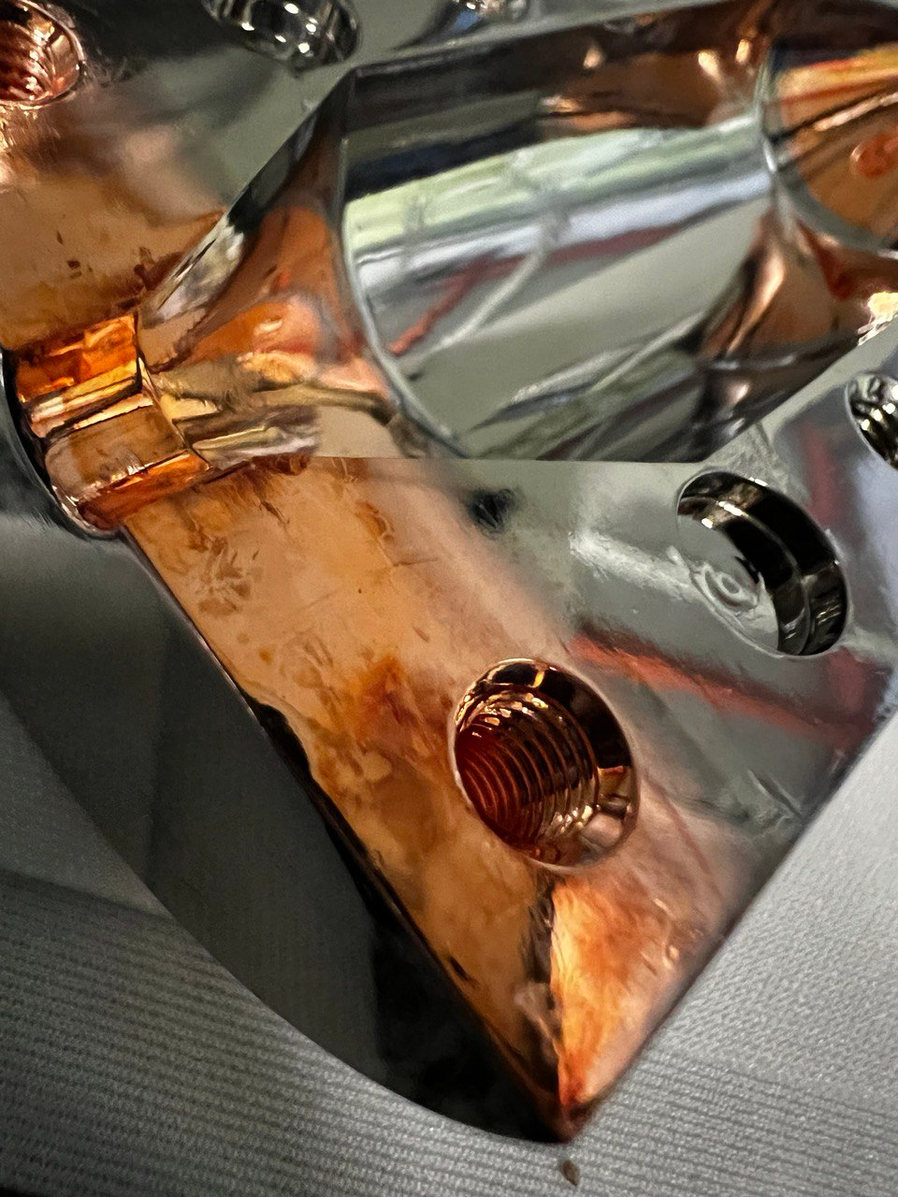
Next steps: 9 GHz haloscope
Workflow
Stripping of the SC layer
Persulphate etching
Plasma Electrolytic Polishing preparation
NbBL deposition
Nb₃Sn deposition
Measurements
E. Chyhyrynets
PEP
verified
Persulphate etched
Persulphate etched
PEP

Slide 9
Thank you!

