Slide 1

LONGITUDINAL DYNAMICS
Along the direction of the acceleration
How the particles moves and what are the forces acting
David Alesini
(INFN-LNF, Frascati, Rome, Italy)

Slide 2

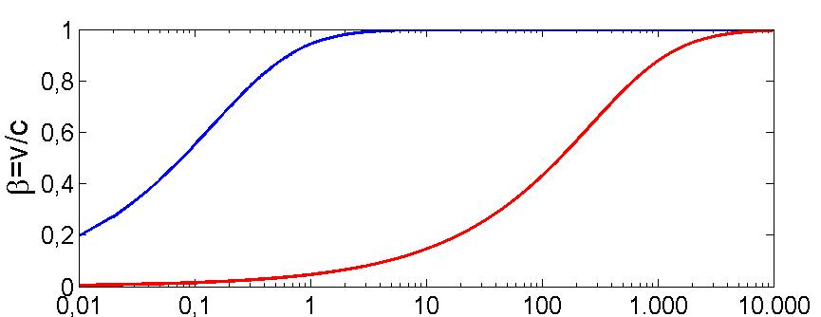
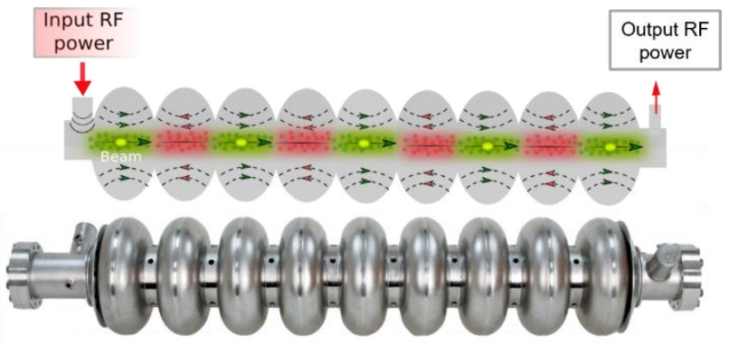
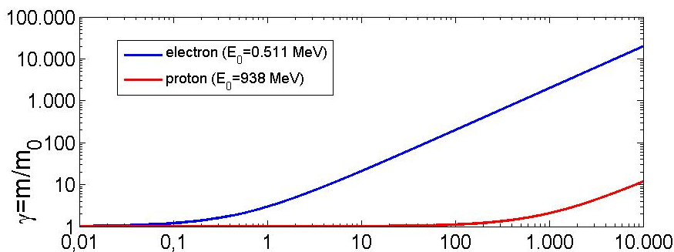
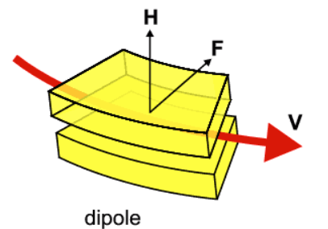

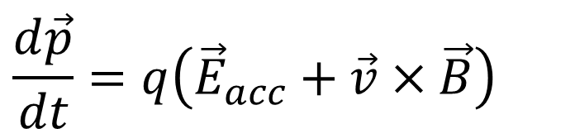


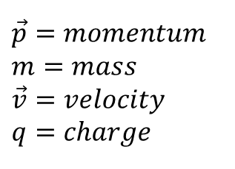

LORENTZ FORCE: ACCELERATION AND FOCUSING RECAP
The basic equation that describes the acceleration/bending/focusing processes is the Lorentz Force.
Particles are accelerated through electric fields and are bended and focused through magnetic fields.
$$\vec{p}=momentum \\ m=mass \\ \vec{v}=velocity \\ q=charge$$
$$\frac{d\vec{p}}{dt}=q\left({\vec{E}}_{acc}+\vec{v}×\vec{B}\right)$$
$$E^{2}=E_{0}^{2}+p^{2}c^{2}$$
ACCELERATION
BENDING
p⁺
$$p=qBρ$$
Light particles
$$ΔE=q{ΔV}_{acc}$$
e⁻
Heavy particles
Energy [MeV]
$$ρ$$
B
γ=E/E₀=m/m₀
Energy [MeV]
David Alesini, Longitudinal Dynamics, Erice 2025

Slide 3
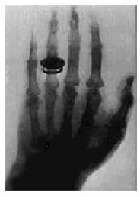

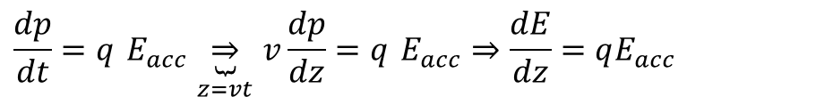
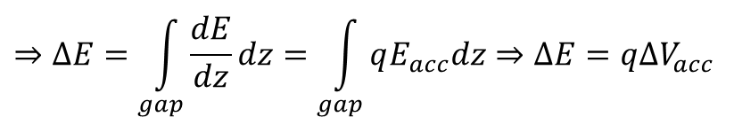
DC ACCELERATION: ENERGY GAIN
The first historical linear particle accelerator was built by the Nobel prize Wilhelm Conrad Röntgen (1900). It consisted in a vacuum tube containing a cathode connected to the negative pole of a DC voltage generator. Electrons emitted by the heated cathode (thermoionic emission) were accelerated while flowing to another electrode connected to the positive generator pole (anode). Collisions between the energetic electrons and the anode produced X-rays.
+
ΔV
-
E_{z}
source
z
Electric field
Anode
Cathode
+
E_{z}
gap
Voltage ΔV
z
Energy Gain calculation
Energy-momentum relation
ΔE
$$E^{2}=E_{0}^{2}+p^{2}c^{2}⇒2EdE=2pdpc^{2}⇒dE=v\frac{mc^{2}}{E}dp⇒dE=vdp$$
t
$$\frac{dp}{dt}=q E_{acc}\underset{z=vt}{\underbrace{⇒}}v\frac{dp}{dz}=q E_{acc}⇒\frac{dE}{dz}=qE_{acc}$$
Lorentz force
rate of energy gain per unit length
$$⇒ΔE=\int_{gap}{\frac{dE}{dz}dz}=\int_{gap}{qE_{acc}dz}⇒ΔE=q{ΔV}_{acc}$$
energy gain
David Alesini, Longitudinal Dynamics, Erice 2025

Slide 4
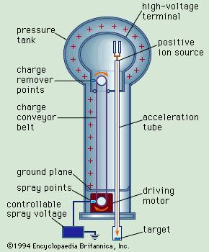
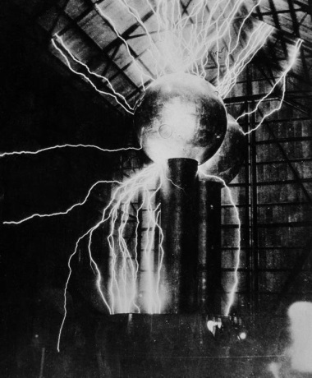
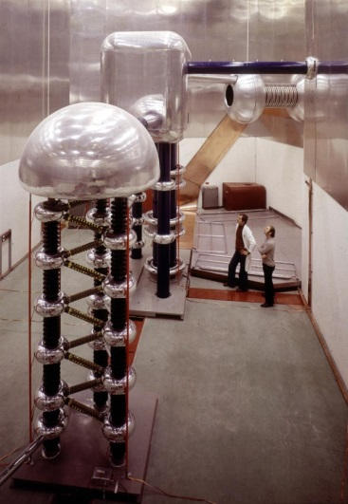
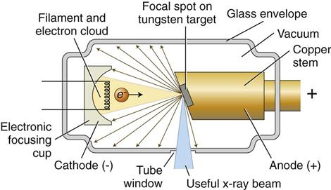
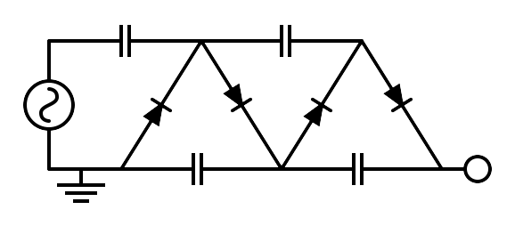
ELECTROSTATIC ACCELERATORS
To increase the achievable maximum energy, Van de Graaff invented an electrostatic generator based on a dielectric belt transporting positive charges to an isolated electrode hosting an ion source. The positive ions generated in a large positive potential were accelerated toward ground by the static electric field.
LIMITS OF ELECTROSTATIC ACCELERATORS
DC voltage as large as ∼10 MV can be obtained (E∼10 MeV). The main limit in the achievable voltage is the breakdown due to insulation problems.
APPLICATIONS OF DC ACCELERATORS
DC particle accelerators are in operation worldwide, typically at V<15MV (E_{max}=15 MeV), I<100mA.
They are used for:
⇒ material analysis
⇒ X-ray production,
⇒ ion implantation for semiconductors
⇒ first stage of acceleration (particle sources)
750 kV Cockcroft-Walton
Linac2 injector at CERN from 1978 to 1992
David Alesini, Longitudinal Dynamics, Erice 2025

Slide 5
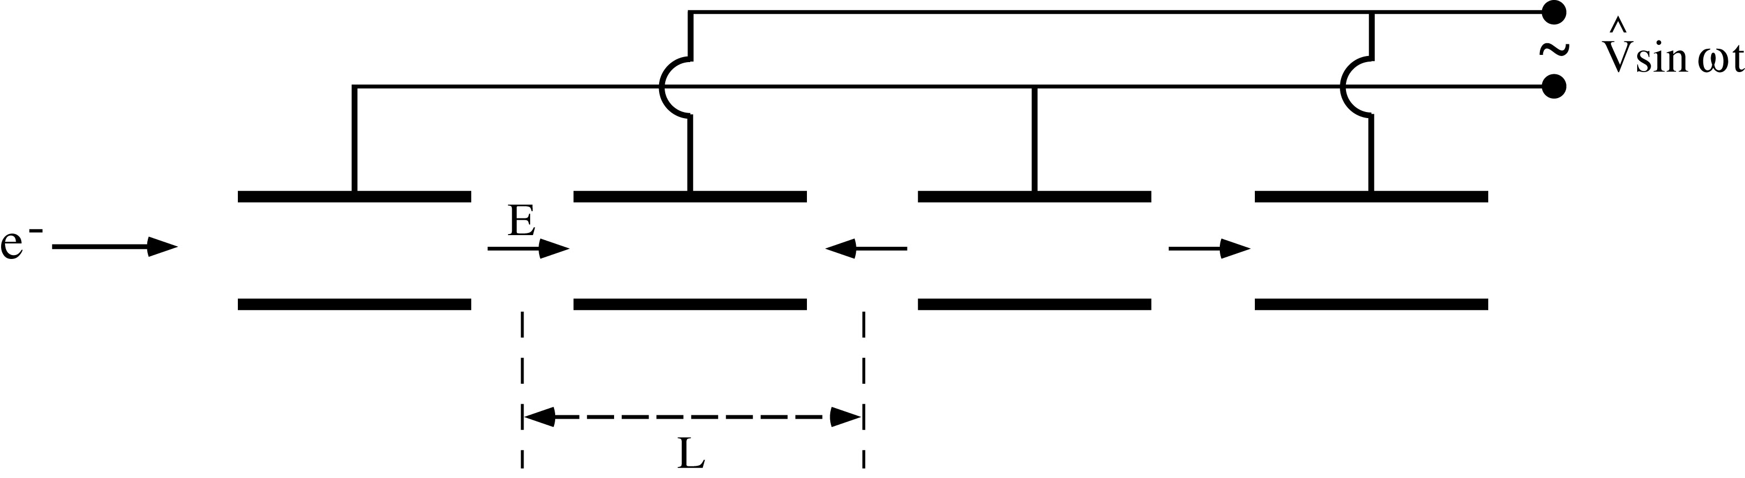
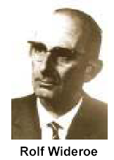
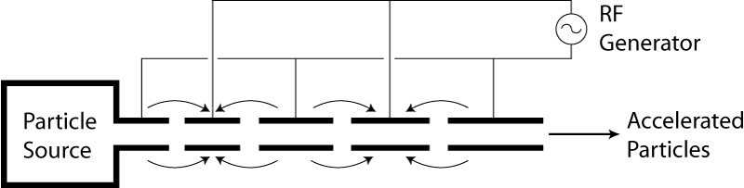
RF Accelerators : Wideröe “Drift Tube LINAC” (DTL)
(protons and ions)
Basic idea: the particles are accelerated by the electric field in the gap between electrodes connected alternatively to the poles of an AC generator. This original idea of Ising (1924) was implemented by Wideroe (1927) who applied a sine-wave voltage to a sequence of drift tubes. The particles do not experience any force while travelling inside the tubes (equipotential regions) and are accelerated across the gaps. This kind of structure is called Drift Tube LINAC (DTL).
⇒If the length of the tubes (or, equivalently, the distances between the centers of the accelerating gaps) increases with the particle velocity during the acceleration such that the time of flight between gaps is kept constant and equal to half of the RF period, the particles are subject to a synchronous accelerating voltage and experience an energy gain of ∆E=q∆V at each gap crossing.
⇒In principle a single RF generator can be used to indefinitely accelerate a beam, avoiding the breakdown limitation affecting the electrostatic accelerators.
⇒The Wideroe LINAC is the first RF LINAC
L₁
L_{n}
David Alesini, Longitudinal Dynamics, Erice 2025

Slide 6

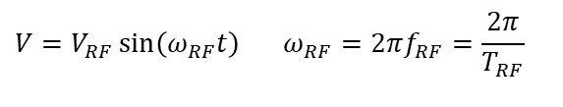


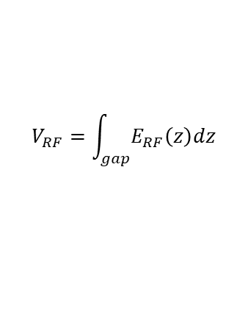
RF ACCELERATION: BUNCHED BEAM
We consider now the acceleration between two electrodes fed by an RF generator
$$V=V_{RF}\sin\left(ω_{RF}t\right) ω_{RF}=2πf_{RF}=\frac{2π}{T_{RF}}$$
$$V_{RF}=\int_{gap}{E_{RF}\left(z\right)dz}$$
E_{z}
source
Only these particles are accelerated
z
ΔE
$$E_{z}\left(z,t\right)=E_{RF}\left(z\right)\sin\left(ω_{RF}t\right)$$
gap
t_{inj}
$$φ_{inj}=ω_{RF}t_{inj}$$
z
$$ΔE=qV_{RF}\sin\left(φ_{inj}\right)$$
These particles are not accelerated and basically are lost during the acceleration process
DC acceleration
RF acceleration
charge
charge
Bunched beam (in order to be synchronous with the external AC field, particles have to be gathered in non-uniform temporal structure)
t
RF period
t
David Alesini, Longitudinal Dynamics, Erice 2025

Slide 7
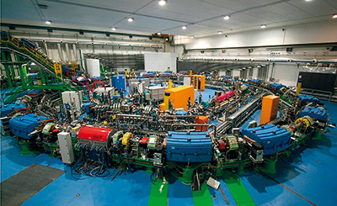
SYNCHROTRONS
Synchrotrons are circular accelerators. Particles are bended by dipole magnets, while acceleration is provided by standing wave RF cavities.
Differently from LINACs, in synchrotrons the particles run over closed orbits so that they are accelerated by the RF cavities in a very large number of turns.
Since the beam energy and momentum increase turn by turn, the bending magnetic field has to be increased proportionally to the momentum, in order to keep invariant the bending radii and the orbit.
The revolution frequency also increases with energy, which requires variation of the RF frequency to maintain the synchronization between beam and accelerating field.
V
t
E
ρ
bending
radius
V
V
V
David Alesini, Longitudinal Dynamics, Erice 2025

Slide 8
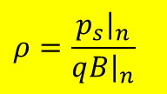


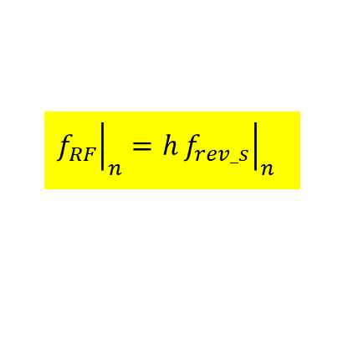
Synchronous particle AND HARMONIC NUMBER
The synchronous particle is the particle that undergoes the ideal acceleration process, gaining a constant amount of energy ΔE per turn remaining all the time on the design orbit.
To this purpose two conditions have to be satisfied turn by turn:
V
turn n
T_{rev}
turn n+1
Momentum of the synchronous particle at turn n
Condition on the magnetic field: during the acceleration, the magnetic field has to increase in order to keep the radius constant (energy ramping⇒magnetic field ramping)
$$ρ=\frac{{\left.p_{s}\right|}_{n}}{q{\left.B\right|}_{n}}$$
$$V_{RF}$$
dipole bending radius (invariant during the whole acceleration process)
t₁
t₂
time
dipole magnetic field at turn n
T_{RF}
Condition on the rf frequency:
To gain always the same amount of energy at each turn, the synchronous particle needs to arrive at the cavity after one turn with the same phase.
This implies that the rf frequency must be an integer multiple of the revolution frequency
Moreover, during acceleration, the particle velocity increases (and tends asymptotically to the speed of light), as a consequence the frequency of the RF system (f_{RF}) must change to be synchronous with the beam motion.
${ΔE}_{s}=qV_{RF}sinφ_{s}$= $qV_{RF}\sin\left(ω_{RF}t_{s}\right)$
T_{rev 1}
T_{rev 2}
$${\left.f_{RF}\right|}_{n}=h{\left.f_{rev_s}\right|}_{n}$$
T_{rev}
harmonic number:
corresponds to the number of stable synchronous particles that can be accelerated in the synchrotron
time
David Alesini, Longitudinal Dynamics, Erice 2025

Slide 9
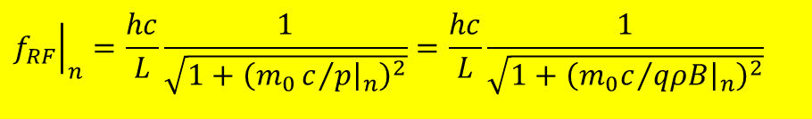
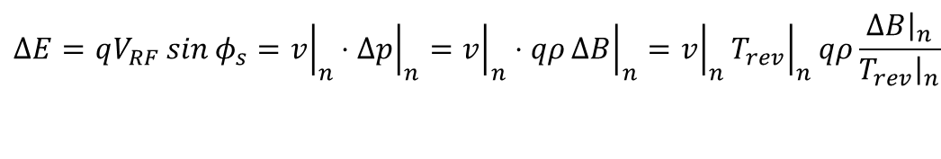
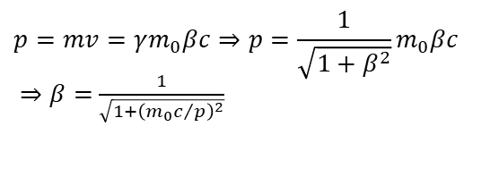



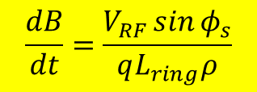

ACCELERATION PROCESS: B FIELD and f_{RF} VARIATION
frequency
Energy
velocity
c
T_{rev}
hc/L
ΔE
L/c
1
2
3
4
5
6
turn
1
2
3
4
5
6
turn
1
2
3
4
5
6
turn
1
2
3
4
5
6
turn
Dipole field
$$\begin{matrix}ΔE=qV_{RF}\sin{φ_{s}}={\left.v\right|}_{n}{\left.⋅Δp\right|}_{n}={\left.v\right|}_{n}⋅qρ{\left.ΔB\right|}_{n}={\left.v\right|}_{n}{\left.T_{rev}\right|}_{n}qρ\frac{{\left.ΔB\right|}_{n}}{{\left.T_{rev}\right|}_{n}} \\ \\ \end{matrix}$$
$$\frac{dB}{dt}=\frac{V_{RF}\sin{φ_{s}}}{qL_{ring}ρ}$$
RF frequency
$$dE=vdp$$
$$L_{ring}$$
$$\sim \frac{dB}{dt}$$
$${\left.f_{RF}\right|}_{n}={\left.hf_{rev}\right|}_{n}=h\frac{{\left.v\right|}_{n}}{L}=h\frac{c{\left.β\right|}_{n}}{L}$$
B
$$p=mv=γm_{0}βc⇒p=\frac{1}{\sqrt{1+β^{2}}}m_{0}βc$$
$⇒β=$ $\frac{1}{\sqrt{1+{\left({m_{0}c}/p\right)}^{2}}}$
f_{RF} asyntotically tends to hc/L as B becomes much larger than m₀c/qρ , i.e. when the particle becomes ultra-relativistic and v→c
rf frequency evolution can be directly calculated from the magnetic cycle
The Energy of the ring is “ramped” increasing B and contemporary increasing f_{RF}
B has to grow linearly with time
$${\left.f_{RF}\right|}_{n}=\frac{hc}{L}\frac{1}{\sqrt{1+{\left(m_{0}c/{{\left.p\right|}_{n}}\right)}^{2}}}=\frac{hc}{L}\frac{1}{\sqrt{1+{\left({m_{0}c}/{qρ{\left.B\right|}_{n}}\right)}^{2}}}$$
B_{in}
David Alesini, Longitudinal Dynamics, Erice 2025
time

Slide 10
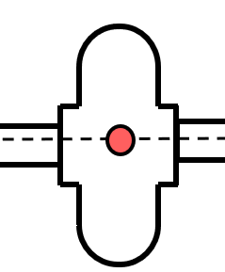

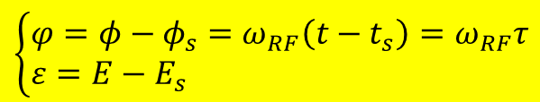
NON-SYNCHRONOUS PARTICLES
The longitudinal dynamics (position and energy evolution) of a non-synchronous particle (“close” in position and energy to the synchronous particle) can be described using the following quantities calculated at the cavity position which describe the generic particle phase (time of arrival) and energy with respect to the synchronous particle:
Arrival time (phase) of a generic particle at the RF cavity
Arrival time (phase) of the synchronous particle at the RF cavity
$$\left\{\begin{aligned}&φ=φ−φ_{s}=ω_{RF}\left(t−t_{s}\right)=ω_{RF}τ \\ &ε=E−E_{s}\end{aligned}\right.$$
Energy of a generic particle (immediately before the RF cavity)
Energy of the synchronous particle (immediately before the RF cavity)
V
Energy
ε>0 means that the non-synchronous particle has an energy larger than the synchronous one
E
E_{s}
time
t_{s}
t
n-1
n
n+1
turn
$$τ$$
τ>0 means that the non-synchronous particle arrives later than the synchronous one.
David Alesini, Longitudinal Dynamics, Erice 2025

Slide 11


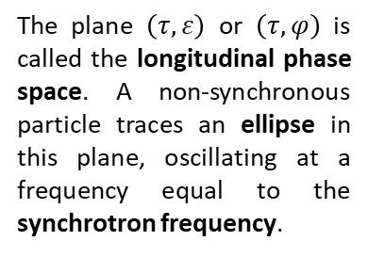
SYNCHROTRON OSCILLATIONS: INTUITIVE APPROACH
Consider a synchronous phase on the rising slope of the RF voltage and a non-synchronous particle entering the RF cavity later than the synchronous particle, but with the same energy at cavity entrance (turn 1).
The particle experiences a higher accelerating voltage than the synchronous particle, gaining more velocity. On the next turn, it partially recovers its lag relative to the synchronous particle. (Conversely, a particle arriving earlier sees a lower voltage and falls slightly behind on the following turn).
Thus, non-synchronous particles are progressively pulled toward the synchronous particle. Due to overshooting when they reach the synchronous phase, they oscillate around it. This mechanism is known as the principle of phase stability.
These oscillations are called synchrotron oscillations, and their frequency is the synchrotron frequency
3…
turn
1
2
1
2
3
turn
V_{RF}
V_{RF}
The plane $\left(τ,ε\right)$ or $\left(τ,φ\right)$is called the longitudinal phase space. A non-synchronous particle traces an ellipse in this plane, oscillating at a frequency equal to the synchrotron frequency.
turn n
turn n+1
3
time
time
2
t_{s}
t
t_{s}
t
1
$$τ_{n}$$
$$τ_{n+1}$$
Synchronous particle
David Alesini, Longitudinal Dynamics, Erice 2025

Slide 12

STABLE AND UNSTABLE SYNCHRONOUS PHASE
By examining the accelerating voltage curve as a function of time, one could in principle place the synchronous particle on the descending side of the VRF peak.
In this position, the energy gain per turn for the synchronous particle remains the same.
However, a non-synchronous particle entering the cavity earlier or later than the synchronous particle will progressively drift away, increasing its lead or lag.
Thus, the two possible synchronous phases correspond to one STABLE phase and one UNSTABLE phase. Only the stable phase can be used for accelerating a particle bunch.
V_{RF}
time
STRATEGY FOR STUDY NON-SYNCHRONOUS PARTICLES LONGITUDINAL DYNAMICS
Calculation of the revolution-time variation for a non-synchronous particle whose momentum differs from the synchronous momentum by a small amount.
Solve the equations in the case of small-amplitude oscillations
large-amplitude oscillations
electron rings
Write two coupled differential equations that describe the evolution of $φ$ and $ε$
David Alesini, Longitudinal Dynamics, Erice 2025

Slide 13
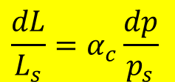
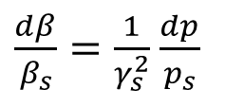
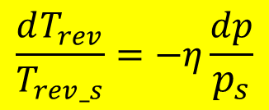
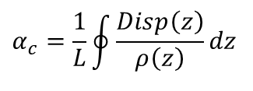

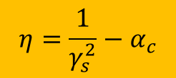
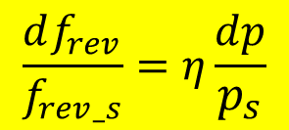
MOMENTUM COMPACTION AND SLIP FACTOR
p_{s}+dp
If a particle is slightly shifted in momentum (dp) with respect to the synchronous one (p_{s}), we have:
p_{s}
cavity
a different velocity
a different orbit length.
$\frac{dβ}{β_{s}}=\frac{1}{γ_{s}^{2}}$ $\frac{dp}{p_{s}}$
The relative orbit length variation for a given relative particle momentum variation is a property of ring optics called “momentum compaction” factor a :
DIPOLE
p_{s}
$$\frac{dL}{L_{s}}=α_{c}\frac{dp}{p_{s}}$$
$$α_{c}=\frac{1}{L}\oint{\frac{Disp\left(z\right)}{ρ\left(z\right)}dz}$$
p_{s}+dp (longer trajectory)
there is one energy called transition energy γ_{tr} for which η becomes zero, meaning that there is no change in the revolution frequency for particles with a small momentum deviation
$T_{rev}=\frac{L}{βc}⇒\frac{dT_{rev}}{T_{rev_s}}=\frac{dL}{L_{s}}−\frac{dβ}{β_{s}}=α_{c}\frac{dp}{p_{s}}−\frac{1}{γ_{s}^{2}}\frac{dp}{p_{s}}$= $\left(α_{c}−\frac{1}{γ_{s}^{2}}\right) \frac{dp}{p_{s}}$
$$γ_{tr}=\frac{1}{\sqrt{α_{c}}}$$
$$η=\frac{1}{γ_{s}^{2}}−α_{c}$$
$$\frac{dT_{rev}}{T_{rev_s}}=−η\frac{dp}{p_{s}}$$
$$\frac{df_{rev}}{f_{rev_s}}=η\frac{dp}{p_{s}}$$
⇒ α_{c} is usually positive so that:
below transition energy (η>0) particle revolution frequency increases with energy (the velocity increase dominates the orbit length increase);
above transition energy (η<0) revolution frequency decreases with energy (since v≅c and orbit length variation dominates in this case).
α_{c} is usually <0.01⇒with 1% energy variation we have 10⁻⁴ relative length orbit variation (dL/L)
“slip factor” is the relative change in revolution frequency with momentum
David Alesini, Longitudinal Dynamics, Erice 2025

Slide 14
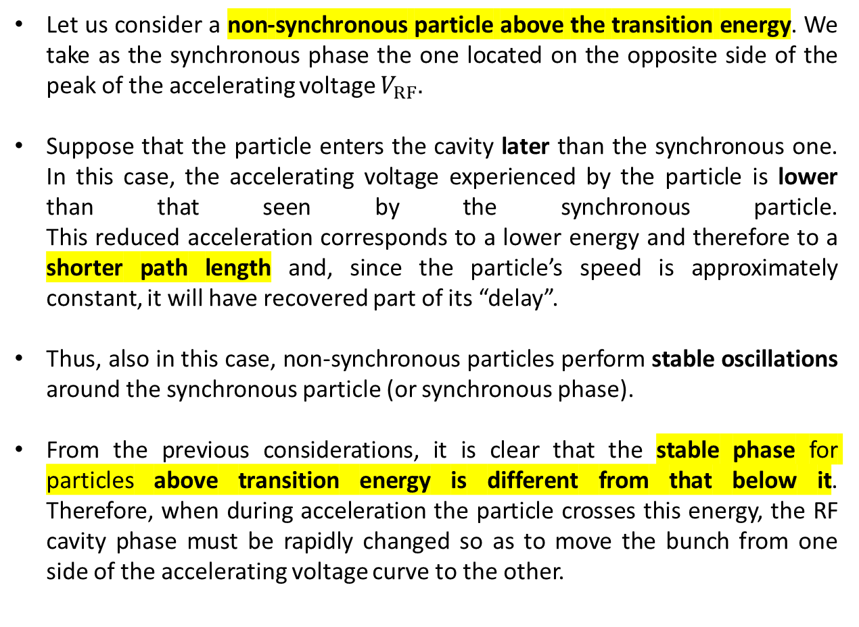
SYNCHROTRON OSCILLATIONS ABOVE TRANSITION ENERGY:
INTUITIVE APPROACH
Let us consider a non-synchronous particle above the transition energy. We take as the synchronous phase the one located on the opposite side of the peak of the accelerating voltage $V_{RF}$.
Suppose that the particle enters the cavity later than the synchronous one. In this case, the accelerating voltage experienced by the particle is lower than that seen by the synchronous particle. This reduced acceleration corresponds to a lower energy and therefore to a shorter path length and, since the particle’s speed is approximately constant, it will have recovered part of its “delay”.
Thus, also in this case, non-synchronous particles perform stable oscillations around the synchronous particle (or synchronous phase).
From the previous considerations, it is clear that the stable phase for particles above transition energy is different from that below it. Therefore, when during acceleration the particle crosses this energy, the RF cavity phase must be rapidly changed so as to move the bunch from one side of the accelerating voltage curve to the other.
V
turn n
time
t_{s}
t
V
turn n+1
time
t_{s}
t
David Alesini, Longitudinal Dynamics, Erice 2025

Slide 15
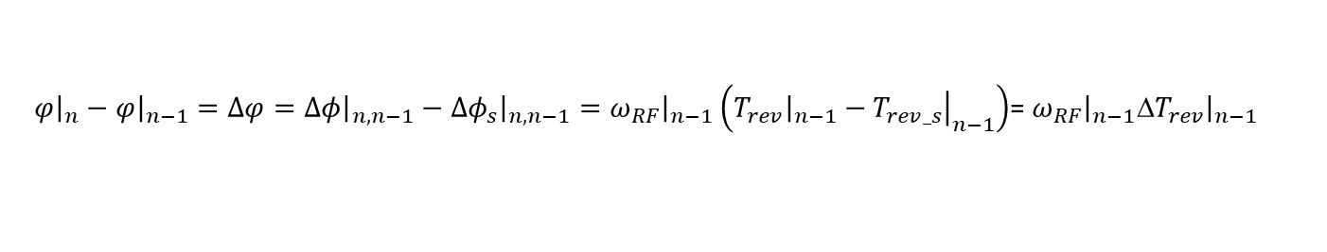


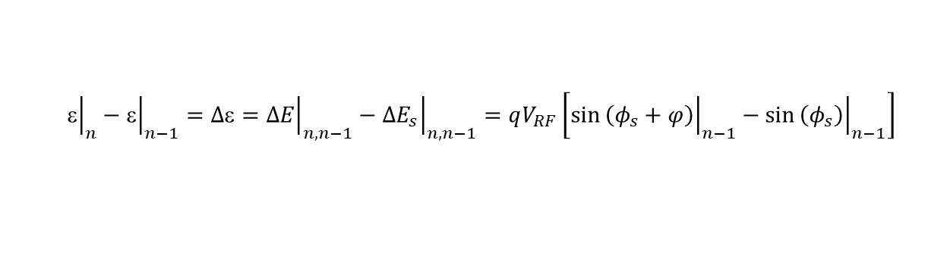
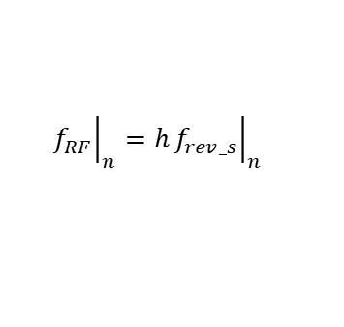
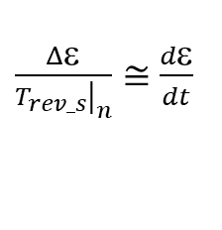

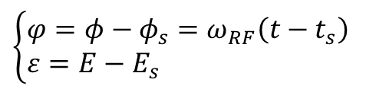
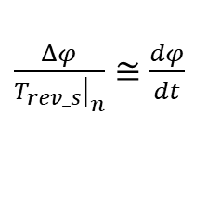
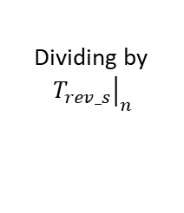
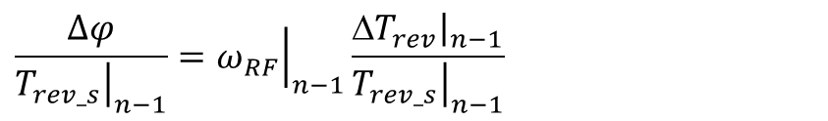
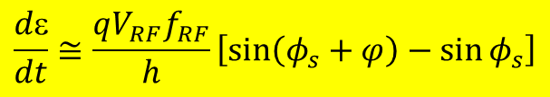


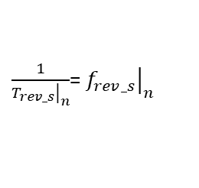




ENERGY-PHASE EQUATIONS
$$\left\{\begin{aligned}&φ=φ−φ_{s}=ω_{RF}\left(t−t_{s}\right) \\ &ε=E−E_{s}\end{aligned}\right.$$
We want to calculate the evolution of the energy and phase deviations ($ε,φ$) of a generic particle
energy
Dividing by
${\left.T_{rev_s}\right|}_{n}$
$${\left.\right|}_{n}−{\left.ε\right|}_{n−1}=Δε={\left.ΔE\right|}_{n,n−1}−{\left.ΔE_{s}\right|}_{n,n−1}=qV_{RF}\left[\sin{{\left.\left(φ_{s}+φ\right)\right|}_{n−1}}−\sin{{\left.\left(φ_{s}\right)\right|}_{n−1}}\right]$$
$$\frac{Δε}{{\left.T_{rev_s}\right|}_{n}}=\frac{qV_{RF}}{{\left.T_{rev_s}\right|}_{n}}\left[\sin{{\left.\left(φ_{s}+φ\right)\right|}_{n−1}}−\sin{{\left.\left(φ_{s}\right)\right|}_{n−1}}\right]$$
$\frac{1}{{\left.T_{rev_s}\right|}_{n}}$= ${\left.f_{rev_s}\right|}_{n}$
$$ΔE=qV_{RF}\sin\left(φ\right)$$
phase
$${\left.f_{RF}\right|}_{n}=h{\left.f_{rev_s}\right|}_{n}$$
$$\left\{\begin{aligned}&{\left.Δφ_{s}\right|}_{n,n−1}={\left.ω_{RF}\right|}_{n−1}{\left.T_{rev_s}\right|}_{n−1} \\ &{\left.Δφ\right|}_{n,n−1}={\left.ω_{RF}\right|}_{n−1}{\left.T_{rev}\right|}_{n−1}\end{aligned}\right.$$
Approximating
$\frac{Δε}{{\left.T_{rev_s}\right|}_{n}}≅$ $\frac{dε}{dt}$
subtracting
${\left.φ\right|}_{n}−{\left.φ\right|}_{n−1}=Δφ={\left.Δφ\right|}_{n,n−1}−{\left.Δφ_{s}\right|}_{n,n−1}={\left.ω_{RF}\right|}_{n−1}\left({\left.T_{rev}\right|}_{n−1}−{\left.T_{rev_s}\right|}_{n−1}\right)$= ${\left.ω_{RF}\right|}_{n−1}Δ{\left.T_{rev}\right|}_{n−1}$
$$\frac{dε}{dt}≅\frac{qV_{RF}f_{RF}}{h}\left[\sin\left(φ_{s}+φ\right)−\sin{φ_{s}}\right]$$
Dividing by
${\left.T_{rev_s}\right|}_{n}$
$\frac{Δφ}{{\left.T_{rev_s}\right|}_{n}}≅$ $\frac{dφ}{dt}$
$$\frac{Δφ}{{\left.T_{rev_s}\right|}_{n−1}}={\left.ω_{RF}\right|}_{n−1}\frac{Δ{\left.T_{rev}\right|}_{n−1}}{{\left.T_{rev_s}\right|}_{n−1}}$$
$$\frac{dφ}{dt}≅−ω_{RF}η\frac{dp}{p_{s}}$$
$$dE=ε=v_{s}dp$$
$$\frac{dφ}{dt}≅−\frac{2πhη}{L_{ring}p_{s}}ε$$
$$\frac{dT_{rev}}{T_{rev_s}}=−η\frac{dp}{p_{s}}$$
$\frac{1}{{\left.T_{rev_s}\right|}_{n}}$= ${\left.f_{rev_s}\right|}_{n}$
$${\left.f_{RF}\right|}_{n}=h{\left.f_{rev_s}\right|}_{n}$$
System of coupled non linear differential equations
David Alesini, Longitudinal Dynamics, Erice 2025

Slide 16













SMALL AMPLITUDE OSCILLATIONS: SYNCHROTRON FREQUENCY
$$\frac{dε}{dt}=\frac{qV_{RF}f_{RF}}{h}\left[\sin\left(φ_{s}+φ\right)−\sin{φ_{s}}\right]$$
$$\frac{dφ}{dt}=−\frac{2πhη}{L_{ring}p_{s}}ε$$
Multipling both members for ${p_{s}}/η$ and deriving both terms with respect to t
$$\frac{p_{s}}{η}\frac{d^{2}φ}{dt^{2}}+\frac{d\left({p_{s}}/η\right)}{dt}\frac{dφ}{dt} =−\frac{2πh}{L_{ring}}\frac{dε}{dt}$$
Non linear differential equation that gives the phase evolution
$$\frac{d^{2}φ}{dt^{2}}+\frac{{2πf_{RF}ηqV}_{RF}\cos{φ_{s}}}{{p_{s}L}_{ring}}φ=0$$
$$\frac{d^{2}φ}{dt^{2}}+\frac{η}{p_{s}}\frac{d\left({p_{s}}/η\right)}{dt}\frac{dφ}{dt} =−\frac{q{2πf_{RF}ηV}_{RF}}{{p_{s}L}_{ring}}\left[\sin\left(φ_{s}+φ\right)−\sin{φ_{s}}\right]$$
And neglecting the damping term (adiabatic acceleration), i.e.:
$\frac{η}{p_{s}}\frac{d\left({p_{s}}/η\right)}{dt}$<<1
We neglect this damping term
$$_{s}^{2}$$
Assuming small oscillations around the synchronous particle
$\sin\left(φ_{s}+φ\right)−\sin{φ_{s}}≅$ $φ \cos{φ_{s}}$
Stability is obtained when $_{s}^{}$ is real so that $_{s}^{2}$is positive. Since most terms in $_{s}^{2}$are positive, this reduces to
we end up with the equation of an harmonic oscillator
$$\frac{d^{2}φ}{dt^{2}}+Ω_{s}^{2}φ=0$$
$$η\cos{φ_{s}>0}$$
Where $_{s}^{}$is called synchrotron angular frequency.
The RF voltage acts as a restoring force for the longitudinal motion
David Alesini, Longitudinal Dynamics, Erice 2025

Slide 17





STABLE ACCELERATING SYNCHROTRON PHASES
$$η>0$$
$$γ<γ_{tr}$$
$$η<0$$
$$γ>γ_{tr}$$
Below transition, the stable synchronous phase are on the rising slope of the accelerating voltage
$$η\cos{φ_{s}>0}$$
V
Above transition, we have the opposite: the oscillation is unstable on the rising slope, and the stable region for oscillations is on the falling slope
phase
Consequently, the rf system needs to make a rapid change of rf phase when crossing the transition energy, a “phase jump”, otherwise the particles in the bunch become dispersed, have a wrong energy gain, and eventually get lost
$$η<0$$
V_{RF}
$$η>0$$
At transition, the velocity change and the path-length change with momentum compensate for each other. As a consequence, the relative longitudinal motion stops. Particles that are not at the synchronous phase will get the same non-nominal energy gain in each turn and will accumulate an energy error that will increase the energy spread and can lead to a loss of the particle ⇒ Therefore, transition has to be passed quickly to minimize the longitudinal emittance increase and the losses.
phase
φ
φ_{s}
Δφ
David Alesini, Longitudinal Dynamics, Erice 2025

Slide 18







ENERGY-PHASE OSCILLATIONS IN PHASE SPACE
Energy-phase oscillations can be represented in the longitudinal phase space
$$ε$$
$$f_{s}=\sqrt{\frac{{f_{RF}ηqV}_{RF}\cos{φ_{s}}}{{{2πp}_{s}L}_{ring}}}$$
$$\hat{ε}$$
$$\left\{\begin{aligned}&φ=\hat{φ}\cos\left(Ω_{s}t\right) \\ &ε=\hat{ε}\sin\left(Ω_{s}t\right)\end{aligned}\right.$$
ϕ
Synchronous particle
The trajectory of a generic particle in the longitudinal phase space is an ellipse.
The maximum energy deviation is reached at ϕ=0 while the maximum phase excursion corresponds to $ε$=0.
the bunch occupies an area in the longitudinal phase space called longitudinal emittance and the projections of the bunch in the energy and phase planes give the energy spread and the bunch length.
$$ε$$
$$ε$$
Longitudinal emittance
0
ϕ
Energy spread
Number of particles
f_{s} can range form Hz to tens of kHz depending on the machine (low/high energy, protons or electrons). It is much smaller than f_{rev}
Bunch length
ϕ
David Alesini, Longitudinal Dynamics, Erice 2025
0

Slide 19











LARGE AMPLITUDE OSCILLATIONS
So far we have considered small amplitude oscillations. To study the longitudinal dynamics at large amplitude oscillations, we have to consider the non linear system of differential equations without small oscillation approximations. In the case of adiabatic acceleration approximation, it is possible to easily obtain the following relation between and ϕ (somewhat related to the the Hamiltonian of the system):
$$\frac{1}{2}ε^{2}+\frac{{L_{ring}p_{s}f_{rev}qV}_{RF}}{2πhη}\left[\cos{φ}−φ\sin{φ_{s}}\right]=H$$
⇒For each H we have different trajectories in the longitudinal phase space
⇒the oscillations are stable within a region bounded by a special curve called separatrix: its equation is:
⇒the region inside the separatrix is called RF bucket. The dimensions of the bucket shrinks to zero if φ_{s}=0.
⇒trajectories outside the RF buckets are unstable.
⇒we can define the RF acceptance as the maximum extension in energy that we can accept in an accelerator
Case below transition
$$V$$
$V_{RF}$ $\sin{φ_{s}}$
$$\frac{1}{2}ε^{2}+\frac{{L_{ring}p_{s}f_{rev}qV}_{RF}}{2πhη}\left[\cos{φ−\cos{φ_{s}}}+\left(π−φ_{s}−φ\right)sin{φ_{s}}\right]=0$$
$$φ_{s}$$
$${−φ}_{s}$$
$$φ_{}$$
$$$$
separatrix
Small amplitude oscillations
$${\left.±ε\right|}_{MAX}$$
$$φ_{}$$
$${\left.ε\right|}_{MAX}=±2\sqrt{\frac{{{L_{ring}p_{s}f}_{rev}qV}_{RF}}{2πhη}\left[\cos{φ_{s}}+\left(φ_{s}−\frac{π}{π}\right){\sin{φ_{s}}}\right]}$$
RF bucket
Synchronous particle
Unstable trajectories
David Alesini, Longitudinal Dynamics, Erice 2025

Slide 20




RF BUCKET DURING ACCELERATION
The rf bucket is at a maximum for $φ_{s}$=0 (below transition) or π (above transition). As the synchronous phase approaches π/2 (high acceleration rate), the bucket size becomes smaller and smaller
Case below transition
Case above transition
$$V$$
$$V$$
$$φ_{}$$
$$φ_{}$$
Case below transition
David Alesini, Longitudinal Dynamics, Erice 2025

Slide 21














ADIABATIC DAMPING
So far it was assumed that $p_{s}$ and $η$ did not change appreciably over the time scale of a synchrotron period. Now consider that they vary slowly (adiabatically) with respect to the period of the longitudinal oscillation. Then one needs to be more general in solving the second-order equation of motion because there will be an additional term that is proportional to ${dφ}/{dt}$, indicating that there is a damping of the oscillation.
To undestand what happen if we consider also the effect of the acceleration we can consider the equation of the phase space trajectories in case of small oscillations
$\frac{2πhη}{L_{ring}p_{s}}ε^{2}$+ ${f_{rev}qV}_{RF}\cos{φ_{s}} φ^{2}=H$
$$φ_{max}^{}∝{\left(\frac{2πhη}{{f_{rev}qV}_{RF}L_{ring}p_{s}cos{φ_{s}}}\right)}^{\frac{1}{4}}$$
A particle with some initial conditions will perform an ellipse in the phase space. Its maximum energy devation w_{max} is obtained when φ=φ_{s} (i.e. $φ=0$) and correspondingly its maximum phase excursion is obtained when w=0. Then:
$$_{max}^{}∝{\left(\frac{{f_{rev}qV}_{RF}L_{ring}p_{s}cos{φ_{s}}}{2πhη}\right)}^{\frac{1}{4}}$$
$$φ=0→\frac{2πhη}{L_{ring}p_{s}}ε_{max}^{2}=H$$
$$ε$$
$$ε$$
$$=0→{f_{rev}qV}_{RF}\cos{φ_{s}}φ_{max}^{2}=H$$
$$φ$$
$$φ$$
$$\frac{φ_{max}^{}}{ε_{max}^{}}=\sqrt{\frac{2πhη}{{f_{rev}qV}_{RF}L_{ring}p_{s}cos{φ_{s}}}}$$
The phase excursion is decreasing with the one-fourth power of the energy while the absolute energy spread increases. Nevertheless if we consider the relative energy spread. i.e. ${_{max}^{}}/{E_{s}}$, also this decreases.
Since in the system there are only conservative forces we can also consider the Liouville Theorem that states that the area occupied by the ellipse remains constant during acceleration, i.e.:
Adiabatic damping
$$φ_{max}^{}_{max}^{}=A$$
David Alesini, Longitudinal Dynamics, Erice 2025

Slide 22




SYNCHROTRON RADIATION IN ELECTRON RINGS
Rings for light particles (electrons/positrons) have two peculiar aspects that deeply impact the longitudinal dynamics:
photons
Particle are ultra-relativistic ($γ≫1$) at relatively low energies already (>10 MeV) and their speed is almost constant and equal to c all over the acceleration process
While traveling through bending dipole magnets (or wigglers) the beam emits radiation in a wide spectrum (synchrotron radiation).
The power emitted in the form of synchrotron radiation is given by:
electron
The RF system is much simpler since frequency change is not necessary.
$${\left.U_{rad}\right|}_{turn}=\frac{q^{2}}{3ε_{0}}\frac{β^{3}γ^{4}}{ρ^{2}}$$
emission is completely negligible for heavy particle
Examples: ESRF few MeV/turn, FCCee 0.1-1GeV/turn that correspond to up to 50 MW of emmitted power!
The energy loss due to synchrotron radiation is the fundamental limitation on increasing the energy of electron machines, which is why high-energy electron accelerators require very large bending radii.
Nevertheless, the emitted radiation exhibits exceptional quality in terms of brightness and spectral properties for GeV-range storage rings, producing photons with energies up to around 100 keV. This makes it the foundation of modern synchrotron radiation facilities.
In storage rings operating at constant energy (i.e., without acceleration), this energy loss must be continuously compensated by the RF system.
ρ
David Alesini, Longitudinal Dynamics, Erice 2025

Slide 23






DAMPING OF THE SYNCHROTRON OSCILLATIONS DUE TO RADIATION IN ELECTRON RINGS
Intuitive approach to understand the machanism of damping of the oscillatioan:
the emission depends on the energy of the particle
during one period of synchrotron oscillation when the particle is in the upper half-plane, it loses more energy per turn, when the particle is in the lower half-plane, it loses less energy per turn
the lost energy is restored on average from the RF, so its energy deviation gradually reduces
the phase space trajectory is spiraling towards the origin
Damping effect on the amplitude of the synchrotron oscillation (radiation damping) which would tend to collapse all the particles to the synchronous phase.
V
ε
τ
ε
$$\frac{d^{2}φ}{{dt}^{2}}+α_{ε}\frac{dφ}{dt}+\frac{{2πf_{RF}ηqV}_{RF}\cos{φ_{s}}}{{p_{s}L}_{ring}}φ =0$$
$$\left\{\begin{aligned}&φ=\hat{φ}e^{−\frac{t}{τ_{ε}}}cos\left(Ω_{s}t\right) \\ &ε=\hat{ε}e^{−\frac{t}{τ_{ε}}}sin\left(Ω_{s}t\right)\end{aligned}\right.$$
τ
Injected beam
Damping factor
Damping time
$$σ_{τ}$$
${\sim e}^{−α_{ε}t}$= $e^{−\frac{t}{τ_{ε}}}$
$$α_{ε}≈2\frac{{\left.U_{rad_s}\right|}_{turn}}{T_{rev_s}E_{s}}$$
$$τ_{ε}=\frac{1}{α_{ε}}$$
collapse
NB: Damping times are of the order of 1-100 ms
time
David Alesini, Longitudinal Dynamics, Erice 2025

Slide 24









LONGITUDINAL DISTRIBUTION IN ELECTRON RINGS
Recap: Emission of synchrotron radiation
The synchrotron radiation is emitted in quanta, It is a purely stochastic (Poisson) process.
This process acts as a noise excitation term (long. Emittance increase).
This phenomenon cause a turn-by-turn beam energy loss which has to be compensated by the RF system.
The emission strongly depends on the particle energy, which produces a damping effect on the synchrotron oscillation amplitude.
ε/E(%)
Radiation damping and quantum excitation are two counteracting processes that lead to an equilibrium state characterized by a gaussian particle distribution in the longitudinal phase space.
ε/E(%)
$$σ_{τ}$$
Injected beam
$$\frac{d^{2}φ}{{dt}^{2}}+α_{ε}\frac{dφ}{dt}+\frac{{2πf_{RF}ηqV}_{RF}\cos{φ_{s}}}{{p_{s}L}_{ring}}φ+R=0$$
$$σ_{ε}$$
$e^{−\frac{t}{τ_{ε}}}$
Quantum excitation term
equilibrium
τ (ps)
Damping term
$$σ_{τ_eq}$$
Final equilibrium
n
n
$$\left(\frac{σ_{ε}}{E_{s}}\right)≈\sqrt{\frac{1.47{E_{s}\left[GeV\right]}^{2}}{2R_{s}\left[m\right]}}→≈0.1\%$$
t
$σ_{τ}=\frac{α_{c}}{Ω_{s}}\left(\frac{σ_{ε}}{E_{s}}\right)$ $→≈ps$
$$σ_{τ}$$
τ (ps)
David Alesini, Longitudinal Dynamics, Erice 2025

Slide 25




SYNCHRONOUS OSCILLATIONS IN LINACS
Also in LINACs we have longitudinal oscillations around the synchronous phase. In this case we consider a SW linac structure made by accelerating gaps or cavities.
In each gap we have an accelerating field oscillating in time with an integrated accelerating voltage (V_{acc}) still oscillating in time that can be expressed as:
$$V_{acc}=V_{RF}\cos\left(ω_{RF}t\right)$$
$E_{RF}$=average accelerating field $\left(\frac{V_{RF}}{L}\right)$
No momentum compaction factor
The stable phase is on the rising slope of the RF voltage (same concept for rings below transition)
We still have phase-energy oscillations with frequency
V_{acc}
$$Ω_{T}^{2}=−q\frac{cω_{RF}E_{RF}\sin{φ_{s}}}{E_{0}β_{s}γ_{s}^{3}}$$
φ_{s}
t
In electron linacs ($γ≫1$), these effects vanish, and phase stability no longer applies since all particles travel essentially at the same speed ($c$). Therefore, acceleration is conveniently done on-crest. Longitudinal phase-space manipulations remain possible but require magnetic chicanes or must be performed at low energies (below ~10 MeV).
T_{RF}
David Alesini, Longitudinal Dynamics, Erice 2025

Slide 26

PERTURBATIONS ON THE LONGITUDINAL BEAM DYNAMICS: COLLECTIVE EFFECTS
Collective effects are all the effects that depends on the number of particles. We have two effects that perturb the beam dynamics:
space charge effect
wakefield
Short-range wake fields (excited field from the beam interacting with the accelerator structures) introduce an additional voltage which is added to the accelerating voltage of the cavity and which depends on the position of the particles along the bunch. This leads to a deformation of the original distribution and energy "spread" inside the bunch.
Long range wakefield
Direction of motion
On the other hand, long-range wake fields can generate multi-bunch and/or multi-turn instability phenomena, generating multi-bunch oscillation modes that can give instabilities
Multi-bunch oscillation modes
David Alesini, Longitudinal Dynamics, Erice 2025

Slide 27
ACKNOWLEDGEMENTS
AI would like to acknowledge: A. Gallo, F. Tecker, T. Pieloni, L. Rivkin
REFERENCES
David Alesini, Linac, Proceedings of the CERN-Accelerator-School course on Introduction to Accelerator Physics, 2021
https://arxiv.org/abs/2103.16500
Frank Tecker, Longitudinal Beam Dynamics in Circular Accelerators, Proceedings of the CERN-Accelerator-School course on Introduction to Accelerator Physics, 2020, https://arxiv.org/abs/2011.02932,
Rivkin,
https://indico.cern.ch/event/532397/contributions/2170751/attachments/1349414/2036307/SRBasicsCAS16_LRivkin.pdf
https://indico.cern.ch/event/1226773/contributions/5161290/
THANK YOU
David Alesini, Longitudinal Dynamics, Erice 2025

