Slide 1
Laboratori Nazionali di Legnaro – INFN
γ-spectroscopy measurements for the SPES_MED experiment
Giulia Persi
May 19th, 2025

Slide 2
Outline
Goals
Spectrum analysis overview
Conclusions
Notes:
2

Slide 3
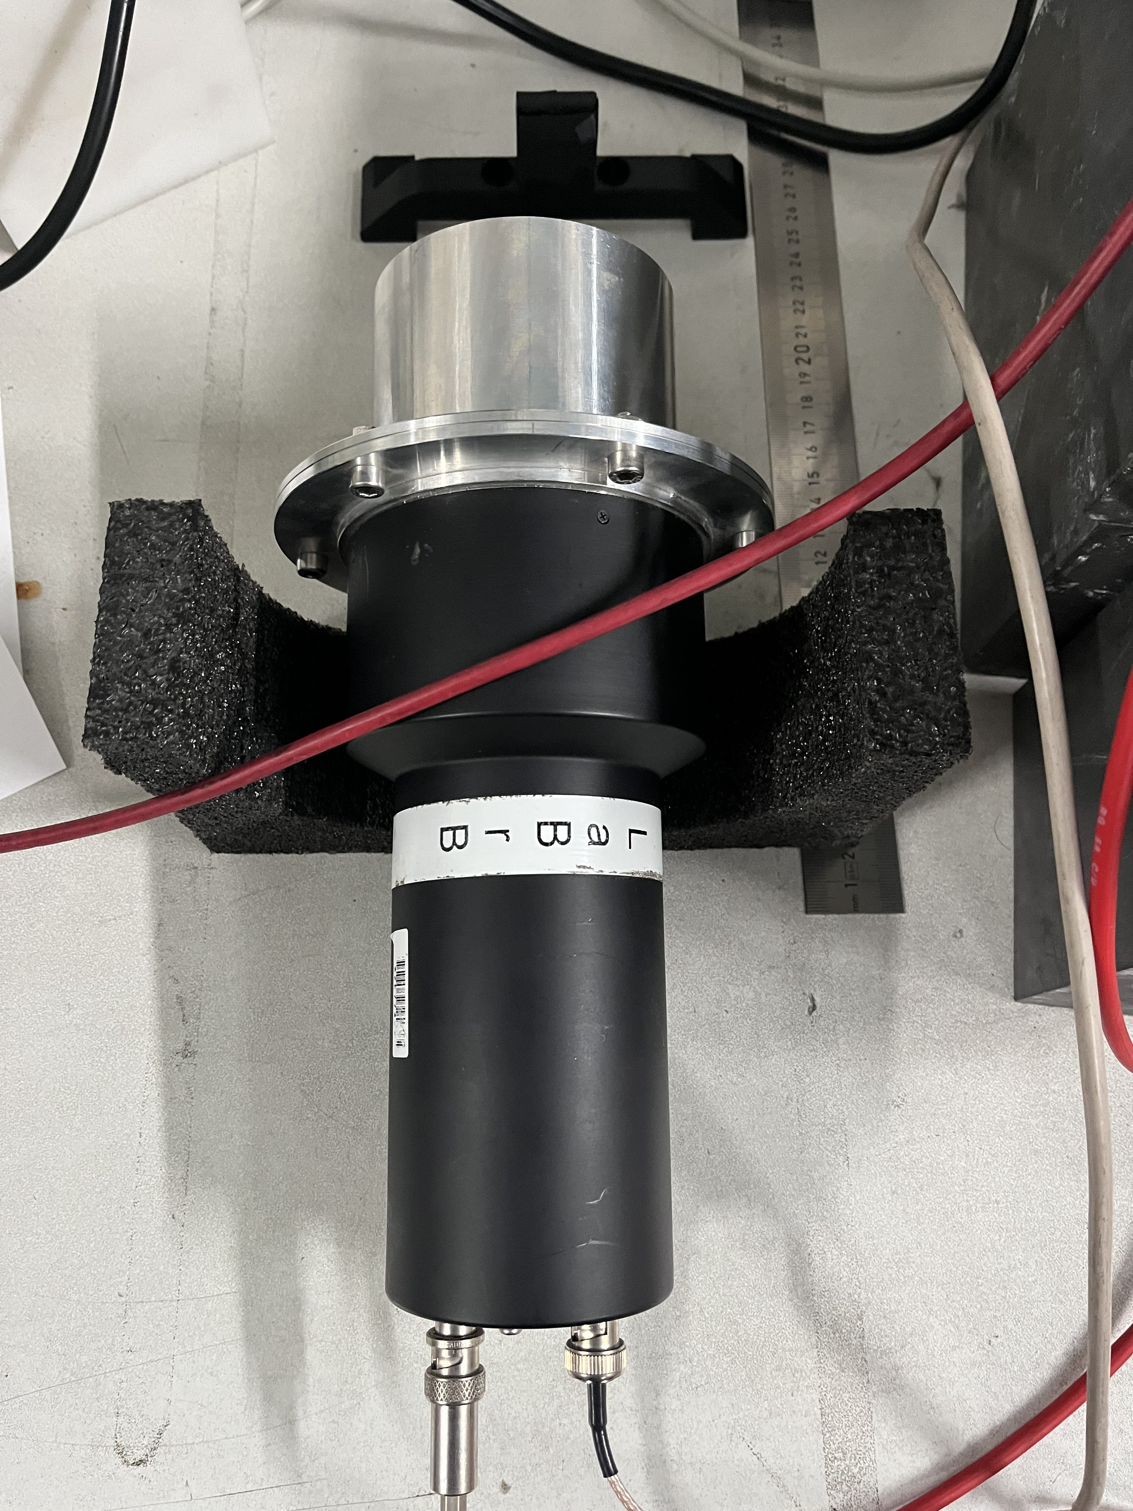
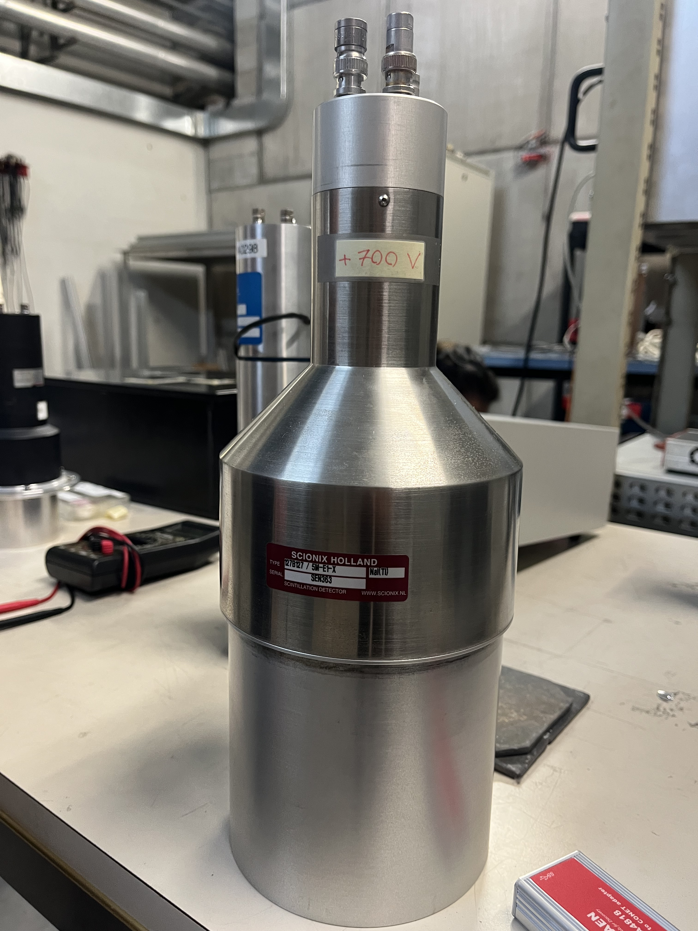
Goals
Detectors to calibrate and analyze:
LBC (Lanthanum BromoChloride) - 1.5 inches
LBC (Lanthanum BromoChloride) - 3 inches
HPGe (High Purity Germanium)
NaI (Sodium Iodide)
Involved sources:
²²Na
⁶⁰Co
¹³⁷Cs
²⁴¹Am (only HPGe)
Notes:
3

Slide 4
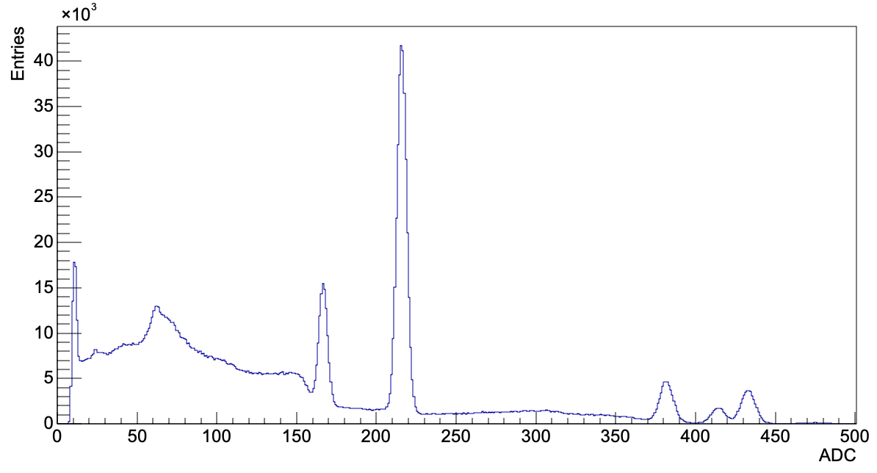
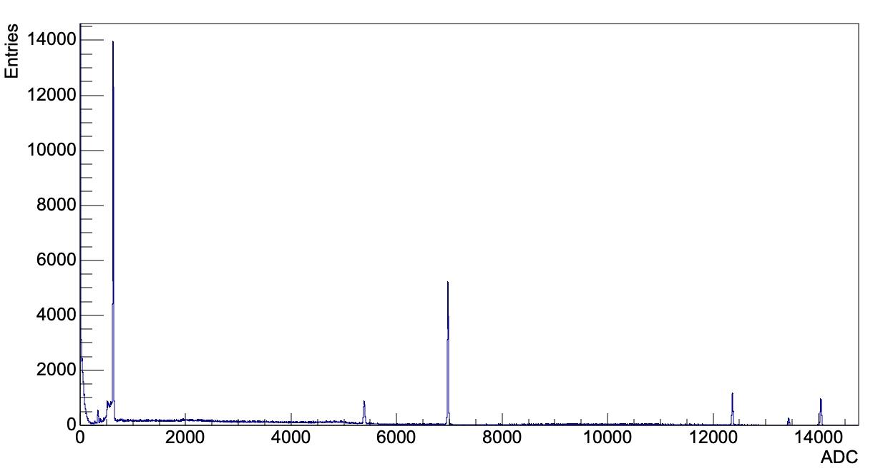
Spectrum analysis overview
Uncalibrated spectrum of ²²Na, ⁶⁰Co, and ¹³⁷Cs sources using LBC 1.5 inches.
Uncalibrated spectrum of ²²Na, ²⁴¹Am, ⁶⁰Co, and ¹³⁷Cs sources using HPGe.
Notes:
4

Slide 5
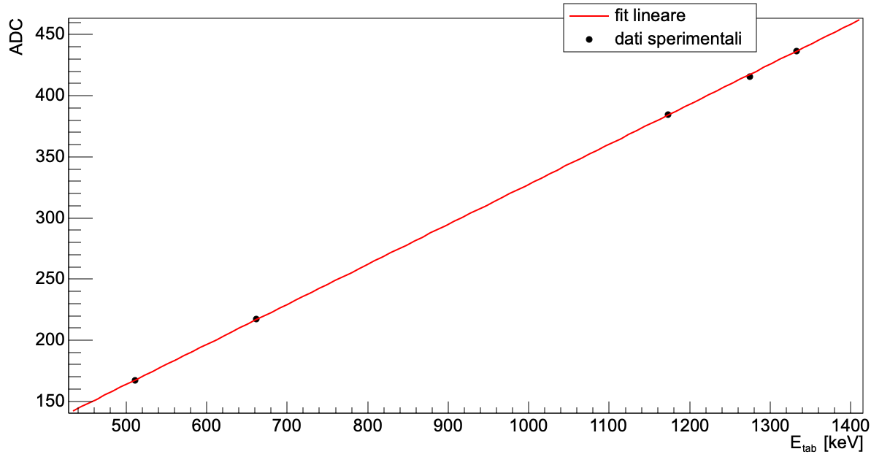
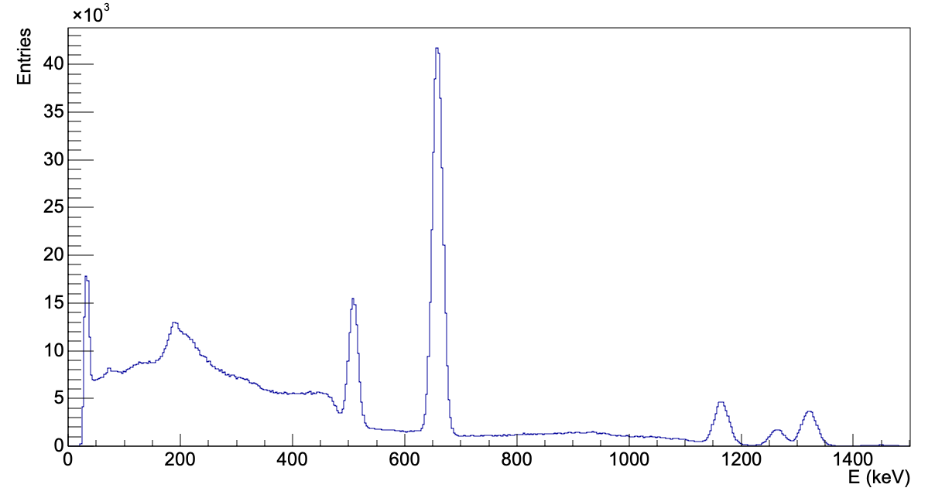
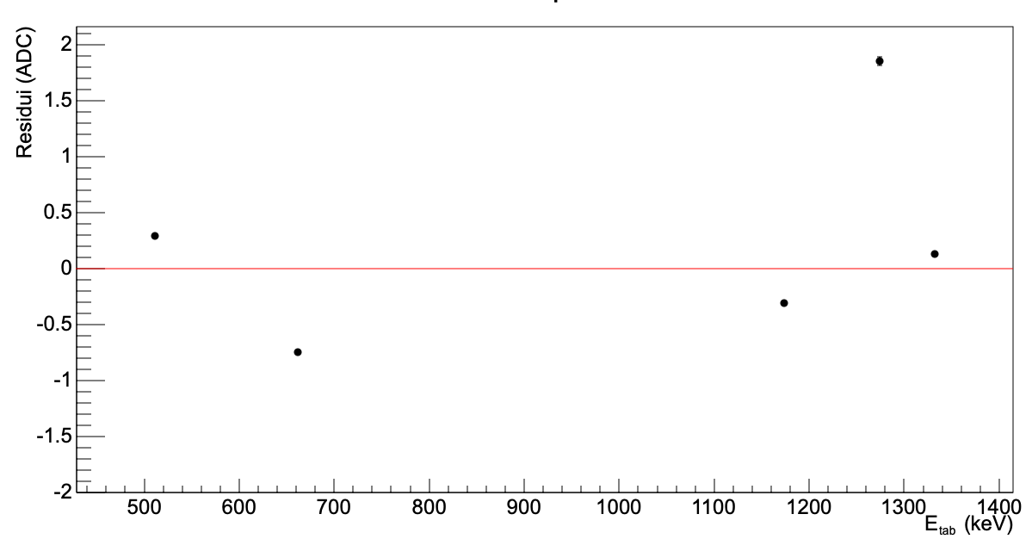
Spectrum analysis overview
Calibrated spectrum using LBC 1.5inches

Slide 6
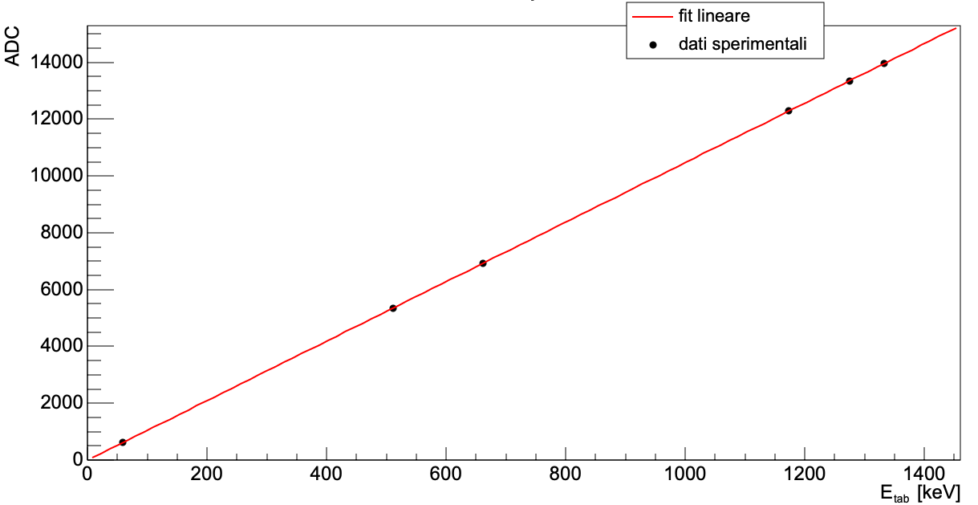
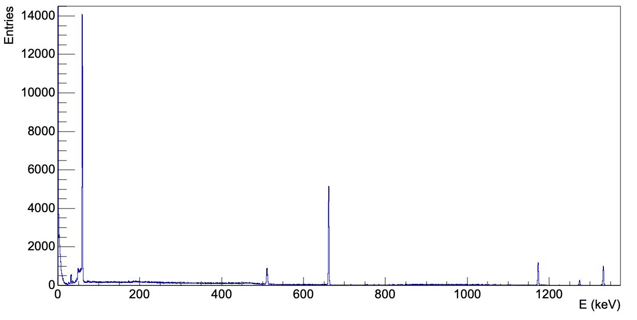
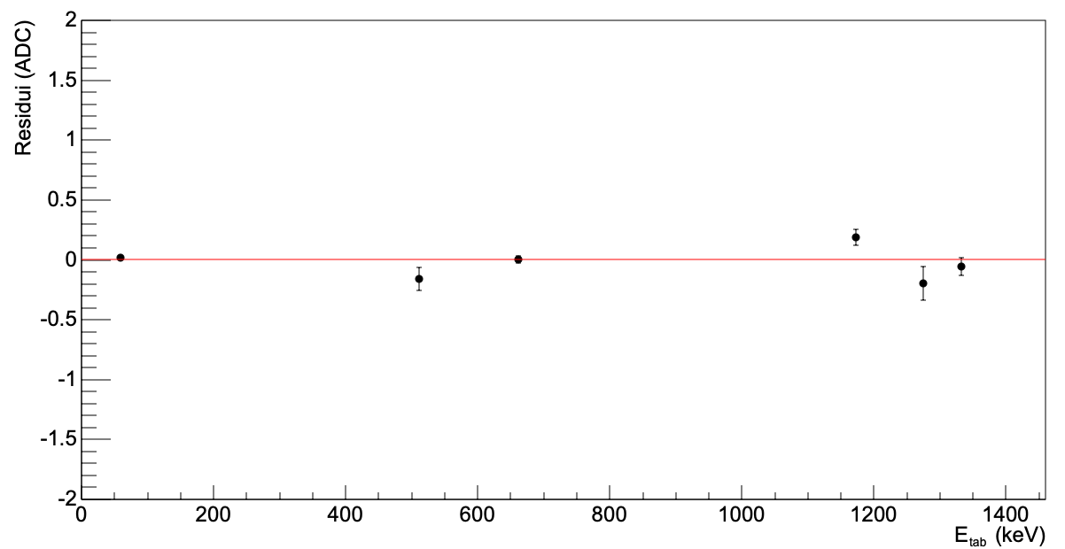
Spectrum analysis overview
Calibrated spectrum using HPGe

Slide 7
Conclusions
Calibration and analysis of the detectors’ resolution, some of them will be compared in terms of performances.
Optimization of HPGe trapezoid parameters like rise time, pole zero, peaking time…
Notes:
7

