Slide 1
Laboratori Nazionali di Legnaro – INFN
Diffusion and effusion of biomedical radiotracers in the SPES-ISOLPHARM target
Sara Luise
May 19th, 2025

Slide 2
Simulation of isotope generation and release process
Theoretical study of the diffusion and effusion processes of magnesium (Mg-28) isotope in silicon carbide (SiC) targets
Computational modelling with Geant4 Monte Carlo software (release 10.7)
Investigate the key parameters of the system
quantify the average release time of the atoms produced
Notes:
2

Slide 3
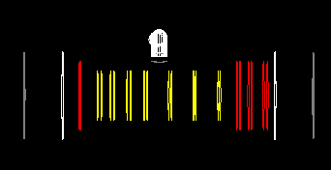
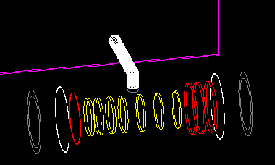
Isotope production
7 disk-shape targets spaced to dissipate the energy deposited → material: SiC SA (no pores)
40 MeV proton beam → T = 1600 °c
Changed simulation geometry:
Target material
Disk radius
Thickness of the disks
Positions of the disks
Notes:
3

Slide 4
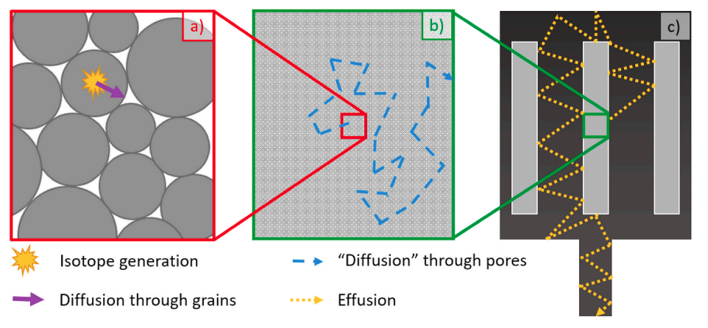
Diffusion and effusion
Diffusion in the molecules of the target material:
average time spent by a particle to exit the grain calculated with the solution of Fick’s equation for a sphere/cilinder
Effusion in the target chamber:
nuclide reaches the target surface and travels in the vacuum system until it reaches another solid surface → average sticking-time summed to the particle global time
Changed simulation parameters:
Target temperature
Distribution of molecule radius
Diffusion coefficient for Mg in SiC
Avarage sticking time of Mg in Ta and C
Notes:
4

